Slide 1



Use of α-, β-, and γ-Cyclodextrins for the Enantiomeric and Isotopologue Separation of Psychoactive Compounds by Capillary Electrophoresis
Prepared by: Nini Ukhurgunashvili
Ivane Javakhishvili Tbilisi State University
Supervisor: Academician Bezhan Chankvetadze

Slide 2
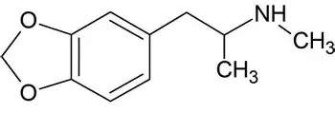
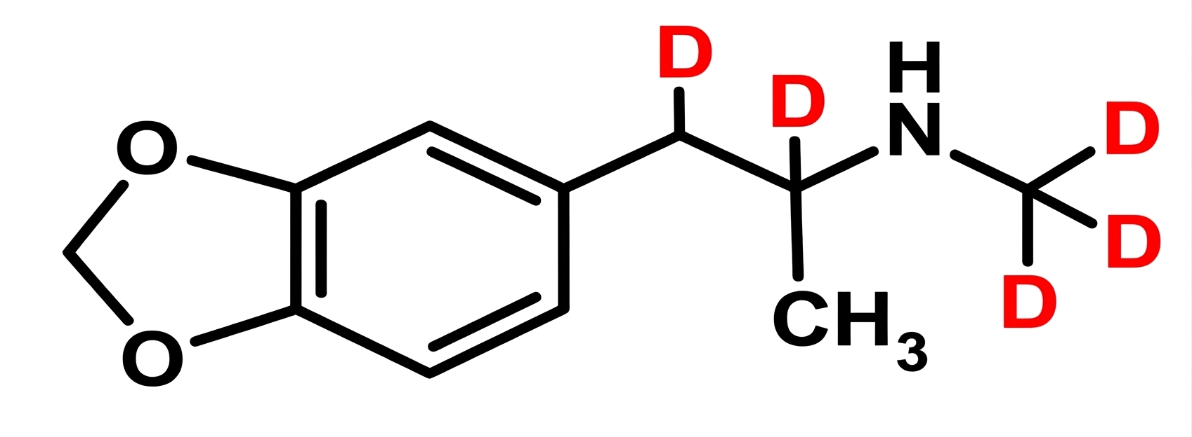
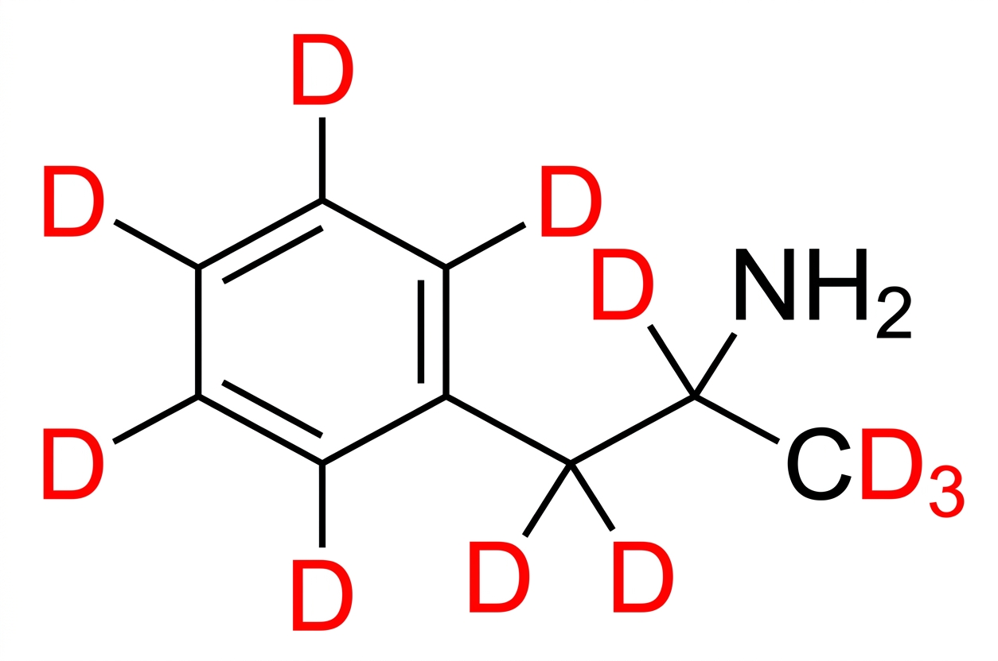
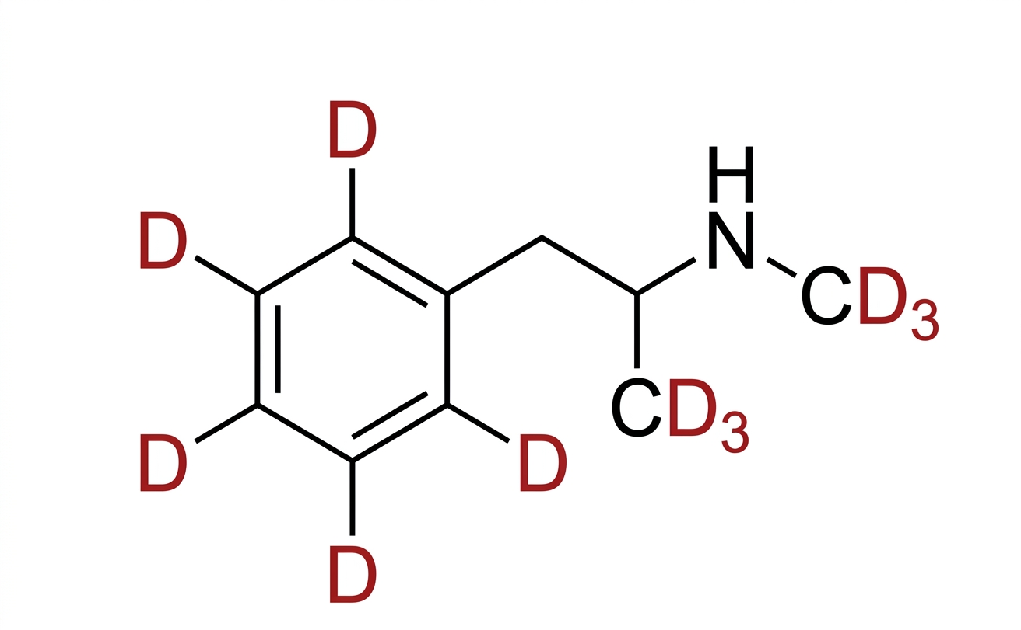
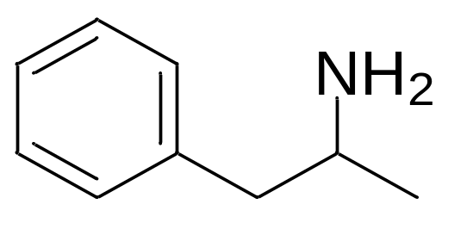
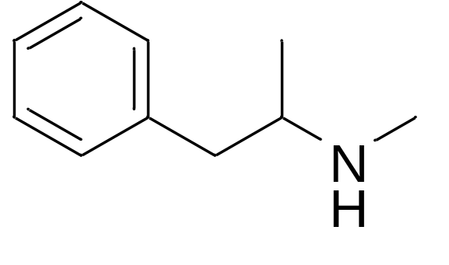
Importance of Isotopologue separation
3,4-Methylenedioxymethamphetamine (MDMA)
3,4-Methylenedioxymethamphetamine-d5 (MDMA-d5)
Amphetamine
Amphetamine-d11
Methamphetamine
Methamphetamine-d11

Slide 3
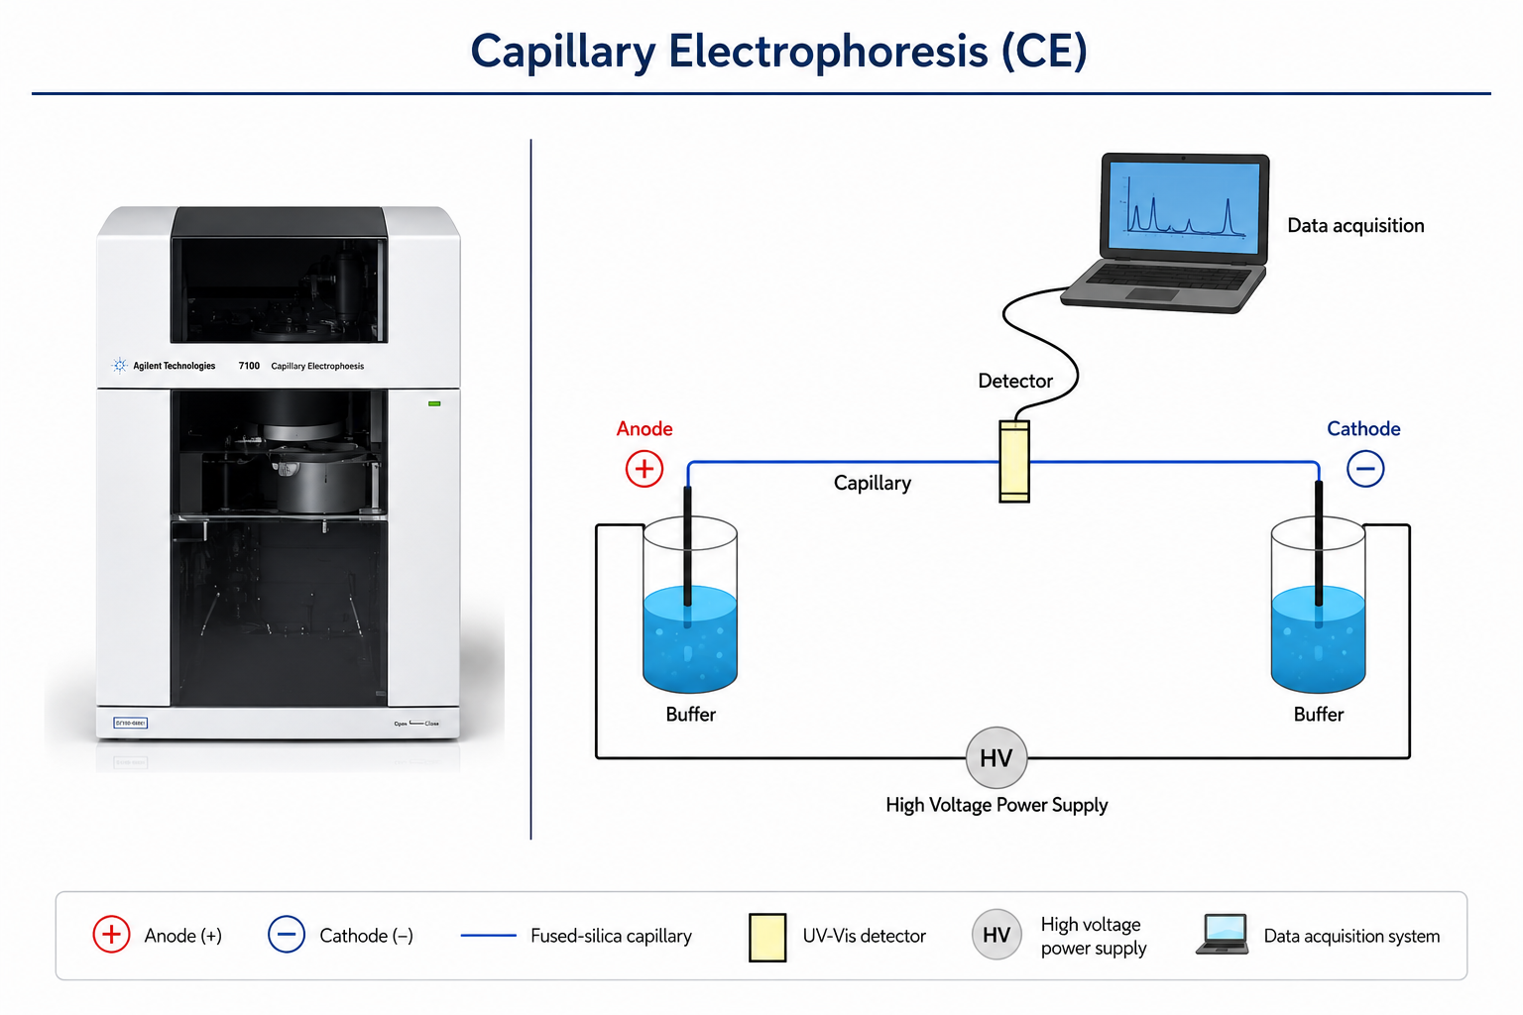

Slide 4

Previous Study
Driven by: Charge differences
Analytes were kept near their pKa values
Separation was based on small differences in net charge.

Slide 5
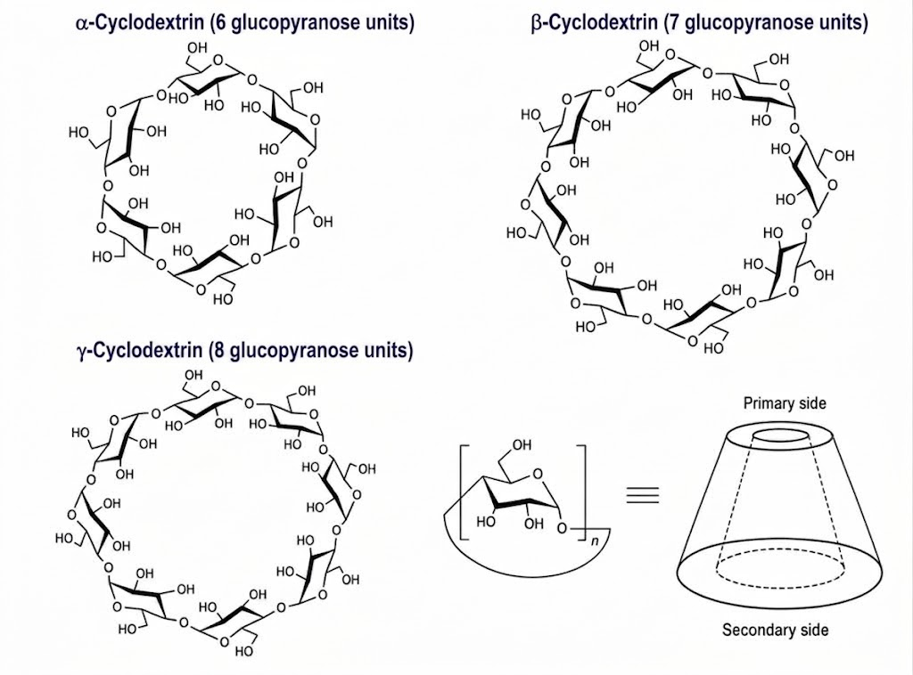
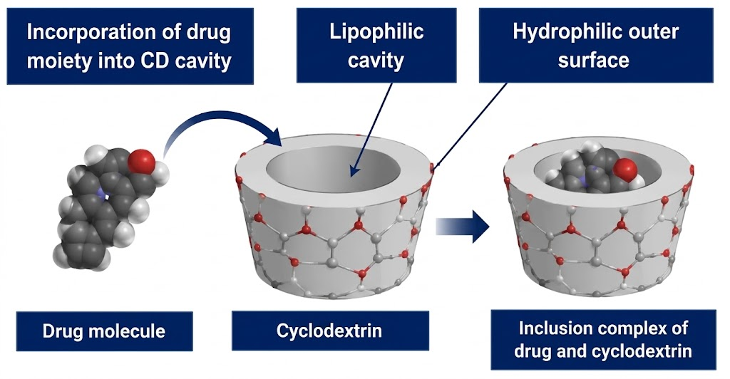
α-, β-, and γ-Cyclodextrins

Slide 6
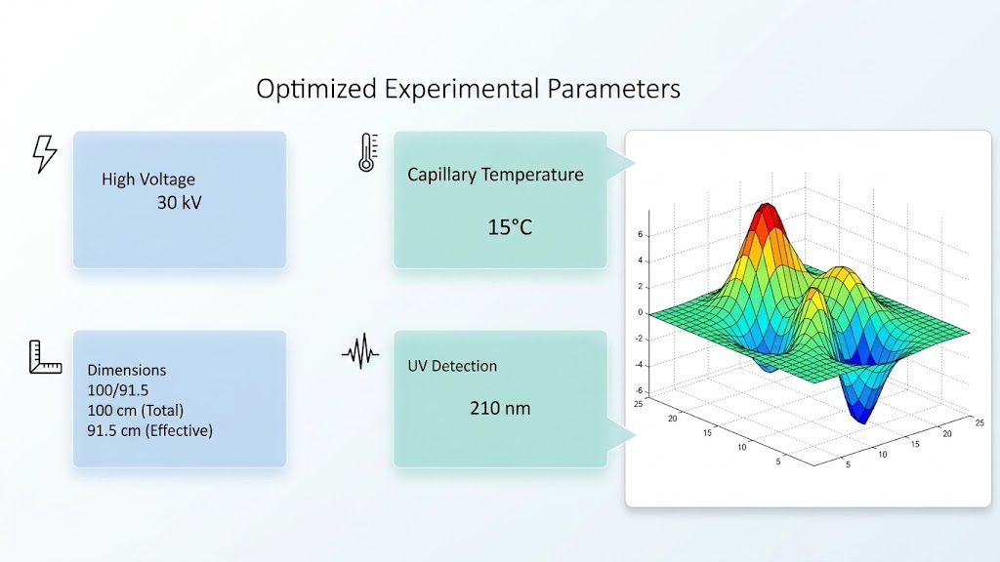
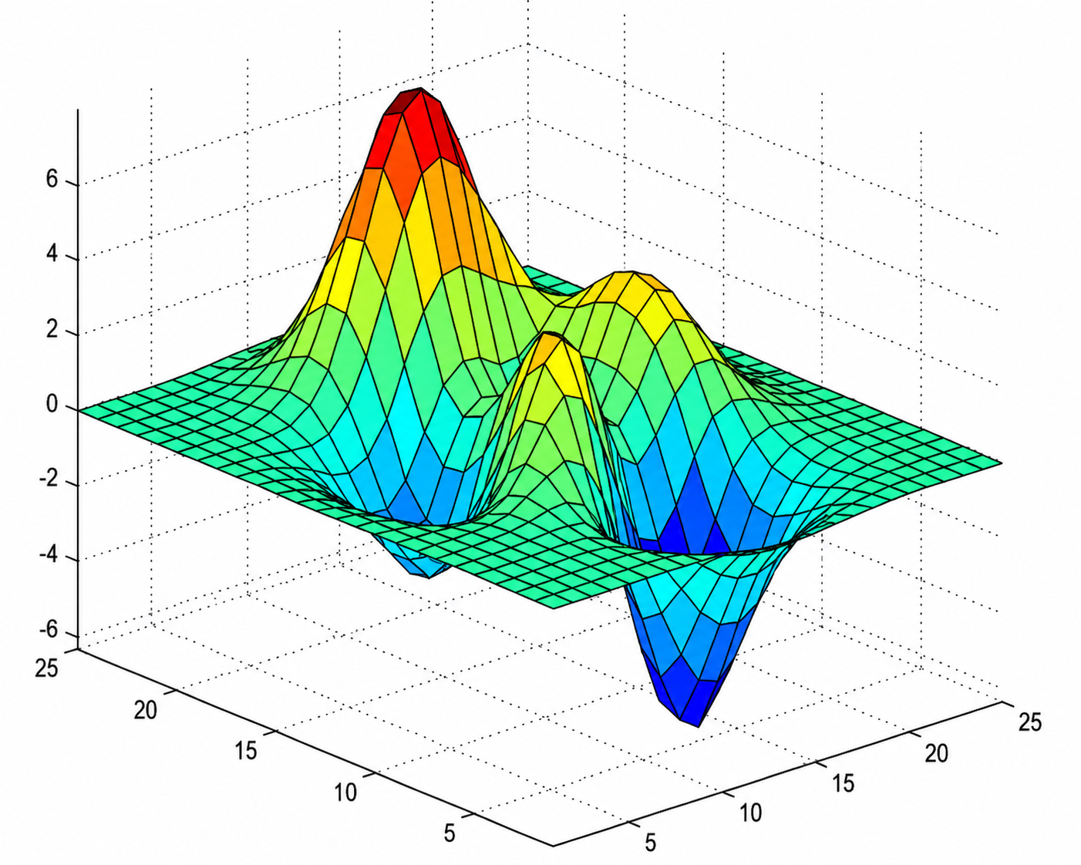
Optimized Experimental Parameters
High voltage
30kV
Capillary Temperature
15⁰c
Capillary Lengths
100/91.5
Total length 100cm
Eff length-91.5cm
UV Detection
210nm

Slide 7
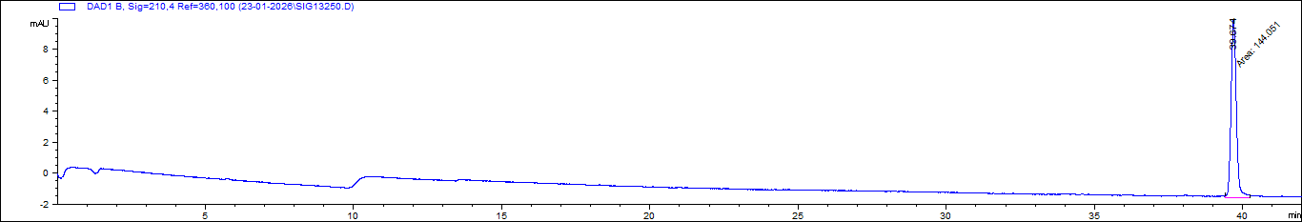
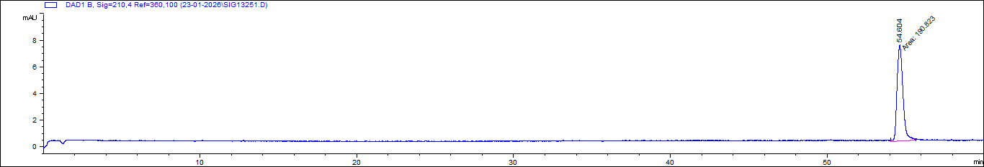
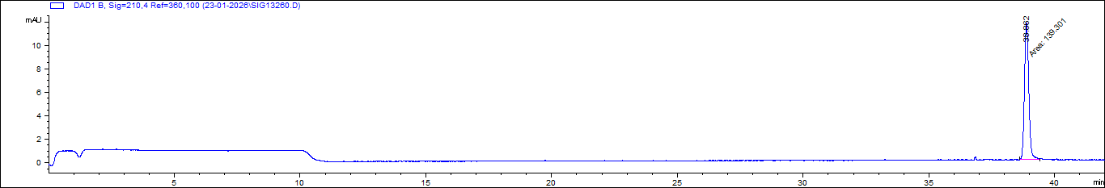
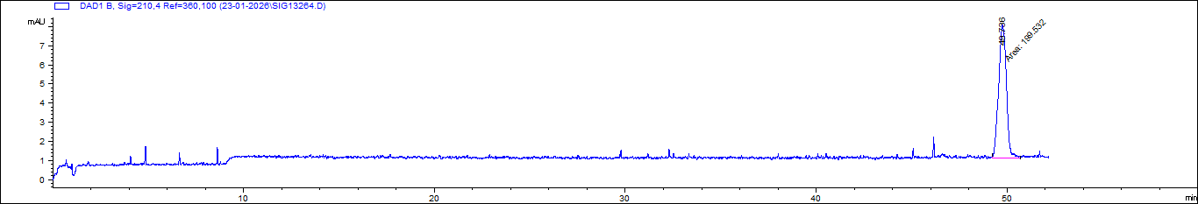
Effect of Neutral Cyclodextrins on Methamphetamine
MET+MET-d11
Buffer: H₃PO₄+TEA (pH 3.1)
Achiral analysis
MET+MET-d11 | Migration time (min) | Number of theoretical plates (N)
Achiral analysis | 39.674 | 254 803
Additive: 20 mg/mL α-CD | 54.604 | 101 543
MET+MET-d11
Buffer: H₃PO₄+TEA (pH 3.1)
Additive: 20 mg/mL α-CD
MET+MET-d11
Buffer: H₃PO₄+TEA (pH 3.1)
Achiral analysis
MET+MET-d11 | Migration time (min) | Number of theoretical plates (N)
Achiral analysis | 38.862 | 248928
Additive: 20 mg/mL γ-CD | 49.736 | 69 723
MET+MET-d11
Buffer: H₃PO₄+TEA (pH 3.1) Additive: 50 mg/mL γ-CD

Slide 8
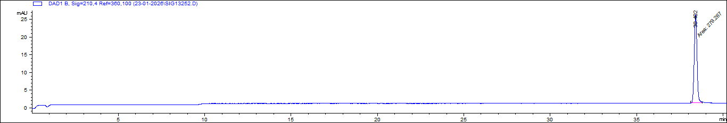
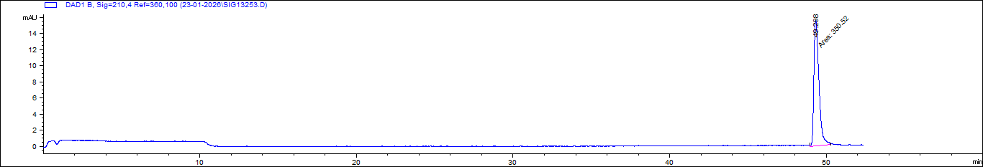
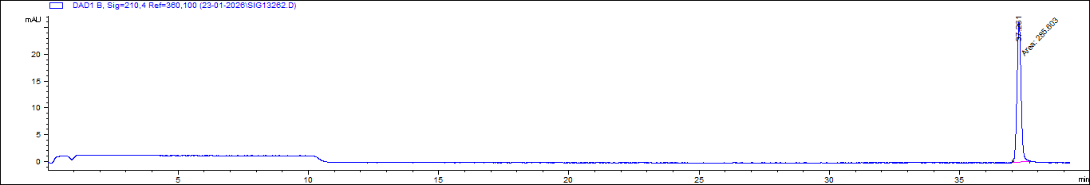
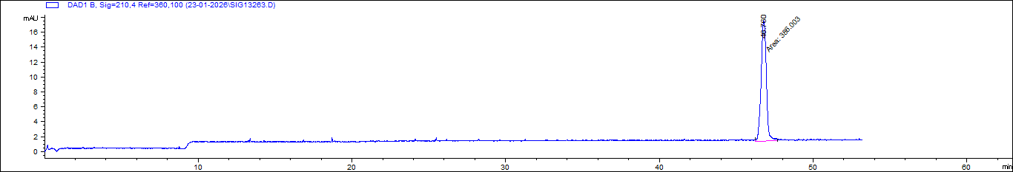
Effect of Neutral Cyclodextrins on Amphetamine and Amphetamine-d11
AMP+AMP-d11
Buffer: H₃PO₄+TEA (pH 3.1)
Achiral analysis
AMP+AMP-d11 | Migration time (min) | Number of theoretical plates (N)
Achiral analysis | 38.402 | 271 926
Additive: 20 mg/mL α-CD | 49.298 | 117 070
AMP+AMP-d11
Buffer: H₃PO₄+TEA (pH 3.1)
Additive: 20 mg/mL α-CD
AMP+AMP-d11
Buffer: H₃PO₄+TEA (pH 3.1)
Achiral analysis
AMP+AMP-d11 | Migration time (min) | Number of theoretical plates (N)
Achiral analysis | 37.261 | 283 326
Additive: 50 mg/mL γ-CD | 46.760 | 95 215
AMP+AMP-d11
Buffer: H₃PO₄+TEA (pH 3.1)
Additive: 50 mg/mL γ-CD

Slide 9
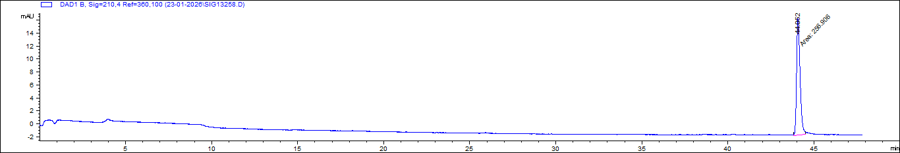
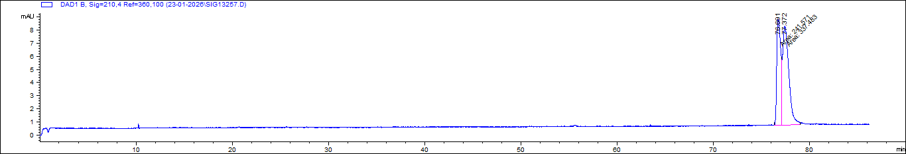
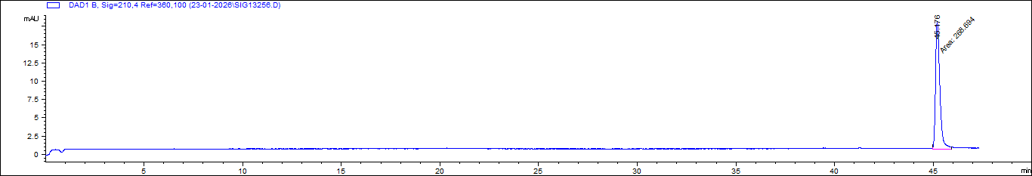
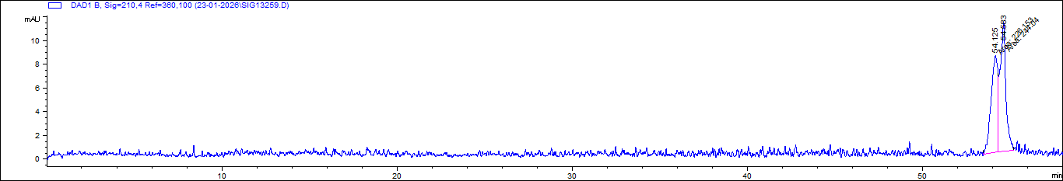
Effect of Neutral Cyclodextrins on MDMA and MDMA-d5
MDMA+MDMA-d5
Buffer: H₃PO₄+TEA (pH 3.1)
Achiral analysis
MDMA + MDMA-d5 | Migration time (min) | Number of theoretical plates (N) | Resolution
Achiral analysis | 45.176 | 226 673 | ---
Additive: 20 mg/mL α-CD | 76.691 | 99 652 | ---
 | 77.372 | 61 973 | 0.61
MDMA+MDMA-d5
Buffer: H₃PO₄+TEA (pH 3.1) Additive: 20 mg/mL α-CD
MDMA+MDMA-d5
Buffer: H₃PO₄+TEA (pH 3.1)
Achiral analysis
MDMA + MDMA-d5 | Migration time (min) | Number of theoretical plates (N) | Resolution
Achiral analysis | 44.052 | 239 957 | ---
Additive: 50 mg/mL γ-CD | 54.125 | 78 119 | ---
 | 54.583 | 105 333 | 0.63
MDMA+MDMA-d5
Buffer: H₃PO₄+TEA (pH 3.1)
Additive: 50 mg/mL γ-CD

Slide 10
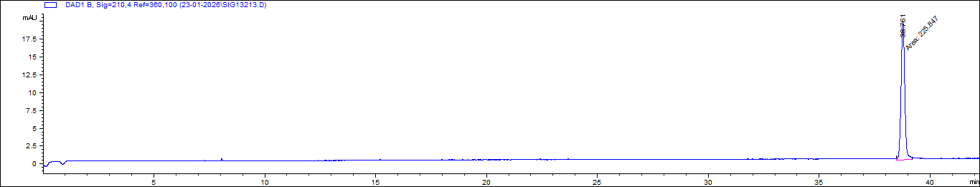
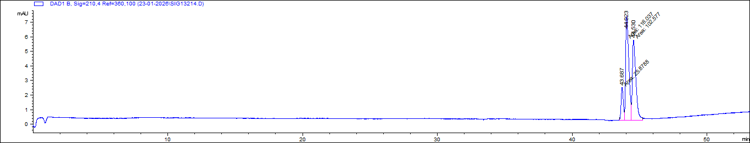
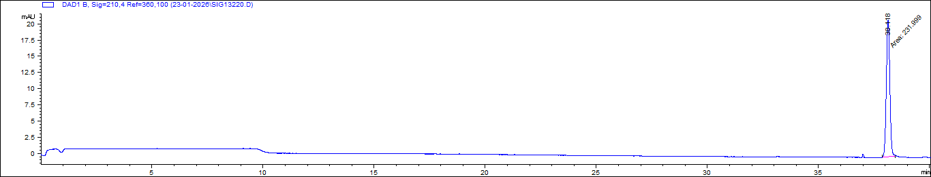
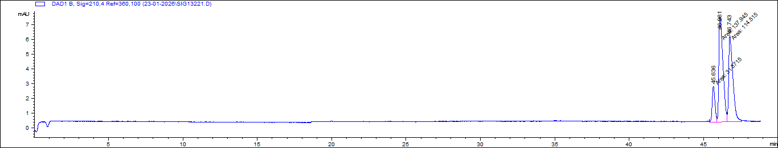
Effect of β Cyclodextrins on Amphetamine and Amphetamine-d11
AMP-AMP-d11
Buffer: H₃PO₄+TEA (pH 3.1)
Achiral analysis
AMP-AMP-d11 | Migration time (min) | Number of theoretical plates (N) | Resolution
Achiral analysis | 38.761 | 271 796 | ---
Additive: 2 mg/mL β-CD | 43.687 | 318 451 | ---
 | 44.023 | 157 469 | 0.89
 | 44.530 | 145 273 | 1.11
AMP-AMP-d11
Buffer: H₃PO₄+TEA (pH 3.1) Additive: 2 mg/mL β-CD
AMP-AMP-d11 | Migration time (min) | Number of theoretical plates (N) | Resolution
Achiral analysis | 38.118 | 289 788 | ---
Additive: 2.5 mg/mL β-CD | 45.636 | 283 688 | ---
 | 46.081 | 125 094 | 1.03
 | 46.743 | 137 526 | 1.29
AMP-AMP-d11
Buffer: H₃PO₄+TEA (pH 3.1)
Achiral analysis
AMP-AMP-d11
Buffer: H₃PO₄+TEA (pH 3.1) Additive: 2.5 mg/mL β-CD

Slide 11
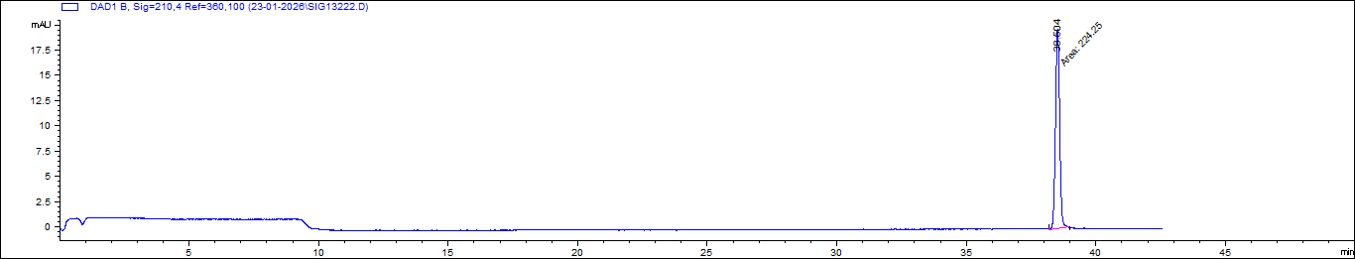
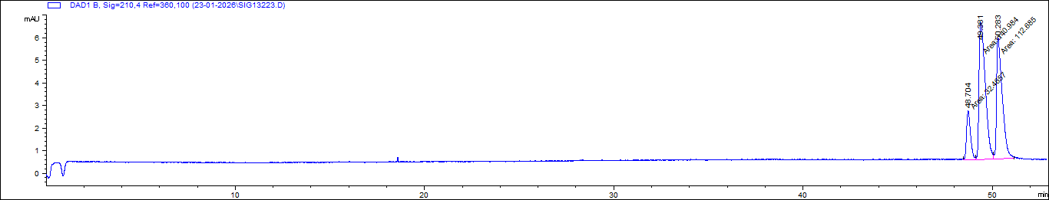
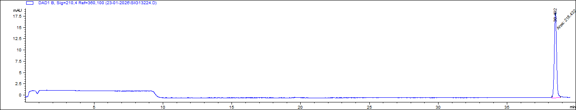
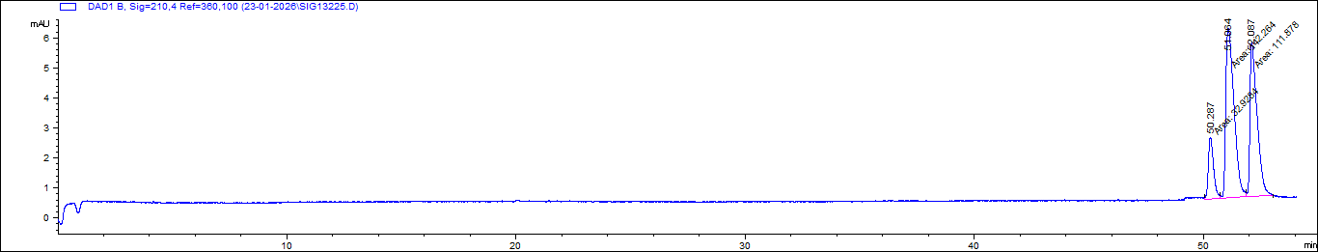
Effect of β Cyclodextrins on Amphetamine and Amphetamine-d11
AMP-AMP-d11
Buffer: H₃PO₄+TEA (pH 3.1)
Achiral analysis
AMP-AMP-d11 | Migration time (min) | Number of theoretical plates (N) | Resolution
Achiral analysis | 38.504 | 278 725 | ---
Additive: 3 mg/mL β-CD | 48.704 | 255 791 | ---
 | 49.381 | 99 578 | 1.34
 | 50.283 | 138 219 | 1.54
AMP-AMP-d11
Buffer: H₃PO₄+TEA (pH 3.1) Additive: 3 mg/mL β-CD
AMP-AMP-d11
Buffer: H₃PO₄+TEA (pH 3.1)
Achiral analysis
AMP-AMP-d11 | Migration time (min) | Number of theoretical plates (N) | Resolution
Achiral analysis | 38.492 | 273 202 | ---
Additive: 3.5 mg/mL β-CD | 50.287 | 246 616 | ---
 | 51.064 | 91 814 | 1.44
 | 52.087 | 136 626 | 1.65
AMP-AMP-d11
Buffer: H₃PO₄+TEA (pH 3.1) Additive: 3.5 mg/mL β-CD

Slide 12
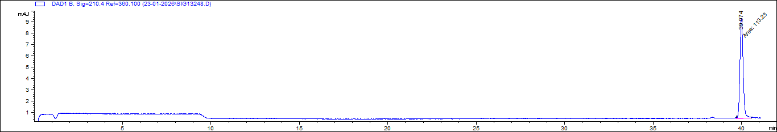
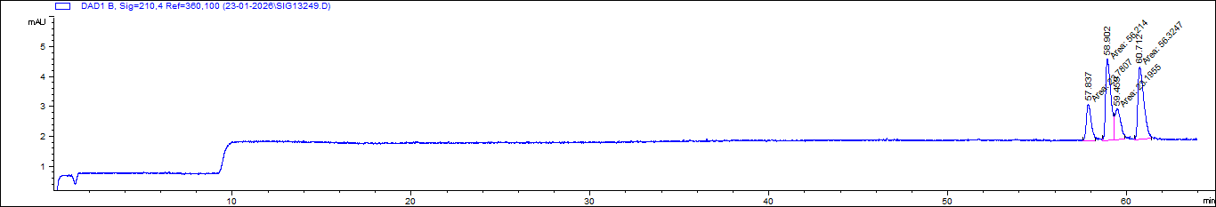
Effect of β Cyclodextrins on Methamphetamine and Methamphetamine-d11
MET+MET-d11
Buffer: H₃PO₄+TEA (pH 3.1)
Achiral analysis
MET+MET-d11
Buffer: H₃PO₄+TEA (pH 3.1)
Additive: 4 mg/mL β-CD
MET+MET-d11 | Migration time (min) | Number of theoretical plates (N) | Resolution
Achiral analysis | 39.974 | 236 813 | ---
Additive: 4 mg/mL β-CD | 57.873 | 217 831 | ---
 | 58.902 | 181 350 | 1.02
 | 59.459 | 132 903 | 1.01
 | 60.712 | 154 684 | 1.02

Slide 13
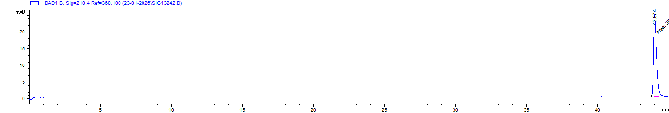
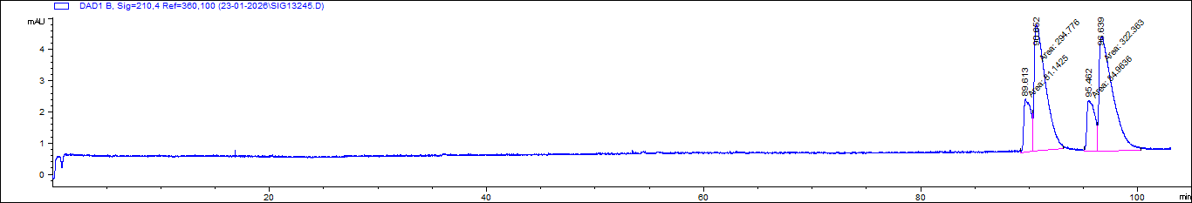
Effect of β Cyclodextrins on MDMA+MDMA-d5
MDMA+MDMA-d5
Buffer: H₃PO₄+TEA (pH 3.1)
Achiral analysis
MDMA+MDMA-d5
Buffer: H₃PO₄+TEA (pH 3.1) Additive: 3 mg/mL β-CD
MDMA+MDMA-d5 | Migration time (min) | Number of theoretical plates (N) | Resolution
Achiral analysis | 43.974 | 221 350 | ---
Additive: 3 mg/mL β-CD | 89.613 | 53 598 | ---
 | 90.862 | 35 444 | 1.01
 | 95.462 | 47 675 | 1.05
 | 96.639 | 29 996 | 1.01

Slide 14
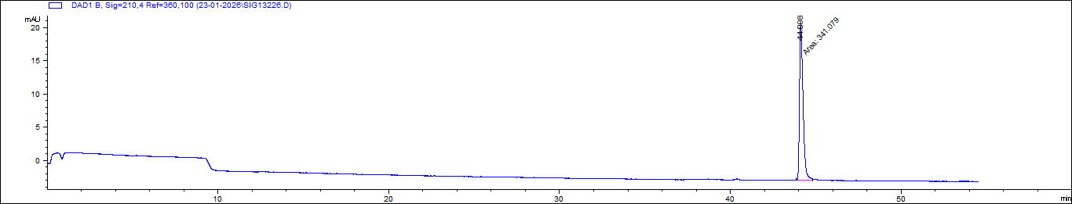
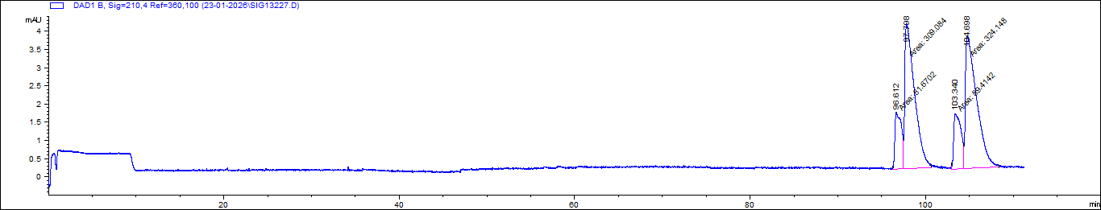
Effect of β Cyclodextrins on MDMA+MDMA-d5
MDMA+MDMA-d5
Buffer: H₃PO₄+TEA (pH 3.1)
Achiral analysis
MDMA+MDMA-d5
Buffer: H₃PO₄+TEA (pH 3.1) Additive: 3.5 mg/mL β-CD
MDMA+MDMA-d5 | Migration time (min) | Number of theoretical plates (N) | Resolution
Achiral analysis | 44.098 | 236 723 | ---
Additive: 3.5 mg/mL β-CD | 96.612 | 50 656 | ---
 | 97.798 | 37 626 | 1.01
 | 103.340 | 50 721 | 1.06
 | 104.698 | 32 708 | 1.01

Slide 15
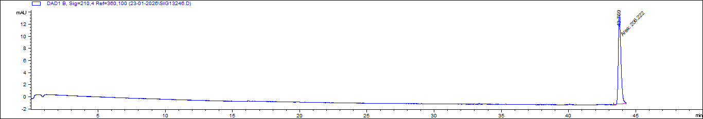
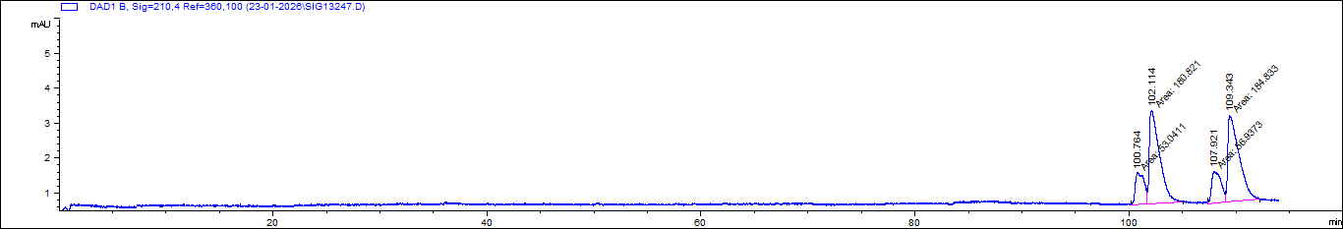
Effect of β Cyclodextrins on MDMA+MDMA-d5
MDMA+MDMA-d5
Buffer: H₃PO₄+TEA (pH 3.1)
Achiral analysis
MDMA+MDMA-d5
Buffer: H₃PO₄+TEA (pH 3.1)
Additive: 4 mg/mL β-CD
MDMA+MDMA-d5 | Migration time (min) | Number of theoretical plates (N) | Resolution
Achiral analysis | 43.759 | 244 409 | ---
Additive: 4 mg/mL β-CD | 100.764 | 52 007 | ---
 | 102.114 | 54 806 | 1.01
 | 107.921 | 57 064 | 1.06
 | 109.343 | 49 223 | 1.01

Slide 16
Conclusion
Low pH Baseline: Achiral electrolyte alone (pH 3.1) is completely ineffective for isotopologue separation.
Chiral Selector & Concentration: Resolution strictly depends on choosing correct chiral selector with optimized concentration.
Research Importance: different enantiomers and isotopologues can trigger distinct pharmacological or toxicological effects.

Slide 17
Thank you for your attention!

