Slide 1



Molecular Dynamics Study of G-Quadruplex Structural Recognition
Georgian-German Science Bridge (GGSB) 2026 Workshop
Nika Chakhunashvili, M.Sc. Student
Institute of Biophysics, Ilia State University
Institute of Neuroscience and Medicine (INM-9), Forschungszentrum Jülich

Slide 2
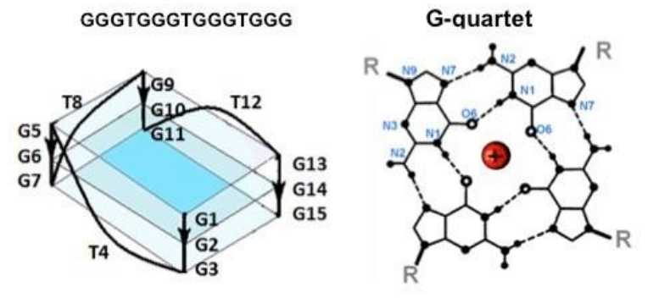
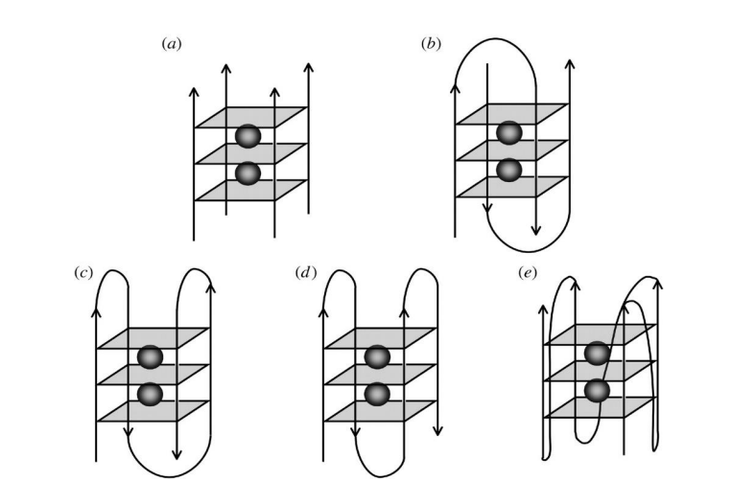

DNA and RNA Quadruplexes (G4s and rG4s) and their structures:
The sequence determines the structure of DNA/RNA.
Quadruplexes are guanine rich secondary structures made of G-quartets.
Cations (such as potassium) determine the folding on nucleic acids.
Study of secondary structures are conducted by spectrometric studies. Nucleic acids are best seen in UV region. Quadruplexes are studied at 295 nm.
Quadruplexes can be parallel or antiparallel in structure. Can be formed with one or multiple strands or DNA.
Georgian-German Science Bridge (GGSB) 2026 Workshop

Slide 3
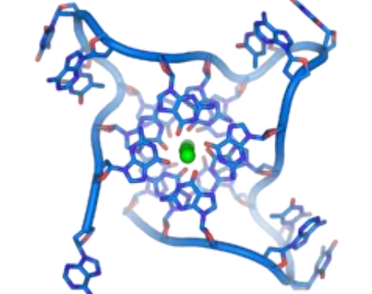
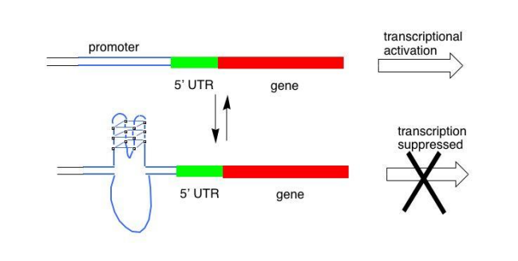
Quadruplexes and their biological role:
Quadruplexes are mainly detected in telomeric regions due to guanine rich requence: TTAGGG.
Takes part in gene regulation and expression.
Are connected to some neurodegenerative disorders including ALS/FTD.
Bugaut A, Balasubramanian S (2012). "5'-UTR RNA G-quadruplexes: translation regulation and targeting.". Nucleic Acids Res. 40 (11): 4727–41.
Georgian-German Science Bridge (GGSB) 2026 Workshop

Slide 4
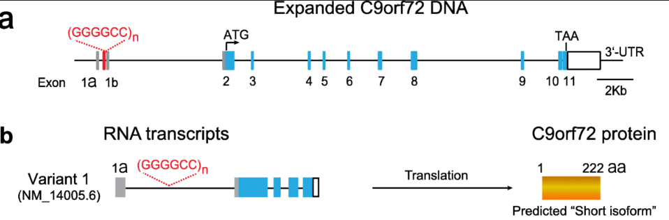
Role of rG4s in neurodegenerative disorders
Jiang, J., Ravits, J. Pathogenic Mechanisms and Therapy Development for C9orf72 Amyotrophic Lateral Sclerosis/Frontotemporal Dementia. Neurotherapeutics 16, 1115–1132 (2019). https://doi.org/10.1007/s13311-019-00797-2
Georgian-German Science Bridge (GGSB) 2026 Workshop

Slide 5
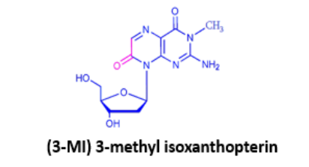
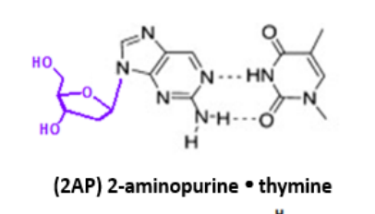
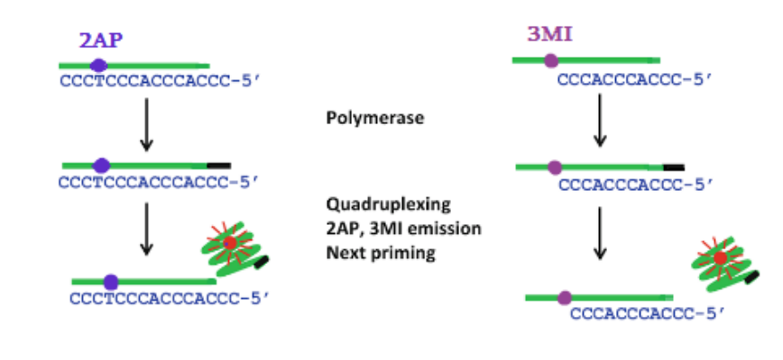
QPA (Quadruplex Primer Amplification)
G3T sequence is used for QPA . It self-forms into a quadruplex in the presence of potassium, as it is preferred over duplexes . The primer, which is a truncated version of G3T , was designed to self-fold into a quadruplex.
For detection, 3-methyl isoxanthopterin (3MI ) or 2-aminopurine ( 2AP ) is used . It is inserted into the fourth position of the primer.
The target molecule, CCCACCACCCC , is required . which is complementary to the primer and binds to the primer and deoxyguanosine triphosphate ( dGTP ) .
Buffers ( e.g., magnesium and potassium ions) are also needed.
Georgian-German Science Bridge (GGSB) 2026 Workshop

Slide 6
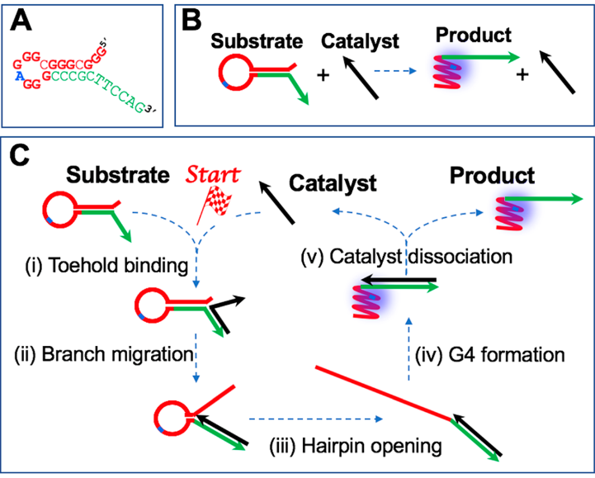
Quadruplexes in non-enzymatic diagnostics
Current research is focused on non-enzymatic, isothermal diagnostic methods.
Based on structural transformation ( ST ) from herpin to quadruplex.
is a thermodynamically irreversible process.
Kankia , B. (2020) Quadruplex -Based Reactions for Dynamic DNA Nanotechnology. J. Phys. Chem. B 2020, 124, 4263-4269.
Georgian-German Science Bridge (GGSB) 2026 Workshop

Slide 7
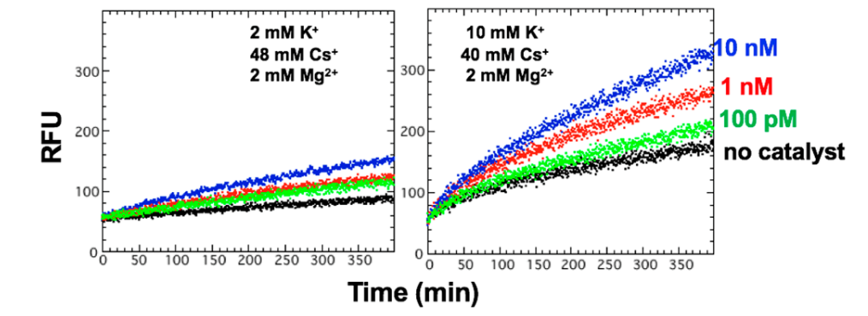
Quadruplexes in non-enzymatic diagnostics
The graph shows fluorometric studies of the ST reaction.
The reaction is a linear reaction, which is why it takes a long time to obtain a strong signal, unlike PCR and QPA.
In the absence of catalyst, signal leakage is evident, especially at high potassium.
Kankia , B. (2020) Quadruplex -Based Reactions for Dynamic DNA Nanotechnology. J. Phys. Chem. B 2020, 124, 4263-4269.
Georgian-German Science Bridge (GGSB) 2026 Workshop

Slide 8
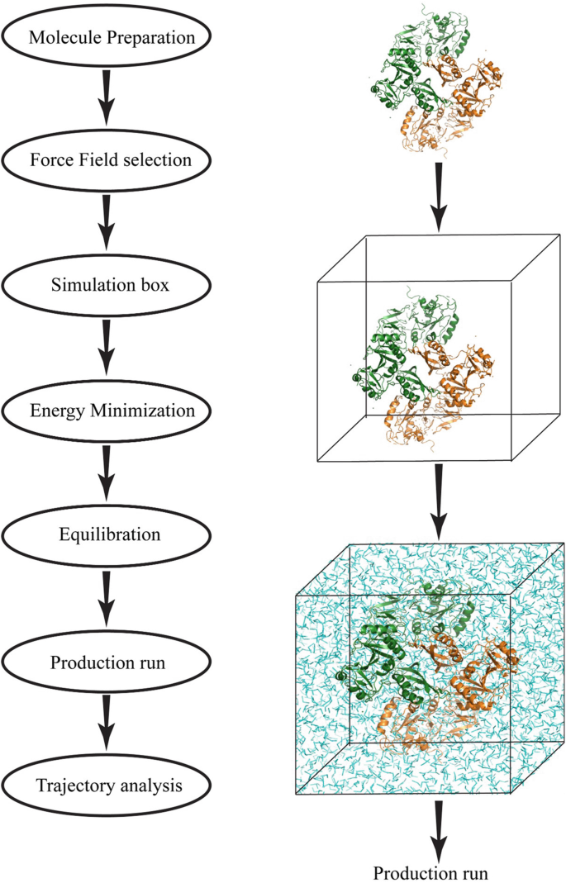
Molecular Dynamics (MD) Simulations
MD simulations utilizes classical mechanics to study the atomistic behavior of different biomolecules including protein and nucleic acids.
Commonly used MD simulation softwares are: GROMACS, NAMD, AMBER and so on.
Molecule preparations are usually done in ChimeraX, PyMOL, etc.
Kumar, V., Yaduvanshi, S. (2023). Protein-Protein Interaction Studies Using Molecular Dynamics Simulation. In: Sousa, Â., Passarinha, L. (eds) Advanced Methods in Structural Biology. Methods in Molecular Biology, vol 2652. Humana, New York, NY. https://doi.org/10.1007/978-1-0716-3147-8_16
Georgian-German Science Bridge (GGSB) 2026 Workshop

Slide 9
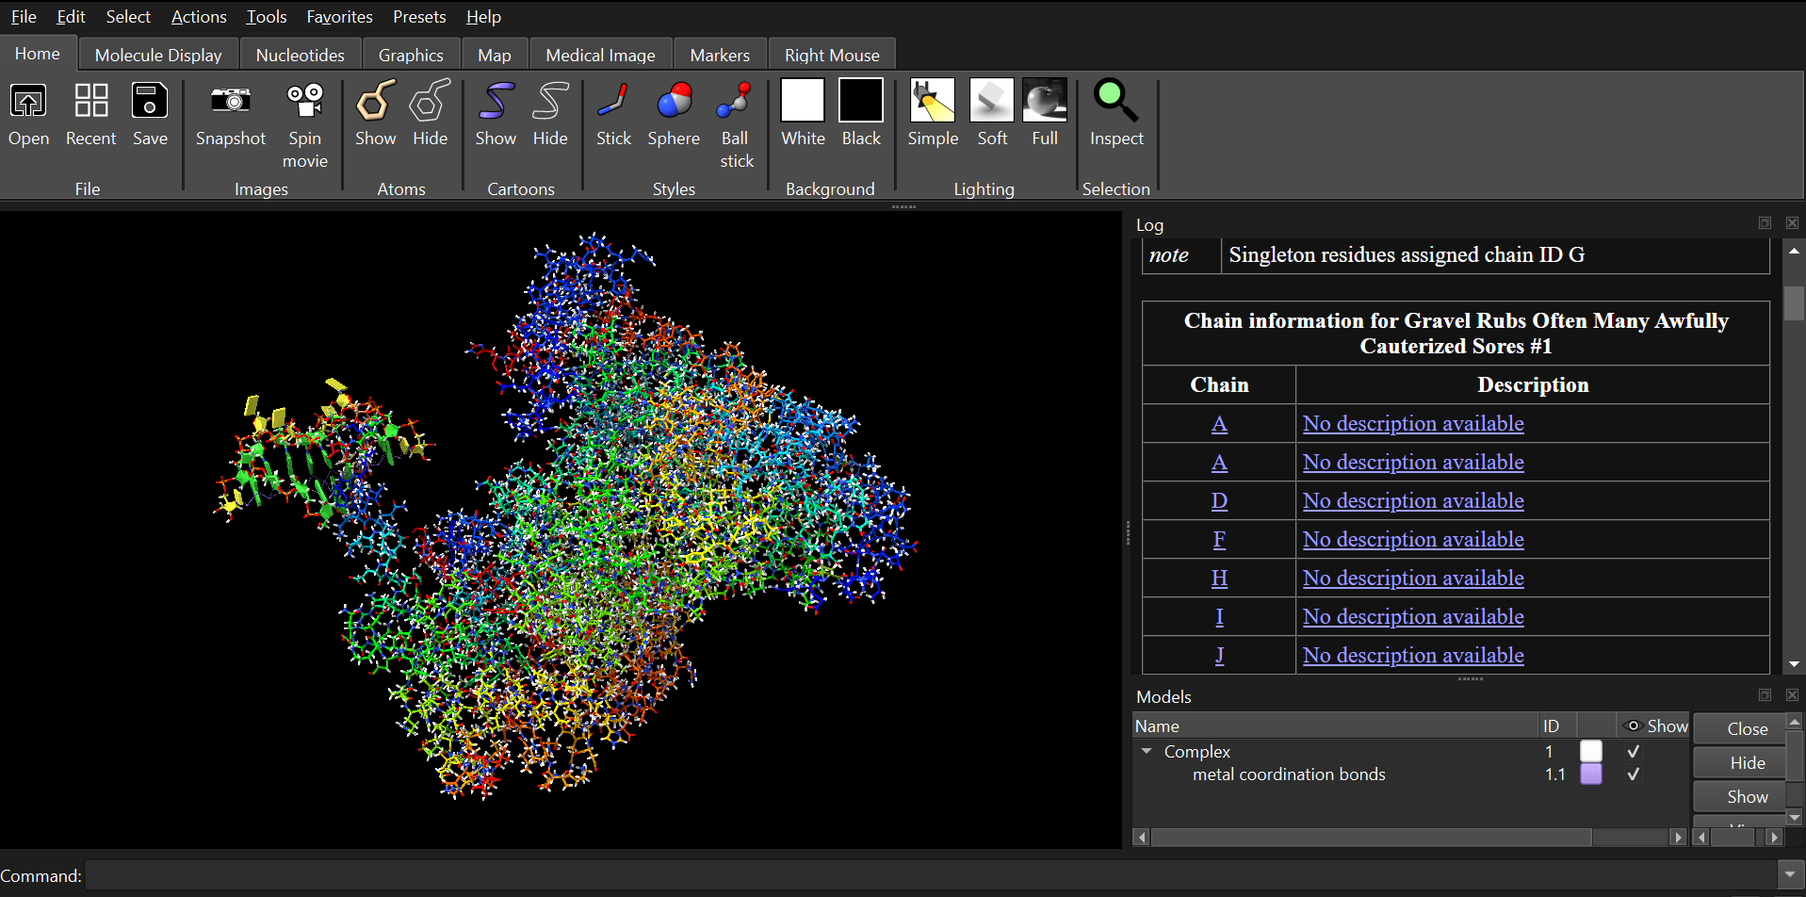
Molecular Dynamics (MD) Simulations
Georgian-German Science Bridge (GGSB) 2026 Workshop

Slide 10
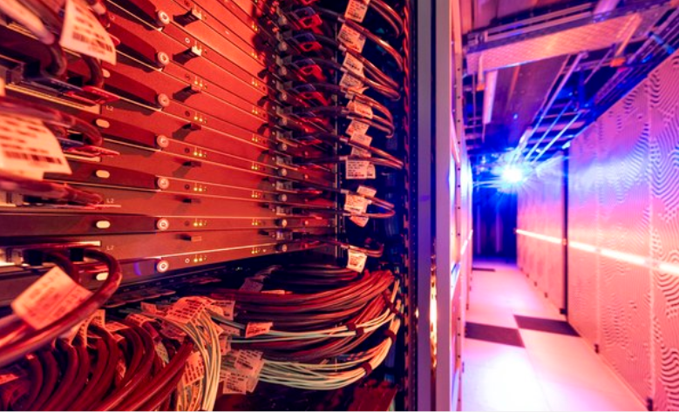
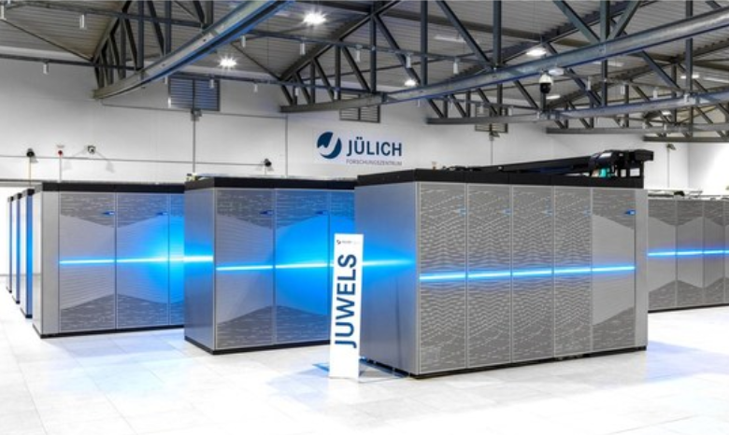
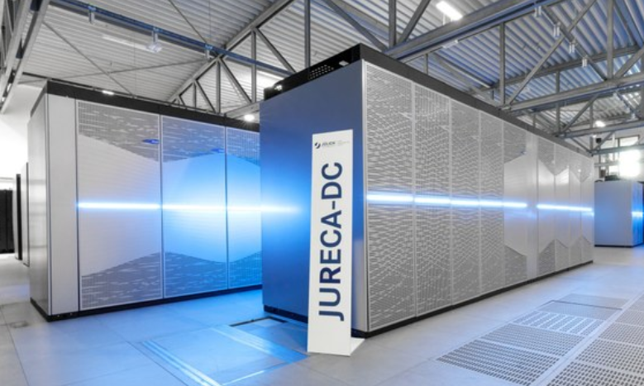
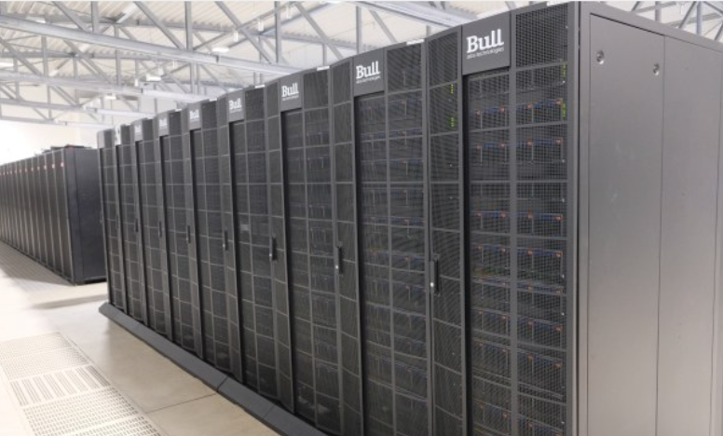
JUPITER
JUWELS
JURECA
JUSUF
Georgian-German Science Bridge (GGSB) 2026 Workshop

Slide 11
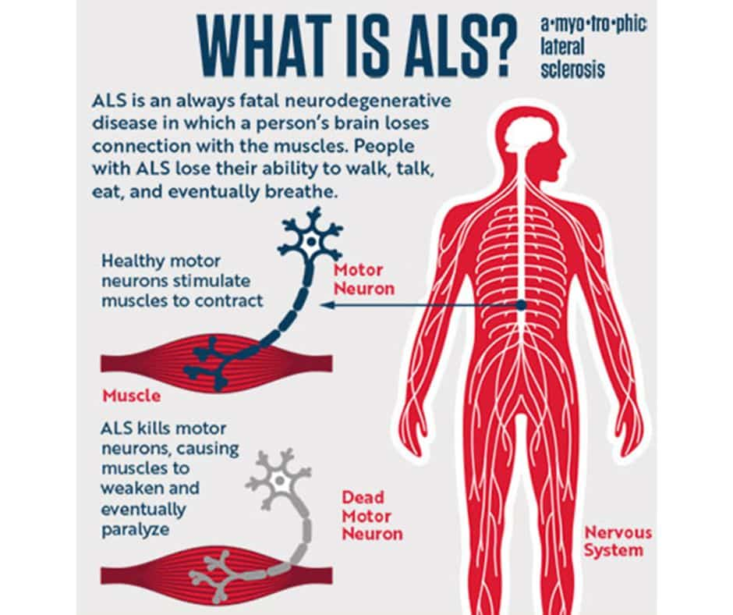
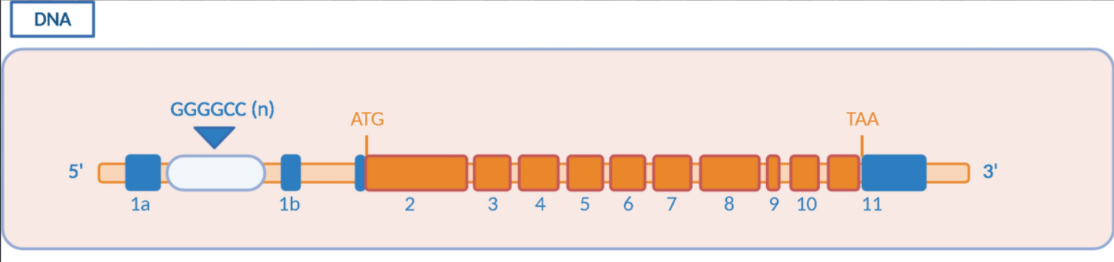
DHX36 helicases and Quadruplexes in Neurodegenerative Disorders
Mutated C9orf72 gene with elongated G4C2 repeat.
Normal range: 2 to 24 repeats (non-pathogenic).
Intermediate range: 25 to 60 repeats (uncertain clinical significance; rarely linked to disease but structurally unstable).
Pathogenic range: 61 to more than 4,000 repeats (causes Amyotrophic Lateral Sclerosis [ALS] and Frontotemporal Dementia [FTD])
Braems, E., Swinnen, B. & Van Den Bosch, L. C9orf72 loss-of-function: a trivial, stand-alone or additive mechanism in C9 ALS/FTD?. Acta Neuropathol 140, 625–643 (2020). https://doi.org/10.1007/s00401-020-02214-x
Georgian-German Science Bridge (GGSB) 2026 Workshop

Slide 12
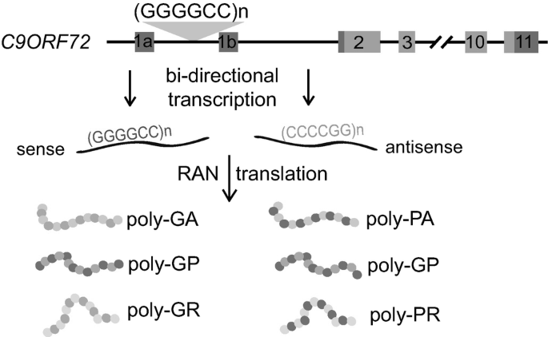
DHX36 helicases and Quadruplexes in Neurodegenerative Disorders
RAN translation is linked to over 40 severe neurodegenerative and neuromuscular disorders driven by repeat expansions.
Produces abnormal, aggregation-prone proteins that damage cells.
Examples of disorders:
Amyotrophic lateral sclerosis (ALS) and frontotemporal dementia (C9orf72-related)
Huntington's disease
Myotonic dystrophy (types 1 and 2)
Spinocerebellar ataxia (e.g., SCA8)
Fragile X tremor/ataxia syndrome (FXTAS)
Wang, S., Sun, S. (2022). Measuring Repeat-Associated Non-AUG (RAN) Translation. In: Matějů, D., Chao, J.A. (eds) The Integrated Stress Response. Methods in Molecular Biology, vol 2428. Humana, New York, NY. https://doi.org/10.1007/978-1-0716-1975-9_8
Georgian-German Science Bridge (GGSB) 2026 Workshop

Slide 13
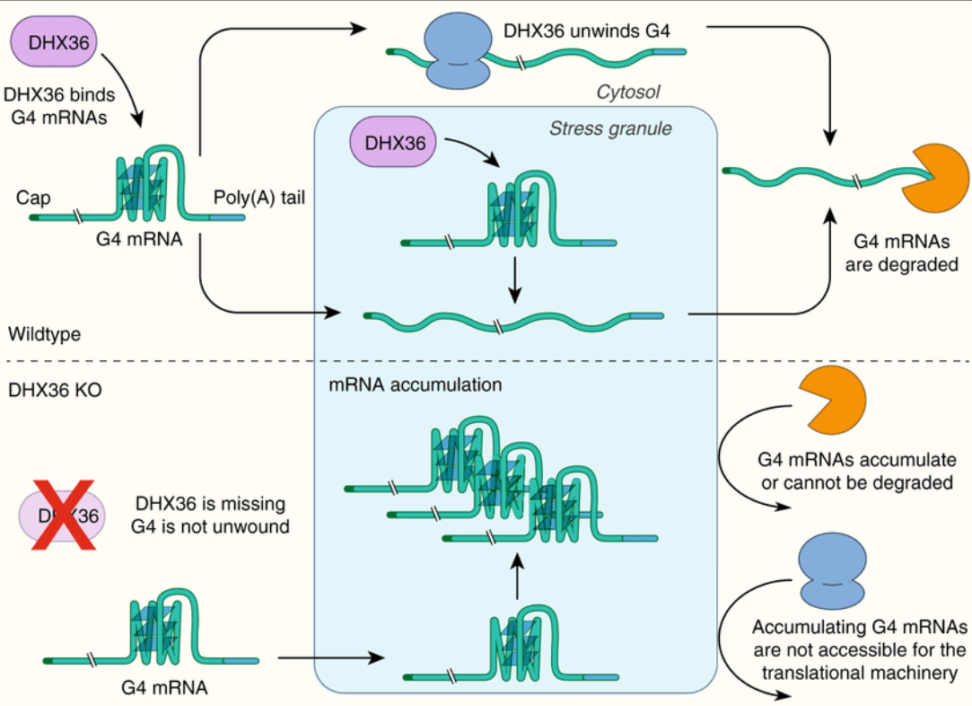
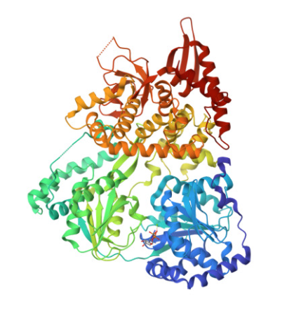
DHX36 helicases and Quadruplexes
Sauer, M., Juranek, S.A., Marks, J. et al. DHX36 prevents the accumulation of translationally inactive mRNAs with G4-structures in untranslated regions. Nat Commun 10, 2421 (2019). https://doi.org/10.1038/s41467-019-10432-5
Georgian-German Science Bridge (GGSB) 2026 Workshop

Slide 14
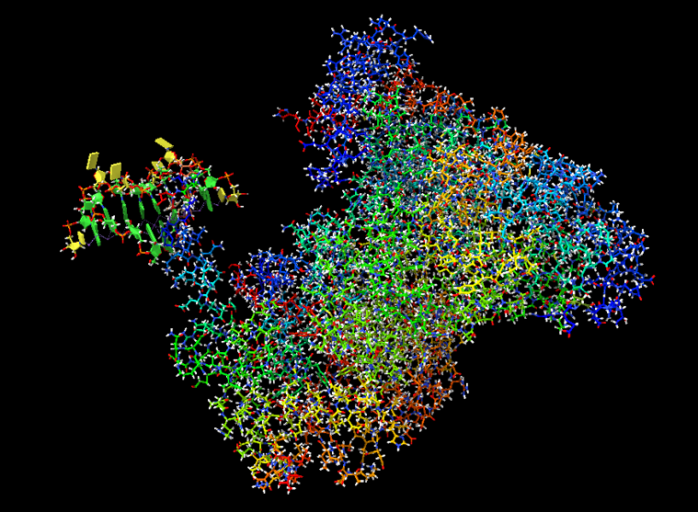
DHX36 helicases and Quadruplexes
System 1: Wild-Type human DHX36 bound to (G₄C₂) rG4
System 2: The DHX36 Y69A (Tyr69Ala) mutant in complex with rG4. By knocking out a key anchoring residue in the DSM domain to gain insights into binding specificity.
System 3: The alternative rG4 topology (e.g., hybrid vs. parallel) to test if recognition depends on this change of topology.
System 4: The wild-type complex without the K⁺ channel ions to evaluate their role in maintaining G-quadruplex core stability.
Georgian-German Science Bridge (GGSB) 2026 Workshop

Slide 15
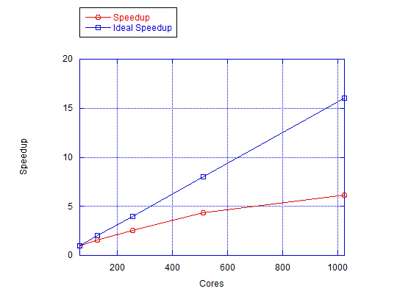
Results of benchmarking on JURECA-DC
Cores | JURECA Nodes | Throughput (ns/day) | Core-Hour Cost (hour/ns) | Speedup (S) | Ideal Speedup | Parallel Efficiency (E)
64 | 0.5 | 24.827 | 0.967 | 1.00 (Baseline) | 1 | 100.00%
128 | 1 | 38.911 | 0.617 | 1.57 | 2 | 78.40%
256 | 2 | 63.876 | 0.376 | 2.57 | 4 | 64.30%
512 | 4 | 108.426 | 0.221 | 4.37 | 8 | 54.60%
1024 | 8 | 153.03 | 0.157 | 6.16 | 16 | 38.50%
Georgian-German Science Bridge (GGSB) 2026 Workshop

Slide 16
Results of benchmarking on JURECA-DC
Configuration | Hardware Allocation | Average Replica Speed (ns/day) | Aggregate Node Throughput (ns/day) | Node-Hour Cost (hours/ns)
1 Replica (Baseline) | 1 CPU Node (128 Cores) | 38.911 | 38.911 | 0.617
4 Replicas (multi-dir) | 1 GPU Node (4x A100) | 124.855 | 499.419 | 0.192
Georgian-German Science Bridge (GGSB) 2026 Workshop

Slide 17
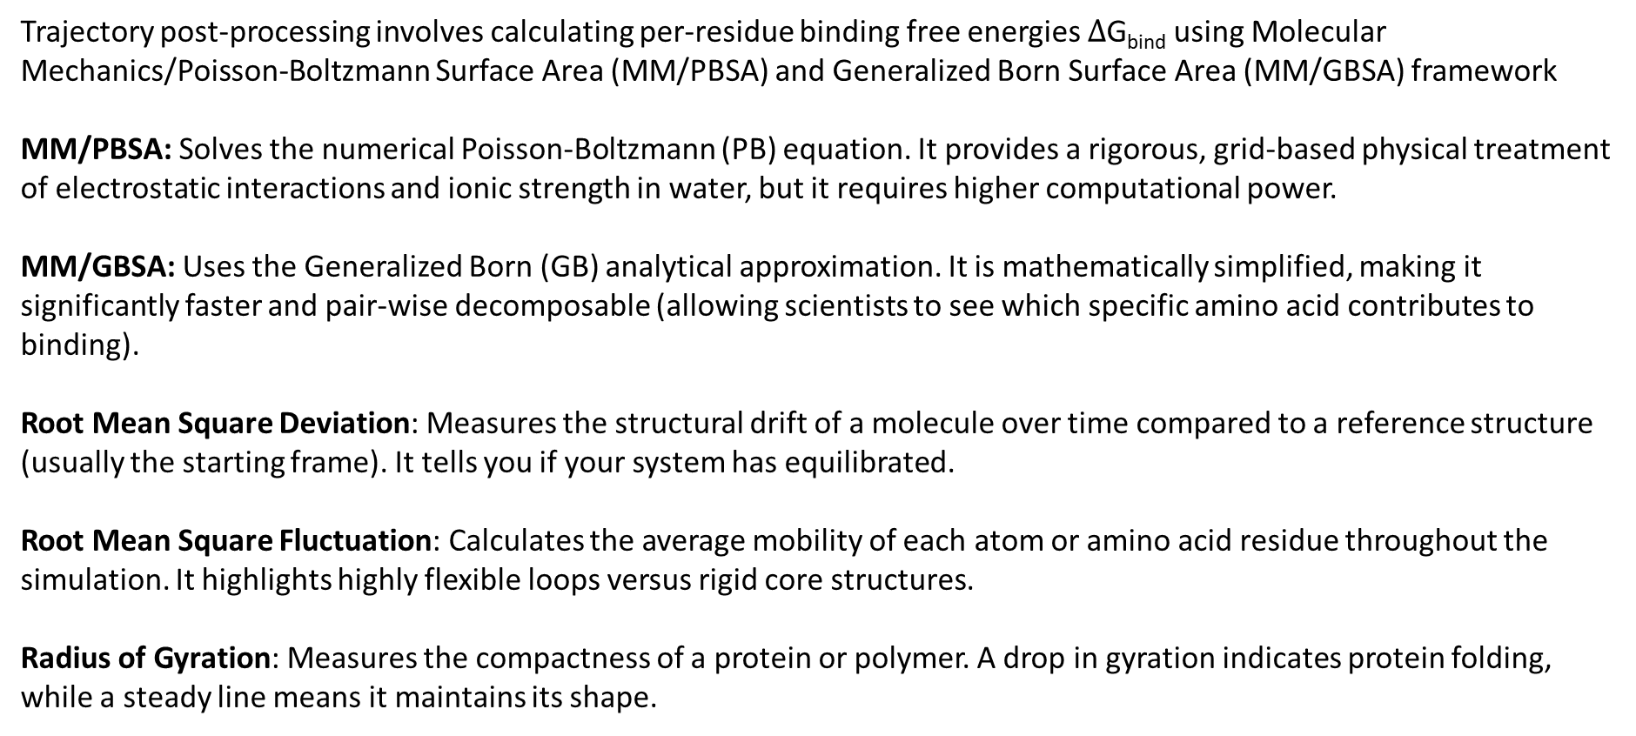
Post-Processing and Thermodynamic Analysis
Trajectory post-processing involves calculating per-residue binding free energies $∆$G_{bind} using Molecular Mechanics/Poisson-Boltzmann Surface Area (MM/PBSA) and Generalized Born Surface Area (MM/GBSA) framework
MM/PBSA: Solves the numerical Poisson-Boltzmann (PB) equation. It provides a rigorous, grid-based physical treatment of electrostatic interactions and ionic strength in water, but it requires higher computational power.
MM/GBSA: Uses the Generalized Born (GB) analytical approximation. It is mathematically simplified, making it significantly faster and pair-wise decomposable (allowing scientists to see which specific amino acid contributes to binding).
Root Mean Square Deviation: Measures the structural drift of a molecule over time compared to a reference structure (usually the starting frame). It tells you if your system has equilibrated.
Root Mean Square Fluctuation: Calculates the average mobility of each atom or amino acid residue throughout the simulation. It highlights highly flexible loops versus rigid core structures.
Radius of Gyration: Measures the compactness of a protein or polymer. A drop in gyration indicates protein folding, while a steady line means it maintains its shape.
Georgian-German Science Bridge (GGSB) 2026 Workshop

Slide 18
Future prospects
Expanding the research to other rG4 repeats that cause neurodegenerative disorders.
Studying the orientations of G-tetrads on atomistic level using QM/MM simulations and their role in the rG4 stabilization.
Studying the exact mechanisms of rG4 aggregates and their interactions with proteins and peptides.
Georgian-German Science Bridge (GGSB) 2026 Workshop

Slide 19
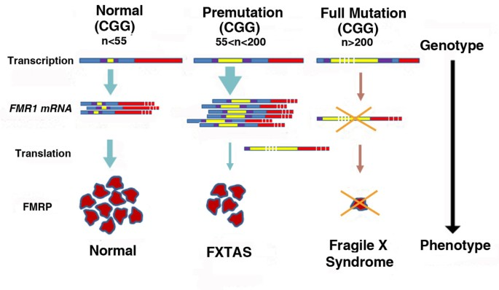
Future prospects
Expanding the research to other rG4 repeats that cause neurodegenerative disorders:
Berman, R.F., Buijsen, R.A., Usdin, K. et al. Mouse models of the fragile X premutation and fragile X-associated tremor/ataxia syndrome. J Neurodevelop Disord 6, 25 (2014). https://doi.org/10.1186/1866-1955-6-25
Georgian-German Science Bridge (GGSB) 2026 Workshop

Slide 20
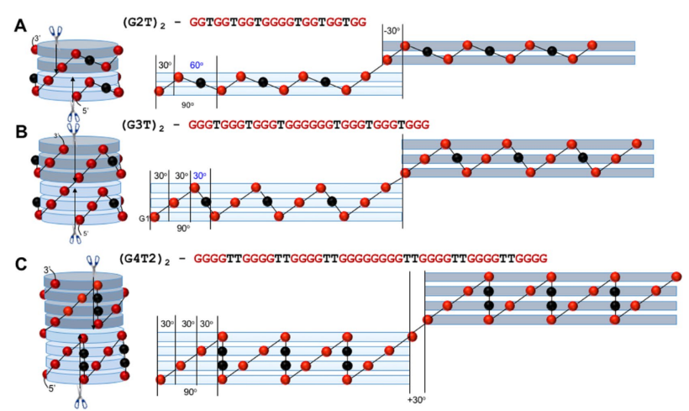
Future prospects
Studying the orientations of G-tetrads on atomistic level using QM/MM simulations and their role in the rG4 stabilization.
Kankia, B. Monomolecular tetrahelix of polyguanine with a strictly defined folding pattern. Sci Rep 8, 10115 (2018). https://doi.org/10.1038/s41598-018-28572-x
Georgian-German Science Bridge (GGSB) 2026 Workshop

Slide 21
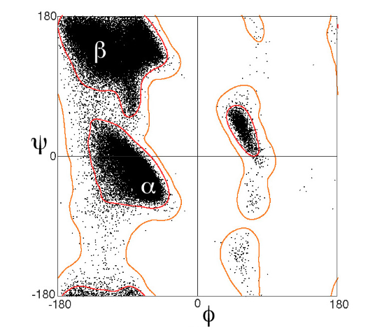
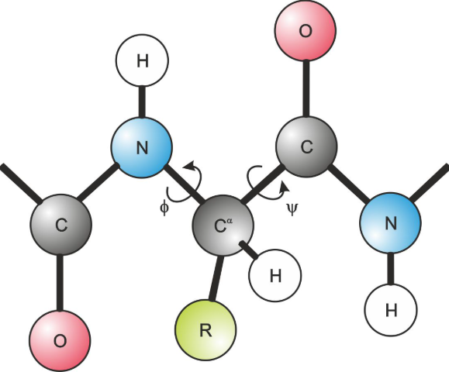
Future prospects
Ramachandran plots used for proteins to predict their energetically allowed orientations of their angles using the angular degrees of freedom within the amino acids, which helps to predict the secondary and tertiary structure of proteins.
Georgian-German Science Bridge (GGSB) 2026 Workshop

Slide 22
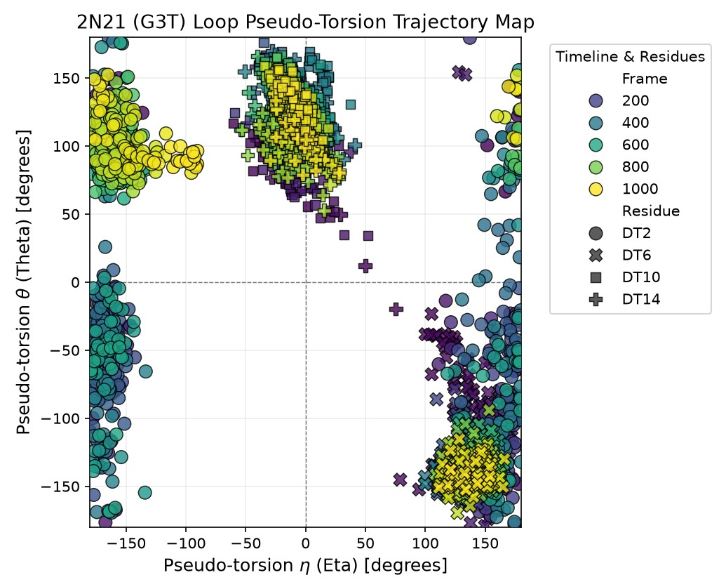
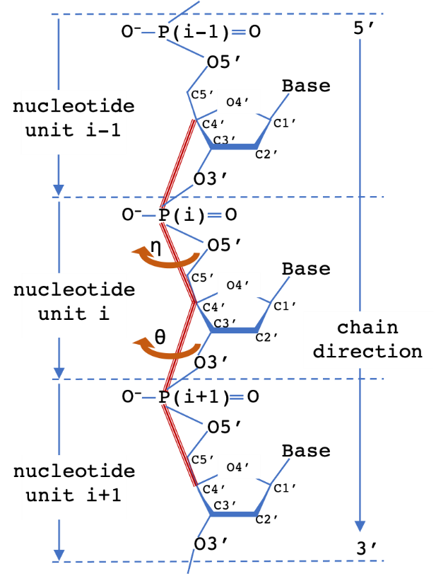
Future prospects
2N21: 5’ – TTGGGTGGGTGGGTGGGT – 3’
Studying the orientations of G-tetrads on atomistic level using QM/MM simulations and their role in the rG4 stabilization.
The simulation was ran on the local computer.
Georgian-German Science Bridge (GGSB) 2026 Workshop

Slide 23
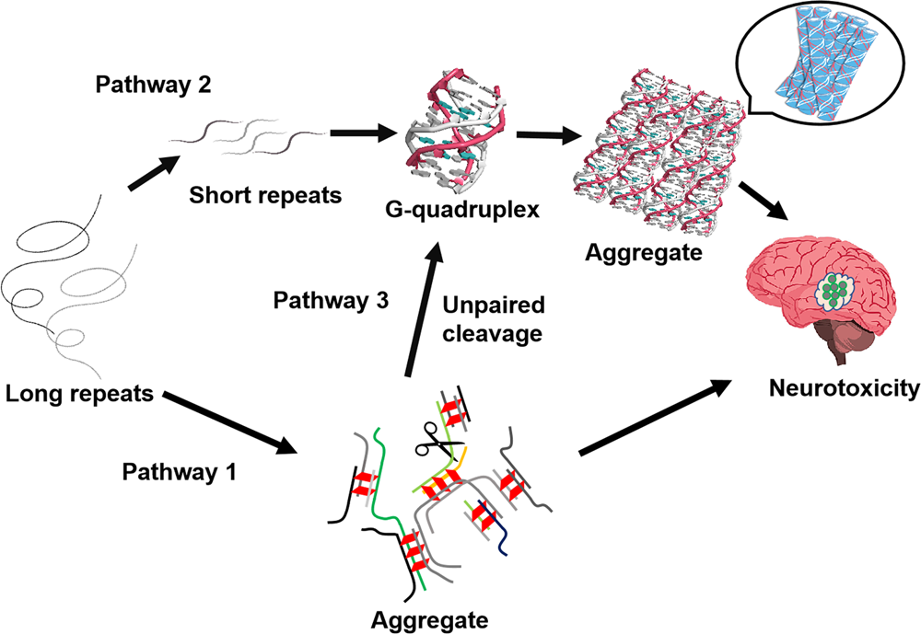
Future prospects
Studying the exact mechanisms of rG4 aggregates and their interactions with proteins and peptides.
Wang, S., Xu, Y. RNA structure promotes liquid-to-solid phase transition of short RNAs in neuronal dysfunction. Commun Biol 7, 137 (2024). https://doi.org/10.1038/s42003-024-05828-z
Georgian-German Science Bridge (GGSB) 2026 Workshop

Slide 24
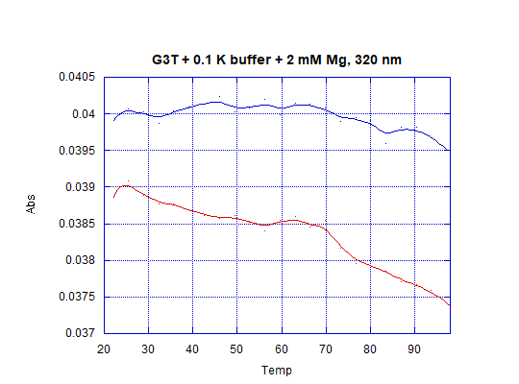
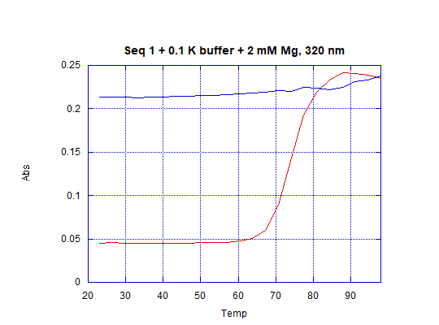
Future prospects
Studying the exact mechanisms of rG4 aggregates and their interactions with proteins and peptides.
Where Seq 1 implies r(G3C) sequence;
Experiments held at Institute of Biophysics, Ilia State University.
Advisor Prof. Besik Kankia
Georgian-German Science Bridge (GGSB) 2026 Workshop

Slide 25
Thank you for your attention

