Slide 1


Numerical Assessment of Alfven Waves Influence on the Atmospheric Irregular Structures
Giorgi Dalakishvili
Ilia State University, GGSB
giorgi.dalakishvili@iliauni.edu.ge
Work is supported by Grant of Shota Rustaveli National Science Foundation of Georgia FR-21-22825

Slide 2
Summary
Introduction to Irregular Structures in the Atmosphere
Sporadic E layer (Es)
Main Equations and Factors Influencing Es Dynamics-Convergence
Main Idea: (Solar) Influence on Es Through Electric Field-Alfven Waves –Signature of the Sun-Earth Coupling
Numerical Approach-Results
Ambipolar Approach-validation
Future Plans
Space for Collaboration: AlfvenWaves-Sun-Earth coupling

Slide 3
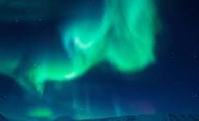
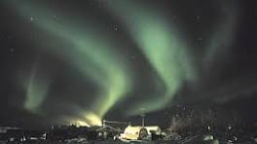
Auroras

Slide 4
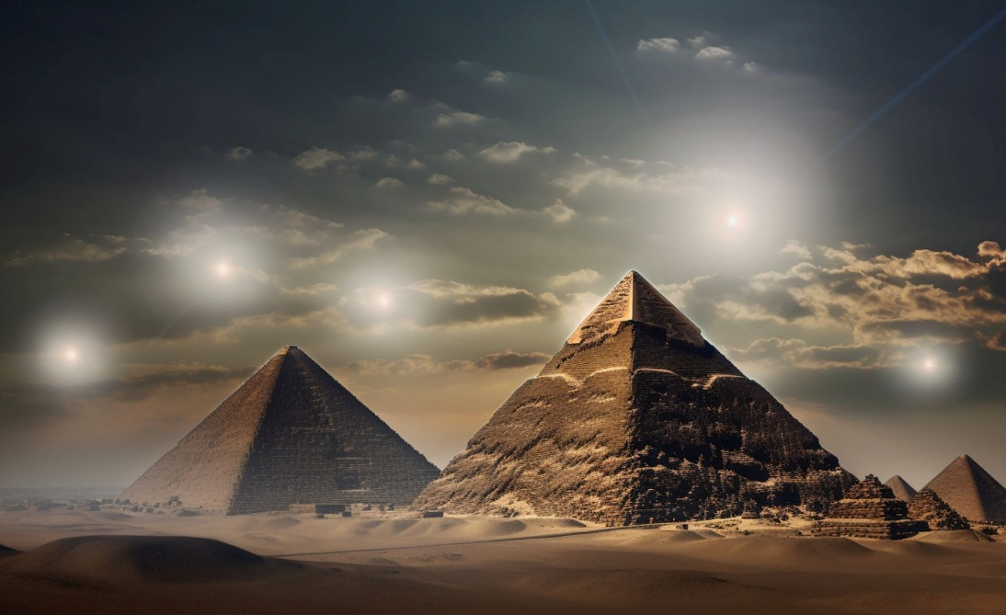
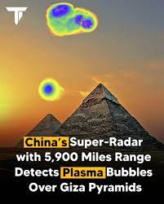
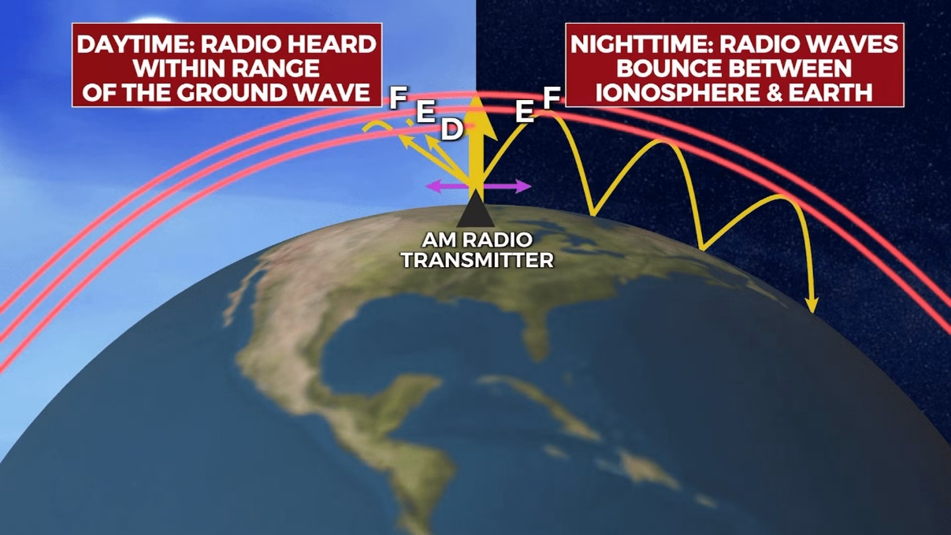
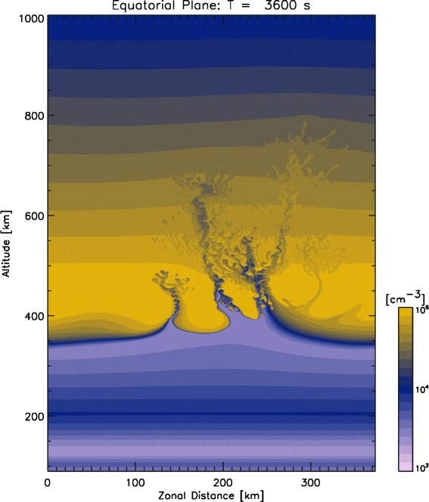
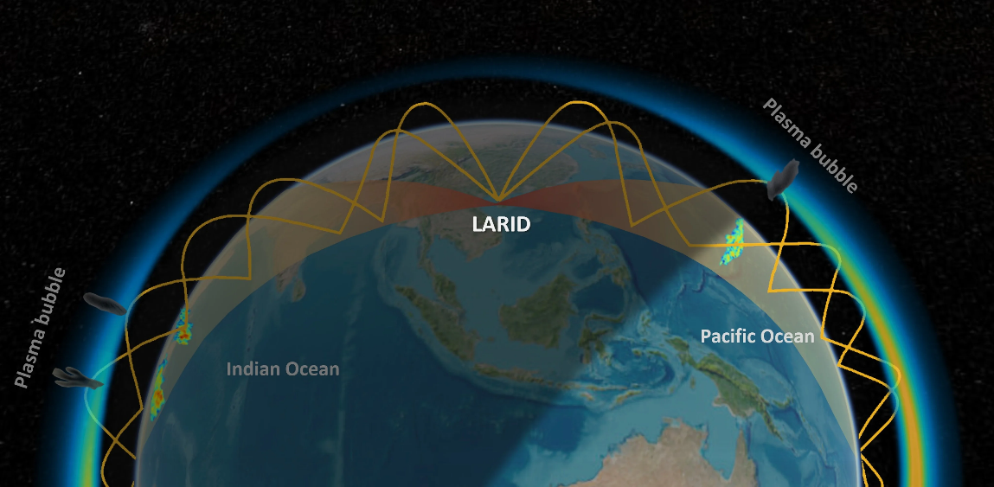
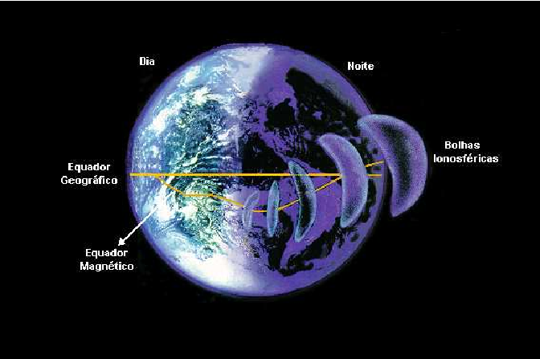
Plasma Bubbles

Slide 5
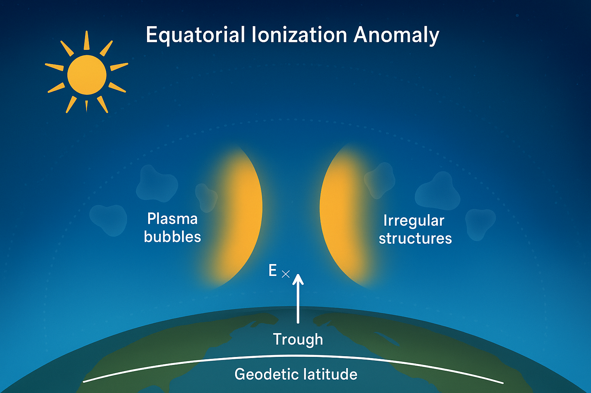
Equatorial Ionization Anomaly (EIA) Irregularities

Slide 6
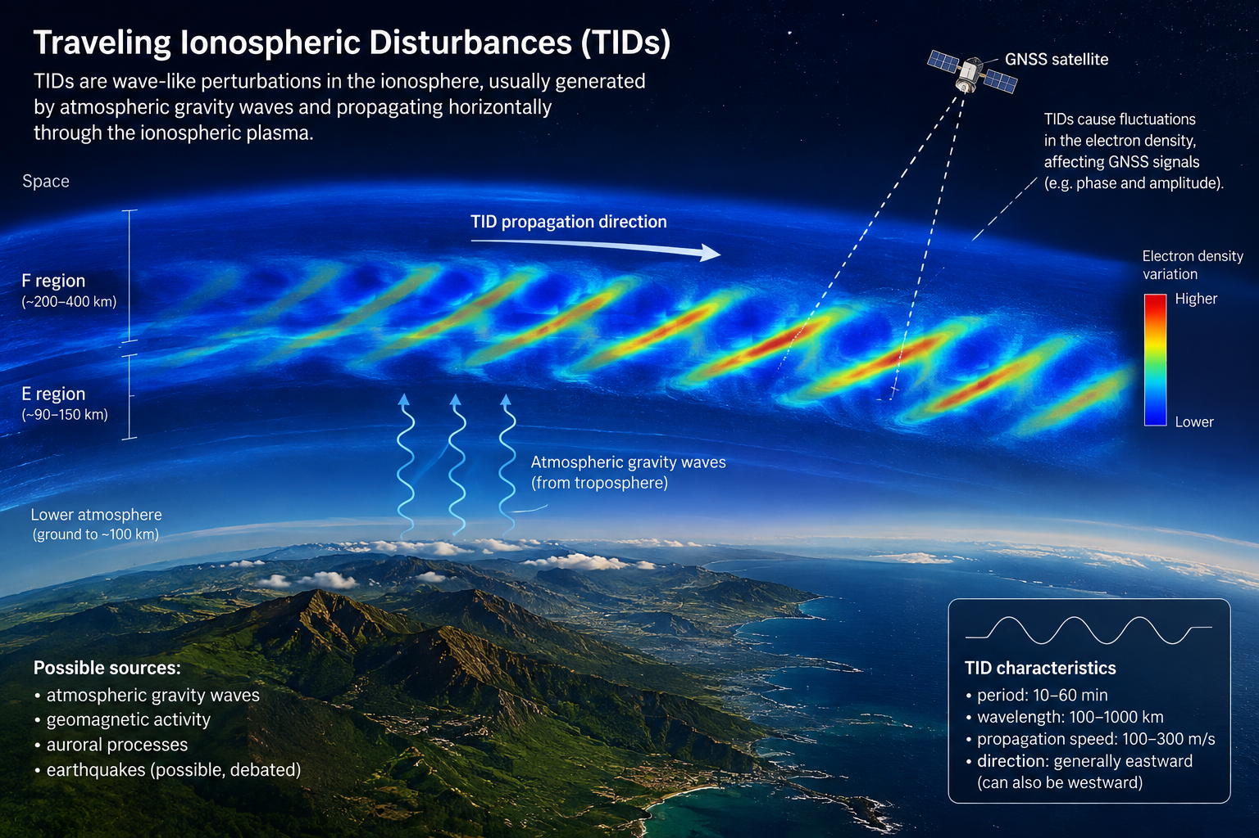
Traveling Ionospheric Disturbances- TIDs

Slide 7
Traveling Ionospheric Disturbances- TIDs
LSTIDs: high-latitude/auroral zone — geomagnetic storms, substorms, Joule heating, Alfvén-wave-driven precipitation
MSTIDs: lower atmosphere/troposphere — convective storms, jet streams, orographic forcing; nighttime midlatitude MSTIDs also self-generated via the Perkins instability (F-region electrodynamic amplification, not just external forcing)
LSTIDs: primarily F-region, propagate across entire hemispheres from auroral source
MSTIDs: F-region (main signature); associated wind perturbations also reach E-region (QP echo, Es interaction)
Vertical extent: TIDs have real vertical structure (tilted phase fronts), spanning the E-to-F-region column, not confined to one altitude
LSTIDs: propagate equatorward from auroral source, phase speed 400–1,000 m/s
MSTIDs: more variable direction, often tied to local meteorology; nighttime midlatitude MSTIDs show a characteristic southwestward propagation tendency (Northern Hemisphere) linked to the Perkins instability geometry; phase speed 100–300 m/s
Both have a vertical propagation component (tilted wavefronts, per gravity wave dispersion relation)
LSTIDs: horizontal wavelength 1,000–3,000 km
MSTIDs: horizontal wavelength 100–300 km
LSTIDs: period 30 min–3+ hours; single event can be tracked for hours as it crosses latitudes
MSTIDs: period 10–60 minutes; nighttime bands can recur/persist over several hours in a quasi-continuous train

Slide 8
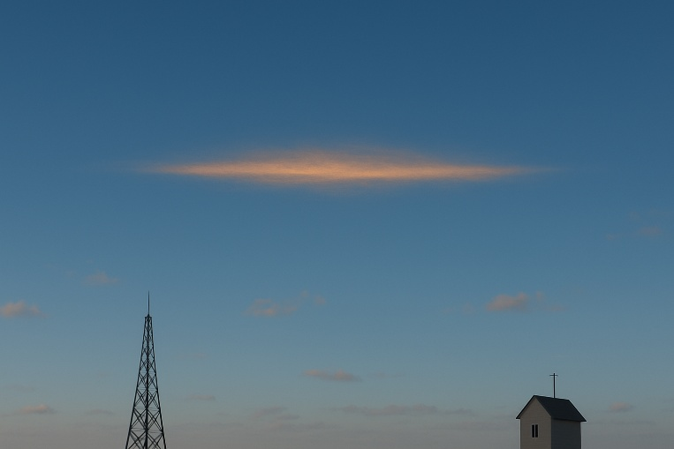
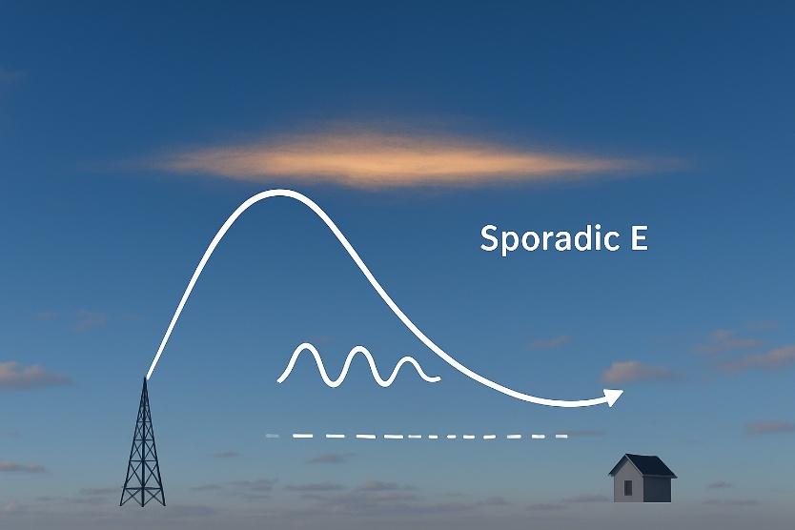
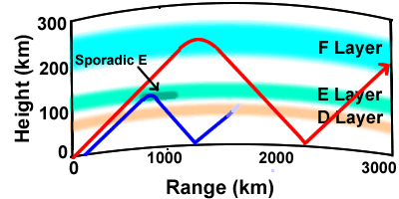
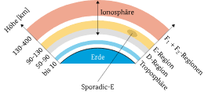
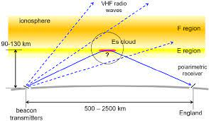
Sporadic E

Slide 9
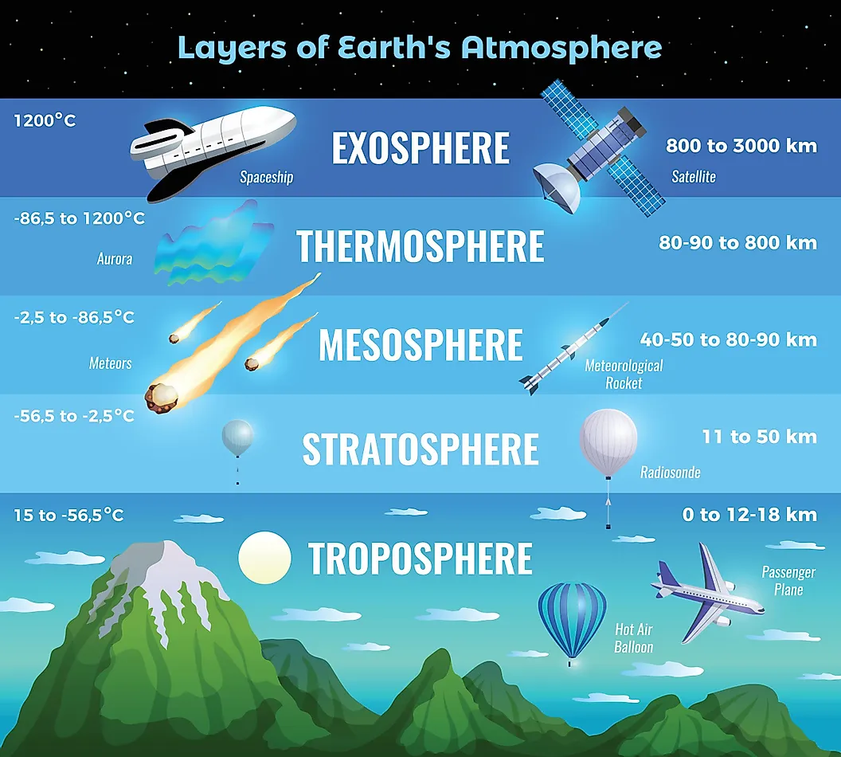
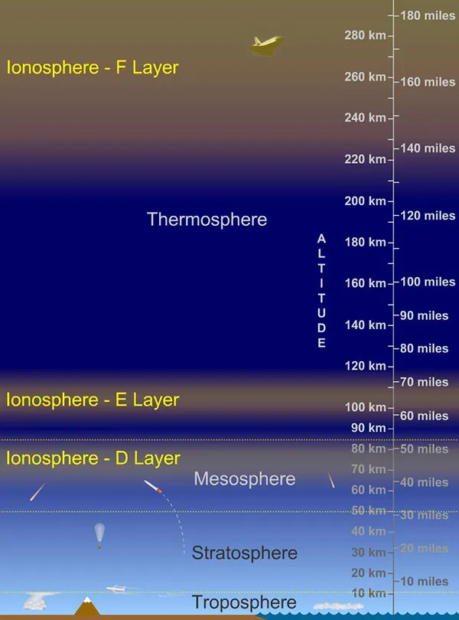
Where are we

Slide 10



Main Equations-Continuity equation
$$\frac{∂N_{i}}{∂t}=−\frac{∂\left(N_{i}W_{i}\right)}{∂z}$$
$$−\frac{∇P_{i}}{N_{i}}+q_{i}\overset{⃑}{V_{i}}×\overset{⃑}{B}+q_{i}\overset{⃑}{E}+M_{i}ν_{in}\left({\overset{⃑}{V}}_{i}−{\overset{⃑}{V}}_{n}\right)=0$$
$$W_{i}=C_{W_{i}U_{n}}U_{n}+C_{W_{i}V_{n}}V_{n}+C_{W_{i}W_{n}}W_{n}+C_{W_{i}U_{E}}U_{E}++C_{W_{i}V_{E}}V_{E}+C_{W_{i}W_{E}}W_{E}−\frac{D}{N_{i}}\frac{∂N_{i}}{∂z}$$
$$W_{iadv}=C_{W_{i}U_{n}}U_{n}+C_{W_{i}V_{n}}V_{n}+C_{W_{i}W_{n}}W_{n}+C_{W_{i}U_{E}}U_{E}++C_{W_{i}V_{E}}V_{E}+C_{W_{i}W_{E}}W_{E}$$
$$\frac{∂N_{i}}{∂t}=−\frac{∂\left(N_{i}W_{iadv}\right)}{∂z}+\frac{∂}{∂z}\left(D\frac{∂N_{i}}{∂z}\right)$$

Slide 11

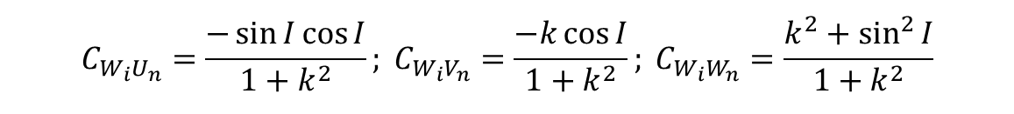

Main Equations-Factors influencing Es dynamics
Neutral Wind
$$C_{W_{i}U_{n}}=\frac{−\sin{I}\cos{I}}{1+k^{2}}; C_{W_{i}V_{n}}=\frac{−k\cos{I}}{1+k^{2}}; C_{W_{i}W_{n}}=\frac{k^{2}+\sin^{2}{I}}{1+k^{2}}$$
$$D=\frac{2K_{B}T\left(k^{2}+\sin^{2}{I}\right)}{M_{i}ν_{in}\left(1+k^{2}\right)}$$
$$k\left(z\right)=\frac{ν_{in}\left(z\right)}{ω_{i}}; ω_{i}=\frac{q_{i}B}{M_{i}}$$

Slide 12
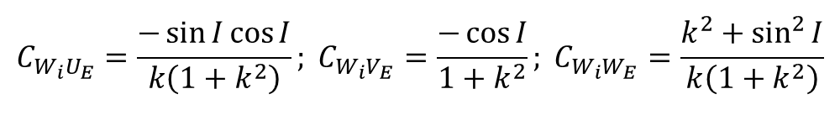

Main Equations-Factors influencing Es dynamics
Electric Field
$$U_{E}=\frac{q_{i}E_{x}}{M_{i}ω_{i}}; V_{E}=\frac{q_{i}E_{y}}{M_{i}ω_{i}}; W_{E}=\frac{q_{i}E_{z}}{M_{i}ω_{i}}$$
$$C_{W_{i}U_{E}}=\frac{−\sin{I}\cos{I}}{k\left(1+k^{2}\right)}; C_{W_{i}V_{E}}=\frac{−\cos{I}}{1+k^{2}}; C_{W_{i}W_{E}}=\frac{k^{2}+\sin^{2}{I}}{k\left(1+k^{2}\right)}$$

Slide 13

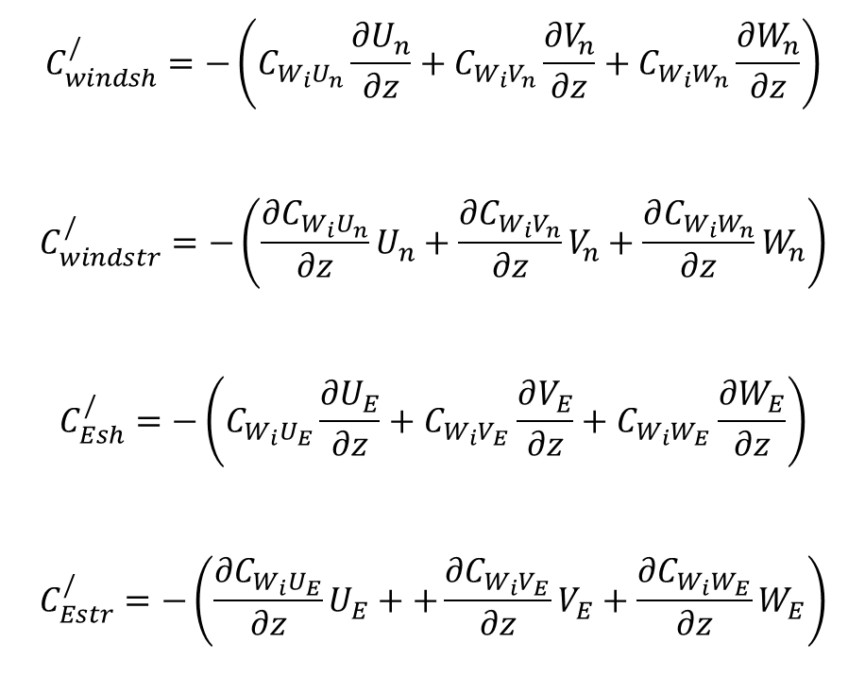
Convergence Mechanism
$$C^{∕}=−\frac{∂W_{iadv}}{∂z}$$
$$C^{∕}=C_{windsh}^{/}+C_{windstr}^{/}+C_{Esh}^{/}+C_{Estr}^{/}$$
$$C_{windsh}^{/}=−\left(C_{W_{i}U_{n}}\frac{{∂U}_{n}}{∂z}+C_{W_{i}V_{n}}\frac{{∂V}_{n}}{∂z}+C_{W_{i}W_{n}}\frac{{∂W}_{n}}{∂z}\right)$$
$$C_{windstr}^{/}=−\left(\frac{∂C_{W_{i}U_{n}}}{∂z}U_{n}+\frac{{∂C}_{W_{i}V_{n}}}{∂z}V_{n}+\frac{∂C_{W_{i}W_{n}}}{∂z}W_{n}\right)$$
$$C_{Esh}^{/}=−\left(C_{W_{i}U_{E}}\frac{{∂U}_{E}}{∂z}+C_{W_{i}V_{E}}\frac{∂V_{E}}{∂z}+C_{W_{i}W_{E}}\frac{{∂W}_{E}}{∂z}\right)$$
$$C_{Estr}^{/}=−\left(\frac{{∂C}_{W_{i}U_{E}}}{∂z}U_{E}++\frac{{∂C}_{W_{i}V_{E}}}{∂z}V_{E}+\frac{{∂C}_{W_{i}W_{E}}}{∂z}W_{E}\right)$$

Slide 14
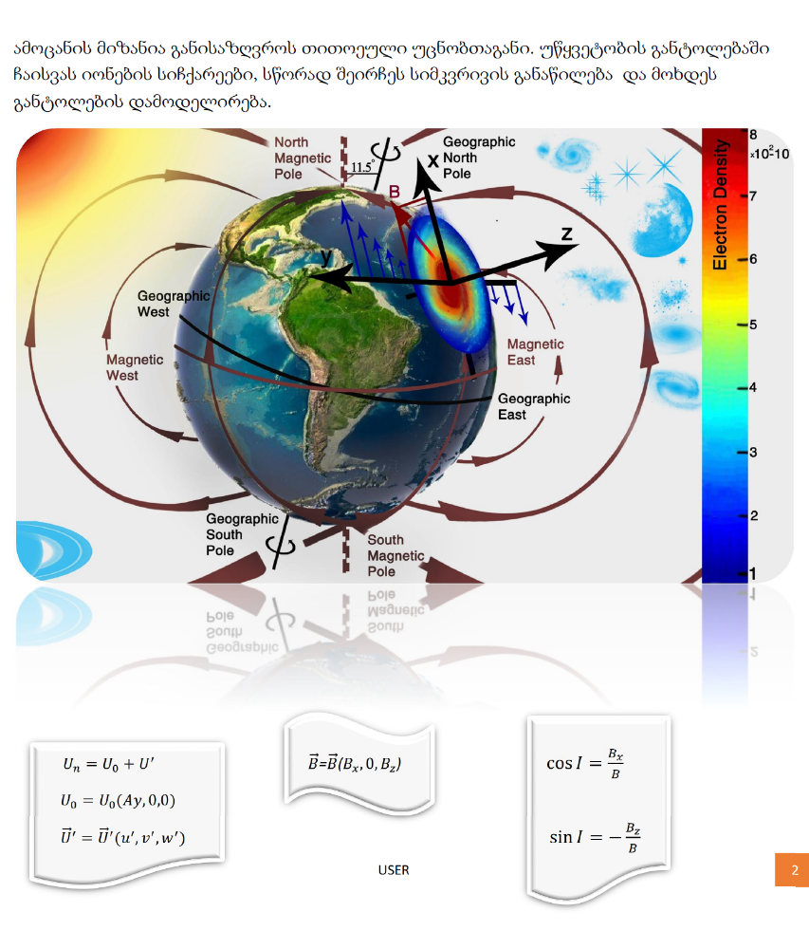
Coordinate System

Slide 15
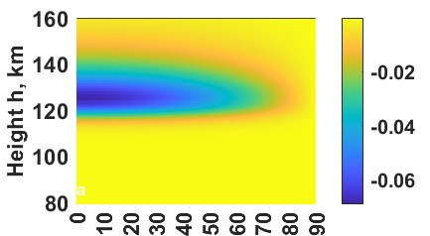
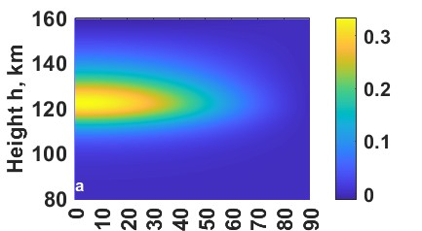

Main Idea-Influence on Es Through Electric Field –Signature of the Sun-Earth Coupling
$$\vec{E}={\vec{E}}_{0}\cos\left(k_{z}z−ωt\right)$$
$$k_{z}=k_{⊥}\sin{I}+k_{∥}\cos{I}$$
$k_{⊥}$=10km ; $k_{∥}$=80km
Convergence due to the shear of the electric field
Convergence due to the atmospheric stratification
and electric field
$$C_{Esh}^{′}=k_{z}\left(C_{W_{i}U_{E}}U_{E}++C_{W_{i}V_{E}}V_{E}+C_{W_{i}W_{E}}W_{E}\right)$$

Slide 16
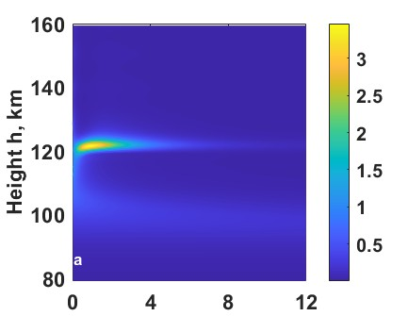
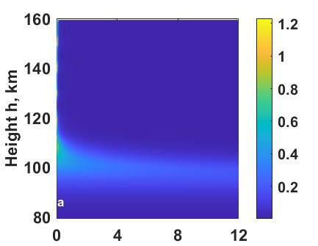
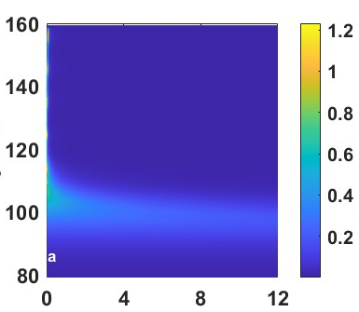

Numerical Simulations-Results Only Electric Field
Left, Upward
Left, Downward
Right, Upward
Right, Downward

Slide 17
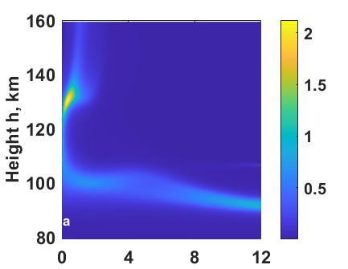
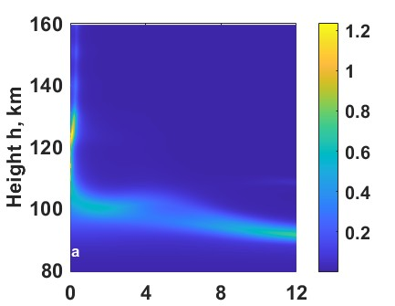


Numerical Simulations-Only Wind and Wind With Electric Field
Only Wind
Left, Downward
Right, Upward
Right, Downward
Left, Upward
Compare numerical simulations with observations and deduce the role of Alfvén waves

Slide 18
Ambipolar approach-Validation
MHD approach can not be applied to the E and F regions; the used code is valuable
Window for extension: MHD could be used in upper regions to study Alfvén waves, and the obtained data could be used in my code
Results of the observations could be used in the present code

Slide 19
Future Plans and Space for Collaboration
Study of Alfvén Waves –MHD codes, experiments, observations
Alfwevn and Gravity Wave Interaction
Influence of the Sun on the Earth’s Atmosphere
Study of Sun-Earth Coupling via its Signature in the Earth’s Atmosphere (TIDs, TEC, Es…Whole Atmospheric Model)

