Slide 1
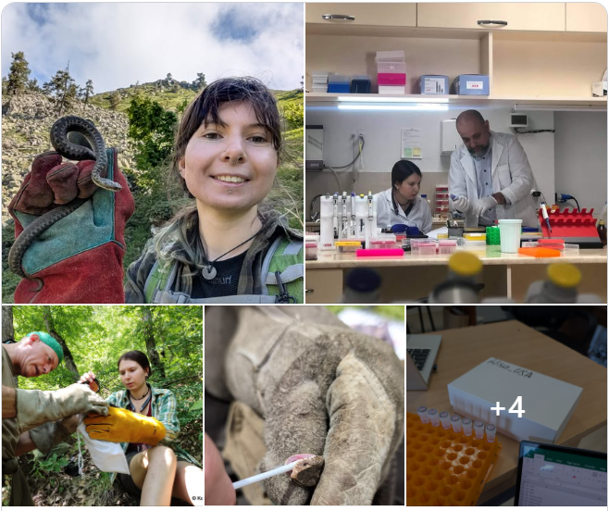

ILIA STATE UNIVERSITY
Integrating
teaching and
research
Building research capacity by developing student researchers
David Tarkhnishvili · 7 September 2026
Notes:
[Sources]
- Source image: E:\SCIENCEMETRICS\Quantitative_ecology_2025.pptx (research photographs supplied by the author)

Slide 2

CONTENT
On modern science
Challenges of education
New knowledge vs education
ISU: how it works in reality
New fields (almost) from scratch
From idea to performance
Challenges for future

Slide 3
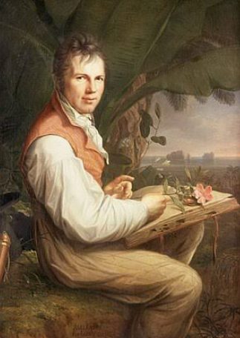
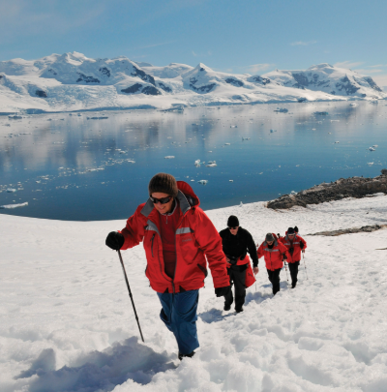
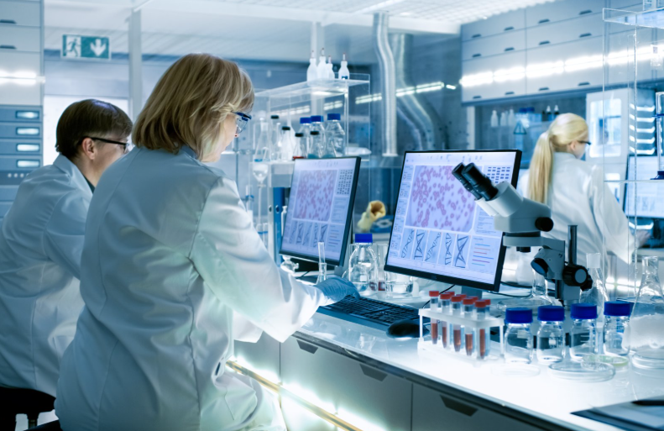
BUILDING A FIELD
Three epochs of science
Universal scientists
Specialists
Information era – back to universals?
Know everything; work alone
Work alone or in teams
Mostly team work
21
Notes:
[Sources]
- ISU Nature Conservation and Forestry curriculum: https://iliauni.edu.ge/en/ajax/downloadFile/82661/MA_Curriculum_Nature_Protection_and_Forestry.pdf

Slide 4
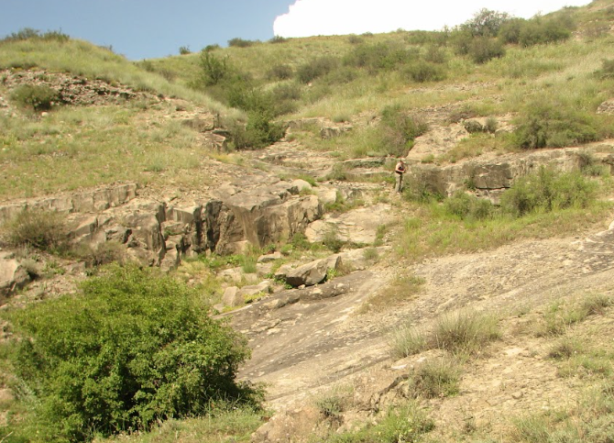
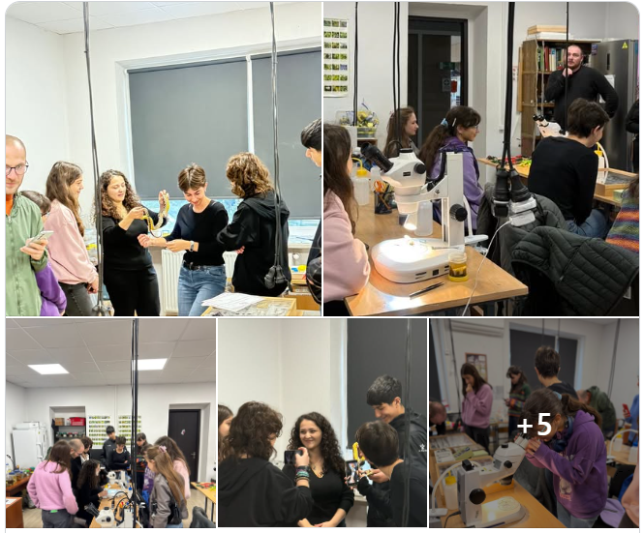
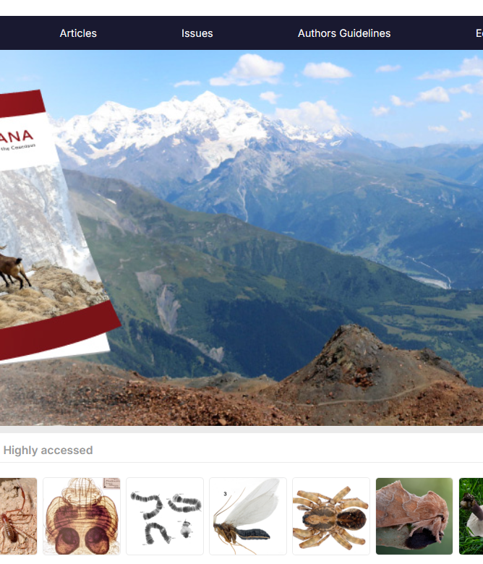
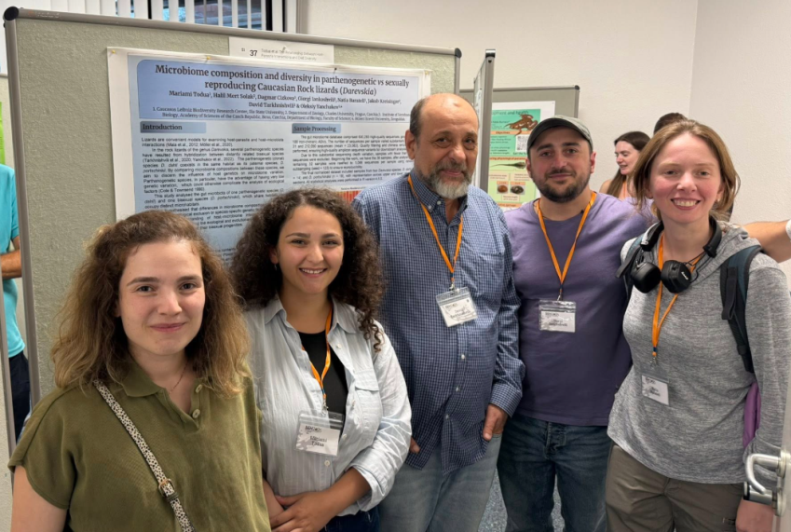
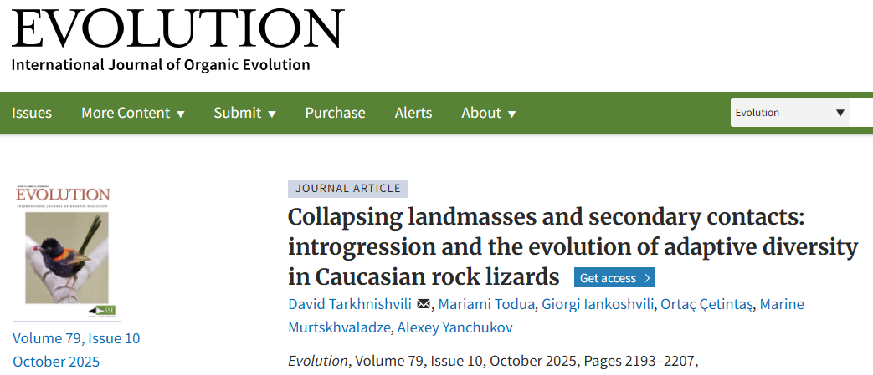
WHY THE NEXUS MATTERS
Few important questions can be answered by one person
Field observations
Laboratory work
Data mining
Statistics + GIS
Writing + review
Modern natural science is team-intensive
02
Notes:
[Sources]
- Source images: author-supplied ecology presentation and research outputs

Slide 5
WHY THE NEXUS MATTERS
Student participation can create a genuine exchange of value
RESEARCH PROJECTS GAIN
STUDENTS GAIN
Additional research capacity
More observations and samples
Help organizing complex data
A pipeline of future researchers
How to create NEW knowledge? EMPIRICAL THINKING
Authentic scientific experience
Practical methodological skills
Professional contacts
First scientific contributions
The work must advance both the project and the student
04
Notes:
[Sources]

Slide 6
WHY THE NEXUS MATTERS
Students learn differently when the answer is not known
READ
LEARN
CONNECT
DEFEND
Primary scientific literature
Methods independently
(YOU CAN START FROM SCRATCH)
Across borders: FIND EXPERT WORLDWIDE
Results before COLLEAGUES
REVIEWERS
From receiving knowledge to producing it
05
Notes:
[Sources]

Slide 7
WHY THE NEXUS MATTERS
A publication demonstrates contribution—not only completion
DEGREE
PUBLICATION
“I completed an
academic programme.”
“I contributed to an answer
that survived external review.”
Professional visibility can begin before graduation
06
Notes:
[Sources]

Slide 8
WHAT WAS NEW
We revers the order: question and data before textbook answers
CONTENT-FIRST TRADITION
INQUIRY-FIRST MODEL
Fixed textbook
Open question
Teacher’s explanation
Students mine data
→
Expected answer
Methods are learned as needed
Grade
Defensible result
10
Notes:
[Sources]
- Inquiry-based research–teaching model: https://papers.ssrn.com/sol3/papers.cfm?abstract_id=2238954

Slide 9
DISTRIBUTED EXPERTISE
No university possesses every assistance a student may need
A missing local expert should redirect a project—
not terminate it
Explore knowledge yourself HOW TO
Find expertise internationally HOW TO
Combine subject and methods supervision
Student running correspondence HOW TO
11
Notes:
[Sources]
- Source image: author-supplied ecology presentation

Slide 10
DISTRIBUTED EXPERTISE
Students learn to build their own scientific network
01
02
03
04
05
Identify a question
Refine it locally
Find an expert
Write the enquiry
Build joint supervision
12
Notes:
[Sources]

Slide 11
DISTRIBUTED EXPERTISE
Distributed supervision combines complementary strengths
INTERNATIONAL SUBJECT EXPERT
LOCAL SUPERVISOR + METHODS TEAM
Current field knowledge
Specialized methodology
Global professional network
External scientific challenge
Continuity and student support
Statistics and research design
GIS and ecological modelling
Institutional responsibility
13
Notes:
[Sources]

Slide 12
DISTRIBUTED EXPERTISE
Transferable methods bridge disciplinary gaps
Research design
Statistics
GIS
Spatial modelling
Molecular methods
Scientific writing
15
Notes:
[Sources]

Slide 13
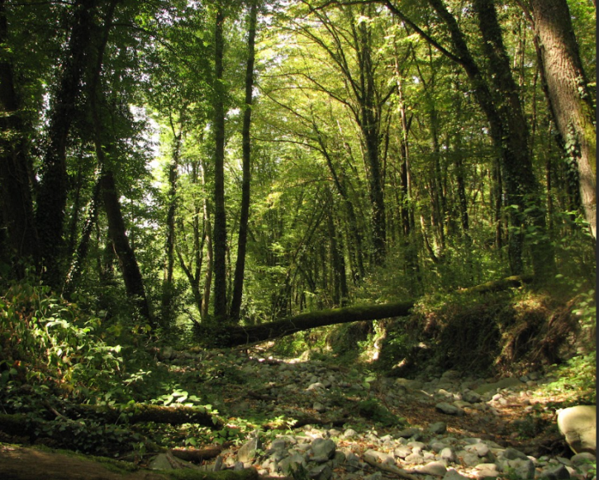
BUILDING A FIELD
When a field matters strategically, bring the expertise in
Temporary imported expertise
Curriculum
Research programme
Permanent local capacity
16
Notes:
[Sources]
- Source image: author-supplied ecology presentation

Slide 14
BUILDING A FIELD
The capacity-building model
01
02
03
04
05
Recruit expertise
Mine existing expertise;
Design curricula
Mentor the first cohort
Build partnerships
Transfer leadership
17
Notes:
[Sources]

Slide 15
BUILDING A FIELD
Forest sciences: a nationally important field with limited local capacity
THE INITIAL GAP
Few advanced training routes
Weak continuity between research, professional education and management practice
A field cannot modernize without a new professional generation
18
Notes:
[Sources]
- Programme context: https://iliauni.edu.ge/en/international-students/study-options/degree-programs/masters-programs/master-in-forest-science-and-natural-resources

Slide 16
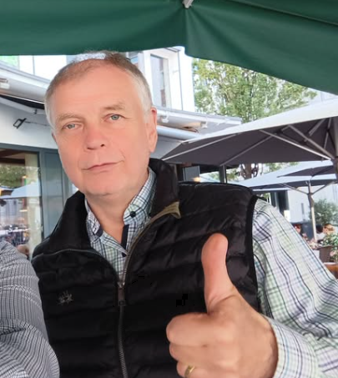
BUILDING A FIELD
International recruitment helped create the programme—not just deliver lectures
German professors
DAAD Langzeitdozentur
Mining local environment
Curriculum design
Graduate supervision
International standards
Professional partnerships
DAAD · GIZ · Ministry · National Forestry Agency
19
Notes:
[Sources]
- ISU forestry programme: https://iliauni.edu.ge/en/international-students/study-options/degree-programs/masters-programs/master-in-forest-science-and-natural-resources
- Curriculum support: https://iliauni.edu.ge/en/ajax/downloadFile/82661/MA_Curriculum_Nature_Protection_and_Forestry.pdf
- Source image: author-supplied ecology presentation

Slide 17
BUILDING A FIELD
The durable product is a scientific school
01
02
03
04
05
Visiting expertise
First graduate cohort
Young Georgian specialists
Public institutions
Next generation
20
Notes:
[Sources]

Slide 18
BUILDING A FIELD
Alumni carry research capacity into public practice
Ministry of Environment
National Forestry Agency
NCDC
National Environment Agency
Protected Areas
Research + consultancy
21
Notes:
[Sources]
- ISU Nature Conservation and Forestry curriculum: https://iliauni.edu.ge/en/ajax/downloadFile/82661/MA_Curriculum_Nature_Protection_and_Forestry.pdf

Slide 19
ISU DEVELOPMENT
ISU institutionalized the research–teaching nexus
“
The same community generates knowledge and teaches it—while students participate in creating knowledge.
ILIA STATE UNIVERSITY MISSION
22
Notes:
[Sources]
- https://iliauni.edu.ge/en/iliauni/mission

Slide 20
ISU DEVELOPMENT
Twenty years: from institutional merger to a research university
2006
2012
2017
2023
2026
ISU established
International programmes expand
Research output accelerates
Peak working-dataset output
Georgia’s leading THE position
23
Notes:
[Sources]
- THE ISU profile: https://www.timeshighereducation.com/world-university-rankings/ilia-state-university

Slide 21
ISU DEVELOPMENT
Research output accelerated after 2017
ALL FIELDS · ANNUAL PUBLICATIONS · 2008–2026 · WORKING DATABASE
2026 partial
24
Notes:
[Sources]
- Working database: E:\SCIENCEMETRICS\data\sciencemetrics.sqlite; Scopus/OpenAlex-linked records, extracted 30 May 2026

Slide 22
ISU DEVELOPMENT
Biology and ecology became a visible growth engine
ANNUAL PUBLICATIONS · ALL FIELDS VS CLASSIFIED BIOLOGY/ECOLOGY · 2008–2026
308
classified biology / ecology papers, all years
3,775
citations to those 308 papers
25
Notes:
[Sources]
- Working database: E:\SCIENCEMETRICS\data\sciencemetrics.sqlite

Slide 23
ISU DEVELOPMENT
Most publications with known quartiles appeared in Q1–Q2 journals
ALL FIELDS · 893 RECORDS · ALL PUBLICATION YEARS · JOURNALS CLASSIFIED WITH 2025 SJR
74%
of records with a resolved quartile are Q1–Q2
26
Notes:
[Sources]
- Working database and quartile file: E:\SCIENCEMETRICS\data\sciencemetrics.sqlite; E:\SCIENCEMETRICS\scimago journal value 2025.csv

Slide 24
EXTERNAL POSITION
Different rankings answer different questions
SYSTEM
2026 POSITION
WHAT IT EMPHASIZES
THE
1201–1500 worldwide; #1 in Georgia
Teaching, research environment, research quality, international outlook
SCImago overall
7,523 worldwide; #2 among Georgian universities
Research 50%, innovation 30%, societal 20%
SCImago subjects
#1 in Georgia in several fields
Subject-specific research output and impact
27
Notes:
[Sources]
- THE: https://www.timeshighereducation.com/world-university-rankings/ilia-state-university
- SCImago: https://www.scimagoir.com/institution.php?idp=2753

Slide 25
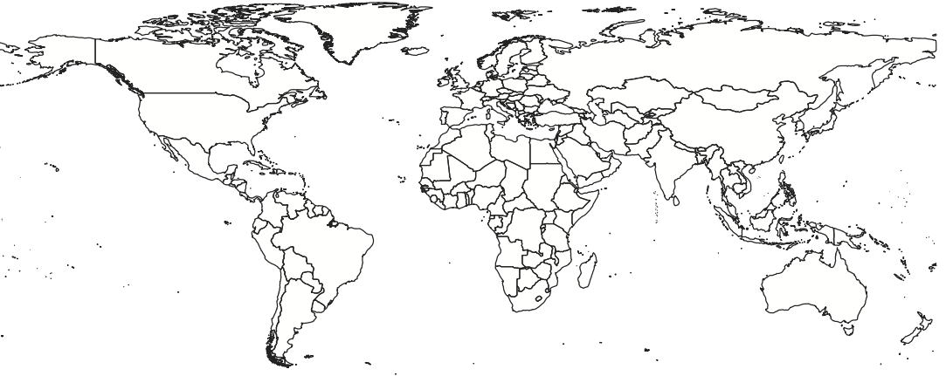
EXTERNAL POSITION
In THE, ISU leads Georgia and enters three subject bands
#1
601–800
601–800
601–800
Georgia — THE World University Rankings
Life Sciences 2026
Physical Sciences 2026
Social Sciences 2026
Overall world band: 1201–1500
28
Notes:
[Sources]
- https://www.timeshighereducation.com/world-university-rankings/ilia-state-university
- https://www.timeshighereducation.com/student/where-to-study/study-in-georgia

Slide 26
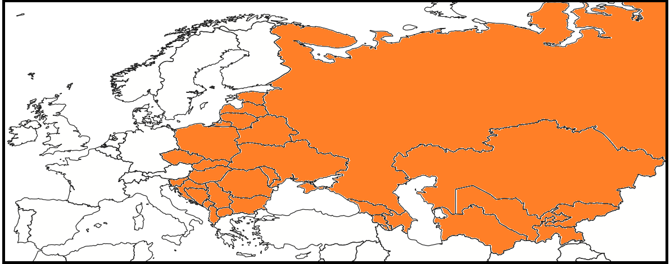
EXTERNAL POSITION
Research quality is ISU’s exceptional regional signal
PHYSICAL SCIENCES
SOCIAL SCIENCES
LIFE SCIENCES
23rd (3rd)
From 149
19th (6th)
From 99
21st (4th)
From 84
regional research-quality position
regional research-quality position
Central/Eastern Europe + Central Asia
29
Notes:
[Sources]
- Author’s analysis of THE 2026 subject tables: https://www.facebook.com/david.tarkhnishvili/posts/pfbid06pxXD9eArrRQBxnEhRPoq385h4gLAqYgnzAYdt3gsx4dRXLfT2Mqc6rZs4iWYqKRl
- THE subject rankings linked in the cited post

Slide 27
EXTERNAL POSITION
Within the Caucasus, ISU occupies the strongest 2026 THE band
UNIVERSITY
OVERALL
LIFE SCIENCES
PHYSICAL SCIENCES
Ilia State University
1201–1500
601–800
601–800
Tbilisi State University
1501+
—
1251+
Yerevan State University
1501+
—
1251+
Baku State University
1501+
—
1001–1250
— = no 2026 subject band displayed on the THE profile; it does not mean zero research
30
Notes:
[Sources]
- THE World University Rankings 2026 institutional profiles: Ilia State University; Tbilisi State University; Yerevan State University; Baku State University
- https://www.timeshighereducation.com/world-university-rankings/ilia-state-university

Slide 28
FROM ENVIRONMENT TO PARTICIPATION
Rankings show that a research environment exists
Research environment
≠
Student experience
The decisive question is whether students enter the environment
32
Notes:
[Sources]

Slide 29
Do students only learn
about research—
or do they become
part of it?
THE ECOLOGY TEAM AS A CASE STUDY
Notes:
[Sources]

Slide 30
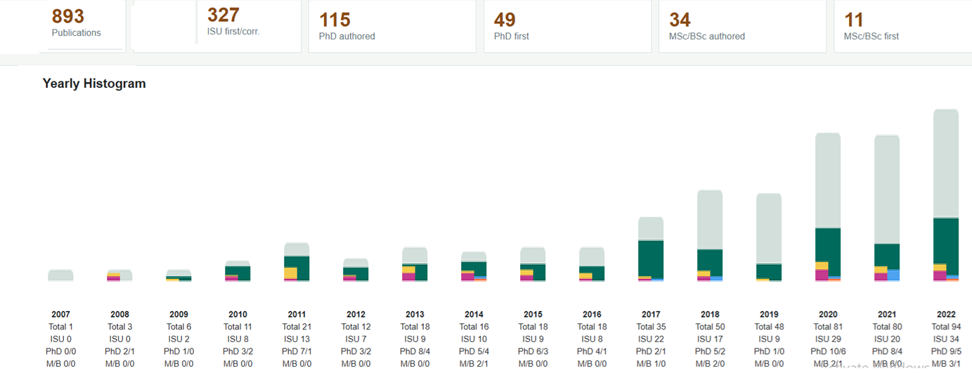
ALL SUBJECTS

Slide 31
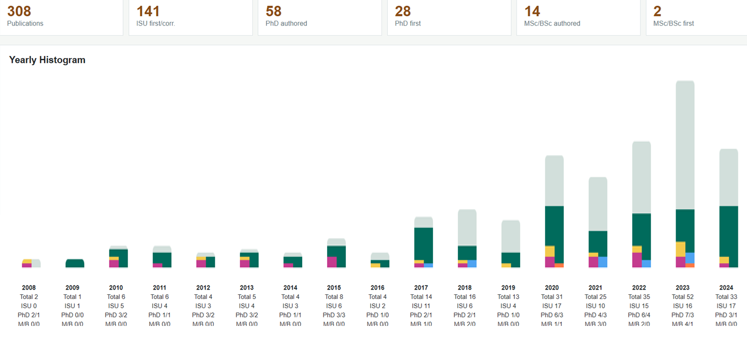
BIOLOGY / ECOLOGY / EVOLUTION

Slide 32
THE ECOLOGY MODEL
Research participation starts before the thesis
Bachelor level
Additional credits (by interest)
Field and laboratory work
Data organization
Literature searches
Research seminars
34
Notes:
[Sources]
- Source image: author-supplied ecology presentation

Slide 33
THE ECOLOGY MODEL
Students contribute across the complete research workflow
FIELD
Sampling · identification · metadata
LAB
Preparation · extraction · quality control
DATA
Cleaning · modelling · interpretation
Only a bit of wishful thinking ☺
36
Notes:
[Sources]
- Source image: author-supplied ecology presentation

Slide 34
THE ECOLOGY MODEL
A thesis becomes one stage of a research programme
01
02
03
04
05
06
Research participation
Bachelor thesis
Master’s thesis
PhD project
Manuscript
Publication
37
Notes:
[Sources]

Slide 35
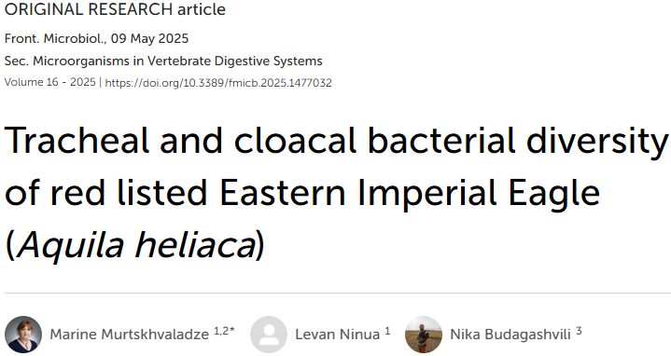
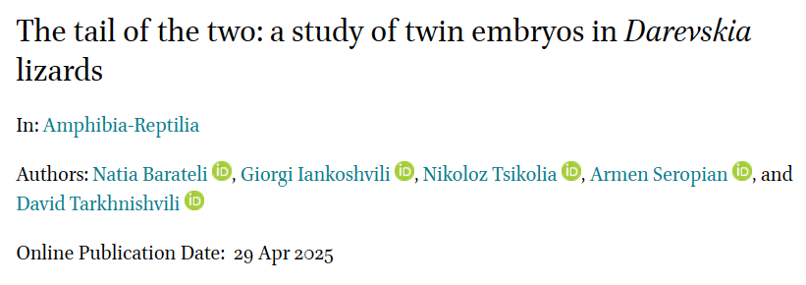
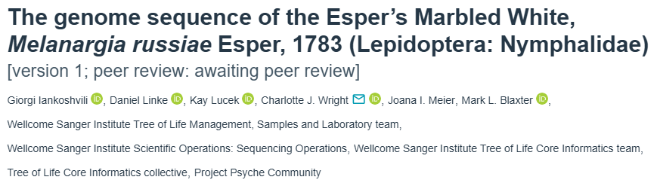
OUTCOMES
Recent publications show students moving into visible authorship
Microbiology
Evolutionary biology
Genome science
Evolution
Publications connect student names to topics, methods and collaborators
41
Notes:
[Sources]
- Source publication screenshots: author-supplied ecology presentation

Slide 36
What the ISU experience suggests
01
Treat students as emerging colleagues
02
Give them authentic, consequential work
03
Connect them to expertise wherever it exists
04
Convert temporary expertise into sustainable local schools
Students do not only learn what is known—they help produce what will be known next.
Notes:
[Sources]

Slide 37
THANK YOU FOR ATTENTION !

Slide 39
METHODOLOGY
Backup · Bibliometric dataset coverage
893
1993–2026
448
records in working database
coverage range; ISU analysis begins in 2006
records still unclassified
Use for trends and working estimates—not yet a final institutional census
44
Notes:
[Sources]
- E:\SCIENCEMETRICS\data\sciencemetrics.sqlite
- E:\SCIENCEMETRICS\README.md

Slide 40
METHODOLOGY
Backup · THE and SCImago are not interchangeable
THE
SCImago
Teaching
Research environment
Research quality
International outlook
Industry
Research · 50%
Innovation · 30%
Societal · 20%
47
Notes:
[Sources]
- THE methodology: https://www.timeshighereducation.com/world-university-rankings/methodology
- SCImago methodology: https://www.scimagoir.com/methodology.php

Slide 41
METHODOLOGY
Backup · SCImago 2026 subject positions in Georgia
Agricultural + Biological Sciences
1st
Biochemistry, Genetics + Molecular Biology
1st
Environmental Science
1st
Engineering
1st
Social Sciences
1st
Earth + Planetary Sciences
2nd
48
Notes:
[Sources]
- https://www.scimagoir.com/institution.php?idp=2753

