Slide 1
GGSB 2026 WORKSHOP • CLOSING SESSION
Overview of the Programs at ISU
and the Role of GGSB
Faculty of Natural Sciences and Medicine • Georgian-German Science Bridge
GEORGIA
GERMANY
Ilia State University, Tbilisi • September 11, 2026

Slide 2
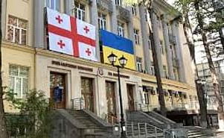
Ilia State University – short history
Ilia State University (ISU) is a flagship public research intensive and comprehensive university in Georgia, located in its capital, Tbilisi.
It was established in 2006 as a merger of six different institutions, each having a long history and a diverse institutional profile. Shortly afterwards it transformed itself into a multi-profile university with its significant research outputs visible at the national and international levels.

Slide 3
TWO DECADES OF GROWTH
ISU today
~16,000
students, incl. 700+ international
4
faculties: Arts & Sciences, Natural Sciences & Medicine, Business, Technology & Education, Law
30+
research institutes, centers and stations
500+
partner institutions worldwide (140+ in Europe)
Ilia State University — History
4

Slide 4
ISU ACADEMIC STRUCTURE
One university, four faculties
Arts & Sciences
Natural Sciences & Medicine
Humanities, social sciences, languages — one of ISU's largest and oldest faculties.
Physics, biology, mathematics, Earth sciences and medicine — ISU's main gateway into GGSB.
Business, Technology & Education
School of Law
Business, IT, engineering and teacher-training programs.
Legal education integrated with the university's research-driven model.
Ilia State University • Georgian-German Science Bridge
2

Slide 5
FACULTY SPOTLIGHT
Natural Sciences and Medicine
A premier research and educational faculty in Georgia and the region, spanning physics, biology, mathematics, ecology, Earth sciences and medicine — with academic staff ranked among Georgia's top for scientific publications.
Degree levels
Bachelor's, Master's and PhD programs, closely tied to active research
Double degrees
Joint Master's in Atmospheric and Near-Space Sciences with French and German universities
Accreditation
WFME-accredited MD program; ABET-accredited Computer Engineering program
Research strength
Ranked 1st nationally by scientific output, 1st in Region in several specialisations
Ilia State University • Georgian-German Science Bridge
3

Slide 6
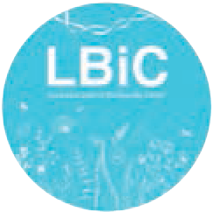
CAUCASUS LEIBNIZ BIODIVERSITY
RESEARCH CENTER
The Caucasus Leibniz Biodiversity Research Center (LBiC) is a collaborative project between ISU and the Leibniz Institute for the Analysis of Biodiversity Change (LIB, Museum Koenig Bonn, Germany), established on April 30, 2024.
The LBiC is dedicated to the study and conservation of the biodiversity of the Caucasus. The objectives of the LBiC include:
Combining the common interests regarding biodiversity research and education of ISU and LIB, it is expressed in clear governance structures and procedures for quality assurance and quality management and in establishing competitive scientific structures at ISU.
Analysis and modeling of the state of biodiversity and its controlling factors and its historical and current changes (also by means of natural history collections).

Slide 7

LEHMANN-HAUPT
INTERNATIONAL DOCTORAL SCHOOL
In addition to ISU faculties and school, ISU established a transdisciplinary “Lehmann- Haupt International Doctoral School” (IDS) in 2017, an umbrella doctoral school with common, subject-overarching instruments for all faculties. With a strong focus on international exchange and mobility the IDS especially offers Cotutelle-based PhD supervision and quality assurance/ control leading to double or even multiple degrees.
IDS implements two double degree PhD programs supported by Volkswagen
Foundation and Shota Rustaveli National Science Foundation of Georgia in partnership with the University of Göttingen (Germany) and the University of Münster (Germany).
The programs cover a wide range of disciplines, including General Linguistics, Language and Language Change, East- European History, Religious and Cultural Studies, Political Science, Forest Ecology, Cosmology, Geophysics and Astrophysics, Chemical Biology, Development Economics, Constitutionalism, Religion and Human Rights.
https://internationaldoctoralschool.iliauni.edu.ge/programs__/the-lehmann-haupt-international-doctoral-program-lhidp/

Slide 8


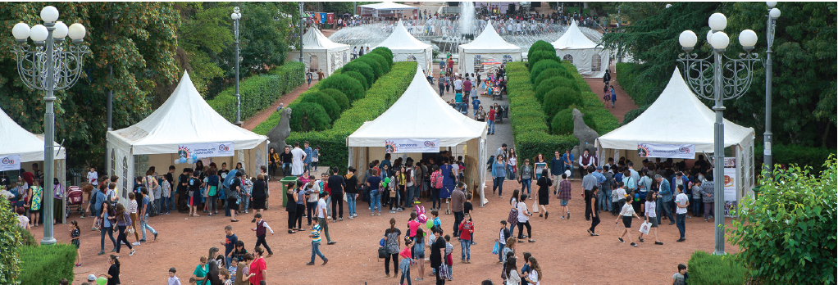
Science Popularization
Iliauni Science Picnic - is one of the largest and most successful annual outdoor events organized by Ilia State University since 2012 which aims at popularizing science among various age groups. The event attracts more than 20,000 visitors every year.

Slide 9
WHAT IS GGSB
The Georgian-German Science Bridge
A framework connecting Georgian and German scientists, students and universities — turning decades of individual research contacts into one shared, lasting collaboration.
PARTNER INSTITUTIONS
Georgia: TSU, GTU, ISU, AUG/FUT
Germany: Forschungszentrum Jülich (FZJ)
Joint research projects & international experiments
GSI/FAIR (Darmstadt)
Shared use of large research infrastructure
HZDR (Dresden-Rossendorf)
Bachelor's, Master's & PhD student exchange
Internships at German research centers
Fields now span nuclear & hadron physics to medicine, neuroscience, energy, materials, and AI.
Joint graduate supervision & data analysis
Ilia State University • Georgian-German Science Bridge
4

Slide 10
FROM CONTACTS TO A BRIDGE
Three decades of collaboration
First contacts between FZJ's Institute of Nuclear Physics and TSU
First Caucasian-German School and Workshop in Hadron Physics
SMART|Labs become an official joint direction; ISU joins
1992
2004
2015–16
1998
2010
2024
First official cooperation agreement, FZJ–TSU
GTU joins; cooperation memoranda renewed
20th anniversary: “The First 20 Years” celebration
Ilia State University • Georgian-German Science Bridge
5

Slide 11
GGSB'S FLAGSHIP RESULT
SMART|Labs: keeping talent in Georgia
SMART = Science, Medicine, Applied Research and Technology. The model was designed to solve a defining problem for small national science systems: brain drain.
1
2
3
4
5
→
→
→
→
Young scientist trains to a high level
Joins research at a German center
Returns to Georgia
Builds/leads a lab at their home university
Knowledge stays in the Georgian system
Since 2015–2016, ISU has developed SMART|Labs alongside GTU and TSU, with FZJ institutes as the German anchor.
Ilia State University • Georgian-German Science Bridge
6

Slide 12
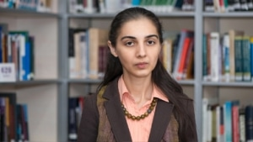
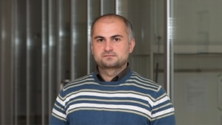
ISU Support of Bridge
Giorgi Dalakishvili
Ketevan Batsatsashvili

Slide 13
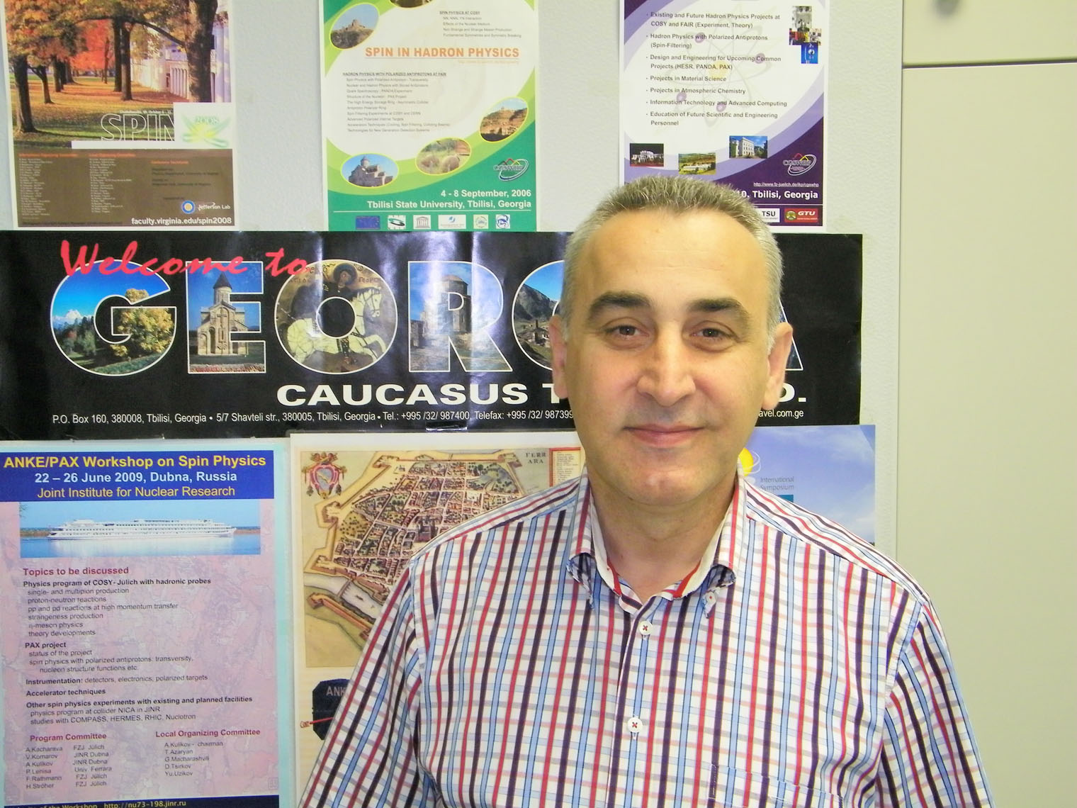
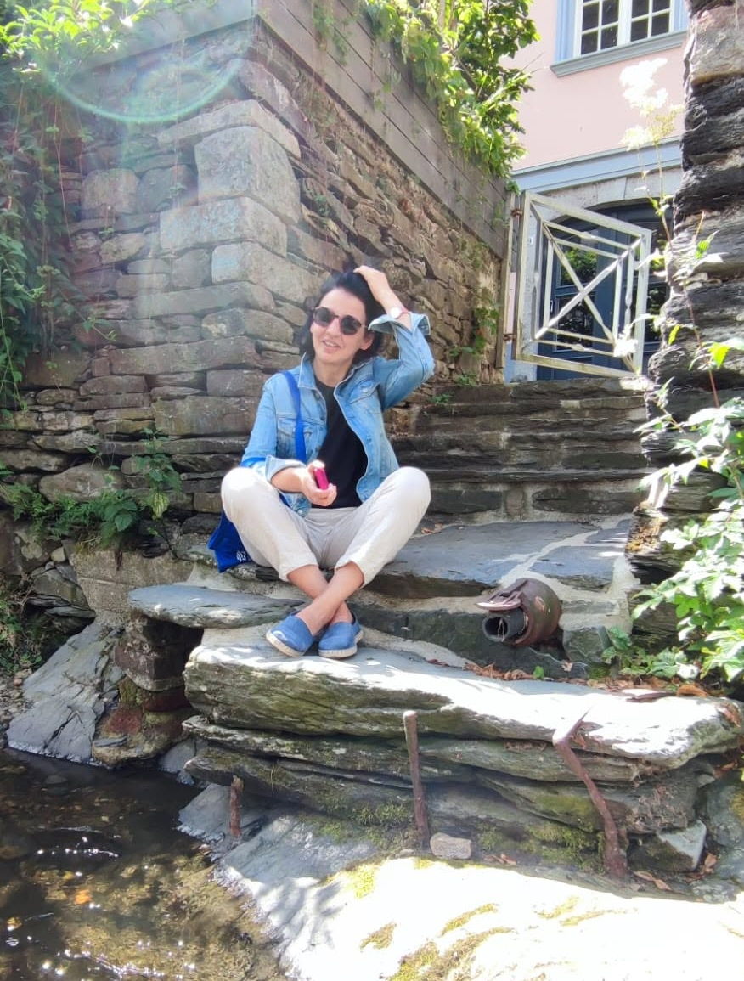
Special Thank to
Andro Kacharava
Maia Batsatsashvili

Slide 14
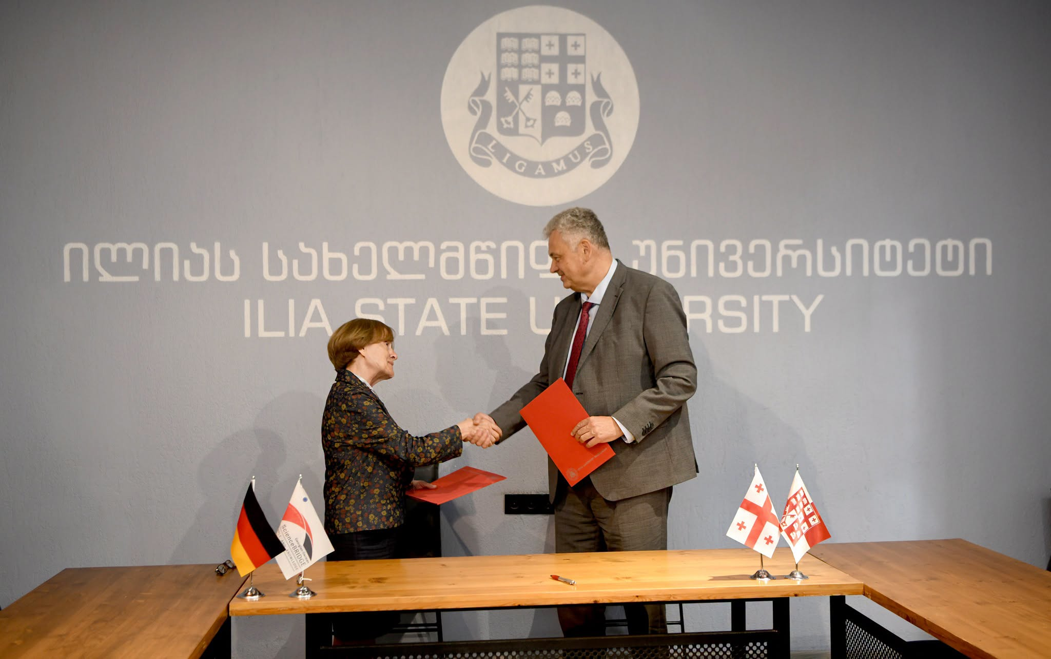
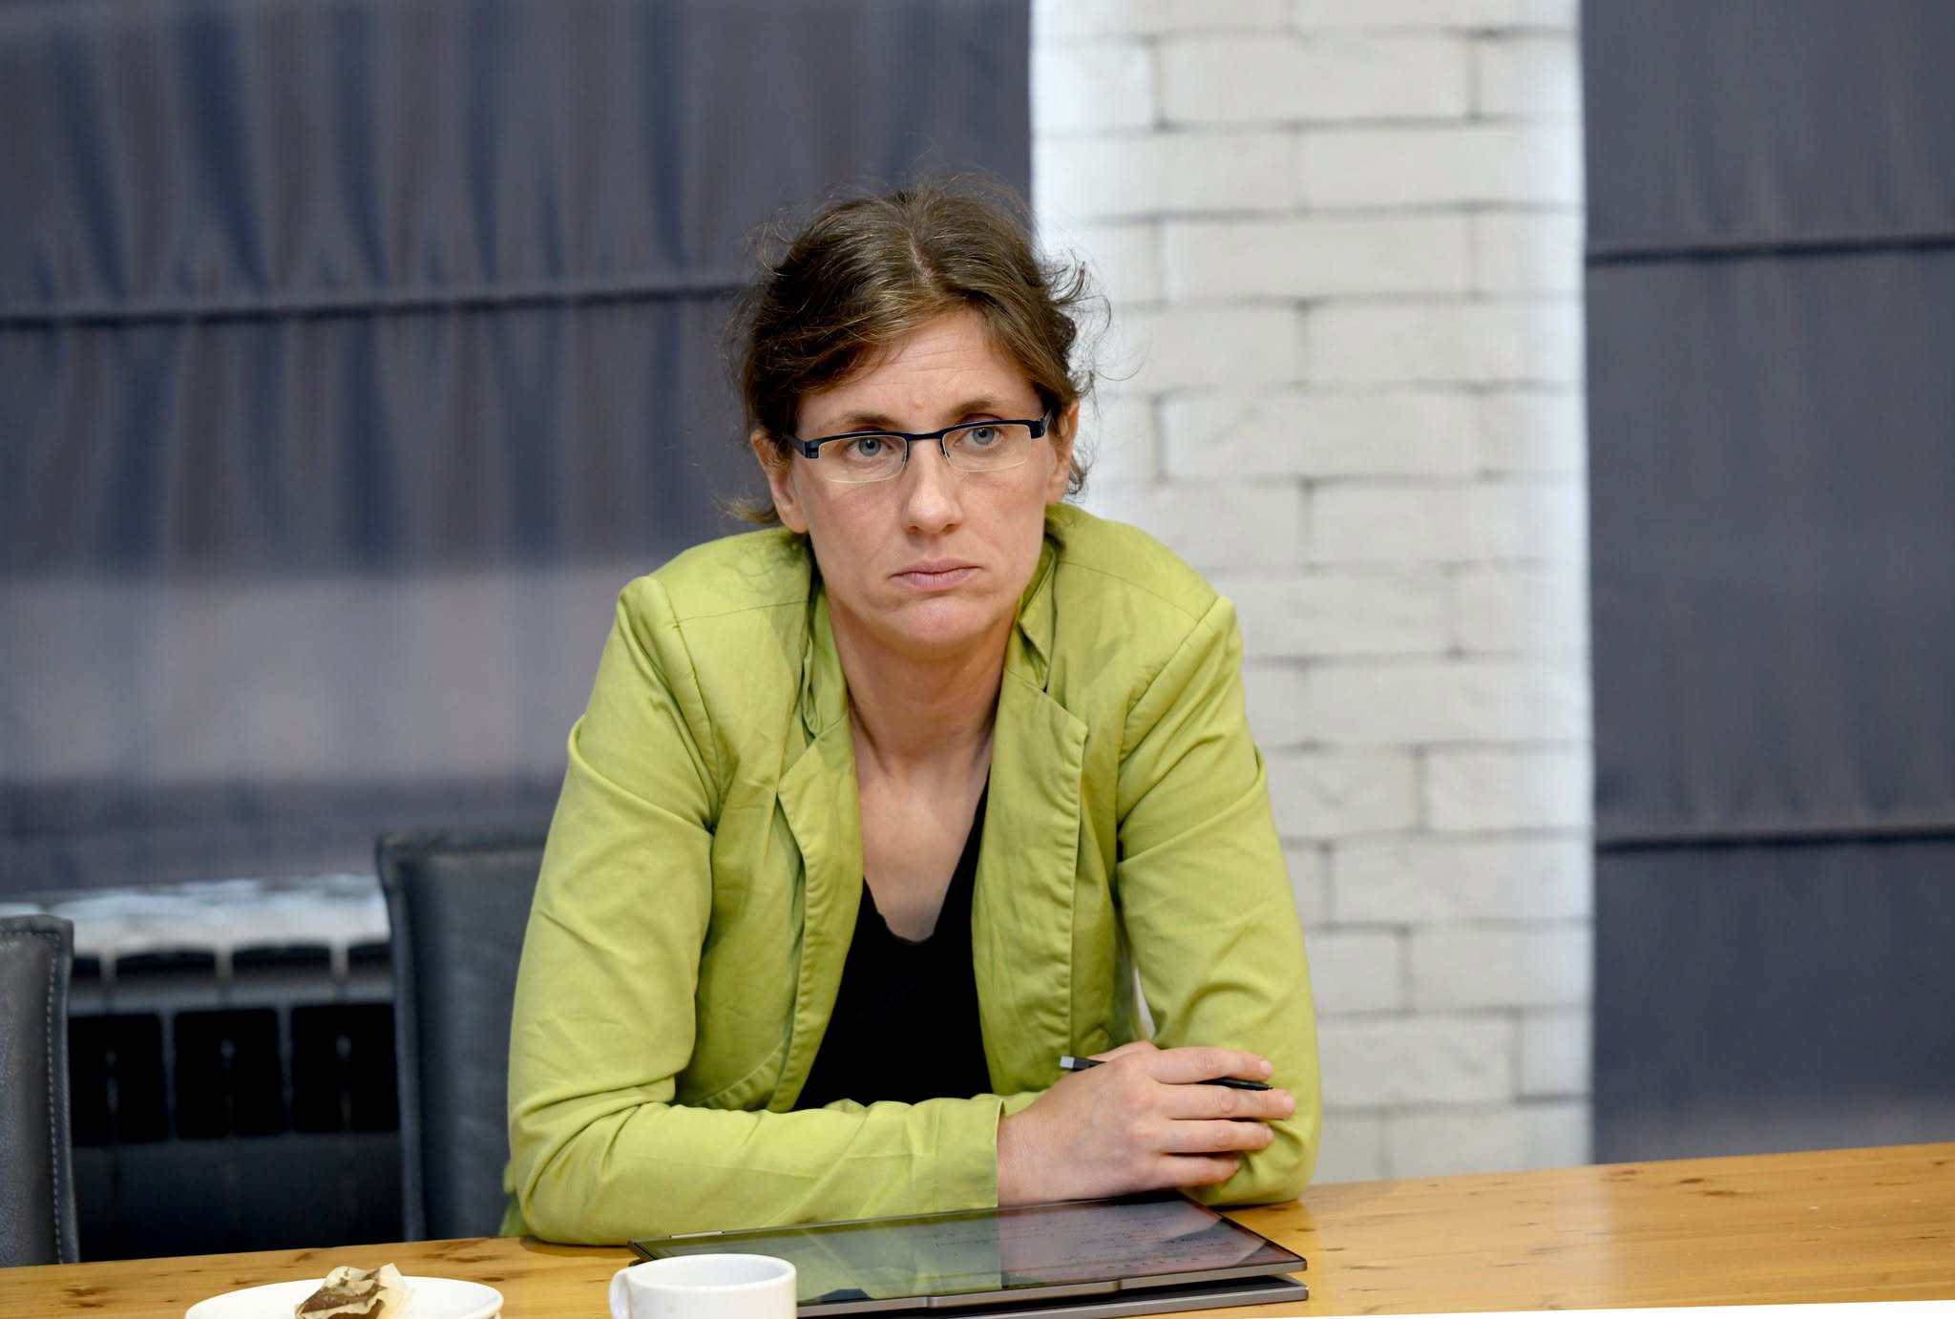
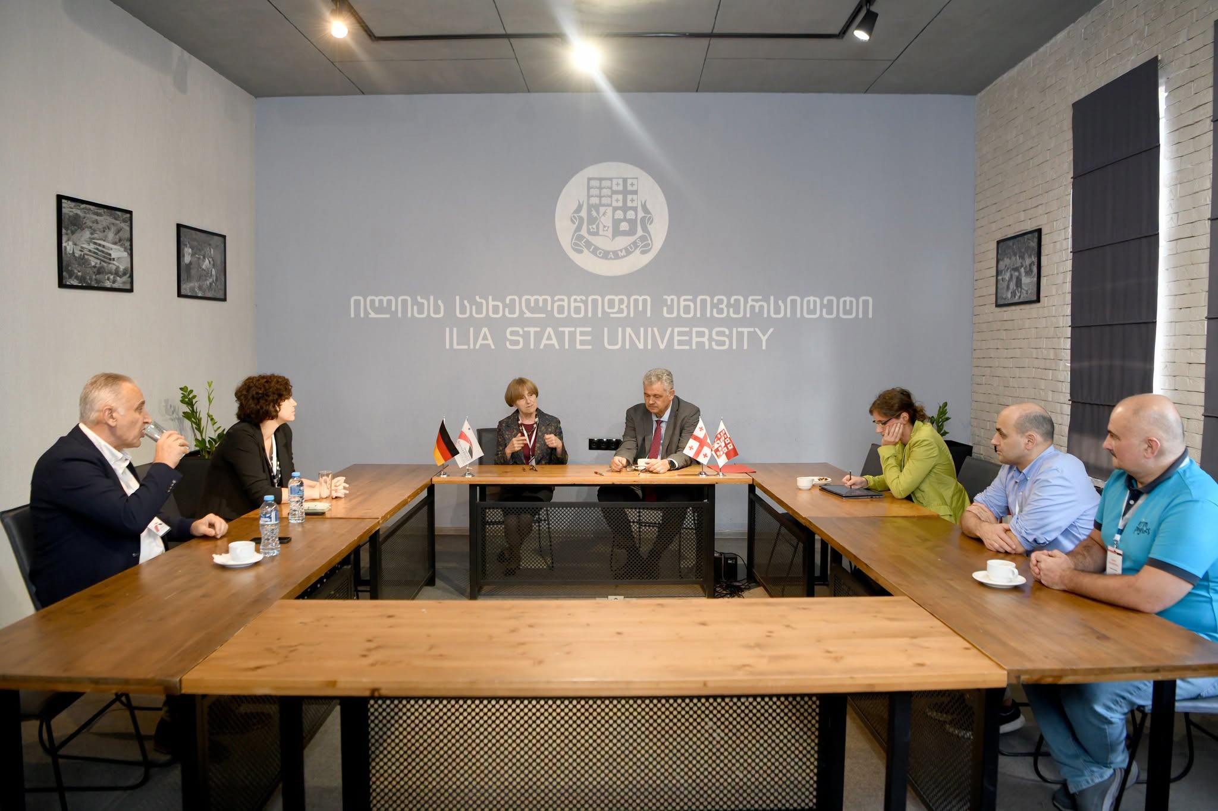
Ilia State University (ISU) and Helmholtz-Zentrum Dresden-Rossendorf (HZDR) have signed a Letter of Intent to further strengthen cooperation in research and innovation.
The document was signed on 7 September 2026 during the visit of Prof. Sebastian Schmidt, Head of the Georgian-German Science Bridge (GGSB), to Georgia.

Slide 15
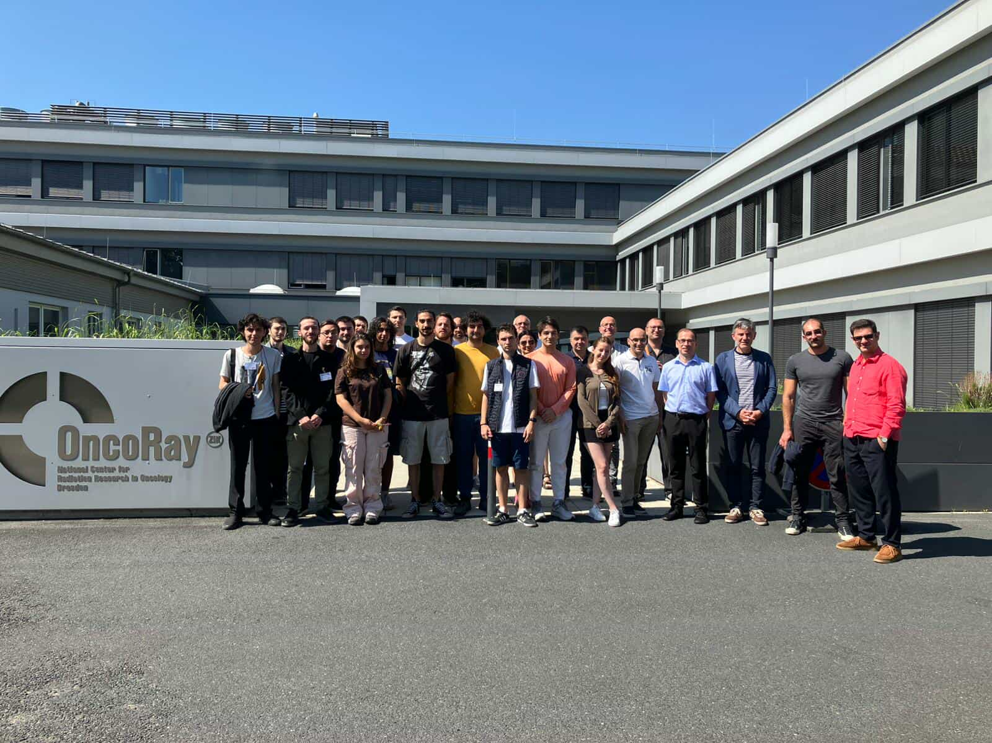
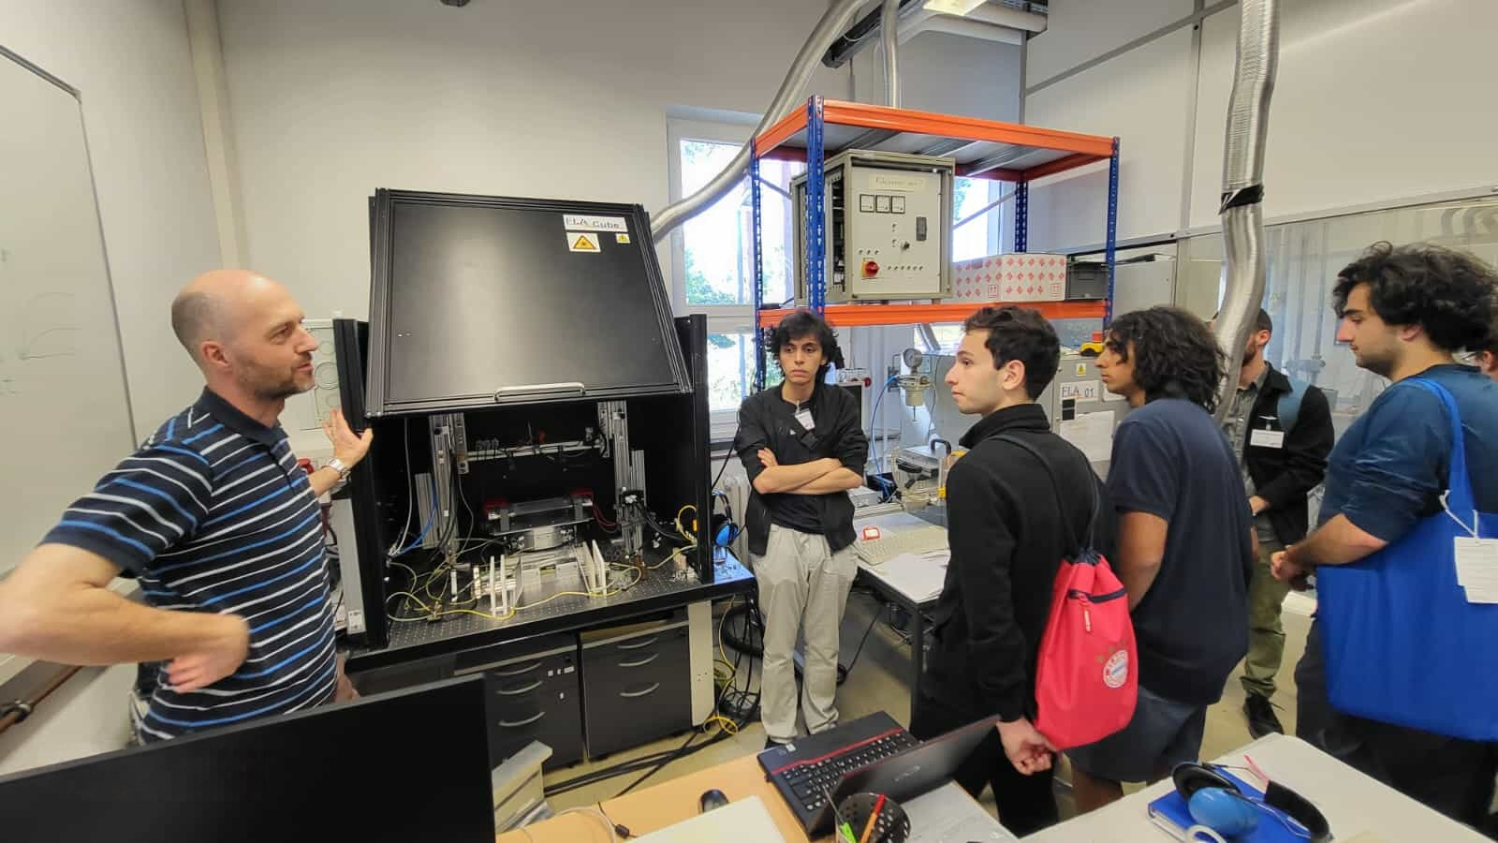
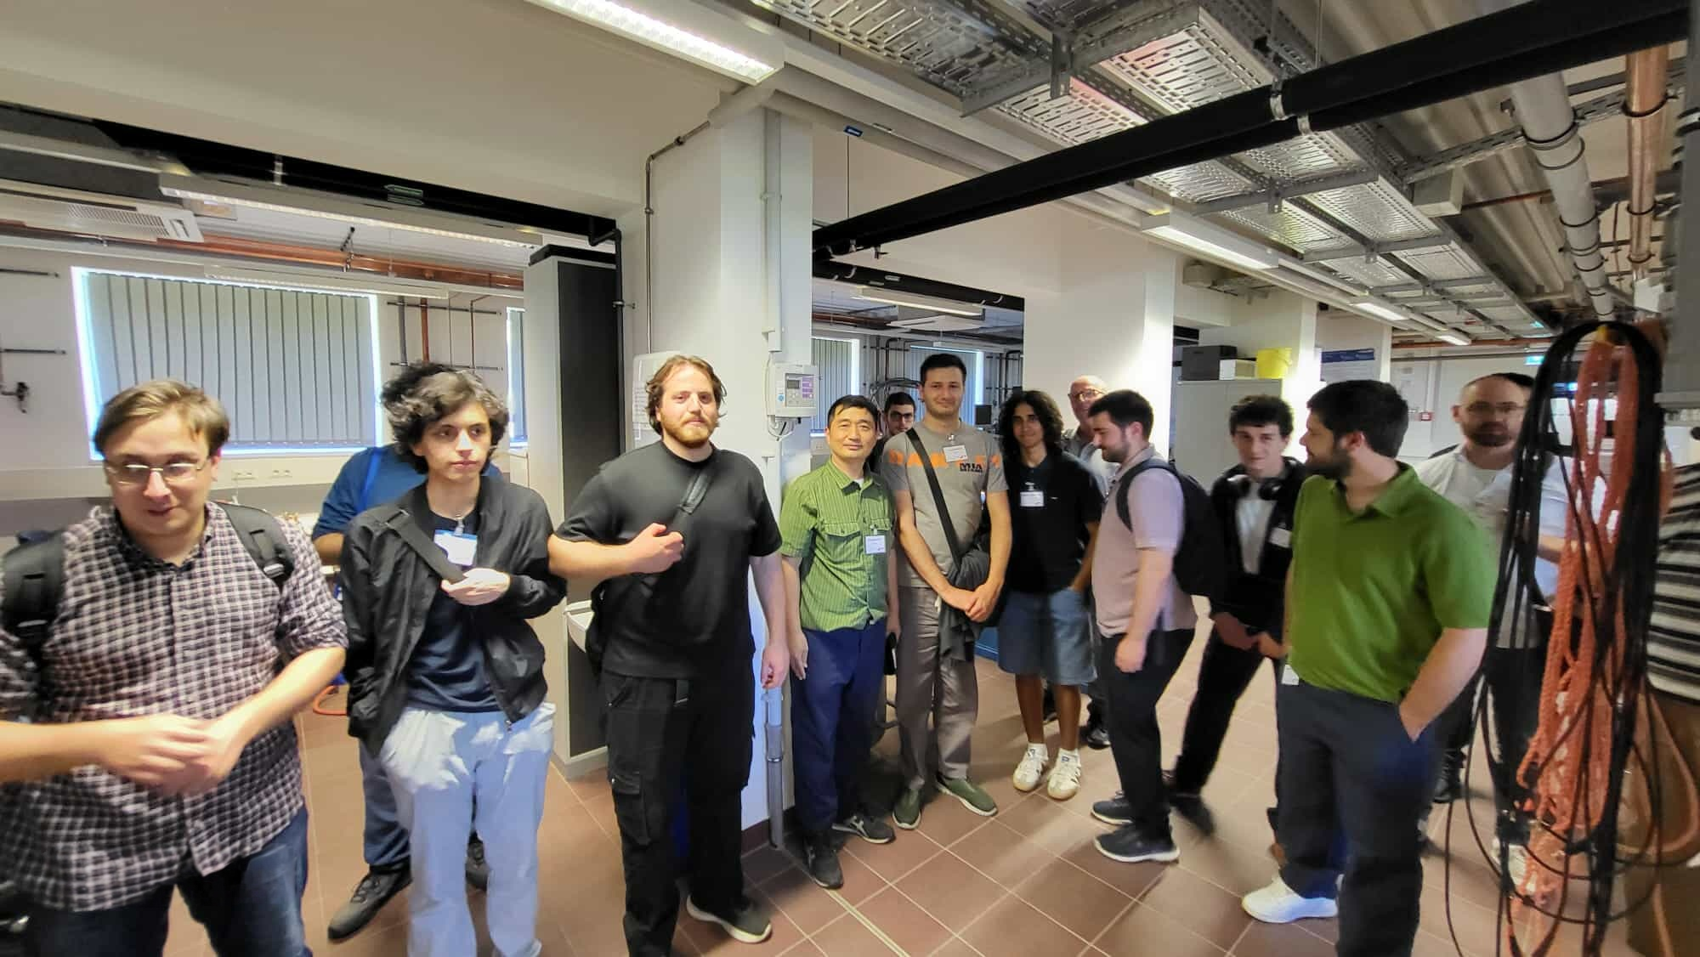
ISU IN ACTION
ISU's role within GGSB
ISU's Faculty of Natural Sciences and Medicine sends bachelor's students each year to GGSB summer schools at German Helmholtz centers — building the pipeline behind SMART|Labs.
2025 summer school at HZDR (Dresden): lectures & hands-on sessions in physics, medicine, engineering and AI
Site visits to OncoRay and radiation-research infrastructure
Closing presentations to HZDR, FZJ & GSI researchers, with feedback on future collaboration
HZDR Summer School, Dresden — September 2025
Ilia State University • Georgian-German Science Bridge
7

Slide 16
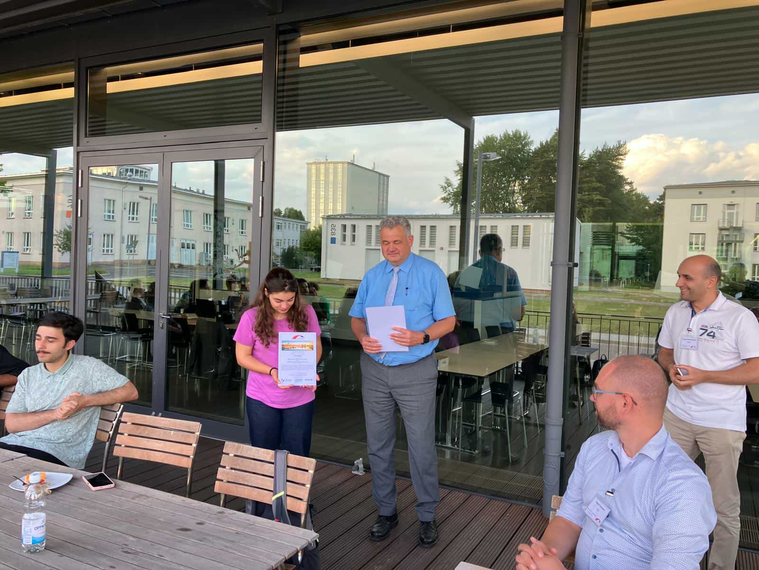
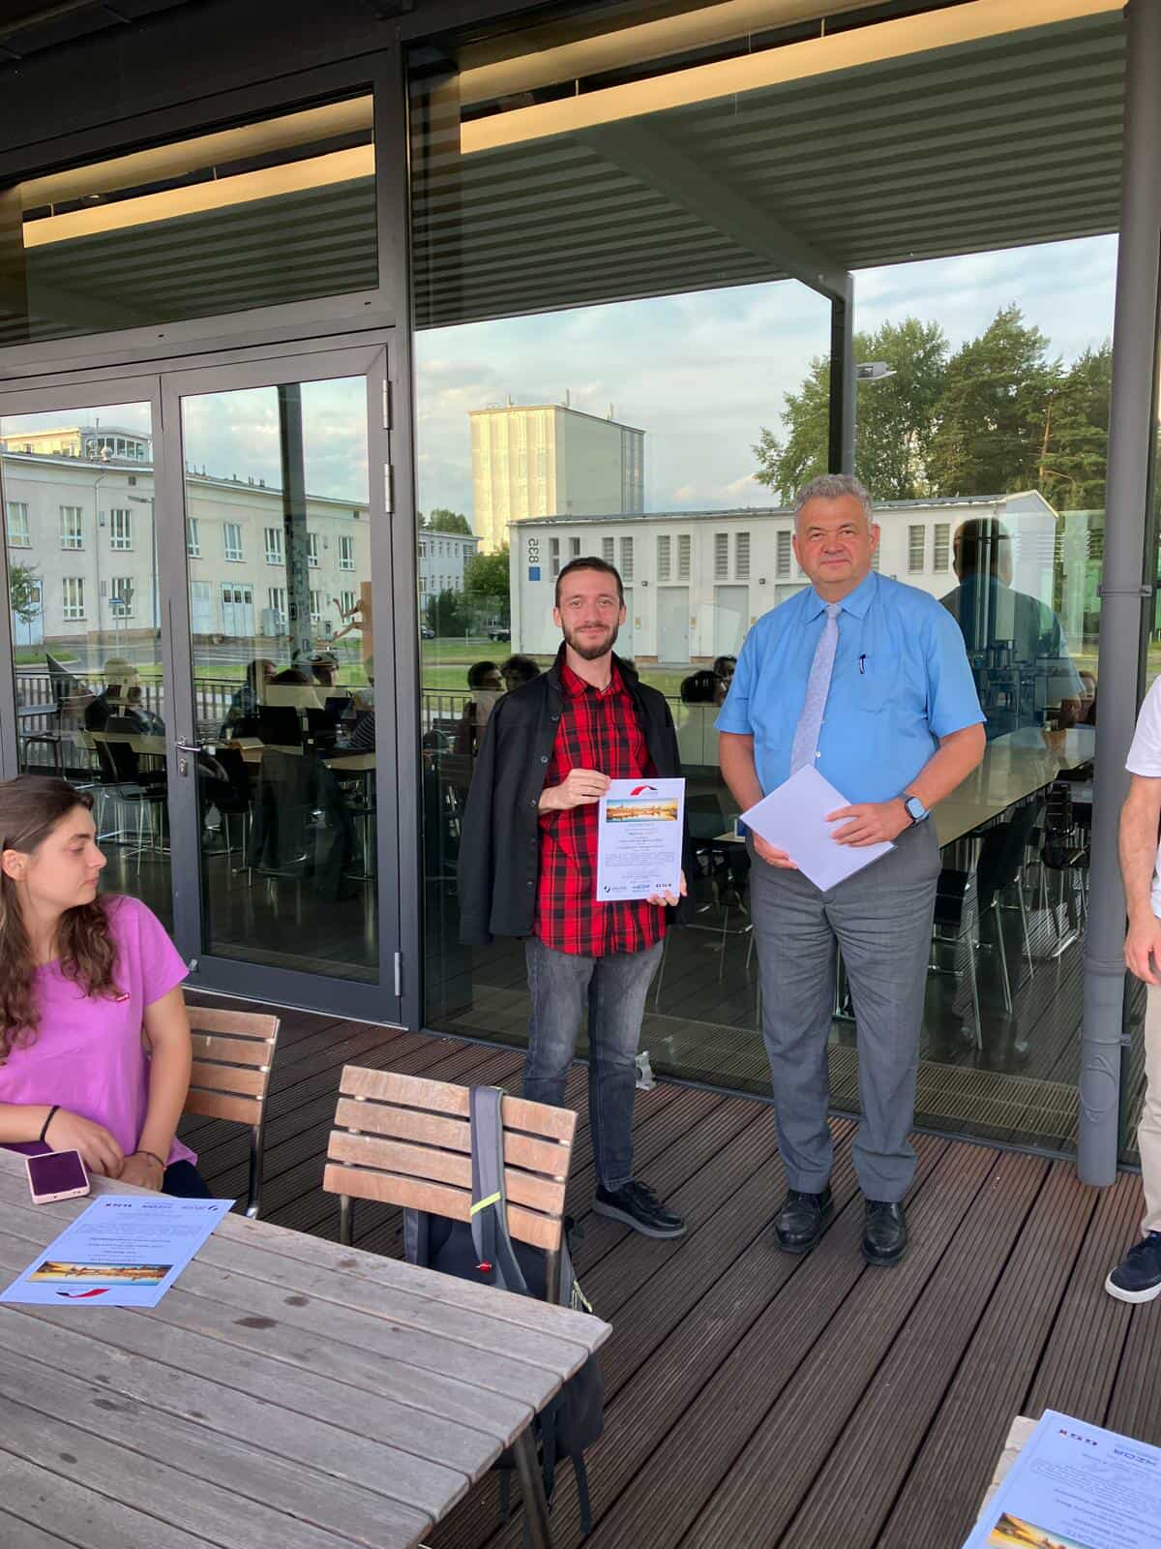
RESULTS & OUTLOOK
What GGSB has built — and what's ahead
A new generation of Georgian scientists with international research experience
A durable institutional network, not just personal contacts
Growing research infrastructure inside Georgia itself
Closer ties to the Helmholtz Association and global collaborations
Looking ahead: GGSB continues to advocate for the disciplinary diversity that two decades of Georgian-German cooperation have been built on.
Certificates awarded at the closing of the HZDR summer school, 2025
Ilia State University • Georgian-German Science Bridge
8

Slide 17
2026
Davit Tarkhnishvili
Giorgi Dalakishvili
Ketevan Batsatsashvili
Vasil Metreveli
Tamar Jolokhava
Nika Chakunashvili
Giorgi Purtskhvanidze
Giorgi Tsiklauri
Giorgi Archaia
Giorgi Kharatishvili
Saba Kalandarishvili
Luka Megrelidze
Nikoloz Zagaidze
Luka Megrelidze
Zhana Mosidze
Kato Melikidze
Vazha Saginadze

Slide 18
Thank you
Ilia State University • Georgian-German Science Bridge
GGSB 2026 Workshop — Closing Session, Tbilisi

