Slide 1



BIOWASTE ACTIVATED CARBON-NICKEL COMPOSITES:
POTENTIAL IN H₂ GENERATION
Ekaterina Romanenko¹,
Lia Gventsadze², David Gventsadze³, Nikoloz Nioradze³
¹Faculty of Exact and Natural Sciences, Ivane Javakhishvili Tbilisi State University, 1 Chavchavadze Ave., Tbilisi 0179, Georgia
²Republic Center for Structure Researches, Georgian Technical University, Tbilisi 0175, Georgia
³TSU, R. Agladze Institute of Inorganic Chemistry and Electrochemistry, Tbilisi 0186, Georgia
e-mail: ekaterina.romanenko101@ens.tsu.edu.ge

Slide 2


Background
H₂ is a high–density energy carrier. Used for transport, industry (steel, NH3, refining), power generation/fuel cells.
Electrolysis enables “green” H₂
Nickel is alternative to Pt, Ru:
  HER: H-adsorption Gibbs Energy approaches the optimal “Goldilocks” value
  OER: activity is tied to the Ni²⁺/Ni³⁺ redox transition at the surface
Carbon supports bring conductivity, alkaline stability, and low cost - Sourced from biowaste.
Activated carbon
C-Ni electrode
Agricultural waste
H₂ gas
Energy

Slide 3
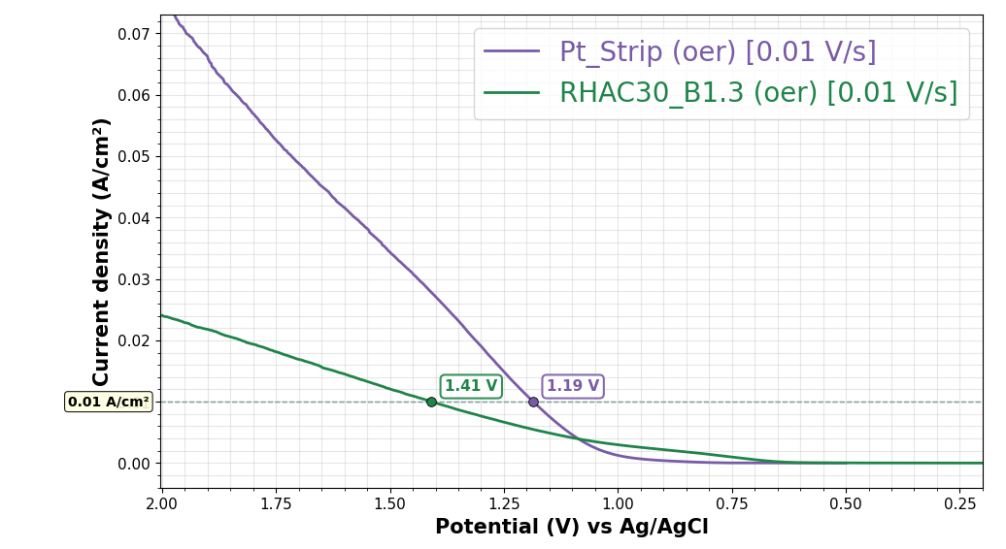
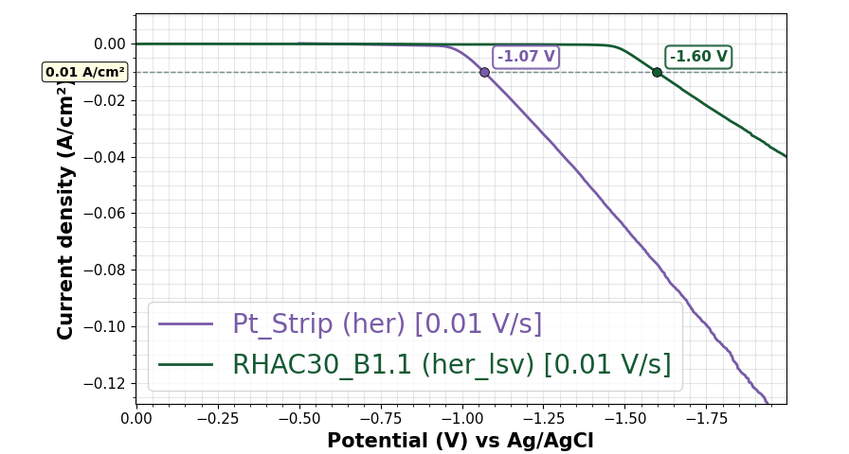
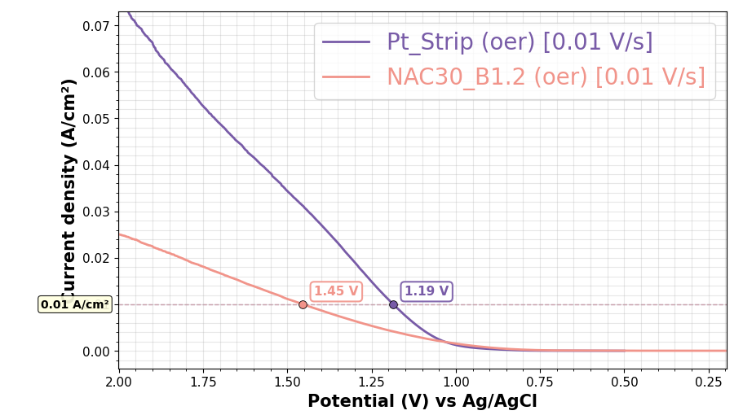
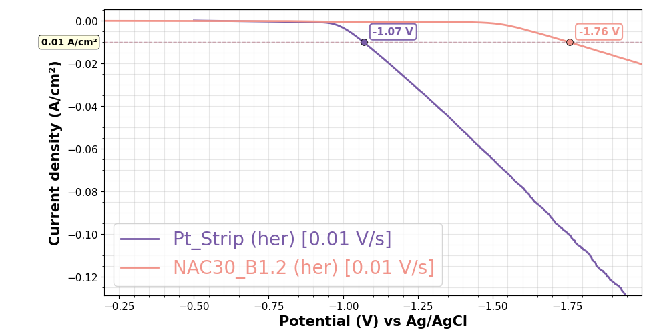
HER & OER BENCHMARKS
OXYGEN GEN
HYDROGEN GEN
Biowaste Activated C-Ni Composites - Ekaterina Romanenko

Slide 4
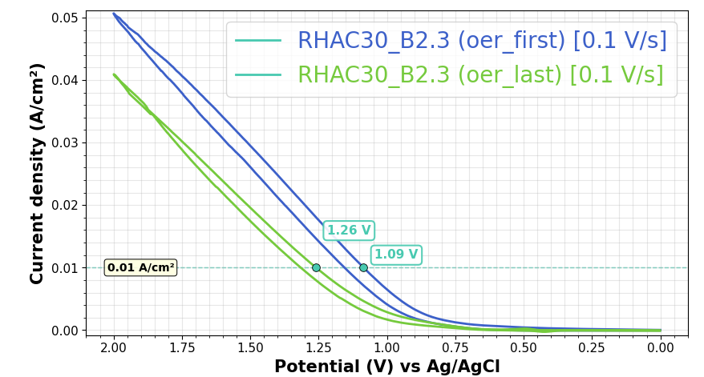
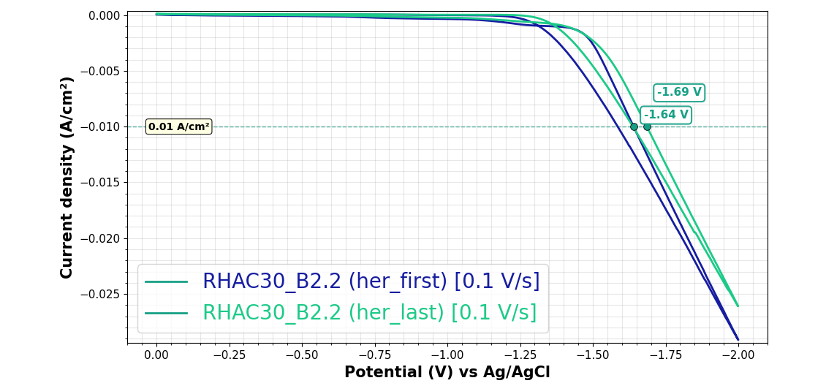
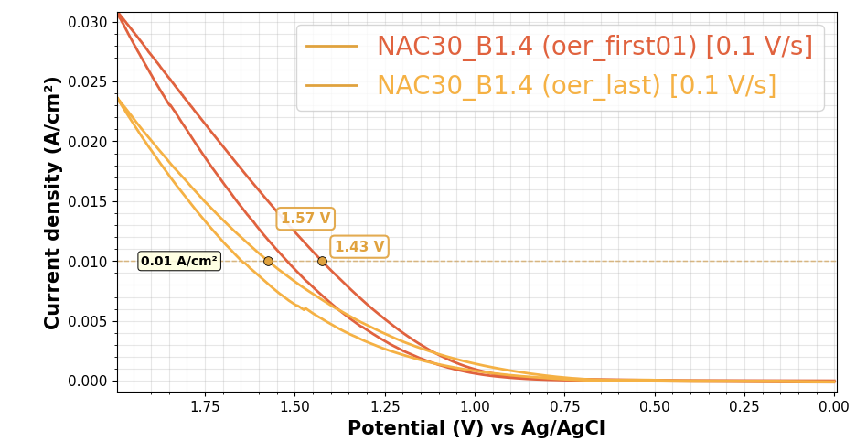
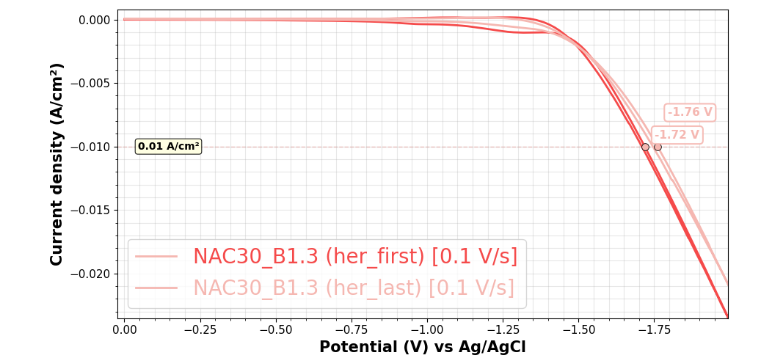
ELECTRODE STABILITY UNDER CYCLING
Δ= 0.17V
Δ= 0.05V
OXYGEN GEN
HYDROGEN GEN
Δ= 0.14V
Δ= 0.04V
Biowaste Activated C-Ni Composites - Ekaterina Romanenko

Slide 5
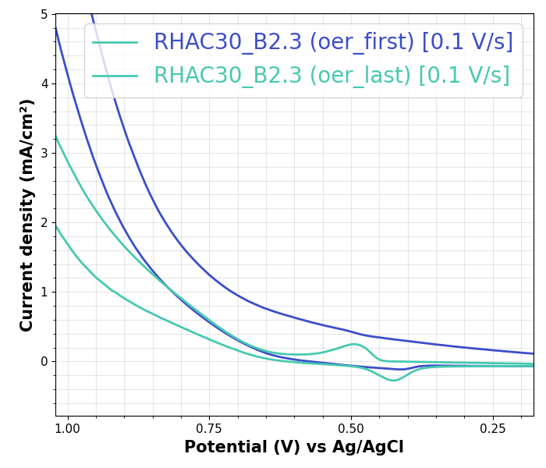
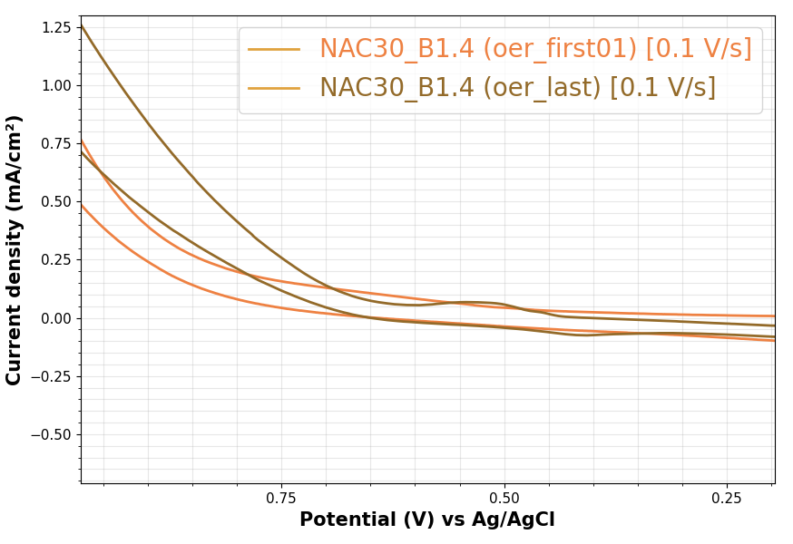
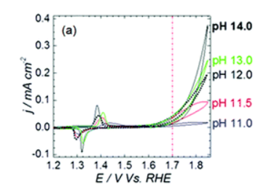
Ni hydroxide/Ni oxyhydroxide transition
Diaz-Morales, et al. The Importance of Nickel Oxyhydroxide Deprotonation on Its Activity towards Electrochemical Water Oxidation. Chemical Science 2016, 7 (4), 2639–2645. https://doi.org/10.1039/C5SC04486C.
pH = 13
pH = 13
Ni(OH)₂ + OH⁻ → NiOOH + H₂O + e⁻

Slide 6
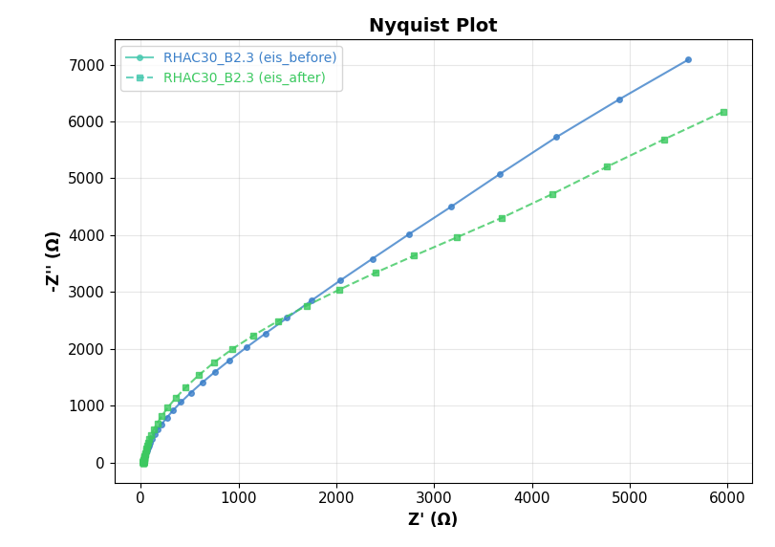
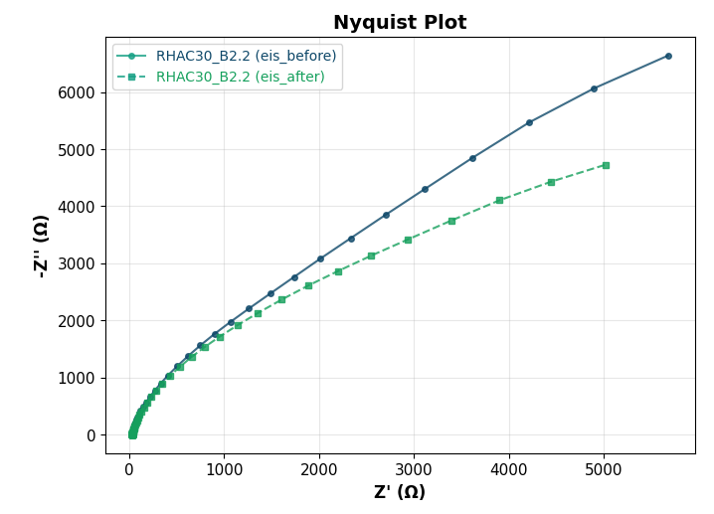
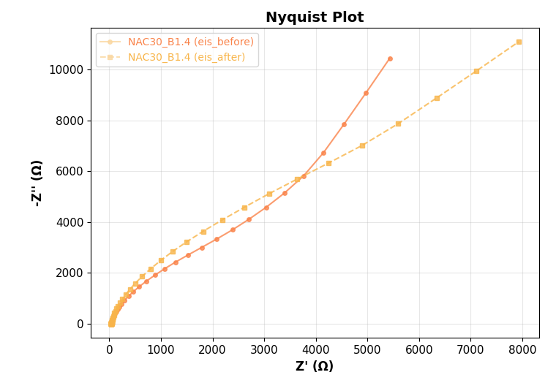
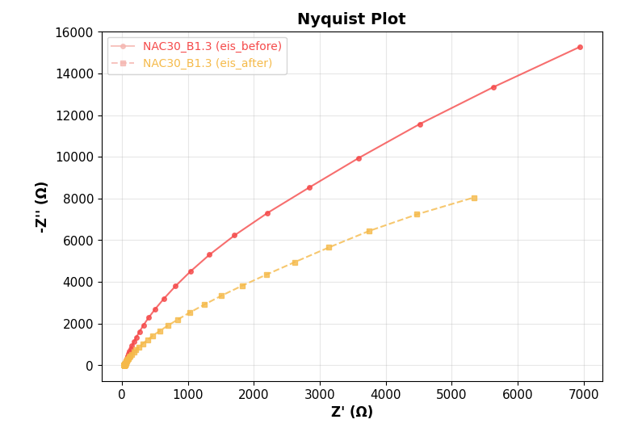
IMPEDANCE SPECTROSCOPY - SURFACE CHARACTERISTICS
Init E (V) = 0
High Frequency (Hz) = 1e+5
Low Frequency (Hz) = 1
Imp SF
Amplitude (V) = 0.005
Quiet Time (sec) = 2
OXYGEN GEN
HYDROGEN GEN
Biowaste Activated C-Ni Composites - Ekaterina Romanenko

Slide 7
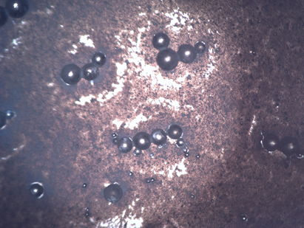
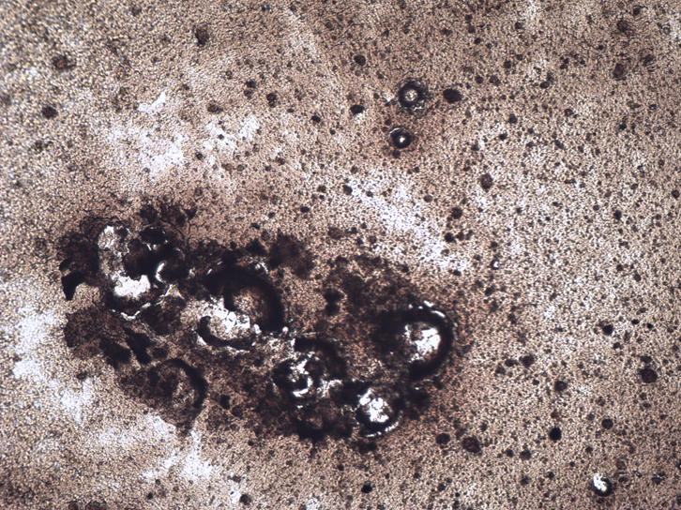

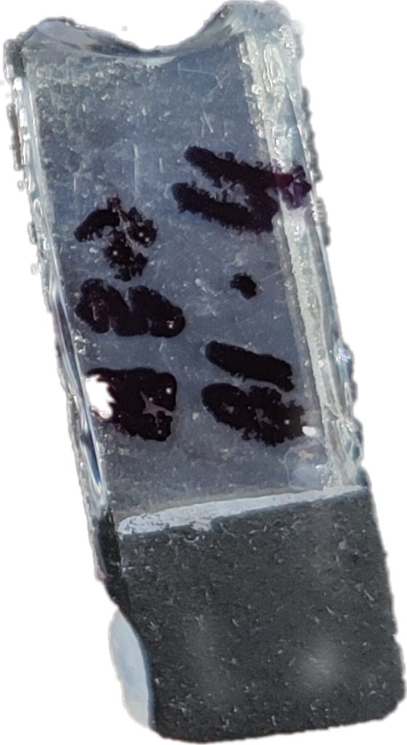
Layered electrode architecture
V
Craters left after sintering
500C, 1hr
RE
CE
0.1M NaOH Electrolyte
RE = Ag/AgCl
CE = Pt strip
PMMA
PEO +PMMA beads + TiO₂
Porous TiO₂
A
A = active geometric area
= 0.6cm2
FTO-GLASS
Polyethylene oxide
+
Poly(methyl methacrylate)
+
Titanium Oxide
Carbon – Nickel composite
+
PEDOT:PSS
Baked on 60 °C, 1h
TiO2 Interlayer
Final electrode

Slide 8
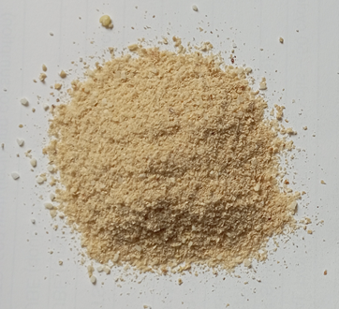

Substrate preparation
Rice husk
RHAC
powder
NAC
powder
Nectarine stone
H₃PO₄;
500 °C; Ar
900 °C H₂O
Chemical activation
Physical activation
+
+
Nickel supported on RHAC
Nickel supported on NAC
+ NiO (30% Ni w/w to Carbon)
.
catalytic pyrolysis
.
.
.
.
.
NiO (s) + H₂ (g) → Ni (s) + H₂O (g)
.
.
.
.
700 °C; Ethanol
Biowaste Activated C-Ni Composites - Ekaterina Romanenko

Slide 9
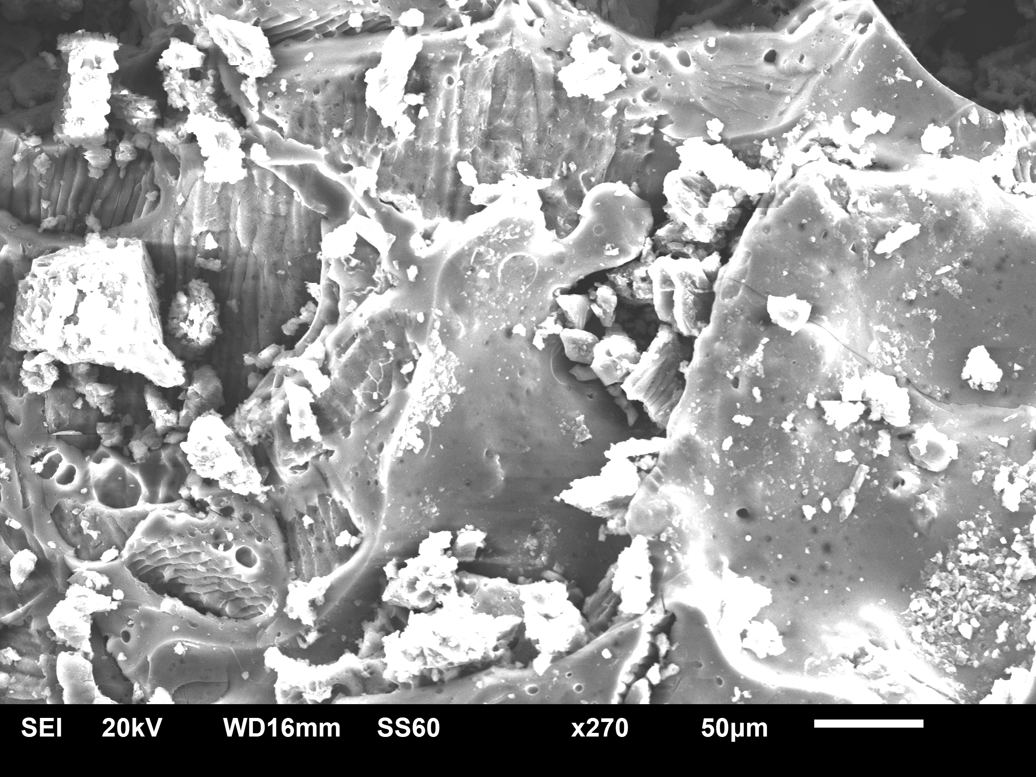
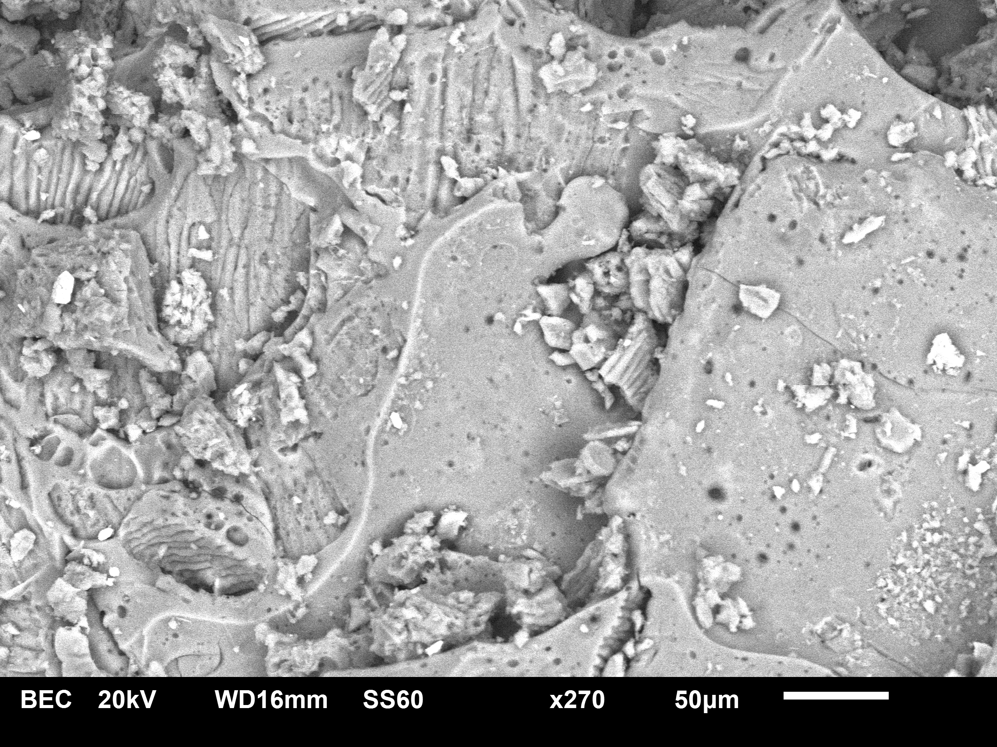
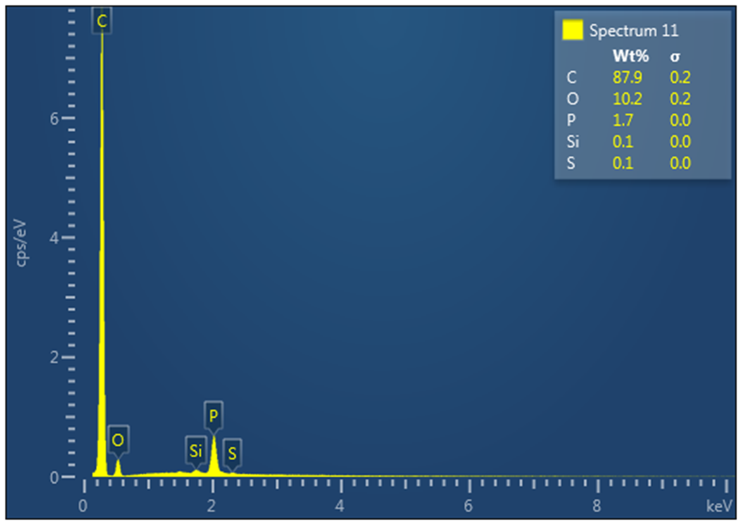
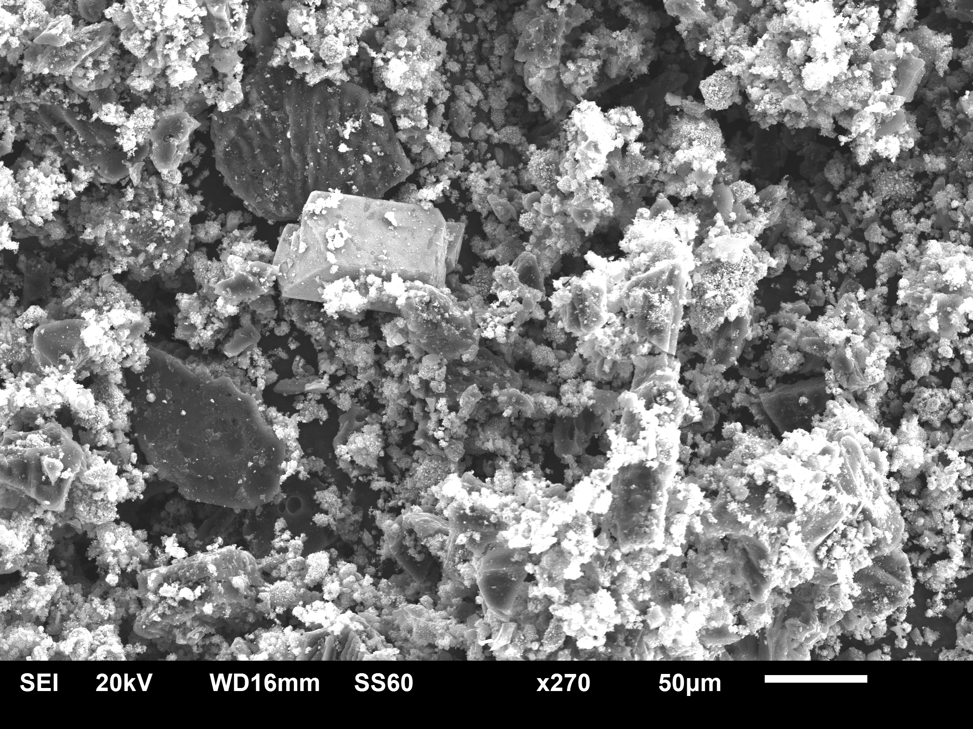
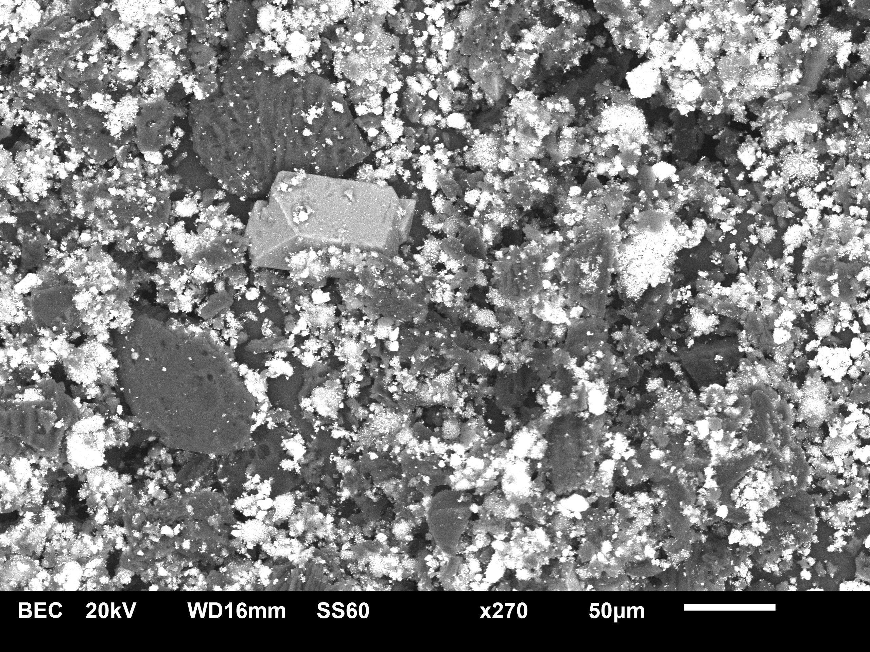
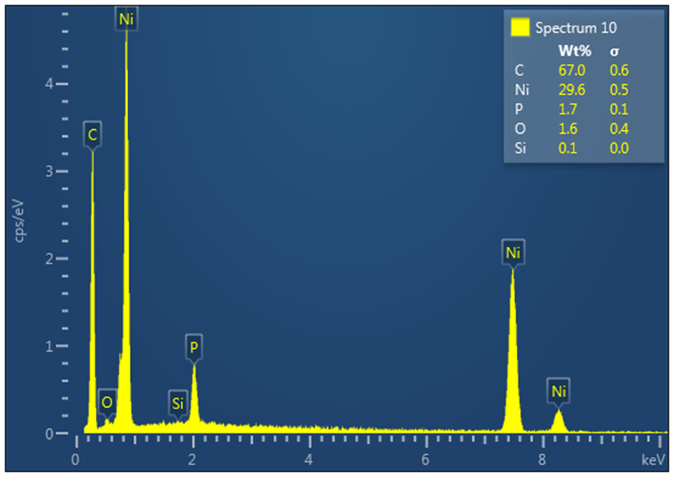
Rice husk Carbon and C-Ni composite
a. RHAC SEI
c. RHAC BEC
e. RHAC EDX
BET Surface Area: 22.8178 m²/g
b. RHAC30 SEI
d. RHAC30 BEC
f. RHAC30 EDX
BET Surface Area: 42.9307 m²/g
Biowaste Activated C-Ni Composites - Ekaterina Romanenko

Slide 10
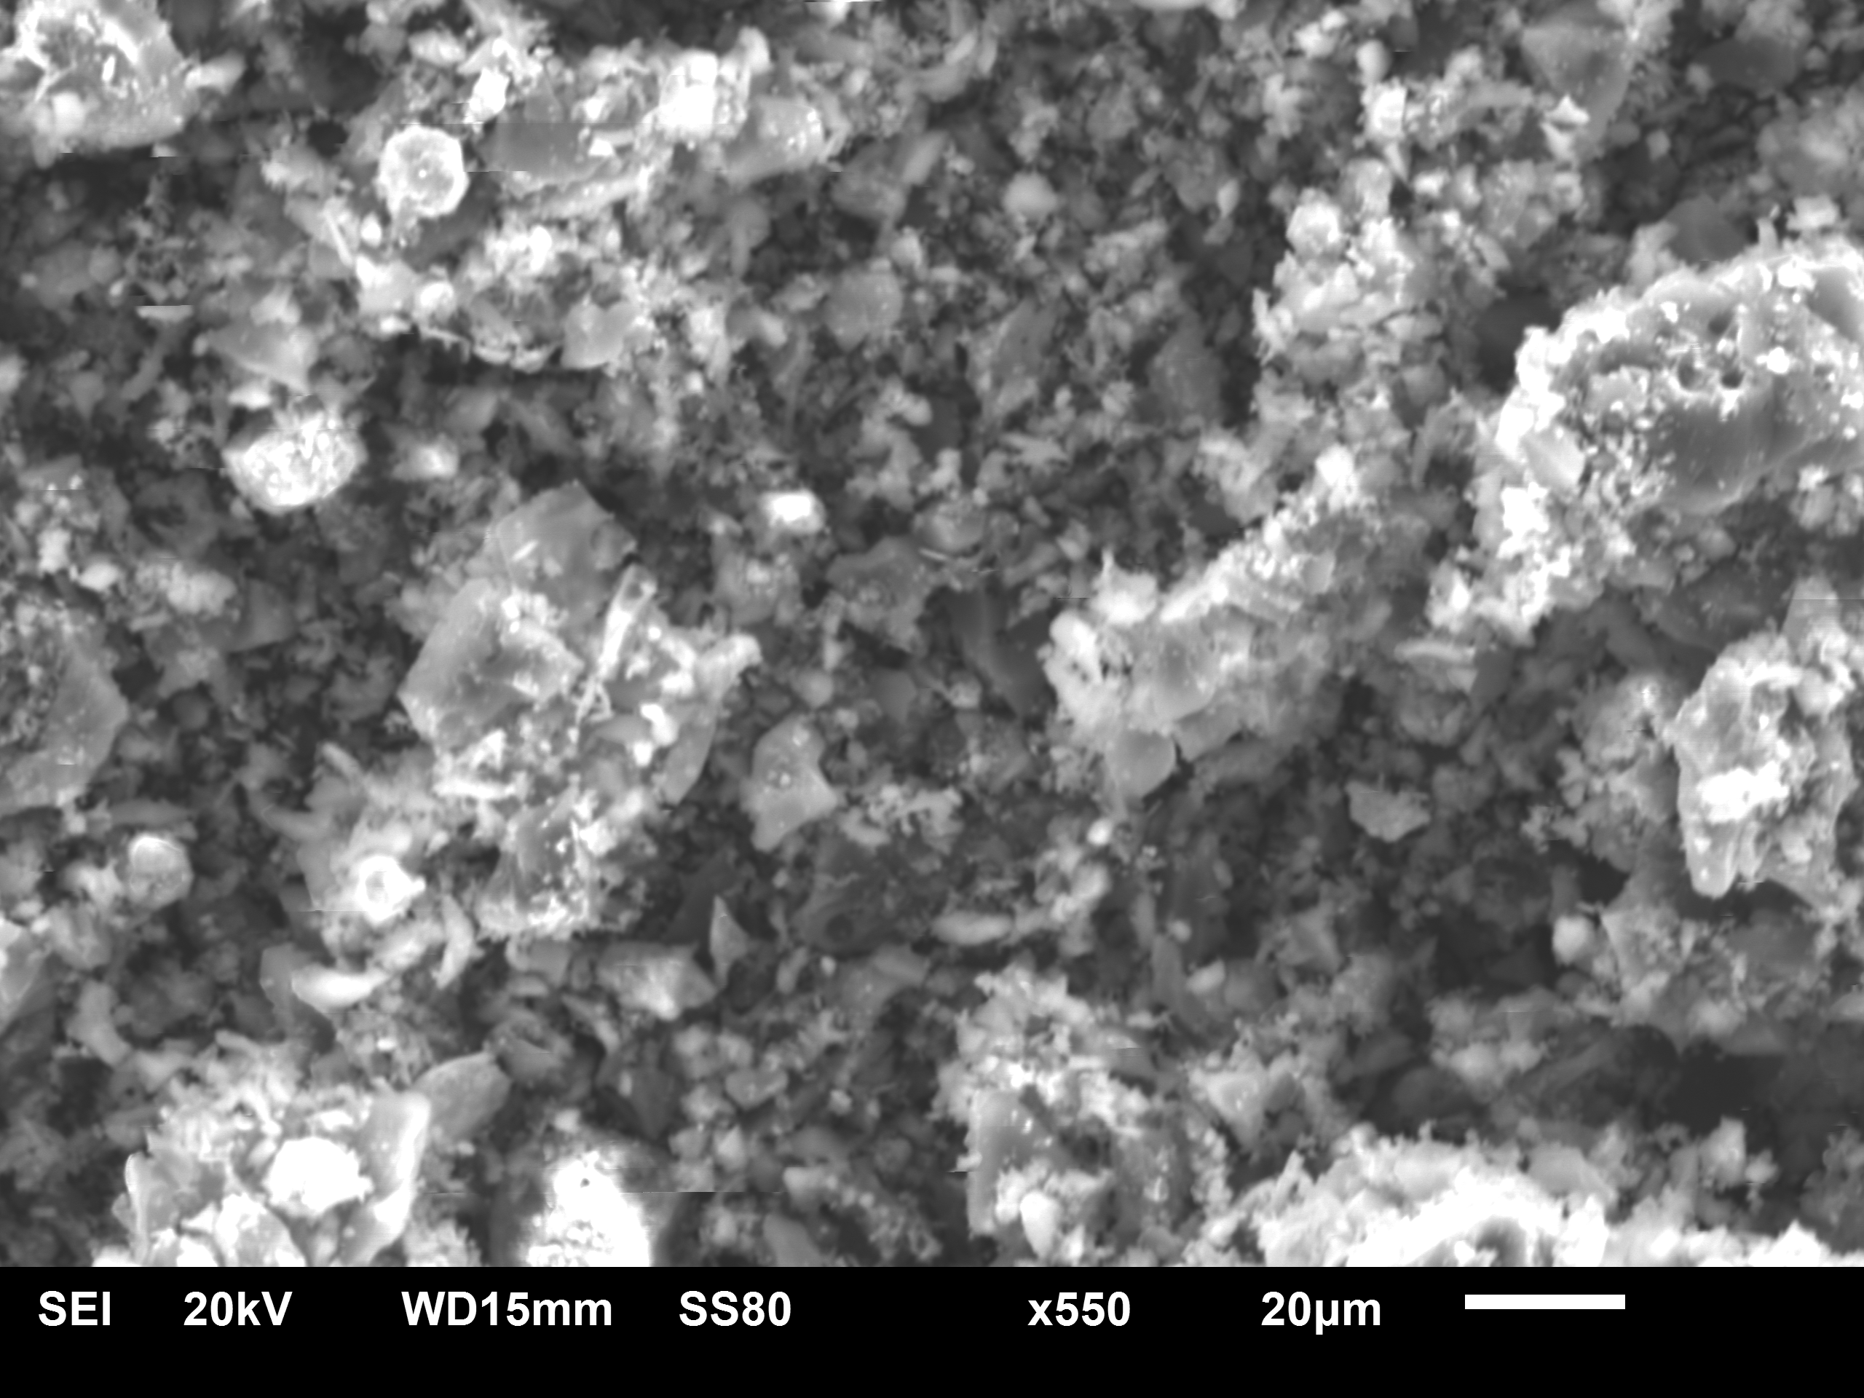
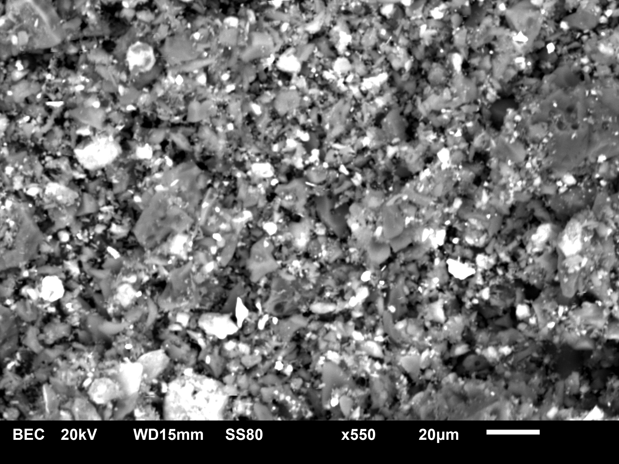
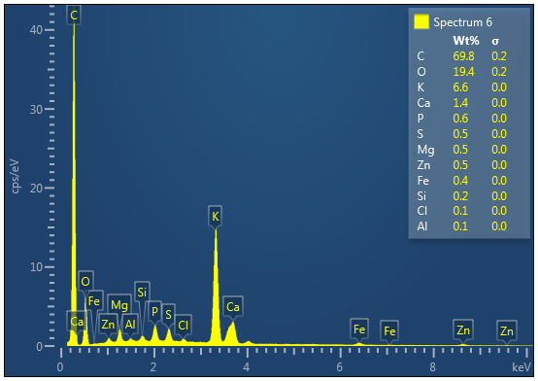
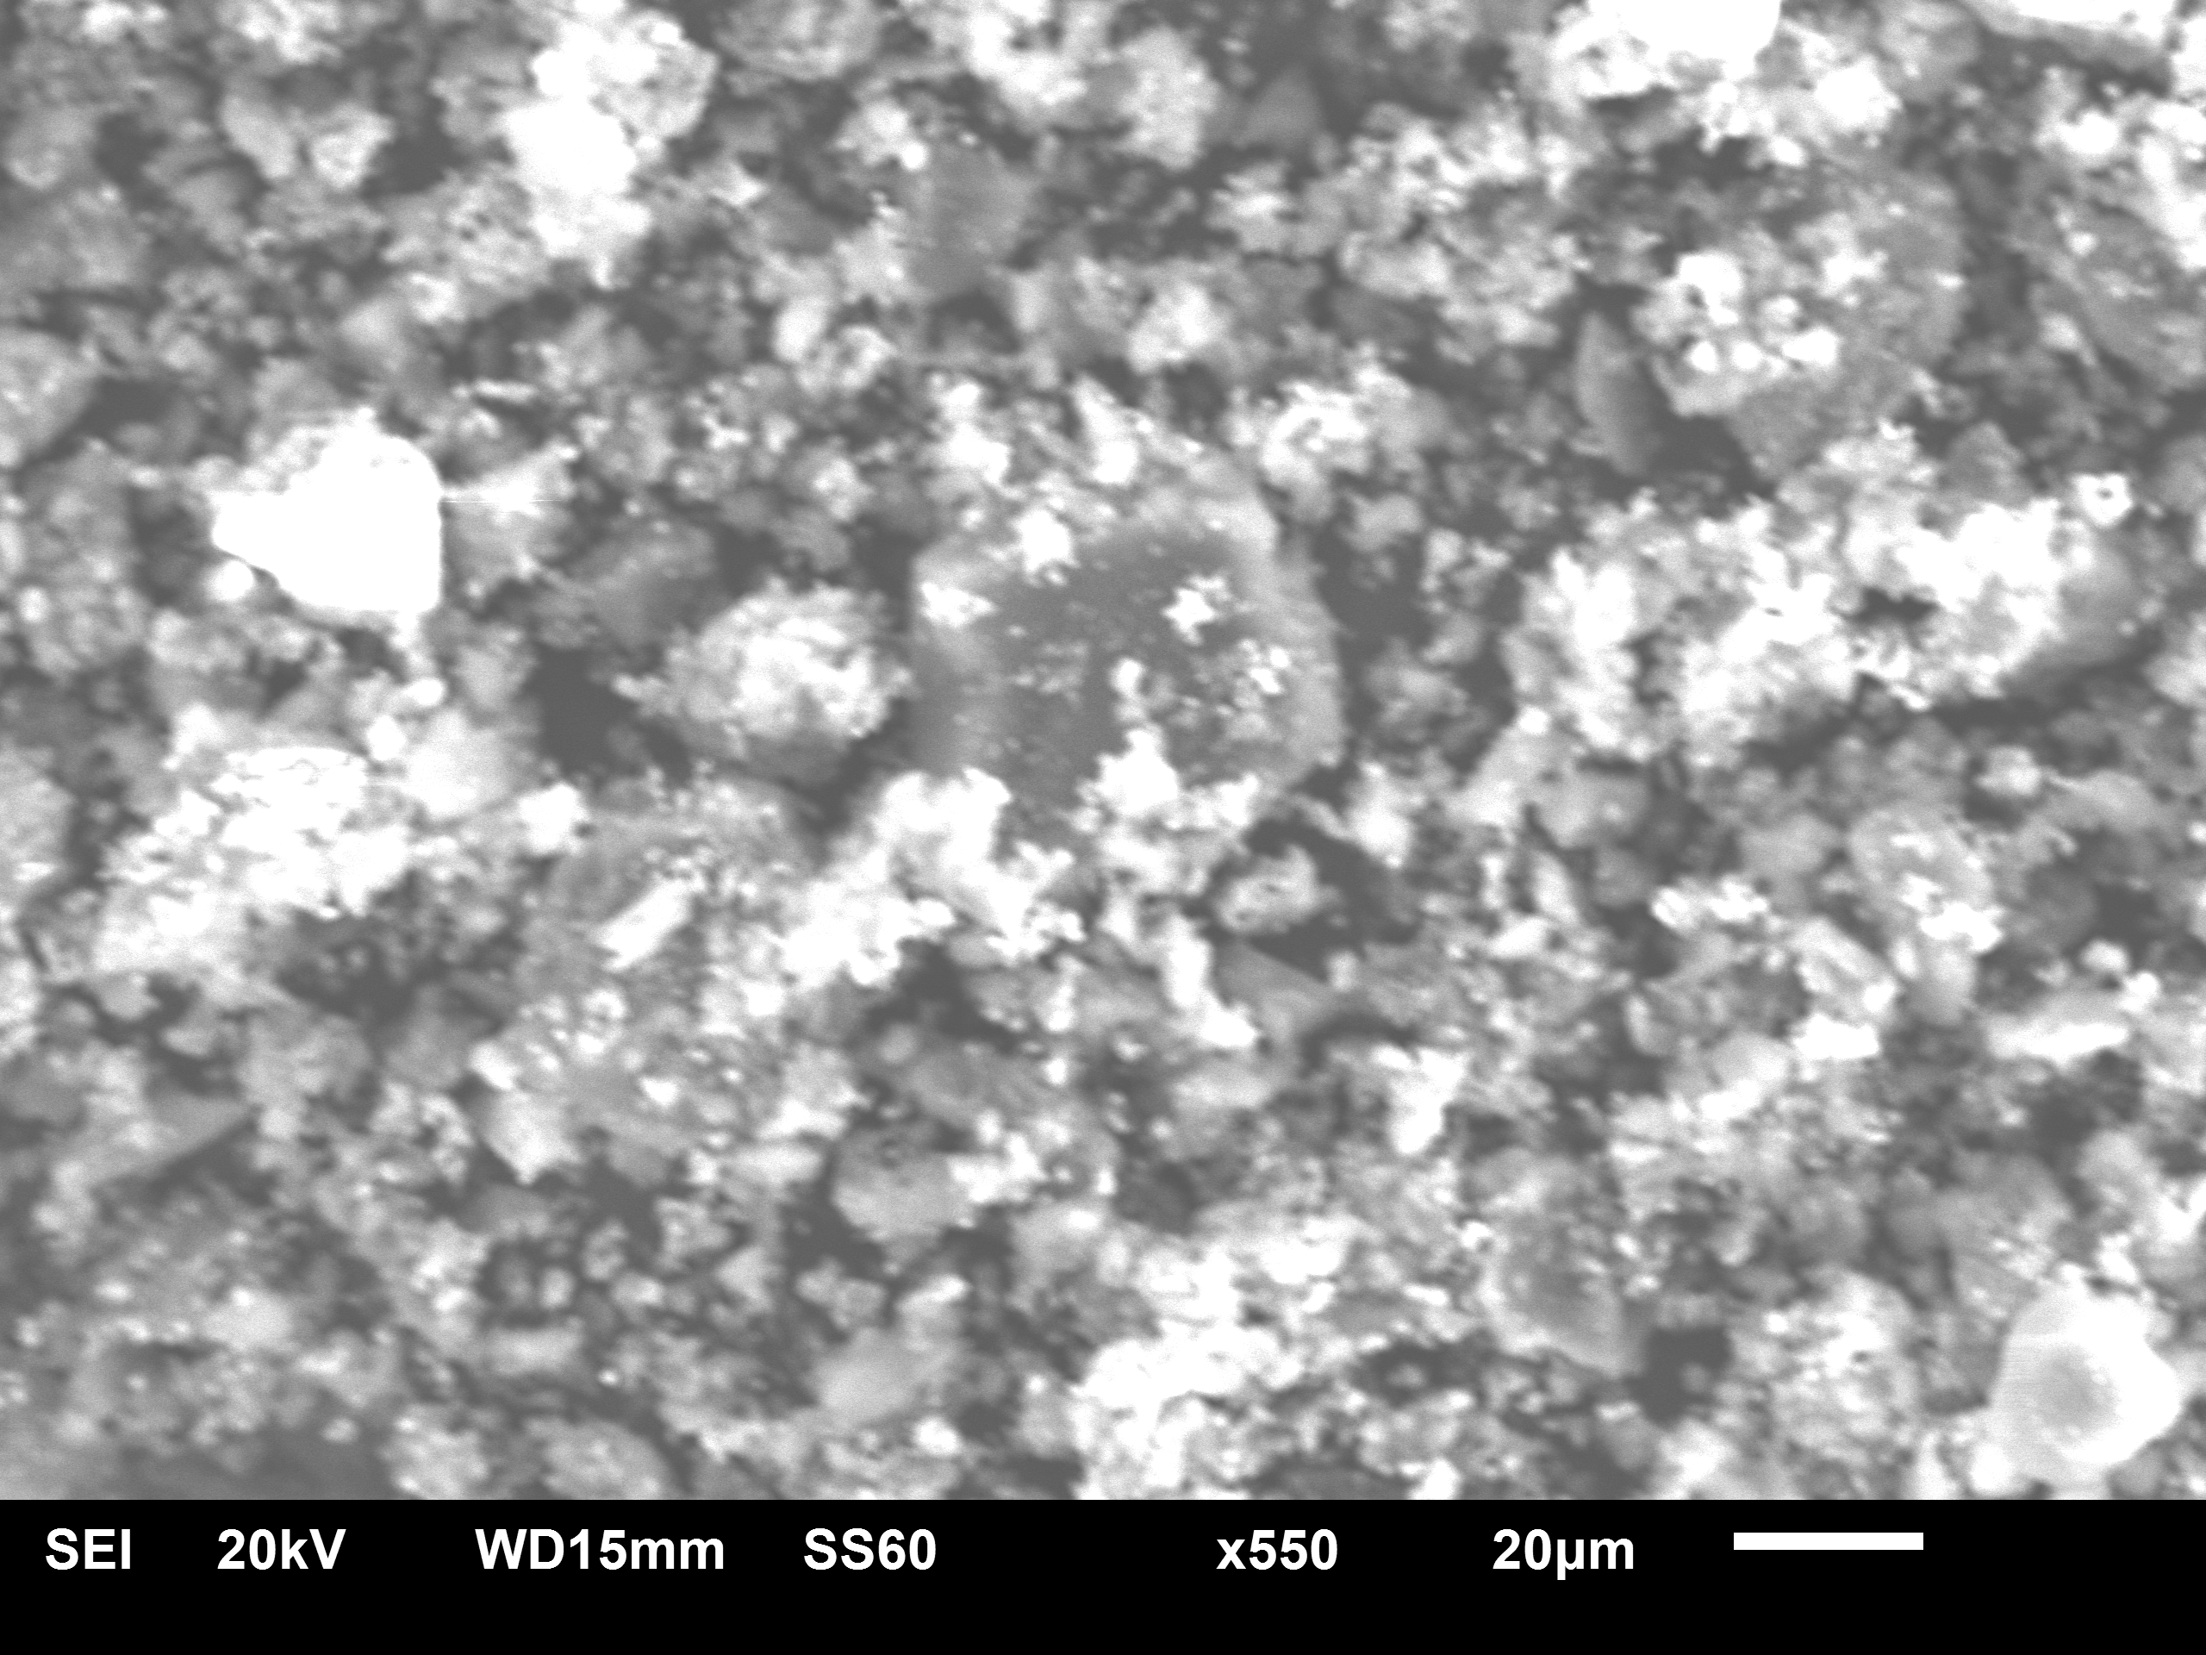
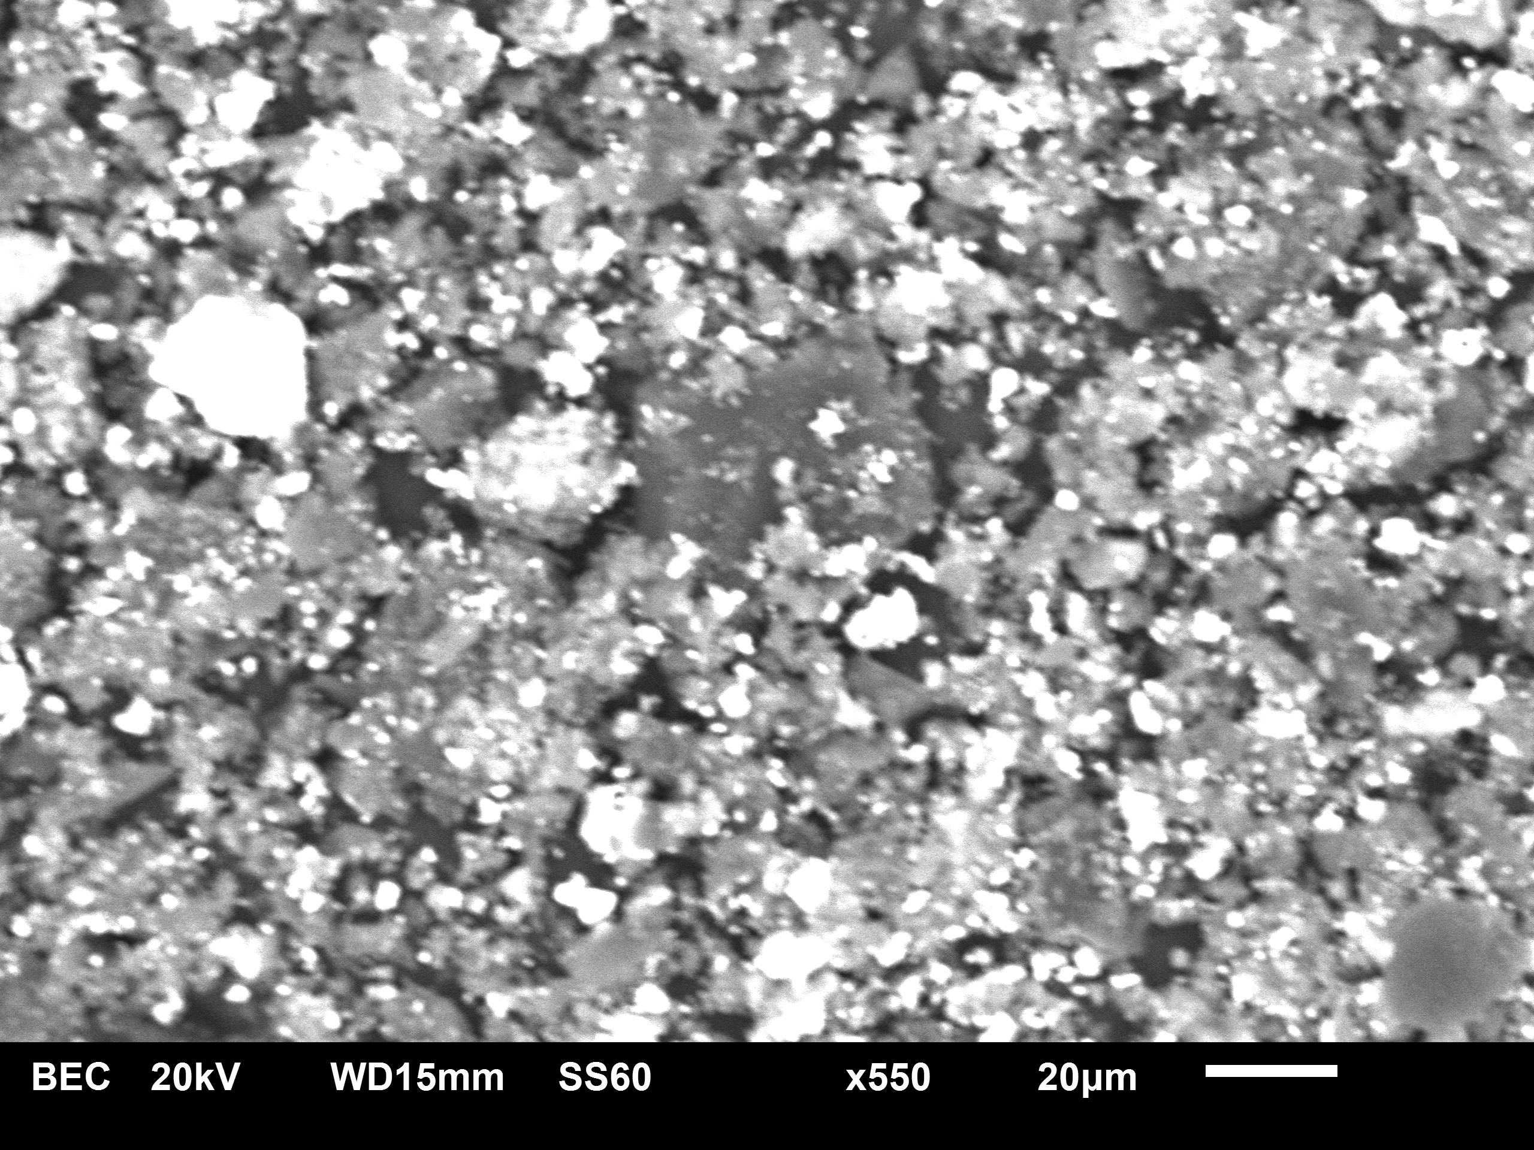
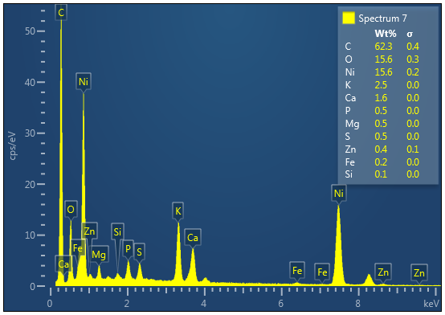
Nectarine stone Carbon and C-Ni composite
a. NAC SEI
c. NAC BEC
e. NAC EDX
b. NAC30 SEI
d. NAC30 BEC
f. NAC30 EDX
Biowaste Activated C-Ni Composites - Ekaterina Romanenko

Slide 11
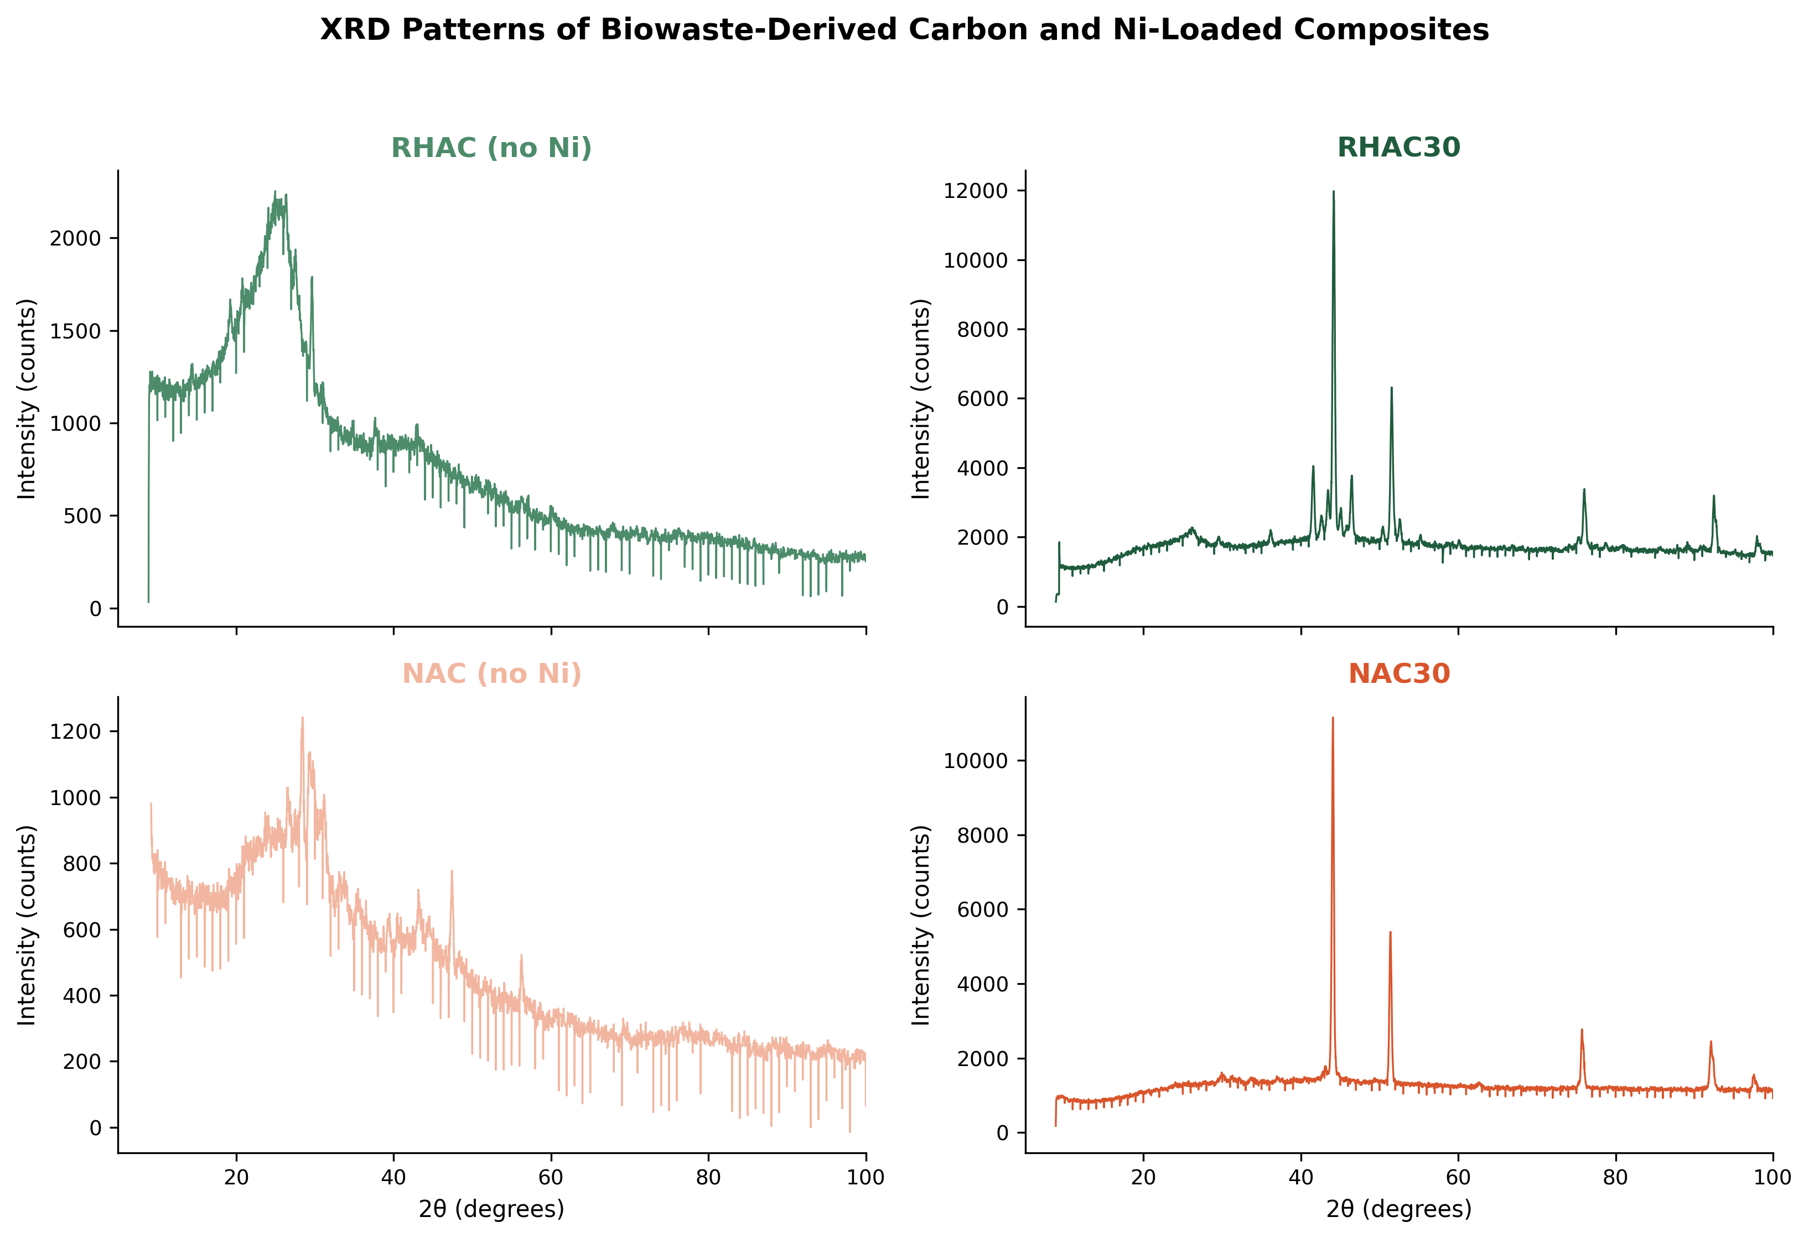
XRD analysis - Ni supported on Carbon
Observed (RHAC30 / NAC30) | NiₓC (x>4), pdf 14-20
44.1–44.2° | 44.43° (111)
51.4–51.6° | 51.80° (200)
75.7–76.0° | 75.51° (220)
92.1–92.5° | 92.52° (311)

Slide 12
Magnetic Susceptibility
Sample | Readings | l (cm) | Δm (g) | χ_{g} | Para / Dia
RHAC0 | −051 → −051 → −052 (x1) | 1.9 | 0.0962 | −3.36 × 10⁻⁷ | Dia magnetic
RHAC20 | Out of range | 1.7 | — | — | Ferro magnetic
Sample | Readings | l (cm) | Δm (g) | χg | Para / Dia
NAC0 | 944 → 965 → 979 → 990 → 1008 → 1022 (x10) | 1.55 | 0.0911 | 1.74 × 10⁻⁴ | Para magnetic
NAC30 | Out of range | 2.5 | 0.122 | — | Ferro magnetic
Biowaste Activated C-Ni Composites - Ekaterina Romanenko

Slide 13
Conclusions
Limitations
Meaningful HER and OER activity demonstrated, though trailing Pt
Ni²⁺/Ni³⁺ redox intensity tracks OER performance directionally
Nectarine stone and rice husk: low-cost, sustainable precursors with distinct properties — systematic comparison ongoing
Electrode-to-electrode consistency is a known limitation
Photoelectrochemical work ongoing - We ran preliminary tests (negative potential - cathode), results were inconclusive and the experiment needs repeating
Sample numbers are still low
Biowaste Activated C-Ni Composites - Ekaterina Romanenko

Slide 14
References
[1] Gong, M.; Zhou, W.; Tsai, M.-C.; Zhou, J.; Guan, M.; Lin, M.-C.; Zhang, B.; Hu, Y.; Wang, D.-Y.; Yang, J.; Pennycook, S. J.; Hwang, B.-J.; Dai, H. Nanoscale Nickel Oxide/Nickel Heterostructures for Active Hydrogen Evolution Electrocatalysis. Nature Communications 2014, 5 (1). https://doi.org/10.1038/ncomms5695.
[2] Yang, Q.; Zeng, J.; Yang, G. W.; Sun, X.; Lin, X.; Liu, K.; Chen, J.; Wang, S.; Lu, X. F. Carbon-Supported Platinum-Based Electrocatalysts for Alkaline Hydrogen Evolution. EES Catalysis 2025. https://doi.org/10.1039/d5ey00147a
[3] Li, J. Oxygen Evolution Reaction in Energy Conversion and Storage: Design Strategies under and beyond the Energy Scaling Relationship. Nano-Micro Letters 2022, 14 (1). https://doi.org/10.1007/s40820-022-00857-x
[4] Diaz-Morales, O.; Ferrus-Suspedra, D.; Koper, M. T. M. The Importance of Nickel Oxyhydroxide Deprotonation on Its Activity towards Electrochemical Water Oxidation. Chemical Science 2016, 7 (4), 2639–2645. https://doi.org/10.1039/C5SC04486C.
[5] Komlev, A., Lähderanta, E., Shevchenko, E., & Vorob’ev-Desyatovskii, N. (2018). Magnetism of purified amorphous carbon. EPJ Web of Conferences, 185, 04012. https://doi.org/10.1051/epjconf/201818504012
[6] Lazzarini, A. (2017). Activated carbons for applications in catalysis: the point of view of a physical-chemist. Rendiconti Lincei, 28(S1), 29–42.
[7] Bin Jumah, A. A Comprehensive Review of Production, Applications, and the Path to a Sustainable Energy Future with Hydrogen. RSC Advances 2024, 14 (36), 26404–26425. https://doi.org/10.1039/d4ra04559a

Slide 15
Questions & Discussion
Thank you for your attention!
Ekaterina Romanenko¹,
Lia Gventsadze², David Gventsadze³, Nikoloz Kereselidze¹, Nikoloz Nioradze³
¹Faculty of Exact and Natural Sciences, Ivane Javakhishvili Tbilisi State University, 1 Chavchavadze Ave., Tbilisi 0179, Georgia
²Republic Center for Structure Researches, Georgian Technical University, Tbilisi 0175, Georgia
³TSU, R. Agladze Institute of Inorganic Chemistry and Electrochemistry, Tbilisi 0186, Georgia
e-mail: ekaterina.romanenko101@ens.tsu.edu.ge

