Slide 1

Separation of Enantiomers of Some Chiral Drugs Using Cyclodextrins by Capillary Electrophoresis
GGSB 2026
Ketevan Akhalkatsi
Prof. Bezhan Chankvetadze

Slide 2
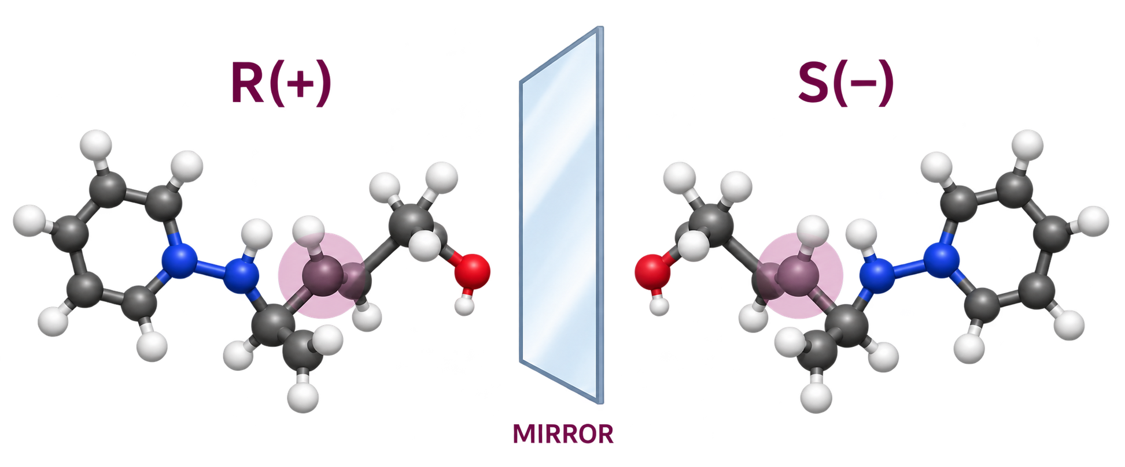



Why Does Chiral Separation Matter?
Enantiomers have the same connectivity but different 3D arrangements
PHARMACOLOGICAL ACTIVITY
Different interactions with
biological targets.
SAFETY
One enantiomer may have different potency or adverse effects.
PHARMACOKINETICS
Absorption, metabolism and elimination can differ.
Therefore, identifying and separating individual enantiomer is important in pharmaceutical analysis.

Slide 3
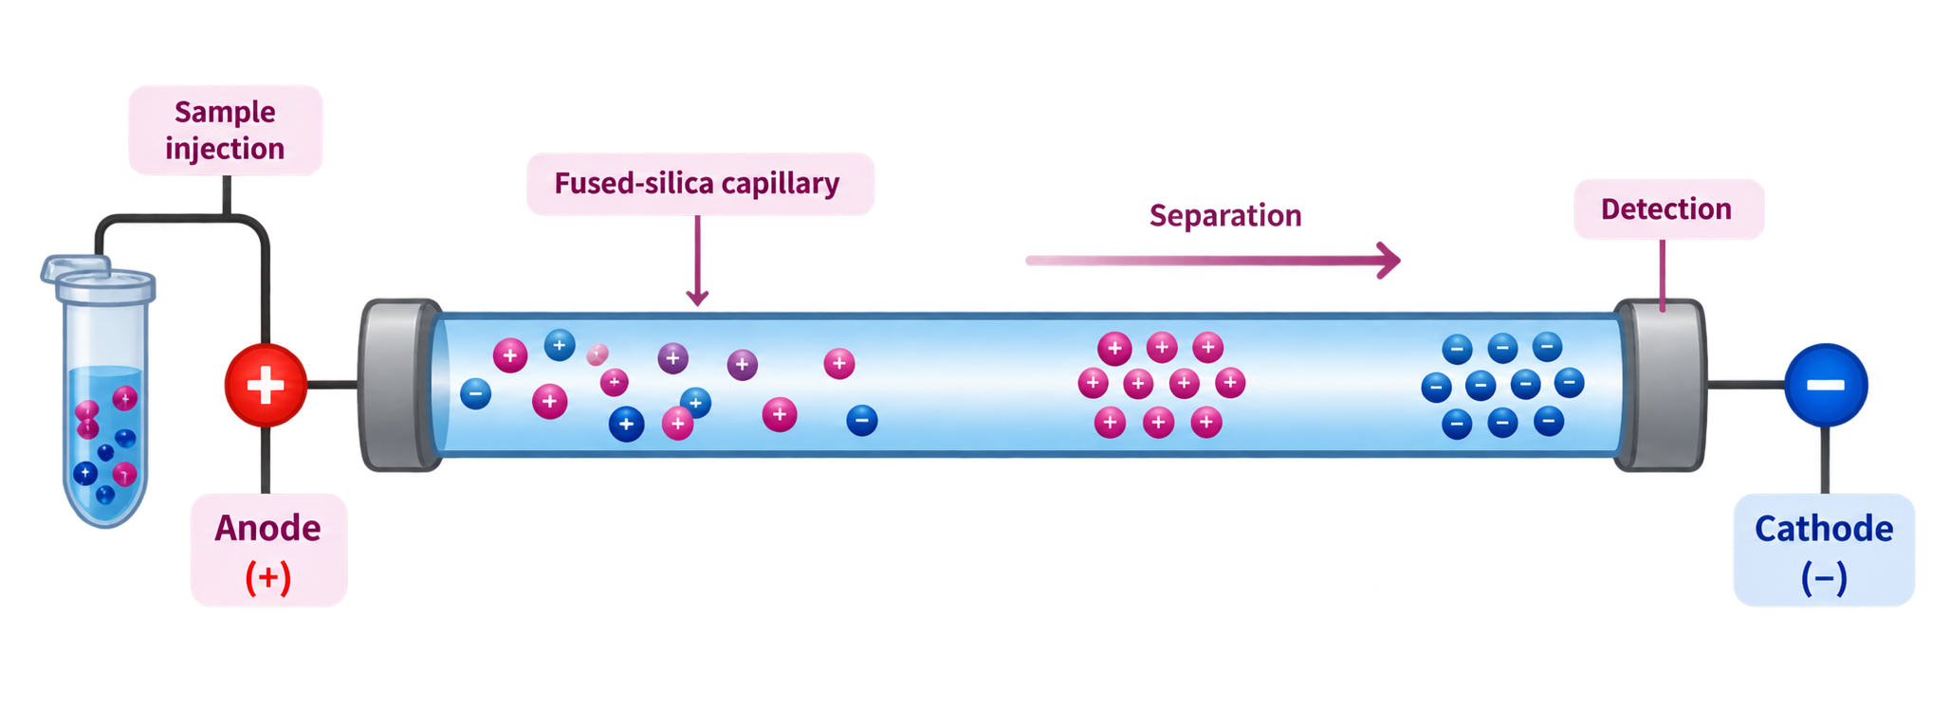
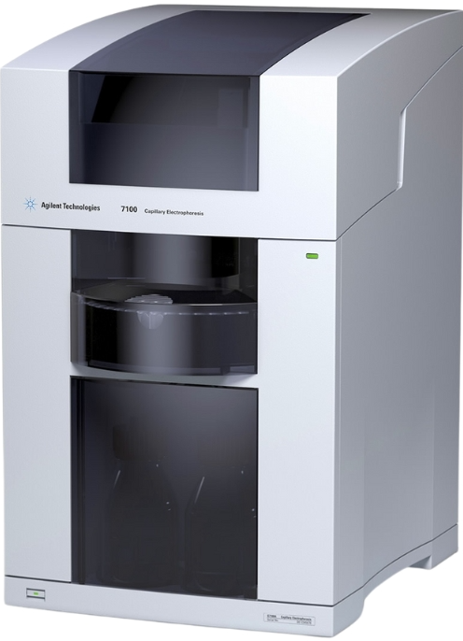




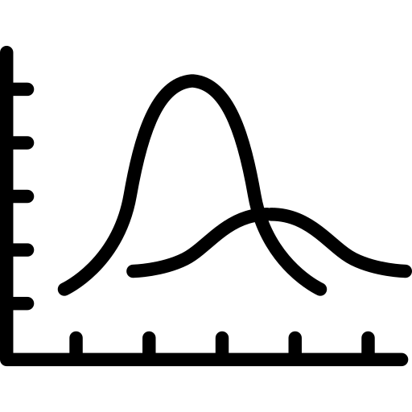


Capillary Electrophoresis (CE)
CE separates charged species according to their electrophoretic mobility inside a narrow capillary under a high electric field.
PRINCIPLE OF CE
CE INSTRUMENT
1. Sample injection
2. High voltage applied
3. Migration
4. Separation
5. Detection
Charged species migrate at different velocities depending on their electrophoretic mobility.
Species are separated based on their charge to size ratio and interaction with the buffer/additives.
Separated species are detected as peaks to produce a graph.
A small volume of sample is injected into capillary.
An electric field is applied across the capillary.

Slide 4
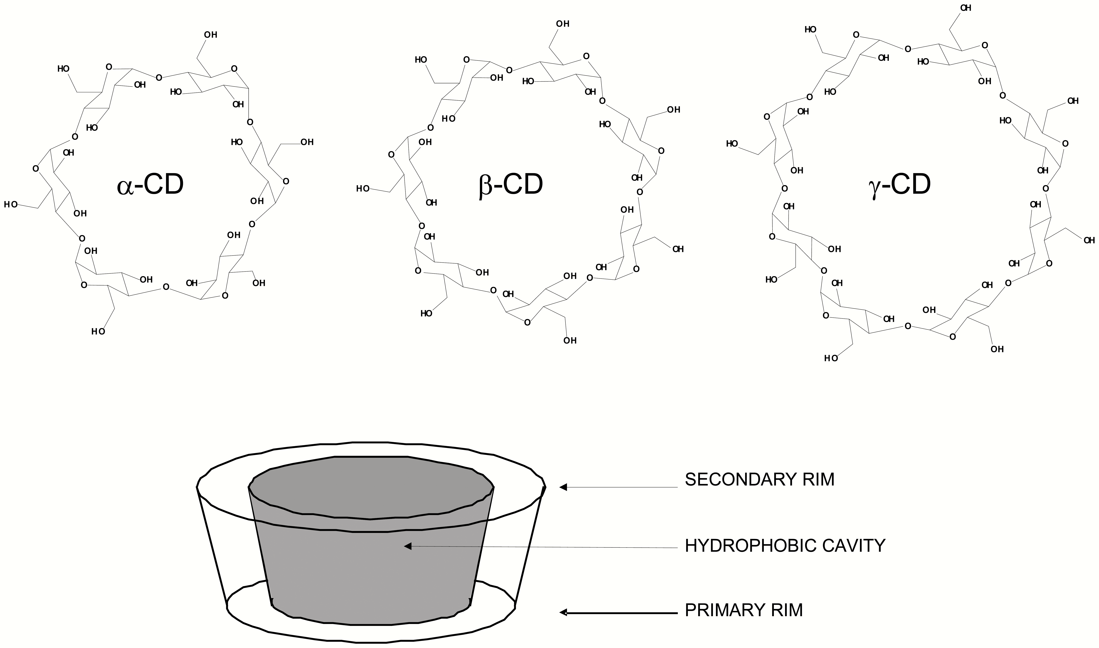
Chiral Recognition by Cyclodextrins
Cyclodextrins act as a chiral hosts and form transient inclusion complexes with enantiomers to give different effective electrophoretic mobilities.
Because the two enantiomers interact differently with the chiral cavity of cyclodextrin, their effective electrophoretic mobilities become different, leading to enantioseparation.

Slide 5

Aim & Objectives
AIM
To achieve enantioseparation of the chiral compounds Sotalol and Promethazine by capillary electrophoresis using native and modified cyclodextrins as chiral selectors, and to investigate the effect of cyclodextrin structure on migration behavior.
OBJECTIVES
1. To separate the enantiomers of Sotalol and Promethazine using capillary electrophoresis (CE).
2. To evaluate and compare the enantioselectivity of native (α, β, γ - cyclodextrin) and modified cyclodextrins.
3. To study the effect of cyclodextrin structure on electrophoretic mobility and migration order.
4. To optimize experimental conditions for effective enantioseparation.
5. To interpret the relationship between cyclodextrin-enantiomer interactions and observed migration behavior.

Slide 6
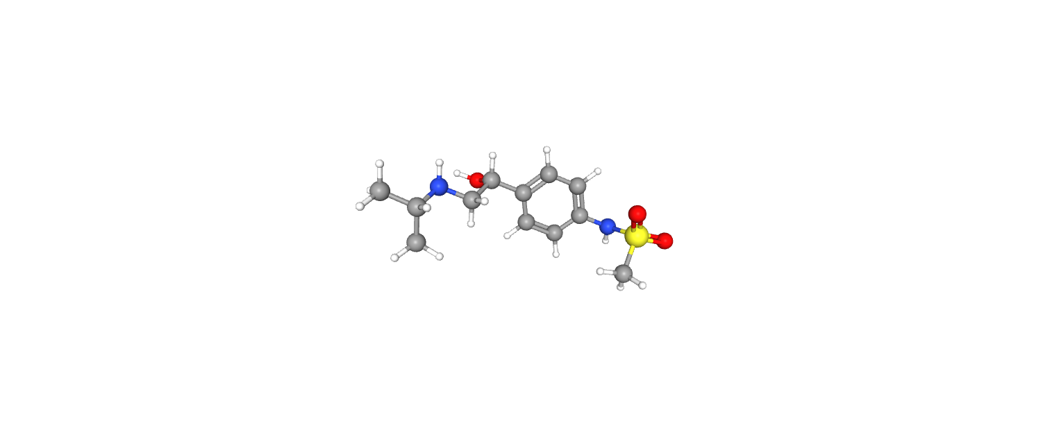
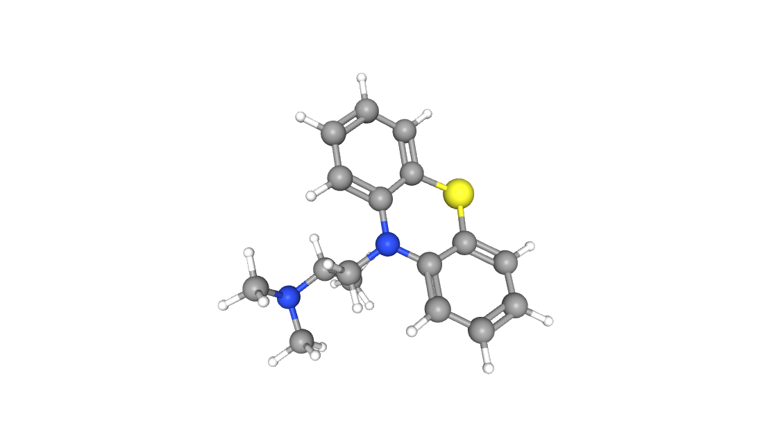
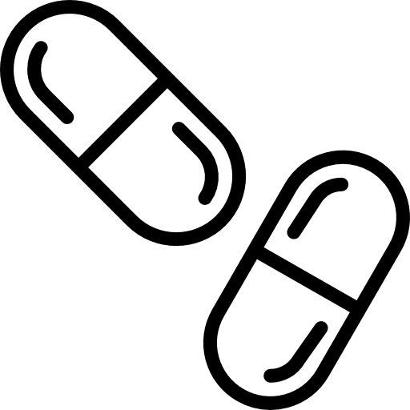

Selected Chiral Drugs
Sotalol
Promethazine
Therapeutic use:
Treatment of arrythmias and hypertension.
Therapeutic use:
Allergy relief, antiemetic and sedative effects.
Chirality relevance:
Enantiomers may exhibit differences in pharmacological activity and potency.
Chirality relevance:
Enantiomers can differ in efficacy, safety and side-effect profile.
These compounds serve as excellent model compounds to evaluate the effect of cyclodextrin selectors on enantioseparation by capillary electrophoresis.

Slide 7
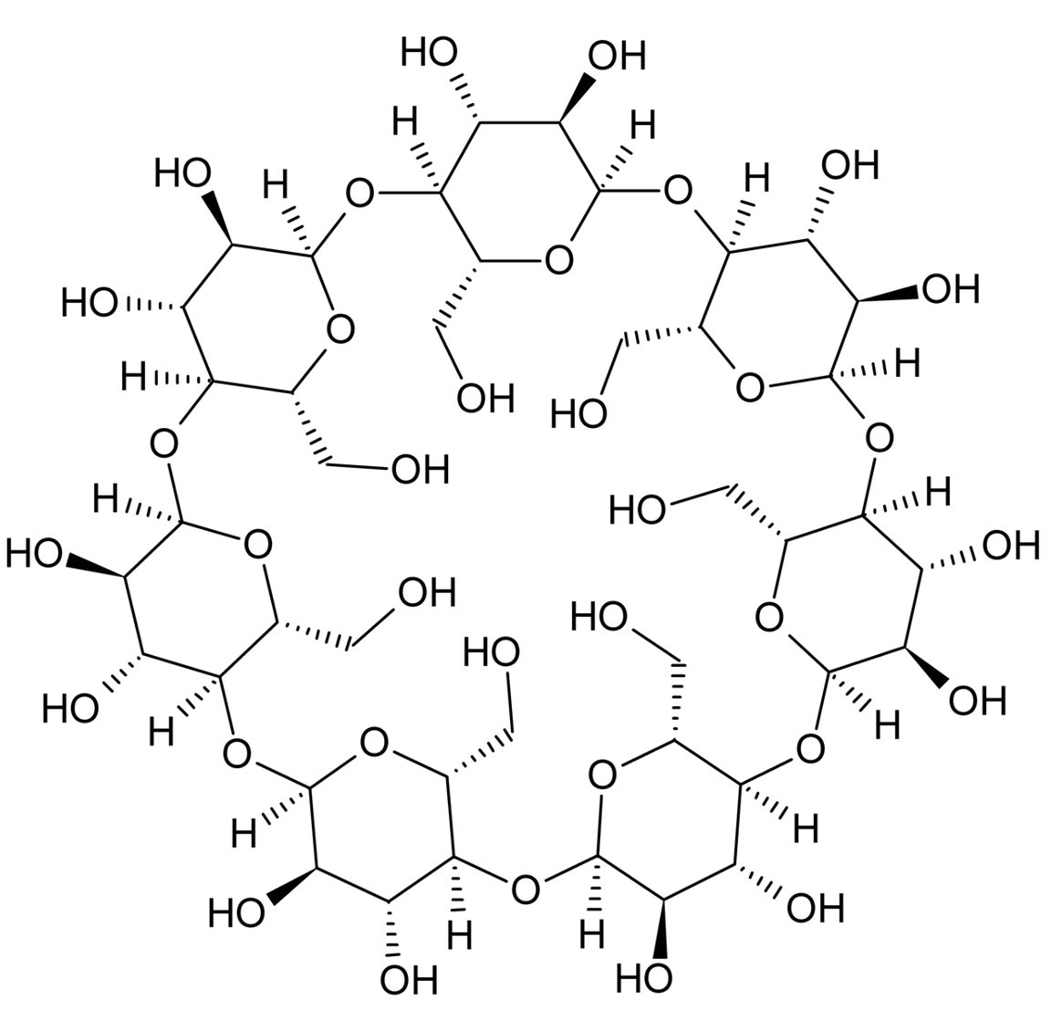
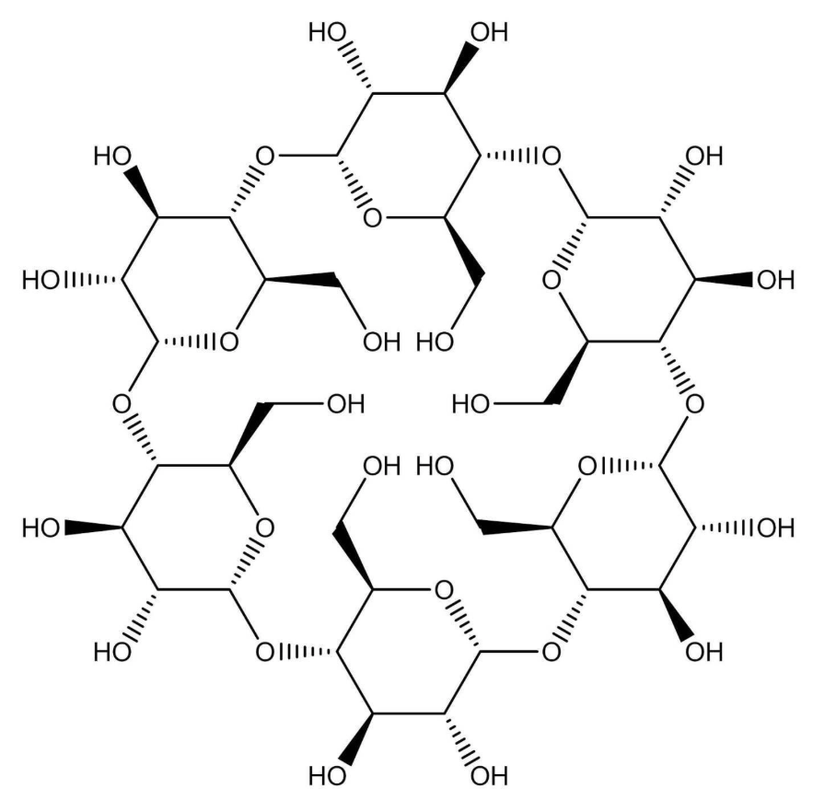
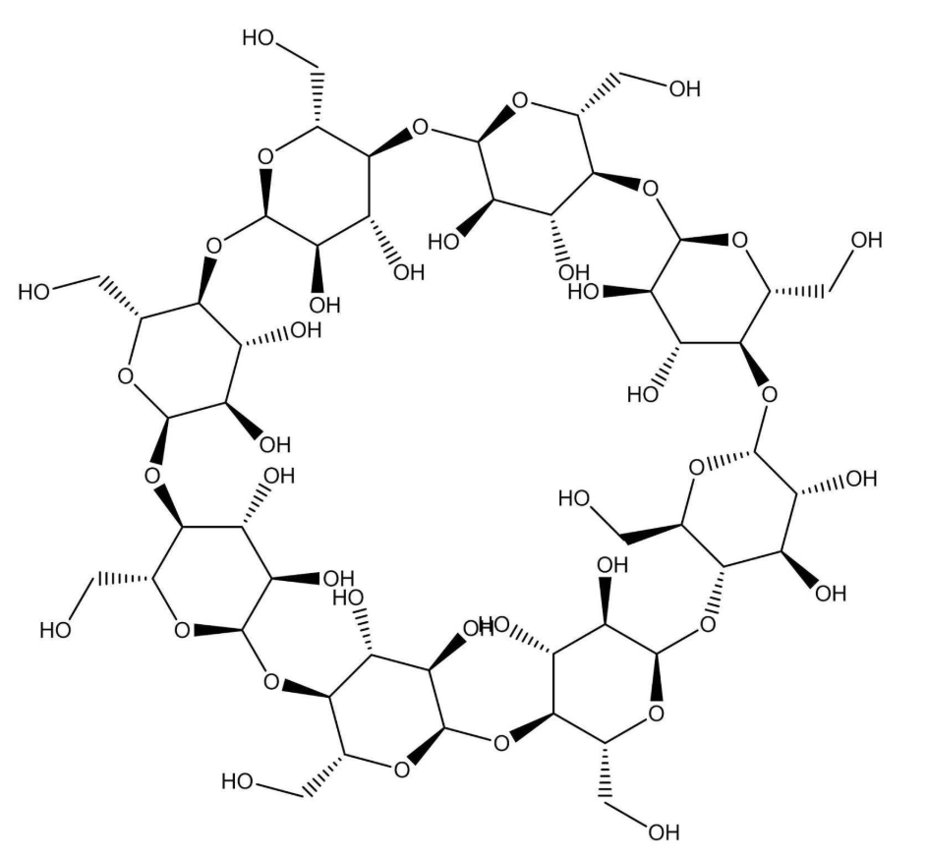
Cyclodextrin Selectors
α-cyclodextrin
β-cyclodextrin
γ-cyclodextrin

Slide 8






Experimental Conditions
SOTALOL
PROMETHAZINE
 | Buffer | 100 mM Potassium dihydrogen phosphate pH = 2.00
 | Inner diameter of capillary | 50.0 μm
 | Total length | 32.5 cm
 | Effective length | 24.0 cm
 | Temperature | 20 °c
 | Buffer | 100 mM Phosphoric acid pH = 2.50
 | Inner diameter of capillary | 50.0 μm
 | Total length | 48.5 cm
 | Effective length | 40.0 cm
 | Temperature | 20 °c
CHIRAL SELECTORS
(HDMS-β-CD) (HDAS-β-CD)
CHIRAL SELECTORS
(HDAS-α-CD) (HDAS-β-CD) (ODMS-γ-CD (γ-CD) (HDMS-β-CD) (β-CD)

Slide 9
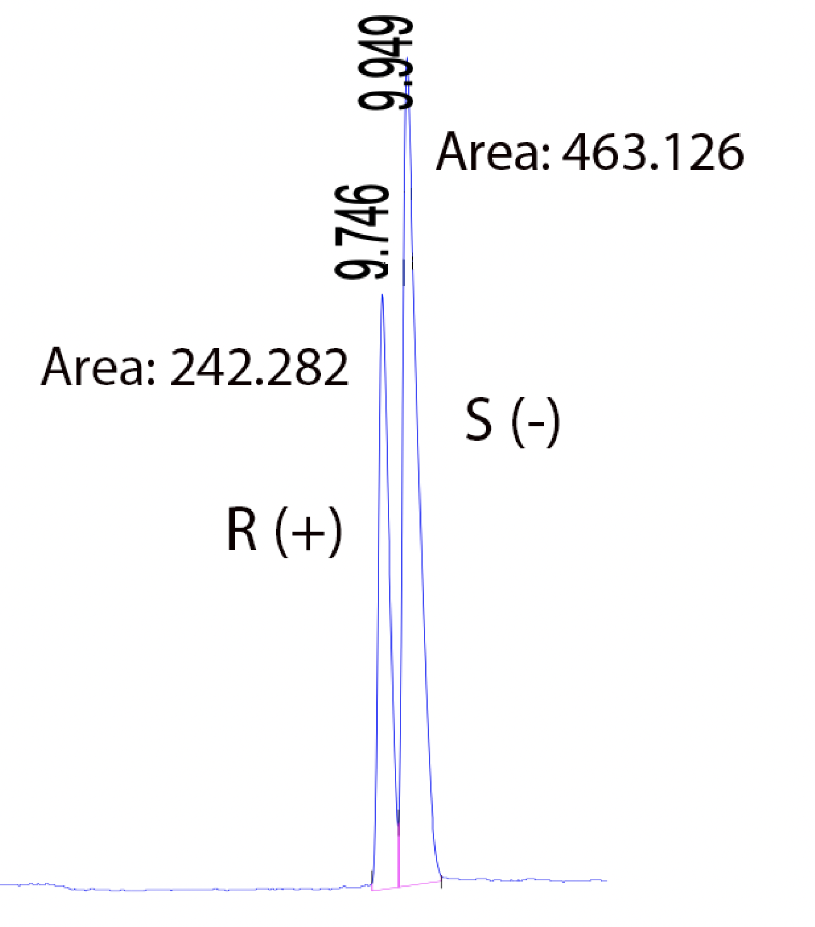
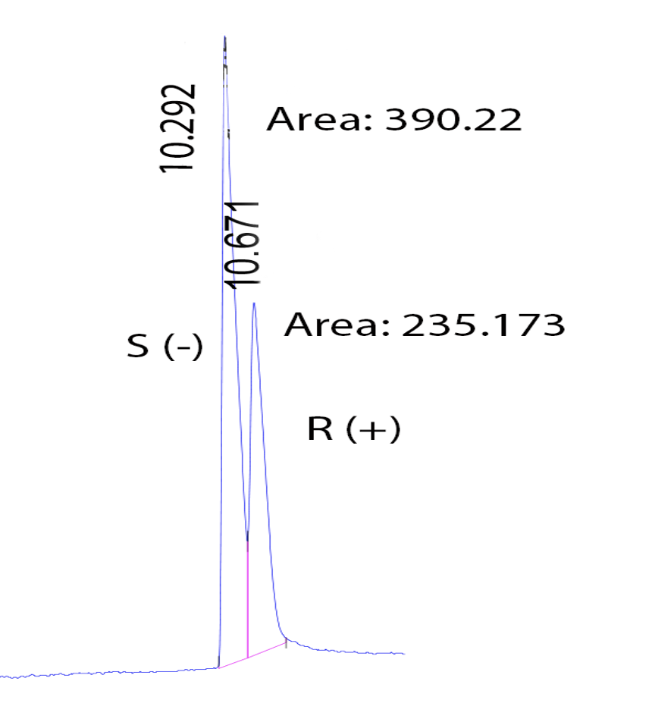




Sotalol - Representative Results
Chiral Selector
60mg/mL Heptakis-(2,3-di-o-methyl 6-sulfo)-β-cyclodextrin
Chiral Selector:
10 mg/mL Heptakis(2,3-di-o-acetyl-6-sulfo)-β-cyclodextrin

Slide 10
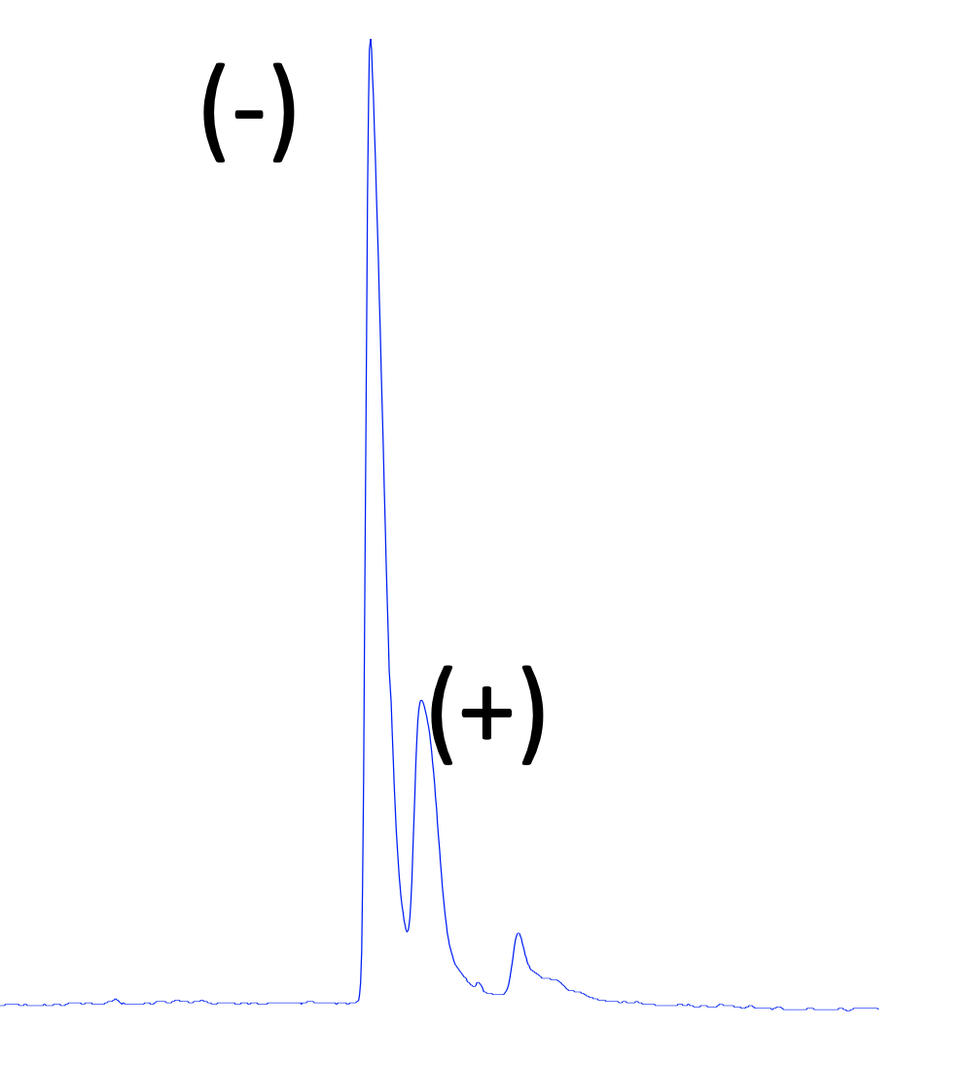
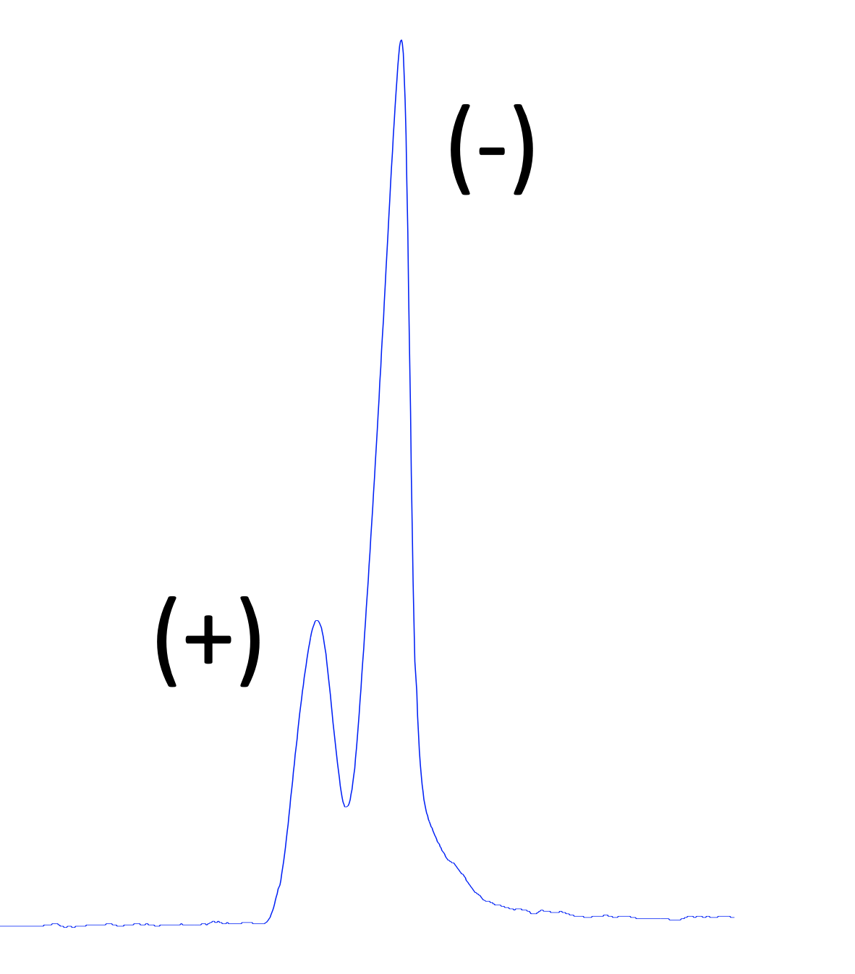
Promethazine - Representative Results
Chiral Selector:
2 mg/mL Heptakis-(2,3-di-o-acetyl-6-sulfo)-α-cyclodextrin
Chiral Selector:
20 mg/mL Octakis-(2,3-o-dimethyl-6-o-sulfo)-γ-cyclodextrin

Slide 11
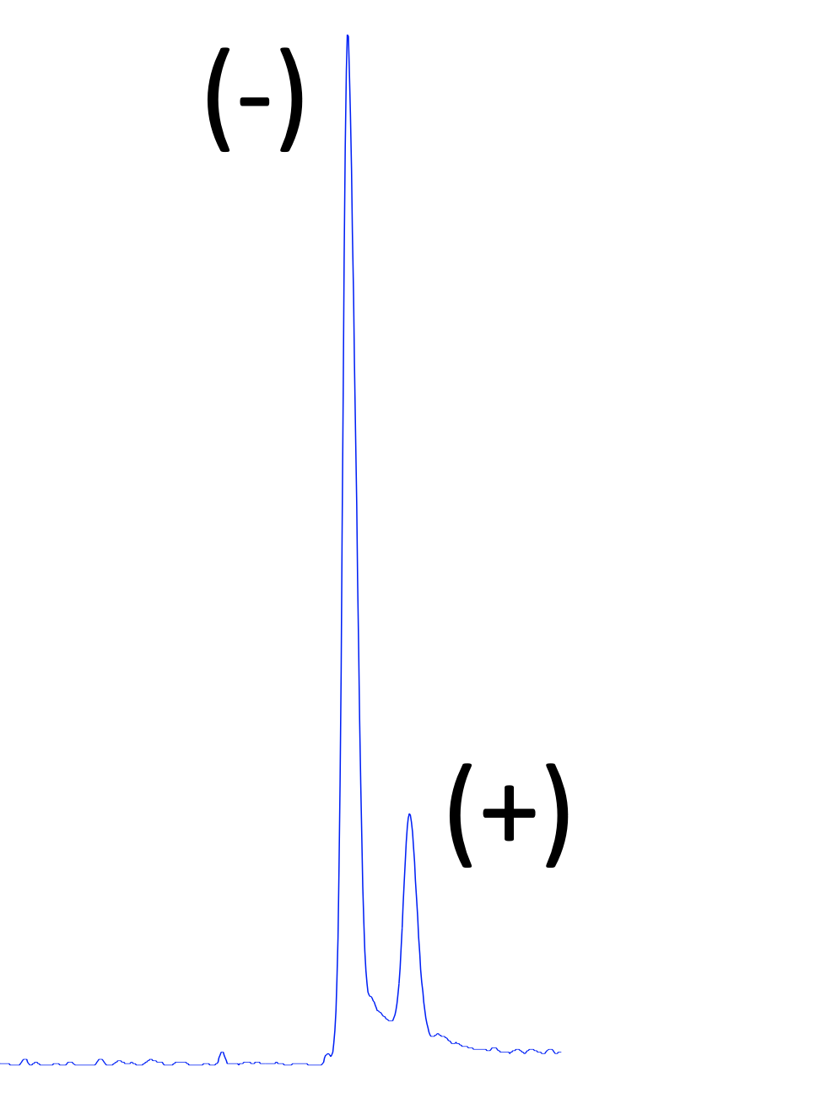
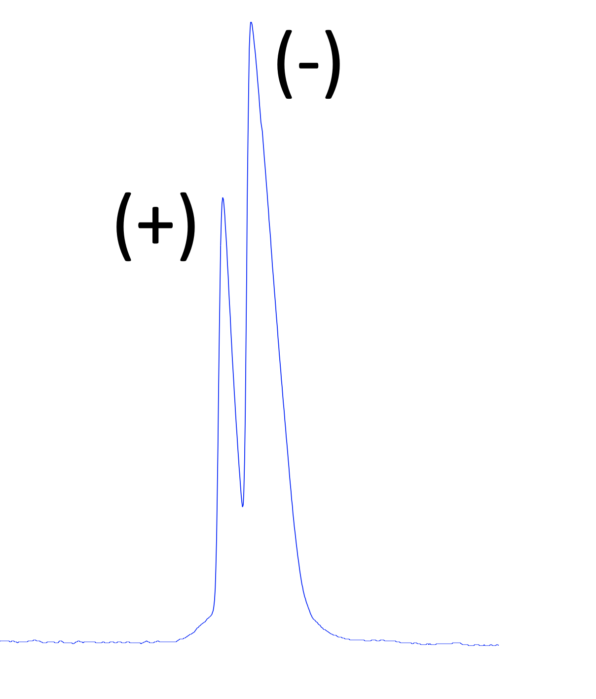
Promethazine - Representative Results
Chiral Selector:
2 mg/mL Heptakis-(2,3-di-o-acetyl-6-sulfo)-β-cyclodextrin
Chiral Selector:
10 mg/mL γ-cyclodextrin

Slide 12
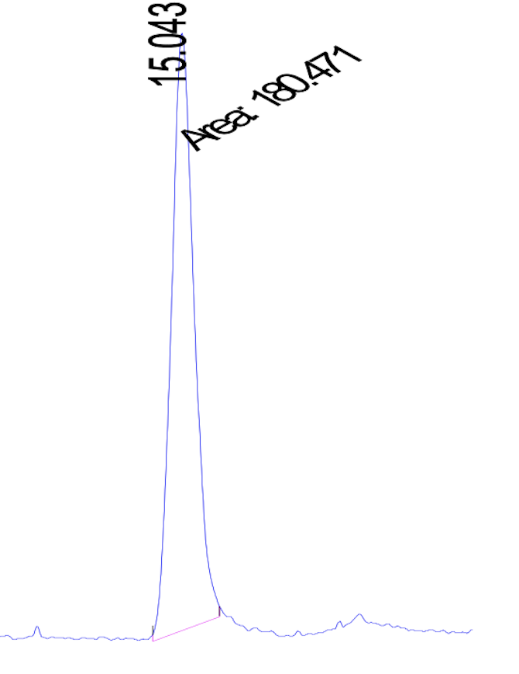
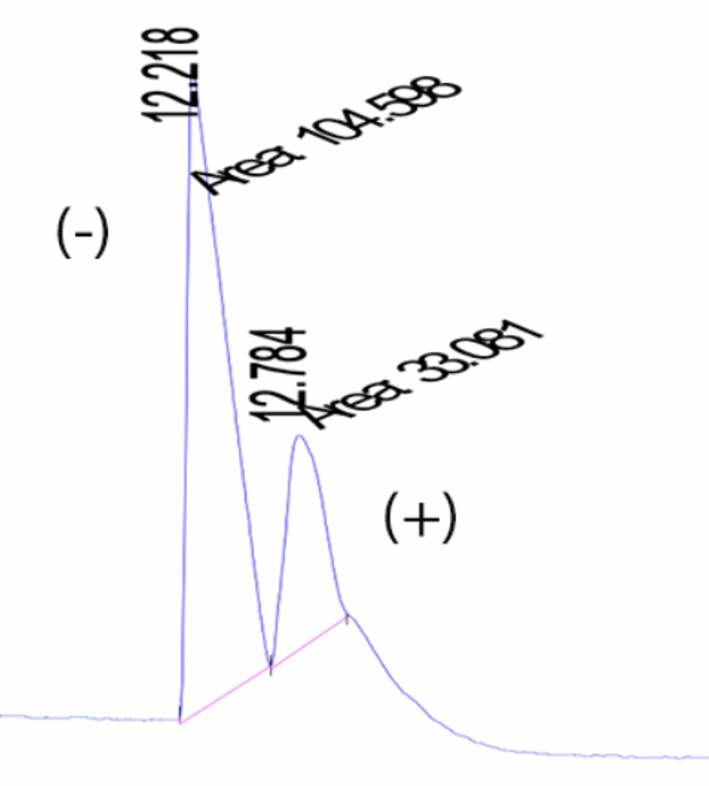
Promethazine - Representative Results
Chiral Selector:
10 mg/mL Heptakis(2,3-di-o-methyl-6-sulfo)-β-cyclodextrin
Chiral Selector:
18 mg/mL β-cyclodextrin

Slide 13
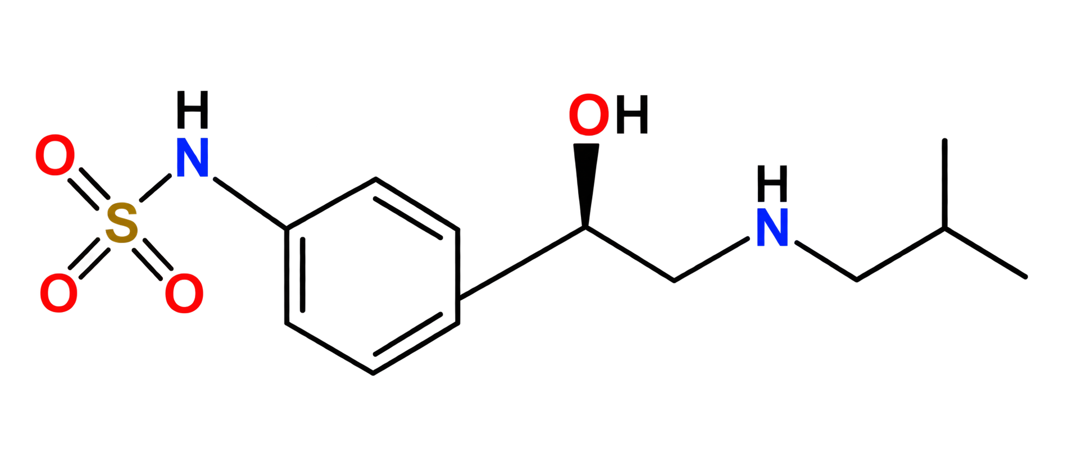
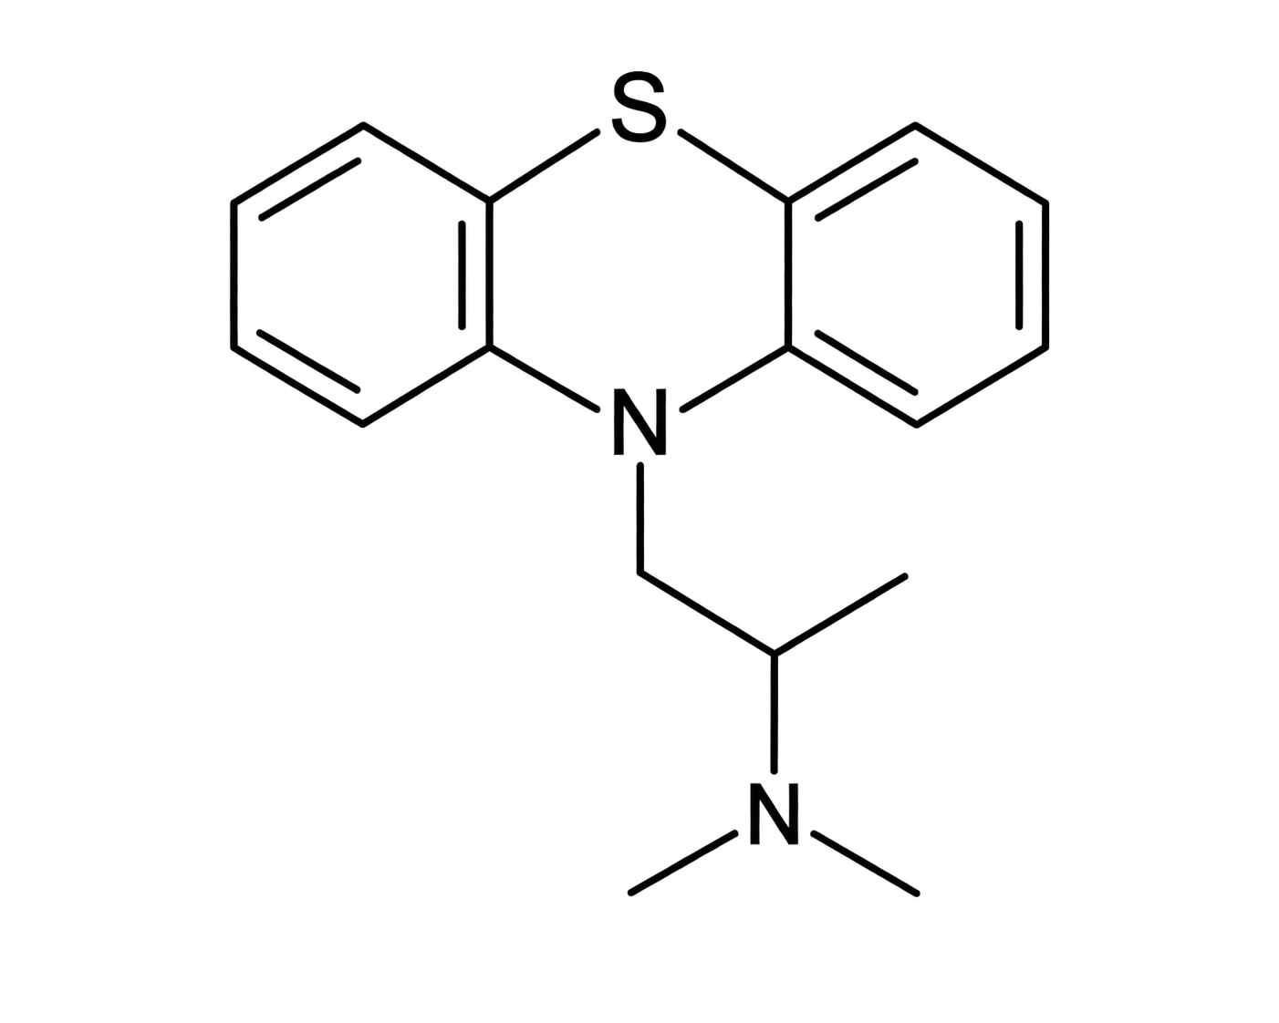
Comparison of Migration Order
Effect of cyclodextrin selector on the migration order of chiral compounds
 | Sotalol | Promethazine
HDAS-α-CD |  | S(-)/R(+)
ODMS-γ-CD |  | R(+)/S(-)
HDAS-β-CD | S(-)/R(+) | R(+)/S(-)
HDMS-β-CD | R(+)/S(-)
γ-CD |  | S(-)/R(+)
β-CD |  | S(-)/R(+)
Changing the cyclodextrin selector can change and even reverse the migration order of the enantiomers.

Slide 14
Conclusion
Cyclodextrins enable enantioseparation by Capillary Electrophoresis
Cyclodextrin-enantiomer interactions produce different effective electrophoretic mobilities, allowing the enantiomers of sotalol and promethazine to be separated.
Cyclodextrin structure strongly influences migration order
Changing the type and substitution of cyclodextrins changed - and even reversed - the migration order of enantiomers.
Chiral interactions affect electrophoretic mobility
Differences in enantiomer-cyclodextrin interaction alter the effective electrophoretic mobility of the enantiomers, resulting in different migration times.
CE with cyclodextrins is a powerful tool for chiral analysis.
By selecting the appropriate cyclodextrin, the separation and migration order of enantiomers can be effectively controlled.

Slide 15
Thank you!

