Slide 1

Ivane Javakhishvili Tbilisi State University - Faculty of Exact and Natural Sciences
Department of Chemistry
Enantioseparation of New Telluronium Complexes Using Reversed- and Normal-Phase High-Performance Liquid Chromatography
4th-year Bachelor's Student at the Department of Chemistry, Tbilisi State University:
Tika Pipia
Supervisor:
Professor Bezhan Chankvetadze, Academician of the Georgian National Academy of Sciences.

Slide 2
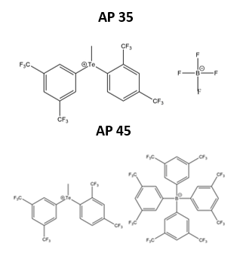
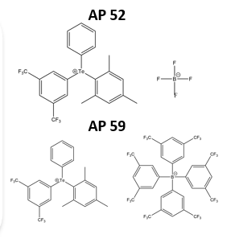
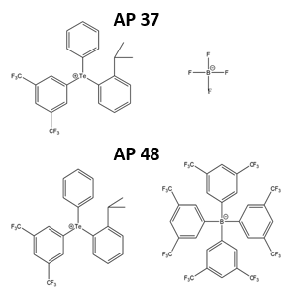
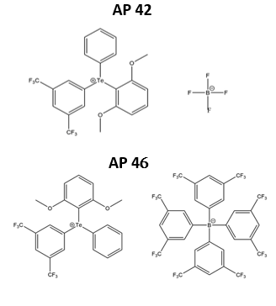
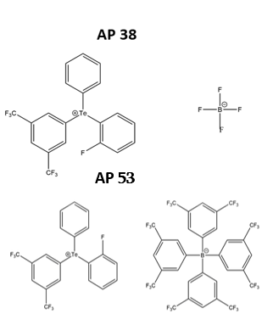
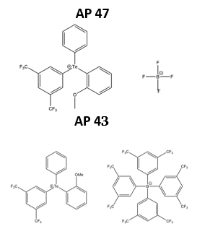
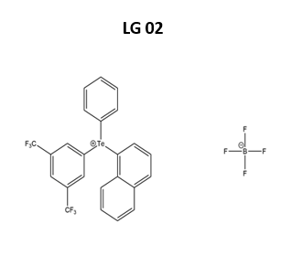
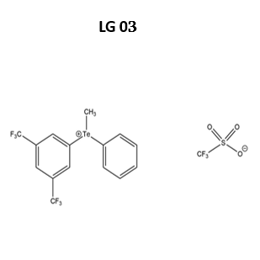
Analytes
AP 43
AP 47
2

Slide 3
Aim and Significance of the Research
Aim:
The aim of the research is to achieve the enantioseparation of telluronium complexes using high-performance liquid chromatography.
Significance:
Chiral telluronium complexes play a vital role in asymmetric synthesis-a chemical process designed to preferentially produce a single enantiomeric form. This asymmetric induction is typically achieved through the employment of chiral catalysts.
3

Slide 4
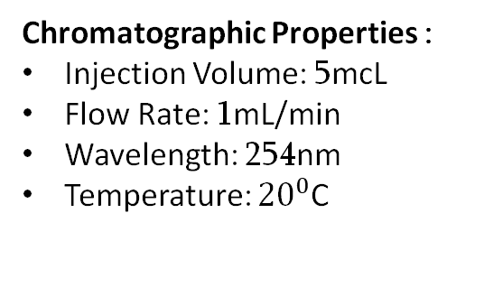
Chromatographic Conditions
Chromatographic Properties :
Injection Volume: 5mcL
Flow Rate: 1mL/min
Wavelength: 254nm
Temperature: ${20}^{0}$C
Mobile Phases:
Hexane/Ethanol (70:30) +0.1% FA
Hexane/Isopropanol (70:30) +0.1% FA
MeOH +0.1% DEA
ACN 5% DI Water +5mMol Ammonium Acetate
Used Chiral Stationary Phases
Lux-Cellulose-1
Lux-Cellulose-2
Lux-Cellulose-3
Lux-Cellulose-4
Lux-i-Cellulose-5
Lux-Amylose-1
4

Slide 5
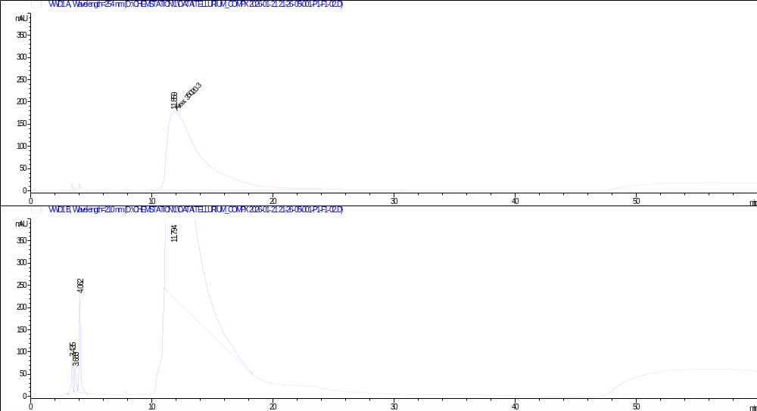
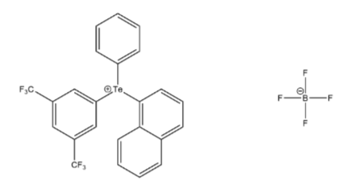
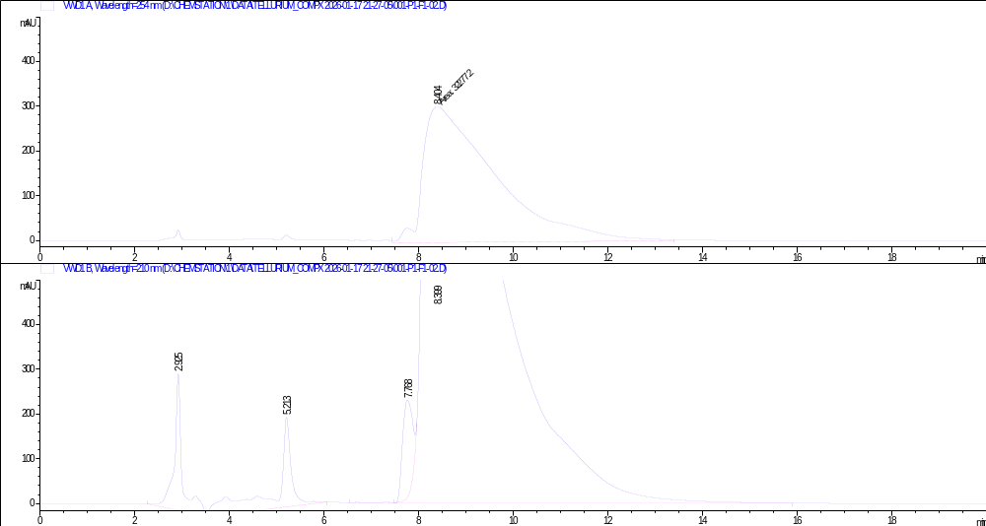
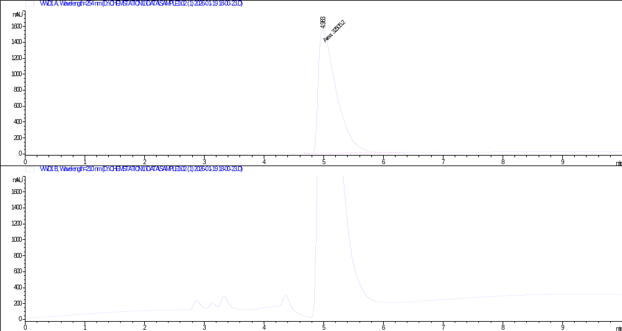
Cellulose-1
When we used Hexane/Ethanol (70:30)​ as the mobile phase, analyse lasted for 80 minutes, but no separation was achived. ​ Similar to the Hexane/EtOH (70:30) system, no separation was achieved when using MeOH with 0.1% DEA or ACN 5% DI Water +5mMol Ammonium Acetate.
Sample Name: 02​
Mobile Phase: Hex/EtOH70/30​
Column: Cellulose-1​
Flow Rate: 1 ml/min​
Wavelength: 254 nm ​
​
Sample Name: 02
Mobile Phase: MeOH +0.1%DEA
Column: Cellulose-1
Flow Rate: 1 ml/min
Wavelength: 254 nm
Sample Name: 02​
Mobile Phase: ACN/Water95/5 + 5mMol Ammonium Acetate​
Column: Cellulose-1​
Flow Rate: 1 ml/min​
Wavelength: 254 nm ​
5

Slide 6
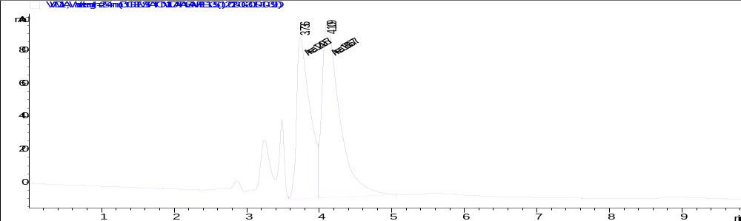
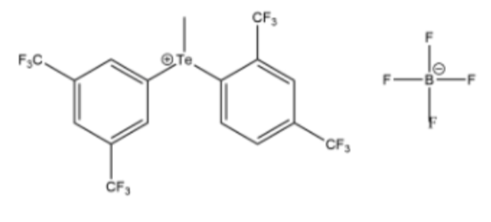
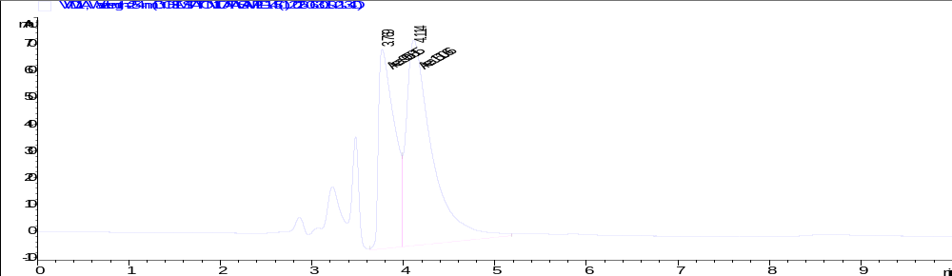
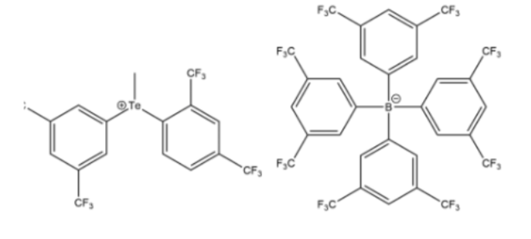
Cellulose-1
After adding 0.1% FA to Hex/EtOH system, separation was achieved for only two out of 14 analytes (sample 35 and sample 45).
Sample Name: 35​
Mobile Phase: Hex/EtOH 70/30​+0.1% FA
Column: Cellulose-1​
Flow Rate: 1 ml/min​
Wavelength: 254 nm ​
Sample Name: 45
Mobile Phase: Hex/EtOH 70/30​+0.1% FA
Column: Cellulose-1​
Flow Rate: 1 ml/min​
Wavelength: 254 nm ​
6

Slide 7
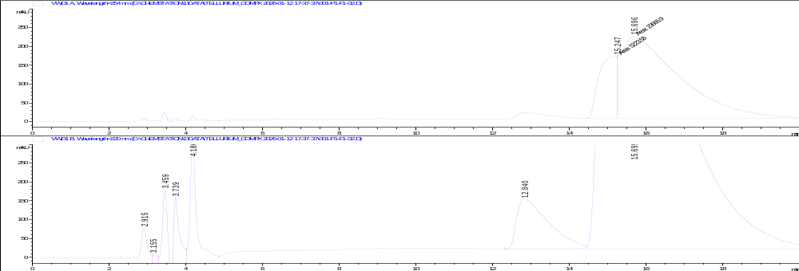
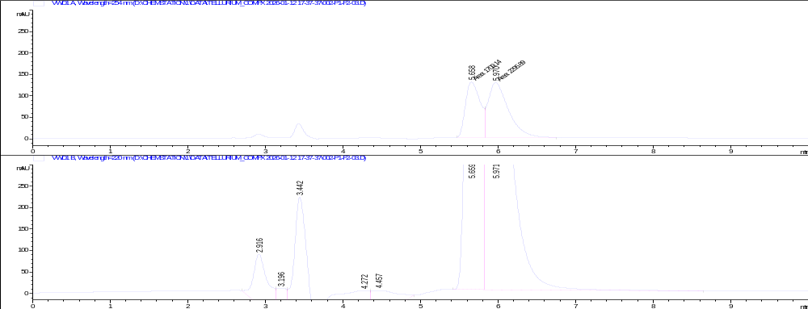
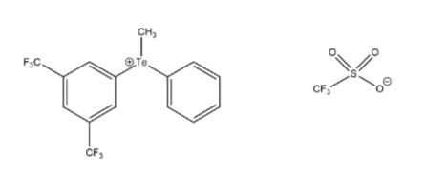
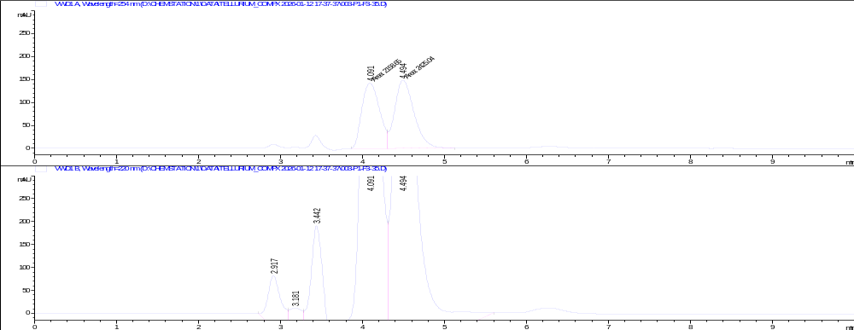
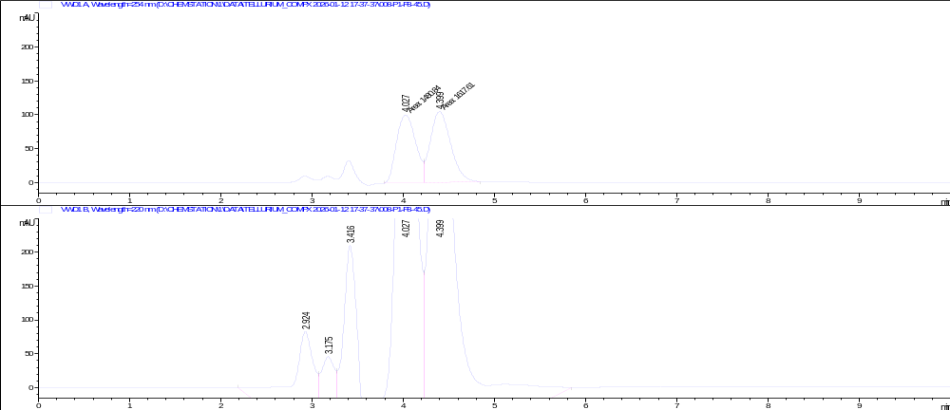
Cellulose-1
Mobile Phase:Hex/IPA70/30 +0.1%FA​​
Sample Name: 02
Mobile Phase: Hex/IPA 70/30)+0.1%FA
Column: Cellulose-1
Flow Rate: 1 ml/min
Wavelength: 254 nm
Sample Name: 03
Mobile Phase: Hex/IPA 70/30)+0.1%FA
Column: Cellulose-1
Flow Rate: 1 ml/min
Wavelength: 254 nm
Sample Name: 35
Mobile Phase: Hex/IPA 70/30)+0.1%FA
Column: Cellulose-1
Flow Rate: 1 ml/min
Wavelength: 254 nm
Sample Name: 45
Mobile Phase: Hex/IPA 70/30)+0.1%FA
Column: Cellulose-1
Flow Rate: 1 ml/min
Wavelength: 254 nm
7

Slide 8
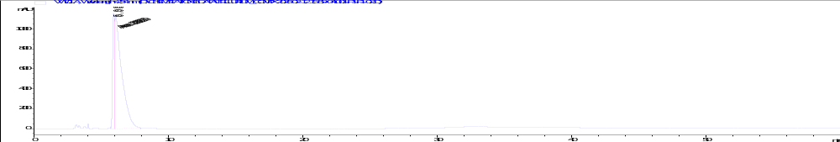
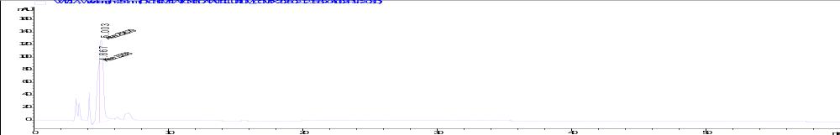
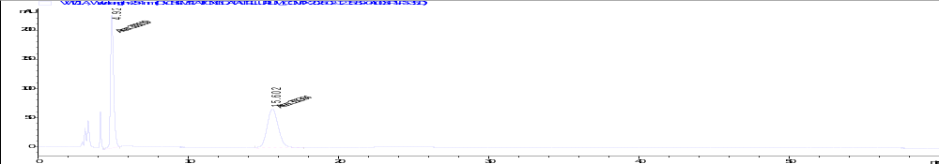
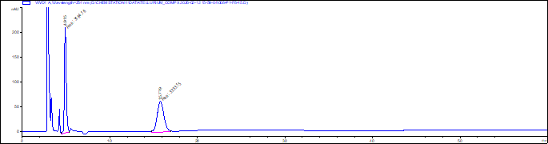
Cellulose-2
In the case of Cellulose-2, separation was achieved using the following mobile phases: ACN/DI water (95:5) + 5 mMol ammonium acetate, Hex/EtOH + 0.1% FA, and Hex/IPA (70:30) + 0.1% FA. Conversely, no separation was observed with MeOH + 0.1% DEA.
Mobile phases: ACN/DI water (95:5) + 5 mMol ammonium acetate
Compound: 02
Compound: 03
Compound: 35
Compound: 45
8

Slide 9
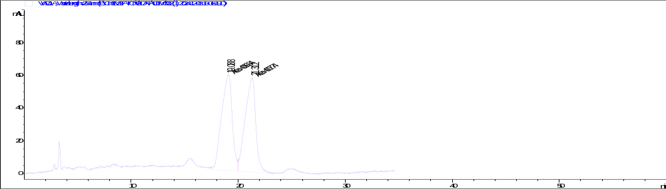
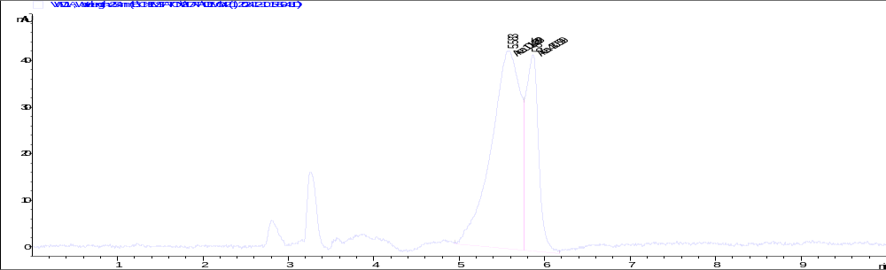
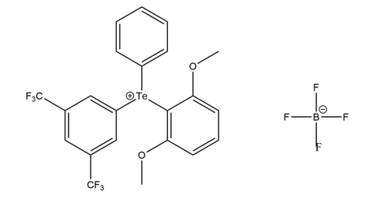
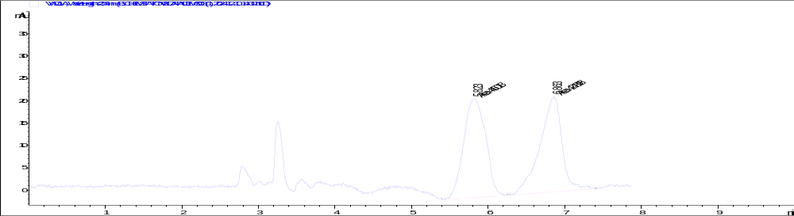
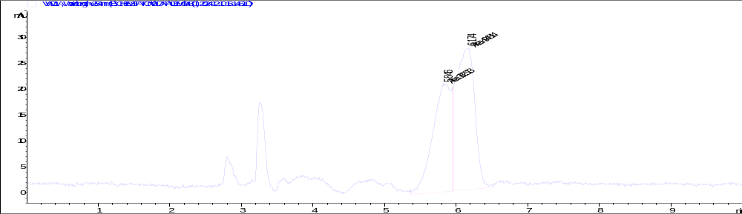

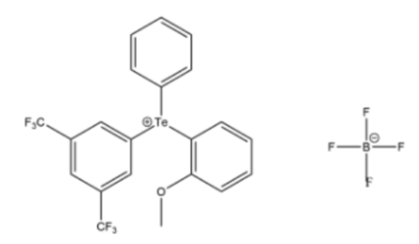
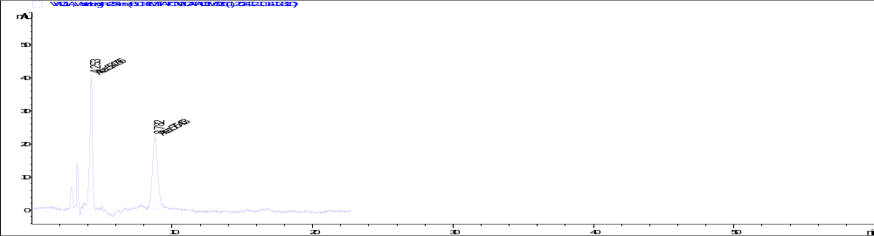
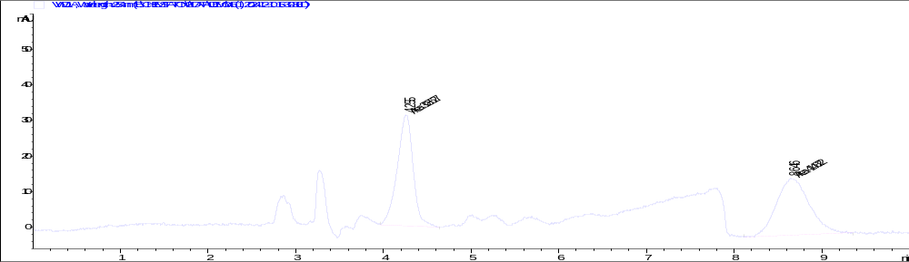
Cellulose-2
Mobile phases: Hex/EtOH70/30 +0.1%FA
Compound: 02
Compound: 42
Compound: 03
Compound: 43
Compound: 35
Compound: 45
9

Slide 10
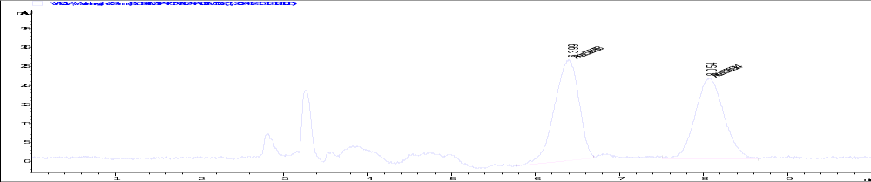
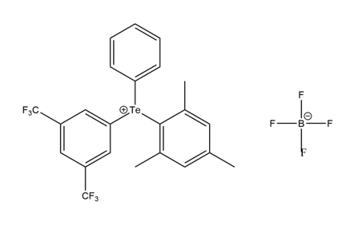
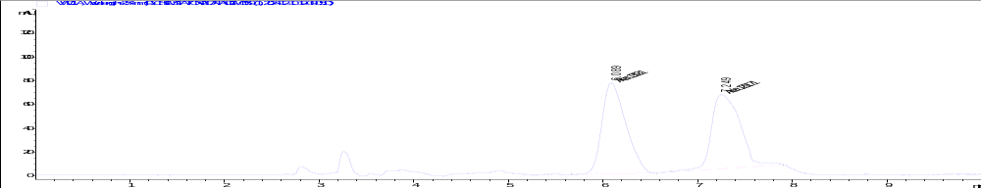
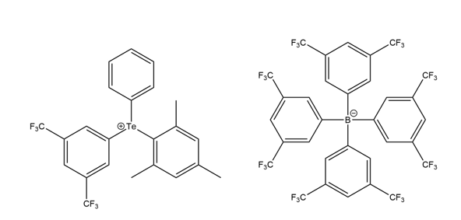
Cellulose-2
Mobile phases: Hex/EtOH70/30 +0.1%FA
Compound: 52
Compound: 59
10

Slide 11
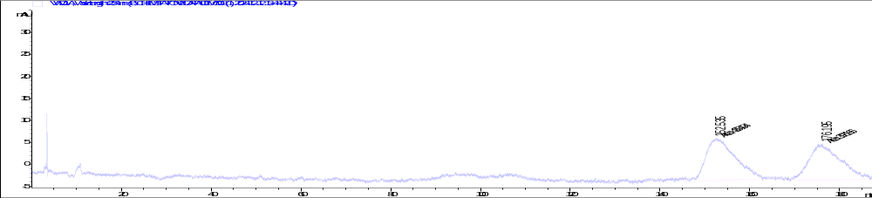
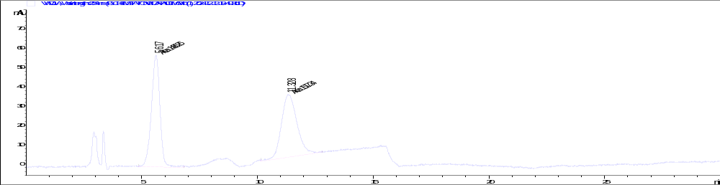
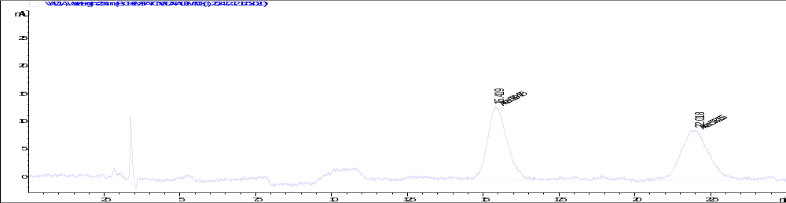
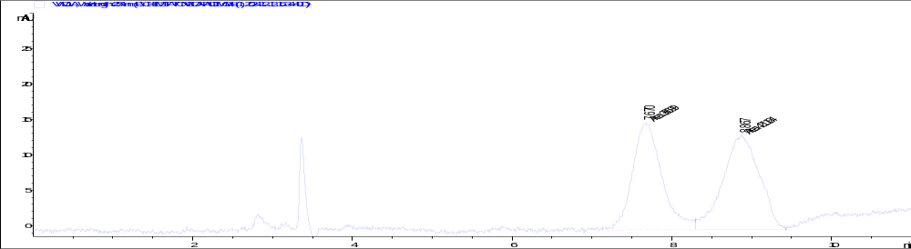
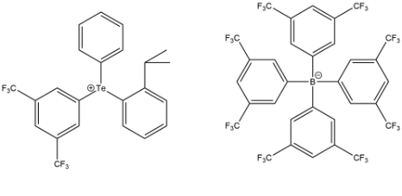
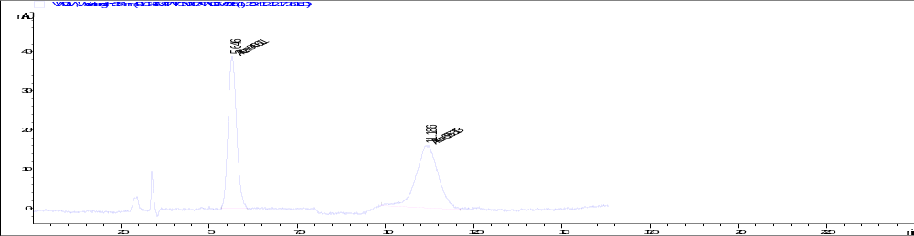
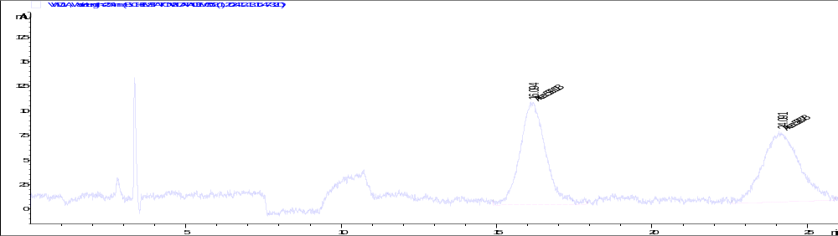
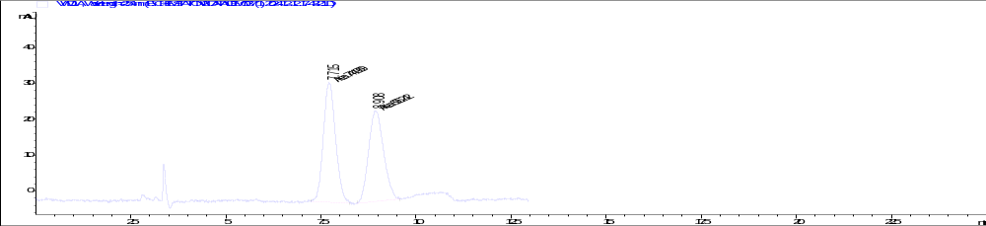
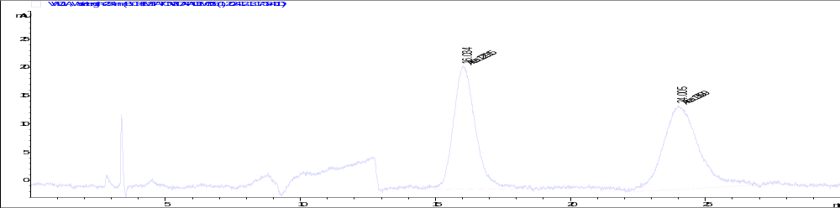
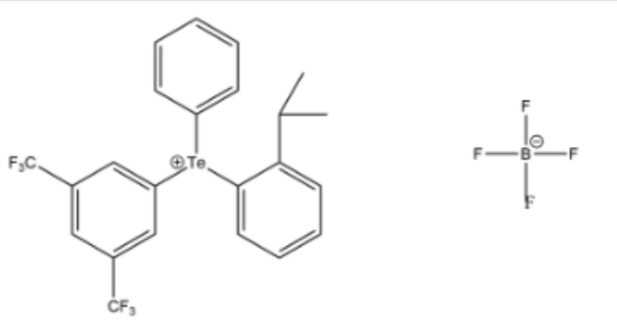
Cellulose-2
Mobile Phase:Hex/IPA70/30 +0.1%FA​
Compound: 02​
Compound: 45
Compound: 03
Compound: 48
Compound: 35
Compound: 52
Compound: 37
Compound: 59
11

Slide 12
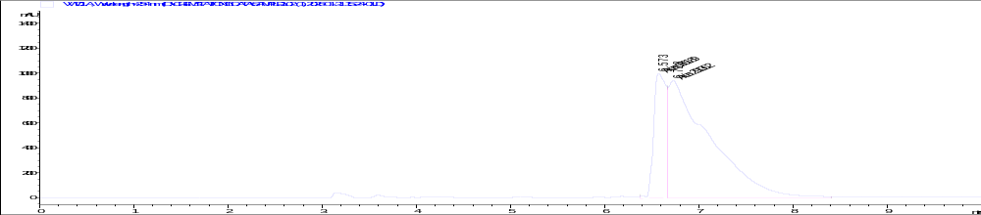
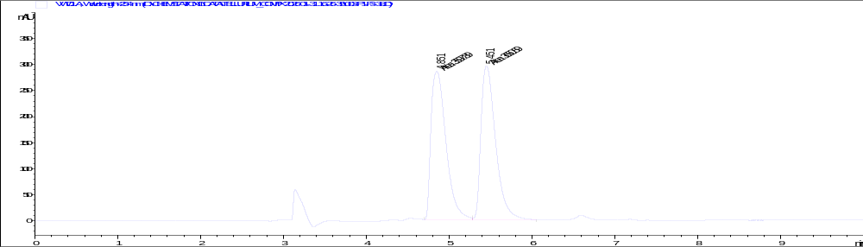









Cellulose-4 Mobile phases: ACN/DI water (95:5) + 5 mMol ammonium acetate
Compound: 02​
Compound: 38​​
Compound: 03​
$α=$1.02
Compound: 45​
Compound: 35​
$α=$1.69
Compound: 48
Compound: 37
$α=$1.69
12

Slide 13




Cellulose-4
Mobile phases: ACN/DI water (95:5) + 5 mMol ammonium acetate ​
Compound: 52
Compound: 53​
Compound: 59
13

Slide 14








Cellulose-4
Mobile Phase:Hex/IPA70/30 +0.1%FA
Compound: 02
Compound: 03
Compound: 35
Compound: 45
Compound: 37
Compound: 48
Compound: 38
Compound: 53
14

Slide 15





Cellulose-4
Mobile Phase:Hex/IPA70/30 +0.1%FA
Compound: 42
Compound: 46
Compound: 52
Compound: 59
ნიმუში: 43
15

Slide 16








Cellulose-4
Mobile phases: Hex/EtOH70/30 +0.1%FA
Compound: 02
Compound: 03
Compound: 35
Compound: 45
Compound: 38
Compound: 53
Compound: 52
Compound: 59
16

Slide 17






i-Cellulose-5
Separation was achieved only when we used Hex/EtOH+0.1% FA and Hex/IPA+0.1% FA phases.
Mobile phases: Hex/EtOH70/30 +0.1%FA​
Mobile Phase:Hex/IPA70/30 +0.1%FA
Compound: 03
α = 1.16
α = 1.07
Compound: 35
α = 1.04
α = 1.11
α = 1.04
Compound: 45
α = 1.08
17

Slide 18









i-Cellulose-5
Separation was achieved only when we used Hex/EtOH+0.1% FA and Hex/IPA+0.1% FA phases.
Mobile phases: Hex/EtOH70/30 +0.1%FA​
Mobile Phase:Hex/IPA70/30 +0.1%FA
Compound: 43
α = 1.28
α = 1.04
α = 1.04
Compound: 47
α = 1.32
Compound: 38
α = 1.05
α = 1.26
Compound: 53
α = 1.22
α = 1.04
18

Slide 19




i-Cellulose-5
Separation was achieved only when we used Hex/EtOH+0.1% FA and Hex/IPA+0.1% FA phases.
Mobile phases: Hex/EtOH70/30 +0.1%FA​
Mobile Phase:Hex/IPA70/30 +0.1%FA
Compound: 52
α = 1.48
α = 1.10
α = 1.10
Compound: 59
α = 1.43
19

Slide 20

In the case of Cellulose-3, no separation was achieved with any of the mobile phases tested. Lux-Amylose-1 was a unique case, as only a single analyte was separated when using Hex/IPA (70:30) + 0.1% FA.
Sample Name: 02
Mobile Phase:Hex/IPA+0.1%FA
Column: Amylose-1
Flow Rate: 1 ml/min
Wavelength: 254 nm
20

Slide 21
Conclusions
A systematic chromatographic screening was carried out using Cellulose and Amylose-based chiral stationary phases in normal- and reversed-phase modes.
The results showed that mobile phase composition and additives strongly influence peak shape and enantioseparation. Additive-free systems gave poor resolution, while 0.1% formic acid significantly improved separation performance.
Overall, normal-phase conditions with formic acid proved to be the most effective for the enantioseparation of the studied tellurium complexes.
21

Slide 22
Thank You!

