Slide 1


ASYMMETRIC SYNTHESIS OF CHIRAL SULFOXIDES BY ENANTIOSELECTIVE OXIDATION OF PROCHIRAL SULFIDES
Gabriel Sarishvili
Senior Student of Chemistry (English) Program, Faculty of Exact and Natural Sciences, Tbilisi State University
Co-Authors: Khatia Tchagalidze, Mariam Sikharulidze
Supervisor: Dr. Rusudan Kakava
Notes:
My name is Gabriel Sarishvili, and today I will present our work entitled "Asymmetric Synthesis of Chiral Sulfoxides by Enantioselective Oxidation of Prochiral Sulfides."
The aim of this project was to investigate how the composition of a titanium–tartrate catalyst affects both enantioselectivity and catalyst stability during the oxidation of 4-nitrothioanisole.

Slide 2
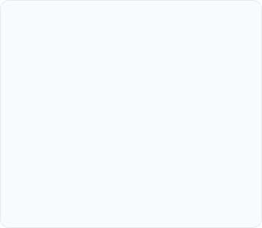


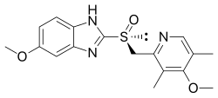
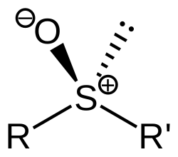
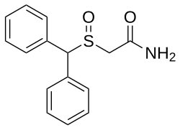
Synthetic and Biological Significance
Pharmaceuticals
Chiral Auxiliaries
Ligand Design
Chiral sulfoxides are key pharmacophores in blockbusters like Esomeprazole and Modafinil.
Widely utilized as versatile building blocks and auxiliaries for stereoselective C-C bond formation.
Emerging roles in asymmetric catalysis as coordinating ligands for various transition metal complexes.
Notes:
Before discussing our work, I'd like to briefly explain why chiral sulfoxides are important.
Sulfoxides contain a stereogenic sulfur atom, meaning they exist as two mirror-image forms called enantiomers. Since biological systems are chiral, these enantiomers often exhibit different biological activities, making enantioselective synthesis highly important.
Chiral sulfoxides are found in several important pharmaceuticals. For example, Esomeprazole, used to treat acid reflux, and Modafinil, a wakefulness-promoting drug, both contain a chiral sulfoxide center.
Beyond medicinal chemistry, they are also widely used as chiral auxiliaries in organic synthesis and have become useful ligands in asymmetric catalysis.
One of the major advances in this field came during the 1980s through the pioneering work of Kagan and Modena, who independently developed titanium–tartrate catalyst systems capable of asymmetric sulfide oxidation.
Our work is based on this classical catalytic system.

Slide 3

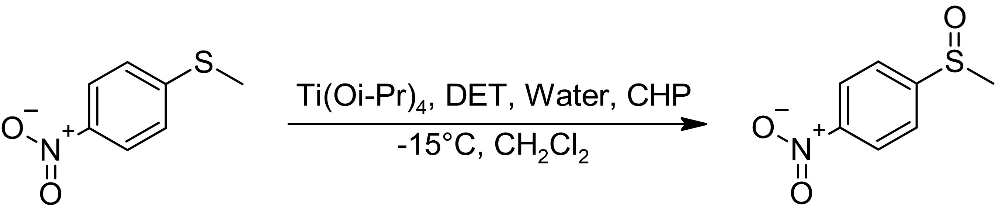
Research Objective
Goals:
Monitor enantiomeric excess throughout the reaction
Investigate catalyst stability
Improve stereochemical performance through catalyst optimization
Oxidation of 4-Nitrothioanisole using Ti:DET catalyst
Notes:
The objective of this project was to investigate the enantioselective oxidation of 4-nitrothioanisole to its corresponding chiral sulfoxide.
Although titanium–tartrate catalysts are well established, their stereoselectivity often decreases during the course of the reaction.
Therefore, our goals were threefold.
First, to monitor how the enantiomeric excess changes throughout the reaction.
Second, to investigate the possible cause of catalyst deterioration.
And finally, to improve catalyst performance through optimization.

Slide 4
Experimental Design
Reaction Conditions
Chiral HPLC analysis
Parameter | Condition
Catalyst | Ti(OiPr)₄
Chiral Ligand | DET
Oxidant | Cumene Hydroperoxide
Solvent | Dichloromethane
Temperature | −15 °C
Reaction Time | 5–6 h
Parameter | Condition
Column | Cellulose-4
Mobile Phase | Methanol
Flow Rate | 1 mL/min
Detection | 254 nm
Catalyst Systems Studied
Ti : DET | 1.0 : 2.5
Ti : DET | 1.0 : 4.0
Notes:
All reactions were performed using titanium isopropoxide as the catalyst precursor and diethyl tartrate as the chiral ligand.
Cumene hydroperoxide served as the oxidant, while dichloromethane was used as the solvent.
The reactions were carried out at minus fifteen degrees Celsius and monitored for approximately five to six hours.
To determine the enantiomeric composition, aliquots were withdrawn at regular intervals and analyzed by chiral HPLC using a Cellulose-4 column with methanol as the mobile phase.
We compared two catalyst systems that differed only in the titanium-to-diethyl tartrate ratio.
The first system used a ratio of 1 to 2.5, while the optimized system used a ratio of 1 to 4.

Slide 5
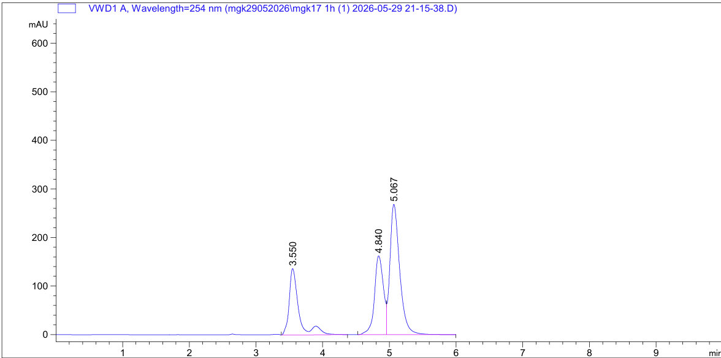
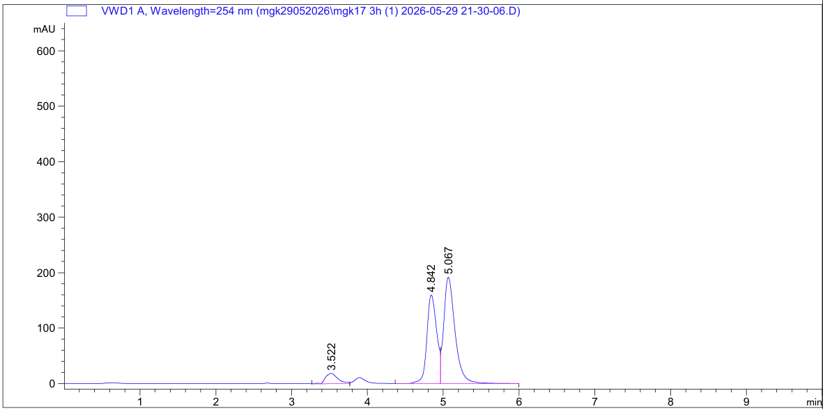
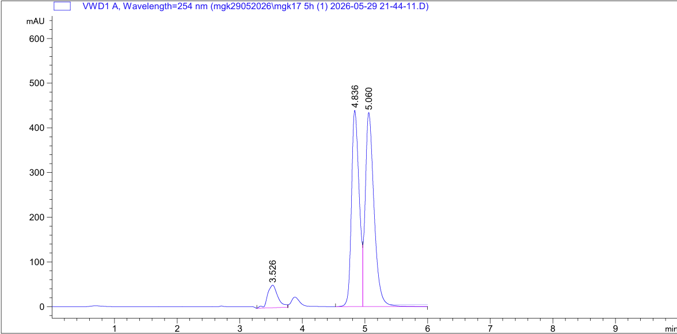
Initial Catalyst System
1 Hour
1 Ti : 2.5 DET system
Initial stereoselectivity is moderate
ee decreases continuously
Product approaches racemic composition at longer reaction times
3 Hour
Time (h) | ee (%)
1 | 29
2 | 29
3 | 16
5 | 6
5 Hour
Notes:
Let's first examine the results obtained with the original catalyst system.
After one hour, the reaction reached an enantiomeric excess of approximately 29 percent.
However, instead of remaining constant, the enantiomeric excess continuously decreased as the reaction progressed.
After three hours, it had fallen to about 16 percent, and after five hours only 6 percent ee remained.
The chromatograms shown below illustrate this trend very clearly.
At one hour, one enantiomer is clearly favored.
However, after five hours, the two peaks become much more similar in size, indicating that the product is approaching a racemic composition.
These observations suggested that the catalyst gradually loses its ability to maintain stereochemical control during the reaction.

Slide 6
Proposed Explanation
Ti(OiPr) + DET
Active Chiral Titanium Complex
Release of isopropanol
Reduced Enantioselectivity
Loss of Chiral Environment
Ligand Exchange at Titanium Center
We hypothesized that isopropanol generated during catalyst formation gradually disrupts the active chiral titanium species.
Notes:
To explain this behavior, we considered the catalyst formation process.
When titanium isopropoxide reacts with diethyl tartrate, isopropanol is released as a by-product.
We hypothesized that this liberated isopropanol may compete with the tartrate ligand for coordination to the titanium center.
If ligand exchange occurs, the active chiral titanium complex gradually becomes disrupted.
Since the catalyst relies on this well-organized chiral environment to induce asymmetry, any disruption would reduce its stereochemical performance.
As a result, the catalyst gradually loses its ability to preferentially form one enantiomer, leading to the decrease in enantiomeric excess that we observed experimentally.
Although we did not directly verify this mechanism, it provides a reasonable explanation for our results.

Slide 7
Optimization Strategy
Mass Action Shield: Increasing DET stoichiometry from 2.5 to 4.0 equivalents to outcompete isopropanol.
Coordination Stability: Excess tartrate prevents liberated alcohol from disrupting the chiral pocket.
Extended Aging: A 1-hour catalyst aging step ensures maximum formation of the selective dimeric complex.
Purity Preservation: High ligand density maintains enantiomeric purity throughout the reaction window.
Notes:
Based on this hypothesis, we developed a simple optimization strategy.
If ligand exchange is responsible for catalyst deterioration, then increasing the concentration of diethyl tartrate should help preserve the active titanium complex through the principle of mass action.
Therefore, we increased the titanium-to-DET ratio from 1 to 2.5 to 1 to 4.
Our expectation was that excess ligand would outcompete isopropanol for coordination to titanium, stabilize the catalyst, and maintain stereochemical control throughout the reaction.

Slide 8
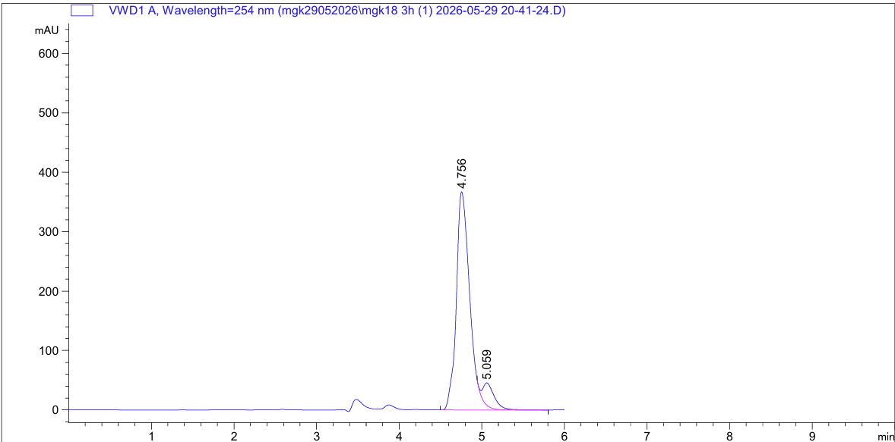
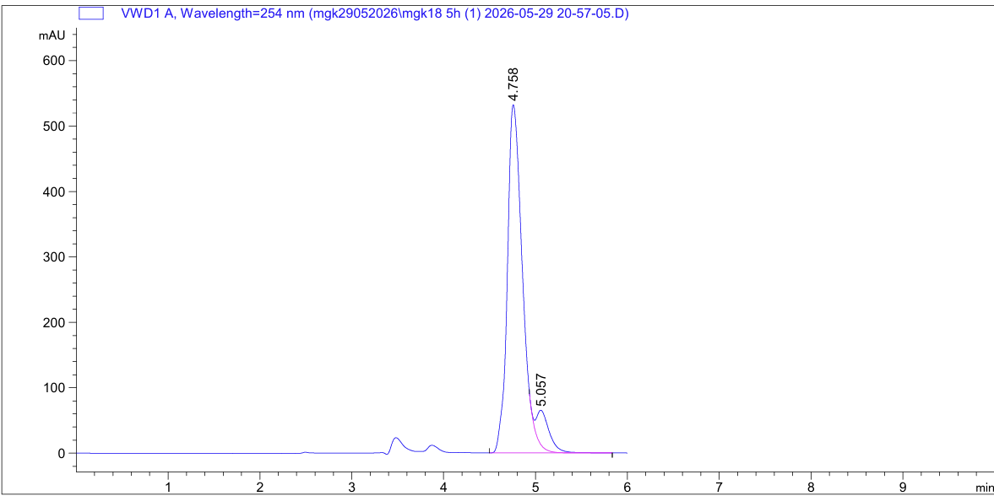
Optimized Catalyst
3 Hour
1.0 Ti : 4.0 DET System
High enantiomeric excess achieved
No significant loss of stereocontrol
Catalyst remains active throughout reaction
Time | ee (%)
1 h | 84
2 h | 83
3 h | 83
4 h | 84
5 h | 84
5 Hour
Notes:
The optimized catalyst system produced the expected outcome.
After only one hour, the reaction already reached approximately 84 percent enantiomeric excess.
More importantly, this value remained essentially unchanged throughout the entire reaction.
Measurements collected after two, three, four, and five hours all remained between approximately 83 and 84 percent ee.
The chromatograms shown here clearly demonstrate this stability.
Unlike the previous catalyst system, the major and minor peaks remain highly unequal throughout the reaction, indicating that stereochemical control is maintained.
These results strongly suggest that increasing the concentration of diethyl tartrate successfully stabilized the active catalyst species.
To further confirm that stereochemical induction originated from the catalyst system itself, the optimized reaction was done using the opposite enantiomer of diethyl tartrate.
As expected, the configuration of the product was inverted while maintaining nearly identical enantiomeric purity.
This confirms that the chirality of the product is directly controlled by the chiral ligand.

Slide 9
Optimized Catalyst
Time | 1:2.5 % ee | 1:4 % ee
1 h | 29 | 84
2 h | 29 | 83
3 h | 16 | 83
5 h | 6 | 84
Key Finding: Increasing DET concentration dramatically improves both initial enantioselectivity and long-term catalyst stability.
Notes:
This slide directly compares the performance of the two catalyst systems.
The original catalyst system not only produced relatively low initial enantioselectivity, but also continuously lost stereochemical control as the reaction progressed.
In contrast, the optimized catalyst produced significantly higher enantiomeric excess and maintained it throughout the entire reaction.
Overall, increasing the concentration of diethyl tartrate dramatically improved both the initial enantioselectivity and the long-term stability of the catalyst.
These results support our hypothesis that ligand concentration plays a critical role in preserving catalyst performance.

Slide 10
Conclusions
✓ Enantioselective oxidation of 4-nitrothioanisole was successfully achieved.
✓ The standard Ti:DET = 1:2.5 catalyst system exhibited progressive loss of enantioselectivity.
✓ ee decreased from approximately 29% to 6% over the reaction period.
✓ Increasing DET concentration to a Ti:DET ratio of 1:4.0 prevented catalyst deterioration.
✓ The optimized catalyst maintained approximately 84% ee throughout the reaction.
✓ Ligand concentration plays a critical role in preserving catalyst stereochemical performance.
Future Work
Investigation of additional sulfide substrates
Further catalyst optimization
Mechanistic studies of titanium–ligand exchange processes
Explore other catalysts
Notes:
To conclude, we successfully achieved the enantioselective oxidation of 4-nitrothioanisole using a titanium–tartrate catalyst system.
The original catalyst exhibited a progressive decrease in enantiomeric excess during the reaction, indicating a gradual loss of stereochemical control.
We proposed that ligand exchange involving isopropanol generated during catalyst formation may contribute to catalyst deterioration.
By increasing the titanium-to-diethyl tartrate ratio from 1 to 2.5 to 1 to 4, we achieved both significantly higher enantioselectivity and greatly improved catalyst stability.
The optimized catalyst maintained approximately 84 percent enantiomeric excess throughout the reaction.
In the future, we plan to investigate additional sulfide substrates, further optimize the catalyst system, explore other catalytic systems, and gain a deeper understanding of the mechanism responsible for catalyst stabilization.

Slide 11
Questions?

Slide 12
References
Pitchen, P.; Deshmukh, M. N.; Dunach, E.; Kagan, H. B. An Efficient Asymmetric Oxidation of Sulfides to Sulfoxides. J. Am. Chem. Soc. 1984, 106 (26), 8188–8193.
Kagan, H. B. Asymmetric Synthesis of Chiral Sulfoxides. Tetrahedron 2001, 57, 2449–2468
Di Furia, F.; Modena, G.; Seraglia, R. Synthesis of Chiral Sulfoxides by Asymmetric Oxidation of Sulfides. Synthesis 1984, 1984 (04), 325–326.
Zhao, S. H.; Samuel, O.; Kagan, H. B. Asymmetric Oxidation of Sulfides Mediated by a Chiral Titanium Complex: Enantioselective Oxidation of Aryl Methyl Sulfides. Org. Synth. 1989, 68, 49–55.
Chankvetadze, B. Contemporary Polysaccharide-Based Chiral Stationary Phases for High-Performance Liquid Chromatography: A Enantioselective Review on Cellulose-4 Matrices. J. Chromatogr. A 2012, 1269, 26–47.
Lindberg, P.; Brändström, A.; Wallmark, B.; Mattsson, H.; Rikner, L.; Hoffmann, K. J. Omeprazole: The First Proton Pump Inhibitor. Med. Res. Rev. 1990, 10 (1), 1–54.

