Slide 1

GGSB 2026
A Student and Collaboration Workshop
September 10, 2026, Tbilisi, Georgia
Enantioselective analysis of 4-methylmethcathinone and its phase I metabolites using capillary electrophoresis-tandem mass spectrometry (CE-MSMS)
Nutsa Shermadini
Faculty of Exact and Natural Sciences
Ivane Javakhishvili Tbilisi State University
Supervisor: Prof. Bejan Chankvetadze

Slide 2
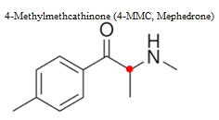

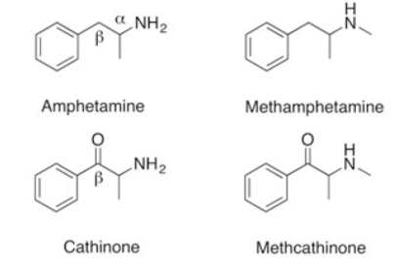

What is 4-MMC?
4-Methylmethcathinone (4-MMC), also known as mephedrone, is a popular synthetic central nervous system stimulant and belongs to the group of New Psychoactive Substances (NPS).
Synthesis of 4-MMC was first reported in 1929 by Sam de Burnaga Sanchez in Bulletin de la Société Chimique de France under the name “toluyl alpha-monomethylaminoethyl ketone.” It subsequently emerged on the recreational drug market in the early 2000s and gained widespread popularity between 2006 and 2010.
Its structural origins can be traced to nature, specifically to the khat plant (Catha edulis), whose leaves have been chewed for centuries due to their content of the naturally occurring alkaloid cathinone.

Slide 3
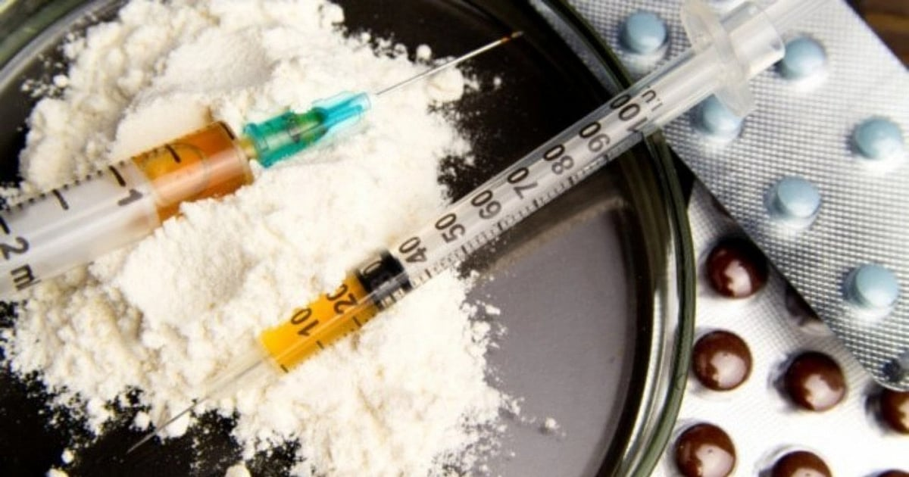
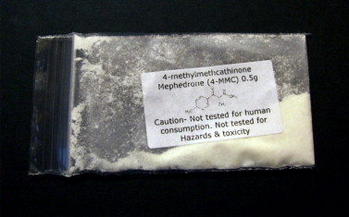
Effects of 4-MMC on Humans
Psychoactive Effects:
Potent stimulant and empathogen (MDMA-/cocaine-like profile)
Euphoria and mood elevation
Increased energy and alertness
Enhanced sociability and talkativeness
Physiological Effects
Tachycardia (↑ heart rate)
Hypertension (↑ blood pressure)
Mydriasis (pupil dilation)
Appetite suppression
Toxicity and Adverse Effects:
Anxiety and paranoia
Hallucinations (high doses)
Hyperthermia
Seizures
High abuse and dependence potential
At low doses, 4-MMC, commonly associated with so-called “bath salts,” induces characteristic stimulant-like effects such as increased energy, mood elevation, and euphoria.

Slide 4
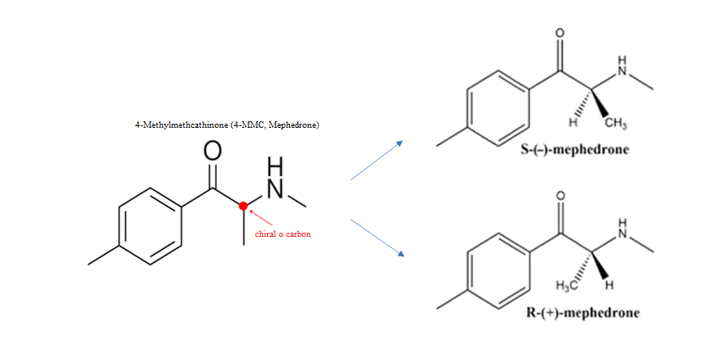
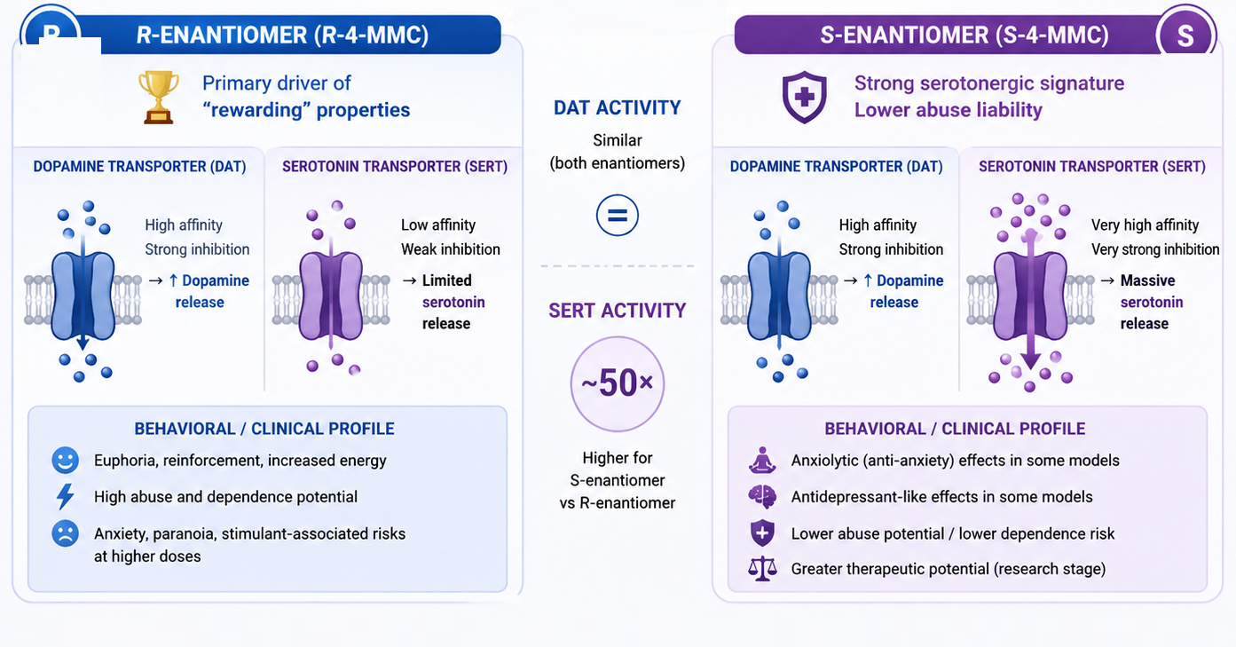
Enantiomers
After entering the body, the two forms exhibit different pharmacokinetic profiles, including differences in bioavailability, metabolic rate, and toxicity.
R-Enantiomer
S-Enantiomer

Slide 5
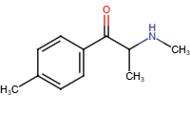
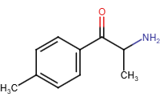
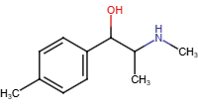
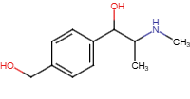
Phase I Metabolism
When a person consumes Mephedrone, the liver's cytochrome P450 enzymes immediately go to work to make the molecule more water-soluble so the body can excrete it. This is Phase I Metabolism.
4-MMC undergoes three main chemical transformations during Phase I metabolism:
1. N-Demethylation (The Primary Pathway) (Nor-MEPH): The liver removes a methyl group (-CH₃) from the nitrogen atom of the mephedrone molecule. Crucially, nor-mephedrone still retains the original chiral center.
2. Keto-Reduction: The ketone group (C=O) on the beta-carbon is reduced to a hydroxyl group (-OH), turning the molecule into an alcohol. Brand-new second chiral center is created. (Dihydro-MEPH)
3. Tolyl-Hydroxylation: A hydrogen atom on the methyl group attached to the benzene ring is replaced by a hydroxyl group (-OH).

Slide 6
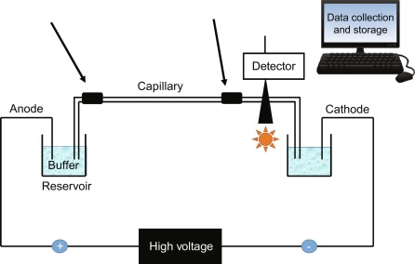
Purpose of the study and method used
Capillary Electrophoresis-Tandem Mass Spectrometry (CE-MS/MS)
Capillary Electrophoresis (CE): Substances are separated according to their mobility under the influence of an electric field.
Different substances have different migration velocities; therefore, they reach the detector through the capillary at different times, resulting in separation. This allows us to differentiate between substances that are chemically similar but possess different sizes or charges.
Tandem Mass Spectrometry (MS/MS): After the electrophoresis separates the components in space, they enter the mass spectrometer, which detects them based on their mass-to-charge ratio (m/z).

Slide 7
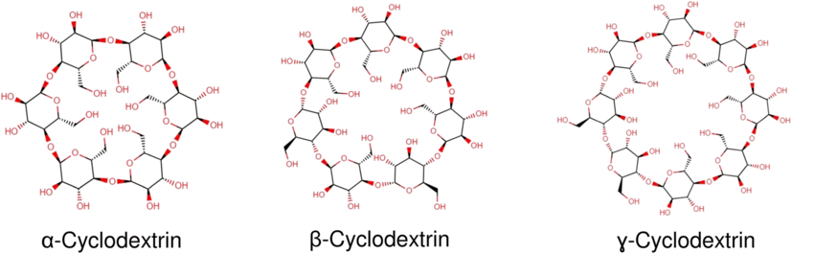
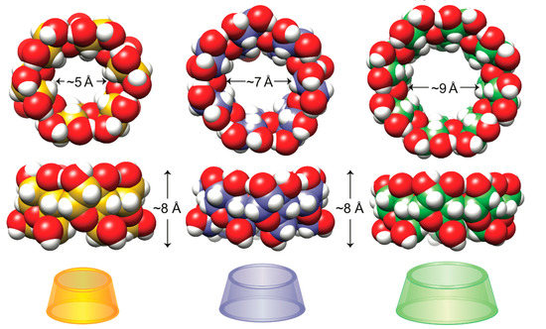
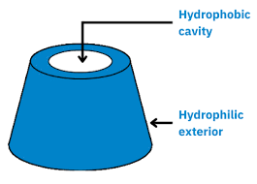
Purpose of the study and method used
Cyclodextrins
What is Cyclodextrin (CD)? Cyclodextrins are cyclic oligosaccharides composed of D-glucopyranose units. They possess a hydrophobic inner cavity and a hydrophilic outer surface.
Complex Formation (Host-Guest): Chiral molecules (the "guest") enter the cyclodextrin cavity (the "host") and form temporary complexes.
Separation Mechanism: Due to their differing geometries, the R- and S-enantiomers fit differently into the cyclodextrin cavity. Consequently, one enantiomer forms a more stable complex and migrates through the capillary more slowly than the other. This difference enables their complete chiral separation.

Slide 8
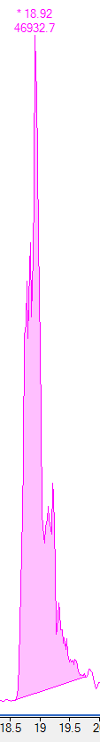

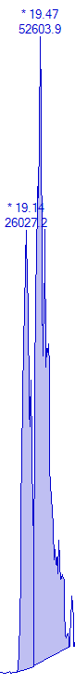
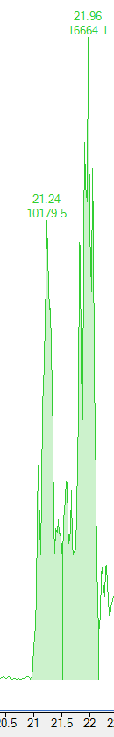
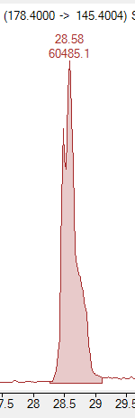
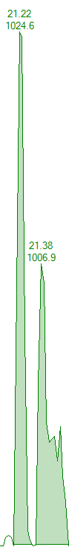

Experimental Part
20 % Filling 0.125 mg/ml
10 % Filling 0.25 mg/ml
20 % Filling 0.25 mg/ml
40 % Filling 0.25 mg/ml
Intensity
Intensity
Intensity
Intensity
Analysis of mephedrone (4-MMC) standard under different capillary filling and concentration conditions using HS-β-CD, 20 mM ammonium formate pH 2.23, 30 kV. Sheath liquid flow rate 0.5 mL/min.
ც
80 % Filling 0.25 mg/ml
ც
60 % Filling 0.25 mg/ml
10 % Filling 0.5 mg/ml
a
b
c
d
Acquisition time (min)
Acquisition time (min)
Acquisition time (min)
Acquisition time (min)
For the partial capillary filling modes of 10%, 20%, and 40%, the corresponding mass spectrometric signal of 4-MMC (m/z 178.4000 -> 145.4004) was characterized by an unstable baseline, peak tailing, and insufficient resolution (see Fig. a–d).
Intensity
Intensity
Intensity
In the next stage, increasing the capillary filling to 60% and 80% showed a trend toward improved resolution (see Fig. e–g),
e
f
g
Acquisition time (min)
Acquisition time (min)
Acquisition time (min)

Slide 9
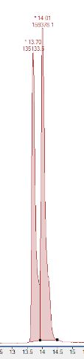

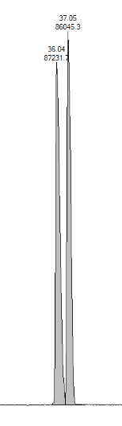
Experimental Part
40 % Filling 6 mg /ml
80 % Filling 6 mg /ml
80 % Filling 6 mg/ml
The flexible sulfobutylether side chains and moderate negative charge of sulfobutylether-β-cyclodextrin (SBE-β-CD) provide optimal host–guest type interaction.
Intensity
Intensity
Intensity
Fig. 3 Analysis of mephedrone (4-MMC) standard under different capillary filling and concentration conditions using SBE-β-CD, 20 mM ammonium formate (a, b: pH 2.1; c: pH 2.3), 30 kV, varying the sheath liquid flow rate (0.6 mL/min)
a
b
c
Acquisition time (min)
Acquisition time (min)
Acquisition time (min)

Slide 10
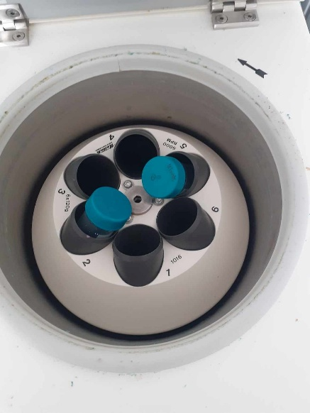
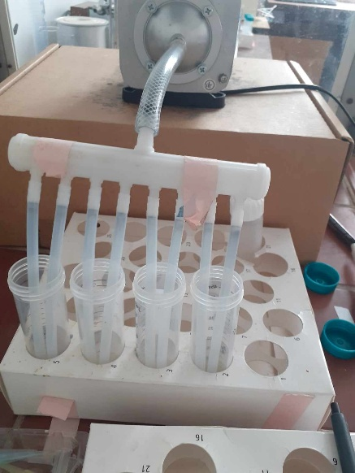
Experimental Part
Sample volume: 100 µL saliva /
500 µL urine
2 µL ammonium hydroxide NH4OH
3 mL of extractant: chloroform/ethyl acetate mixture (9:1)
100 µL acidified methanol (1% HCl)
Transfer of the extracted sample to a clean vial/container
Centrifuge at 3,500 RPM for 10 minutes
Vortex for 5 minutes
Evaporate to dryness under a stream of air, then dissolve in 100 µL of methanol
Transfer to vials, evaporate to dryness, and dissolve in the buffer
10

Slide 11
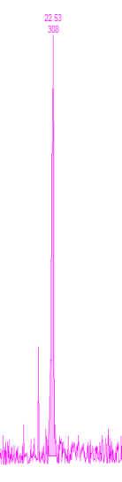
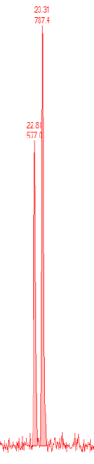
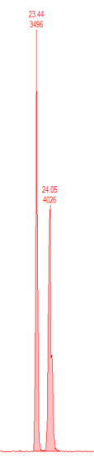

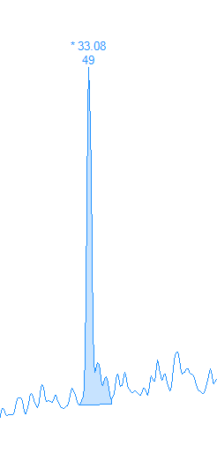
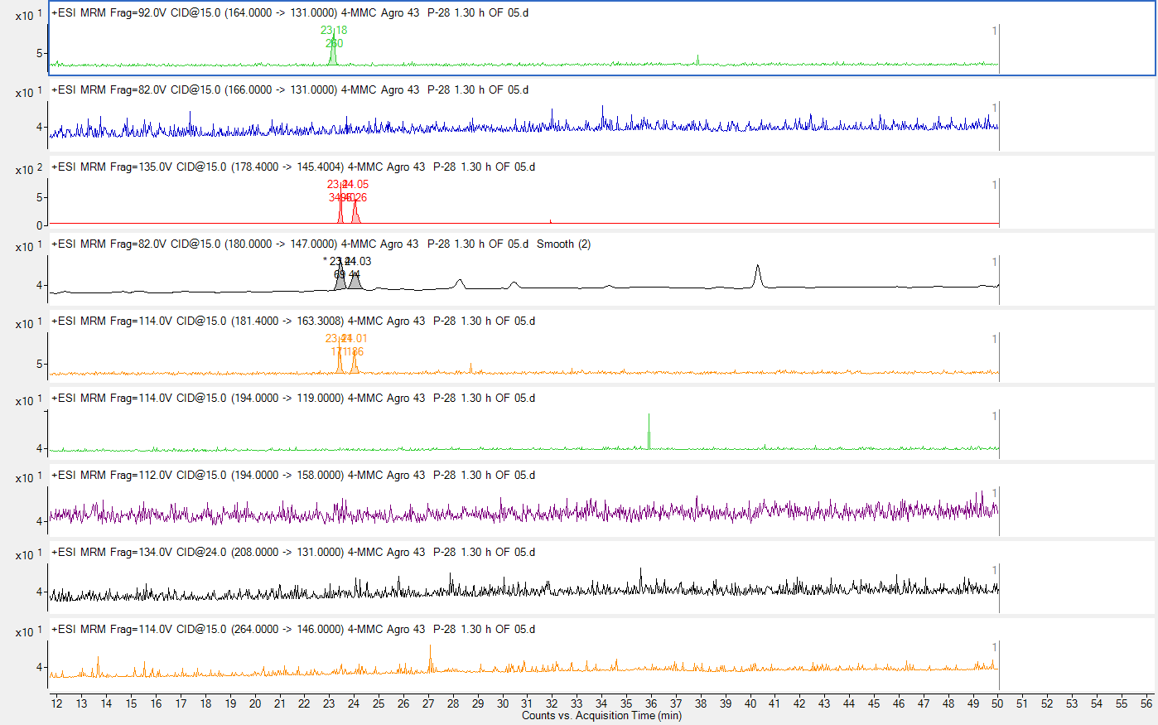
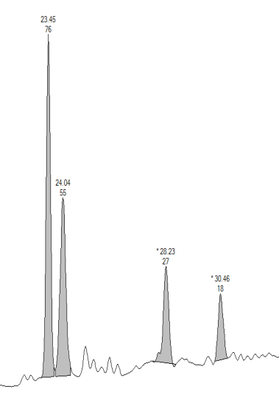
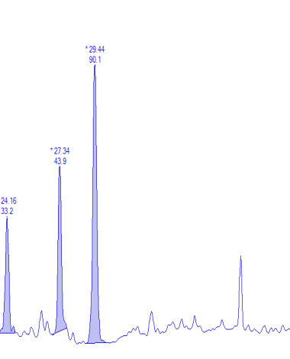
Experimental Part
OF P27 (after 1.5 h)
OF P28 (after 1.5 h)
Nor-MEPH
4-MMC
Dihydro-MEPH
M2
4-MMC
Nor-MEPH
Dihydro-MEPH
M2
Intensity
Intensity
Intensity
Intensity
Intensity
Intensity
Intensity
Intensity
Acquisition time (min)
Acquisition time (min)
Acquisition time (min)
Acquisition time (min)
Acquisition time (min)
Acquisition time (min)
Acquisition time (min)
Acquisition time (min)
Fig. 4chromatogramsof mephedrone (4-MMC) and its Phase I metabolites in an authentic oral fluid sample. Extraction was performed using an optimized LLE method in an alkaline NH₄OH medium (chloroform/ethyl acetate 9:1 v/v). SBE-β-CD 3 mg, 80% capillary filling, 20 mM ammonium formate, pH 2.3. Identification of the parent compound and major metabolic products via corresponding mass spectrometric MRM transitions is shown.
11

Slide 12
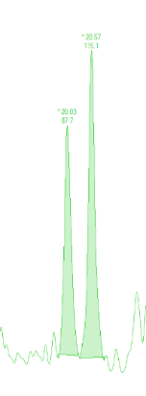
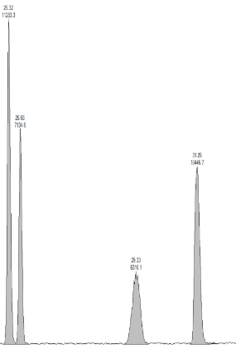

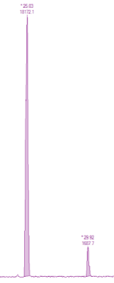

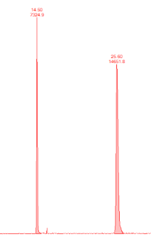


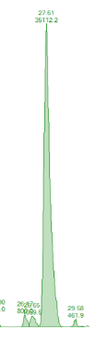

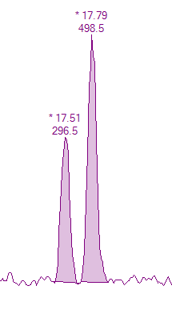

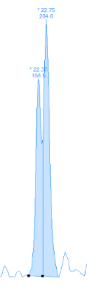
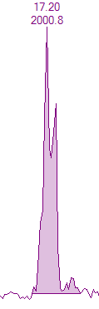



Experimental Part
Urine Sample 4185
Nor-MEPH
Nor-MEPH-OH
4-MMC
M6
Dihydro-MEPH
Intensity
Intensity
Intensity
Intensity
Intensity
Nor- MEPH
Nor- MEPH -OH
4-MMC
Dihydro-4-MMC
Acquisition time (min)
Acquisition time (min)
Acquisition time (min)
Acquisition time (min)
Acquisition time (min)
M2
4-COOH-4-MMC
Succ.-Nor-MEPH
Intensity
Intensity
Intensity
Intensity
Intensity
Intensity
Intensity
Acquisition time (min)
Acquisition time (min)
Acquisition time (min)
Acquisition time (min)
M6
M2
4-COOH-4MMC
M21
Succ.-Nor- MEPH
Acquisition time (min)
Acquisition time (min)
Acquisition time (min)
Fig. 5 chromatograms of mephedrone (4-MMC) and its Phase I metabolites in a urine sample (Urine Sample 4185). Extraction was performed using an optimized LLE method in an alkaline NH₄OH medium (chloroform/ethyl acetate 9:1 v/v). SBE-β-CD 3 mg, 80% capillary filling, 20 mM ammonium formate, pH 2.3.
Intensity
Intensity
Intensity
Intensity
Intensity
Acquisition time (min)
Acquisition time (min)
Acquisition time (min)
Acquisition time (min)
Acquisition time (min)
Fig. 6 6 mg, 50% capillary filling, 20 mM ammonium formate, pH 2.3.
12

Slide 13
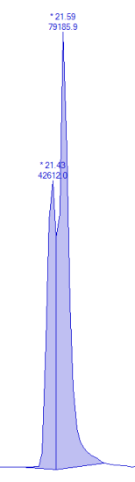
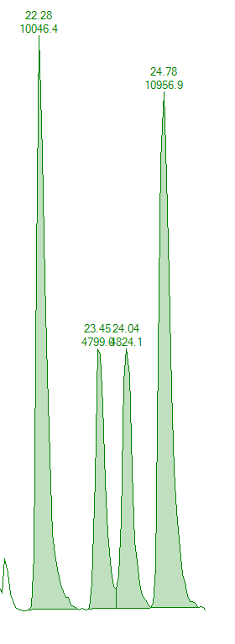
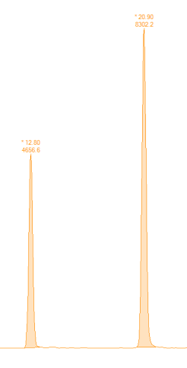
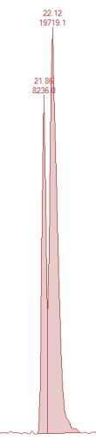
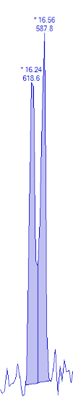

Experimental Part
Urine Sample 4185
Nor-4-MMC
Nor-4-MMC-OH
4-MMC
Dihydro-4-MMC
M6
4-COOH-4MMC
Fig. 7 Chromatograms of mephedrone (4-MMC) and its Phase I metabolites in a urine sample (Urine Sample 4185). Extraction was performed using an optimized LLE method in an alkaline NH₄OH medium (chloroform/ethyl acetate 9:1 v/v). SBE-β-CD 3 mg, 50% capillary filling, 20 mM ammonium formate, pH 2.3.
13

Slide 14
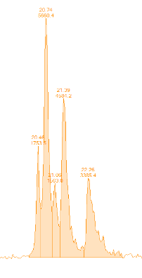






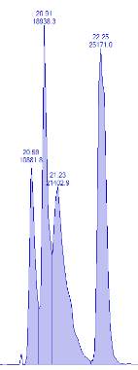
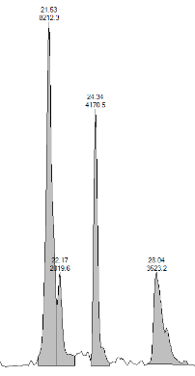




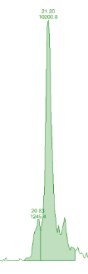
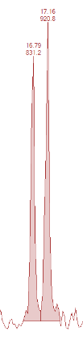

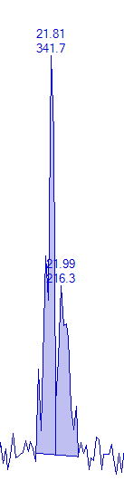

Experimental Part
Urine Sample 4185
Sulfotransferase (SULT) metabolism occurring in the organism.
Nor-4-MMC-OH
4-MMC
Dihydro-4-MMC
Demeth-Hydroxy-suflate
Nor-4-MMC
Nor-4-MMC-OH
4-MMC
Dihydro-4-MMC
Demeth-Hydroxy-suflate
Intensity
M6
M2
4-COOH-4MMC
Succinic-Nor-MMC
Reduced-demeth-hydroxy-sulfate
Intensity
M2
4-COOH-4MMC
Succinic-Nor-MMC
Reduced-demeth-hydroxy-sulfate
Acquisition time (min)
Fig. 7 Chromatograms of mephedrone (4-MMC) and its Phase I metabolites in an urine sample (Urine Sample 4185). Extraction was performed using an optimized LLE method in an alkaline NH₄OH medium (chloroform/ethyl acetate 9:1 v/v). HS-β-CD 0.25 mg / 0.5 mg, 40%/80% capillary filling, 20 mM ammonium formate, pH 2.3.
Acquisition time (min)
14

Slide 15
SUMMARY
An optimal CE-MS/MS method was developed for the enantioselective separation of mephedrone.
Enantiomeric separation was successfully observed in the samples; notably, for the first time, complete separation of all four isomers of the dihydro-metabolite was achieved in real biological samples.
The method is efficient and provides a foundation to refine and analyze other samples at our disposal.
15

Slide 16
Thank You for Your Attention!

