Slide 1
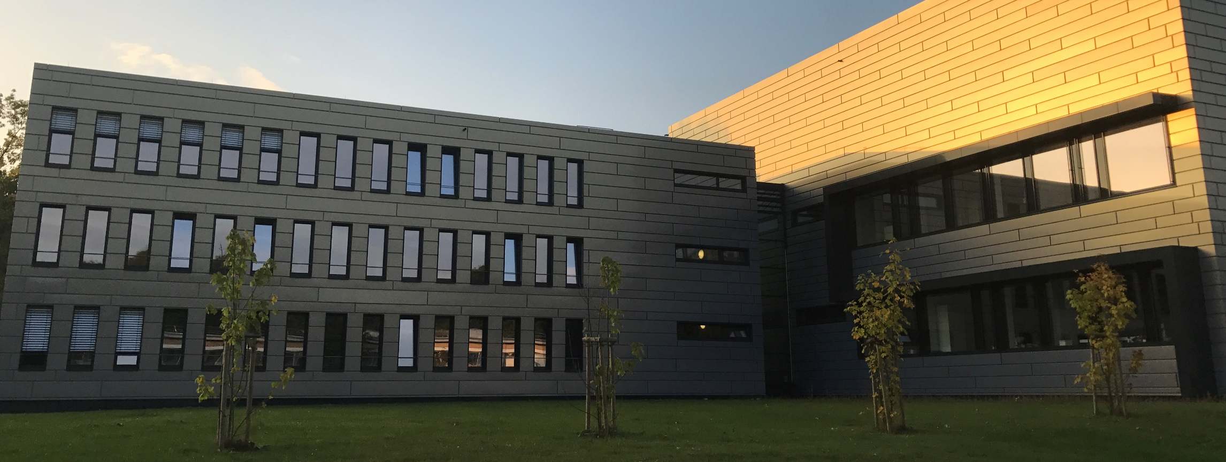






Georgian-German Science Bridge Workshop 2026
Introduction to Nuclear Medicine
Institute for Neuroscience and Medicine, Nuclear Chemistry (INM – 5)
Davit Gabadadze

Slide 2
Nuclear Medicine uses radioactive molecules to assess body functions for diagnosis and therapy
Molecular Imaging
Radiotherapy
Positron-Emission Tomography (PET)
Single Photon Emission Computed Tomography (SPECT)
GGSB Workshop 2026 2 08.09.2026

Slide 3
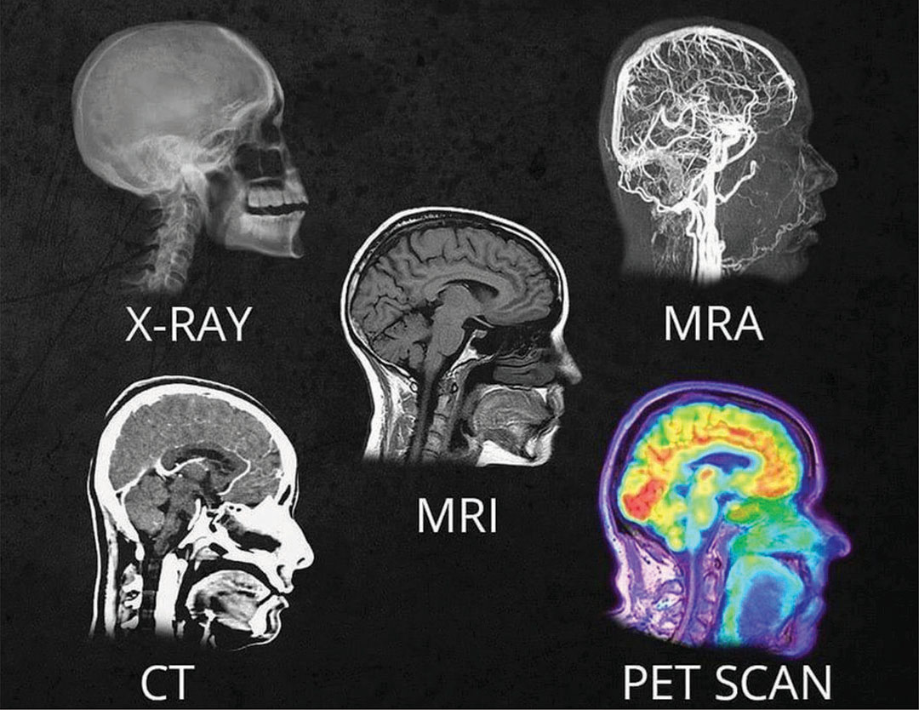
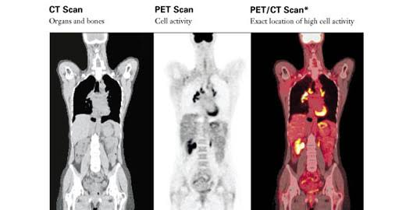
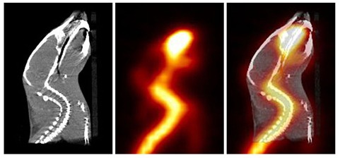
Different Imaging Modalities
GGSB Workshop 2026 3 08.09.2026

Slide 4
GGSB Workshop 2026 4 08.09.2026

Slide 5

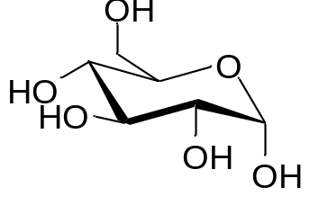
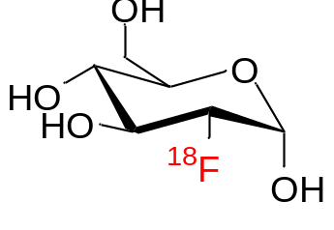
Tracer Principle
Radioisotopes behave like their stable counterparts.
They enable molecular tracking without changing biological behavior.
D-Glucose
[¹⁸F]FDG
G. C. de Hevesy
GGSB Workshop 2026 5 08.09.2026

Slide 6
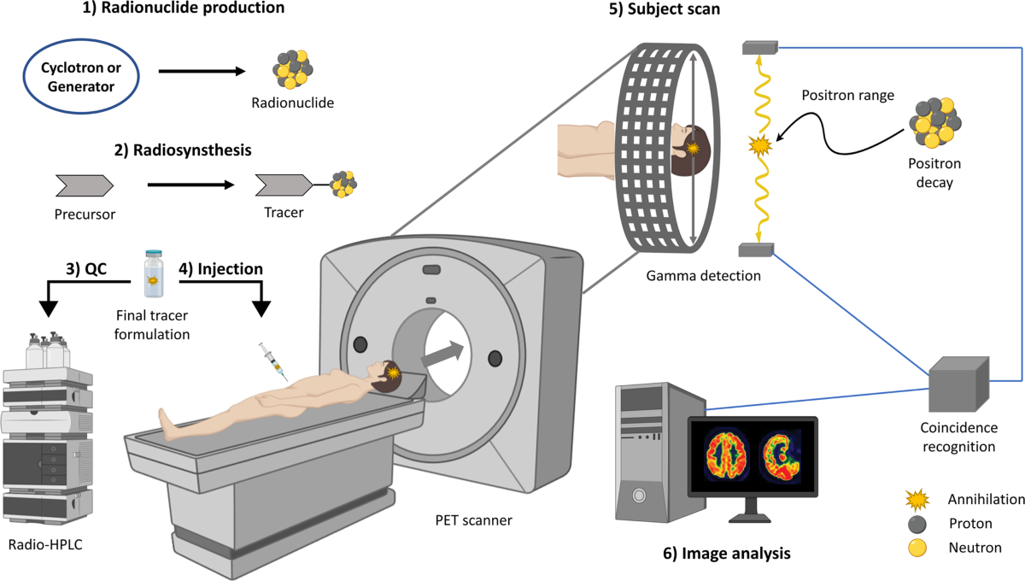
GGSB Workshop 2026 6 08.09.2026

Slide 7
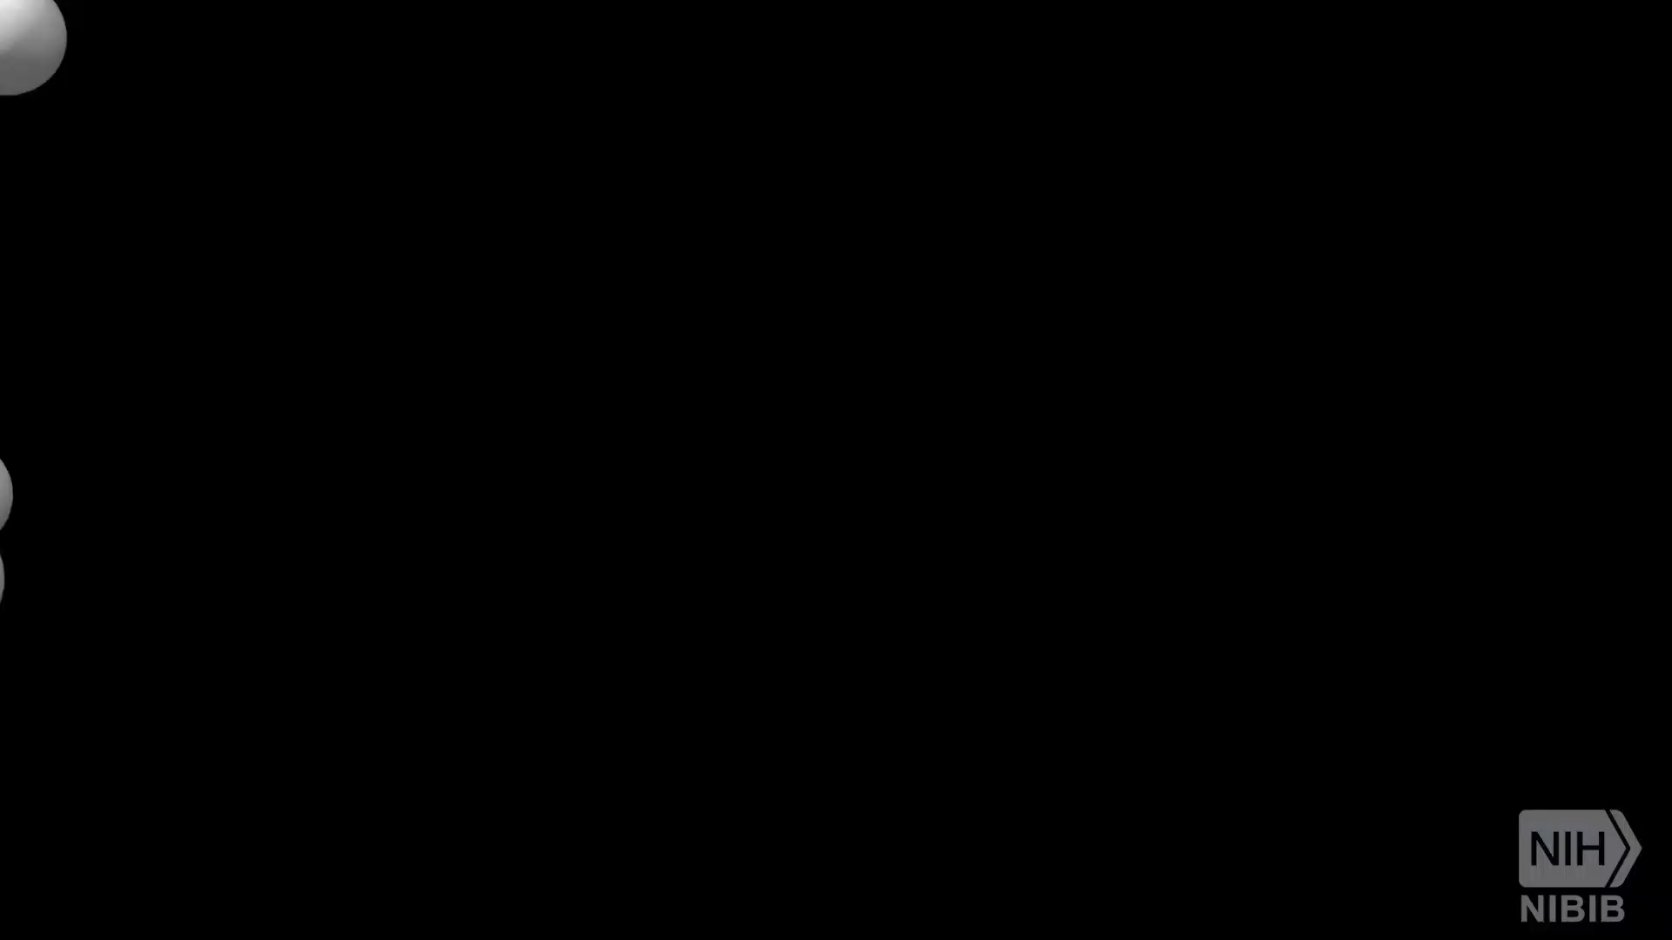
GGSB Workshop 2026 7 08.09.2026

Slide 8
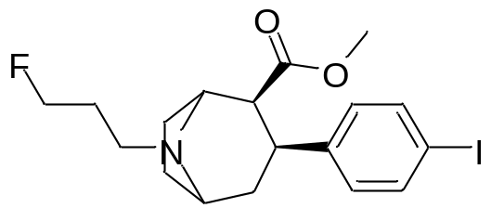
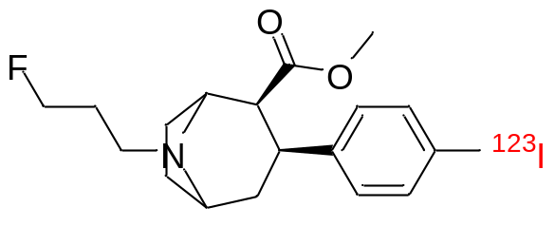
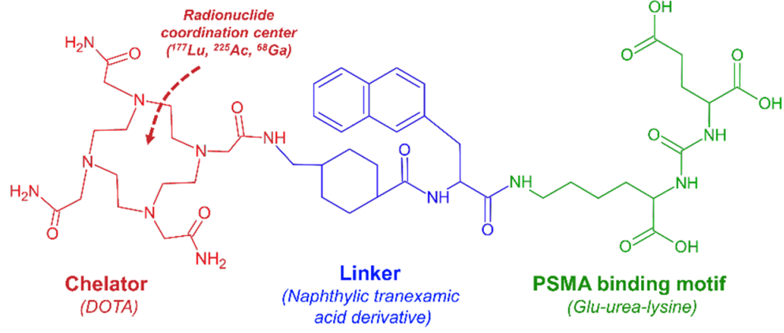
Isotopic Analog
¹⁸F-Labeled Derivative
Ioflupane
[¹²³I]ioflupane
D-Glucose
[¹⁸F]FDG
GGSB Workshop 2026 8 08.09.2026

Slide 9
Design and Development of Radiopharmaceuticals
WHAT CAN BE LABELLED?
WHAT CAN BE VISUALIZED?
1
Small molecules
Metabolism & Perfusion
1
drugs, sugars and receptor ligands
[¹⁸F]FDG → glucose metabolism; [¹⁵O]H₂O → perfusion
2
Amino acids & metabolites
Transport & Metabolic pathways
2
natural substrates and analogues
Methionine/FET → amino-acid transport
3
Peptides
Receptors
3
compact, high-affinity targeting vectors
DOTATATE → SSTR; GRPR peptides → GRPR
4
Peptidomimetics
Enzymes & Cell-surface targets
4
drug-like mimics of peptide recognition
PSMA ligands → PSMA
5
Proteins & enzymes
Protein distribution / Enzyme localisation
5
larger biological recognition systems
Labelled proteins/enzymes → their biodistribution/localisation
6
Antibodies & fragments
Cell-surface proteins
6
high specificity; slower distribution
Trastuzumab → HER2; anti-CD20 → CD20
7
Oligos, nanoparticles & cells
Gene expression / Cell tracking / Microenvironment
7
specialised or emerging platforms
Oligos → Nucleic-acid targets; Cells → Migration; Nanoparticles → Microenvironment
GGSB Workshop 2026 9 08.09.2026

Slide 10
Prerequisites of Radiopharmaceutical
Clinical relevance | Answers a meaningful diagnostic or therapeutic question
Target selectivity | Target is abundant and accessible in diseased tissue but limited in important healthy organs
High affinity | Strong binding at the very low concentrations used for radiopharmaceuticals
Specific binding | Uptake is target-mediated and can be reduced in a blocking experiment
High target uptake | A sufficient fraction of administered activity reaches the intended tissue
Low nonspecific uptake | Minimal binding to unrelated proteins, membranes and healthy tissues
Favourable pharmacokinetics | Reaches the target efficiently and clears appropriately from blood and background tissues
High target-to-background ratio | Produces clear images or selective therapeutic irradiation
Adequate target retention | Remains at the target long enough for imaging or therapy
Suitable clearance | Preferably rapid and predictable elimination without excessive retention in kidneys, liver or other critical organs
Metabolic stability | Does not rapidly form radioactive metabolites with unwanted biodistribution
Appropriate lipophilicity and charge | Compatible with the required membrane passage, organ distribution and excretion
Low pharmacological mass | Diagnostic doses should not significantly disturb the process being measured
Low toxicity and immunogenicity | Vector, precursor, chelator, excipients and impurities must be safe
GGSB Workshop 2026 10 08.09.2026

Slide 11
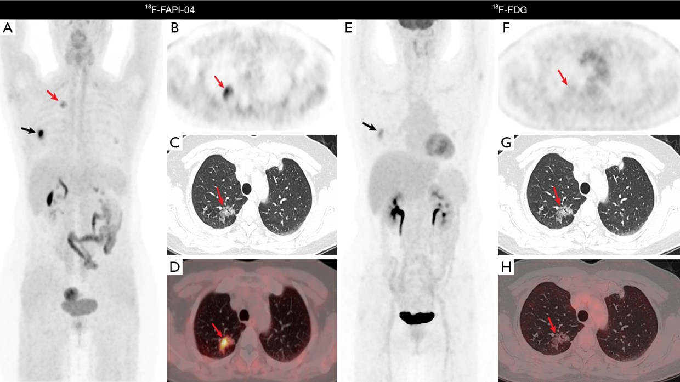
Changing the tracer changes what becomes visible!
LIANG, H., HUANG, Q., HE, Y., MAI, Y., CHEN, Z., WANG, B., FANG, N., HU, J., LI, X., ZHANG, N., LIU, E., LI, X.. Comparison of the diagnostic accuracy between ¹⁸F-FAPI-04 PET/CT and ¹⁸F-FDG PET/CT in the clinical stage IA of lung adenocarcinoma. Journal of Thoracic Disease, North America, 17, feb. 2025. Available at: <https://jtd.amegroups.org/article/view/96974>. Date accessed: 03 Aug. 2026.
GGSB Workshop 2026 11 08.09.2026

Slide 12
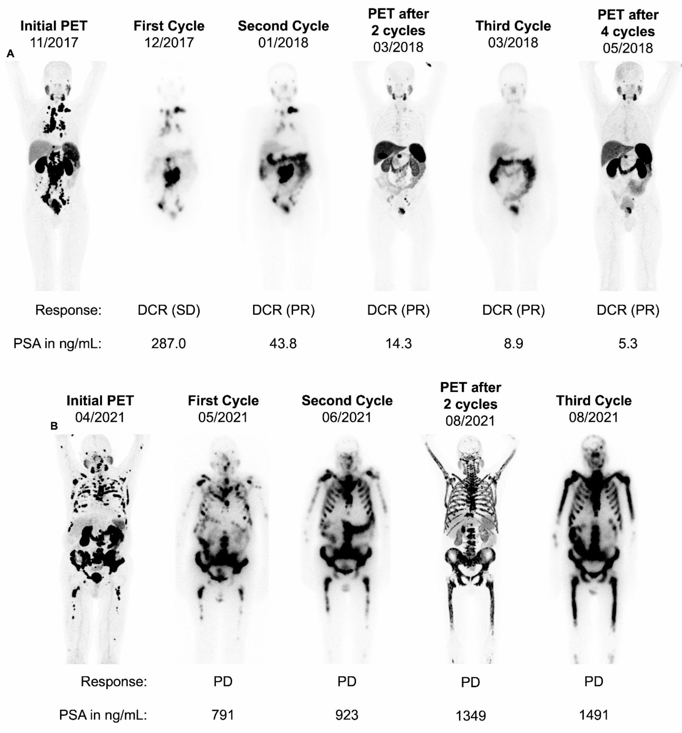
See what you treat and treat what you see
⁶⁸Ga/¹⁸F-PSMA PET → confirm PSMA expression → ¹⁷⁷Lu-PSMA therapy → post-therapy imaging
Ventura, D., Rassek, P., Schindler, P. et al. Early treatment response assessment with [¹⁷⁷Lu]PSMA whole-body-scintigraphy compared to interim PSMA-PET. Cancer Imaging 24, 126 (2024). https://doi.org/10.1186/s40644-024-00773-w
GGSB Workshop 2026 12 08.09.2026

Slide 13
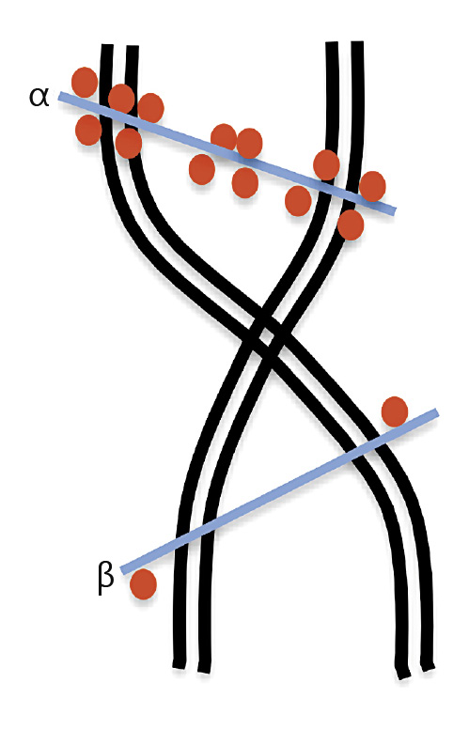
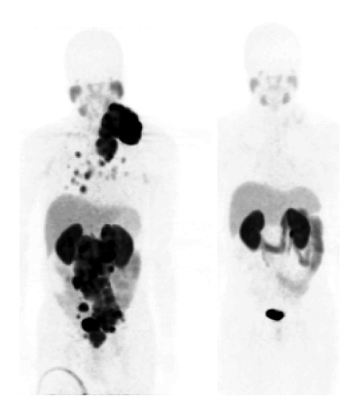
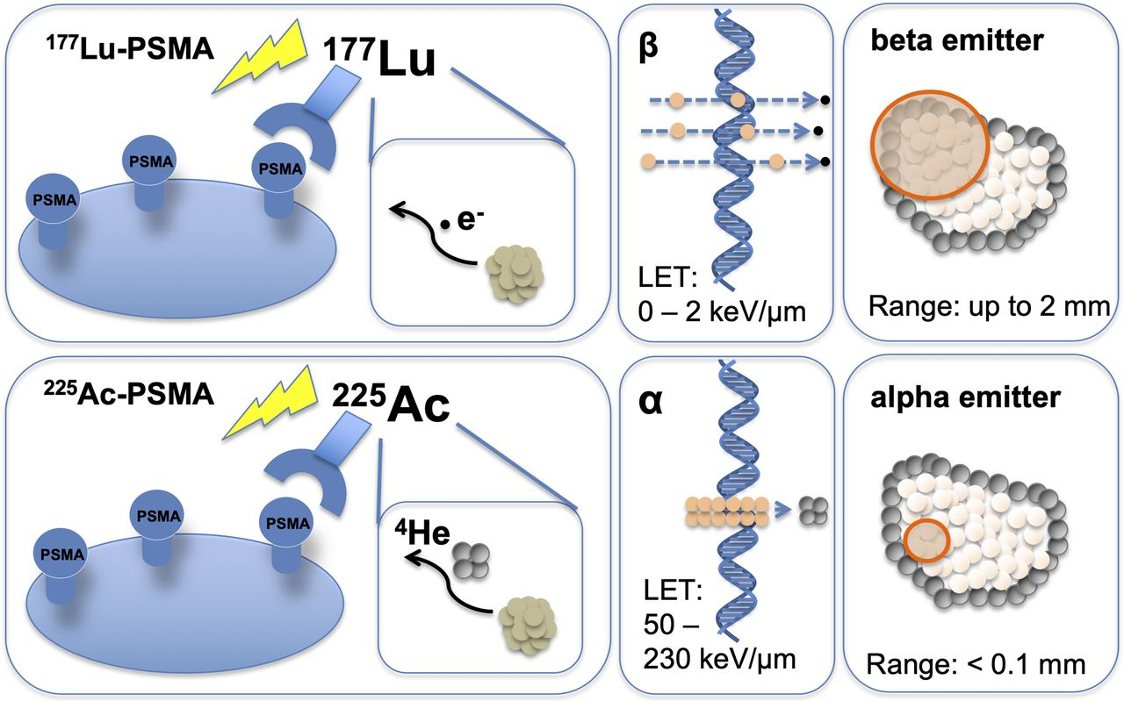
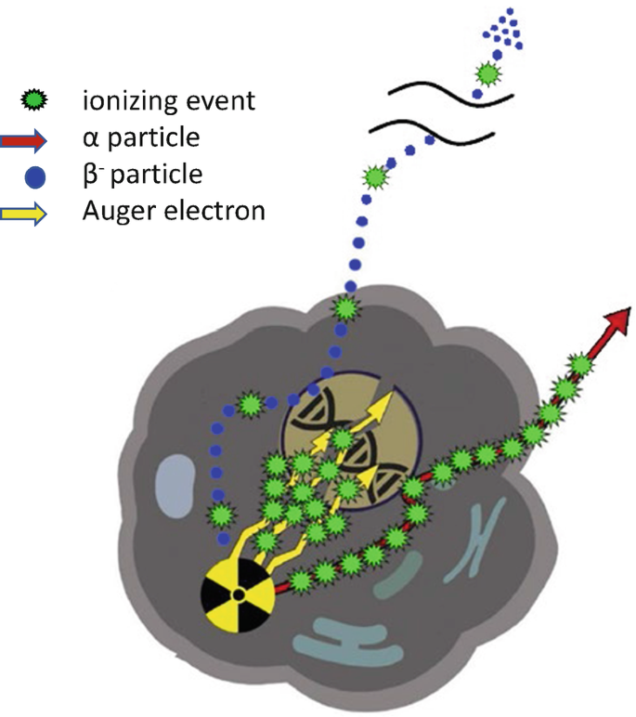
Targeted Alpha Particle Therapy
⁶⁸Ga-PSMA studies in a patient with metastatic prostate cancer prior to (left) and after (right) ²²⁵Ac-PSMA TAT. There was an excellent functional response to treatment with concurrent clinical and biochemical response (prostate-specific antigen decreased from 1,301 to 0.05 ng/L).
Images courtesy of Prof. Mike Sathekge, Department of Nuclear Medicine, Steve Biko Academic Hospital, University of Pretoria, Pretoria, South Africa. PSMA, prostate-specific membrane antigen; TAT, targeted alpha particle therapy.
Range of different emissions in comparison to the size of a typical cell
Navalkissoor, S.; Grossman, A., Targeted Alpha Particle Therapy for Neuroendocrine Tumours: The Next Generation of Peptide Receptor Radionuclide Therapy. Neuroendocrinology 2019, 108 (3), 256-264.
Benedikt Feuerecker, Clemens Kratochwil, Hojjat Ahmadzadehfar, Alfred Morgenstern, Matthias Eiber, Ken Herrmann and Kelsey L. Pomykala Journal of Nuclear Medicine May 2023, 64 (5) 685-692; DOI: https://doi.org/10.2967/jnumed.122.265353
Hoehr, C. (2023). The Next Generation of Therapeutic Radionuclides. In: Bodei, L., Lewis, J.S., Zeglis, B.M. (eds) Radiopharmaceutical Therapy. Springer, Cham. https://doi.org/10.1007/978-3-031-39005-0_23
GGSB Workshop 2026 13 08.09.2026

Slide 14
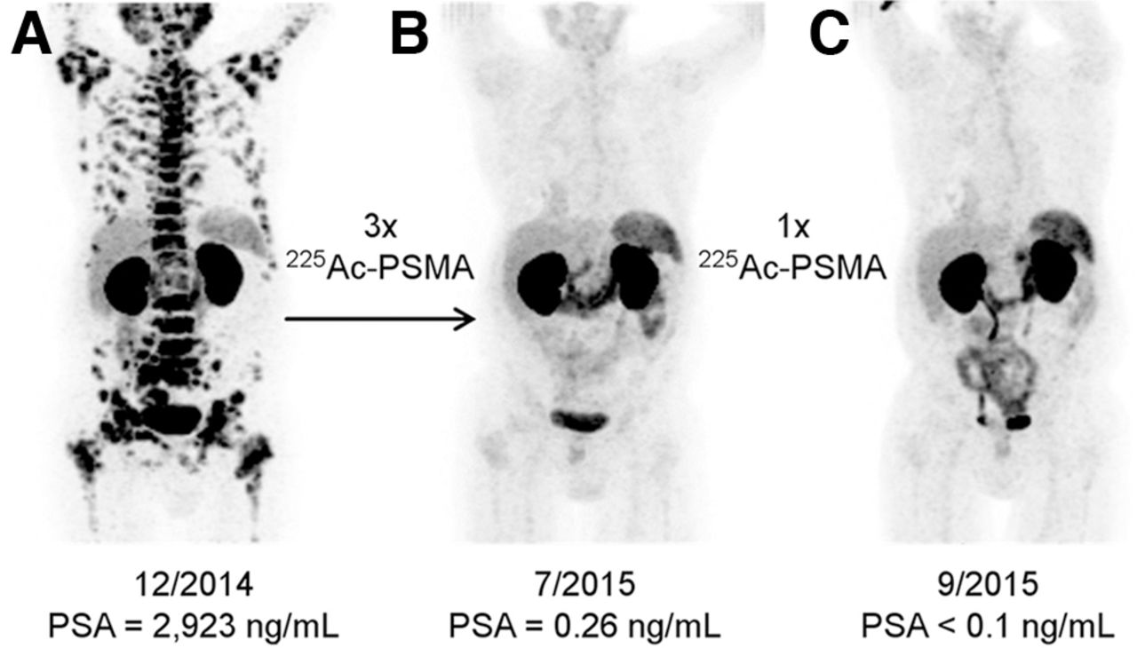
Targeted Alpha Particle Therapy For Prostate Tumors
⁶⁸Ga-PSMA-11 PET/CT scans of patient A. Pretherapeutic tumor spread (A), restaging 2 month after third cycle of ²²⁵Ac-PSMA-617 (B), and restaging 2 month after one additional consolidation therapy (C).
Clemens Kratochwil, Frank Bruchertseifer, Frederik L. Giesel, Mirjam Weis, Frederik A. Verburg, Felix Mottaghy, Klaus Kopka, Christos Apostolidis, Uwe Haberkorn, Alfred Morgenstern. Journal of Nuclear Medicine Dec 2016, 57 (12) 1941-1944; DOI: 10.2967/jnumed.116.178673
GGSB Workshop 2026 14 08.09.2026

Slide 15
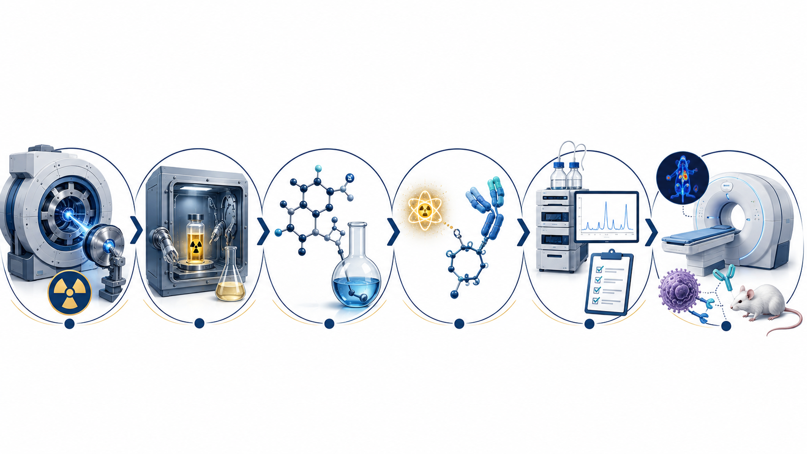
Workflow
Radionuclide Production
Isolation / Separation
Precursor synthesis
Radiolabeling
Quality Control
Biological Evaluation
GGSB Workshop 2026 15 10.09.2026

Slide 16
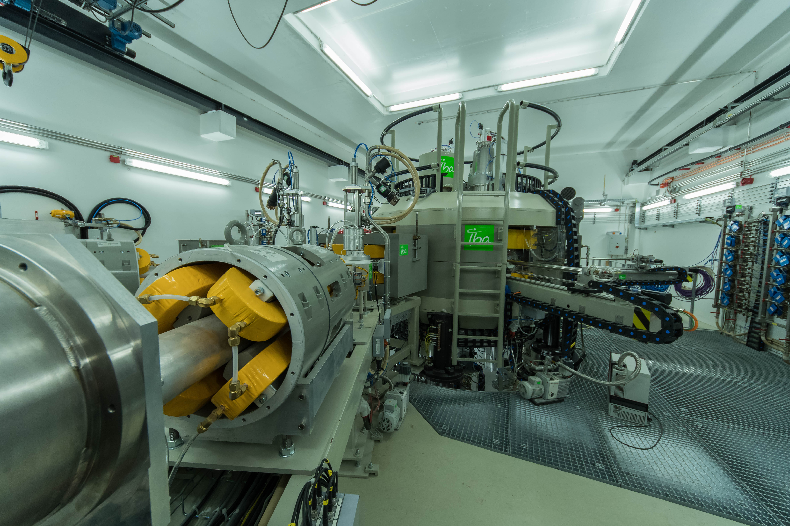
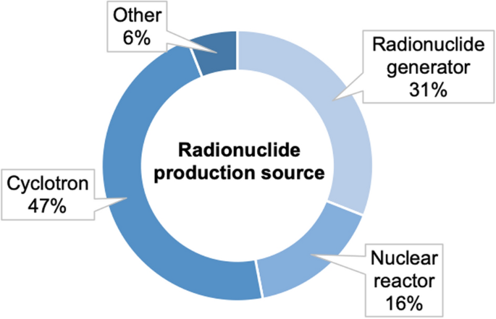
Radionuclide Production
Cyclone 30XP (IBA)
GGSB Workshop 2026 16 10.09.2026

Slide 17
Radionuclide Production
Cyclone 30XP (IBA)
GGSB Workshop 2026 17 10.09.2026

Slide 18
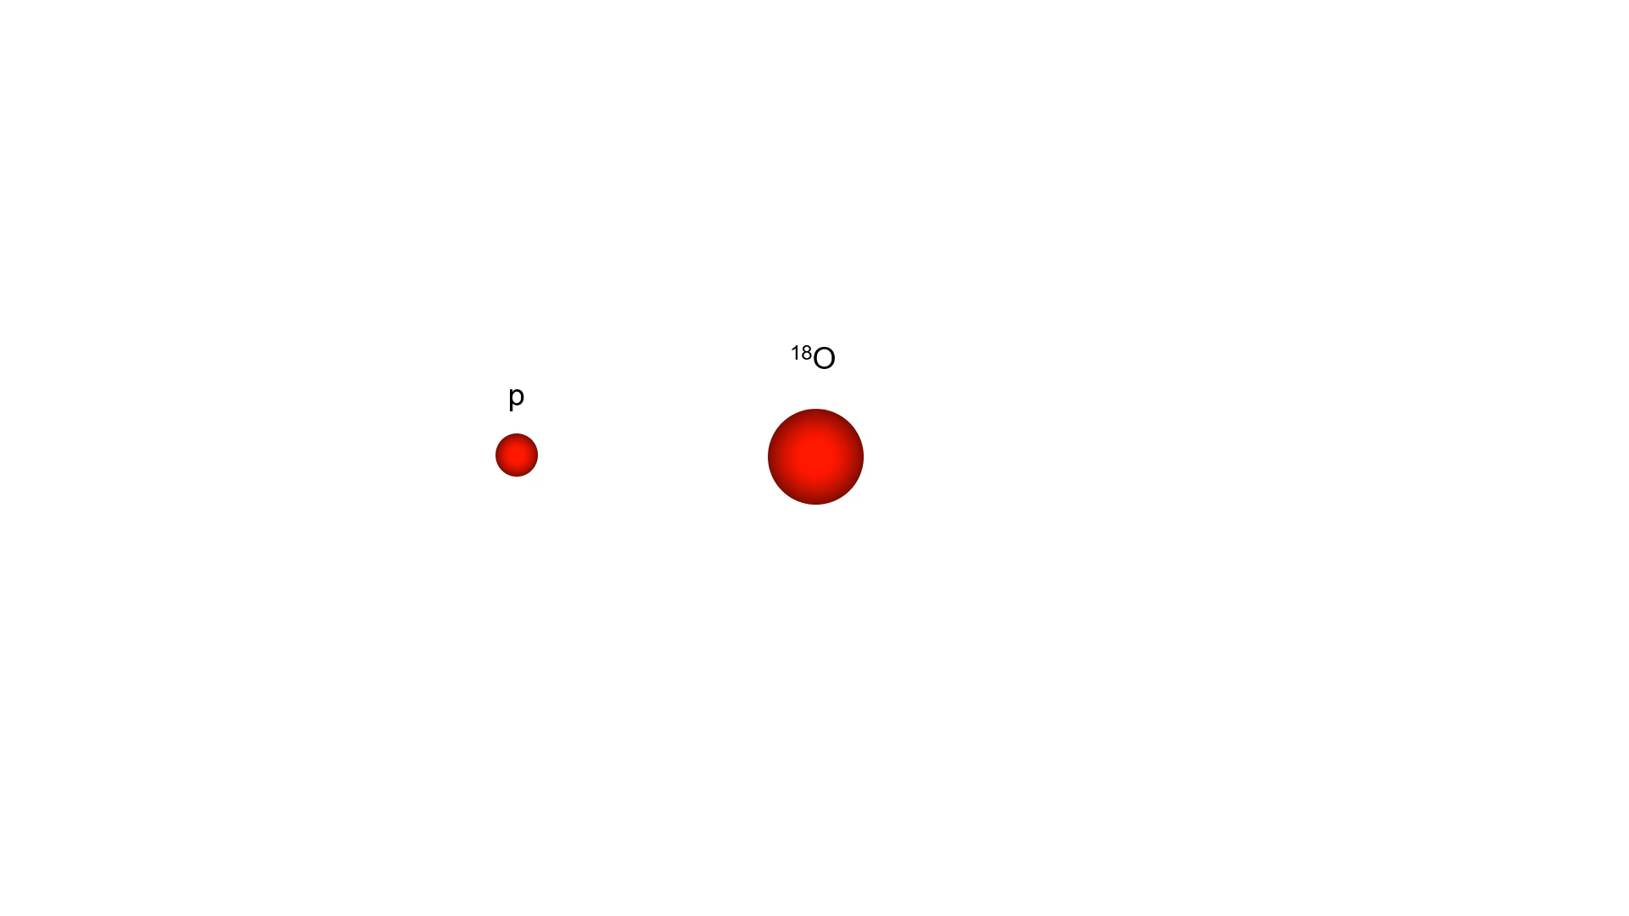
Radionuclide Production
Reaction route
Excitation functions
Energy window
Target thickness
Activity + purity
Current + time
Beam + cooling
Target + backing
¹⁸O(p, n)¹⁸F
²⁰Ne(d, α)¹⁸F
¹⁶O(³He, p)¹⁸F
¹⁶O(α, np)¹⁸F
GGSB Workshop 2026 18 10.09.2026

Slide 19
Radionuclide Production
One target nucleus
Several possible products
(p,n) ⁷⁵Se
⁷⁵As
lower energy
p
(p,pn) ⁷⁴As
next threshold
(p,3n) ⁷³Se
desired route
(p,4n) ⁷²Se
higher energy
Energy
GGSB Workshop 2026 19 10.09.2026

Slide 20
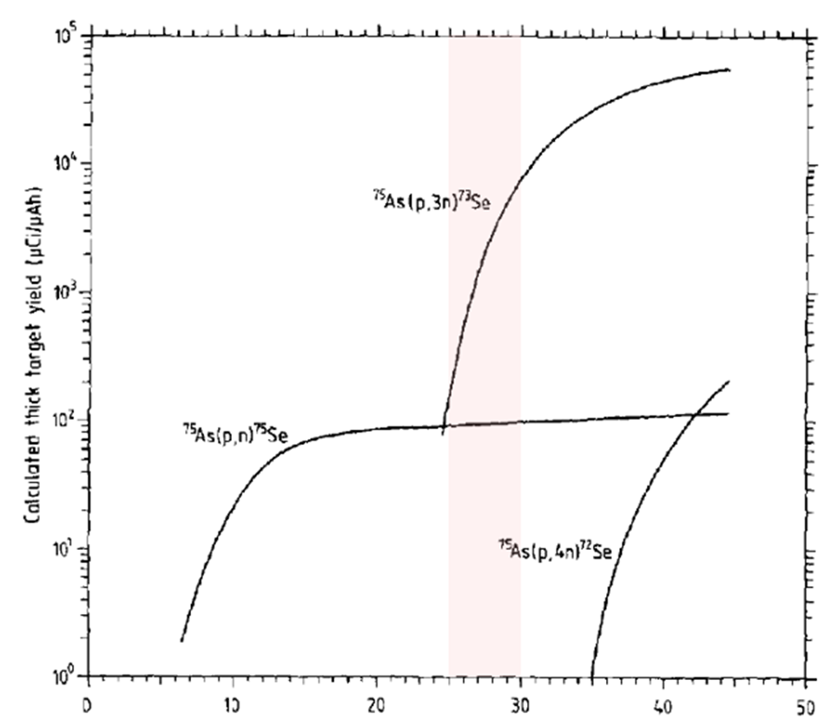
Radionuclide Production
Suitable energy window
High ⁷³Se production while the other channels remain suppressed
Why impurities matter
⁷²Se, ⁷³Se and ⁷⁵Se share the same chemistry and cannot be separated conventionally
Energy controls radioisotopic purity.
GGSB Workshop 2026 20 10.09.2026

Slide 21
Radionuclide Production
EXPLODED TARGET
Nuclear
Thermal / mechanical
Chemical
Target material
Isotopic enrichment
Conductivity & melting point
Rapid dissolution
Trace-element purity
Vapour pressure
Product separation
Backing
Target density
Adhesion & expansion
Target recovery
Coolant
No backing is universally best: thermal performance, activation and chemistry must be balanced.
GGSB Workshop 2026 21 10.09.2026

Slide 22
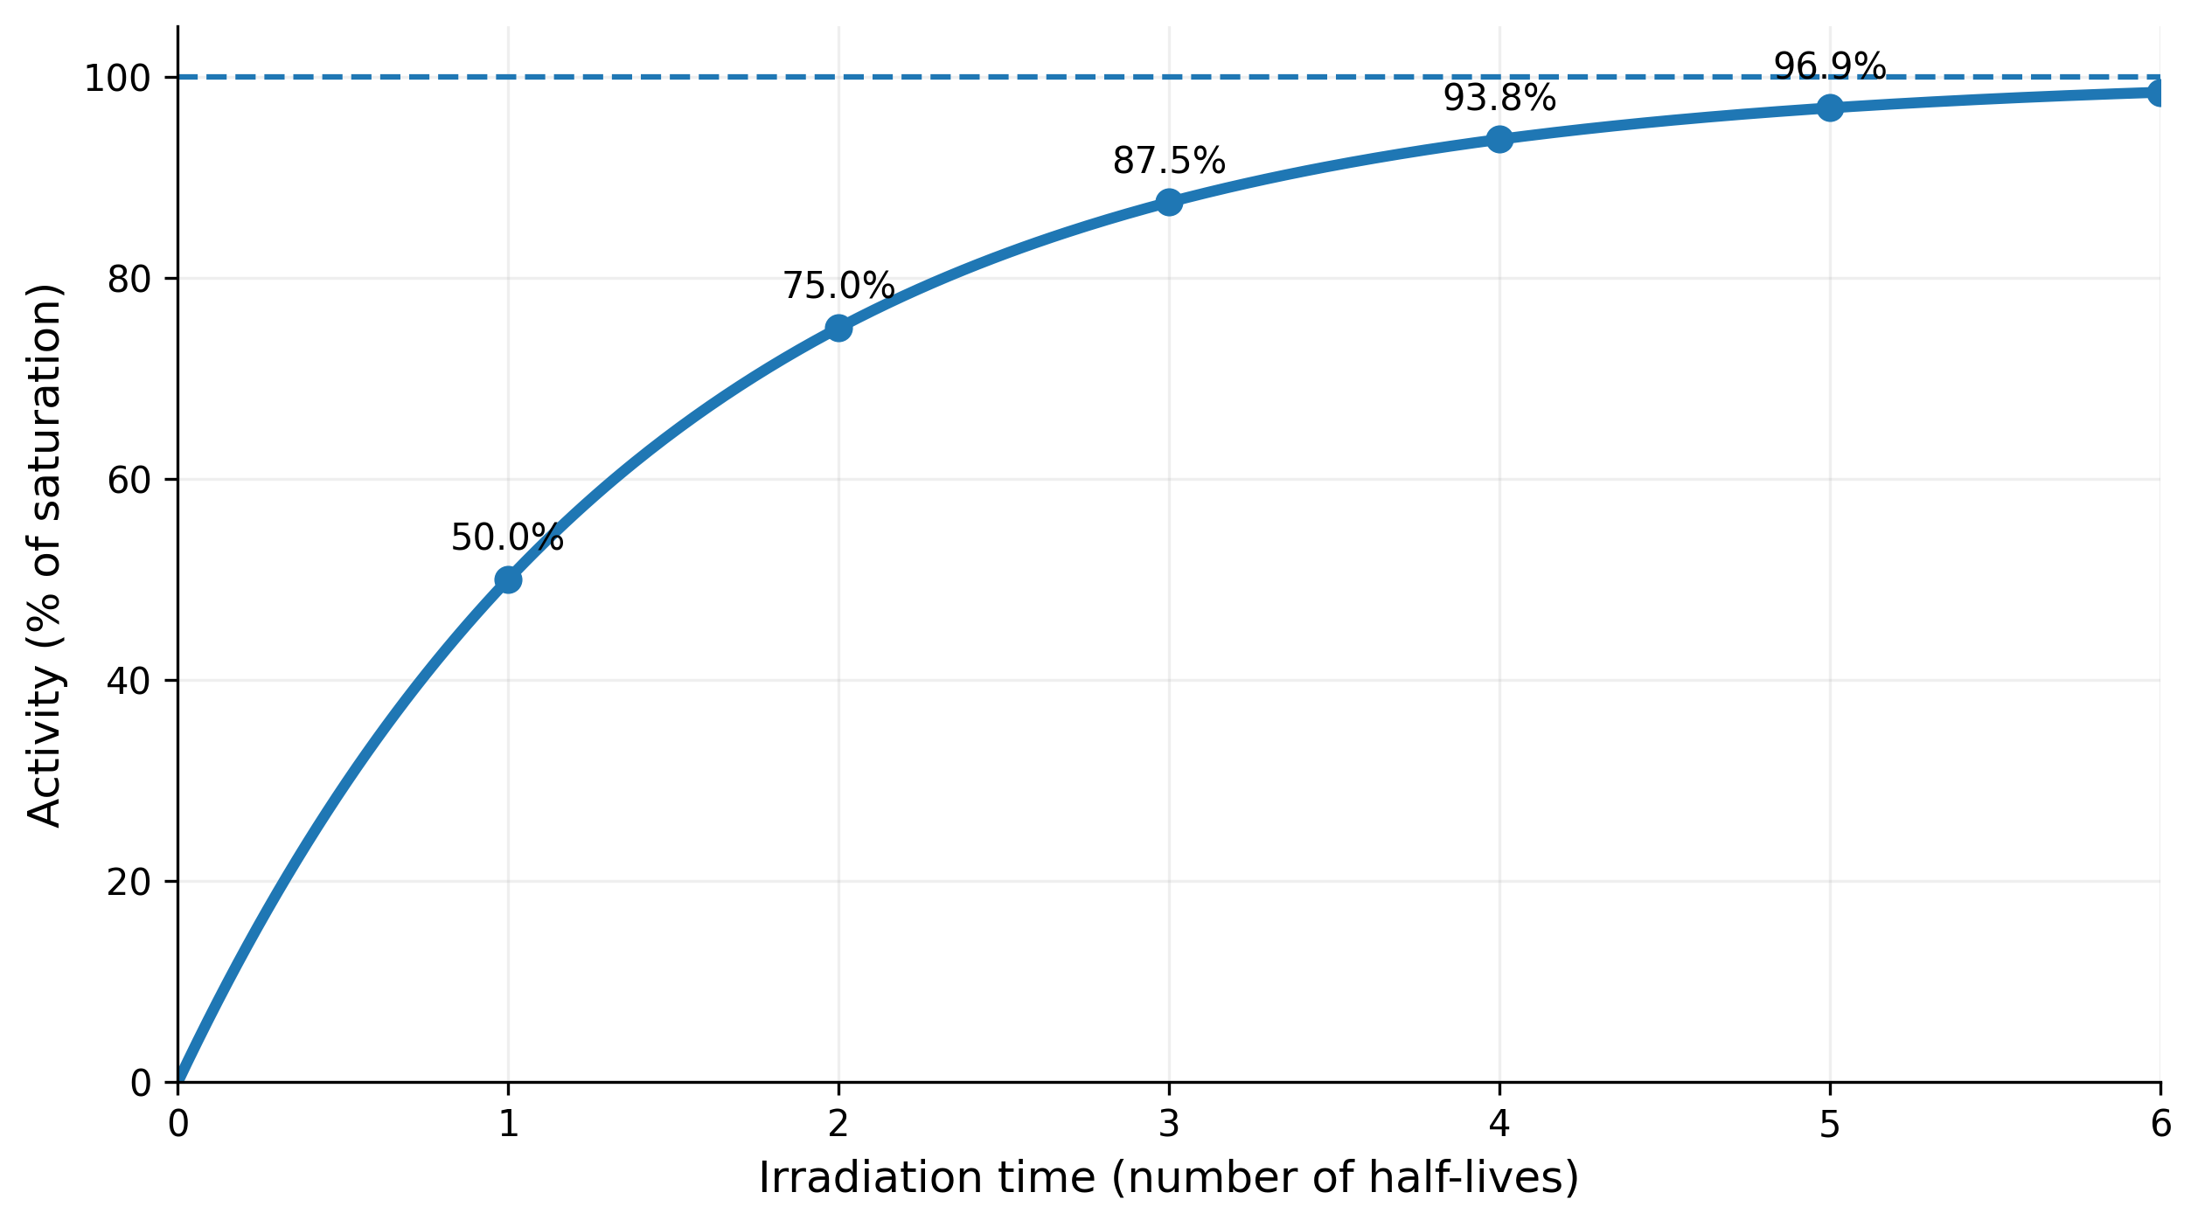

Radionuclide Production
Increase irradiation time
Increase beam current
raises production rate approximately linearly
1× current
2× current
3× current
4× current
Higher current also raises power density,
temperature and failure risk.
$$\frac{A\left(t\right)}{A_{sat}}=1−e^{−λt}$$
GGSB Workshop 2026 22 10.09.2026

Slide 23
Workflow
Radionuclide Production
Isolation / Separation
Precursor synthesis
Radiolabeling
Quality Control
Biological Evaluation
GGSB Workshop 2026 23 10.09.2026

Slide 24
Isolation / Separation
Irradiated target
Dissolution / release
Matrix separation
Specification check
Ready for labelling
Concentration
Medium exchange
Speciation control
GGSB Workshop 2026 24 10.09.2026

Slide 25
Isolation / Separation
Desired radionuclide
often picogram-to-nanogram mass
Target matrix
milligrams to grams
Small surface losses and trace-metal contamination can impair subsequent radiolabeling.
Radioactive
product
GGSB Workshop 2026 25 10.09.2026

Slide 26
Isolation / Separation
Counterion
Oxidation
state
Hydrolysis /
colloids
RADIONUCLIDE
SPECIATION
Protonation
state
Coordination
environment
Redox potential
GGSB Workshop 2026 26 10.09.2026

Slide 27
Isolation / Separation
Soluble salt
Metal oxide
Metal
Volatile product
Water or dilute acid
Acid + heat or ligands
Strong or oxidizing acid
Thermal release / distillation
rapid dissolution
rate depends on density
backing compatibility matters
matrix may remain intact
GGSB Workshop 2026 27 10.09.2026

Slide 28
Workflow
Radionuclide Production
Isolation / Separation
Precursor Synthesis
Radiolabeling
Quality Control
Biological Evaluation
GGSB Workshop 2026 28 10.09.2026

Slide 29
Precursor Synthesis
A_{Final} = A_{EOB} × 2^{(−t(total) / T½)} × η_{process} × η_{labeling} × η_{purifying}
Decay loss and chemical recovery multiply; they do not occur independently.
100%
84%
71%
59%
50%
EOB
Isolation
Labelling
Purification
QC / use
GGSB Workshop 2026 29 10.09.2026

Slide 30
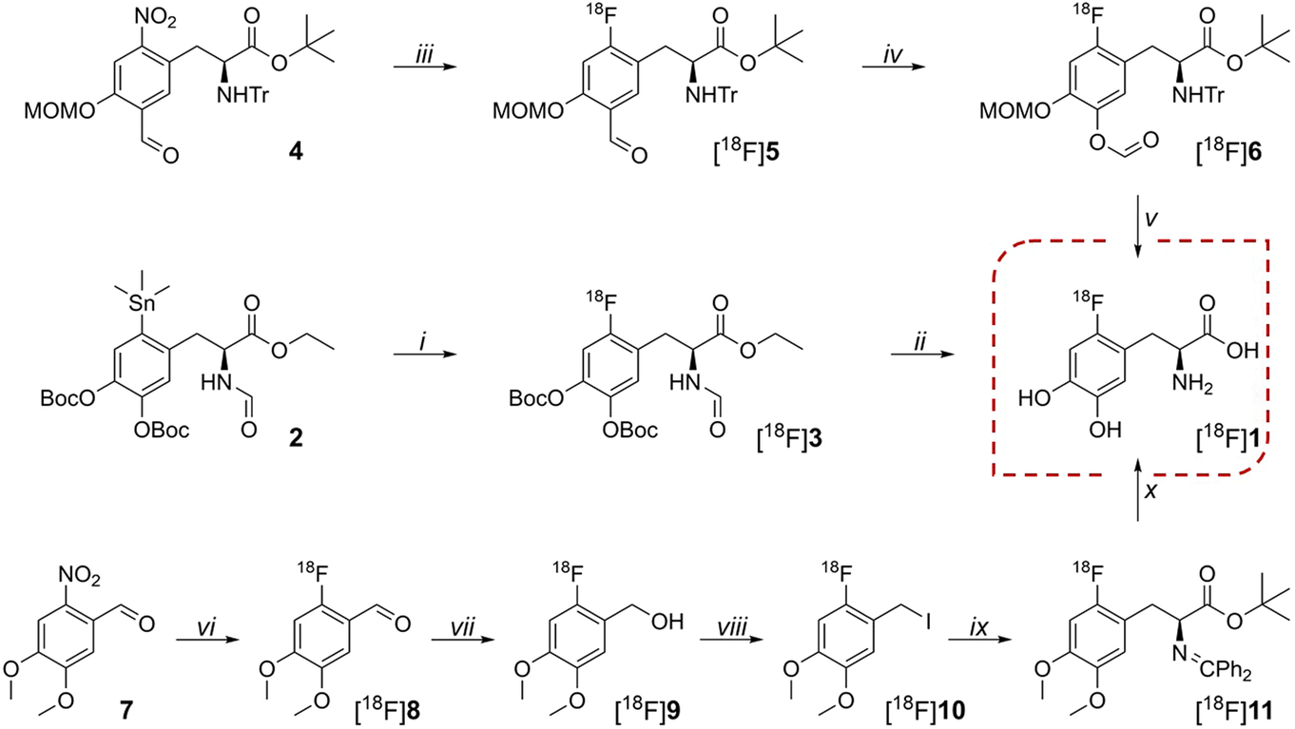
Precursor Synthesis
The three different synthetic pathways to [¹⁸F]1. i, [¹⁸F]F₂, CHCl₃, RT; ii, 57% HI, 150 °C; iii, [¹⁸F]TBAF, DMSO, 110 °C; iv, m-CPBA, MeCN, 55 °C; v, 30% HCl, EtOH, 50 °C; vi, [¹⁸F]KF/K₂₂₂, DMF, 165 °C; vii, NaBH₄, H₂O @ tC18, RT; viii, 57% HI @ tC18, RT; ix, Ph₂C=NCH₂Boc, DCM, cPTC, KOH, − 20 °C; x, 57% HI, 165 °C..
Andersen, V.L., Soerensen, M.A., Dam, J.H. et al. GMP production of 6-[¹⁸F]Fluoro-l-DOPA for PET/CT imaging by different synthetic routes: a three center experience. EJNMMI radiopharm. chem. 6, 21 (2021). https://doi.org/10.1186/s41181-021-00135-y
GGSB Workshop 2026 30 10.09.2026

Slide 31
Workflow
Radionuclide Production
Isolation / Separation
Precursor synthesis
Radiolabeling
Quality Control
Biological Evaluation
GGSB Workshop 2026 31 10.09.2026

Slide 32
Radiolabeling
pH
too acidic
reactive window
too basic
Radionuclide and precursor are reactive while the molecule remains stable.
TEMPERATURE
too slow
lowest effective T
degradation
Reach the required conversion within the available time without damaging the product.
PRECURSOR AMOUNT
poor capture
minimum robust amount
chemical burden
Use enough for fast, reproducible labelling—but no more than necessary.
GGSB Workshop 2026 32 10.09.2026

Slide 33
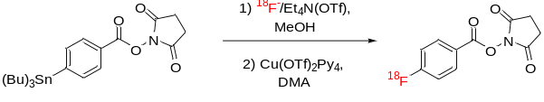
Radiolabeling
DIRECT COVALENT LABELLING
R–OTs + [¹⁸F]F⁻ → R–[¹⁸F]F
The radionuclide becomes part of the molecular skeleton.
INDIRECT: PROSTHETIC GROUP
[¹⁸F]SFB + H₂N–Biomolecule → [¹⁸F]fluorobenzoyl–NH–Biomolecule
A small labelled synthon is conjugated under mild conditions.
RADIOMETAL CHELATION
V–L–C + [M*]ⁿ⁺ → M*–C–L–V
M* radiometal • C chelator • L linker • V targeting vector
GGSB Workshop 2026 33 10.09.2026

Slide 34
Workflow
Radionuclide Production
Isolation / Separation
Precursor synthesis
Radiolabeling
Quality Control
Biological Evaluation
GGSB Workshop 2026 34 10.09.2026

Slide 35
Quality Control
CHEMICAL PURITY
What nonradioactive material remains?
HPLC–UV / LC–MS / GC / ICP–MS
precursor • solvents • metals • by-products
RADIOCHEMICAL PURITY
Where is the desired radionuclide chemically?
radio-HPLC / radio-TLC / SEC
free [⁷³Se] species vs [⁷³Se]tracer
RADIONUCLIDIC PURITY
Which radionuclides produce the activity?
gamma spectrum / measured half-life
⁷⁵Se • ⁷²Se • ⁷⁴As
Correct radionuclide ≠ correct molecule ≠ chemically clean formulation
GGSB Workshop 2026 35 10.09.2026

Slide 36
Quality Control
HIGH MOLAR ACTIVITY
LOW MOLAR ACTIVITY
Aₘ = activity / amount
1 GBq
1 GBq
Bq/mol • commonly GBq/µmol
R
R
R
R
*
R
R*
R
R
Why biology cares
R
R
R
R
Non-radioactive ligand can occupy
a finite number of receptors
before the radiotracer arrives.
few molecules
many molecules
More precursor lowers Aₘ only when competing or nonradioactive material remains in the final sample.
GGSB Workshop 2026 36 10.09.2026

Slide 37
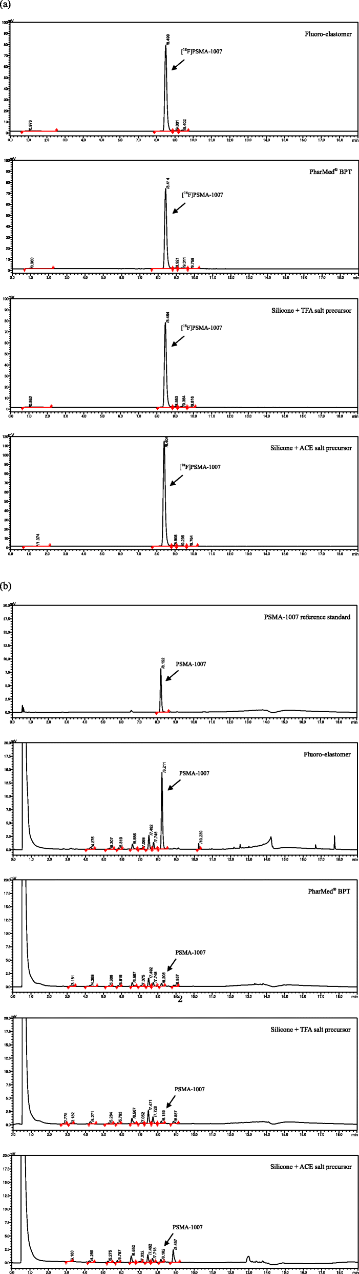
Quality Control
Radio-chromatograms of [¹⁸F]PSMA-1007
UV-chromatograms of the PSMA-1007
Residual precursor lowers Aₘ only when competing or nonradioactive product remains in the final sample.
Fluoro-elastomer: 46 GBq/µmol → low Am
​PharMed BPT: 1184 GBq/µmol → high Am ​
Silicone: 1411 GBq/µmol → high Am ​
Naka, S., Watabe, T., Kurimoto, K. et al. Automated [¹⁸F]PSMA-1007 production by a single use cassette-type synthesizer for clinical examination. EJNMMI radiopharm. chem. 5, 18 (2020). https://doi.org/10.1186/s41181-020-00101-0
GGSB Workshop 2026 37 10.09.2026

Slide 38
Workflow
Radionuclide Production
Isolation / Separation
Precursor synthesis
Radiolabeling
Quality Control
Biological Evaluation
GGSB Workshop 2026 38 10.09.2026

Slide 39
Biological Evaluation
Metabolic Stability
QC PASS
Serum / plasma
Does the parent tracer remain intact?
✓
Correct radionuclide
Correct chemical form
Protein binding
What fraction remains freely available?
✓
✓
Acceptable formulation
Challenge molecules
Does the label survive realistic competition?
Does the radioactive signal behave like the biology of the target?
The final biological question
GGSB Workshop 2026 39 10.09.2026

Slide 40
Biological Evaluation
n-OCTANOL
LIPOPHILICITY
membrane permeability
nonspecific membrane binding
renal vs hepatobiliary clearance
blood–brain barrier potential
PLASMA PROTEIN BINDING
radioactivity distribution
BUFFER pH 7.4
protein-bound
free fraction
Longer circulation may increase—but free tissue access may decrease.
logD₇,₄ = log₁₀(C_{octanol} / C_{buffer})
GGSB Workshop 2026 40 10.09.2026

Slide 41
Biological Evaluation
Blocking
Saturation
Competition
“Does excess ligand remove the signal?”
“How does the tracer fill the receptor pool?”
“Can cold molecules fight off the tracer?”
Specificity / receptor-mediated uptake
Kd + Bmax → tracer affinity + capacity
IC₅₀ / Kᵢ → apparent affinity of competitor
GGSB Workshop 2026 41 10.09.2026

Slide 42
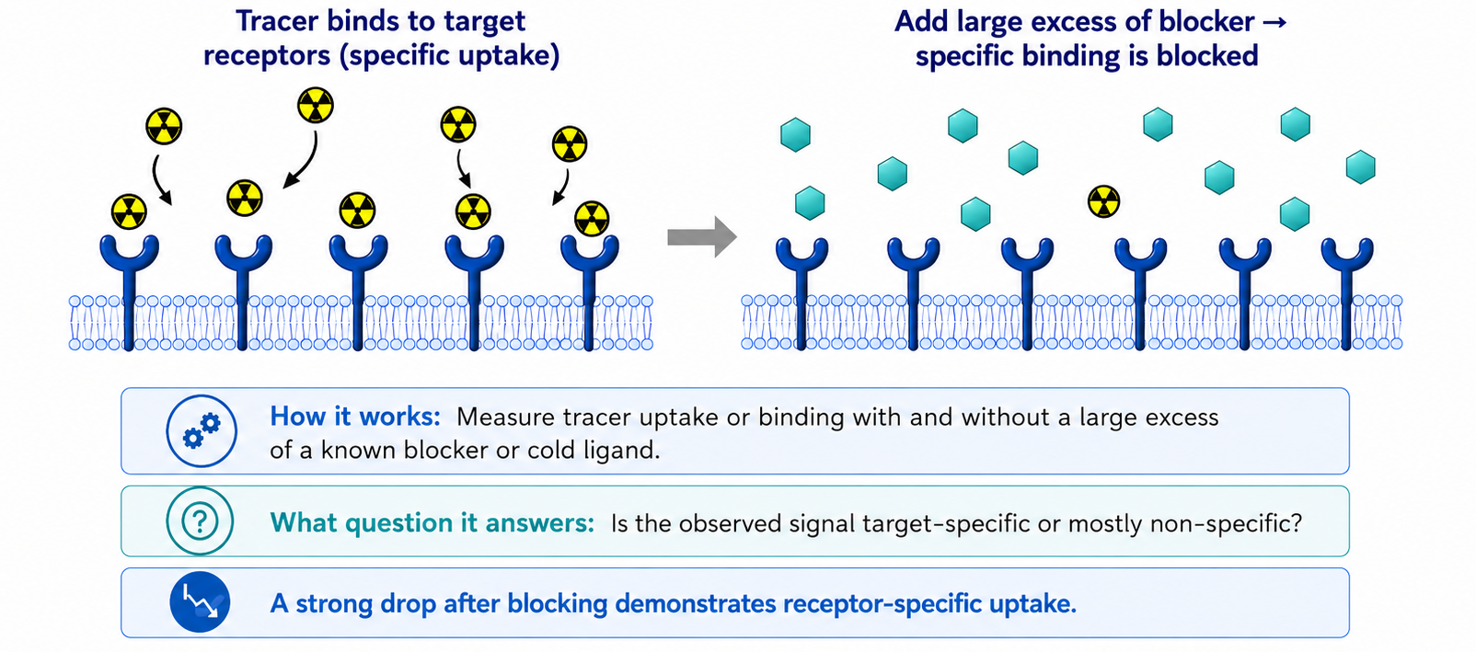
Biological Evaluation, Blocking Experiment
GGSB Workshop 2026 42 10.09.2026

Slide 43
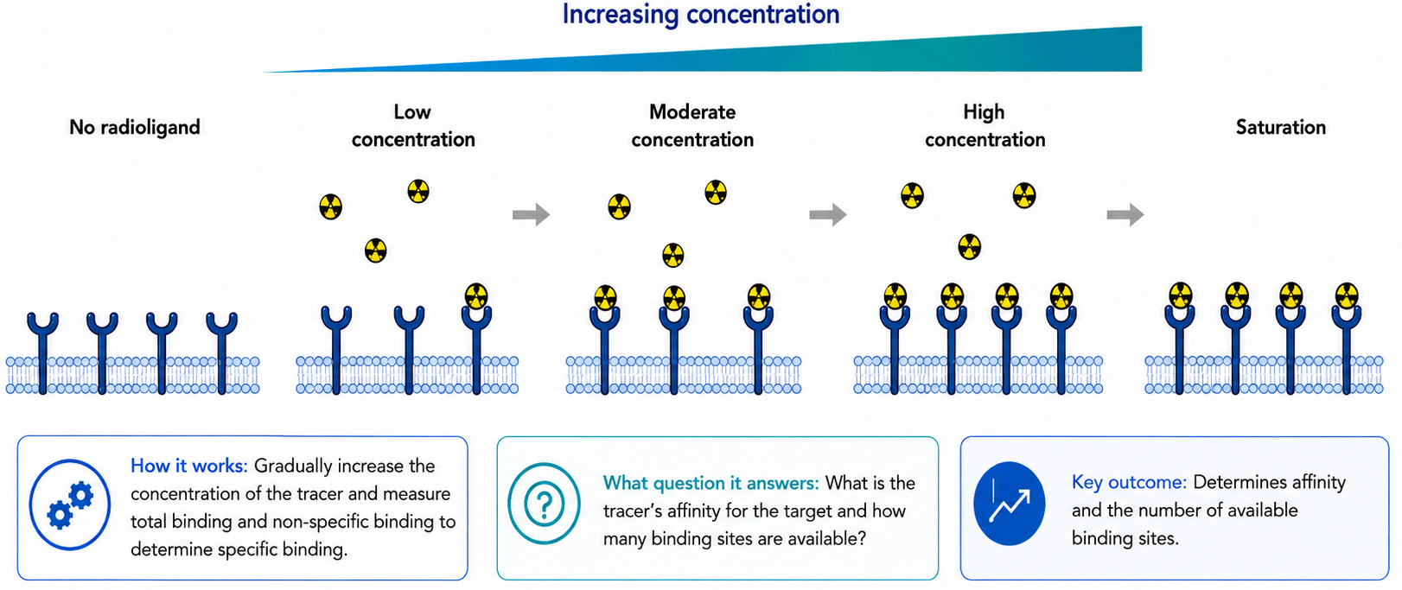
Biological Evaluation, Saturation assay
K_{d} = Radioligand Affinity
B_{max} = Available Binding-Site Capacity
GGSB Workshop 2026 43 10.09.2026

Slide 44
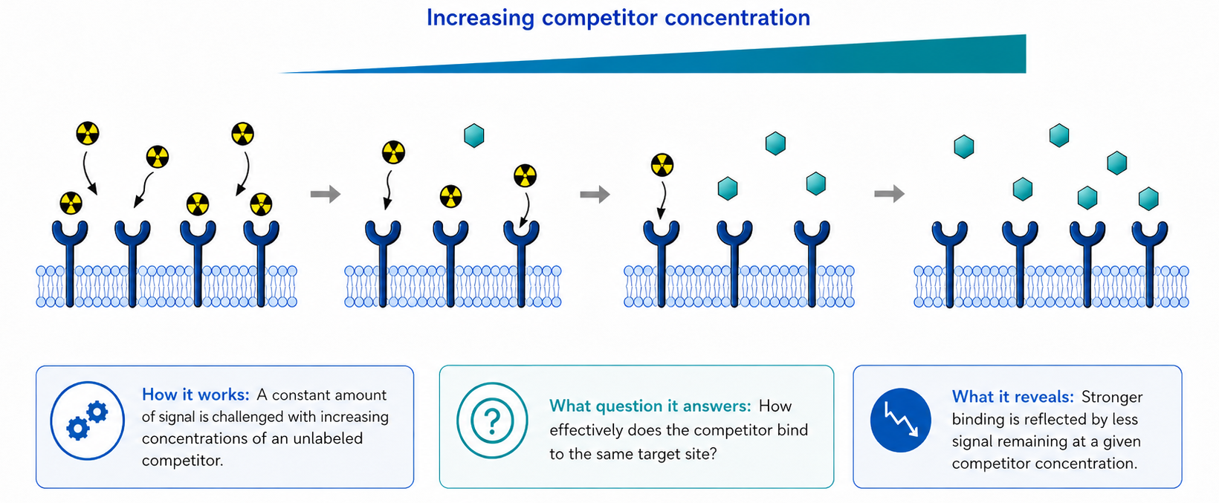
Biological Evaluation, Competition Binding
IC₅₀ - Indicates the concentration of an inhibitor required to inhibit a biological or biochemical function by 50% in vitro
GGSB Workshop 2026 44 10.09.2026

Slide 45
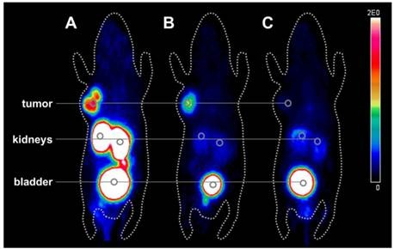
Biological Evaluation
A / B: tracer alone
Tumor is visible because free receptors bind the radiotracer.
C: tracer + 100× unlabeled ligand
Receptors are occupied by nonradioactive compound, so the PET tumor signal collapses.
GGSB Workshop 2026 45 10.09.2026

Slide 46
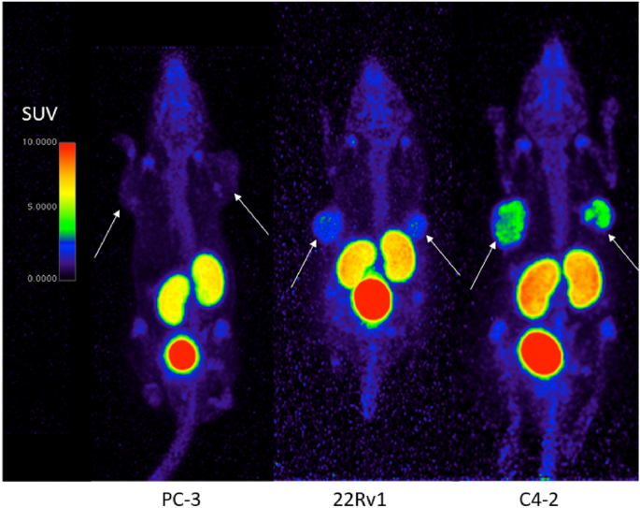
Biological Evaluation
Cell models in this example
PC-3
PSMA negative
→ no clear tumor uptake
22Rv1
low PSMA expression
→ visible but weaker uptake
C4-2
high PSMA expression
→ stronger tumor uptake
Negative Control
Positive/High-expression model
Piron, S., Verhoeven, J., De Coster, E. et al. Impact of the molar activity and PSMA expression level on [¹⁸F]AlF-PSMA-11 uptake in prostate cancer. Sci Rep 11, 22623 (2021). https://doi.org/10.1038/s41598-021-02104-6
GGSB Workshop 2026 46 10.09.2026

Slide 47
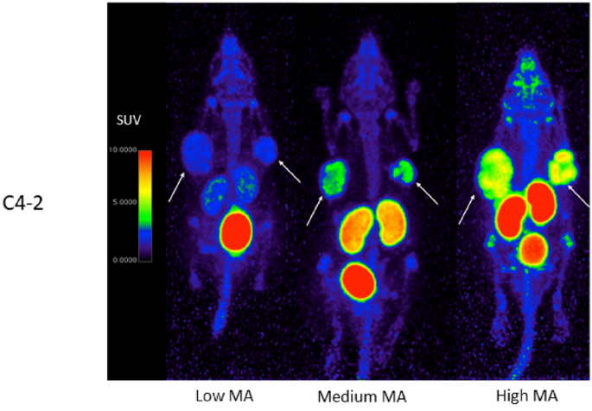
Biological Evaluation
Same target, different mass dose
Low apparent molar activity
more cold PSMA ligand
→ receptors partially saturated
→ weaker tumor uptake
High apparent molar activity
less cold ligand
→ more free receptors for tracer
→ stronger tumor uptake
Piron, S., Verhoeven, J., De Coster, E. et al. Impact of the molar activity and PSMA expression level on [¹⁸F]AlF-PSMA-11 uptake in prostate cancer. Sci Rep 11, 22623 (2021). https://doi.org/10.1038/s41598-021-02104-6
GGSB Workshop 2026 47 10.09.2026

Slide 48
Summary
1
2
3
4
5
6
7
8
Clinical
question
Target
Identification
Tracer
design
Nuclide
production
Separation /
labelling
Quality
control
Biological
Evaluation
Clinical Translation
Which process or
receptor matters?
Vector • linker •
radionuclide
Reaction route •
energy • target
Fast chemistry •
high usable activity
Identity • purity •
stability • Aₘ
Binding • blocking •
in vivo validation
Diagnosis • staging •
theranostics
1. What becomes visible?
Tracer and target define the biological signal.
2. Can it be made reliably?
Production, processing and labelling define usable activity.
3. Can the signal be trusted?
QC and biological controls prove specificity.
GGSB Workshop 2026 48 10.09.2026

Slide 49
Thank You For Your Attention!

