Slide 1





AgroBot
A smart, self-navigating, tracked robot prototype designed to automate crop spraying (or irrigation).
For farmers managing precision agriculture on small-to-medium plots or greenhouse environments.
Title bot name here
Engineered with environmental responsibility at its core, key structural components utilize upcycled materials, including repurposed plastic bottles for fluid reservoirs, directly reducing plastic waste.
Built with accessible microelectronics and efficient low-power relays, AgroBot delivers high-end automation at a fraction of commercial costs. Optimized fluid delivery minimizes liquid waste and operational expenses.
AgroBot combines a rugged tracked drive with gyroscope navigation for reliable straight-line movement. Sensor-driven automation ensures precise fluid distribution, maximizing efficiency across diverse field terrains.

Slide 2
Key Features
AgroBot
A smart, self-navigating, tracked robot prototype designed to automate crop spraying (or irrigation).
Agro Bot combines a rugged tracked drive with gyroscope navigation for reliable straight-line movement. Sensor-driven automation ensures precise fluid distribution, maximizing efficiency across diverse field terrains.
Built with accessible microelectronics and efficient low-power relays, Agro Bot delivers high-end automation at a fraction of commercial costs. Optimized fluid delivery minimizes liquid waste and operational expenses.
Engineered with environmental responsibility at its core, key structural components utilize upcycled materials, including repurposed plastic bottles for fluid reservoirs, directly reducing plastic waste.
For farmers managing precision agriculture on small-to-medium plots or greenhouse environments.

Slide 3
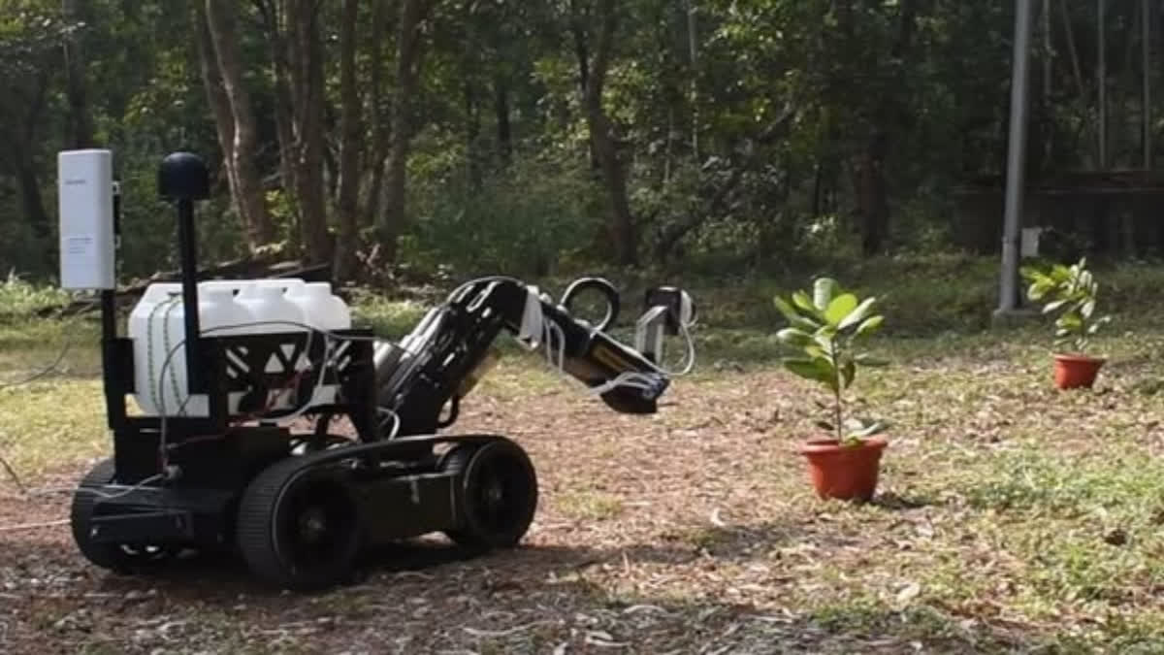
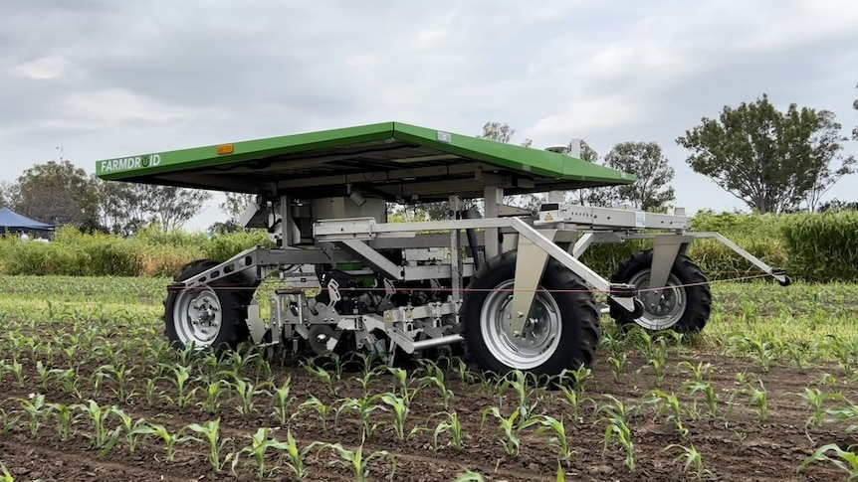
Unlike similar products like ones in the images shown here Agro Bot is a generalized machine which helps medium sized crop owners quite a bit because of its cost being several times cheaper than the industrial one
For example:
General industry estimates for weeding/pesticide robots range from approximately $35,000 to over $500,000 for high-end, self-propelled AI systems.

Slide 4

Relays/Drivers
Arduino UNO
SLA battery 1.3AH/20HR for power
Main Parts
Tank Tracks with 12v motors
Mini pumps 12v
Inputs
Sensors

Slide 5
Relays/Drivers
MPU6050 6-Axis Motion Sensor (Gyroscope + Accelerometer)
Function: Tracks the robot's orientation, tilt, and angular velocity in real time.
Primary Role in AgroBot: Provides dynamic straight-line trajectory correction. If uneven terrain or track slippage causes the robot to drift, the Arduino uses MPU6050 feedback to adjust motor steering instantly.
Main Parts
Communication: I^2C protocol
Inputs
Sensors

Slide 6
Relays/Drivers
Potentiometer
Acts as a tactile input dial for navigating through the OLED screen's UI menu
Main Parts
Button
For confirmation and choosing crop parameters.
Inputs
Sensors

Slide 7
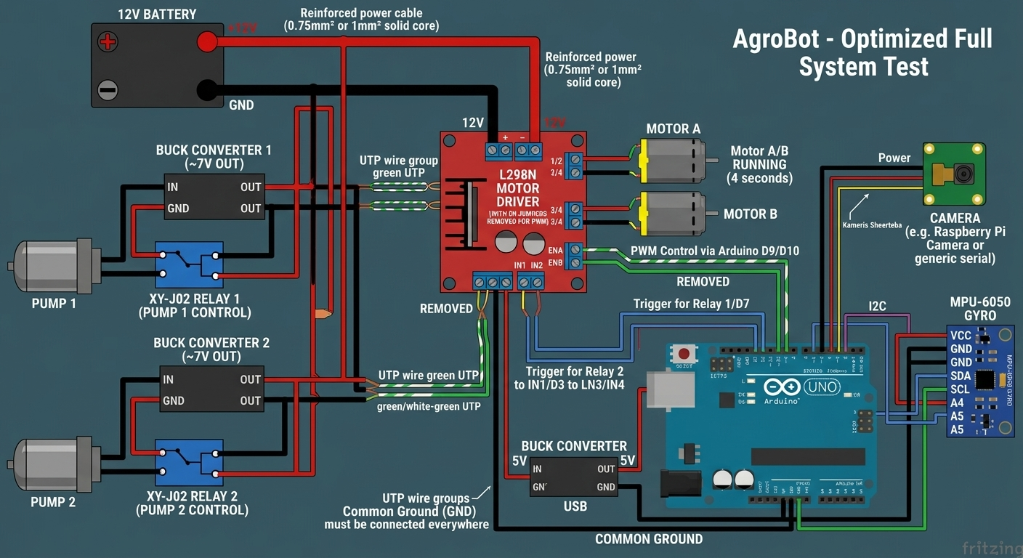
Relays/Drivers
L298N Dual H-Bridge Motor Driver
High-power dual DC motor controller that interfaces low-power logic signals from the Arduino with high-current motors.
Main Parts
XY-J02 Digital Relay Timer Module
Optocoupler-isolated relay module with integrated timing circuit and digital readout screen.
Inputs
Sensors

Slide 9
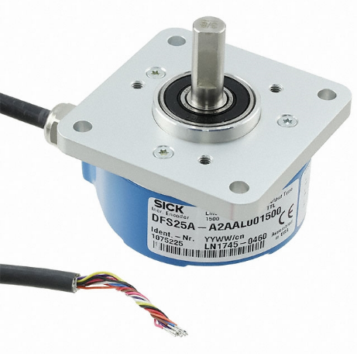
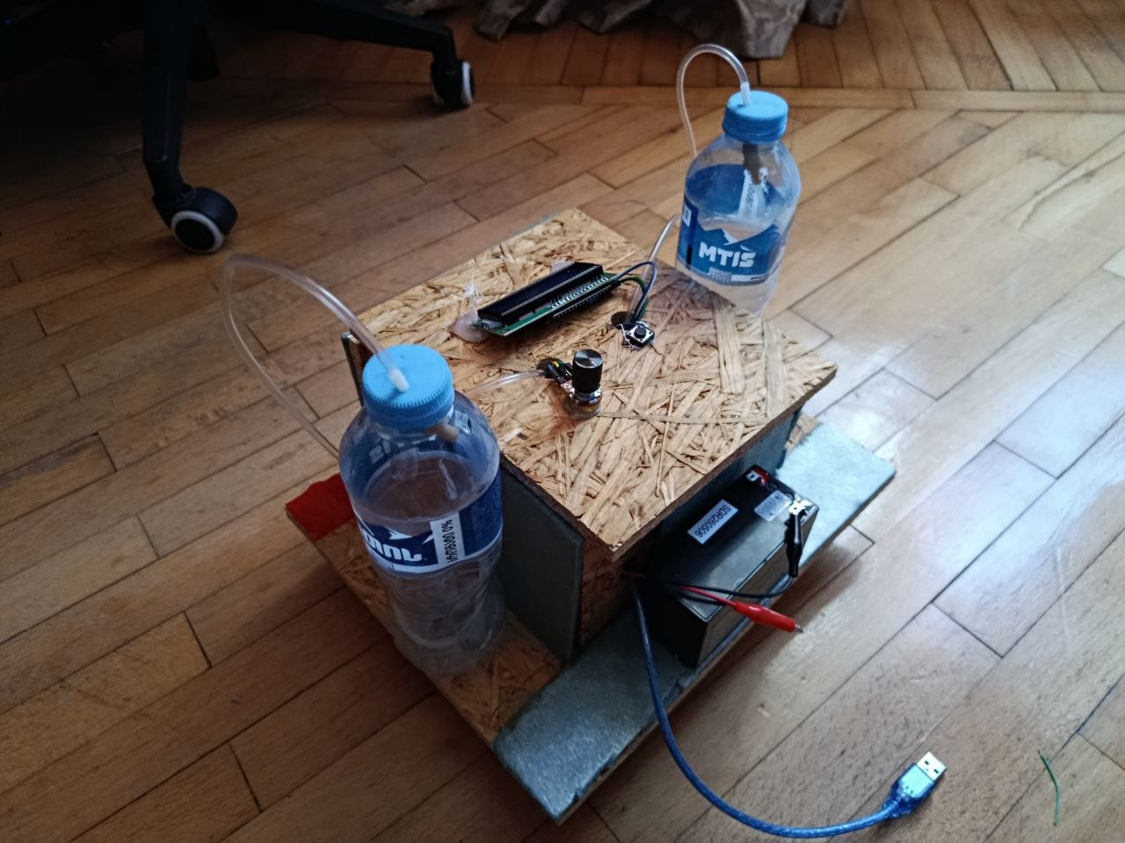
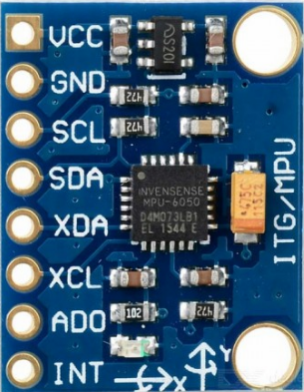
Pathing and adjustment Logic
Heading Initialization
(Setting Target Angle)When you select a drive mode from the OLED menu and start the robot, the Arduino reads the initial orientation from the MPU6050 via the I2C bus . This starting angle is stored in memory as the Target Heading
Error Calculation & Dynamic Steering Adjustment
When the Arduino calculates the deviation angle:
For example left drift; Arduino pulse-corrects by momentary pulse modulation to the right track to pivot back left. Because the L298N hardware jumpers are locked to 100% speed, steering corrections are executed through micro-adjustments in track drive direction (HIGH/LOW pin states) rather than variable speed reduction.
Real-Time Yaw Rate Reading
(Detecting Drift)While moving forward, the MPU6050 continuously measures angular velocity (yaw rate) around the Z-axis at high frequency If the robot hits a bump, mud, or experiences track slippage, the actual heading deviates from the target heading

Slide 10
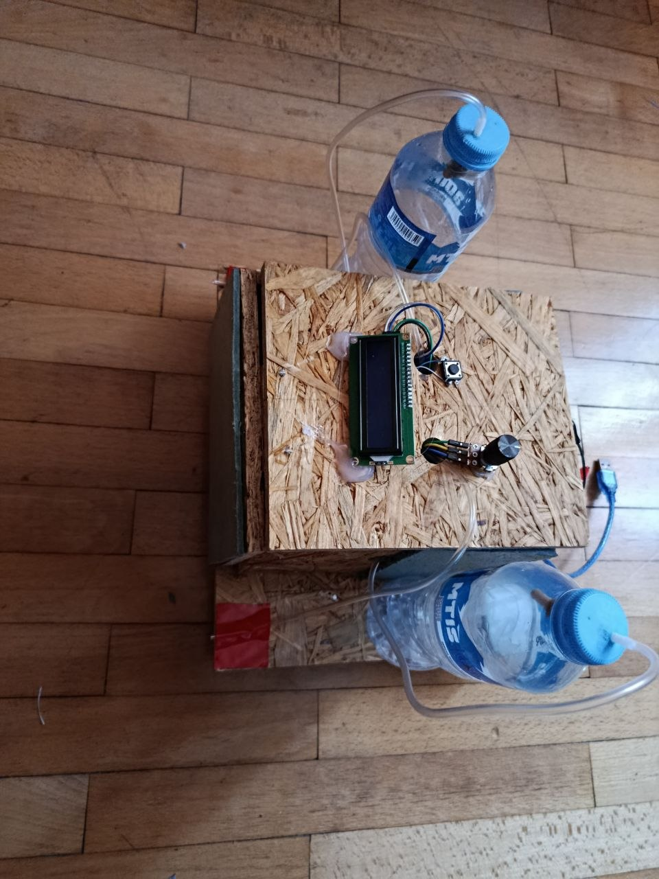
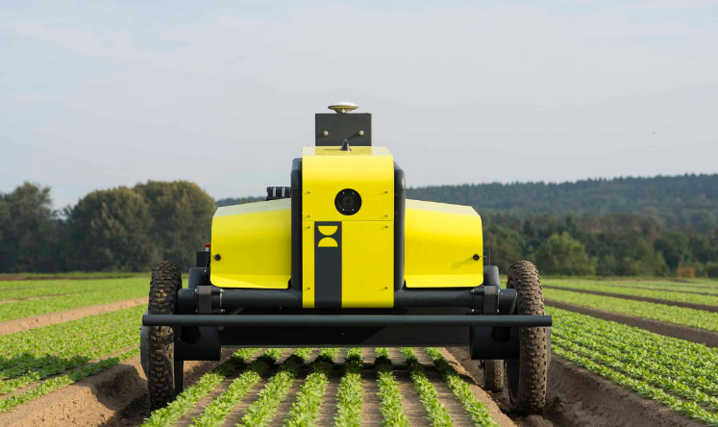
Pros over commercially available models:
Ultra-Low Cost & High ROI: Commercial spraying robots cost thousands of dollars, making them inaccessible for small-scale farming. AgroBot delivers core precision-spraying and gyro-guided navigation at a fraction of the cost, using affordable, off-the-shelf microelectronics.
Open Source Architecture: Built on the accessible Arduino platform, all hardware schematics and control firmware are fully open-source. Users have complete transparency and ownership over their system without proprietary software locks or subscription fees.
Modular & Highly Customizable: Designed with a flexible modular layout, AgroBot can easily be modified to fit specific farm needs—whether adding extra spray nozzles, swapping tanks, or upgrading chassis tracks.
Easy Upgradability: The system is built to evolve. Farmers or developers can easily add new sensors (such as ultrasonic obstacle avoidance, soil moisture sensors, or camera-based AI tracking) by connecting them directly to the open expansion pins on the Arduino board.
Eco-Friendly & Sustainable Construction: By integrating upcycled materials—such as repurposed plastic bottles for fluid reservoirs—AgroBot reduces plastic waste while keeping manufacturing costs exceptionally low.
Modular & Highly Customizable: Designed with a flexible modular layout, AgroBot can easily be modified to fit specific farm needs—whether adding extra spray nozzles, swapping tanks, or upgrading chassis tracks.
Rapid Repairability & Local Parts Sourcing: Unlike commercial systems that require specialized technicians and expensive vendor parts, every component on AgroBot (from L298N drivers to standard DC pumps) can be swapped in minutes using widely available, low-cost electronics.

Slide 11
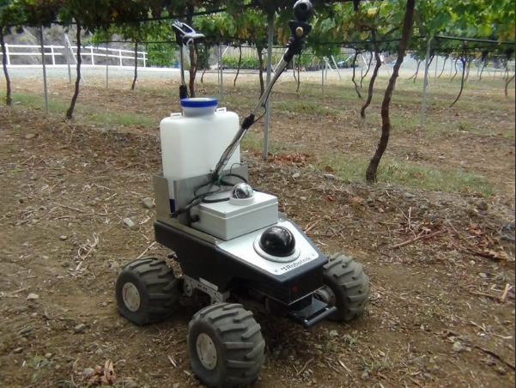
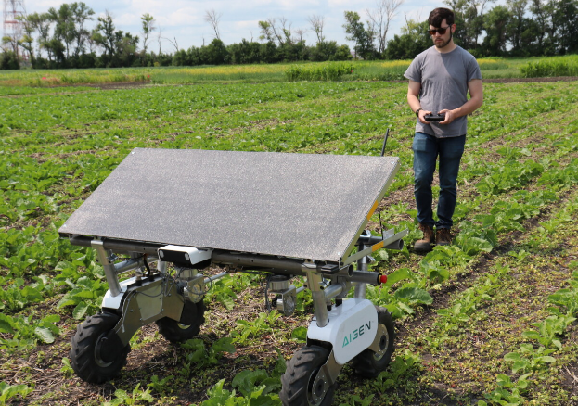
Ultra-Low Cost & High ROI: Commercial spraying robots cost thousands of dollars, making them inaccessible for small-scale farming. AgroBot delivers core precision-spraying and gyro-guided navigation at a fraction of the cost, using affordable, off-the-shelf microelectronics.
Pros over commercially available models:
Modular & Highly Customizable: Designed with a flexible modular layout, AgroBot can easily be modified to fit specific farm needs—whether adding extra spray nozzles, swapping tanks, or upgrading chassis tracks.
Rapid Repairability & Local Parts Sourcing: Unlike commercial systems that require specialized technicians and expensive vendor parts, every component on AgroBot (from L298N drivers to standard DC pumps) can be swapped in minutes using widely available, low-cost electronics.
Easy Upgradability: The system is built to evolve. Farmers or developers can easily add new sensors (such as ultrasonic obstacle avoidance, soil moisture sensors, or camera-based AI tracking) by connecting them directly to the open expansion pins on the Arduino board.
Eco-Friendly & Sustainable Construction: By integrating upcycled materials—such as repurposed plastic bottles for fluid reservoirs—AgroBot reduces plastic waste while keeping manufacturing costs exceptionally low.
Open Source Architecture: Built on the accessible Arduino platform, all hardware schematics and control firmware are fully open-source. Users have complete transparency and ownership over their system without proprietary software locks or subscription fees.
Modular & Highly Customizable: Designed with a flexible modular layout, AgroBot can easily be modified to fit specific farm needs—whether adding extra spray nozzles, swapping tanks, or upgrading chassis tracks.

Slide 12
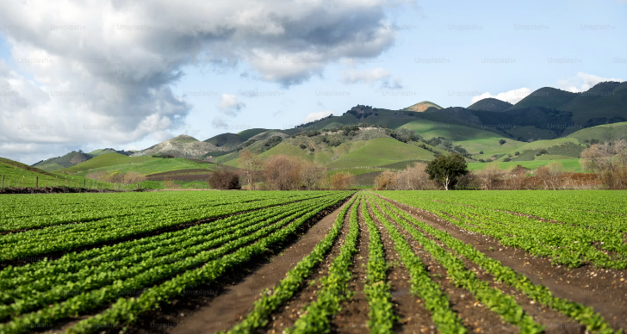
Easy Upgradability: The system is built to evolve. Farmers or developers can easily add new sensors (such as ultrasonic obstacle avoidance, soil moisture sensors, or camera-based AI tracking) by connecting them directly to the open expansion pins on the Arduino board.
Eco-Friendly & Sustainable Construction: By integrating upcycled materials—such as repurposed plastic bottles for fluid reservoirs—AgroBot reduces plastic waste while keeping manufacturing costs exceptionally low.
Cons over commercially available models:
Modular & Highly Customizable: Designed with a flexible modular layout, AgroBot can easily be modified to fit specific farm needs—whether adding extra spray nozzles, swapping tanks, or upgrading chassis tracks.
Rapid Repairability & Local Parts Sourcing: Unlike commercial systems that require specialized technicians and expensive vendor parts, every component on AgroBot (from L298N drivers to standard DC pumps) can be swapped in minutes using widely available, low-cost electronics.
Basic Obstacle Detection: The initial core design prioritizes autonomous line-following and precise timed spraying; active dynamic obstacle avoidance requires adding optional ultrasonic or LiDAR expansion modules.
SLA Battery Energy Density Sealed Lead-Acid battery provides
a working runtime of approximately
30\45 minutes under full operational load
(motors + pumps active),
requiring recharging or battery
swaps for extended field sessions.
Manual Calibration Required: Without expensive multi-constellation GPS or RTK correction modules, straight-line tracking relies purely on MPU6050 gyroscope integration, which requires initial calibration to offset drift over long distances.

Slide 13
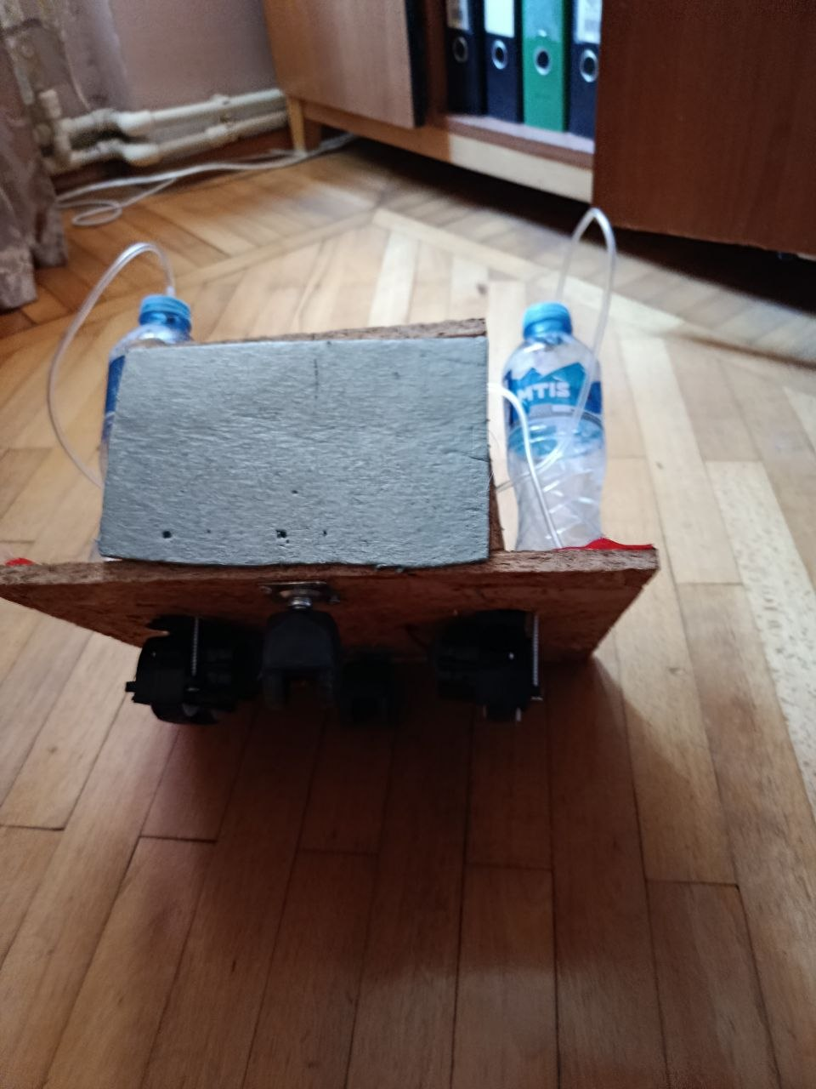
The End
Thanks for your attention
Made By: Alexander Tsurtsumia

