Slide 1

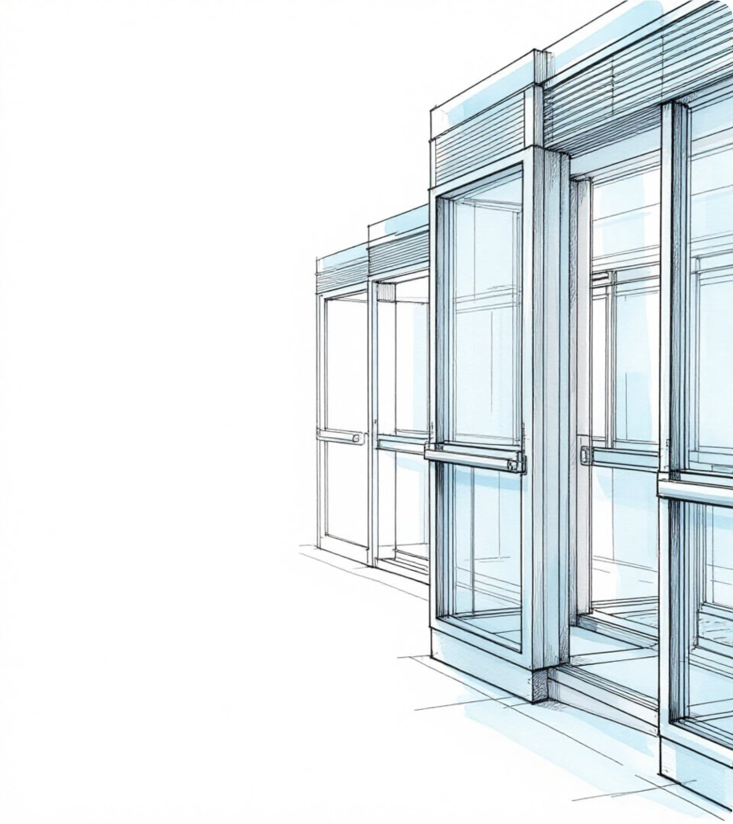




Platform
Screen Door
Systems
Engineering safety and operational efficiency
in high-density urban rail environments.

Slide 2


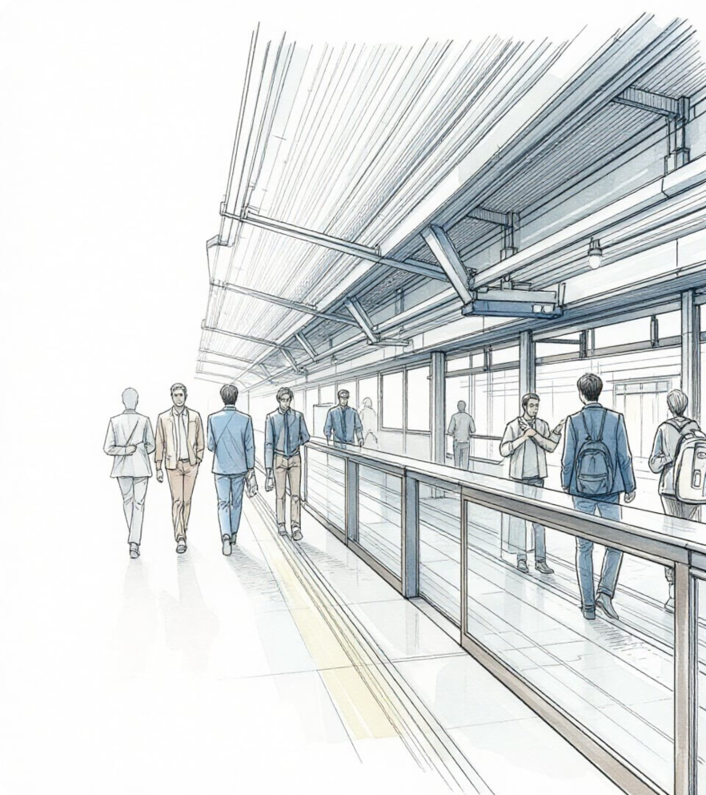



Introduction
The Vital Urban Artery

Slide 3


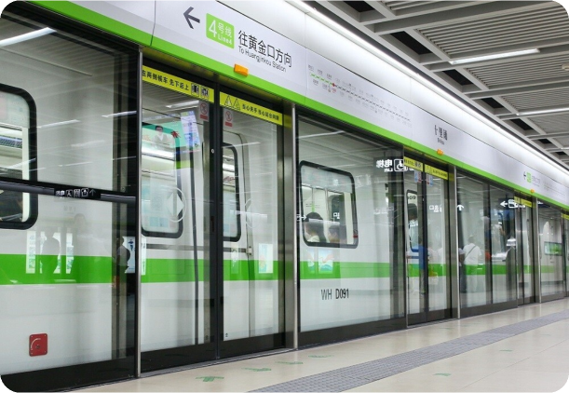
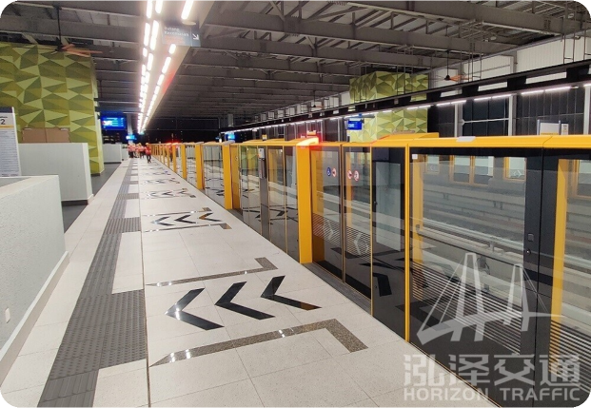
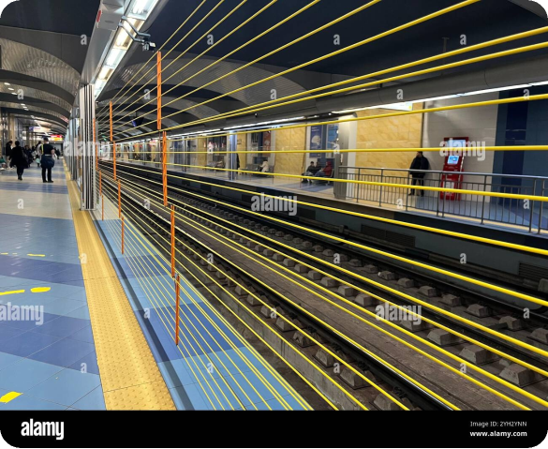
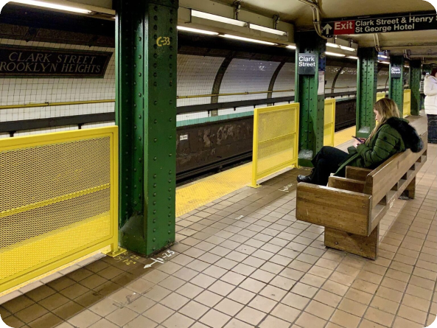
Technical Specifications

Slide 4

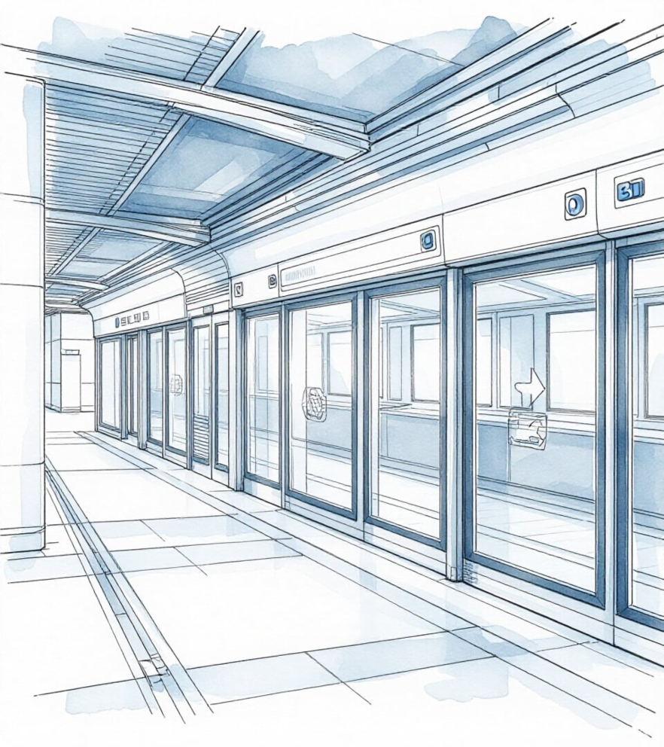
Regional Trends
South Korea & China

Slide 5


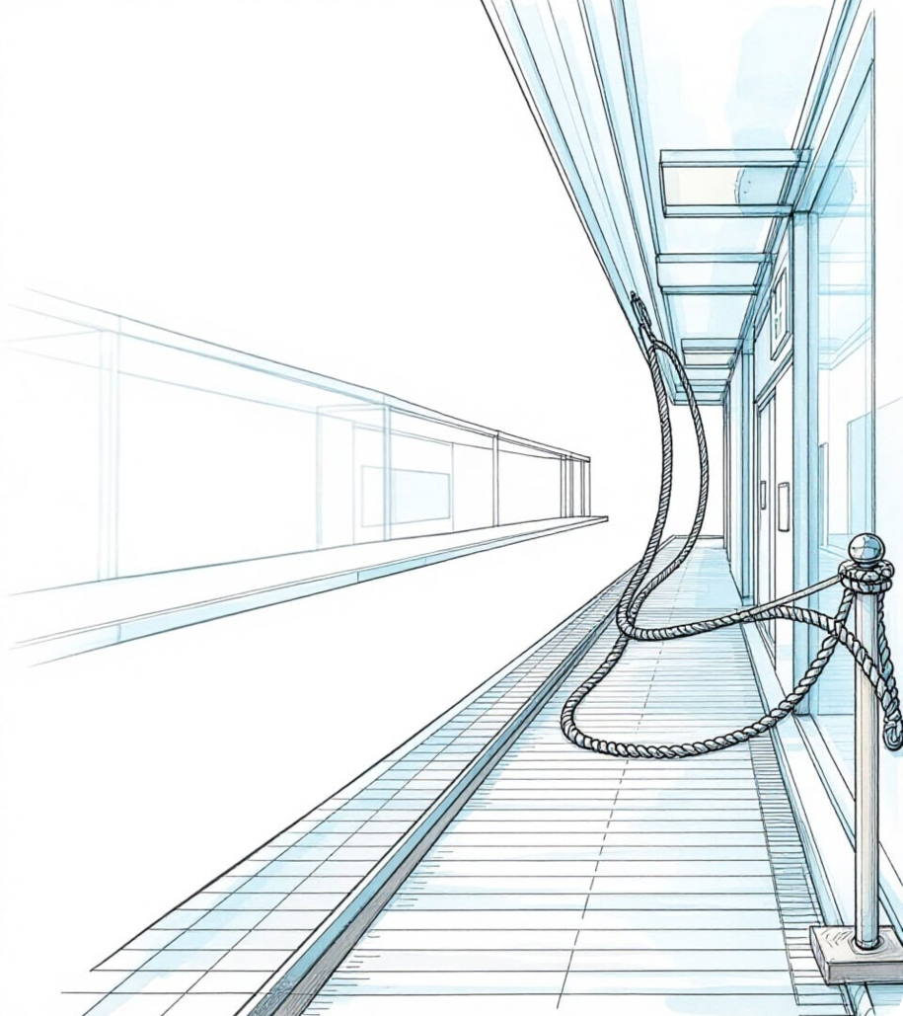
Comparative Analysis
Japan, Europe & North America

Slide 6

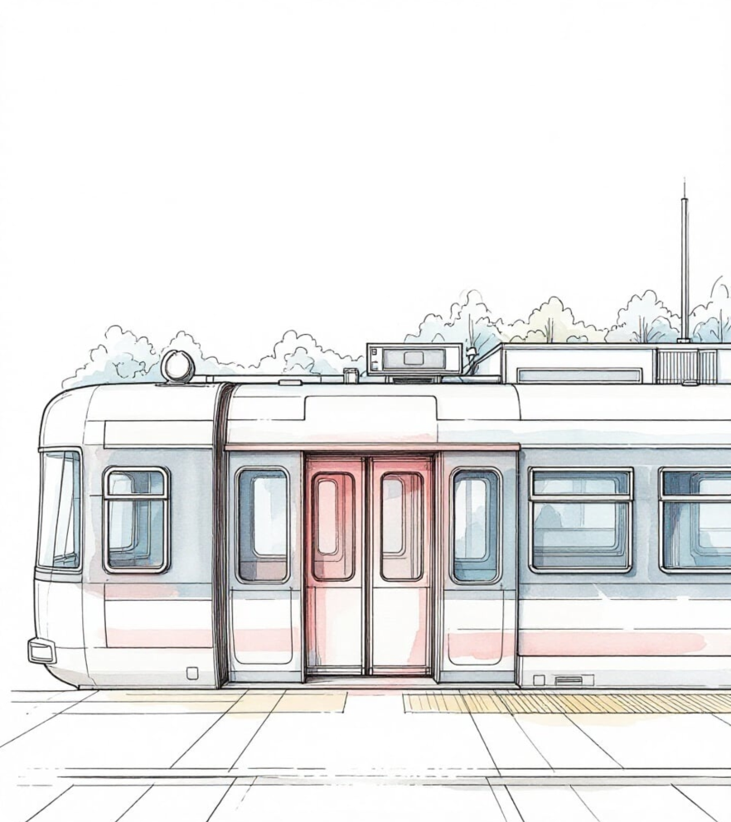
Critical Safety Risk
The Fatal Void Space

Slide 7
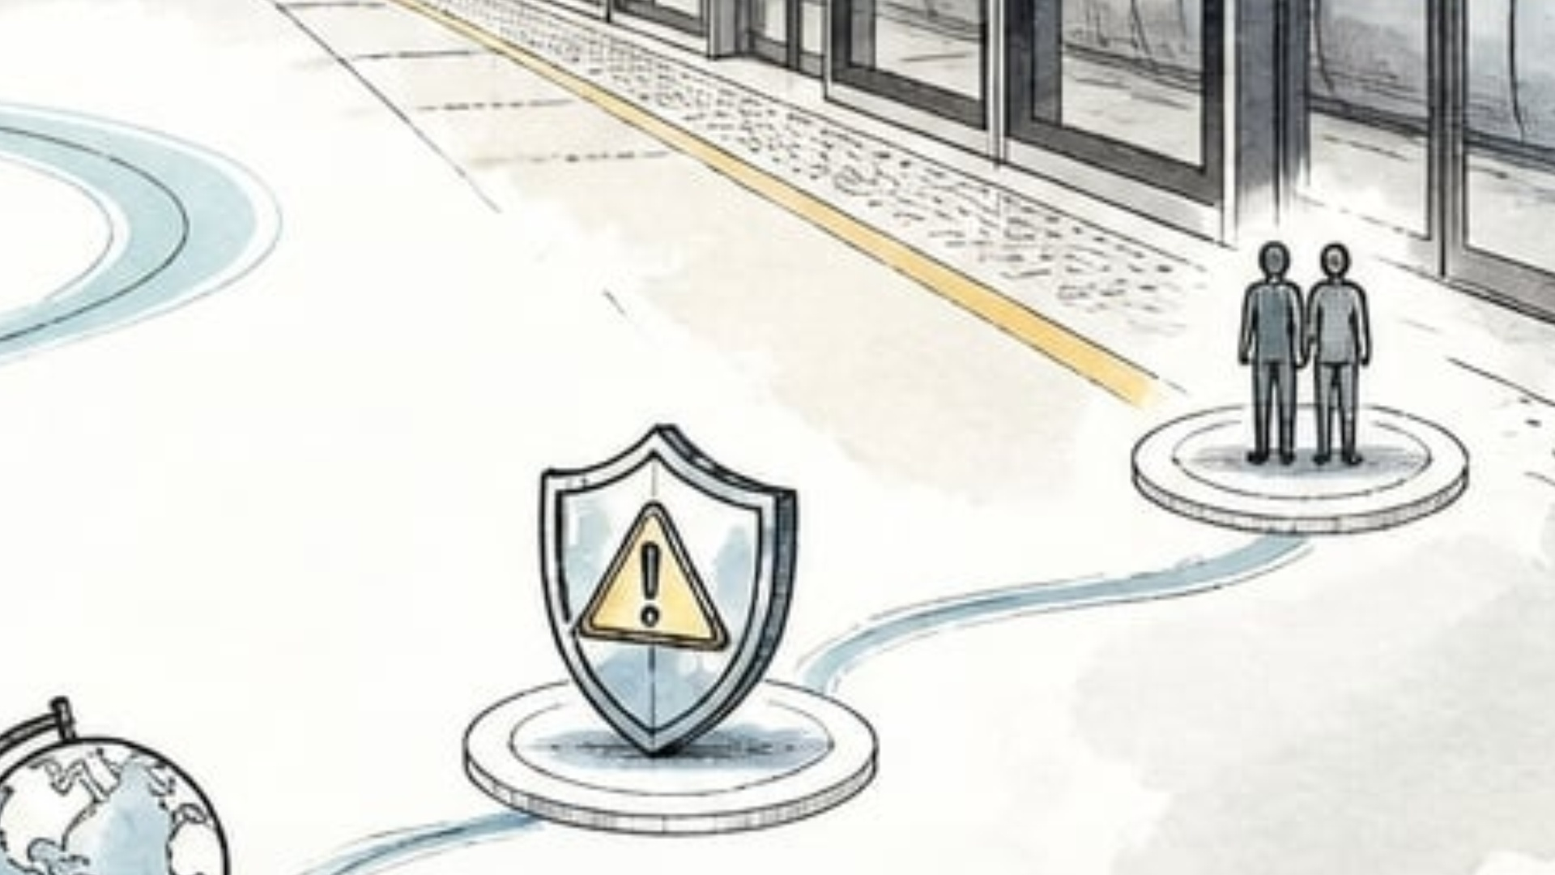
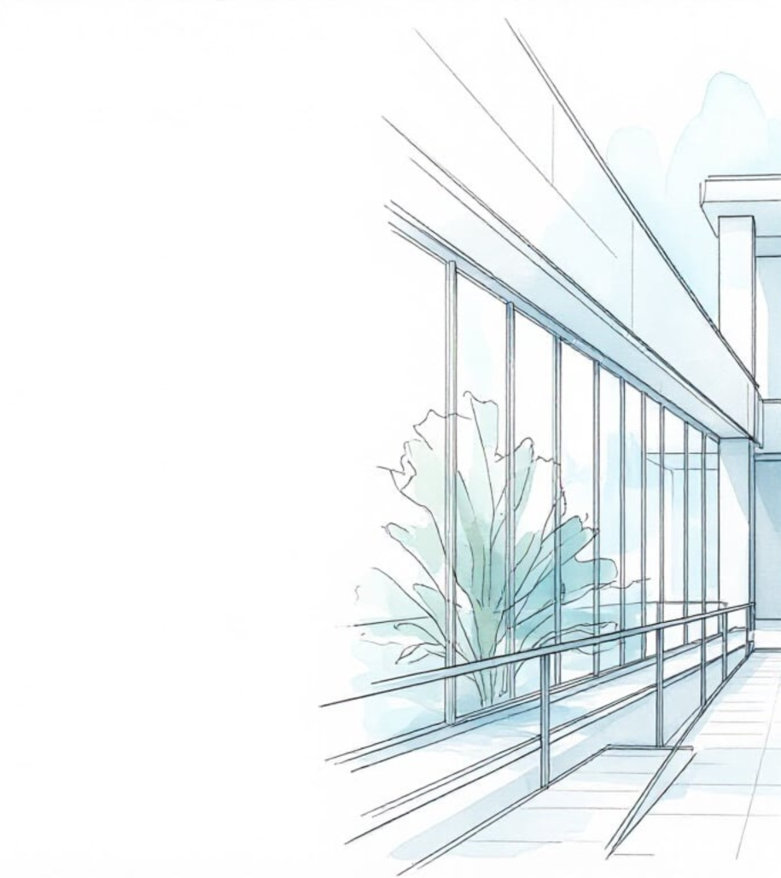
CONCLUSION
Thank you for your
time and attention

Slide 8
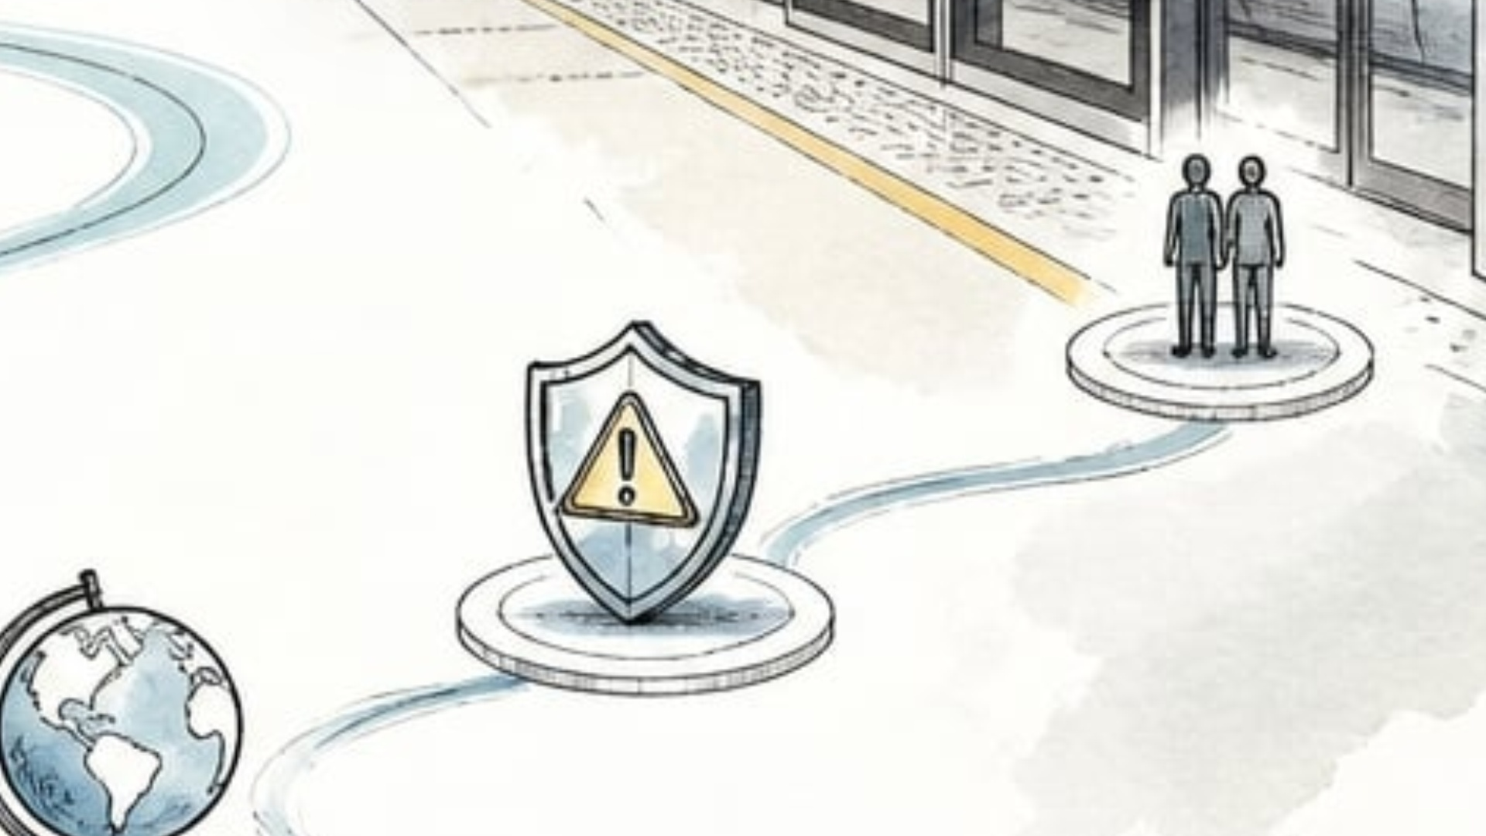

Bibliography
http://www.seoulmetro.co.kr/en/page.do?menuIdx=649
https://www.mlit.go.jp/tetudo/tetudo_tk6_000043.html
https://www.uitp.org/publications/world-report-on-metro-automation/
https://www.caixinglobal.com/2014-11-07/woman-dies-after-getting-trapped-in-doors-of-beijing-subway-101012932
https://www.koreaherald.com/article/980490
https://www.youtube.com/watch?v=NKiqiFmIjJ0

