Slide 1
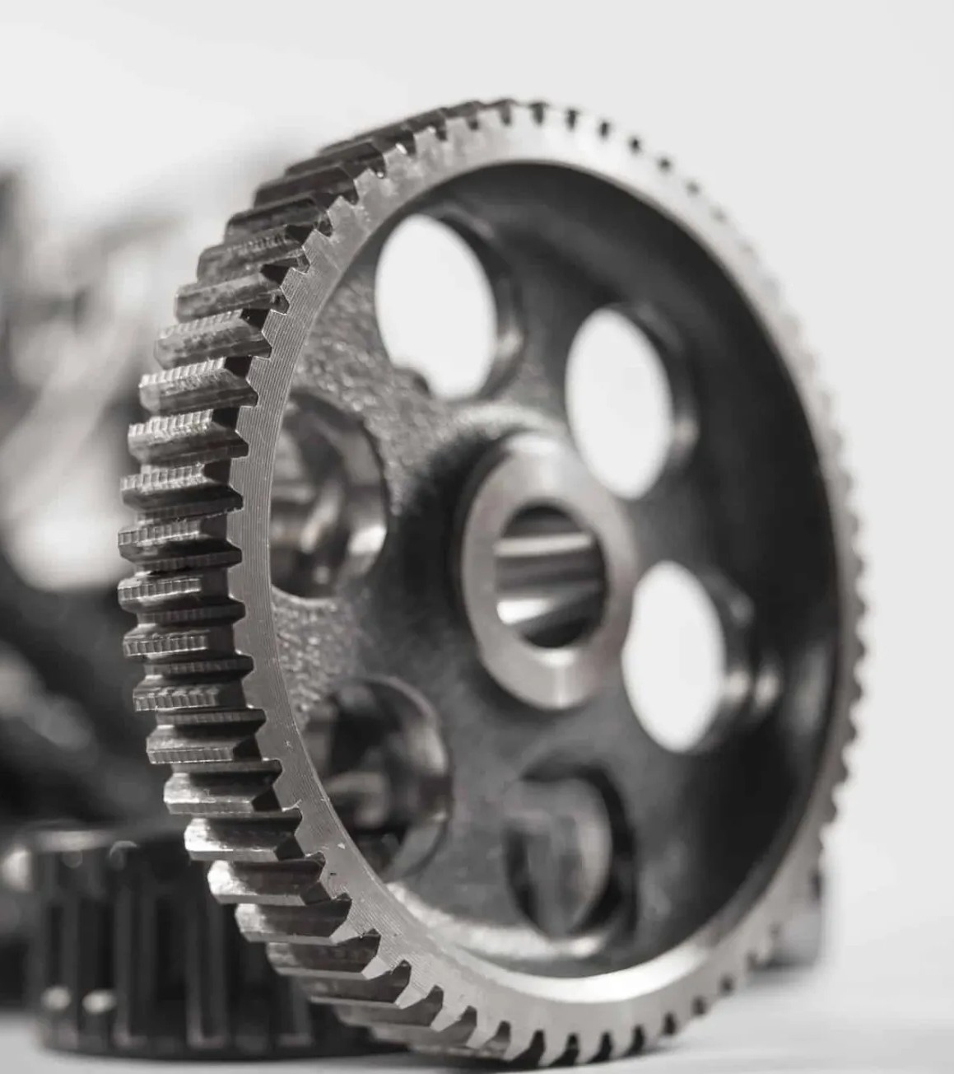

Design and development of a 6-DOF Articulated manipulator for multi-task capability
Student Sandro Khvedeliani
Bachelor of mechanical engineering
Agricultural university of Georgia
Mail: skhve2023@agruni.edu.ge
Gear link https://www.3ds.com/make/solutions/additive-manufacturing

Slide 2
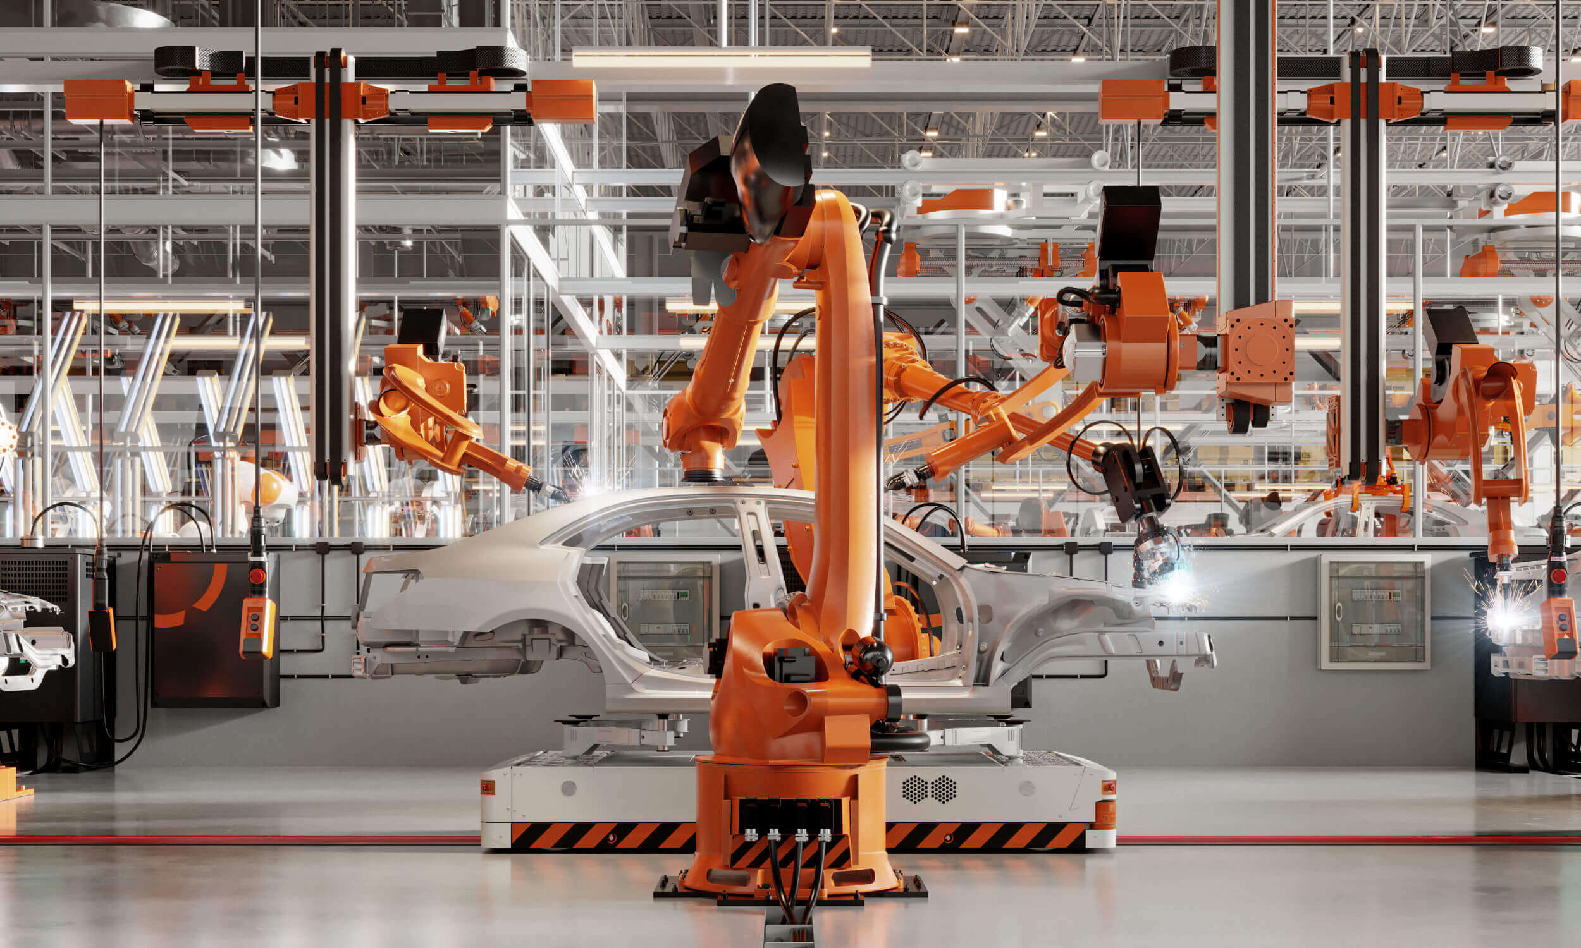
Manufacturing/Assembly
Welding
Painting/coating
Packaging

Slide 3
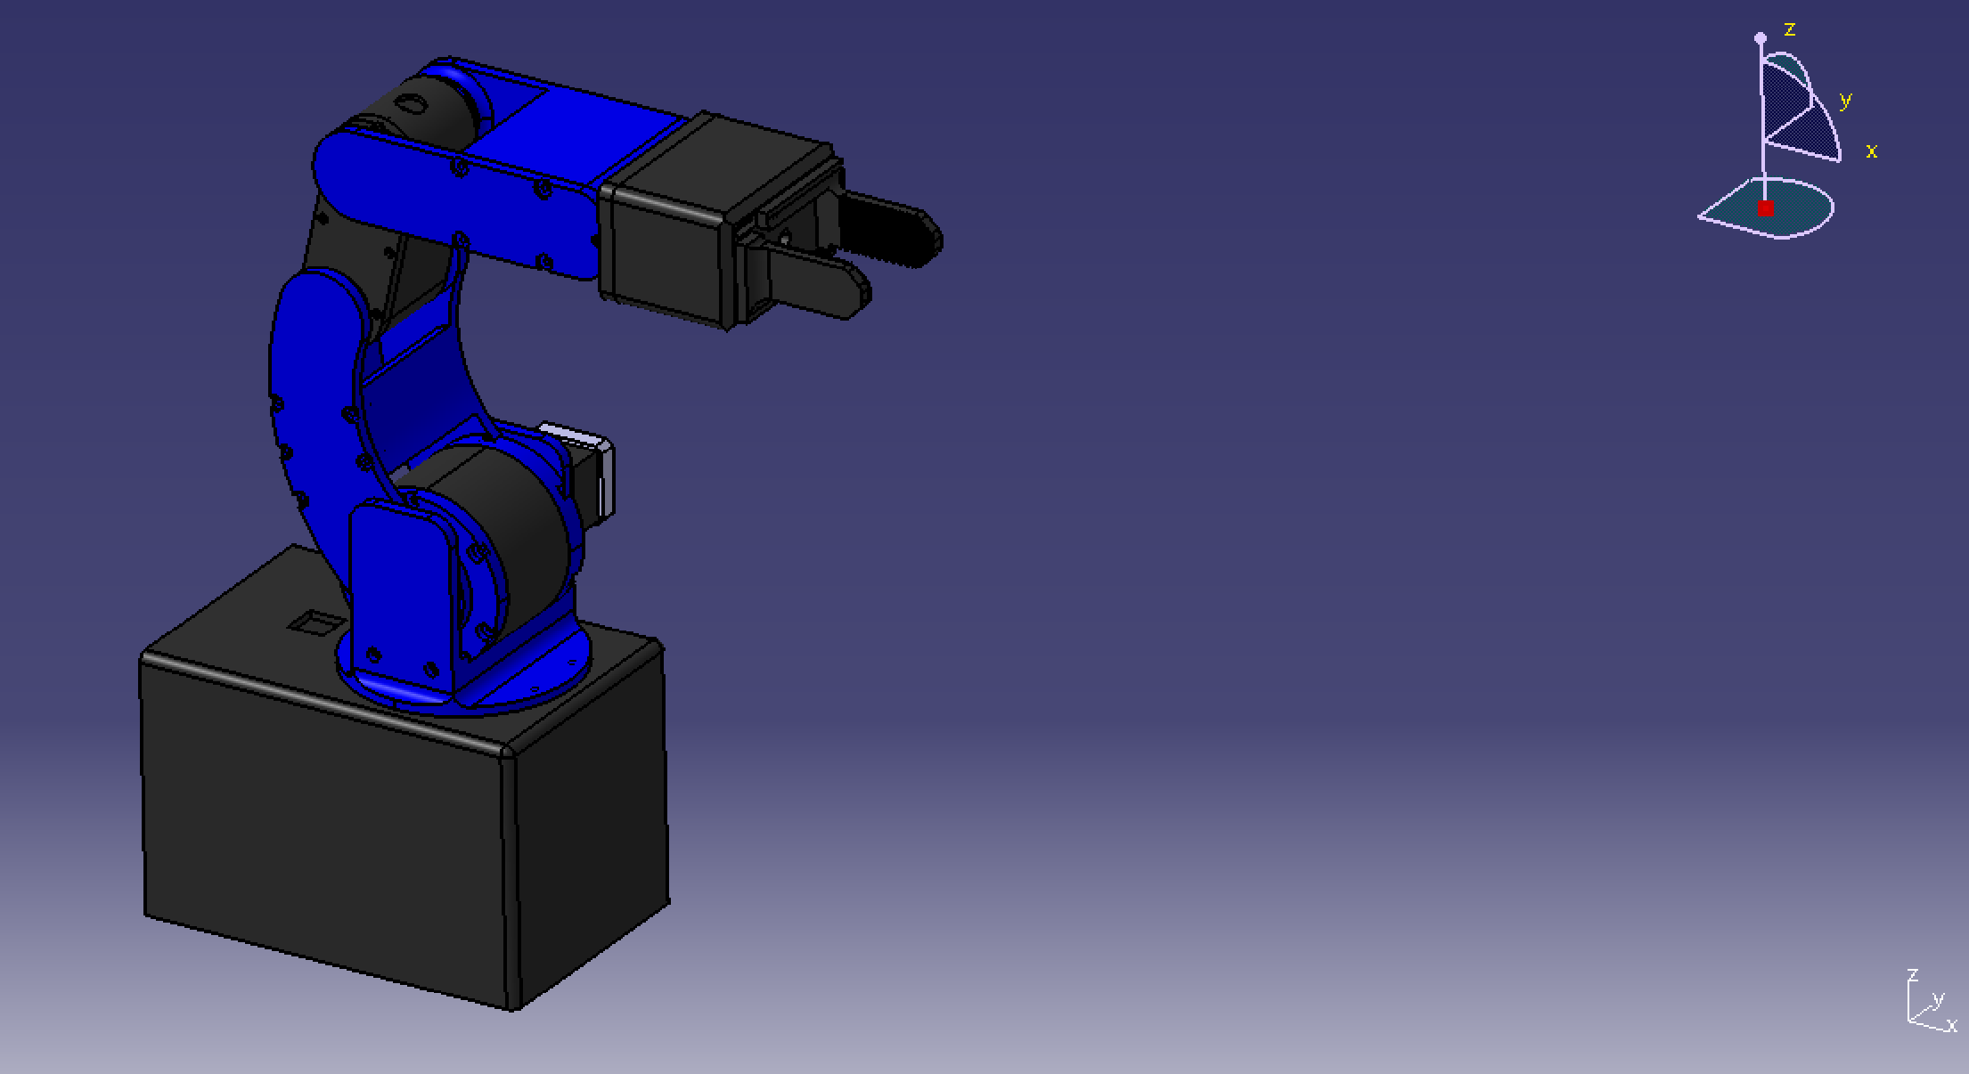
Under 70$
Payload over 1kg
modular design and interchangeable end effectors.
Target positioning accuracy: ±5 mm

Slide 4
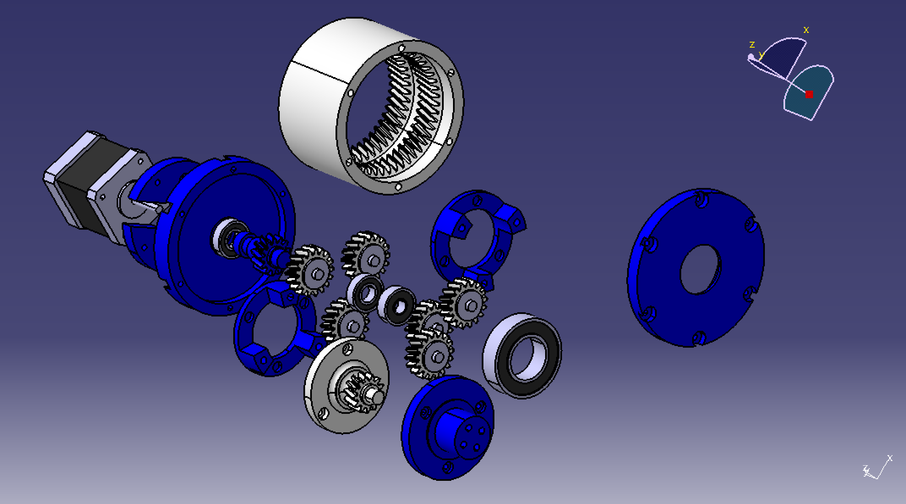
Zr=47
Zp=17
Zs=13
Reductor architecture
i=1+47/13=4.62

Slide 5
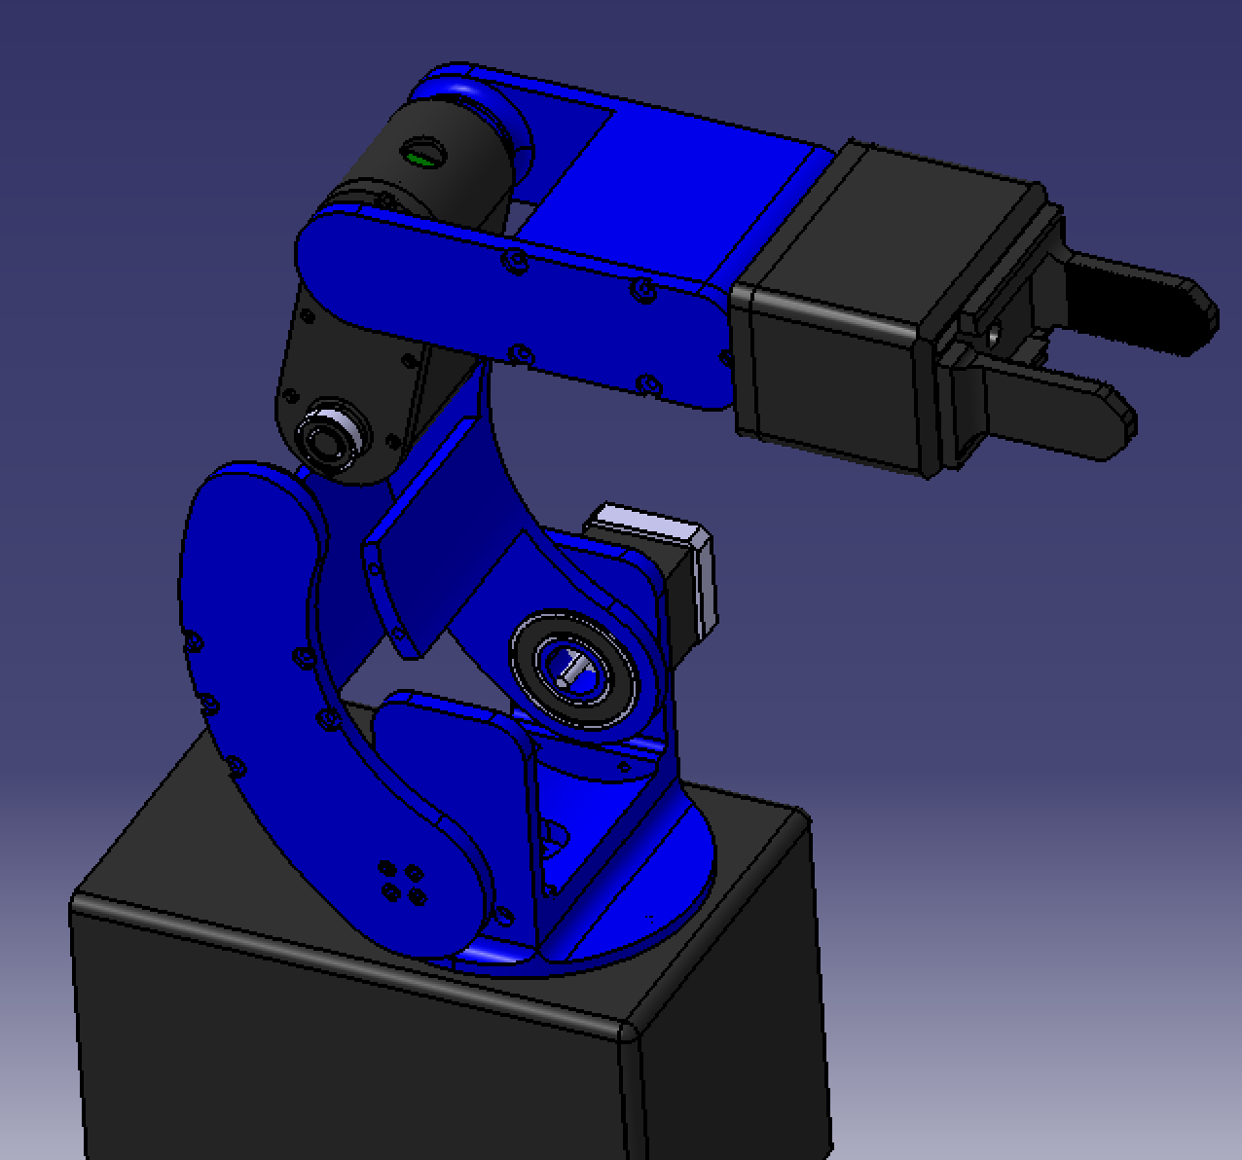
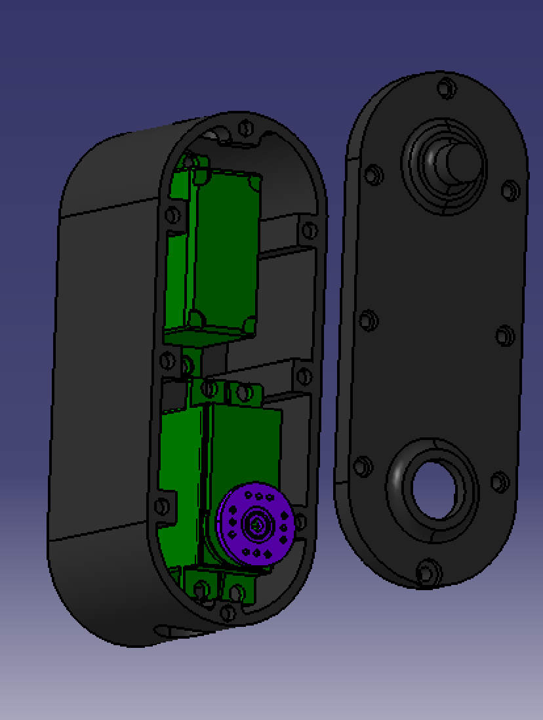

Slide 6
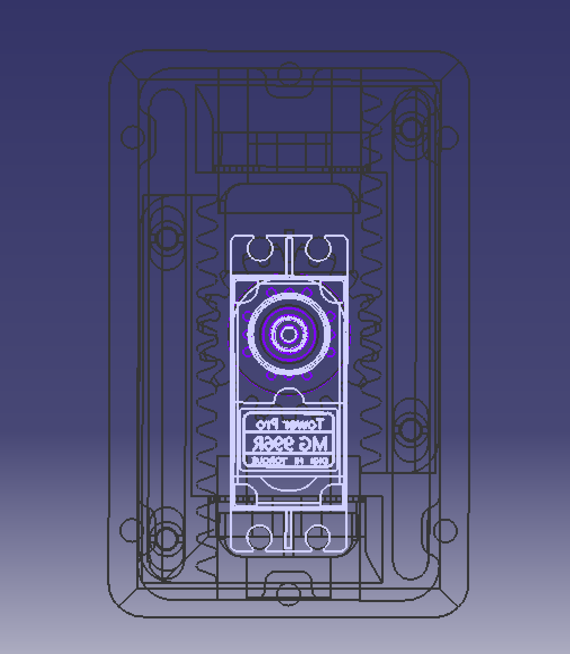
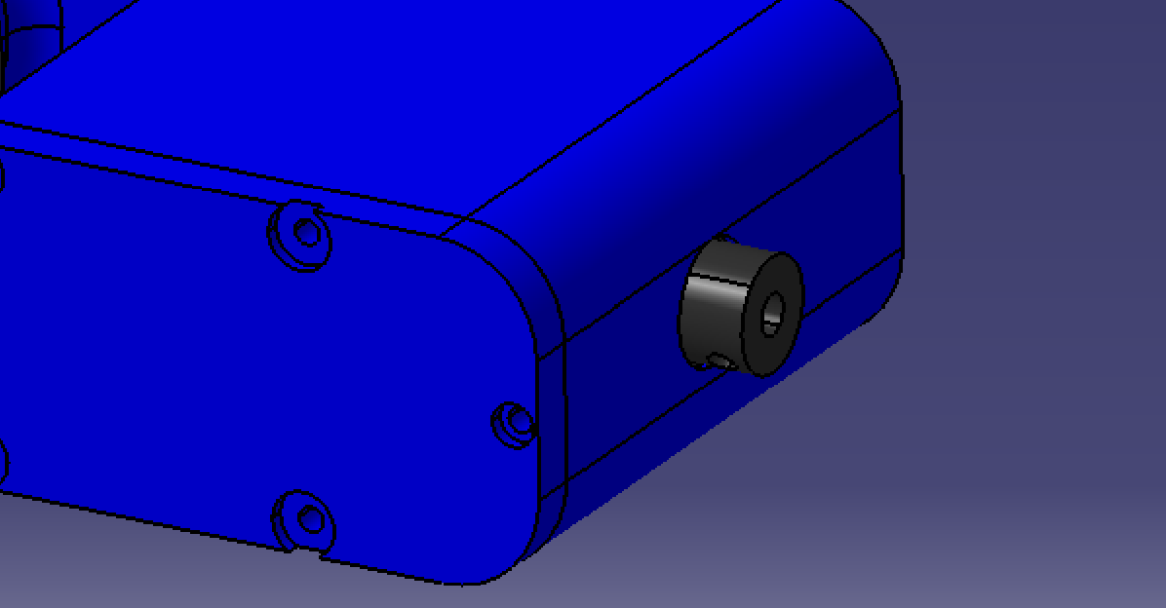
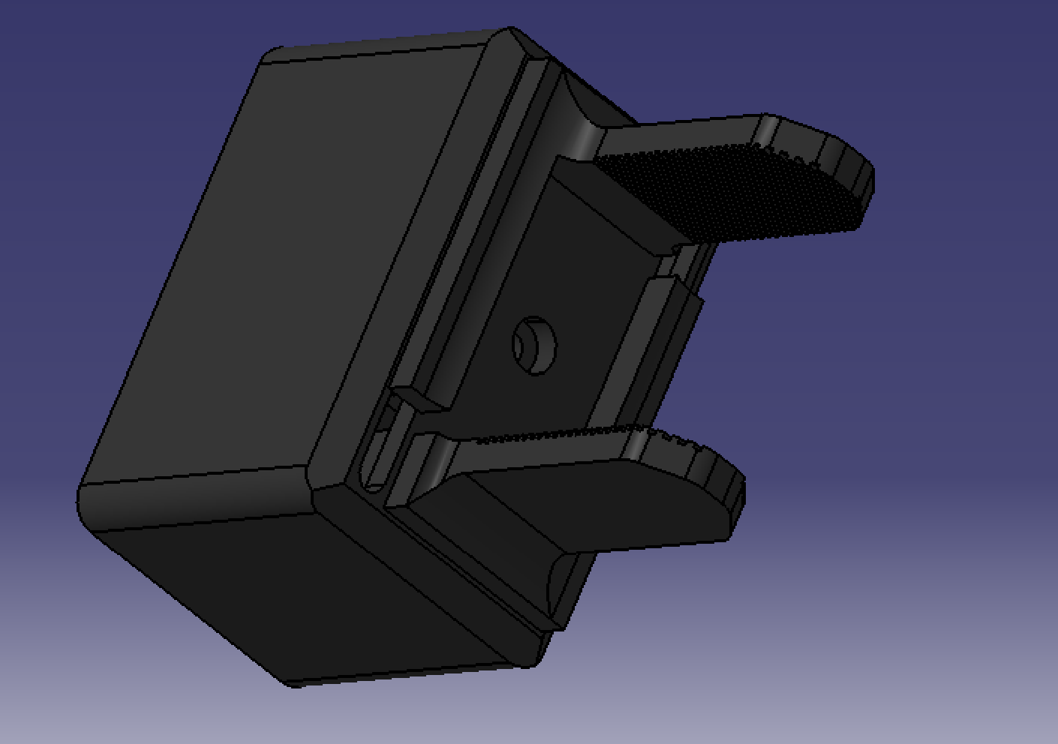

Slide 7
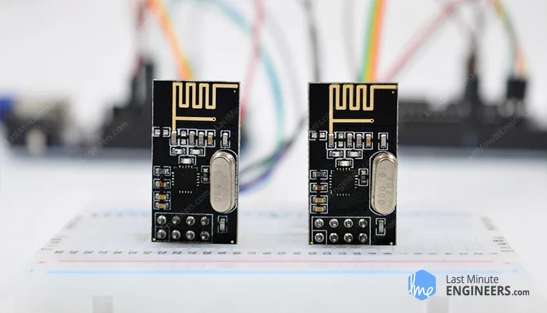
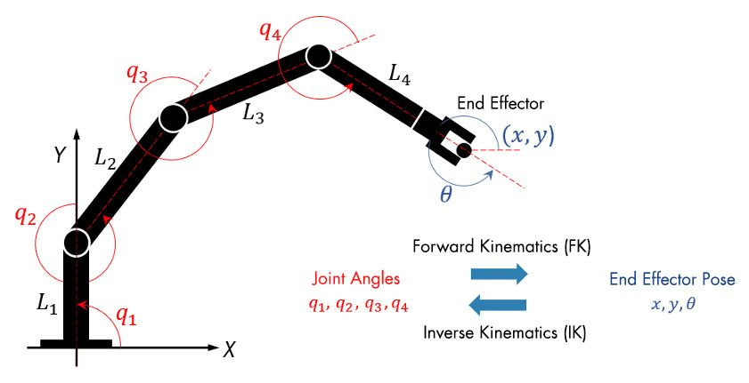
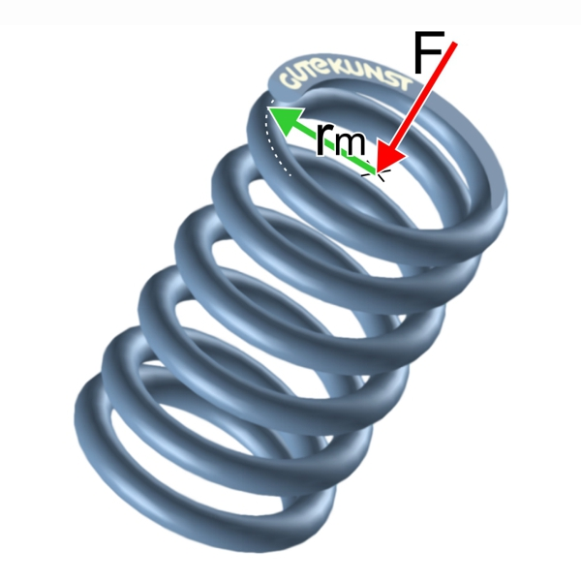
Next Week: Completing the Prototype
Complete printing and assembly of all joints
Integrate remaining mechanical components
inverse kinematics in MATLAB
Replace direct Arduino joystick control with RC control
Add springs for more torque

Slide 8
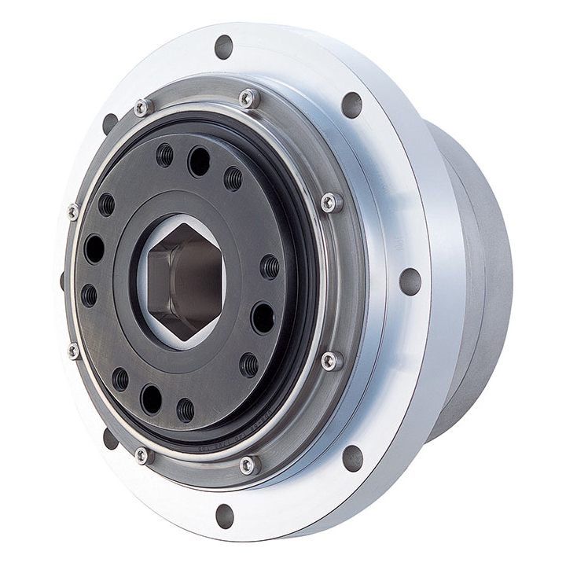
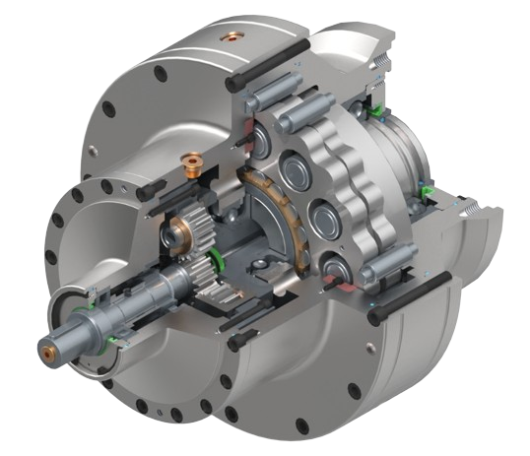
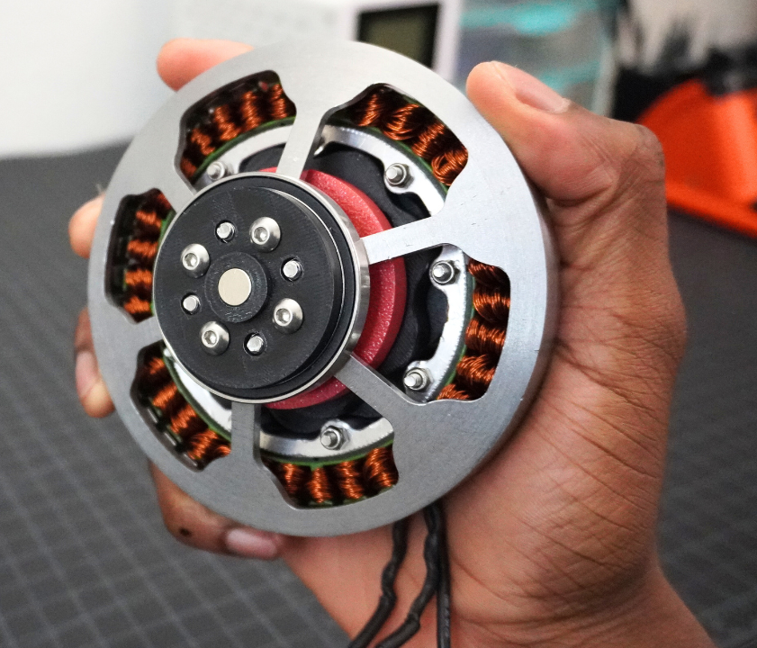
Next Week: Completing the Prototype
Replace current planetary gearbox with a higher-performance transmission
Investigate cycloidal drive and other alternatives
Reduce backlash and improve torque transmission
Increase payload beyond 1 kg

Slide 9
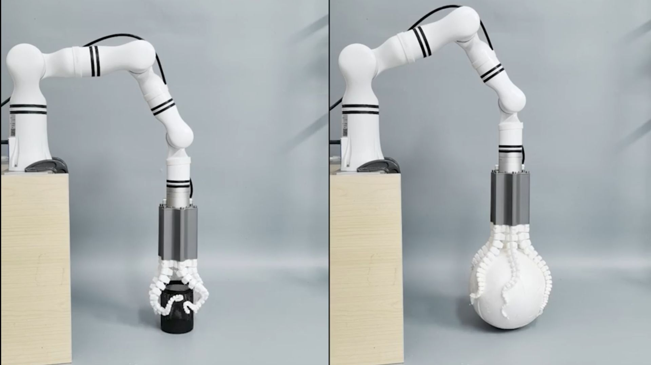
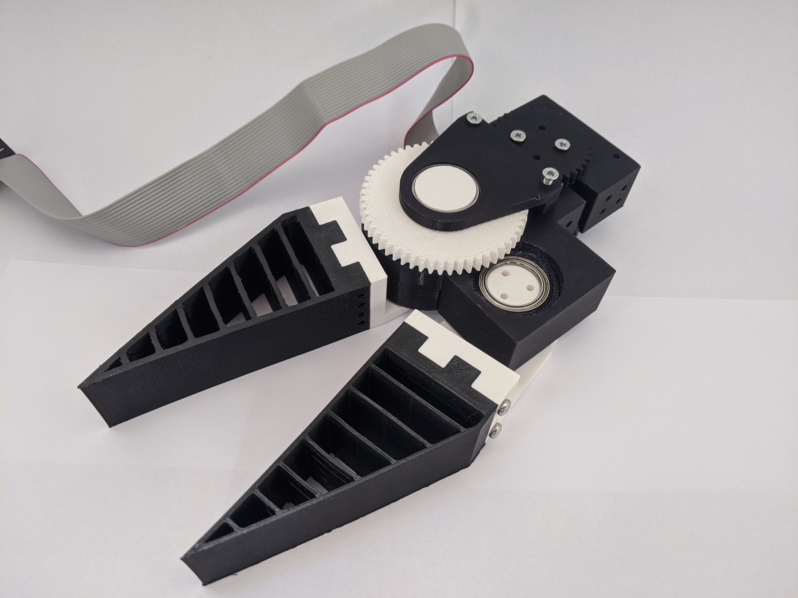
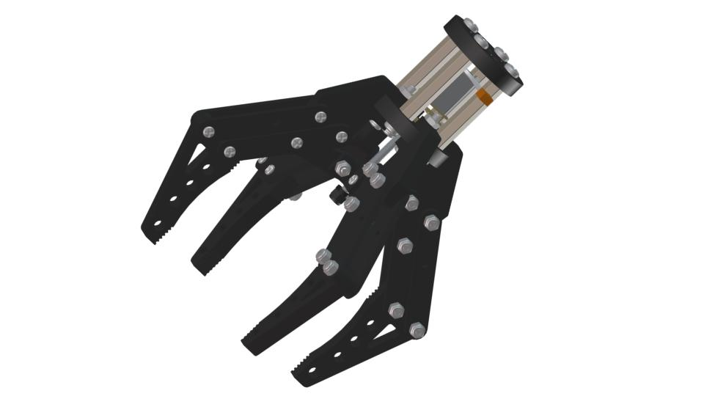
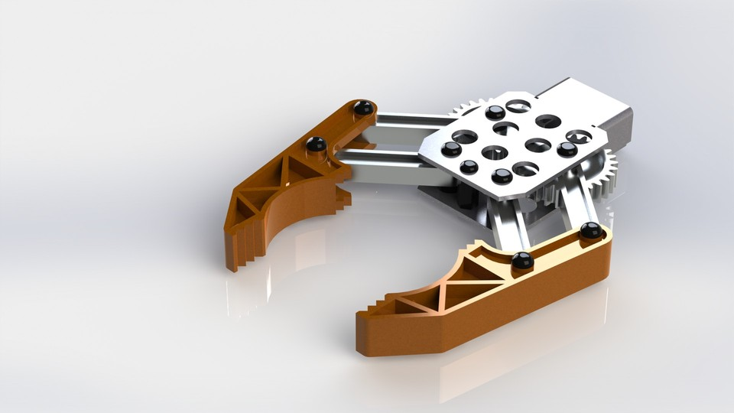

Slide 10
Thanks for attention

