Slide 1
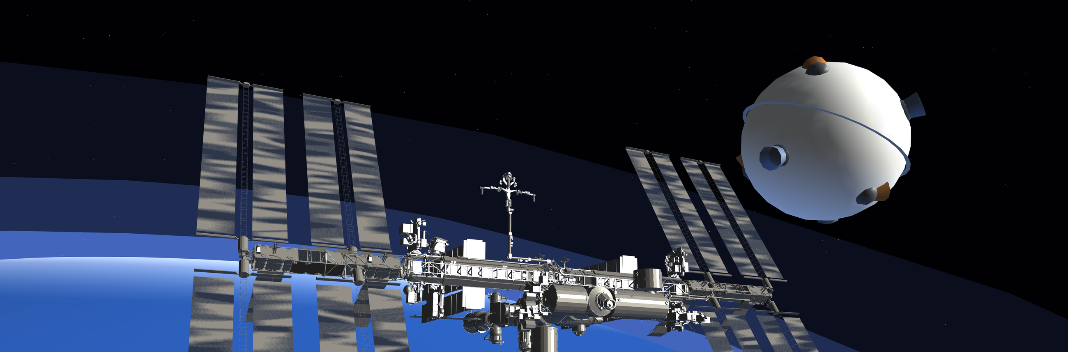


Sphere-1
TEMUR MAKHARADZE, MECHANICAL ENGINEERING
BACHELOR'S THESIS DEFENCE, TBILISI, 10 SEPTEMBER 2026
A miniature drone that flies free in orbit and inspects satellites from close range, pushed by cold gas instead of a chemical rocket. I am going to be covering hrusters, the flight dynamics, and the test rig.
Notes:
0:00-0:40. Hold the ESP32 board. Sphere-1: a 23 cm, 500 g free-flying inspection drone that gets close to assets like the ISS and photographs them. Four disciplines, one loop. Do not read the slide.

Slide 2
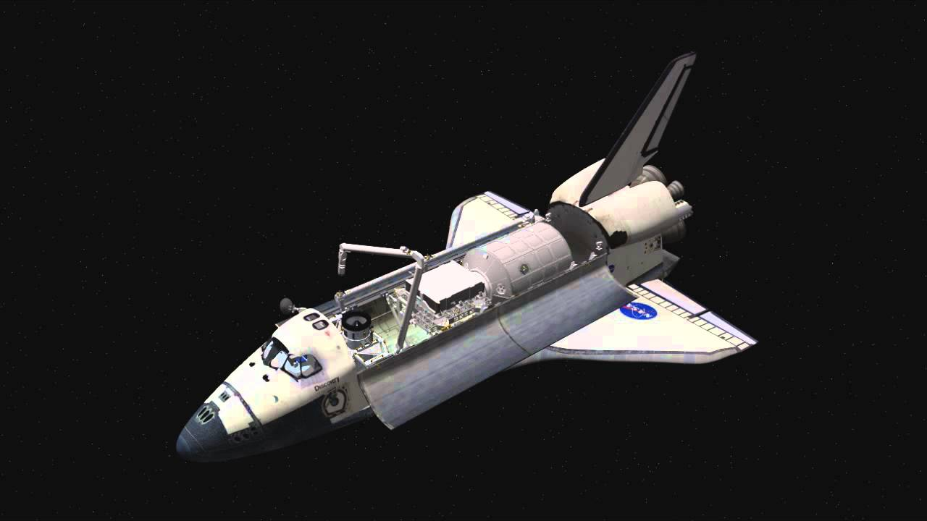
Why this needs to exist
Notes:
Open here, not with the vehicle. Tell it as a story and let the room get uncomfortable at the three cancelled requests. Land the boxed line. Then the aftermath is the argument: a fifty-foot boom and a choreographed backflip are what you build when you have no free-flying camera. SAY THE LIMIT YOURSELF: Sphere-1 would not have flown on Columbia, no arm and no station to deploy from. But the reason that crew never got an answer is that nobody could look, and that is the gap this fills. Never imply the drone would have saved them.

Slide 3
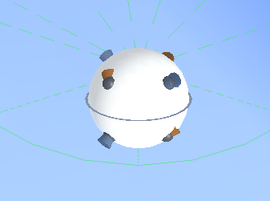
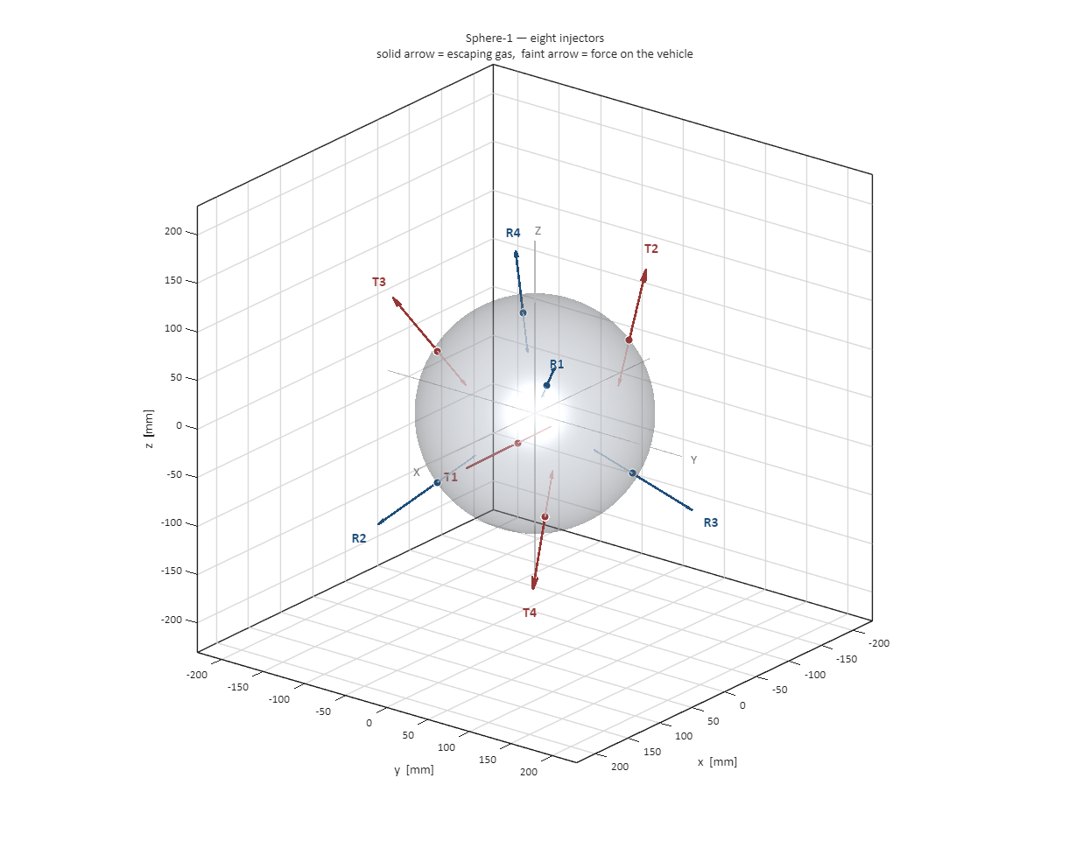
What is Sphere-1?
the vehicle
thrust directions from the eight nozzles
Miniature sphere that flies on its own and manoeuvres within a few metres of the asset, carrying a visible and a thermal camera. Eight cold-gas nozzles, no moving parts outside the valves, and nothing in the exhaust that can settle on what it is photographing.
Notes:
Short slide now that the problem has been stated. Vehicle on the left, the eight push directions on the right. End on the rocket question and go straight to the next slide.

Slide 4
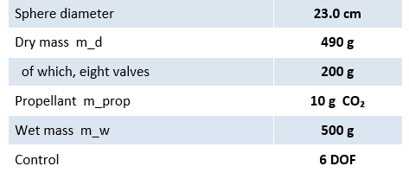
Design constraints
Flying this close rules out a chemical rocket straight away. Its exhaust leaves soot and corrosive residue, and that would settle on exactly the cameras and solar panels the drone was sent to inspect. We would damage the thing we came to photograph.
Quantity
Value
Sphere diameter
23.0 cm
Dry mass m_d
490 g
of which, eight valves
200 g
Propellant m_prop
10 g CO₂
Wet mass m_w
500 g
Control
6 DOF
Scope. This budget covers the functional vehicle: valves, electronics, tank and propellant. Structure, debris shielding and pressure-vessel certification for proximity operations near a crewed asset are outside this thesis and are not estimated. 500 g is a design target chosen to keep the functional core honest, not the mass of a flight article.
Notes:
1:10-1:50. Lead with the constraint. Say 490 grams slowly, and point at the valve line: 200 of those 490 grams are the eight valves. That is the number the actuator section turns on. Then read the scope line out loud, do not let them find it. 500 g is a target you chose to keep the functional core disciplined; certification mass is not yours to estimate. Drawing that boundary yourself is much stronger than being pushed onto it.

Slide 5
Choice of propellant
Nitrogen is the usual choice for cold gas. It gives more push per gram, and it cannot freeze anywhere inside our nozzle. On paper it wins.
Nitrogen N₂
Carbon dioxide CO₂
Isp ceiling
79.6 s
72.5 s
State at 20 °C
gas
liquid
Storage pressure
200 + bar
≈ 57 bar
Tank wall
thick, heavy
thin, light
Stored mass per litre
baseline
several ×
Freezing risk
none
below 216.6 K
It loses on storage. Nitrogen stays a gas at room temperature, so a useful amount needs a 200-bar tank, and a tank that strong is heavy. Carbon dioxide turns liquid at about 57 bar, so the same bottle holds several times as much.
Notes:
3:50-4:35. Give the argument against your own decision first. End on the boxed line; it sets up the next slide.

Slide 6
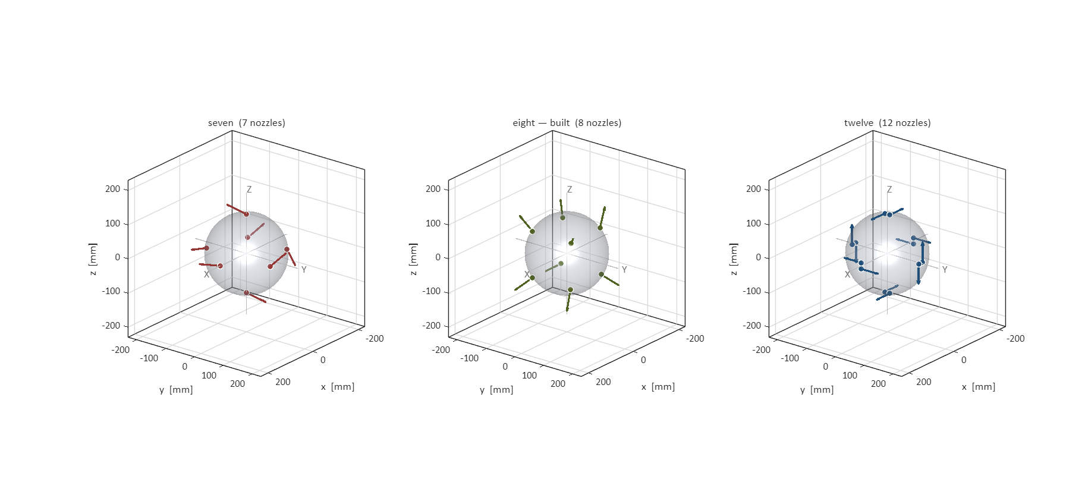
Actuator layout: three iterations
The drone has to control six things at once: push along three axes, and turn about three axes. Thrusters can only push, never pull, and that makes it harder — covering all six directions takes at least seven of them.
Notes:
8:25-9:00. NEW SLIDE. This frames the next three. Say the N+1=7 theorem once, clearly. Then: three iterations, three different failure modes. If anyone asks about the 80 g injector, the boxed line is your answer, and it is honest: the bench part is not the flight part.

Slide 7
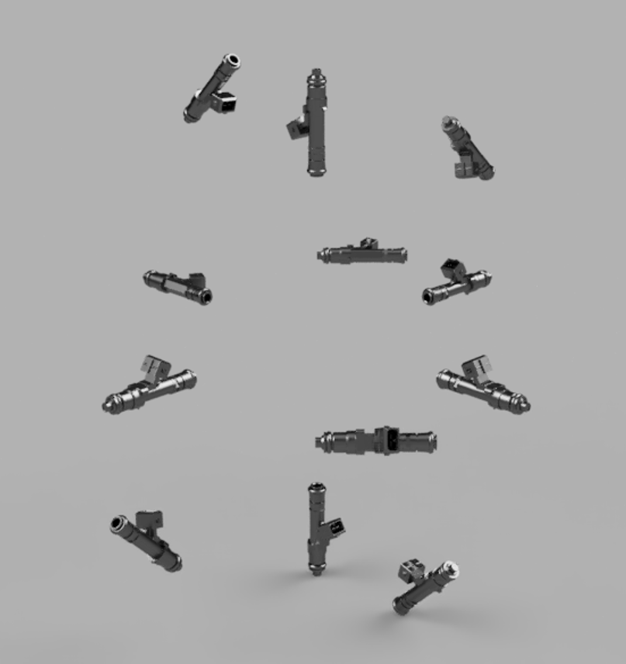
Iteration 1 — twelve nozzles
The conventional layout: six opposing pairs, one for each direction of each axis. Every pair pushes straight along the axis it controls, so choosing which to fire is a lookup table with no real mathematics in it.
What it gets right:
100 %
of fired thrust reaches the commanded axis
21.66 mN·m
torque per pair, 2.78 × the eight-nozzle layout
trivial
allocator — no redundancy to resolve
Why it was abandoned:
Twelve valves at 25 g each is 300 g. Add the 290 g of structure, tank, battery and electronics and there is nothing left for propellant — the design is 90 g over budget before a single gram of gas goes in. It cannot be built, and it is not close.
Six antagonistic pairs, the conventional RCS
More torque per pulse, and nothing to pulse with.
Notes:
9:00-9:35. NEW WORDS on your slide. Be positive about it first: this is the layout that works, and it is what everyone else flies. Give it the 100 % and the 2.78x honestly. Then the mass. The line to land is the boxed one.

Slide 8
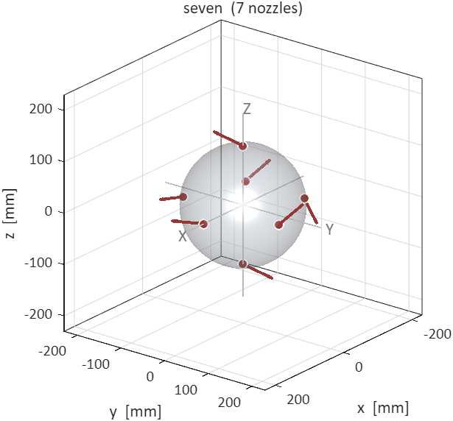
Iteration 2 — seven nozzles
Why it still fails:
1.
No antagonistic pairs exist.
With seven thrusters in general position there is no pair whose thrusts cancel except along one axis. Every command recruits all seven.
2.
Every translation carries a parasitic torque.
The allocator can null it, but only by firing additional thrusters against the ones producing the translation you asked for.
3.
The attitude loop then fights the translation loop.
Each correction perturbs the other axis, and on a 10 g tank that exchange is paid for in propellant until the tank is empty.
Notes:
9:35-10:05. NEW SLIDE. This is the one people forget to ask about, so volunteering it scores. Note the honest part: seven genuinely gives more propellant. It is control coupling that kills it, not mass. That distinction shows you understand both constraints separately.

Slide 9
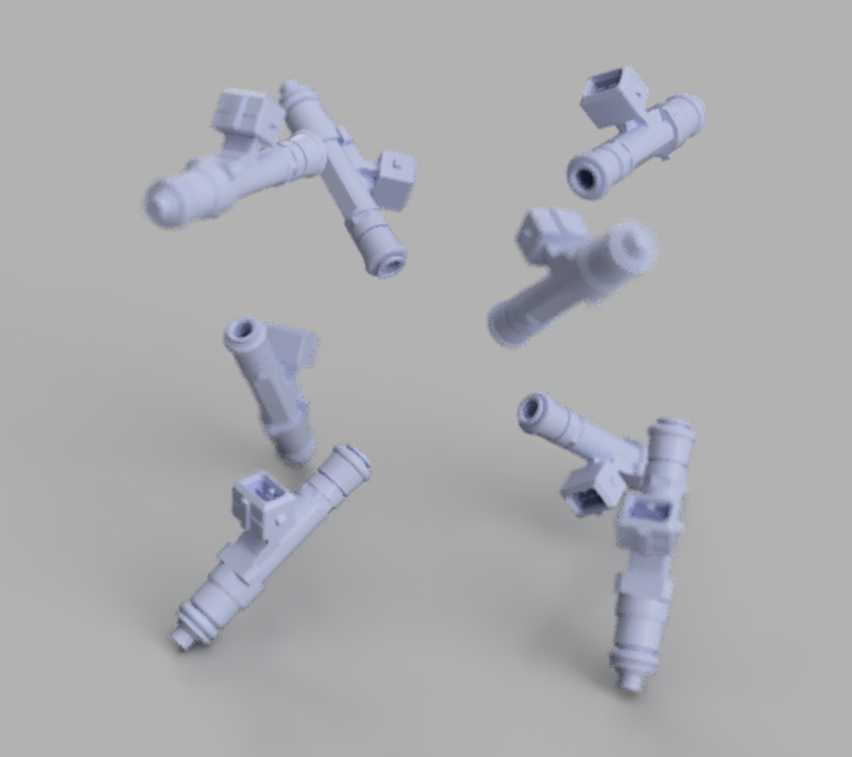
Iteration 3 — eight nozzles
One redundant thruster buys back the decoupling:
R1–R4 radial translation group
Spaced around the equator, each pointing straight out through the centre of the sphere. Because the line of thrust passes through the centre, these push the drone without turning it at all.
τ = r × F = 0 for r⊥ = 0.000 mm
T1–T4 canted rotation group
Mounted on the 115 mm surface and swung 38.50° away from radial. That swing is what creates the lever: a nozzle pointing straight out has none. R·sin θ = 71.59 mm, against 115 mm for a nozzle firing flat along the hull.
Two symmetric groups of four
Notes:
Two groups, two jobs. The key correction to make out loud: the cant is not a dodge around the plume, it IS the moment arm. A nozzle pointing straight out makes zero torque, which is exactly what the radial group does. IF ASKED WHY NOT RECESS THE HULL AND KEEP THE NOZZLE TANGENTIAL: going fully tangential recovers 1.606x the torque, which saves 0.31 s on a 90 degree slew and costs 1.3 days of pointing life, because burn rate is proportional to torque. Also a vacuum plume turns up to 167 degrees for CO2, so a groove shields only the first few millimetres. If asked about 7.79: geometric ideal; 7.45 and 5.87 are the measured achievable values.

Slide 10
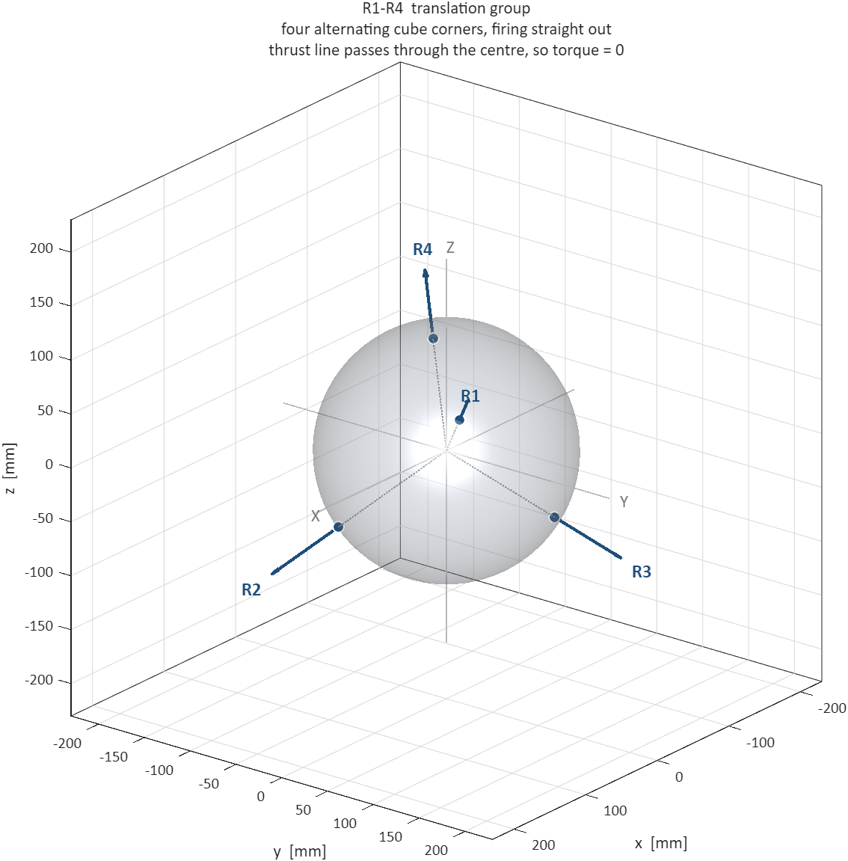
Moving: one axis at a time
The four radial nozzles sit on alternating corners of a cube, each pointing straight out through the centre. Every one of them therefore pushes on all three body axes at once, with 1/√3 = 0.577 of its thrust on each.
F = (F₀/√3) · A · d , A = [ −1 −1 +1 +1 ; −1 +1 −1 +1 ; −1 +1 +1 −1 ]
Fire the right two and the other two axes cancel each other exactly:
Axis
Nozzles fired
Net force
Net torque [mN·m]
+X
R3 + R4
+ 108.76 mN
0.000
−X
R1 + R2
− 108.76 mN
0.000
+Y
R2 + R4
+ 108.76 mN
0.000
−Y
R1 + R3
− 108.76 mN
0.000
+Z
R2 + R3
+ 108.76 mN
0.000
−Z
R1 + R4
− 108.76 mN
0.000
Notes:
Read ONE row out loud, not six: 'for plus X I fire R3 and R4, and their Y and Z parts cancel.' The phrase that matters is 'because of where the nozzles are, not because a controller corrected it'. Then say the torque column is exactly zero, and hold that word — it is what earns the split into two groups. Next slide is the contrast.

Slide 11
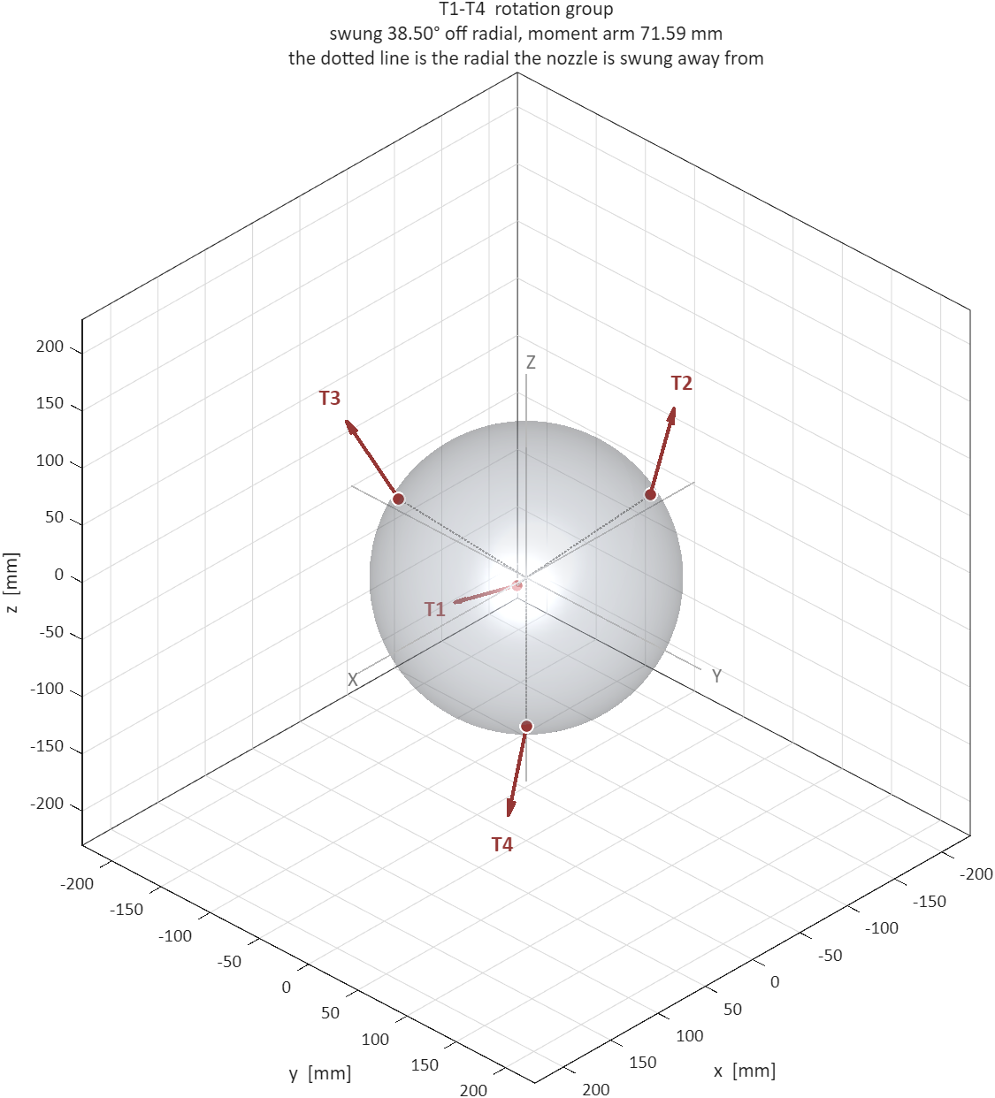
Turning: one axis at a time
The canted four are the only source of torque here, because the radial four make exactly none. But they sit on measured hardware, not a perfect tetrahedron, so turning is less tidy than moving.
Axis
Nozzles fired, with duty
Torque [mN·m]
Side push [mN]
+X
T1 0.65 · T3 0.35 · T4 1.00
5.87
132
−X
T1 0.35 · T2 1.00 · T3 0.65
5.84
132
+Y
T1 1.00 · T3 1.00
7.45
156
−Y
T2 1.00 · T4 1.00
7.46
8
+Z
T2 0.35 · T3 1.00 · T4 0.65
5.87
78
−Z
T1 1.00 · T2 0.65 · T4 0.35
5.87
78
Notes:
This is the honest version and it is stronger than a tidy one. Say it plainly: moving is a lookup table, turning is not. Point at the +X row — three nozzles, none of them fully open. If asked about 7.79: that is the ideal geometric value; 7.45 is the real best axis and 5.87 is the guaranteed worst. The side-push column is the parasitic force the translation group has to mop up.

Slide 12
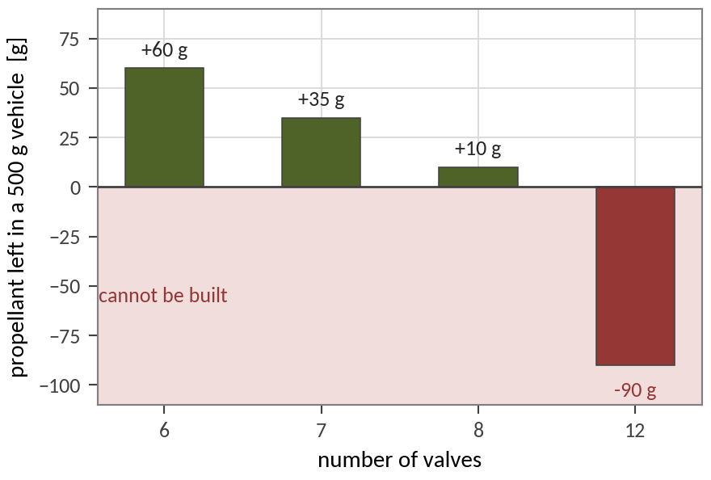
Why the extra efficiency does not pay
Tilting costs real torque: the tetrahedral projection is 57.7 % and the cant another 62.3 %, so eight nozzles deliver only 36 % of the twist twelve would give from the same gas. On its own that argues for going back to twelve. But twist per pulse is half the story — what a mission spends is twist multiplied by how long the tank can supply it.
Notes:
11:45-12:25. NEW SLIDE, and the payoff for the whole section. The argument in one sentence: twelve is more efficient per pulse, but the four extra valves cost more propellant than the extra efficiency is worth, and past 17.5 g a valve the vehicle cannot be built at all. Point at the crossover on the right chart, then at the grey band, and say 'every valve we can buy sits in there'.

Slide 13
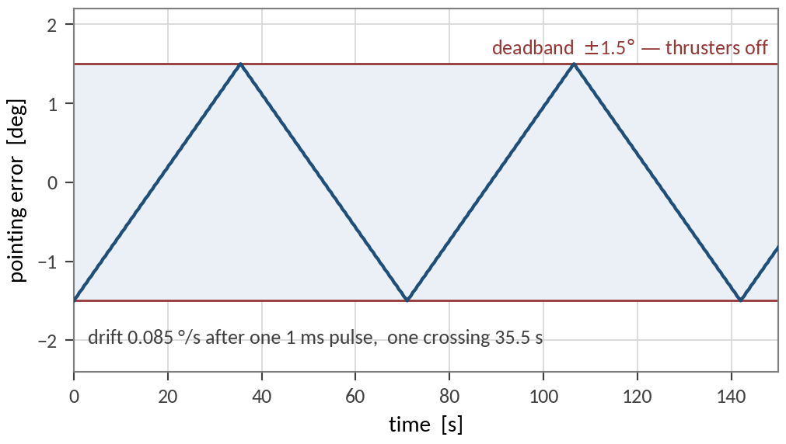
The smallest pulse we can make
The valves cannot be opened halfway. They are shut or open, and need 1.0 ms to open cleanly. So there is a smallest push the vehicle can ever deliver, and every command is built out of whole copies of it.
MIB = F₀ · t_min = 94.188 mN × 1.0 ms = 94.19 µN·s
One pulse from a canted pair, and what follows from it:
ω = τ · t_min / ( 2 · I )
0.085 °/s
the drift rate one pulse leaves behind
T_c = 2 θ_db / ω
35.5 s
how long it then takes to cross the deadband
Δm = 2 ṁ · t_min
0.41 mg
the propellant that one pulse costs
Firing without pause empties the tank in 48 seconds.
So while the drone points within ± 1.5° of target, every thruster is off and it simply drifts. Only at the edge does it spend one pulse to turn itself around.
That sawtooth is not a badly tuned controller. It is the propellant budget being protected.
Notes:
Build it in order: the valve cannot throttle, so the smallest pulse is fixed. Then read the three lines down the chain — one pulse gives this drift, which takes this long to cross, and costs this much gas. Those three lines are the whole mission-life argument in miniature, and the next slides just multiply them out. Say the sawtooth is deliberate before anyone can read it as a fault.

Slide 14
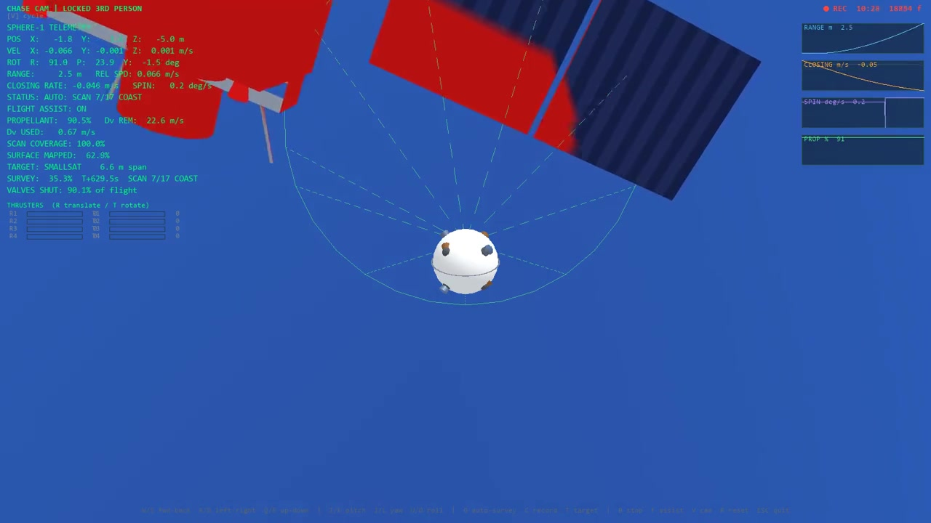
The straight-line pattern, flown
the real 25.6-minute flight, played at 15×
6.6 m
84 m
8
0.38 m
target satellite
of flight path
straight legs
closest approach
Notes:
Let it loop and talk over it. Point at one burn, then at the long dark stretch. Then own the two boxes without being asked: the run came closer than planned, and the usable delta-v is 41 % of the ideal because the nozzles sit on cube corners and off-axis commands fire some of them against each other. That 41 % is the same effect as the 58 % axis efficiency earlier, averaged over the directions a real survey needs.

Slide 15
What comes next
Three things stand between the model in this talk and a vehicle that flies, and they are in this order because each one feeds the next.
1.
Flow-bench the injector.
Measure how much gas it actually passes, instead of trusting the datasheet. That single number sets the thrust, the mass flow and the minimum pulse, so every other figure in this talk moves with it.
2.
Measure the real inertia.
Hang the assembled vehicle on two strings, time how long it takes to twist back and forth about each axis, and recover the inertia from the period. Cheap, and far more trustworthy than what the CAD assumes.
3.
Retune the gains and fly it.
Re-derive the controller against the measured inertia, flash it, and close the loop on the physical vehicle instead of on the simulated one.
I_zz = m · g₀ · d² · T² / ( 16 π² L )
The bifilar pendulum, which is step two.
Notes:
Short and forward-looking. Three steps, in order, each feeding the next. Do not open the inertia-assumption argument here — if someone asks about the uniform-body model, answer it then. End by inviting questions.

Slide 16
Thank you.
I would be glad to take questions.
wet / dry mass
500 / 490 g
propellant
10 g CO₂
valve mass, flight / bench
25 g / 80 g
γ · R
1.280 · 188.9
triple point
216.6 K
Me / (Ae/At) limit
1.589 / 1.266
Isp conv / CD
46.33 / 48.42 s
throat Ø
0.80 mm
chamber pressure
1.5392 bar
mass flow
0.2073 g/s
thrust per nozzle
94.188 mN
force per axis
108.76 mN
minimum impulse bit
94.19 µN·s
cant · moment arm
38.50° · 71.59 mm
pointing life, 3 axes
3.3 days
Δv / 10 m hops
9.18 m/s / 46
turn authority Y / X,Z
7.45 / 5.87
axis efficiency, rot / trans
36 % / 58 %
12-nozzle torque advantage
2.78 ×
crossover valve mass
14.7 g
αmax
169.2 °/s²
slew 30° / 90°
0.84 / 1.46 s
I CAD / shell
2.637 / 4.408 e-3
kp · kd
7.1432e-2 · 1.7469e-2
ωn · ζ nominal
3.680 rad/s · 0.900
integrator
RK4, 5 ms, 200 Hz
survey, orbit / ballistic
73 % / 24 % tank
surveys per tank
1.4 / 4.1
valves shut, ballistic
88 %
Δv conversion, measured
41 %
Notes:
Q&A. Leave this up. Every number a panel member can ask for is on it. If you are asked something you have not computed, say so and say how you would compute it. Never invent a number in front of this panel.

