Slide 1
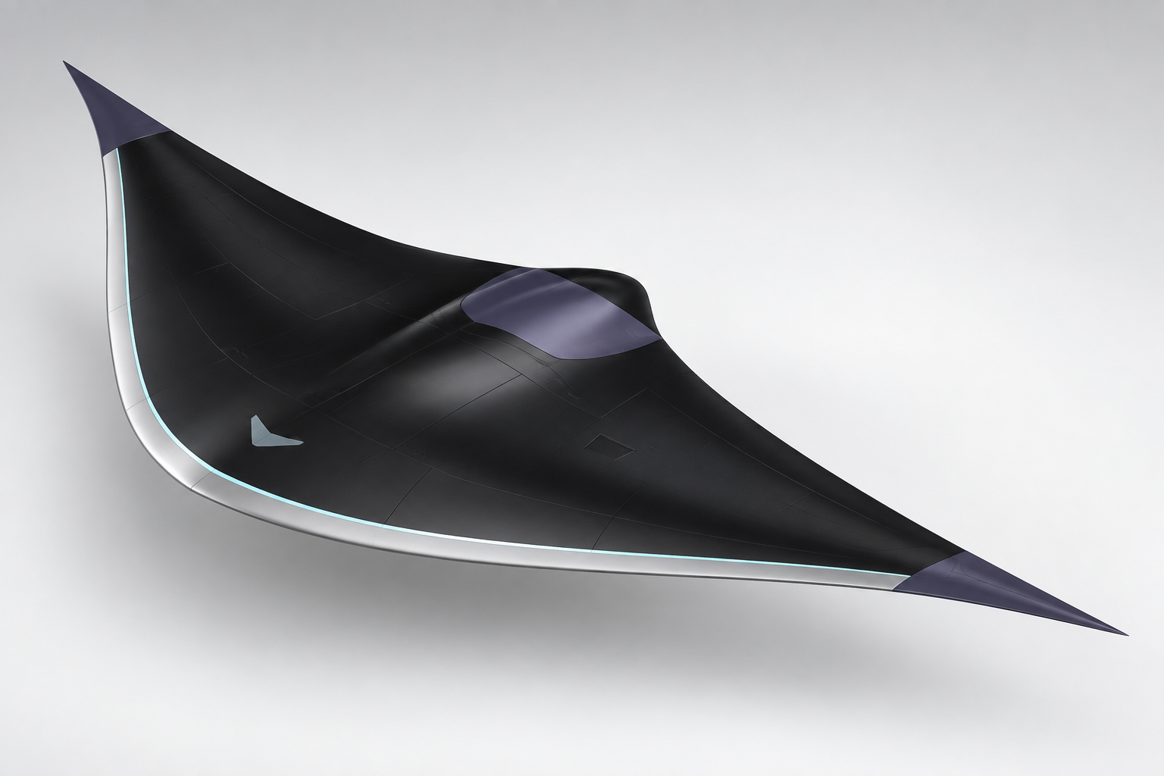
Hydro-X
Optionally Piloted Hypersonic Aerospace Vehicle with Inflight Hydrogen Generation Propulsion System
(Some Updates)
Ivane Maisaia
(AUG)
GGSB 2026: A Student and Collaboration Workshop
Science at Existing and Planned SMART|Labs in Georgia
Kakha Bendukidze Campus, Tbilisi
Hydro-X / GGSB 2026
01
Notes:
TARGET: 40 seconds.
Source: Ivane Maisaia, Hydro-x.pptx, AIAA Aviation Forum 2023, supplied by author. Today I will present Hydro-X, an optionally piloted aerospace vehicle concept with proposed inflight hydrogen generation. I first presented the idea at AIAA Aviation in 2023. This workshop version retains the original vision and separates the aircraft architecture from the hydrogen-production mechanism that still needs experimental proof. My focus is the leading-edge interaction with atmospheric water and the measurements needed to establish whether it can deliver useful hydrogen. I am seeking collaborators for a controlled subsystem experiment.

Slide 2
The problem Hydro-X addresses
Hypersonic propulsion needs H₂
Hydrogen supports high-speed combustion, but its low density creates a large storage volume and mass penalty.
Carried storage has a mission penalty
Tank, oxidizer and structural mass increase vehicle size, drag and acceleration cost.
Hydro-X research question
Atmospheric production is the route
Can leading-edge interaction produce measurable H₂ from atmospheric water during flight?
The system must capture water, split it, separate H₂/O₂, compress the gases and protect against recombination.
Source: Maisaia, AIAA 2023-3234, Introduction and Sec. III.B.
Hydro-X / GGSB 2026
02
Notes:
TARGET: 55 seconds.
Source: Ivane Maisaia, Hydro-x.pptx, AIAA Aviation Forum 2023, supplied by author. Based on the paper abstract, Introduction and Sec. III.B, pp. 1–5. The paper identifies hydrogen as an effective fuel for hypersonic propulsion, while its low density makes storage bulky. Additional tank and oxidizer volume increases vehicle size and mass, which is especially costly at high speed because drag and acceleration penalties matter. The paper therefore asks whether atmospheric water can become an onboard hydrogen source during flight. The unresolved engineering problem is the complete chain: capture dilute atmospheric water, split it under a rapidly moving and strongly heated flow, separate hydrogen before recombination, compress it, store it, and deliver it to propulsion. Hydro-X is a concept for investigating this chain; the mechanism and mission-level benefit remain to be demonstrated.

Slide 3
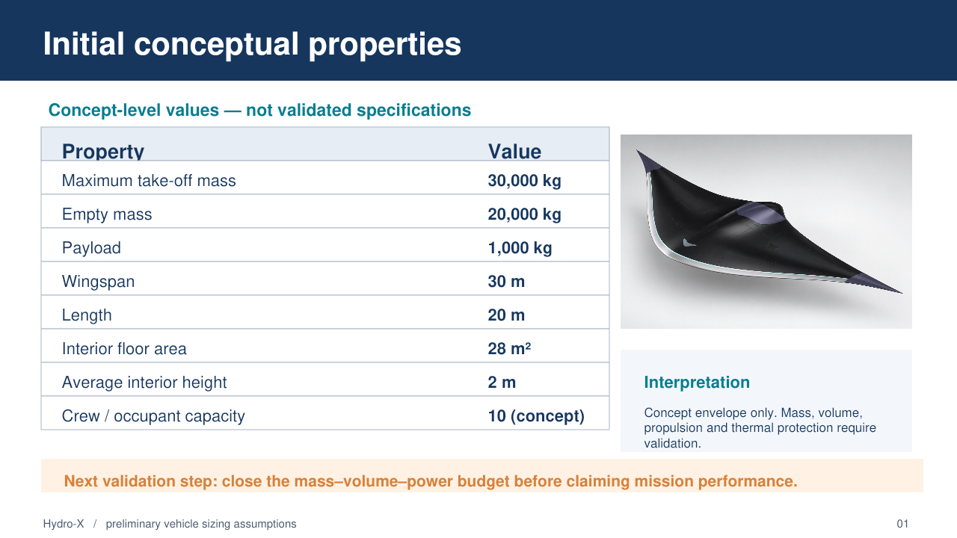

Slide 4
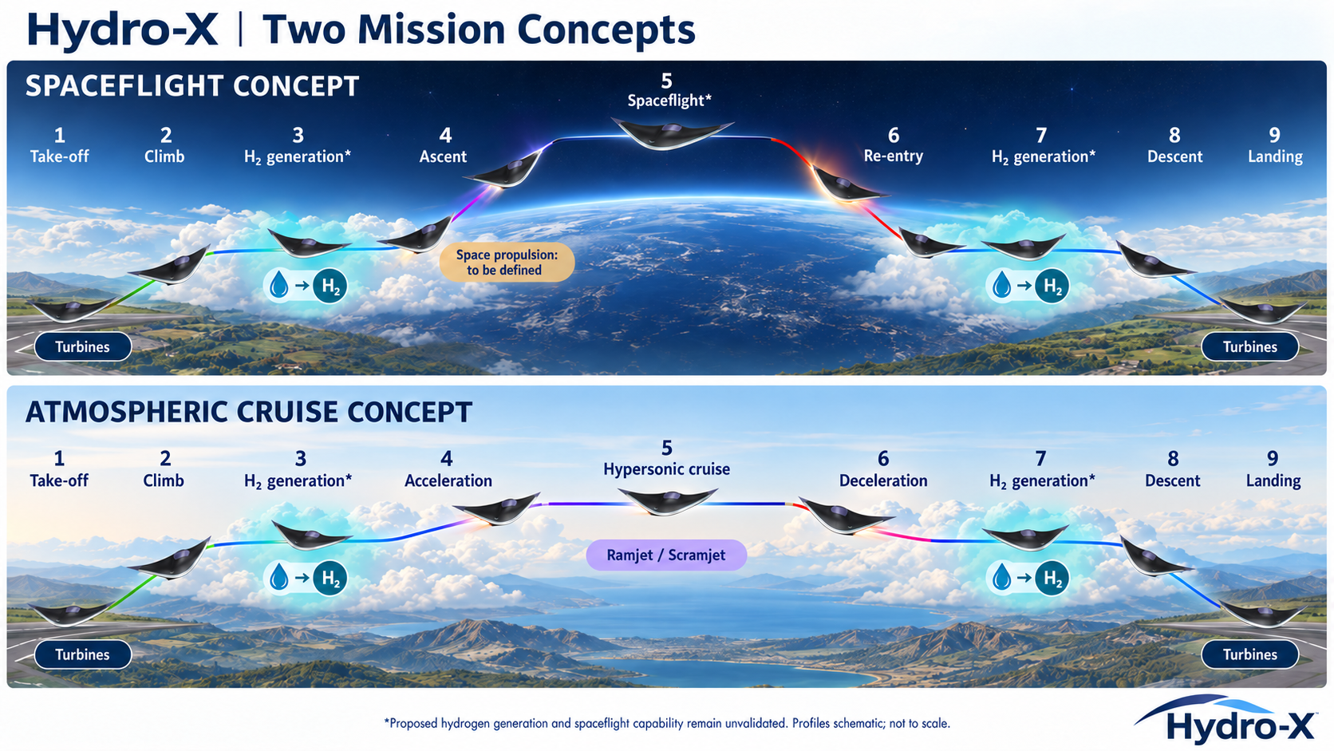
Hydro-X / GGSB 2026
03
Notes:
TARGET: 60 seconds.
Source: Ivane Maisaia, Hydro-x.pptx, AIAA Aviation Forum 2023, supplied by author. Original slides 3–4. Visual: AI-generated concept illustration developed with the author in this conversation. Internal geometry and operation are illustrative. Both profiles begin and end at a runway. Turbines support take-off and low-speed flight. The blue collection phases represent the proposed production of hydrogen from atmospheric water, before and after the main mission. The atmospheric scenario uses a central ramjet or scramjet for high-speed cruise. The spaceflight scenario is a longer-term ambition and requires a defined propulsion capability beyond the airbreathing envelope. These profiles describe intent, not validated trajectories. For a first flight demonstration, safe recovery must not depend on hydrogen generation succeeding. The present research focus is the extraction subsystem.

Slide 5
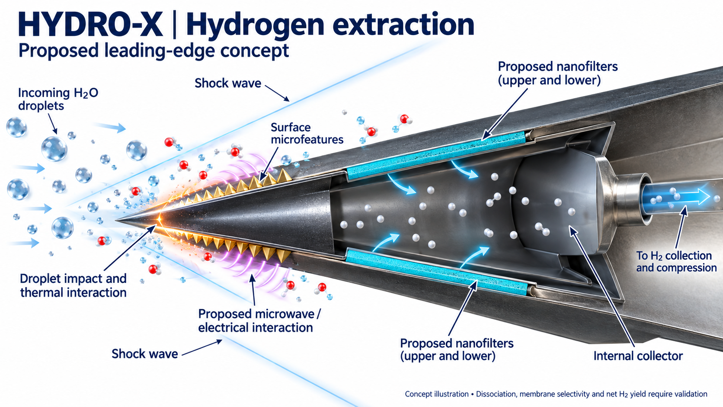
Research hypothesis: localized excitation followed by recoverable H₂ separation
Hydro-X / GGSB 2026
04
Notes:
TARGET: 90 seconds.
Source: Ivane Maisaia, Hydro-x.pptx, AIAA Aviation Forum 2023, supplied by author. Original slide 5. Visual: AI-generated concept illustration developed with the author in this conversation. Internal geometry and operation are illustrative. The proposed mechanism starts with water droplets interacting with the leading edge. The vehicle transfers some mechanical energy to the intercepted flow and droplets. Surface features may localize the interaction and contribute to charge separation. The hypothesis is that mechanical excitation, electrical discharge and associated heating can support dissociation in a small region. The nanofilters in this illustration represent proposed separation components, not demonstrated membranes. The important missing link is recovery of molecular hydrogen before recombination. The original work also proposed microwave generation, but it did not establish the conversion mechanism or measure microwave power. Each pathway needs independent measurement.

Slide 6
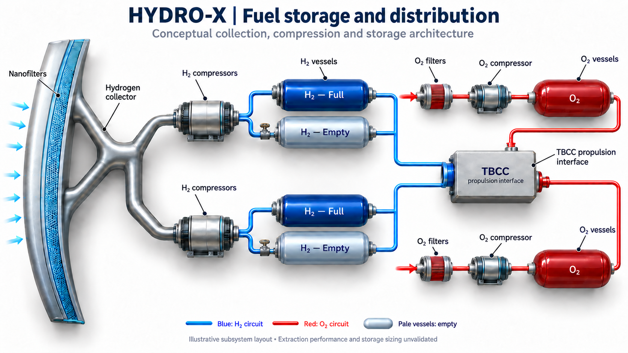
Collection, storage and propulsion interface
O₂ storage supports a proposed future mode. The non-airbreathing engine remains undefined.
Hydro-X / GGSB 2026
06
Notes:
TARGET: 45 seconds.
Source: Ivane Maisaia, Hydro-x.pptx, AIAA Aviation Forum 2023, supplied by author. Original slide 6. Visual: AI-generated concept illustration developed with the author in this conversation. Internal geometry and operation are illustrative. After production, hydrogen must pass through collection and separation, compression and storage before reaching propulsion. The original architecture also includes an oxygen circuit. Hydrogen and oxygen remain separate throughout handling and storage. The vessel labels full and empty describe conceptual operating states, not proven tank capacity or switching logic. In normal airbreathing propulsion the oxidizer comes from the atmosphere. The oxygen outlet is therefore an interface for a possible future non-airbreathing mode, not evidence that the illustrated TBCC already operates in space. Compression power, purity, tank mass, valve control and separation performance are still open design requirements.

Slide 7
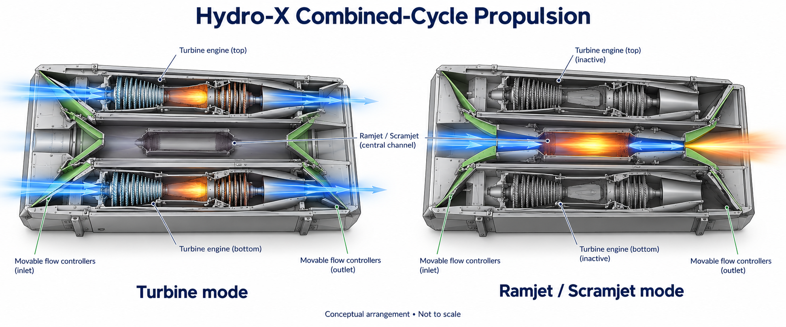
Turbine-based combined-cycle propulsion
Two flanking turbines + One central ramjet/scramjet flowpath
Hydro-X / GGSB 2026
07
Notes:
TARGET: 50 seconds.
Source: Ivane Maisaia, Hydro-x.pptx, AIAA Aviation Forum 2023, supplied by author. Original slide 9. Visual: AI-generated concept illustration developed with the author in this conversation. Internal geometry and operation are illustrative. The architecture is a plan view. Two turbine engines flank one central ramjet or scramjet path. All three paths run from the underside inlet toward the rear of the aircraft. In turbine mode, the controllers direct flow into the outer passages. At suitable conditions, the central flowpath takes over while the turbine paths are isolated. The illustration shows intended routing only. Stable transition, inlet operability, turbine protection and restart need their own analysis. There are no validated transition Mach numbers in this presentation, and this arrangement alone does not establish propulsion outside the atmosphere.

Slide 8
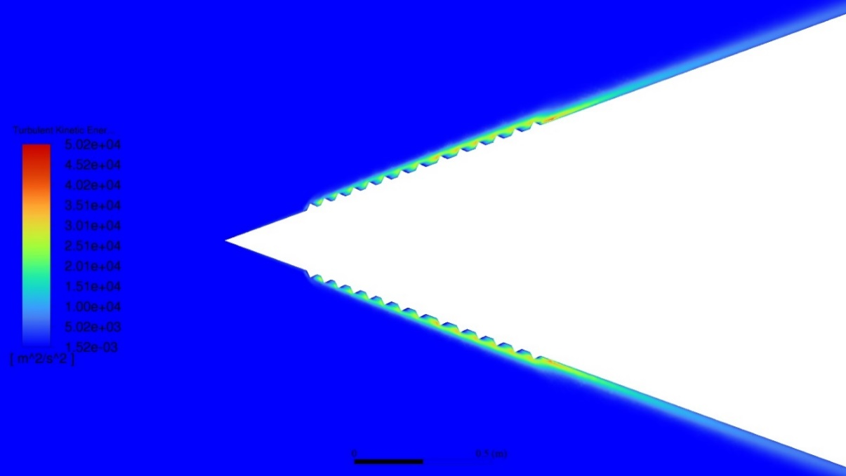
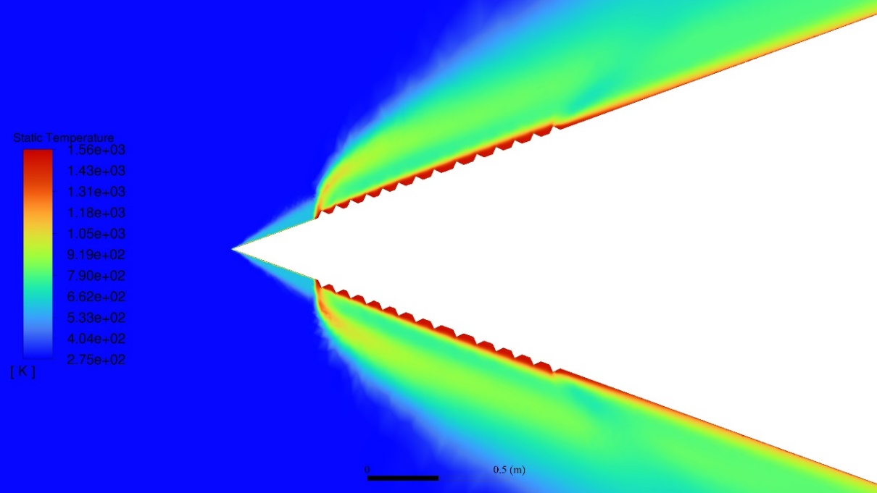
What the original CFD shows
Turbulent kinetic energy
m²/s² = J/kg
Temperature
Approximately 1500 K
Neither contour establishes hydrogen yield or recoverable power.
Hydro-X / GGSB 2026
08
Notes:
TARGET: 65 seconds.
Source: Ivane Maisaia, Hydro-x.pptx, AIAA Aviation Forum 2023, supplied by author. Original slides 8 and 10. The images are the original CFD contours, not generated illustrations. The calculation shows flow-field quantities around a patterned surface. Its turbulent kinetic energy has units of square metres per second squared, equivalent to joules per kilogram. The original 50 kJ label omitted that specific-energy meaning. The temperature contour reaches approximately 1500 kelvin, but temperature is not heat-transfer power. These plots do not demonstrate microwave output, dissociation or recovered hydrogen. Before extending the simulation, the geometry and boundary conditions must be reconciled with the original model files. The next comparison should integrate wall heat transfer and drag for smooth and patterned surfaces.

Slide 9
Energy sources and conversion pathways
MECHANICAL INPUT
ELECTRICAL INPUT
Vehicle motion and droplet impact
Localized transfer at the leading edge
Impact-generated charge
Possible collection from cloud fields
CONVERSION TO BE TESTED
Discharge and heating in a small reaction region
Proposed microwave coupling requires a defined generator
Hydro-X / GGSB 2026
05
Notes:
TARGET: 55 seconds.
Source: Ivane Maisaia, Hydro-x.pptx, AIAA Aviation Forum 2023, supplied by author. Original slide 5 and author clarification in this conversation. These are proposed pathways, not established performance claims. The vehicle’s kinetic energy reaches the interaction region through forces and flow deceleration. Heating and impact-induced electricity may be successive conversions of that same mechanical input, so we cannot add them twice. Pre-existing cloud electrical energy is a separate possible external input, but the collector voltage under load and current remain unknown. Microwave concentration requires a specified generator and coupling mechanism. A high local field or temperature does not by itself establish energy delivered to useful chemistry. The experiment must account separately for mechanical input, external electrical input and recoverable chemical output.

Slide 10
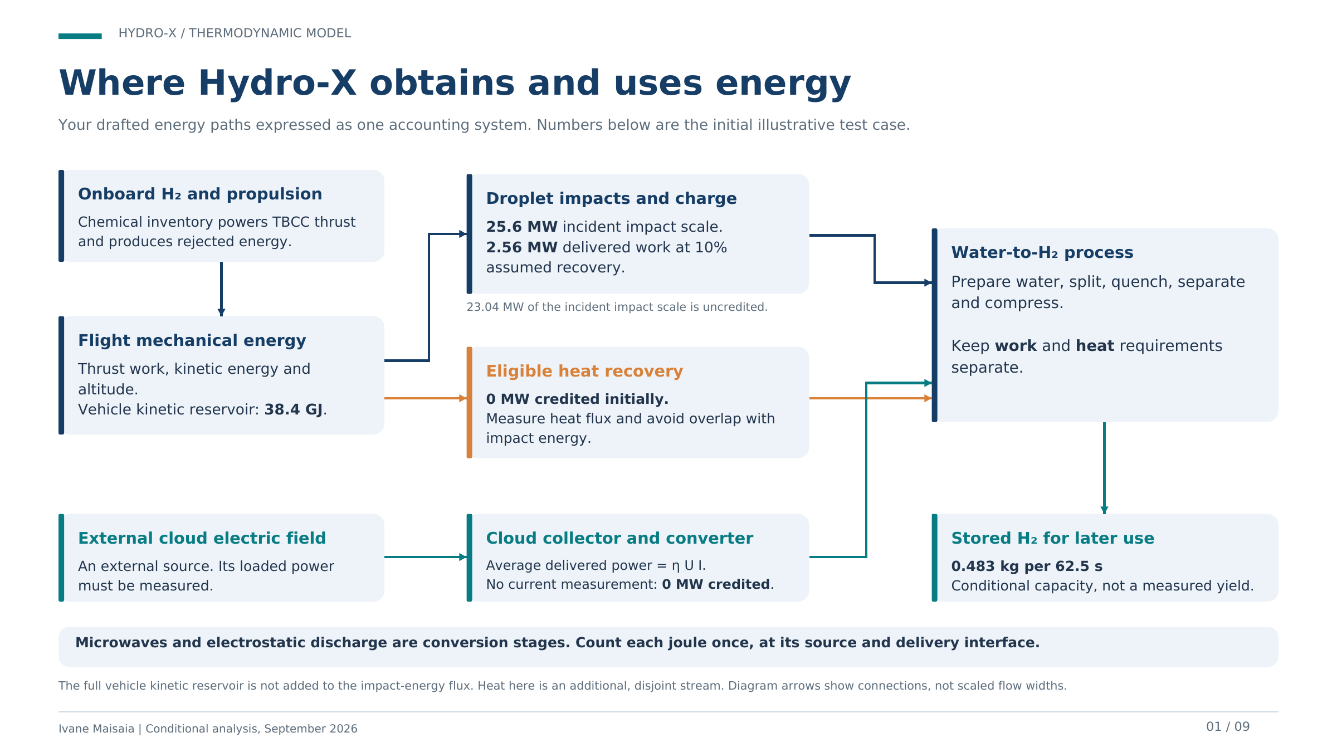
Hydro-X / GGSB 2026
05
Notes:
TARGET: 55 seconds.
Source: Ivane Maisaia, Hydro-x.pptx, AIAA Aviation Forum 2023, supplied by author. Original slide 5 and author clarification in this conversation. These are proposed pathways, not established performance claims. The vehicle’s kinetic energy reaches the interaction region through forces and flow deceleration. Heating and impact-induced electricity may be successive conversions of that same mechanical input, so we cannot add them twice. Pre-existing cloud electrical energy is a separate possible external input, but the collector voltage under load and current remain unknown. Microwave concentration requires a specified generator and coupling mechanism. A high local field or temperature does not by itself establish energy delivered to useful chemistry. The experiment must account separately for mechanical input, external electrical input and recoverable chemical output.

Slide 11
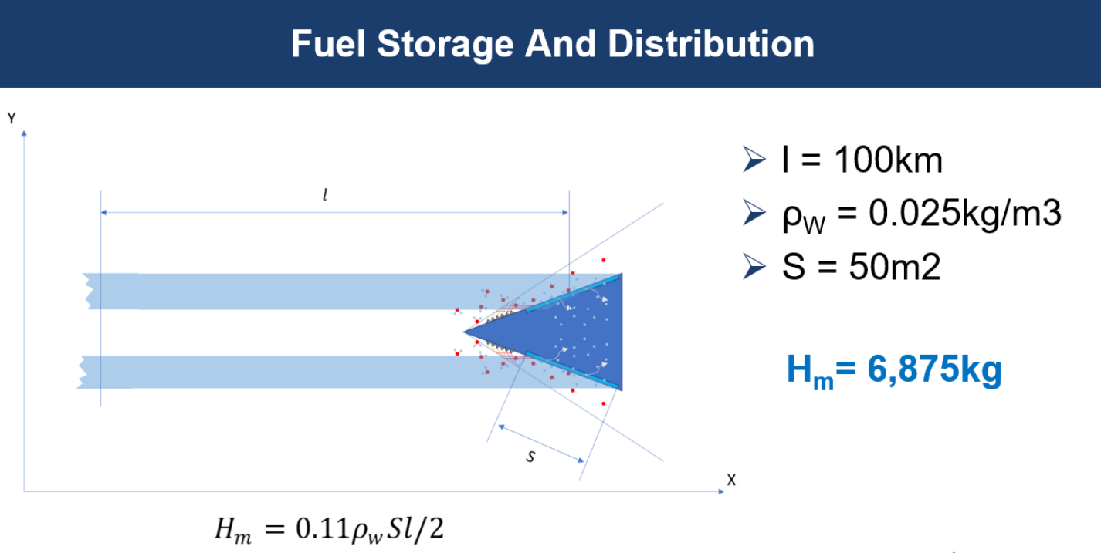
Fuel collection: corrected energy balance
PESSIMISTIC SCREENING CASE
Corrected inputs
Water content
Capture fraction
0.19 g/m³
50%
Conversion / H₂ recovery
Heat and cloud power credit
10% / 80%
0 MW / 0 MW
Conditional result
≈ 0.18 kg H₂ / passage
Original headline
62.5 s interval | ≈ 2.8 g/s | before aircraft integration
6,875 kg H₂ in 62.5 s
Assumption-driven mass estimate; not a measured production rate.
What is missing for feasibility?
Available: 0.97 MW credited impact work + 0 MW heat
1 kg target: 2.46 MW work + 2.64 MW heat
Need measured conversion, quench/recovery, delivered heat or RF power, and incremental drag + hardware mass.
Screening assumptions, not flight measurements. The concept becomes feasible only if recovered H₂ benefit exceeds added drag, power and system mass.
Hydro-X / GGSB 2026
07
Notes:
TARGET: 60 seconds.
Source: Ivane Maisaia, Hydro-x.pptx, AIAA Aviation Forum 2023, supplied by author. The supplied original fuel-collection slide used 25 g/m³ liquid water content and an assumed 50% extraction factor to calculate 6,875 kg H₂ in 62.5 s. This added slide uses a deliberately pessimistic screening case from the revised thermodynamic model: 0.19 g/m³ liquid water content, 50% capture, 10% single-pass conversion, 80% H₂ recovery, no credited heat, and 10% of droplet impact energy delivered as work. The resulting approximately 0.18 kg H₂ per 62.5-second passage is conditional, not a measured yield. The main feasibility question is whether a real coupon can produce the required conversion and recovery while avoiding a larger drag and mass penalty. Sources: Han et al. 2025, https://agupubs.onlinelibrary.wiley.com/doi/full/10.1029/2024JD041795 ; NIST water data, https://webbook.nist.gov/cgi/cbook.cgi?ID=C7732185&Mask=3 .

Slide 12
First experimental proof
TEST ARTICLE
MEASUREMENTS
Smooth and patterned
leading-edge coupons
Mechanical input
Voltage and current over time
Collected H₂ and gas purity
CONTROLLED COMPARISONS
Dry / wet interaction
Electrical excitation off / on
Blank and material-consumption checks
First gate: repeatable H₂ above blanks, with all energy inputs accounted for.
Hydro-X / GGSB 2026
10
Notes:
TARGET: 80 seconds.
Source: Ivane Maisaia, Hydro-x.pptx, AIAA Aviation Forum 2023, supplied by author. Proposed work, not completed tests or confirmed facility capabilities. I propose an instrumented leading-edge coupon rather than a complete aircraft prototype as the first experiment. Compare a smooth reference with the patterned surface. Run dry and wet conditions, with controlled electrical excitation off and on where applicable. Measure the mechanical conditions, voltage and current, any RF emission and molecular hydrogen in the collected gas. Include blanks and check whether electrodes or surface material are consumed. A positive outcome is repeatable hydrogen above the blank with the input energy accounted for. Only after establishing that mechanism should we assess a representative flight environment and scale the system.

Slide 13
For Questions
Ivane Maisaia
i.maisaia@unairtech.com
linkedin.com/in/ivane-maisaia
Hydro-X / GGSB 2026
11
Notes:
TARGET: 45 seconds.
Source: Ivane Maisaia, Hydro-x.pptx, AIAA Aviation Forum 2023, supplied by author. Closing and questions. This presentation offers a vehicle concept, a proposed interaction mechanism and preliminary CFD, but it does not yet offer demonstrated inflight hydrogen production. I am looking for collaborators who can help define a small, measurable experiment. Useful capabilities include controlled droplet interaction, electrical and RF diagnostics, gas analysis and membrane or surface characterization. These are requested capabilities, not a claim that any specific SMART Lab already has them. The immediate deliverable would be a jointly defined coupon experiment and a go or no-go criterion based on hydrogen recovery and energy accounting. Which available or planned facilities could help establish that first result?

Slide 14
References
[1] Mr. Scott R. Thomas, Mr. James F. Walker, “Fundamental Aeronautics Program - Hypersonics Project Overview of the
TBCC Discipline”, National Aeronautics and Space Administration, 2009 Annual Meeting September 29-October 1, 2009.
[2] Scott R. Thomas, Donald T. Palac, Charles J. Trefny, and Joseph M. Roche ,“Performance Evaluation of the NASA GTX
RBCC Flowpath”, NASA/TM—2001-210953
[3] Xiao-Su Yi , Shanyi Du, Litong Zhang, “Composite Materials Engineering, Volume 1 Fundamentals of Composite
Materials”, Chemical Industry Press, Beijing and Springer Nature Singapore Pte Ltd. 2018, pp. 92, 151,152.
[4] David Glass, Ray Dirling, Harold Croop, Tim Fry and Geoffrey Frank, ”Materials Development for Hypersonic Flight
Vehicles”, 14th AIAA/AHI International Space Planes and Hypersonic Systems and Technologies Conferences, Canberra,
Australia, 2006.
[5] William D. Callister, Jr., David G. Rethwisch, “Materials Science and Engineering, 9th ed.”, Danvers, MA, 2014, pp. 522
525.
[6] Ivane Maisaia, “Optionally Piloted Hypersonic Aerospace Vehicle With Inflight Hydrogen Generation Propulsion system”, AIAA AVIATION 2023 Forum, 12-16 June 2023, San Diego, CA and Online, https://doi.org/10.2514/6.2023-3234

