Slide 1
Minimization of thermo-mechanical influences on the image quality of satellite optical systems
INSTITUTE OF TECHNOLOGY AND Engineering
GIORGI KAKABADZE
04.09.2026
Notes:
The upper atmosphere contains valuable information about Earth's climate and allows early detection of changes,
but space environment can significantly affect on-orbit systems,
therefore, before trusting atmospheric measurement, precision of spaceborne instrumentation must be ensured.

Slide 2





How I appeared in Jülich

Slide 3

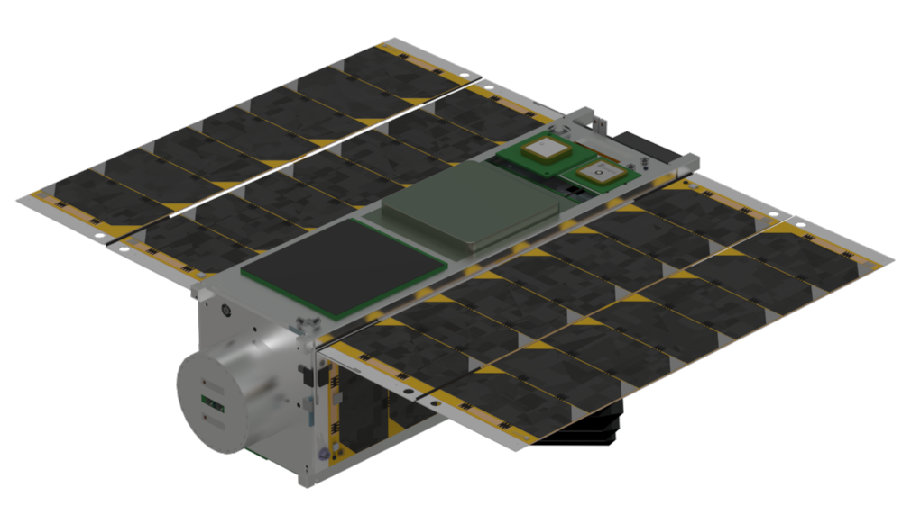
Observe atmosphere
Limb
Nadir

Slide 4
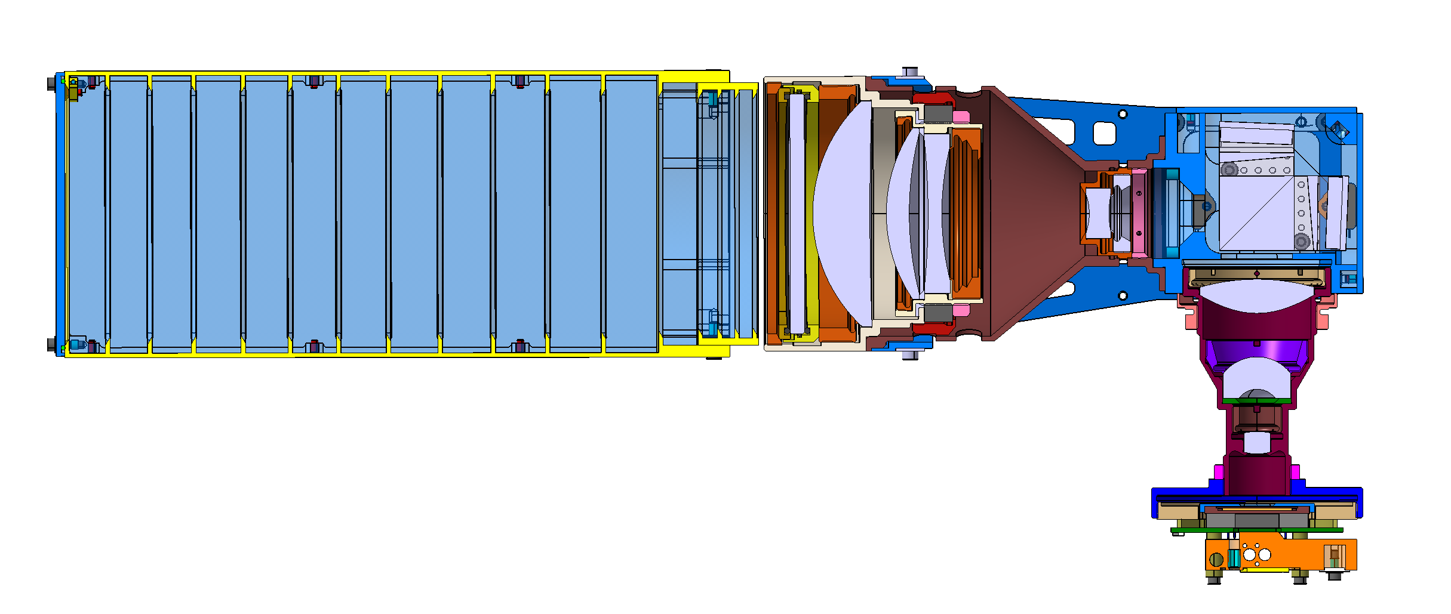


SHIPAS
Spatial Heterodyne Interferometer Performance Assessment in Space
Grating
Prism
Spacer
BAFFLE
FRONT OPTICS
SPATIAL HETERODYNE INTERFEROMETER
$$α$$
$$β$$
Beamsplitter
Prism
DETECTOR OPTICS
Final Image on Detector
DETECTOR
Notes:
Small device with no moving parts,
purpose of baffle (straylight and albido),
Interference explained.

Slide 5
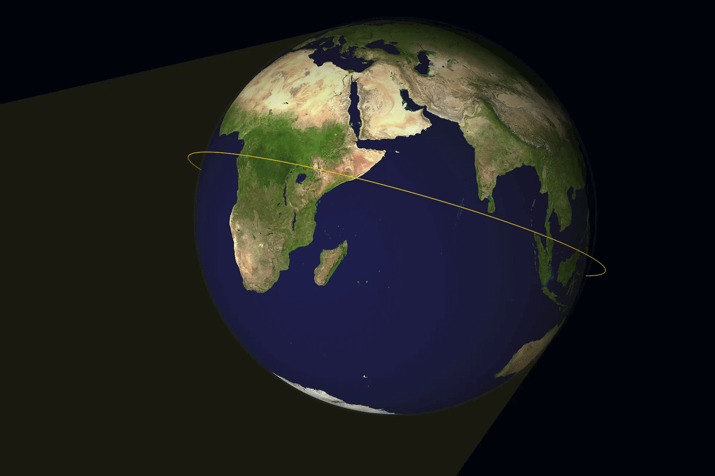


Orbital Environment
Low Earth Orbit
Orbital period around 90 minutes
Minimum temperature $−42℃$
Maximum temperature $+50℃$
Four critical thermal cases

Slide 6
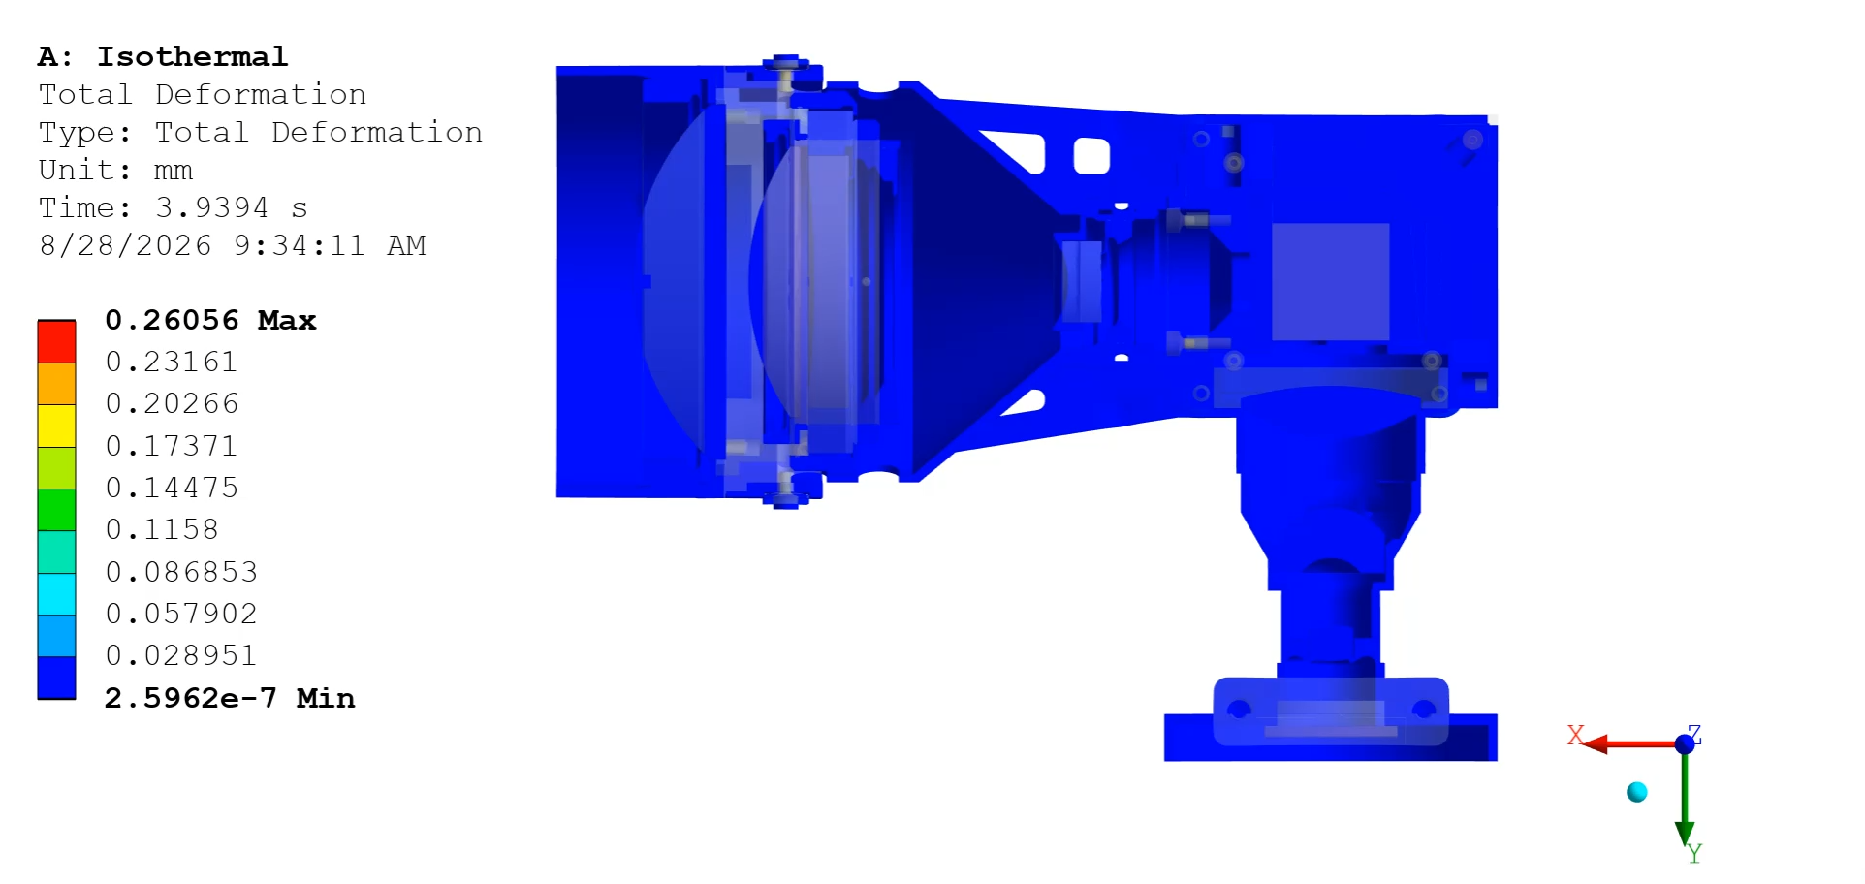
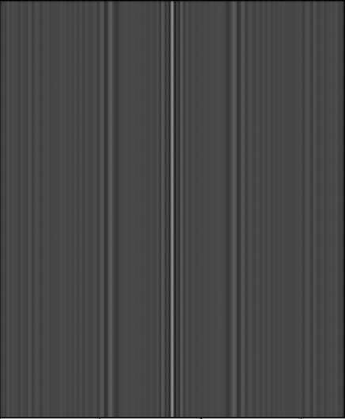
What happens to the System?
Animation was created by the assistance of OpenAI

Slide 7
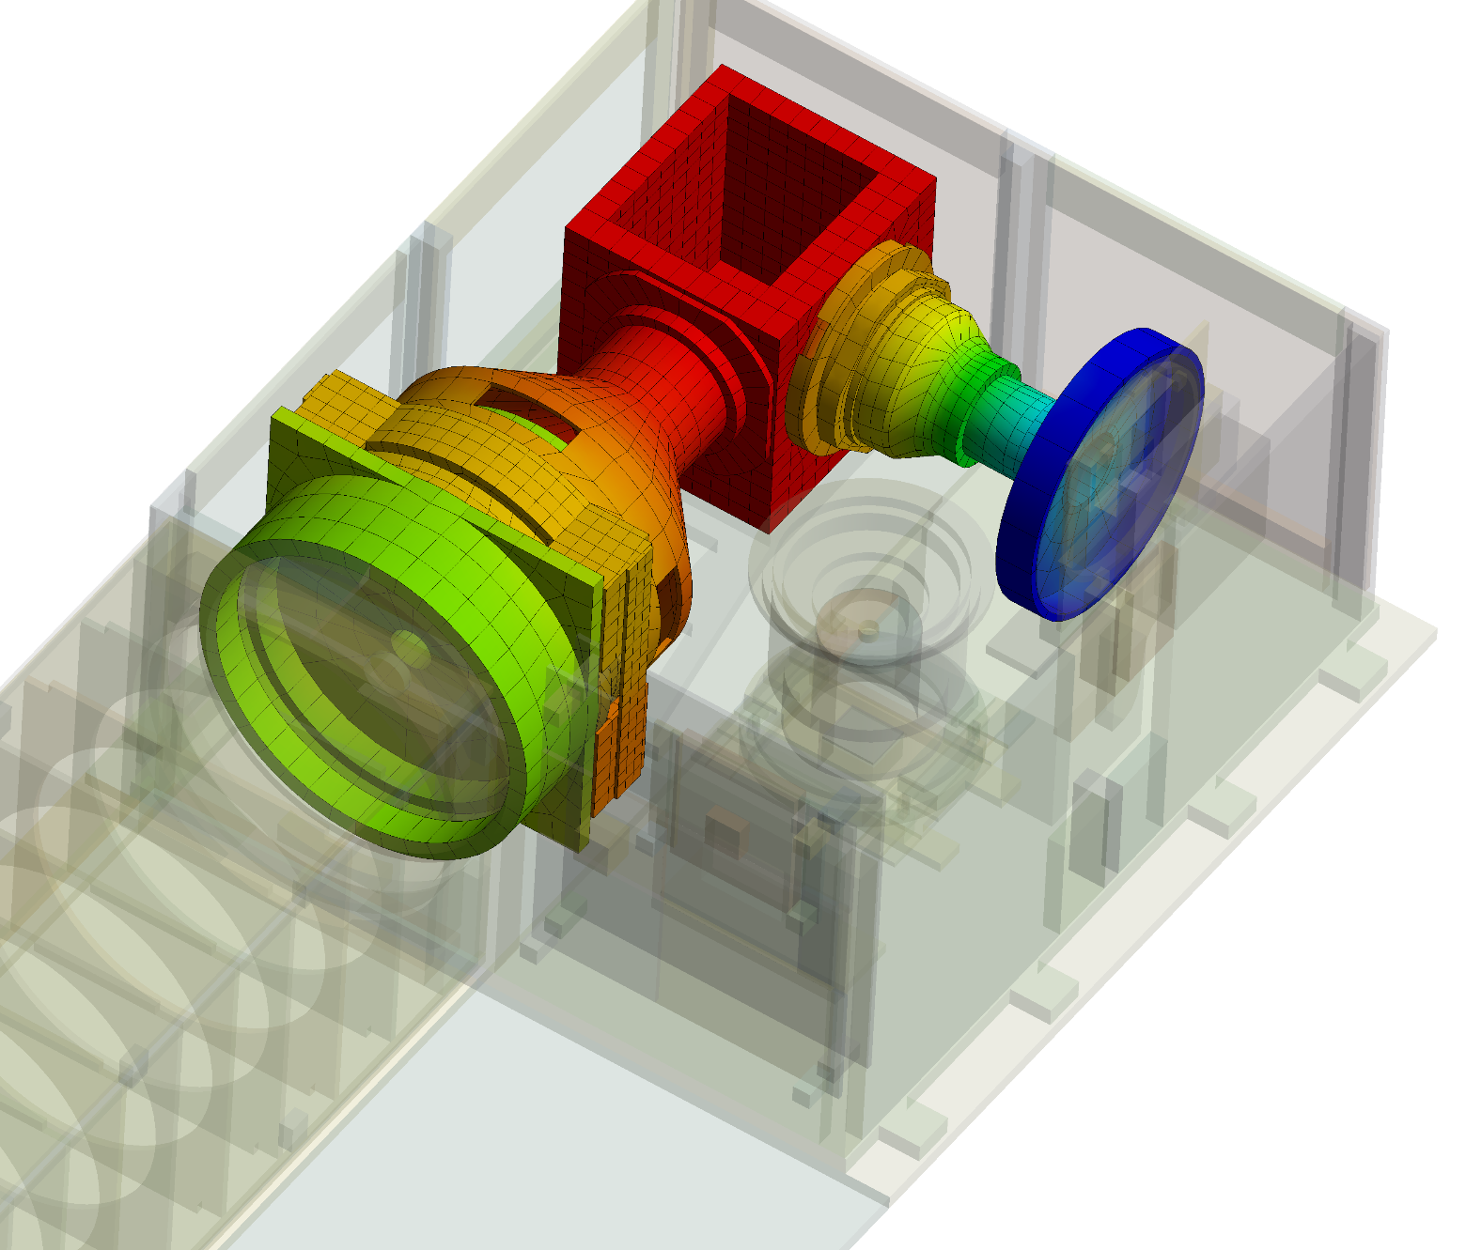
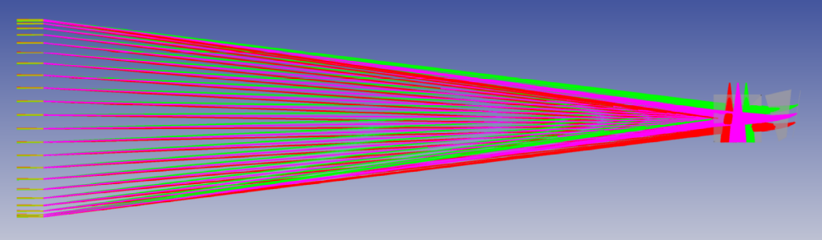
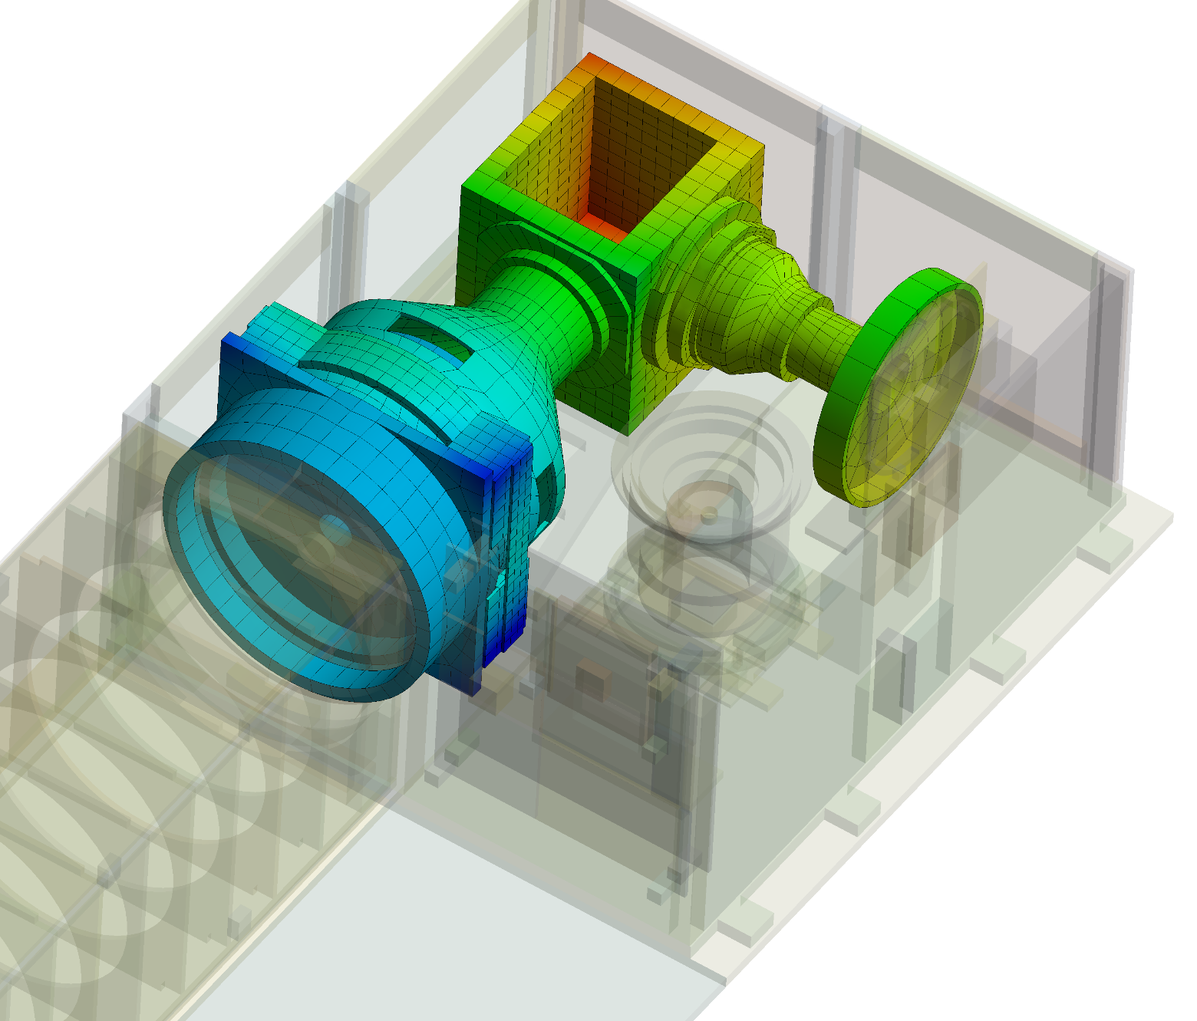
Structural-thermal-optical-performance
STOP Analysis Workflow
Design
Thermal Analysis
Temperature Fields
Structural Analysis
Improvement
Temperature, °C
no
38.8
Sufficient Image Quality?
12.6
Detector image
Optical Ray Tracing
Structural Displacements
Displacement, mm
0.12
yes
0.04
Final Design
Final Image on Detector
Motion Monitoring Tool
Deiml, M. (2017). Development of a small satellite remote sensing payload for passive limb sounding of the atmospheric oxygen emission. Ph.D. dissertation, Universitätsbibliothek Wuppertal.

Slide 8
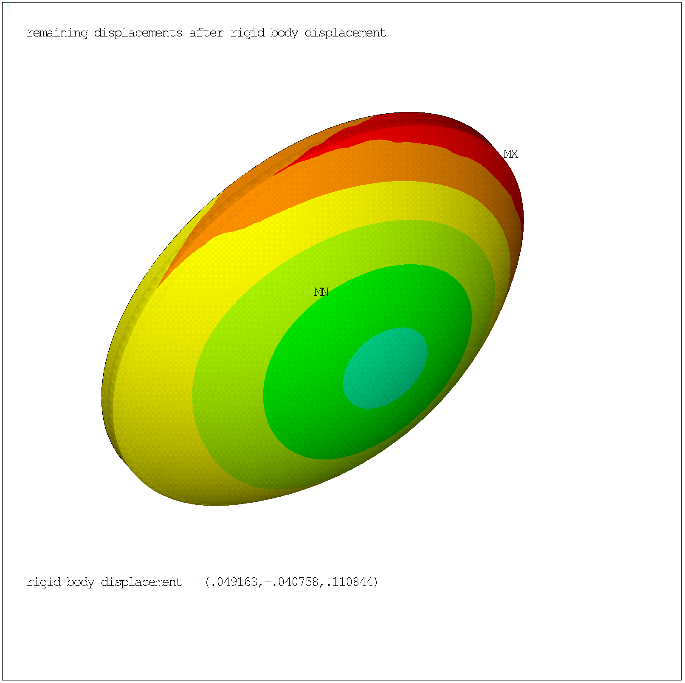
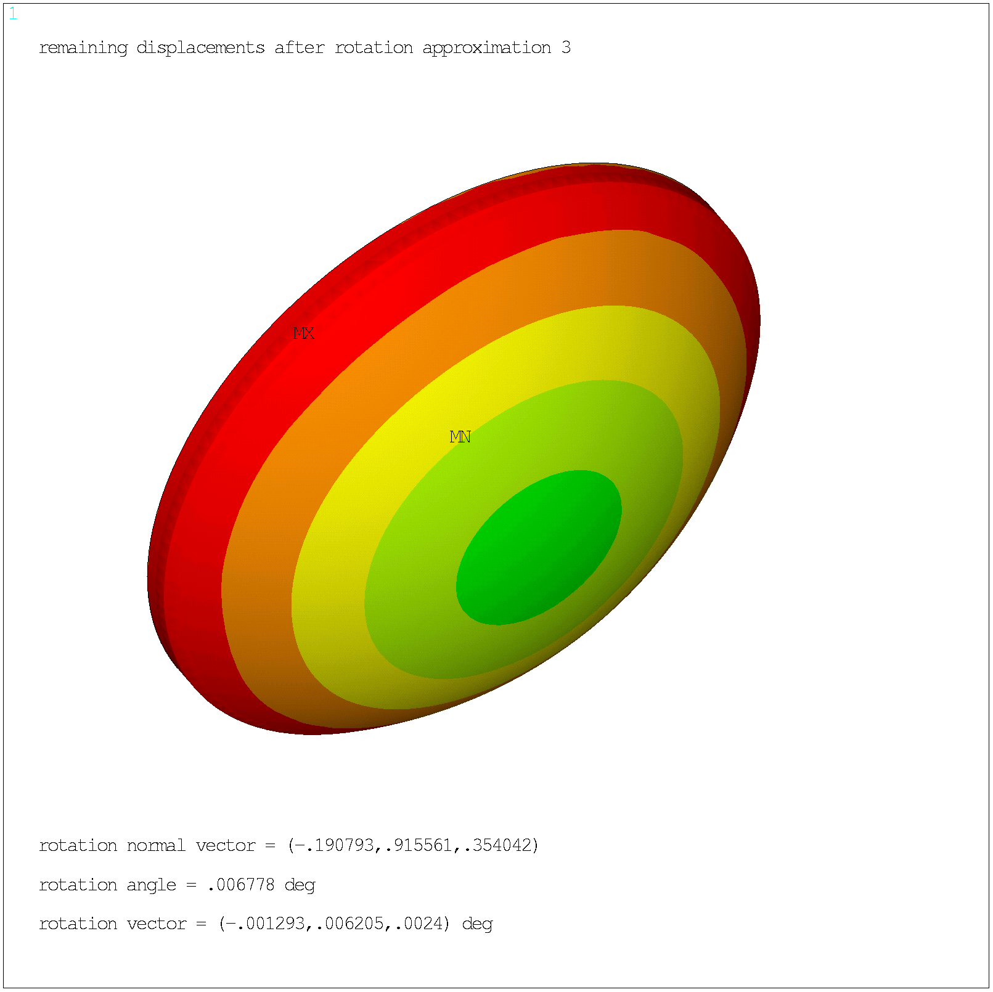
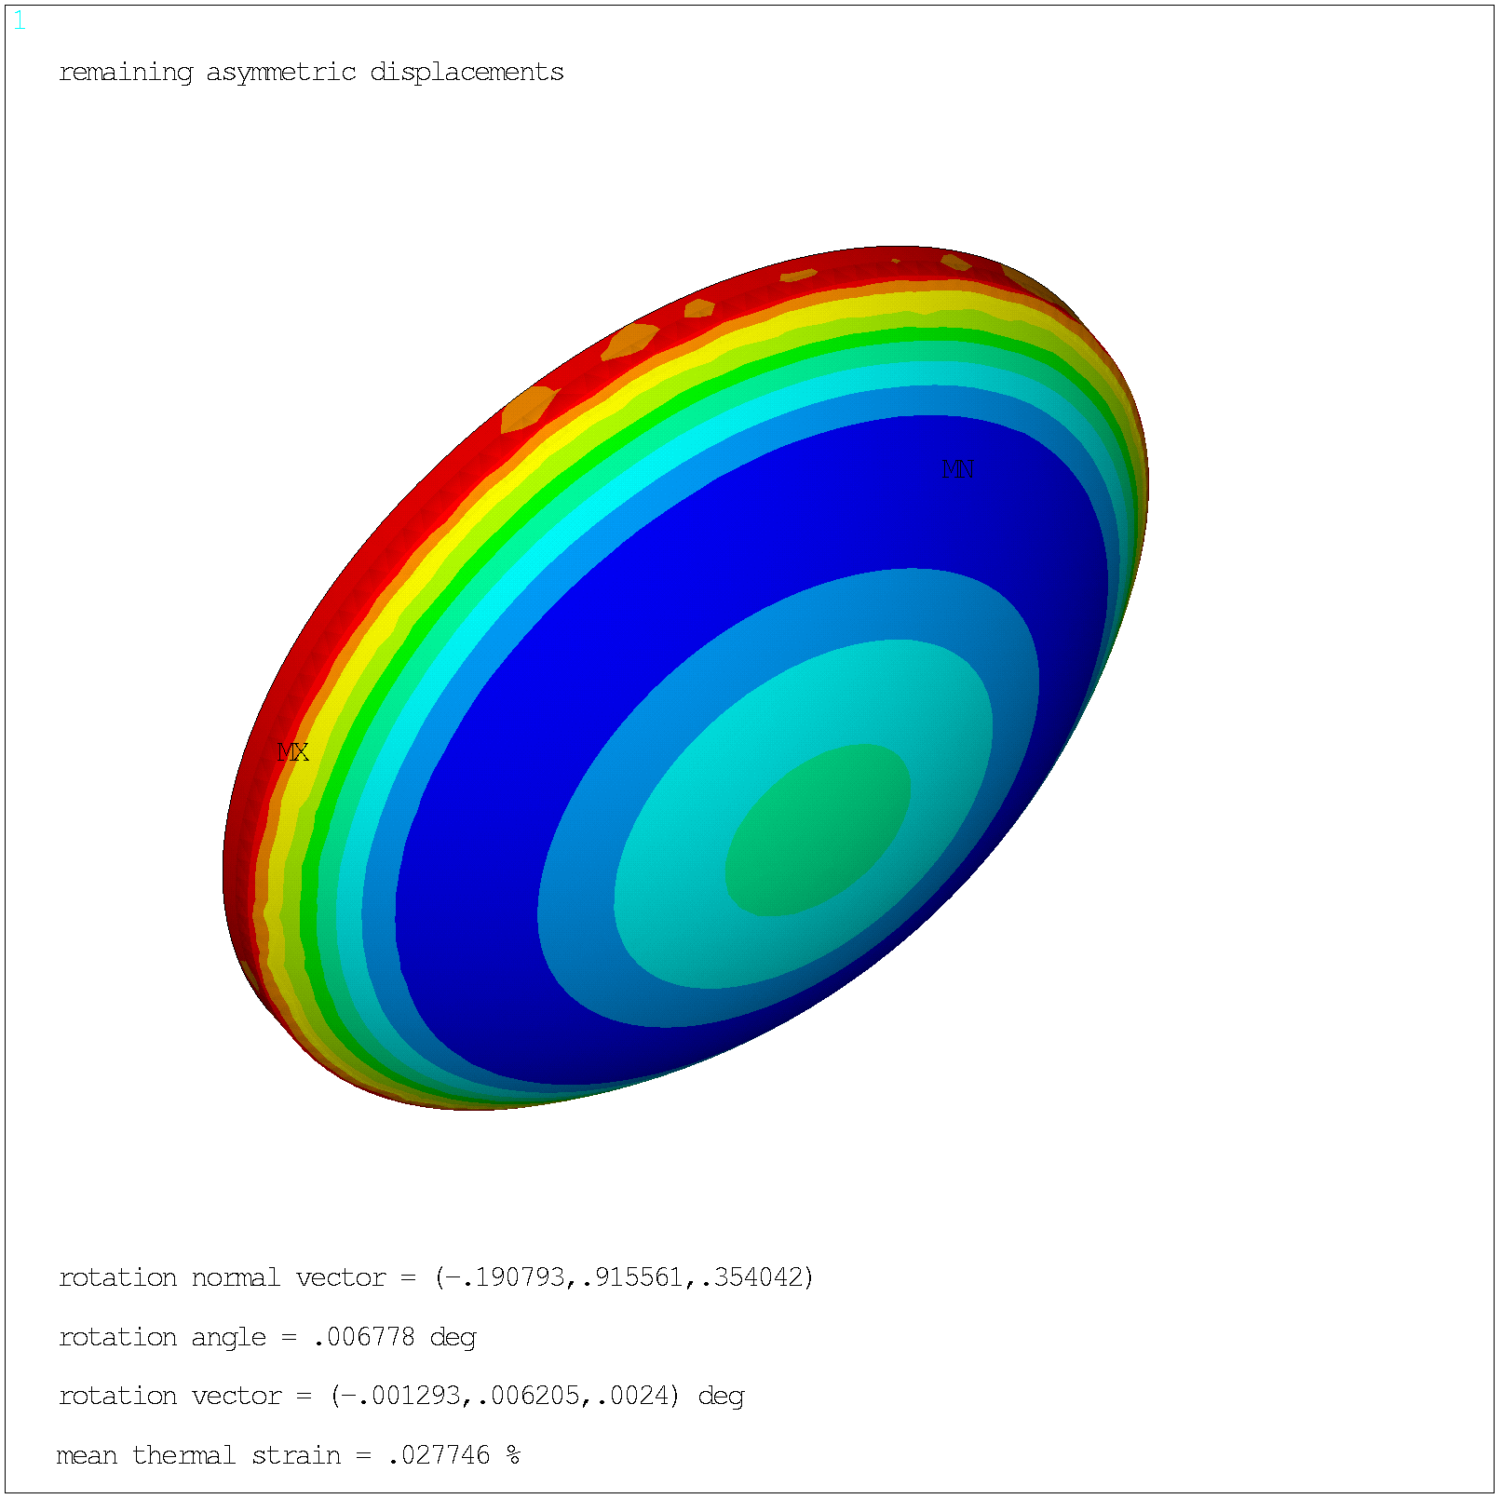
Motion Monitoring Tool
Example: Lens 1 of SHIPAS for isothermal case
Axial Displacements
Remaining displacements after subtracting
a) rigid body displacement
max. 13.3 μm
Rotation
b) rigid body rotation
max. 11.1 μm
Scaling
c) thermal expansion
max. 4.7 μm
Asymmetric deformation

Slide 9
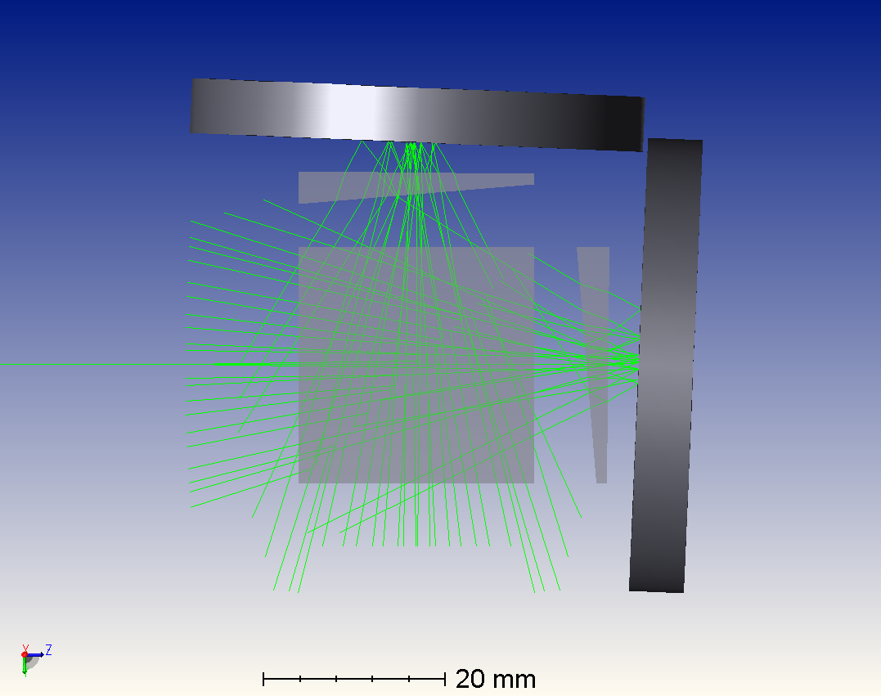
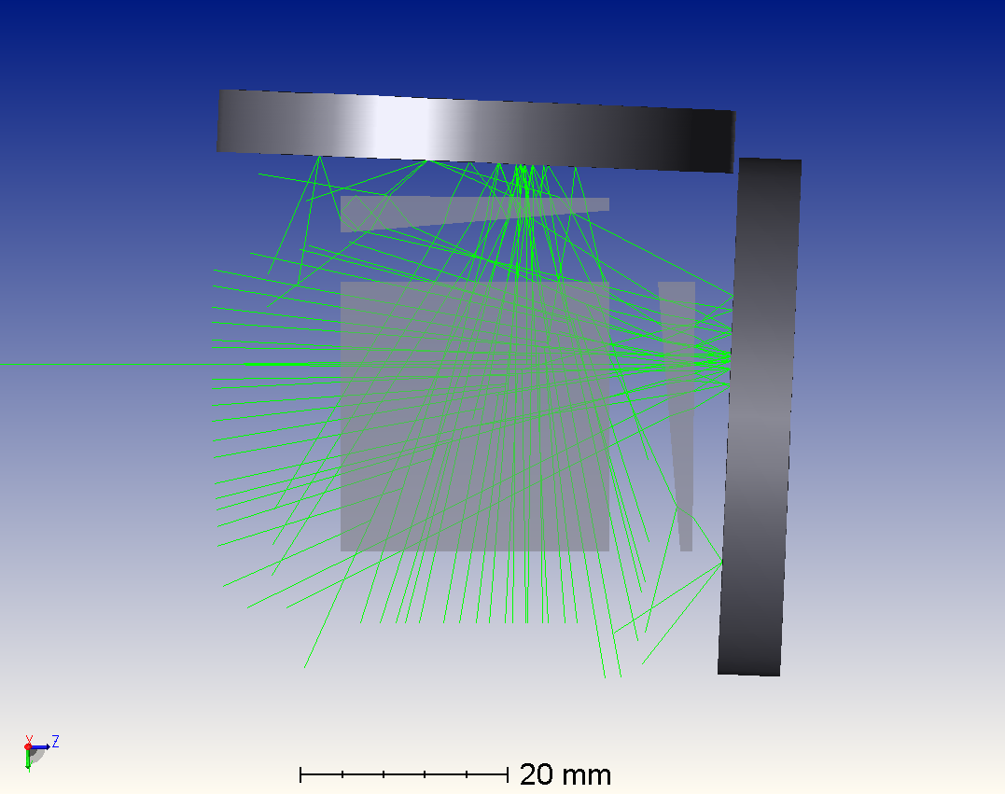
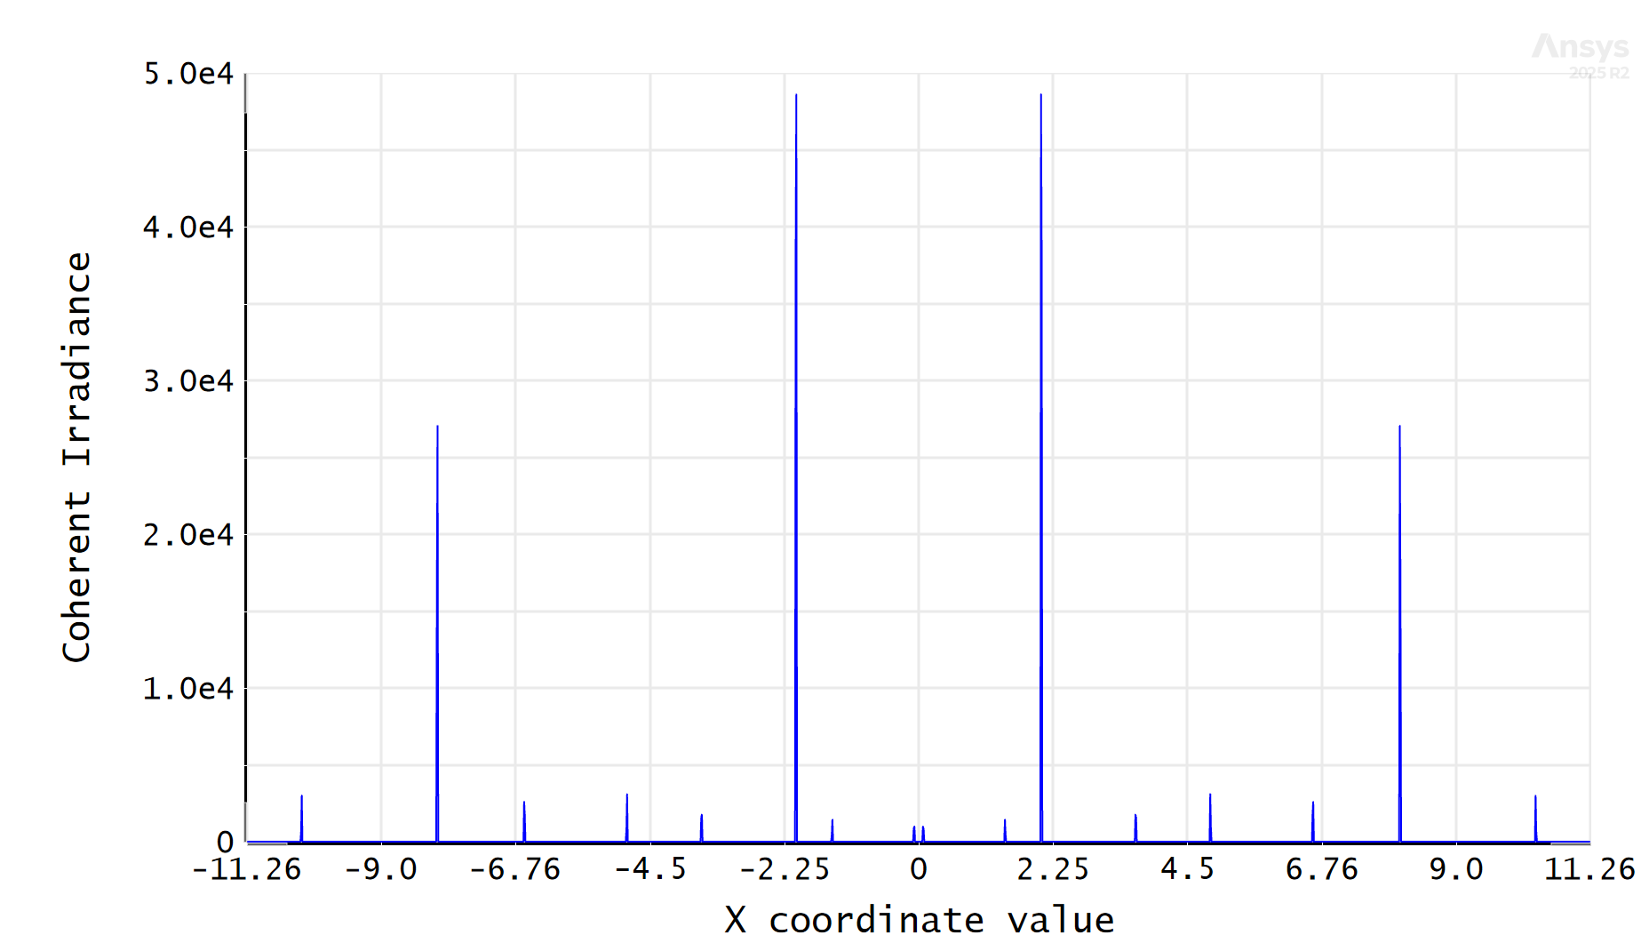
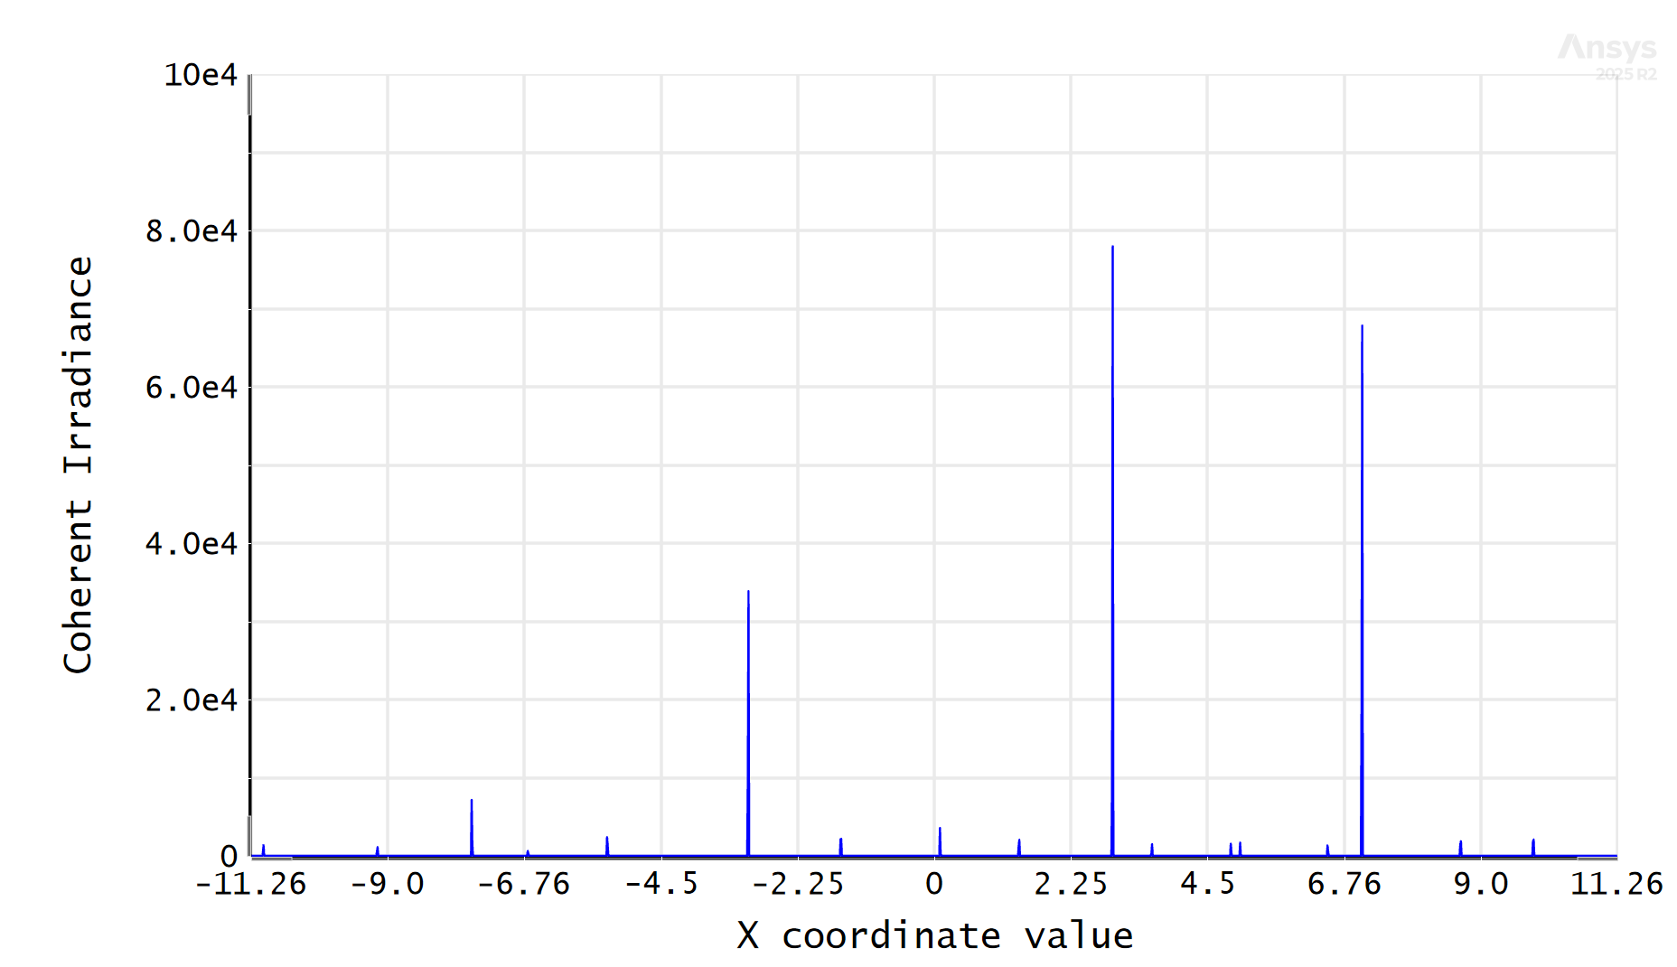
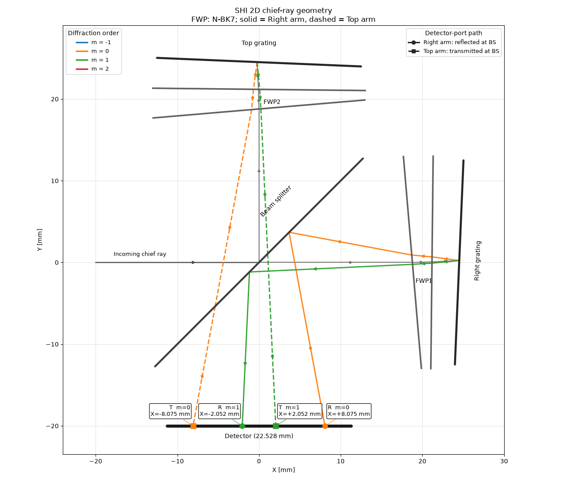
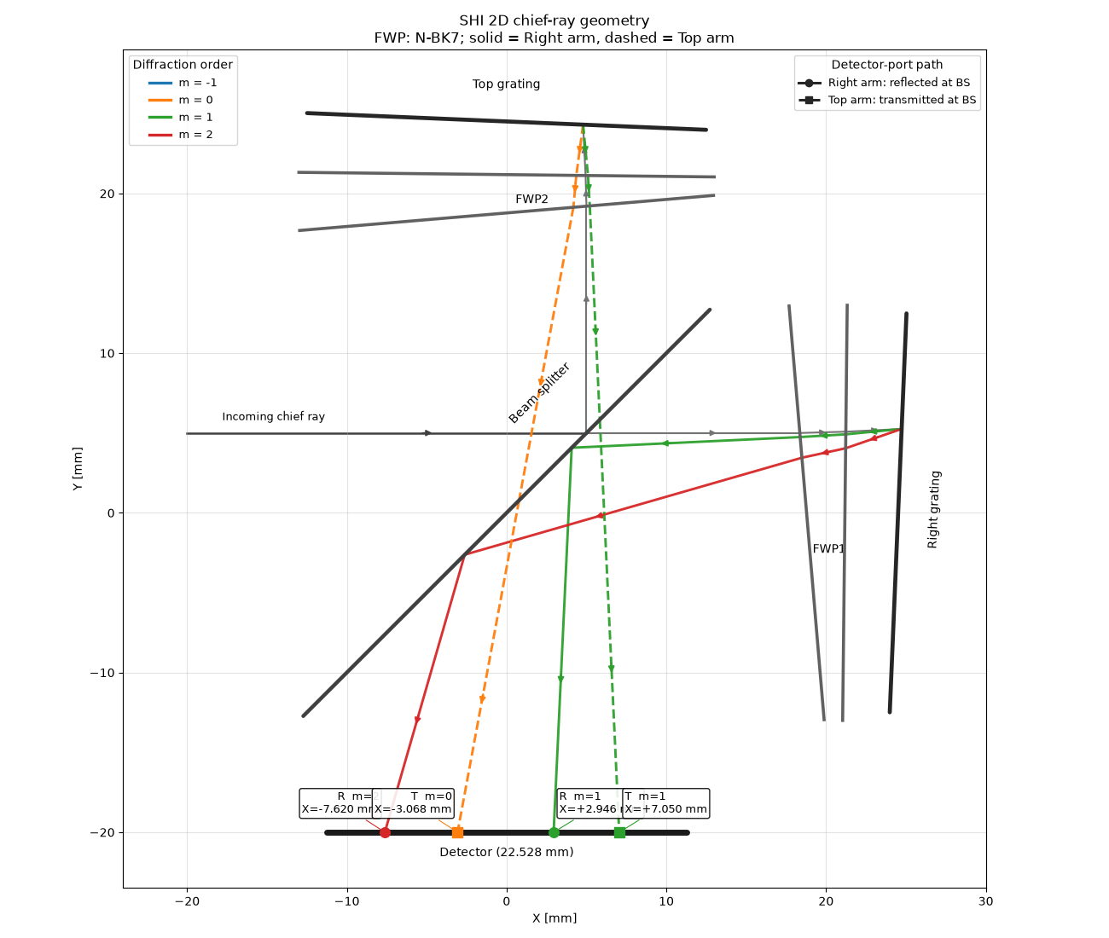
Analytical validation
simulation y=0mm
simulation y=5mm
simulation y=0mm
simulation y=5mm
analytical (python) y=0mm
analytical (python) y=5mm
Peak | 1 | 2 | 3 | 4
analytical y=0 | -8.075 | -2.052 | 2.052 | 8.075
simulation y=0 | -8.076 | -2.056 | 2.056 | 8.076
analytical y=5 | -7.62 | -3.068 | 2.946 | 7.05
simulation y=5 | -7.625 | -3.069 | 2.95 | 7.056
incoming ray
incoming ray
Detector
Detector
-20 -10 0 10 20 30
-20 -10 0 10 20 30
x [mm]
x [mm]
Notes:
Mention that analytical tool was programmed by me

Slide 10
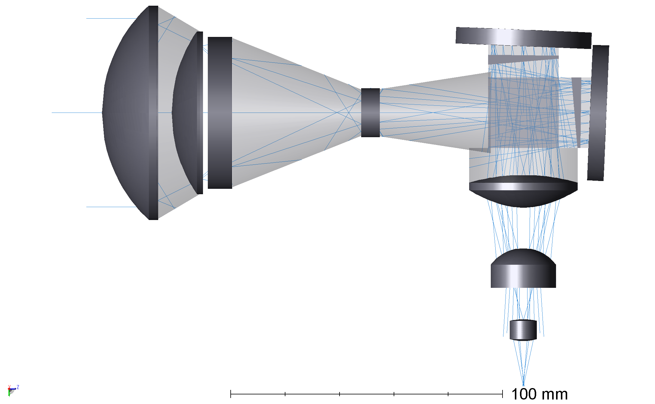
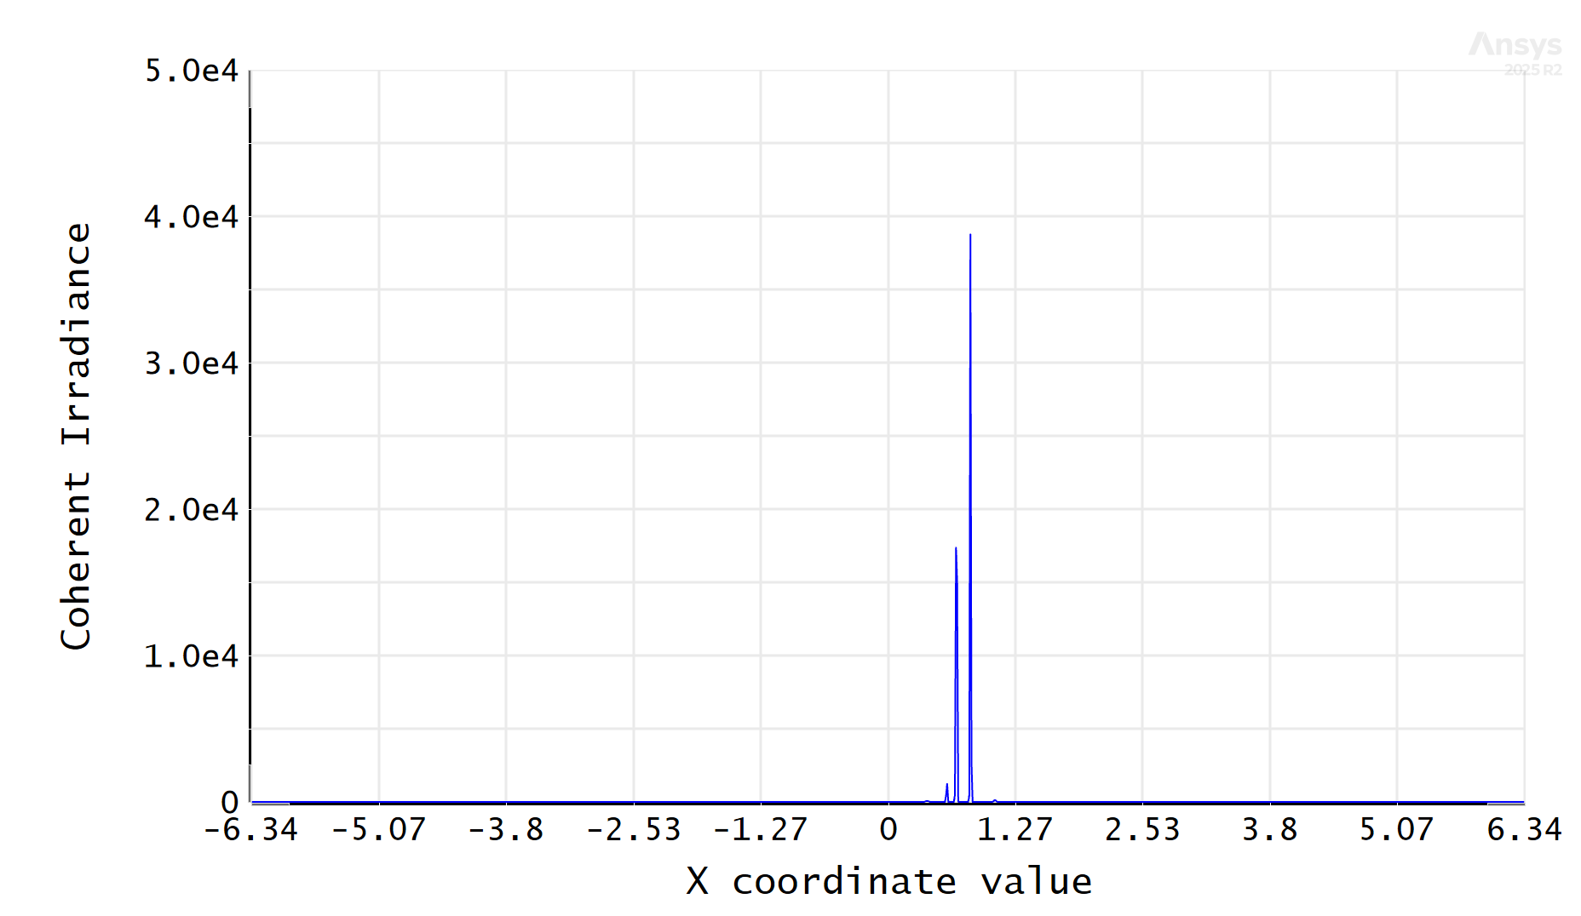
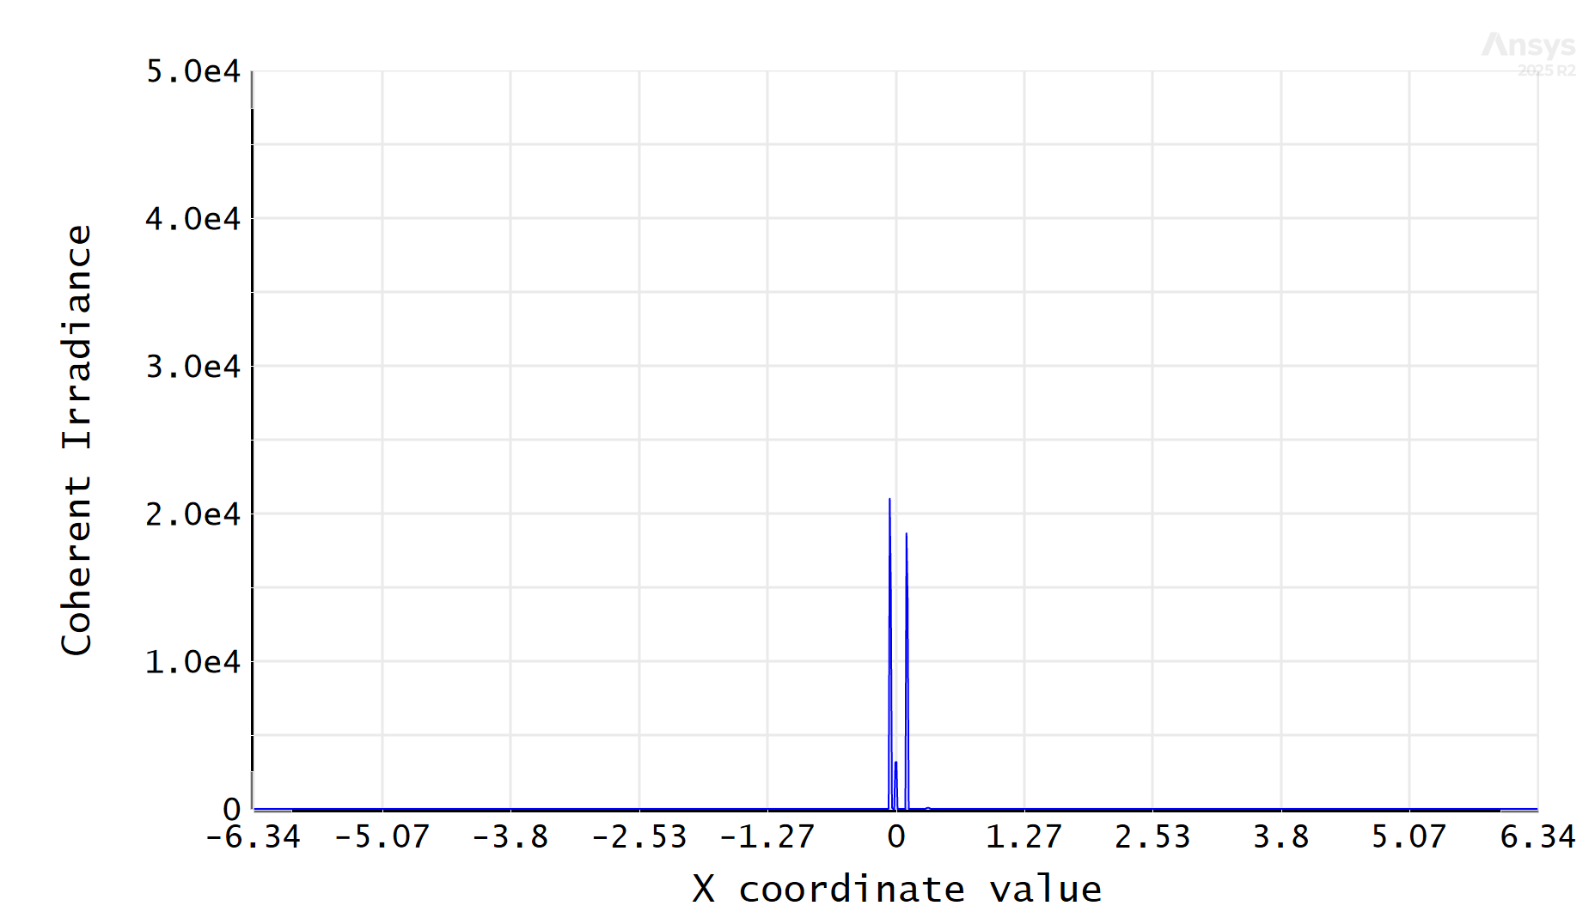
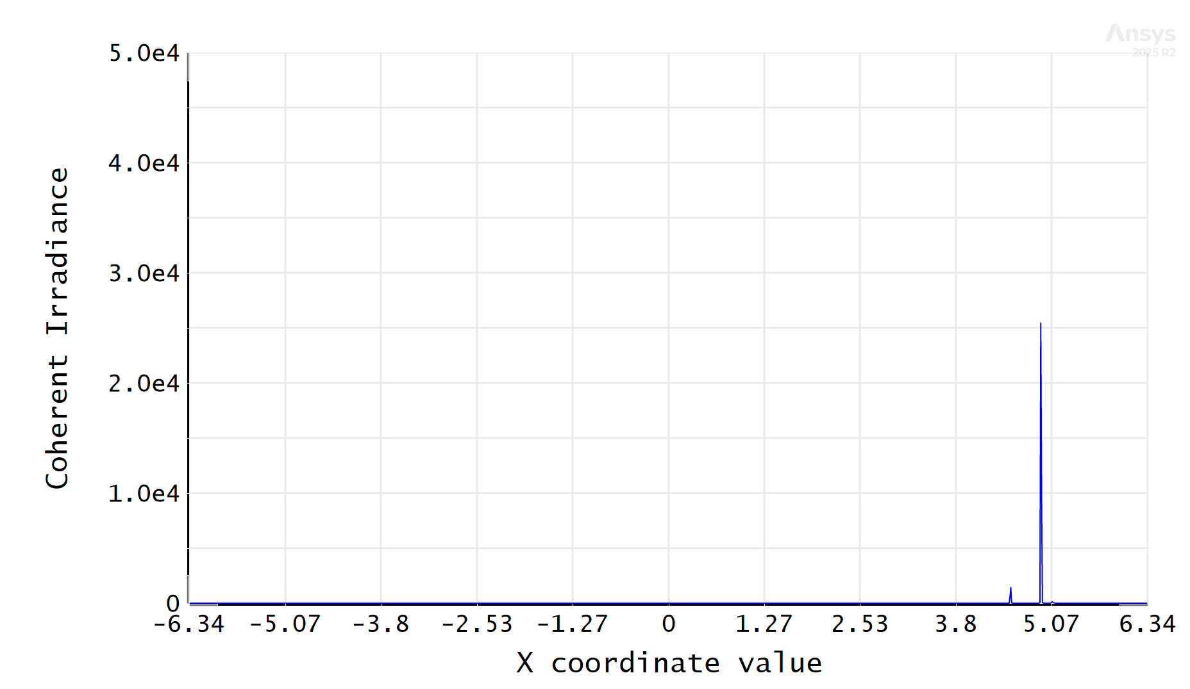
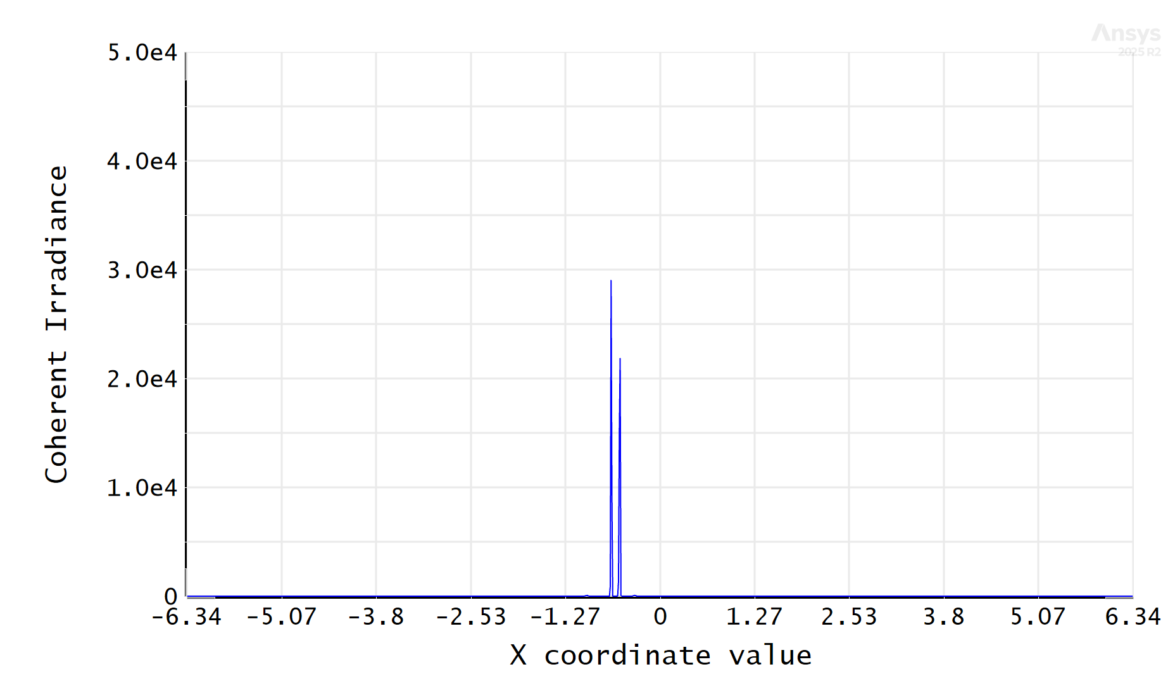
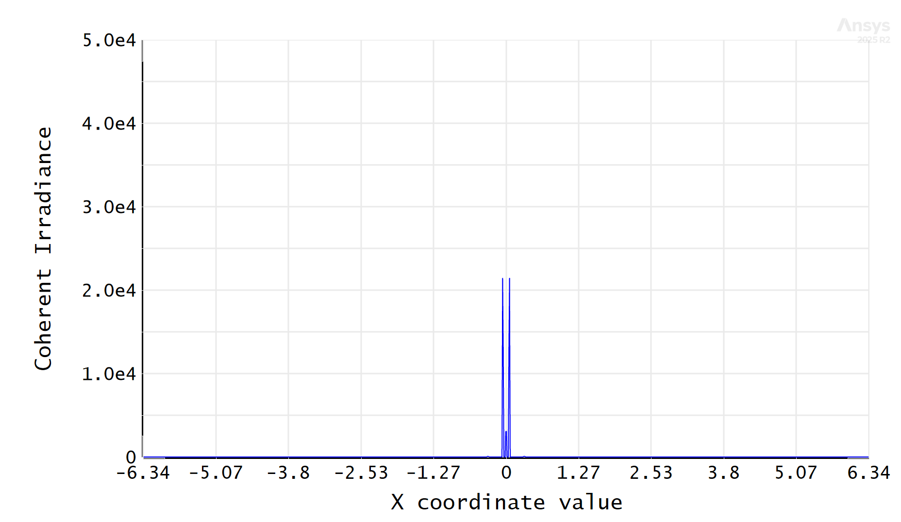
Point Source Analysis
Preparing simulations for validation
Lens 1 X + 1 deg
Grating 1 X + 1 deg
Lens 5 Z + 1 mm
Lens 1 Y + 1 mm

Slide 11
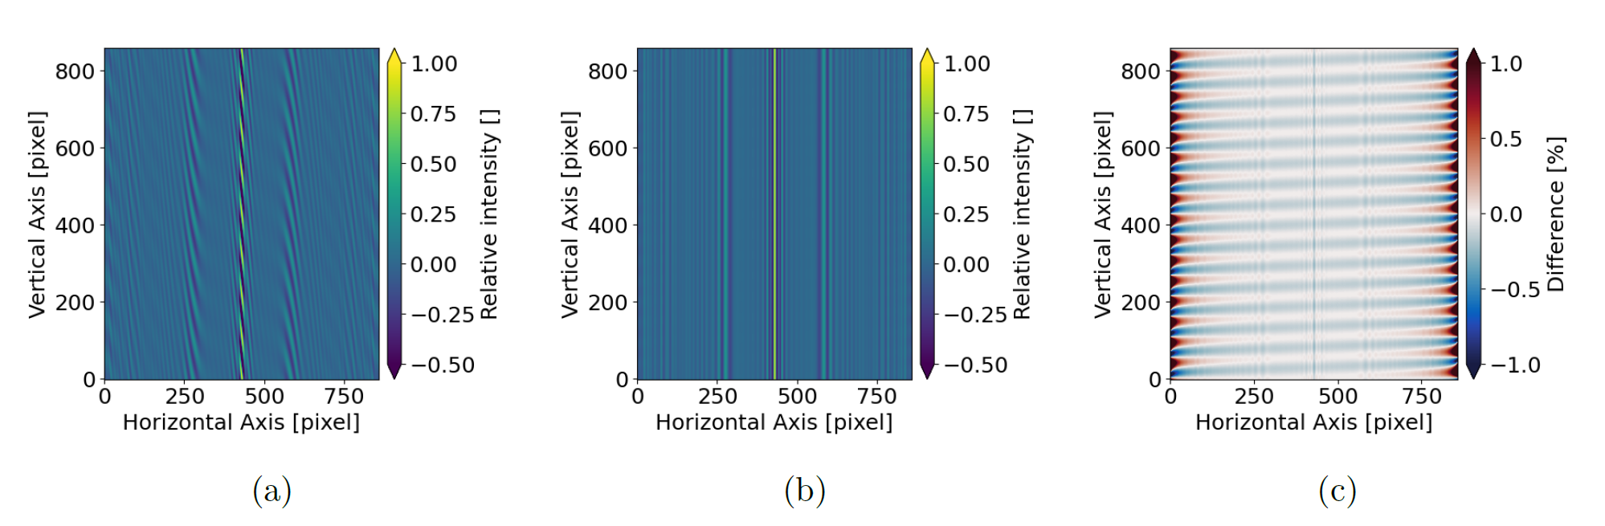
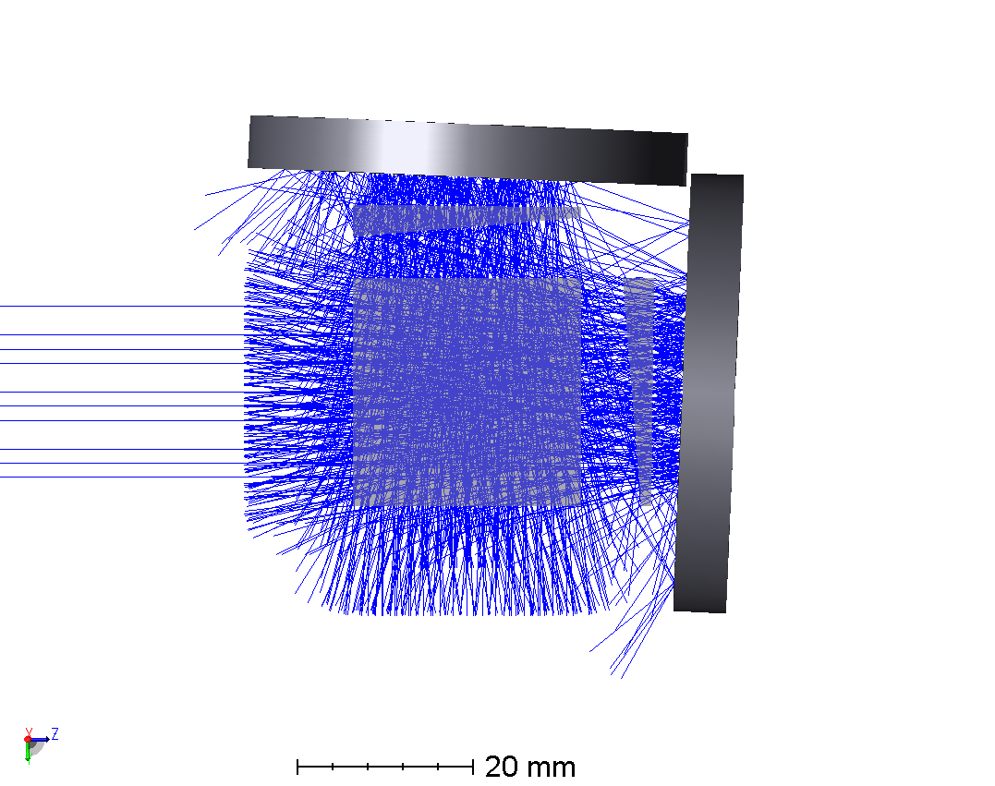
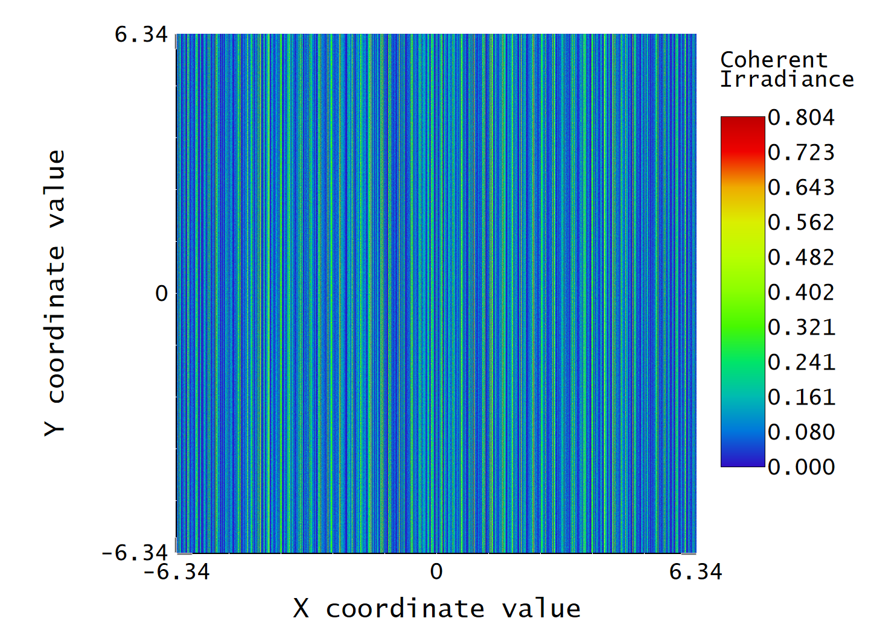

Fringe degradation due to Grating tilt
Postprocessing tool to recover fringes from Ntokas (2023)
Origin of the problem in SHI

Slide 12
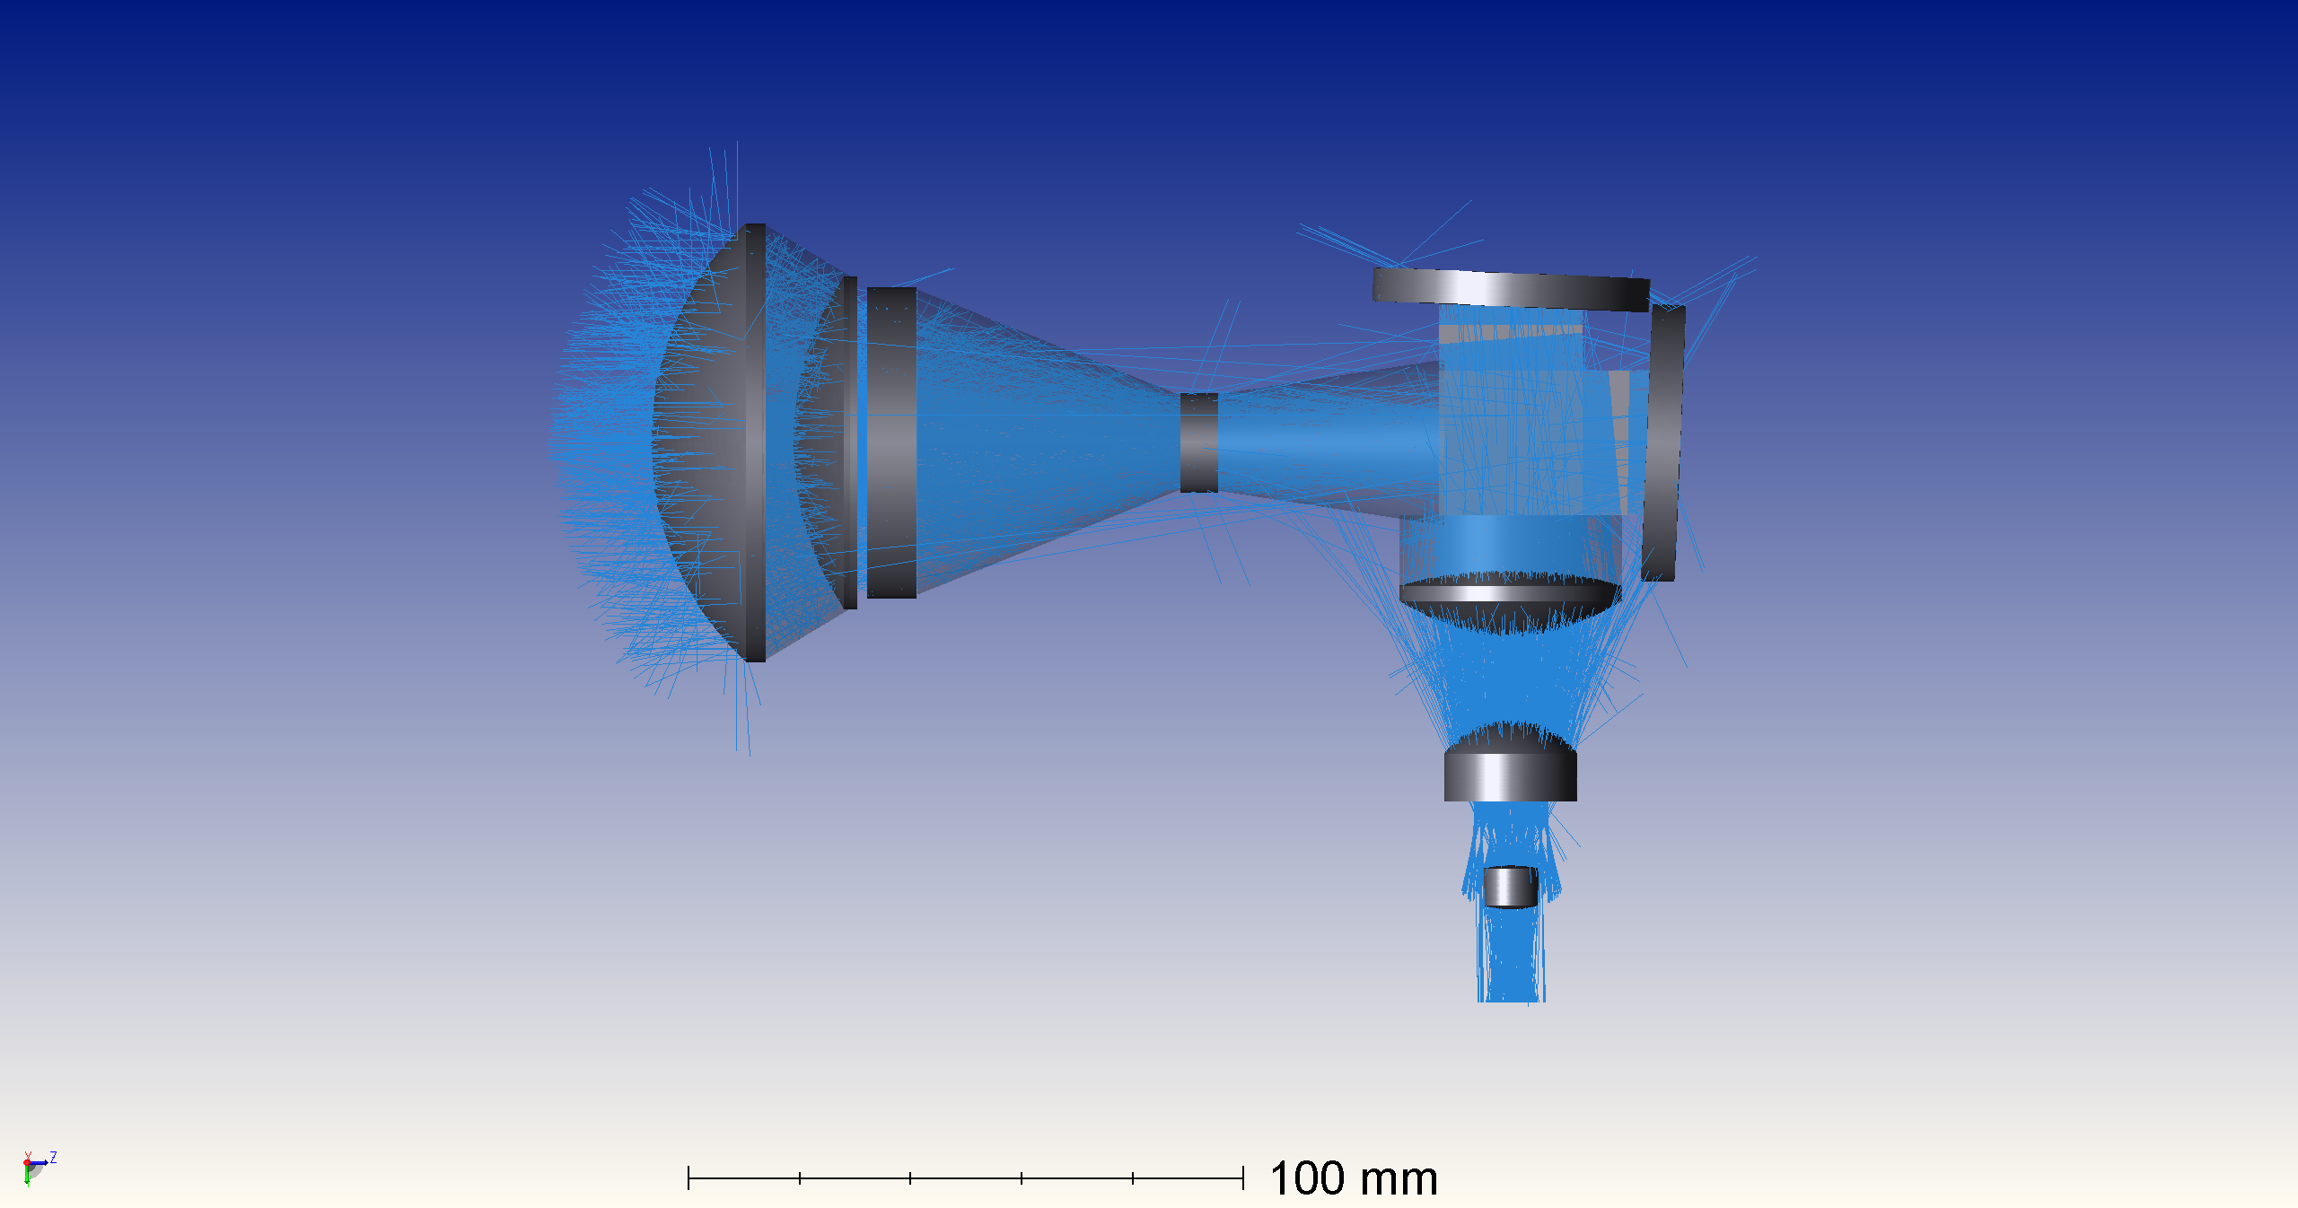
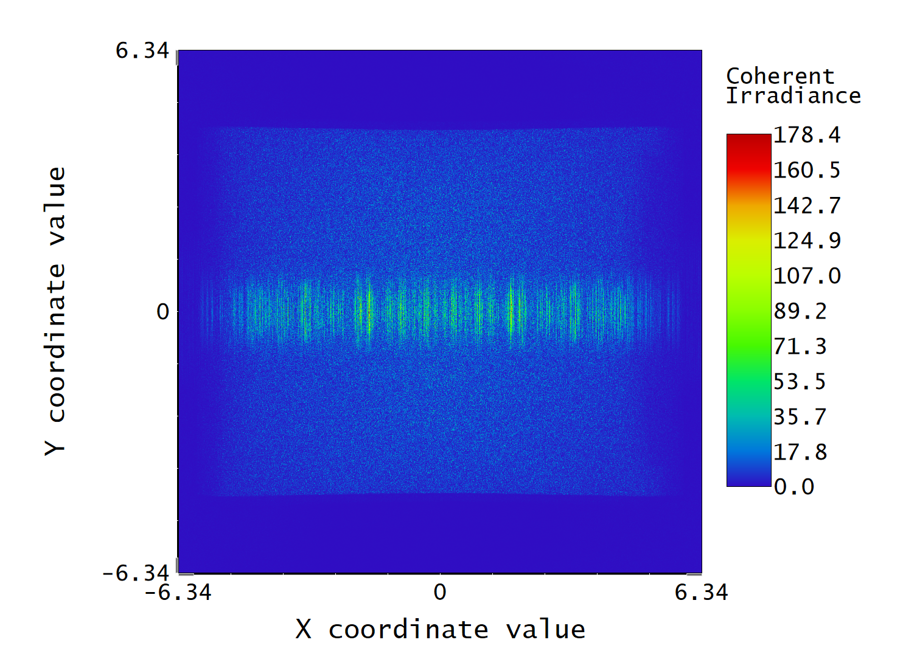
Full system analysis
2.7 billion rays
Covering central line segment of the detector
This method is enough for fringe degradation monitoring

Slide 13
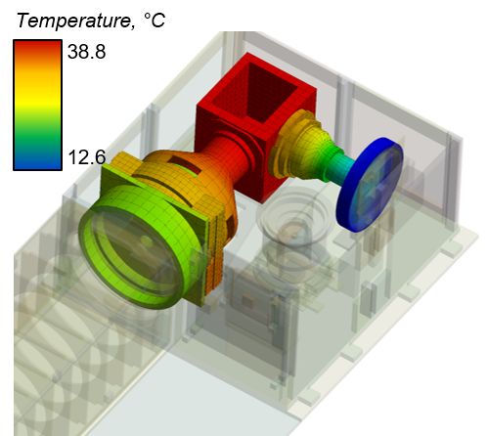
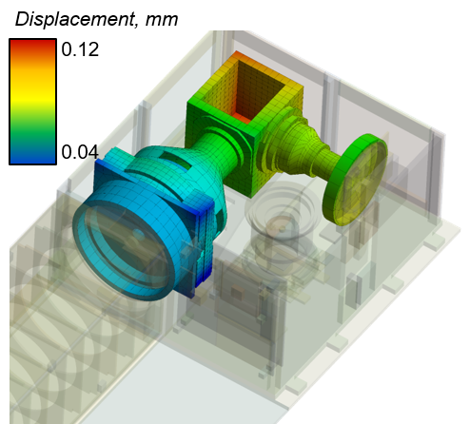
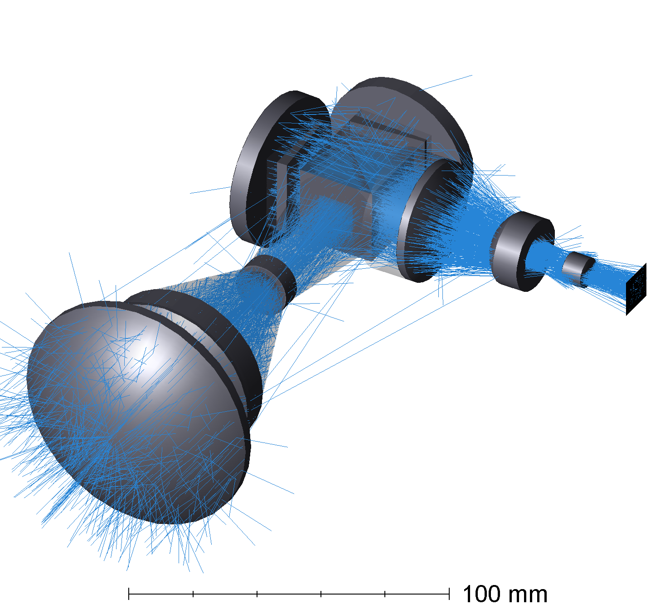
Current status
Interdisciplinary modelling
Thermal model
Structural model
Optical model

Slide 14
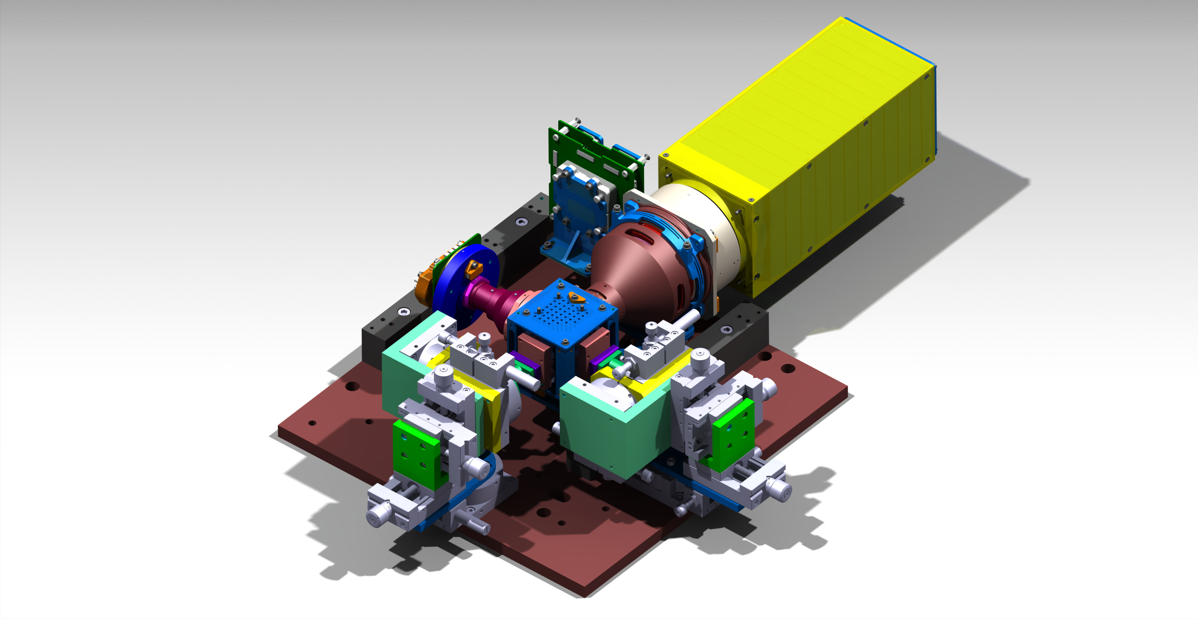
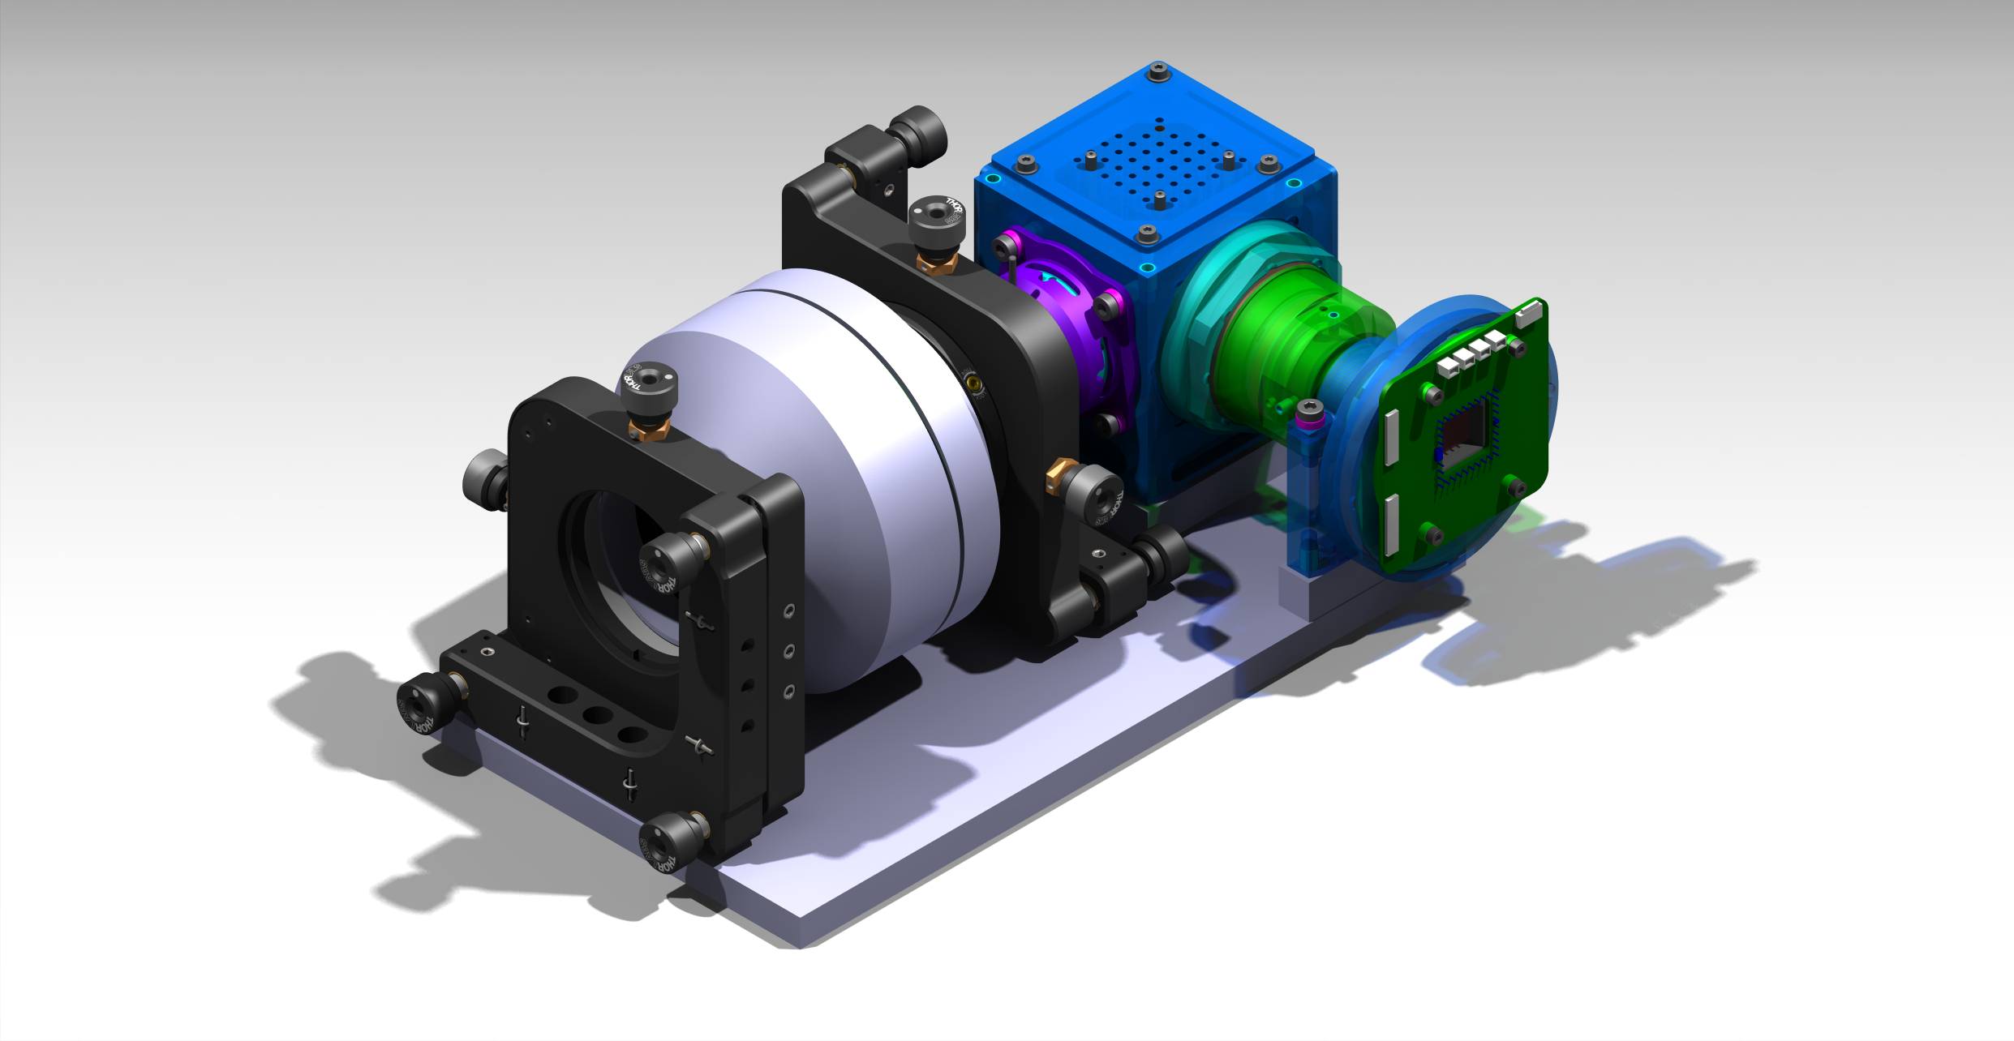
Further steps
SHI mounting tool
Preparing the Experiment
Create experimental setup
Validate numerical model
Analyze detector picture after deformation
experimental setup
Identify critical optical elements
Provide STOP based design suggestions

Slide 15


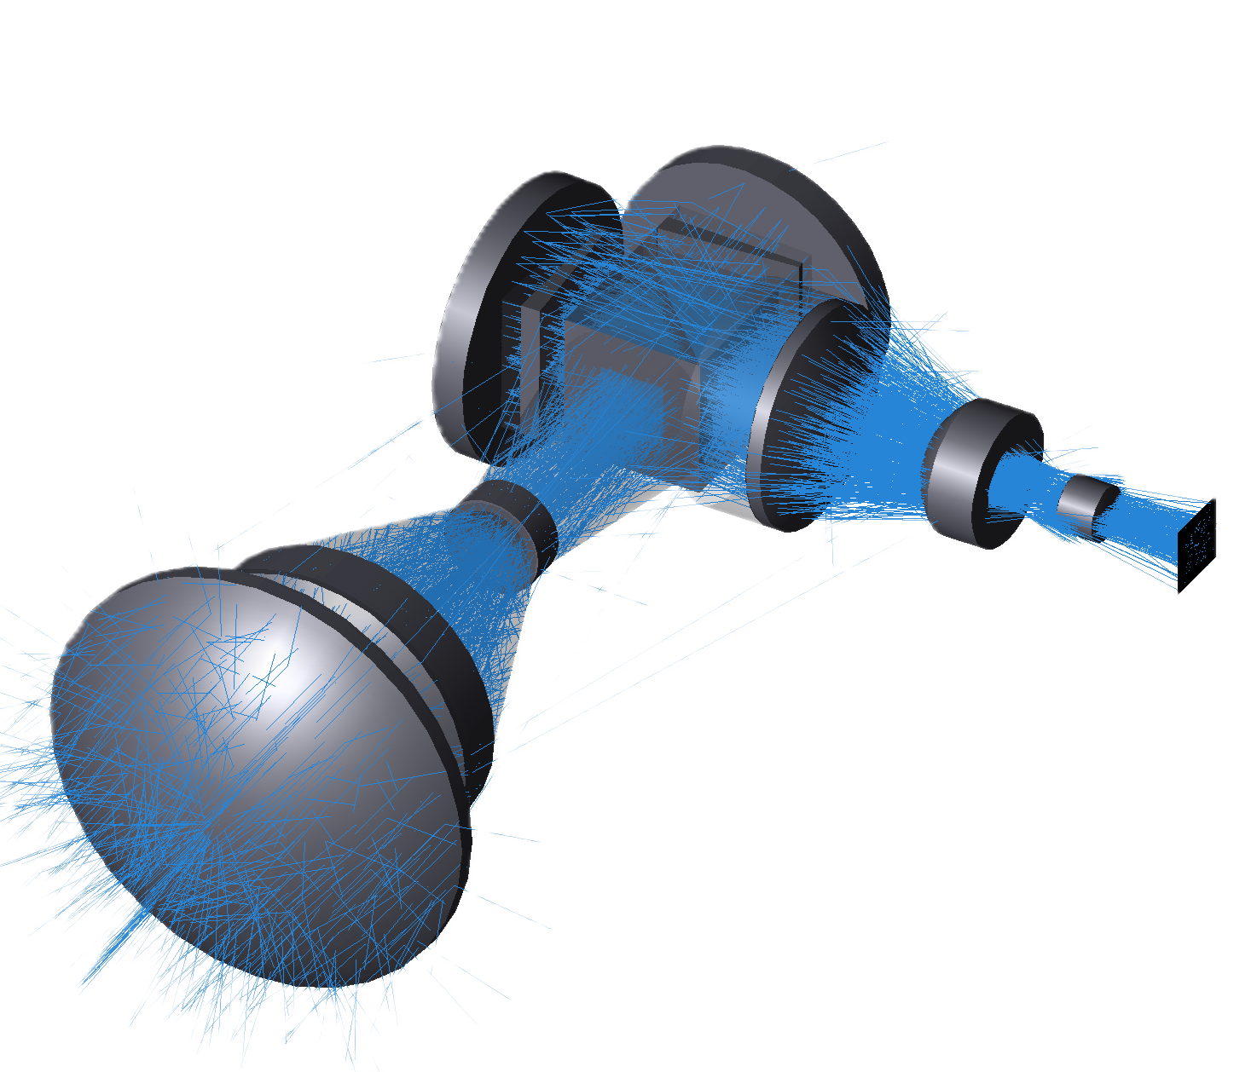
Conclusion
Scientific Contribution
STOP workflow development
Commercial software based
Identify main contributors in image degradation
Provide future design recommendations

Slide 16
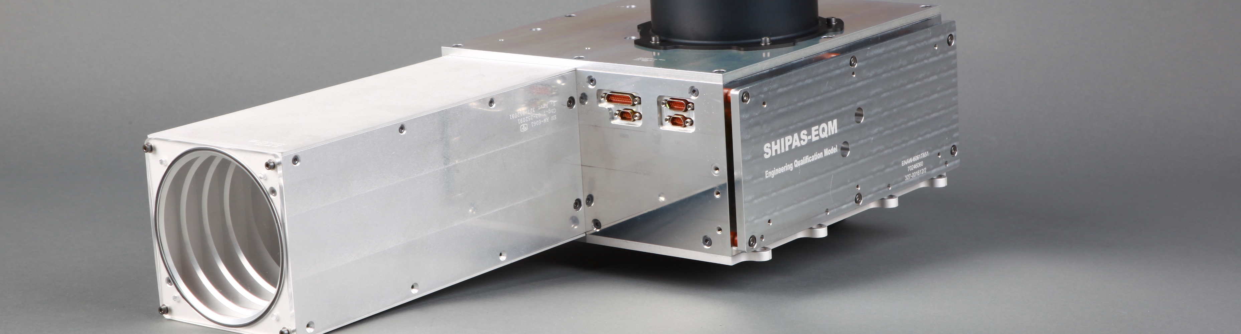
Thank you for your attention

