Slide 1

Detection of Muons Produced by UltraShort High-Intensity Laser
Masters’s student at the University of Georgia – Rusudan Kvesitadze

Slide 2
Motivation
Wakefield Accelerators: Potential for Future Compact Muon Sources
Need for a Detector to Verify Muon Production
Prototype Validation Using Cosmic Muons

Slide 3
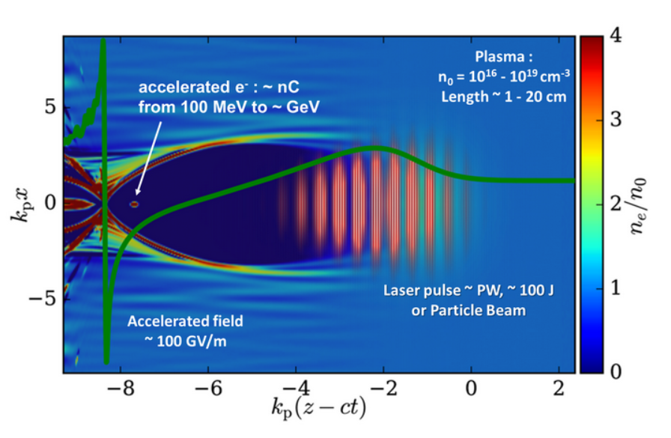

Laser Wakefield Acceleration

Slide 4
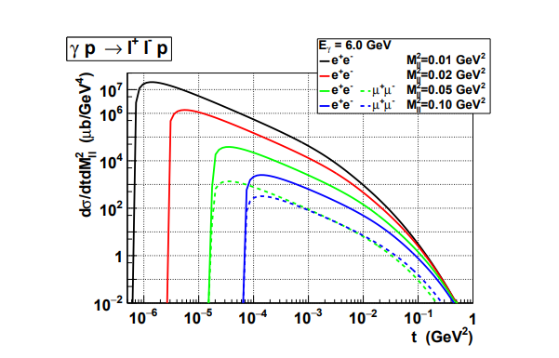
Muon Generation Mechanism
Electrons (GeV)
e⁺e⁻
μ ⁺μ⁻
Pb
γ
Production Rate
Electrons (1 – 10 GeV)
Target (Pb)
Bethe-Heitler Proccess
Momentum Transfer

Slide 5
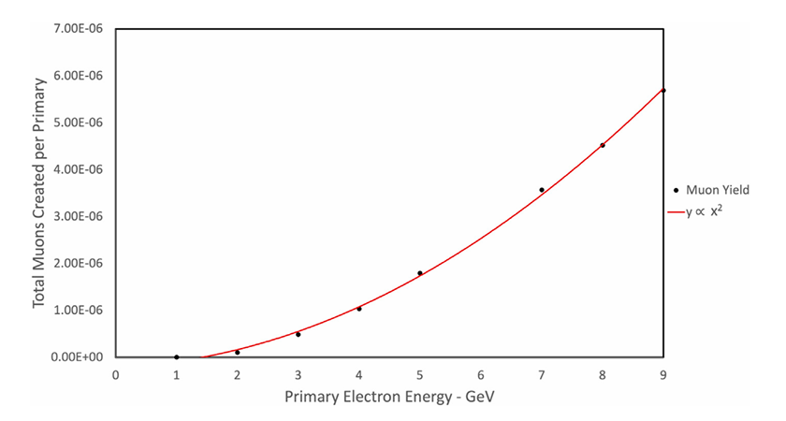
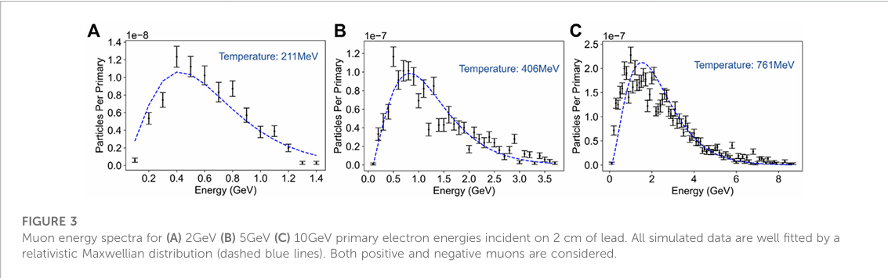
Numerical simulation results (FB-PIC + FLUKA)
• 2 cm lead (Pb) target.
• Average number of muons produced per primary electron.
Muon energy spectrum for 2, 5, and 10 GeV electron beams. The blue dashed line represents a fit obtained using a relativistic Maxwell distribution, while the indicated “temperature” is the effective parameter of this fit.

Slide 6
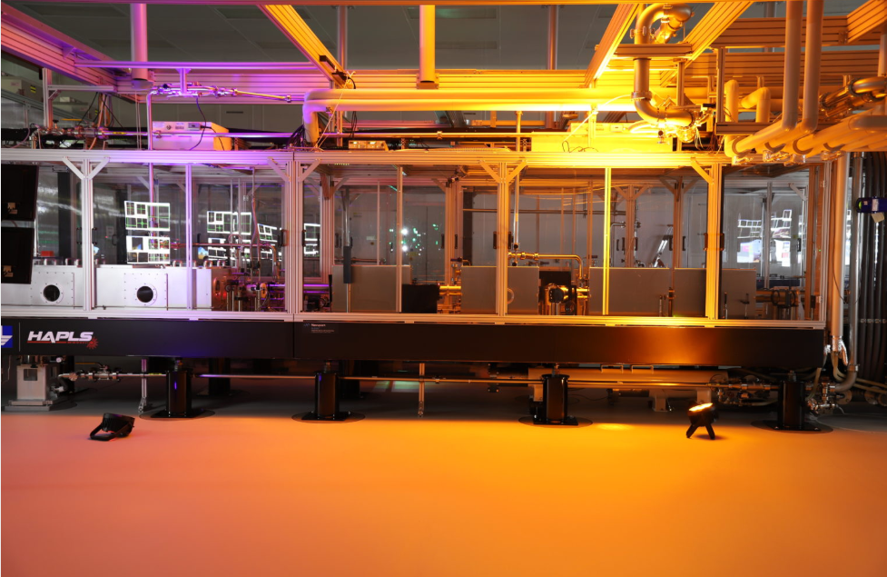
ELI Beamlines – L3-HAPLS / ELBA
Laser: L3-HAPLS
Peak power: 1 PW
Pulse energy: up to 30 J
Pulse duration: <30 fs
Repetition rate: up to 10 Hz
Acceleration: LWFA
Electron beam for the planned experiment: 1.5–4 GeV
Charge: 100–1000pC (10⁸ – 10⁹ electron)

Slide 7
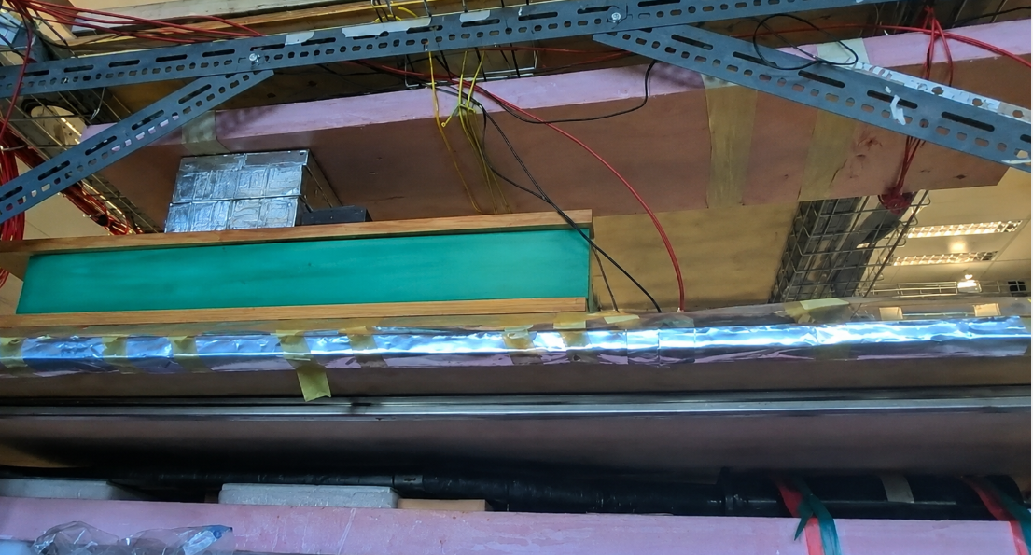
Measurement of the Cosmic Muon Lifetime and Development of a Detector Prototype
Detector Logic Diagram
Detector Prototype
pb
Shielding + μ moderator
Trigger scintillator
scintillator
e-
Veto

Slide 8
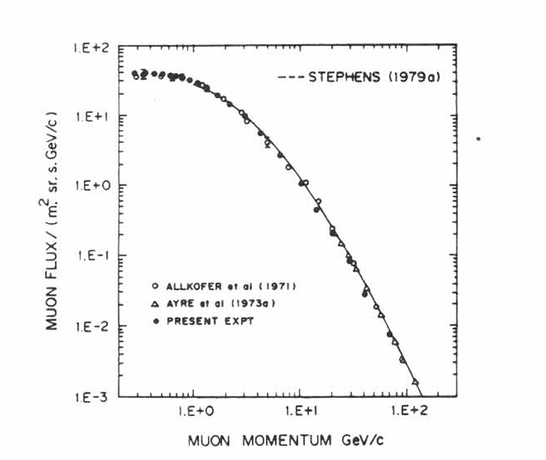

Measurement of the Cosmic Muon Lifetime and Development of a Detector Prototype
Measurement of the mean lifetime of low-energy cosmic muons.
Although muon decay is a random process, its decay probability per unit time is constant. Therefore, the distribution of decay times for a large number of muons follows an exponential law.
N₀ ₋ initial amplitude, B - Background, τ - mean muon lifetime.

Slide 9
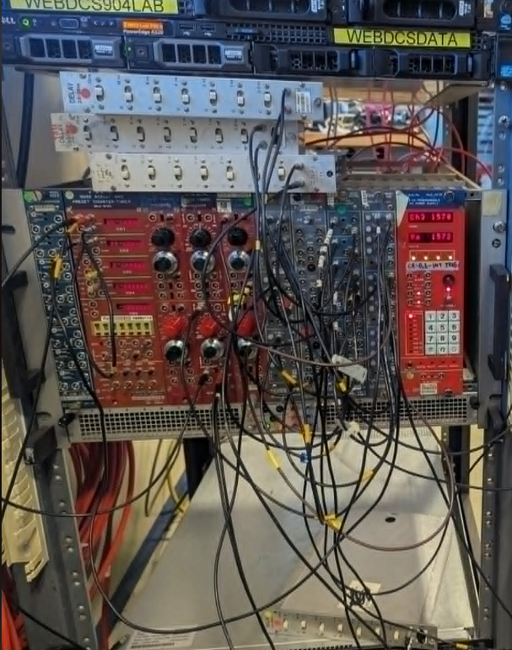
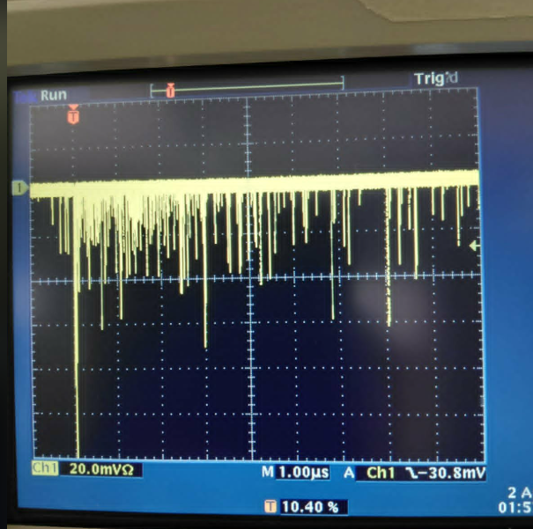
Measurement of the Cosmic Muon Lifetime and Development of a Detector Prototype
Nuclear Electronics Modules Used
Muon Decay Signals on the Oscilloscope

Slide 10
Future Measurments
Long-term measurements to obtain the exponential muon decay spectrum.
Application of the detector to detect muons produced by LWFA.
Estimation of the energy and yield of muons produced by the laser source.

