Slide 1


Georgian-German Science Bridge 2026: A Student and Collaboration Workshop
Tbilisi, Georgia
September 7-12
Determining Dimuon Branching Fraction of ψ(2S) from ATLAS Data
Leila Cherkezishvili
Ivane Javakhishvili Tbilisi State University- Faculty of Exact and Natural Sciences, Department of Physics, 4th year of Bachelor
Rusudan Kvesitadze
The University of Georgia- Experimental Physics of Particles, 2nd year of Master
Supervisor: Vakhtang Kartvelishvili
Lancaster University, Experimental Particle Physics

Slide 2
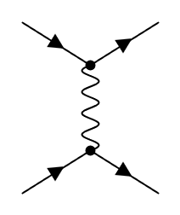
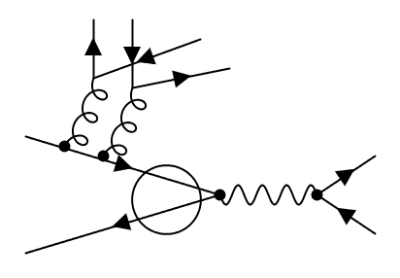




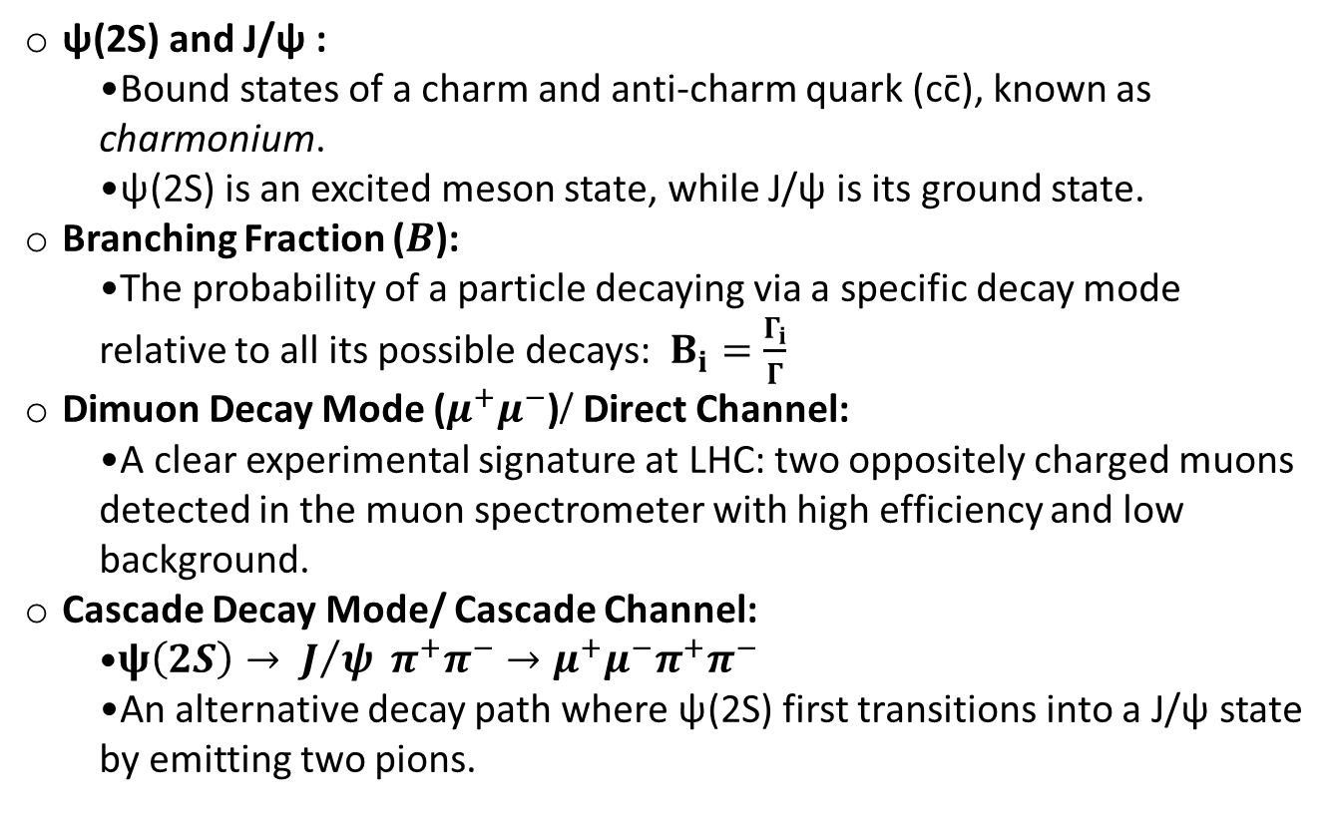






Key Concepts & Definitions
c̄
$$μ^{−}$$
ψ(2S) and J/ψ :
  Bound states of a charm and anti-charm quark (cc̄), known as charmonium.
  ψ(2S) is an excited meson state, while J/ψ is its ground state.
Branching Fraction ($B$):
  The probability of a particle decaying via a specific decay mode relative to all its possible decays: $B_{i}=\frac{Γ_{i}}{Γ}$
Dimuon Decay Mode ($μ^{+}μ^{−}$)/ Direct Channel:
  A clear experimental signature at LHC: two oppositely charged muons detected in the muon spectrometer with high efficiency and low background.
Cascade Decay Mode/ Cascade Channel:
  $ψ\left(2S\right)→ J/ψ π^{+}π^{−}→μ^{+}μ^{−}π^{+}π^{−}$
  An alternative decay path where ψ(2S) first transitions into a J/ψ state by emitting two pions.
$$ψ\left(2S\right)$$
γ*
c
$$μ^{+}$$
$$π^{+}$$
u
d̄
ū
$$π^{−}$$
d
g
c
g
$$μ^{−}$$
$$ψ\left(2S\right)$$
$$J/ψ$$
γ*
$$μ^{+}$$

Slide 3
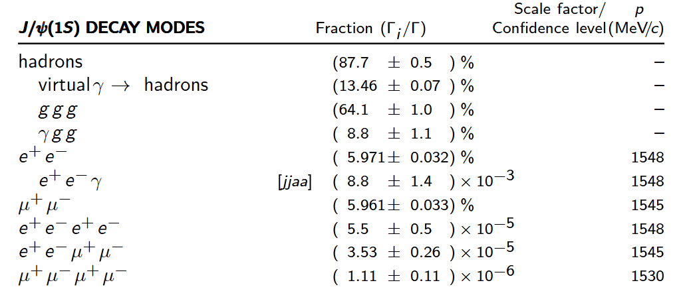
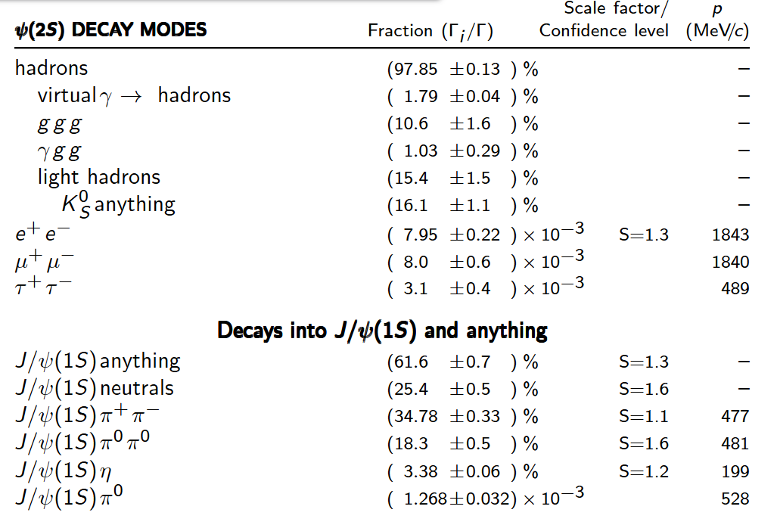
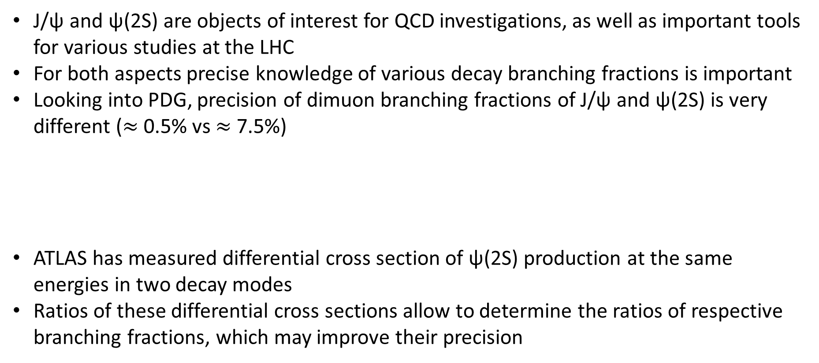
Motivation
J/ψ and ψ(2S) are objects of interest for QCD investigations, as well as important tools for various studies at the LHC
For both aspects precise knowledge of various decay branching fractions is important
Looking into PDG, precision of dimuon branching fractions of J/ψ and ψ(2S) is very different ($≈$0.5% vs $≈$7.5%)
ATLAS has measured differential cross section of ψ(2S) production at the same energies in two decay modes
Ratios of these differential cross sections allow to determine the ratios of respective branching fractions, which may improve their precision

Slide 4
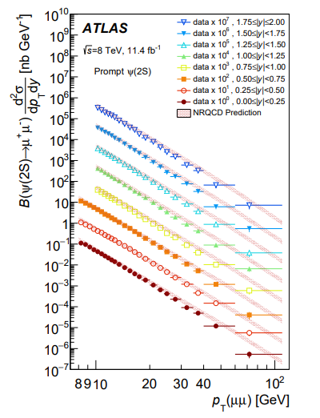
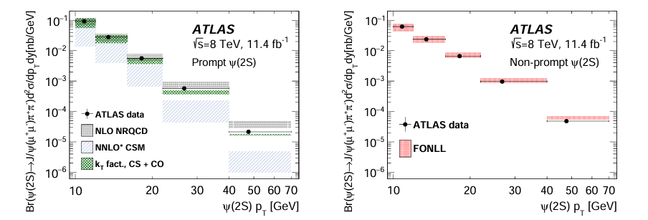

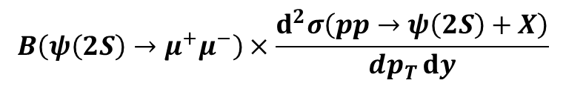
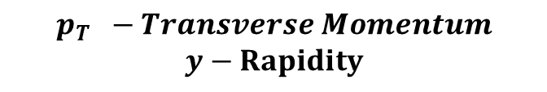
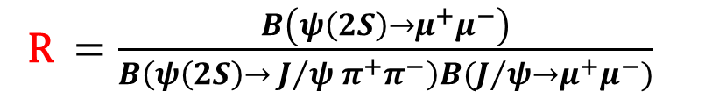
ATLAS DATA - $μ^{+}μ^{−}$ & J/ ψ $π^{+}π^{−}$modes
Taking the ratio of these two cross section measurements one effectively measures the ratio of branching fractions:
$$B\left(ψ\left(2S\right)→μ^{+}μ^{−}\right)×\frac{ⅆ^{2}σ\left(pp→ψ\left(2S\right)+X\right)}{dp_{T}ⅆy}$$
(DIVIDE)
$$B\left(ψ\left(2S\right)→ J/ψ π^{+}π^{−}\right)B(J/{ψ→μ^{+}μ^{−}})×\frac{ⅆ^{2}σ\left(pp→ψ\left(2S\right)+X\right)}{dp_{T}ⅆy}$$
https://link.springer.com/article/10.1140/epjc/s10052-016-4050-8
R $=\frac{B\left(ψ\left(2S\right)→μ^{+}μ^{−}\right)}{B\left(ψ\left(2S\right)→ J/ψ π^{+}π^{−}\right)B(J/{ψ→μ^{+}μ^{−}})}$
$$p_{T }−Transverse Momentum$$
$$y−Rapidity$$
https://link.springer.com/article/10.1007/JHEP09(2014)079

Slide 5
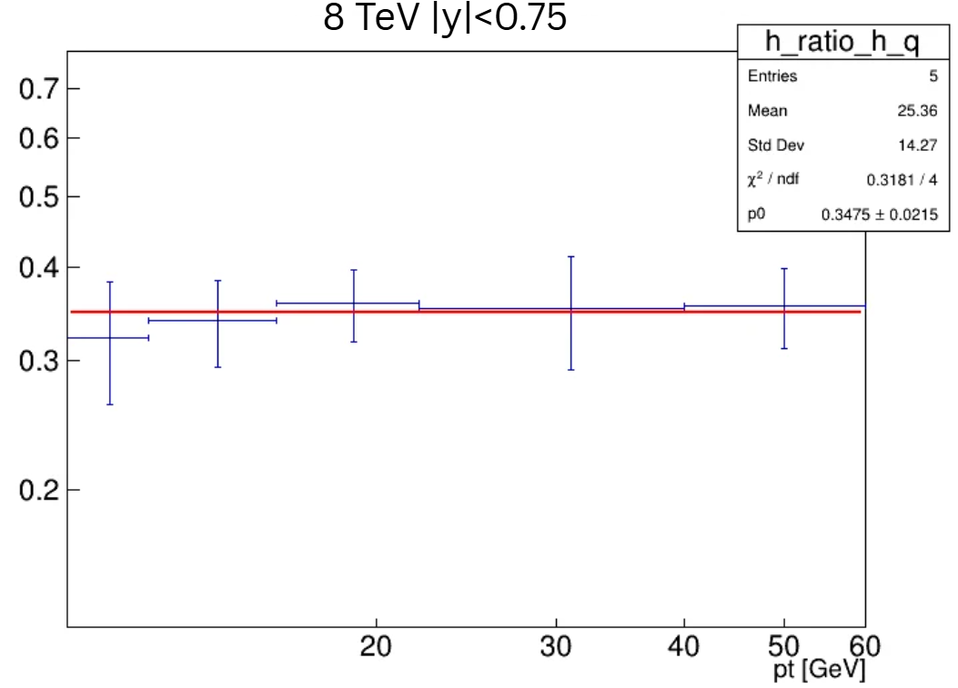
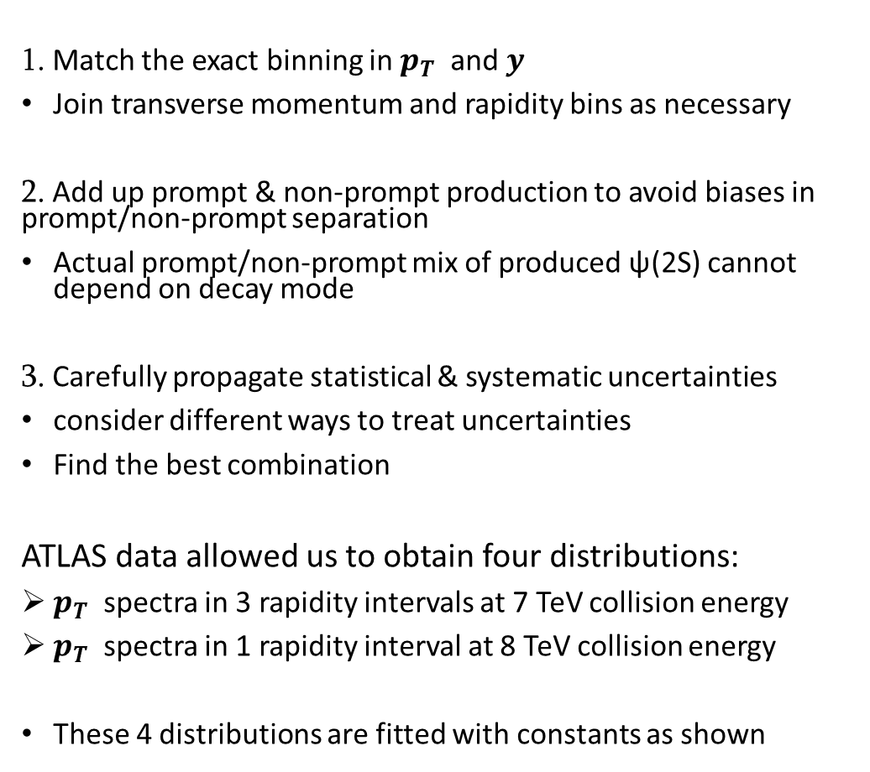

DATA ANALYSIS: Strategy
1. Match the exact binning in $p_{T }$and $y$
Join transverse momentum and rapidity bins as necessary
2. Add up prompt & non-prompt production to avoid biases in prompt/non-prompt separation
Actual prompt/non-prompt mix of produced ψ(2S) cannot depend on decay mode
3. Carefully propagate statistical & systematic uncertainties
consider different ways to treat uncertainties
Find the best combination
ATLAS data allowed us to obtain four distributions:
$p_{T }$spectra in 3 rapidity intervals at 7 TeV collision energy
$p_{T }$spectra in 1 rapidity interval at 8 TeV collision energy
These 4 distributions are fitted with constants as shown
R
$$p_{T}$$

Slide 6
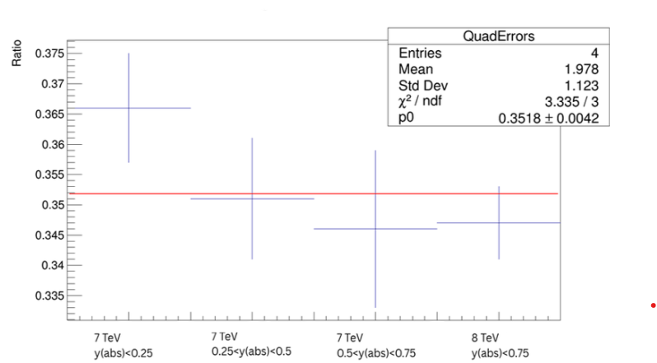
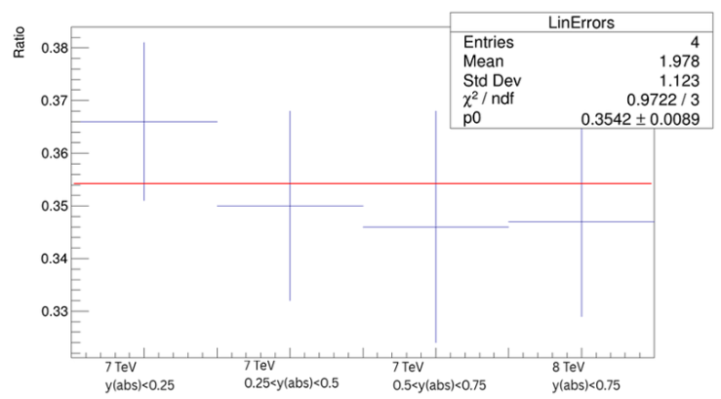
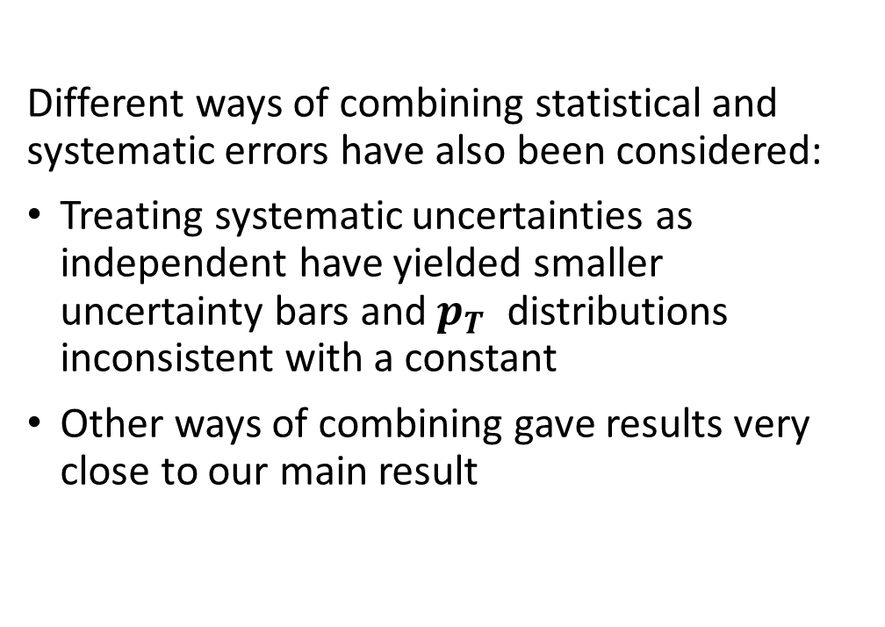
Possible Combinations
Different ways of combining statistical and systematic errors have also been considered:
Treating systematic uncertainties as independent have yielded smaller uncertainty bars and $p_{T }$distributions inconsistent with a constant
Other ways of combining gave results very close to our main result

Slide 7
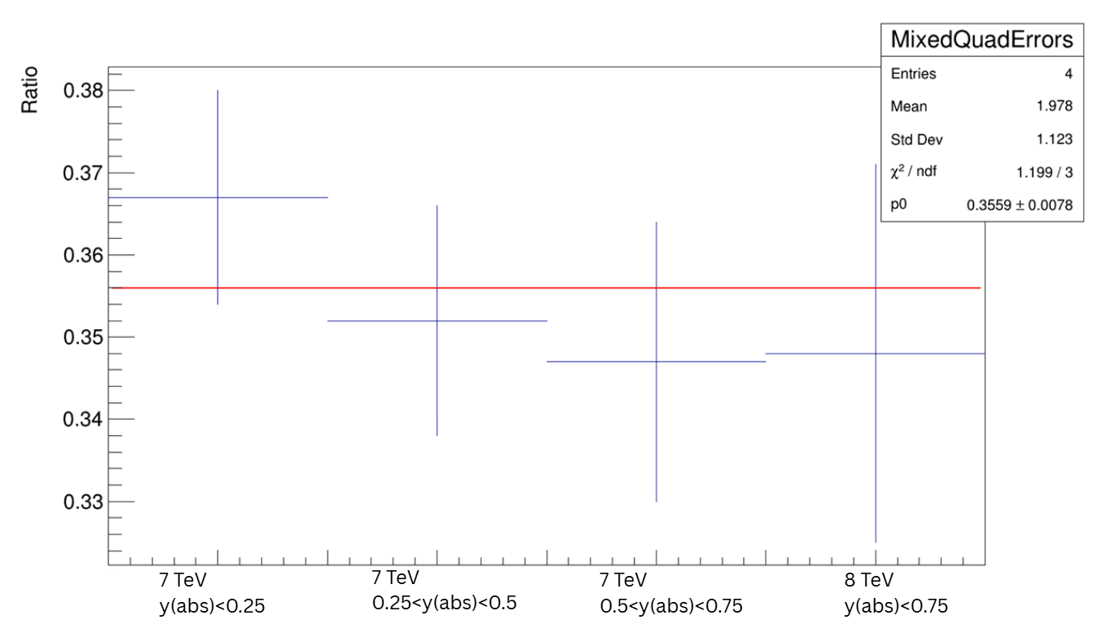
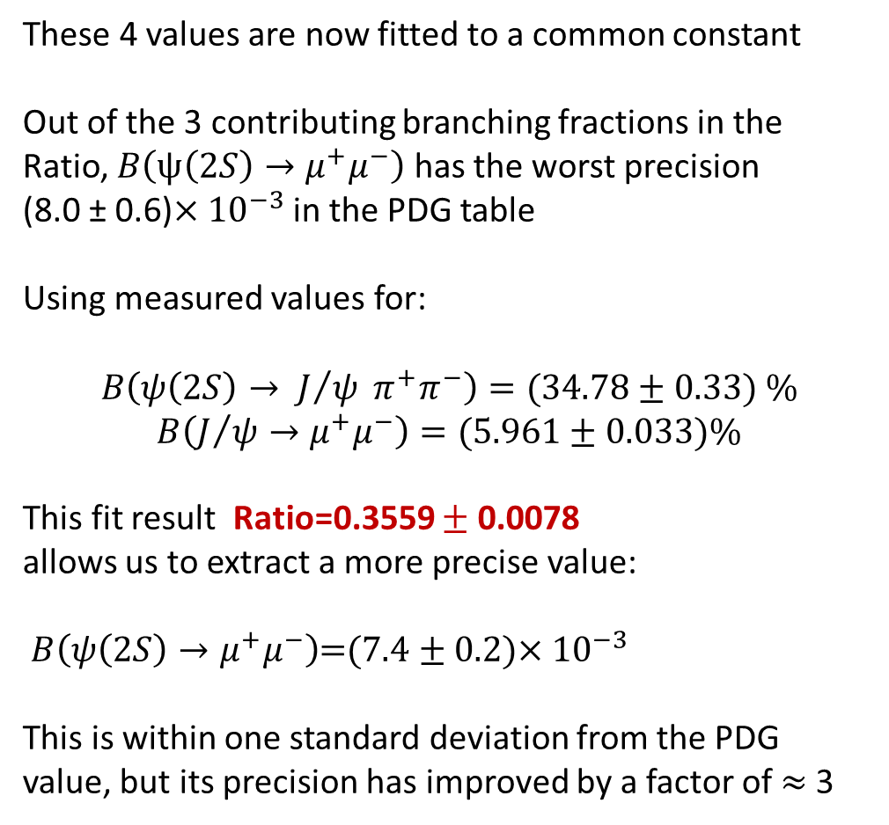
Results
These 4 values are now fitted to a common constant
Out of the 3 contributing branching fractions in the Ratio, $B\left(ψ\left(2S\right)→μ^{+}μ^{−}\right)$ has the worst precision
(8.0 ± 0.6)$×{10}^{−3}$ in the PDG table
Using measured values for:
$$B\left(ψ\left(2S\right)→ J/ψ π^{+}π^{−}\right)=(34.78±0.33) \%$$
$$B\left(J/{ψ→μ^{+}μ^{−}}\right)=\text{(}\text{5}\text{.}\text{961}±\text{0}\text{.}\text{033}\text{)\%}$$
This fit result Ratio=0.3559 $±$ 0.0078
allows us to extract a more precise value:
$B\left(ψ\left(2S\right)→μ^{+}μ^{−}\right)$=(7.4 ± 0.2)$×{10}^{−3}$
This is within one standard deviation from the PDG value, but its precision has improved by a factor of $≈$3

Slide 8
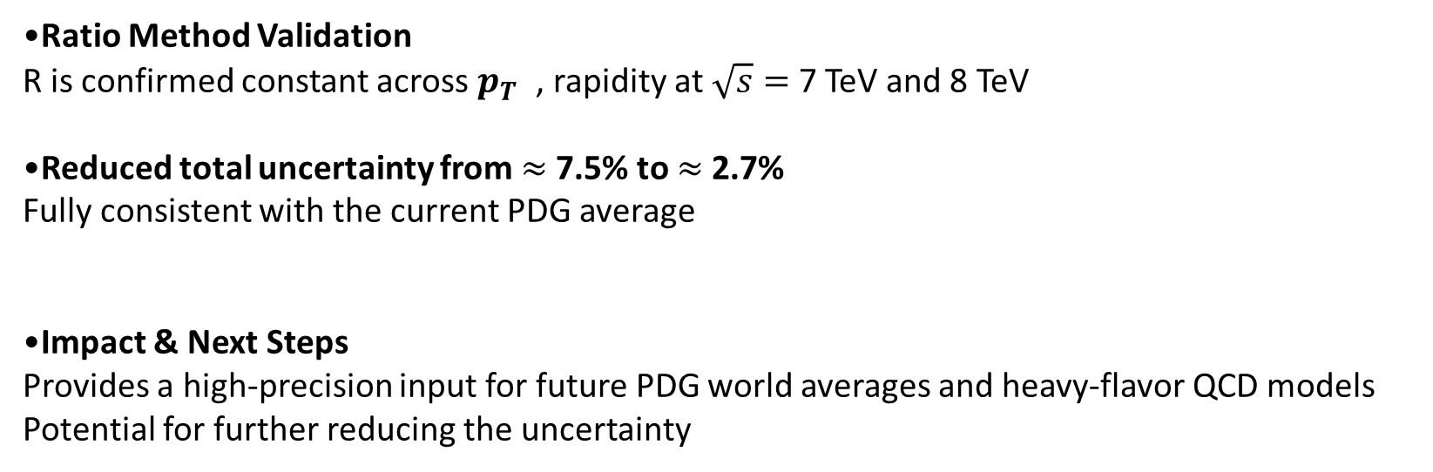
Summary & Outlook
Ratio Method Validation
R is confirmed constant across $p_{T }$, rapidity at $\sqrt{s}=$ 7 TeV and 8 TeV
Reduced total uncertainty from $≈$7.5% to $≈$2.7%
Fully consistent with the current PDG average
Impact & Next Steps
Provides a high-precision input for future PDG world averages and heavy-flavor QCD models
Potential for further reducing the uncertainty

Slide 9








Thank You!

