Slide 1


GEORGIAN-GERMAN SCIENCE BRIDGE · SMART|EDM_Lab
Testing and
Parametric Evaluation of SiPM Power Supplies
`
Dynamic-load stability and supply-voltage-rejection testing of the SiPM detector power supply, with data acquisition on Red Pitaya and analysis in CERN ROOT
Nikoloz Kalichava
Electronic and Automated Systems Engineering, Georgian Agrarian University
Supervisor: Prof. Davit Mchedlishvili ·

Slide 2
NIKOLOZ KALICHAVA
FOCUS
Sensors • Embedded Systems • DAQ
Electrical & Computer Engineering | Research and Instrumentation
Tbilisi, Georgia • nkali2022@agruni.edu.ge • +995 557 777 953
EDUCATION
RESEARCH & LABORATORY EXPERIENCE
SELECTED PROJECTS
Agricultural University of Georgia
BSc, Electrical & Computer Engineering
2022–Present | GPA: 3.78
V. Komarovi Physics & Math School N199
2015–2019
SMART|EDM_Lab — Research Engineering Intern
• Pulse oximeter — analog amplification, filtering and biomedical sensor interfacing
• “Po ludus” — ATmega64 checkers system with graphical LCD and embedded game engine
• Locator for blind individuals — ATmega168, ultrasonic sensing, microSD audio and PWM
• Water-tank relay controller and AVR digital clock/timer
Tbilisi State University | Mar 2026–Present
• Detector and instrumentation development with Forschungszentrum Jülich
• Scintillation crystals, PMTs and data-acquisition systems
• Testing and characterization of measurement systems and laboratory equipment
• Electronics, simulations and experimental setup development
TRAINING & RECOGNITION
MEASUREMENTS & SENSOR SYSTEMS
Certificate • Apr–May 2026 • Top 2
MODERN TESTING METHODS IN ENGINEERING
Certificate • Jun 2025 • Top 2
QUALI Start-up Lecture Week, GGSB
International academic conference • Aug 2025
FIDE-registered chess player
School Olympiad and team champion
INDUSTRY & TECHNICAL PRACTICE
TECHNICAL SKILLS
Georgian Standards and Metrology
Electrical Department Intern | Oct 2025–Jan 2026
PROGRAMMING
C++ • AVR Assembly • Python • Java
HARDWARE & EMBEDDED
AVR / ATmega / ATtiny • Analog and digital circuits • Sensor interfacing • Hardware–software integration
TOOLS
MATLAB/Simulink • Proteus • NI Multisim • Microchip Studio • Linux • AutoCAD
• Measurement and calibration of electrical quantities
• Metrology, standardization and laboratory practice
• Hands-on work with electronics
UGT Tech Hub | Computer architecture, networking, cloud and cybersecurity | 2024–2025

Slide 3
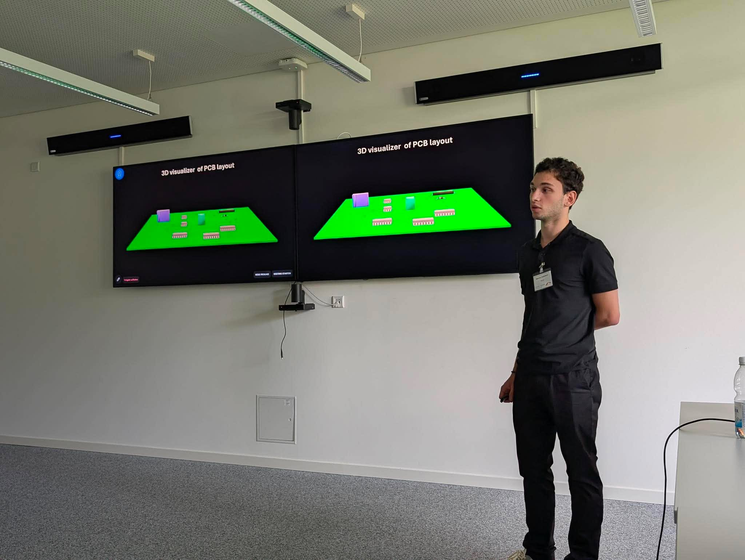
NIKOLOZ KALICHAVA
FOCUS
Sensors • Embedded Systems • DAQ
Electrical & Computer Engineering | Research and Instrumentation
Tbilisi, Georgia • nkali2022@agruni.edu.ge • +995 557 777 953
EDUCATION
RESEARCH & LABORATORY EXPERIENCE
SELECTED PROJECTS
Agricultural University of Georgia
BSc, Electrical & Computer Engineering
2022–Present | GPA: 3.78
V. Komarovi Physics & Math School N199
2015–2019
SMART|EDM_Lab — Research Engineering Intern
• Pulse oximeter — analog amplification, filtering and biomedical sensor interfacing
• “Po ludus” — ATmega64 checkers system with graphical LCD and embedded game engine
• Locator for blind individuals — ATmega168, ultrasonic sensing, microSD audio and PWM
• Water-tank relay controller and AVR digital clock/timer
Tbilisi State University | Mar 2026–Present
• Detector and instrumentation development with Forschungszentrum Jülich
• Scintillation crystals, PMTs and data-acquisition systems
• Testing and characterization of measurement systems and laboratory equipment
• Electronics, simulations and experimental setup development
TRAINING & RECOGNITION
MEASUREMENTS & SENSOR SYSTEMS
Certificate • Apr–May 2026 • Top 2
MODERN TESTING METHODS IN ENGINEERING
Certificate • Jun 2025 • Top 2
QUALI Start-up Lecture Week, GGSB
International academic conference • Aug 2025
FIDE-registered chess player
School Olympiad and team champion
INDUSTRY & TECHNICAL PRACTICE
TECHNICAL SKILLS
Georgian Standards and Metrology
Electrical Department Intern | Oct 2025–Jan 2026
PROGRAMMING
C++ • AVR Assembly • Python • Java
HARDWARE & EMBEDDED
AVR / ATmega / ATtiny • Analog and digital circuits • Sensor interfacing • Hardware–software integration
TOOLS
MATLAB/Simulink • Proteus • NI Multisim • Microchip Studio • Linux • AutoCAD
• Measurement and calibration of electrical quantities
• Metrology, standardization and laboratory practice
• Hands-on work with electronics
UGT Tech Hub | Computer architecture, networking, cloud and cybersecurity | 2024–2025

Slide 4
THE PROBLEM
SiPM detectors — and why their power supply matters
SiPM — Silicon Photomultiplier
A semiconductor, photon-sensitive detector used to register very weak light signals and convert them into electrical pulses — often paired with a scintillator.
Working range
25–70 V
For power supply design see the talk by Salome Tvauri (with Mchedlishvili) (AUG)
“Designing a Low-Dropout Regulator for higher voltage SiPMs”
This is the question our research set out to answer, in two complementary ways:
The catch:
Does the supply stay stable when the load current changes? (dynamic load / K-coefficient testing)
A SiPM needs a stable bias voltage, roughly 25–70 V. Any instability in the power supply feeds directly into the detector's gain and noise — and therefore into measurement precision and accuracy.
Does the supply reject noise coming in on its input line? (Supply Voltage Rejection, SVR)
GGSB Laboratory Testing and Parametric Evaluation of SiPM Power Supplies
5

Slide 5
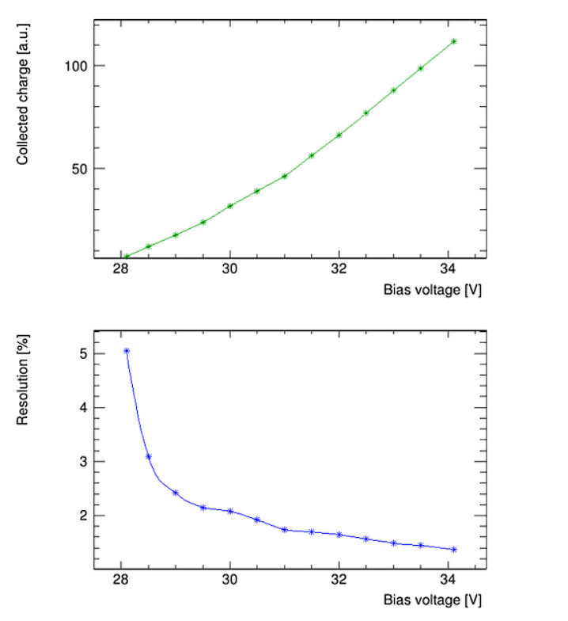
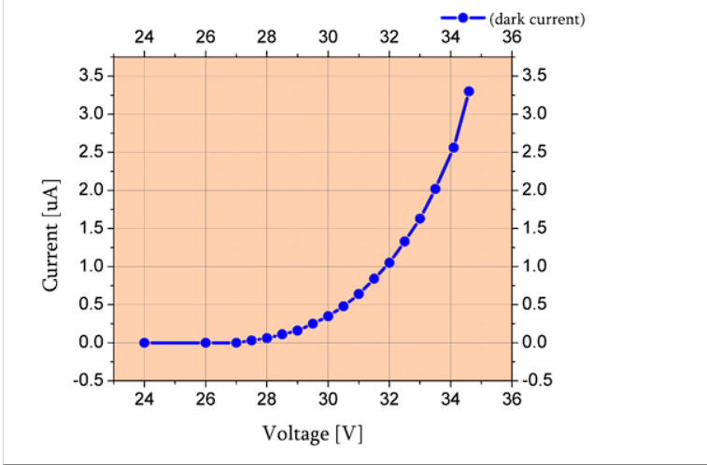
THE PROBLEM
SiPM Characteristics
GGSB Laboratory Testing and Parametric Evaluation of SiPM Power Supplies
5

Slide 6
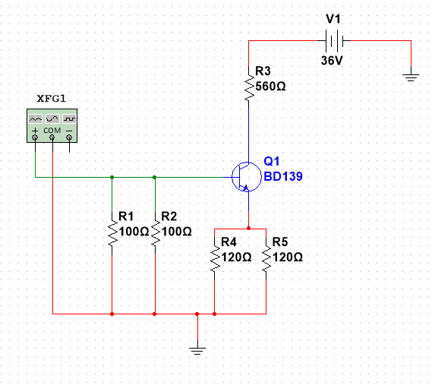
Parallel resistors:
R_{in} = 50 Ω
R_{e} = 60 Ω
Collector current limit:
I_{C}= (V_{CC}−V_{CE}) / (R_{E}+R_{C}) Amp limited(58ma)
The base-current math
PROJECT · LOAD TESTING
Emulating the detector's load: the active load circuit
Goal
Test how stable the SiPM power supply stays when the load current changes — the way a real detector's current draw would.
Circuit
BD139 (BJT) sinks current on command, simulating the detector's dynamic load.
Base network: two 100 Ω resistors in parallel → 50 Ω equivalent
Emitter network: two 120 Ω resistors in parallel → 60 Ω equivalent,
Signal generator drives the transistor base with a control pulse
GGSB Laboratory Testing and Parametric Evaluation of SiPM Power Supplies
7

Slide 7
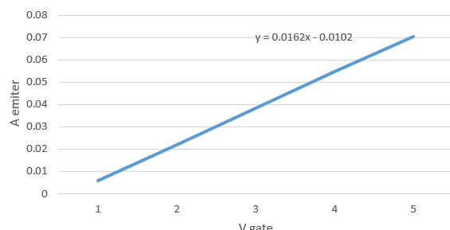







Transfer parameter Calibration : Emitter current vs Generator voltage
Emitter current vs. generator voltage
(from a linear fit to the measured base–emitter relation):
I_{E}=16.2*V_{G}−10.2
Analyse in ROOT
Data acquisition
Store
Settings
V_{out} : 36, 42, 48, 55, 60, 65, 70 V;
V_{G} : 3, 4, 5 V — 24 combinations in total.
$$I_{Load}=\frac{{(V}_{in}−V_{BE})}{R_{E}}$$
Each measurement is written to a .root file for later, reproducible analysis.
A C++ macro reads every file (struct, arrays, pointers, std::pair for multi-value returns) and fits each curve with TH1F*/TGraphErrors*.
RedPitaya + .root based software
V_be is not precisely known (it is a function of many parameters – temperature, currents and changes from transistor to transistor)

Slide 8
PROJECT A · LOAD TESTING
Measurement and analyzes procedure
Settings
Data acquisition
Store
Analyze in ROOT
V_{out} : 36, 42, 48, 55, 60, 65, 70 V;
V_{G} : 3, 4, 5 V — 21 combinations in total.
Each measurement is written to a .root file for later, reproducible analysis.
A C++ macro reads every file (struct, arrays, pointers, std::pair for multi-value returns) and fits each curve with TH1F*/TGraphErrors*.
RedPitaya + .root based software
K = ( ΔV_{out} / (V_{out} · I_{load}) ) × 100 %
Smaller K means the output voltage barely moves as load current changes — i.e. a more stable supply. K was computed, with its error, for every supply-voltage / load-current combination.
For every milliamp of current I demand, what percentage of the output voltage does the supply give up
GGSB Laboratory Testing and Parametric Evaluation of SiPM Power Supplies
8

Slide 9
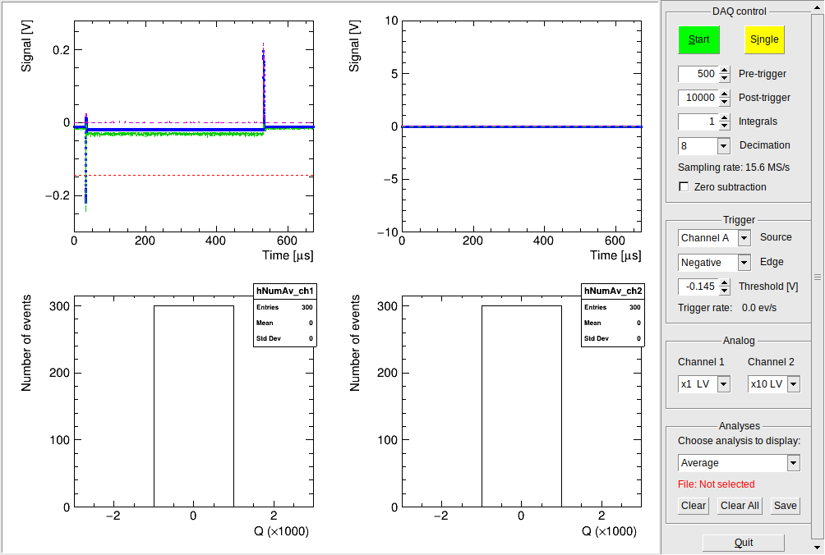
THE PROBLEM
RedPitaya DAQ
GGSB Laboratory Testing and Parametric Evaluation of SiPM Power Supplies
5

Slide 10
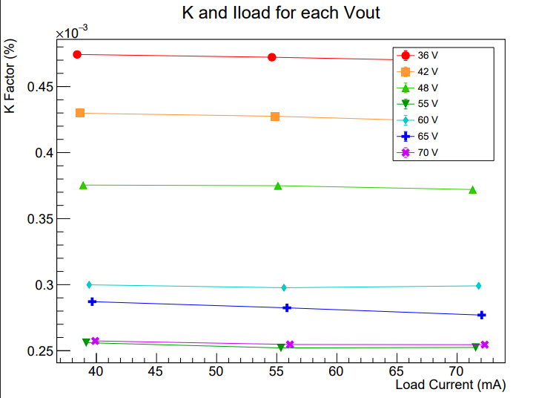
THE PROBLEM
K coefficient
GGSB Laboratory Testing and Parametric Evaluation of SiPM Power Supplies
5

Slide 11
PROJECT A · LOAD TESTING
Result: the sweet spot is 55–75 V
Lowest K & error at
What the sweep covered
55 V & 75 V
Supply voltages tested | 36, 42, 48, 55, 60, 65, 70 V
Load voltages tested | 3, 4, 5 V
Total measurement files | 24 .root files
Fit tool | ROOT — TGraphErrors, linear fit per curve
— exactly the SiPM's normal operating region.
Every K-vs-load-current curve was plotted for each of the 7 supply voltages on one shared axis, so the trend across voltages is directly comparable.
Practical hurdle we hit
On the software side, the pol0 fit had to be tuned per-experiment, and load current (a function of load voltage alone) produced overlapping points that we deliberately offset for readability.
GGSB Laboratory Testing and Parametric Evaluation of SiPM Power Supplies
9

Slide 12
PROJECT B · SVR
Supply noise rejection
Goal
Test setup
Source: 10 Vpp sine wave from the signal generator
Frequency sweep: 75 – 1075 Hz across 7 points
Acquisition: Red Pitaya, oscilloscope in DC-coupling mode
C1 = 1 µF: blocks the DC bias and passes the AC ripple component to the measurement system
Why DC decoupling: The SiPM supply output contains a high DC bias with a much smaller AC ripple superimposed on it.
The coupling capacitor removes the DC component, allowing the AC ripple to be measured independently and preventing the high DC voltage from reaching the measurement input.
Inject a controlled sine wave onto the supply's input and see how much of it survives to the output — i.e. how well the supply rejects incoming ripple or noise.
Because the injected disturbance is controlled and known, the residual AC component at the output can be compared directly with the injected signal. This gives a quantitative measure of the supply's ripple/noise rejection at each tested frequency.
GGSB Laboratory Testing and Parametric Evaluation of SiPM Power Supplies
10

Slide 13
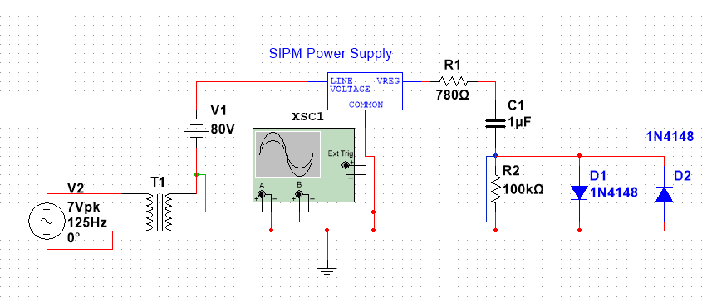
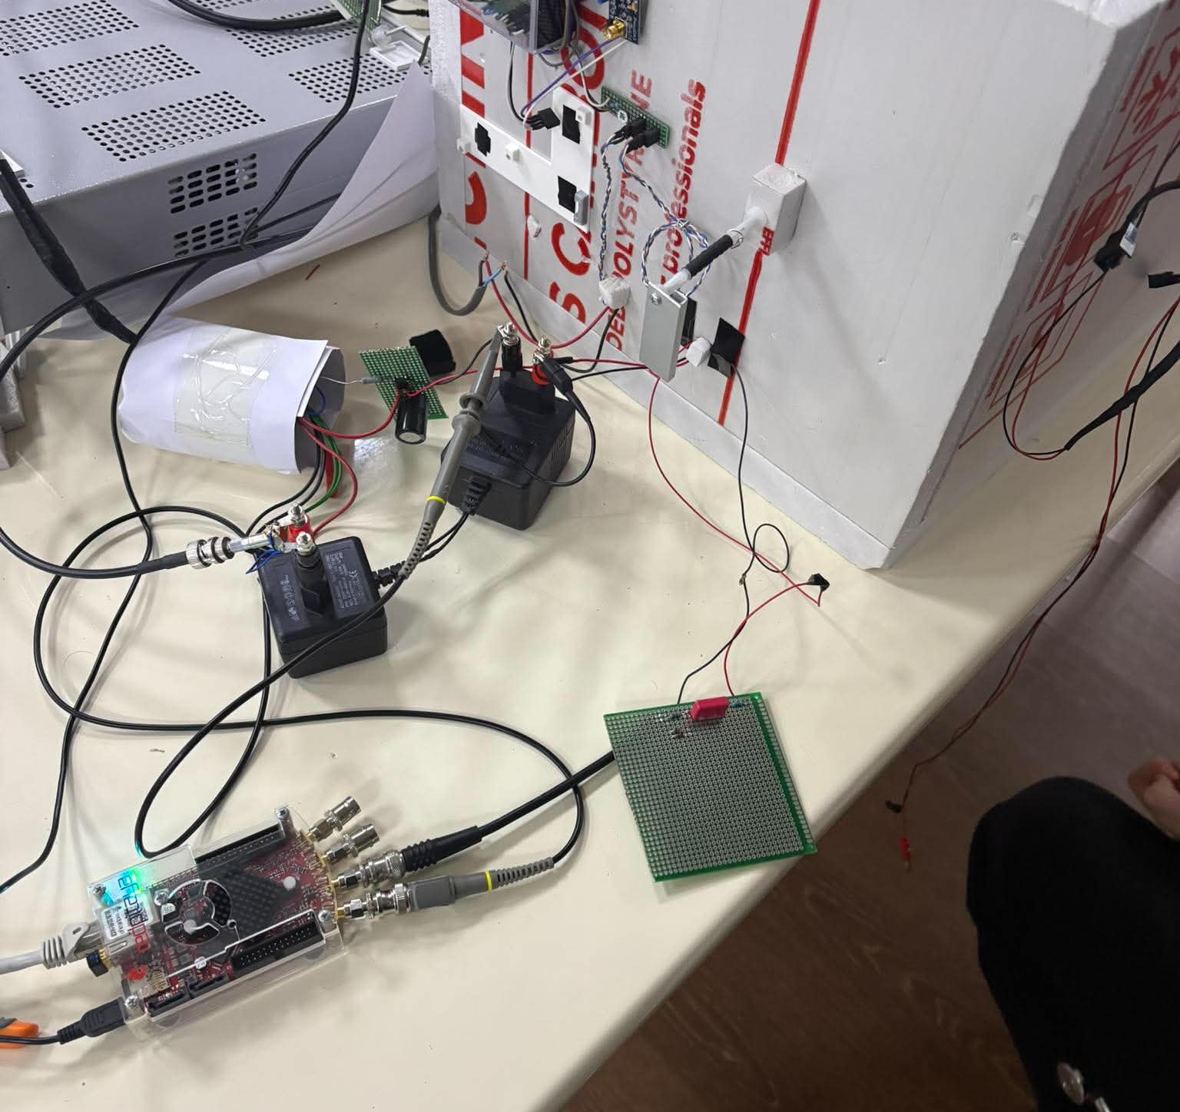
THE PROBLEM
SiPM detectors — and why their power supply matters
The calculation of parametres
At f = 50 Hz, C = 1 μF:
X_{C} = 1/(jωC) ≈ −j3183 Ω
Z = R1 + X_{C} = 700 − j3183 Ω
With R2 = 100 kΩ ≫ R1, X_C:
|H(jω)| ≈ 0.99 → U_{out} ≈ 0.99 V
But two opposed diodes clip the swing:
U_{out} ≈ ±0.7 V, I_{peak} ≈ 0.43 mA
R2 also sets the discharge path:
τ = R2C = 0.1 s, f_{c} ≈ 1.59 Hz
Redpitaya DAQ
GGSB Laboratory Testing and Parametric Evaluation of SiPM Power Supplies
5

Slide 14
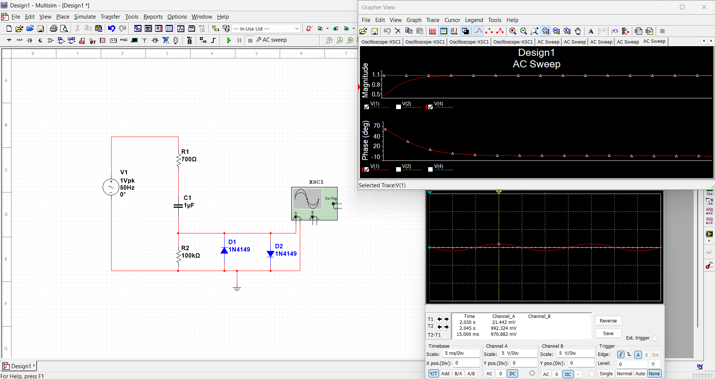

Slide 15
PROJECT B · SVR
Measurement and analyzes procedure
1
2
3
4
Read
>
FFT
>
Pick peak
>
Ratio → dB
Open the .root file; pull the input-channel and output-channel histograms (hShape_ch1 / ch2).
Run FFTW3 on each channel to move from the time domain into the frequency domain.
Read off the amplitude at exactly the frequency the generator was driving that measurement.
Divide input peak by output peak, convert to decibels, plot against frequency.
The SVR definition
SVR(dB) = 20 · log₁₀( V_{in} / V_{out} )
A higher SVR value means the supply blocks more of the input noise — a better-behaved supply for a detector that needs a clean bias voltage.
GGSB Laboratory Testing and Parametric Evaluation of SiPM Power Supplies
11

Slide 16
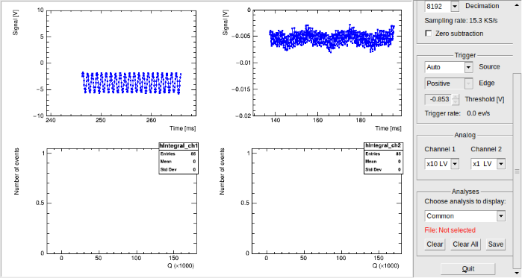
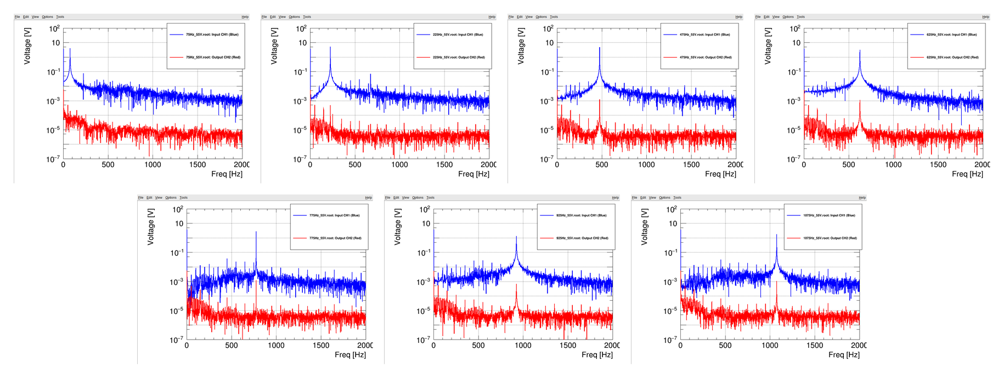
Inp (ch1)
Out
(ch2)
FFT Signals

Slide 17
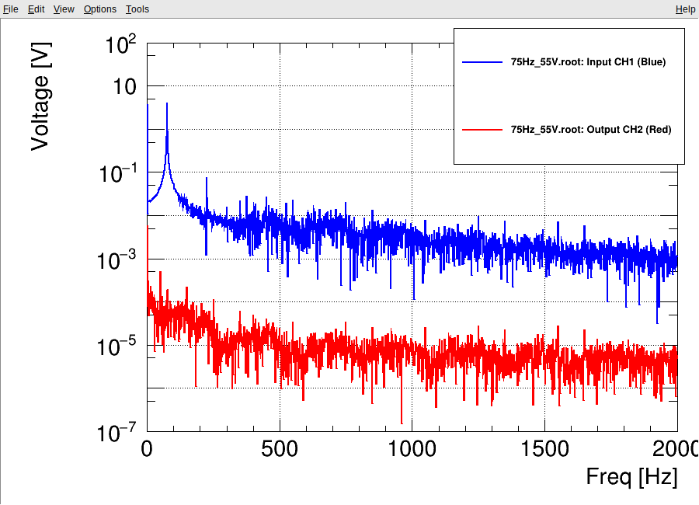

Slide 18
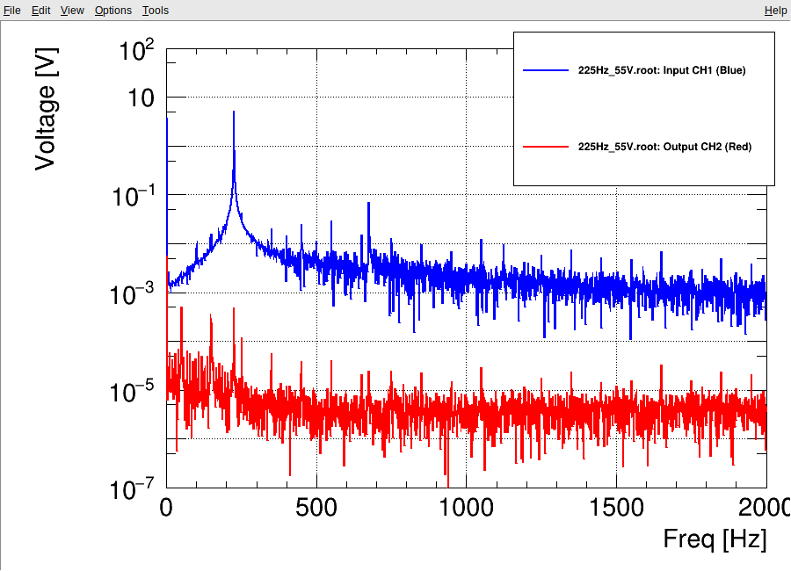

Slide 19
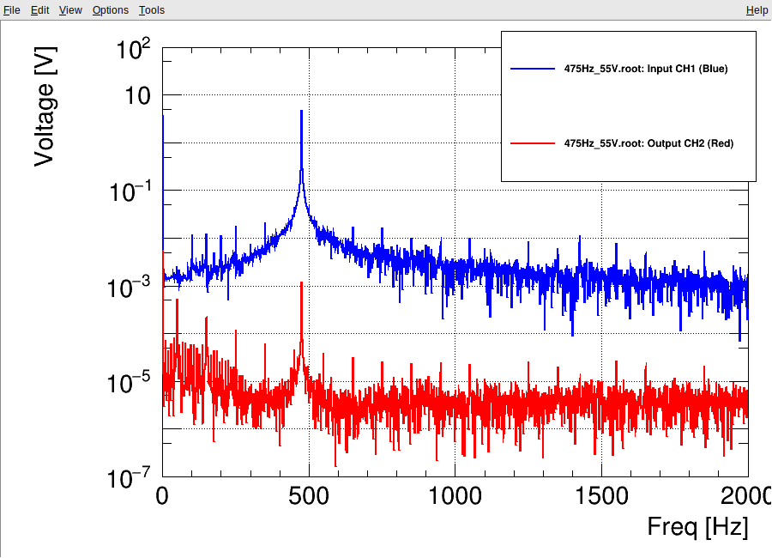

Slide 20
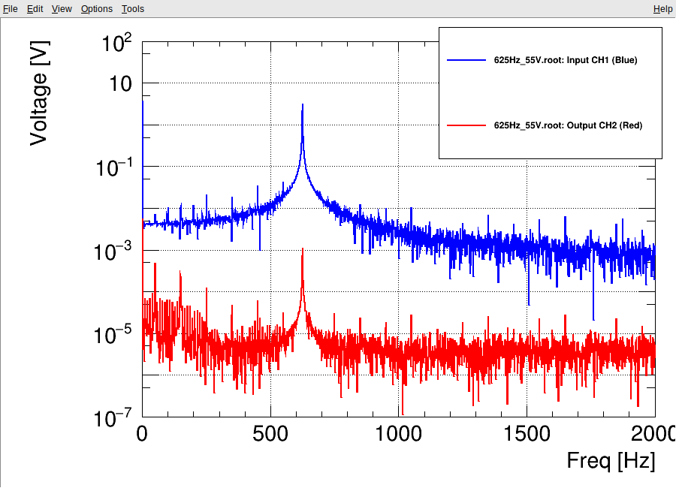

Slide 21
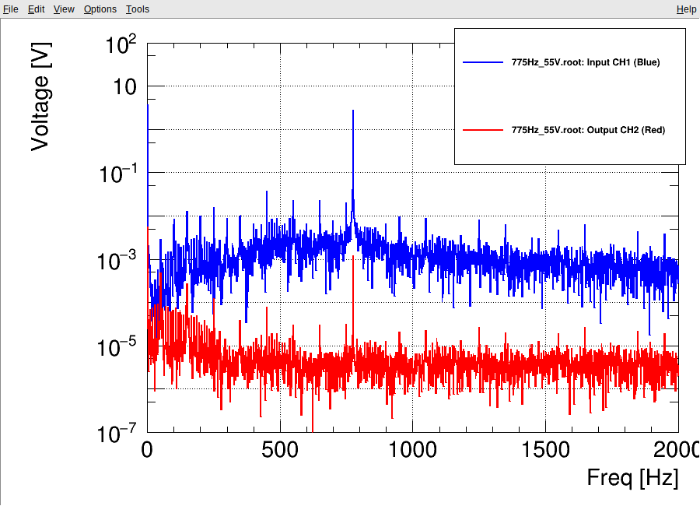

Slide 22
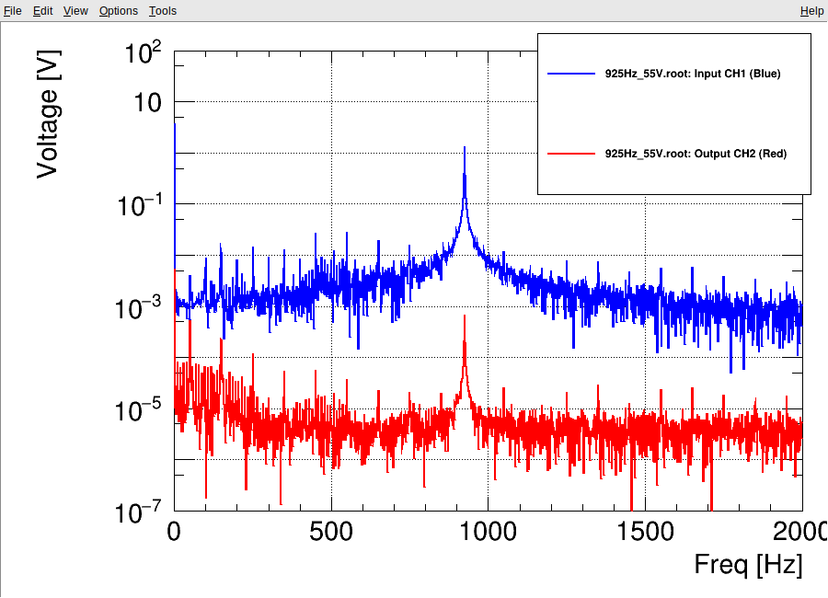

Slide 23
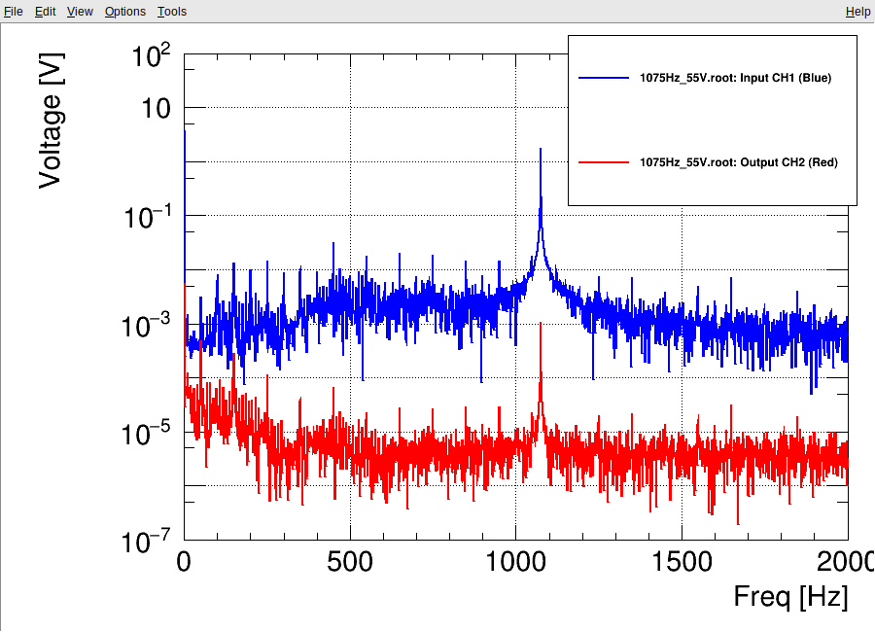

Slide 24
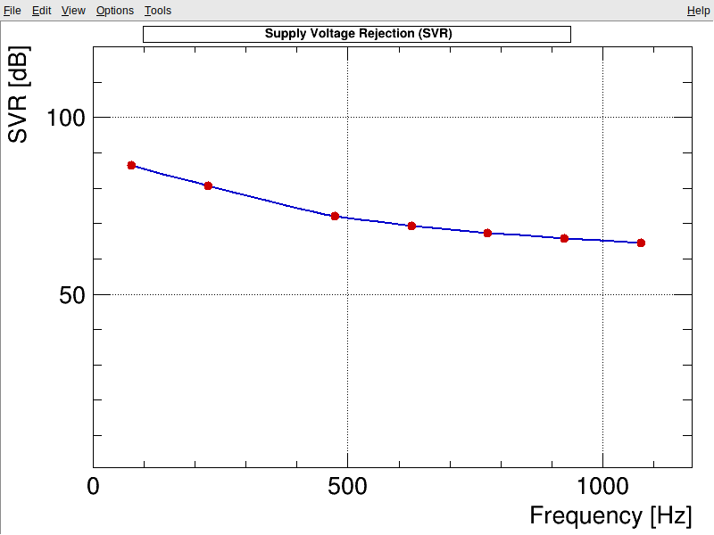
PROJECT B · SVR
Result: strong low-frequency rejection, tapering off with frequency
Reading the trend
75Hz → SVR ≈ 85 dB — strong noise suppression
475 Hz → SVR ≈ 72 dB
1075 Hz → SVR ≈ 65 dB
Even at the top of the swept range, SVR stays well above the noise floor — the supply is consistently good at absorbing input-line disturbances across the whole tested band.
GGSB Laboratory Testing and Parametric Evaluation of SiPM Power Supplies
12

Slide 25
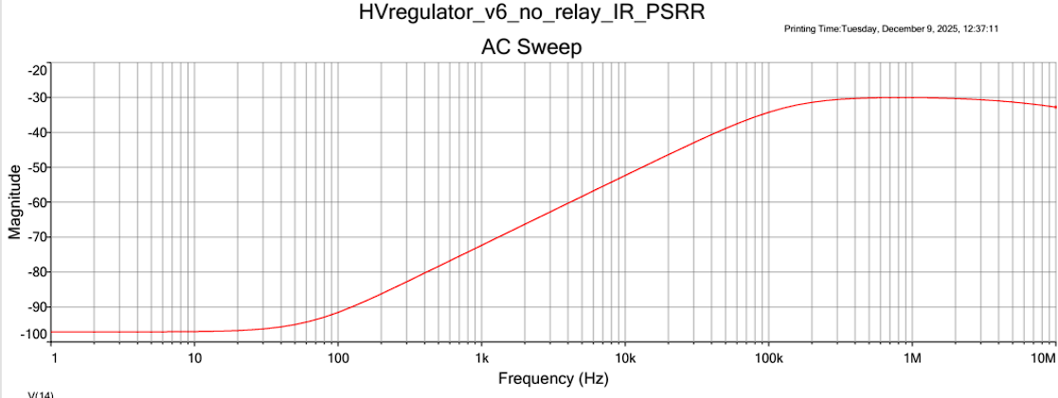
Simulation Results
dB has a negative sign , because of the division of V_{out} to the V_{IN}
Simulation result was approximately equal to our tests between
75Hz-1075Hz

Slide 26
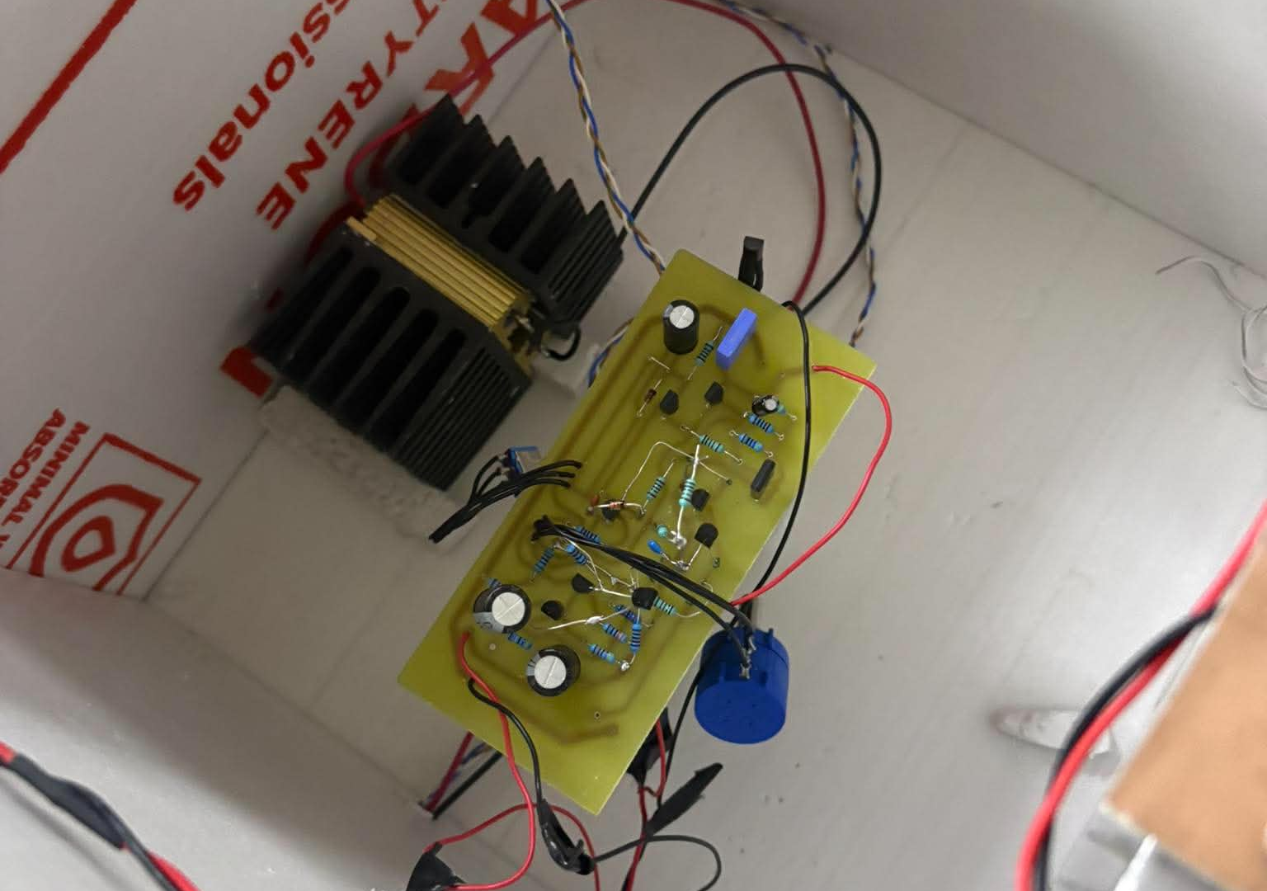
ENGINEERING NOTES
What actually went wrong — and how we fixed it
Output capacitor shunted the AC signal
Problem: A capacitor on the power-supply output effectively shorted the AC test signal, so it couldn't be measured there.
Fix: Removed that capacitor for the duration of the SVR measurements.
GGSB Laboratory Testing and Parametric Evaluation of SiPM Power Supplies
13

Slide 27
CONCLUSION
The power supply is well-suited to SiPM operation
✓
Dynamic-load testing shows the lowest instability coefficient (K) right where the detector actually operates — around 60–65 V.
✓
SVR testing shows the supply keeps rejecting input-line noise strongly across the whole tested range, from about 85 dB at 100 Hz down to a still-solid ~65 dB at 1 kHz.
✓
Together, these two independent tests point to the same conclusion: this supply holds a stable, clean bias voltage across the SiPM's normal working conditions.
Bottom line: two independent, quantitative tests validate the SiPM power supply for use in the SMART|EDM_Lab detector chain.
GGSB Laboratory Testing and Parametric Evaluation of SiPM Power Supplies
14

Slide 28
What the research gave me
TAKEAWAYS
New tools
Linux terminal workflows, Red Pitaya as a DAQ/scope/generator platform, and CERN ROOT for fitting and histogramming.
Circuits II, Electronics, and Programming 2 stopped being abstract — BJT biasing, filtering, and C++ data structures all showed up in one real project.
Coursework → pracice
Ownership
Team habits
Taking one
measurement — SVR
or K-coefficient — from
a soldered circuit all the
way to a finished, defensible plot.
Shared early-stage work, then clean division of responsibility once the technical scope was clear.
GGSB Laboratory Testing and Parametric Evaluation of SiPM Power Supplies
Notes:
Willms
Alltag am ITE besteht aus Zusammenarbeit der Kompetenzen anstatt Team- und Abteilungsgrenzen
3 große übergreifende Kompetenzfelder: Maschinenbau, Elektronik und Automatisierung
Kompetenzen stehen nicht nebeneinander oder übereinander, sondern greifen ineinander und ergänzen sich
Zugewinn der Elektronikgruppe des ehemaligen ZEA-2
Weitere Kompetenzschwerpunkte: Erprobung, Werkstoffe, Simulation und Software ergänzt durch KI
Kompetenzen orientieren sich nicht am Organigramm
Kompetenzen sind in mehreren Teams in verschiedenen Ausprägungen vorhanden - Beispiel: Werkstoffexpertise
Vertiefung durch Fort- und Weiterbildung sowie durch eigene F&E
Erst das Zusammenspiel dieser Kompetenzen und neu geschaffene Erkenntnisse erlauben es uns all die komplexen und einzigartigen Anlagen, Geräte und Instrumente zu entwickeln und zu bauen, die bei unseren Partnern – bei Ihnen – zum Einsatz kommen

Slide 29
Thank you
Questions & discussion
· Nikoloz Kalichava
SMART|EDM_Lab, Georgian-German Science Bridge

