Slide 1
Reading out a cosmic veto box
What the front-end electronics can and cannot do — a simulation study of veto_box V0.0.1
Vazha Saginadze
Ilia State University, Tbilisi
CERN Non-Member State Summer Student Programme 2026
Supervisors: Magnus Mager, Jochen Klein — ALICE ITS
GGSB Workshop 2026
Notes:
Framing: the board exists and is assembled, the measurement campaign is defined. This talk is what the design predicts and what we will check against it.

Slide 2
Why the box has to exist
ALICE ITS2 now runs at a fake-hit rate below the rate of real particles crossing a sensor on the bench.
10⁻⁷ hits / pixel / event
~20 Hz
12 channels
ITS2 fake-hit rate — one to two orders below the design requirement
real particles crossing the 260 × 460 mm² box at sea level
six boards, two MicroFC-60035 SiPMs each, one board per EJ-200 panel
Once a MAPS sensor is quieter than the cosmic and ambient background, a bench measurement no longer measures the sensor. Surround it with scintillator, timestamp every crossing particle, drop the frames that coincide.
The optical design — box size, SiPM placement, photon yield — is D. Galea's Geant4 study, and this talk does not repeat it.
My part was the readout: the board, the analogue front end, the bias chain and the firmware. Everything from here on is electronics.
V. Saginadze · veto_box V0.0.1 simulation study · GGSB 2026
1
Notes:
Ninety seconds. The tension: the sensor is now quieter than the room it sits in.

Slide 3
What the simulation asks the electronics to deliver
Every number is fixed by the Geant4 study or the SiPM data sheet — the specification, not my choices.
trigger condition
≥ 2 SiPMs, each ≥ 2 p.e.
Three consequences drove the whole design
coincidence window
20 ns
The bias must be adjustable and temperature-stabilised
10 °C moves the breakdown voltage by 215 mV — 9 % of a 2.5 V overvoltage.
The threshold must be adjustable
A DAC, not a resistor divider, so the working point can be scanned once the box is built.
The coincidence cannot be done in software
20 ns is 3.4 instructions at 170 MHz. It has to be hardware.
readout gate
200 ns
overvoltage range
2.5 – 5.0 V
breakdown voltage
24.7 V typical
bias to be generated
27 – 30 V
temperature coefficient for Vbr
21.5 mV/°C
dark count rate per SiPM
1.2 – 2.4 MHz
expected signal
several hundred p.e. per muon
V. Saginadze · veto_box V0.0.1 simulation study · GGSB 2026
2
Notes:
Do not read the table. Point at it and go to the three consequences.

Slide 4
veto_box V0.0.1 — one channel
64.25 × 70.40 mm, four layers. Two SiPMs, two signal chains, one STM32G431KB. Six boards give the twelve channels.
EJ-200 panel
MicroFC-60035
OPA356 TIA
COMP1 + DAC3
TIM capture
+ optical coupler
6×6 mm, 18980 cells
10 kΩ ‖ 15 pF
threshold in firmware
5.9 ns bins
Bias: OPA454 stage, gain 11 from DAC1. The firmware holds the overvoltage constant against 21.5 mV/°C.
Readout: comparator, threshold DAC and capture timer are all inside the MCU — no discriminator chip and no trimmer on any of the twelve channels.
Every quantity that sets the working point — bias, threshold, coincidence window — is a firmware parameter, not a resistor. That is what makes the board recoverable when the simulation's assumptions move.
V. Saginadze · veto_box V0.0.1 simulation study · GGSB 2026
3
Notes:
The last line is the design philosophy and it pays off later: the fix for the timing result is a firmware change, not a respin.

Slide 5
Where the project is, and what I did about it
The board is designed and assembled and the firmware brings the microcontroller up. Nothing has been measured with light.
Done
Not done in eight weeks
board designed in KiCad, fabricated and assembled
toolchain, flashing and logging in Rust + Embassy
clock tree at 170 MHz; ADC reads the die temperature
DAC, comparator and capture chain
any measurement with light — no single-photoelectron staircase
the box itself, and the five other boards
So the design was verified in simulation instead
Circuit topology and every component value are extracted programmatically from veto_box_V0.0.1.kicad_sch — not retyped from the drawing.
The SiPM is a Corsi equivalent circuit whose elements are derived from data-sheet quantities alone: C_term 3400 pF, C_fast 48 pF, recharge 95 ns, V_br 24.7 V.
The amplifiers are two-pole macromodels built from the TI data-sheet GBW, open-loop gain, noise density and output swing. Stackup and trace geometry come from the .kicad_pcb.
Only two parasitics were calibrated — package inductance and grid resistance — and only against the data sheet's own fast-output rise time and width.
V. Saginadze · veto_box V0.0.1 simulation study · GGSB 2026
4
Notes:
The honesty slide. Be direct about what is missing, then show the simulation is anchored to the real design files.

Slide 6
First, the model reproduces the data sheet
Three independent checks, no fitting: the model was built from capacitance and time constants, then asked for gain and pulse shape.
2.65 × 10⁶ electrons
0.97 ns rise
3.03 ns FWHM
simulated gain at 2.5 V overvoltage — data sheet 3.0 × 10⁶ (−12 %)
fast-output 10–90 % rise time — data sheet 1.0 ns
fast-output pulse width — data sheet 3.2 ns
And it reproduces the report's own number. Feeding the simulated chain into R_acc = N(N−1)·τ·R_n² gives 1.86 × 10⁴ Hz for twelve channels at a 2 p.e. threshold in a 20 ns window — the 19 kHz quoted in the summer-student report, from a completely separate calculation.
Charge closure was the acceptance test throughout, and it caught two real modelling errors: the avalanche switch initially discharged the full 27 V bias instead of the 2.5 V overvoltage, and the integrated charge came out 7× the physical value.
Everything after this slide rests on a model that closes on the data sheet to about 10 %.
V. Saginadze · veto_box V0.0.1 simulation study · GGSB 2026
5
Notes:
Credibility slide. Mention that charge closure found real bugs — the verification was adversarial, not decorative.

Slide 7
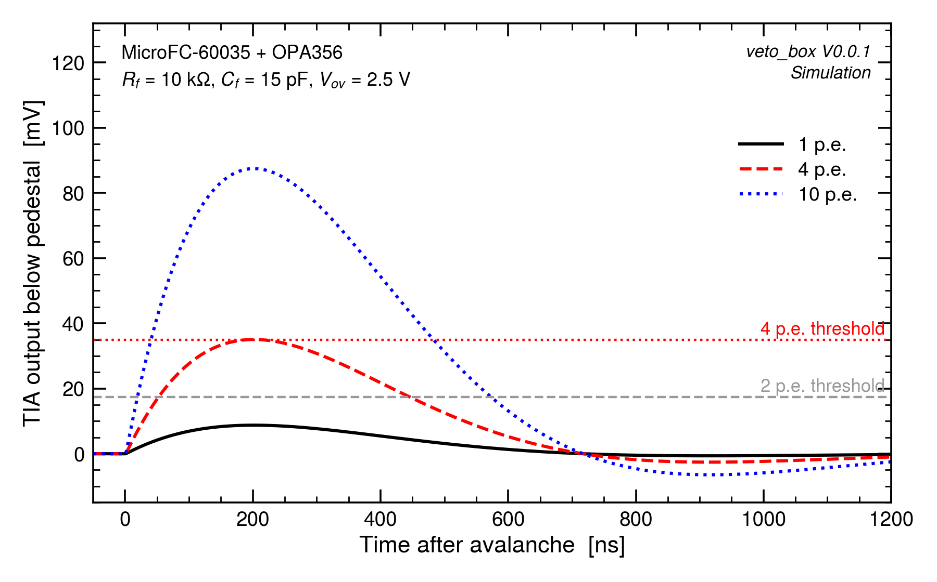
How big is a photoelectron at the comparator?
The full chain simulated from the extracted netlist: SiPM → 10 kΩ bias network → OPA356 transimpedance amplifier → comparator input.
8.73 mV per photoelectron
4 p.e. threshold = 34.9 mV below the 1.572 V pedestal
10–90 % rise: 119 ns
Time to peak: 201 ns
V. Saginadze · veto_box V0.0.1 simulation study · GGSB 2026
6
Notes:
8.73 mV per photoelectron sets the threshold scale. The pulse takes 201 ns to reach its peak — that number is the whole problem.

Slide 8
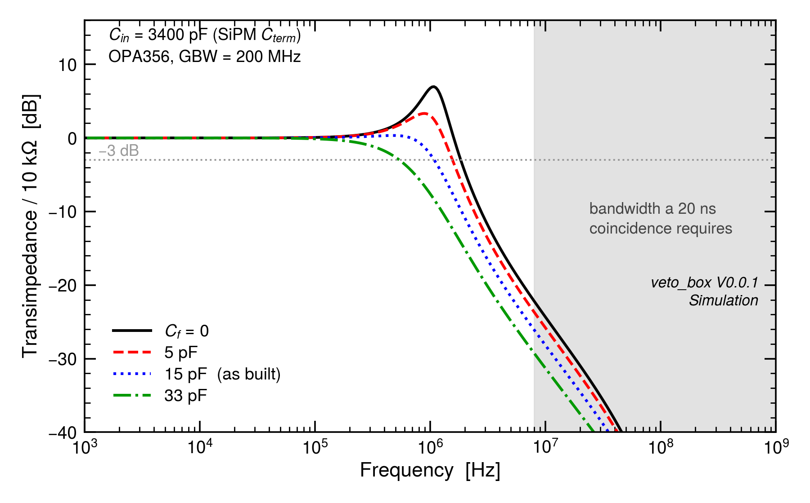
The bandwidth is not a component choice — it is the sensor
3400 pF of SiPM terminal capacitance working against a 200 MHz op-amp. Sweeping the feedback capacitor barely moves the ceiling.
As built (15 pF): 1.12 MHz
Cf = 0: 1.85 MHz and 7 dB of peaking
Phase margin as built: 98°, peaking 0.34 dB
15 pF was a good conservative choice — simply not the limiting factor
V. Saginadze · veto_box V0.0.1 simulation study · GGSB 2026
7
Notes:
Even with the feedback capacitor removed entirely the bandwidth only reaches 1.85 MHz, and it peaks. No value of Cf gets to the tens of MHz a 20 ns coincidence needs.

Slide 9
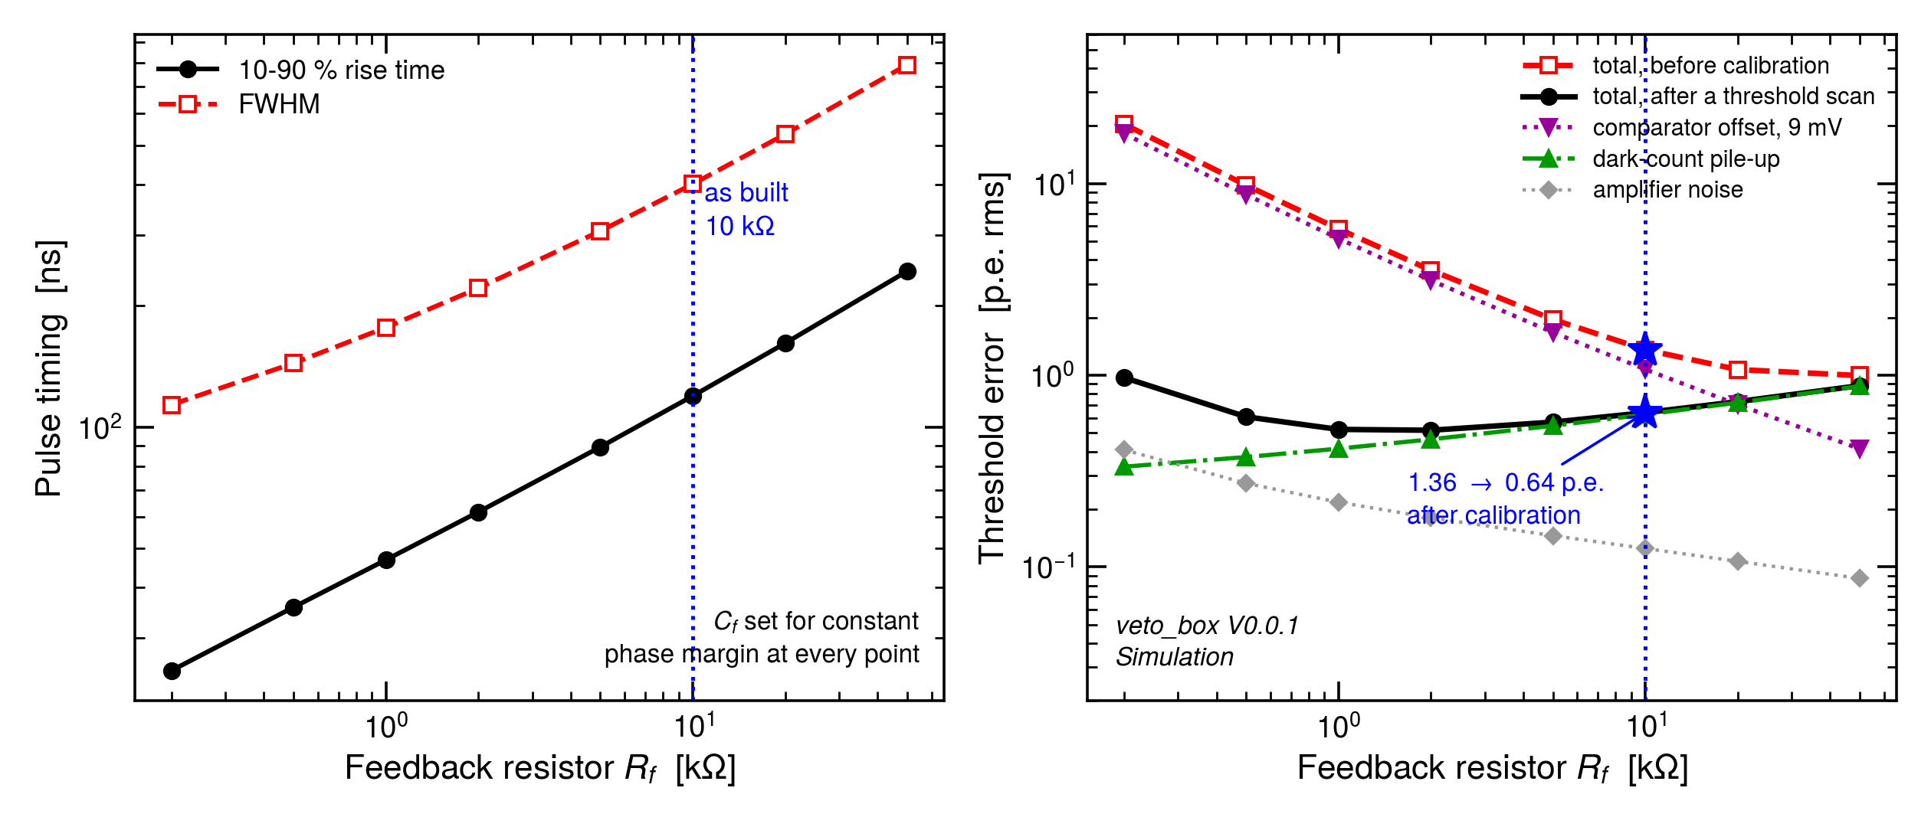
The threshold scan is worth more than any choice of Rf
Sweeping the feedback resistor with Cf re-chosen each time for constant phase margin. The two regimes pull opposite ways.
Before calibration: 1.36 p.e. at 10 kOhm
After a per-channel scan: 0.64 p.e.
Larger Rf helps before, smaller Rf helps after
So the scan matters more than the resistor
10 kOhm keeps the raw offset near 1 p.e. without a 500 ns pulse
V. Saginadze · veto_box V0.0.1 simulation study · GGSB 2026
8
Notes:
Before calibration the comparator offset dominates at every Rf and a larger Rf helps. After a per-channel threshold scan removes it, only pile-up is left and a smaller Rf helps. 10 kOhm sits between the two, and the calibration is worth more than either.

Slide 10
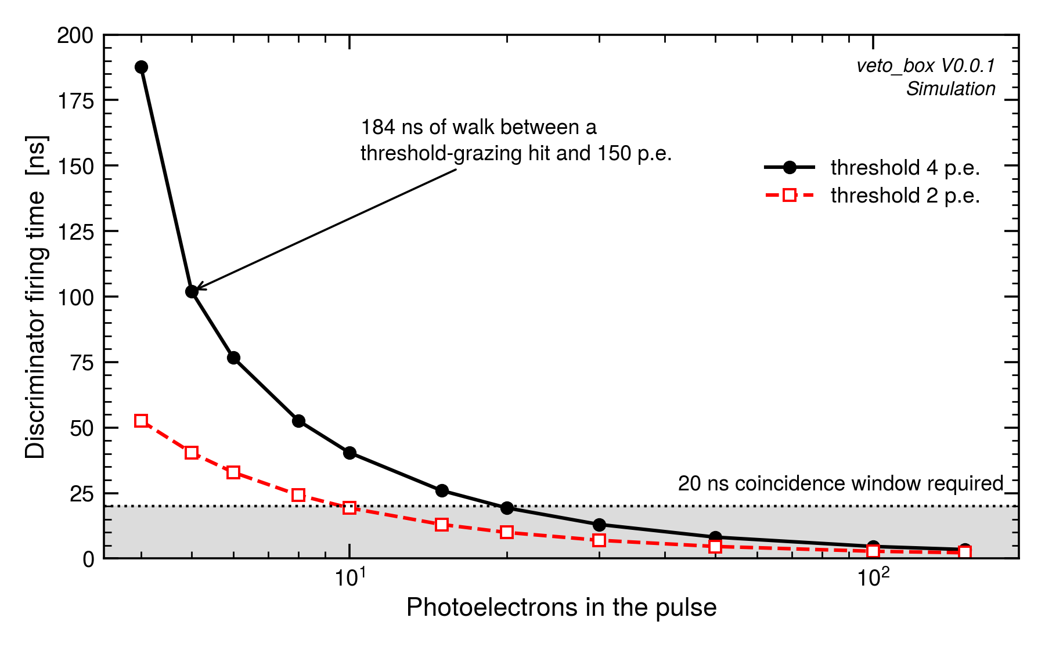
So the standard output cannot make a 20 ns coincidence
Time from the avalanche to the comparator edge, for pulses between 4 and 150 photoelectrons at a fixed threshold.
184 ns of walk across the amplitude range
The specification asks for 20 ns
Even over a narrow 10–50 p.e. range the walk is 32 ns
Set by the rise time, so no threshold setting fixes it
The comparator adds 16.7 ns typ / 31 ns max of its own, and below 15 p.e. never reaches the 100 mV overdrive that is specified at
V. Saginadze · veto_box V0.0.1 simulation study · GGSB 2026
10
Notes:
The central result. 184 ns of amplitude walk against a 20 ns window. Not a layout problem and not a threshold problem — it follows from the 119 ns rise time.

Slide 11
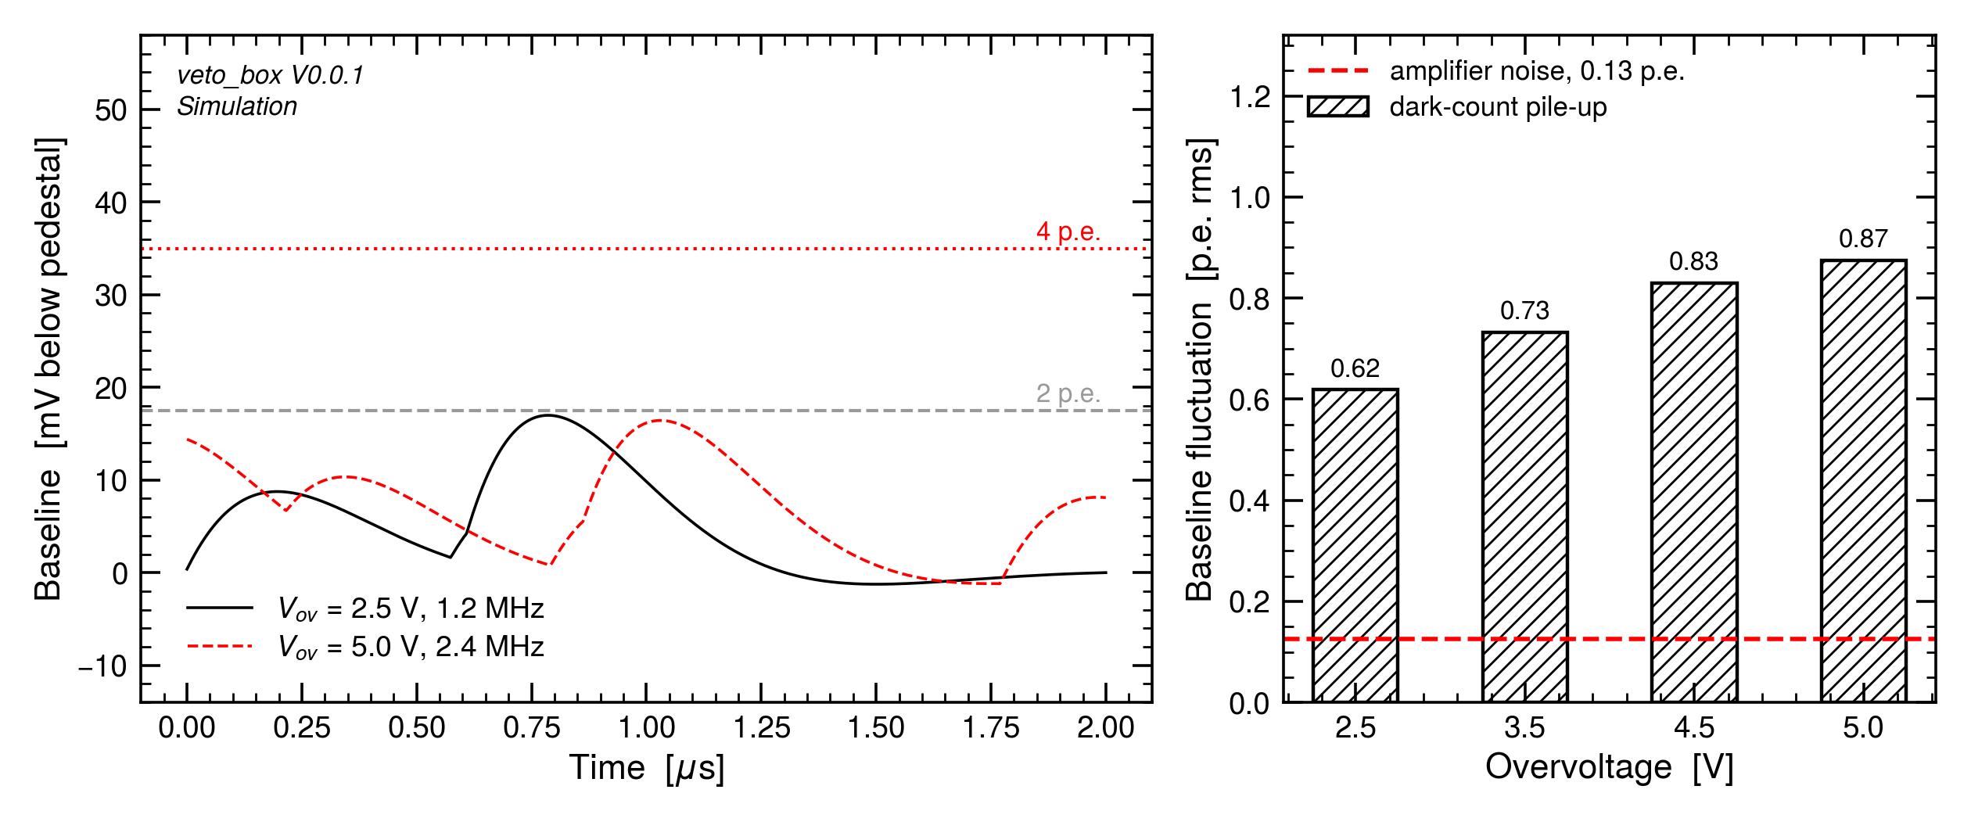
And the noise floor is the sensor too, not the amplifier
A 392 ns-wide pulse and a 1.2–2.4 MHz dark rate: about half of all pulses overlap another one.
Amplifier noise: 1.10 mV = 0.13 p.e. rms
Dark-count pile-up: 0.62 – 0.87 p.e. rms
The baseline itself moves by 4–8 mV
Five to seven times the amplifier — the sensor sets the floor, not the electronics
V. Saginadze · veto_box V0.0.1 simulation study · GGSB 2026
11
Notes:
Campbell's theorem on the simulated single-photoelectron response, cross-checked against a Monte-Carlo dark train — they agree to 4 %. The amplifier contributes 0.13 p.e.; the dark counts five to seven times more.

Slide 12
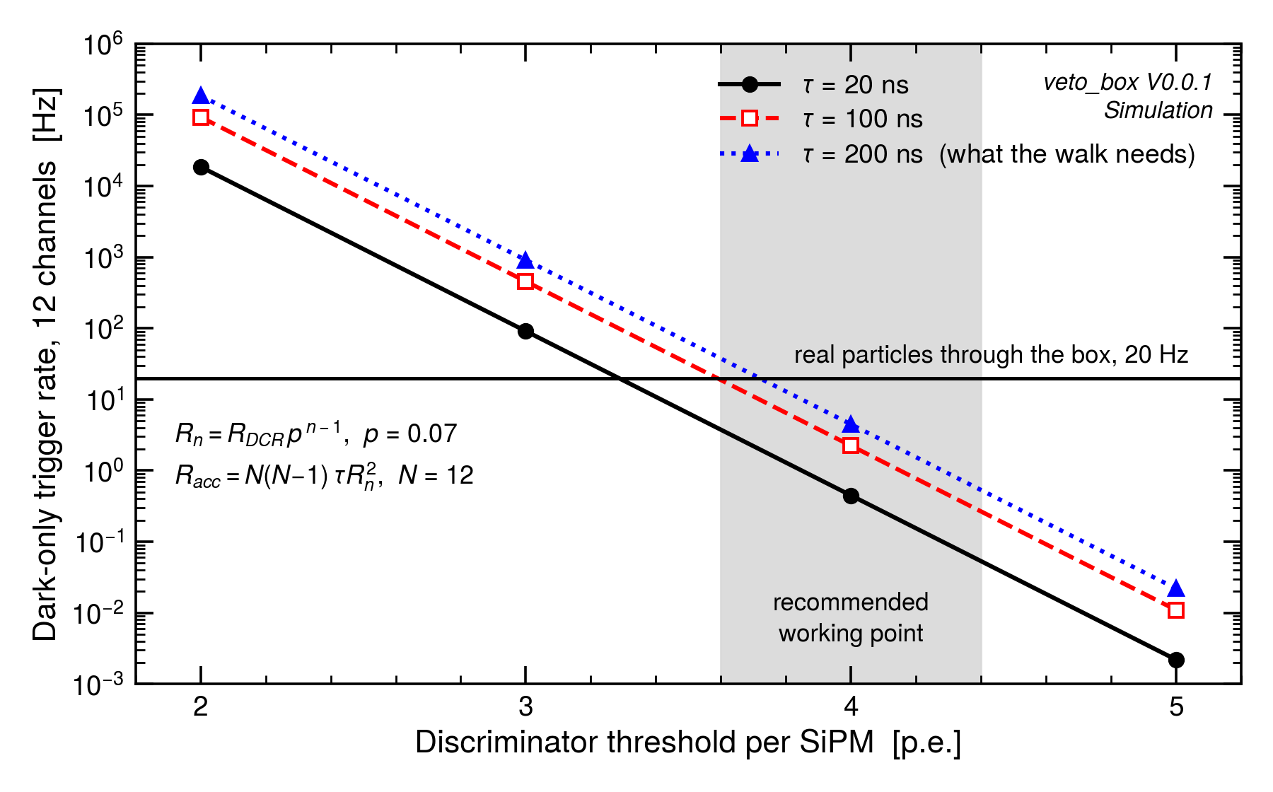
But the board as built is still usable — at 4 p.e.
Widening the coincidence window to cover the walk costs one decade of accidentals. Raising the threshold buys two decades per photoelectron.
2 p.e. / 20 ns: 19 kHz — 900× the real rate
4 p.e. / 200 ns: 4.5 Hz — a fifth of the real rate
Recommendation: raise the threshold, widen the window
V. Saginadze · veto_box V0.0.1 simulation study · GGSB 2026
12
Notes:
The constructive half. 4 p.e. in a 200 ns window gives 4.5 Hz of accidentals against 20 Hz of real particles, and 200 ns is still far finer than an ALPIDE readout frame.

Slide 13
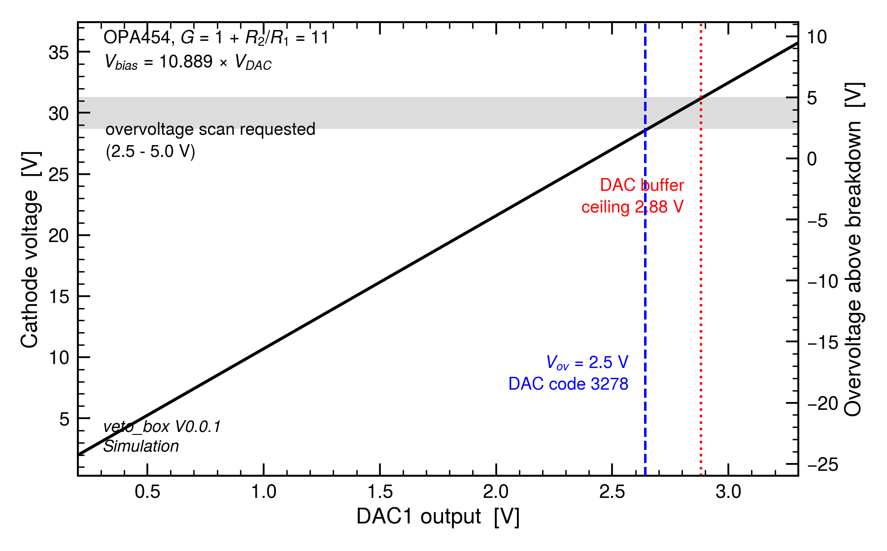
The bias chain covers the whole overvoltage scan
OPA454 non-inverting stage, gain 11 through the R3/R22 divider, driven by DAC1 and filtered at 159 Hz.
V_bias = 10.889 × V_DAC, linear across the range
2.5 V overvoltage at DAC code 3278 of 4095
Maximum reachable overvoltage: 5.09 V
Only 0.09 V of margin at the top of the scan
V. Saginadze · veto_box V0.0.1 simulation study · GGSB 2026
13
Notes:
Simulated gain 10.889 against an ideal 10.8911. The scan is reachable, but the top of it has only 90 mV of margin against the DAC's buffered output ceiling.

Slide 14
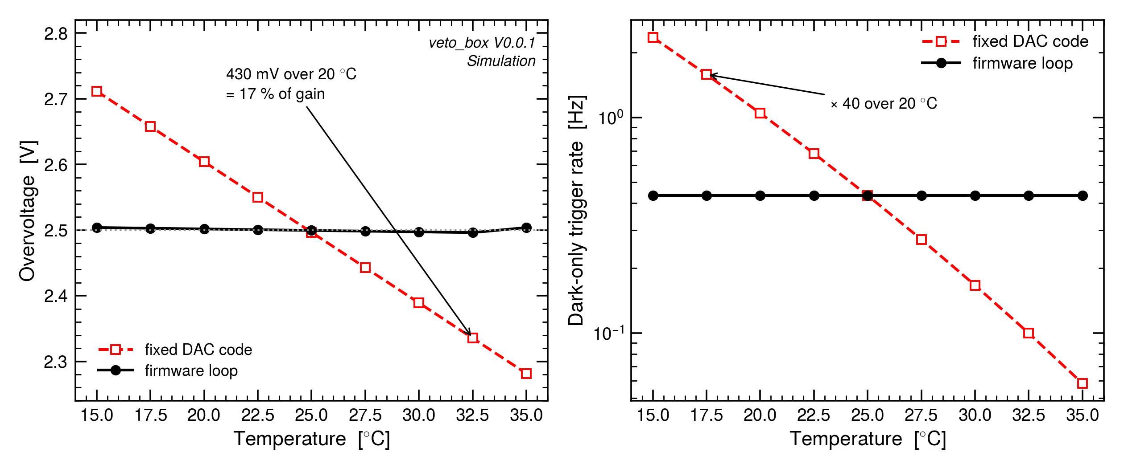
Why the temperature loop earns its place
The breakdown voltage moves 21.5 mV/°C, the gain moves with it, and the dark rate falls about two decades per photoelectron of threshold.
Uncompensated: 430 mV of overvoltage over 20 °C
That is 17 % of gain, and ×40 in dark trigger rate
Compensated: ±3.9 mV, one DAC LSB
One LSB = 0.41 °C of breakdown drift
V. Saginadze · veto_box V0.0.1 simulation study · GGSB 2026
14
Notes:
A fixed threshold in millivolts silently becomes a different threshold in photoelectrons. Over an ordinary 20 °C laboratory swing the dark trigger rate moves by a factor of forty.

Slide 15
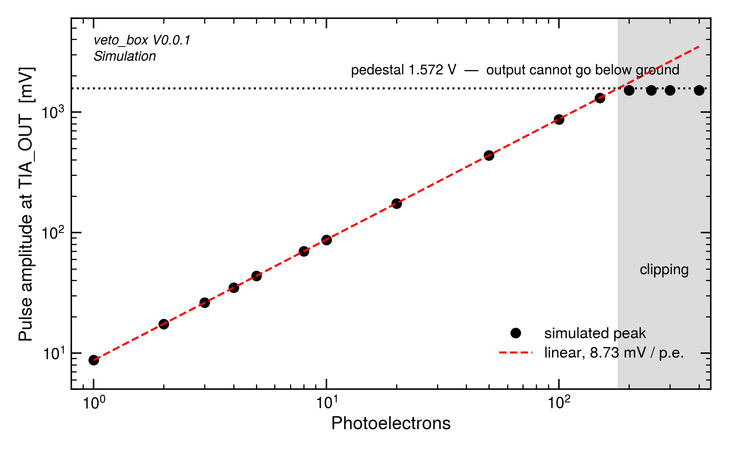
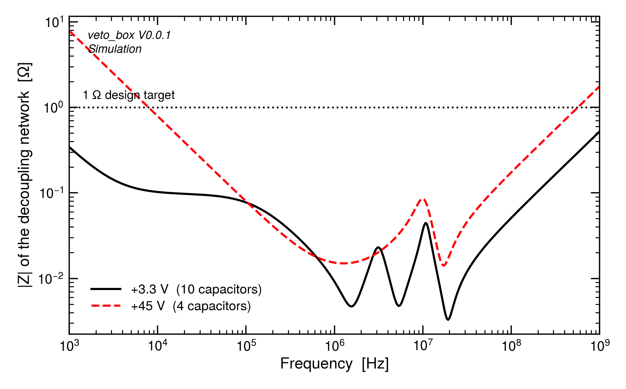
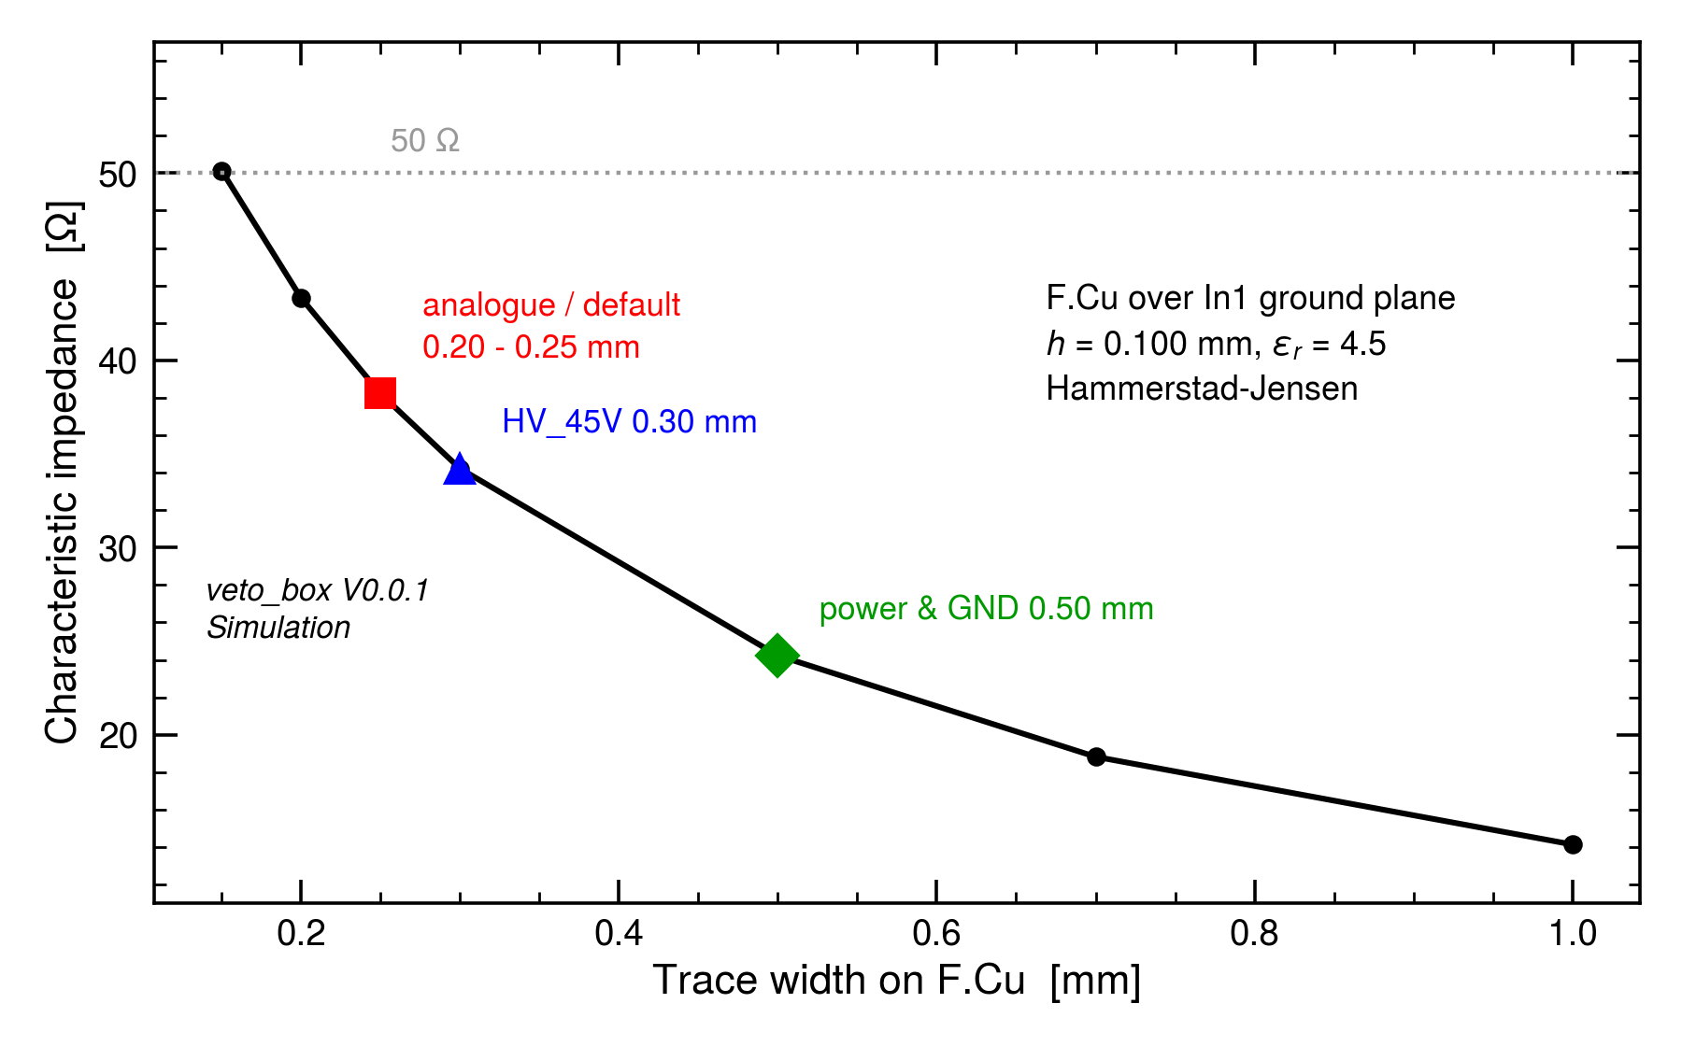
Everything else the board has to do, it does
Dynamic range, supply integrity and layout were checked for problems and did not produce any.
Dynamic range
Supply impedance
Layout
Linear to 150 p.e.; clips at 180 p.e. when the single 3.3 V rail runs out. Tolerable for a veto, which needs the time of a hit rather than its size.
+3.3 V stays at 50 mΩ to 100 MHz across ten capacitors; +45 V at 170 mΩ. Both an order below the 1 Ω target.
All ten critical analogue nets are on F.Cu over the solid In1 ground plane with zero vias. The anode trace adds 4.4 pF against the sensor's 3400 pF.
One thing to fix: the firmware reads the STM32 die temperature, which sits 6.4 °C above the board and moves with CPU load — 137 mV of systematic bias error. The thermistor beside the SiPM is not optional.
V. Saginadze · veto_box V0.0.1 simulation study · GGSB 2026
15
Notes:
Move quickly. This is the 'I looked and found nothing' slide, plus one genuine finding about the temperature sensor.

Slide 16
What I would change, and what I would leave alone
Three of the four are firmware or a populate option. None of them needs a new board.
1.
Raise the threshold to 4 p.e. and widen the window to ~200 ns
Firmware only. Takes the dark-only trigger rate from 900× the real particle rate to a fifth of it, and 200 ns still resolves an ALPIDE frame comfortably.
2.
Populate the NTC beside the SiPM
The STM32 die sensor sits 6.4 °C above the board and moves with CPU load — 137 mV of systematic bias error that the compensation loop cannot see.
3.
Set HYST[2:0] = 1 and scan the threshold on every channel
Table 73 gives an offset of −9/+3 mV — up to 1.03 p.e., and 1.37 p.e. of spread between two channels. With hysteresis that is 1.15 p.e. of systematic error against 0.63 p.e. of random. HYST=0 re-triggers on noise; HYST≥2 costs over a photoelectron.
4.
Reclaim bias headroom
Only 0.09 V of margin at the top of the 5.0 V overvoltage scan. Raising the OPA454 gain from 11 to about 13 fixes it and costs only DAC resolution (8.8 → 10.4 mV per step).
Leave alone: the 10 kΩ feedback resistor — the design-space study puts it within 6 % of the best threshold error reachable on this input node. The SiPM fast output was considered and not pursued: it needs a wideband stage of roughly 300× and a board respin, and the 4 p.e. / 200 ns working point meets the requirement without one.
V. Saginadze · veto_box V0.0.1 simulation study · GGSB 2026
16
Notes:
If asked why not the fast output: it needs an extra wideband gain stage and a respin, and the firmware working point already meets the physics requirement. Say it once and move on.

Slide 17
What the simulation says
The chain works, and its scale is set
8.73 mV per photoelectron, linear to 150 p.e., amplifier noise of only 0.13 p.e.
The 20 ns coincidence is out of reach on this input node
184 ns of amplitude walk. f_3dB = sqrt(GBW / 2π·Rf·Cin) — with 3400 pF of sensor a 20 ns rise would need a 65 GHz amplifier. A property of the sensor, not of the design.
The real noise floor is dark-count pile-up
0.62–0.87 p.e. rms, five to seven times the amplifier — a direct consequence of the 392 ns pulse width.
The board is still usable, at a different working point
4 p.e. in a 200 ns window: 4.5 Hz of accidentals against 20 Hz of real particles — firmware only, no hardware change.
The threshold budget is dominated by the comparator, and it is calibratable
Offset and hysteresis give 1.15 p.e. of systematic error against 0.63 p.e. random — a per-channel threshold scan is mandatory, not optional.
The bias design holds up
Gain 10.889, the full 2.5–5.0 V scan reachable, and the firmware loop holds the overvoltage to one DAC LSB against a ×40 drift.
Board designed and assembled · firmware brings the platform up · the measurement campaign is now specified
Notes:
Close on the fact that the board exists and measurement can start against specific numbers on day one.

Slide 18
