Slide 1




GGSB 2026 Workshop
Tbilisi | September 9, 2026
Evolution of Geomagnetic field:
Multiscale analysis
Luka Tsulukidze¹, Giorgi Mamatsashvili ², Oleg Kharshiladze ¹, Frank Stefani ²
¹ Ivane Javakhishvili Tbilisi State university
³ Helmholtz-Zentrum Dresden Rossendorf, Institute of fluid dynamics, Dresden, Germany
Research was supported by
Shota Rustaveli National Science Foundation of Georgia (GH-25-053)

Slide 2
Generation of Geomagnetic field
Conducting fluid motion in outer core generates magnetic field.
Earth outer core parameters:
Reynolds number:
$$Re∼{10}^{8}−{10}^{9}$$
Magnetic Reynolds number:
$$Rm∼{10}^{2}−{10}^{3}$$
Magnetic Prandtl number:
$$Pm=\frac{ν}{η}∼{10}^{−6}−{10}^{−5}$$
Biskamp, Magnetohydrodynamic Turbulence (CUP, 2003)

Slide 3
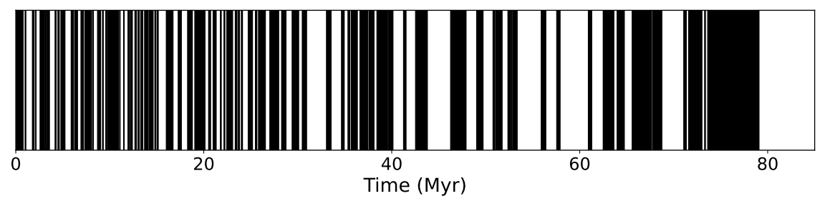
Geomagnetic field reversals
Paleomagnetic data reveals reversals of the Earth's magnetic field.
The process is irregular, featuring both long and short periods.
The last reversal occurred 780,000 years ago.
On average, there are 5 reversals per million years.
Stefani et al., Geophys. Astrophys. Fluid Dyn. (2007)
Cande & Kent, J. Geophys. Res. (1992)

Slide 4
Physical setup
$$∇⋅u=0, ∇⋅B=0$$
$$\frac{∂B}{∂t}=∇×\left(u×B\right)+η∇^{2}B$$
$$\frac{∂u}{∂t}+\left(u⋅∇\right)u+2Ω×u=$$
$$-\frac{1}{ρ}∇P+\left(∇×B\right)×B+ν∇^{2}u$$
3D Cartesian unstratified shearing flow.
Strictly Zero Net Magnetic Flux
Tested regimes:
$$Pm=4 → Rm=20000, Re=5000$$
$$Pm=1 → Rm=20000, Re=20000$$
$$Pm=0.33 → Rm=20000, Re=60000$$

Slide 5
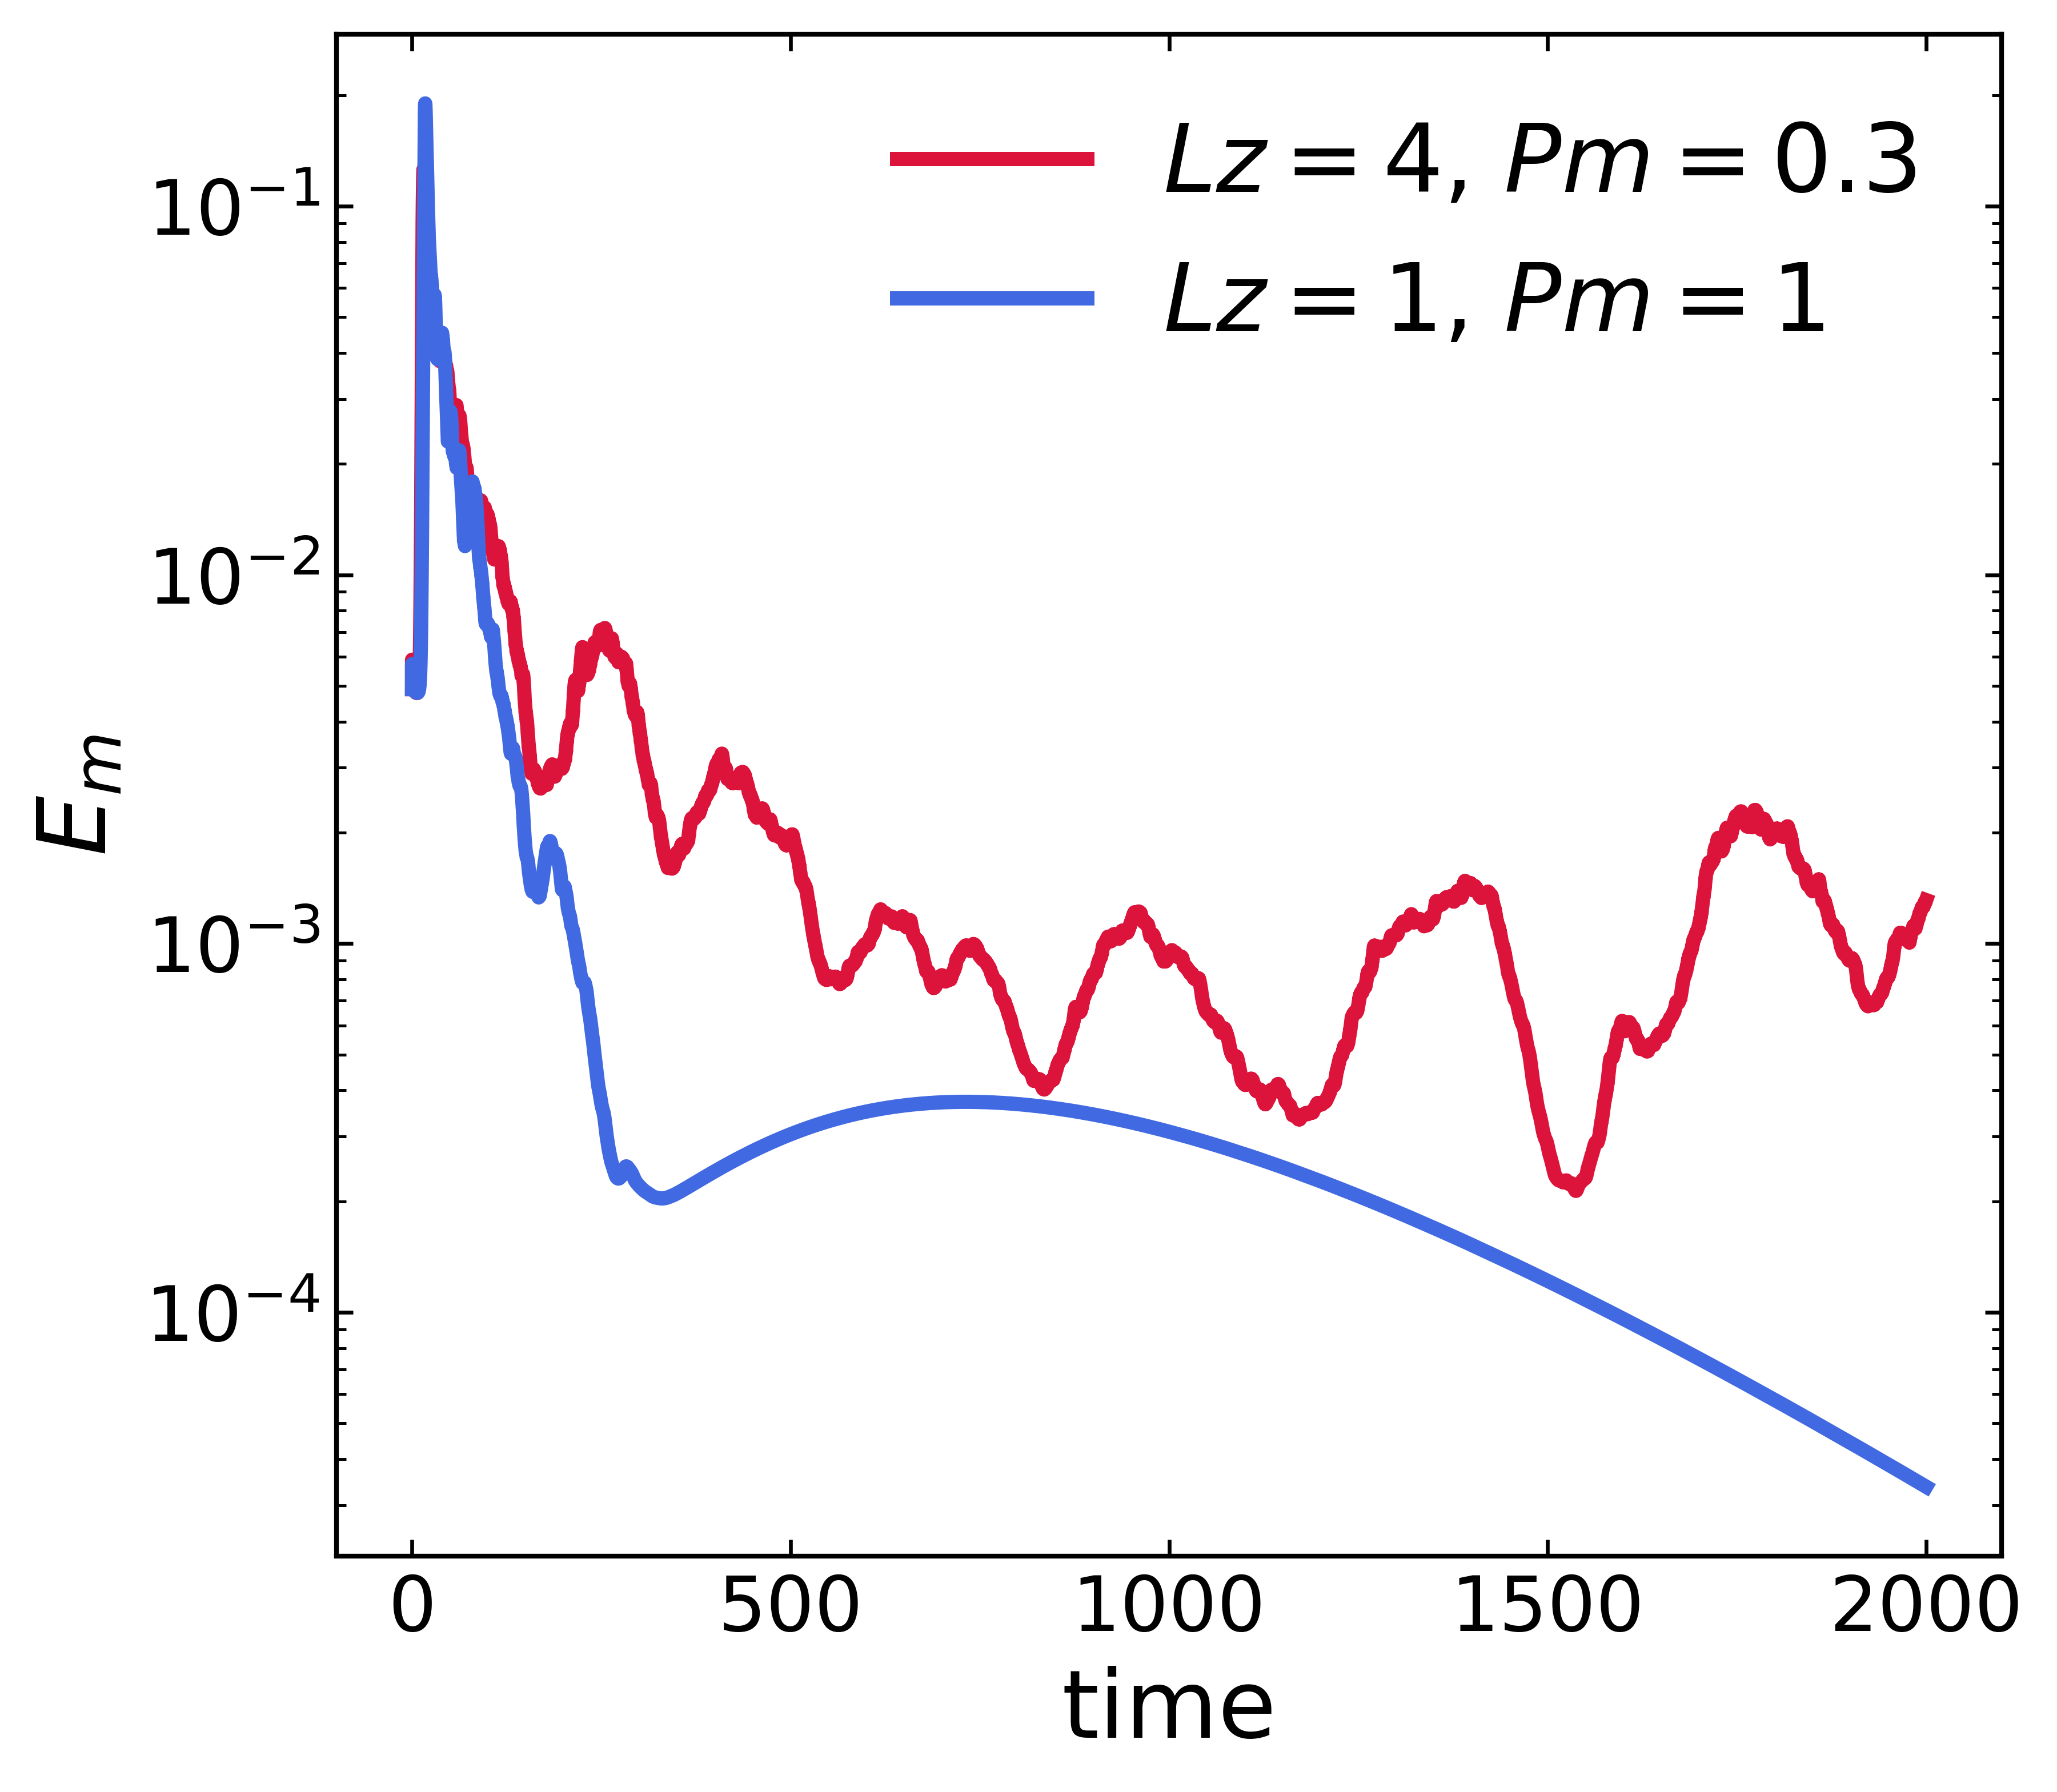
Magnetic energy and domain sizes
With lower $$L_{z} = 1$$ we see strong dissipation of magnetic energy, for Pm = 1. Turbulence dies and generated magnetic field dies with it
Increasing box size $$L_{z} = 4$$ changes the picture, even for case of Pm = 0.3 turbulence is sustained and magnetic energy also survives.

Slide 6
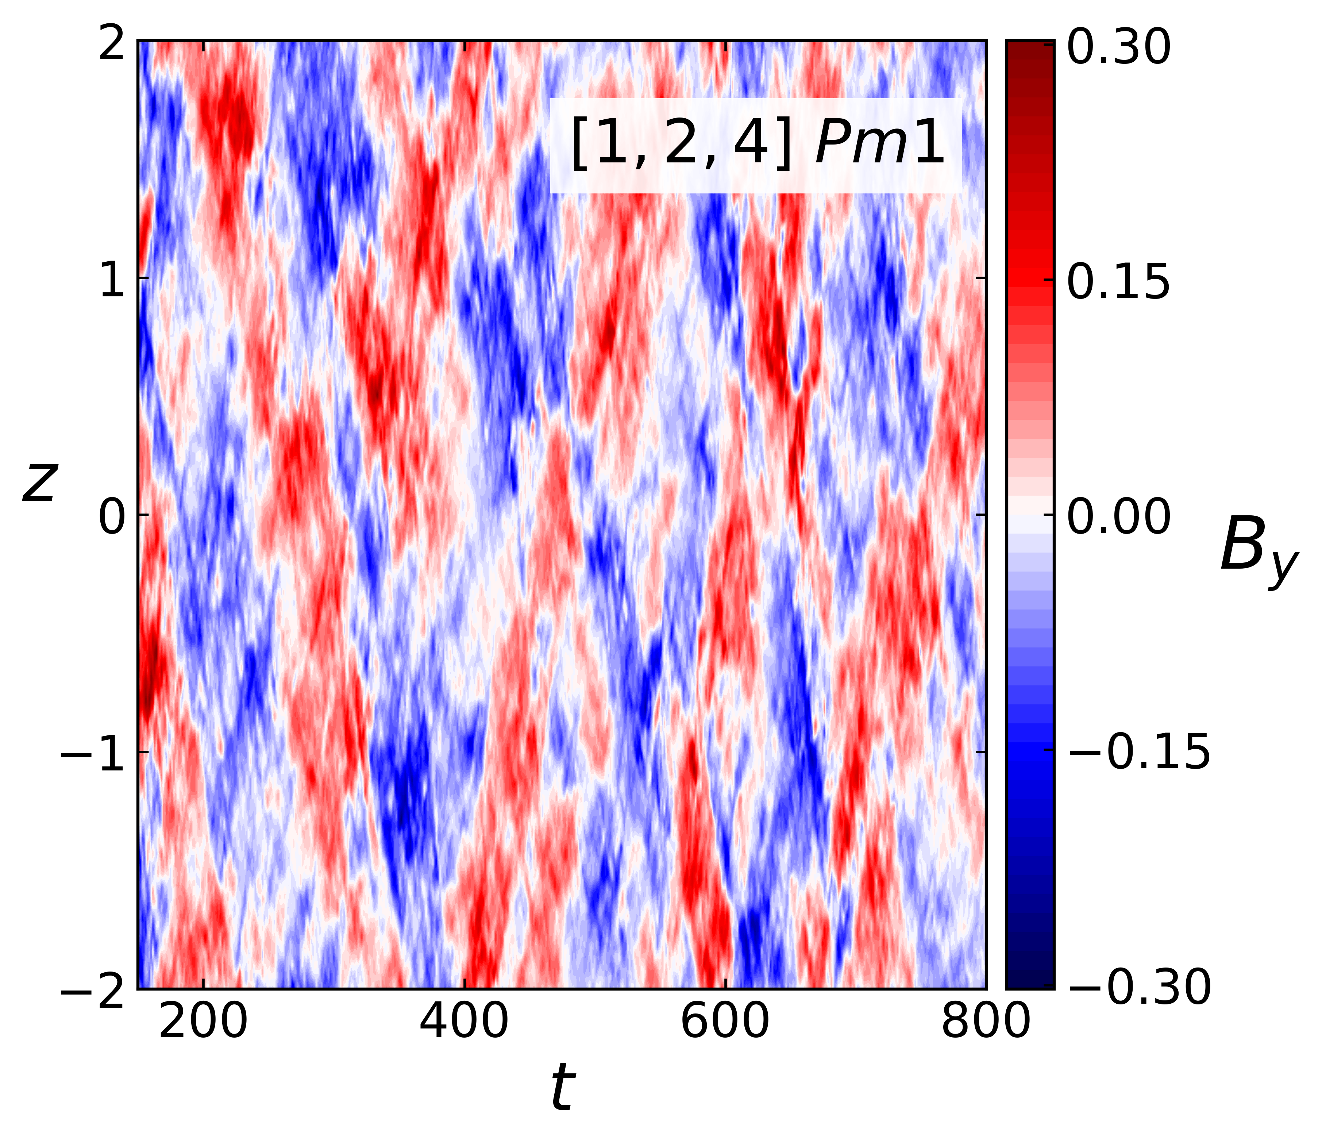
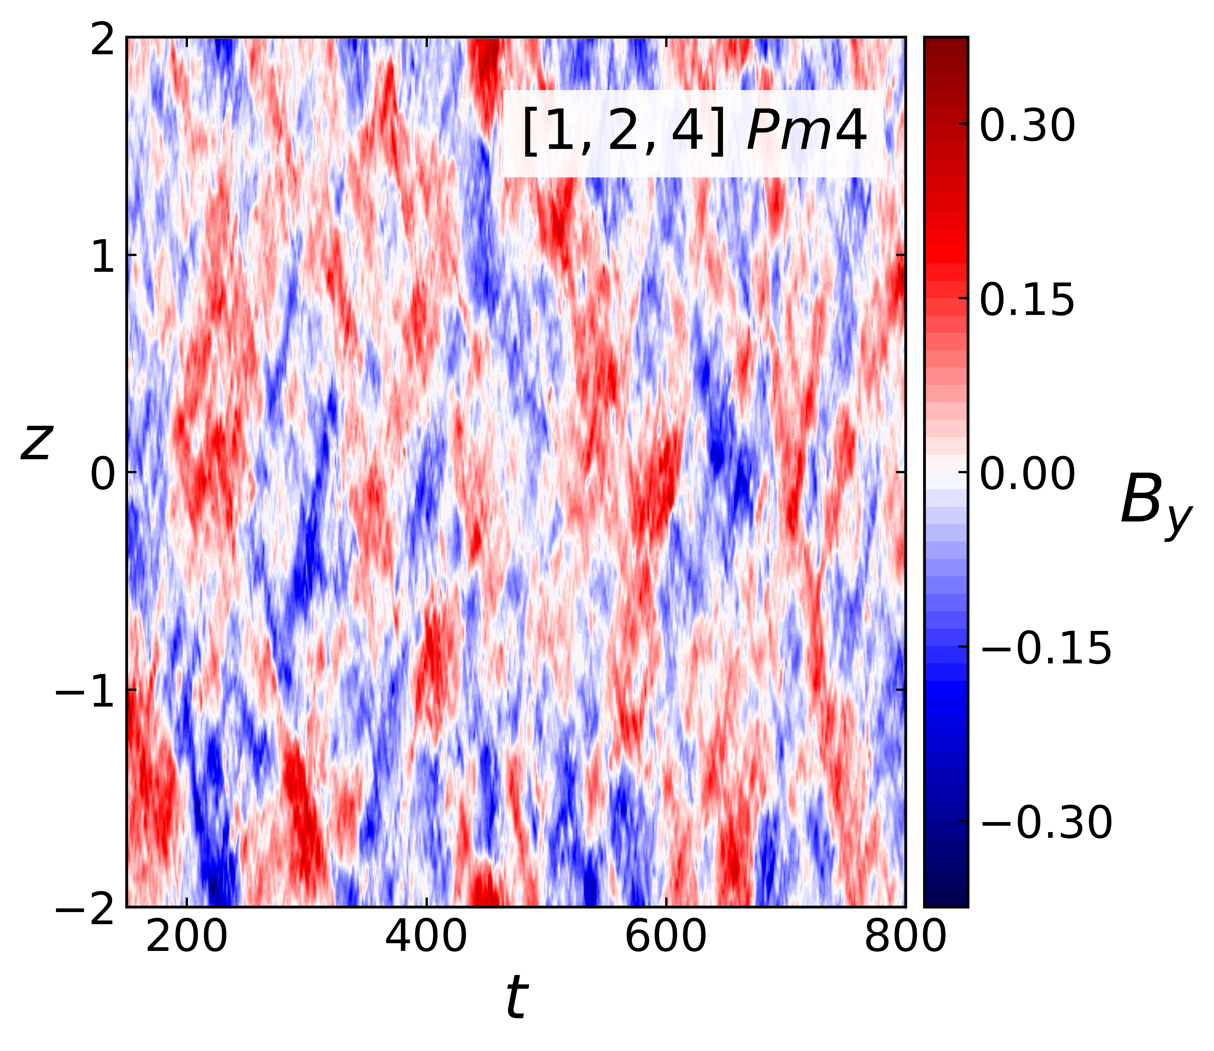
Spatiotemporal Dynamics
Higher Pm-s

Slide 7
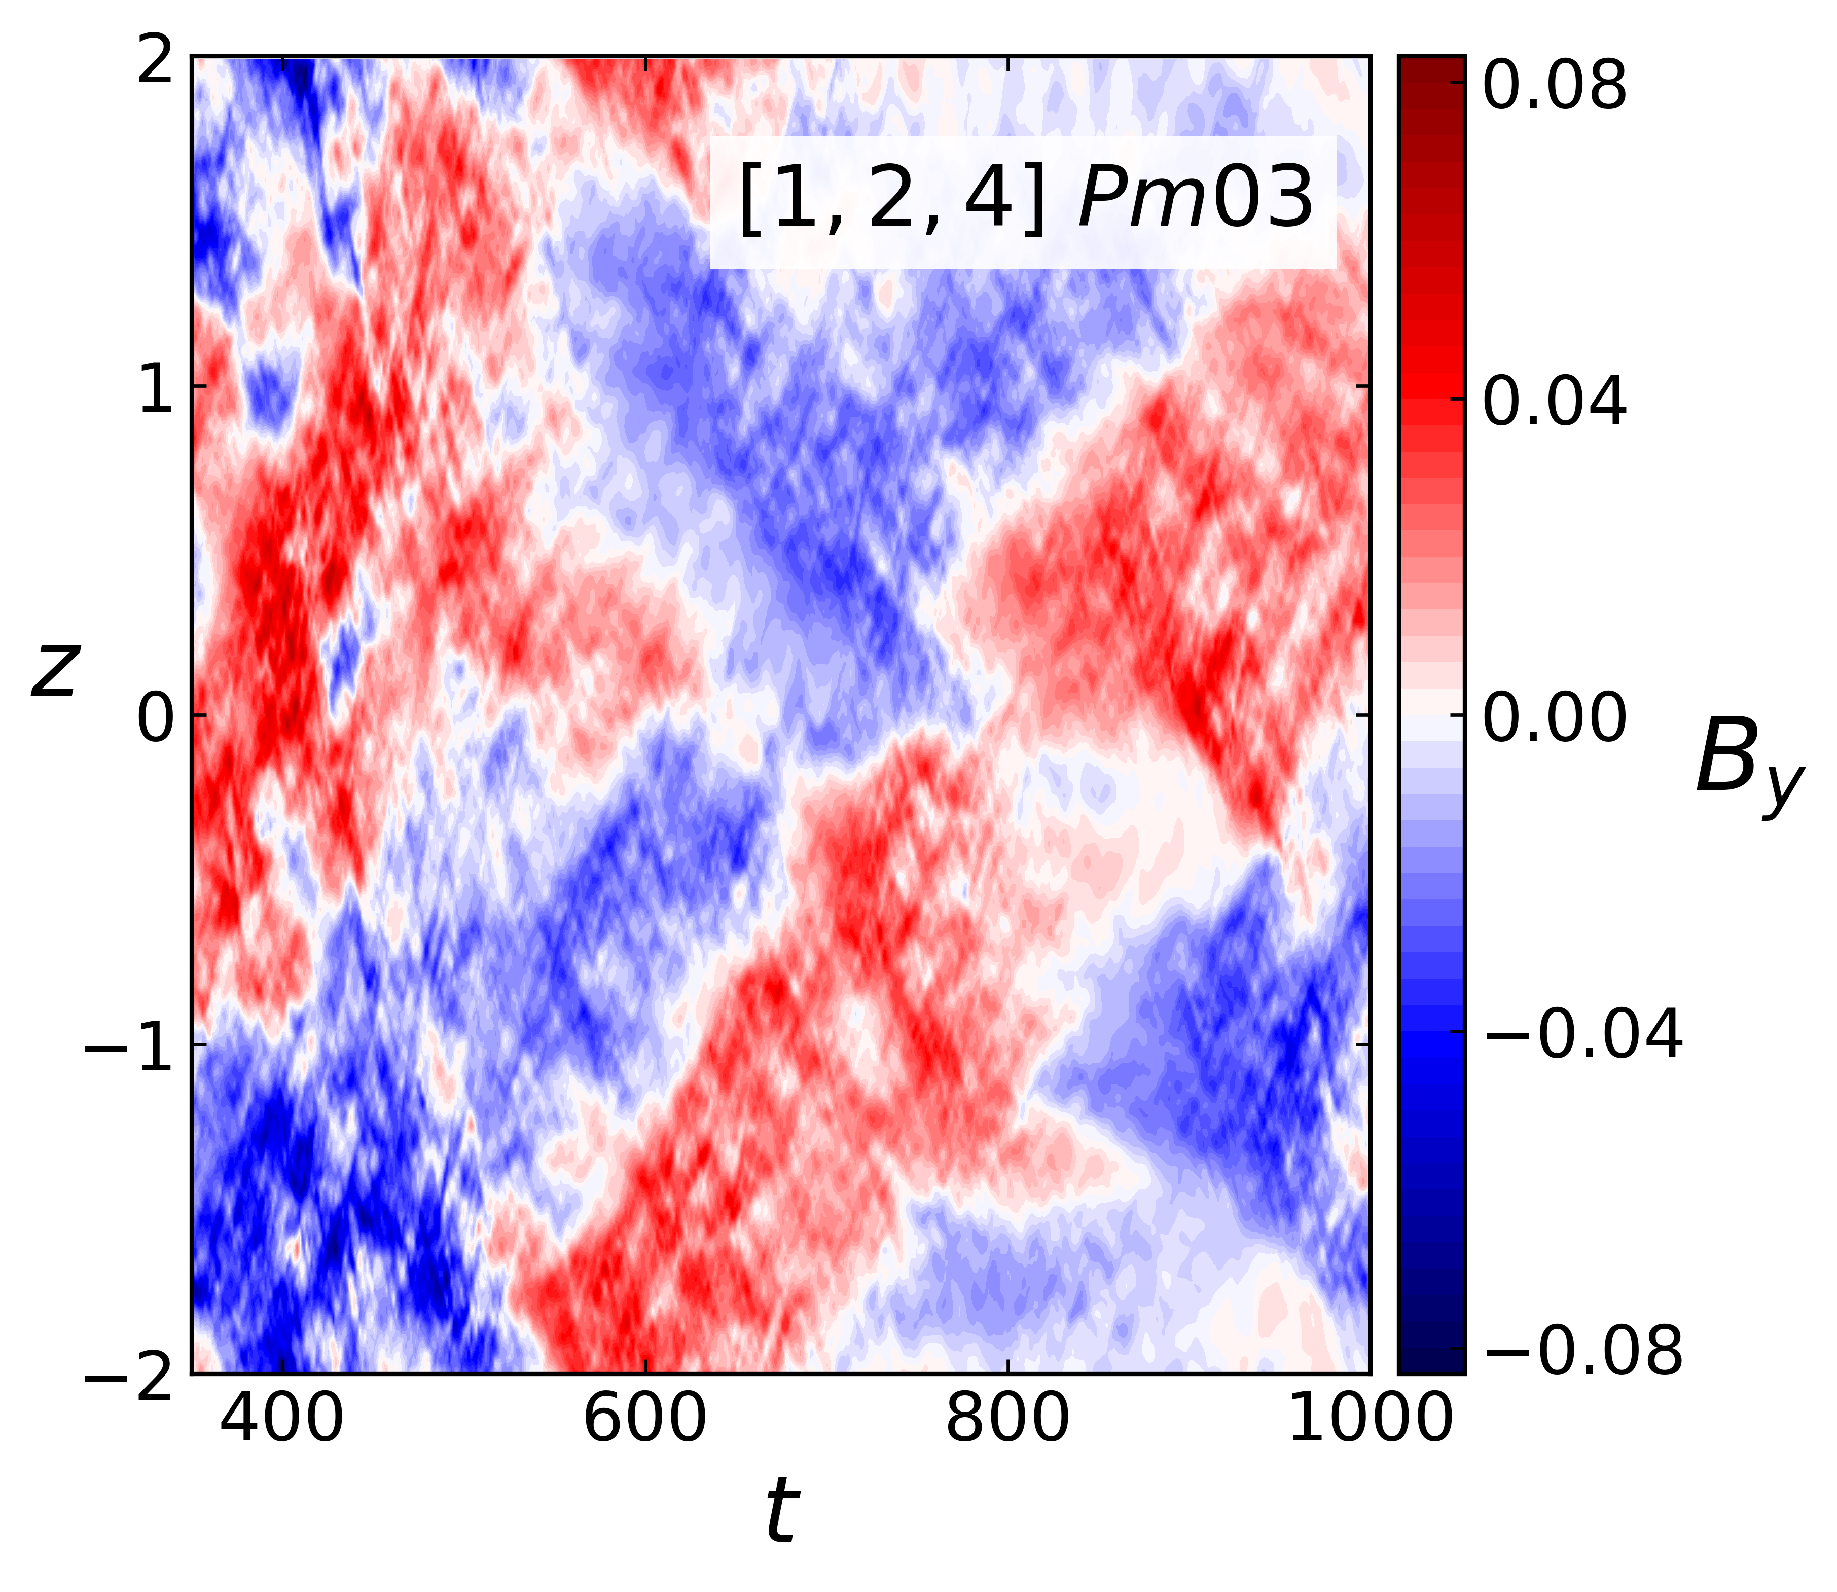
Lower Pm case
Pm = 0.3 – Macroscopic structures
Pm = Mean field scales for Pm=1,4 are similar
For Pm = 0.3 we get way larger spatial and temporal structures, we see longer stable polarity periods, than for Pm = 1 and 4

Slide 8
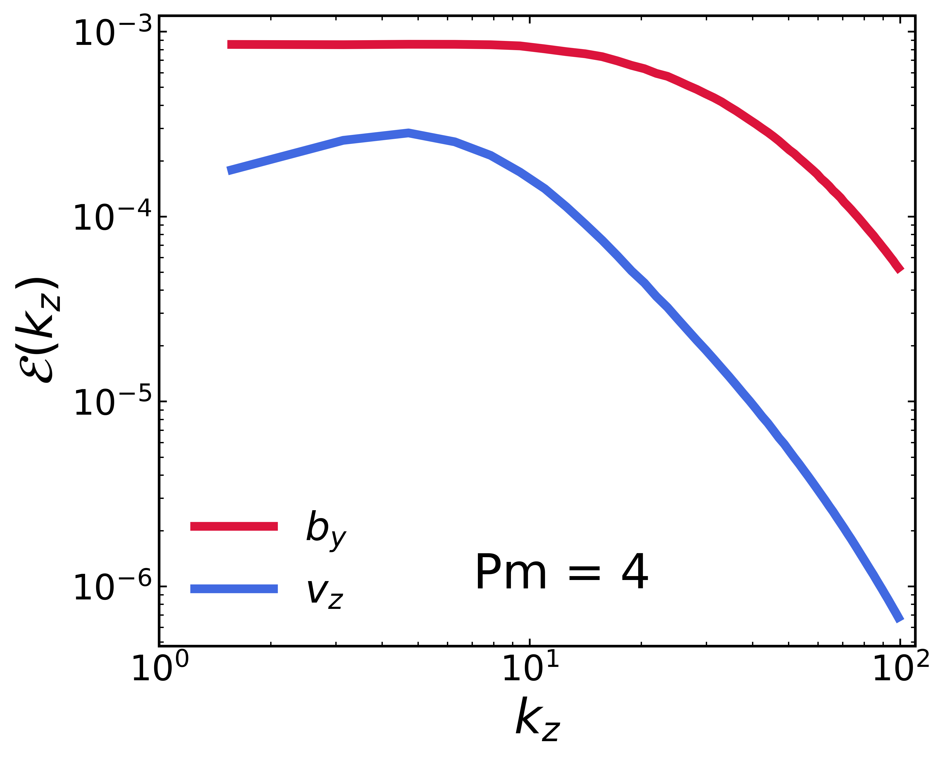
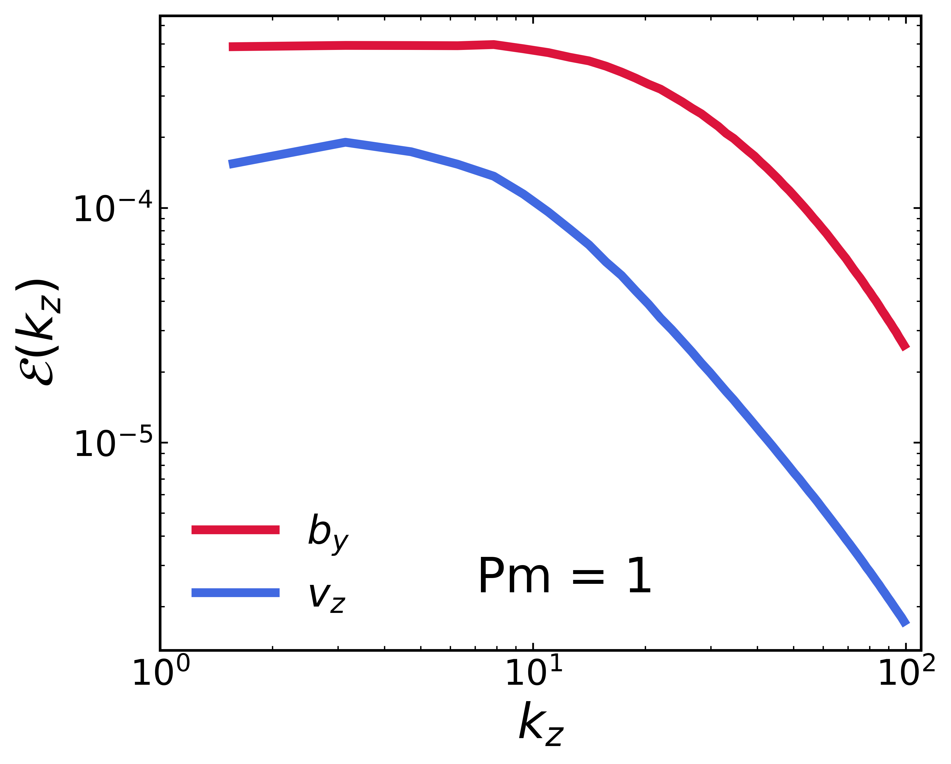
Turbulent Mixing
Turbulent magnetic field and velocity spectras for $$Pm = 4$$
Turbulent magnetic field and velocity spectras for $$Pm = 1$$

Slide 9
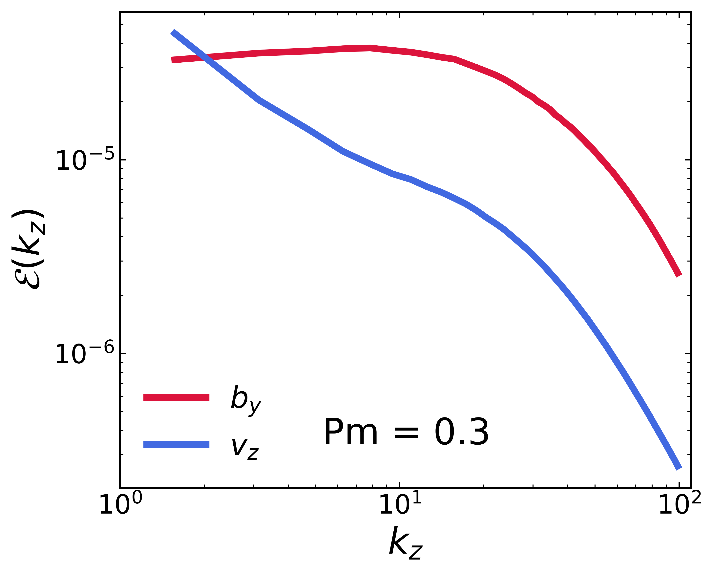
Suppressing Turbulent Mixing
For Pm = 4 and Pm = 1 energy of the ის $$v_{z}$$ and turbulent $$b_{y}$$ are on the same physical scales
For Pm = 0.3 separation of scales become evident
The value of $$v_{z}b_{y}$$ decreases and large scale magnetic fiels is less dissipated by the turbulent mixing
Turbulent magnetic field and velocity spectras for $$Pm = 0.3$$

Slide 10
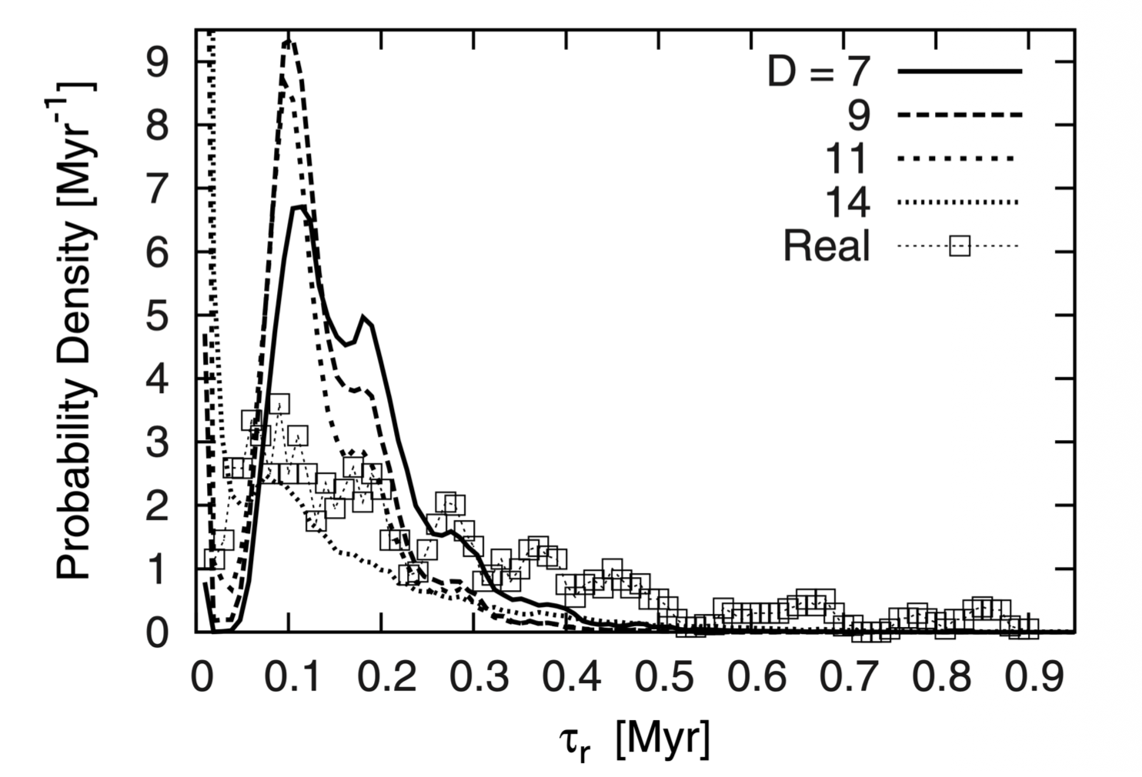
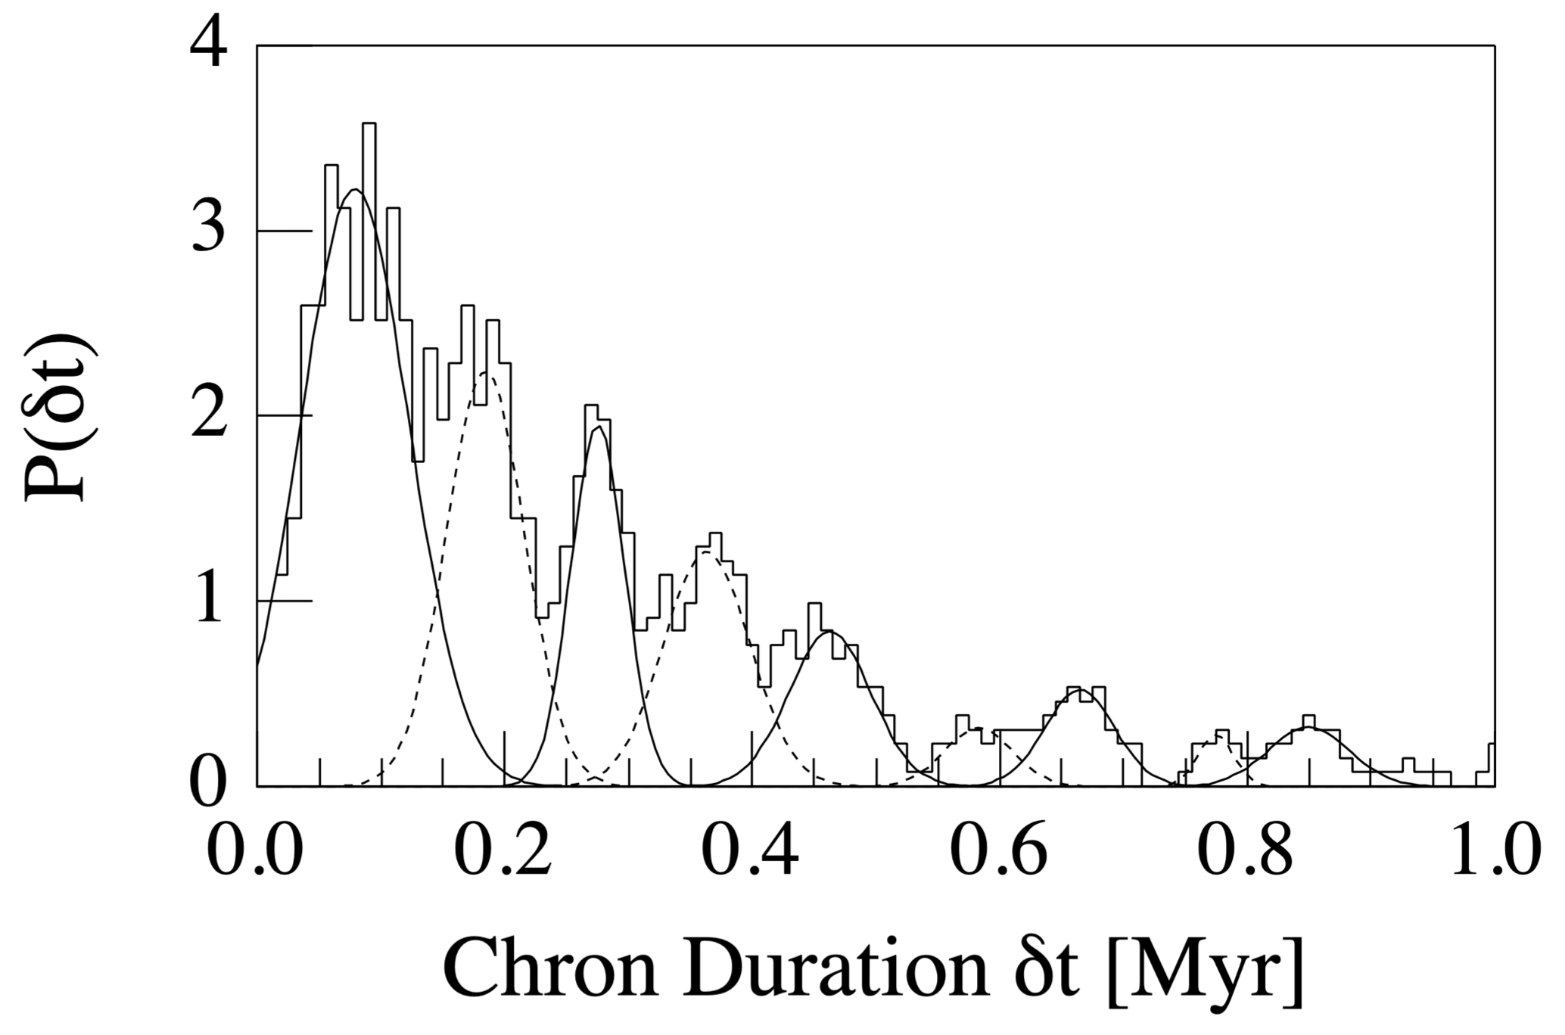
Geodynamo and
Milankovitch cylces
Fischer, Stefani & Gerbeth, Eur. Phys. J. B (2008)
Consolini & De Michelis, Phys. Rev. Lett. (2003)
Multiplicative stochastic resonance operates in the simplified model, although the statistics are insufficient.
The peaks of the 95,000-year Milankovitch cycle and its harmonics indicate a stochastic resonance mechanism.
10

Slide 11
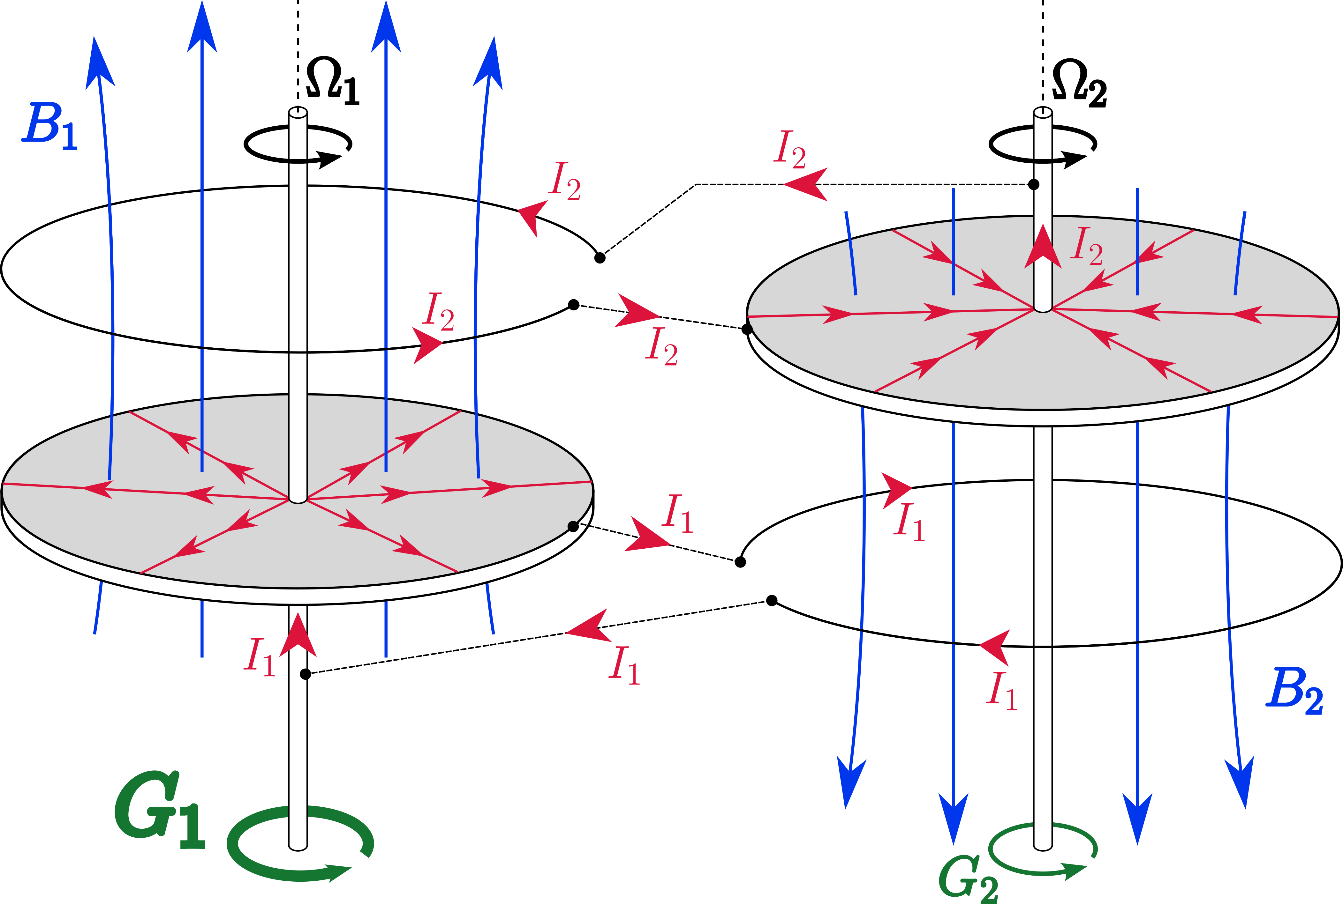
Assymetric model
$$α=G1/G2$$ – fraction of torques,
Three equation system
$${\dot{X}}_{1}=-μX_{1}+X_{2}Y$$
$${\dot{X}}_{2}=-μX_{2}+\left(Y-p\right)X_{1}$$
$$\dot{Y}=-kY-X_{1}X_{2}+r$$
Where:
$$p=\frac{α^{2}-1}{2kα}$$
Donato et al., Int. J. Mod. Phys. B (2009)

Slide 12
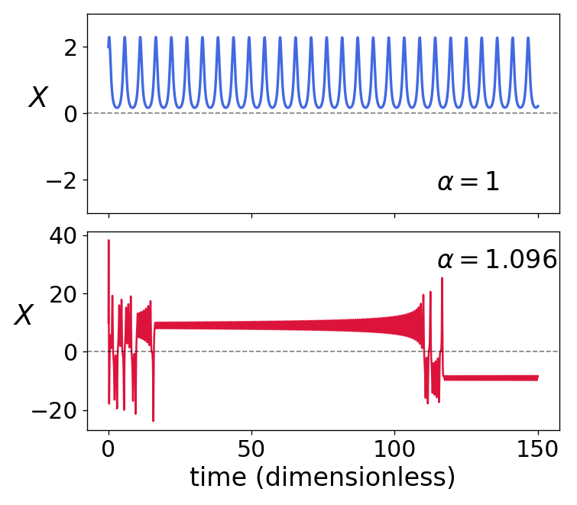
Assymetric model
and rare reversal chaos
Symmetry breaking ($$α≠1$$) caused the emergence of reversals
By selecting specific parameters, the model's reversals approximate the actual statistics (the chaos of infrequent reversals)
Discussed:
$$μ=5.36$$
$$α=1.096$$
Frick & Pleshkov, Phys. Rev. E (2024)

Slide 13
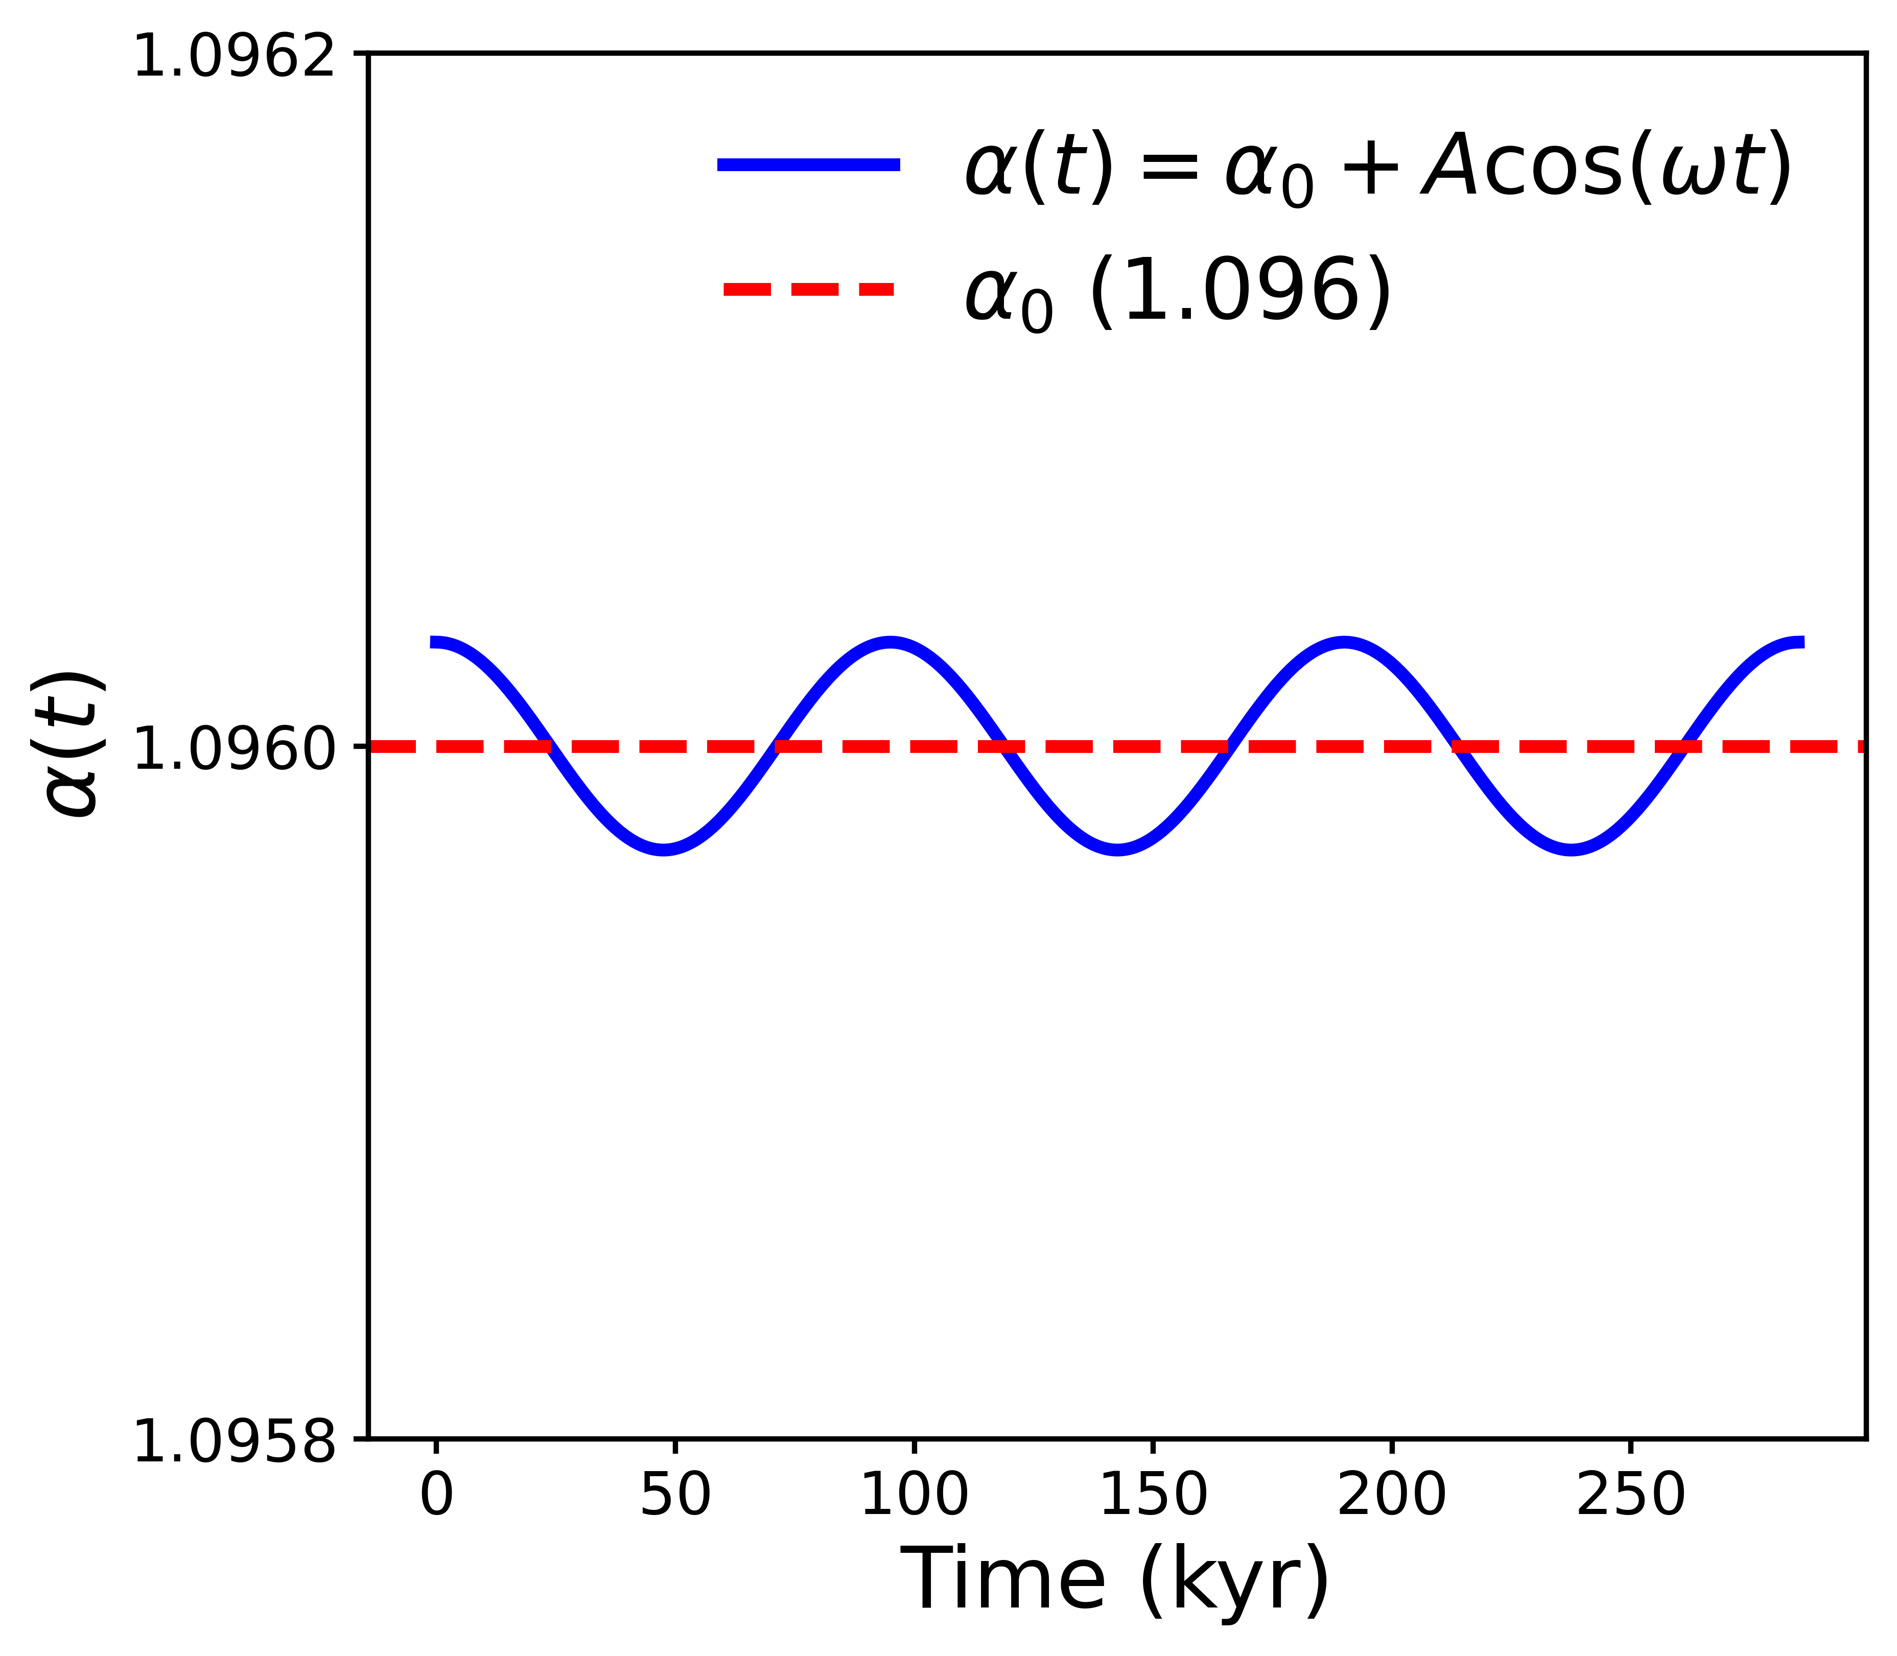
Milankovitch cycles in
the Rikitake model
If precession is the driving mechanism of the geodynamo, an orbital influence on the reversals is likely.
We introduce Milankovitch cycles into the Rikitake model.
The cycles act harmonically on the asymmetry parameter $$α$$:
$$α(t)=α_{0}+A cos\left(\frac{2π}{T_{Ω}}t\right)$$
$$α_{0}$$ – Assymetry parameter
$$A$$ – Very small amplitude

Slide 14
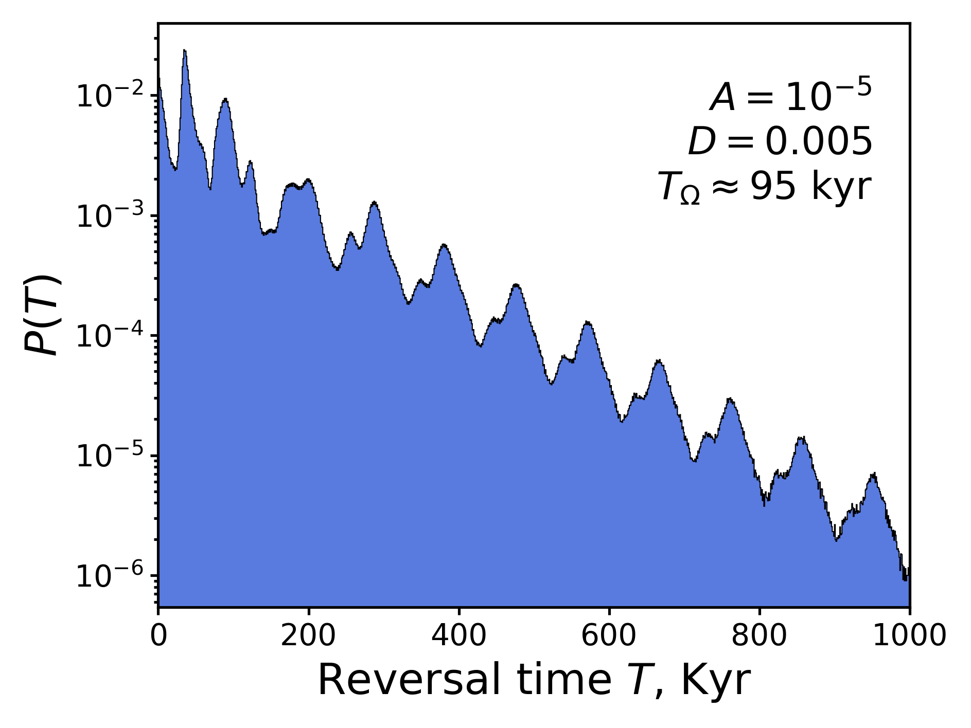
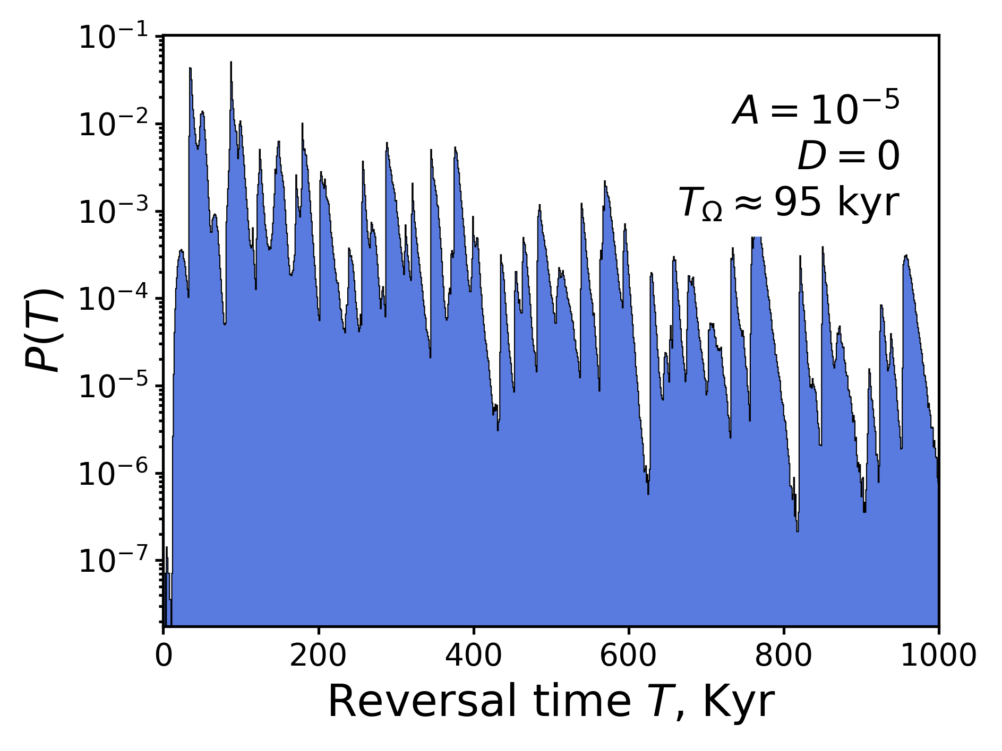
95,000-year period
A very small $$\left({\sim 10}^{-5}\right)$$ amplitude fails to exert a sufficient effect on the system.
The addition of noise leads to the formation of peaks, which points to a stochastic resonance mechanism

Slide 15
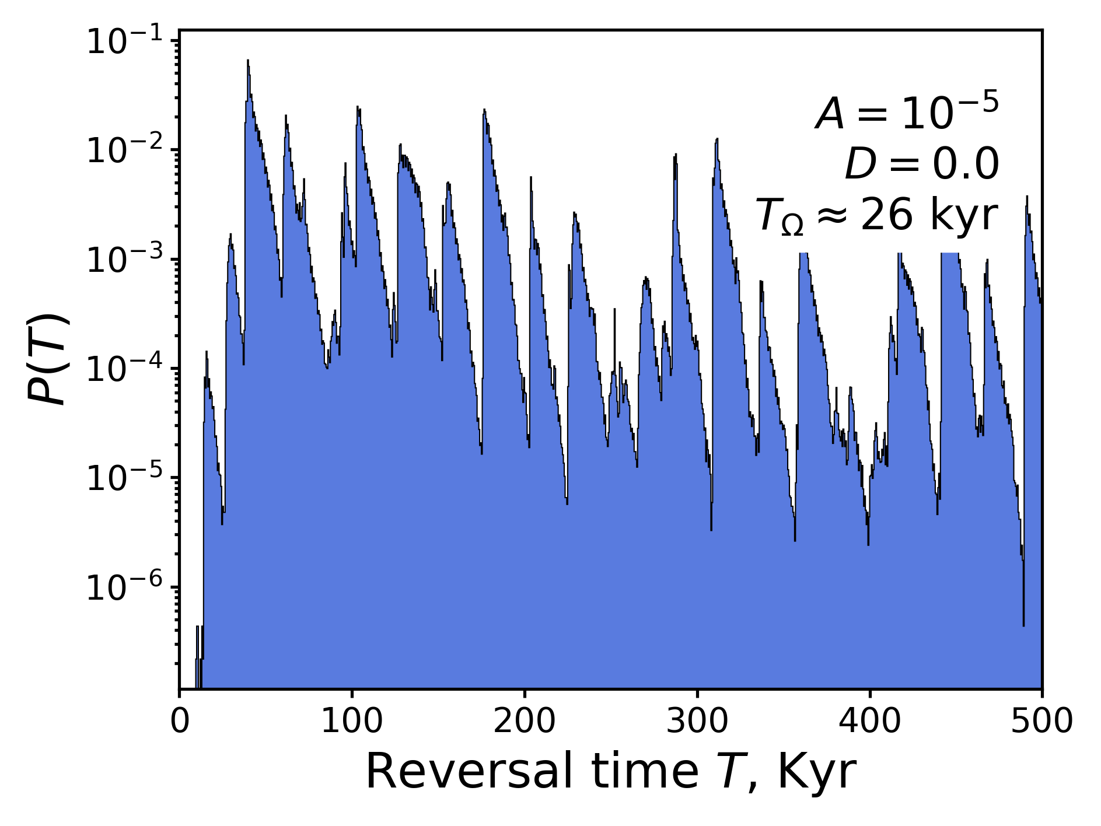
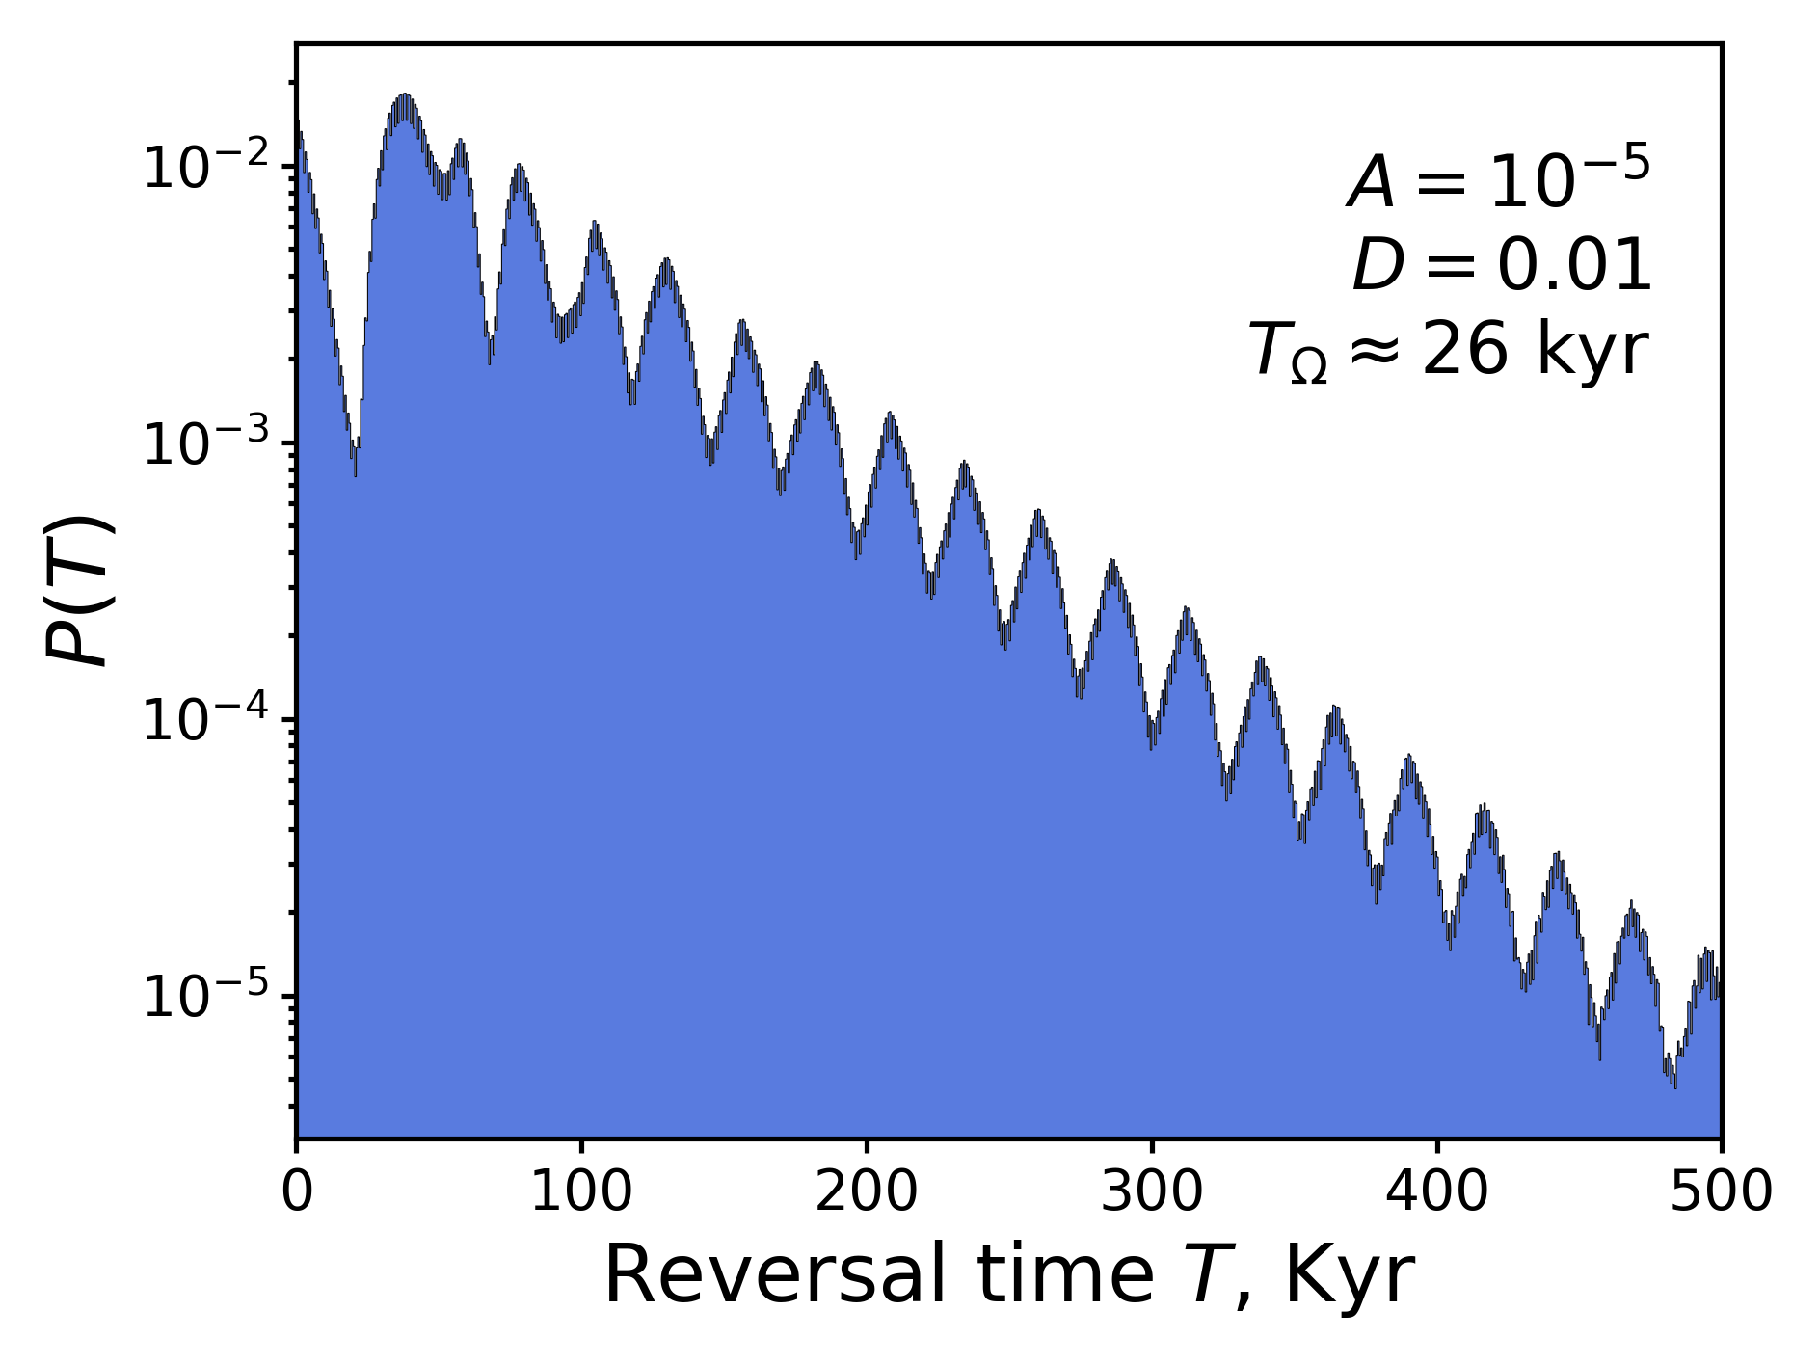
26,000-year period
Similarly, for the 26 Kyr period, a very small amplitude fails to exert a sufficient effect on the system, while noise amplifies the effect

Slide 16
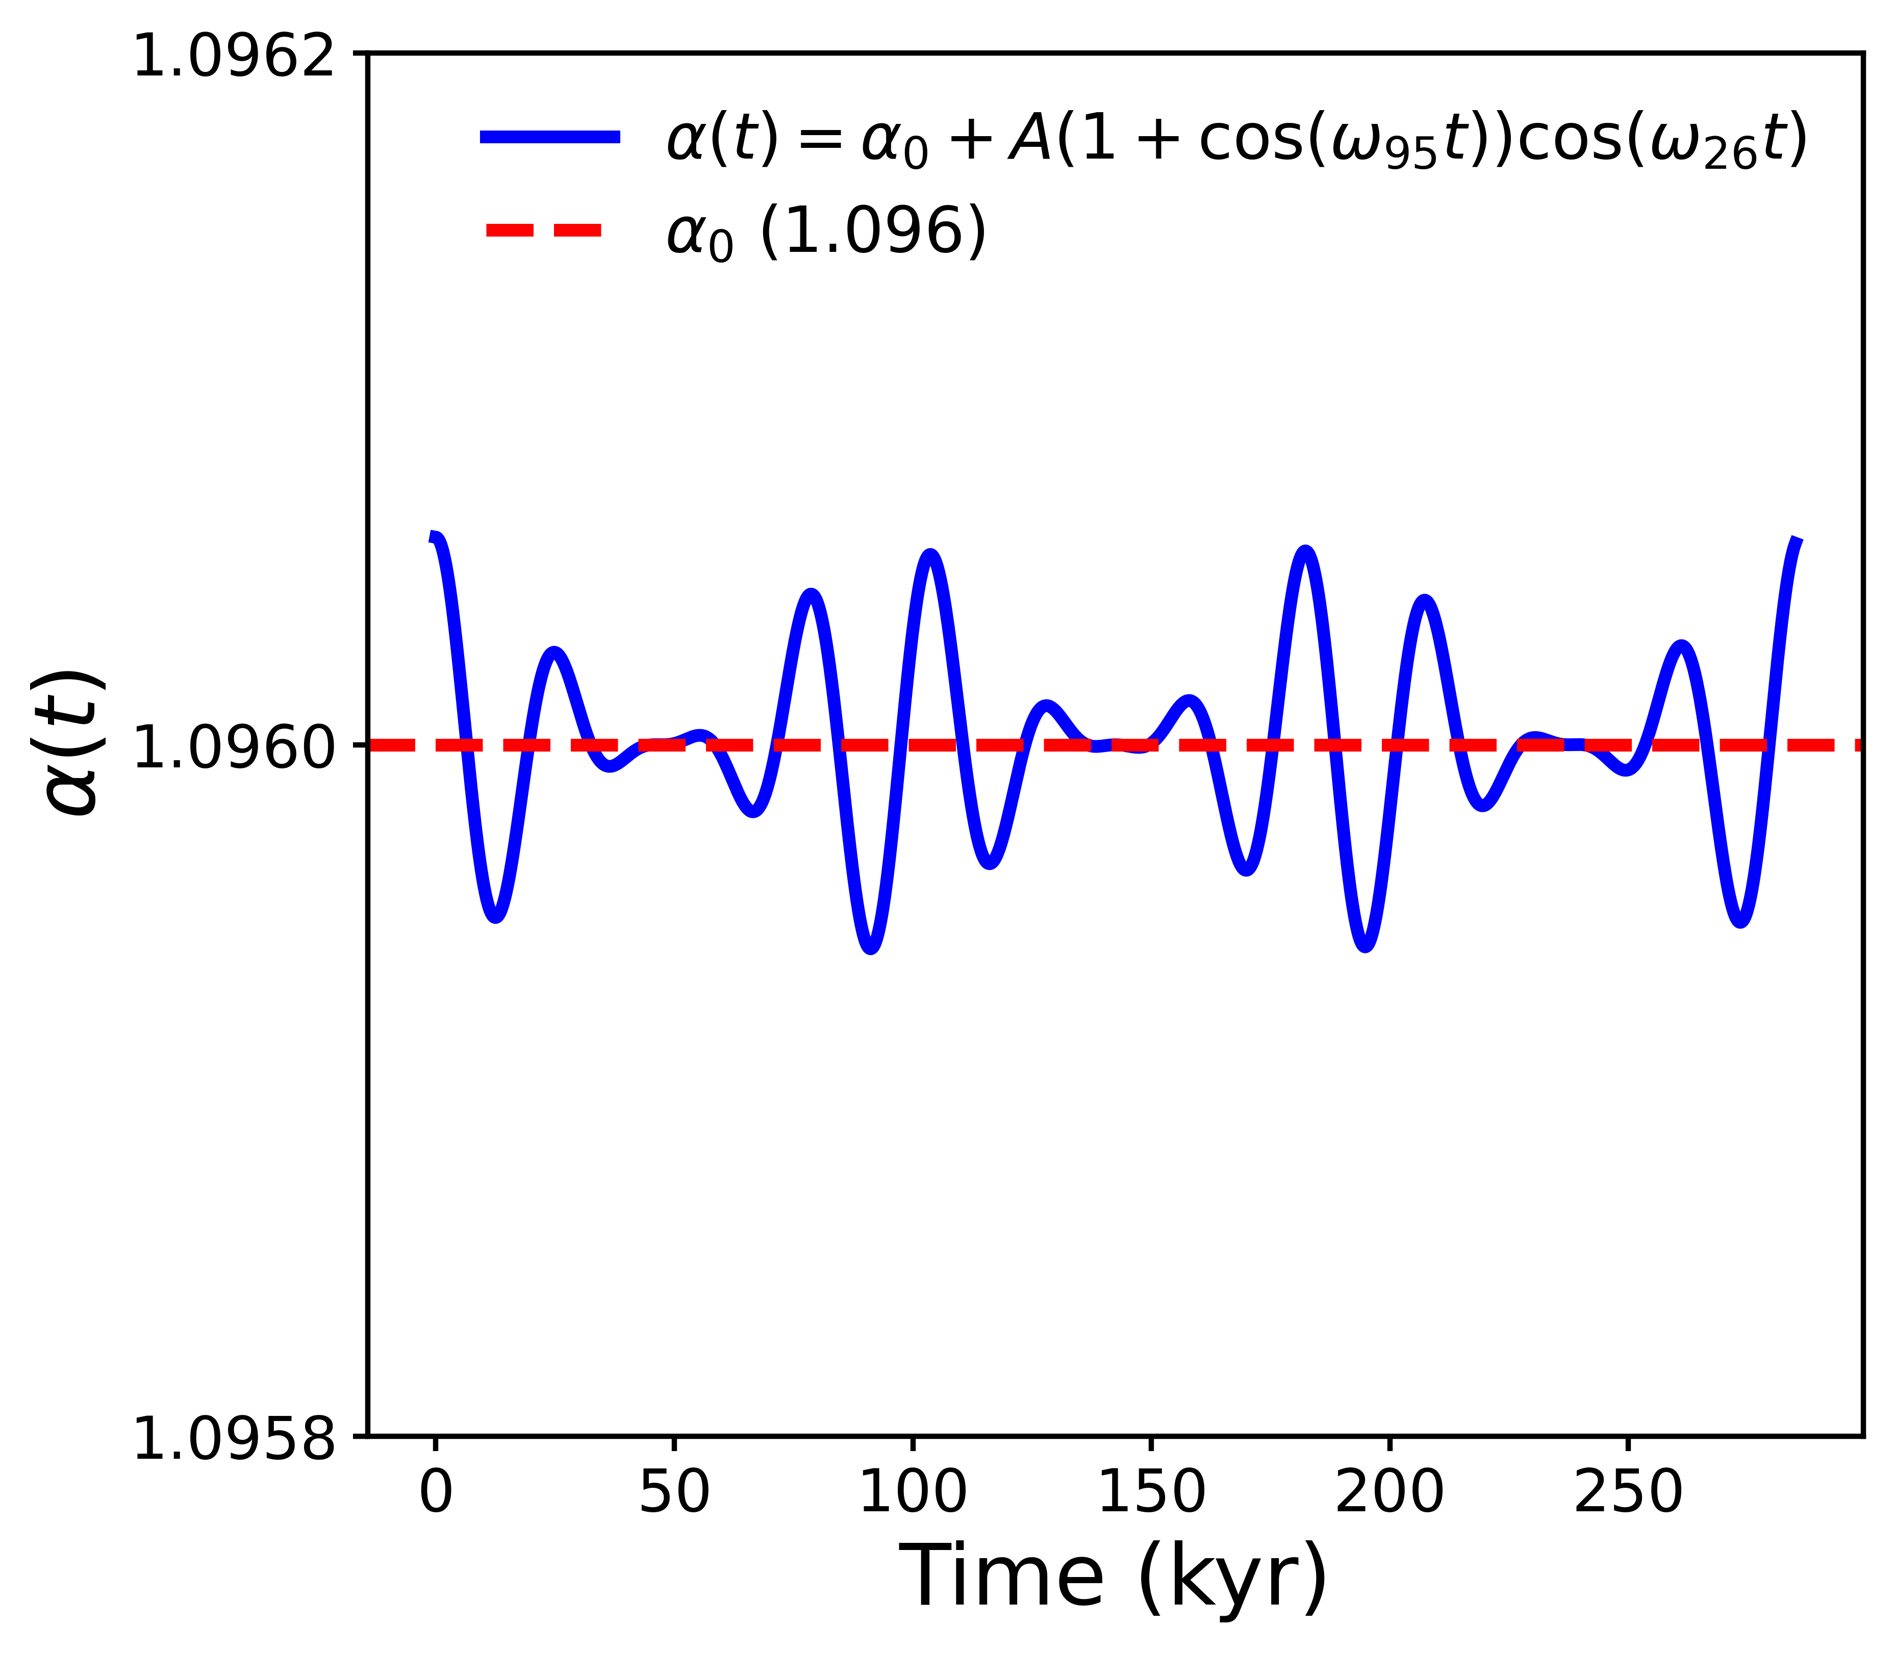
Amplitude modulation
Precession exerts the primary influence on the geodynamo (the reversals), and the 95,000-year cycle of changes in eccentricity alters the amplitude of precession
The assymetry parameter $$α$$ is acted upon by a 26,000-year harmonic cycle (precession), whose amplitude is modulated by a 95,000-year period.
$$α\left(t\right)=α_{0}+A\left(1+\cos\left(\frac{2π}{T_{95}}t\right)\right)\cos\left(\frac{2π}{T_{26}}t\right)$$

Slide 17
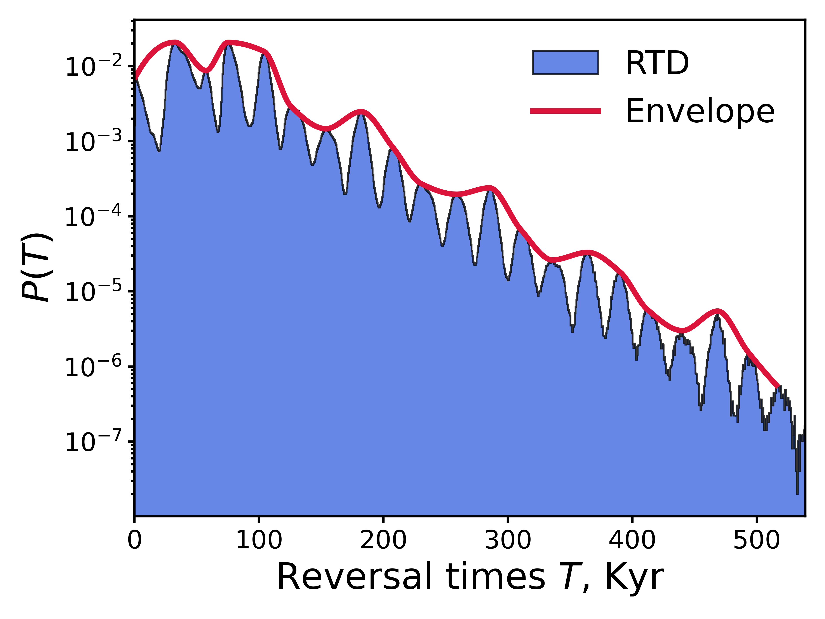
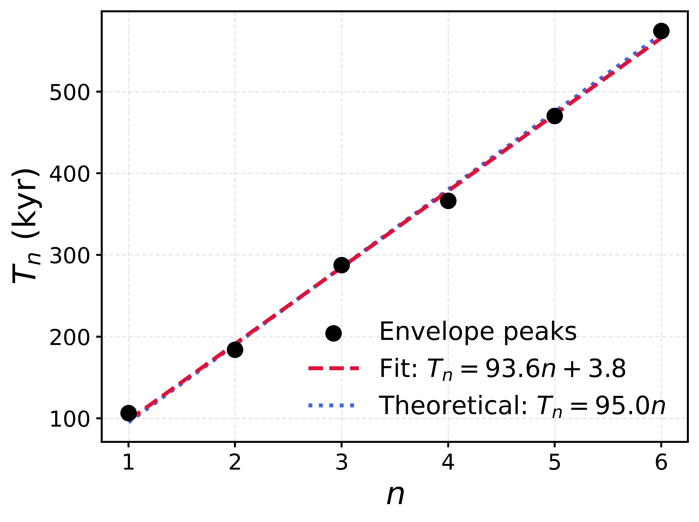
Amplitude Modulation
$$A=2×{10}^{-5}, D = 0.0005.$$ Distinct peaks are visible at the 26,000-year periods, whose envelopes also exhibit a periodicity.
The peaks of the envelopes exactly match the theoretical curve (the 95,000-year period and its harmonics

Slide 18
Conclusions
Dynamo Survival via Scale Separation (Micro-Scale): By expanding the physical domain, subcritical dynamos survive extreme turbulence at low Prandtl numbers (Pm = 0.3). Fourier analysis proves that scale separation acts as a physical shield, decoupling kinetic and magnetic fluctuations to suppress turbulent dissipation.
Multiplicative Stochastic Resonance: Building on a phase-space model with mechanical symmetry breaking (which exhibits rare-reversal chaos), we demonstrated that the geodynamo acts as a highly sensitive nonlinear amplifier. Optimal stochastic noise allows these chaotic reversals to perfectly phase-lock to weak external signals
Orbital Pacing (Macro-Scale): Applying a realistic amplitude-modulated orbital forcing, where the 95-kyr eccentricity cycle acts as an envelope for the 26-kyr precession cycle, perfectly reproduces the empirical statistical data, proving that orbital mechanics can dictate the timing of magnetic reversals.

Slide 19
Thank you for your attention!

