Slide 1



Integrating Plant Bio monitoring and Low-Cost Air Quality Monitoring for PM assessment in Georgia
Kato Melikidze
Kato.melikidze.1@iliauni.edu.ge

Slide 2

My Background
Ilia State University
Entomology Lab
Geology Lab
Science Popularisation Project- mobile lab in regions
Field works
Determination of Wood Density and Related Parameters for Tree Genera
Assessment of Red List Forest Species of Georgia
Check list for Georgian flora
National Forest Inventory in Georgia
Member of NARI - (Network of Amateur Researchers Inquiry)
Green Pole
Eco Tips Book - Part 1,2,3,4
Monitoring of Stone Dry Cutting in Tbilisi
Civil Air Quality Monitoring System Setup

Slide 3

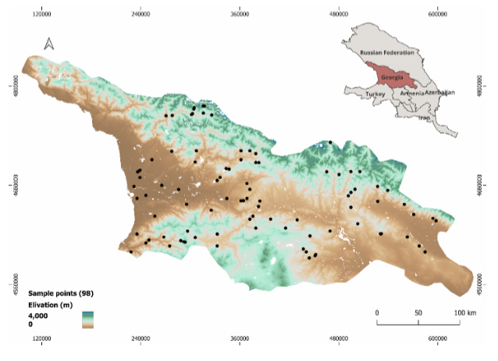
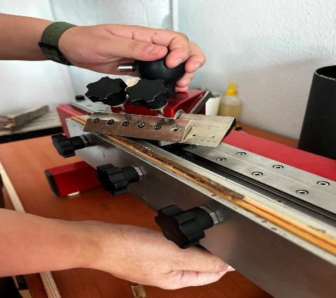
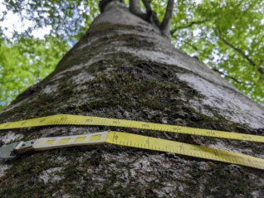
Age, Carbon stock, Wood density, Annual growth

Slide 4
My Background
Ilia State University
Entomology Lab
Geology Lab
Science Popularisation Project- mobile lab in regions
Field works
Determination of Wood Density and Related Parameters for Tree Genera
Assessment of Red List Forest Species of Georgia
Check list for Georgian flora
National Forest Inventory in Georgia
Member of NARI - (Network of Amateur Researchers Inquiry)
Green Pole
Eco Tips Book - Part 1,2,3,4
Monitoring of Stone Dry Cutting in Tbilisi
Civil Air Quality Monitoring System Setup

Slide 5
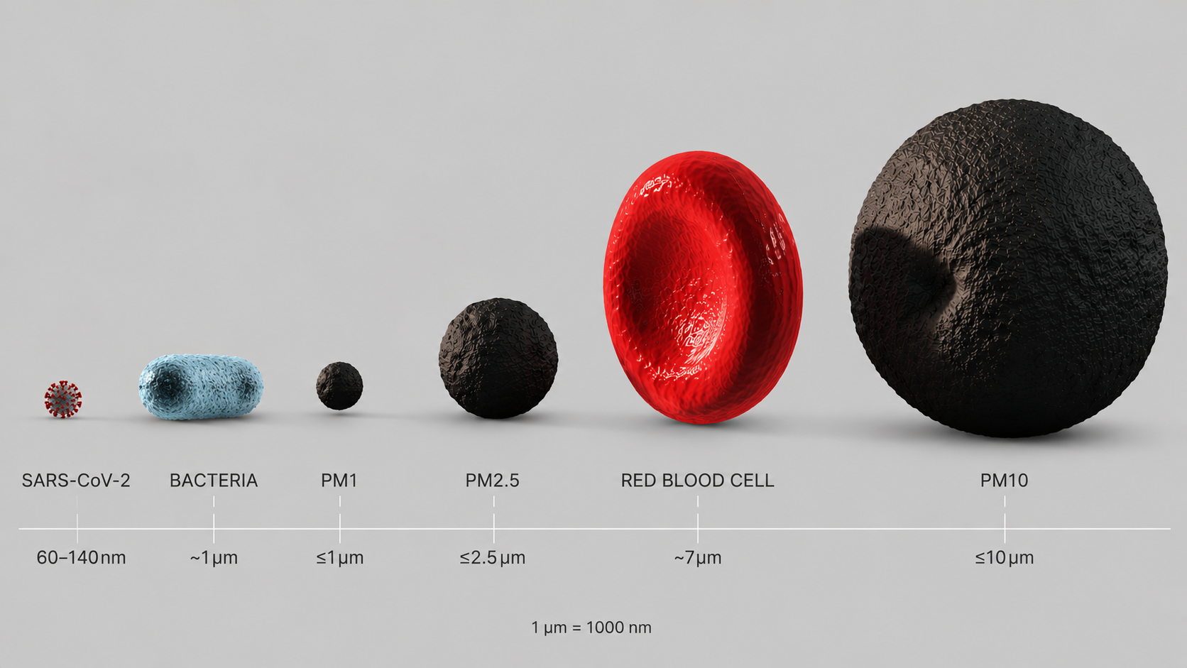
Air Pollution: PM particles
PM1 ≤ PM2.5 ≤ PM10
PM10
• Respiratory tract irritation
• Asthma
PM2.5
• Respiratory diseases
• Increased risk of lung cancer
PM1
• Cardiovascular diseases
• Nervous system damage
• Premature mortality
https://seetheair.org/2022/05/16/particulate-matter-pm2-5-mega-guide/

Slide 6
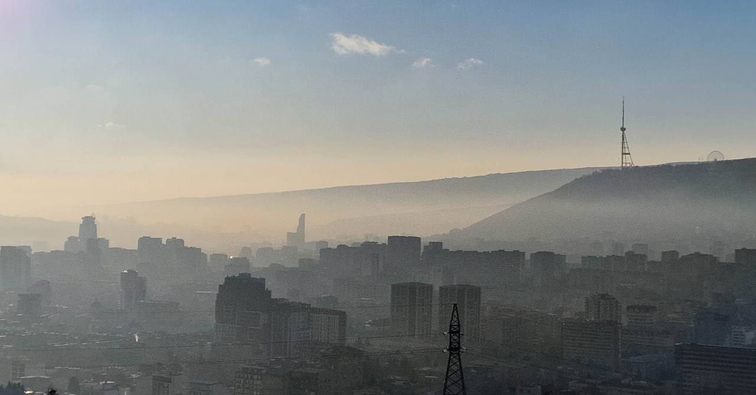
The Air Pollution Challenge in Georgia
• 7M premature deaths/year (WHO, 2024)
• PM2.5: 7.6X above WHO guideline
• PM influenced by meteorological, spatial & temporal factors
https://www.reddit.com/r/tbilisi/comments/14qgdef/tbilisi_shaded_relief_map_highlights_the_terrain/#lightbox

Slide 7
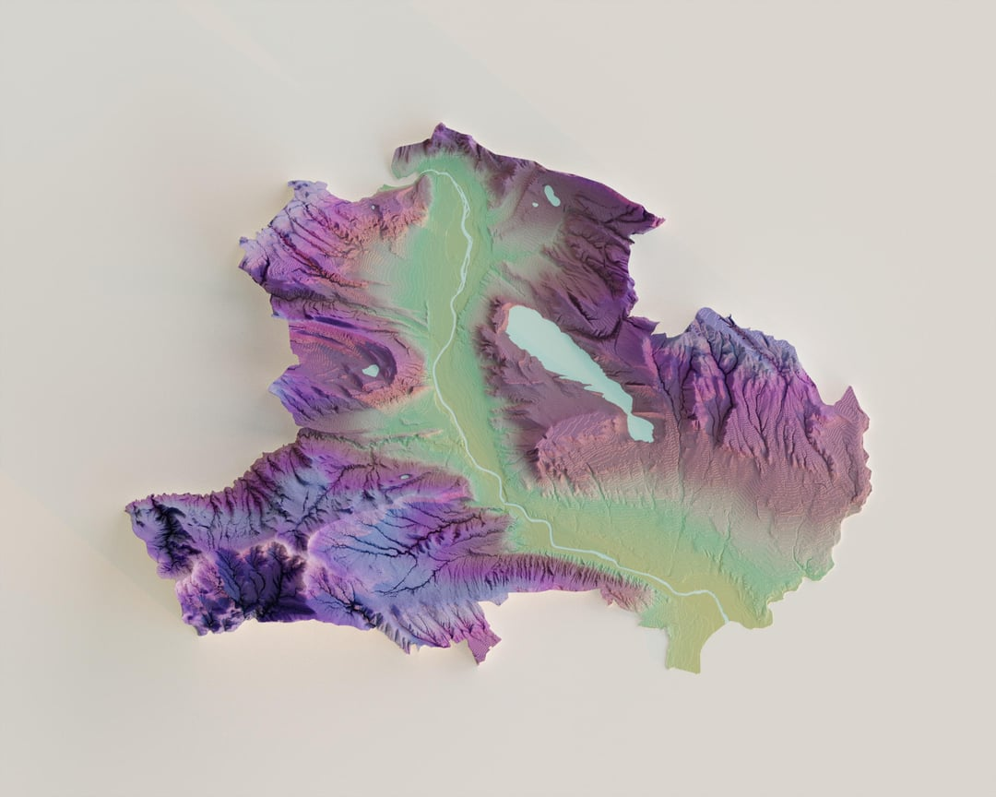
Tbilisi

Slide 8

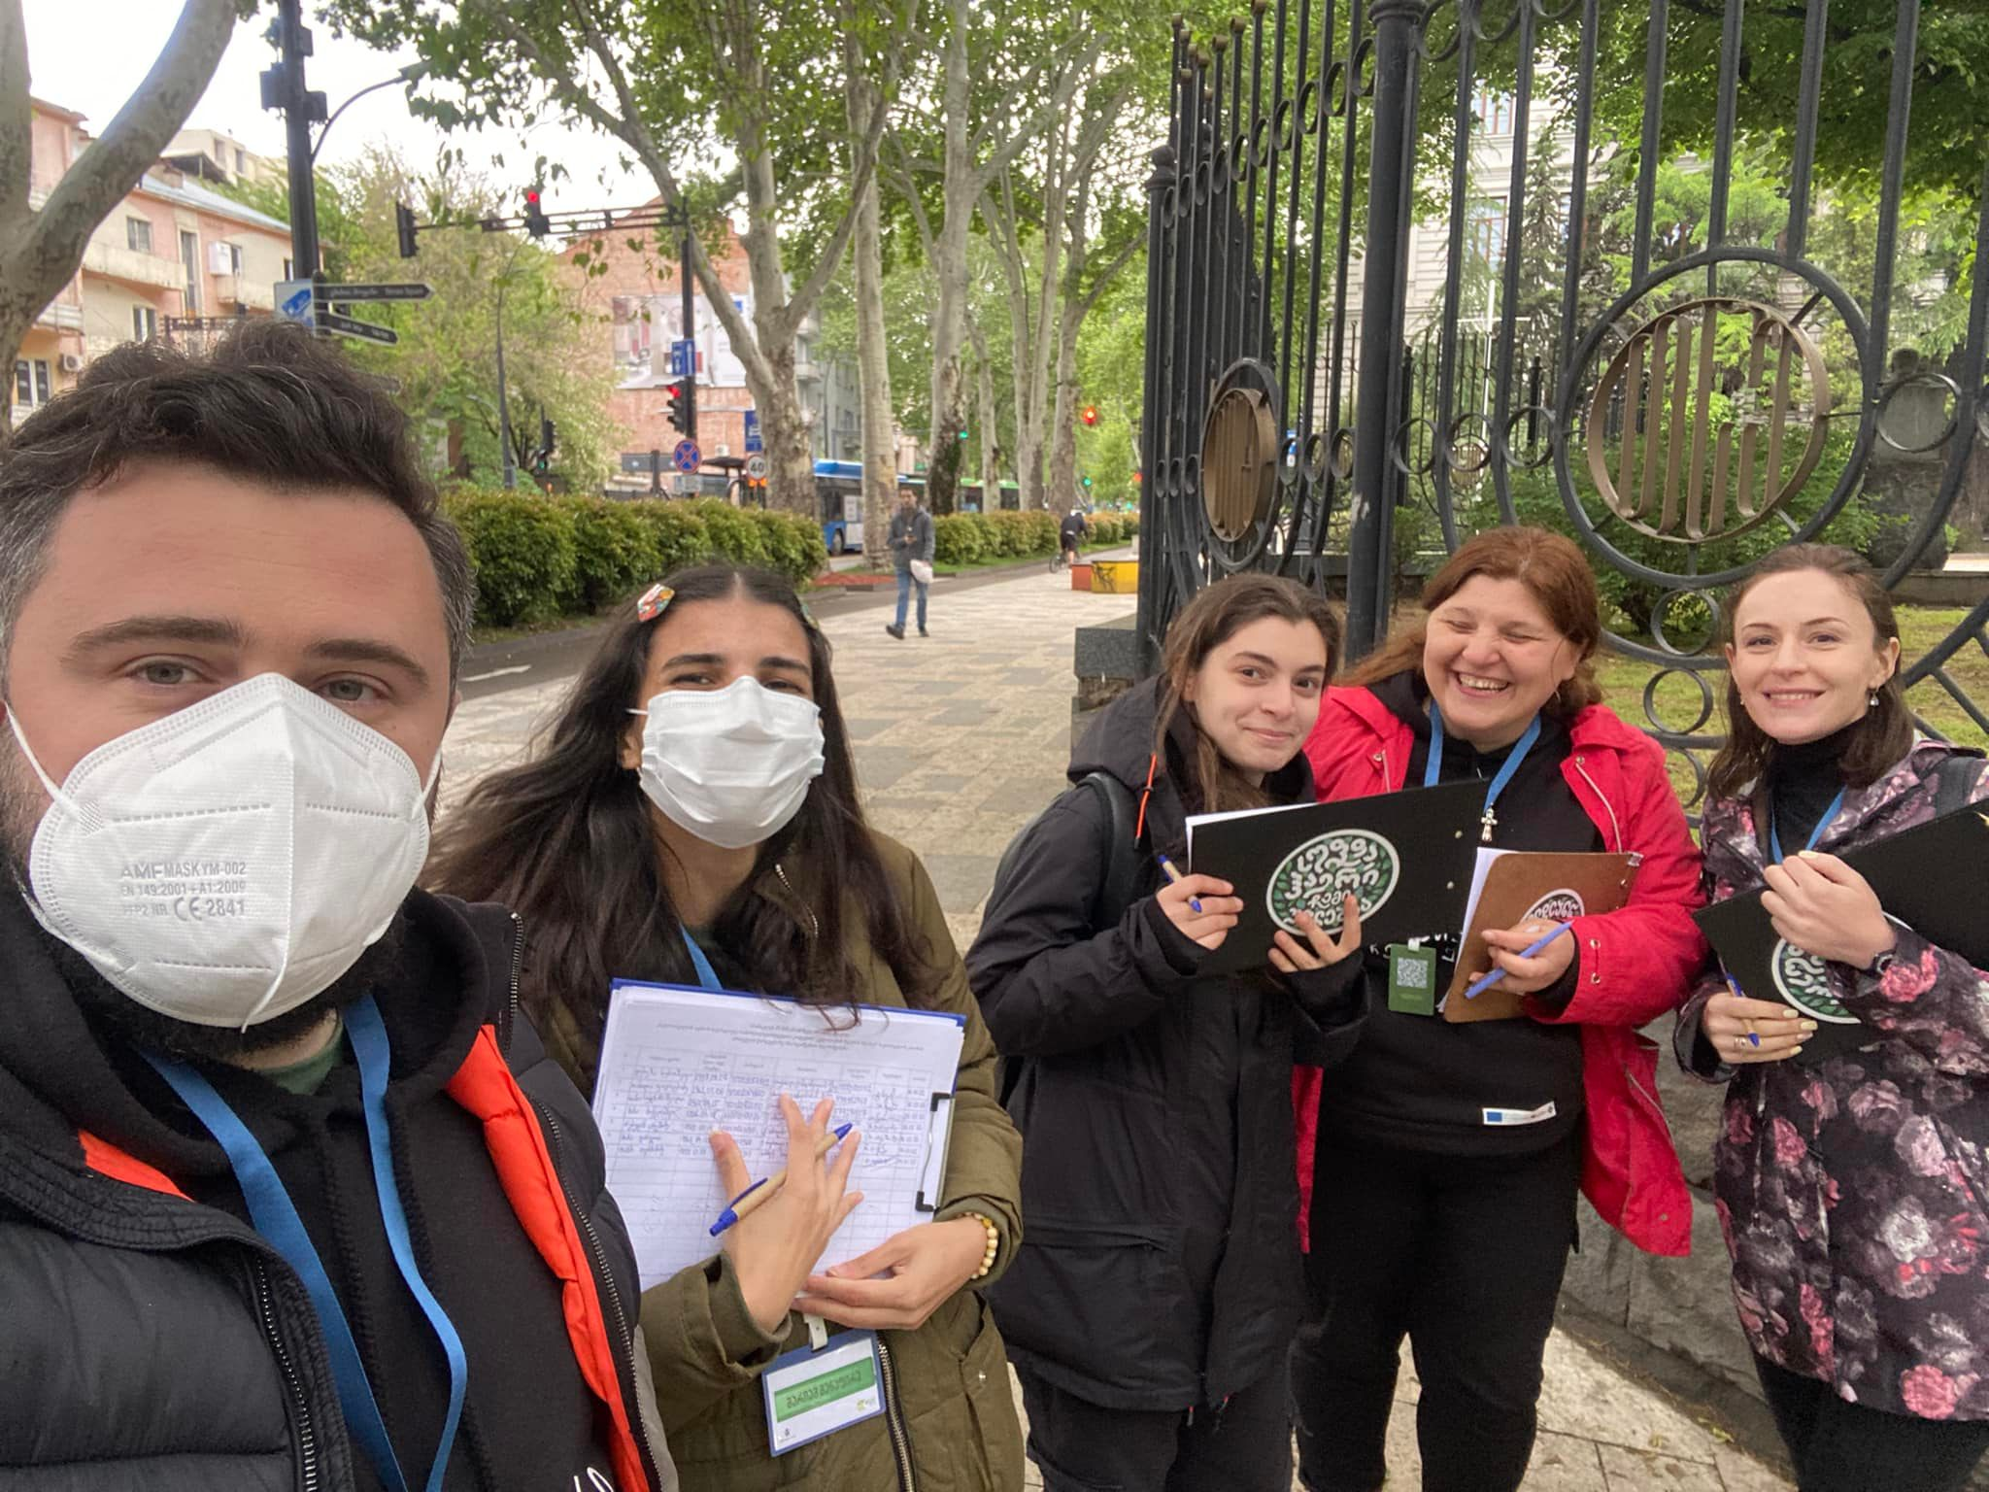
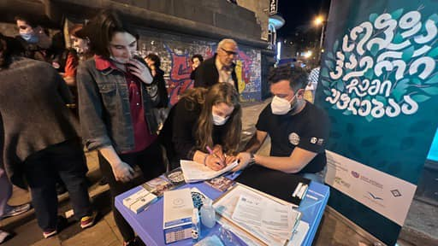
Civil Activism + Enforcement Mechanism

Slide 9
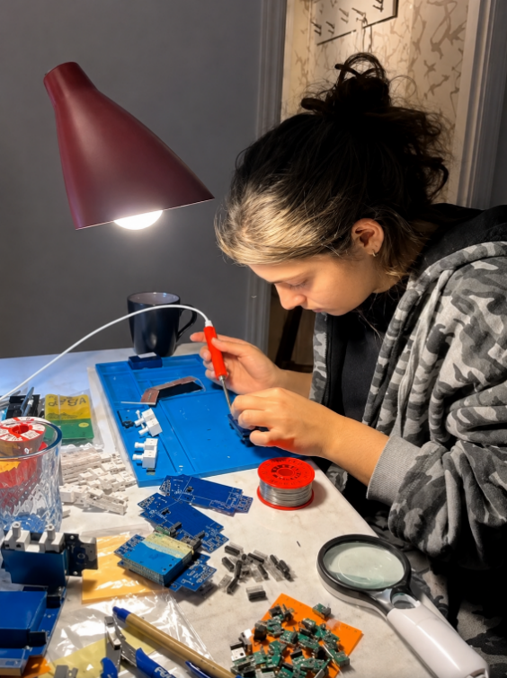


Civilian Monitoring Network – “Cometer”
• A project by Green Pole, Arnika, and the Embassy of the Czech Republic
• Assembly, installation, monitoring, and software development

Slide 10
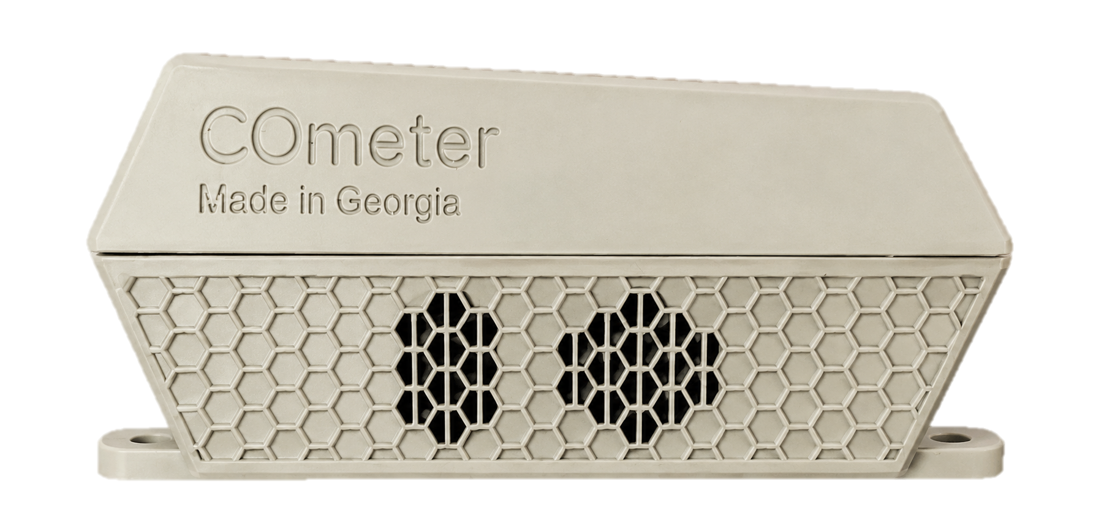
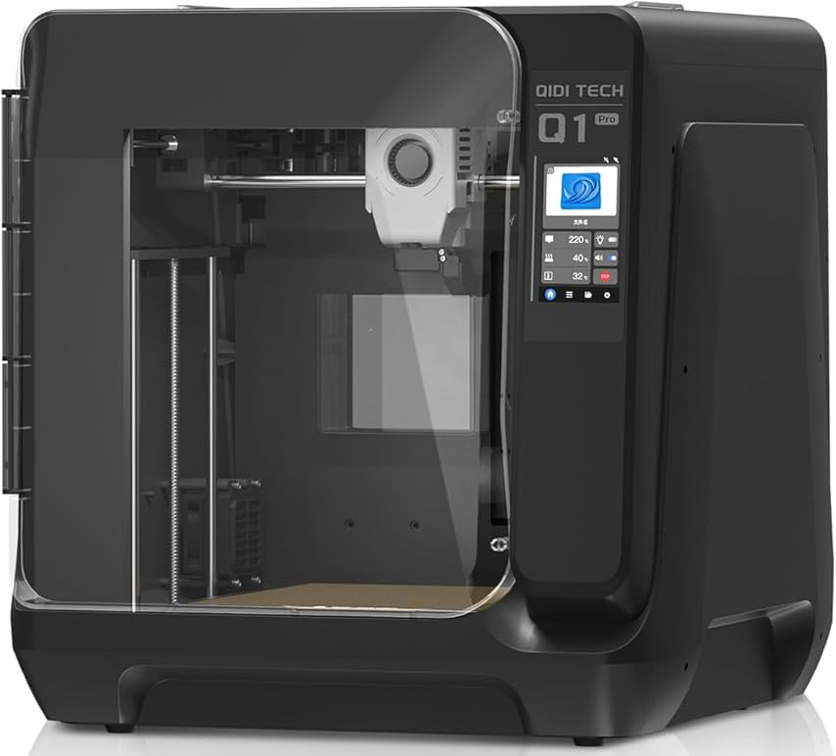





Technical Specifications
Measures:
PM1, PM2.5, PM10
VOC (Volatile Organic Compounds)
Nox
Temperature, Humidity, Pressure
+ Ozone, Radiation, NO2
Calibration

Slide 11

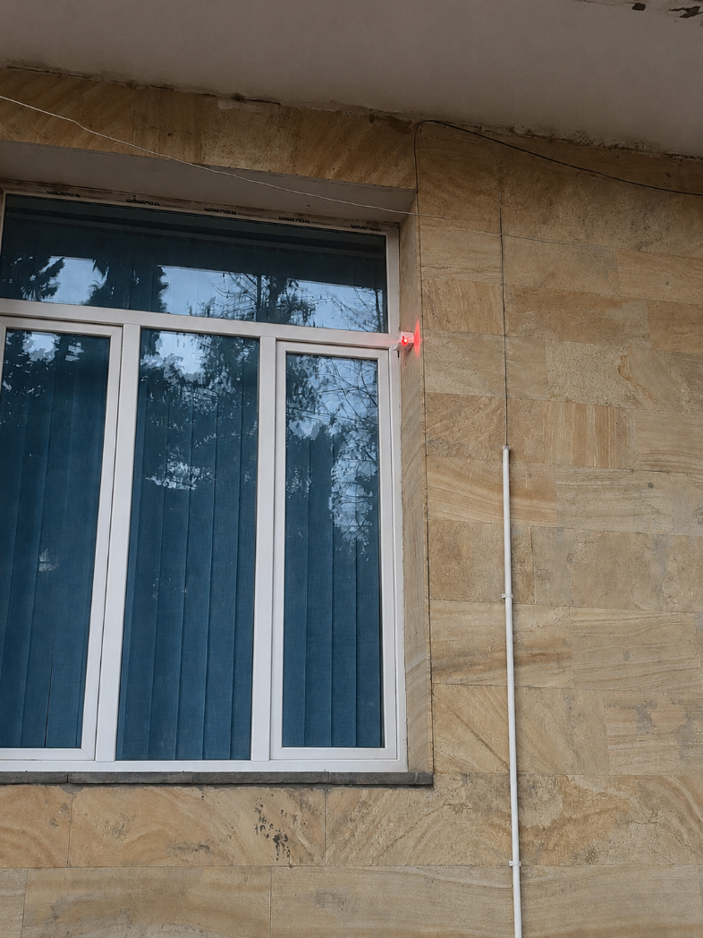
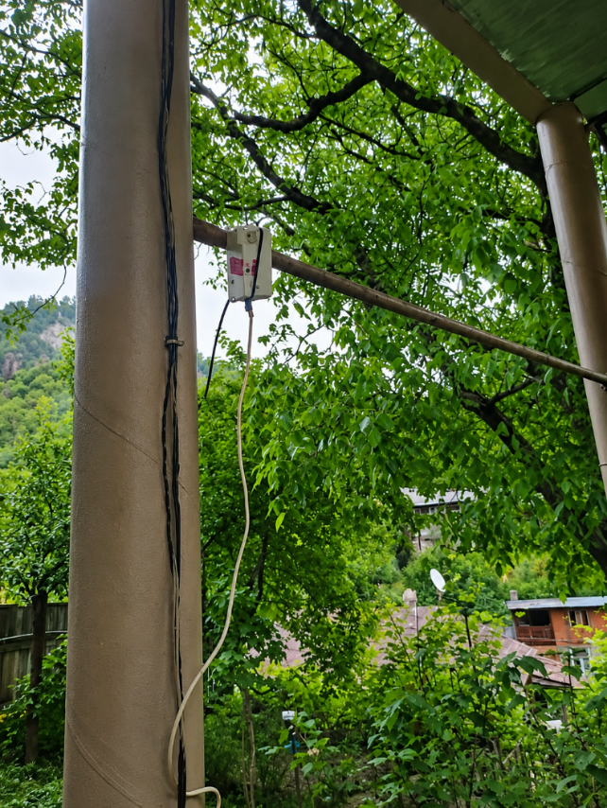
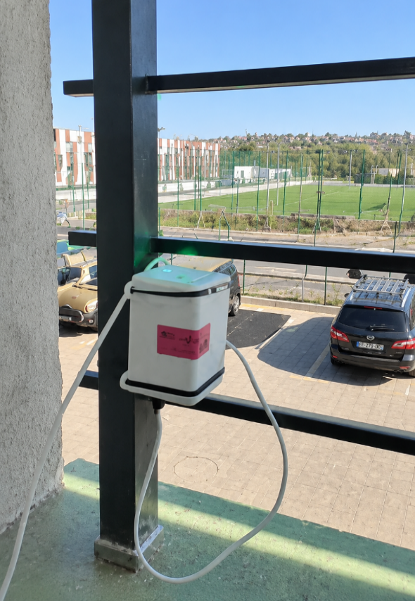
Deployment and Measurements
• Installed at a height of 4–5 m
• 19 populated areas – 94 sensors
• Measurements recorded every 15 minutes

Slide 12
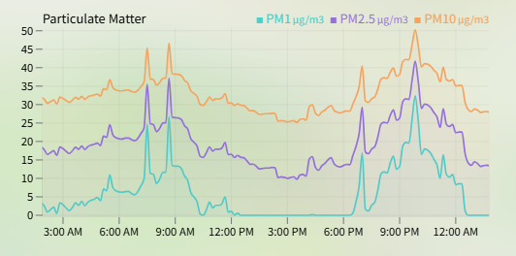
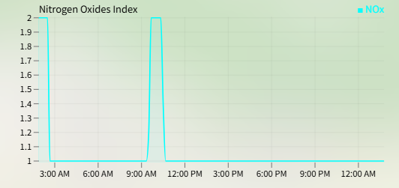
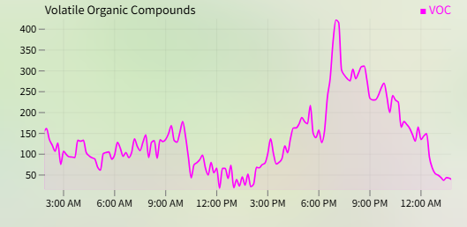
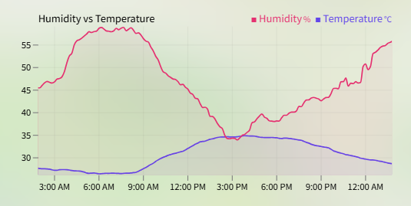
The Results

Slide 13
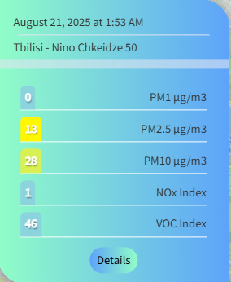
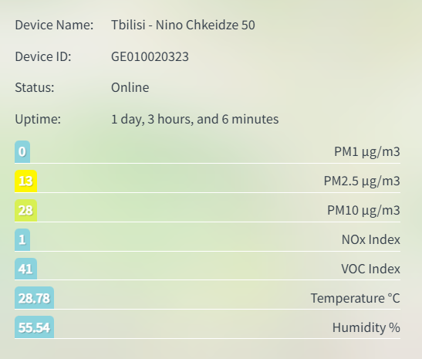
The Results

Slide 14
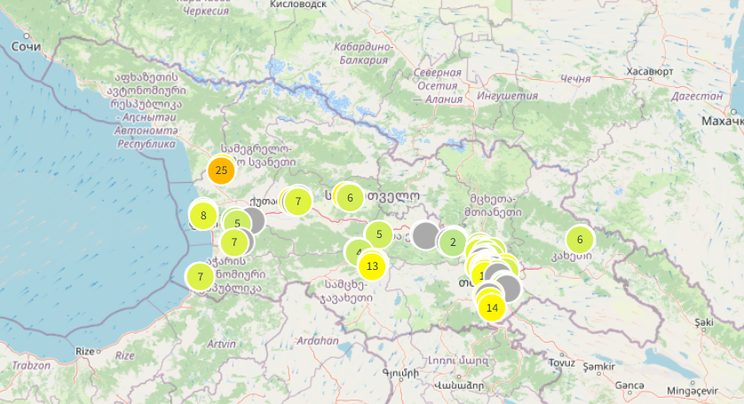
Data Processing
 | Populated areas | Number of sensors | Number of data points
Before data processing | 19 | 94 | >1 500 000
After data processing | 16 | 55 | 442 470

Slide 15
Aim of the research:
Evaluating factors affecting PM1 concentrations in Georgia.
Research Questions:
What is the impact of meteorological factors on PM1 concentrations?
What are the seasonal and diurnal variations of PM1?

Slide 16
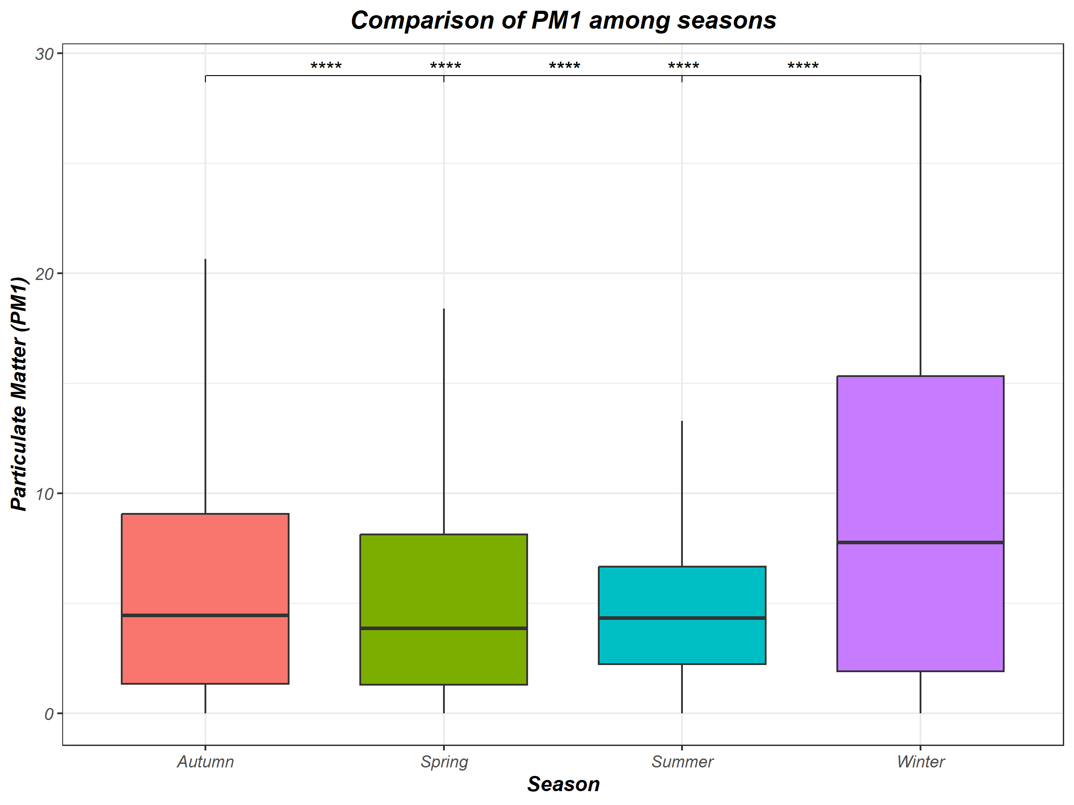
Comparison of PM1 Among Seasons
Statistically significant
Kruskal–Wallis: p < 0.001
Pairwise Wilcoxon: p < 0.001

Slide 17
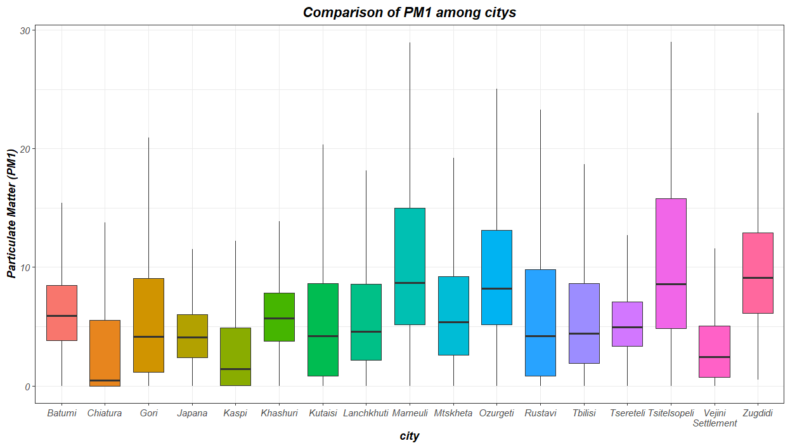
Comparison of PM1 among cities

Slide 18
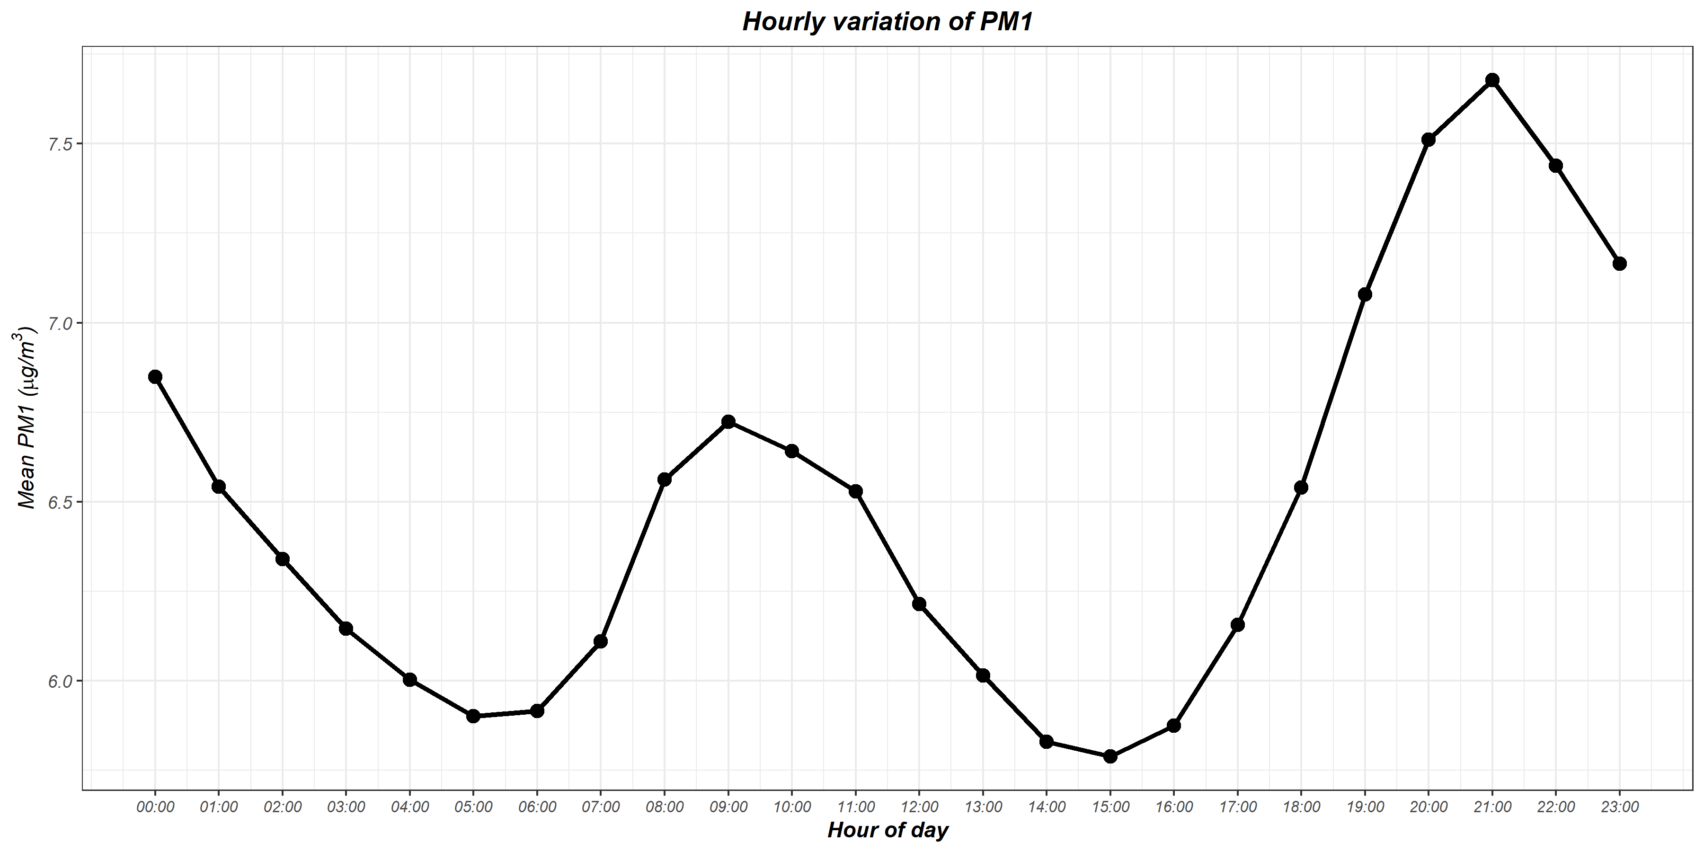
Hourly variation of PM1

Slide 19
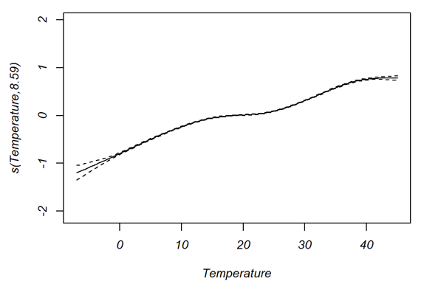
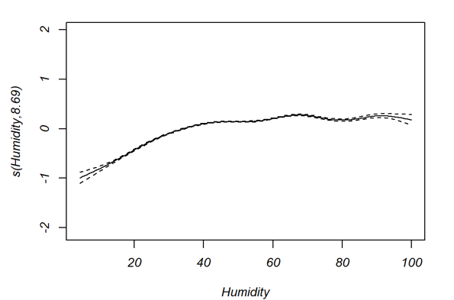
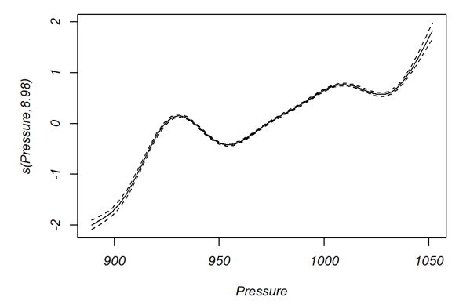
GAM Model (Meoteorological factors)

Slide 20
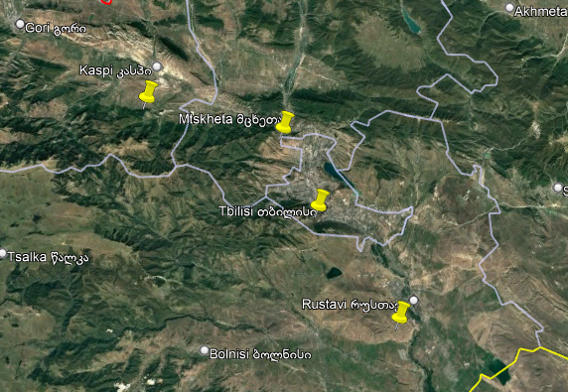
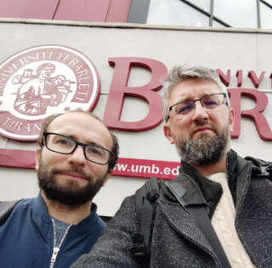

Selected Cities
Warsaw University of Life Sciences
Dr hab. inż. Robert Popek,
Tbilisi, Mtskheta, Rustavi, Kaspi
Dr hab. Arkadiusz Przybysz

Slide 21
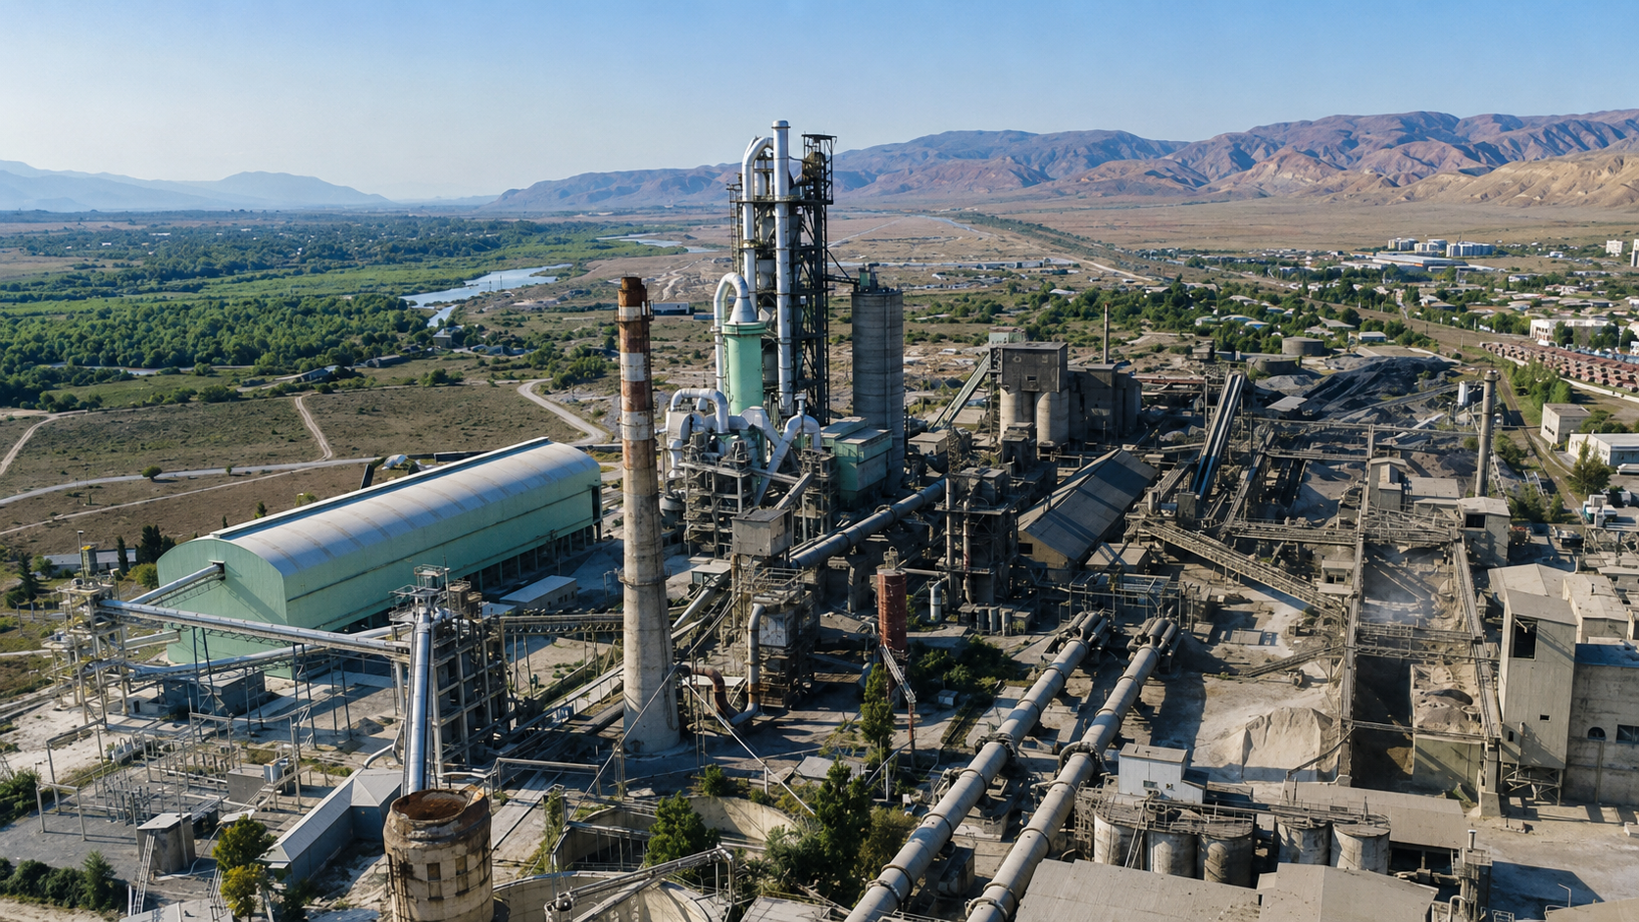
Kaspi Cement Plant
https://tbilisipost.ge/news/rodis-ashenda-kaspshi-ementis-qarkhana--istoria-da-ganvitareba/6322

Slide 22
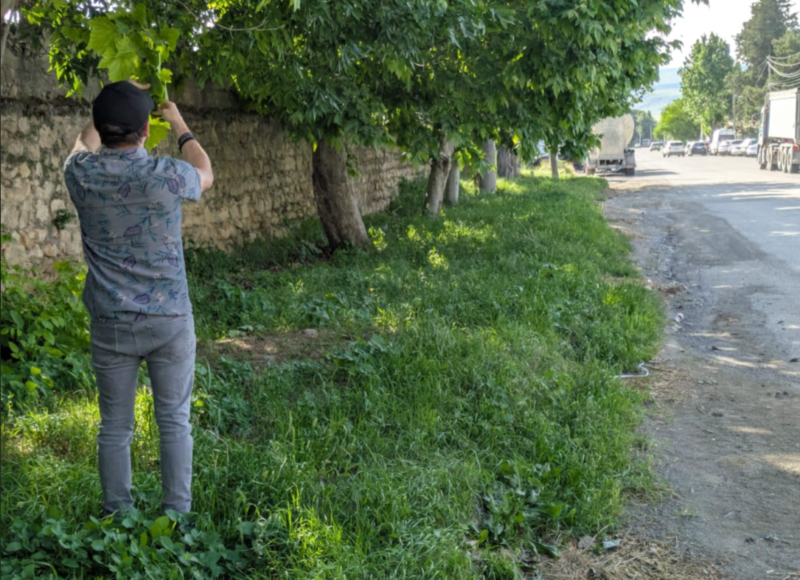
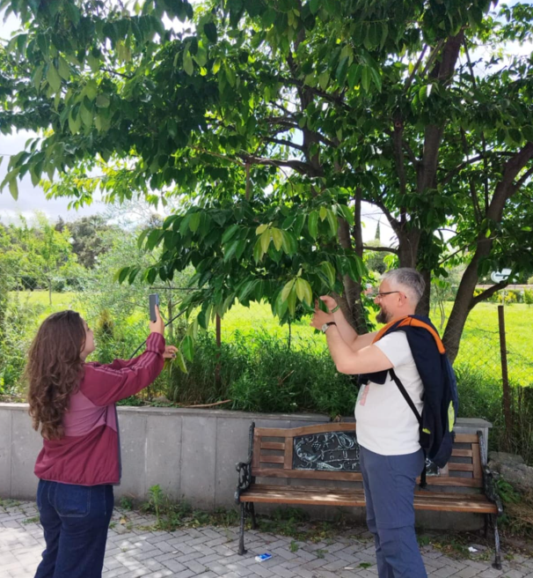
Collecting Leaves

Slide 23
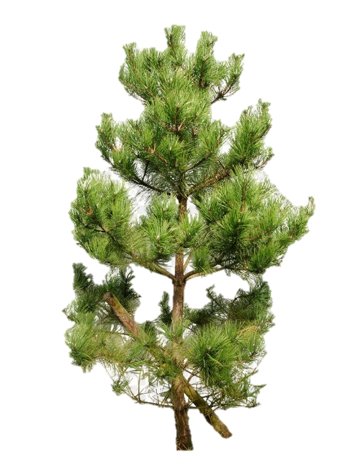
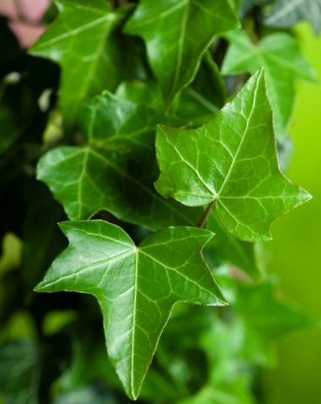
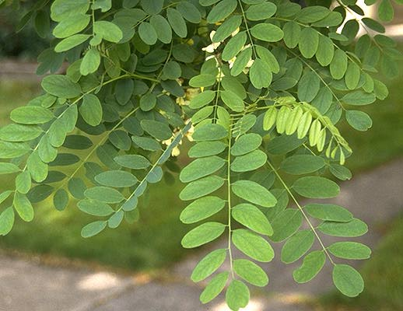
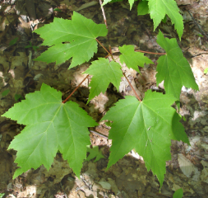
Plant Species
Pinus nigra (black pine)
Robinia pseudoacacia (black locust)
Hedera helix (common ivy)
Acer (maple)
Widespread occurrence
Good air filtration
Deciduous, evergreen conifer, climbing plants

Slide 24
Examined Parameters
Methods
PM (0.2-2.5, 2.5-10 and 10-100 µm)
1. deposited directly on the leaf surface
2. migrated to plant waxes
Trace elements – heavy metals (Cu, Fe, Mn…)
Microplastic on leaf surface
- filtration-weighing method
- XRF (X-ray fluorescence)
- FTIR

Slide 25
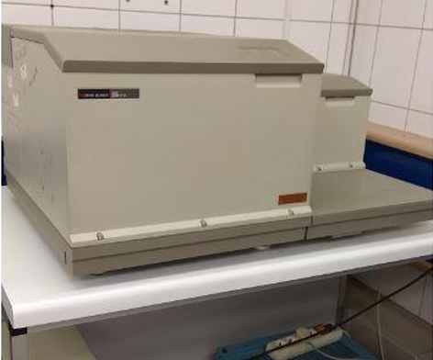
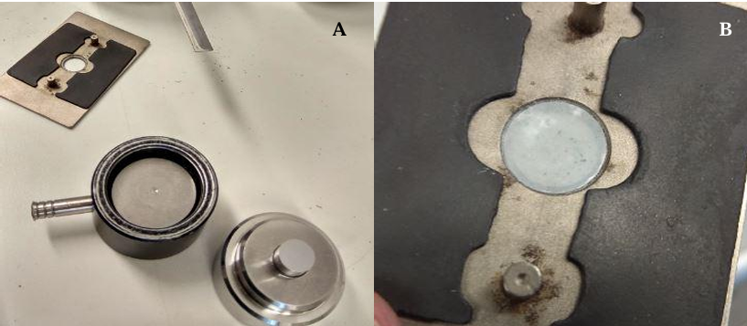
FTIR

Slide 26
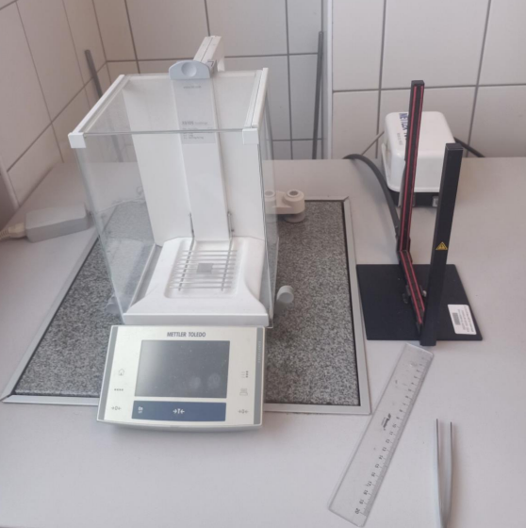
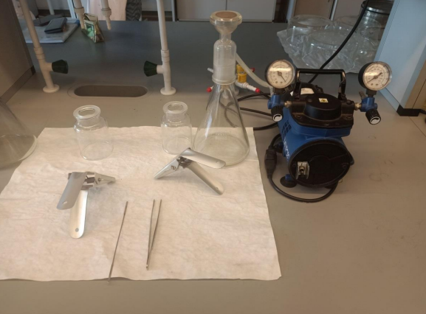
PM filtration-weighing method

Slide 27
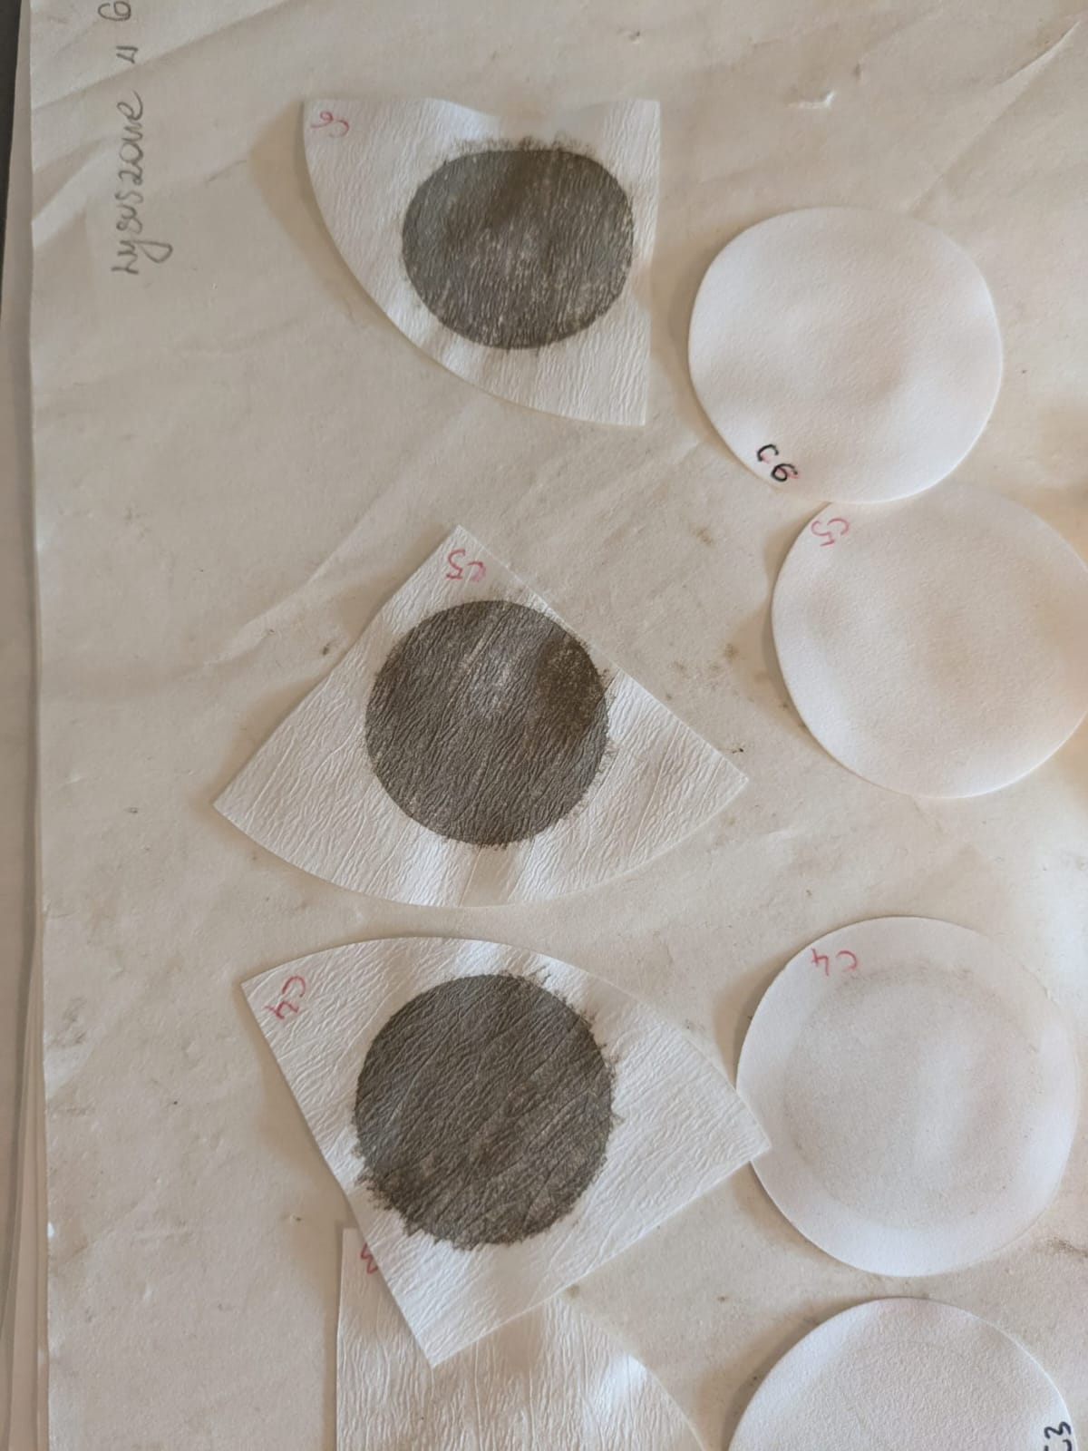
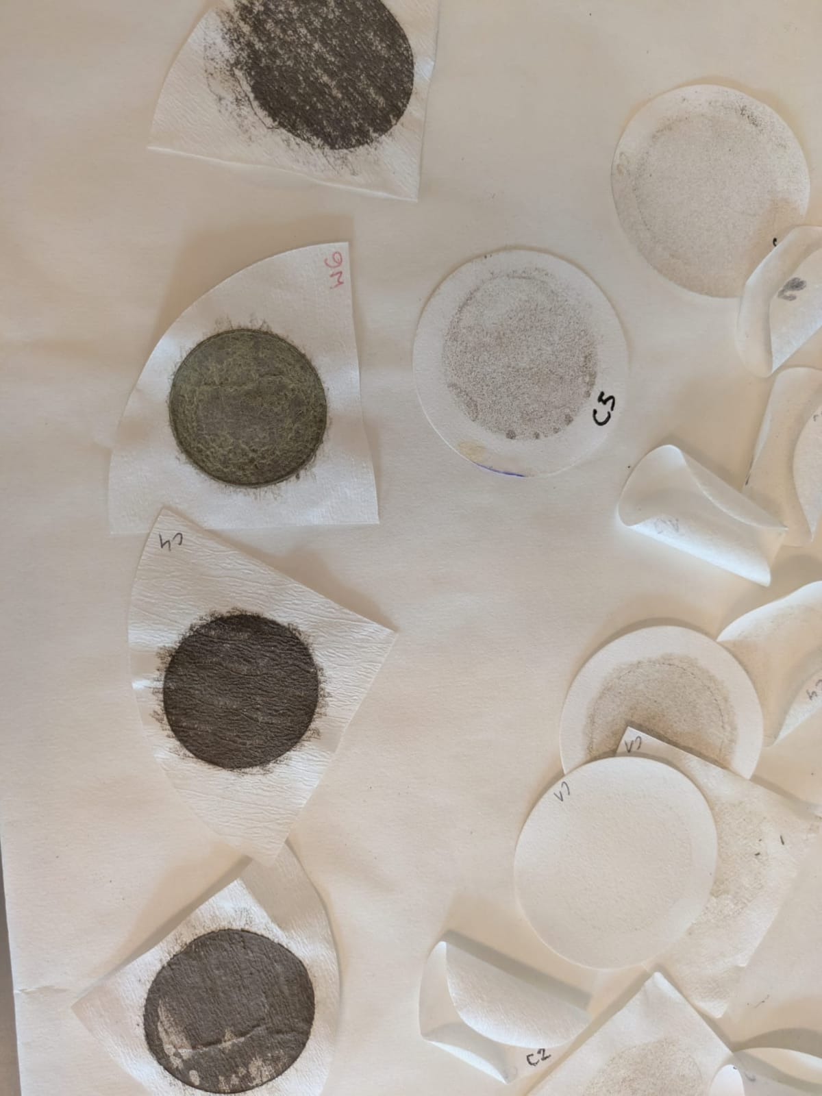

Slide 28
Thank you for attention!

Slide 29
Used Sources
Chen, Z. H., S. Y. Cheng, J. B. Li, X. R. Guo, W. H. Wang, and D. S. Chen. 2008. “Relationship between Atmospheric Pollution Processes and Synoptic Pressure Patterns in Northern China.” Atmospheric Environment 42 (24): 6078–6087.
Emekwuru, N., Nwabueze, and O. Ejohwomu. 2023. “Temperature, Humidity and Air Pollution Relationships during a Period of Rainy and Dry Seasons in Lagos, West Africa.” Climate 11 (5): 113
Hrnciar, Matus, Simona Bočková, Jan Chytrý, Jan Labohy, Roman Bohovic, Martin Skalsky, Marcela Cernochova, and Nini Toidze. 2023. Air Pollution in Georgia as Seen from Space. Prague-Tbilisi: Arnika - Citizens Support Centre
Karagulian, Federico, Claudio A. Belis, Carlos Francisco C. Dora, Annette M. Prüss-Ustün, Sophie Bonjour, Heather Adair-Rohani, and Markus Amann. 2015. “Contributions to Cities’ Ambient Particulate Matter (PM): A Systematic Review of Local Source Contributions at Global Level.” Atmospheric Environment 120: 475–483.
Kirkitadze, Darejan D. 2023. “Statistical Characteristics of Monthly Mean and Annual Concentrations of Particulate Matter PM2.5 and PM10 in Three Points of Tbilisi in 2017–2022.” Journals of Georgian Geophysical Society 26 (1).
Krittanawong C, Qadeer YK, Hayes RB, Wang Z, Thurston GD, Virani S, Lavie CJ. 2023. PM2.5 and cardiovascular diseases: State-of-the-Art review. International Journal of Cardiology Cardiovascular Risk and Prevention, Volume 19. Journal Article.
Kukhalashvili, V. G., M. G. Pipia, N. G. Gigauri, A. A. Surmava, and L. N. Intskirveli. 2022. “Study of Tbilisi City Atmosphere Pollution with PM2.5 and PM10-Microparticles During COVID-19 Pandemic Period.” Journals of Georgian Geophysical Society 25 (2).
Li, Xiaolan, Yanjun Ma, Yangfeng Wang, Ningwei Liu, and Ye Hong. 2017. “Temporal and Spatial Analyses of Particulate Matter (PM10 and PM2.5) and Its Relationship with Meteorological Parameters over an Urban City in Northeast China.” Atmospheric Research 198: 185–193.
Lou, C., H. Liu, Y. Li, Y. Wang, N. Liu, and Y. Hong. 2017. “Relationships of Relative Humidity with PM2.5 and PM10 in the Yangtze River Delta, China.” Environmental Monitoring and Assessment 189: 582.
Mandal, Mamun, Robert Popek, Arkadiusz Przybysz, Anamika Roy, Sujit Das, and Abhijit Sarkar. 2023. Breathing Fresh Air in the City: Implementing Avenue Trees as a Sustainable Solution to Reduce Particulate Pollution in Urban Agglomerations. Plants 12, no. 7: 1545.
Mandal, U. K., R. Popek, A. Przybysz, R. Singh, A. Roy, and S. Ghosh. 2022. “Not Only Trees Matter—Traffic-Related PM Accumulation by Vegetation Layers in Urban Forests.” Sustainability 14 (5): 2973.
Moreno, T., A. Karanasiou, F. Amato, F. Lucarelli, S. Nava, G. Calzolai, M. Chiari, E. Coz, B. Madrid Artíñano, J. Lumbreras, R. Borge, E. Boldo, C. Linares, A. Alastuey, X. Querol, and W. Gibbons. 2013. Daily and Hourly Sourcing of Metallic and Mineral Dust in Urban Air Contaminated by Traffic and Coal-Burning Emissions. Atmospheric Environment 68: 33–44.
Nguyen, M. V., G. H. Park, and B. K. Lee. 2017. “Correlation Analysis of Size-Resolved Airborne Particulate Matter with Classified Meteorological Conditions.” Meteorology and Atmospheric Physics 129: 35–46.
Polichetti, Giuliano, Stefania Cocco, Alessandra Spinali, Valentina Trimarco, and Alfredo Nunziata. 2009. “Effects of Particulate Matter (PM10, PM2.5 and PM1) on the Cardiovascular System.” Toxicology 261 (1–2): 1–8.
Putaud, J.-P., R. Van Dingenen, A. Alastuey, H. Bauer, W. Birmili, J. Cyrys, H. Flentje, S. Fuzzi, R. Gehrig, H. C. Hansson, and others. 2010. “A European Aerosol Phenomenology – 3: Physical and Chemical Characteristics of Particulate Matter from 60 Rural, Urban, and Kerbside Sites across Europe.” Atmospheric Environment 44 (10).
Sensirion AG. 2022. Datasheet SEN5x Environmental Sensor Node for HVAC and Air Quality Applications.
Tai, Amos P. K., Loretta J. Mickley, and Daniel J. Jacob. 2010. “Correlations between Fine Particulate Matter (PM2.5) and Meteorological Variables in the United States: Implications for the Sensitivity of PM2.5 to Climate Change.” Atmospheric Environment 44 (32): 3976–3984.
United States Environmental Protection Agency. 2026. “Particulate Matter (PM) Basics.” https://www.epa.gov/pm-pollution/particulate-matter-pm-basics (16.06.2026)
Wood, Simon N. 2017. Generalized Additive Models: An Introduction with R. 2nd ed. Boca Raton: Chapman and Hall/CRC.
Mandal, Mamun, Robert Popek, Arkadiusz Przybysz, Anamika Roy, Sujit Das, and Abhijit Sarkar. 2023. Breathing Fresh Air in the City: Implementing Avenue Trees as a Sustainable Solution to Reduce Particulate Pollution in Urban Agglomerations. Plants 12, no. 7: 1545.
World Health Organization. 2021. WHO Global Air Quality Guidelines: Particulate Matter (PM2.5 and PM10), Ozone, Nitrogen Dioxide, Sulfur Dioxide and Carbon Monoxide. Geneva: World Health Organization.
World Health Organization. Air Quality, Energy and Health: Type of Pollutants https://www.who.int/teams/environment-climate-change-and-health/air-quality-and-health/health-impacts/types-of-pollutants (1609.06.2026)
Krittanawong C, Qadeer YK, Hayes RB, Wang Z, Thurston GD, Virani S, Lavie CJ. 2023. PM2.5 and cardiovascular diseases: State-of-the-Art review. International Journal of Cardiology Cardiovascular Risk and Prevention, Volume 19. Journal Article.
Zender-Świercz, E., B. Galiszewska, M. Telejko, and M. Starzomska. 2024. The Effect of Temperature and Humidity of Air on the Concentration of Particulate Matter—PM2.5 and PM10. Atmospheric Research 312: 107733.

