Slide 1

Application of a Dual Chiral Selector CE-MS/MS Method to Forensic Toxicological Analysis of MDMA and Its Metabolites
Mariam Shubitidze
Prof. Bezhan Chankvetadze
Notes:
Good morning, everyone. Today I am presenting our research on a dual chiral selector capillary electrophoresis tandem mass spectrometry method for analyzing MDMA and its major metabolites.

Slide 2
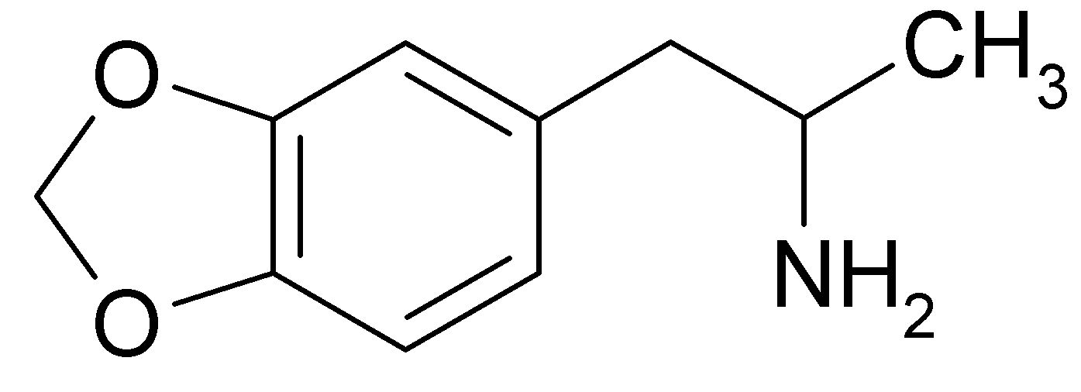
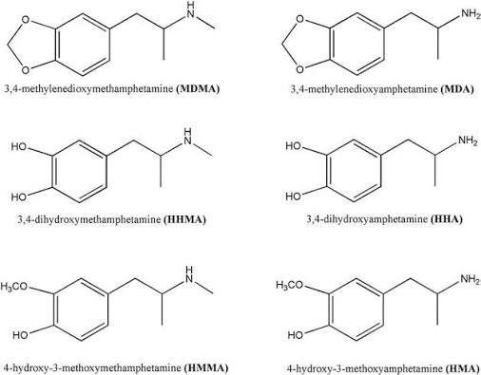
MDMA Metabolism & Chiral Complexity
Notes:
In forensic cases, measuring total MDMA concentration only gives half the picture. MDMA and its metabolites are chiral molecules, meaning their left- and right-handed enantiomers clear through the body at different rates. The main liver enzyme responsible for MDMA metabolism is stereoselective. Its active site physically fits S-MDMA better than R-MDMA, allowing it to break down S-MDMA much faster and leaving R-MDMA behind in higher concentrations. By measuring how this enantiomeric ratio shifts over time, toxicologists can estimate a critical piece of information: time-since-ingestion. Our goal was to build a fast, sensitive method to achieve baseline separation.

Slide 3
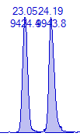
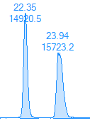


Baseline resolution of Enantiomers :
MDMA, MDA, HMA, HMMA
Segment filling
Filling with 0.5 mg/ml HS-b-CD (60% filling ) (1)
Filling with the 15mg/ml HS-y-CD (20% filling) (2)
HMMA
HMA
MDMA
MDA
Challenge: Preventing non-volatile chiral selectors from fouling the ESI source
Notes:
Achieving complete enantioseparation across MDMA and its metabolites is challenging. Initially, when we tested segment filling using a 60% plug of HS-beta-CD followed by a 20% plug of HS-gamma-CD, we only achieved baseline separation for the metabolites HMMA and HMA, while MDMA and MDA remained unseparated single peaks. We used cyclodextrins as chiral selectors because MDMA and its metabolites have no charge differences, so their bucket-like cavities are required to physically trap and separate the R- and S-enantiomers during electrophoresis

Slide 4


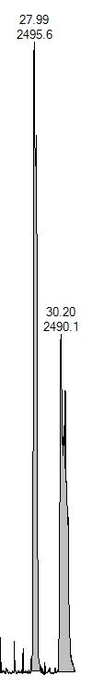
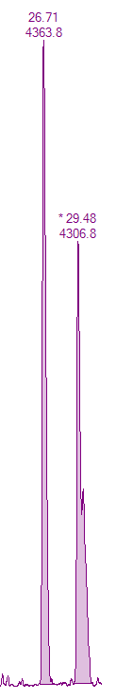
Dual-Selector System: Complete Enantioseparation
Segment filling
Filling with the 15mg/ml HS-y-CD (20% filling) (1)
Filling with 0.5 mg/ml HS-b-CD (60% filling ) (2)
HMMA
HMA
MDMA
MDA
Challenge: high total plug volume causes current fluctuations and risks ESI source fouling.
Notes:
However, simply reversing the injection order—yielded complete baseline enantioseparation across all four compounds. Beta-cyclodextrin has a smaller cavity of seven glucose units, which fits parent MDMA and MDA perfectly. Gamma-cyclodextrin, with eight units, has a wider cavity needed for bulkier metabolites like HMMA and HMA. When we filled 60% of the capillary with HS-beta-CD and 20% plug of HS-gamma-CD, we achieved complete baseline separation for all four peak pairs.Despite this separation success, filling 80% of the capillary with non-volatile chiral selectors created a major operational bottleneck: high total plug volume caused severe current fluctuations and posed a significant risk of fouling the mass spectrometer's ESI source.

Slide 5
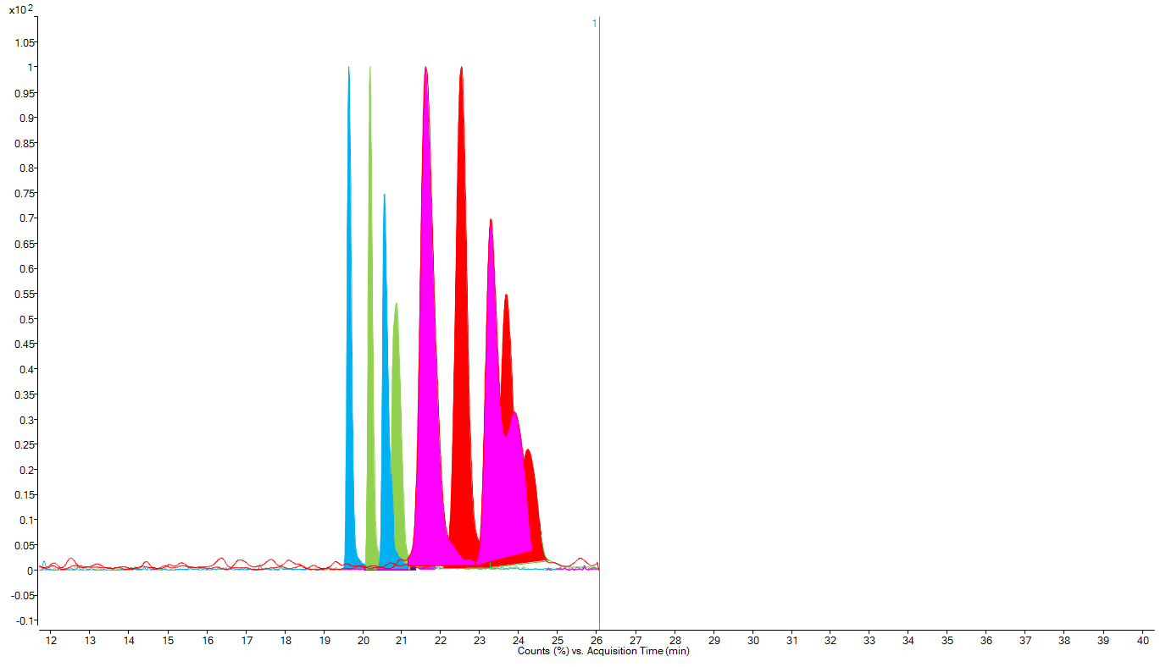
Method Optimization: Reduced Dual-Plug & MS Parameters
1.Filling with the 15mg/ml HS-y-CD (10% filling)
2.Filling with 0.5 mg/ml HS-b-CD (10% filling )
Notes:
To fix this, we drastically cut down the selector volume. We scaled down to a 10% plug of 15 mg/mL HS-gamma-CD and a 10% plug of 0.5 mg/mL HS-beta-CD. This reduced the total selector volume inside the capillary to just 20%. Even with these short plugs, the two selectors worked together as a team to maintain sharp, baseline-resolved double peaks for HMMA, HMA, MDA, and MDMA.

Slide 6
Instrumental Setup & Method Validation
Notes:
Because these small plugs migrate independently during electrophoresis, they never reach the mass spectrometer. This protects our instrument while giving us excellent quantitative linearity with R^2 values above 0.99.

Slide 7
R/S MDMA Oral Fluid Pharmacokinetiks
Time (h) | R-MDMA (ng/ml) | S-MDMA (ng/ml)
0 | 0 | 0
0.25 | 97.79266025 | 90.89688308
0.5 | 364.7432674 | 383.6803622
0.75 | 746.6097408 | 567.4964178
1 | 1808.623411 | 1448.133402
1.5 | 2236.202737 | 1504.147398
2 | 2257.028953 | 1675.647639
3 | 1445.999967 | 970.9697983
4 | 842.3515933 | 519.3696502
6 | 827.5049659 | 507.7879976
8 | 638.8026001 | 288.1388857
10 | 470.5996117 | 224.1695476
24 | 97.13768116 | 0
Time (h) | HMMA-I (ng/ml) | HMMA-II (ng/ml)
0 | 0 | 0
0.75 | 41.11733658 | 44.09190485
1 | 99.97941266 | 99.65461847
1.5 | 110.1329452 | 116.0488365
2 | 82.18037346 | 99.76788885
3 | 55.67593328 | 61.05489679
6 | 39.42186909 | 44.63377609
8 | <LOD | <LOD
10 | <LOD | <LOD
24 | <LOD | <LOD
0-4 Hours: Racemic disposition (R:S ≈ 1:1)
> 6 Hours: Enantiomeric drift due to faster clearance of S-MDMA
Notes:
Next, we analyzed patient oral fluid samples taken at different time points up to 24 hours. In the first 4 hours after taking MDMA, R- and S-enantiomers stay at near-equal 1-to-1 ratios, peaking around 800 ng/mL. However, after 6 hours, a clear enantiomeric drift occurs because the body clears S-MDMA much faster than R-MDMA. By 24 hours, R-MDMA remains at 97ng/mL in oral fluid, while S-MDMA drops to 0 ng/mL. Because oral fluid is easy and non-invasive to collect, watching this R-to-S ratio change gives a clear way to estimate time since ingestion.

Slide 8
R/S –MDMA Plasma Disposition & Enantiomeric Drift
Key Numbers
(R) | (S)
Tmax= 1 hour : 152.9 ng/mL | Tmax= 1 hour : 132.6 ng/mL
T= 24 hours : 19.2 ng/mL | T= 24 hours : 0 ng/mL
R/S Ratio Progression : (1.0 → 2.8)
Time (h) | R-MDMA (ng/ml) | S-MDMA (ng/ml)
0 | 0 | 0
1 | 152.920737 | 132.6550952
1.5 | 94.09310318 | 92.53297233
2 | 80.4230879 | 50.75716608
4 | 74.05407228 | 51.12369562
6 | 47.31454433 | 17.70570844
10 | 23.28034262 | 9.3165059
24 | 19.2002859 | 0
Notes:
Our matching patient plasma data confirmed the biological mechanism behind this shift. In plasma, both enantiomers peak at 1 hour post-dose. Over 24 hours, liver metabolism clears S-MDMA completely down to zero, while R-MDMA lingers at 19.2 ng/mL. When we plot the plasma R/S ratio over time, it forms a straight line rising from 1.0 at ingestion up to 2.8 at 24 hours. Proving that oral fluid directly reflects blood circulation validates non-invasive oral fluid testing for forensic time estimation.

Slide 9
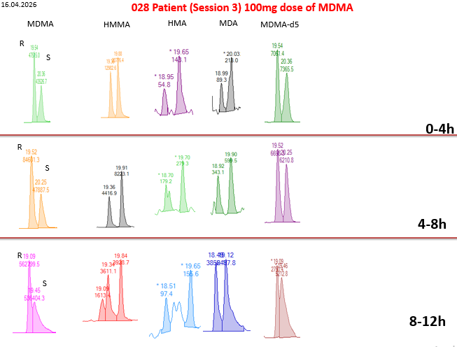
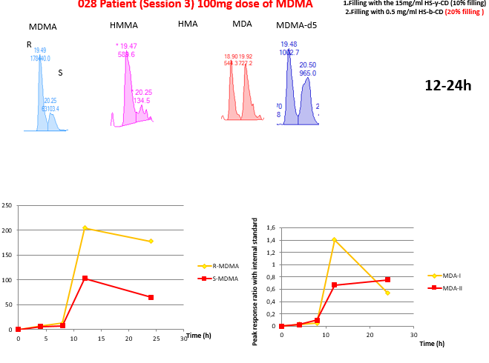
Urinary Enantiomeric Drift Over 24 Hours
Notes:
Looking at urinary excretion in Patient over 24 hours, our method maintains sharp baseline resolution for parent MDMA, its Phase-I metabolites, and the deuterated internal standard across all time blocks. We used deuterated MDMA as an internal standard because its identical chemical behavior ensures precise quantitation. It co-migrates with our target analytes to automatically correct for any minor signal loss or matrix effects in the mass spectrometer. In early collection windows, R- and S-MDMA peaks remain relatively balanced. However, in the 12 to 24-hour window, the R-MDMA peak is very high, while S-MDMA is at 63,000. As shown in the excretion curves at the bottom, total urinary elimination peaks between 8 and 12 hours post-dose, with R-MDMA consistently exceeding S-MDMA. This further confirms the faster systemic clearance of the S-enantiomer

Slide 10
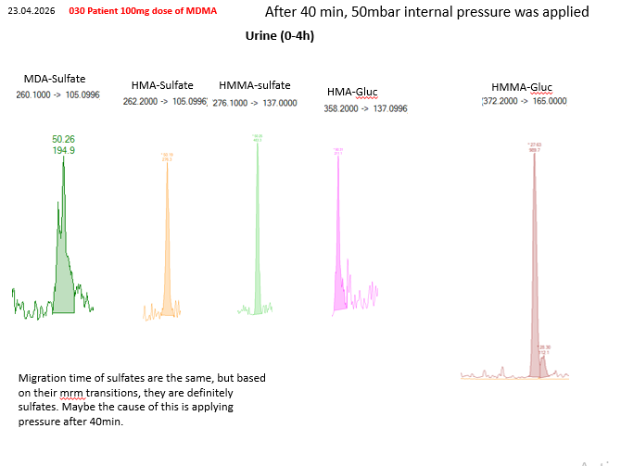
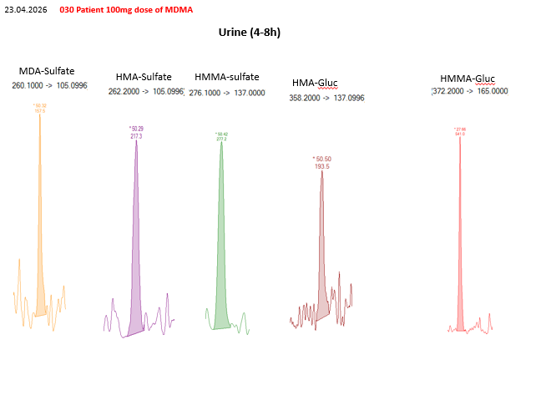
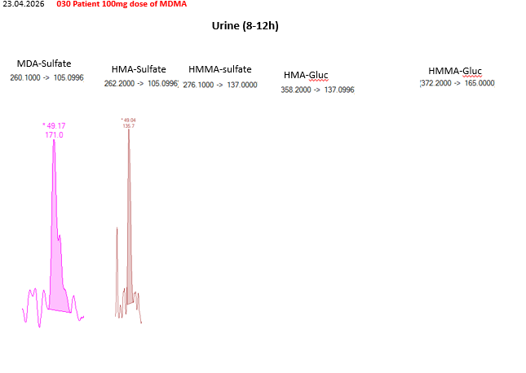
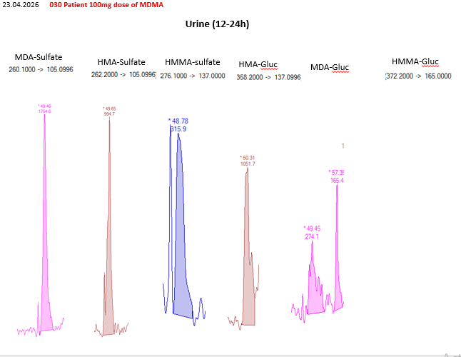
Direct Phase-II Conjugate Identification (Glucuronides & Sulfates)
Notes:
Finally, we looked at detecting Phase-II metabolites in urine directly, without enzymatic treatment. Standard workflows require hours of chemical treatment to break conjugates down before testing. Using our 10%/10% dual-plug setup, we set specific mass spec channels to detect intact conjugates directly. We successfully identified MDA-Sulfate, HMA-Sulfate, HMMA-Sulfate, HMA-Glucuronide, and HMMA-Glucuronide. Although the three sulfates co-migrated around 50 minutes because we applied internal pressure, their distinct mass channels allowed clear identification, saving hours of sample preparation time.

Slide 11
Thank You For Your Attention
Notes:
To wrap up, using 10% partial-filling plugs of HS-gamma-CD and HS-beta-CD gives us a fast, MS-friendly method that separates parent drug enantiomers, Phase-I metabolites, and intact Phase-II conjugates in one run.

