Slide 1



First Baseline Separation of Isotopomers by Capillary Electrophoresis
Prepared by: Nikoloz Gonitashvili
Ivane Javakhishvili Tbilisi State University
Supervisor: Academician Bezhan Chankvetadze

Slide 2
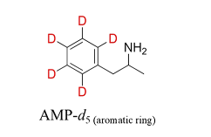
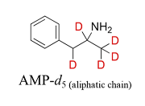
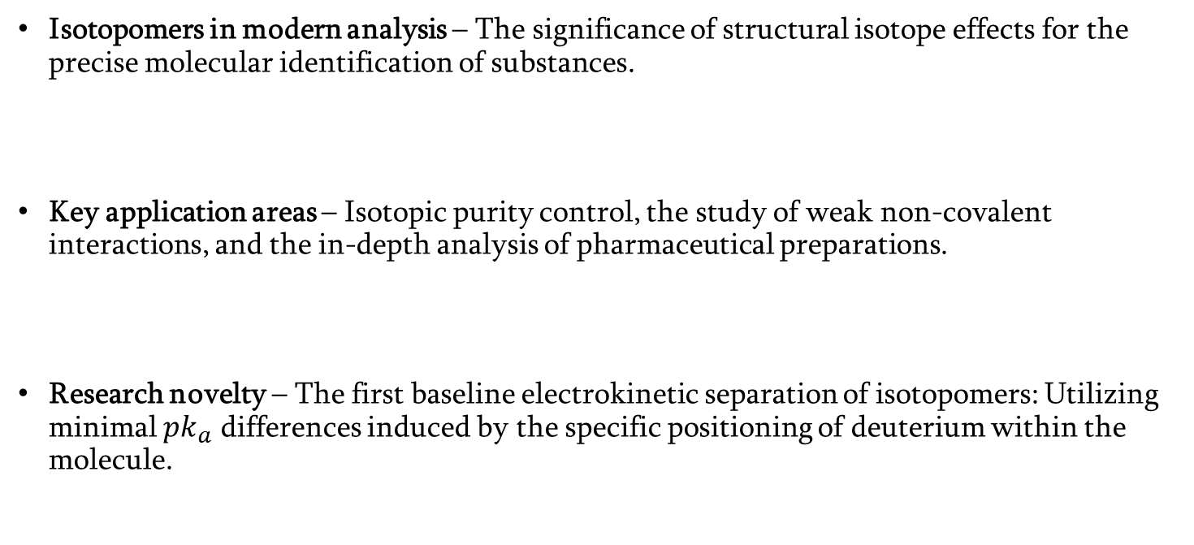
Research Relevance and Methodological Novelty
Isotopomers in modern analysis – The significance of structural isotope effects for the precise molecular identification of substances.
Key application areas – Isotopic purity control, the study of weak non-covalent interactions, and the in-depth analysis of pharmaceutical preparations.
Research novelty – The first baseline electrokinetic separation of isotopomers: Utilizing minimal $pk_{a}$ differences induced by the specific positioning of deuterium within the molecule.

Slide 3
Research Goals and Objectives
Investigation of the first baseline electrokinetic separation of isotopomers in capillary electrophoresis
Optimization of the separation environment: selecting the ideal pH range, buffer composition, and evaluating the impact of chiral/achiral additives.

Slide 4
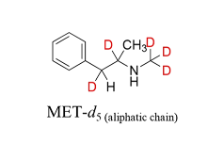
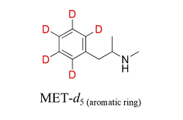
ISOTOPOMERS

Slide 5
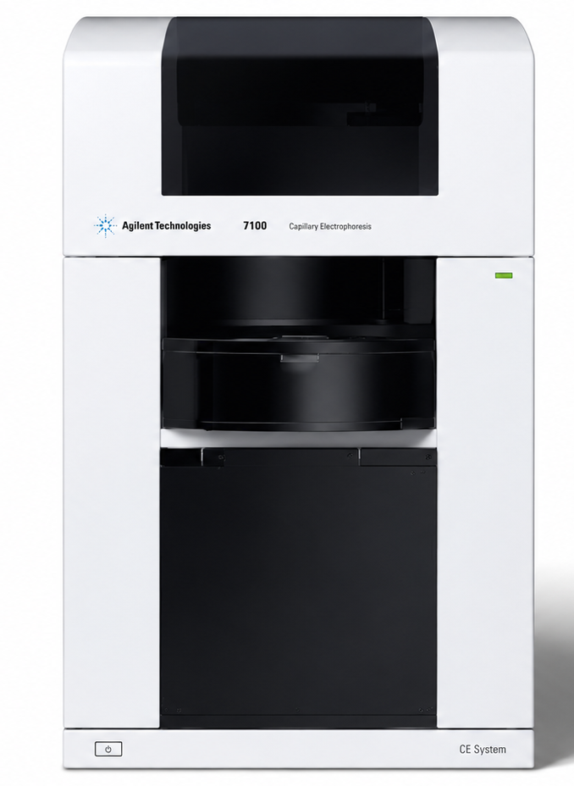
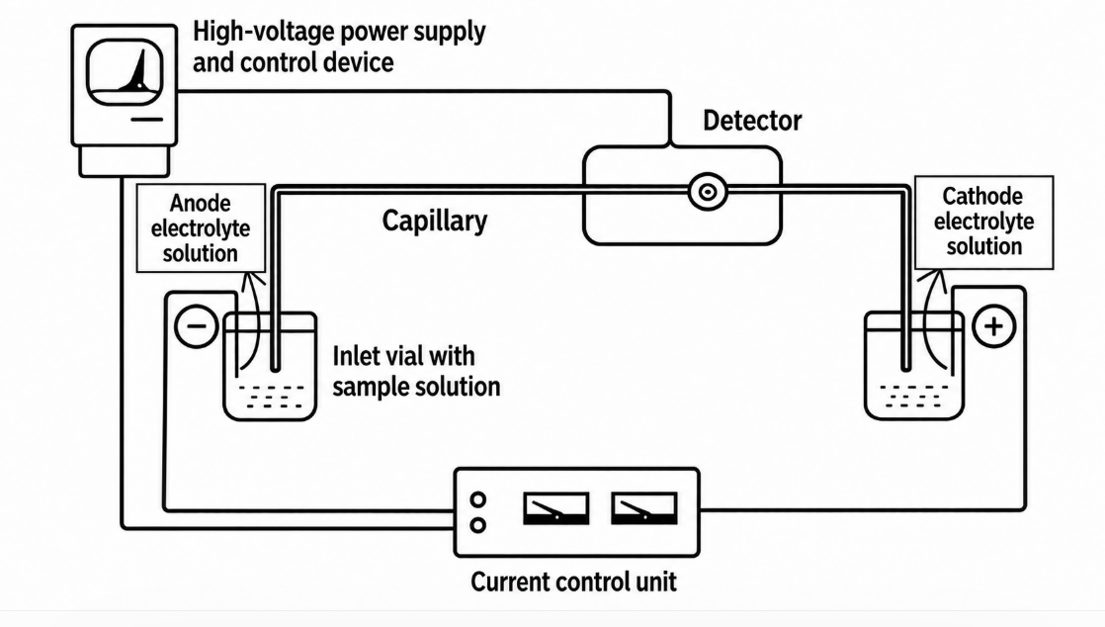
Capillary Electrophoresis Instrumentation
Agilent 7100 Capillary Electrophoresis with Diode-Array Detector (DAD)

Slide 6
Experimental Section
Capillary Electrophoresis Parameters:
  Capillary: Bare fused-silica; 50 μm I.D., 375 μm O.D.
  Length: 98.5 cm total length (90 cm effective length).
  Temperature: 15 °C.
  Voltage: +30 kV (Current: 65–70 μA).
  Injection: Electrokinetic injection (30 kV for 10 s).
  Detection: UV detection at 210 nm.
Optimized Buffer for Isotomers : 50 mM CHES buffer (pH 11.0).
Capillary Conditioning (Flushing):
  Methanol – 10 min
  Water – 5 min
  0.1 M NaOH – 10 min
  Water – 5 min
  Separation Buffer – 15 min
  Flushing Pressure: 1000 mbar.

Slide 7
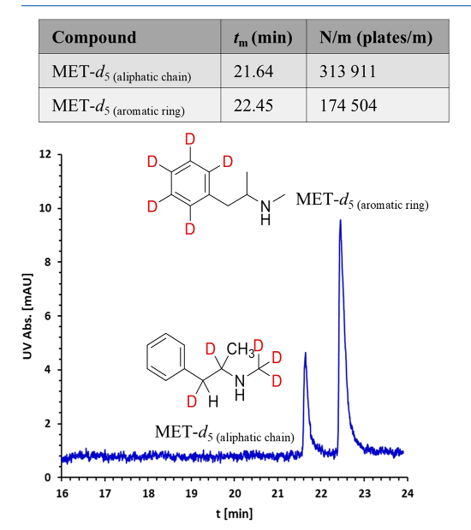
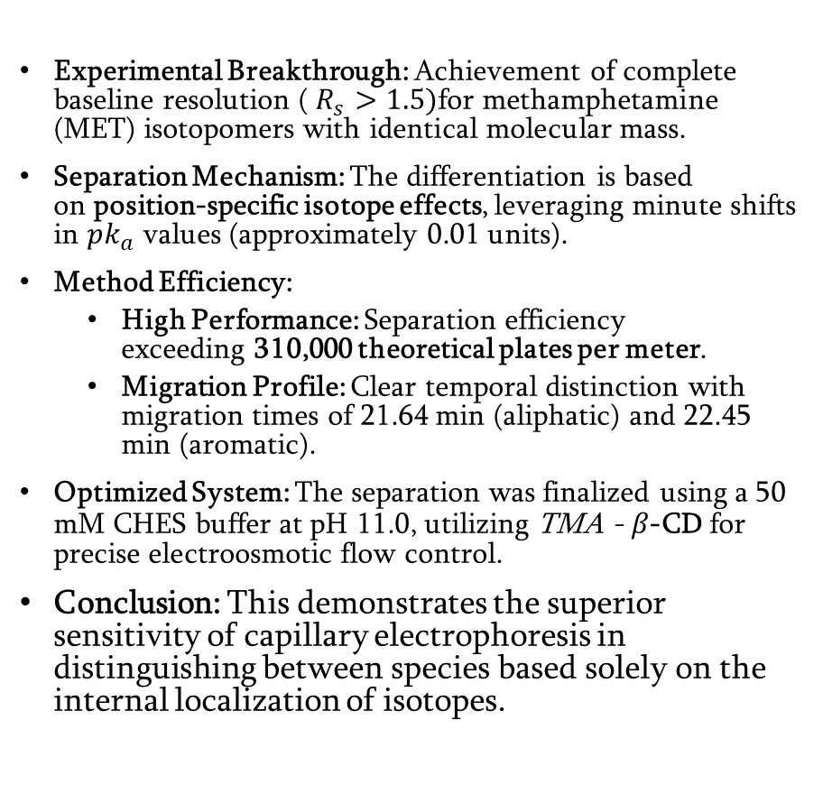
First Baseline Separation
Experimental Breakthrough: Achievement of complete baseline resolution ( $R_{s}>1.5)\text{for} \text{methamphetamine}\text{ (}\text{MET}\text{) }\text{isotopomers} \text{with} \text{identical} \text{molecular} \text{mass}\text{.}$
Separation Mechanism: The differentiation is based on position-specific isotope effects, leveraging minute shifts in $pk_{a}$ values (approximately 0.01 units).
Method Efficiency:
  High Performance: Separation efficiency exceeding 310,000 theoretical plates per meter.
  Migration Profile: Clear temporal distinction with migration times of 21.64 min (aliphatic) and 22.45 min (aromatic).
Optimized System: The separation was finalized using a 50 mM CHES buffer at pH 11.0, utilizing TMA - $β\text{−}\text{CD} \text{for} \text{precise} \text{electroosmotic} \text{flow} \text{control}\text{.}$
Conclusion: This demonstrates the superior sensitivity of capillary electrophoresis in distinguishing between species based solely on the internal localization of isotopes.

Slide 8
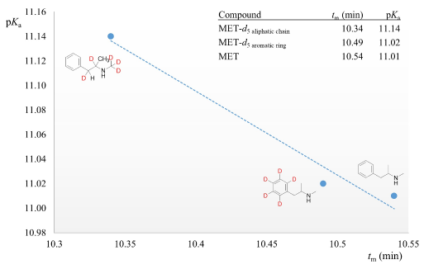

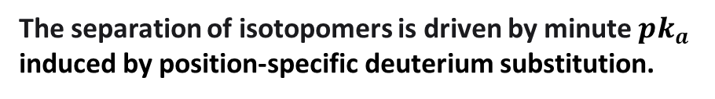
The Role of $pk_{a}$ in the Separation Mechanism
The separation of isotopomers is driven by minute $pk_{a}$ induced by position-specific deuterium substitution.
Deuterium atoms located on the aromatic ring increase basicity more significantly than those on the aliphatic chain, resulting in distinct migration profiles.
This isotopic $pk_{a}$ shift is effectively leveraged at an optimal pH of 11.0, where partial deprotonation creates the necessary difference in effective mobility.

Slide 9
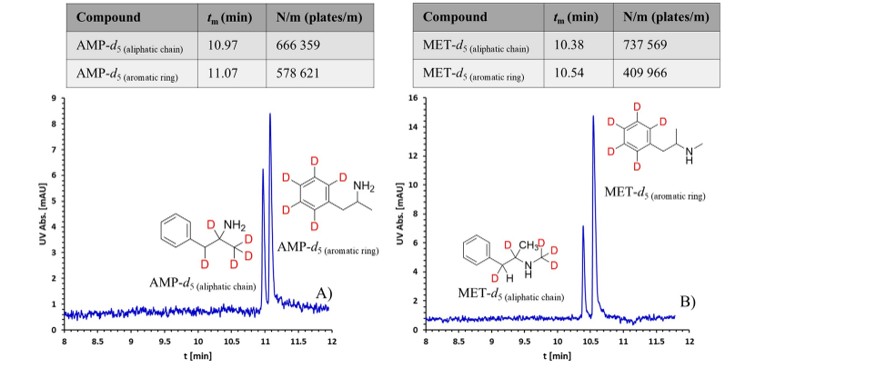
Electrophoretic separation of AMP and MET isotopomers
The capillary electrophoresis method provides sensitivity to $pk_{a}$ differences (0.01 units) comparable to advanced NMR spectroscopy, but requires one to two orders of magnitude less sample

Slide 10
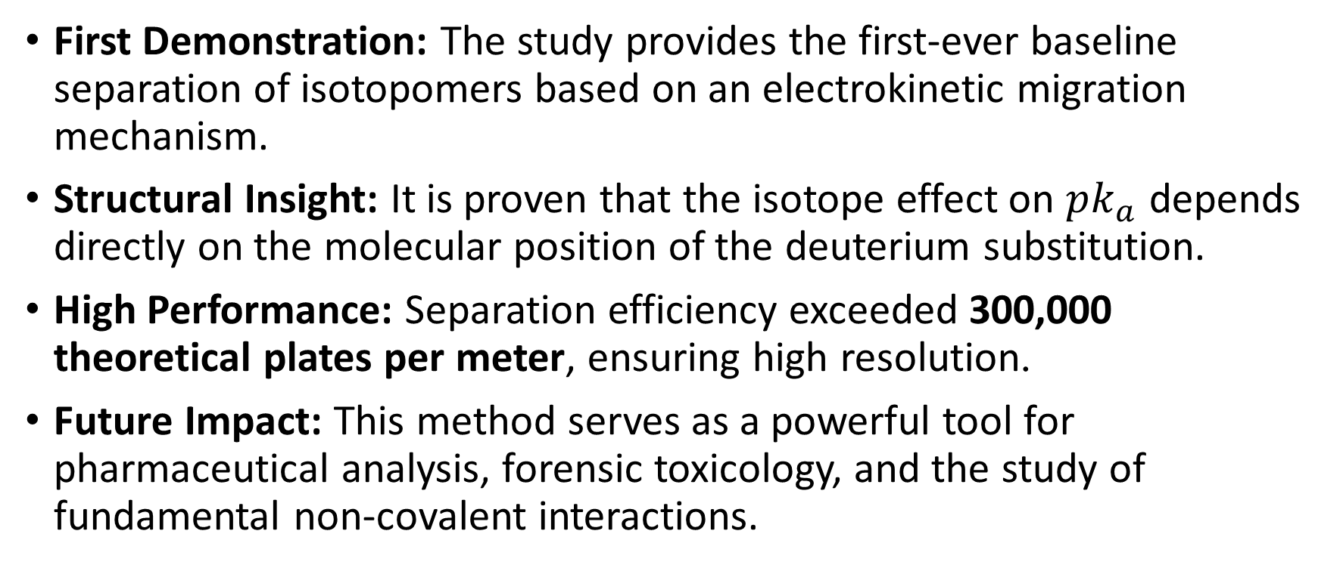
Conclusions
First Demonstration: The study provides the first-ever baseline separation of isotopomers based on an electrokinetic migration mechanism.
Structural Insight: It is proven that the isotope effect on $pk_{a}$ depends directly on the molecular position of the deuterium substitution.
High Performance: Separation efficiency exceeded 300,000 theoretical plates per meter, ensuring high resolution.
Future Impact: This method serves as a powerful tool for pharmaceutical analysis, forensic toxicology, and the study of fundamental non-covalent interactions.

Slide 11
Thank you for your attention

