Slide 1



Separation of Deuterated Isotopologues by Capillary Electrophoresis
Prepared by : Ana Kuntchulia
Ivane Javakhishvili Tbilisi State University
Supervisor: Academician Bezhan Chankvetadze

Slide 2
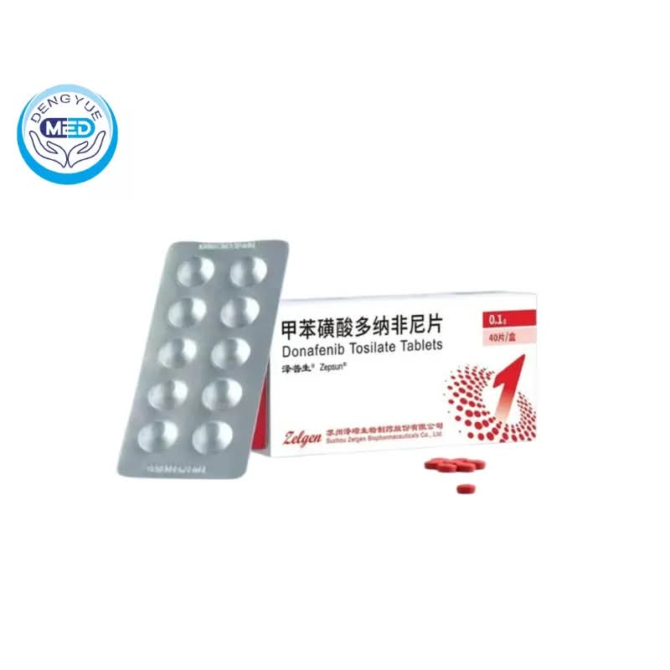
Relevance of the Research and Methodological Novelty
Isotopologues in Modern Analysis: Their Applications in Pharmaceutical and Biomedical Research
Key Areas of Application: Pharmacokinetics of Deuterated Drugs, Biomedical Diagnostics, and Doping Control
Research Novelty: Electrokinetic Separation of Isotopologues – Demonstrating Method Efficiency Using Weak Base Compounds

Slide 3
Research Aims and Objectives
Investigation of the electrokinetic separation of weak-base isotopologues in capillary electrophoresis.
Optimization of the pH range and buffer systems, and evaluation of the impact of additives.

Slide 4
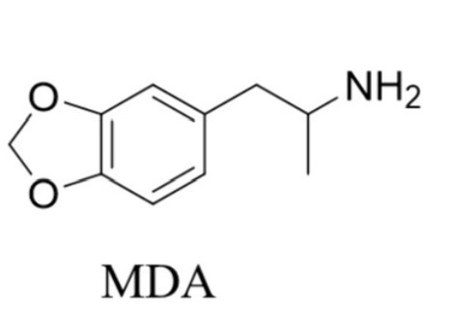
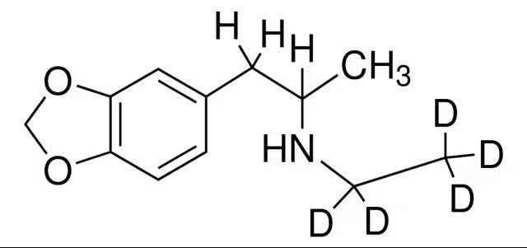
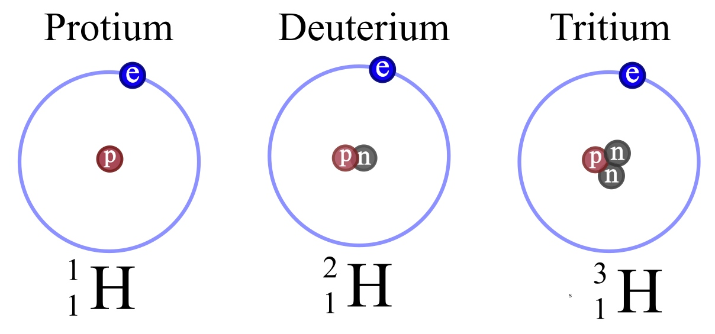
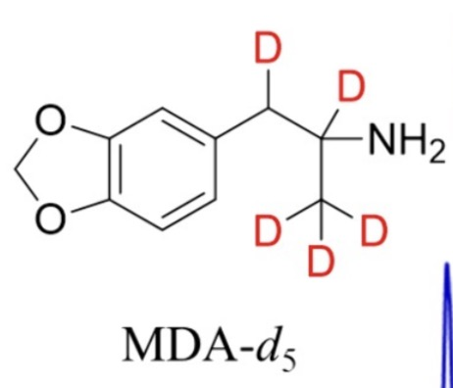
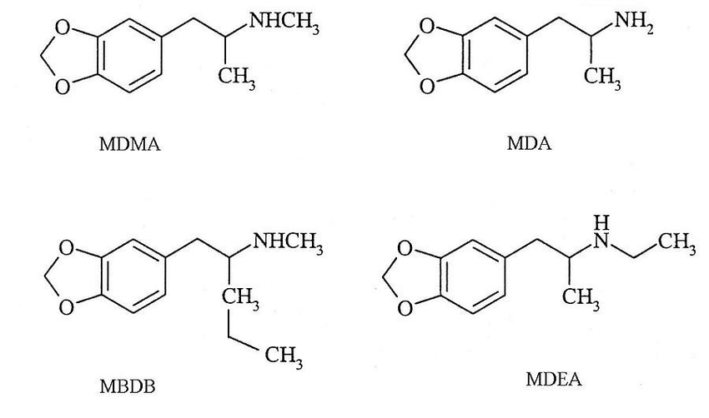
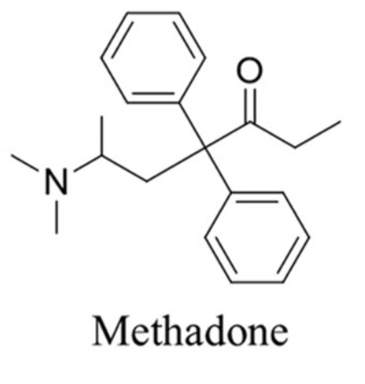
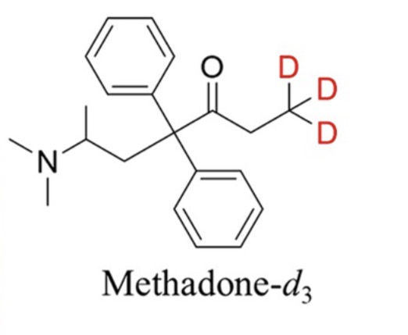
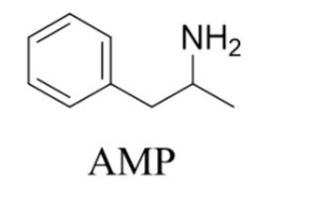
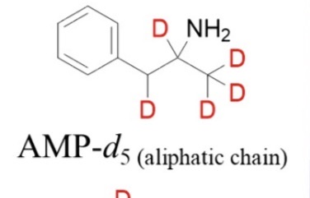
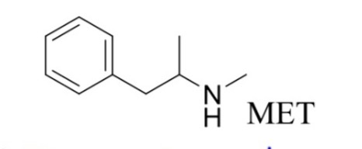
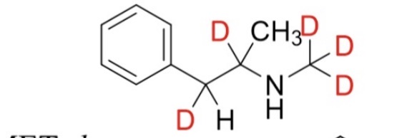
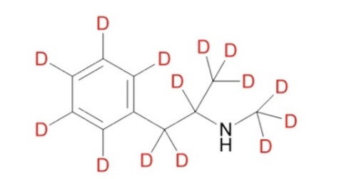
Isotopes and Isotopologues
3,4-Methylenedioxyamphetamine (MDA)
3,4-Methylenedioxyamphetamine-d5 (MDA-d5)
3,4-Methylenedioxyamphetamine-d5 (MDA-d5)
3,4-Methylenedioxymethamphetamine-d5 (MDMA-d5)
Methamphetamine-d5
Methamphetamine-d14

Slide 5
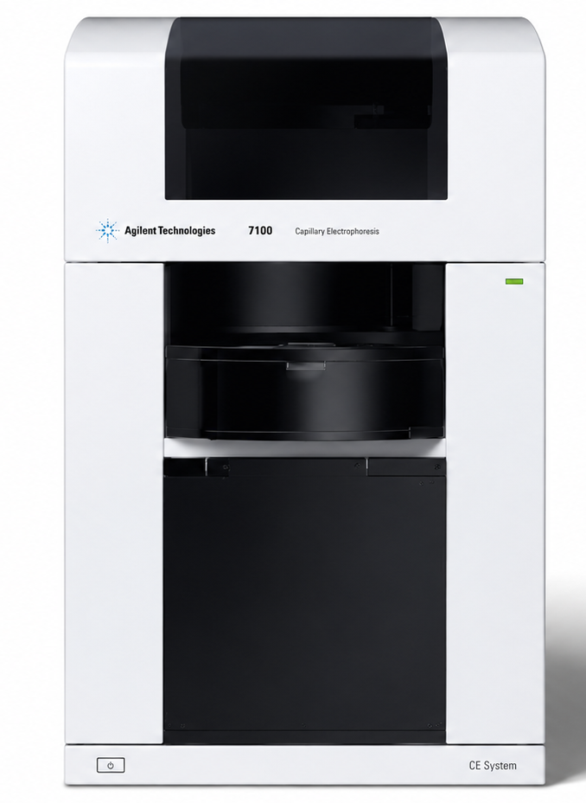
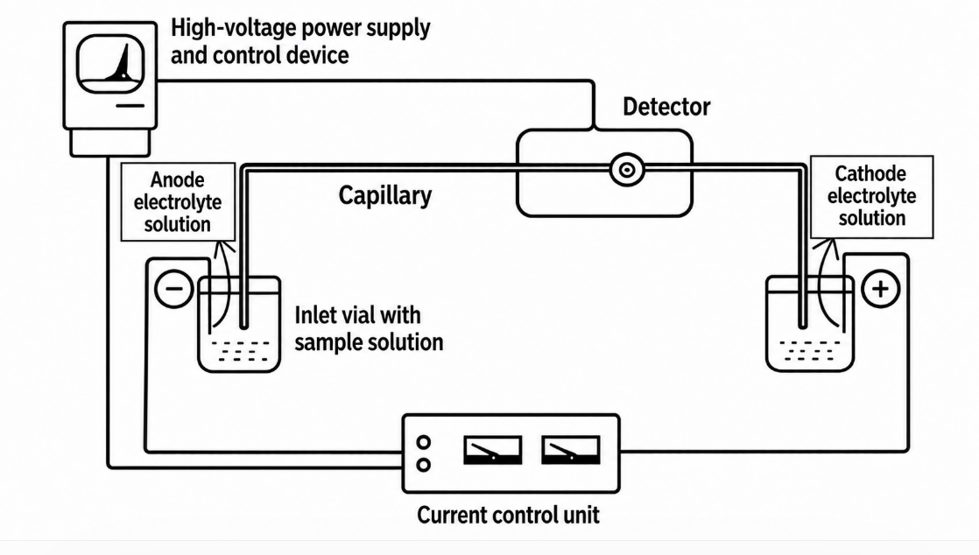
Capillary Electrophoresis Instrumentation
Agilent 7100 Capillary Electrophoresis with Diode-Array Detector (DAD)

Slide 6
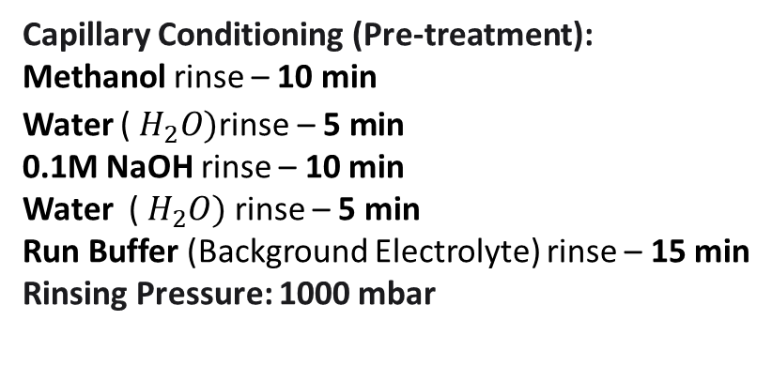
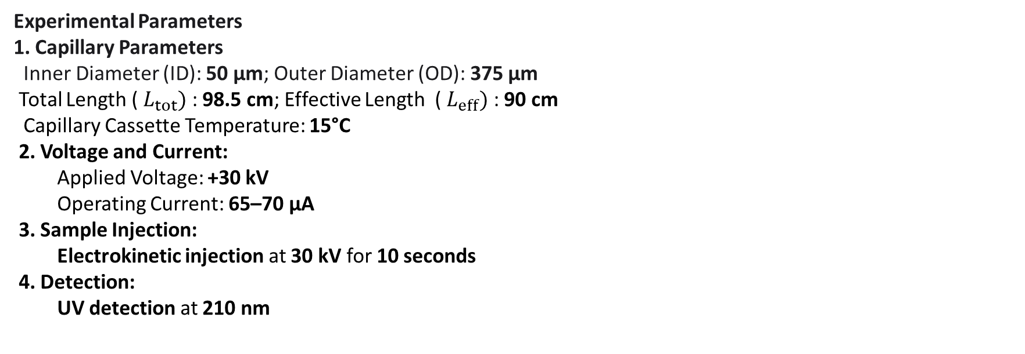
Experimental Section
Experimental Parameters
1. Capillary Parameters
Inner Diameter (ID): 50 μm; Outer Diameter (OD): 375 μm
Total Length ( $L_{tot})$ : 98.5 cm; Effective Length ( $L_{eff})$ : 90 cm
Capillary Cassette Temperature: 15°C
2. Voltage and Current:
  Applied Voltage: +30 kV
  Operating Current: 65–70 μA
3. Sample Injection:
  Electrokinetic injection at 30 kV for 10 seconds
4. Detection:
  UV detection at 210 nm
Capillary Conditioning (Pre-treatment):
Methanol rinse – 10 min
Water ( $H_{2}O)\text{rinse}\text{ – }\text{5 }\text{min}$
0.1M NaOH rinse – 10 min
Water ( $H_{2}O)$ rinse – 5 min
Run Buffer (Background Electrolyte) rinse – 15 min
Rinsing Pressure: 1000 mbar

Slide 7
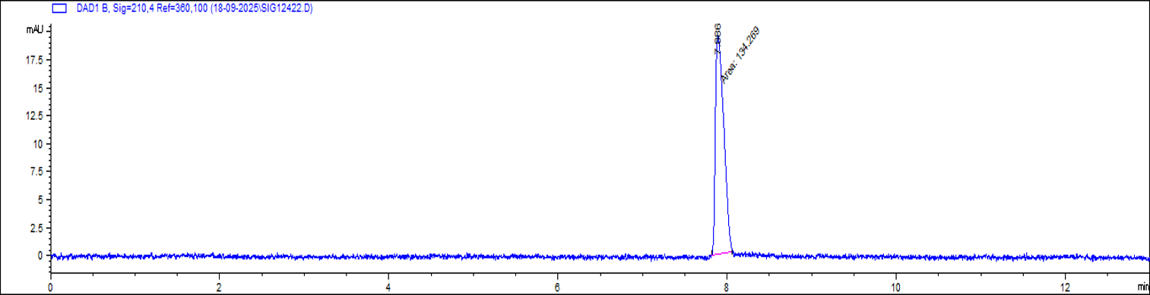
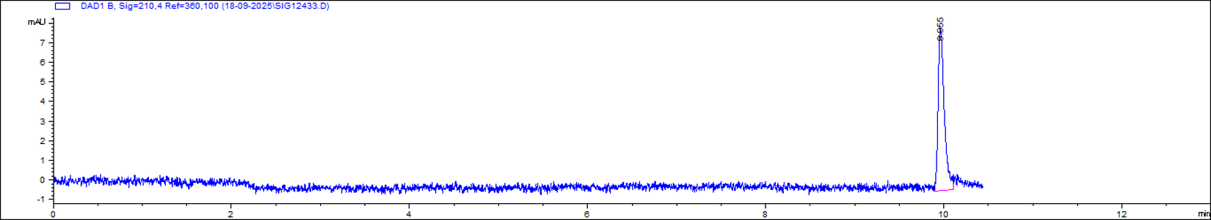
Results and Discussion
Migration time (t) minutes | Number of theoretical plates (N)
7,886 min | 26634
pH 4.8
Amphetamine, amphetamine-d5
Migration time (t) minutes | Number of theoretical plates (N)
9,995 | 120494
pH 4.8
Methamphetamine,Methamphetamine-d5

Slide 8
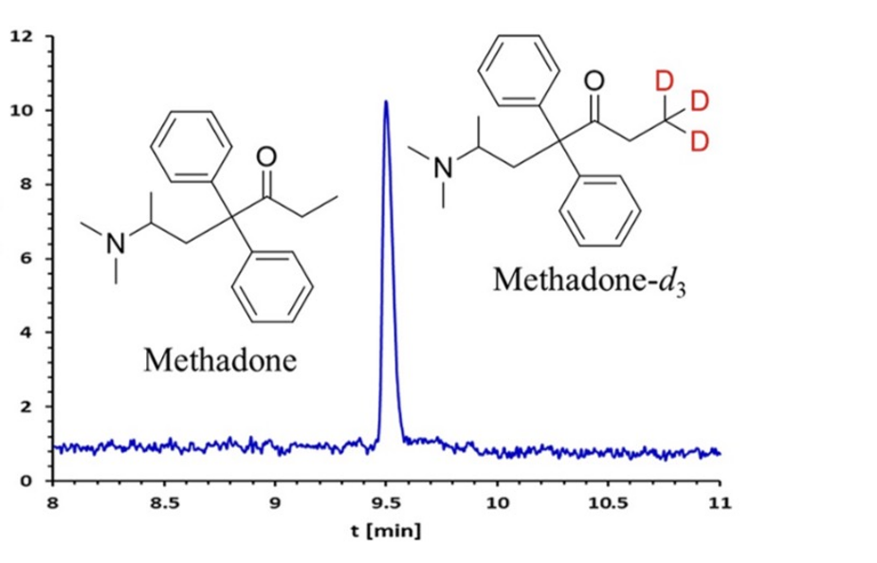
Attempt to separate methadone and methadone-D3
Migration time (t) minutes | Number of theoretical plates (N)
9,50 | 225 556

Slide 9
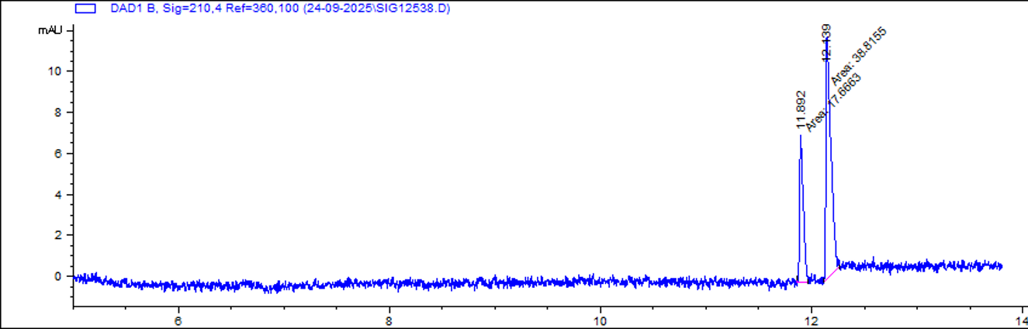
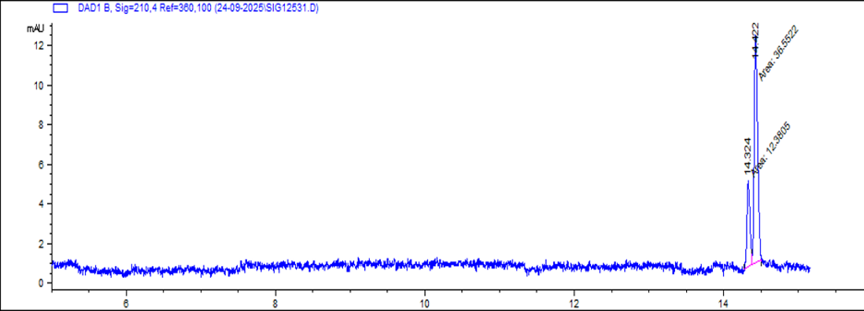
Role of acid-base equilibrium in separation (pKa)
Migration time (t) minutes | Number of theoretical plates (N) | Resolution Rs
11,892 | 521 2791 | 3.21
pH 11.72
12, 139 | 304 046
Migration time (t) minutes | Number of theoretical plates (N) | Resolution Rs
14.324 | 568 314 | 1.21
14.422 | 445 944
pH 11.72

Slide 10
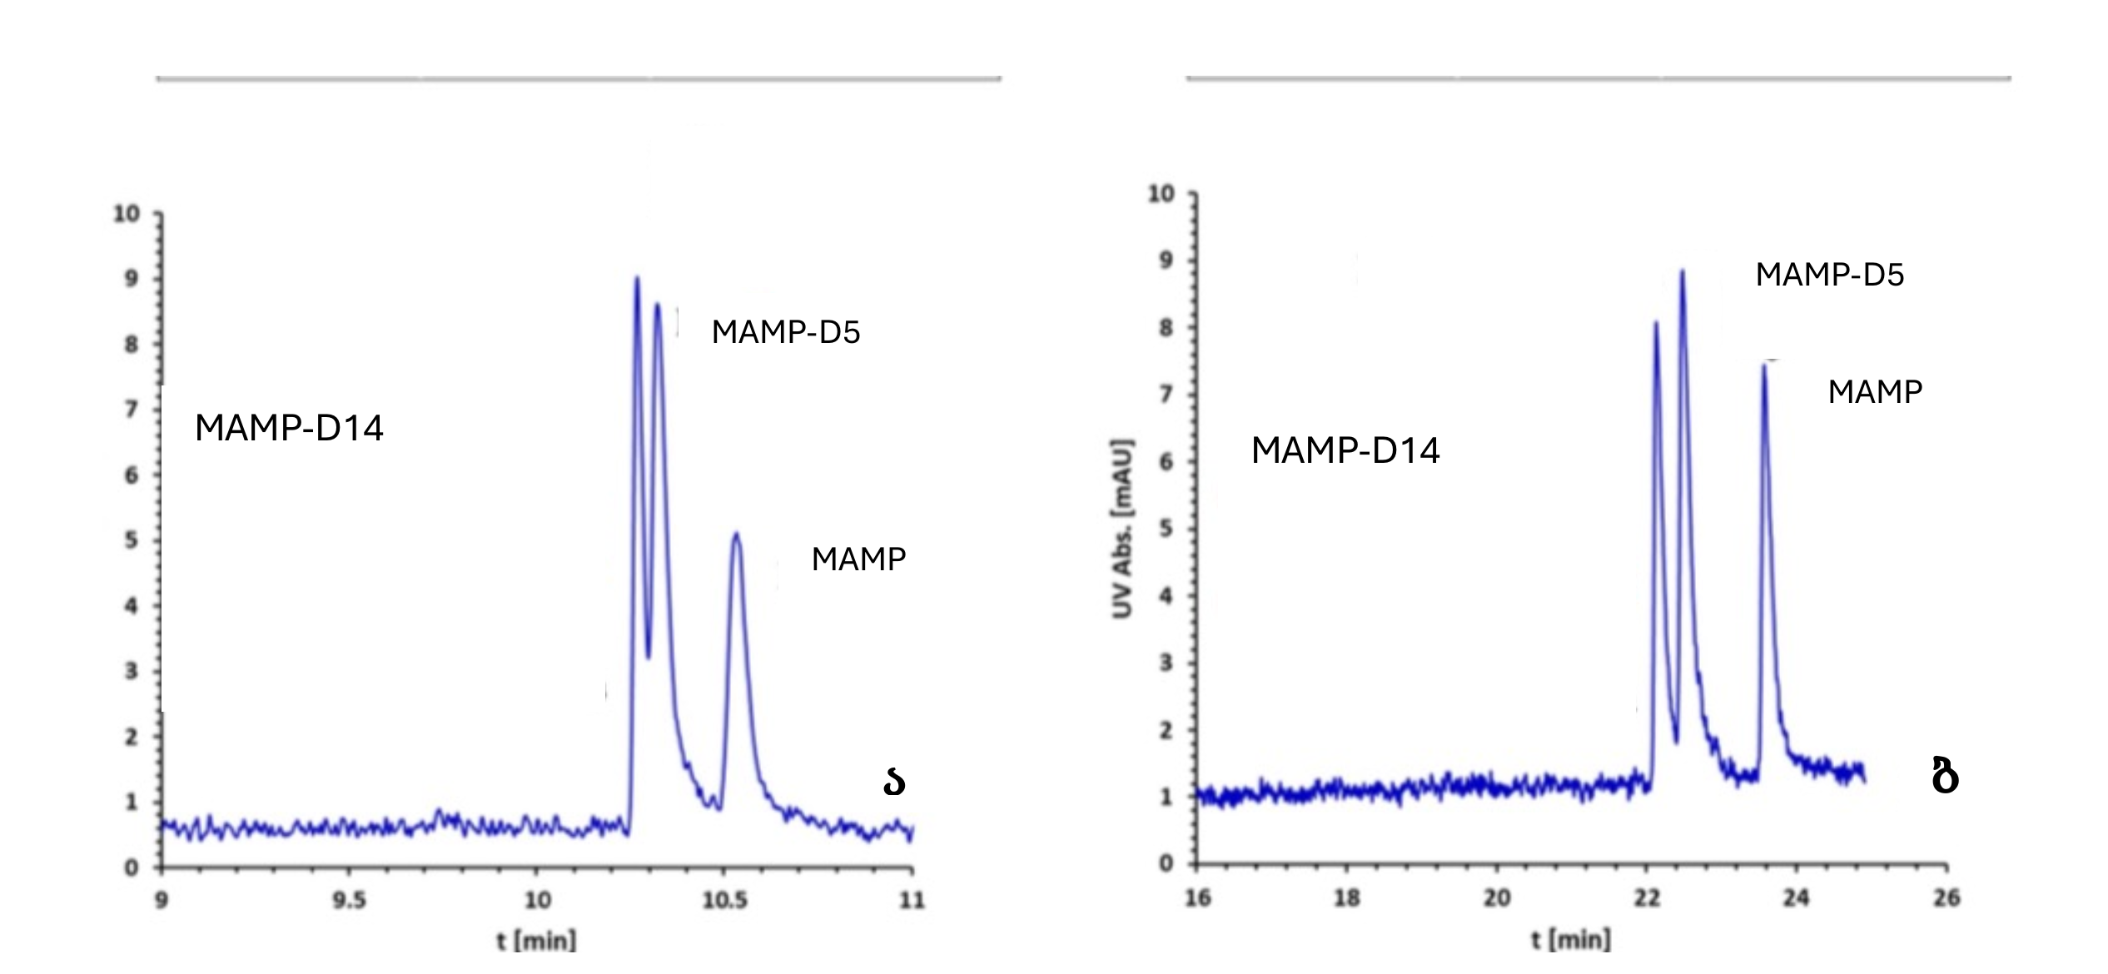

Study of the addition of TMA-β-CD
Borate buffer 50 mM, pH 11.0
Borate buffer + 0.025 mg·m$L^{−1}\text{TMA}\text{−}\text{β}\text{−}\text{CD}$
Migration time (t) minutes | Number of theoretical plates (N) | Resolution (Rs)
10.26 | 857 493 | 0,9
10.32 | 387 623 | 2,63
10.52 | 262 096
Migration time (t) minutes | Number of theoretical plates (N) | Resolution (Rs)
20.12 | 192 814 | 1,55
22.47 | 264 360 | 4,74
23.56 | 189 891

Slide 11
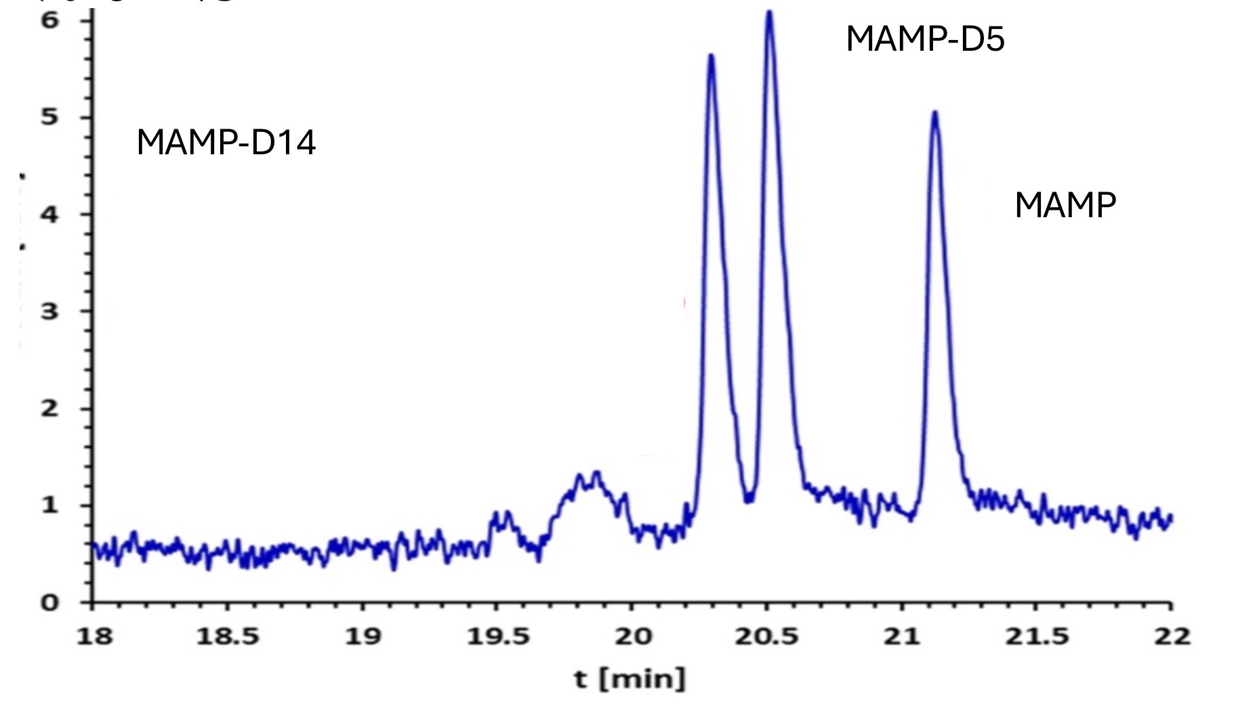
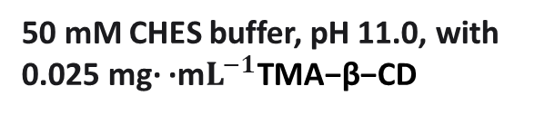
Study of the use of CHES buffer
Migration time (t) minutes | Number of theoretical plates (N) | Resolution (Rs)
20.29 | 476 459 | 1.71
20.50 | 475 561 | 4.83
21.12 | 467 088
50 mM CHES buffer, pH 11.0, with 0.025 mg· ·m$L^{−1}\text{TMA}\text{−}\text{β}\text{−}\text{CD}$

Slide 12
Conclusion
Capillary electrophoresis allows for the reliable estimation of very small differences in pKa.
It has been shown that under standard capillary electrophoresis conditions, with appropriate optimization (electroosmotic flow, pH), the separation of isotopologues is possible.
Thus, capillary electrophoresis is an effective and sensitive tool for studying isotope effects and detecting minute differences in pKa.

Slide 13
Thank you for your attention

