Slide 1
ENVIRONMENTAL RESEARCH
Environmental Quality Assessment of Soils and Waters
Through Heavy Metal Analysis Using MP-AES:
A Case Study from Selected Areas of Western Georgia
Researchers:
Ana Gabedava & Nino Takaishvili

Slide 2
Research Aim and Context
02
Two Related Environmental Datasets
Assessment of the main chemical parameters of soils and waters in Ozurgeti Municipality and identification of elements of concern
Main Objective
Water
10 water samples from Ozurgeti Municipality — river, spring, well, and sulfur water
Analysis
Soil
10 soil samples from Ozurgeti Municipality, collected from different locations and 0–30 / 30–60 cm layers
Physicochemical parameters, heavy metals, and major elements
2

Slide 3
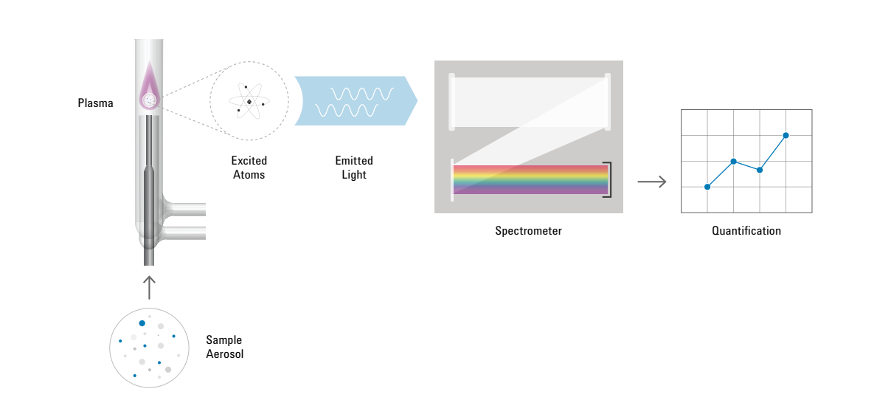
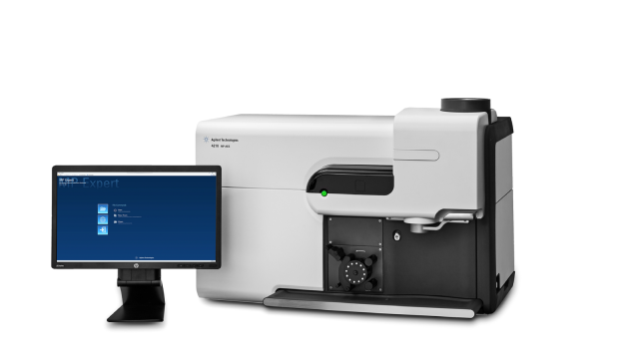
03
Agilent 4210 MP-AES
The analytical core of the study
Microwave Plasma–Atomic Emission Spectroscopy
Why it matters in this study
Multi-Element quantitative analysis
Safety
Simplicity
High sensitivity
Environmental samples → quantitative elemental data
3

Slide 4
04
Spatial Overview of Soil Samples
Sample locations, depth and sampling time
№ | Location | Depth | Date
1 | Ozurgeti, vegetable garden | 0–30 cm | 2025 May
2 | Ozurgeti, vegetable garden | 30–60 cm | 2025 March
3 | Ozurgeti, cornfield | 0–30 cm | 2025 March
4 | Ozurgeti, cornfield | 30–60 cm | 2025 March
5 | Ozurgeti, Hazelnut orchard | 0–30 cm | 2025 March
6 | Ozurgeti, Hazelnut orchard | 30–60 cm | 2025 March
7 | Village Meria, Hazelnut orchard | 0–30 cm | 2025 March
8 | Village Meria, Hazelnut orchard | 30–60 cm | 2025 March
9 | Village Likhаuri, Citrus orchard | 0–30 cm | 2025 March
10 | Village Likhаuri, Citrus orchard | 30–60 cm | 2025 March
10 samples • 5 main locations • two depth layers
4

Slide 5
05
Soil Parameters
Moisture, pH and CaCO₃
№ | Moisture % | pH | CaCO₃ mg/g
1 | 8.90 | 6.90 | 14.40
2 | 9.45 | 6.65 | 12.20
3 | 8.17 | 6.57 | 10.30
4 | 9.13 | 6.52 | 10.70
5 | 7.94 | 6.48 | 10.90
6 | 7.95 | 6.65 | 12.10
7 | 5.32 | 6.75 | 8.70
8 | 5.45 | 6.54 | 10.10
9 | 7.75 | 6.83 | —
10 | 6.91 | 6.53 | 10.00
Mean pH
6.64
Mean moisture
7.70 %
pH range
6.48–6.90
CaCO3
1.0-1.4 %
5

Slide 6
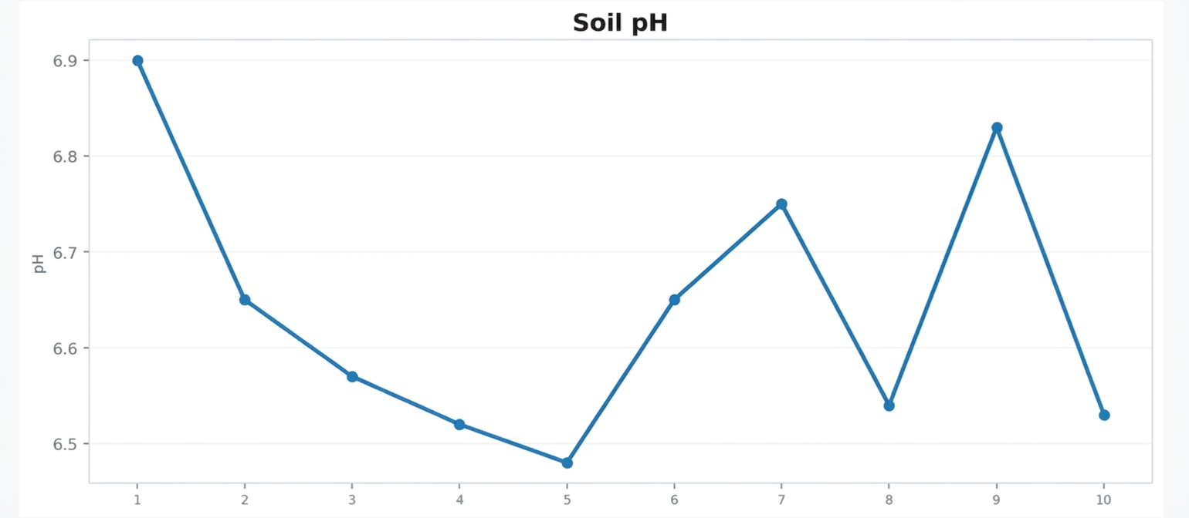
06
Soil pH
Comparison of pH among samples
Interpretation: slightly acidic / nearly neutral reaction
pH ranges from 6.5–6.9 in all samples
6

Slide 7
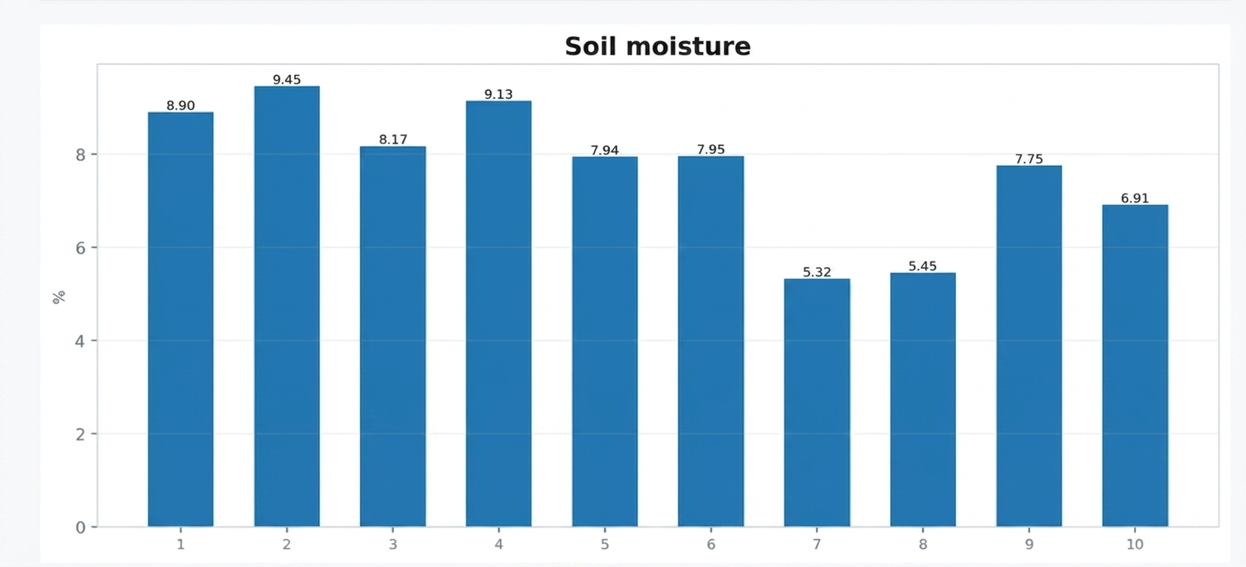
07
Soil Moisture
Variation in moisture among samples
Maximum: Sample 2 — 9.45 %
Minimum: Sample 7 — 5.32 %
7
OZURGETI • ENVIRONMENTAL RESEARCH

Slide 8
08
Heavy Metals in Soil
MP-AES analysis results, mg/kg, g/kg
№ | mg/kg |  |  |  |  |  |  |  | g/kg
 | Cd | Pb | Zn | Cu | Ni | Cr | Sb | Mn | Fe
1 | * | 47.00 | 194.9 | 177 | 5.00 | 112 | 69 | 1117 | 75.10
2 | 1.00 | 16.00 | 150.2 | 116 | 10.00 | 115 | 78 | 984 | 78.50
3 | * | 56.00 | 125.7 | 66 | 6.00 | 114 | 69 | 939 | 79.70
4 | * | * | 107.6 | 65 | 9.00 | 132 | 76 | 990 | 82.00
5 | * | 16.00 | 143.0 | 75 | 8.00 | 112 | 63 | 1047 | 82.30
6 | 1.00 | * | 101.0 | 56 | 12.00 | 121 | 76 | 945 | 90.40
7 | * | * | 86.10 | 57 | * | 125 | 53 | 642 | 95.40
8 | * | * | 76.60 | 53 | * | 120 | 66 | 753 | 90.90
9 | 1.00 | * | 131.6 | 105 | * | 115 | 49 | 850 | 91.50
10 | 1.00 | * | 84.60 | 72 | * | 89 | 62 | 580 | 42.50
MPC (pH<7) | 1-1.5 | 50 | 150-200 | 150 | 100 | 65 | 4 | 2500
PLC (pH>6.5) | 0.4-0.5 | 40-50 | 80-150 | 60-80 | 60-80 | 50-60 | 2-4 | 1200-1300
* < DL (Below Detection Limit)
8

Slide 9
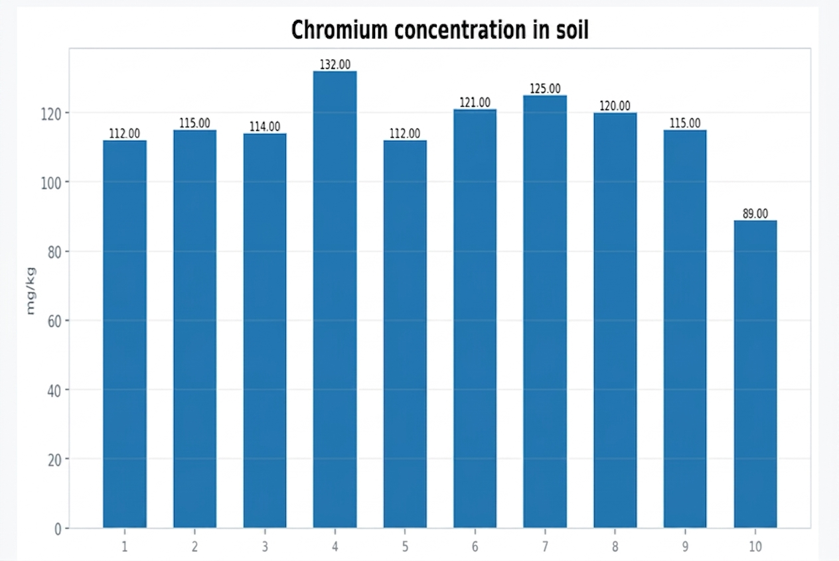
09
Spatial Variation of Chromium (Cr)
One of the most notable indicators in the soil dataset
Highest value
132 mg/kg
sample 4
Mean
115.5 mg/kg
Minimum
89.0 mg/kg
sample 10
9

Slide 10
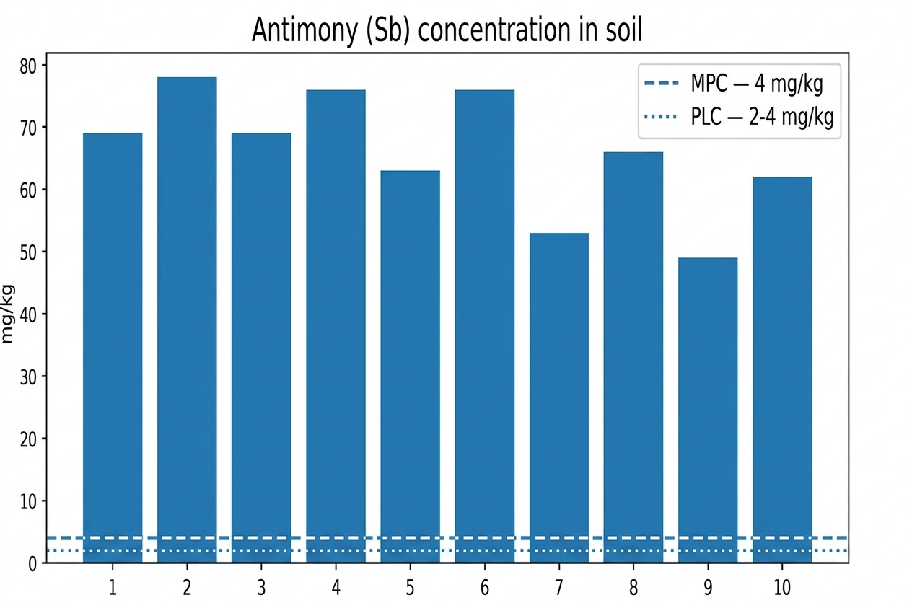
10
Antimony (Sb) — One of the Main Findings of the Study
KEY
Location | Sb in soil mg/kg | Sb in water mg/L
Likhаuri | 49 (0–30 cm) 62 (30–60 cm) | 0.15
Meria | 53 (0–30 cm) 66 (30–60 cm) | 0.08
Ozurgeti | 63 (0–30 cm) 78 (30–60 cm) | 0.10
KEY FINDING
49-78 mg/kg
Exceedance: 12–20 times the MPC
10

Slide 11
11
Major Elements in Soil
Li, K, Na, Ca and Mg — quantitative comparison
№ | mg/kg
 | Li | K | Na | Ca | Mg
1 | 9 | 3547 | 3120 | 4709 | 9142
2 | 12 | 3422 | 1900 | 989 | 5104
3 | 14 | 3635 | 2330 | 870 | 4809
4 | 8 | 3262 | 2610 | 2795 | 10259
5 | 9 | 3288 | 1940 | 3512 | 10479
6 | 9 | 3215 | 1980 | 3308 | 9673
7 | 7 | 2929 | 2070 | 3378 | 9895
8 | 8 | 3025 | 2140 | 2754 | 10519
9 | 9 | 3764 | 1860 | 2741 | 10571
10 | 8 | 3622 | 1490 | 2727 | 10562
Ca and Mg values show particularly pronounced differences among samples
11

Slide 12
12
Key Findings from Soil Analysis
Main conclusions from the numerical data
01
pH
6.5–6.9
02
Moisture
Slightly higher in some deeper layers
5.32–9.45 %
03
Cr
High concentration, mean 115 mg/kg
04
Fe
High mass concentration
Range 4.2-9.5 %
05
Sb
Exceedance: 12–20 times the MPC
12

Slide 13
13
Water Samples
Different types of water in Ozurgeti Municipality
№ | Water type | Date
1 | Village Likhаuri, Achi River | 31.10.2025
2 | Village Konkchati, spring water | 31.10.2025
3 | Village Vakijvari, well water | 31.10.2025
4 | Village Silauri, spring water | 31.10.2025
5 | Village Tkhinvali, sulfur water | 31.10.2025
6 | Village Chanieti, well water | 31.10.2025
7 | Village Bakhvi, well water | 31.10.2025
8 | Village Makvaneti, spring water | 02.11.2025
9 | Village Meria, spring water | 31.10.2025
10 | City Ozurgeti, well water | 01.11.2025
River • Spring • Well • Sulfur water
13

Slide 14
14
Key Water Parameters
pH, total and temporary hardness
№ | pH | Total hardness mg-eq/L | Temporary hardness mg-eq/L | Class
1 | 7.68 | 0.63 | 0.56 | Soft
2 | 7.21 | 4.08 | 3.72 | Hard
3 | 6.81 | 0.71 | 0.76 | Soft
4 | 7.52 | 5.0 | 2.6 | Hard
5 | 7.75 | 0.43 | 0.96 | Soft
6 | 6.11 | 0.38 | 0.32 | Soft
7 | 5.82 | 0.36 | 0.36 | Soft
8 | 6.28 | 0.31 | 0.32 | Soft
9 | 6.71 | 1.4 | 1.44 | Soft
10 | 7.0 | 0.99 | 0.64 | Soft
MPC | 6-9 | 7-10 | -
Soft water: 8 / 10 sample
Hard water: 2 / 10 sample
Mean pH 6.89
14

Slide 15
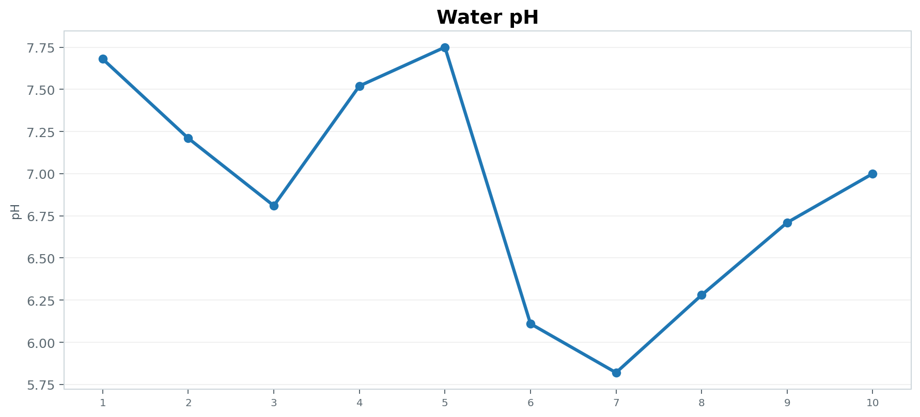
15
Water pH Profile
Comparison of acid-base reaction among samples
Minimum pH: 5.82 (Sample 7) • Maximum pH: 7.75 (Sample 5)
15

Slide 16
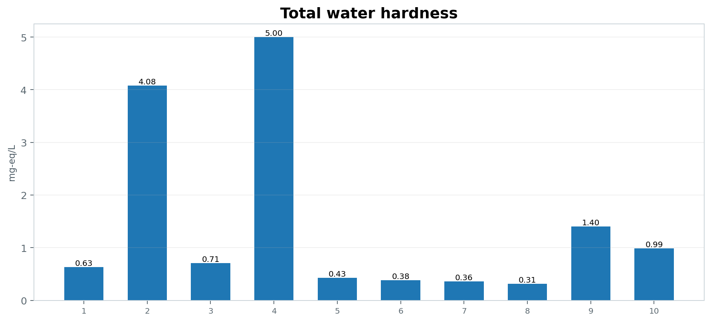
16
Total Water Hardness
Comparison of hardness values across all samples
Highest total hardness: 5.00 mg-eq/L — Sample 4
16

Slide 17
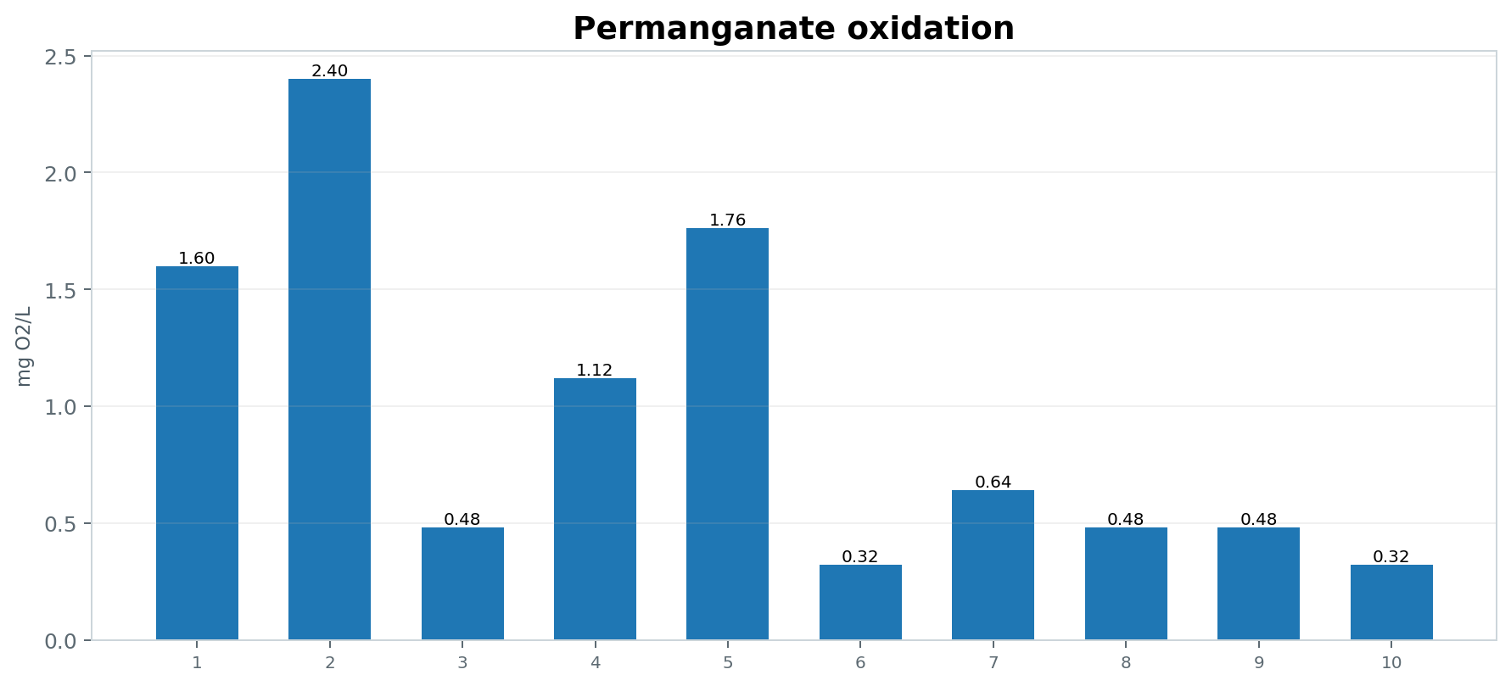
17
Permanganate Oxidation
Comparison of oxidation values among water samples
All samples are below the MPC of 3.0 mg O₂/L.
17

Slide 18
18
Heavy Metals in Water
MP-AES — complete concentration table
№ | mg/L
 | Cd | Pb | Zn | Cr | Cu | Mn | Fe | Sb | Co | Ni
1 | * | * | * | * | * | * | 0.03 | 0.15 | 0.01 | *
2 | * | 0.03 | * | * | 0.01 | * | 0.08 | 0.16 | 0.03 | 0.02
3 | * | * | * | * | 0.01 | * | 0.02 | 0.13 | 0.03 | *
4 | * | 0.01 | * | * | 0.01 | * | 0.02 | 0.07 | 0.01 | 0.01
5 | * | 0.03 | * | * | 0.01 | * | 0.04 | 0.15 | 0.01 | 0.01
6 | * | * | * | * | * | 0.09 | 0.04 | 0.11 | 0.02 | 0.01
7 | * | * | 0.01 | * | 0.01 | 0.03 | 0.42 | 0.10 | 0.02 | 0.01
8 | * | * | * | * | 0.01 | 0.01 | 0.11 | 0.09 | 0.03 | 0.01
9 | * | * | * | * | 0.01 | * | 0.03 | 0.08 | 0.02 | 0.01
10 | * | * | * | * | 0.01 | * | 0.04 | 0.10 | 0.03 | *
MPC | 0.003 | 0.01 | 3 | 0.05 | 1 | 0.5 | 0.3 | 0.02 | - | 0.02
WHO | 0.003 | 0.01 | 3 | 0.05 | 2 | 0.08 | 0.3 | - | - | 0.07
* < DL (Below Detection Limit)
18

Slide 19
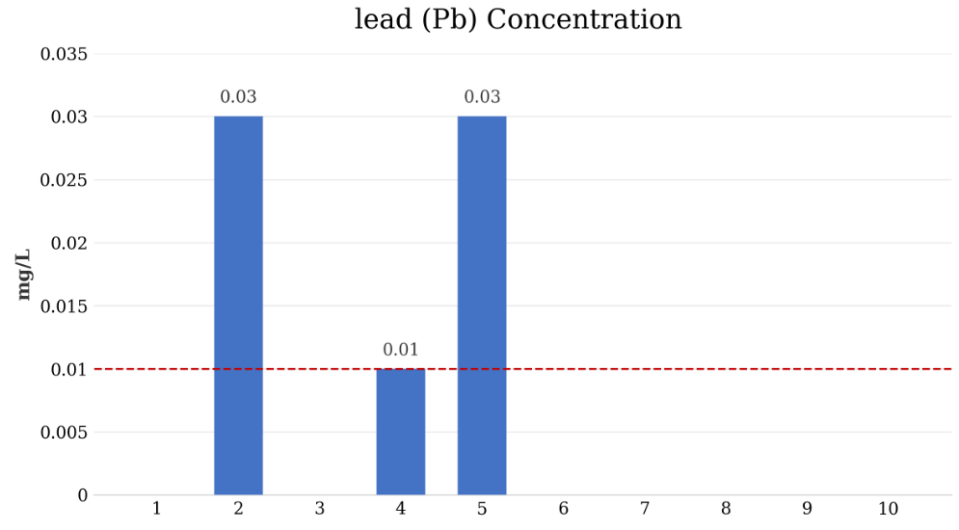
19
lead (Pb) Concentration in Water
The most notable quantitative difference among samples
3x Exceedance:
sample: 2, 5
In Sample No. 4, the value is exactly at the limit, while lead was not detected at the other 7 locations
19

Slide 20
20
Major Ions in Water
K⁺, Na ⁺, Ca²⁺ and Mg²⁺ — an integrated chemical profile
a | mg/L
 | K⁺ | Na⁺ | Ca²⁺ | Mg²⁺
1 | 0.61 | 2.92 | 6.20 | 3.20
2 | 1.68 | 7.81 | 79.20 | 0.30
3 | 0.78 | 2.46 | 16.00 | -0.90
4 | 1.48 | 14.28 | 40.00 | 7.50
5 | 1.31 | — | 7.4 | 0.60
6 | 3.70 | 4.10 | 6.80 | 0.40
7 | 2.35 | 3.30 | 4.40 | 1.40
8 | 3.68 | 5.58 | 2.40 | 1.90
9 | 0.44 | 4.95 | 18.20 | 4.90
10 | 7.41 | 5.91 | 14.00 | 2.90
Sample 2 is notable for its high Ca²⁺ value — 79.2 mg/L.
Maximum Na: 14.28 mg/L
20

Slide 21
21
Integrated Conclusion
Combined interpretation of soil and water data
Soil
01
pH (6.5–6.9) and CaCO₃ (10–14 mg/g) are consistent with a normal, slightly acidic / neutral environment
Iron (Fe: 42.5–95.4 g/kg) and chromium (Cr: 115 mg/kg) concentrations are high, but remain within natural background variation
(Sb): Antimony in soil reaches 49–78 mg/kg, significantly exceeding the maximum permissible concentration (MPC). Potential Origins: Natural geochemical background, long-term environmental accumulation, or anthropogenic impact.
02
Water
80% of the samples are soft, and permanganate oxidation is within the normal range at all locations (< 3.0 mg O₂/L).
(Pb): At 2 locations (village of Konchkati and Tkhinvali), the lead concentration is 0.03 mg/L, which is 3 times higher than the limit (0.01 mg/L)
Overall: targeted monitoring is recommended
20

Slide 22
Thank you
for your attention!

