Slide 1




ROLE OF FORMIC ACID IN THE ENANTIOSEPARATION OF NEW CHIRAL TELLURONIUM COMPLEXES USING HIGH-PERFORMANCE LIQUID CHROMATOGRAPHY
Author: Ina Pipia
Supervisor: Academician Bezhan Chankvetadze

Slide 2
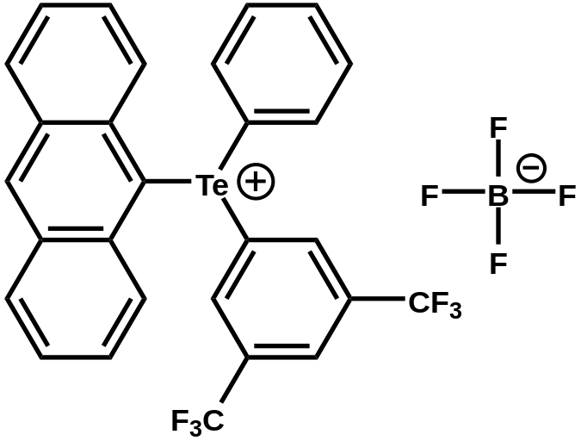
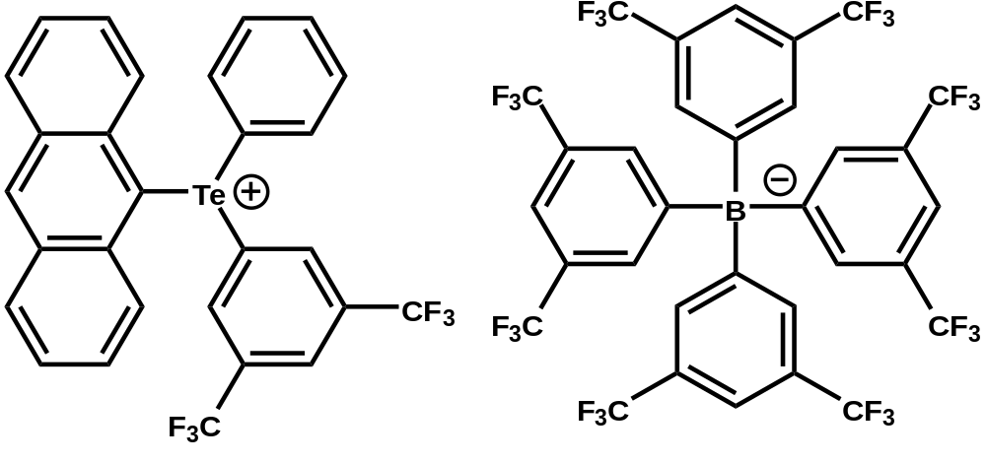
Aim of the study
LGR918
LGR924
Achieve HPLC enantioseparation of newly synthesized chiral telluronium complexes.
Compare LGR918 and LGR924, which share the same cation but contain different anions.
Investigate whether the observed species is the intact complex, the common cation, or a formate-associated species.
Evaluate the influence of mobile-phase additives, especially formic acid, on enantioseparation.
2

Slide 3
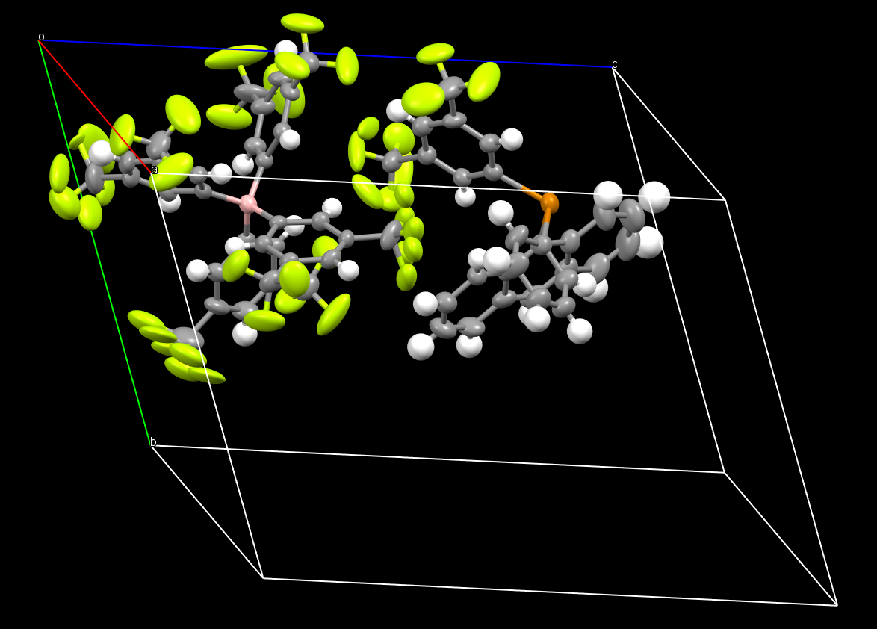
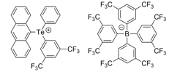
X-ray crystallography analysis of Rac-LGR924
3

Slide 4
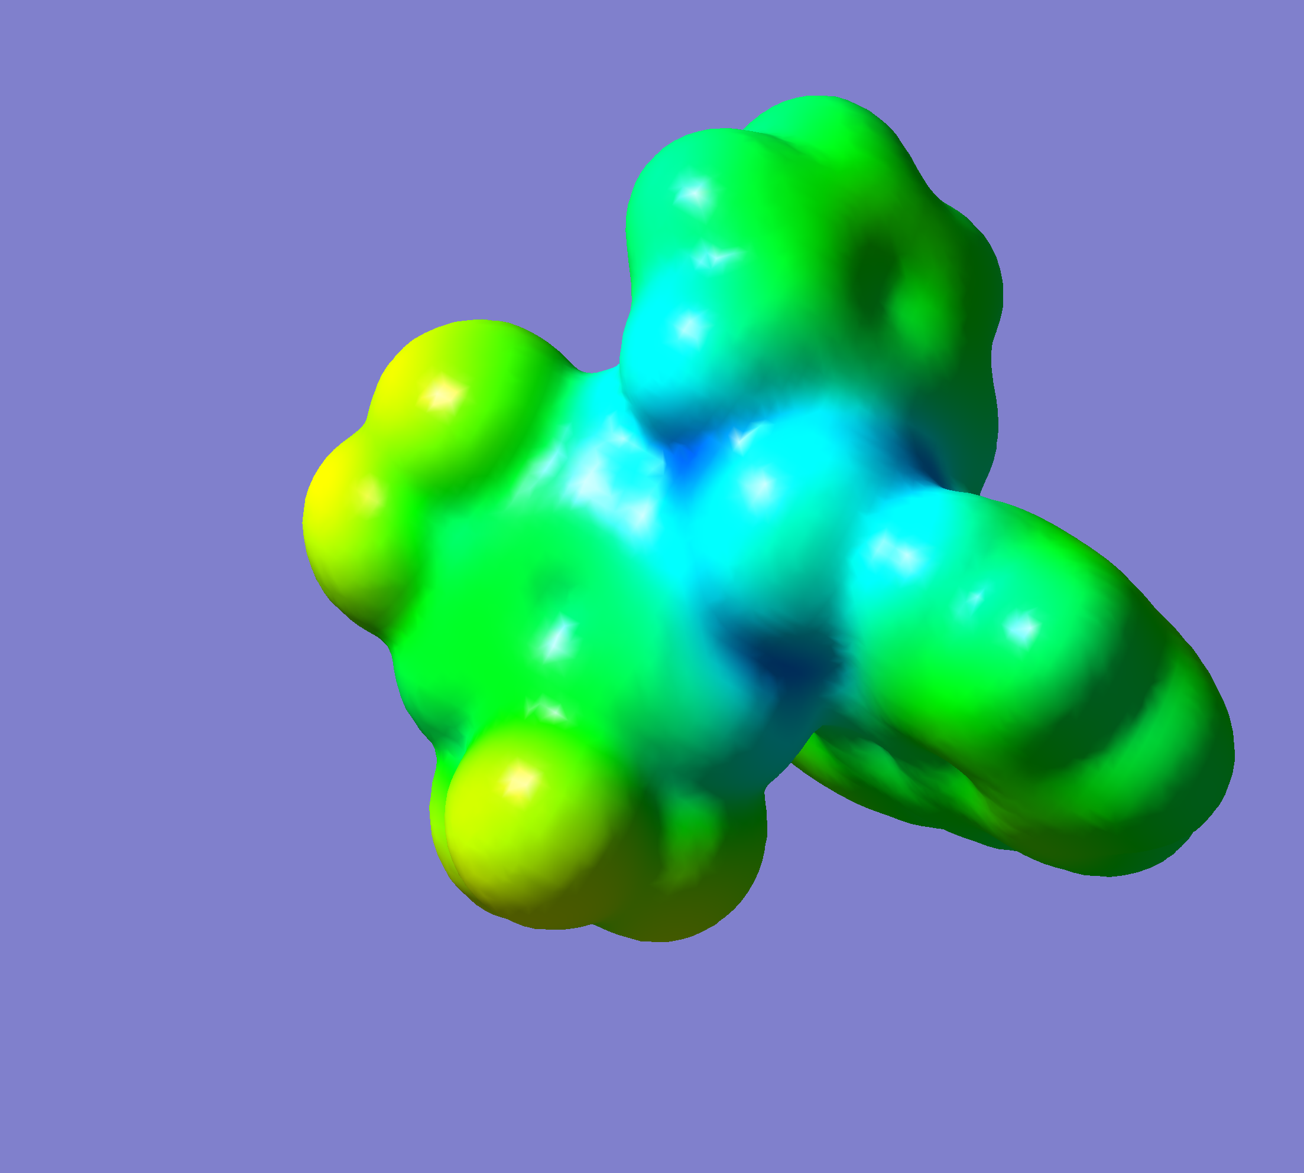
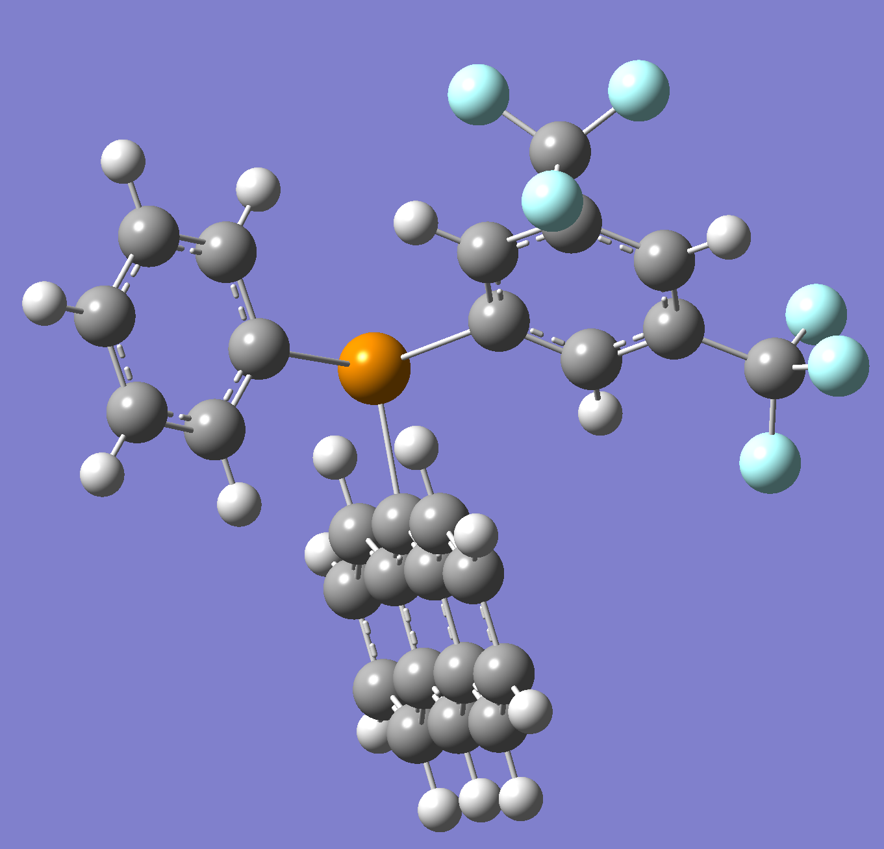
Molecular Structure and σ-Hole Representation of the Telluronium Complex
σ-hole
σ-hole
σ-hole
σ-hole
σ-hole
σ-hole
Molecular electrostatic potential surface
4
3D molecular model

Slide 5
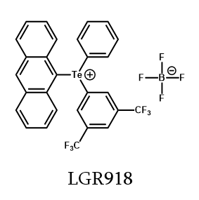
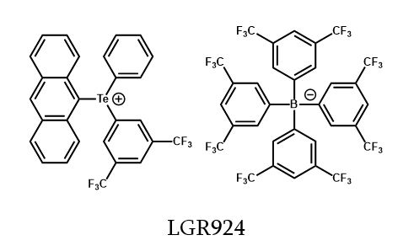
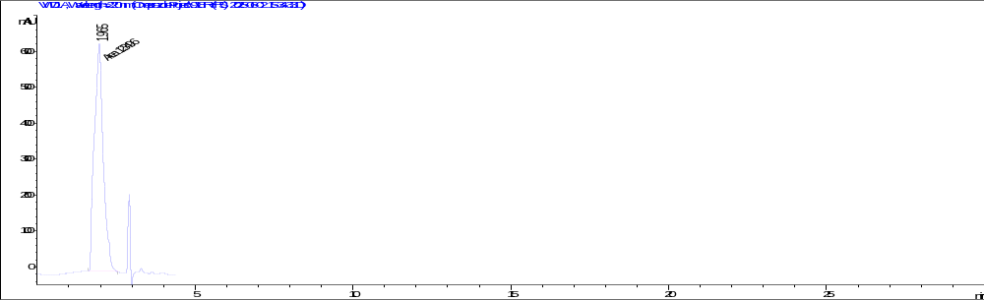
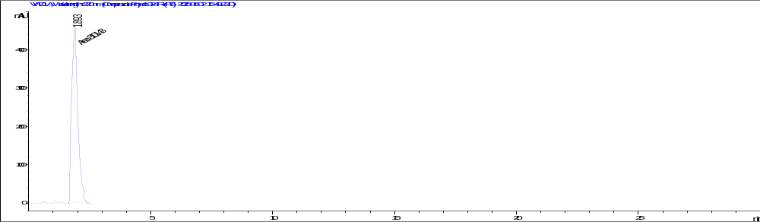
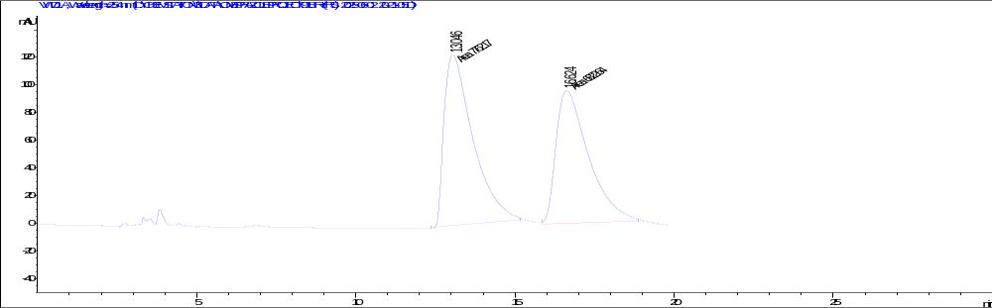
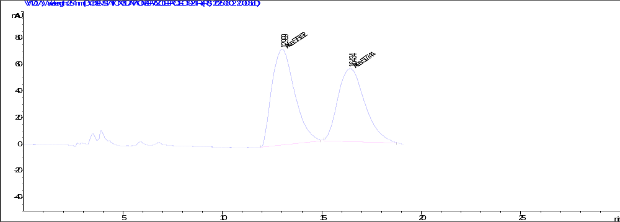
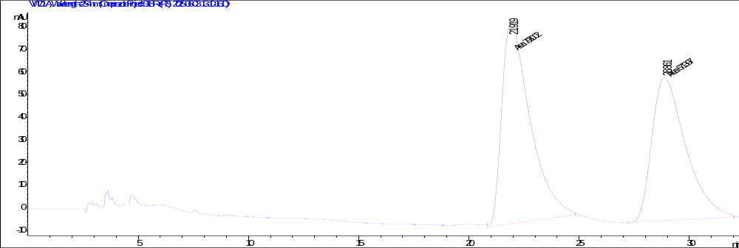
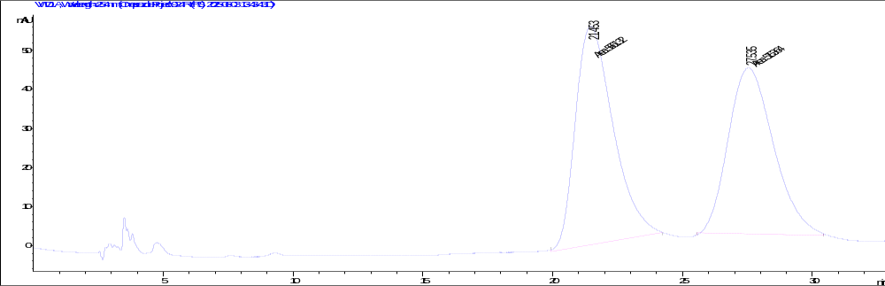
Effect of Hexane Content on the Enantioseparation
Mobile Phase: EtOH+0.1%FA
1.9
1.8
13.0
16.6
Mobile Phase: EtOH/Hex 30:70 +0.1%FA
12.9
16.6
Chromatographic Conditions :
Column-Cellulose-4
Injection Volume: 5mcL
Flow Rate: 1mL/min
Wavelength: 254nm
21.8
21.4
28.8
27.5
Mobile Phase: EtOH/Hex 20:80 +0.1%FA
5

Slide 6

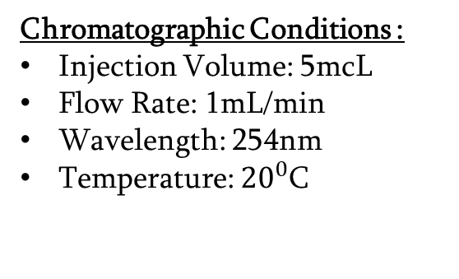
Used mobile and stationary phases
Screening Stage
Chiral Columns:
Mobile Phases:
Hexane : Ethanol (70:30)
Hexane : Ethanol (70:30) +0.1%FA
Hexane : Isopropanol (70:30) +0.1%DEA
Acetonitrile (ACN) +0.1%DEA
Methanol (MeOH) +0.1%DEA
Lux-Cellulose-1
Lux-Cellulose-2
Lux-Cellulose-3
Lux-Cellulose-4
Lux-i-Cellulose-2
Lux-i-Cellulose-5
Lux-Amylose-1
Lux-Amylose-2
Lux-Amylose-3
Lux-i-Amylose-3
Chromatographic Conditions :
Injection Volume: 5mcL
Flow Rate: 1mL/min
Wavelength: 254nm
Temperature: ${20}^{0}$C
Mobile Phase Additives:
DEA
NH4OH
Formic Acid (FA)
Ammonium Acetate
6

Slide 7
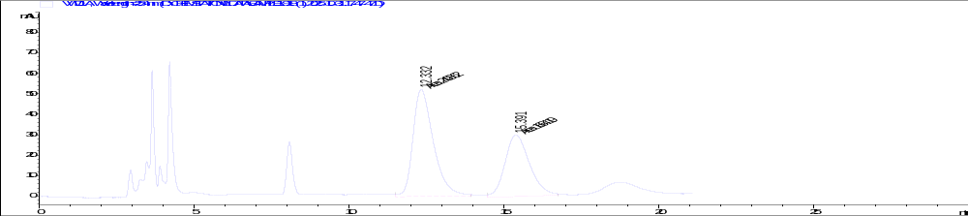
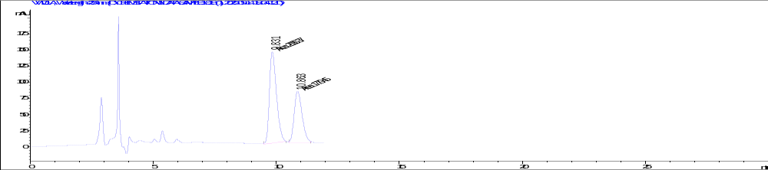
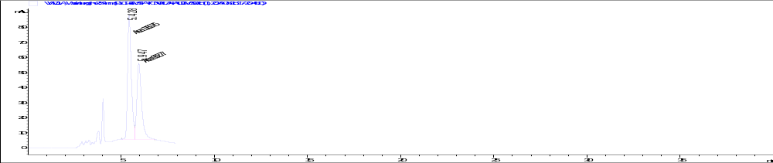
Formic-acid-dependent enantioseparation
Cellulose-2
Mobile Phase: Hex/EtOH 70/30+0.1%FA
Cellulose-4
i-Amylose-3
7

Slide 8
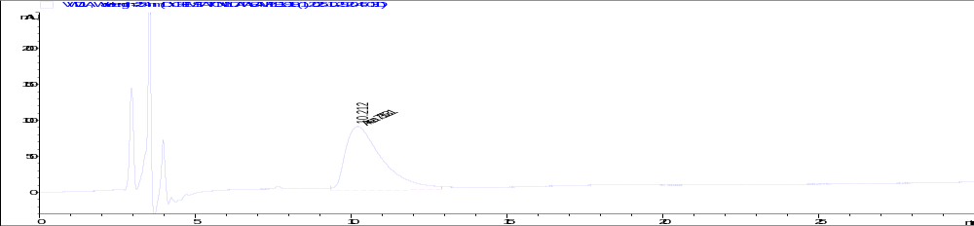
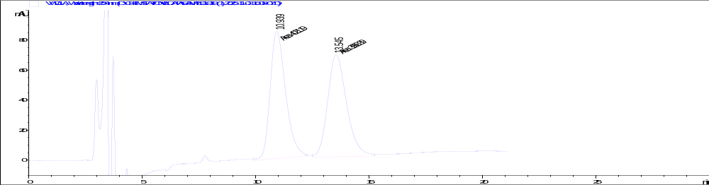
Effect of Prior Formic Acid Exposure on Enantioseparation
This Analyze was performed before FA being introduced to the column
Column: Cellulose-2
Mobile Phase: Hex/EtOH 70/30
Flow Rate: 1mL/min
Wavelenght: 254nm
Inj.Volume: 5mcL
918
Spiked Sample
10.2
918
12.3
Spiked Sample
Column: Cellulose-2
Mobile Phase: Hex/EtOH 70/30+0.1%FA
Flow Rate: 1mL/min
Wavelenght: 254nm
Inj.Volume: 5mcL
15.3
10.9
13.5
918
Racemate
Column: Cellulose-2
Mobile Phase: Hex/EtOH 70/30
Flow Rate: 1mL/min
Wavelenght: 254nm
Inj.Volume: 5mcL
8

Slide 9
Decrease Of Enantioseparation
The column was washed with isopropanol and methanol to reduce the possible formic-acid-conditioned state.
After switching back to Hexane/Ethanol 70:30 without formic acid, LGR918 was analyzed repeatedly.
Enantioseparation gradually decreased, suggesting that the formic-acid-related column effect was progressively lost.
13.0
16.6
Column: Lux-Cellulose-2 | Mobile phase: Hex/EtOH 70/30+ 0.1% FA
9

Slide 10
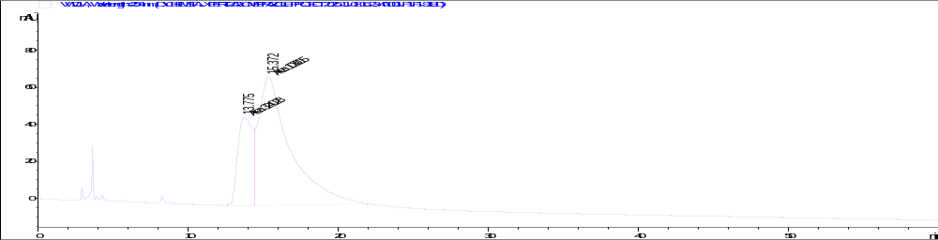
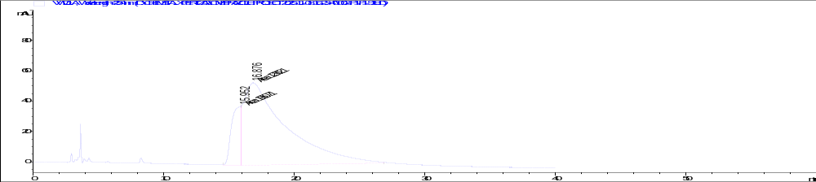
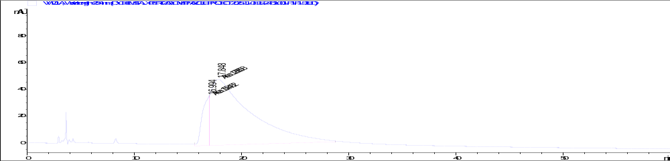
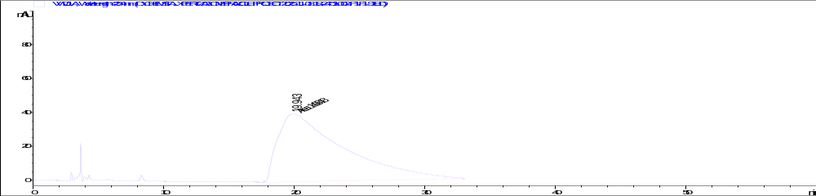
918
15.3
Column: Cellulose-2
Mobile Phase: Hex/EtOH 70/30
Flow Rate: 1mL/min
Wavelenght: 254nm
1H
13.7
16.8
2H
15.9
17.8
3H
16.9
4H
19.9
10

Slide 11
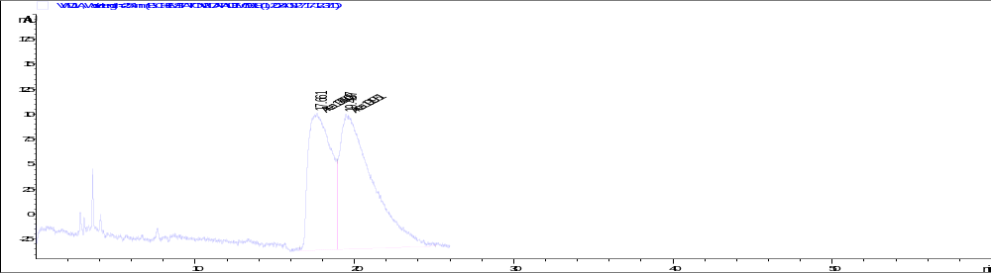
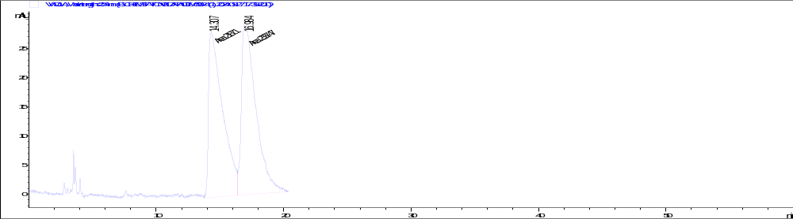

Low formic-acid concentration: time-dependent restoration
918 – 1st injection
17.6
19.4
Chromatographic Conditions:
Column: Cellulose-2
Mobile Phase: Hex/EtOH 70/30+0.00125%FA
Flow Rate: 1mL/min
Wavelenght: 254nm
Inj.Volume: 5mcL
924 injection
14.3
16.9
Using 0.00125% FA, the first 918 injection did not reach baseline separation. After 924 was injected, a repeated 918 injection showed improved separation.
918 – 2nd injection
14.0
16.8
11

Slide 12
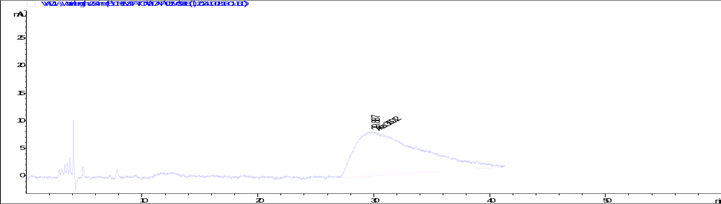
Restoration Of The Enantioseperation
• Methanol washing was used to remove the FA-conditioned enantioselective state.
• After washing, Hex/EtOH (70:30) was run and LGR918 was analyzed.
• With longer methanol washing, retention time increased and peak shape broadened.
• After switching to Hex/EtOH + 0.00125% FA, several injections/time were required to restore reproducible separation.
The column was washed for 0.5 hours in hexane/ethanol (70/30) mobile phase.
Column: Cellulose-2
Mobile Phase: Hex/EtOH 70/30
Flow Rate: 1mL/min
Wavelenght: 254nm
Inj.Volume: 5mcL
19.8
12

Slide 13
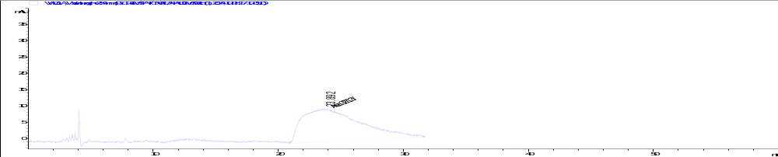
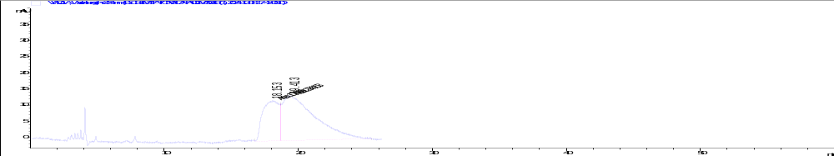
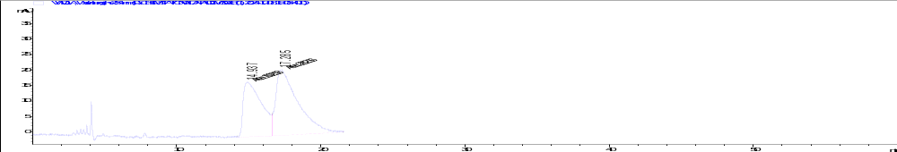
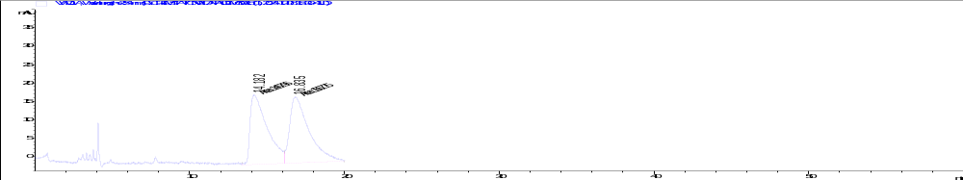
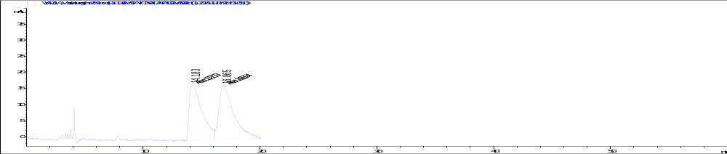
Restoration of enantioseparation with 0.00125% formic acid
23.8
18.1
19.4
Chromatographic Conditions:
Column: Cellulose-2
Mobile Phase: Hex/EtOH 70/30+0.00125%FA
Flow Rate: 1mL/min
Wavelenght: 254nm
Inj.Volume: 5mcL
14.9
17.2
14.1
16.8
14.1
16.8
13

Slide 14

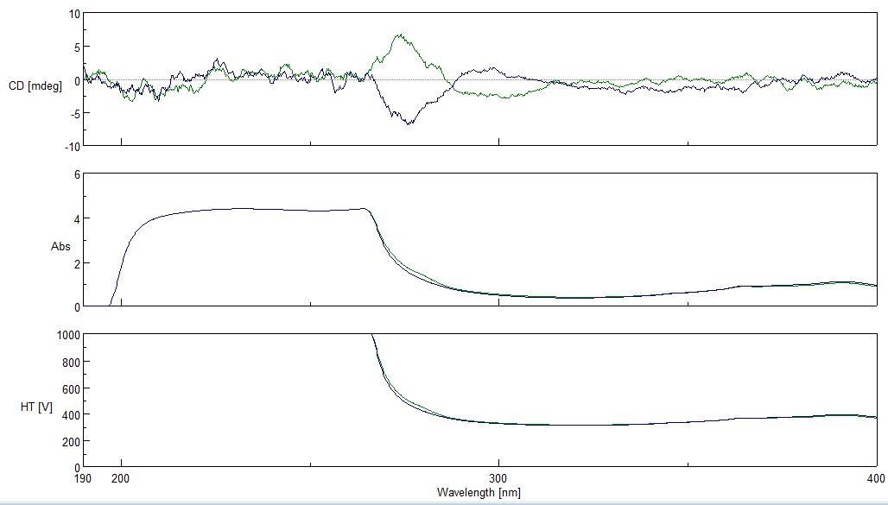
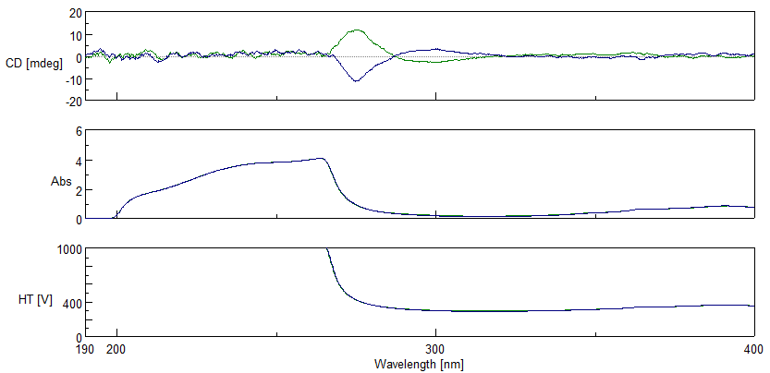
CD spectra of enantiomeric fractions
CD gives chiral information beyond UV-DAD
924 II
918 II
924 I
918 I
14

Slide 15
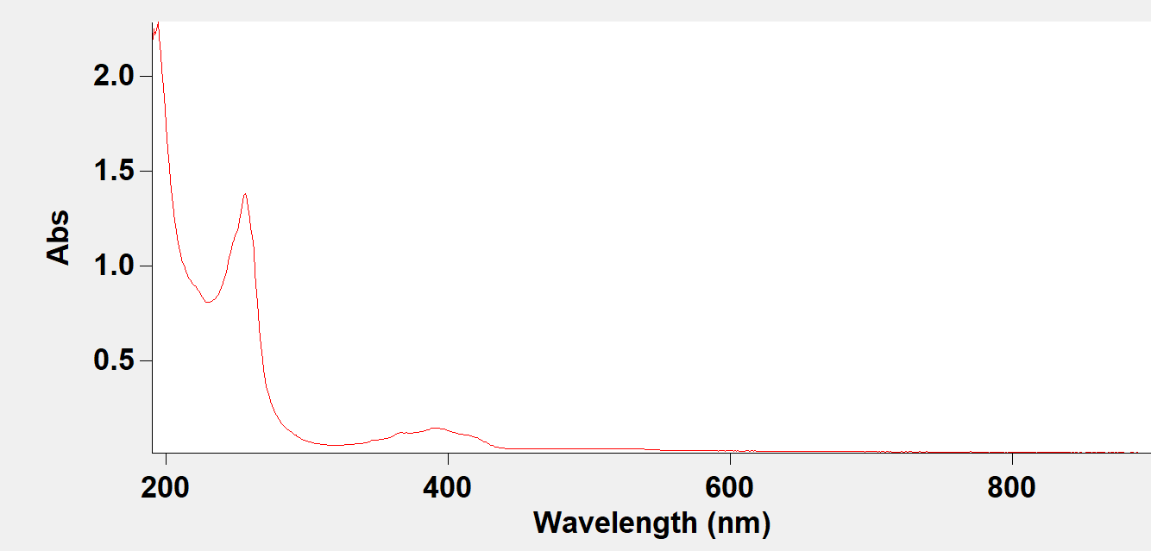
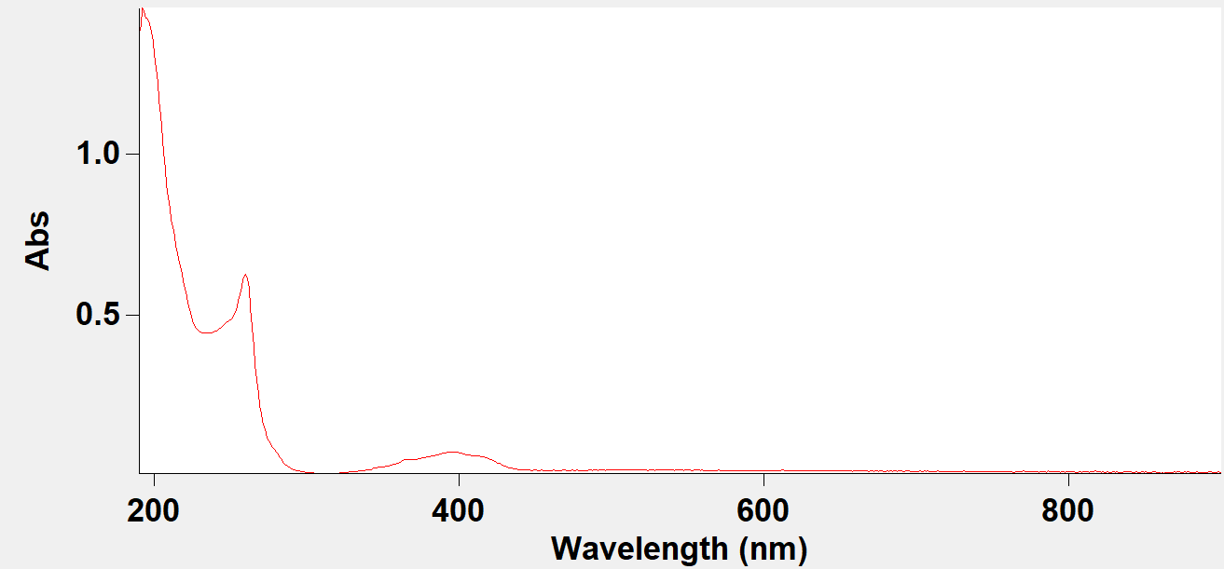
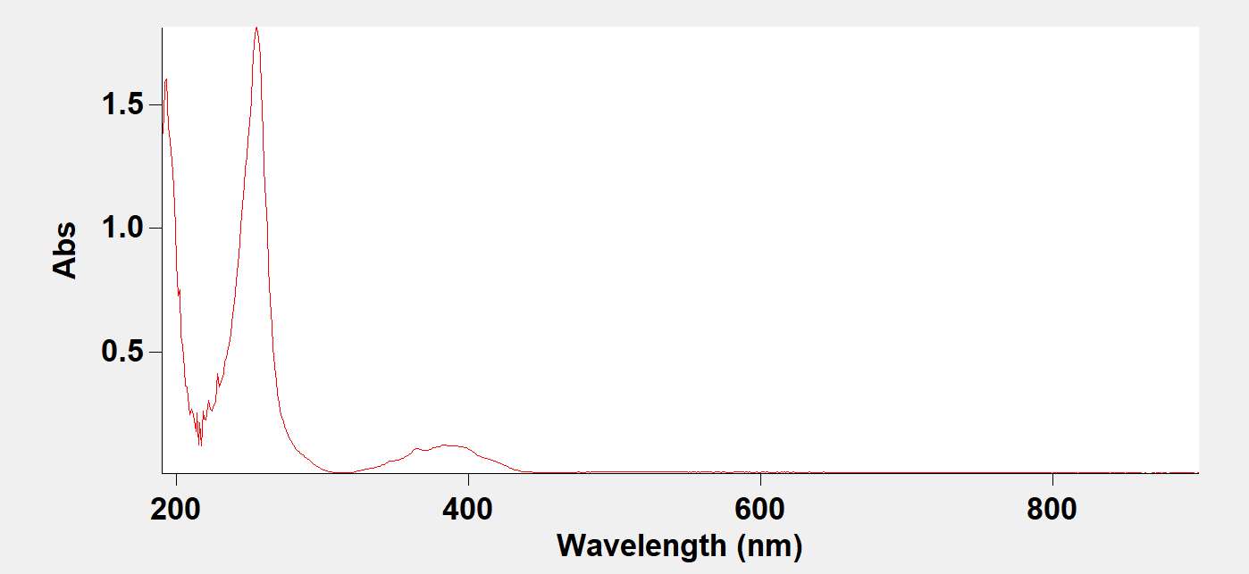
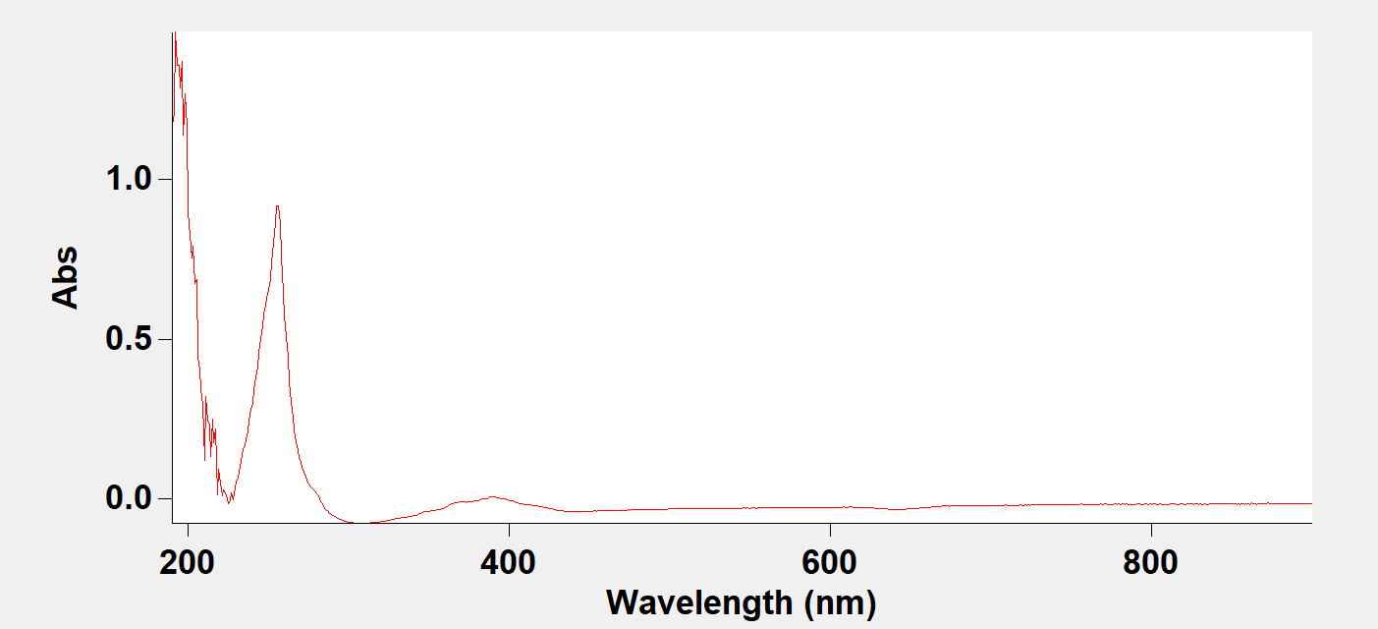
Effect of Formic Acid on UV-Visible Spectra
Agilent Technologies Cary 60 UV-VIS
Does the presence of formic acid alter the UV-visible absorption profile of LGR918 and LGR924?
918 ACN
924 ACN
918 ACN+FA
924 ACN+FA
16

Slide 16
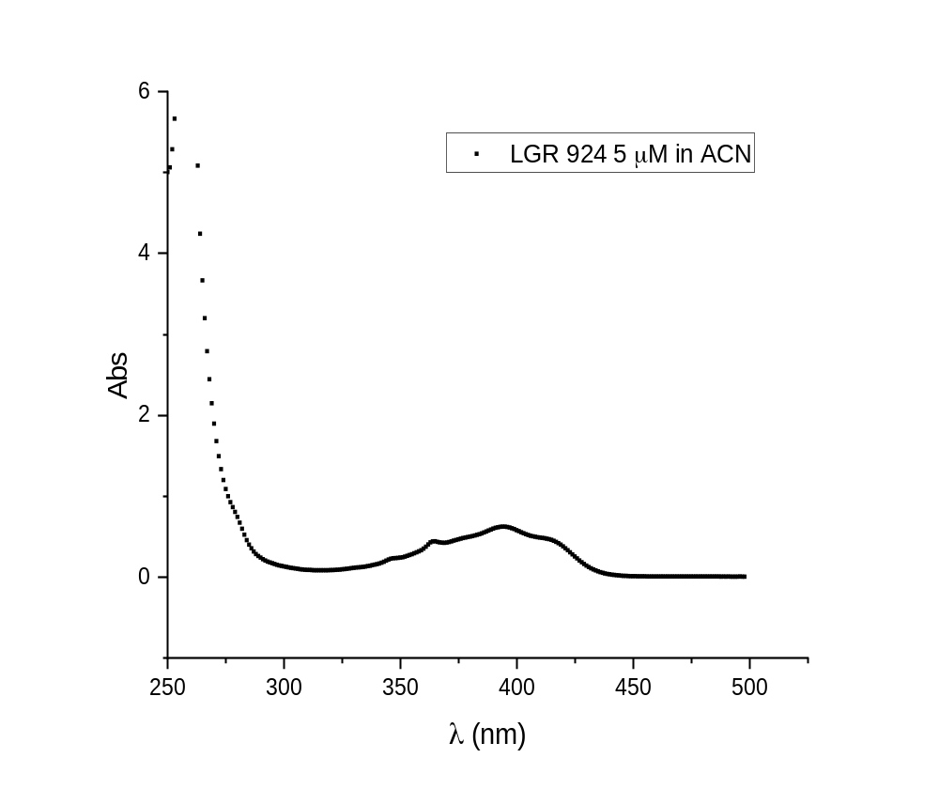
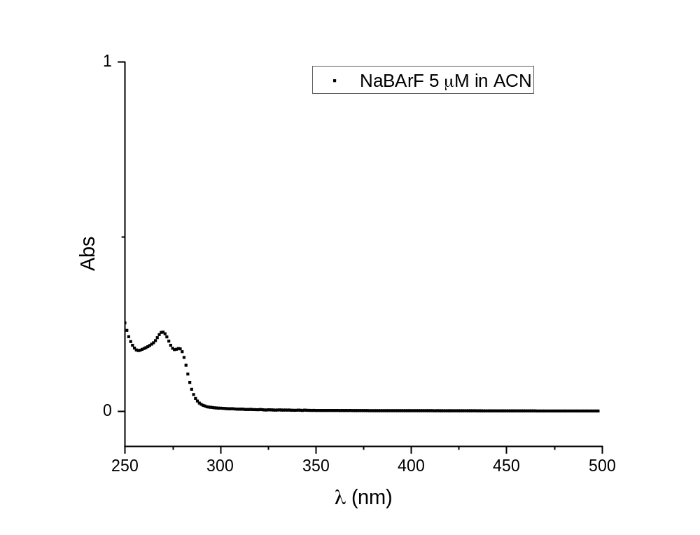
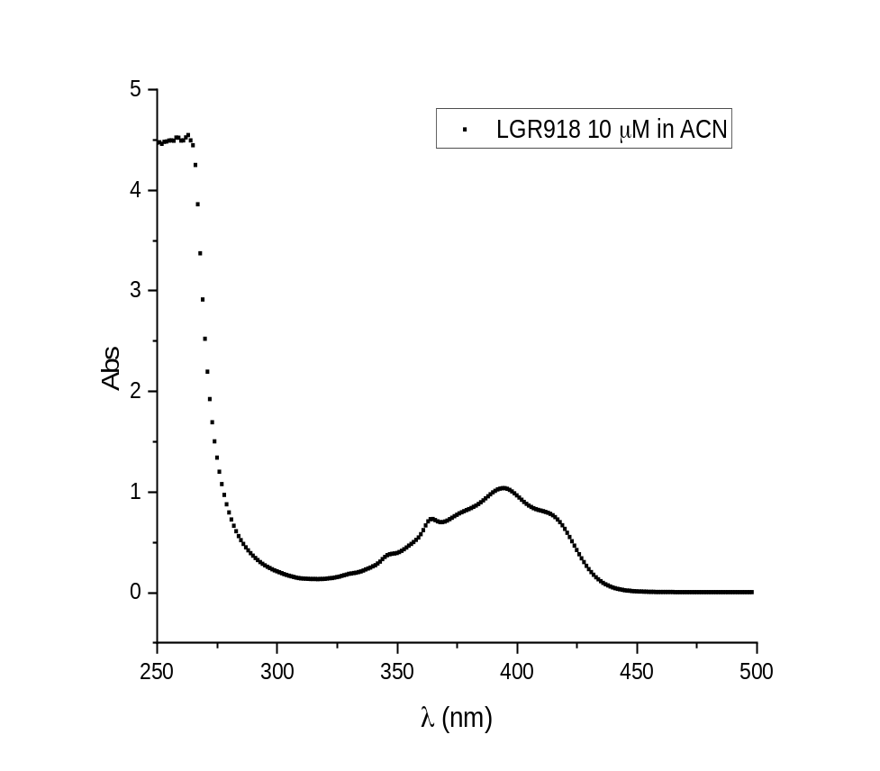
UV-Vis Analysis of LGR918 and LGR924 Conducted in Strasbourg
BArF
17

Slide 17
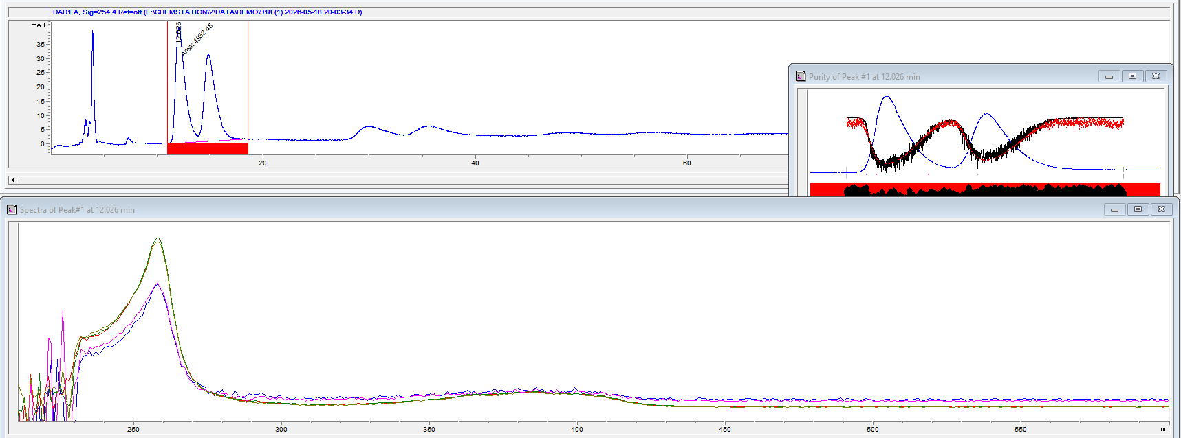
HPLC-DAD Analysis of LGR918 with Formic Acid
918
New Cellulose-2 Column
Hex/EtOH 70/30 + 0.1% FA
19

Slide 18
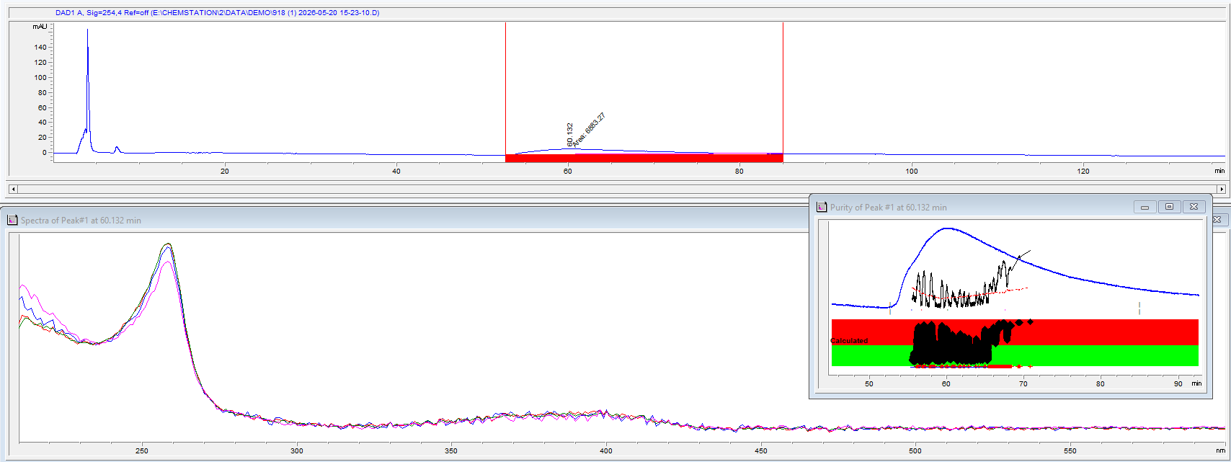
HPLC-DAD Analysis of LGR918 without Formic Acid
918
New Cellulose-2 Column
Hex/EtOH 70/30
18

Slide 19
Current Interpretation
• The optimal enantioselective separation was achieved on a cellulose-based chiral column under normal-phase conditions using Hex/EtOH with formic acid.
• Formic acid plays an important role in the separation, although column conditioning and residual acid effects may also influence the chromatographic behavior.
• UV and HPLC-DAD spectra of LGR918 and LGR924 were similar, suggesting that the main UV-active species is associated with the common chiral telluronium cation.
20

Slide 20
Thank you for your attention!

