Slide 1


Università Politecnica delle Marche
Department of Biomedical Sciences
SABA JORBENADZE
PhD Student
The potential of Capillary Electrophoresis tandem Mass Spectrometry (CE-MS/MS) in the forensic toxicology analysis of various psychoactive substanCes and their phase-1 and phase-2 metabolites in human biological fluids
Supervisors:
Doctor of Chemistry, Academician of the National Academy of Sciences of Georgia, Head of the Department of Physical and Analytical Chemistry, Professor Bezhan Chankvetadze
Professor Dr. Francesco Paolo Bùsardo

Slide 2
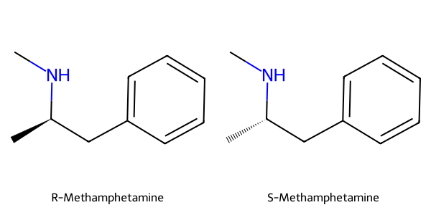

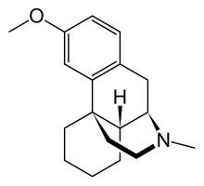
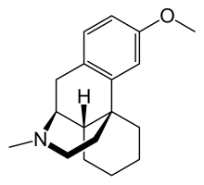
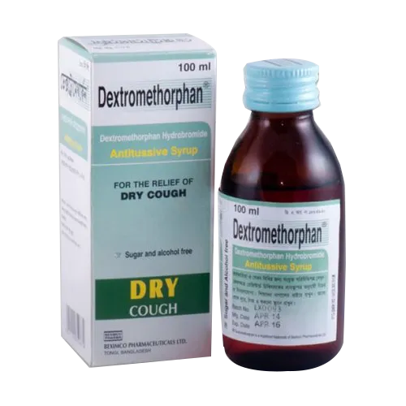
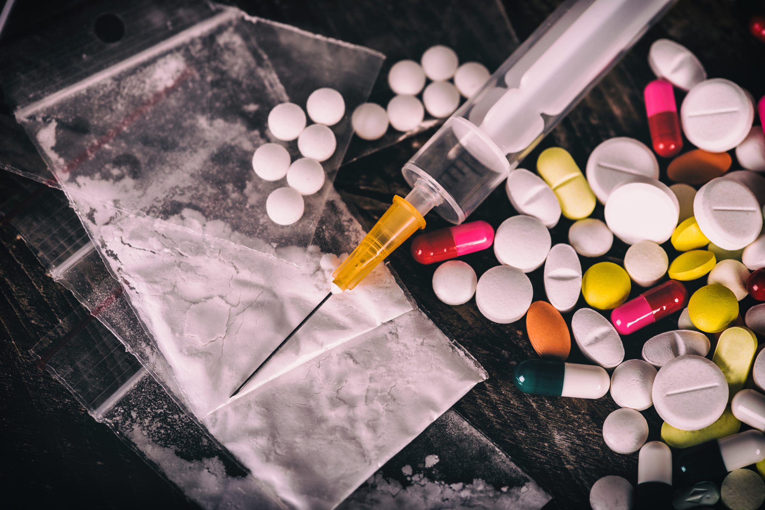
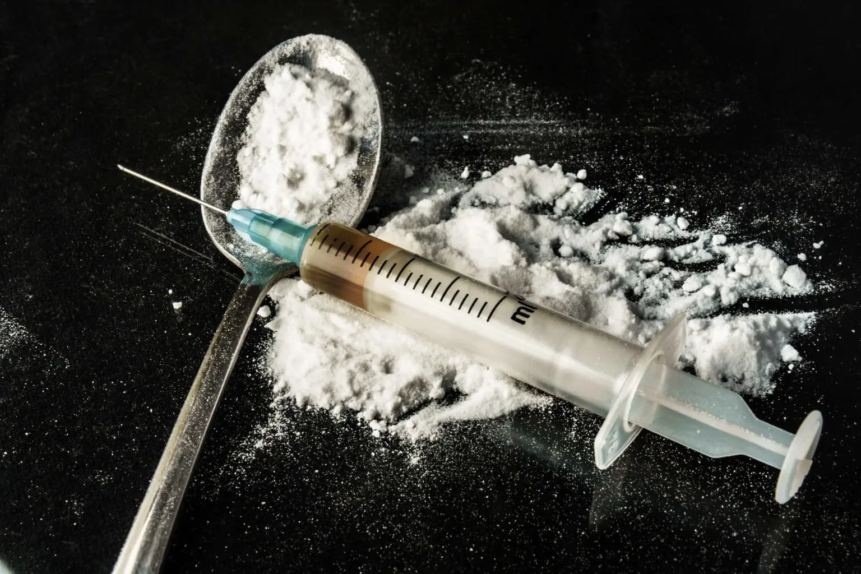
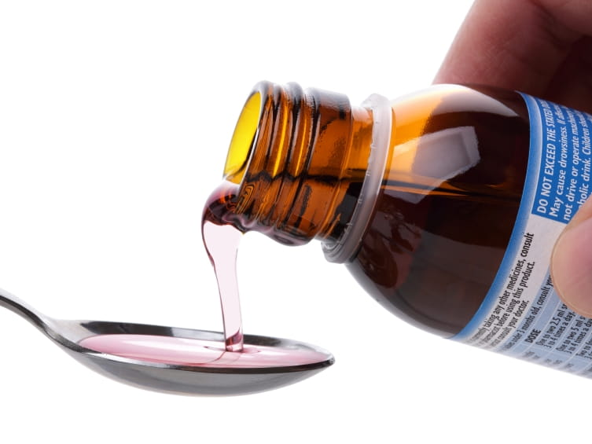
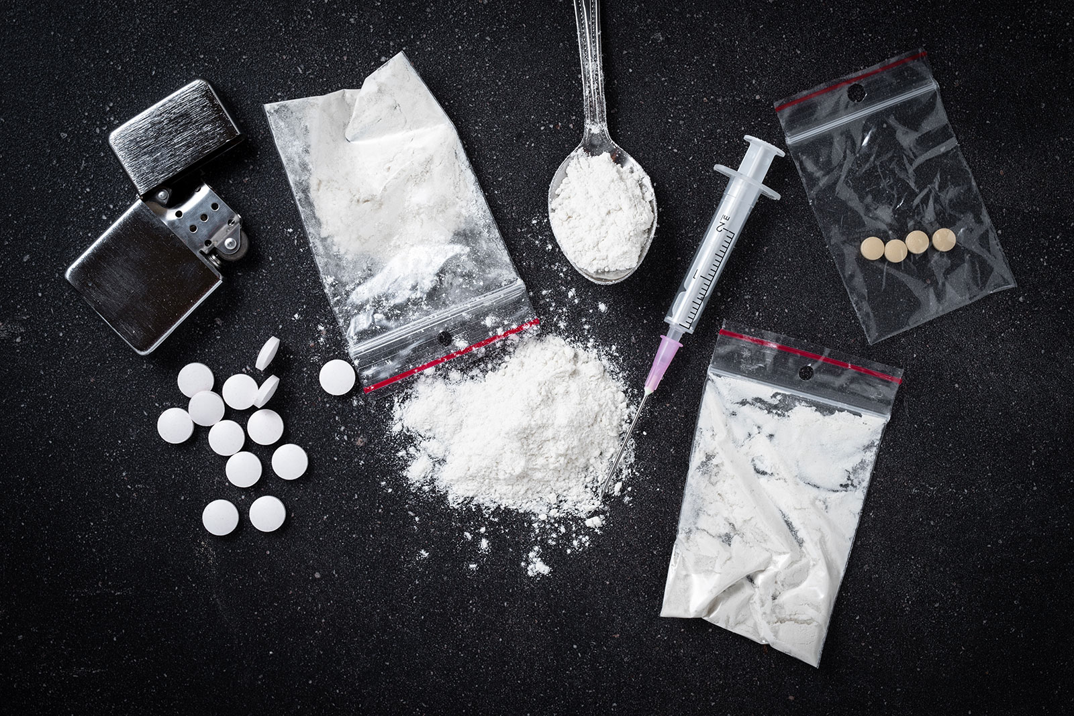
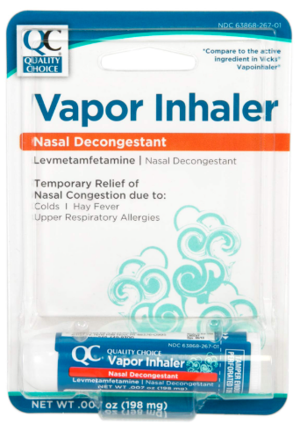

Importance of enantioselective analysis
Levomethorphan
Dextromethorphan
● Illegal narcotic
● A narcotic approximately 5 times more potent than morphine
● Its o-demethylated metabolite, levorphanol, is a more potent active ingredient
● Causes hallucinations and dysphoria at low doses, and fatal consequences at high doses,
In low doses:
● Cough and cold remedy
● Antidepressant
● Sedative and stimulant
R-Methamphetamine
- Weaker CNS stimulant
- Used in some over-the-counter nasal decongestants (e.g., Vicks inhaler).
S-Methamphetamine
- More potent CNS stimulant
- Higher abuse potential.

Slide 3
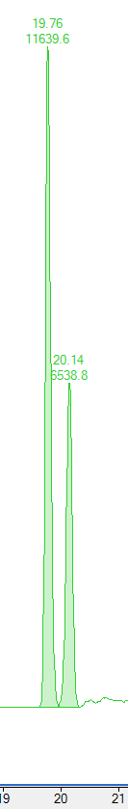
Estimating the time of consumption
1) Investigation of pharmacokinetic profile
2) Evaluate the ratio of enantiomers
Concentration (ng/ml)
Ratio of peak responses of R-MDMA and S-MDMA
Time (h)
Time (h)
R-MDMA
Oral fluid sample of random person
Unknown time of consumption
S-MDMA

Slide 4
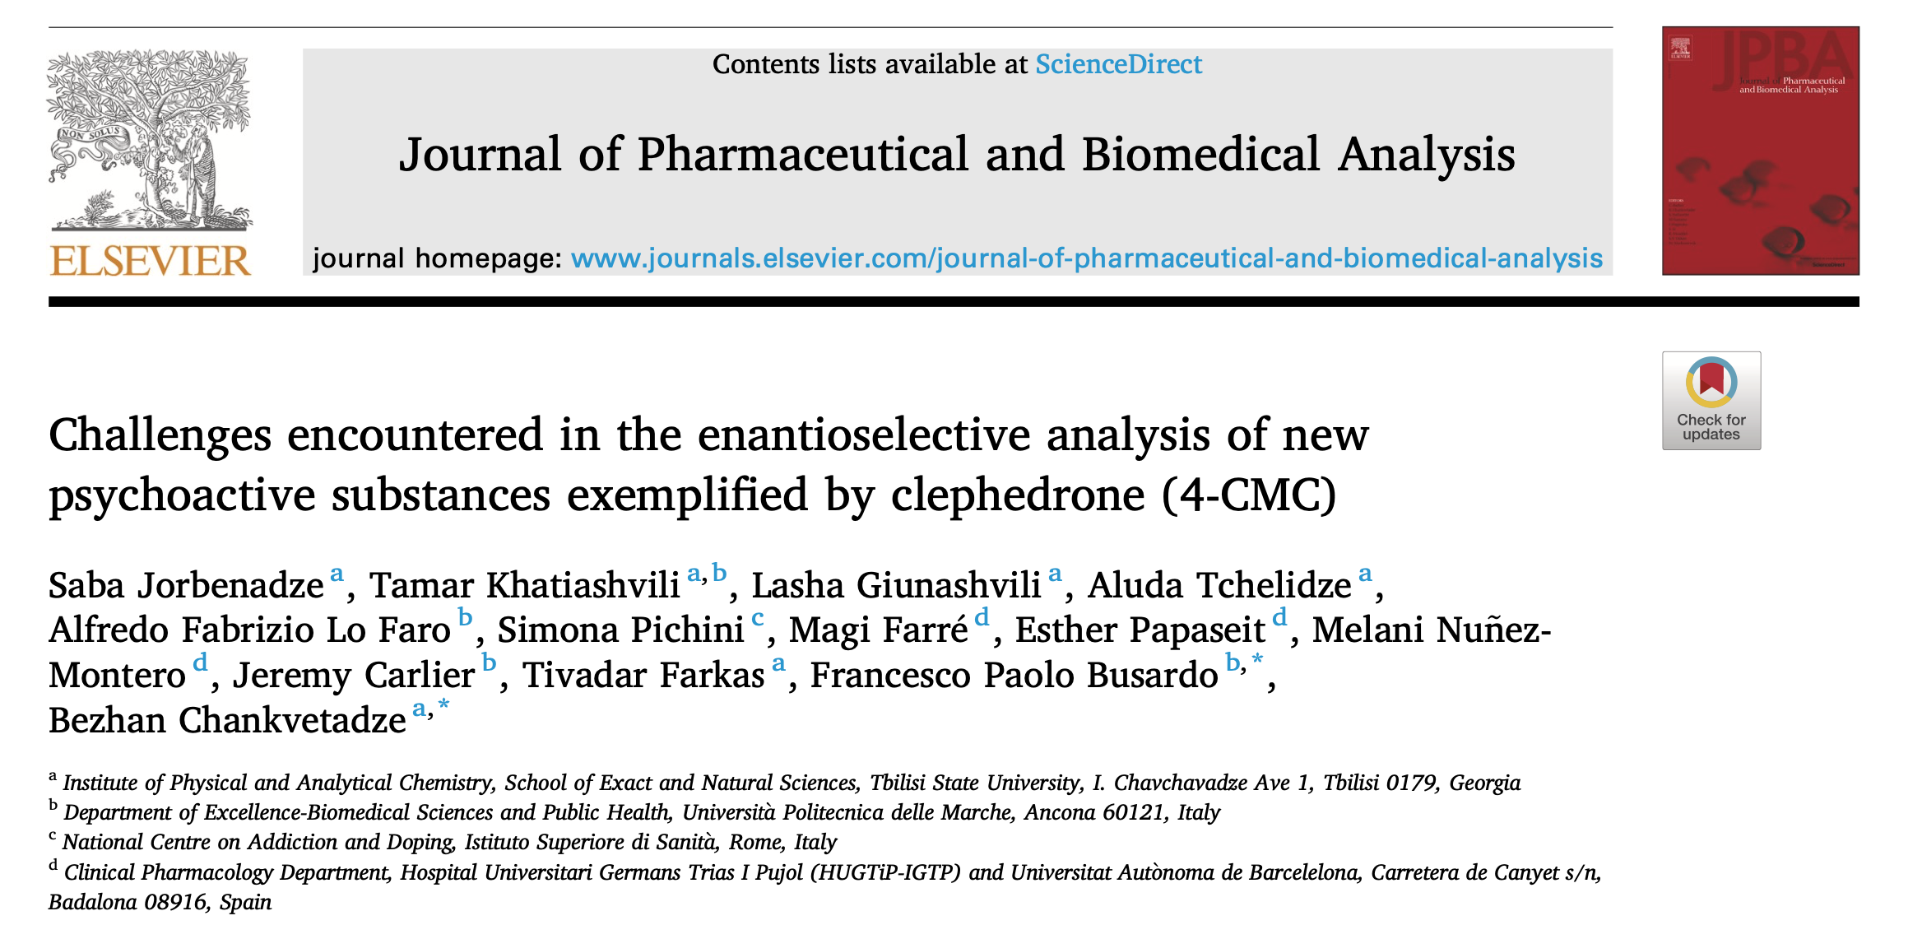
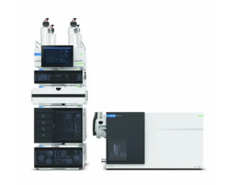
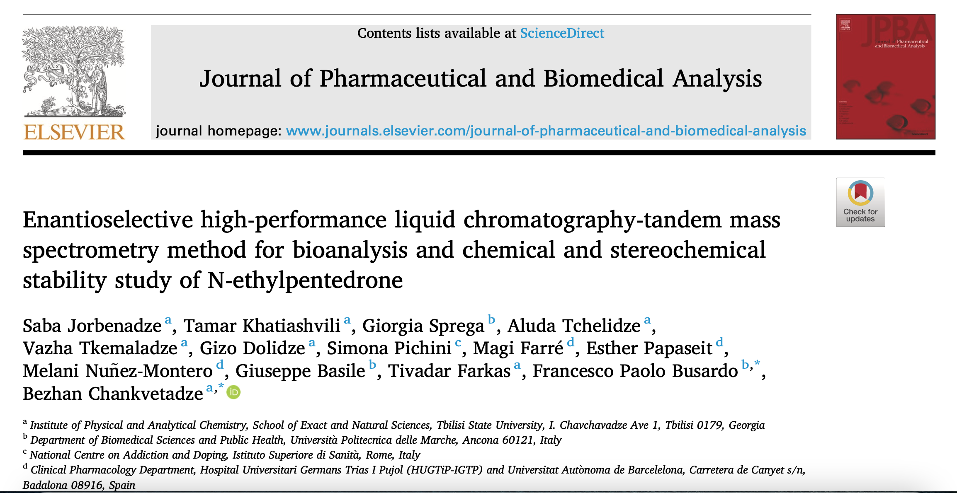
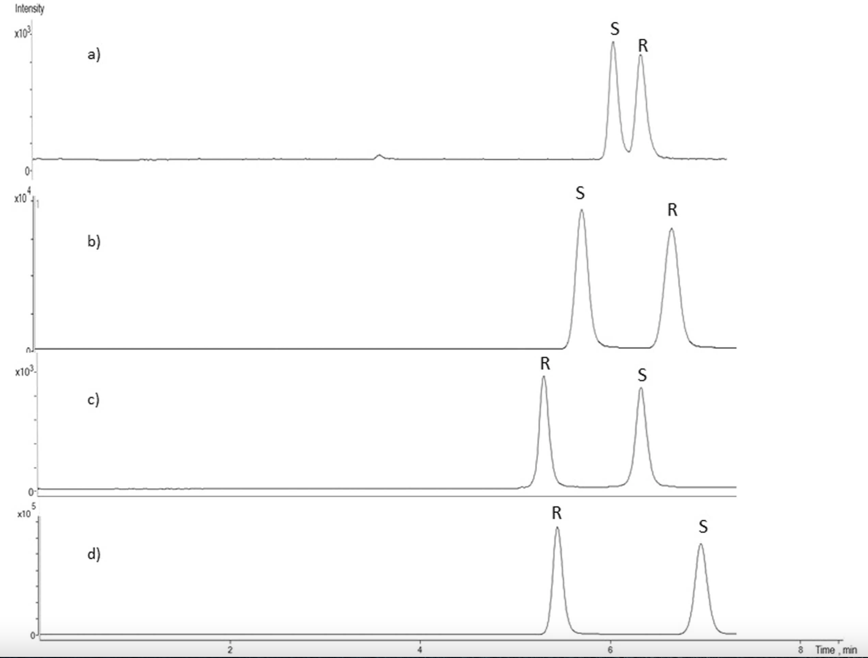
High-performance liquid chromatography tandem mass spectrometry
(HPLC-MS/MS)
HPLC-MS/MS

Slide 5
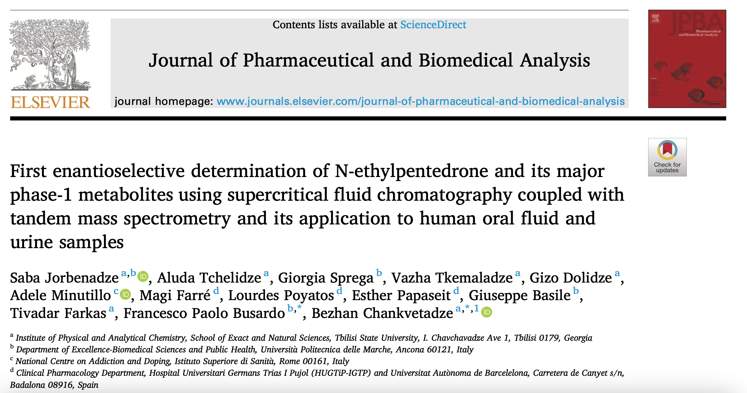
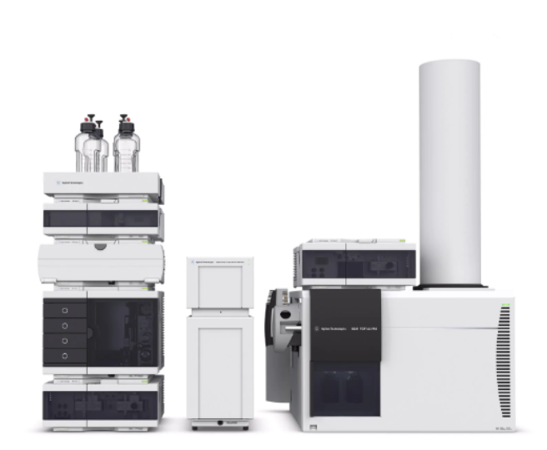
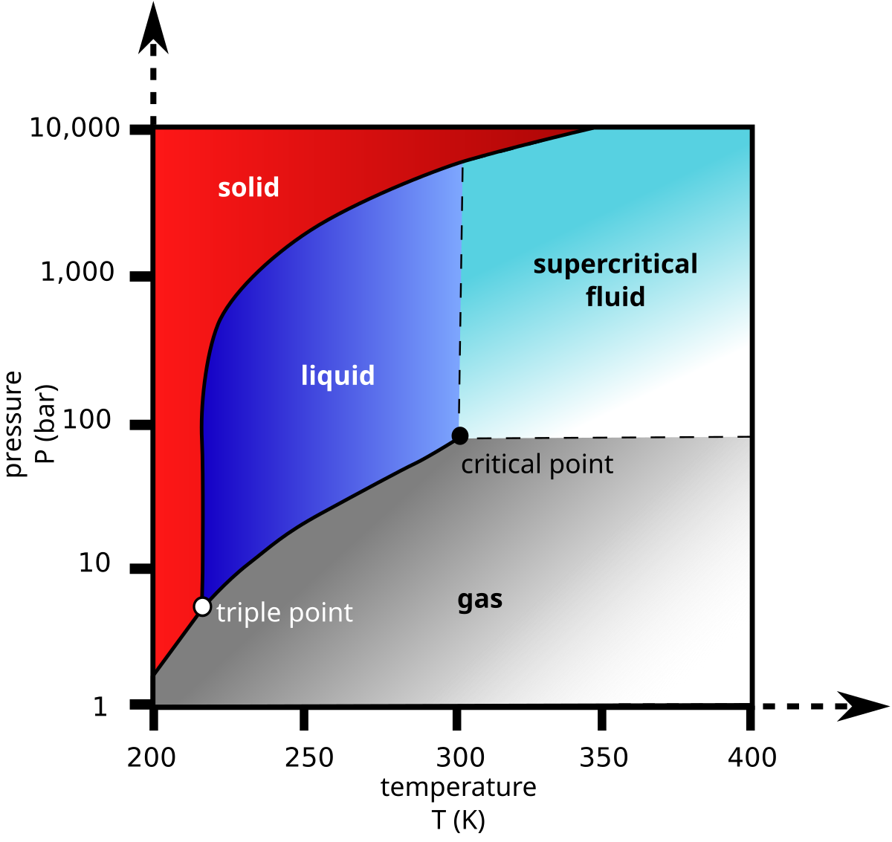
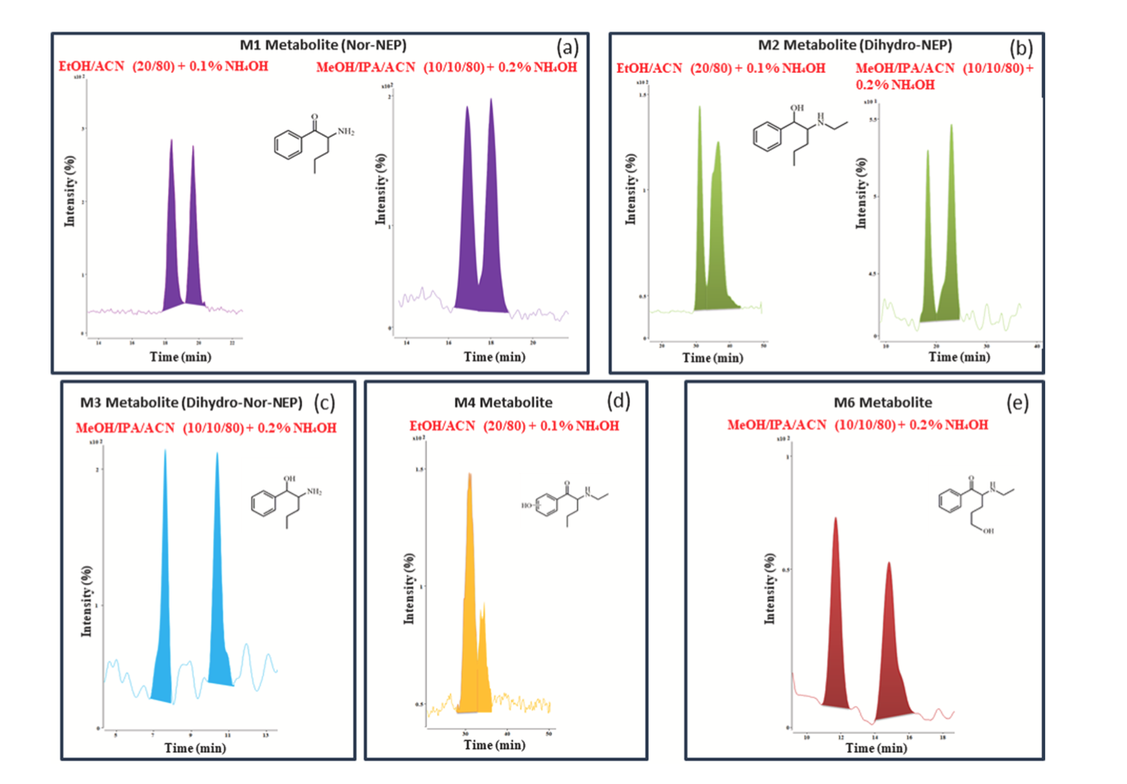
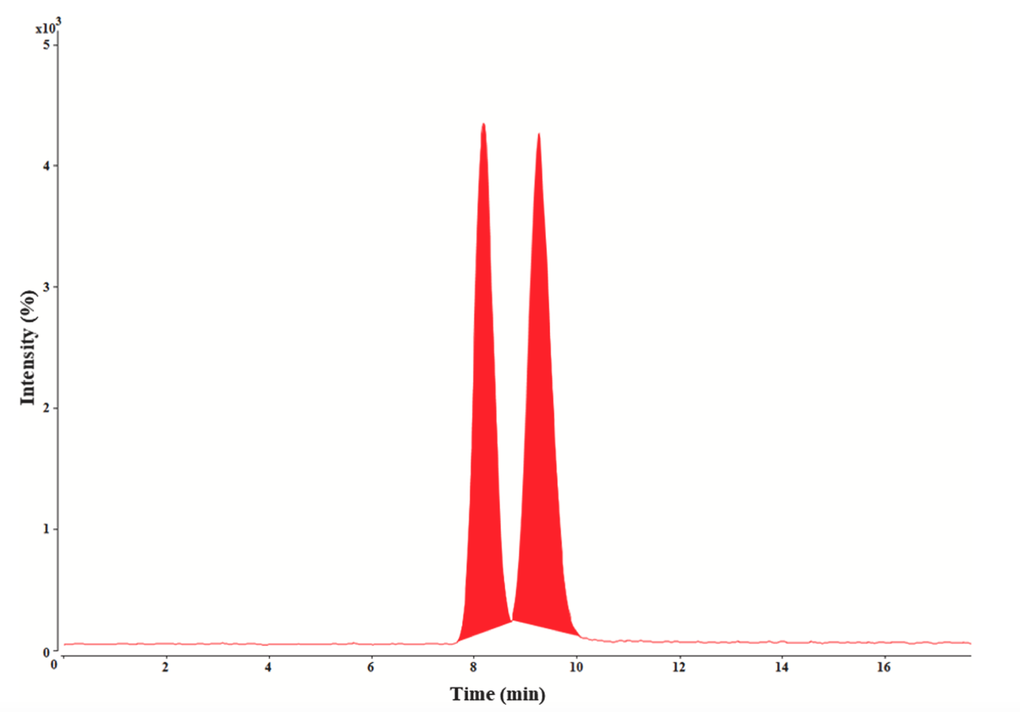
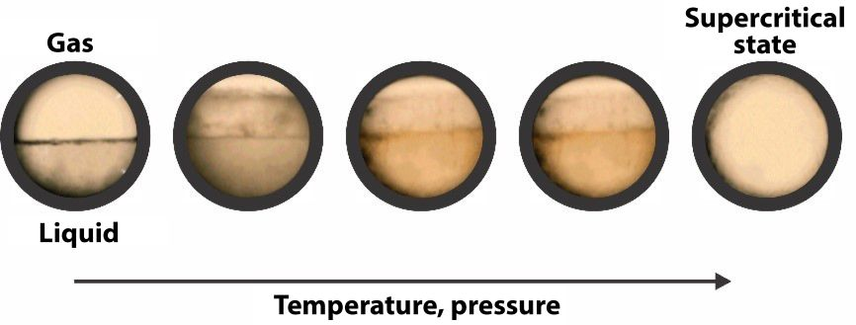
Supercritical fluid chromatography tandem mass spectrometry
(SFC-MS/MS)
SFC-MS/MS

Slide 6
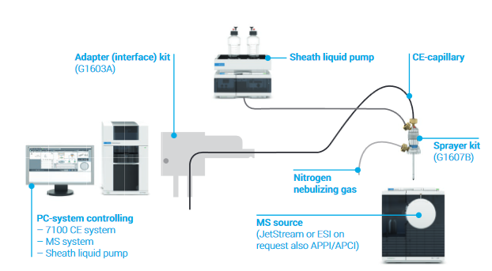
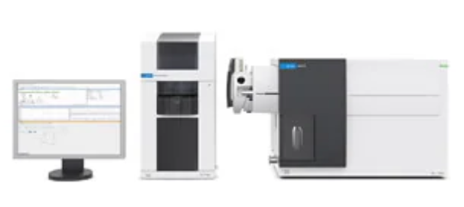
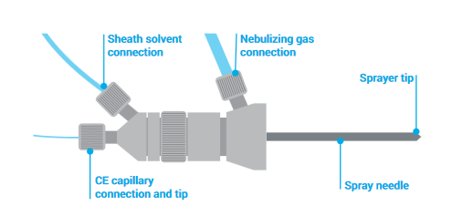
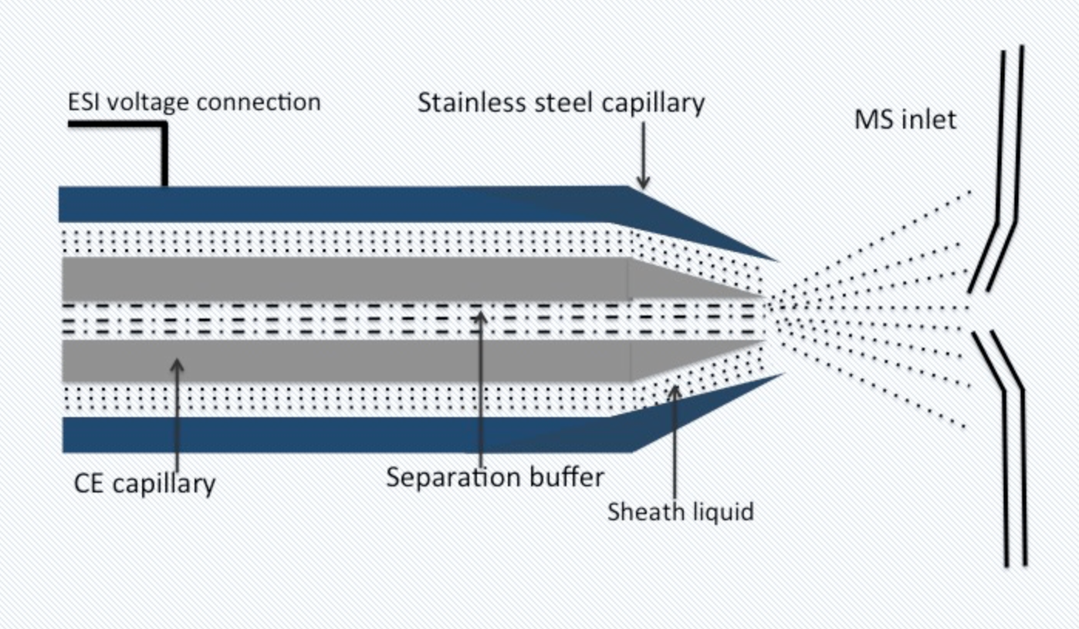
Capillary electrophoresis tandem mass spectrometry (CE-MS/MS) interface
Coaxial sheath liquid electrospray ionization

Slide 7
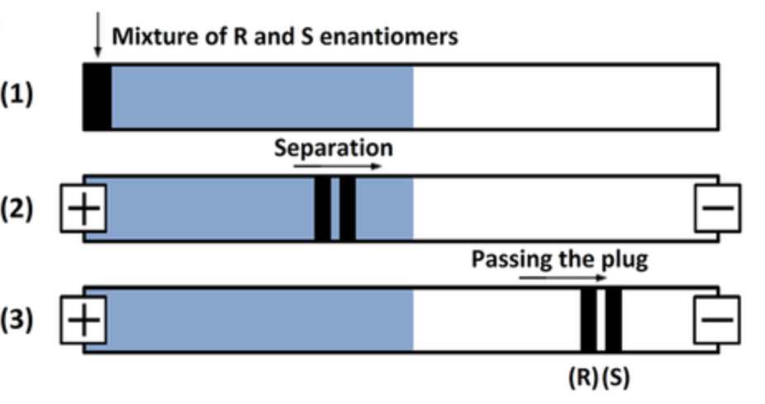
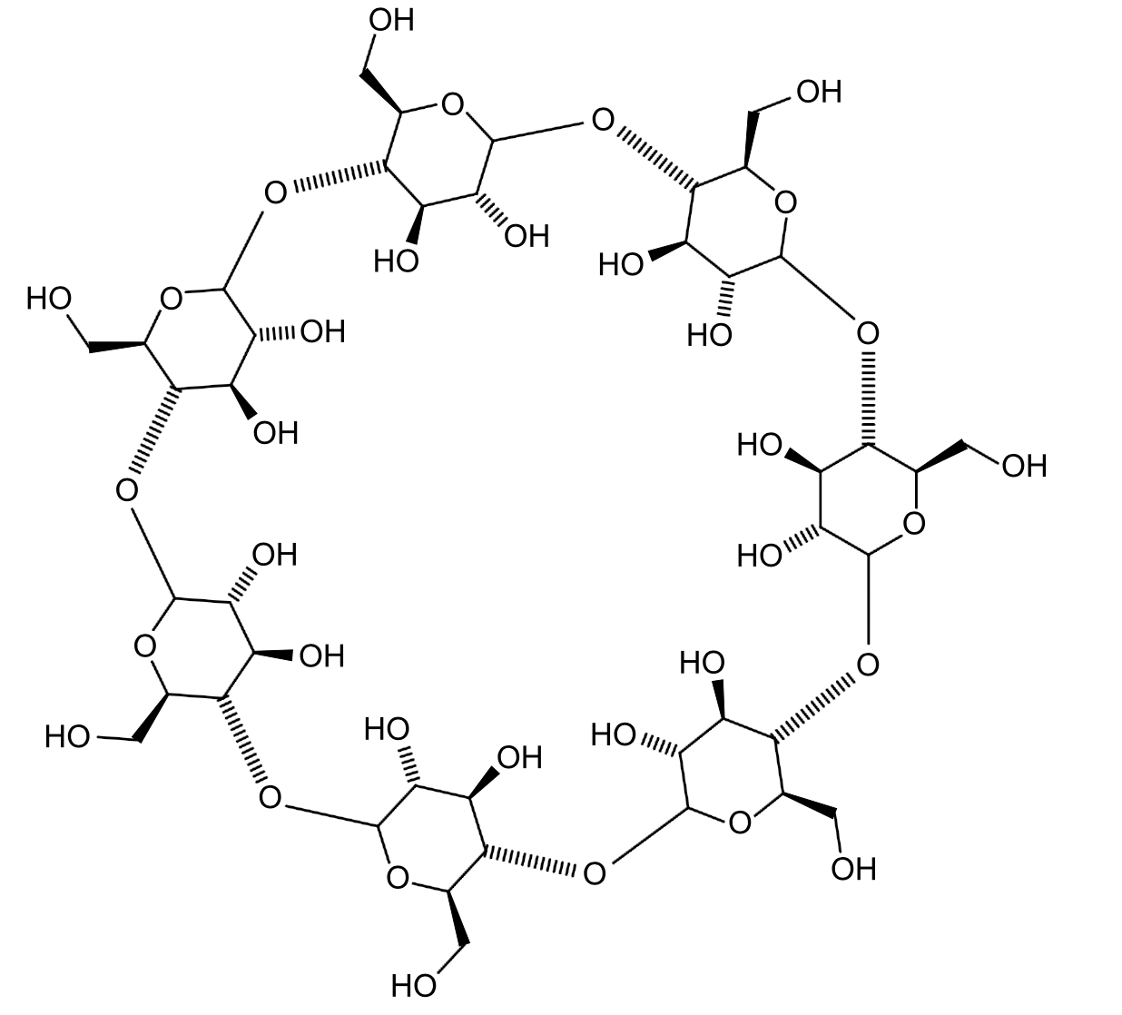
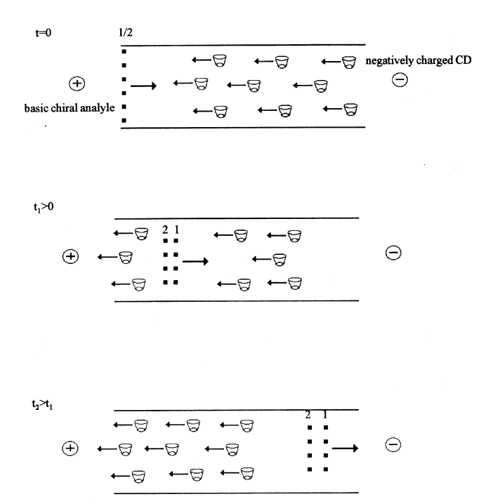
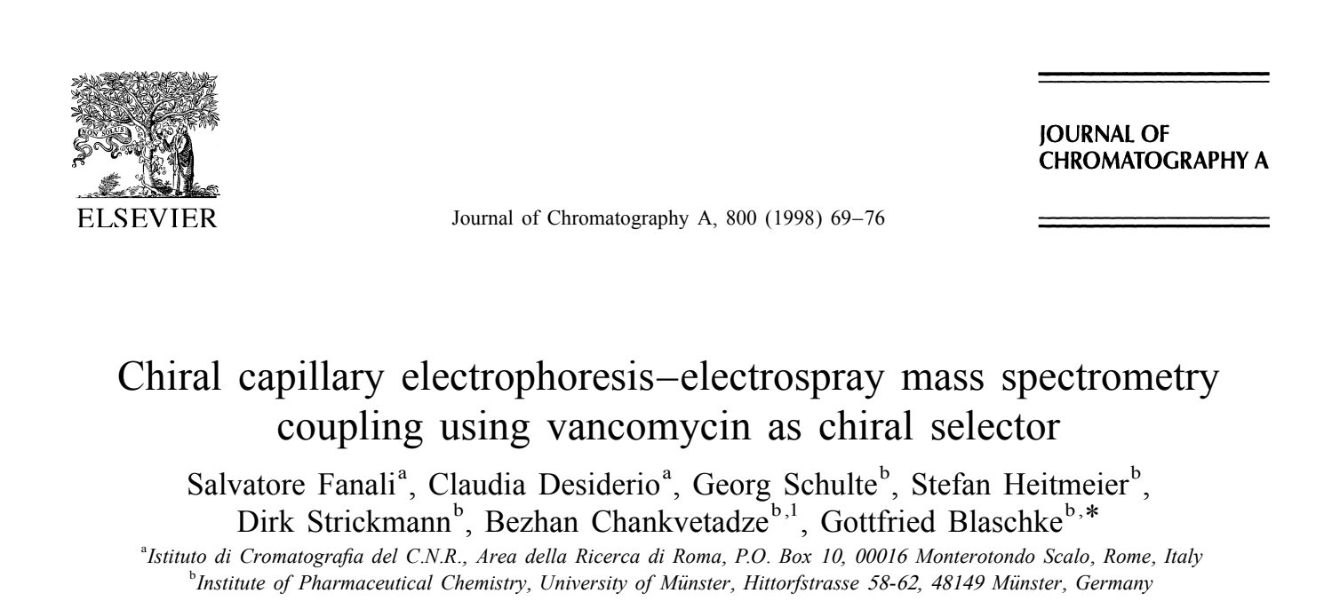
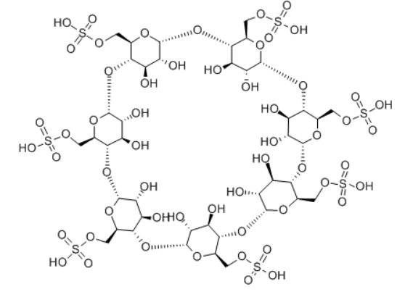
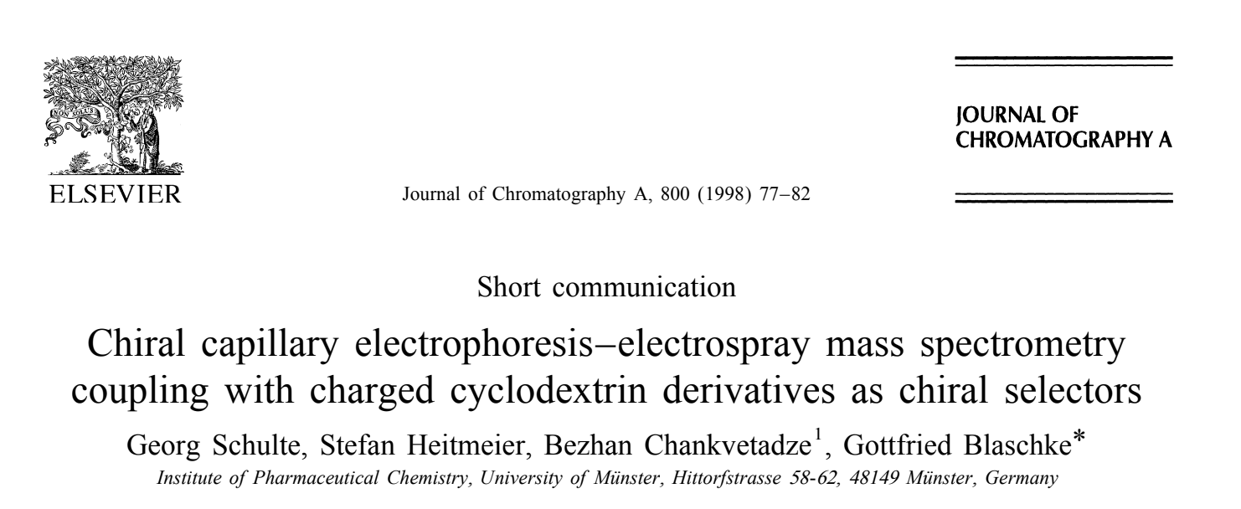
Approaches of the chiral analysis in CE-MS/MS
Target substance
Interaction between cyclodextrin and enantiomers of the target substance
separation of enantiomers
negatively charged cyclodextrin
positively charged basic substance
Interaction between negatively charged cyclodextrin and positively charged enantiomers of the target substance
separation of enantiomers

Slide 8
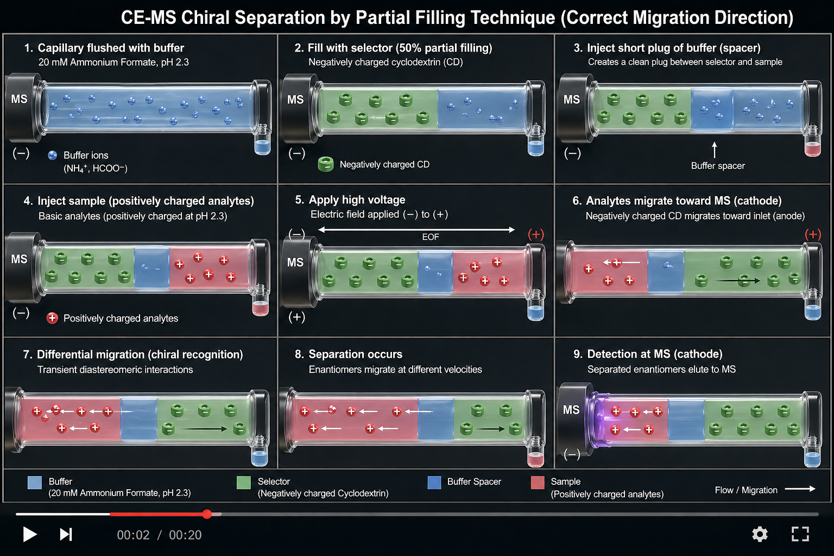

Slide 9
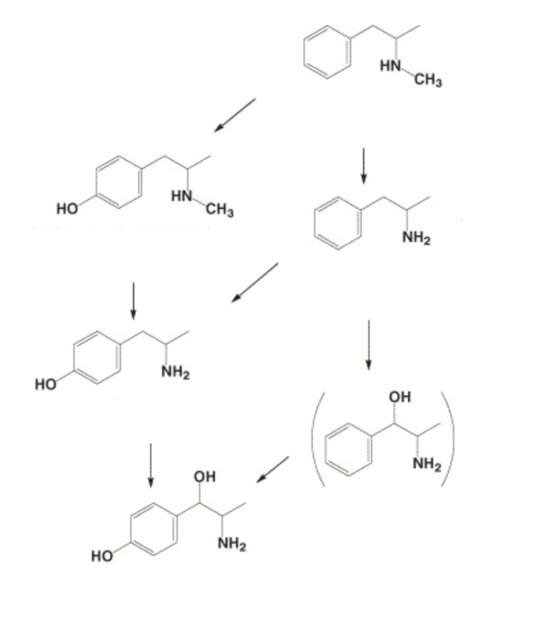
Enantioselective analysis of Methamphetamine (MAMP) , Amphetamine (AMP) and there phase-1 metabolites in human biological fluids
MAMP
4-OH-MAMP
AMP
4-OH-AMP
Norephedrine
4-OH-Norephedrine

Slide 10
2
80 % filling
Chiral selector: 3 mg/ml SBE-B-CD (sulfobutylether-beta-cyclodextrin)
BGE-20 mM ammonium formate buffer(pH-2.09)
x10
1
1
1.75
1.5
AMP
1.25
1
0.75
0.5
0.25
0
2
x10
1
1
1
0.8
MAMP
0.6
0.4
0.2
0
2
x10
1
1
1
0.8
4-OH-AMP
0.6
0.4
0.2
0
2
x10
1
1
1
0.8
4-OH-MAMP
0.6
0.4
0.2
0
1
2
3
4
5
6
7
8
9
10
11
12
13
14
15
16
17
18
19
20
21
22
23
24
25
26
27
28
Counts (%) vs. Acquisition Time (min)

Slide 11
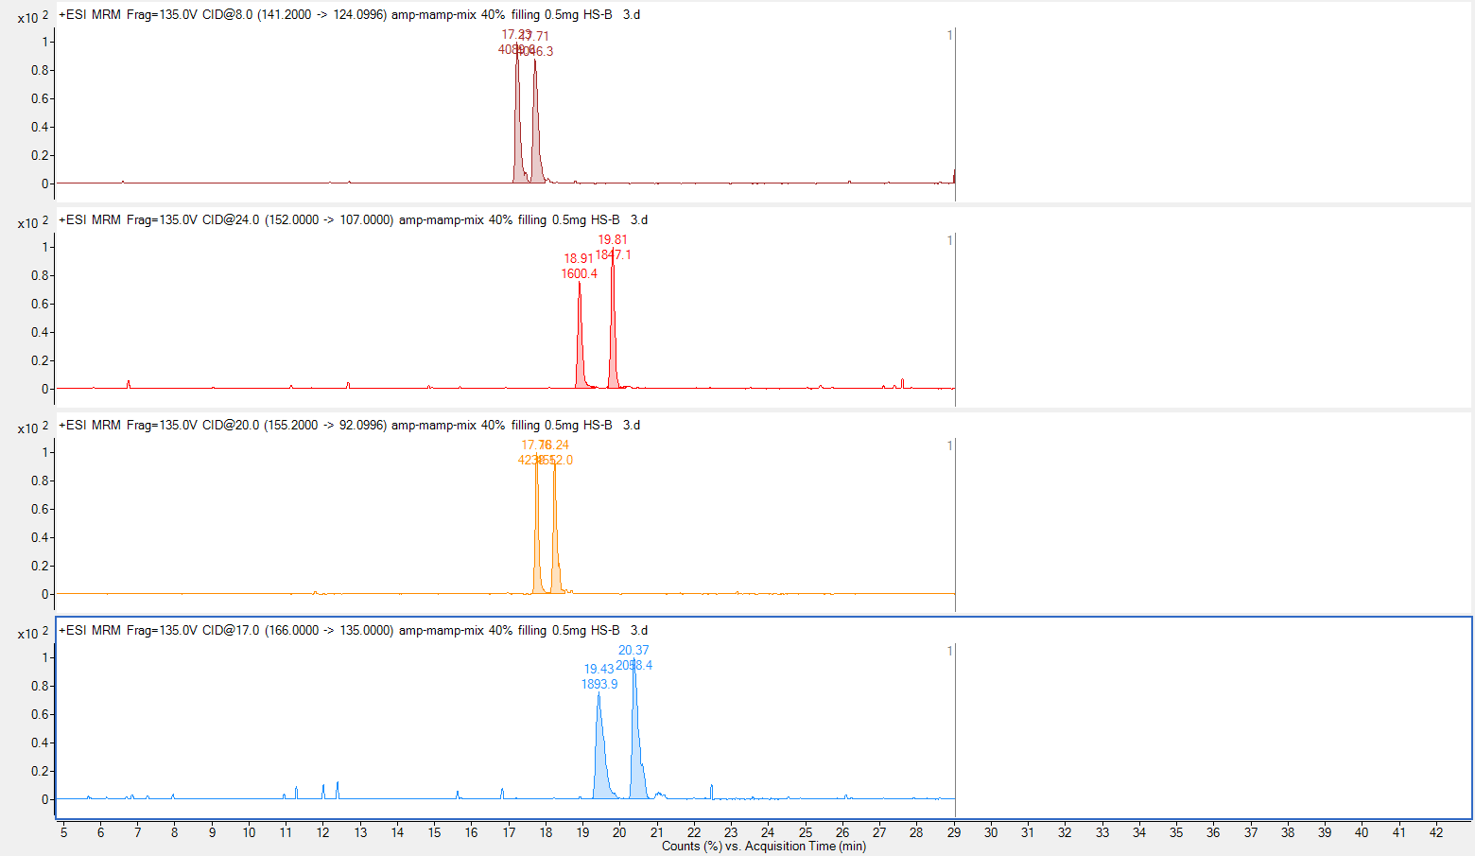
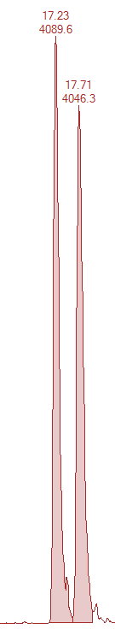
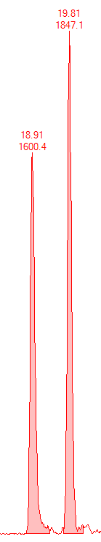
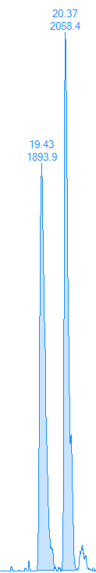
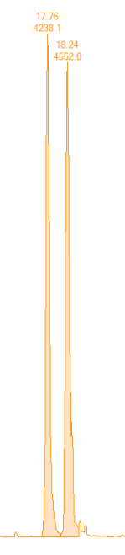
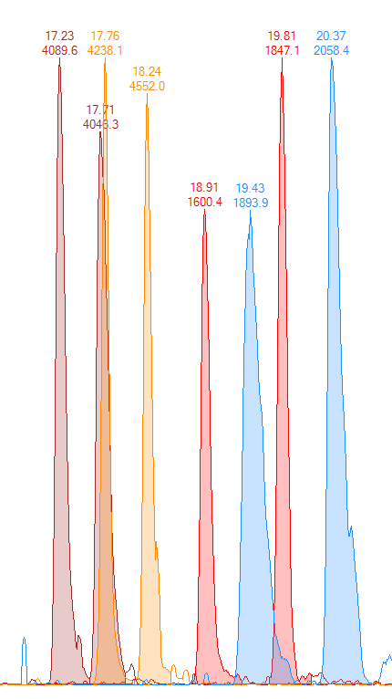
40% filling
0.5 mg/ml HS-b-CD(highly sulfated-beta-cyclodextrin)
AMP
AMP
4-OH-MAMP
MAMP
4-OH-AMP
4-OH-AMP
MAMP
TIC
4-OH-MAMP

Slide 12
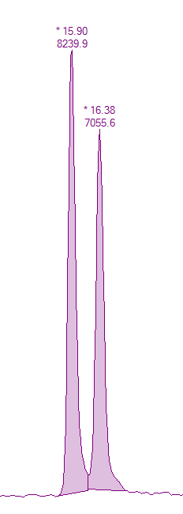
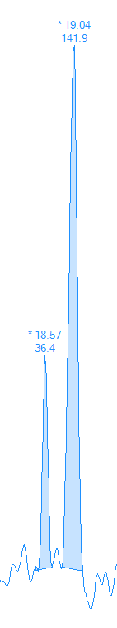
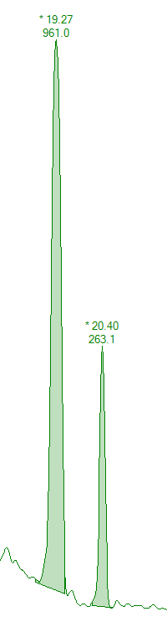
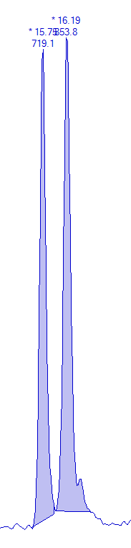
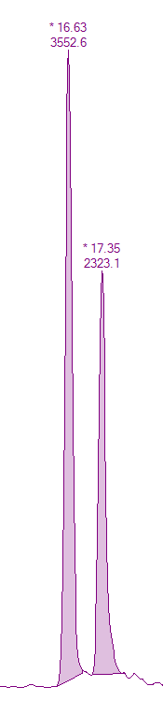
Oral fluid sample
AMP
MAMP
AMP-d5
MAMP-d5
4-OH-AMP
4-OH-MAMP
Not detected

Slide 13
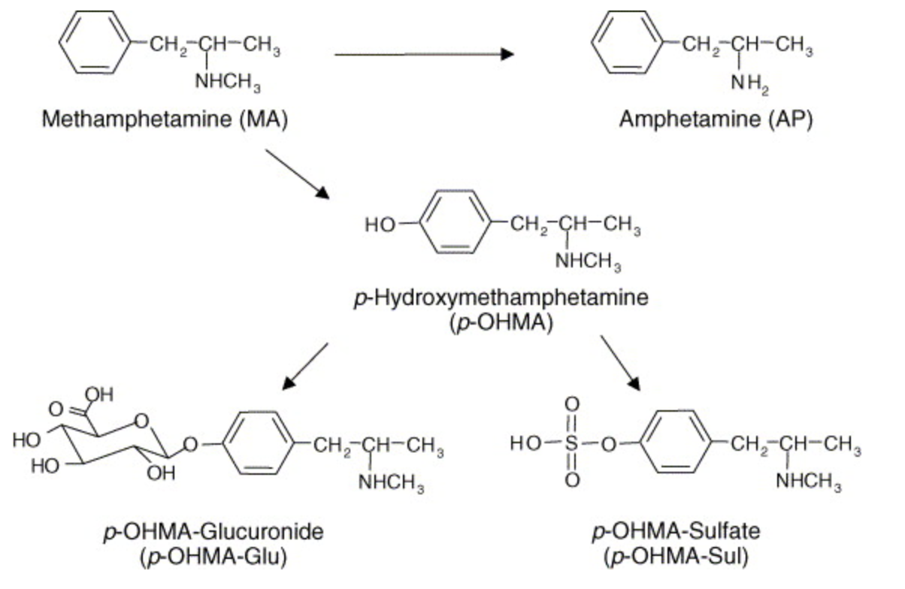
Phase-2 metabolites of methamphetamine and amphetamine
MAMP
AMP
4-OH-MAMP
4-OH-MAMP-Glucoronide
4-OH-MAMP-Sulfate

Slide 14
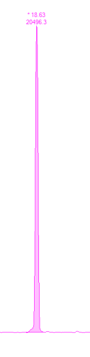

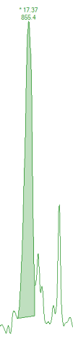
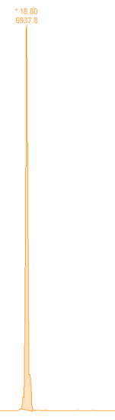
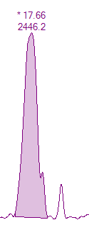
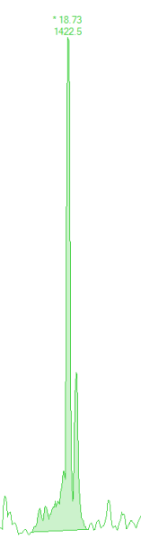
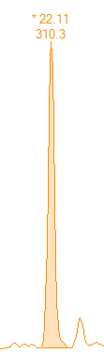


Urine sample N1
(S)- AMP
(S)- MAMP
4-OH-AMP
4-OH-MAMP
Norephedrine
4-OH-Norephedrine
4-OH-AMP-Sulfate
4-OH-MAMP-Sulfate
4-OH-MAMP-Gluc

Slide 15






Urine sample N2
(S)- AMP
(S)- MAMP
4-OH-AMP
4-OH-MAMP
4-OH-MAMP-Gluc
4-OH-MAMP-Gluc

Slide 16






Enantioselective analysis of 3,4-methylendioxy-methamphetamine (MDMA) and their phase-1 and phase-2 metabolites
3,4,-methylendioxy-methamphetamine
MDMA
4-Hydroxy-3-methoxyamphetamine
HMA
3,4,-dihydroxy-methamphetamine
HMMA
3,4,-methylendioxyamphetamine
MDA
HMMA-Glucoronide
HMMA-Sulfate

Slide 17




80% filling
0.5 mg/ml HS-b-CD
HMMA
HMA
MDMA
MDA

Slide 18




20% filling
15 mg/ml HS-y-CD
HMMA
HMA
MDMA
MDA

Slide 19




Segment filling order
0.5 mg/ml HS-b-CD (60% filling) (first)
15 mg//ml HS-y-CD (20% filling) (second)
Dependence of the order of segment filling on enantioseparation
HMMA
HMA
MDMA
MDA
Segment filling order
15 mg/ml HS-y-CD (20% filling) (first)
0.5 mg/ml HS-b-CD (60% filling ) (second)
MDMA
MDA
HMMA
HMA

Slide 20






1. 15 mg/ml HS-y-CD (20% filling)
2. 0.5 mg/ml HS-b-CD (60% filling)
MDA
HMA
MDMA
MDA
HMA
MDMA
HMMA
HMMA

Slide 21




Urine sample
HMA-Sulfate
HMMA-sulfate
HMA-Gluc
HMMA-Gluc

Slide 22



Enantioselective analysis of new methadone-like substance – Dipyanone and its phase-1 and phase-2 metabolites in human blood and urine samples

Slide 23

Chiral column: Lux-Cellulose-3 (250x4.6mm, 3um)
Mobile phase: ACN/H2O (80/20) +0.1% NH4OH
Flow rate– 1ml/min
Methadone-d3
Dipyanone

Slide 24



















Urine sample
Dipyanone
M14-M15
M1
M7
M13
M526
M528
M12
M10
M5
M512

Slide 25


Enantioseparations of Dipyanone using CE-MS/MS technique
1 mg/ml SBE-B-CD (50%filling )
0.5 მგ/მლ HS-B-CD (40 filling)

Slide 26












Dipyanone
M1
M18
M7
M13
M14-M15
M10
M5
M526
M528
M512
M12

Slide 27









Enantioselective analysis of N-ethylpentedrone (NEP) and their phase-1 metabolites
NEP
M4
M1
M6
M2
M5
M3
M7
M8

Slide 28






N-ethylpentedrone (NEP)
Dihydro-N-ethylpentedrone
HPLC-MS/MS
SFC-MS/MS
CE-MS/MS

Slide 29

Enantioselective analysis of 4-methylmethcathinone (4-MMC) and their phase-1 and phase-2 metabolites

Slide 30
















Urine sample
NOR-MEPH
Nor-MEPH-OH
4-MMC
Dihydro-4-MMC
M6
4-COOH-4-MMC
M2
Succ-Nor-MEPH

Slide 31
Thank you for you attention
HPLC-MS/MS
SFC-MS/MS
CE-MS/MS

Slide 32


