Slide 1
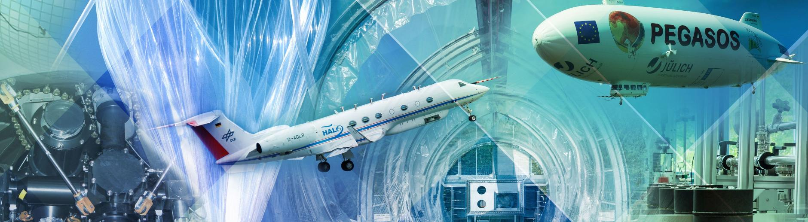
Study of climate system processes and air quality at FZJ
2026/09/09 I ROBERT WEGENER

Slide 2
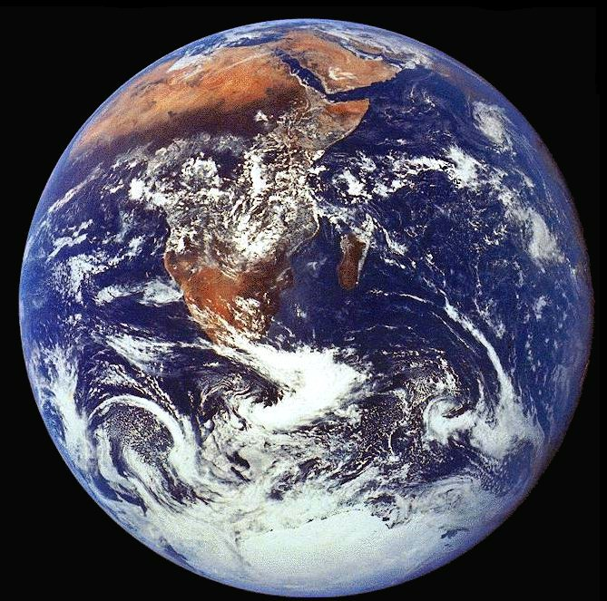
AIR POLUTION – A GLOBAL PERSPECTIVE
Subline
NASA

Slide 3
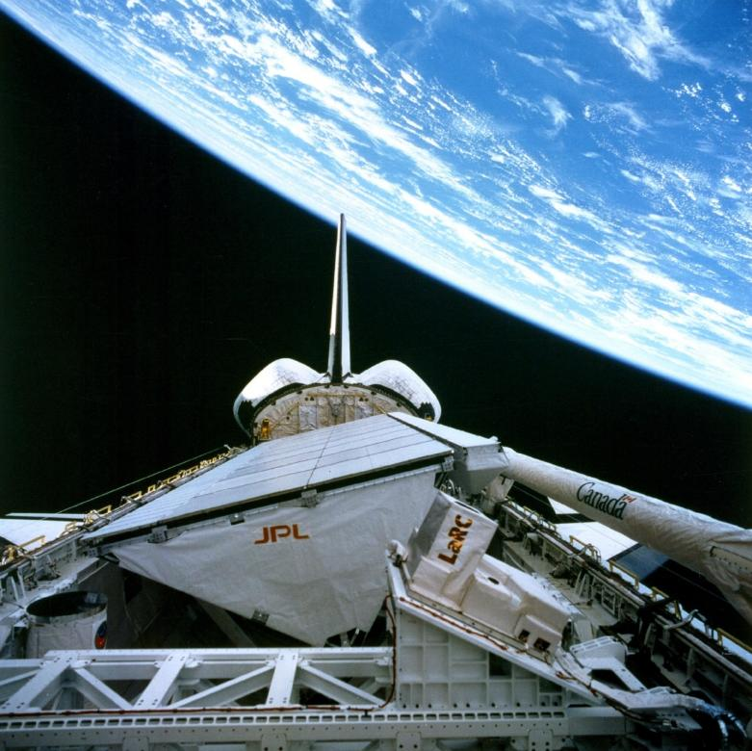
AIR POLUTION – A GLOBAL PERSPECTIVE
Subline
Subline
Earth Radius
6370 km
NASA
Atmosphere
~ 100 km
NASA Space Shuttle Endeavour

Slide 4
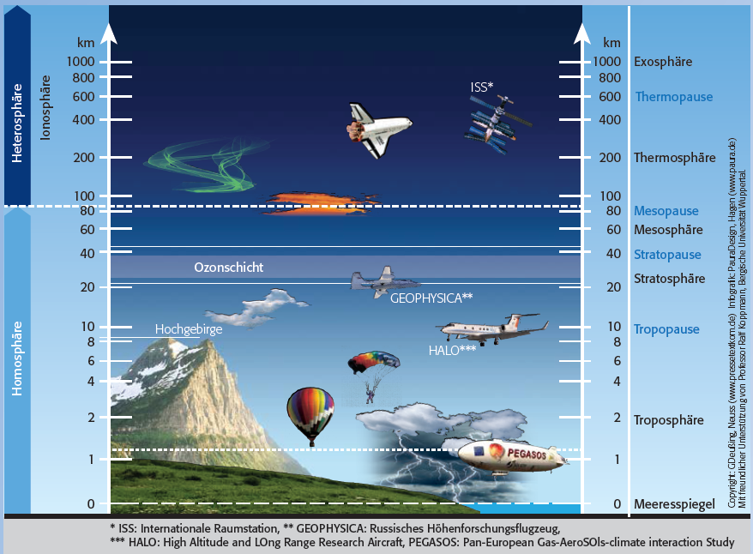
AIR POLUTION – A GLOBAL PERSPECTIVE
Subline
Subline
Institute of Climate and
Energy Systems
ICE-4: Stratosphere
ICE-3: Troposphere
NASA Space Shuttle Endeavour

Slide 5
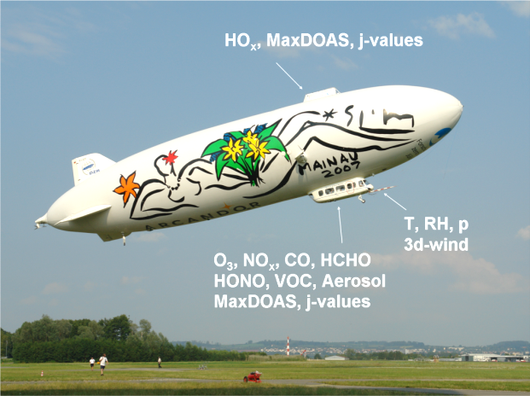
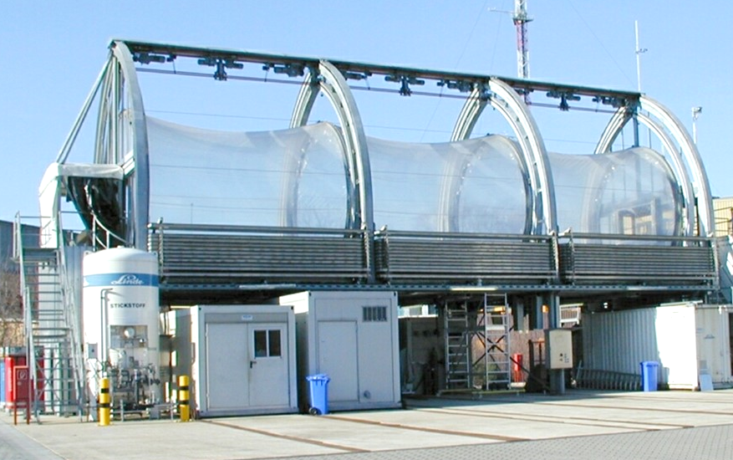
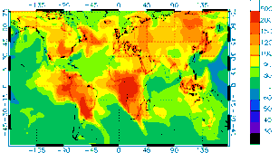
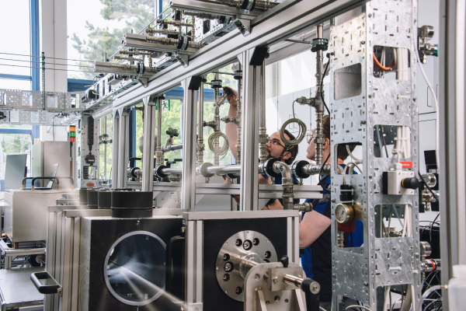
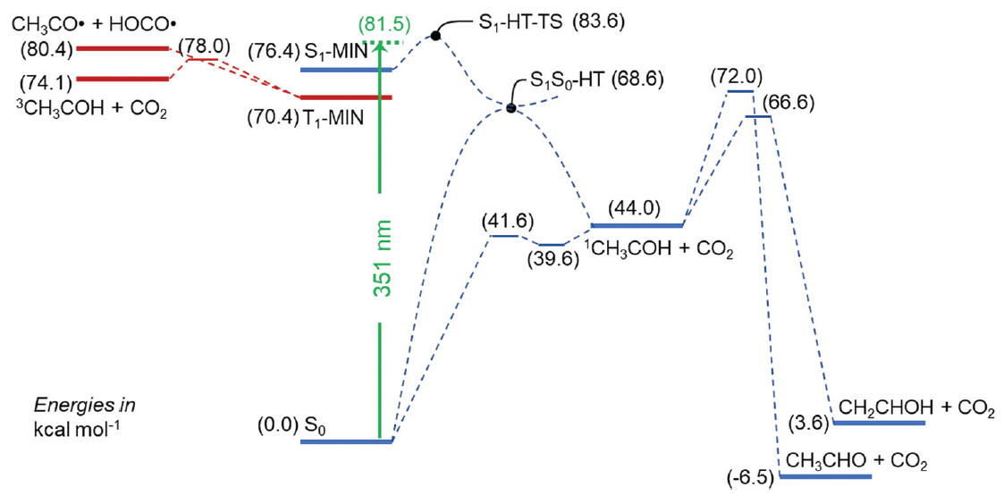
Atmospheric Observations
Processes in Chamber Experiments
Understanding Air Quality and Climate Warming
Simulation and Forecast
Quality Assurance / Instrument Development
Reaction Kinetics

Slide 6
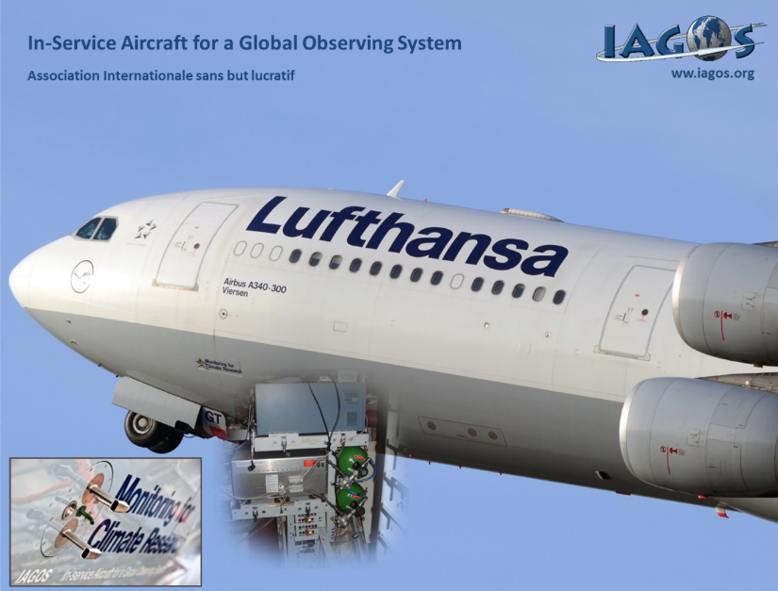
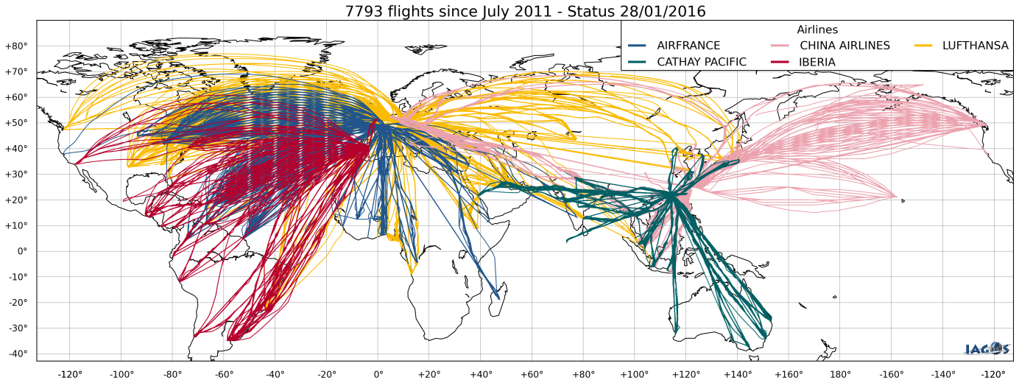
OBSERVATIONS
EU-Infrastructure IAGOS

Slide 7
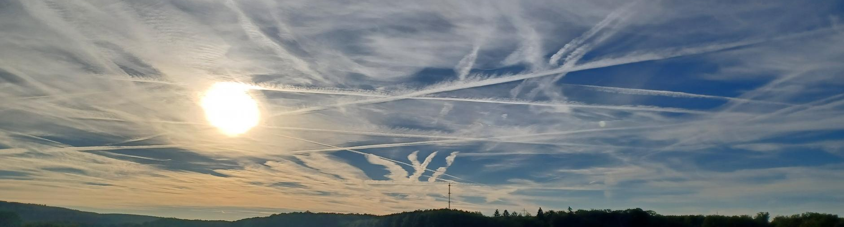
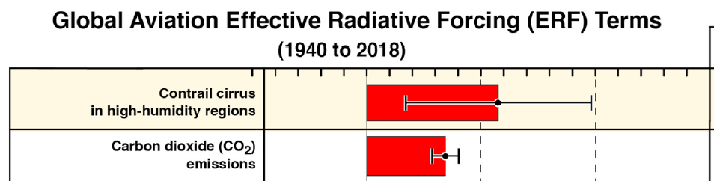
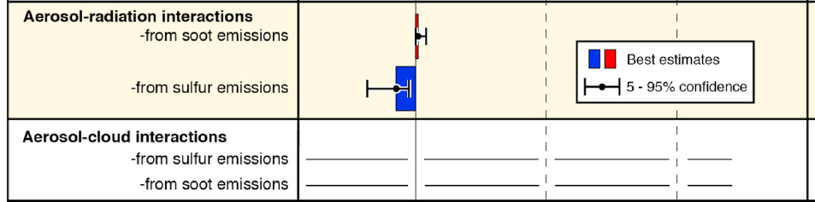
OBSERVATIONS
Water vapour predictions to reduce radiative forcing
Conf. levels
low
high
low
low
very
low
warming
Contrail cirrus doubles aviation CO₂ warming
Aviation soot has a warming radiative impact
Low confidence persists in the climate impact of aviation aerosol and contrail cirrus

Slide 8
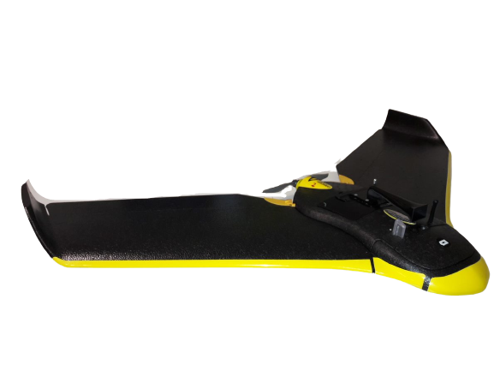
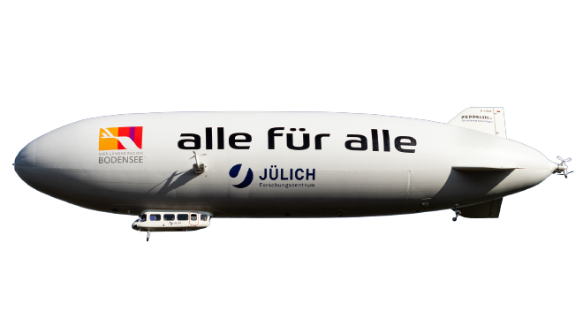
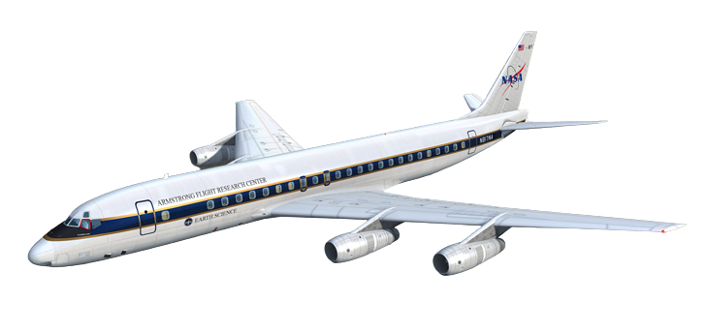
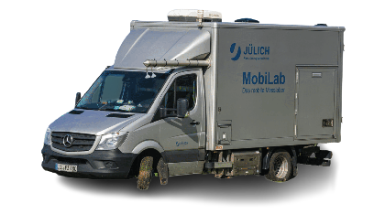
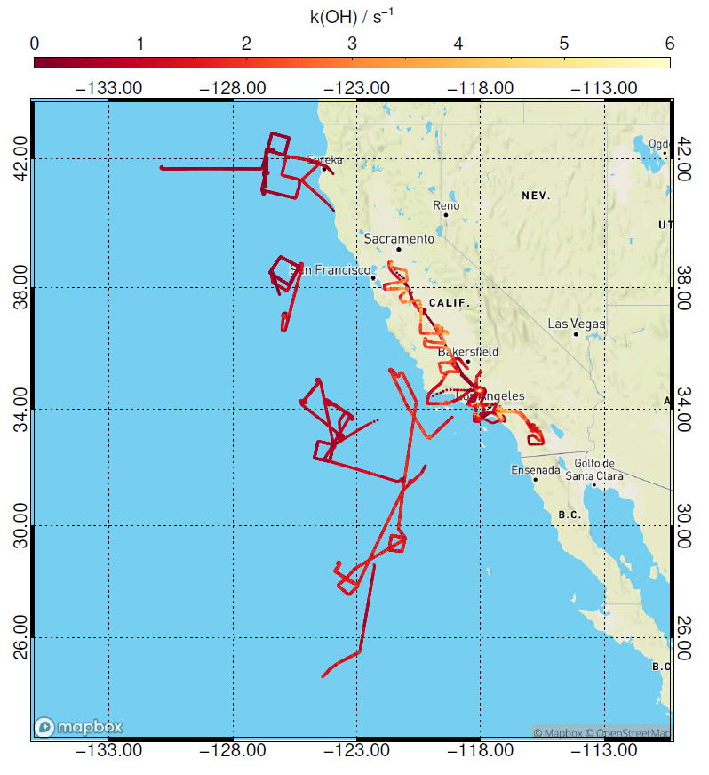
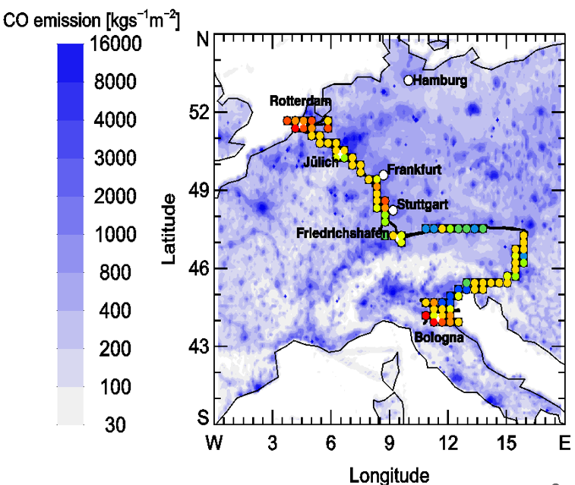
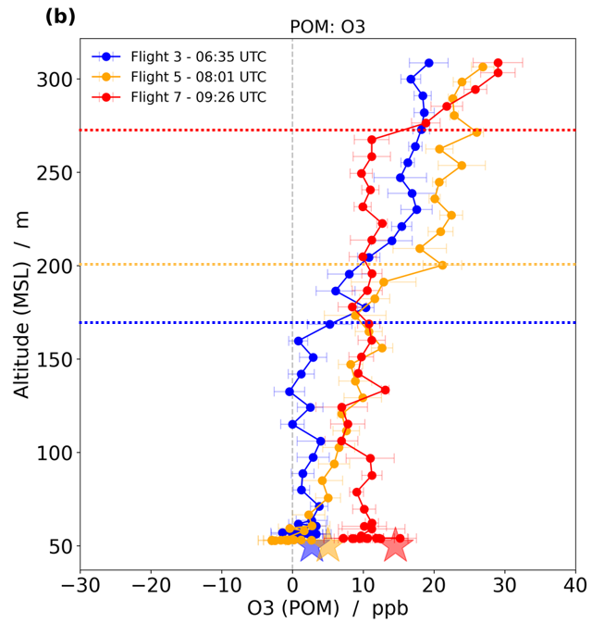
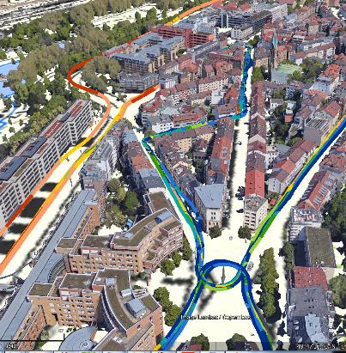
OBSERVATIONS
Zeppelin
UAVs
Aircraft
MobiLab
Observation of air masses while chemical aging
Measurement of vertical profile of air pollutants
Observations of pollutants in large areas
Validation of local emissions sources / air quality model

Slide 9
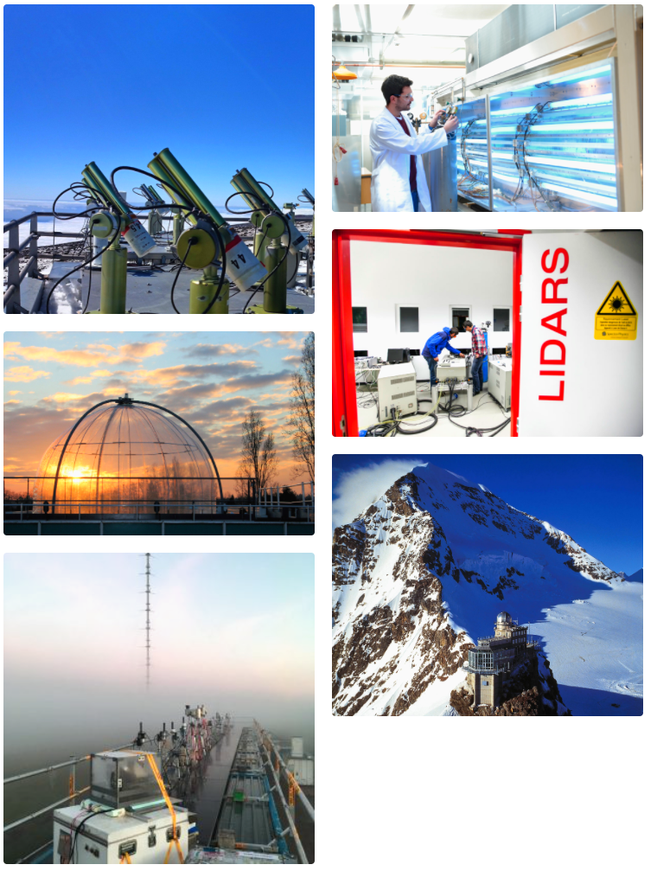
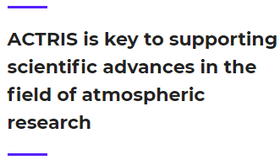
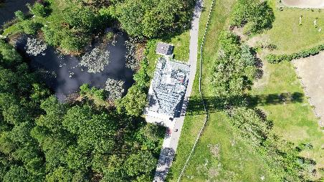
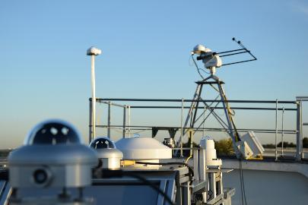
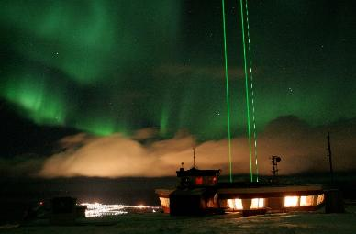
OBSERVATIONS
ACTRIS is a pan-European research infrastructure producing high-quality data and information on short-lived atmospheric constituents and on the processes leading to the variability of these constituents in natural and controlled atmospheres.

Slide 10
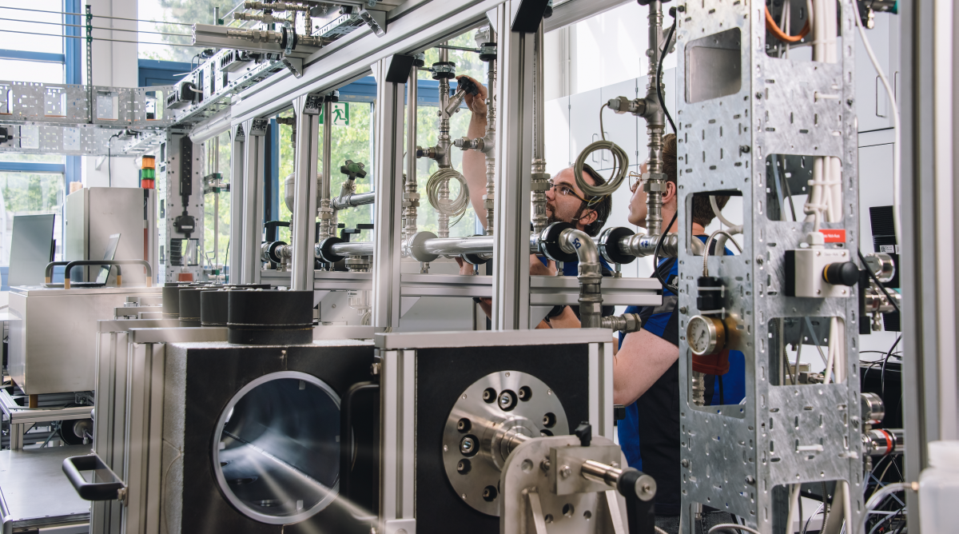
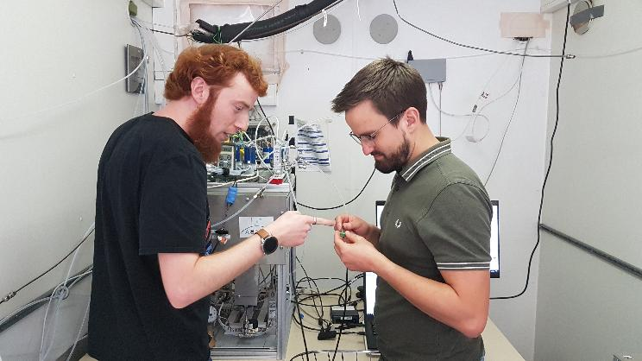
OBSERVATIONS
Calibration Centers in Jülich...
are responsible for nitrogen oxides, organic compounds and oxygenated organic compounds,
serves 30 measurement stations, 11 chambers / laboratories, 3 mobile platforms,
offers a large calibration flow tube,
provides comparison of measurements by a high number of instruments in experiments in the chamber.

Slide 11
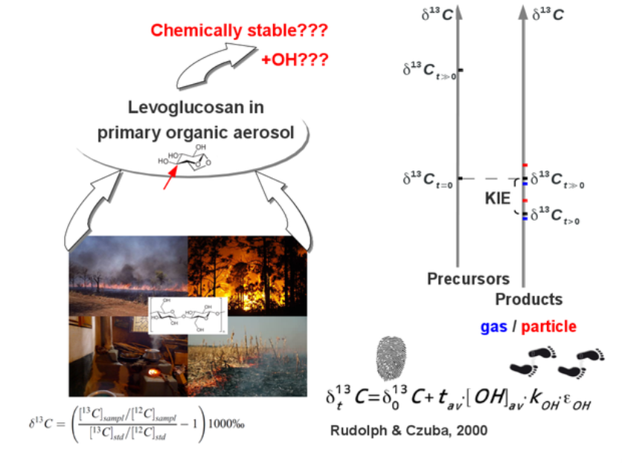
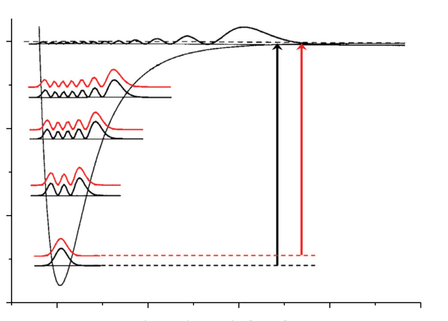
OBSERVATIONS
Measurements of stable isotopes
For source attribution
To elucidate transport times
Ana Kuntchulia (3-rd Year B. Sc. Student, TSU) “Separation of Deuterated Isotopologues by Capillary Electrophoresis”
Nikoloz Gonitashvili (3-rd Year B. Sc. Student, TSU) “First Baseline Separation of Isotopomers by Capillary Electrophoresis”

Slide 12
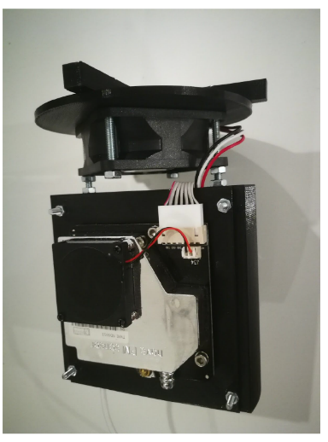
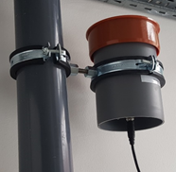
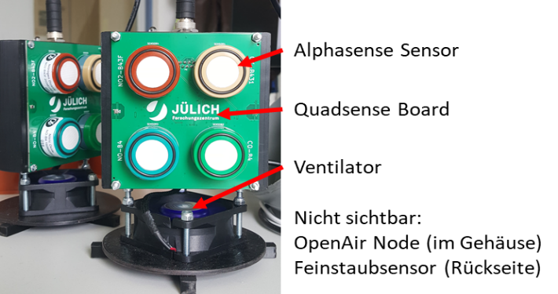
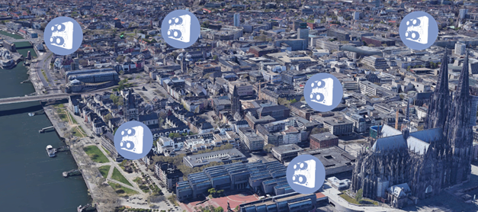


OBSERVATIONS
With budget sensors
Sensors for harmful gases (NO, NO₂, CO, Ozone)
Kato Melikidze (Bachelor, ISU) "Integrating Low-Cost Air Quality Monitoring for Particulate Matter Assessment in Georgia“
Luka Menabde (TSU)“Particulate matter contamination measurement in Tbilisi using traditional instruments and modern budget friendly sensors”

Slide 13
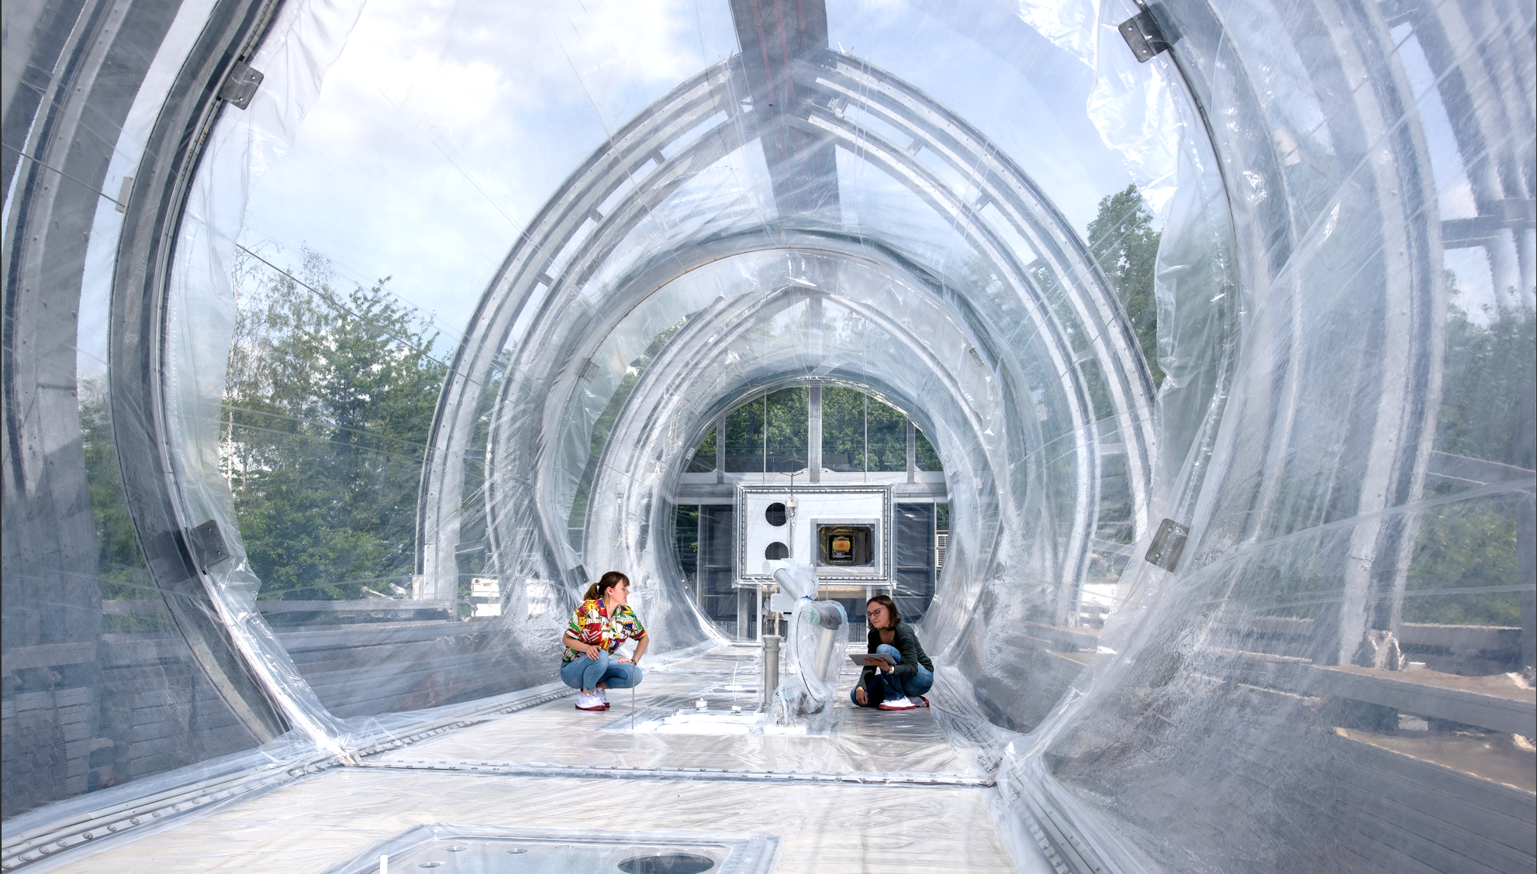
OBSERVATIONS
Simulation of atmospheric processes
Quality assurance of instruments
Access for users to chamber and data

Slide 14
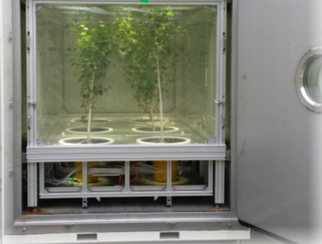
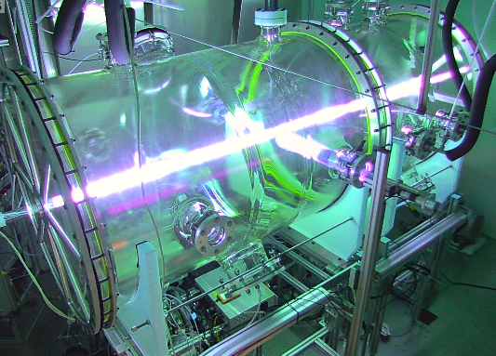
Chamber Experiments
Outdoor SAPHIR
SAPHIR-PLUS
Indoor SAPHIR-STAR
Chemical processes and formation of ozone / particles at today‘s and future‘s atmospheric conditions in day-long experiments
Using real plant emissions to investigate their chemical trans-formation and impact on air quality
Chemical processes and formation of ozone / particles in steady-state stirred reactor

Slide 15
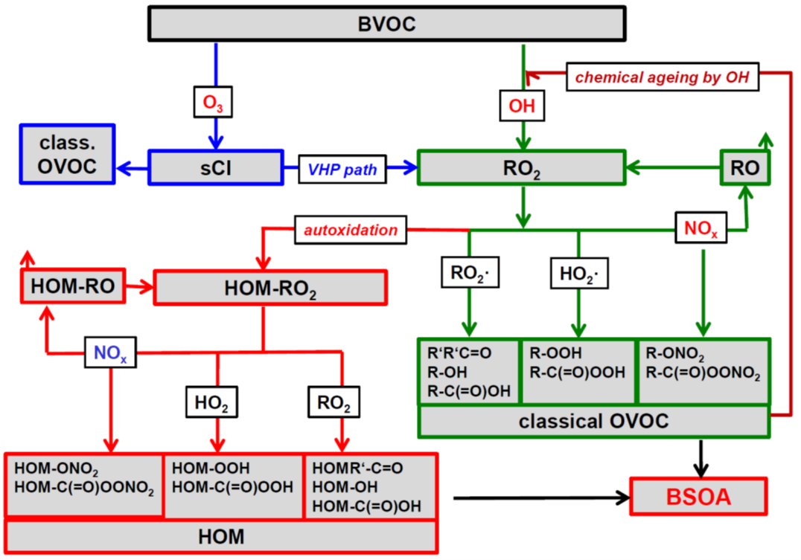
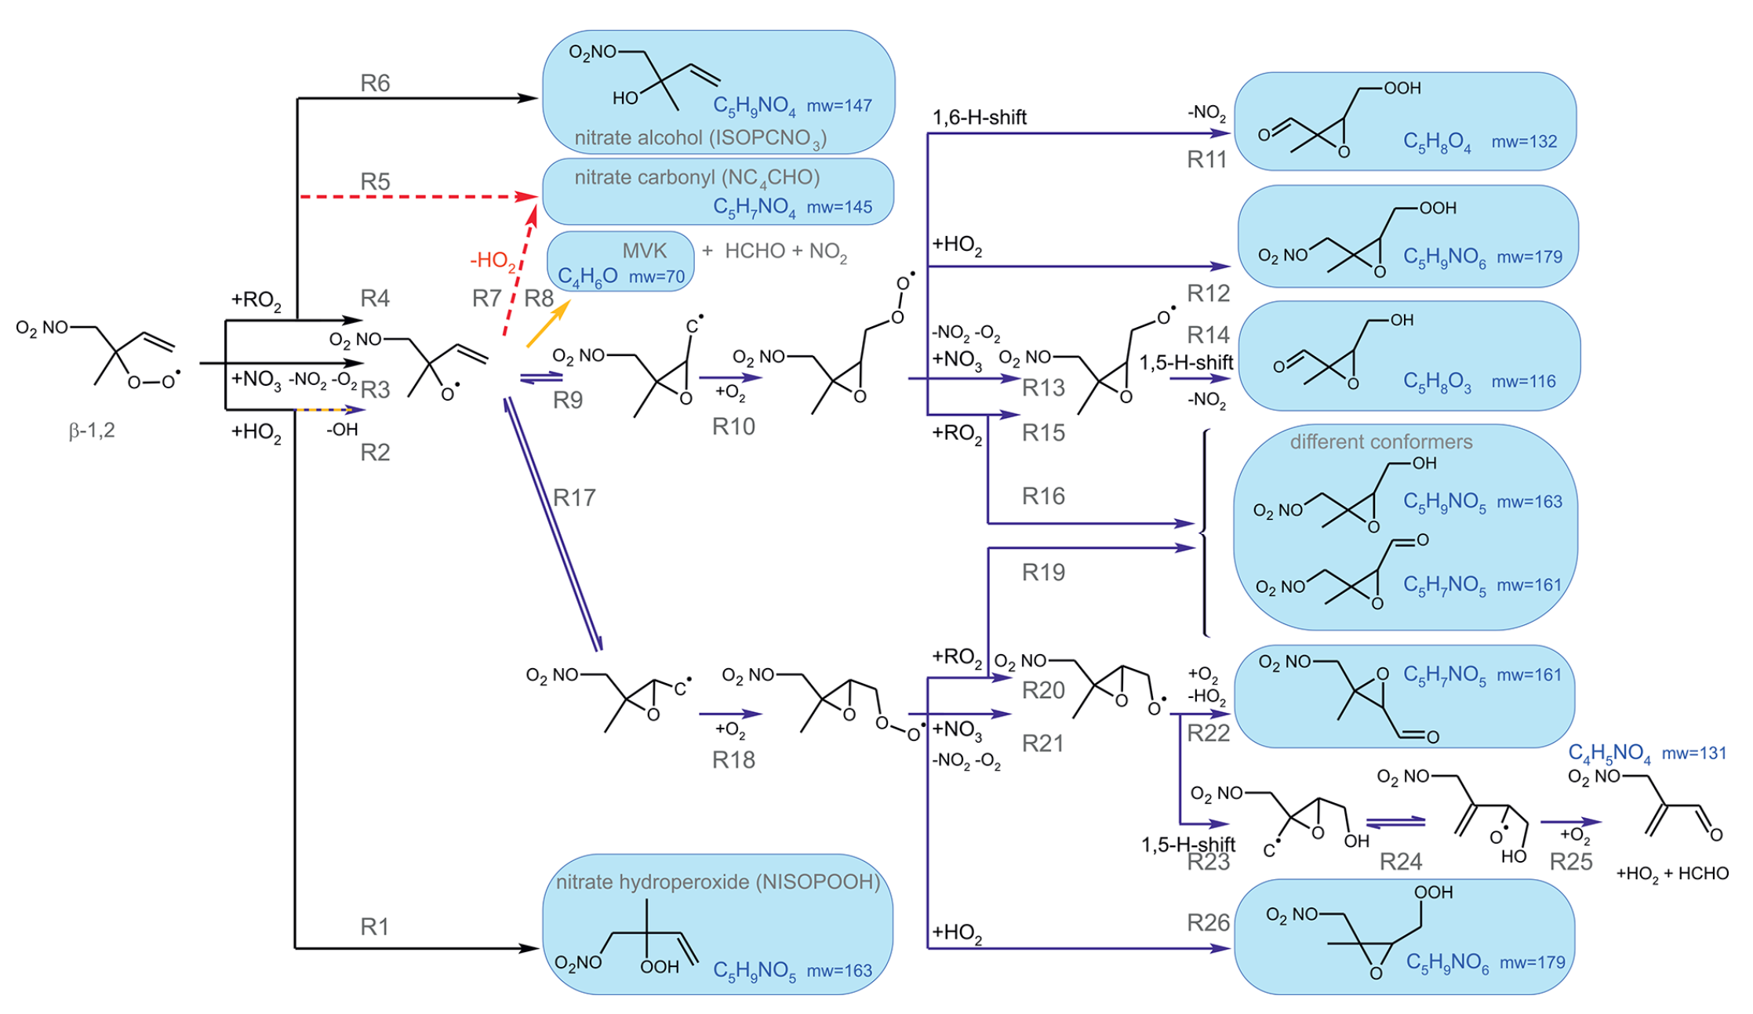
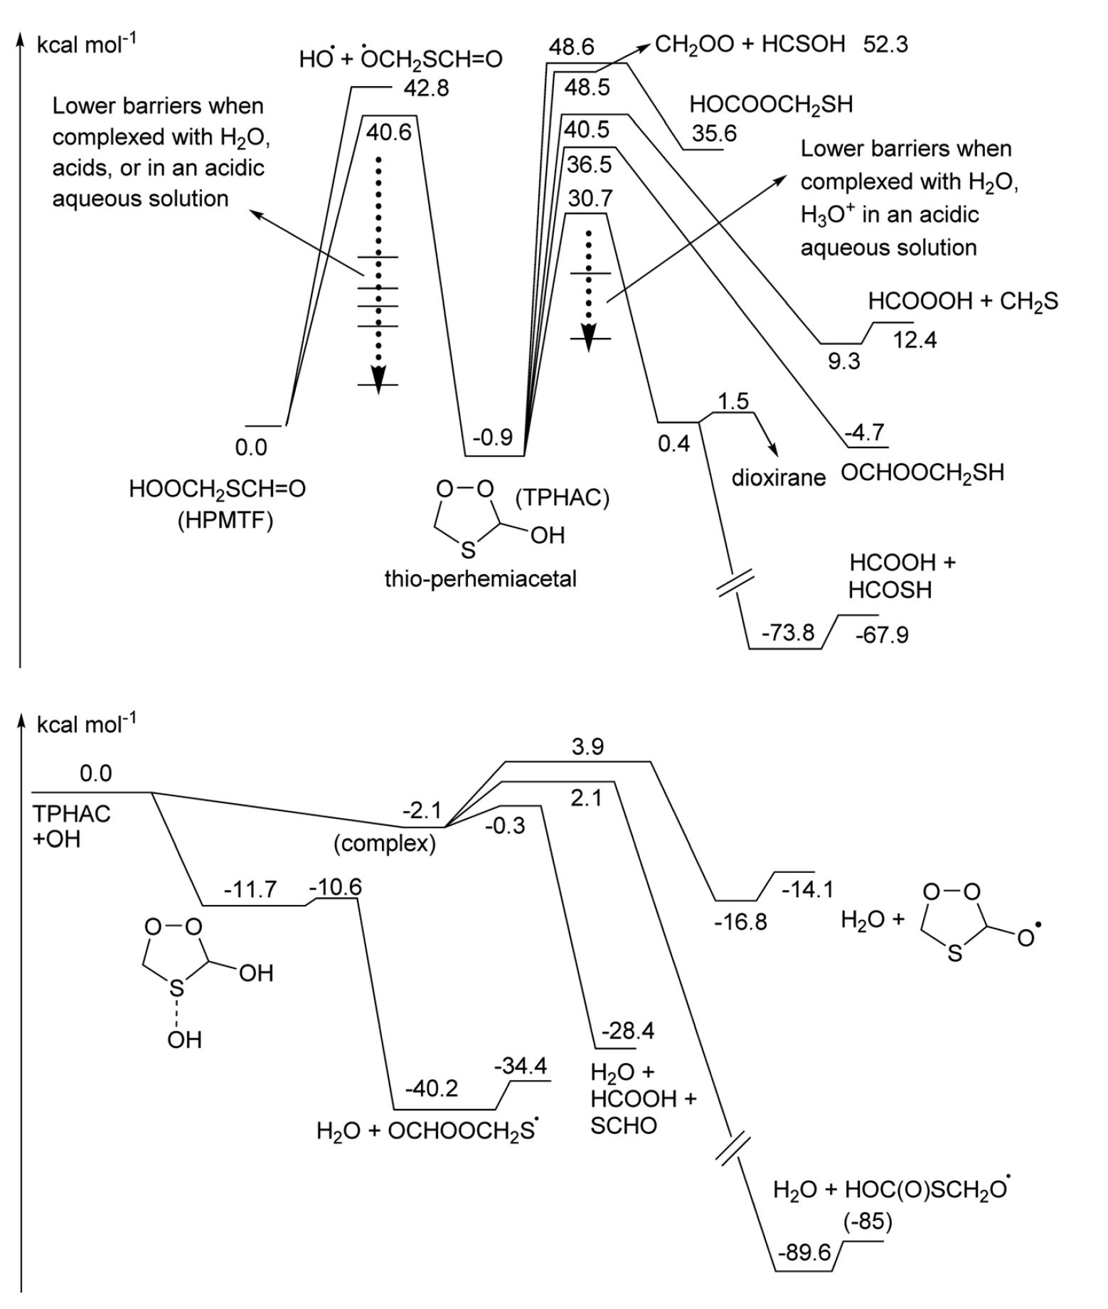
Reaction Kinetics
Mechanistic studies
Model development
Kinetic theory studies
Discovery and identification of pathways of atmospheric oxidation processes
Comparison, validation, and extension of chemical mechanims and calculations
Theoretical calculations, kinetic studies, development of structure-activity relationships (SAR)

Slide 16

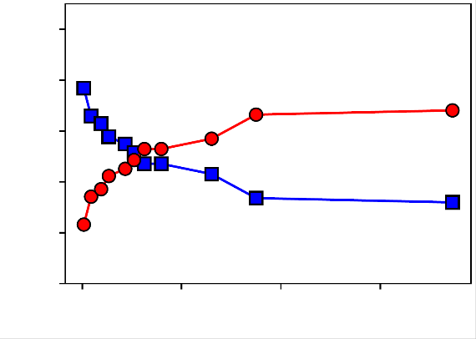
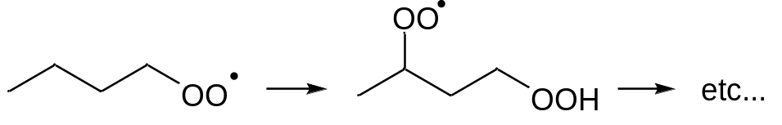
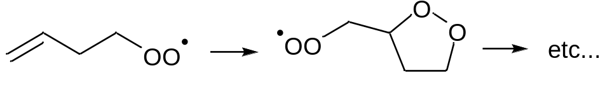
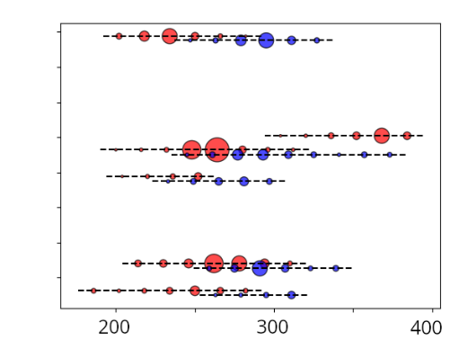
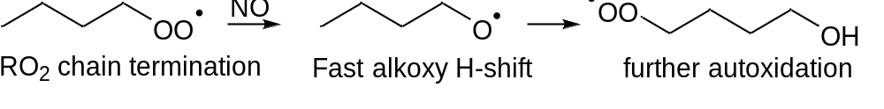
Reaction Kinetics
Example: formation of highly oxidated molecules (HOMs) from biogenic RO₂
Theory: Extensive SAR characterization of RO₂ autoxidation reaction rates and trends
SAPHIR-STAR
Experiment: Alkoxy radical chemistry can sustain, even enhance, HOM formation.
1.0
Normalized HOM fraction
0.8
Alkoxy-derived HOM
0.6
0.4
RO₂-only HOM
0.2
Increasing NO
Successive O₂ addition
0.0
Experiment: Characterization of HOM “families“ following viable autoxidation paths
0
20
40
NO [ppb]
Different backbones
Theory: autoxidation chain termination does not imply autoxidation stop
Mass
Nozière et al. Angew. Chem. 2019 ; Vereecken et al. ACP 2020 ; Zhao et al. ACP 2021 ; Vereecken et al. PCCP 2021 ; Wu et al. ACP 2021 ;
Shen et al. EST 2021 ; Tsiligiannis et al. GRL 2022 ; Guo et al. ACP 2022 ; Shen et al. Science Adv. 2022 ; Luo et al. ACP 2023, Nozière et al. PCCP 2024

Slide 17
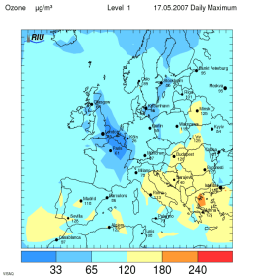
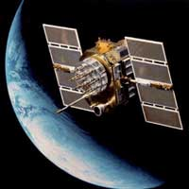
SIMULATIONS
Global chemistry-climate interactions
Regional scale processes and feedbacks
→ Improvements by data assimilation methods
Operational forecasting and chemistry / emission analysis
→ Copernicus Atmosphere Monitoring Service

Slide 18
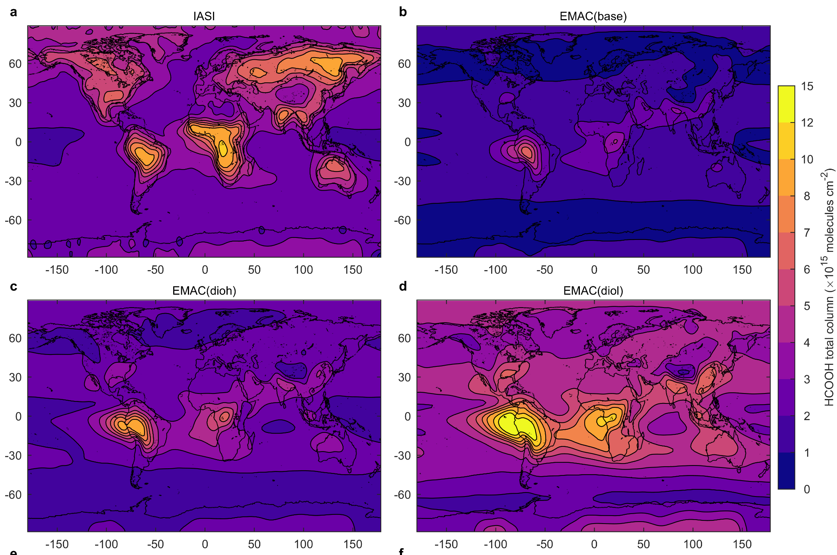
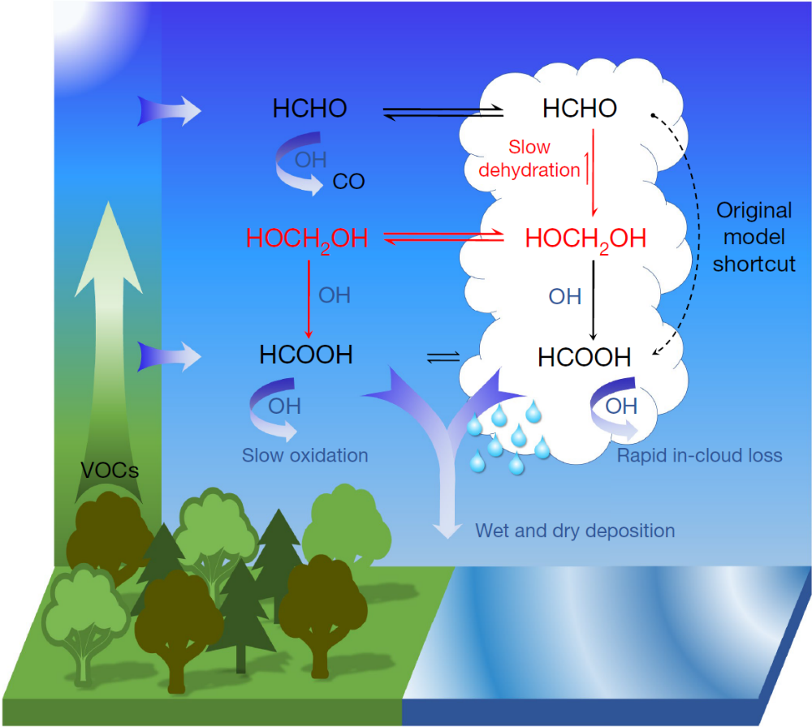



SIMULATIONS
Example: Formation of Formic Acid
Model (revised)
View from space
HOCH₂OH_{(g)}
Satellite
HCHO_{(g)}
HCOOH_{(g)}
Ina Pipia (3-rd Year B.Sc. Student, TSU) “Role of Formic Acid in the Enantioseparation of New Chiral Telluronium Complexes Using High-Performance Liquid Chromatography”
Model
HCOOH
total column
(10¹⁵ molec cm⁻²)

Slide 19


SIMULATIONS
Air Quality at Urban Scale
Results
Simulations at 2x2m grid
Main part of ozone production happens on main streets where RO_{x} are advected to.
A significant part of ozone is produced in parks.
Ozone production
NO_{x} (NO+NO₂)

Slide 20

https://www.fz-juelich.de/en/ice/ice-3
Contacts:
Robert Wegener (r,wegener@fz-juelich.de)
Giorgi Jibuti (giorgi.jibuti@tsu.ge)

