Slide 1

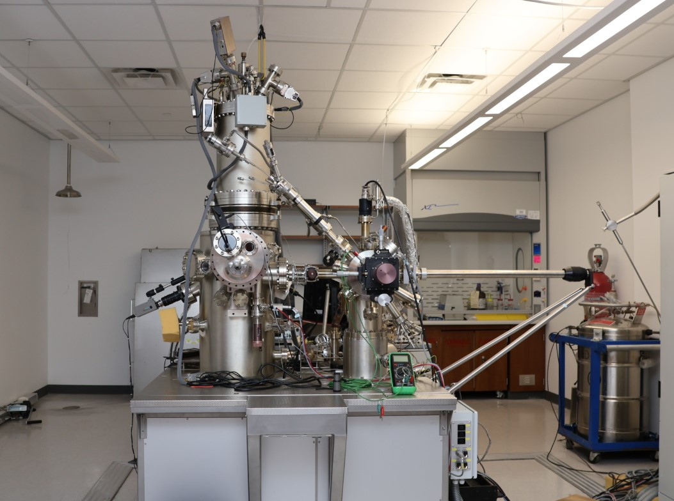
STM
Scanning Tunneling Microscope
Gabriel Gogishvili

Slide 2
STM
Scanning Tunneling Microscope
Invented in 1981
Nobel Prize in 1986
Utilizing Quantum Tunneling
Magnification of ~10⁸
Resolution of Individual Atoms

Slide 3
STM
Working Principle
Conductive Surfaces
Ultra-Sharp Tip
Scanning Over the Surface
Measuring Tunneling Current

Slide 4
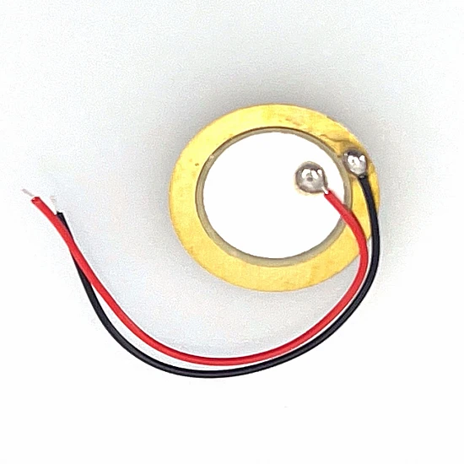
STM
Working Principle

Slide 5
STM
Working Principle

Slide 6
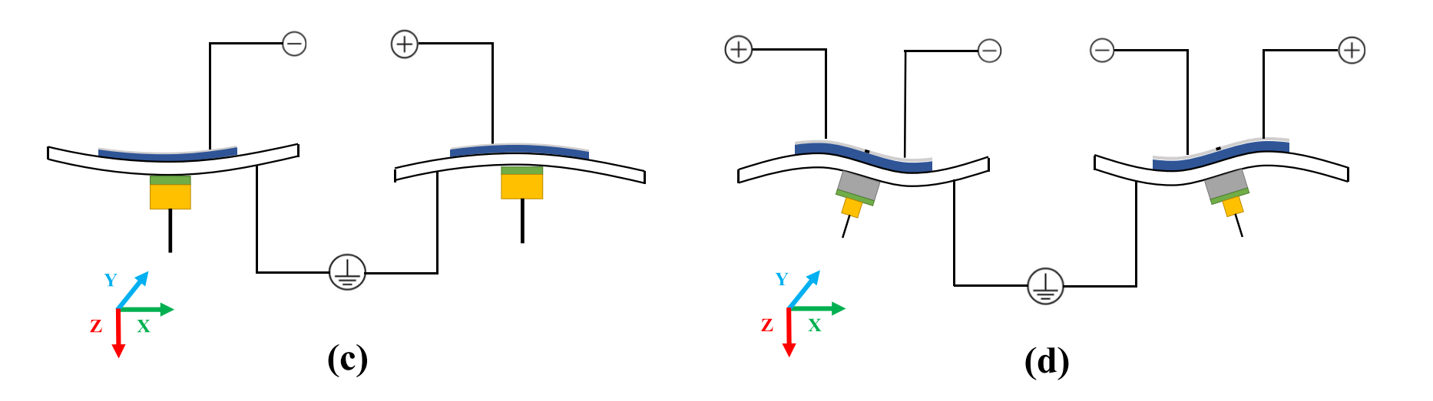
STM
Working Principle

Slide 7
Electronics
Tip
16 Bit ADC
Preamplifier
Z+X
Z+Y
Piezo-Driver
X
Y
Z-X
4-Ch DAC
Z
Z-Y
Microcontroller
BIAS
Test Surface

Slide 8
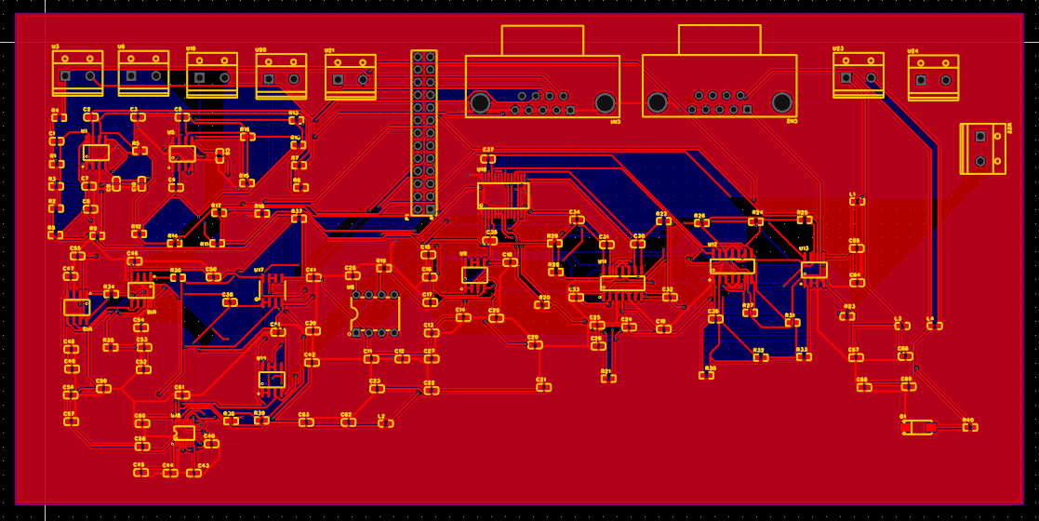
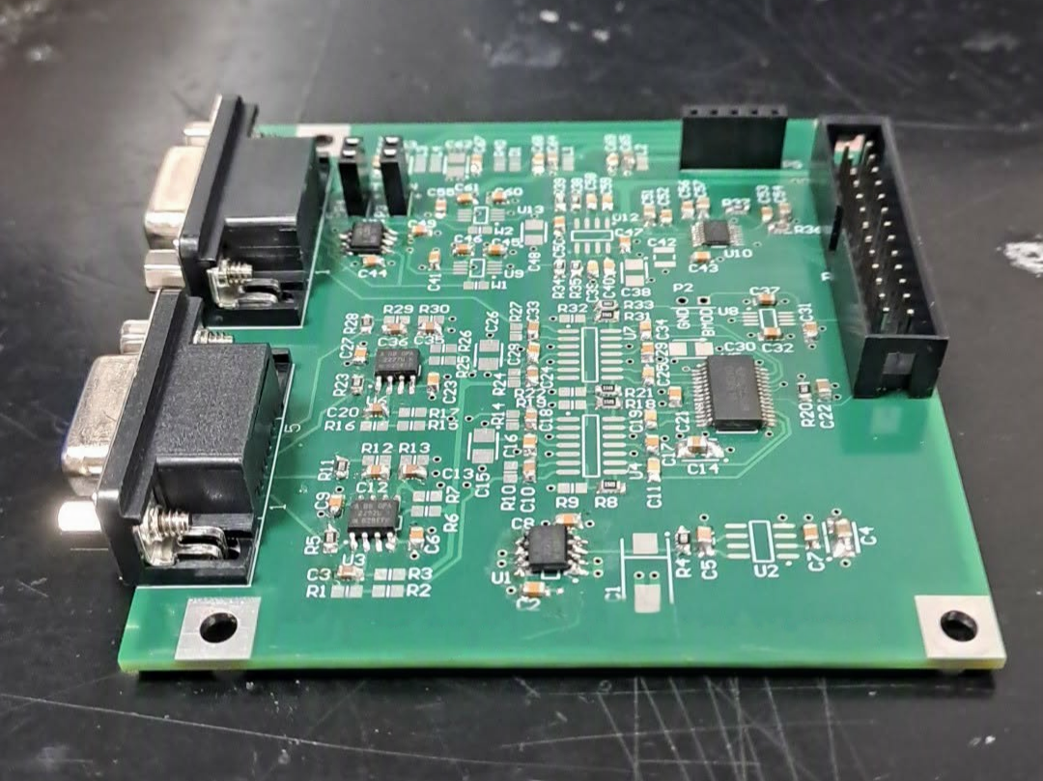
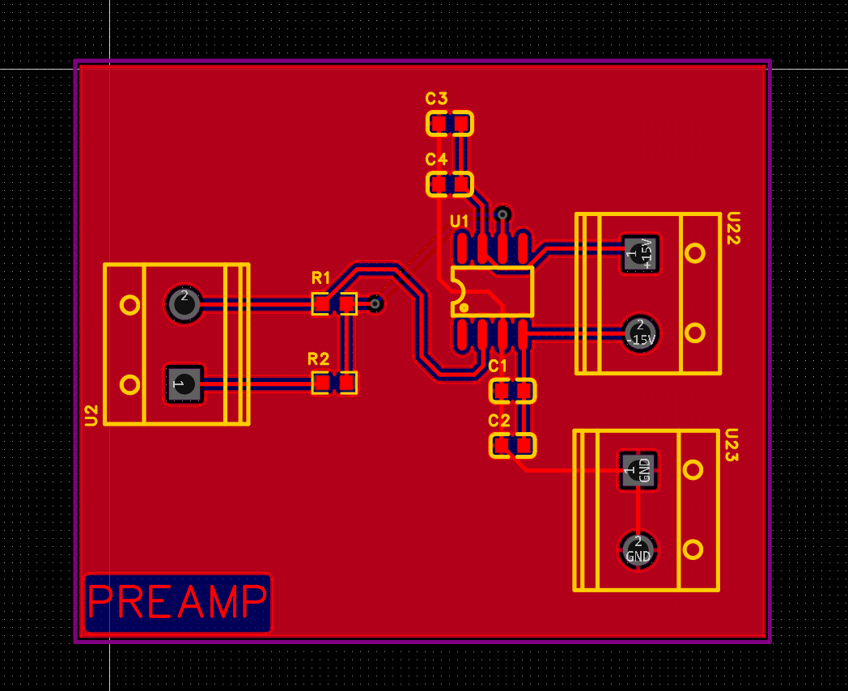
Electronics
Tip
16 Bit ADC
Preamplifier
X
Y
4-Ch DAC
Z
Microcontroller
BIAS
Z+X
Z+Y
Piezo-Driver
Z-X
Z-Y
Suspension Springs
Test Surface
Actual Microscope
Strong Magnets

Slide 9
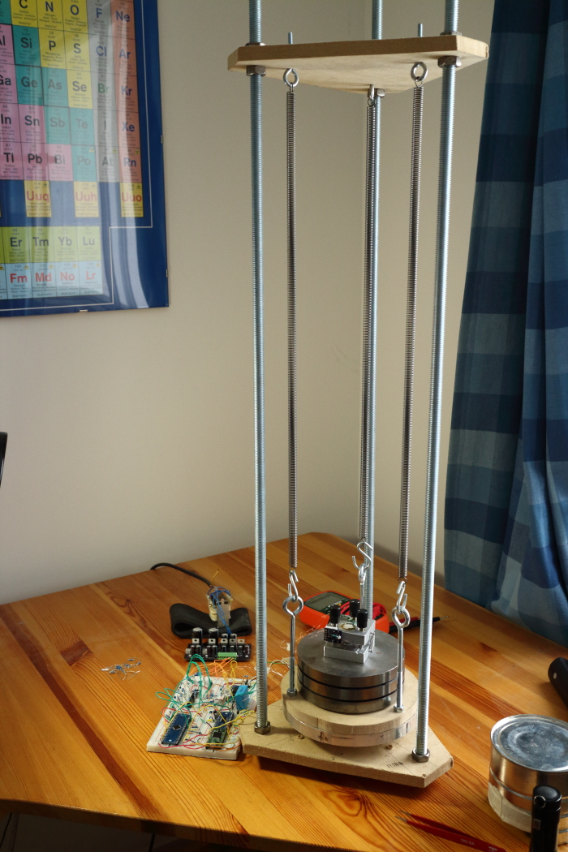
Vibration Isolation
Suspension Springs
Actual Microscope
Strong Magnets

Slide 10
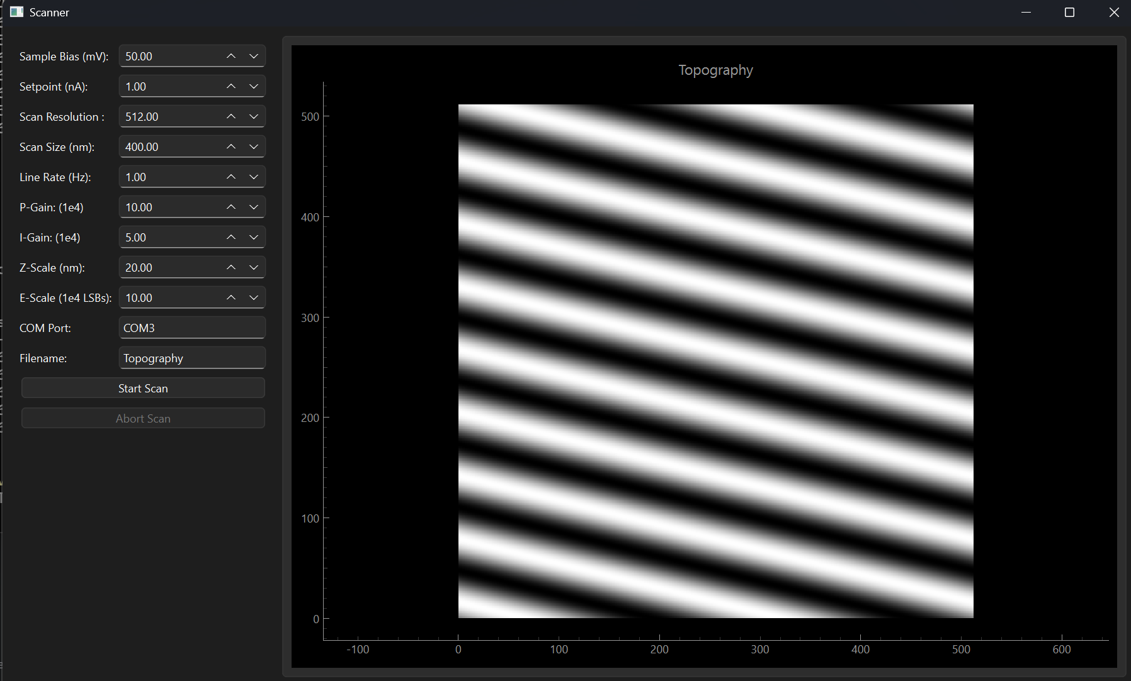
Software
Notes:
<number>

Slide 11
Thank You!
Notes:
<number>

