Slide 1
FPGA-Based VPN Security System
Giorgi Mandzulashvili

Slide 2
AES (Advanced Encryption Algorithm)
Plain Text:
Cipher Text:
Plain Text:
Hello, how are you?
XncsuyFeOKbdf3L24PFzaoAmig==
Hello, how are you?

Slide 3
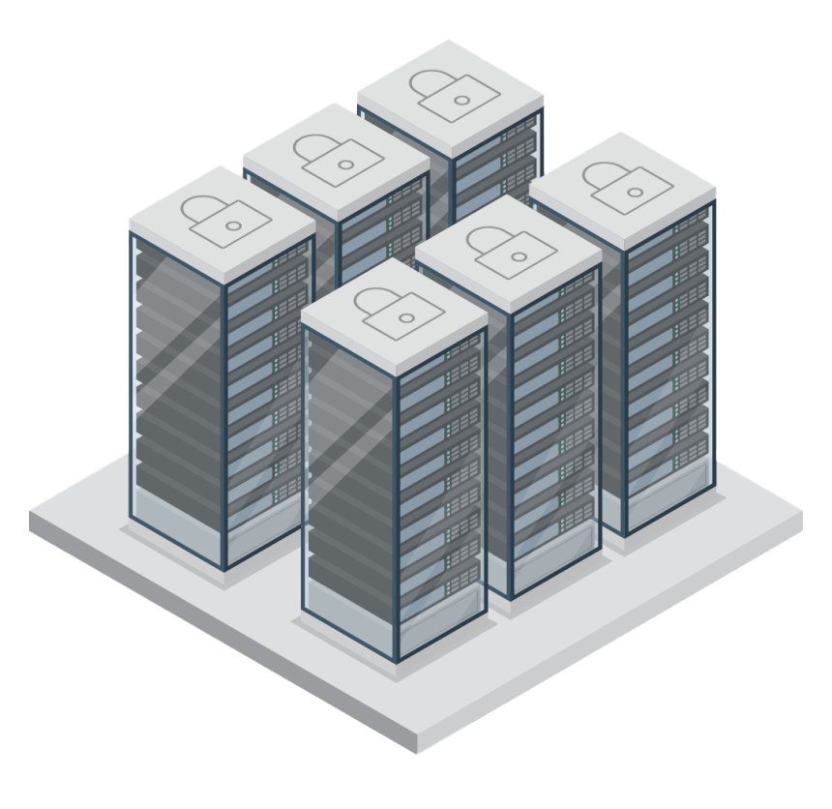
The Problem of Scale
Massive streams of data overwhelm CPUs
Encryption math consumes CPU clock cycles
CPU loses processing time for running databases
Server crashes and application performance fails
Software alone is not enough to handle high-throughput cryptography

Slide 4
The Solution
01
AES-128
02
Pipelining
Hardware Implementation in GCB mode
Implementation of pipelining for each round
03
DMA Controller
04
VPN System
Direct memory transfer bypassing the CPU
Full integration of crypto core and networking

Slide 5
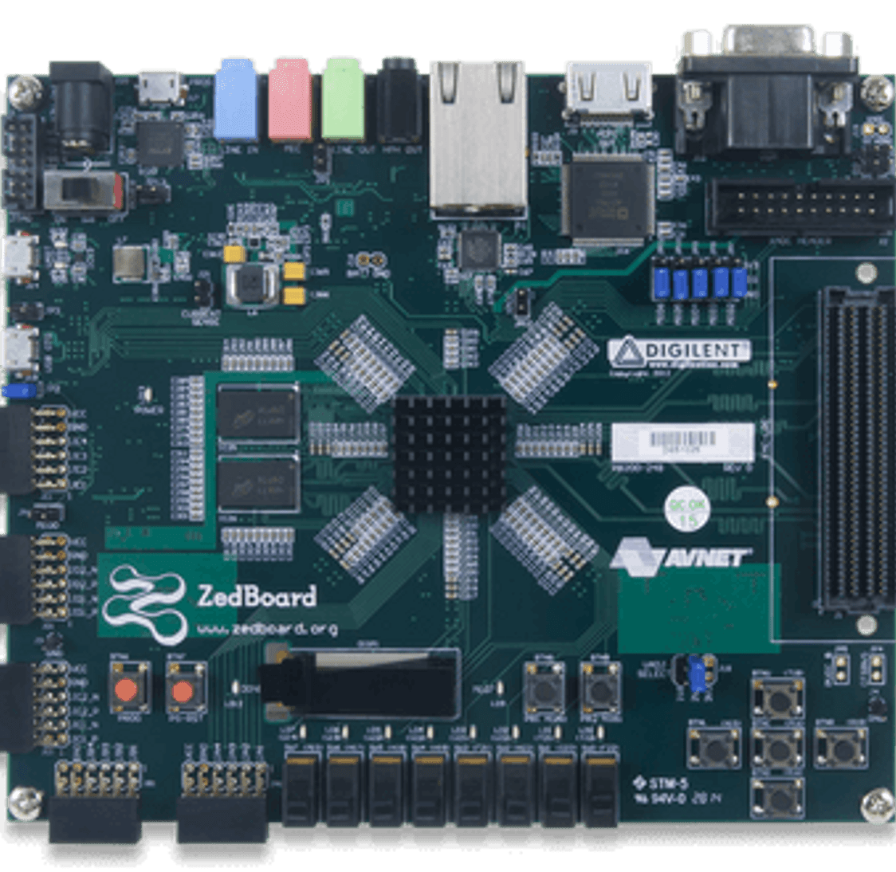
ZedBoard
Zynq-7000:
SoC: Xilinx Zynq-7020 (XC7Z020)
Processor: Dual-core ARM Cortex-A9 @ 667 MHz
FPGA Logic: 85K logic cells, 53,200 LUTs
Memory: 512 MB DDR3, 256 Mb QSPI Flash, SD card slot
Display Output: HDMI (1080p), VGA, OLED display (128x32)
Connectivity & I/O: Gigabit Ethernet, USB 2.0 OTG,
8x PMOD headers, FMC expansion connector

Slide 6
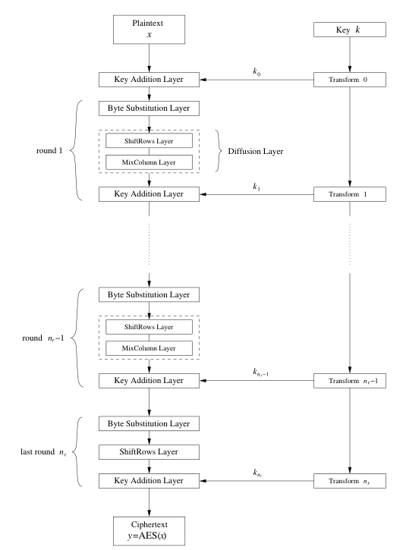
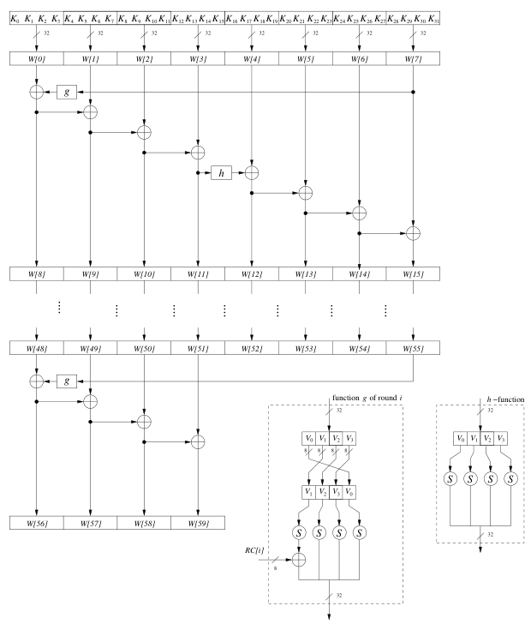
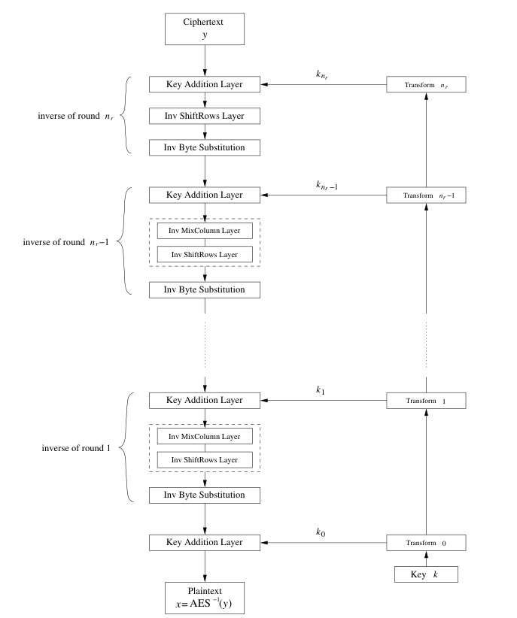
Structure of the AES Algorithm

Slide 7
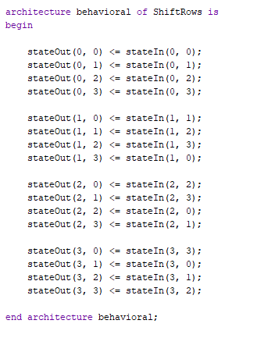
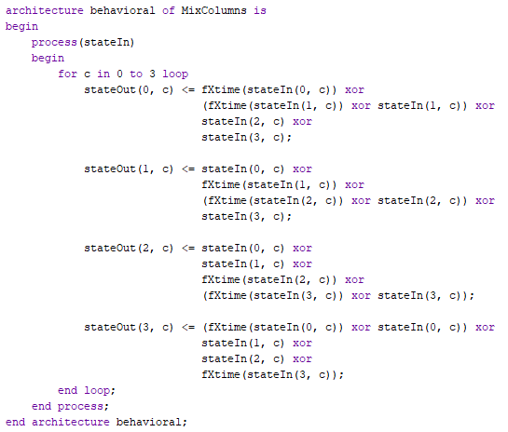
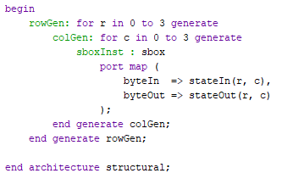
Implementation of the Algorithm
SubBytes
ShiftRows
MixColumns

Slide 8
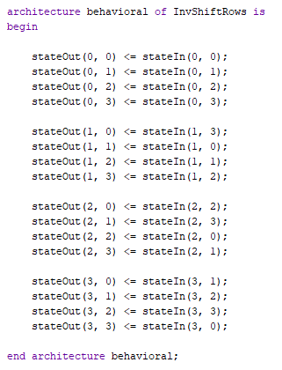
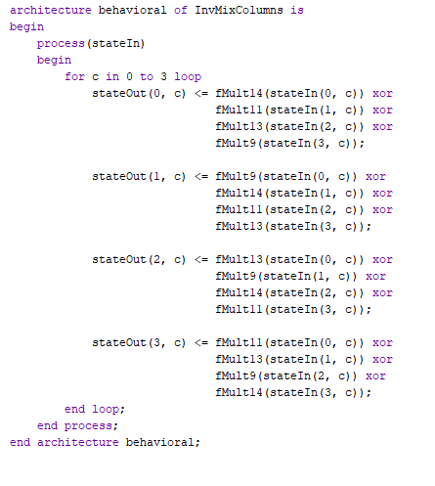
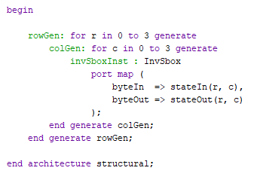
Implementation of the Algorithm
InvSubBytes
InvShiftRows
InvMixColumns

Slide 9
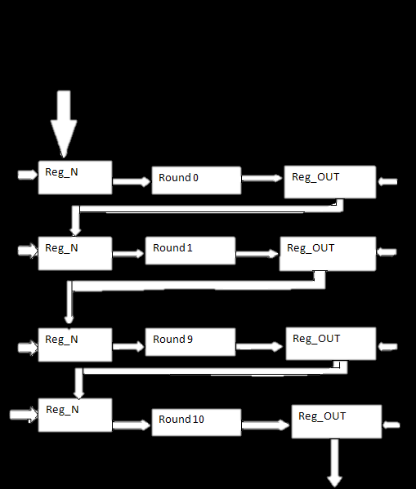
Pipelining the Algorithm
Registers placed between rounds break long combinational timing paths
Shortened propagation delay allows the system clock to run significantly faster
Accepts and outputs a new 128-bit data block on every clock cycle once the pipeline fills
Uses additional Flip-Flops and adds initial latency to gain massive streaming performance

Slide 10
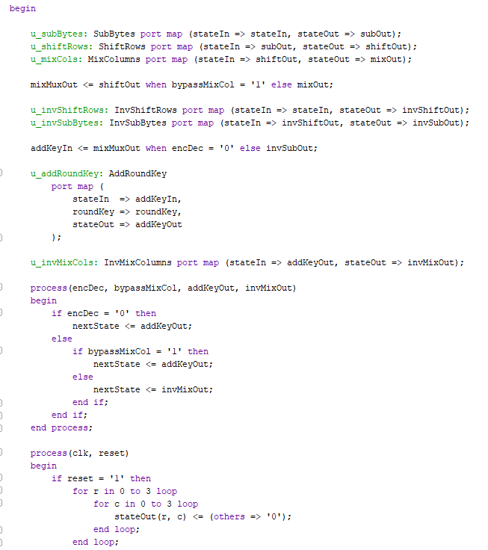
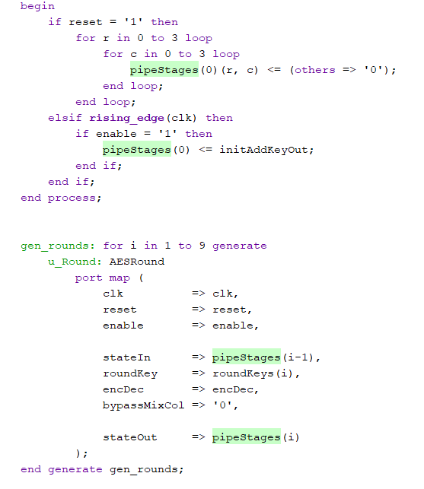
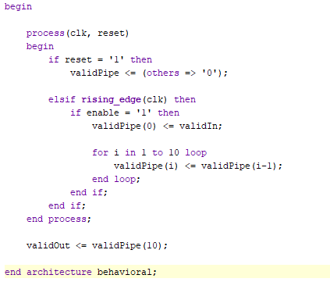
Implementation of the Pipeline
AESRound
Datapath
Controller

Slide 11
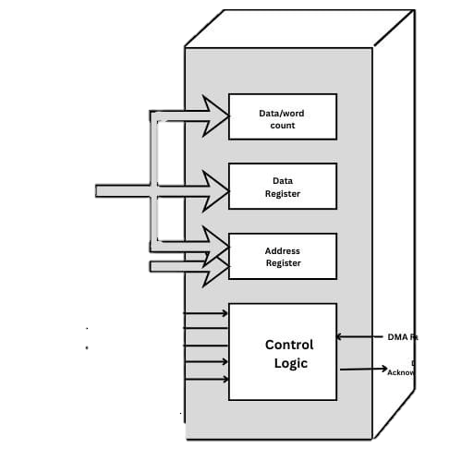
DMA Controller
Offloads data transfers between DDR3 RAM and PL fabric without CPU intervention
Stores source/destination pointers and tracks packet buffer lengths
Control logic manages DMA Request and Acknowledge signaling over AXI interconnects
Limits processor involvement to transfer initialization and interrupt handling

Slide 12
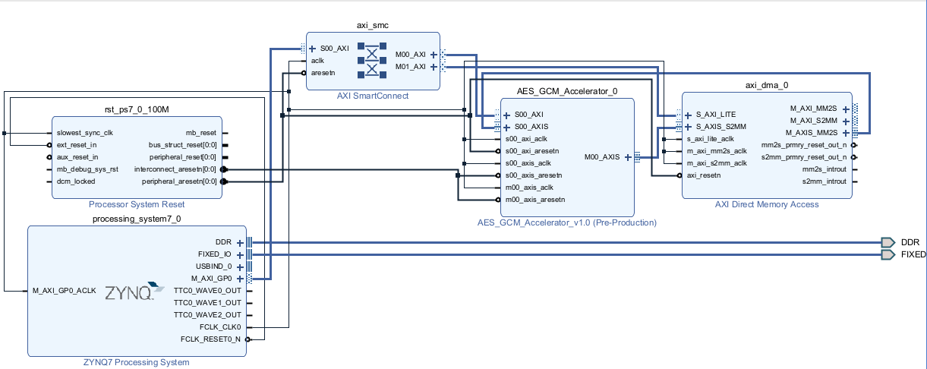
Block Diagram

Slide 13

VPN Application
ARM CPU handles key negotiation; FPGA logic executes packet encryption
Hardware pipeline encrypts network payloads on-the-fly without CPU context-switching overhead
Data buffers stream directly between Gigabit Ethernet controllers and PL logic via DMA
Enables low-latency IPsec or custom encrypted tunnels capable of saturating full network bandwidth

Slide 14
Thank you!

