Slide 1
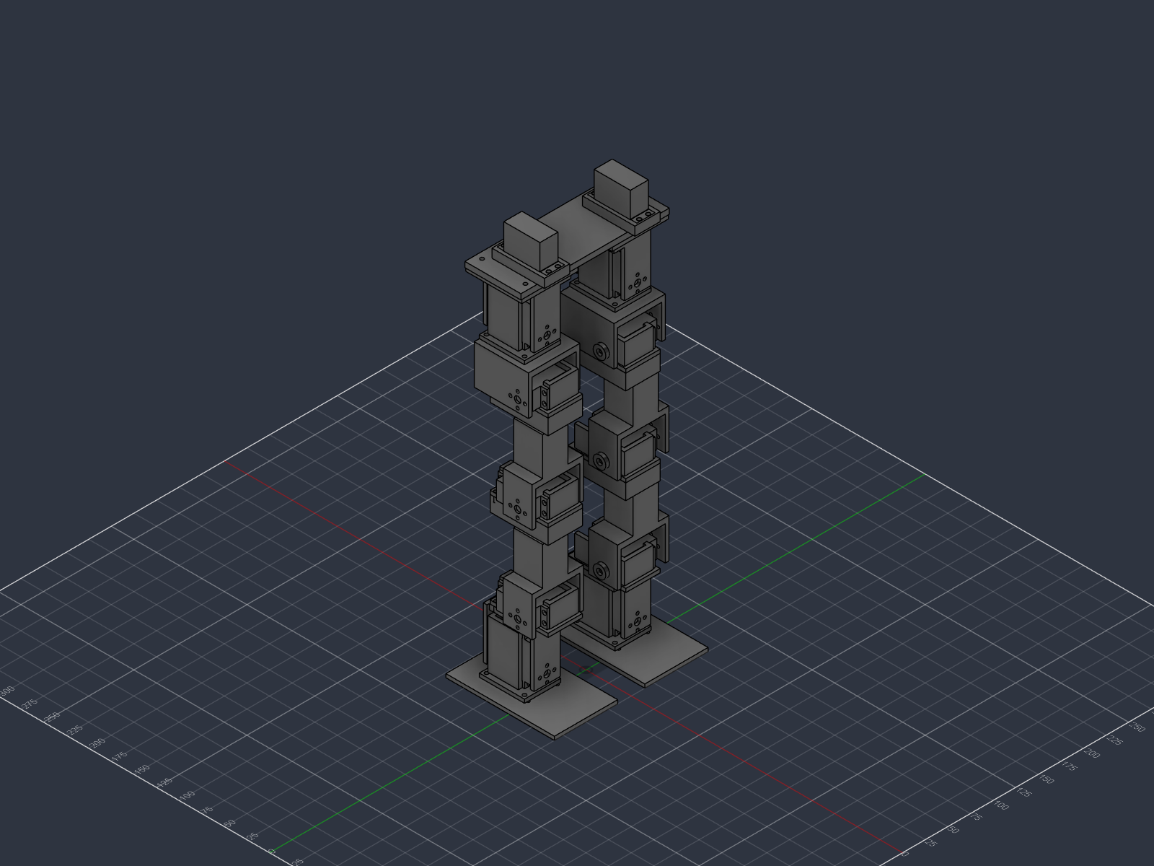
OSC
A 12-DOF Bipedal
Walking Robot O.S.C.
INSERT IMAGE:
01_full_robot.png
(Desktop/OSC_Screenshots)
Design, validation and construction of a printed humanoid platform
intended for learned locomotion
440
12
~2.0
mm tall
degrees of freedom
kg target mass
Notes:
"Hello everyone, my name is Georgios Konstantinos Lypiridis, and
today I'm presenting my junior project progress.
My project is a twelve degree-of-freedom bipedal walking robot.
Twelve DOF means twelve independently driven joints — six per leg.
The goal isn't just a robot that walks. Plenty of hobby robots do
that with a fixed, pre-programmed motion. My goal is a platform that
can LEARN to walk — which is a much harder mechanical and electrical
problem. It's the foundation for any complex movement these legs
might eventually do — dancing, kicking, exercising. It's this need
to learn that shaped almost every decision I'm going to show you.
I designed the whole thing from scratch: the kinematics, every
printed part, the power system, the control electronics. There's
hardly any open-source project at this scale — you either find the
thousand-dollar versions on social media, or something rudimentary
and toy-like. Where I am right now: the design is complete,
electronics are working, all parts are printed, and I have one joint
fully assembled and moving, which I'll show you live in a few
minutes."
<number>

Slide 2
MOTIVATION
Why build it like a human leg
Our environment is built for human bodies. If robots are going to work inside it — not around it — humanoid form is what lets them use the same stairs, doors, and tools we already built for ourselves.
Hip — 3 DOF
Swing forward/back, swing sideways, rotate in/out — all independent. A true ball-and-socket equivalent.
Knee — 1 DOF
Bends one way. Human knees have a few degrees of soft-tissue give in other directions — negligible for locomotion, so I built a pure hinge.
Ankle — 2 DOF (of 3)
Tilts fore-aft and side-to-side. The third anatomical direction — axial rotation — is only a few degrees in a real ankle, so I didn't actuate it.
3 + 1 + 2 = 6 per leg, 12 total — not a chosen number, the minimum for a foot to reach any position and orientation on the ground.
Notes:
"Before I go into detail, I want to talk about the motivation behind this. Our society has adapted its environment to suit us. With the rise of technology, I believe we need to adapt robotics into humanoid form, so machines can benefit from the same human-friendly environment we already built for ourselves. That's why I decided to look into human anatomy as the starting point.
A human leg has three joints: hip, knee, ankle. But 'joint' undersells it — the hip alone moves in three independent directions. You can swing your leg forward, swing it sideways, and rotate it inward or outward, all separately. That's three degrees of freedom in one joint.
The ankle also technically moves in three directions, but here we hit our first restricted range of motion — try rotating your ankle side to side and you'll only get a few degrees, mostly from ligament give rather than real joint travel. The knee is worse — it has two restricted directions on top of its main bending motion.
What this means for building a robot with human-like joints: the restricted directions aren't contributing meaningfully to movement, so I can leave them out. Three at the hip, one at the knee, two at the ankle. Six per leg, twelve total. That's not a number I picked — it's the minimum needed to place a foot anywhere it needs to go and orient it correctly on the ground. Fewer, and there are foot placements the leg physically cannot reach. More, and you're carrying weight and complexity for motion you can't use.
So structurally, this robot mirrors the human leg almost exactly."
<number>

Slide 3
THE CONTROL PROBLEM
Standing up is an unstable equilibrium
A clock pendulum hangs BELOW its pivot — gravity restores it to centre. This robot is the opposite: its mass sits high, resting on two small feet. Tip it, and gravity pushes it further over, not back.
What tau actually means
Not "time until it falls" — it's the doubling time of the instability. Every ~190 ms, an uncorrected tilt grows by a factor of e (~2.7x).
Standard control practice: react 5-10x faster than the instability you're fighting, to leave margin for sensing, computation, and actuator lag.
tau / 5 to tau / 10 = 19-38 ms -> a correction should reach the joints within roughly 20-40 ms.
This sets a MINIMUM required rate for the balance control loop — a separate question from how fast the servos themselves are driven, which is a resolution question I'll get to shortly.
Small-angle model (rod pivoting at the ankle):
θ`` = (g / L) * θ
Positive sign = unstable (a stable pendulum has a minus). Solution grows exponentially, timescale:
τ = √(L / g) ~ 0.19 s
for L (centre-of-mass height) ~ 0.35 m
Notes:
"Let's talk about the core control problem I'm solving.
A robot standing on two feet is what's called an inverted pendulum.
A normal pendulum — a clock pendulum — hangs below its pivot, and
gravity pulls it back to centre. That's stable. My robot is the
opposite: almost all its mass sits high up, and it touches the ground
only at two small points. Tip it slightly and gravity doesn't correct
it — gravity accelerates it further over.
i calculated the required frequencies to make the control loop to function. and its 20-40 miliseocnds. That number comes back later,
because it's what shaped my control electronics decisions — though
not in the way you'd first guess, which I'll get to."
<number>

Slide 4
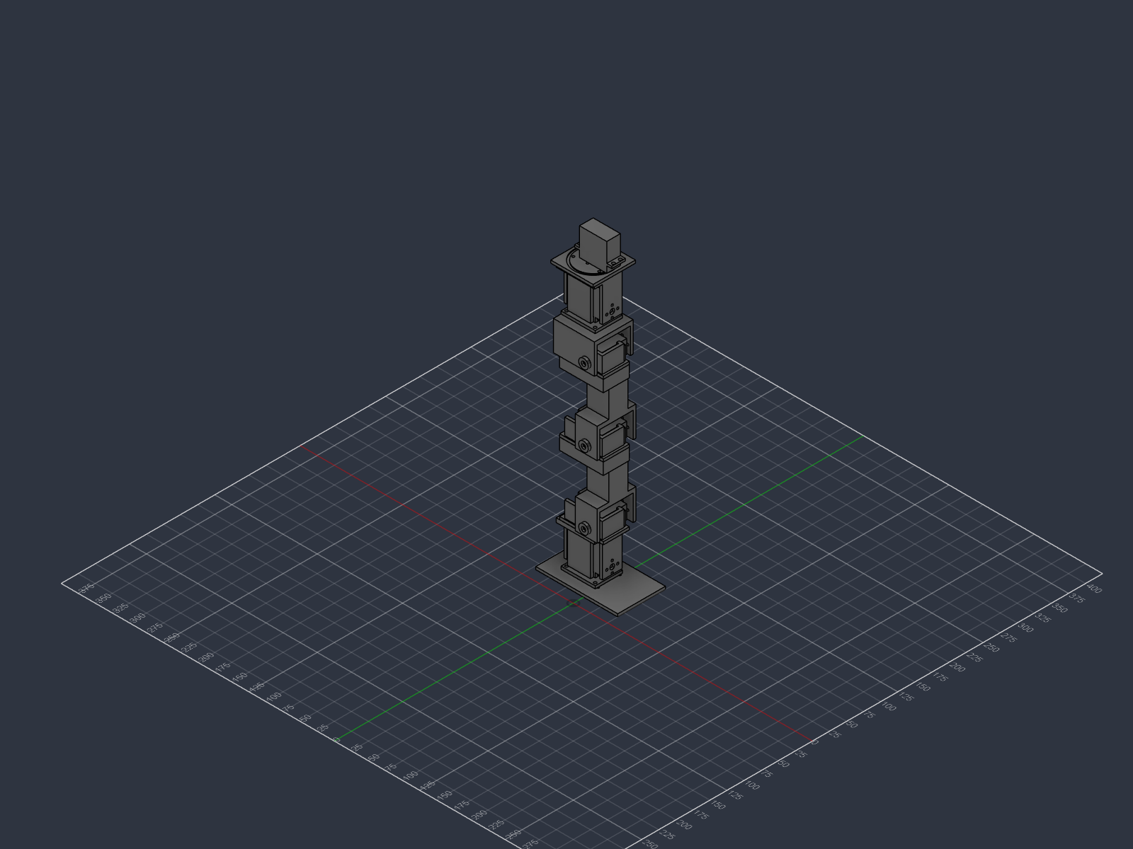
ARCHITECTURE
Kinematic chain
HEIGHT ABOVE GROUND, MM
400.0
Hip yaw
Z — vertical · leg rotates horizontally
348.8
Hip roll
X — fore/aft · leg spreads sideways
296.4
Hip pitch
Y — lateral · leg swings forward/back
191.4
Knee
Y — lateral · leg shortens
Link lengths
Ankle pitch
Shin 105mm · Thigh 105mm
Hip spacing 100mm · Foot 120×70mm
86.4
Y — lateral · foot tilts fore/aft
Shortened from 120mm late in the design: bending deflection scales with length cubed, so 12% shorter bought 33% more stiffness.
24.8
Ankle roll
X — fore/aft · foot tilts side to side
Notes:
"This is the kinematic chain — six joints per leg, twelve in total, listed with their real heights above the ground in millimetres.
From the bottom up: ankle roll, ankle pitch, knee, hip pitch, hip roll, and hip yaw.
Six degrees of freedom per leg is the minimum for a general-purpose biped. Three at the hip gives you a spherical joint — the leg can point in any direction. One at the knee sets leg length. Two at the ankle
orient the foot against the ground. Fewer than six and you lose the ability to place the foot arbitrarily; more than six and you're adding mass and complexity for redundancy you can't easily exploit.
<number>

Slide 5
DESIGN RATIONALE
Why the joints sit in that order
Hip: yaw → roll → pitch
An honest limitation
Reading outward from the body. Pitch sits closest to the thigh because it is the primary walking axis — putting it last keeps its axis horizontal and perpendicular to the leg no matter what yaw and roll are doing. Sagittal swing then stays clean and decoupled.
On a human, the two ankle axes very nearly intersect. On this robot they are 62 mm apart, because each joint is a discrete servo block rather than a compact mechanism.
The same applies at the hip: the three axes do not meet at a point.
Consequence: the inverse kinematics has no closed-form solution and must be solved numerically, and the offsets add parasitic motion that the controller has to compensate.
This is the price of building from off-the-shelf servos instead of custom actuators. It is a real cost and I want to name it rather than hide it.
Ankle: roll → pitch
Roll is nearest the foot so the foot stays flat on the ground when the leg tilts laterally. Pitch above it handles fore-aft lean, which is the axis that carries peak load during single support.
Notes:
"Joint ordering is not arbitrary — it changes how hard the robot is to control.
At the hip, reading outward from the body: yaw, then roll, then pitch. Pitch is closest to the thigh. The reason is that pitch is the primary walking axis — it's the one doing the big swings every step. By putting it last in the chain, its axis stays horizontal and perpendicular to the leg regardless of what yaw and roll are doing. That keeps forward-backward swing clean and decoupled from the other two. If you put pitch first, its axis would tilt whenever roll moved, and every walking motion would become a coordinated three-axis problem instead of a one-axis problem.
At the ankle, roll is nearest the foot and pitch above it. Roll near the foot means the sole stays flat on the ground when the leg tilts sideways.
<number>

Slide 6
SUBSYSTEM
The foot
120 × 70 mm, 4 mm thick, with four force-sensitive resistors under the corners.
Why this size
FSR
The foot IS the support polygon. Too small and balance is impossible; too large and the swing leg catches on the ground and the robot cannot lift its own foot clear.
Why four sensors
One sensor tells you a foot is loaded. Three or more let you compute centre of pressure — where the ground reaction force actually acts. That is the measured quantity ZMP balance control needs.
support polygon = the region the centre of mass must stay inside
Load concentration
Each FSR sits in a recess with a rigid 10 mm pad above it, so force lands inside the 12.7 mm active area instead of spreading across the whole plate. Without this the readings wander.
Notes:
"The foot looks like the simplest part, but it's one of the most
important, because the foot defines the support polygon - the region
on the ground where, as long as the robot's centre of mass stays
above it, the robot stays standing. Step outside that region and it
falls. So the foot's size is a direct trade-off: too small and
there's no balance margin at all; too large and the leg that's
mid-step catches on the ground and can't clear it. Mine is 120 by 70
millimetres, sized for a robot this height.
There are four pressure sensors, one under each corner. These are
analog force sensors, not on-off switches, which matters — it means
I can compute the centre of pressure, the exact point within the
foot where the weight is landing, as a weighted average of all four
readings. That tells the robot not just that it's tipping, but which
way and by how much."
<number>

Slide 7
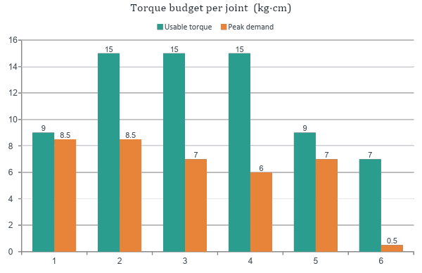
ENGINEERING DECISION
Matching actuators to load
Three servo types
QY3242BLS — 42 kg·cm brushless, 7.4 V. Ankle pitch, knee, hip pitch.
PDI-6225MG — 25 kg·cm, 6 V max. Ankle roll, hip roll.
DS3218MG — 20 kg·cm, 6 V. Hip yaw only.
Hip yaw gets the weakest servo deliberately: its axis is vertical, so gravity exerts no moment on it at all. Its only load is inertial — about 0.5 kg·cm to swing the leg.
Notes:
"I'm using three different servo models, and where each one goes
wasn't arbitrary — I calculated the torque at every joint and matched
the strongest servos to the highest-load positions.
Ankle pitch turned out to be the single highest-load joint in the
whole robot, which might seem strange — what does that joint even do,
lift the ankle a little bit? But look at the other leg: while it's
mid-step, the entire body load crushes down onto this one ankle. A
very easy thing to overlook. So it gets my strongest servo, a 42
kilogram-centimetre brushless unit, alongside the knee and hip pitch.
events like these were all kept in mind in choosing the other servo placements as well
<number>

Slide 8
POWER ARCHITECTURE
Three rails, because one would destroy seven servos
7.4 V
6.0 V
5.0 V
direct from battery
via 15 A buck converter
via separate converter
6 × QY3242BLS
brushless, HV rated
4 × PDI-6225MG
2 × DS3218MG
Teensy 4.1, IMU,
foot sensors
The PDI servo is rated 6 V absolute maximum. A fully charged 2S pack sits at 8.4 V — 40 % over. A single shared rail would have destroyed five PDI and two DS units on first power-up. Logic is kept on its own converter so servo current spikes cannot brown out the microcontroller mid-step.
Notes:
"My voltage situation is quite simple. My three servo types don't share a voltage. The brushless servos are
rated for 7.4 volts. My other servos are rated 6 volts, absolute
maximum. thats why i need a buck converter for those sets of servos.
i also need a separate 5 volts through a
third converter for the control electronics.
<number>

Slide 9
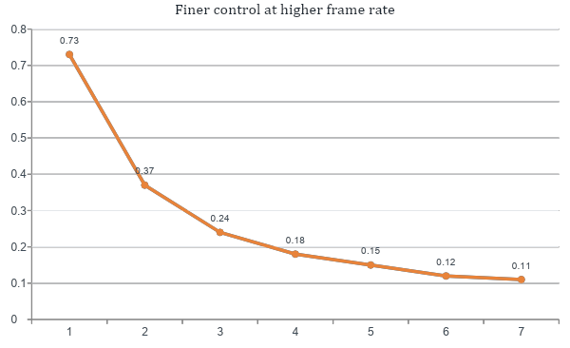
EXPERIMENT
Control resolution: a measured result
What I tested
All three servo models, seven frame rates, 21 test points.
At each rate: buzzing at rest, case temperature, full travel, step visibility.
Only one failure — the PDI buzzed faintly at 333 Hz.
Chosen: 300 Hz
6.7× finer than the 50 Hz default
Notes:
"Remember the twenty-to-forty-millisecond number from earlier? Here's
where it actually applies — and it's a little more subtle than one
number turning into one frequency.
There are two different rates involved, and I want to be precise
about which is which. The first is the CONTROL LOOP rate — how often
the software reads the sensors, decides on a correction, and issues
new joint targets. The physics sets a floor for that: inverting the
twenty-to-forty-millisecond budget gives roughly twenty-five to fifty
updates per second as the minimum.
The second is the PWM REFRESH rate — how often the driver board
actually re-sends the pulse signal to the servo. This is a separate,
faster process underneath the control loop, and it's the one I
tested and tuned.
Hobby servos are conventionally driven at fifty pulses per second
I tested it and came to the conclusion that 300 Hz is the way to go.
<number>

Slide 10
DESIGN FOR MANUFACTURE
Eleven parts, twenty-five assemblies
11
25
606 g
0
unique printed parts
total prints
PETG for the whole robot
structural parts bought
Reuse through symmetry
Built for a real printer
One servo cradle design serves ankle pitch, knee AND hip pitch — three joints, one part, printed six times.
The shin and thigh are the same component instanced twice.
Three parts came out symmetric about their own centreline, so one print serves both legs.
PETG, not PLA — PLA creeps under sustained load, so a robot standing still would slowly sag at the knees.
Heat-set brass inserts at every joint, so parts survive repeated disassembly during tuning.
Print orientation set per part so layer lines never run perpendicular to the main bending load.
Notes:
for the 3d design i opted to make modules for each yaw, pitch or roll. since i reuse roll 3 times any mistakes in the cradles can fixed with editing the singular one
Everything is PETG, not the more common PLA, because PLA slowly
deforms under constant load at room temperature — a robot standing
still for an hour would gradually sag at the knees.
<number>

Slide 11
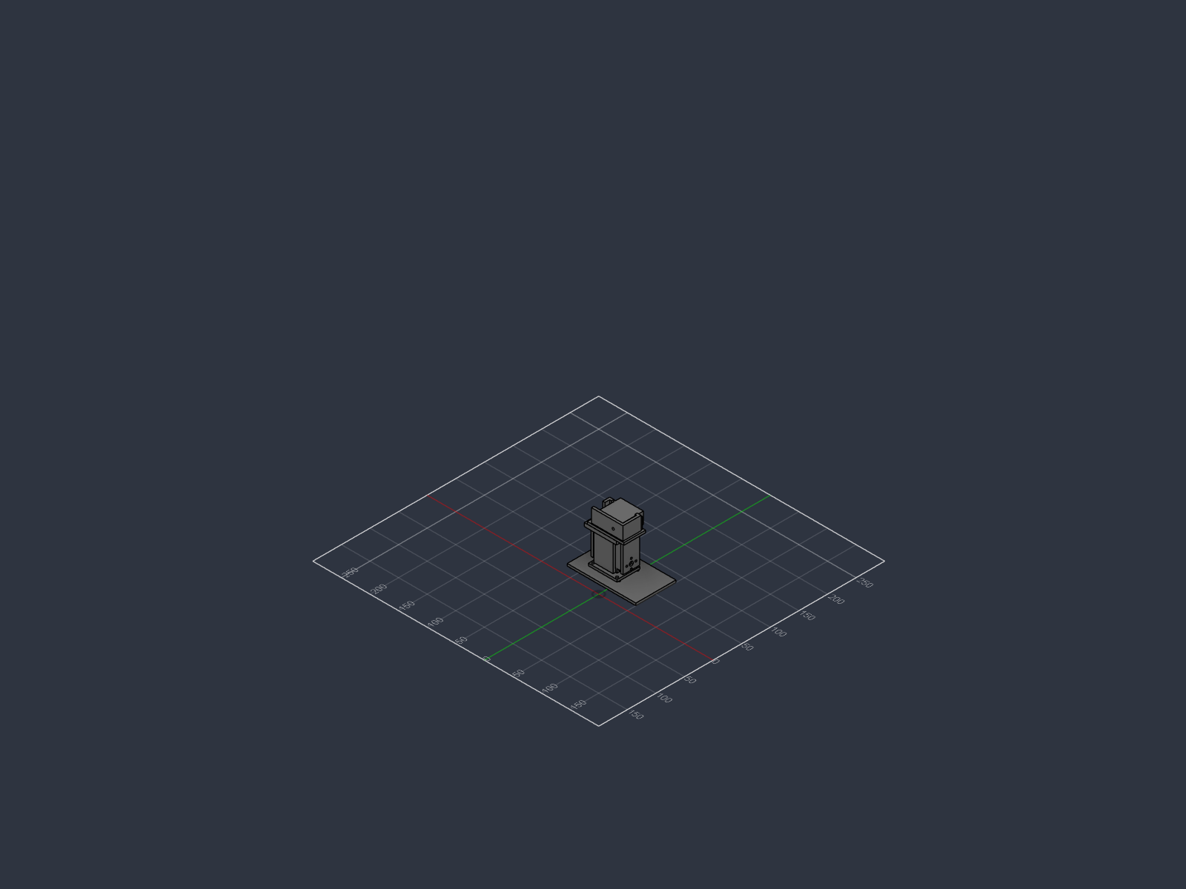
STATUS
Where the project stands today
Complete
Outstanding
Mechanical design complete, 12 DOF, both legs
All 25 parts printed
Servo characterisation complete — 21 test points
Teensy + servo driver + IMU working together
Ankle roll joint fully assembled and moving
Assemble remaining joints
Battery + magnetic encoders in transit
Joint calibration and limit finding
Scripted gait, then learned locomotion
Notes:
"I want to show you this working rather than just describe it — or
at least a piece of it. This is the ankle roll joint: foot, servo,
and the linkage that connects them, fully assembled. I'm going to
send it a command from my laptop."
demo
"What you're watching is the complete control path working end to
end: a command leaves my laptop, goes through the microcontroller,
through the driver board, and the servo responds.
<number>

Slide 12
WHAT COMES NEXT
From parts to learned locomotion
01
Assemble
Heat-set inserts, servos into cradles, joints closed. Every servo centred before its horn goes on — the spline indexes every 14.4°, so a horn fitted carelessly gives a lopsided joint permanently.
02
Calibrate
Find each joint's true neutral and its physical limits, and store them. This is what stops the robot breaking itself.
03
Scripted gait
Static walk driven by the IMU and foot sensors. Proves the mechanics and gives a baseline to beat.
04
Learned gait
Add joint encoders, build an accurate simulation model, train a policy, transfer it to hardware.
The hard part is not walking. It is sim-to-real transfer — and that needs joint position feedback the robot does not yet have.
Notes:
"Four stages from here.
First, assemble.
Second, calibrate.
Third, a scripted gait.
Fourth, learned locomotion.
Right now my robot has no idea what angle its own joints are at. It commands a position and assumes the servo got there. Under load it won't have. That's roughly half of the observation data a learning policy needs, and it's missing.
The fix is magnetic encoders — I'm using AS5048A modules. The mounting provisions are already designed into the printed parts at five of the six joints per leg
<number>

Slide 13
In Conclusion
Mechanical design complete, 12 DOF, both legs
PETG printed parts
Teensy and electronics working together
Physical as of now: Ankle roll joint fully assembled and moving
Reinforcement Learning on the way
Full Assembly on the way
Thank you for your time
Questions?
Notes:
"So, in conclusion: a twelve-degree-of-freedom leg architecture built
by working backward from human anatomy, a power and control system
sized against the real obstacles I ran into, and a build process
that caught its own mistakes along the way. Happy to take questions,
or to let you look at the joint up close — though it's a bit of a
prototype until the rest of the parts arrive."
The other major approach is supervised learning, and it needs labelled correct answers — example states paired with the correct action. Nobody has that for walking; there's no dataset of 'the right joint torque for every possible robot state.' Imitation learning is a middle ground — record a demonstration and copy it — but I'd need a working gait to record from in the first place, which is exactly what I don't have yet. And it tends to fail the moment the robot drifts even slightly off the recorded path, because it never saw that situation.
Reinforcement learning is the one that fits: it only needs a reward, like 'did you fall or not, how far did you move' — not a labelled correct answer. It discovers the strategy itself through trial and error. That also matches what walking actually is — a sequential problem where each action changes the next state, which is what RL is built around. Standard supervised learning assumes independent examples; it doesn't naturally model that feedback loop."
If they narrow further — "why not imitation learning specifically, since it's simpler"
"It's simpler, and it's actually a reasonable phase-two option once I have a working gait to record. But it inherits the demonstration's limitations — if the demonstrated walk is a bit conservative, the policy stays conservative. RL can discover strategies a human demonstrator wouldn't have shown it."
Same rule as before
If it goes further than this, don't stretch:
"That's genuinely the next phase I haven't built out yet — happy to go deeper after, but I don't want to guess in front of you."
<number>

