Slide 1
HARDWARE MODEL OF CARDIAC CELL
Nata Petremghvdlishvili

Slide 2
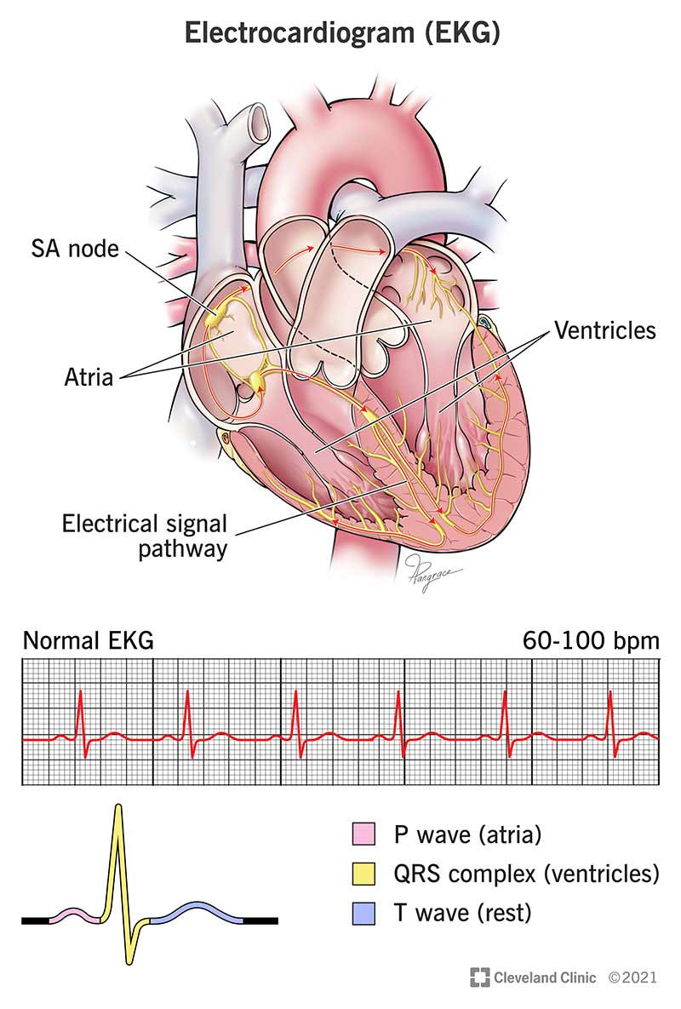
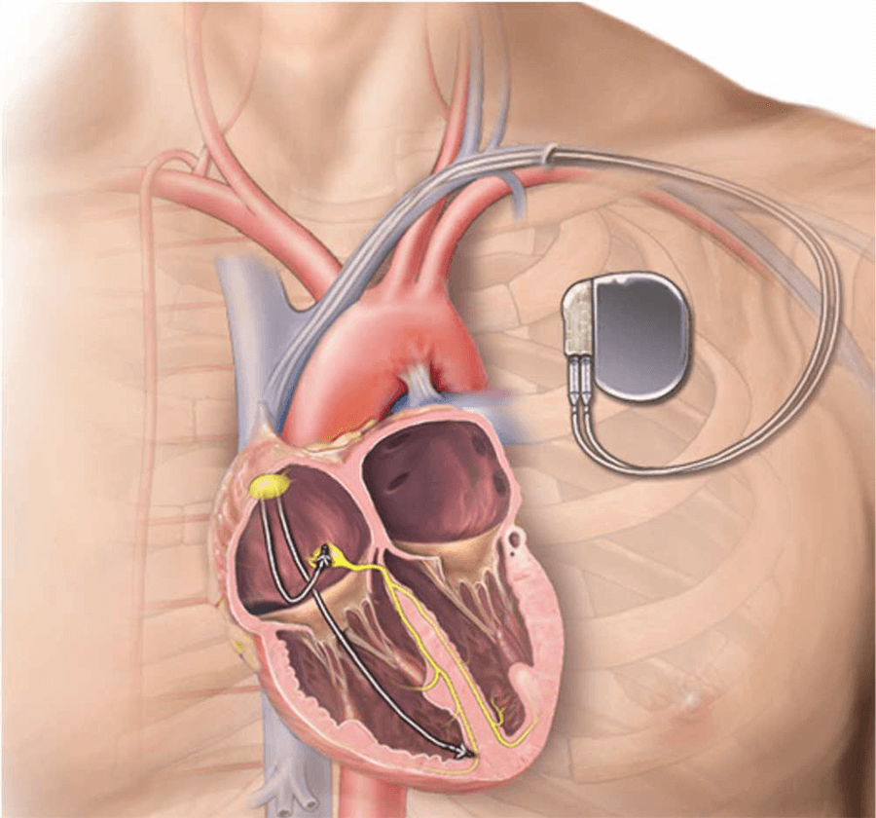
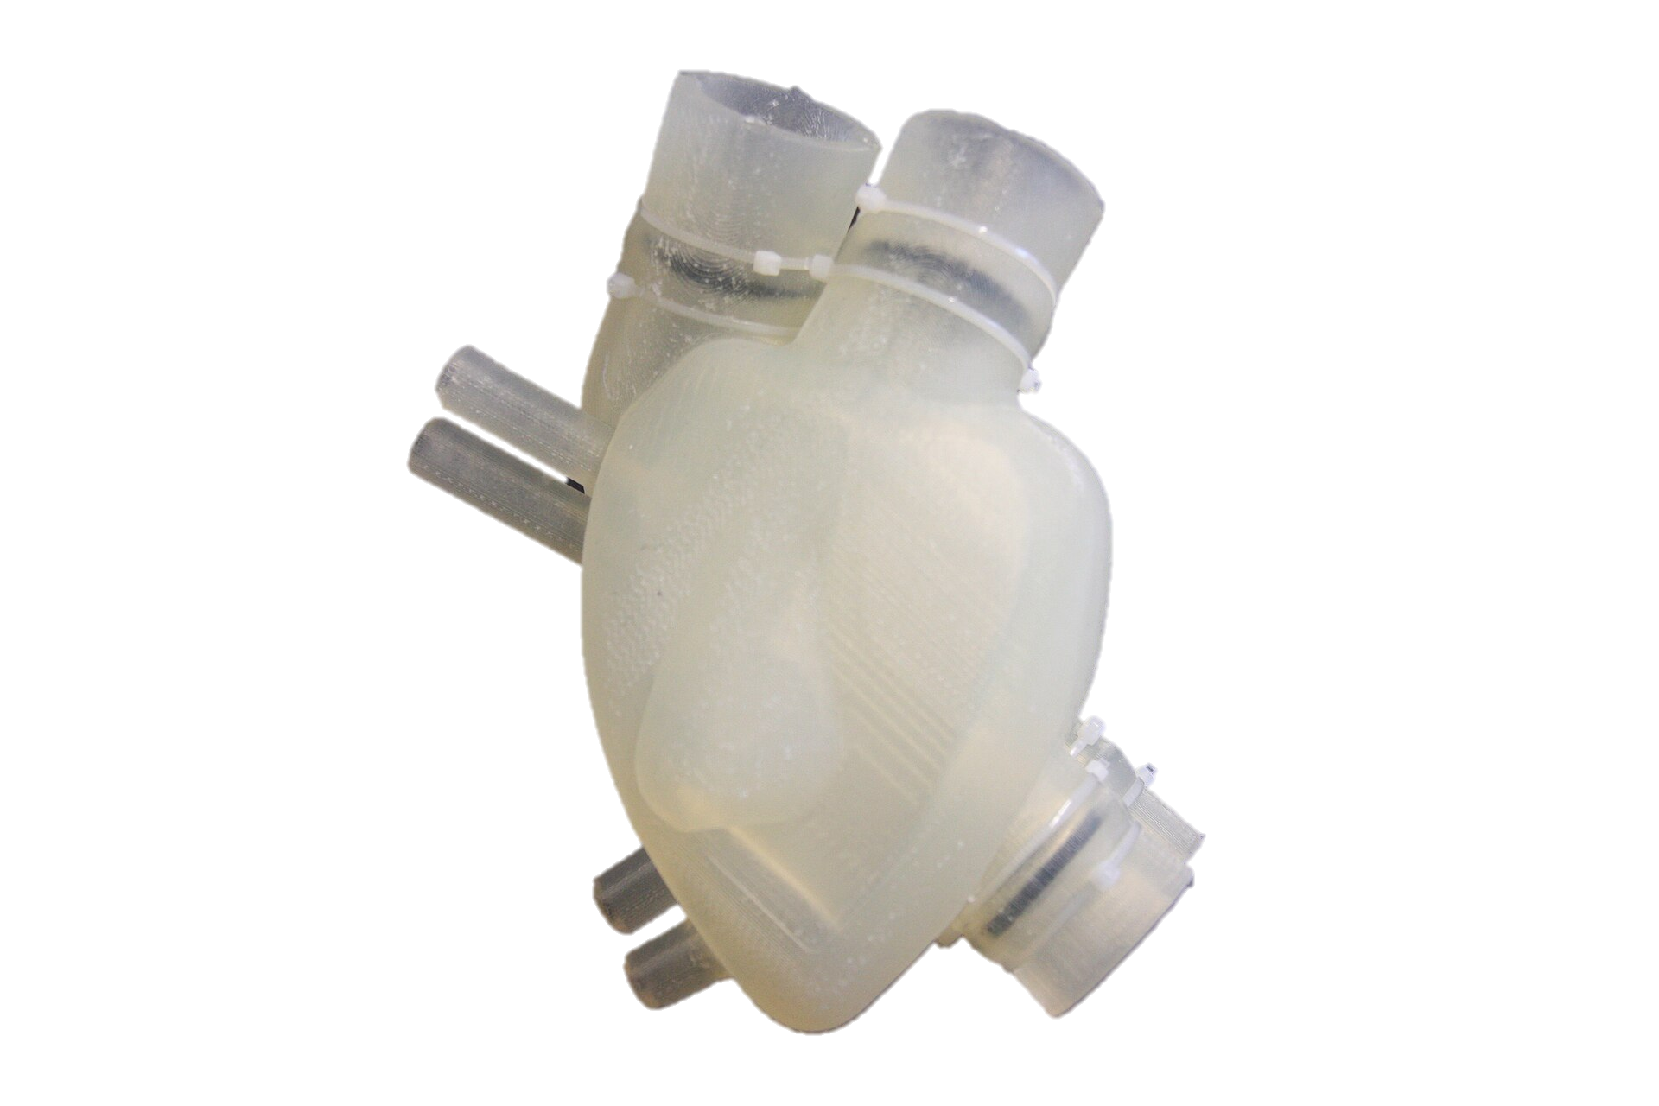
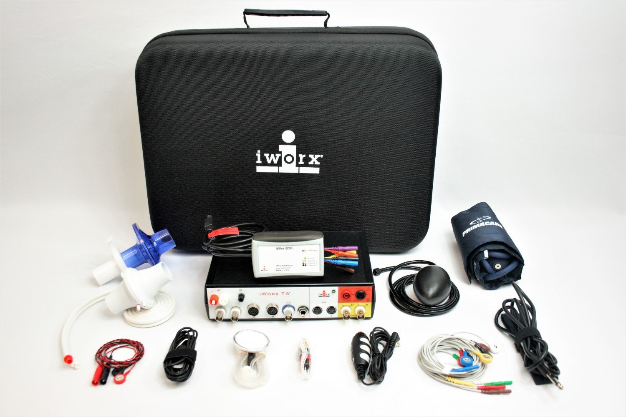
Idea and background
02

Slide 3
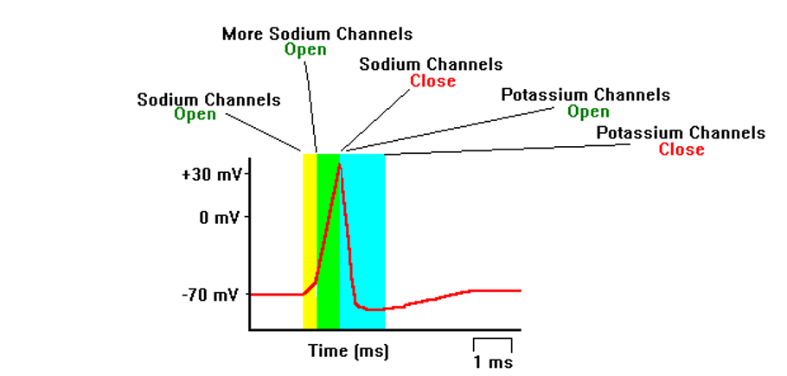
Notes:
ction potentials are the cellular impulses that control messaging in the nervous system. These action potentials are shaped by a series of steps involving the opening and closing of ion channels. n a typical action potential, when a neuron is stimulated, sodium channels begin to open. Given the concentration gradient, sodium ions begin to rush into the cell and increase its voltage. This process is called depolarization. If the cell is depolarized to a threshold level, many voltage gated sodium channels open, leading to a sharp spike in the cell’s voltage. Once a peak voltage is reached, the sodium channels close, and the open potassium channels take over. Given the potassium concentration gradient, open potassium channels lead to positive potassium ions leaving the cell and lowering the cell’s voltage (repolarizing/hyperpolarizing). Since these channels are slow to close, the voltage eventually dips below the resting potential. Finally, when the potassium channels close, the cell returns to resting potential. ardiac cells have similar behavior as neuron action potentials with two key differences. Firstly, cardiac cells do not require a stimulus to fire. Instead, cardiac cells spontaneously fire at a regular pace in order to control the heartbeat (Luo et al, 1991). Secondly, cardiac action potentials have a significantly different shape from neuron action potentials. The depolarizing spike is extremely fast with a plateau phase causing repolarization to take far longer than in a neuron action potential. This increased repolarization time allows the cell to maintain a constant heartbeat on a second timescale (Ramanathan et al, 2006)

Slide 4
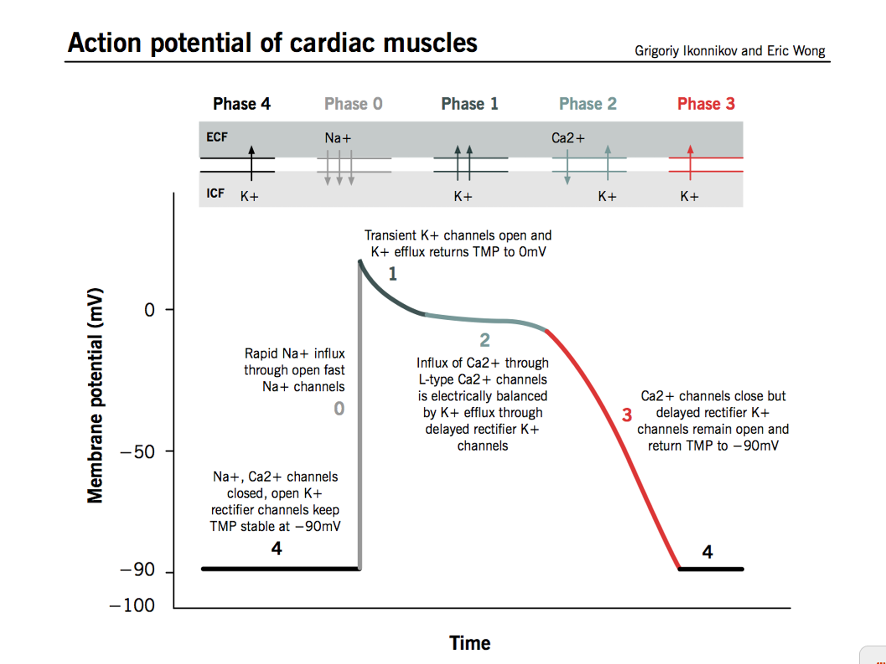
Notes:
hase 0: An action potential from a neighboring pacemaker cell causes the membrane potential to rise above -90 mV. Fast Sodium channels start to open, leaking Sodium ions into the cell and further increasing the membrane potential. As the membrane potential crosses the “threshold potential”, there are enough fast Sodium channels to generate a self-sustaining inward current. The membrane potential crosses above 0 mV briefly at which point fast Sodium channels start to close.
Phase 1: Potassium channels briefly open, causing an outward flow of Potassium ions and returning the membrane potential closer to 0 mV
Phase 2: Calcium channels activated during depolarization cause a constant inward current of Calcium ions. Potassium ions leak out the cell through delayed rectifier Potassium channels. The balance of these currents causes a plateau of the membrane potential.
Phase 3/4: Calcium channels start to inactivate and Potassium ions flow through inward rectifier channels. This causes the membrane potential to come back to its resting potential and prepare for another depolarization.

Slide 5
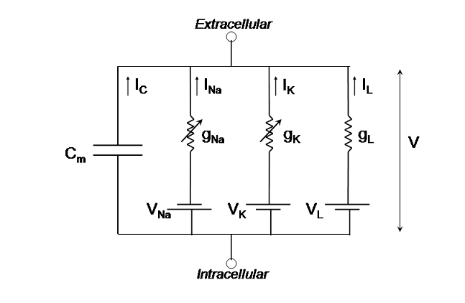
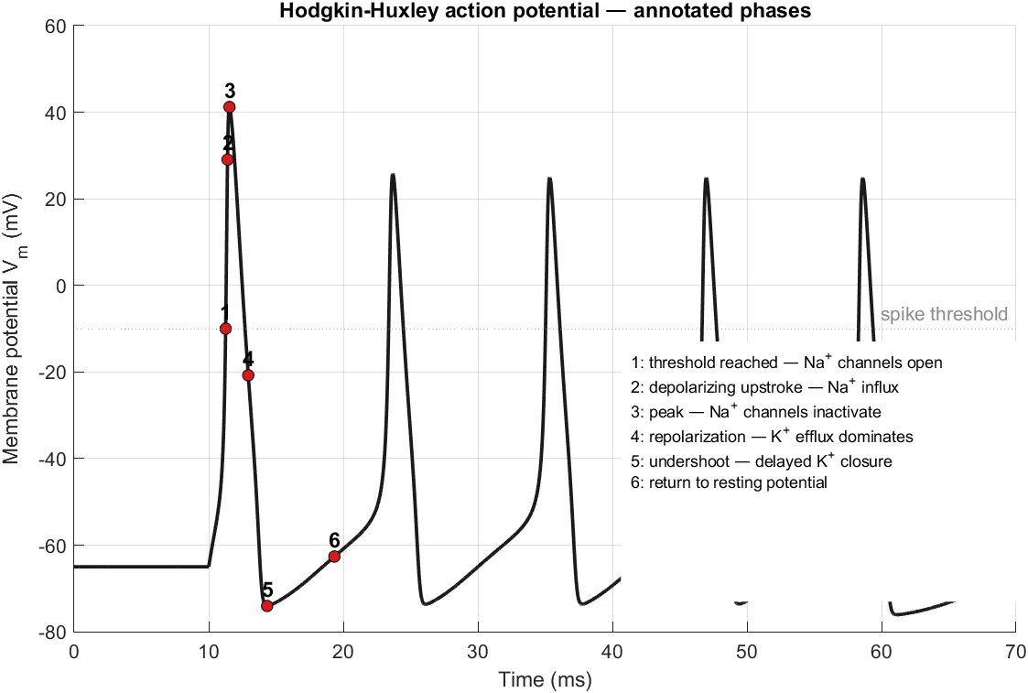
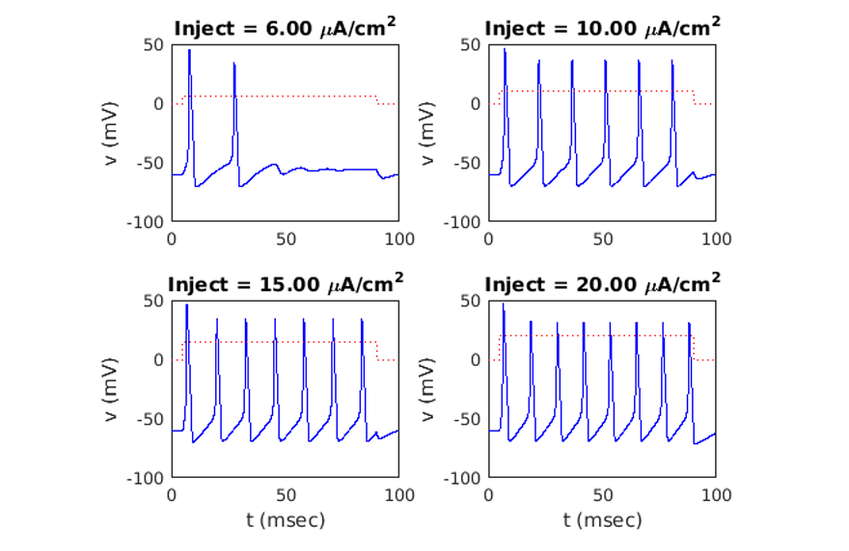
Hodgkins Huxley
The base conductance is a constant coefficient for each term. The current is determined as the sum of products, the gating variables, and the difference between membrane voltage and equilibrium potential
Notes:
ch ion has a base conductance and equilibrium potential (Appendix 1, Table 1).. Hodgkin and Huxley updated the gating variables in an exponential sense, dividing the changing of the variables into two rate functions, 𝛼 and𝛽. Finally, the change in voltage is solved for by dividing the current by membrane capacitance. The capacitor acts as an integrator to the current. To solve for these equations, integration methods such as Euler’s method can be used to find the voltages. For each of these potentials a sustained stimulus current is required to fire the neurons.

Slide 6
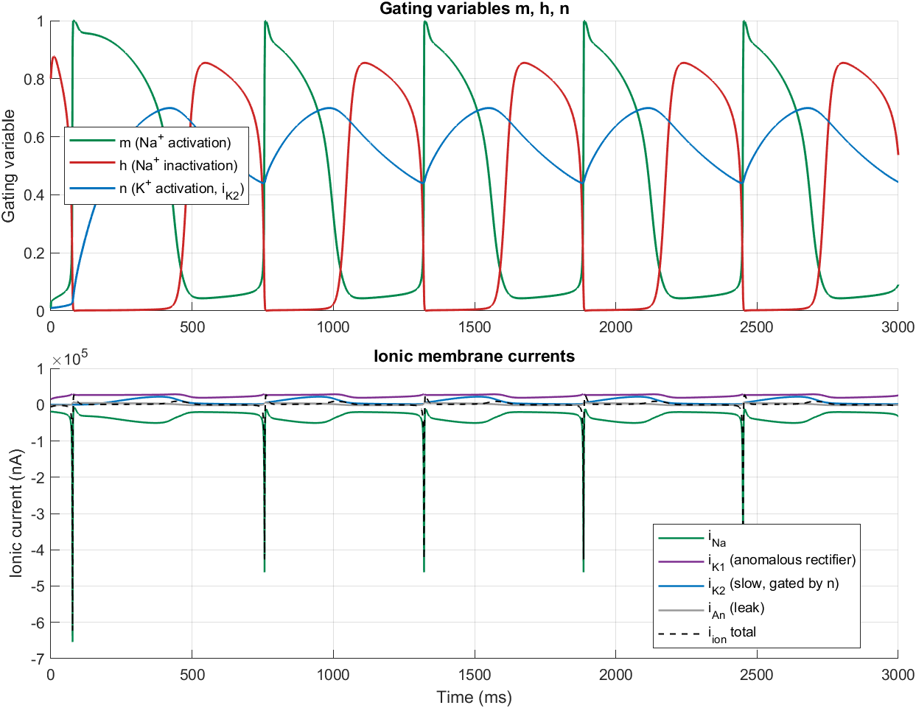
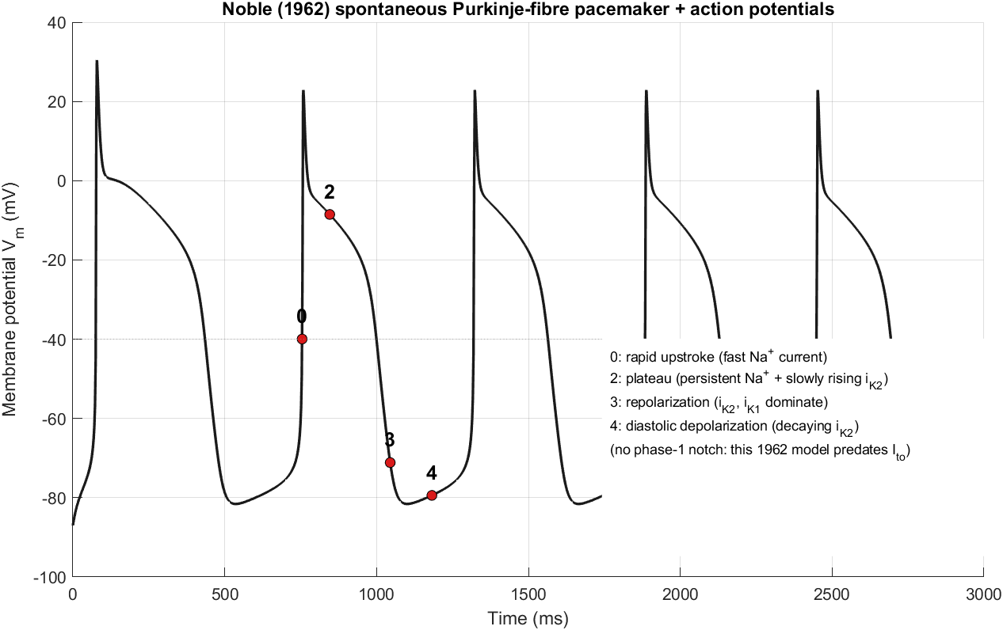
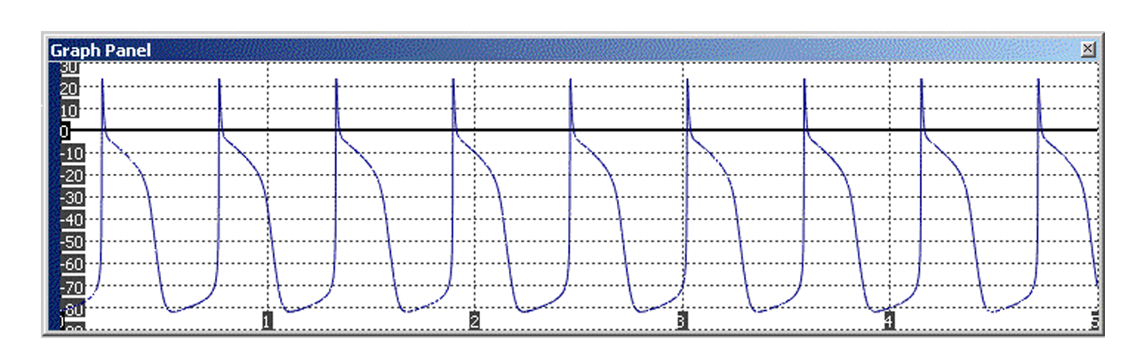
Notes:
Noble model is simply a modification of Hodgkin Huxley. Both neuron models make the use of changing ion conductance with gating variables and rate variables. In our modeling of Denis Noble, we used Euler integration as we had previously with Hodgkin Huxley. However, individual equations were changed. After changing currents, all other elements of this program changed. Importantly, there was no current injection. This is because cardiac cells as modeled by Denis Noble do not require external stimulation to fire.

Slide 7
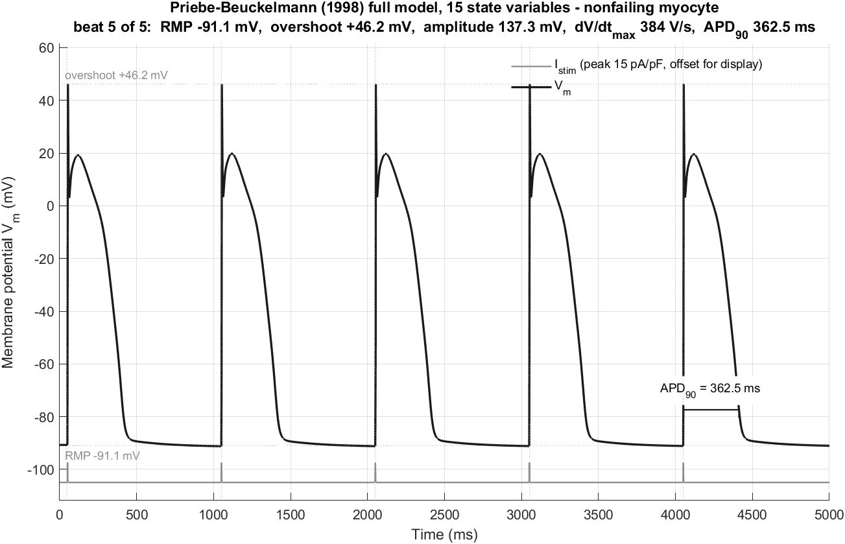
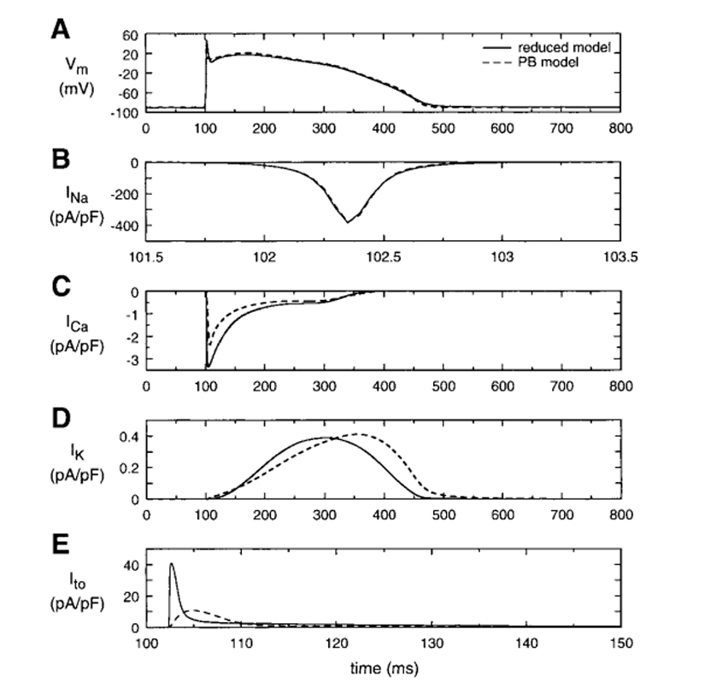
it is appropriate to assume that intracellular concentrations of calcium ions do not change significantly throughout the course of an action potential and can remain constant. The sodium calcium exchange and the sodium potassium pump only change based on these concentrations, and can also be assumed to be constant
Notes:
hile the Priebe Beuckelman Model is extremely accurate, the amount of calculation required is impractical to run on a microcontroller while still maintaining biologically accuracy to a human heartbeat. It is necessary to therefore find a model that exists between the Noble Model and the Priebe Beuckelmann models of cardiac cells. In order to do so, it is important to realize that several currents and concentrations are relatively constant throughout the process of the cardiac action potentials. For instance,
. Therefore, several of the currents can be combined in order to limit the total number of currents available. duced Priebe Beuckelmann model. In this model, Bernus et al reduced the previous model from 10 currents and 17 variables down to 5 currents and six total variables (Bernus et al, 2002). This was done so by leaving concentrations constant where possible, and eliminating several gating variables. The result of this simplification was the creation of a still biologically accurate model to Priebe Beuckelmann, but also a model that was easier to work with. Although most of the currents still exist in this model, they are essentially constant or exponential with voltage as seen in Figure 10 below.

Slide 8
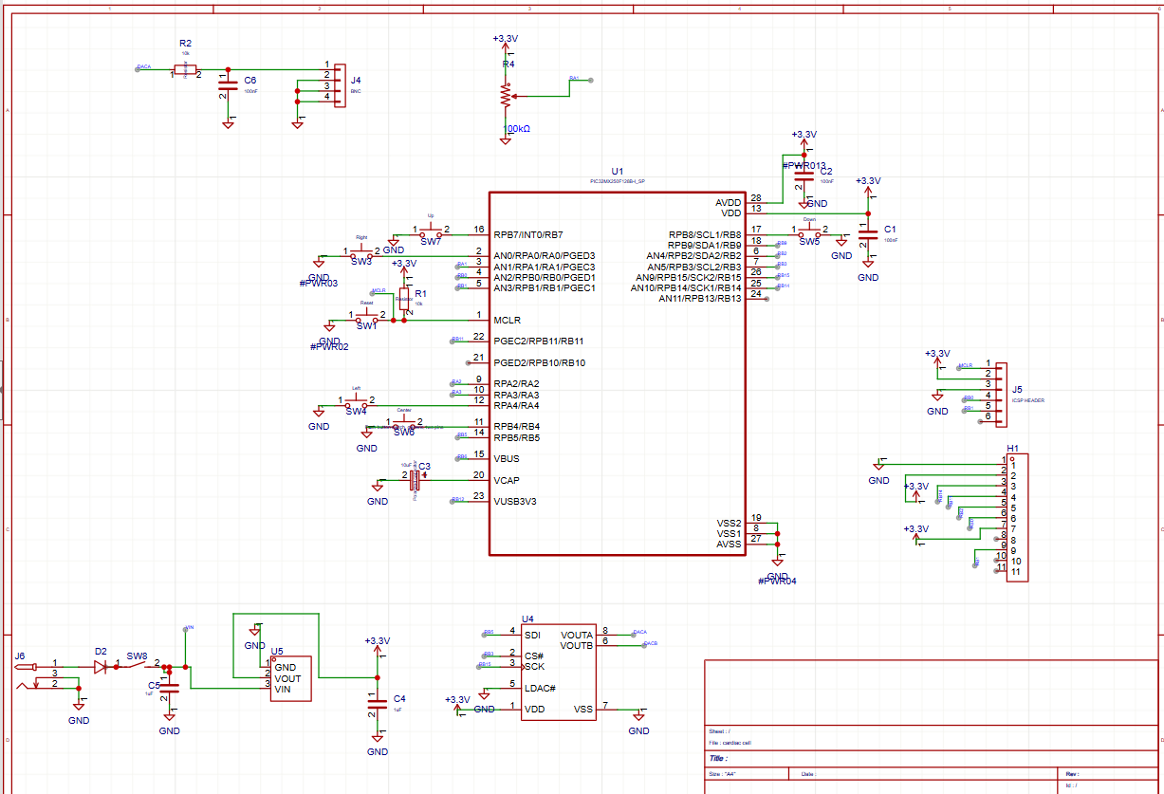

Slide 9
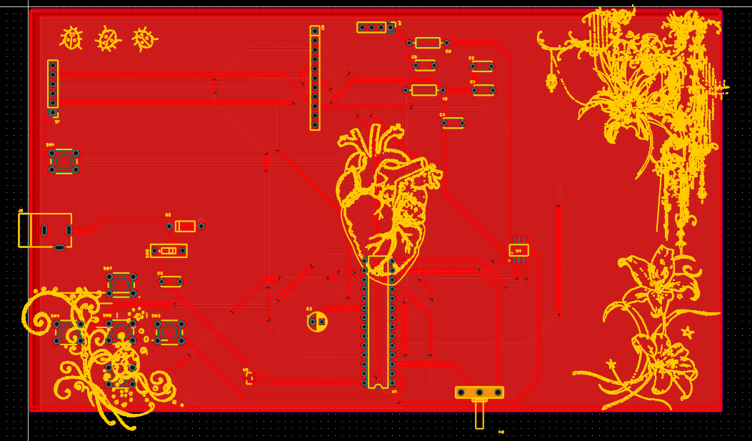
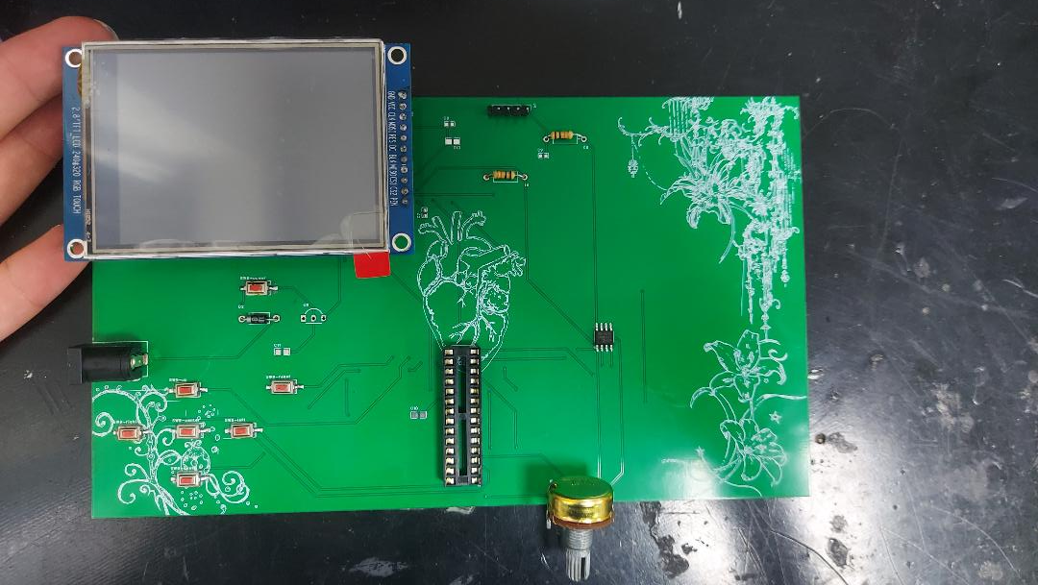

Slide 10
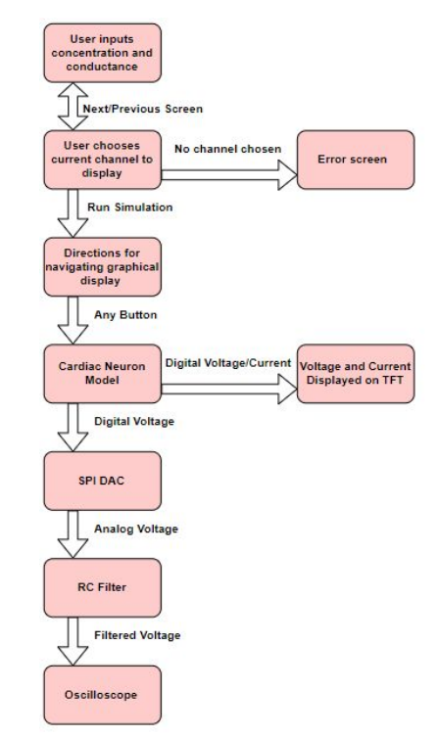
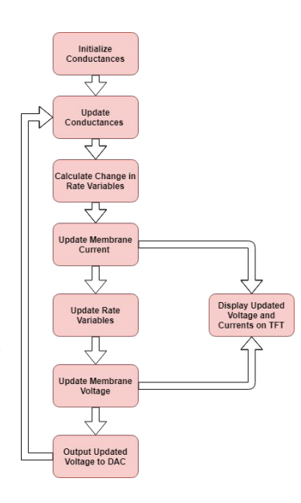
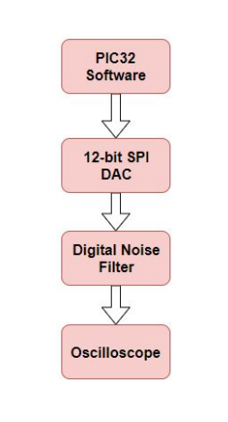
Methodology

Slide 11
Thank you for your attention

