Slide 1
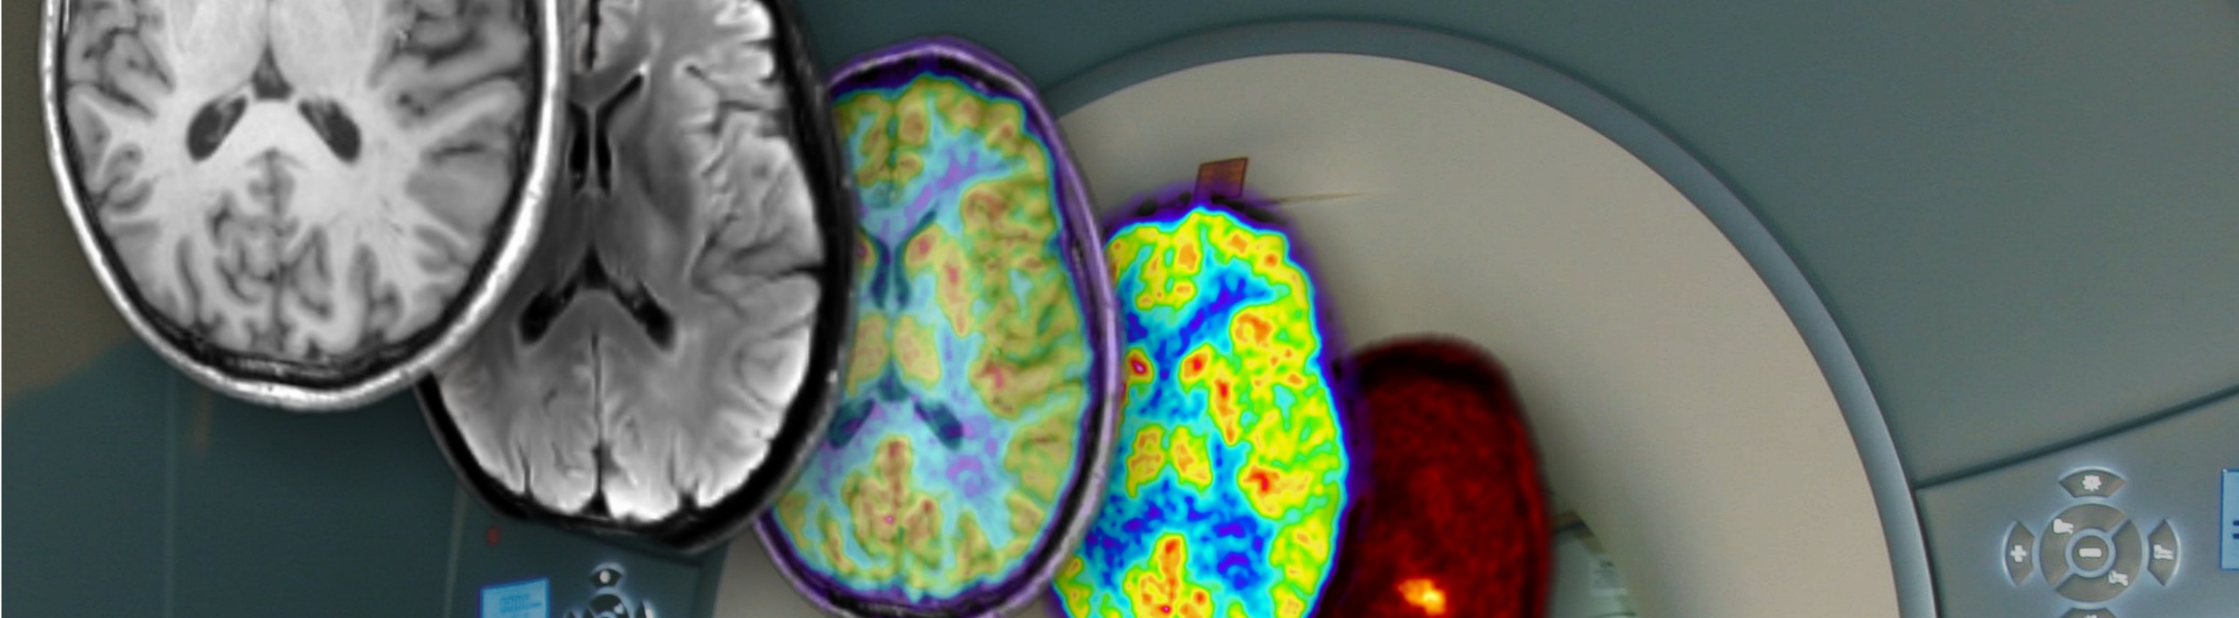
AI for Image Reconstruction in Low-Field MRI
Presenter: Zaheer Abbas
N. Jon Shah, Director
Institute of Neuroscience and Medicine - 4
Forschungszentrum Jülich GmbH
Jülich, Germany
Professor of MRI Physics
Department of Neurology
Universitätsklinikum Aachen
Aachen, Germany

Slide 2
Why Does Low-Field MRI Need AI?
02
1
2
3
4
Signal
Encoding
Reconstruction
Validation
What receiver coils actually measure
Why the data live in k-space
How prior knowledge enters an estimate
How to detect unsupported detail
MRI does not directly capture a visible image.
The scanner measures weak electromagnetic signals from tissue.
Magnetic gradients encode spatial location in these signals.
The raw measurements are stored in k-space.
Reconstruction converts k-space into an MRI image.
In low-field MRI, weak signals and noise make reconstruction difficult.
The goal is not an image that merely looks clean. It is an estimate that agrees with the acquired data and is credible for the clinical task.

Slide 3
Tissue signal → encoded data
03
Magnetisation
Coils sense signal
Gradients encode location
Model-based reconstruction
B0 aligns spins; an RF pulse perturbs the net magnetisation.
Relaxing spins induce a small, time-varying voltage.
Frequency and phase vary with spatial position.
Invert the encoding model to estimate tissue contrast.
The human body contains many hydrogen atoms, especially in water and fat.
A magnetic field aligns the hydrogen spins inside the body.
A radio-frequency pulse temporarily disturbs these aligned spins.
When the pulse stops, the spins return to their original state.
During this relaxation, they produce weak electromagnetic signals.
Receiver coils capture these signals, while gradients encode their location.
The encoded data are stored in k-space and reconstructed into an MRI image.

Slide 4
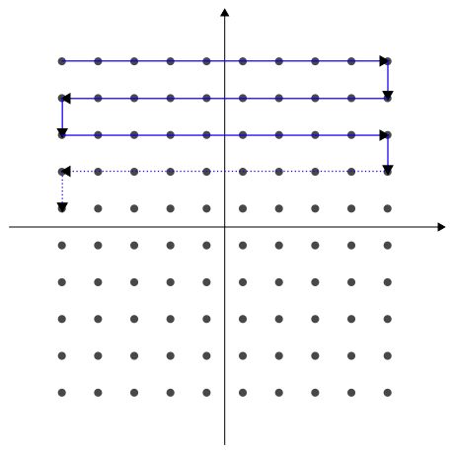
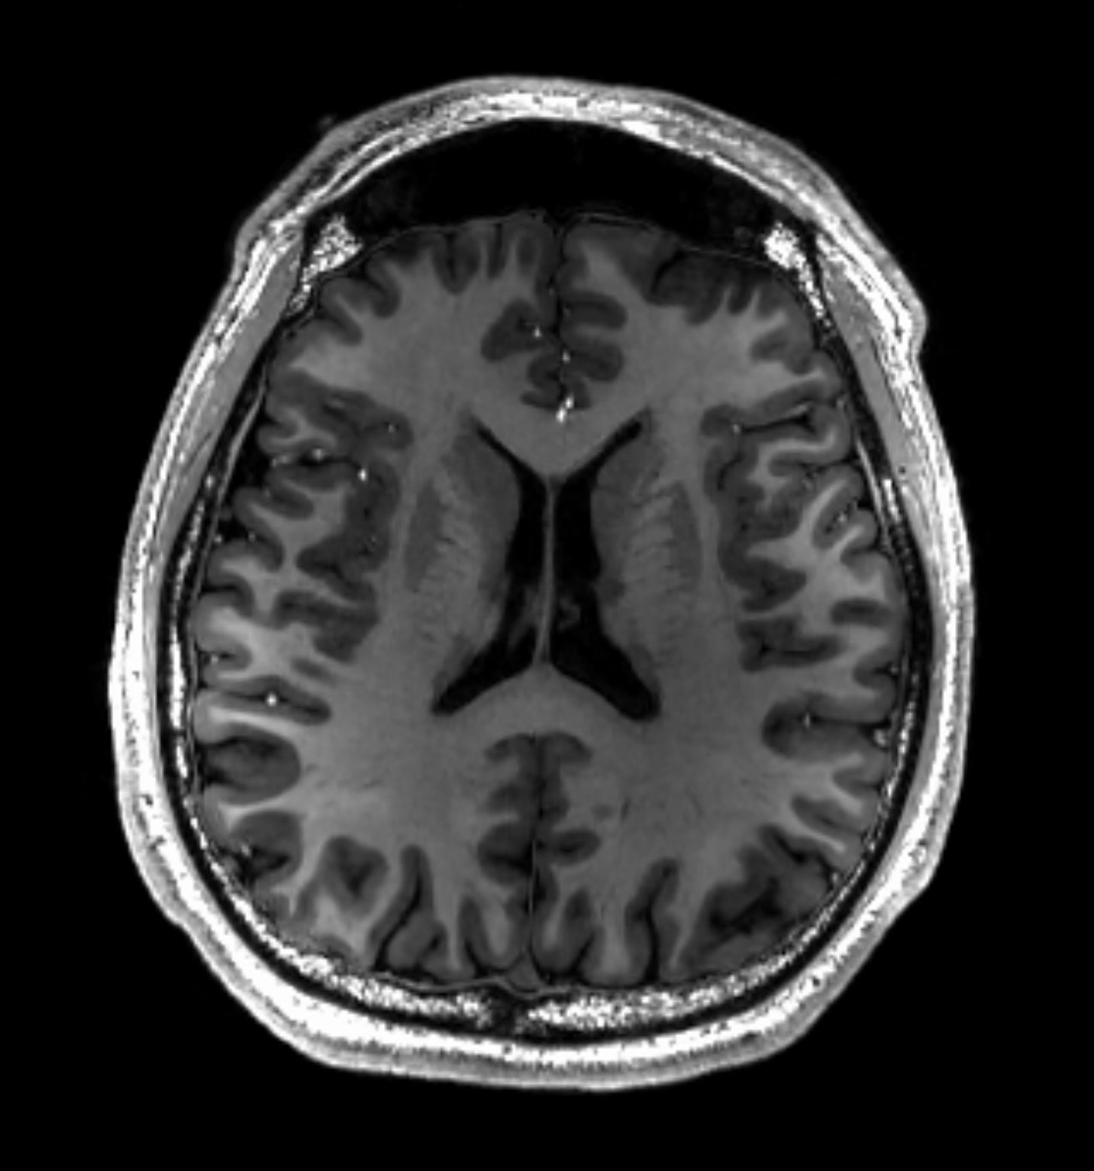
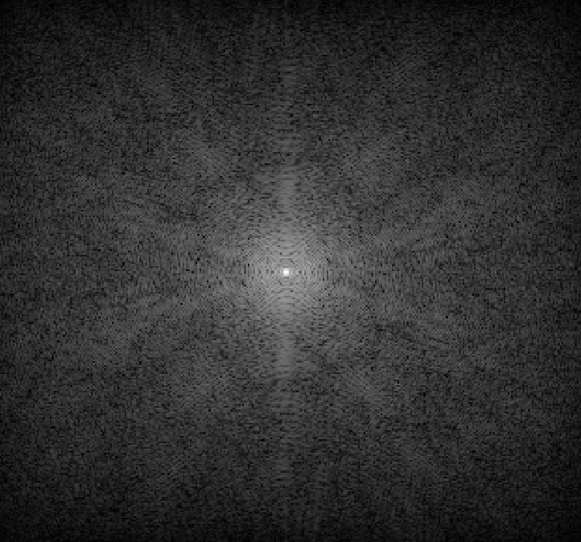
k-space is a frequency map—not a picture
04
Each sample records a spatial-frequency component
combine samples
with inverse FFT
Reconstructed image estimate
Left: IngFrancesco, Wikimedia Commons (CC BY-SA 3.0). Right: Asnaebsa, Wikimedia Commons (CC BY-SA 4.0).
k-space is the raw data space used in MRI.
It does not look like a normal anatomical image.
Each point contains spatial-frequency information from the body.
The centre of k-space mainly controls image contrast and overall signal.
The outer regions contain fine details and sharp edges.
Missing or noisy k-space samples cause blur, artifacts, or loss of detail.
An inverse Fourier transform converts k-space data into an MRI image.

Slide 5
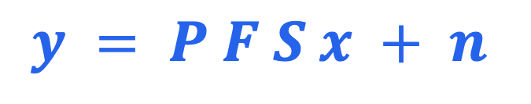
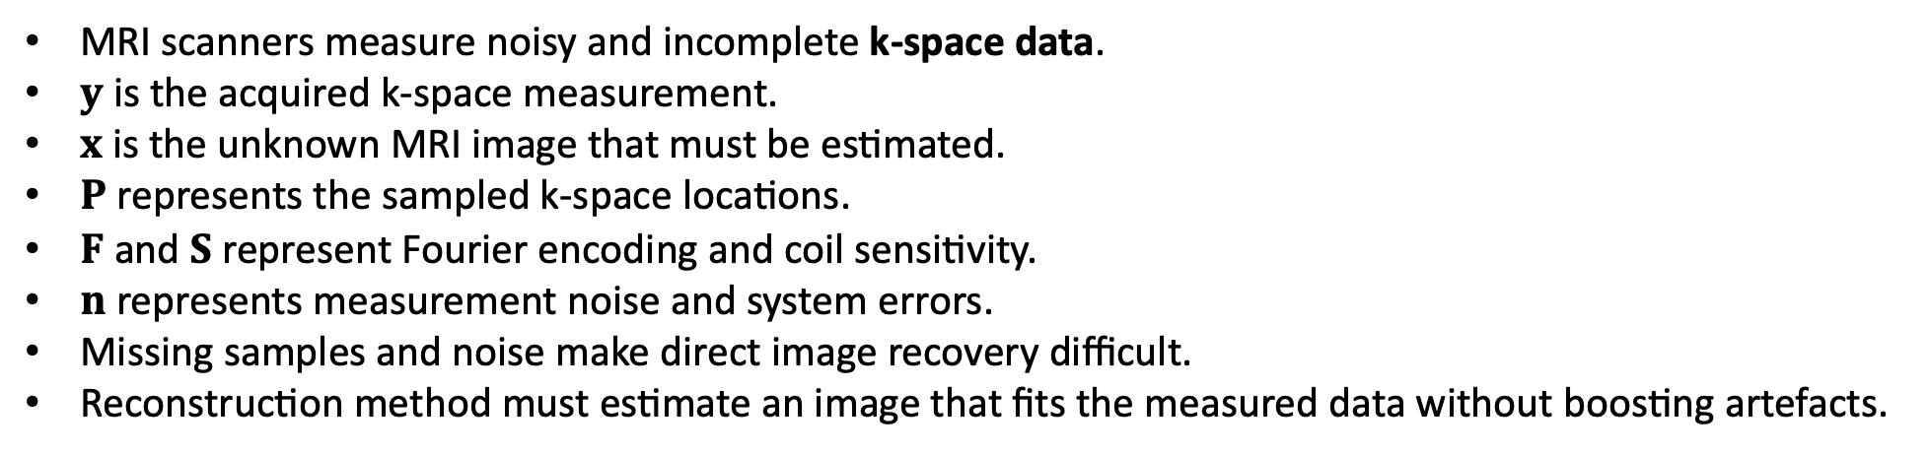
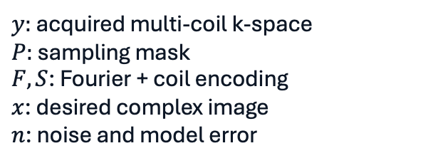
MRI reconstruction: a noisy, incomplete inverse problem
05
$$y = P F S x + n$$
acquired
k-space y
inverse
problem
$y:$ acquired multi-coil k-space
$P:$ sampling mask
$F,S$: Fourier + coil encoding
$x$: desired complex image
$n$: noise and model error
estimate x̂
MRI scanners measure noisy and incomplete k-space data.
$y$ is the acquired k-space measurement.
$x$is the unknown MRI image that must be estimated.
$P$represents the sampled k-space locations.
$F$ and $S$represent Fourier encoding and coil sensitivity.
$n$represents measurement noise and system errors.
Missing samples and noise make direct image recovery difficult.
Reconstruction method must estimate an image that fits the measured data without boosting artefacts.
Conceptual formulation based on MRI reconstruction literature: Hammernik et al. (2018); Aggarwal et al. (2019).
With missing samples or weak signal, more than one image can explain the data. Reconstruction chooses a plausible estimate using both data and prior assumptions

Slide 6
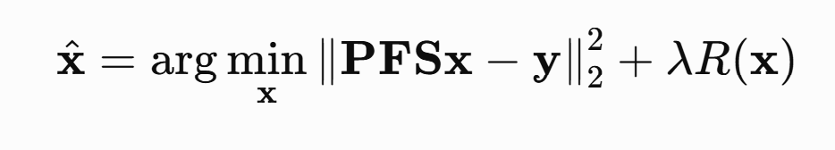
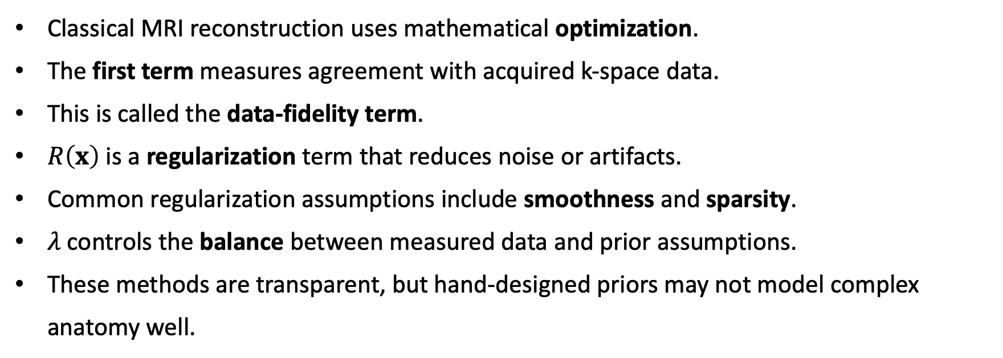
Before AI: solve an optimization problem
06
measured
data y
data
fidelity
Classical MRI reconstruction uses mathematical optimization.
The first term measures agreement with acquired k-space data.
This is called the data-fidelity term.
$R\left(x\right)$ is a regularization term that reduces noise or artifacts.
Common regularization assumptions include smoothness and sparsity.
$λ$ controls the balance between measured data and prior assumptions.
These methods are transparent, but hand-designed priors may not model complex anatomy well.
solution x̂
Classical methods are transparent and often reliable. Their limitation is that hand-designed priors may not capture complex anatomy or scan-specific noise.
Conceptual formulation based on MRI reconstruction literature: Hammernik et al. (2018); Aggarwal et al. (2019).

Slide 7
What “low field” means in practice
07
3 T
1.5 T
0.3 T
64–50 mT
high field
high SNR, fast
clinical baseline
broad sequence support
low field
lower signal; simpler siting
ultra-low field
portable / point-of-care
MRI magnetic field strength is measured in Tesla (T).
Most hospital MRI scanners operate at 1.5 T or 3 T.
Low-field MRI commonly refers to systems below 1 T.
Examples include 0.3 T systems and portable scanners around 50–64 mT.
Lower field strength produces a weaker MRI signal and lower signal-to-noise ratio.
However, low-field scanners can be smaller, cheaper, and easier to install.
AI reconstruction can help improve image quality from weaker low-field measurements.
Claim source: Sarracanie & Salameh, Frontiers in Physics (2020); Lyu et al., Scientific Data (2023).

Slide 8
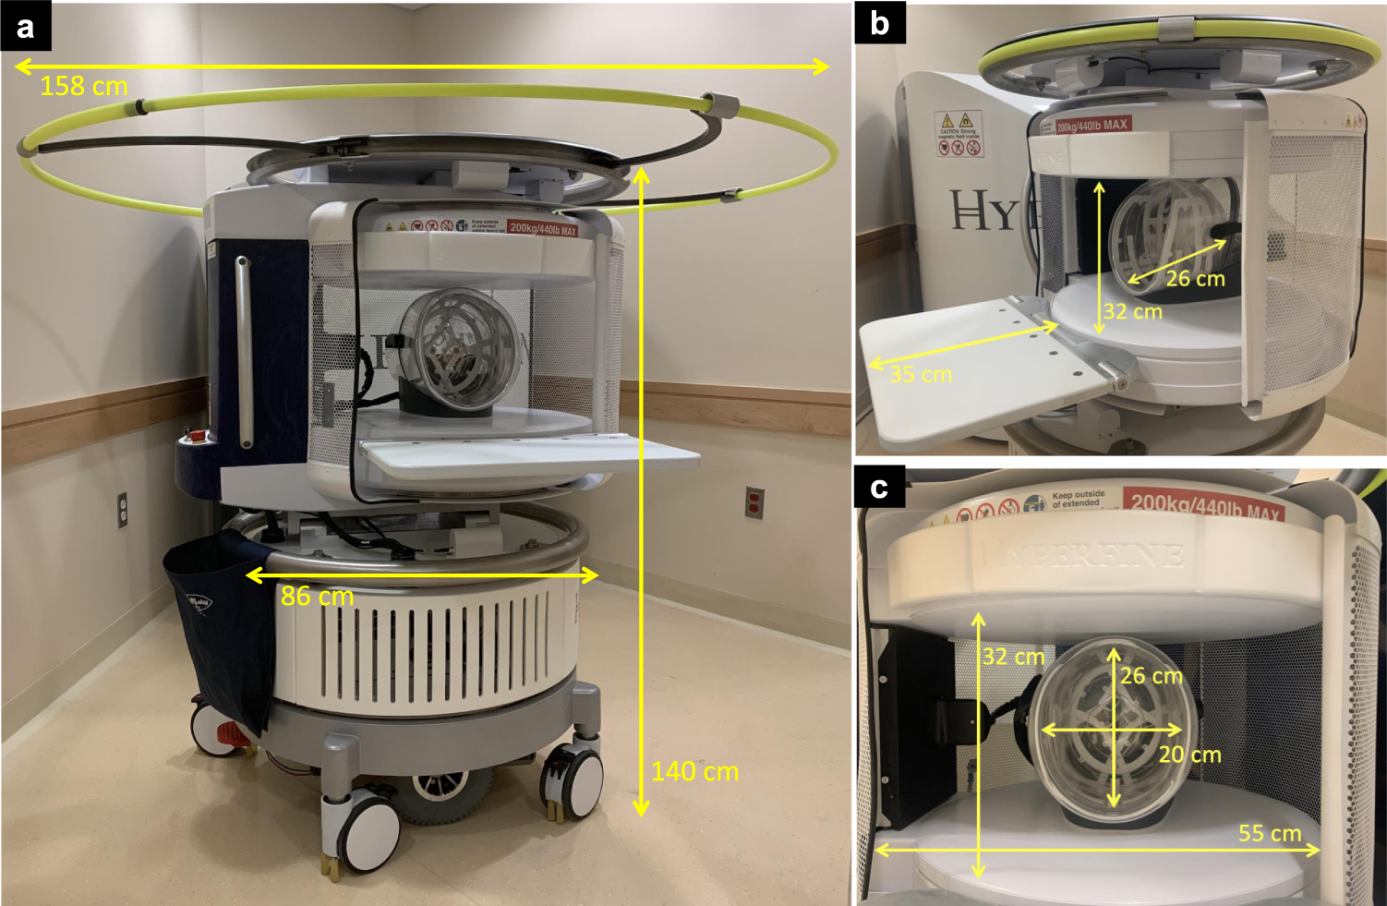
Why lower-field systems are attractive
08
Potential benefits
• Can be sited nearer to patients
• May reduce infrastructure demand
• Enables bedside / ICU investigation
• Could expand research and access
Portable 64 mT MRI scanner
Figure: Sheth et al., Nature Communications (2021), Fig. 1, CC BY 4.0.

Slide 9
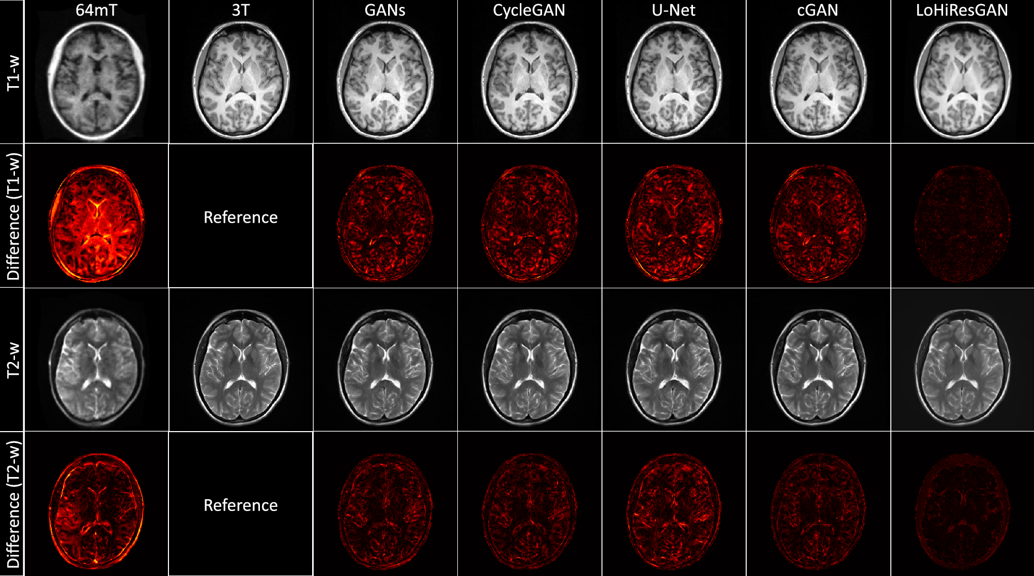
Why are low-field images harder to reconstruct
09
Four interacting causes
• Lower polarization → lower SNR
• Compensation: longer scans or larger voxels
• Reconstruction can amplify noise
• Motion, coils and calibration add artifacts
Important distinction: AI can denoise or regularise an estimate, but it cannot recover information that was never measured with certainty.
Figure: Lee et al., Scientific Reports (2023), Fig. 1, CC BY 4.0; low-field constraints: Lyu et al. (2023).

Slide 10
Where AI Can Help in MRI Reconstruction
10
Denoising
Accelerated reconstruction
Artifact correction
Resolution recovery
Remove random noise from the same sampling pattern
Estimate an image from undersampled k-space
Model structured errors such as motion or aliasing
Improve detail only with measurement-aware constraints
Denoising: reduces random noise while preserving important anatomical structures.
Accelerated reconstruction: estimates an image from fewer k-space measurements and can reduce scan time.
Artifact correction: suppresses motion, aliasing, coil, and hardware-related artifacts.
Resolution recovery: improves visible detail when supported by the acquired data.
In low-field MRI, AI mainly helps reconstruct images from weak and noisy measurements.
AI output should remain consistent with the measured k-space data, not only look visually clean.
Conceptual taxonomy informed by Zhu et al. (2018) and Lyu et al. (2023).

Slide 11
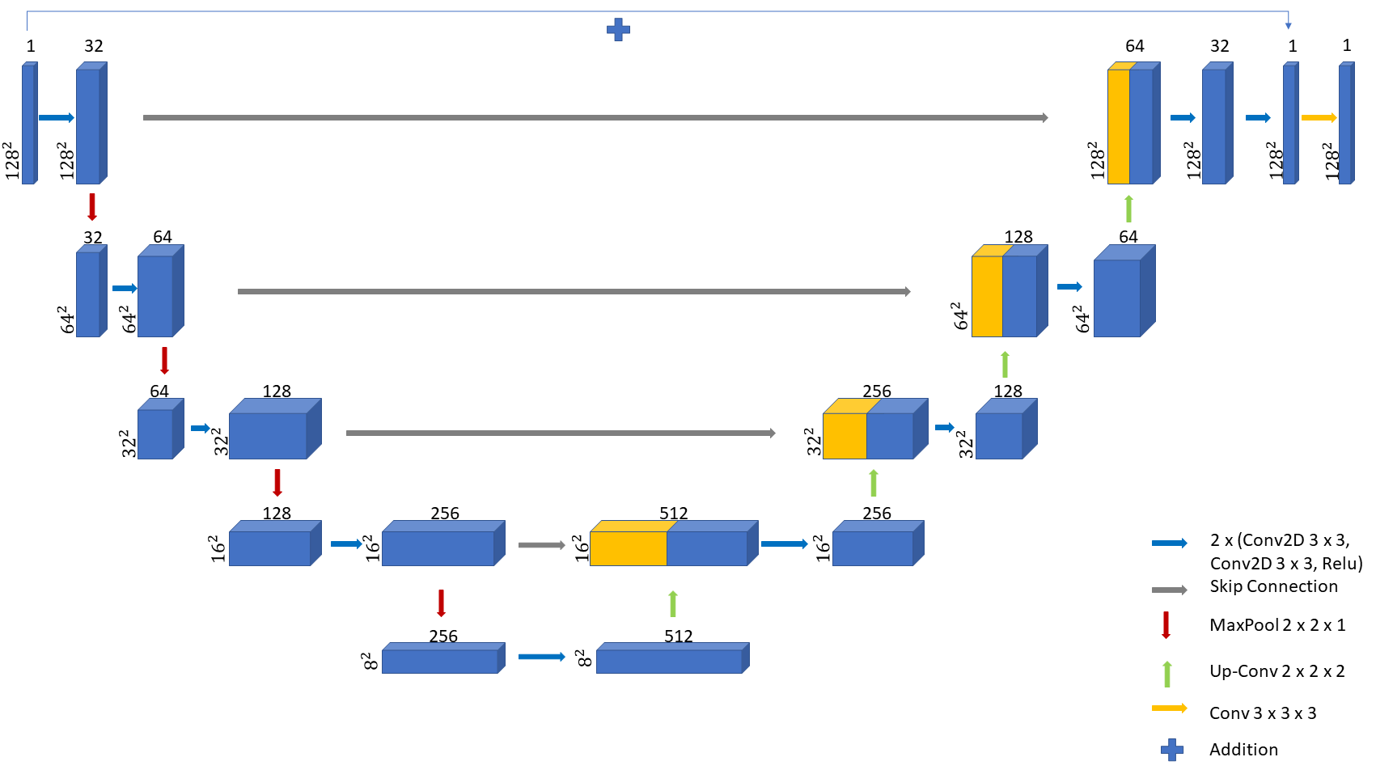
U-Net for MRI Reconstruction
11
A U-Net is a convolutional neural network used for image reconstruction.
It receives a noisy or undersampled MRI image as input.
The encoder learns broad anatomical and contextual features.
The bottleneck combines information from a large image region.
Conceptual diagram; architecture idea based on U-Net-style MRI reconstruction methods and fastMRI literature.
The decoder upsamples features to restore image resolution.
Skip connections transfer fine spatial details from the encoder to the decoder.
The output is a cleaner MRI image estimate that should still be checked against measured data.

Slide 12
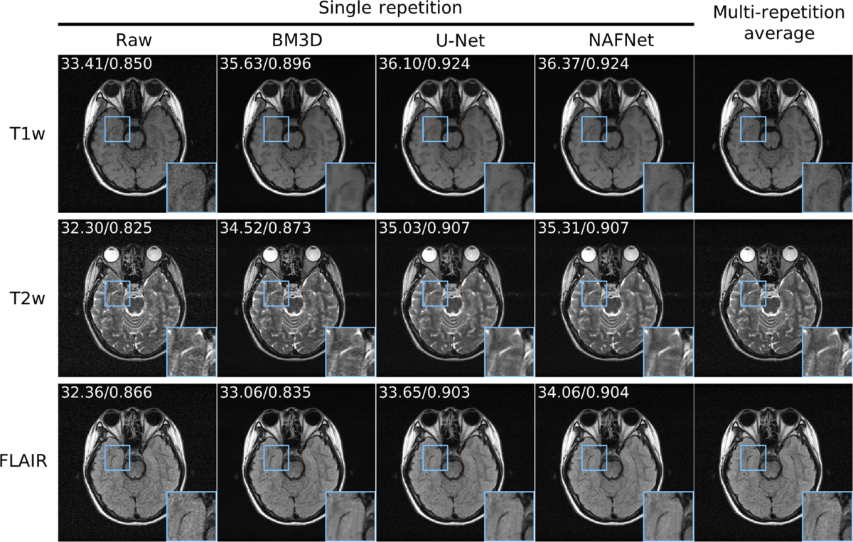
Case study 1: paired 0.3 T MRI denoising
17
A 0.3 T MRI scanner produces weaker signals than high-field MRI systems.
The low-field images therefore contain more visible noise and less clear detail.
Paired low-field and higher-quality MRI images can be used for supervised training.
Input: noisy 0.3 T MRI image.
Target: matched higher-quality reference MRI image.
The model learns to reduce noise while preserving brain structures and edges.
Results show clearer anatomical detail, but clinical validation is still necessary.
Figure: Lyu et al., Scientific Data (2023), Fig. 6, CC BY 4.0.

Slide 13
How to quantify reconstruction quality
19
PSNR
SSIM
NMSE
Error magnitude
Higher is better; sensitive to pixel scale
Structural similarity
Higher is better; can miss subtle pathology
Normalised squared error
Lower is better; depends on reference scaling
The reconstructed image is compared with a high-quality reference image.
PSNR measures pixel-level reconstruction error; higher is better.
SSIM measures similarity in structure, contrast, and brightness; closer to 1 is better.
NMSE measures normalized reconstruction error; lower is better.
Visual inspection is needed to check fine anatomical structures and artifacts.
High metric values do not always mean that pathology is preserved correctly.
Clinical or expert evaluation is essential before using AI reconstruction in practice.
Evaluation practices informed by fastMRI and reconstruction challenge literature.

Slide 14
References
25
[1] National Institute of Biomedical Imaging and Bioengineering. Magnetic Resonance Imaging (MRI). https://www.nibib.nih.gov/science-education/science-topics/magnetic-resonance-imaging-mri
[2] Sarracanie, M., & Salameh, N. (2020). Low-field MRI: How low can we go? Frontiers in Physics, 8, 172. https://doi.org/10.3389/fphy.2020.00172
[3] Zhu, B., Liu, J. Z., Cauley, S. F., et al. (2018). Image reconstruction by domain-transform manifold learning. Nature, 555, 487–492. https://doi.org/10.1038/nature25988
[4] Hammernik, K., Klatzer, T., Kobler, E., et al. (2018). Learning a variational network for reconstruction of accelerated MRI data. Magnetic Resonance in Medicine, 79(6), 3055–3071. https://doi.org/10.1002/mrm.26977
[5] Aggarwal, H. K., Mani, M. P., & Jacob, M. (2019). MoDL: Model-based deep learning architecture for inverse problems. IEEE Transactions on Medical Imaging, 38(2), 394–405. https://doi.org/10.1109/TMI.2018.2865356
[6] Yaman, B., Hosseini, S. A. H., Moeller, S., et al. (2020). Self-supervised learning of physics-guided reconstruction neural networks without fully sampled reference data. Magnetic Resonance in Medicine, 84(6), 3172–3191. https://doi.org/10.1002/mrm.28378
[7] Zbontar, J., Knoll, F., Sriram, A., et al. (2018). fastMRI: An Open Dataset and Benchmarks for Accelerated MRI. arXiv:1811.08839. https://arxiv.org/abs/1811.08839
[8] Wang, Z., Bovik, A. C., Sheikh, H. R., & Simoncelli, E. P. (2004). Image quality assessment: From error visibility to structural similarity. IEEE Transactions on Image Processing, 13(4), 600–612. https://doi.org/10.1109/TIP.2003.819861
[9] Lyu, M., Mei, L., Huang, S., et al. (2023). M4Raw: A multi-contrast, multi-repetition, multi-channel MRI k-space dataset for low-field MRI research. Scientific Data, 10, 264. https://doi.org/10.1038/s41597-023-02181-4
[10] Koonjoo, N., Zhu, B., Bagnall, G. C., Bhutto, D., & Rosen, M. S. (2021). Boosting the signal-to-noise of low-field MRI with deep learning image reconstruction. Scientific Reports, 11, 8248. https://doi.org/10.1038/s41598-021-87482-7
[11] Islam, K. T., Zhong, S., Zakavi, P., et al. (2023). Improving portable low-field MRI image quality through image-to-image translation using paired low- and high-field images. Scientific Reports, 13, 21183. https://doi.org/10.1038/s41598-023-48438-1
[12] Mazurek, M. H., Cahn, B. A., Yuen, M. M., et al. (2021). Portable, bedside, low-field magnetic resonance imaging for evaluation of intracerebral hemorrhage. Nature Communications, 12, 5119. https://doi.org/10.1038/s41467-021-25441-6

Slide 15
Questions?
What should an AI system prove before its reconstructed image is trusted?
Thank you

