Slide 1

Temperature monitoring of industrial and non-industrial equipment with a thermal camera
Giorgi Khmaladze, a student of the Master's Program in Computer and Automated Systems Engineering at the Georgian Agrarian University
2026
Notes:
<number>

Slide 2
About Me
Giorgi Khmaladze – Completed a bachelor's degree in Computer and Automated Systems Engineering at the Georgian Agricultural University, and currently a student in the master's program of the same field at the same university. Working at APD Systems as an automation engineer.
About Job
I work as an automation engineer, where I plan, develop, and execute automated systems throughout Georgia and even internationally. I have worked on projects including hydroelectric power plants, large hotels, water pumping stations, industrial dispensers, and more..
Technical Skills
Proficient in C programming, with additional experience in C++ and Python. Skilled in PCB design, having designed several boards for both university coursework and independent projects outside the university. Experienced with microcontrollers, having completed several projects involving them during university, such as video signal generator and Georgian alphabet projector.
Notes:
<number>

Slide 3
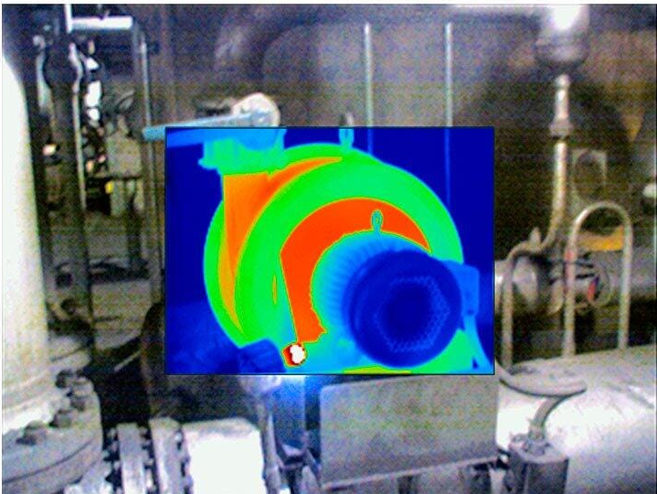
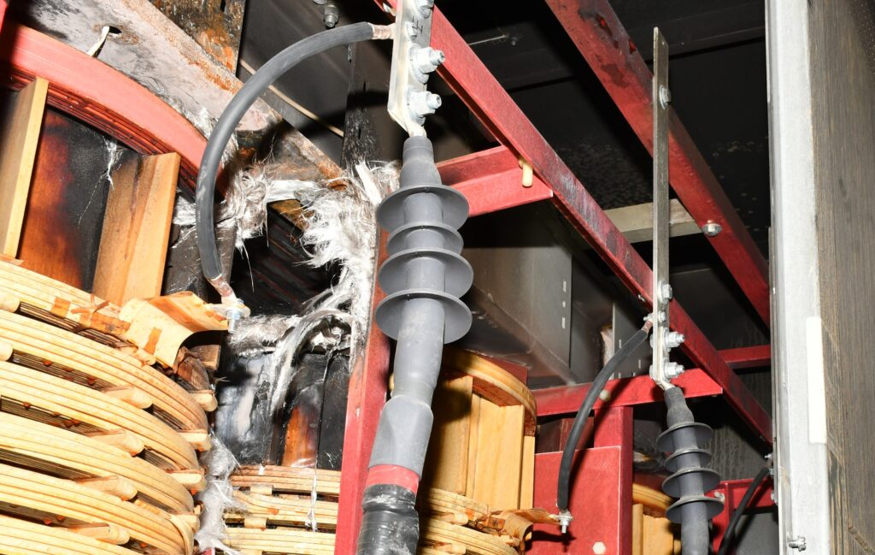
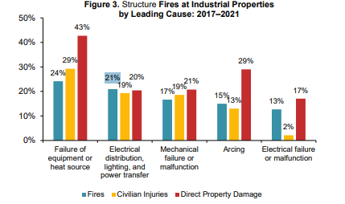
The Problem: Undetected Overheating
21%
of industrial structure fires involved electrical distribution, lighting and power-transfer equipment.
Source: National Fire Protection Association®
(NFPA)
Notes:
<number>

Slide 4
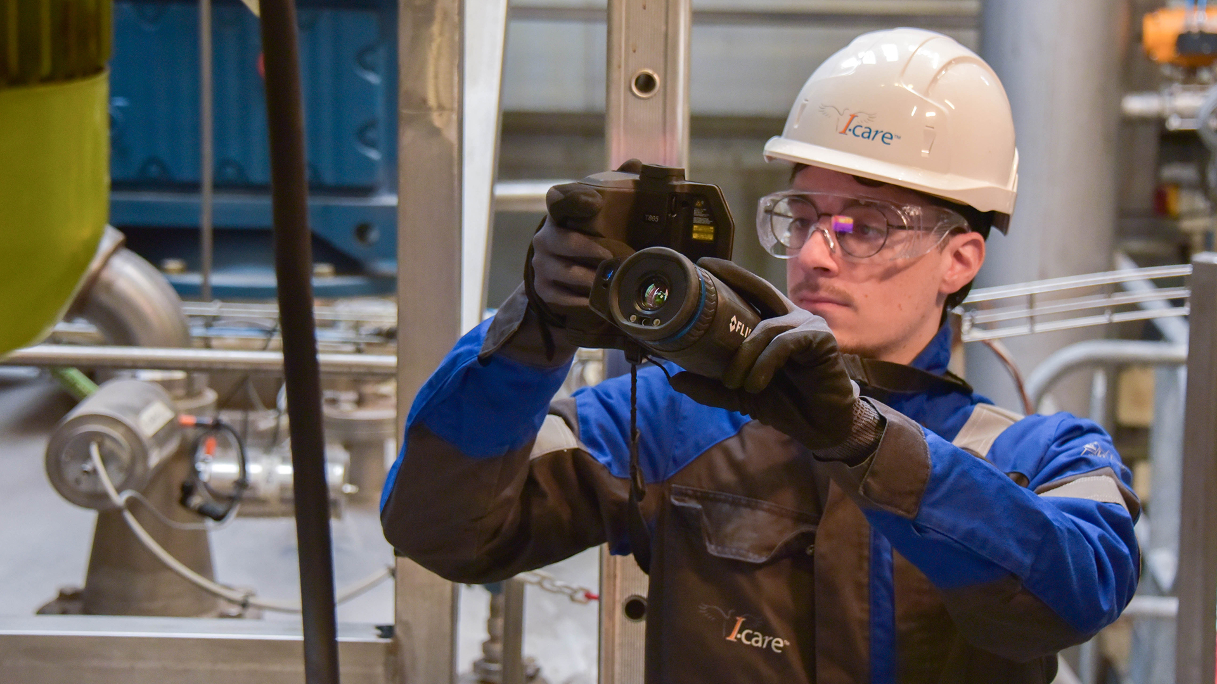
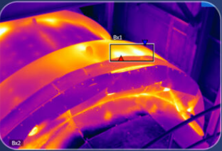
Why thermal monitoring?
25-30%
of maintenance cost reduction reported in surveyed sectors adopting thermal-imaging-based predictive maintenance
Source: Fluke Corporation. Thermal Imaging in Preventive Maintenance Programs. Fluke.
Notes:
<number>

Slide 5
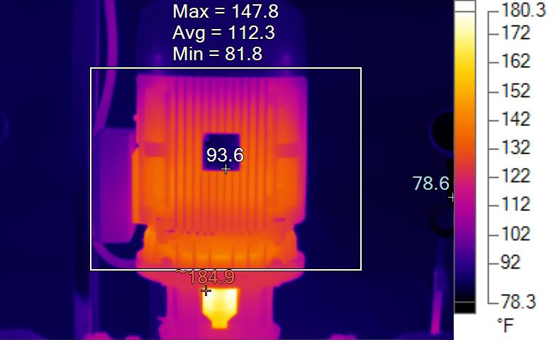
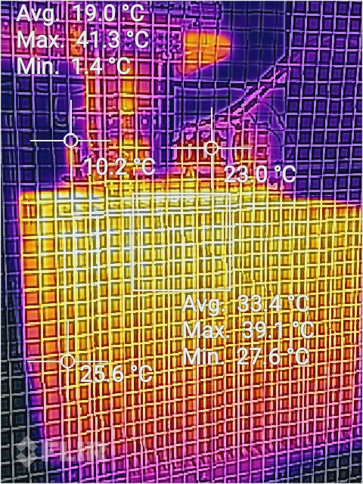
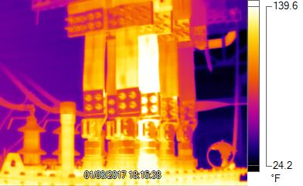
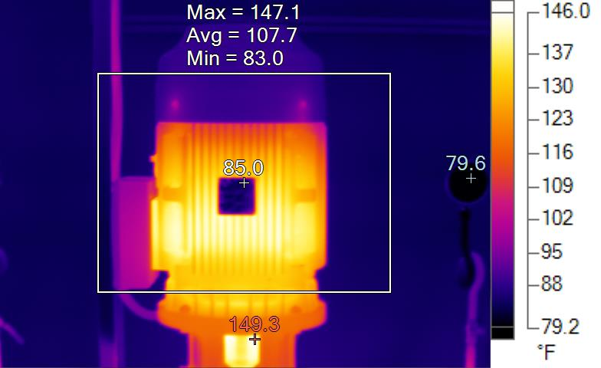
Why thermal monitoring?
Notes:
<number>

Slide 6
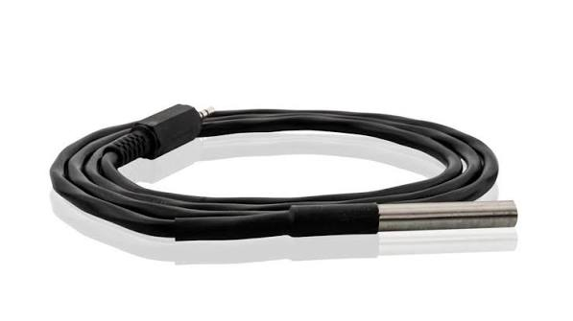
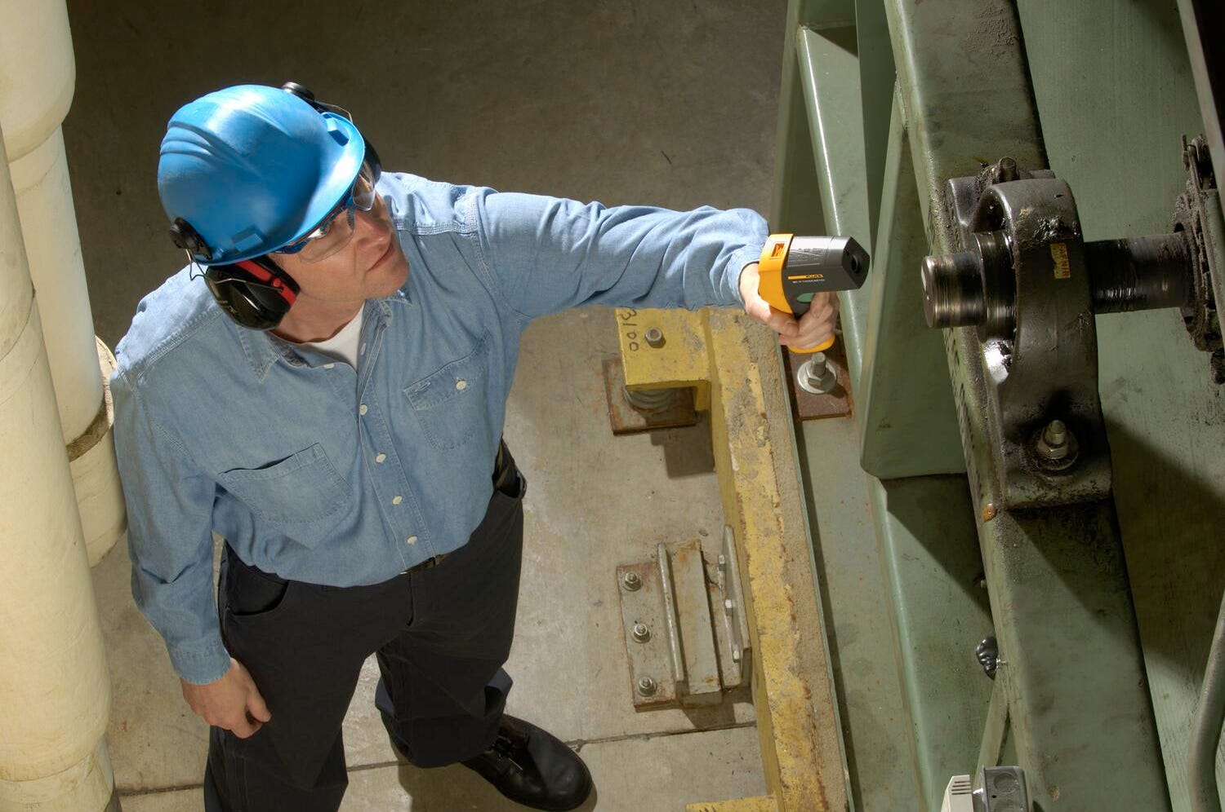
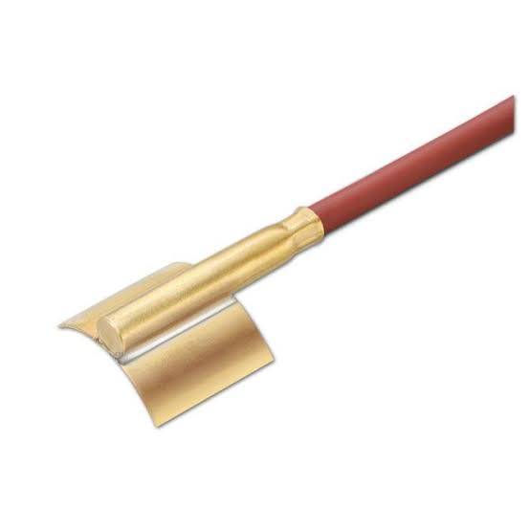
Existing Approaches & Their Limitations
Proposed Approach
Continuous, non-contact
Full-surface thermal coverage
Integrated into automation
Contact Sensors
Handheld Inspection
Notes:
<number>

Slide 7
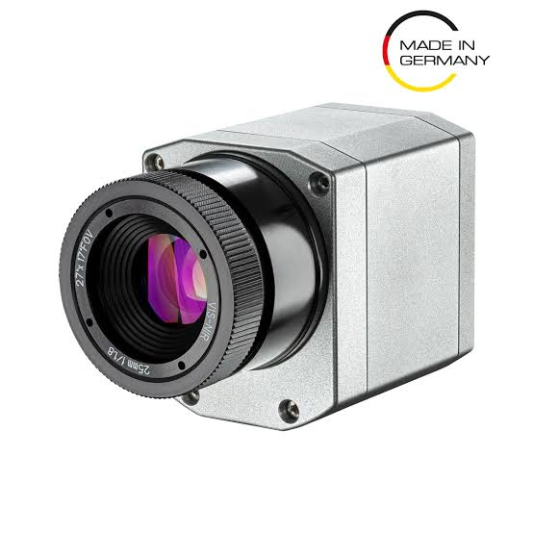
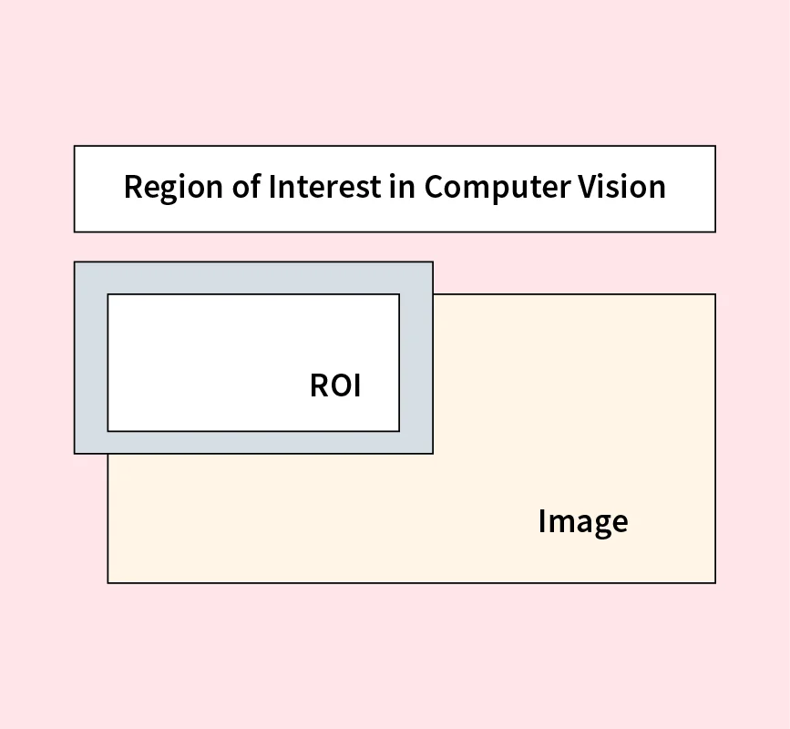
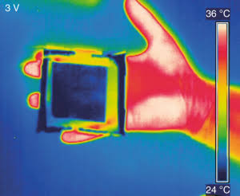
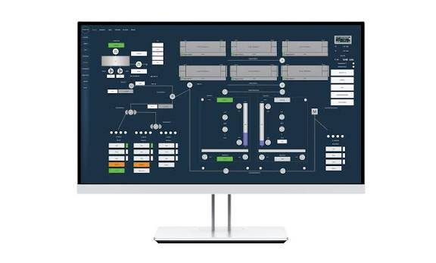
Proposed Idea — Concept Flow
Thermal
Camera
Region Of interest-Based
Frame Capture
Adaptive
Detection
SCADA +
PC App
Notes:
<number>

Slide 8



System Architecture — Three Layers
Hardware Layer
FLIR Lepton 3.5 radiometric thermal camera, RaspBerry Pi 5
Processing Layer
Adaptive baseline detection algorithm
Integration Layer
SCADA (OPC UA/Modbus) + PC application
Notes:
<number>

Slide 9
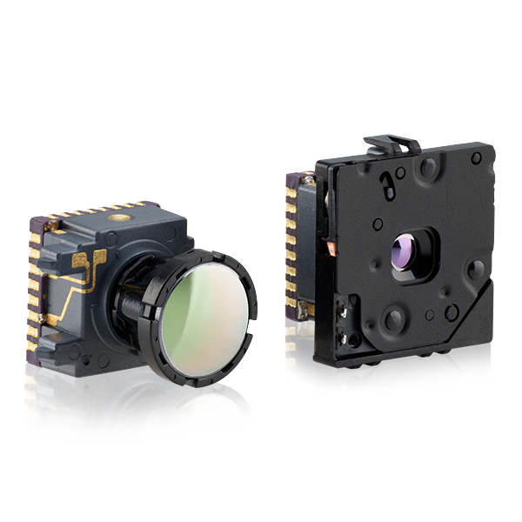
Hardware Layer – Camera (FLIR Lepton 3.5)
Resolution: 160 × 120 pixels.
Radiometry: Built-in radiometric capability that measures absolute temperature up to 400°C (752°F).
Thermal Sensitivity: Less than 50 mK (0.05°C).Field of View (FOV): 57° standard lens.
Interface: SPI video interface and I²C control interface.
Power Consumption: Approximately 140 mW during operation and 5 mW in standby.
Notes:
<number>

Slide 10
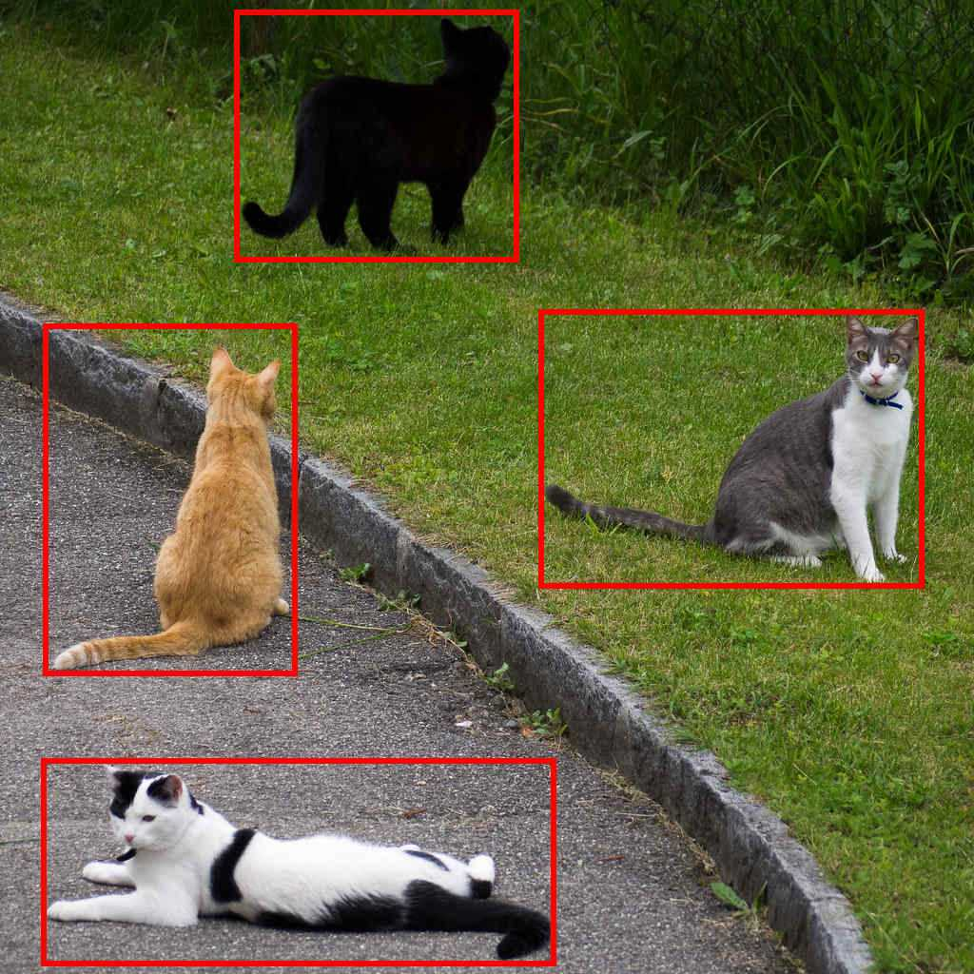
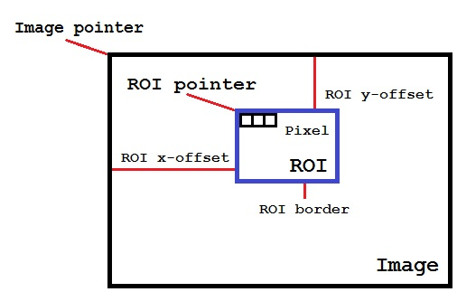
Region-of-Interest (ROI) Selection
Notes:
<number>

Slide 11
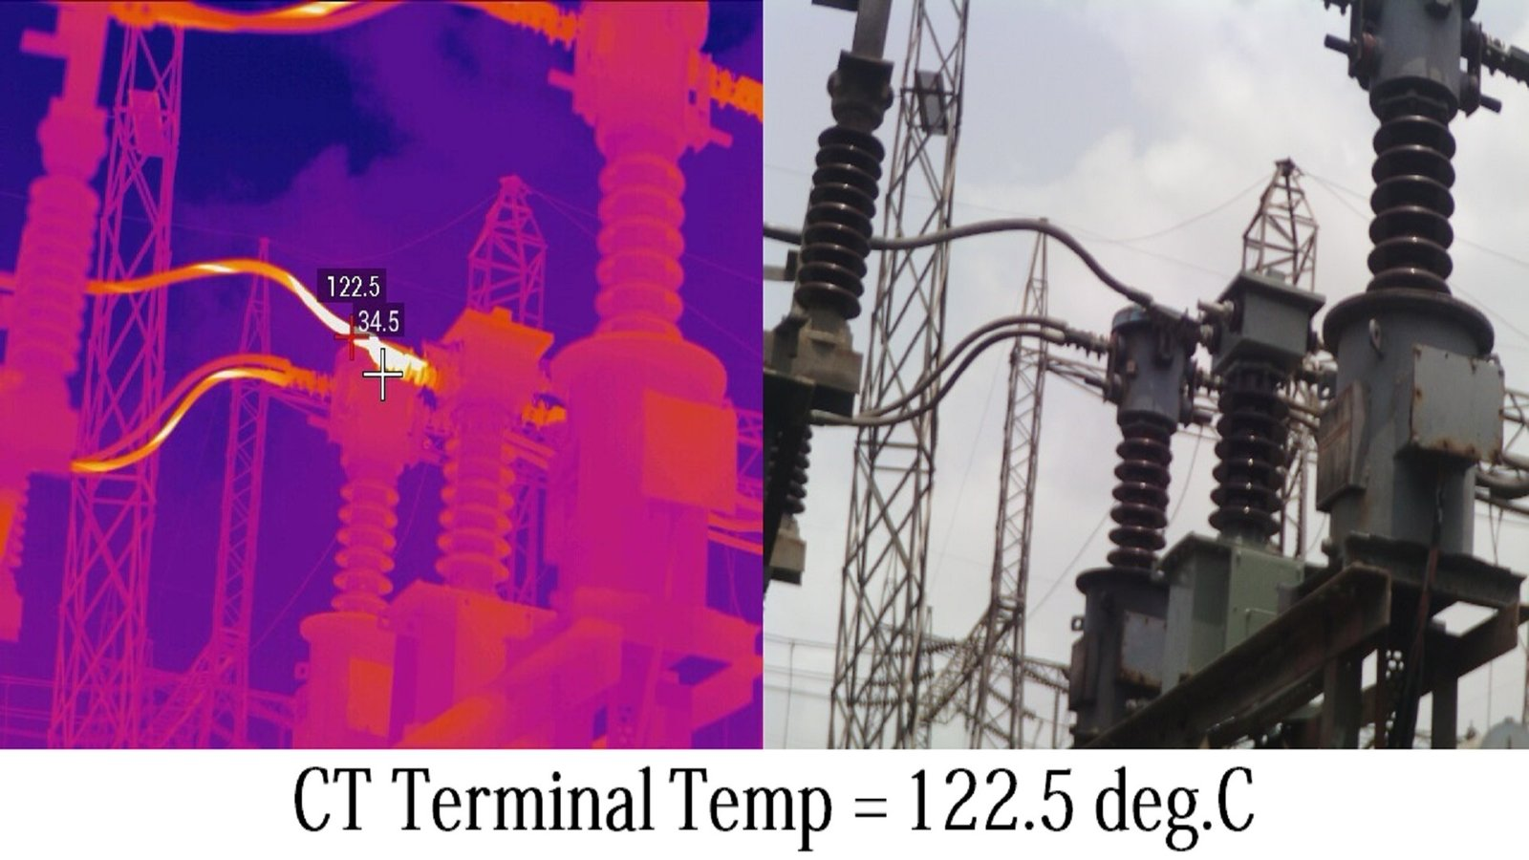
Detection Algorithm — Adaptive Baseline
1
Per-ROI max-pixel extraction (not average)
2
Noise filtering via connected-component analysis
3
Adaptive baseline: algorithm learns each ROI's normal temperature range over time
4
Alert triggered on significant deviation from the ROI's own learned baseline
5
Rate-of-rise tracking flags a developing trend as an early warning, before the threshold is crossed
Notes:
<number>

Slide 12
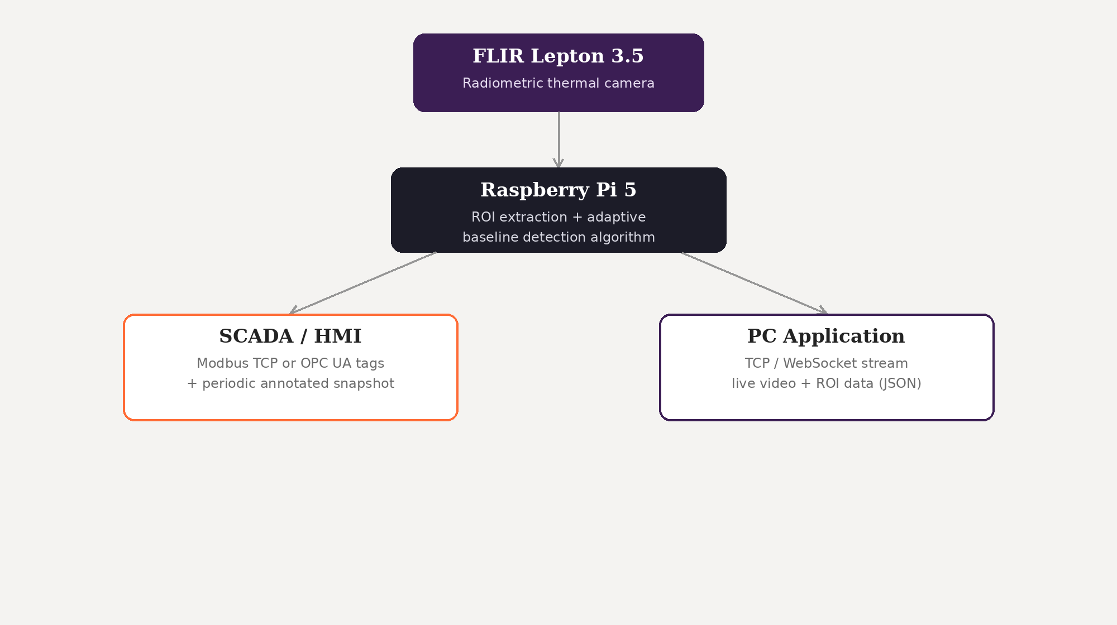
PC/SCADA Integration
Notes:
<number>

Slide 13
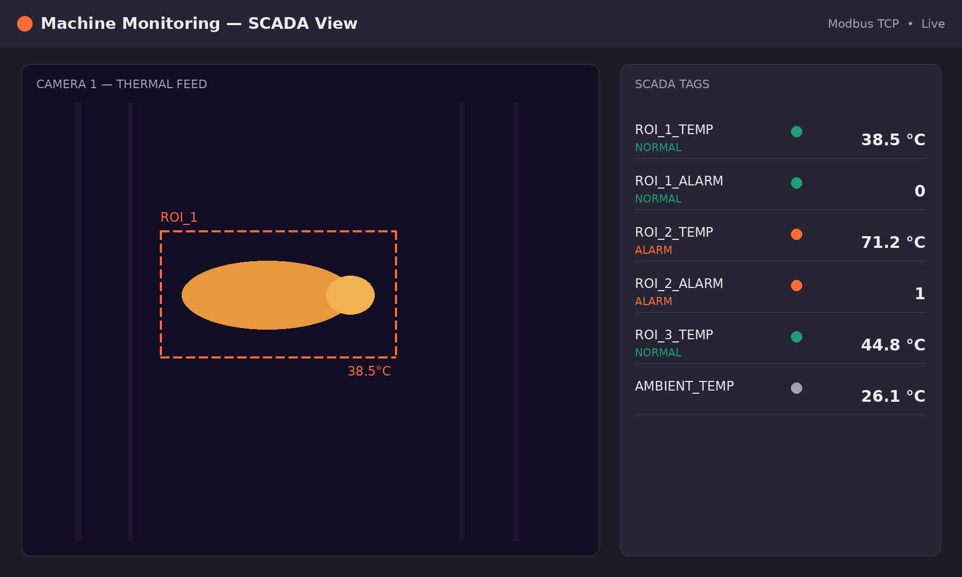
SCADA Integration
Per-ROI temperature values published as standard SCADA tags (Modbus / OPC UA)
SCADA handles alarms, trend logging, and integration with existing control logic
Live/annotated(via RTSP server) thermal frame displayed on the HMI screen
Operators see the same visual context as the PC app, without needing separate software
Notes:
<number>

Slide 14
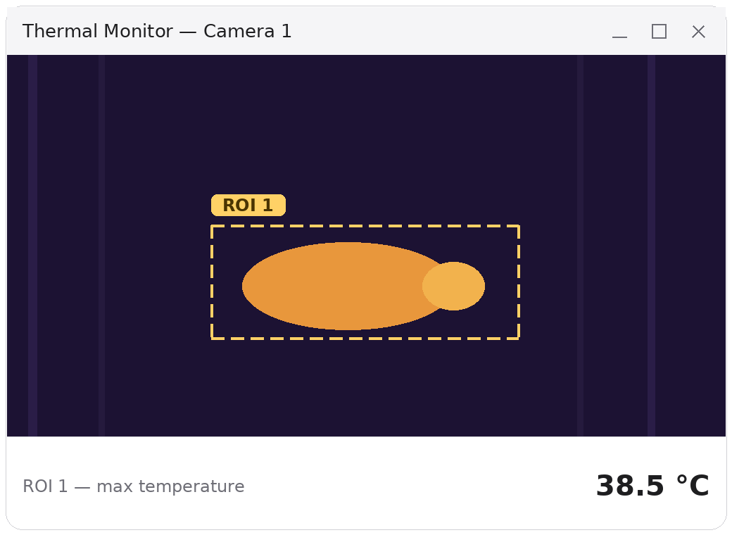
PC Application
Live thermal view with ROI boxes drawn over the feed
Temperature values displayed under/beside each highlighted ROI, updated in real time
Historical trends per ROI, alert log, per-machine configuration
Built in C
Target users: maintenance staff and engineers without SCADA access
Notes:
<number>

Slide 15
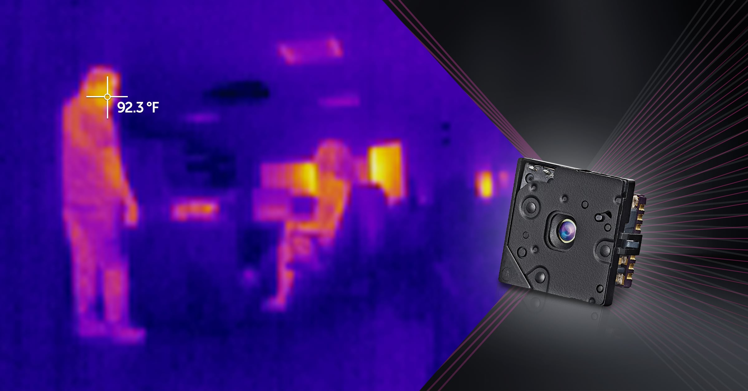
Summary & Goals
Notes:
<number>

Slide 16
Thank you!
Questions?
Notes:
<number>

