Slide 1

Design and Evaluation of a Wireless Power Link
for Low-Power Biomedical Implantable Devices
GGSB 2026: A Student and Collaboration Workshop
Giorgi Maisuradze
Tbilisi, 2026
1
Notes:
Today I will present a circuit-level design and evaluation of a wireless power link for low-power biomedical implantable devices. The current model is implemented in Multisim and focuses on the power-processing chain: AC excitation, transformer-equivalent inductive transfer, Schottky bridge rectification, DC filtering and a resistive sensor-equivalent load.
<number>

Slide 2
Project Objective and Engineering Requirements
Focus: reliable low-power DC delivery on the receiver side
The objective is to design and evaluate a transformer-equivalent inductive wireless power link that converts an AC receiver-side voltage into a stable DC supply for a low-power implantable sensor load.
Target output
Power level
Evaluation approach
Approximately 3.0–3.3 V DC at the load, suitable for a low-power sensor node before final regulation.
mW-range delivery is the evaluated operating range; nominal result is approximately 5 mW.
Load sweep, input-amplitude sweep, frequency sweep and output-capacitor settling test.
Important interpretation: this is a circuit-level evaluation. It demonstrates the power-processing chain but does not yet model implant coil geometry, tissue absorption, temperature rise, SAR, or mechanical encapsulation.
2
Notes:
The main objective is not to claim a complete clinical implant supply, but to evaluate whether the receiver-side circuit can generate a stable low-voltage DC output. The target is around 3.0 to 3.3 V, which is a practical supply class for low-power electronics. The evaluation is based on load, frequency, input amplitude and output capacitor tests.
<number>

Slide 3
System Architecture
From sinusoidal transmitter excitation to regulated-class DC output
The implemented chain consists of a 3 Vrms sinusoidal source at 100 kHz, a 50 Ω source resistance, a 27 nF series compensation capacitor, a 1:1 transformer-equivalent inductive link, a receiver-side compensation capacitor, a Schottky full-bridge rectifier, a 1 µF smoothing capacitor and a resistive load.
3 Vrms
100 kHz
R1 + C1
TX compensation
1:1 transformer
equivalent
C3 + Schottky
bridge
1 µF DC
filter
2.2 kΩ
load
AC link
Rectification
Filtering and load
Transformer-equivalent coupling approximates inductive energy transfer.
10BQ040 Schottky diodes reduce the forward-voltage loss compared with silicon diodes.
Cout smooths the rectified voltage; Rload models low-power electronics.
3
Notes:
The architecture starts with a 3 Vrms, 100 kHz transmitter excitation. R1 and C1 form the transmitter-side network. The inductive link is represented by a 1:1 transformer-equivalent model. On the receiver side, the AC signal is passed through the compensation capacitor and then rectified by a Schottky bridge. The output capacitor smooths the waveform and Rload represents the low-power sensor node.
<number>

Slide 4
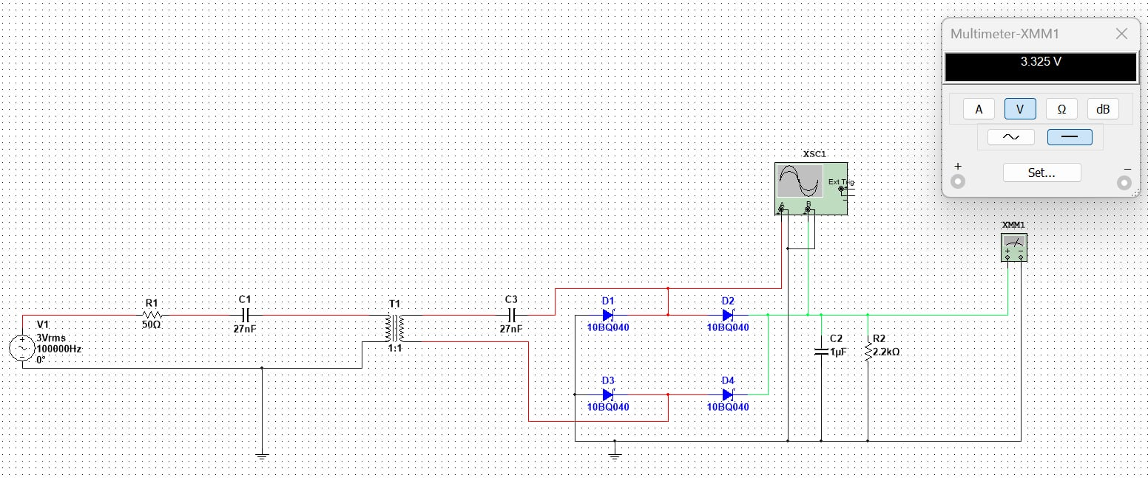
Multisim Simulation Implementation
Updated model and results are based on Multisim measurements
Nominal setup
Rectifier
Key measurement
V1 = 3 Vrms, f = 100 kHz, R1 = 50 Ω, Rload = 2.2 kΩ
10BQ040 Schottky diodes are used to reduce forward-drop losses.
Multimeter output: 3.325–3.33 V DC.
4
Notes:
This slide shows the Multisim implementation used for the updated results. The circuit uses 10BQ040 Schottky diodes, a 1 µF output capacitor and a 2.2 kΩ nominal load. The schematic should be interpreted as a circuit-level implementation, while the functional diagram is the cleaner way to explain the power path.
<number>

Slide 5
Nominal Operating Point
Receiver output under the selected baseline configuration
3.33 V
1.51 mA
5.04 mW
DC output voltage
Load current
Delivered load power
Parameter | Value
V1 | 3 Vrms, 100 kHz
R1 | 50 Ω
Rload | 2.2 kΩ
Vout | 3.33 V DC
Iout = Vout/Rload | 1.51 mA
Pout = Vout²/Rload | 5.04 mW
The result is aligned with the intended target: a low-voltage DC supply in the 3.3 V class, at a delivered power level of approximately 5 mW. This is sufficient to represent a low-power sensor load in a circuit-level proof-of-concept.
5
Notes:
At the nominal operating point, the receiver output is 3.33 V DC. With a 2.2 kΩ load, the current is calculated as 3.33 divided by 2200, which gives 1.51 mA. The delivered load power is V squared over R, which gives approximately 5.04 mW. This is a strong result for a low-power proof-of-concept receiver.
<number>

Slide 6
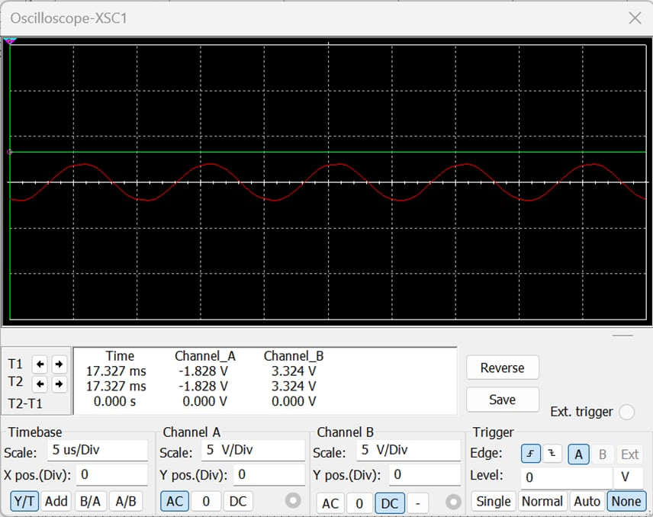
Representative Receiver Waveforms
AC waveform before rectification and DC output after filtering
Channel A
AC-coupled sinusoidal waveform at the receiver/rectifier input region.
Channel B
DC-coupled receiver output: approximately 3.324V.
Interpretation
The bridge and smoothing capacitor convert the induced AC voltage into a stable DC output.
Note: this screenshot is used as the representative nominal waveform. The sweep tables provide the quantitative comparison across loads, frequencies, input amplitudes and capacitors.
6
Notes:
The oscilloscope screenshot confirms the conversion process. Channel A shows the AC waveform near the receiver or rectifier input. Channel B is DC-coupled and shows approximately 3.324 V at the output. This demonstrates that the bridge and smoothing capacitor convert the induced AC signal into a stable DC output.
<number>

Slide 7
Load Sweep: Output Voltage, Current and Power
Rload changed while V1 = 3 Vrms and f = 100 kHz were held constant
Rload | Vout | Iout | Pout
1.0 kΩ | 3.00 V | 3.00 mA | 9.00 mW
1.5 kΩ | 3.17 V | 2.11 mA | 6.70 mW
2.2 kΩ | 3.33 V | 1.51 mA | 5.04 mW
3.3 kΩ | 3.45 V | 1.05 mA | 3.61 mW
4.7 kΩ | 3.55 V | 0.76 mA | 2.68 mW
10 kΩ | 3.70 V | 0.37 mA | 1.37 mW
Conclusion: voltage increases slightly at lighter loads, while delivered power is highest at lower load resistance. The nominal 2.2 kΩ point gives 3.33 V and 5.04 mW.
7
Notes:
In the load sweep, I changed only Rload while keeping the source and frequency constant. The output voltage increases from 3.00 V at 1 kΩ to 3.70 V at 10 kΩ because the load becomes lighter. The delivered power is highest at the lower load values. At the nominal 2.2 kΩ point, the system provides 3.33 V and 5.04 mW.
<number>

Slide 8
Input Amplitude Sweep
The transmitter excitation is a useful control variable
V1 (Vrms) | Vout
1.5 | 1.52 V
2.0 | 2.12 V
2.5 | 2.72 V
3.0 | 3.33 V
3.5 | 3.94 V
4.0 | 4.55 V
Key point
The relationship is nearly monotonic: increasing transmitter voltage increases receiver-side DC output.
This supports a simple future control strategy: adjust transmitter drive amplitude to maintain the receiver output near the target 3.3 V level.
8
Notes:
This test shows how the receiver output depends on transmitter excitation. The output increases almost monotonically from 1.52 V at 1.5 Vrms input to 4.55 V at 4.0 Vrms input. This suggests that transmitter drive amplitude can be used as a control variable in a future closed-loop system.
<number>

Slide 9
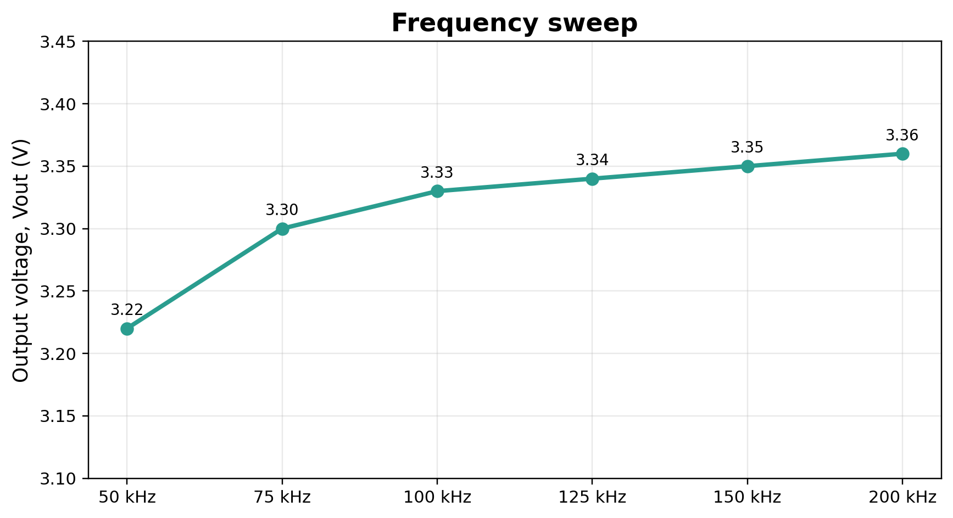
Frequency Sweep
Circuit-level response from 50 kHz to 200 kHz
Frequency | Vout
50 kHz | 3.22 V
75 kHz | 3.30 V
100 kHz | 3.33 V
125 kHz | 3.34 V
150 kHz | 3.35 V
200 kHz | 3.36 V
Interpretation
In the simplified transformer-equivalent model, Vout varies only by about 0.14 V across the tested band.
9
Notes:
The frequency sweep was performed from 50 kHz to 200 kHz. In this simplified transformer-equivalent model, the output changes only slightly, from 3.22 V to 3.36 V. Therefore, I will not claim that the system is fully optimized in frequency. The correct interpretation is that 100 kHz is a stable circuit-level demonstration frequency. A physical coil and tissue model would require separate resonance and safety analysis.
<number>

Slide 10
Output Capacitor / Startup Response
Settling time increases with output capacitance
Cout | Observed time
100 nF | 3 ms
470 nF | 14 ms
1 µF | 16 ms
4.7 µF | 21 ms
10 µF | 30 ms
Trade-off
Larger Cout improves smoothing but increases startup/settling time. A 1 µF capacitor is a practical simulation baseline.
10
Notes:
The output capacitor test shows the startup and settling behavior. Increasing the capacitor from 100 nF to 10 µF increases the observed settling time from about 3 ms to 30 ms. This is the expected trade-off: a larger capacitor improves smoothing but makes the output settle more slowly.
<number>

Slide 11
Engineering Interpretation and Limitations
What the simulation proves — and what it does not prove
Validated at circuit level
Not efficiency yet
Not physical implant validation
AC-to-DC conversion, load sensitivity, amplitude control and output filtering were demonstrated in Multisim.
Only output power was calculated. Full efficiency requires measuring input power and losses.
The model does not include coil geometry, tissue absorption, heating, misalignment or packaging.
The most defensible conclusion is that the proposed receiver architecture can generate a stable 3.3 V-class DC output from a transformer-equivalent inductive link under the simulated conditions. Future work should use coupled inductor/coil models with coupling coefficient, coil separation and tissue-equivalent loading.
11
Notes:
The simulation proves the AC-to-DC power processing chain at the circuit level. It does not yet prove clinical safety, coil misalignment tolerance, tissue heating, SAR or long-term reliability. I would describe the result as a Multisim circuit-level proof-of-concept.
<number>

Slide 12
Conclusion and Next Steps
The Multisim simulation demonstrates that the proposed transformer-equivalent inductive wireless power link can supply a low-power receiver load at the 3.3 V-class level. The nominal operating point produced 3.33 V DC, 1.51 mA and 5.04 mW across a 2.2 kΩ load. Parameter sweeps showed predictable behavior with load resistance, input amplitude, operating frequency and output capacitance.
Next: physical link model
Next: safety-oriented metrics
Next: regulation
Replace ideal transformer with coupled coils and variable coupling coefficient.
Estimate receiver power, ripple, tissue-equivalent loading and temperature-related constraints.
Add low-dropout regulation or closed-loop transmitter amplitude control.
12
Notes:
In conclusion, the updated Multisim results show that the proposed receiver can deliver a stable 3.3 V-class DC output at approximately 5 mW to a low-power load. The next technical steps are to replace the ideal transformer with coupled inductors, evaluate coupling coefficient and distance, add a 3.3 V regulator, and later include tissue phantom and thermal safety analysis.
<number>

