Slide 1
Entomopathogenic Nematodes of Georgia
Biodiversity, Biocontrol Potential, and Modern Research
Presented by: Zhana Mosidze
Institution: Faculty of Natural Sciences and Medicine
Ilia state university, Tbilisi, Georgia
Presented at: September 8, 2026

Slide 2
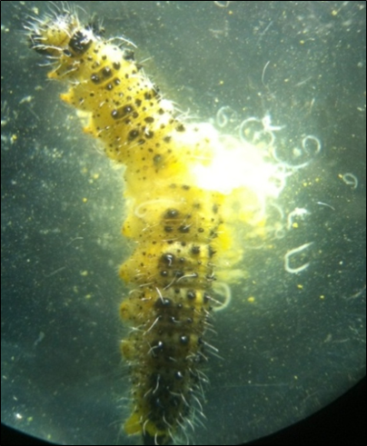
Entomopathogenic Nematodes (EPNs)
🪱 Microscopic soil-dwelling roundworms
🐛 Natural parasites of insects
🦠 Symbiotic bacteria: Xenorhabdus & Photorhabdus → rapid host death
🌱 Eco-friendly biological control
Two main families: Steinernematidae & Heterorhabditidae
Picture 1. Nematodes from infected cabbage worms

Slide 3
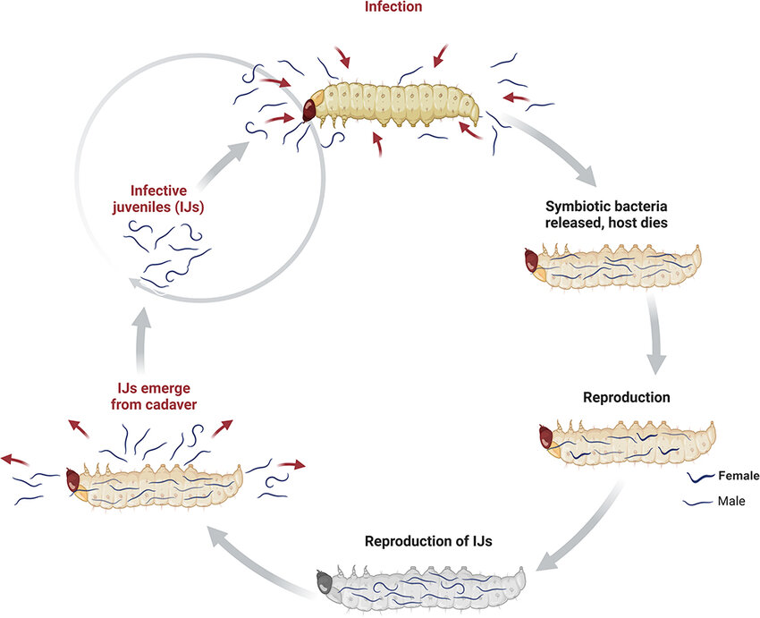
Picture 2. Life cycle of entomopathogenic nematodes (source: El Ainous et al., 2025).

Slide 4
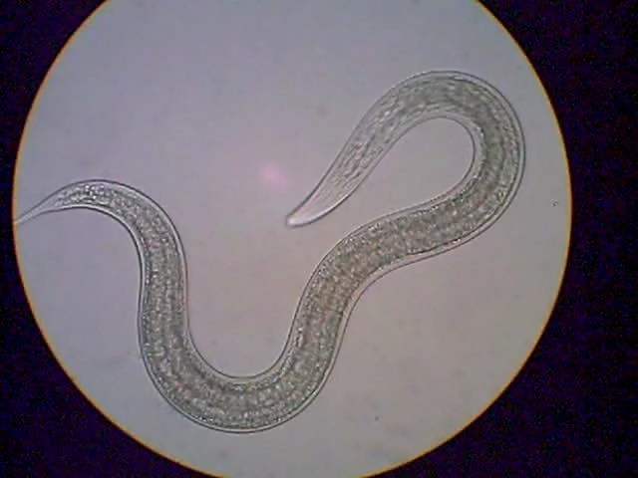
EPN Research and Biodiversity in Georgia
Steinernema borjomiense (Gorgadze et al.): A newly described species isolated from the rhinoceros beetle (Oryctes nasicornis) in Borjomi-Kharagauli National Park.
Other Steinernema species: S. georgica, S. disparica, S. gurgistana, and S. thesami.
Genus Heterorhabditis: Local strains of Heterorhabditis bacteriophora.
Genus Oscheius (Rhabditidae): Collaborative work between Dr. Gorgadze and Italian colleagues (Fanelli et al.) led to the isolation and molecular characterization of Oscheius cyrus and Oscheius insectivorus from hazelnut soils in Samegrelo (Shamgona village).
Genus Phasmarhabditis: Description of Phasmarhabditis thesamica, showing biocontrol potential against pest slugs (Deroceras reticulatum).
Oscheius sp. Taken by: Dr.Oleg Gorgadze

Slide 5
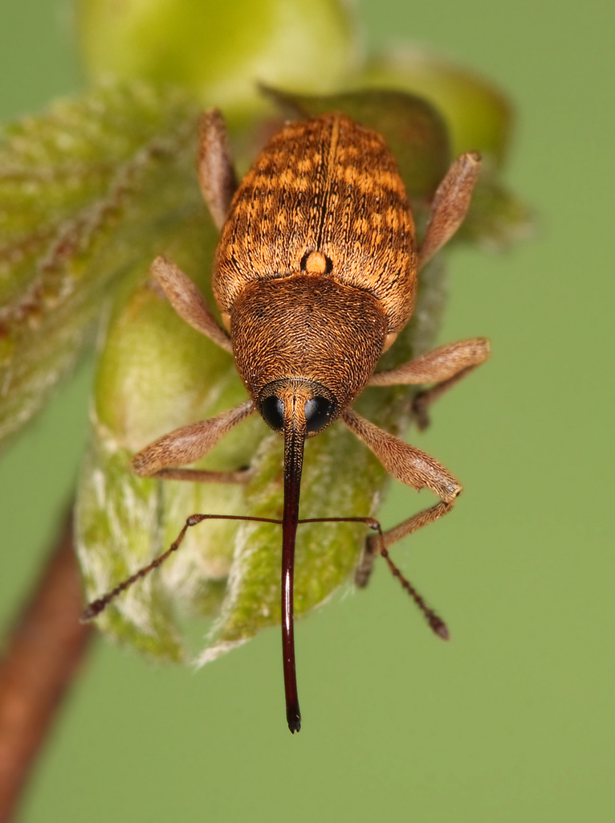
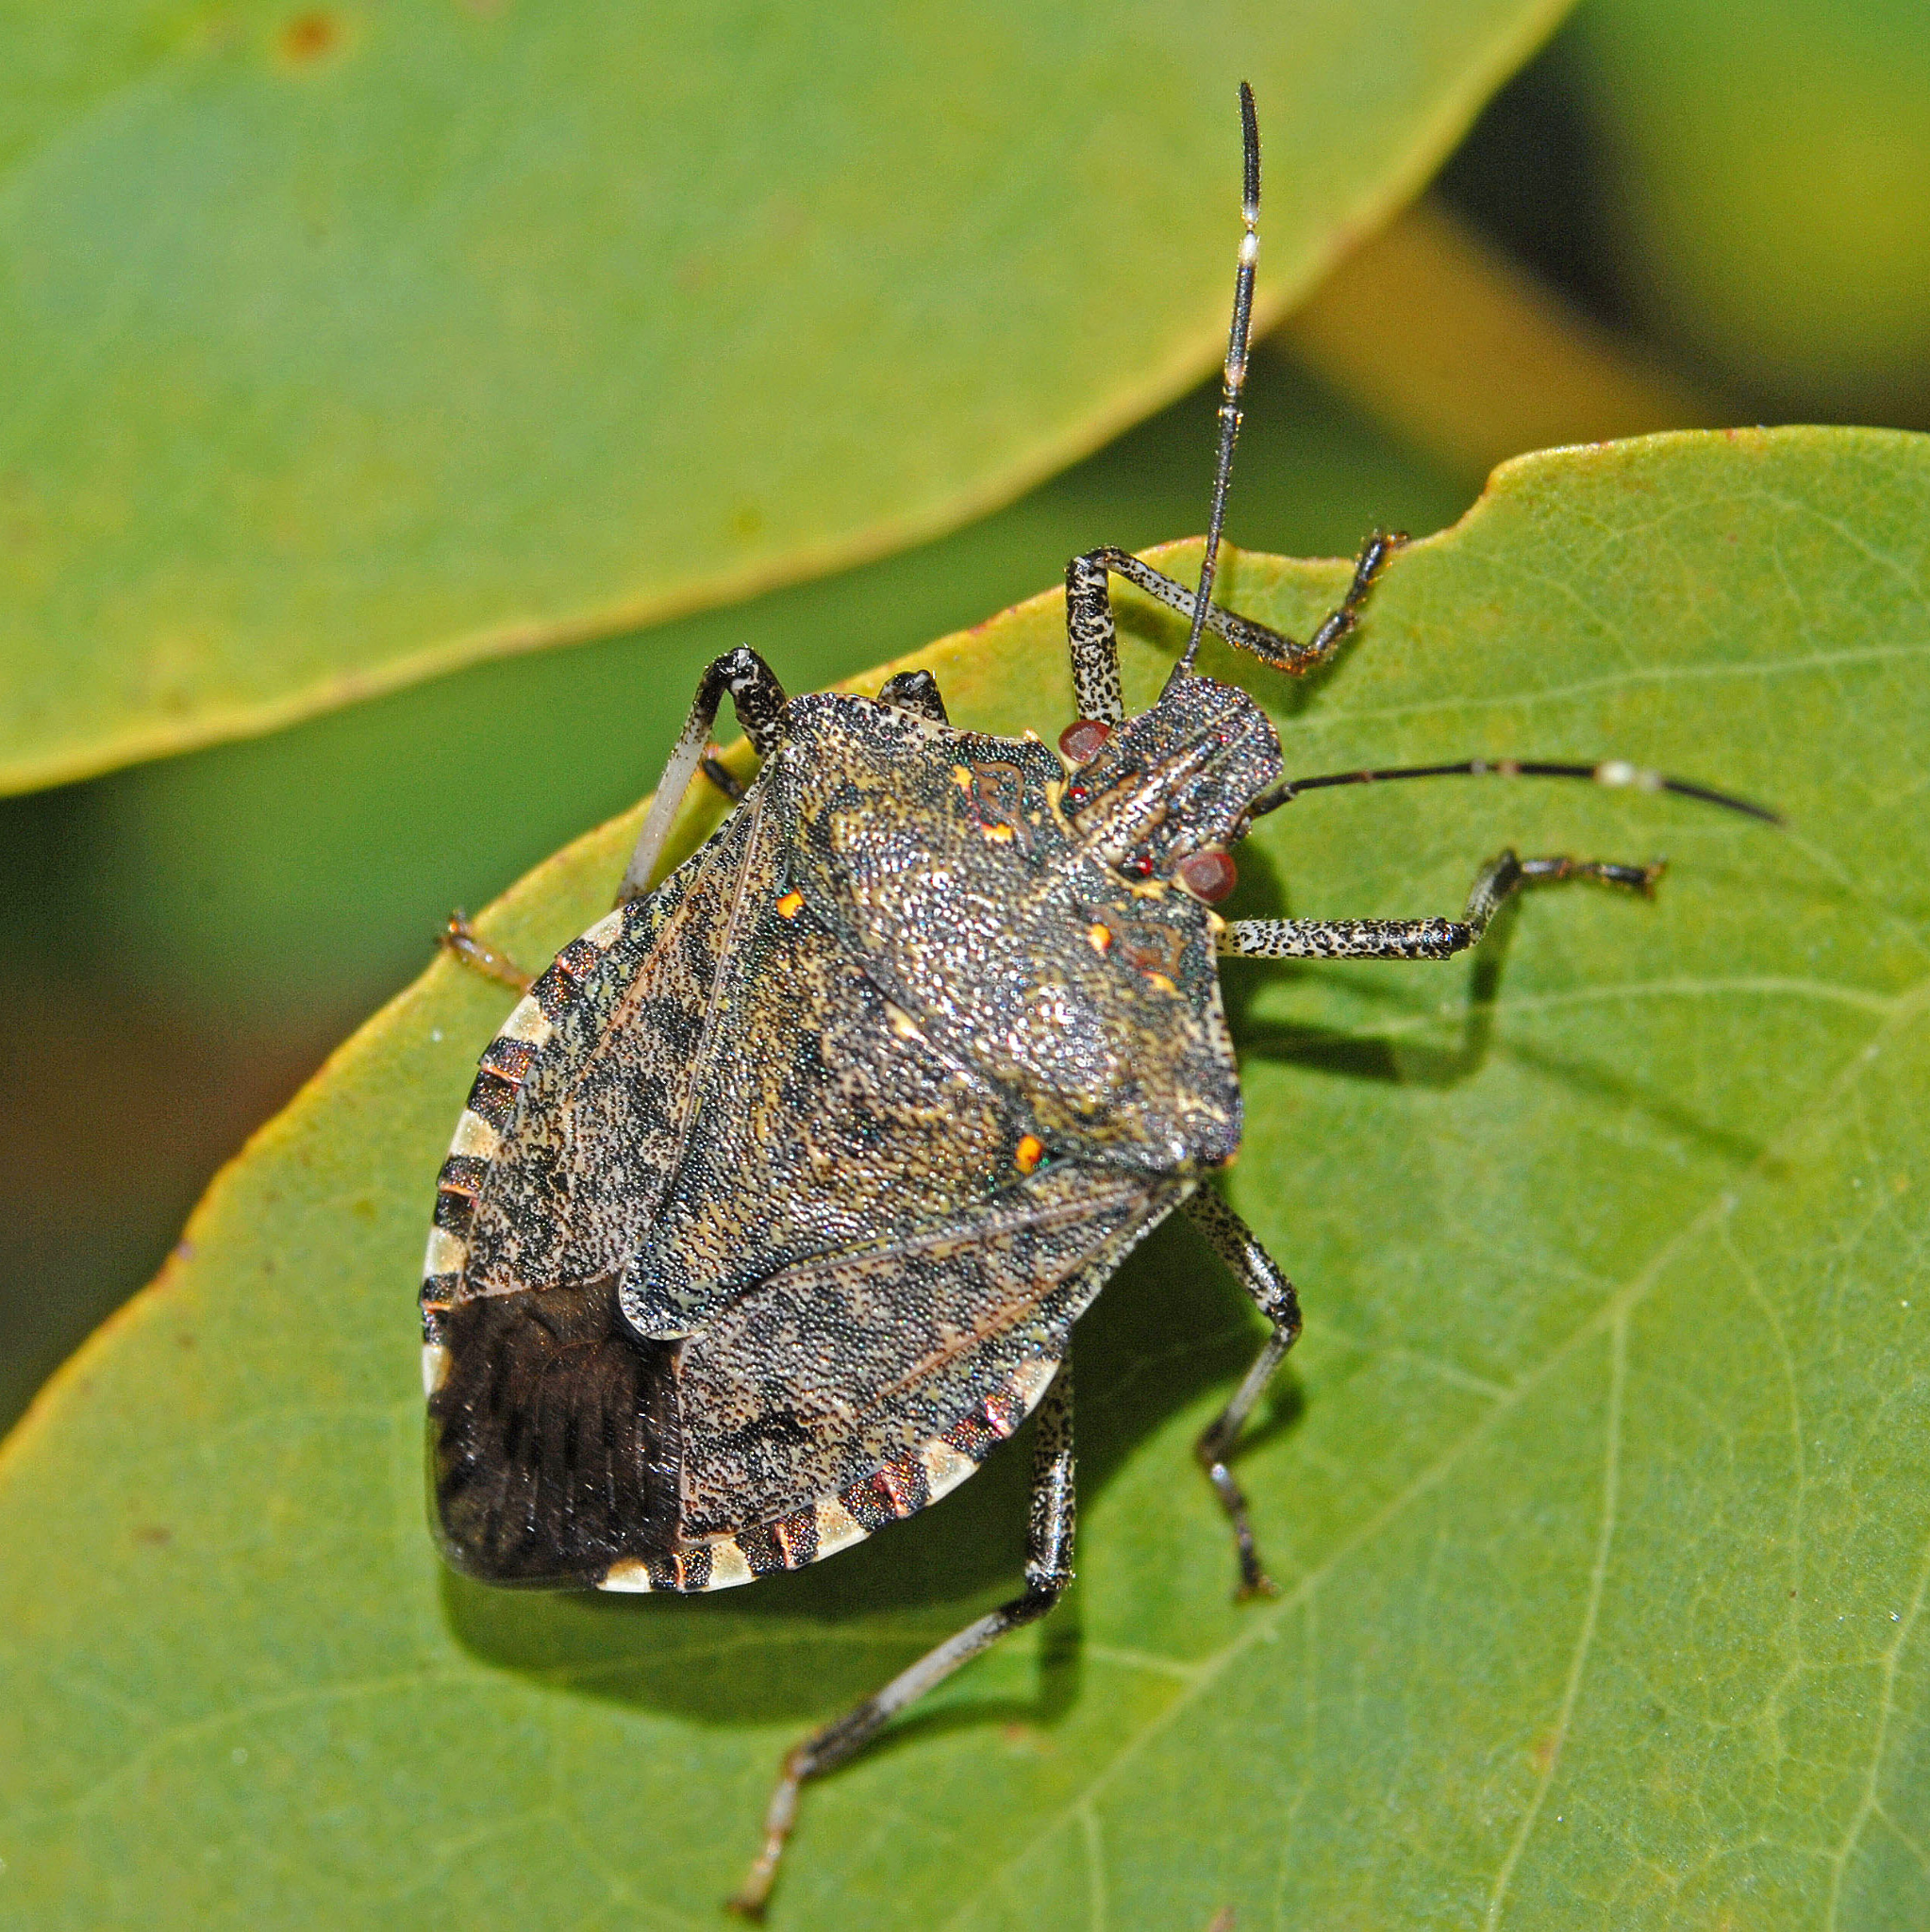
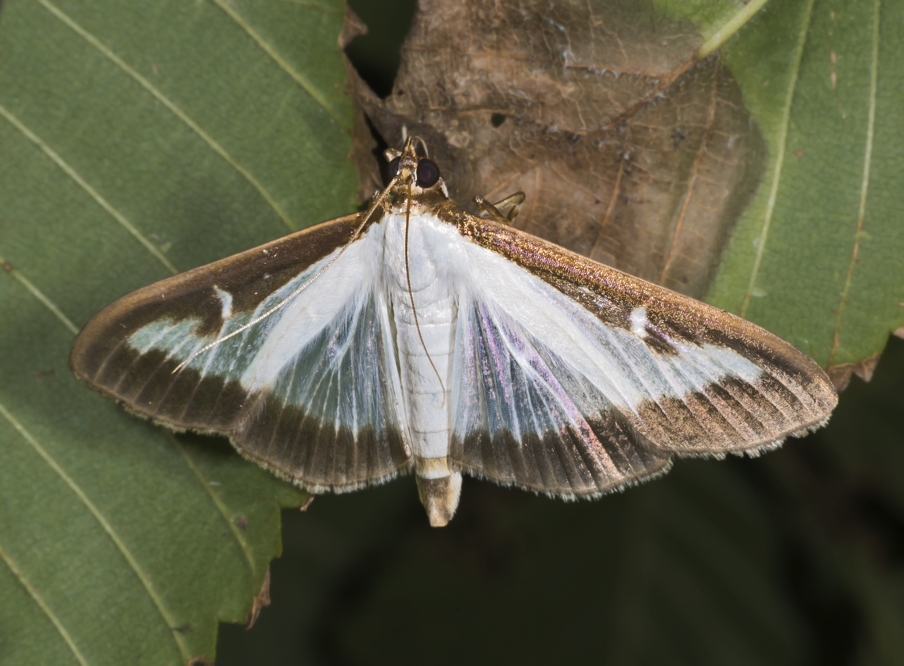
Biocontrol Efficacy Against Local Pests
Local research has focused on testing native EPNs against major agricultural and forest pests:
Hazelnut Weevil (Curculio nucum)
Box Tree Moth (Cydalima perspectalis)
Brown Marmorated Stink Bug (Halyomorpha halys)
Brown Marmorated Stink Bug (Halyomorpha halys) - Google Search
Hazelnut Weevil (Curculio nucum) - Google Search
Box Tree Moth (Cydalima perspectalis) - Google Search

Slide 6
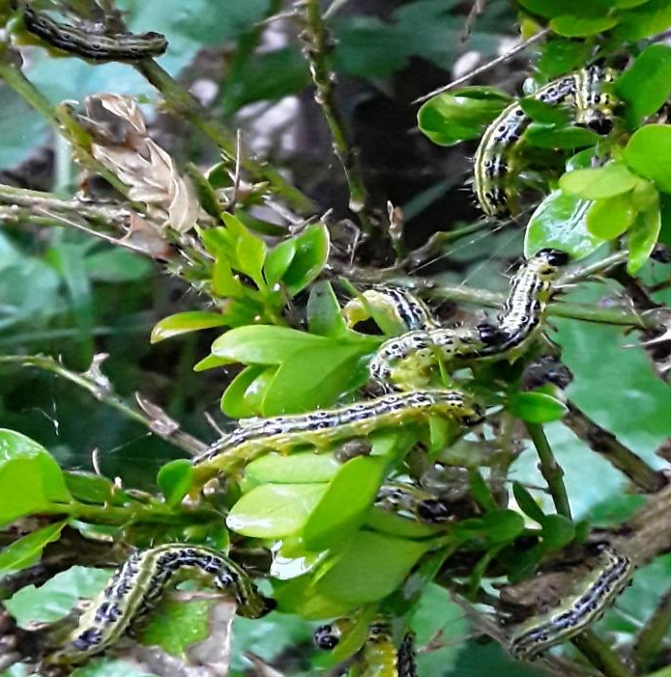
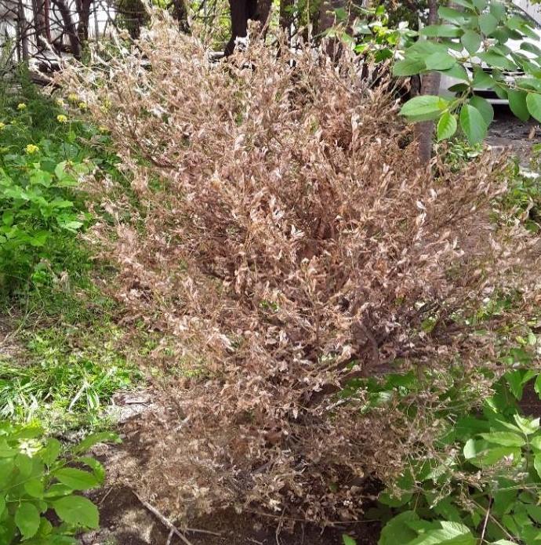
A.
B.
Picture
2
Picture
3
A – Box tree infested with box tree moth larvae; B – Defoliation of a box tree bush caused by box tree moth larvae.

Slide 7
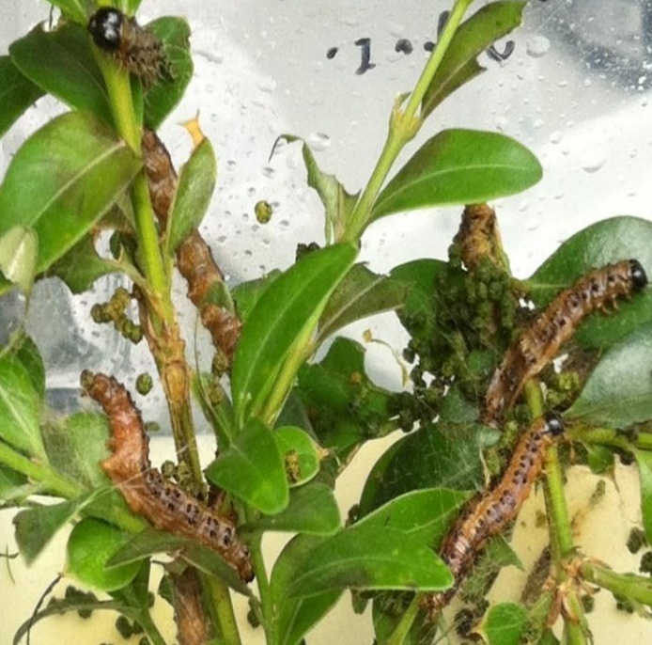
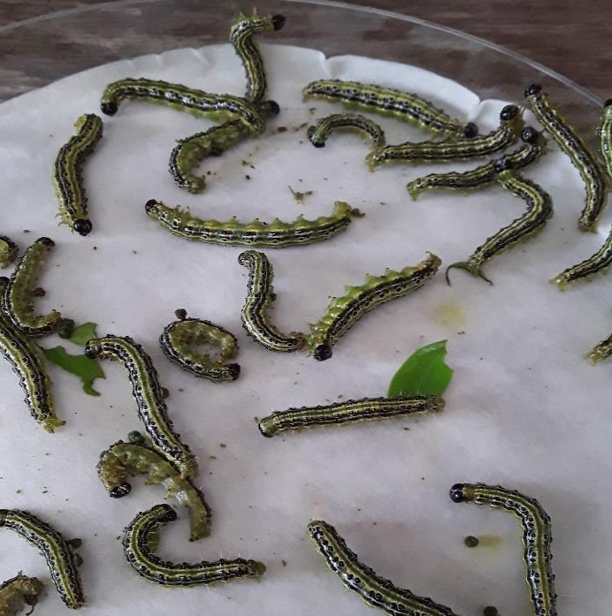
C.
D.
Picture
4
Picture
5
C – Box tree moth infected with Steinernema nematodes; D – infected with Heterorhabditis.

Slide 8
Core advantages
Commercial barriers
• Targeted Action: Safe for non-target organisms & mammals
• Rapid Mortality: Kills host within 24–48 hours
• Active Seeking: IJs actively navigate soil & canopy
• No Resistance: relatively low documented resistance problems
• IPM-Compatible: Integrates smoothly with biological fungicides
• Environmental Sensitivity: High vulnerability to UV & desiccation
• Limited Shelf-Life: Living infective juveniles require cold/special storage
• Production Costs: high production costs for liquid fermentation.

Slide 9
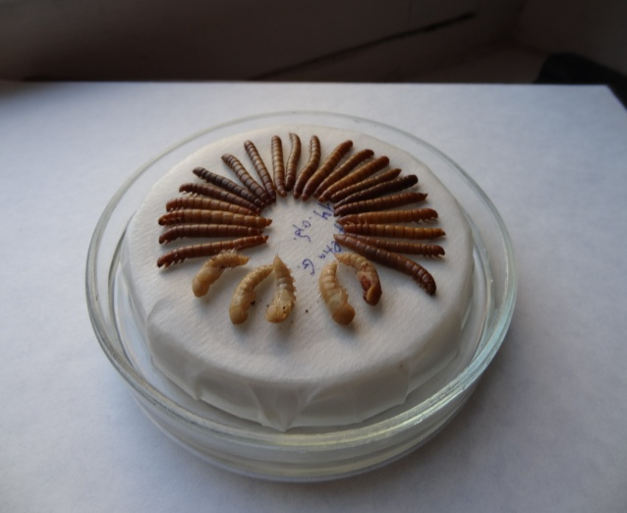
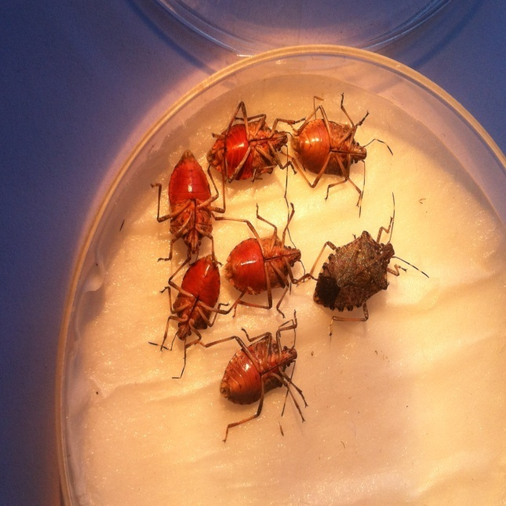
Future research and learning
Picture 6.Cultivation of nematodes
Currently
EPN taxonomy
Morphological & morphometric identification
Research experience under my professor
Next Step
🧑‍🎓 Bachelor's Thesis
🌲 EPNs & Forestry
🐛 Forest pest management
♻️ Sustainable pest control in Georgia
Picture 7. Halyomorpha halys infected with Heterorhabditis

Slide 10
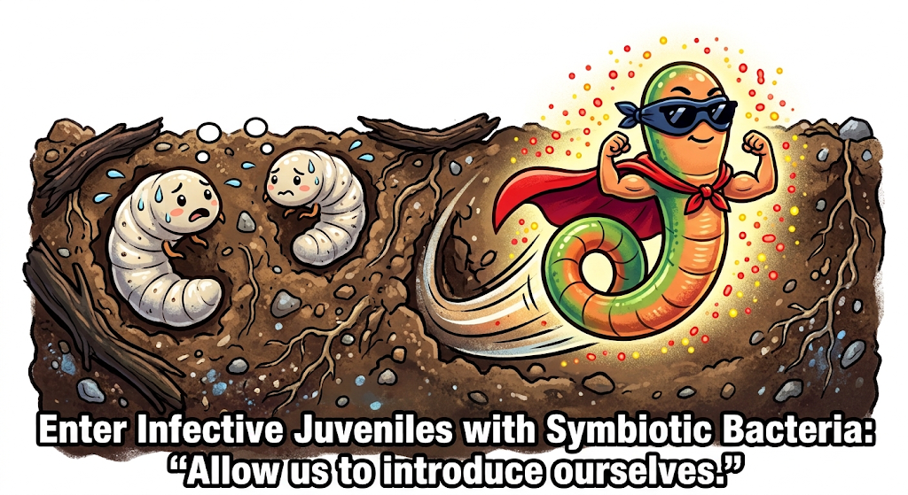
Thanks for your attention!
Pest Insects Thinking They’re Safe in the Soil...
AI Generation

Slide 11
Bibliography:
Gorgadze, O., Kereselidze, M., Beruashvili, M., & Bagaturia, N. (2020). Fauna of nematodes of Georgian hazelnut soils and its entomopathogenic forms. Bulletin of the Georgian National Academy of Sciences, 14(2).
Chubinishvili, M. (2018). Search for entomopathogenic nematodes and bases for their application against major insect pests for biological control in Georgia [Doctoral dissertation, Agricultural University of Georgia].
Fanelli, E., Gorgadze, O., Troccoli, A., & De Luca, F. (2025). Molecular and morphological characterization of Oscheius cyrus and Oscheius insectivorous isolated from hazelnut orchard soils in Georgia. Journal of Nematology, 53.
Blanco-Pérez, R., et al. (2024). Population ecology of entomopathogenic nematodes: Bridging past insights and future applications. Journal of Invertebrate Pathology, 203.
Image Credits
Images provided by Dr. Oleg Gorgadze, Institute of Zoology.

