Slide 1

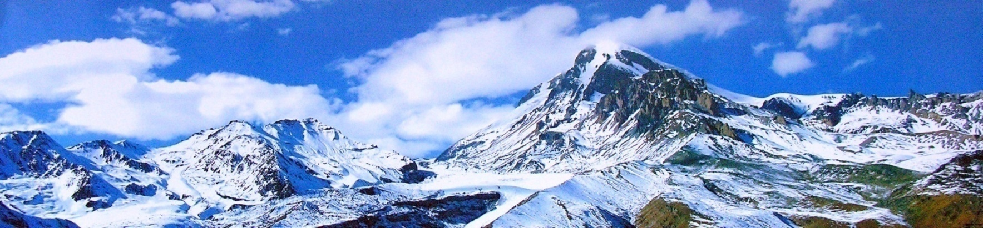
Summary of Published Research: Exploring Altitudinal Variations in Soil and Vegetation within the Alpine Desert of the Central Greater Caucasus, Georgia
Tamar Jolokhava
Ilia State University,
K. Cholokashvili Ave. 3/5, Tbilisi 0162, Georgia.

Slide 2

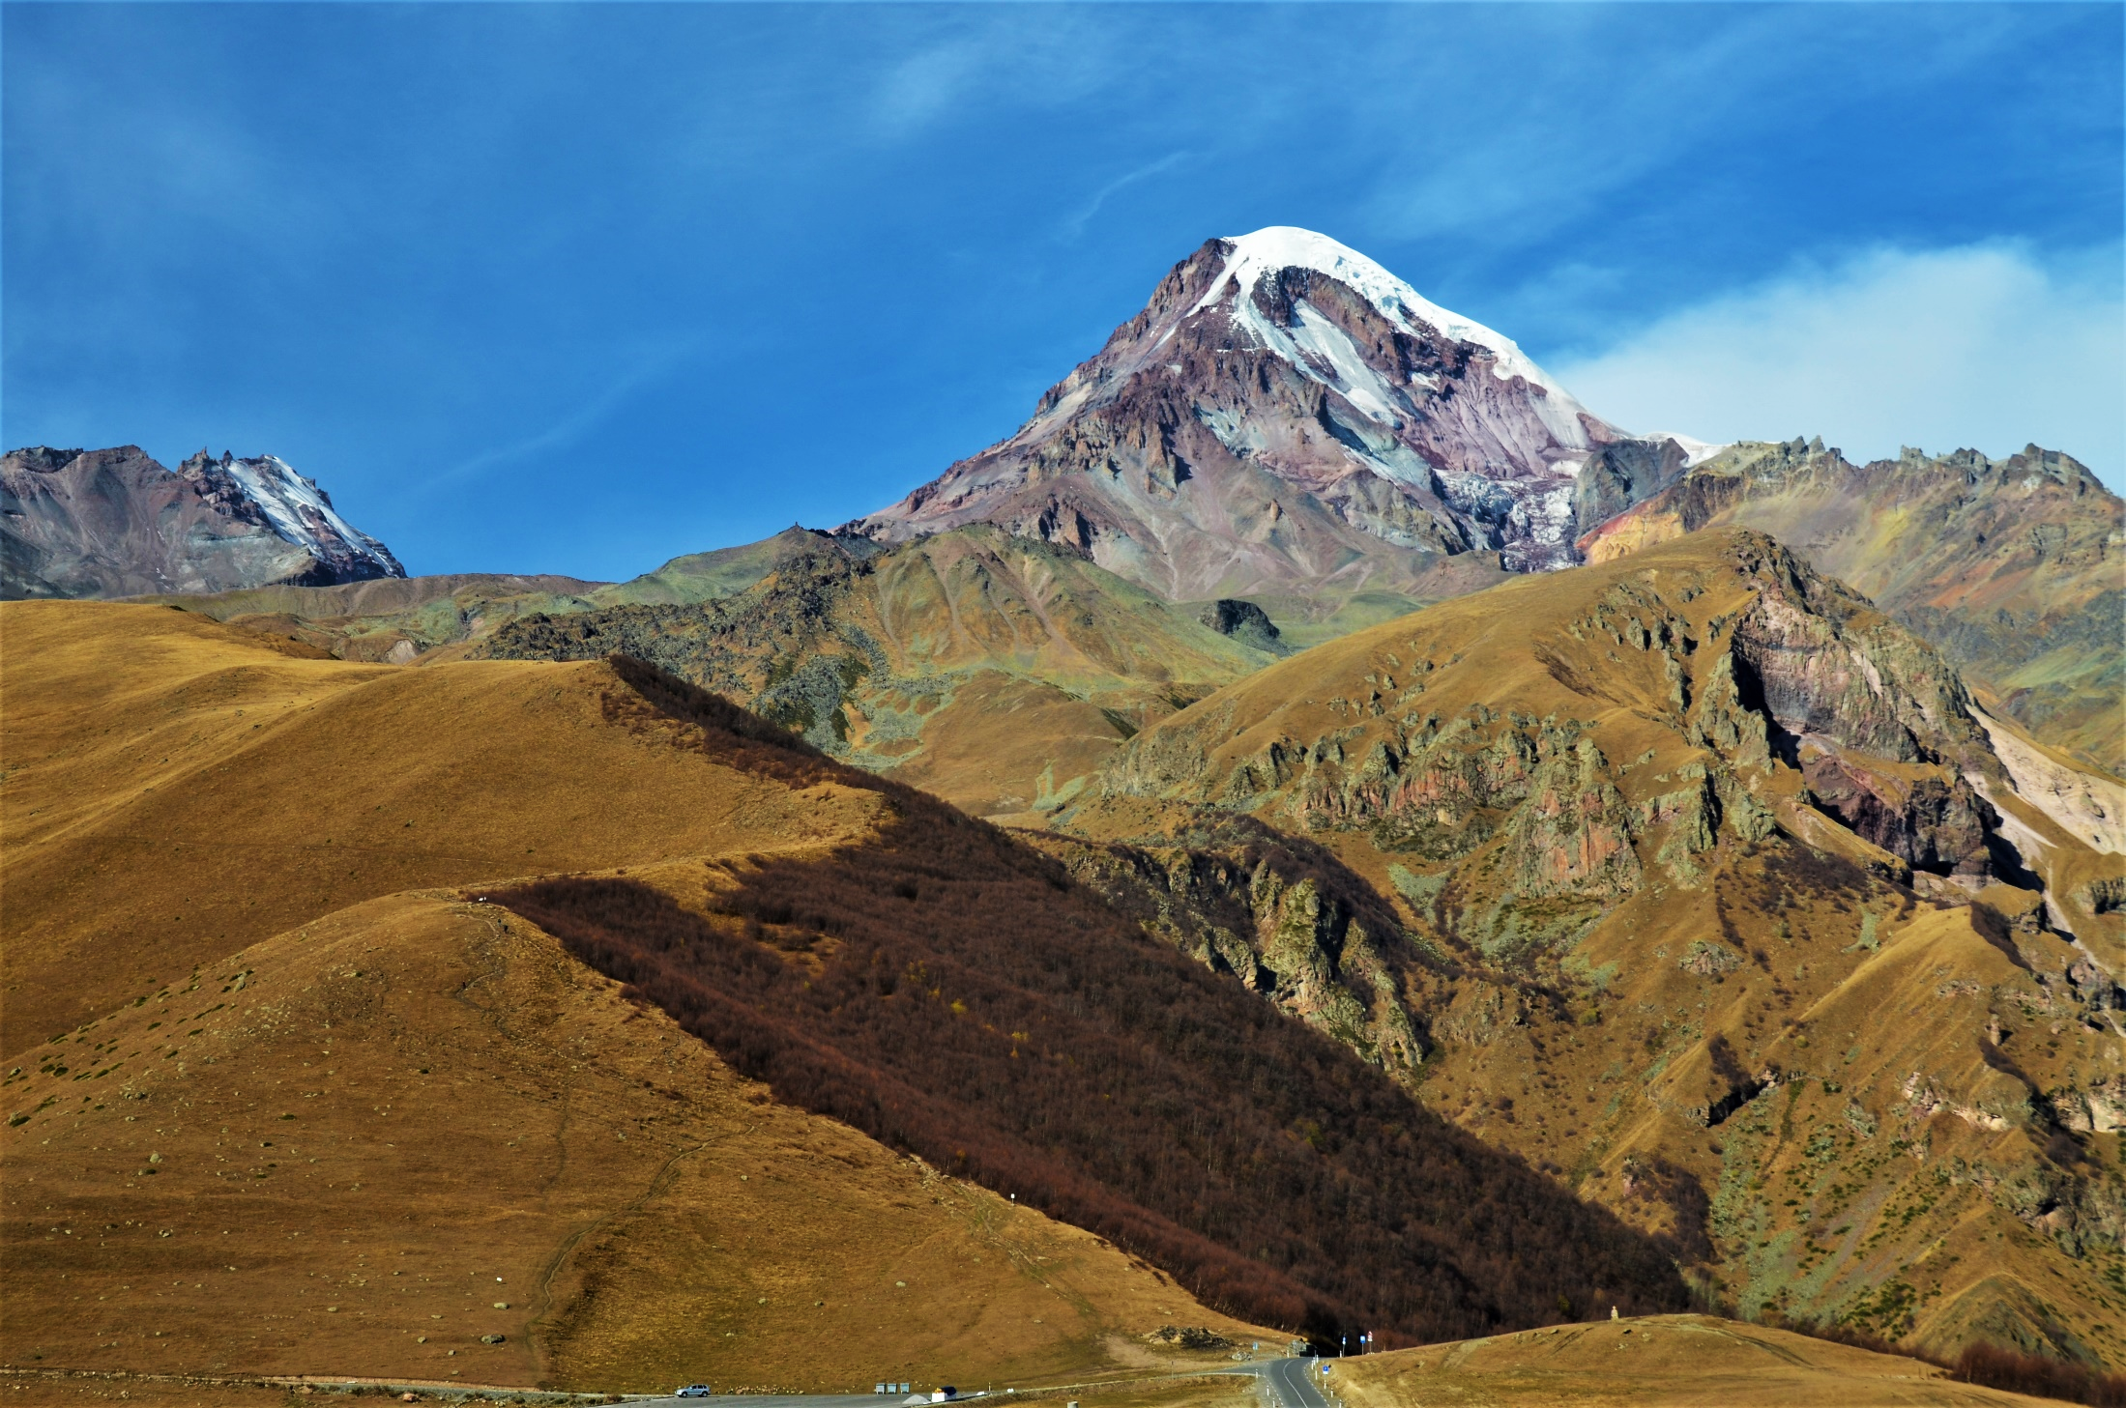
The Goal:
This study examines plant community structure, functionality, and soil characteristics in the Kazbegi region of the Central Greater Caucasus. A transect was established along a ridge with distinct northern and southern slope aspects, spanning elevations from 3000 m to 3900 m inclusive. Sampling was omitted at 3400 m and 3500 m due to glacier coverage, and at 3800 m due to ice. This range encompasses nearly the entire alpine desert belt, including the alpine-nival ecotone.
To understand the specific role of soil pH, we compared two distinct locations at an elevation of 3,000 meters. We studied Mt. Kazbegi and the Gudauri ski resort, which are 25 kilometers apart and share similar abiotic conditions.

Slide 3
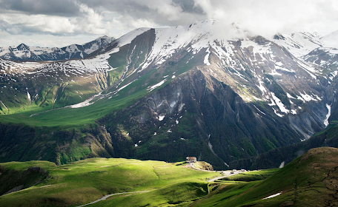
Main issues:
Ecological Parameters: This includes factors such as elevation (meters above sea level), slope aspect, soil pH, and the availability of nutrients, including nitrogen (N), phosphorus (P), and potassium (K).
Plant Species Description: All plant species will be described, with their abundance determined by counting the frequency of countable shoots within patches. Additionally, we will identify monospecific patches (solitary plants) and analyze their share among patches.
Floristic Similarity: We will examine changes in floristic similarity along the elevation gradient, accounting for both northern and southern exposures.
The second part of the study was conducted at two sites on Mt. Kazbegi and the Gudauri ski resort, focusing on climatic characteristics and soil pH. In each sampling plot, plant species descriptions remained unchanged.

Slide 4
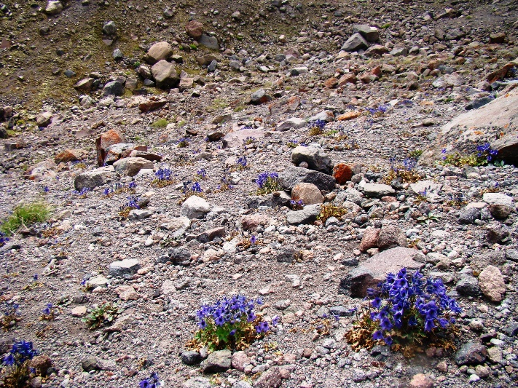
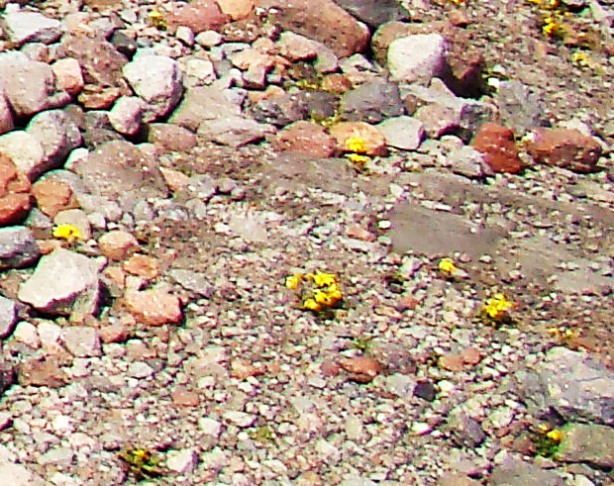
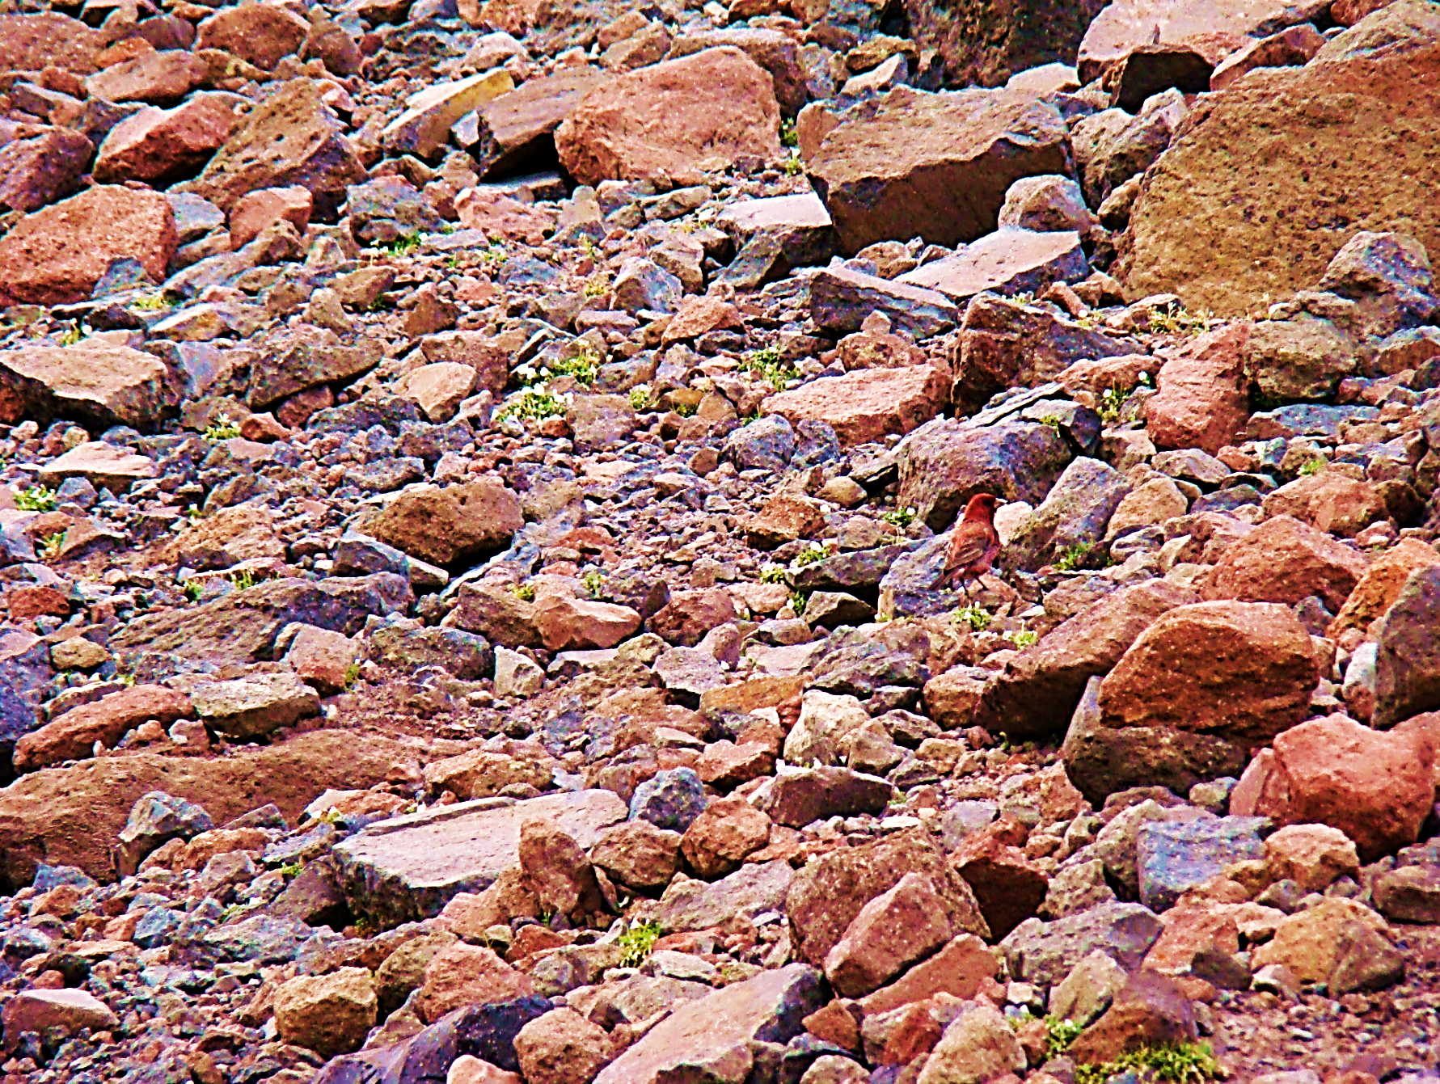
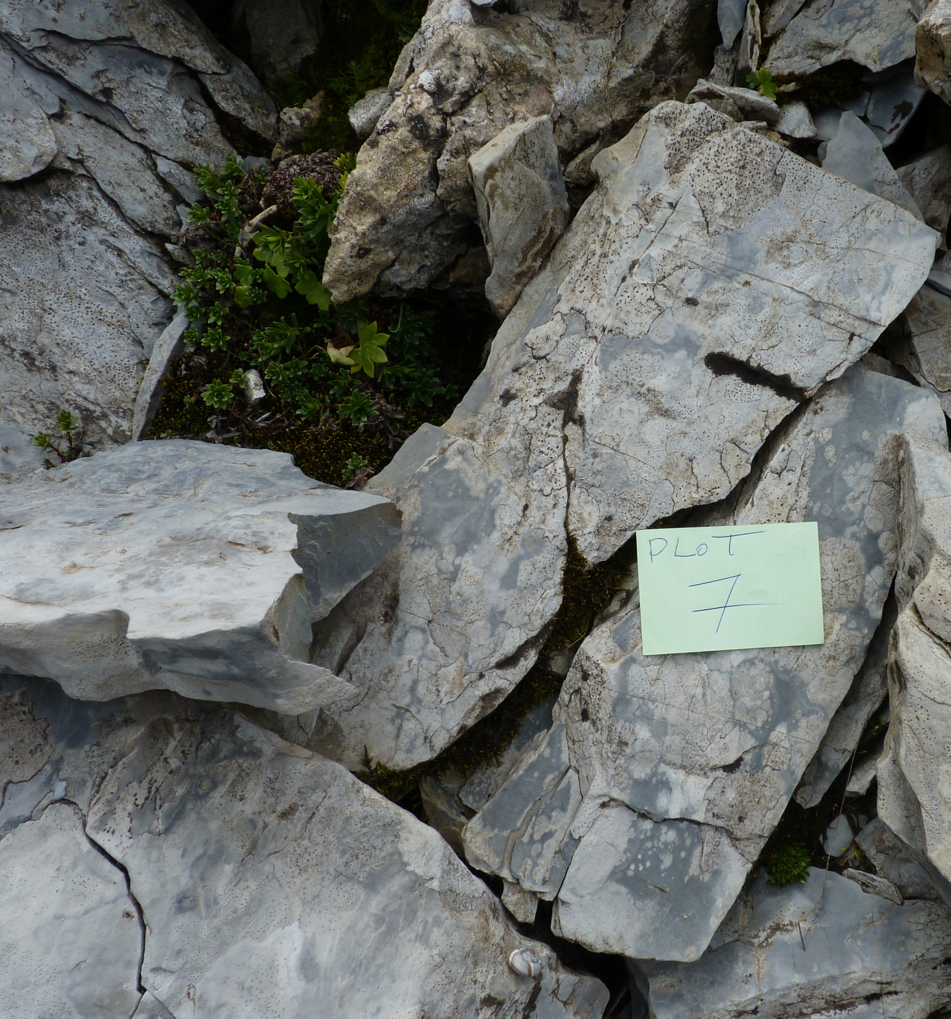
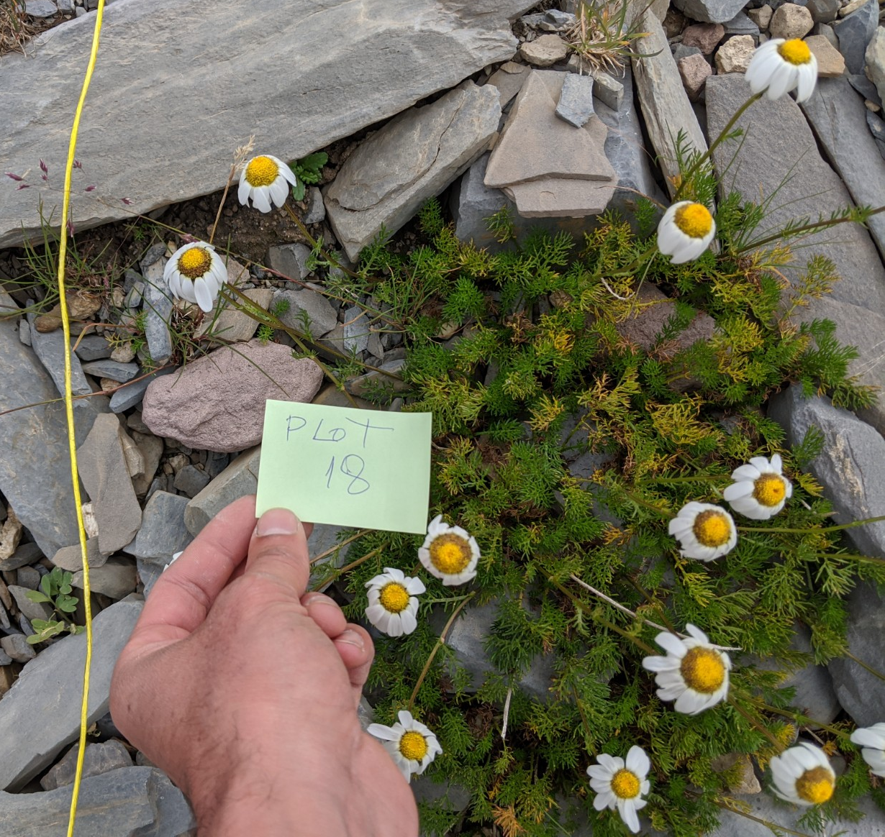
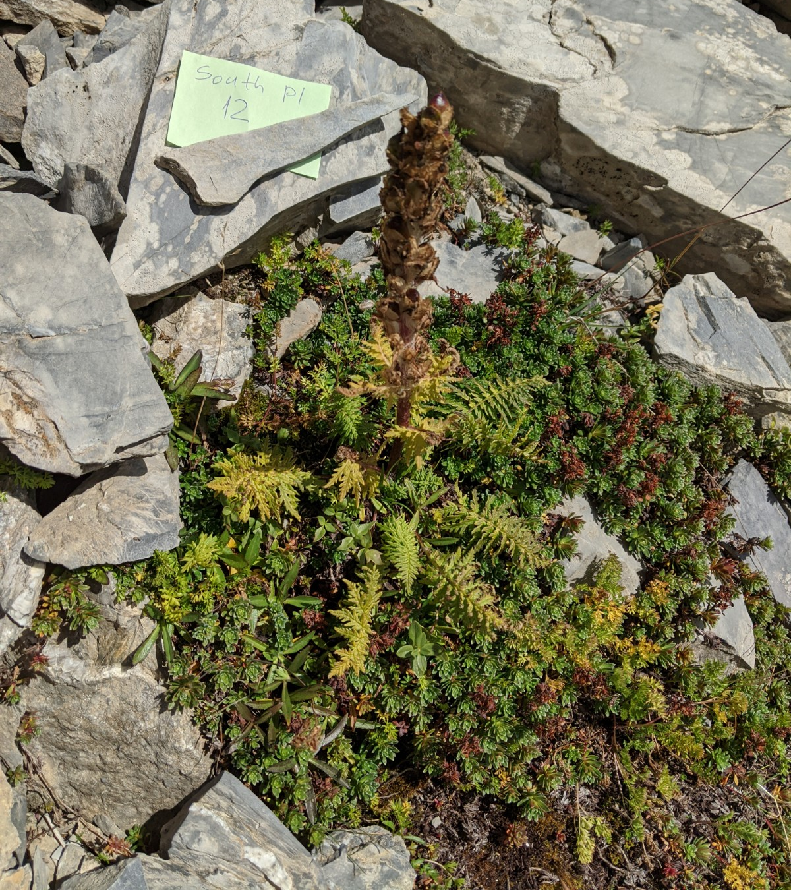
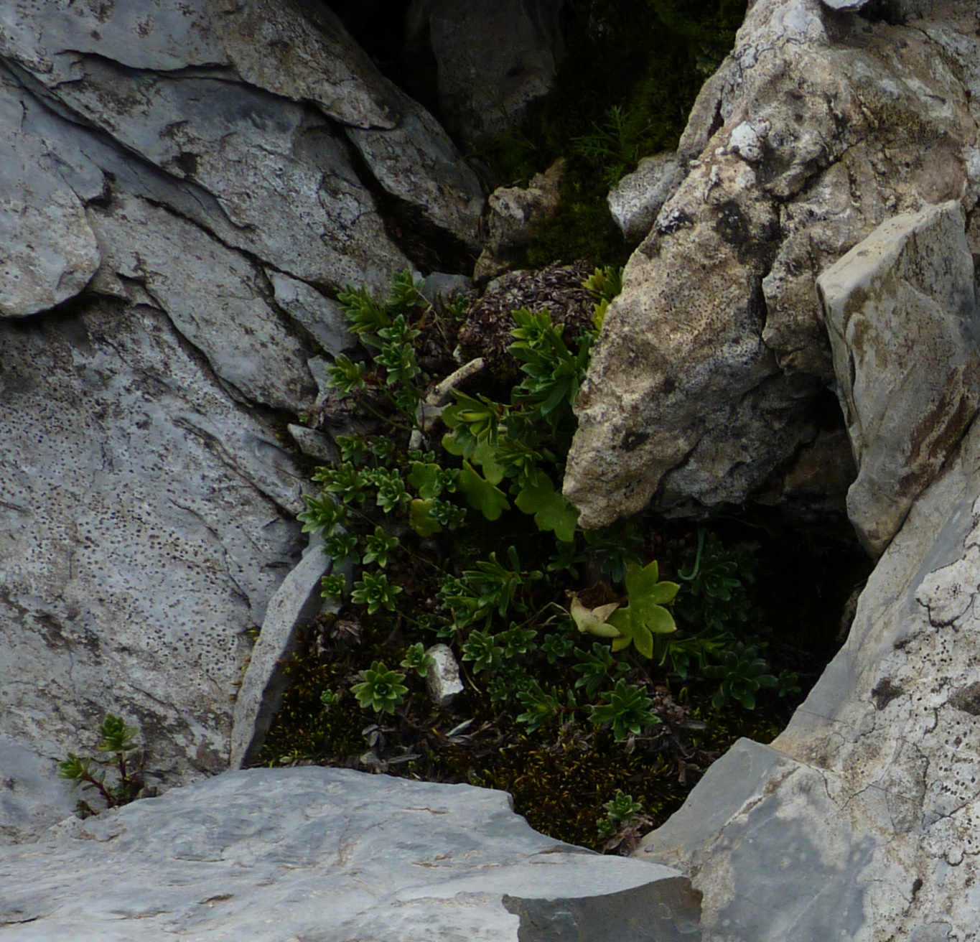
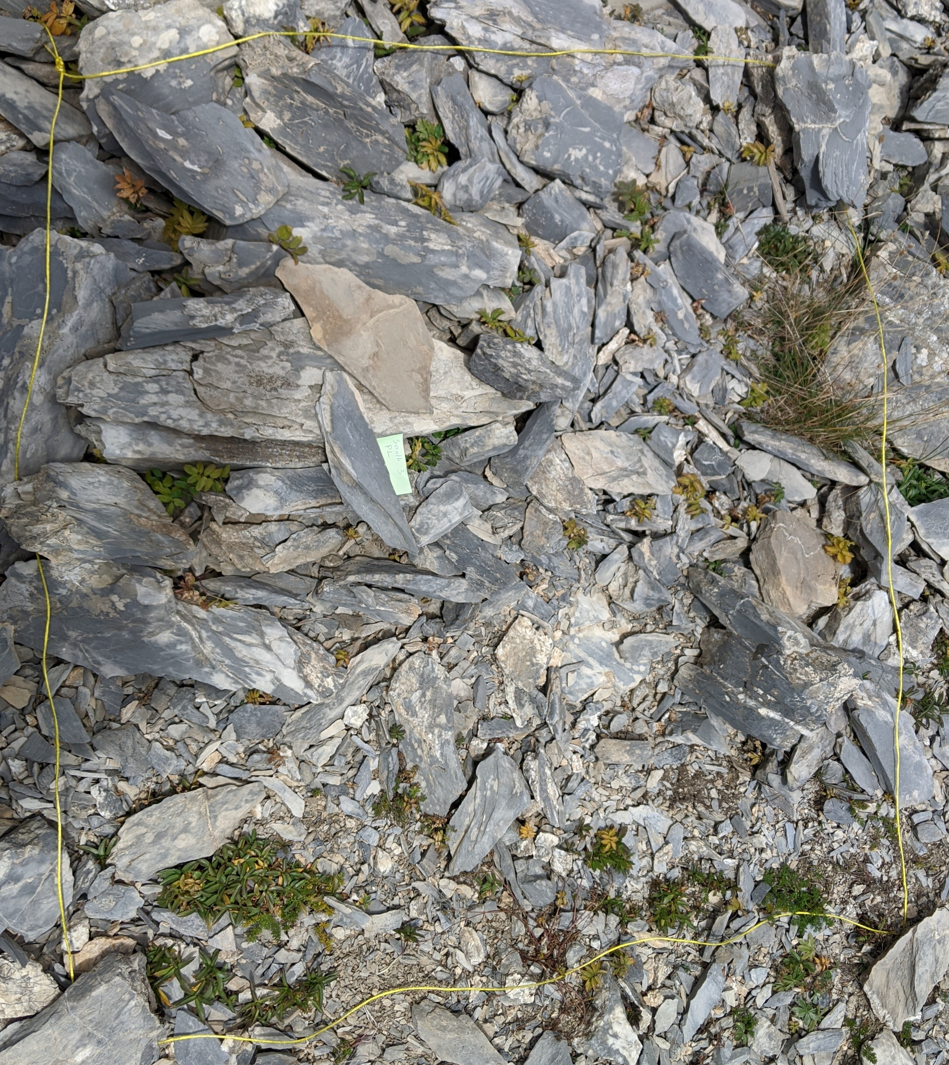
Research subject:
Monospecific and multi-species plant micro-groupings (nanocoenoses) of subnival-nival belts.

Slide 5
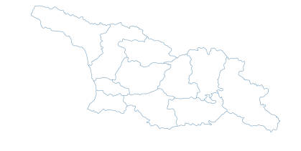
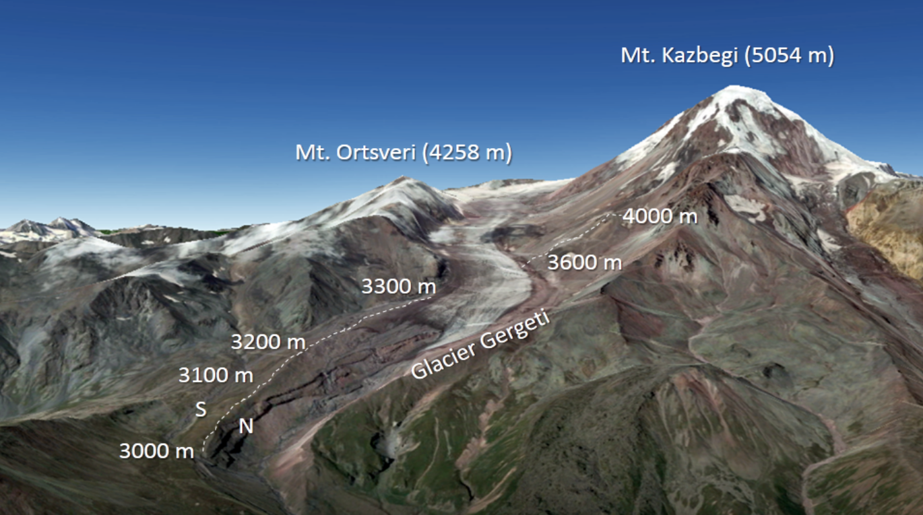
Environmental conditions:
The Kazbegi municipality covers 1081.7 km², with the alpine-nival ecotone at around 3000 m a.s.l. The snowline is at approximately 3950 m a.s.l., while the region's elevations range from 1210 m to 5054 m. The climate is influenced by high elevations, complex topography, and its position on the north-facing macro-slope of the Great Caucasus.
Approximate locations of study areas on the slopes of the Central Great Caucasus: A – Kazbegi (red triangle) and Gudauri (blue triangle)
Study transect on the slopes of Mt. Kazbegi (central Great Caucasus Mountains); N – north slope, S – south slope.

Slide 6
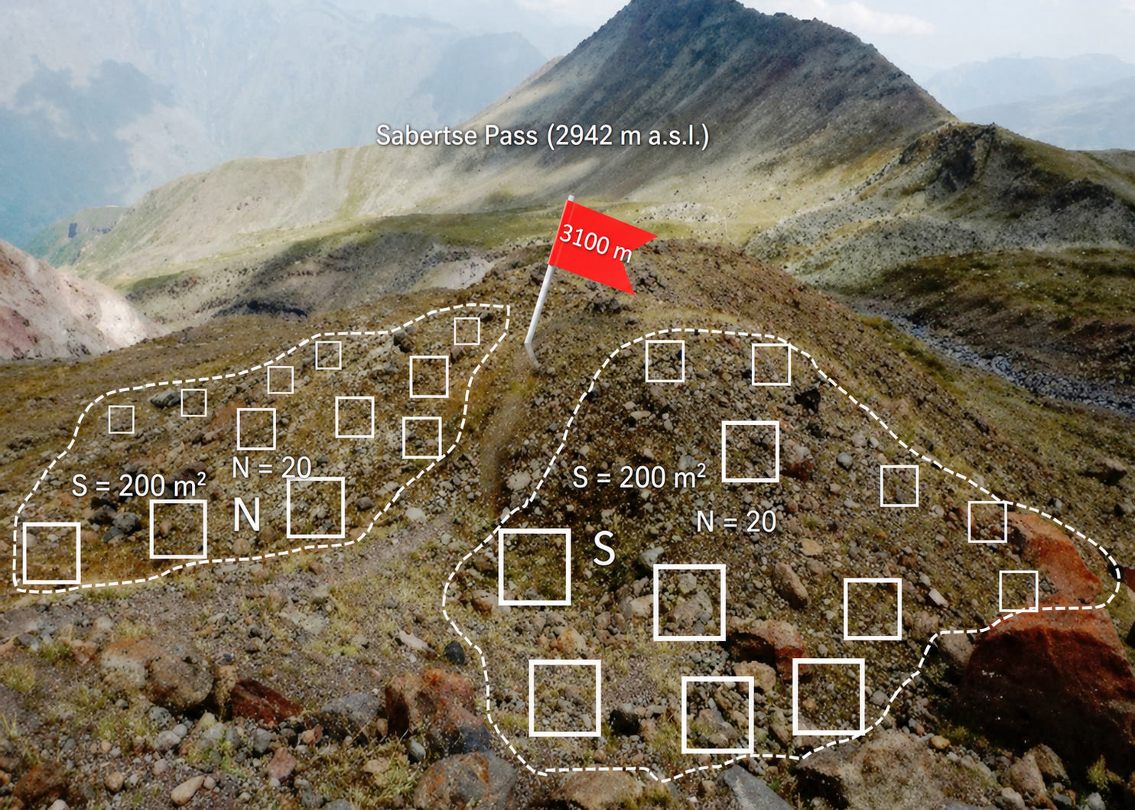
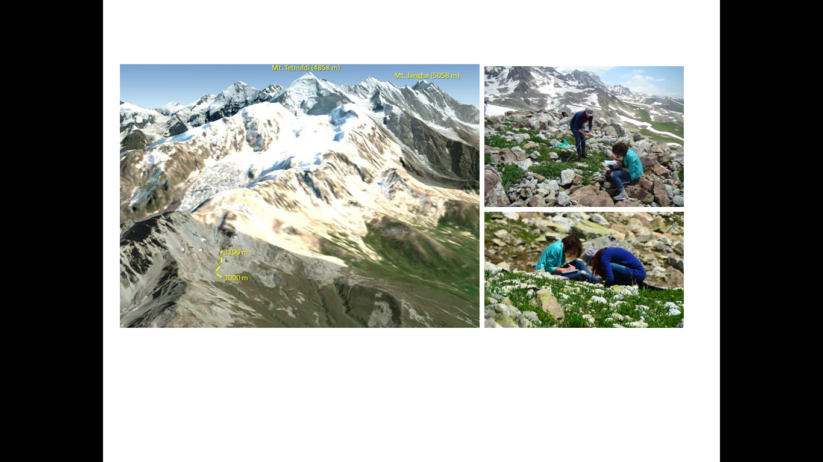
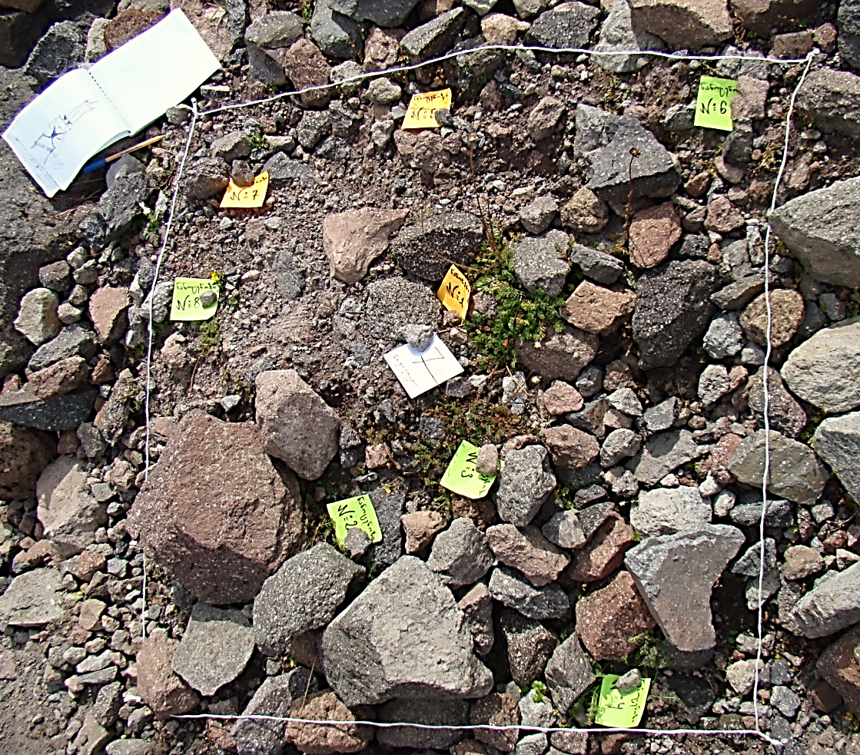
Sampling design:
For the study transect, 20 random sampling plots (1 m × 1 m) were placed at each site, totaling 280 m² across 7 elevations and 2 slopes, with 4–5 m spacing between plots.
In the comparative study site at 3000 m above sea level, the same method was used across 4 sites (2 slopes on Mt. Kazbegi and 2 at the Gudauri ski resort). Each site, approximately 200 m², included 20 random 1 m × 1 m quadrats.
Field Measurements and Assessments:
Soil samples were collected from five randomly selected points at a single location, with a depth of 0-20 cm. For the comparative study site, soil samples were collected from each sampling plot (80 samples total).

Slide 7


Field Measurements and Assessments:
Elevation and slope aspect were measured using a GPS device
Plant species were recorded, and their abundance was assessed by frequency (for plant species names, we followed the International Plant Names Index-IPNI)
Vegetation cover was visually estimated as a percentage, along with the count of solitary plants and patches
Sampling design and laboratory methods:
Soil pH was measured in a 1:2.5 soil/water suspension using a WTW Benchtop pH Meter InoLab® Multi 9310 IDS
Mobile nitrogen and plant-available phosphorus were analyzed with a UV/VIS spectrophotometer (Specord 210 Plus).
Plant-available potassium was determined using a flame atomic absorption spectrometer (Zeenit 700p).
WTW, Inolab, pH 7110;
b) ZEEnit 700 P - Analytik Jena, Germany;
c) SPECORD 210 PLUS - Analytik Jena, Germany

Slide 8
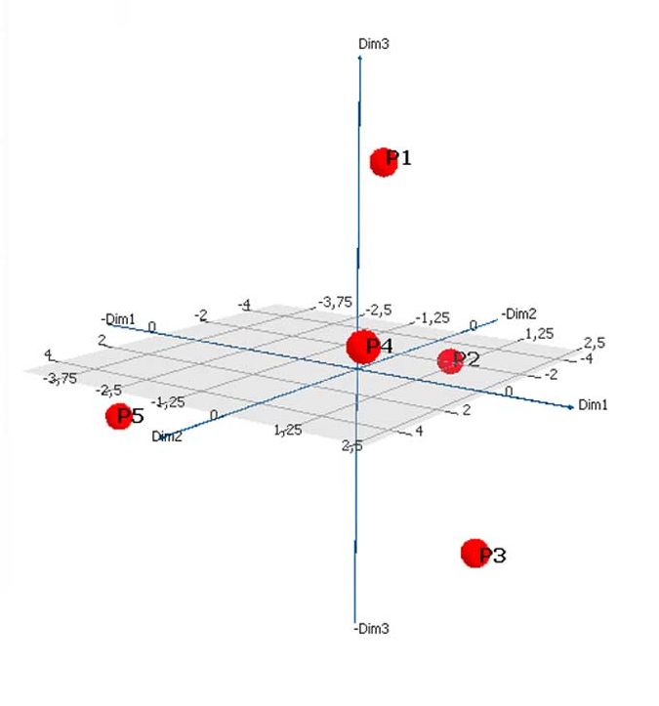
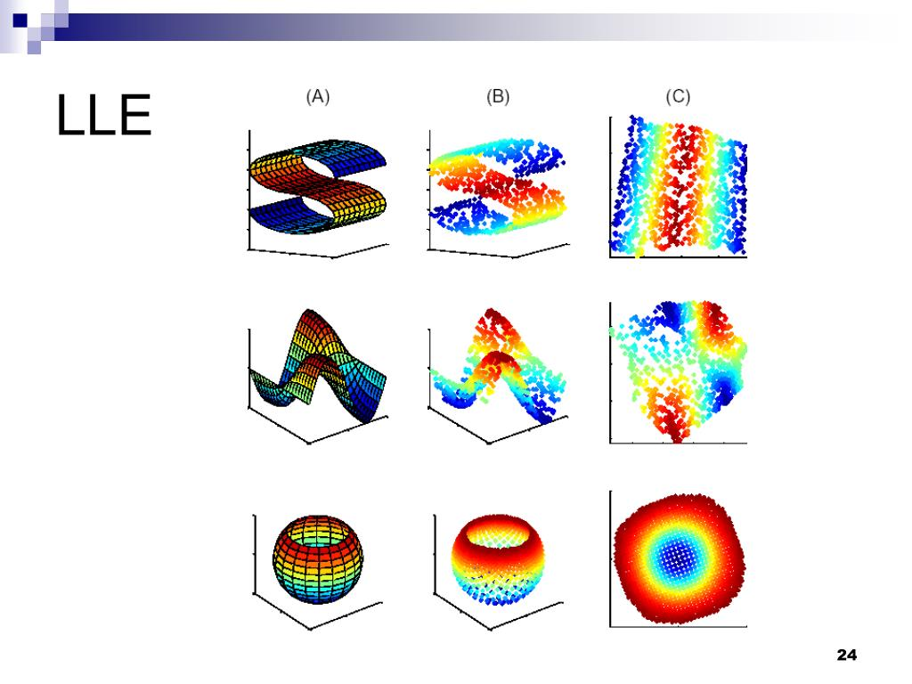
Data analysis:
We conducted correlation analysis using Spearman and Pearson methods, along with multivariate ordination techniques such as non-metric multidimensional scaling (NMDS), principal component analysis (PCA), canonical correspondence analysis (CCA), analysis of covariance (ANCOVA), and linear and non-linear regression
In multivariate ordination, species with a frequency higher than 10 were analyzed.
(1) The transect study: 27 species out of 63.
(2) The comparative study: 33 species out of 74.
The floristic similarity was assessed using the Bray-Curtis index, and the distribution of solitary species was analyzed using a sigmoid function.

Slide 9
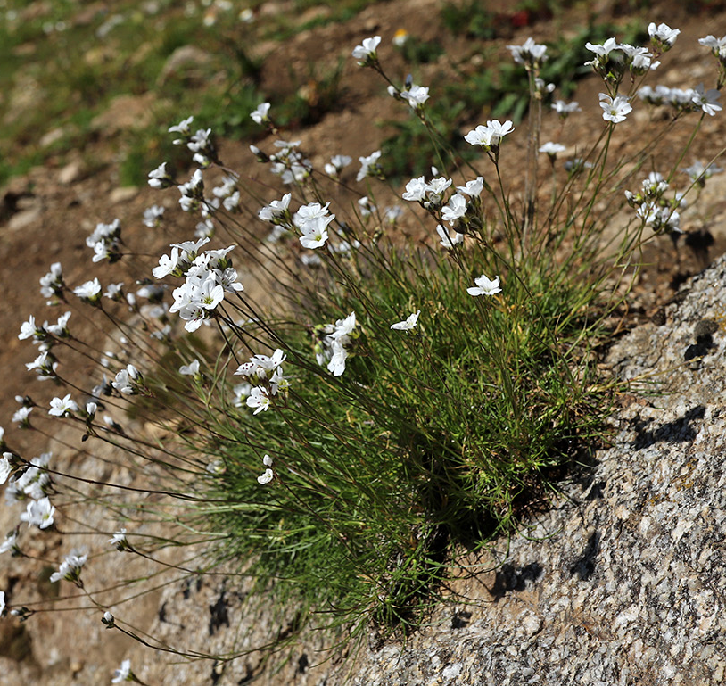
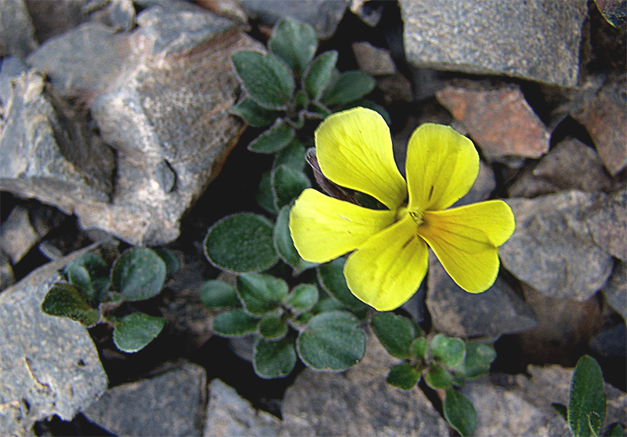
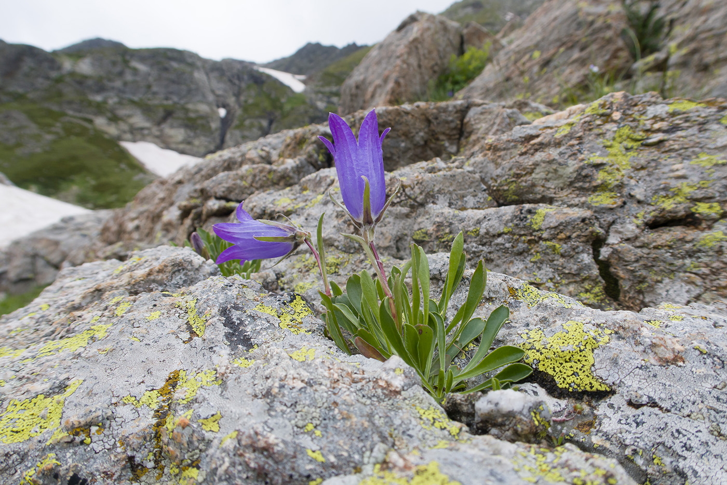
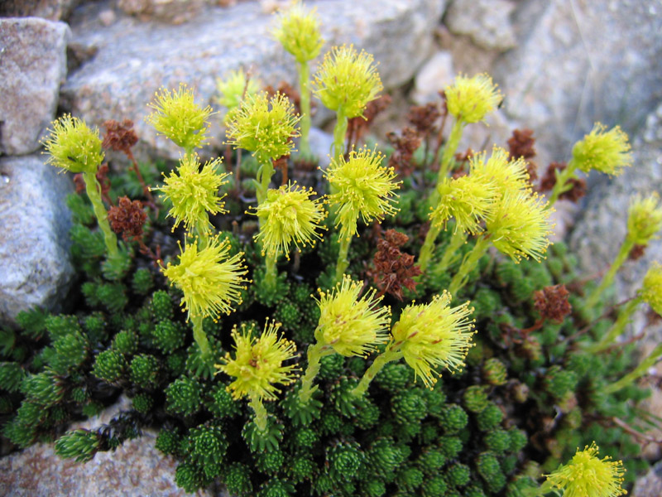
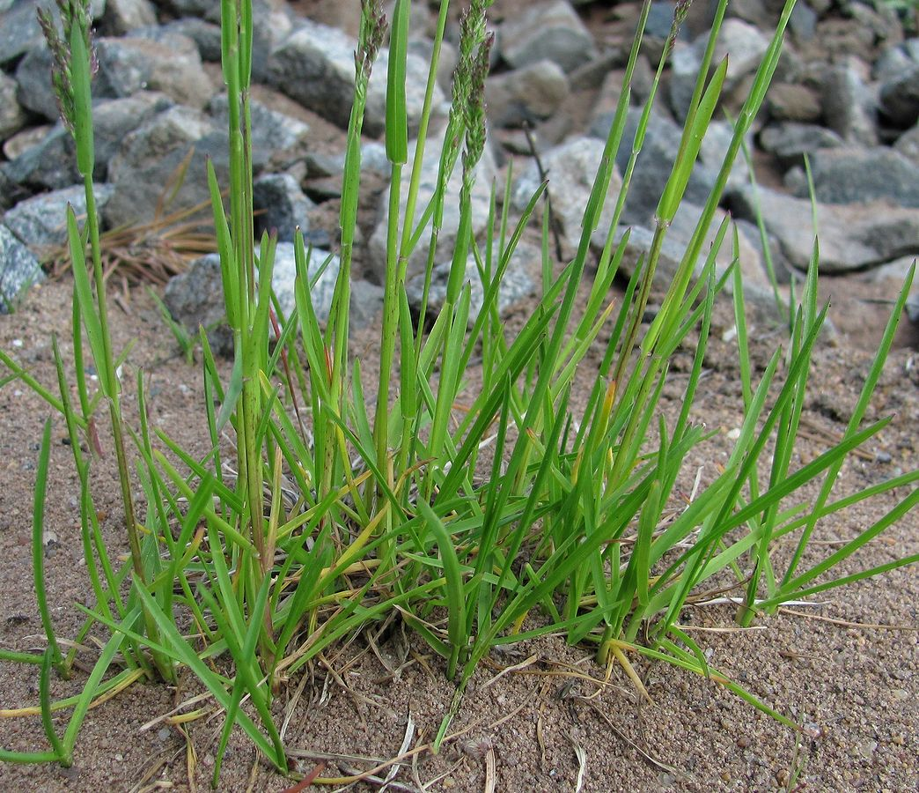
Results: Elevation Gradient & Transect Analysis
A total of 63 vascular plant species have been identified on both the N and S slopes (54 species on the N slopes and 45 on the S slopes). This is more than 58% of all recorded species in this part of the Central Great Caucasus
Arenaria lychnidea
Plant abundance, as measured by countable stems, decreased sharply with increasing elevation (R² < 0.95). This decrease follows an exponential curve on both the north and south slopes.
Endemic species of the Caucasus on both (N/S) slopes
Alchemilla chlorosericea*
Campanula biebersteiniana*
Draba supranivalis*
Jurinea filicifolia*
Minuartia circassica*
Saxifraga scleropoda*
Veronica telephiifolia*
Viola minuta*
Ziziphora pushkinii*
Campanula biebersteiniana
Alchemilla chlorosericea*
Arenaria lychnidea*
Draba supranivalis*
Jurinea filicifolia*
Minuartia circassica*
Poa caucasica*
Veronica telephiifolia*
Ziziphora pushkinii*
Saxifraga scleropoda
Viola minuta
Poa caucasica

Slide 10
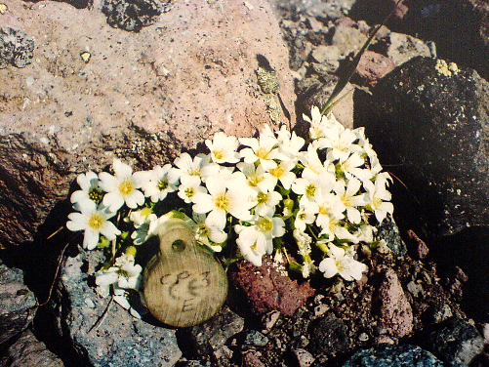
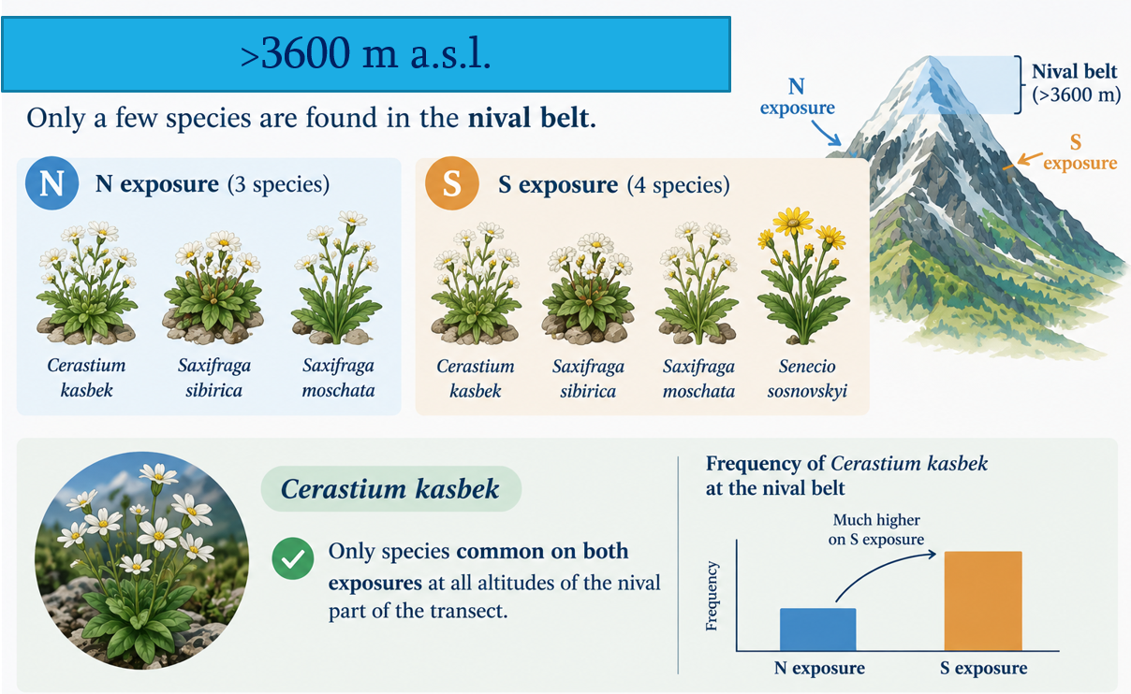
Results: Elevation Gradient & Transect Analysis
Species richness also decreased sharply with increasing elevation and was accurately described by an exponential equation on both the north and south slopes (R² < 0.94).
Only a few species are found in the nival zone, which is located 3600 meters above sea level. Specifically, there are three plant species on the north-facing slopes: Cerastium kasbek, Saxifraga sibirica, and S. moschata. On the south-facing slopes, there are four species: Cerastium kasbek, Saxifraga sibirica, S. moschata, and the annual plant Senecio sosnovskyi. It is also important to note that Cerastium kasbek is the only species that is common to both exposures.

Slide 11
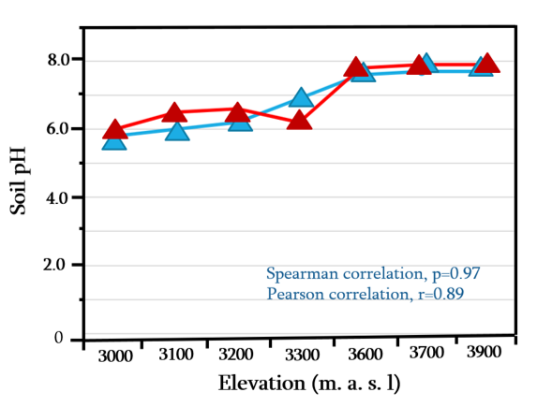
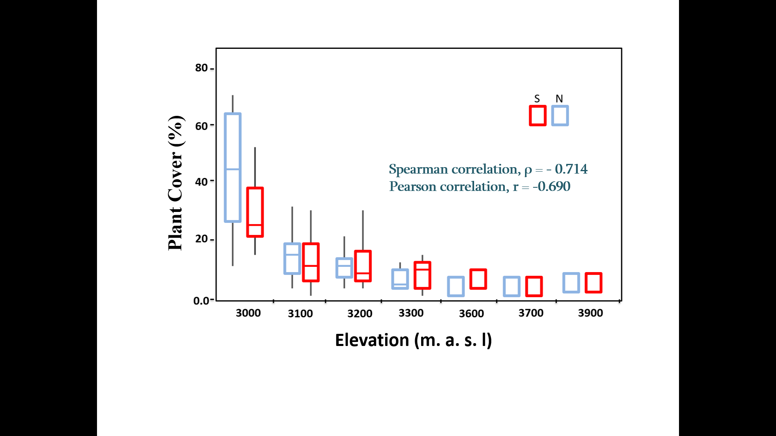
Results: Elevation Gradient & Transect Analysis
Along increasing elevation (3000–3900 m), soil pH increased monotonically and reached alkaline values at the higher elevations with bare bedrock (3600–3900 m), where the surface mainly consisted of talus, as plant cover decreased dramatically with increasing elevation.
At lower elevations, the soil pH increased more steeply on the northern slope, except at 3300 m a.s.l., where the northern slope exhibited a neutral reaction, while the southern slope showed a tendency toward acidification.

Slide 12
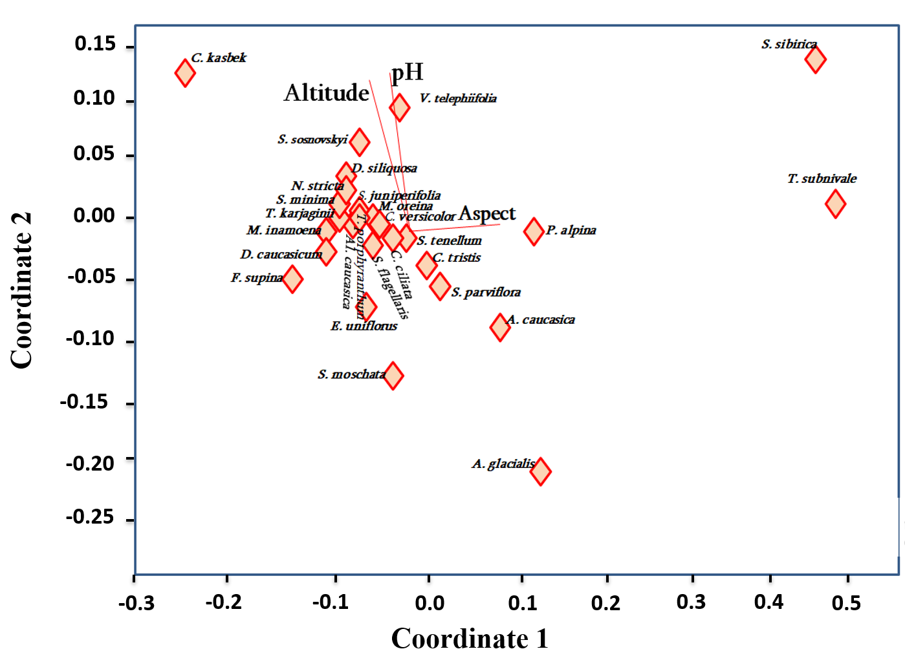
Results: Elevation Gradient & Transect Analysis
For NMDS ordination, environmental variables were used: soil pH, elevation, and slope aspect.
Coordinate 1 explained a high proportion of variation in species distributions (r2 = 0.88) and ran in parallel with the slope aspect. Coordinate 2 runs in parallel with elevation and soil pH, explaining ca. 1/3 of the variation in species distributions (r2 = 0.30). This ordination indicated the importance of slope aspect to species distributions, so we focused our future analysis on patterns of species distributions on slopes with opposite aspects.

Slide 13
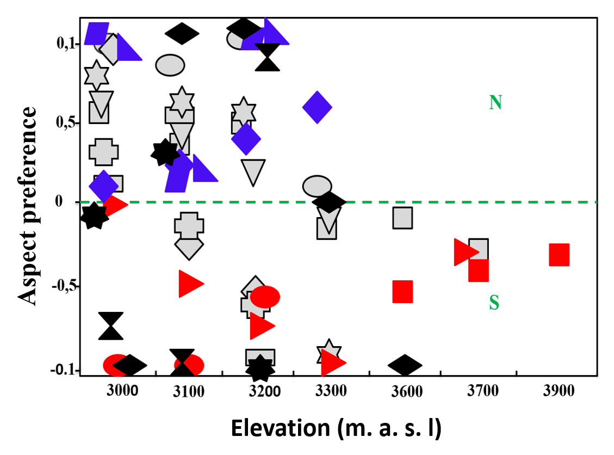
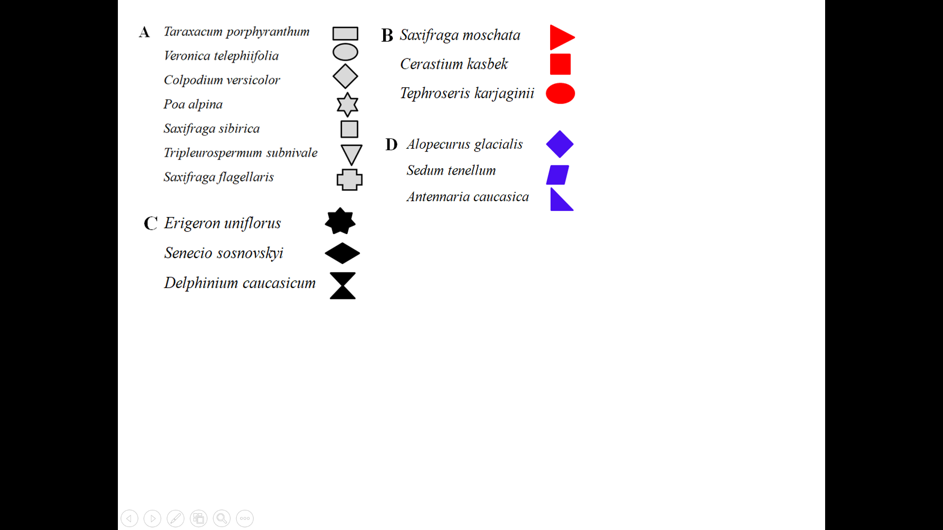
Results: Elevation Gradient & Transect Analysis
Among the species of relatively wide elevation range, four groups of species could be distinguished: (A) species that changed their slope aspect preference at higher elevations from N to S (B) species mostly preferring S slopes, (C) species that changed slope aspect preference from S to N slope or showed rather idiosyncratic pattern, (D) species preferring or increasing their preference to N slopes. All remaining species were collected as a dispersed group.
“dispersed” because these species were too rare and had no clear pattern

Slide 14
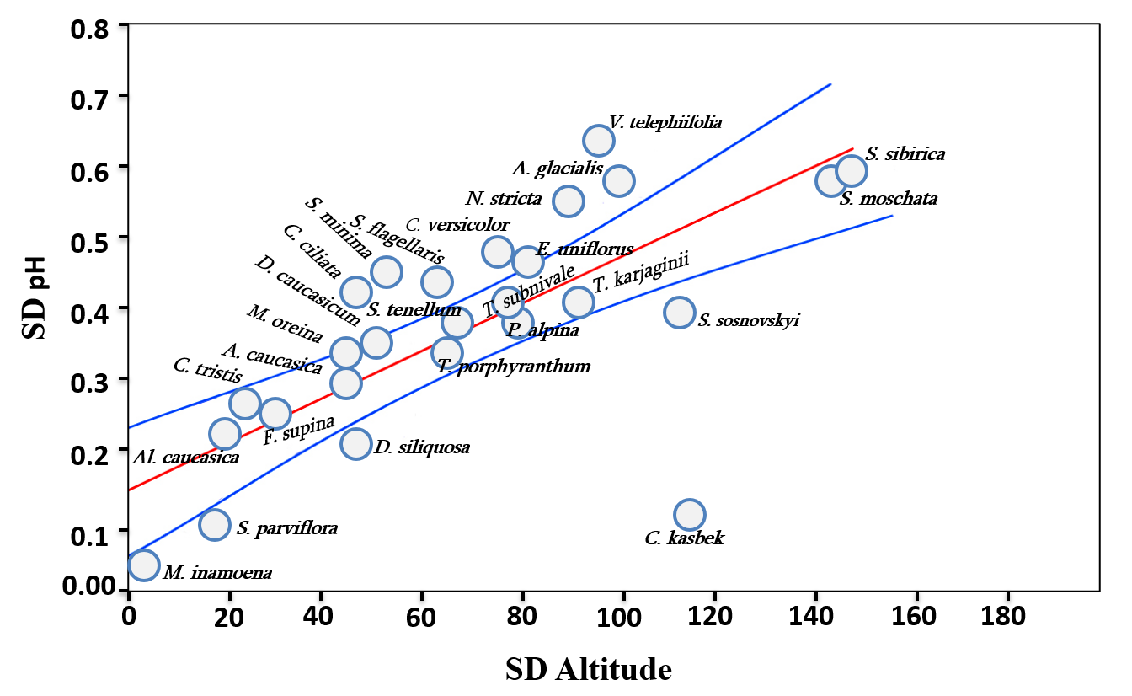
Results: Elevation Gradient & Transect Analysis
In the next step, we analyzed the relation between the SD values of elevation (SD_{Elevation}) and soil pH (SD_{pH}). These two variables appeared to be quite strongly correlated: Pearson and Spearman correlation coefficients were practically equal (r = ρ = 0.74; p<0.0001 by both tests), indicating a linear relation with r² = 0.56.
We compared the regression between the SD values of elevation and soil pH between two groups: species that changed slope preference from N to S (group 1) versus the rest of the species (above; in total, 27 species with frequency ≤10 were analyzed). The other groups were too small to perform statistical tests reliably. ANCOVA showed that the regression slope in these two groups was significantly different (p = 0.014) and it was lower in the group that changed their aspect preference from N to S.

Slide 15
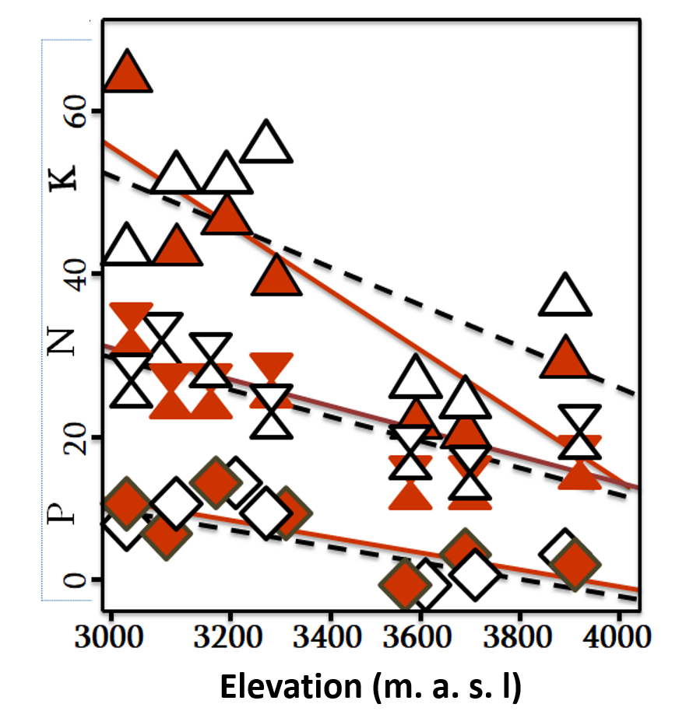
Results: Elevation Gradient & Transect Analysis
Bray–Curtis similarity decreased with the elevation gradient in both exposures (North: R² = 0.989; South: R² = 0.956). Floristic similarity was highest at 3000 m and dropped to near zero above 3600–3900 m.
The percent share of solitary plants in subnival-nival patches along the elevation gradient was effectively described by Hill's function (adjusted R² > 0.95).
Soil pH increased to alkaline levels, while plant-available nitrogen, phosphorus, and potassium decreased significantly from the alpine-nival ecotone to the snow line on both the north and south slopes.

Slide 16
Results: Elevation Gradient & Transect Analysis
Cluster analysis, which also included site elevation along with pH, N, P, and K, produced two distinct groups: sites located at lower (3000-3300m) versus at higher (3600-3900m) elevations, at both north and south slopes (Cophen correlation = 0.79)

Slide 17
Results: Comparative Study at 3000 m (Kazbegi vs. Gudauri)
The climatic characteristics of the Kazbegi and Gudauri sites were found to be very similar, based on data from the Meteoblue database covering 1992 to 2022.
Vegetation cover differed significantly between aspects (N–S), but not between sites (Kruskal–Wallis H = 11.805, p < 0.05). In contrast, soil pH differed significantly among sites but not between aspects (H = 66.036, p < 0.001).

Slide 18
Results: Comparative Study at 3000 m (Kazbegi vs. Gudauri)
Community structure was different in species richness and composition. The similarity of species composition between the sites was remarkably low (Bray-Curtis index = 0.398), but Species composition between aspects was more similar, less so at Kazbegi (Bray-Curtis index = 0.440) than at Gudauri (Bray-Curtis index = 0.580). These differences appeared to be statistically highly significant (p < 0.0001).

Slide 19
Results: Comparative Study at 3000 m (Kazbegi vs. Gudauri)
CCA clearly separated the two study sites (Kazbegi vs. Gudauri), whereas differences between north- and south-facing aspects were much smaller. The ordination was highly significant (p < 0.0001); Axis 1 explained a high proportion of the variation (99.86%) due to increasing soil pH and decreasing vegetation cover, within a 95% confidence interval.

Slide 20
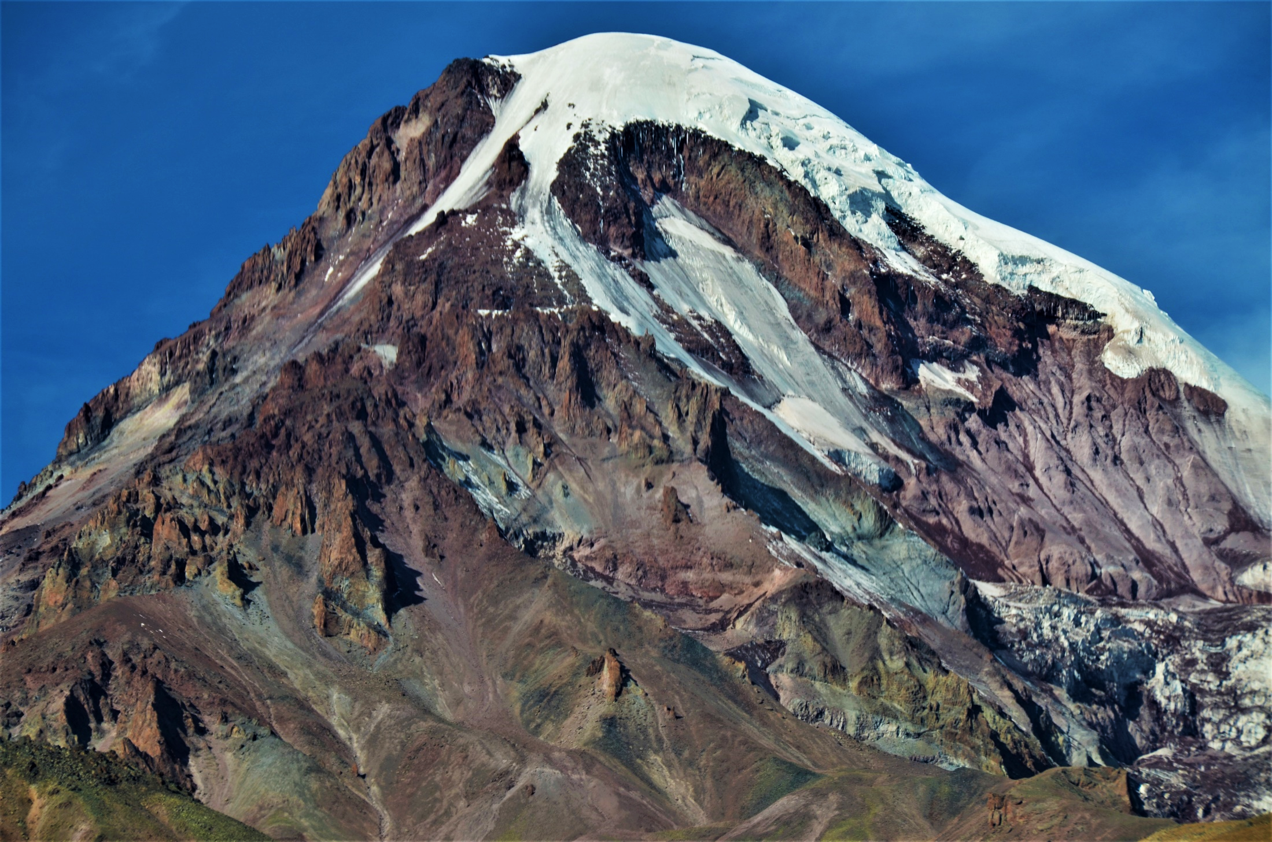
Overall, our findings highlight that soil pH can be a key factor determining species distributions in high mountains, along with primary environmental variables such as temperature. As the first study of this kind, it may serve as a starting point for similar and deeper research on soil pH as a factor shaping plant distribution patterns in extreme habitats such as alpine deserts.
For this stage, it can be concluded that the glacier tongue in our study does not cause a “vegetation switch” in the usual sense of this phrase. However, it might contribute to abrupt changes in some characteristics (the share of solitary plants) and also might affect the distribution of plants along the elevation gradient.

Slide 21
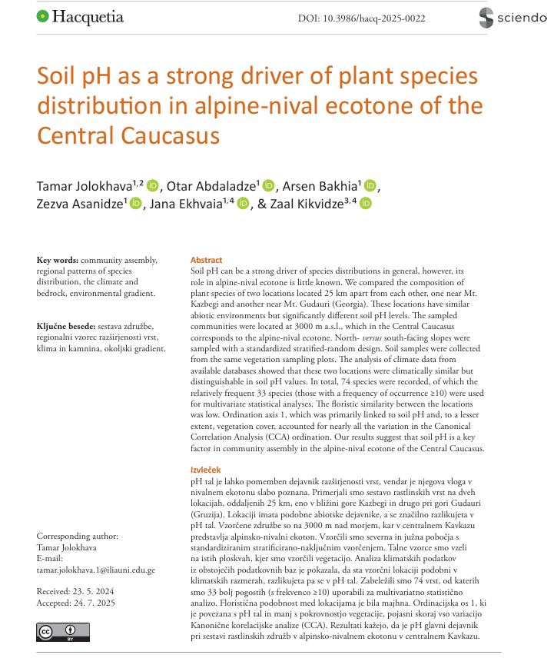
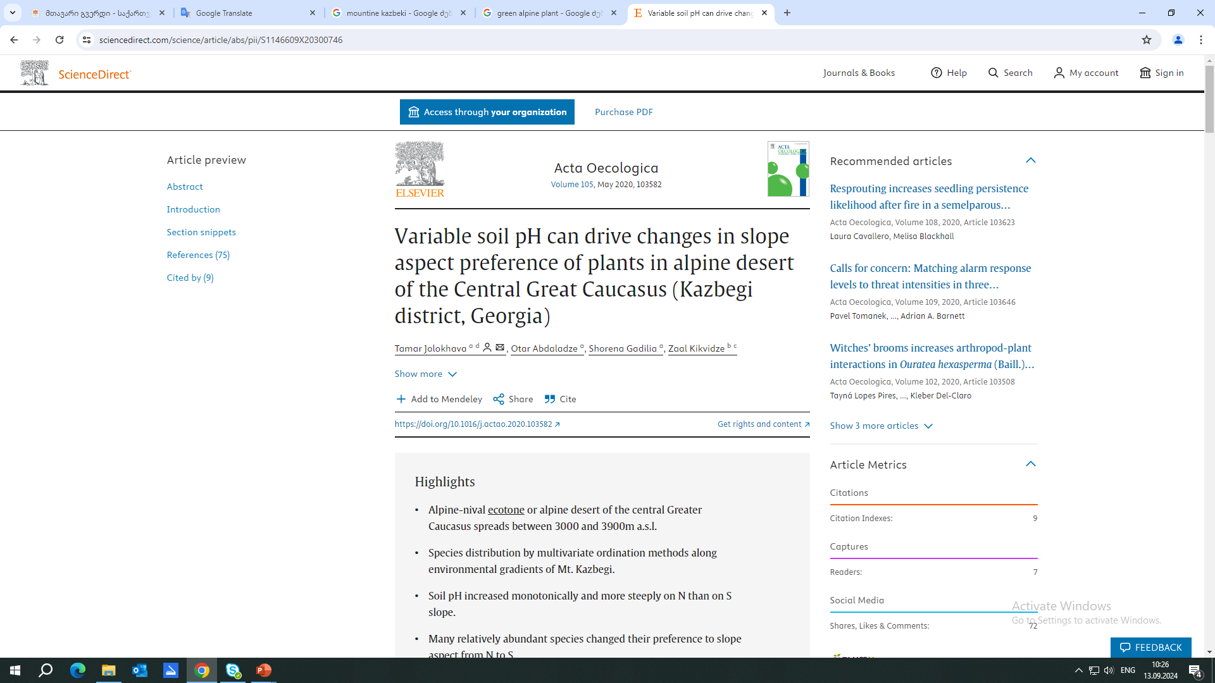
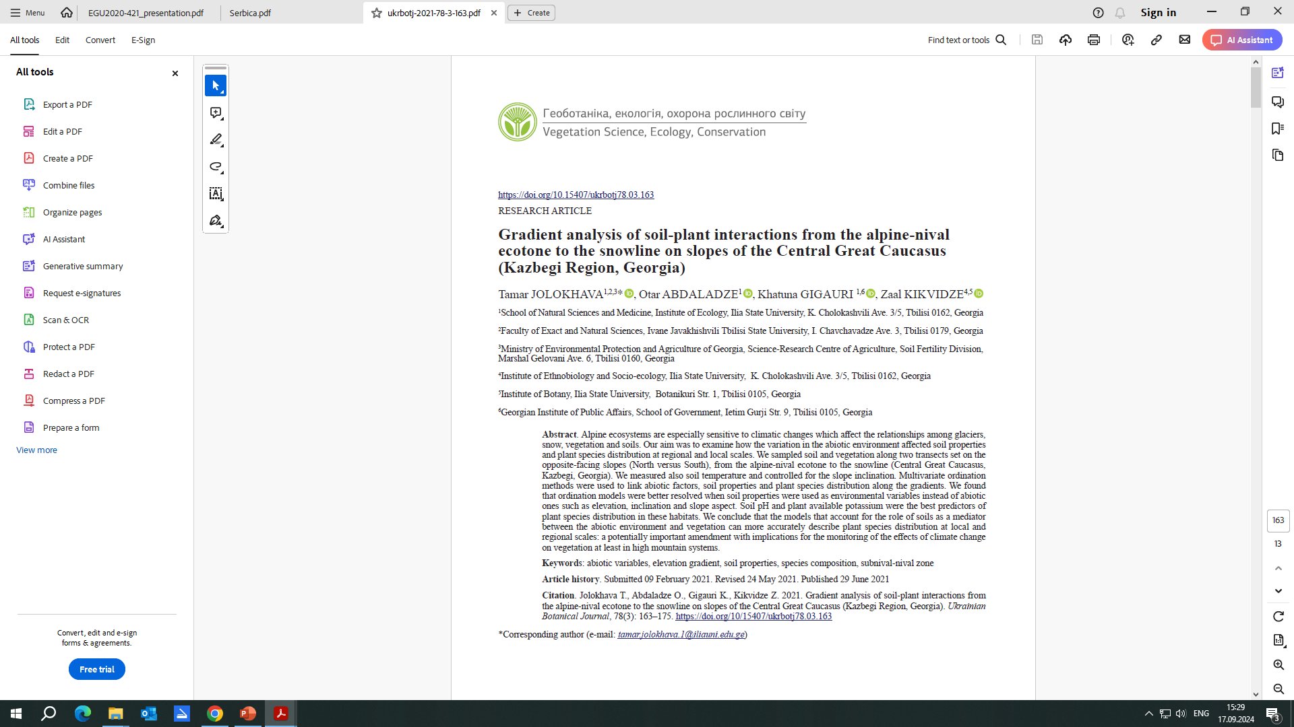
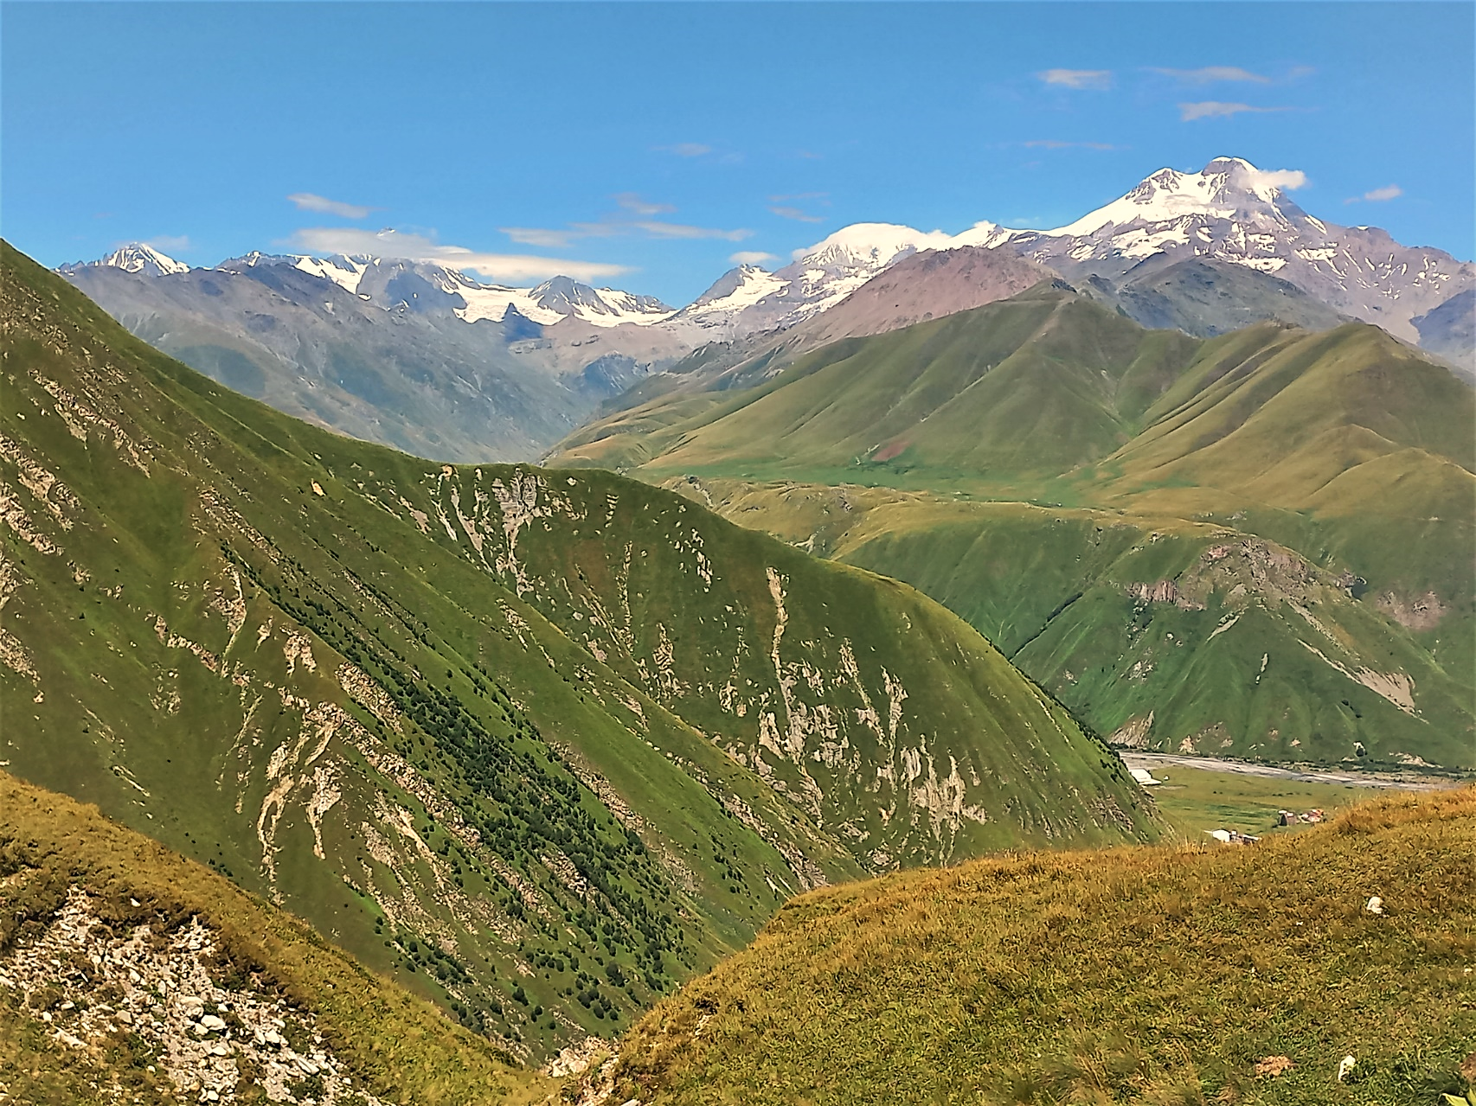
Thank You for Your Attention

