Slide 1
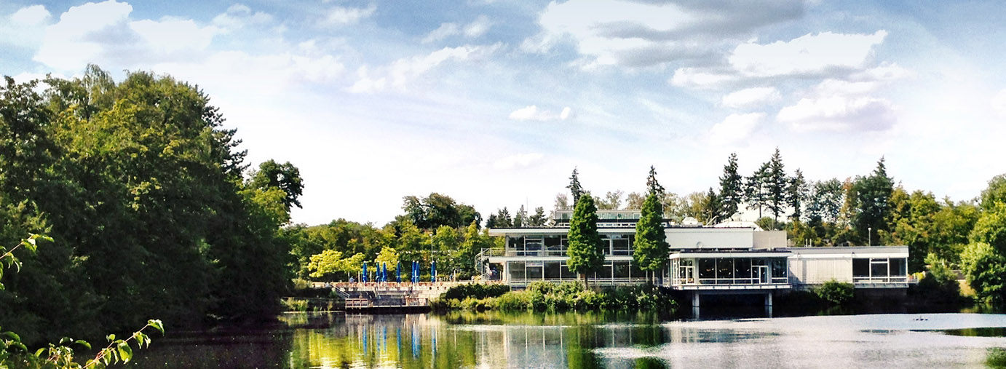
Seabirds Bearing Light
R. Bol¹, P.A. Paquis², A. Choque², C. Wang^{1,3}, R. Moerchen³, W. Amelung³ and B. Fuentes²
¹ Institute of Bio- and Geosciences, Agrosphere Institute (IBG-3), Forschungszentrum Jülich, Germany,
² Departamento de Ingeniería Química y de Medio Ambiente. Universidad Católica del Norte, Antofagasta, Chile
³ Institute of Crop Science and Resource Conservation, Soil Science and Soil Ecology, University of Bonn, Germany

Slide 2
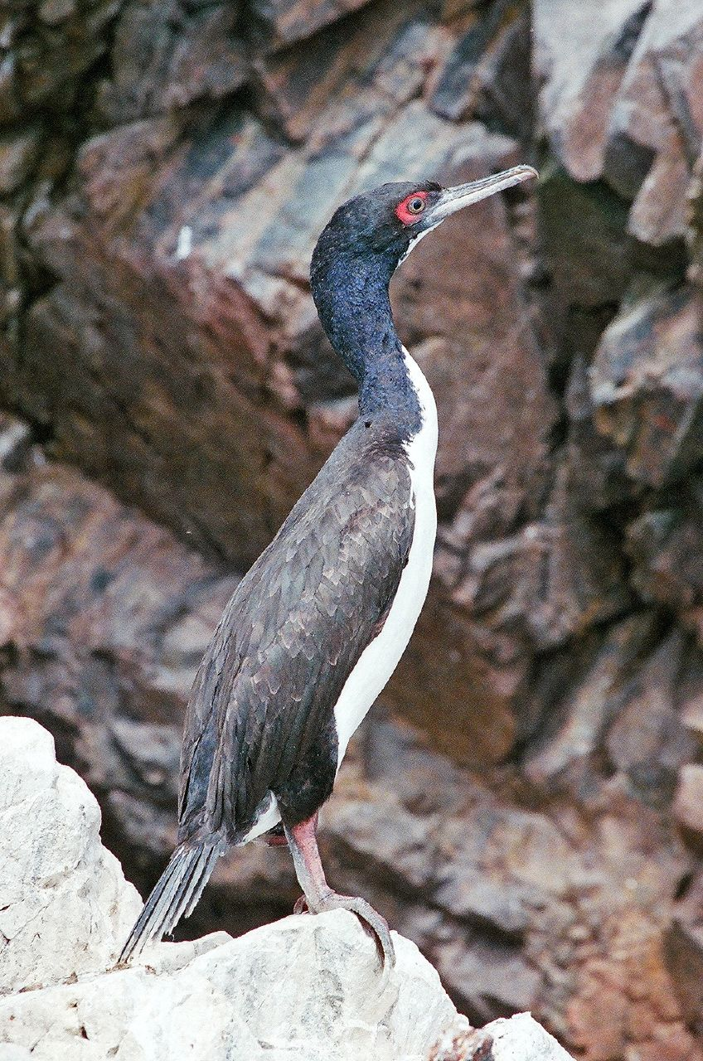
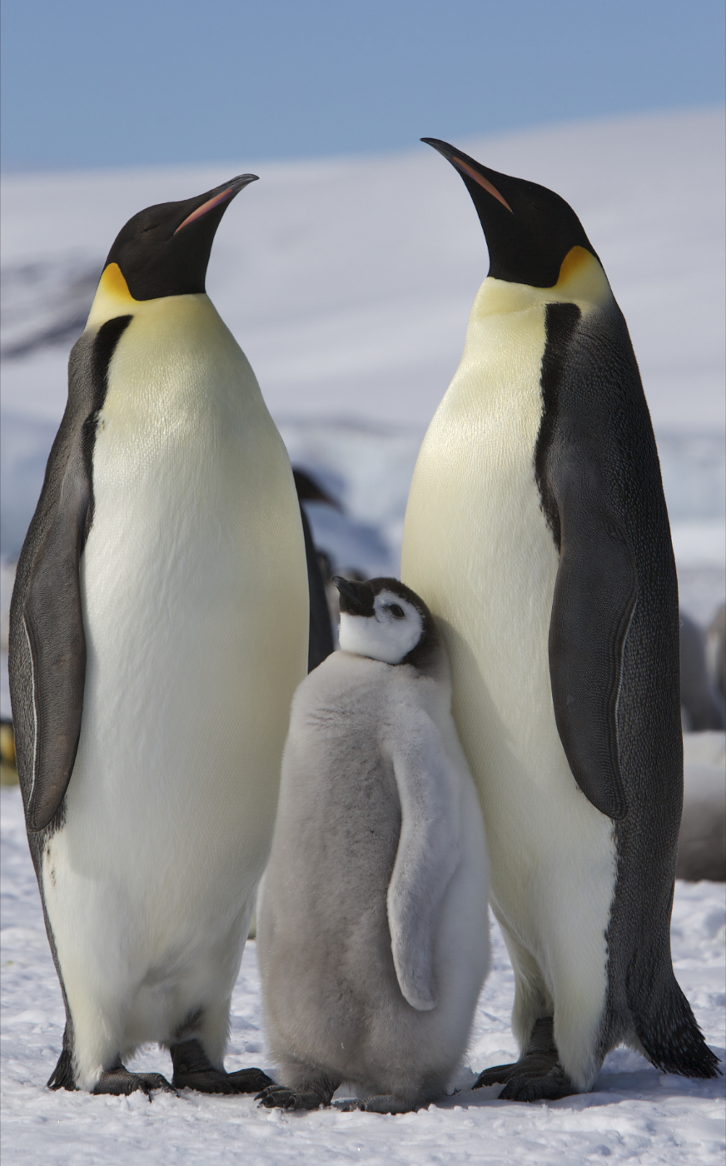
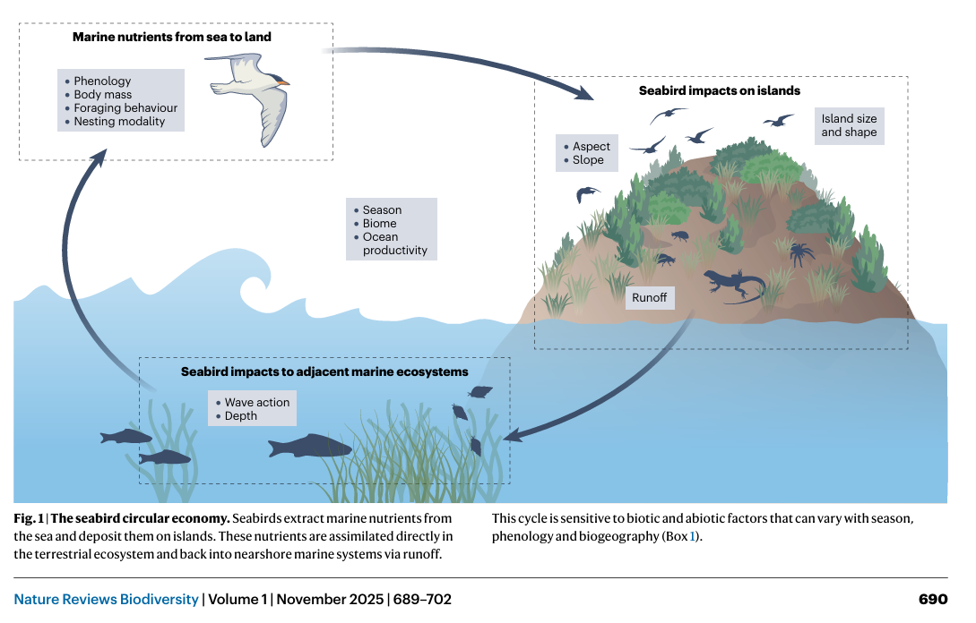
Phosphorus, (Ancient Greek: Φωσφόρος, romanized: Phōsphóros): the greek god which appears as the Morning Star, meaning dawnbringer or light bearing. Element discovered by co-incidence in 1669 by Hennig Brand, a German alchemist
Seabirds, a global population of 900 to 1180 billion individuals (Otago et al, 2018).
Guano, is the accumulated excrement of seabirds or bats. Guano is a highly effective fertilizer due to the high content of nitrogen, phosphate, and potassium, all key nutrients essential for plant growth.
Seabird excreted P, inputs are ~100 Gg P yr and similar in magnitude to other fluxes in global P cycles (Otero et al. 2018).
©Bruno Girin (London, UK)
© Ian Duffy (UK)
Guanay cormorant shag (Leucocarbo bougainvilliorum) in Islas Ballestas, Peru
Emperor penguin (Aptenodytes forsteri) in Antarctica

Slide 3
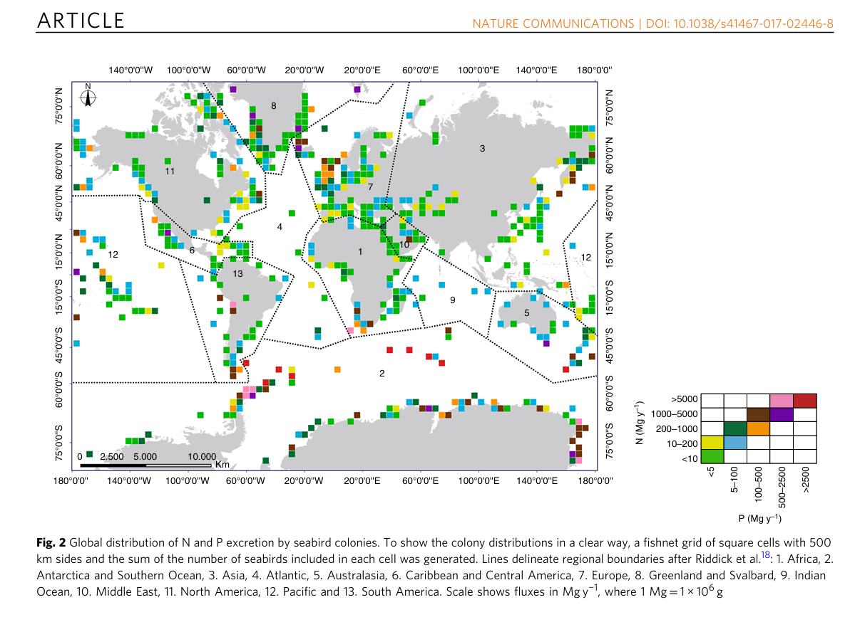
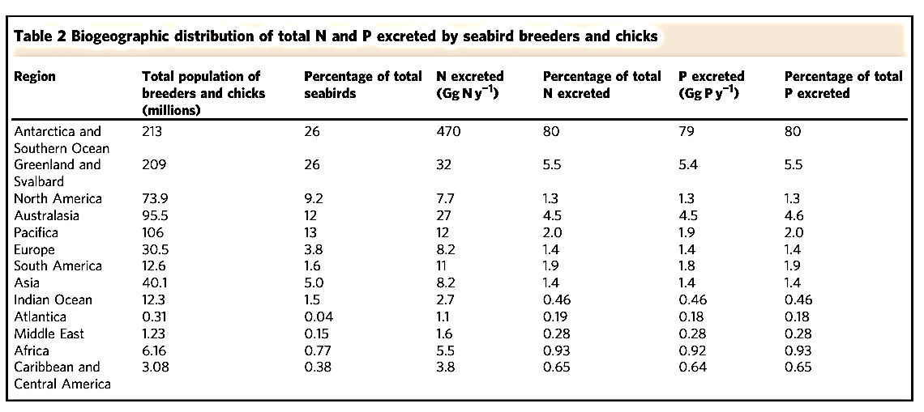
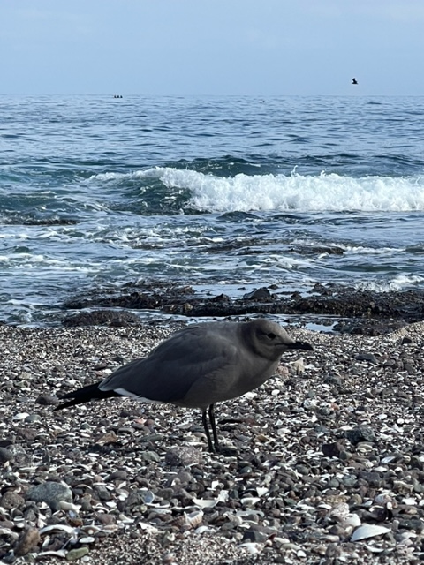

Slide 4
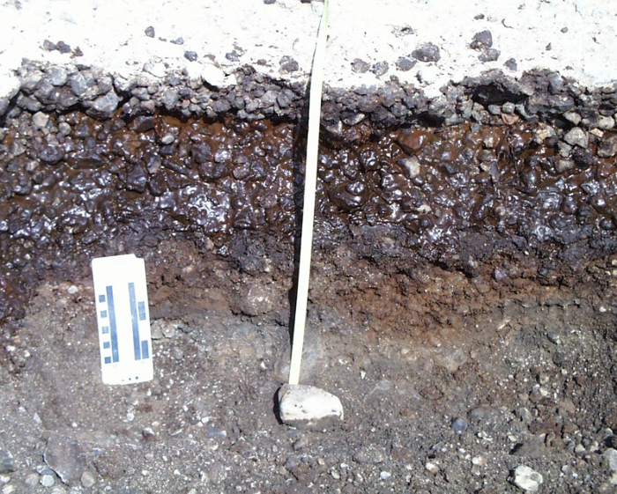
‘Ornithogenic – bird formed soils’
Terrestrial environments significantly altered by the accumulation of large amounts of materials in bird colonies (e.g., guano, feathers, eggshells, pebbles) mainly present on the cold or wet regions of our planet.
Some difficulties in quantification of bird vs. deeper native ‘soil’ P sources

Slide 5
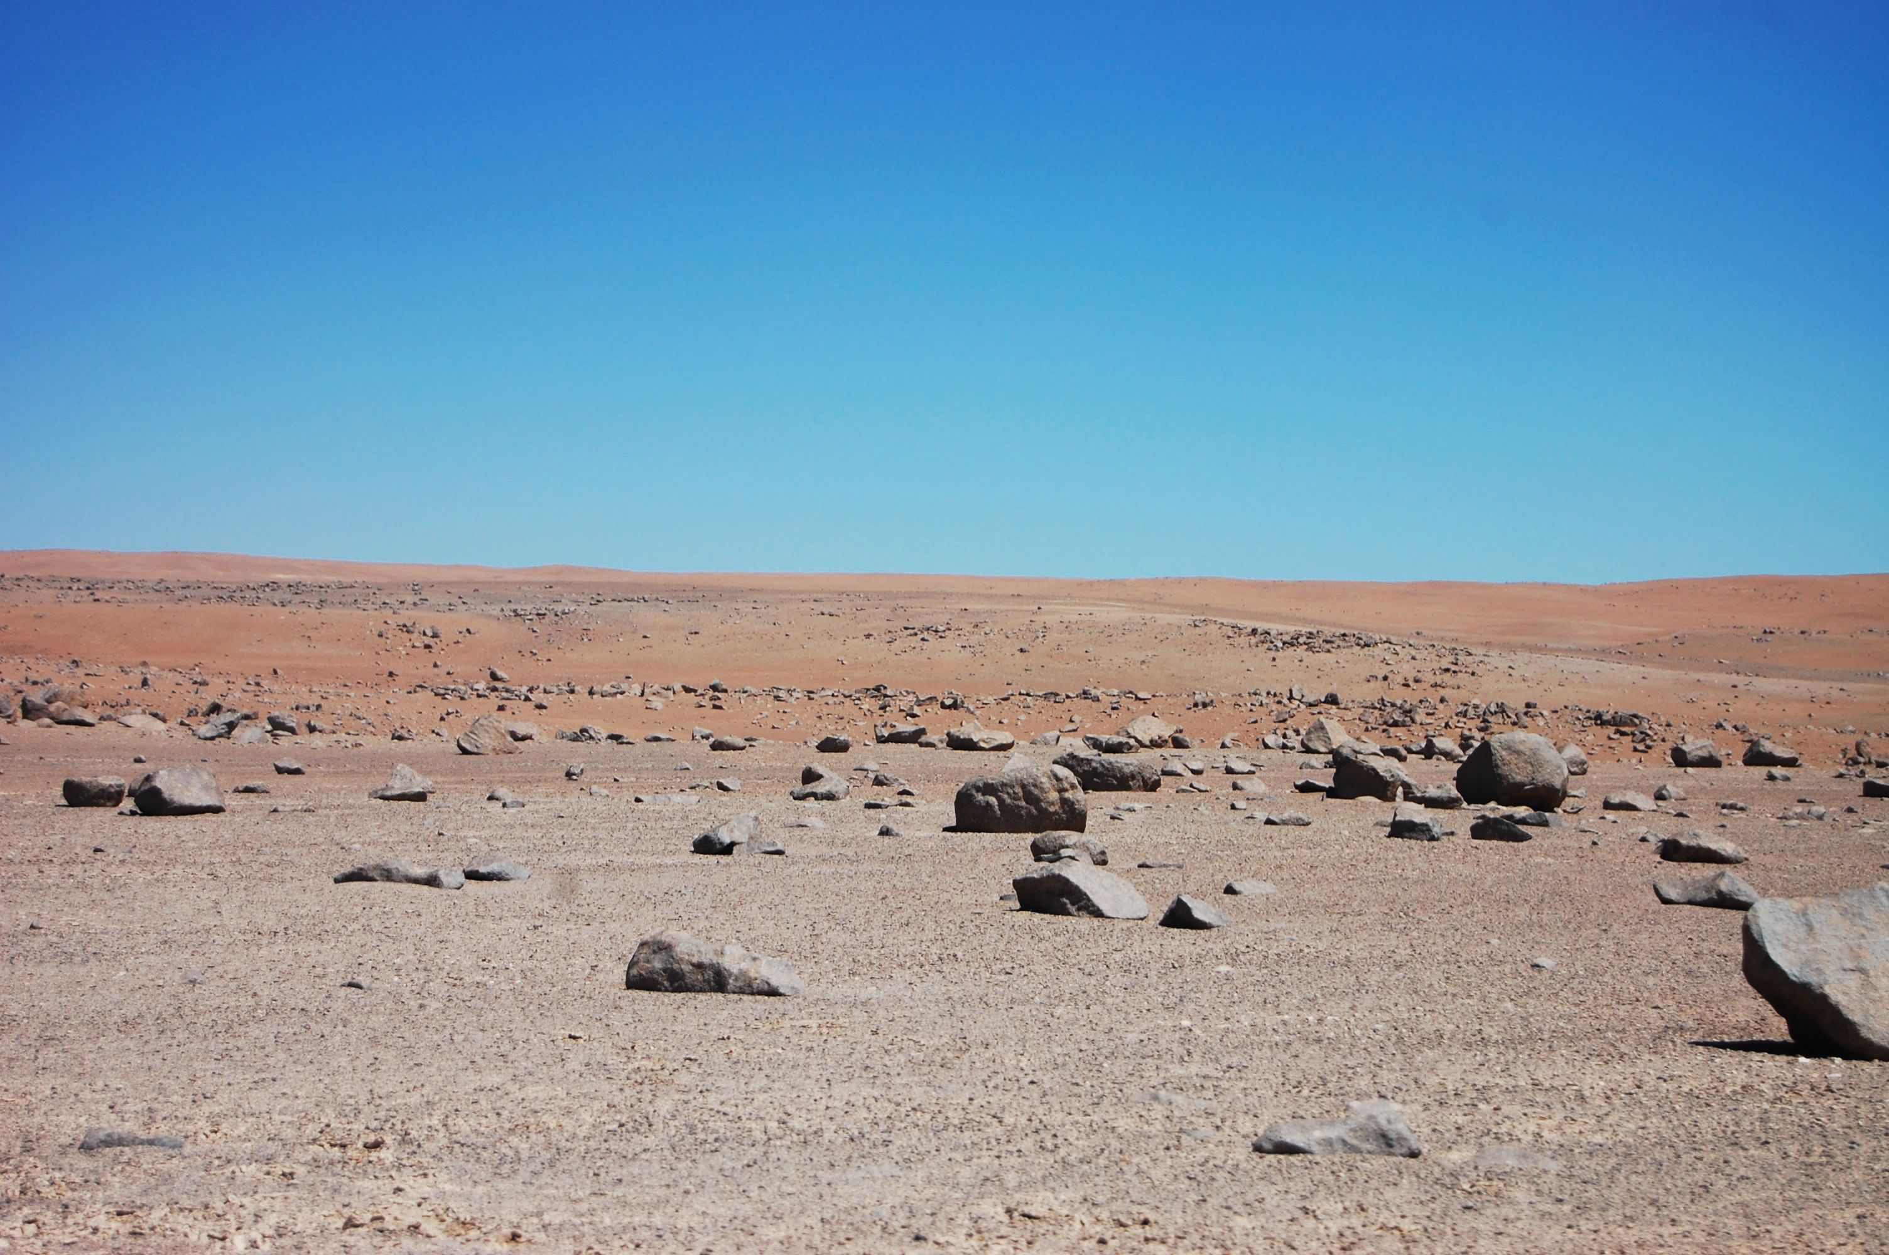
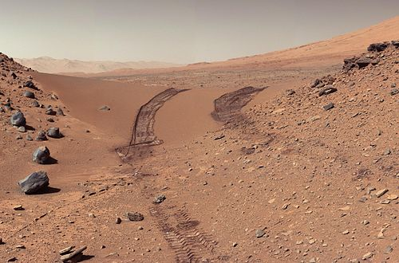
Atacama Desert: An analog of Mars
The Atacama Desert (Chile) is commonly known as the driest place in the world. Some locations receive less than 1 to 3 mm precipitation in a year. Driest place in the Desert being Marie Elena South.
Devoid of vegetation its biogeochemical cycles are mainly controlled by geochemical factors

Slide 6
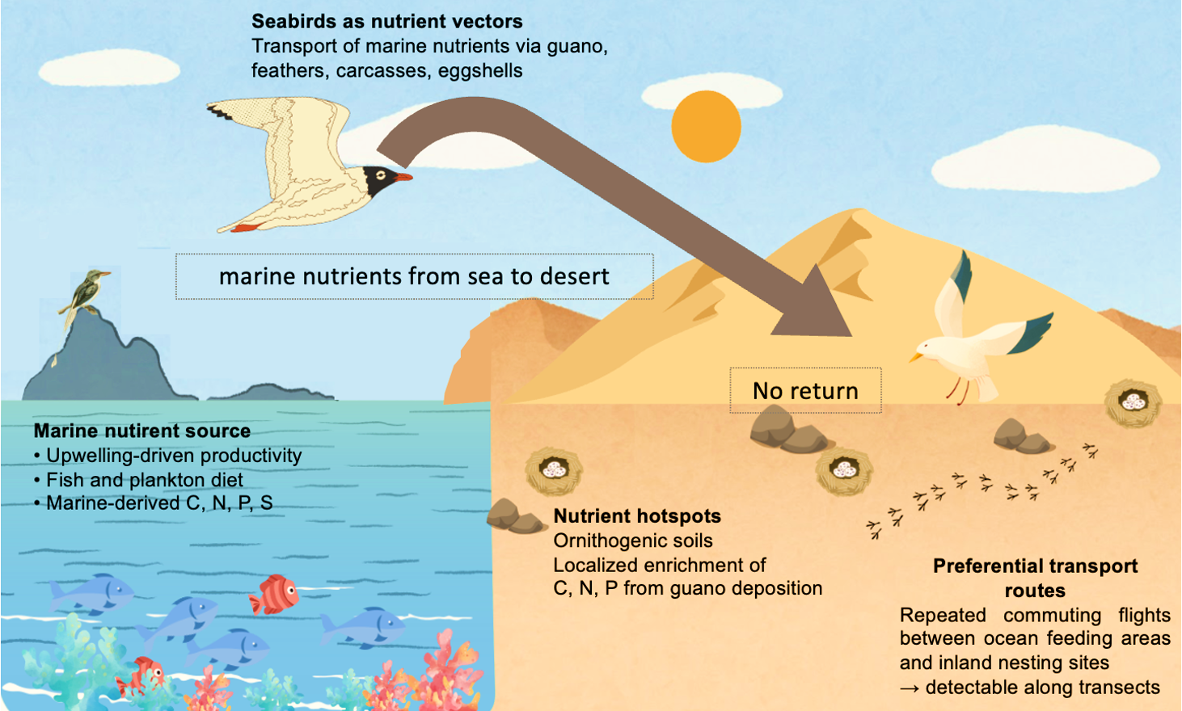
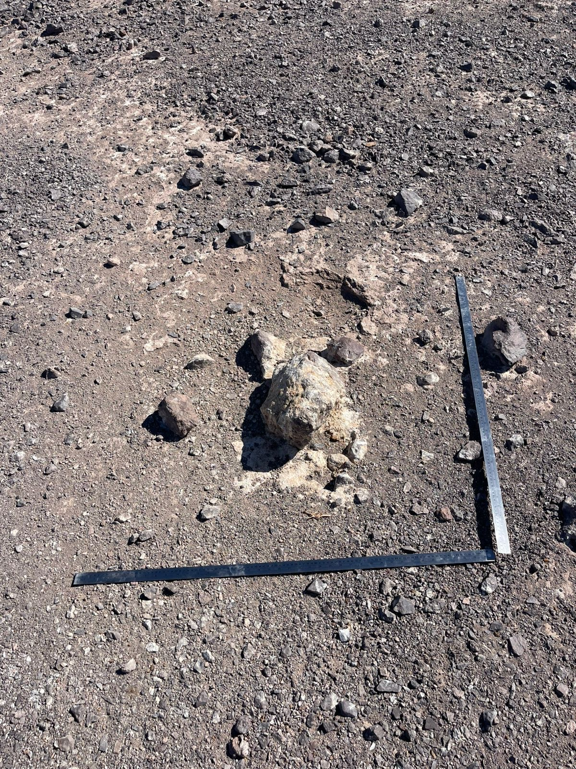
‘’Frozen in dryness’’
Garuma (Grey Gull) is the only known groundnesting seabird in hyper-arid deserts

Slide 7
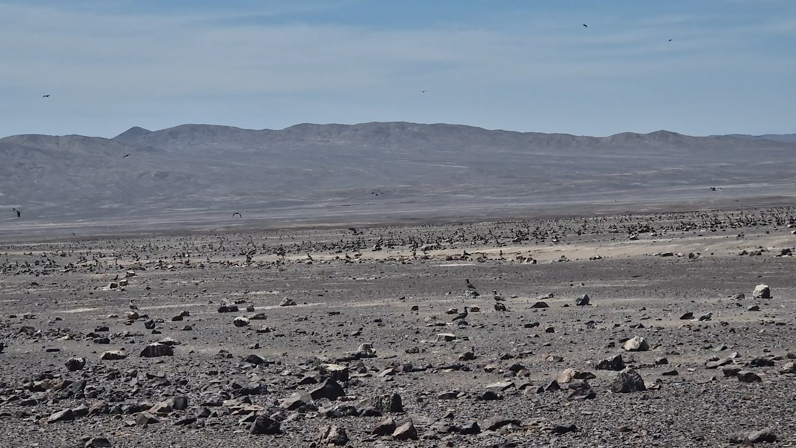

Slide 8
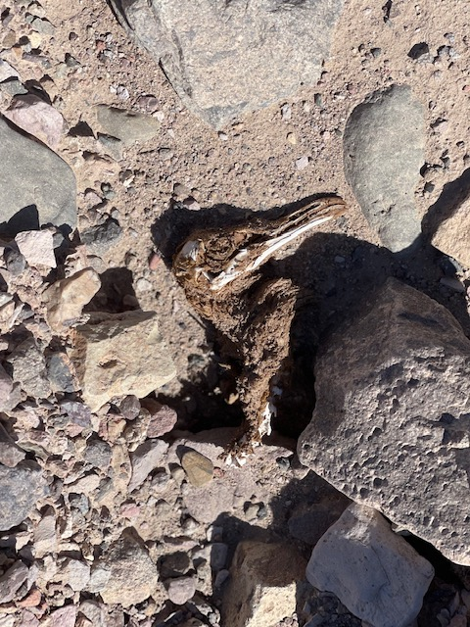
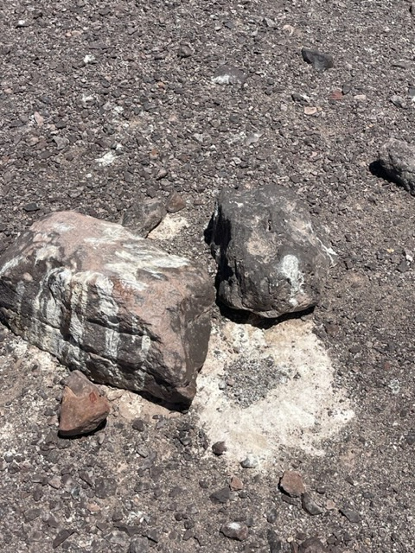
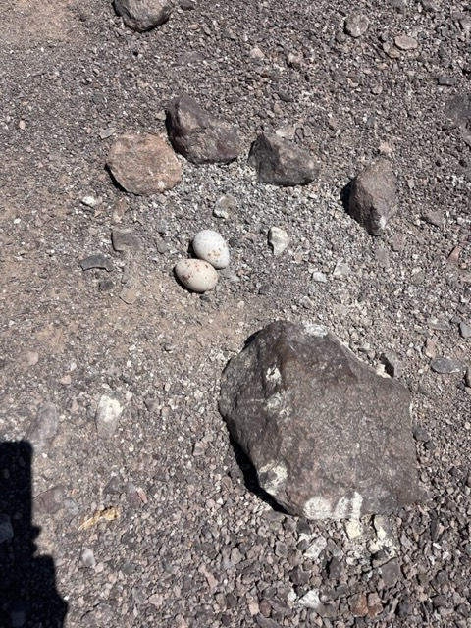
Why measure total and available P here
Unique situation allows, due to absence of co-founding vegetation P inputs, to more precisely quantity ‘marine derived’ seabird total and soluble P soil inputs to terrestrial ecosystems

Slide 9
Material and methods
Sample site: Grey Gull nesting site “El Tigre 2” – near to Maria Elena and control site 2 km away.
Time: between May and July 2024, outside the breeding season, to avoid disturbance to nesting activity.
Random samples were collected within a 120 × 20 m rectangular area (0.24 ha)
123 well-defined breeding areas were identified, of which 70 were randomly sampled. Soil 0-2 cm.
Nesting site
Bare Soil (B-BS)
Shallow Scrapes (B-SS)
Shallow Scrapes, potential nest activity (B-SS*)
High Dropping (B-HD)
Low Dropping (B-LD),
Control area
No Dropping (C-ND)
Bare Soil (C-BS)
Parameters
Bulk density, pH value, Electric conductivity (Ec), Total C, Total P, Inorganic P, organic P and microbial composition.

Slide 10
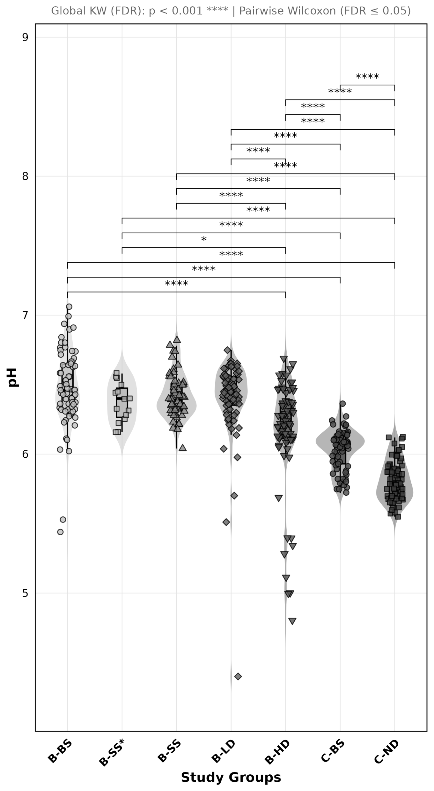
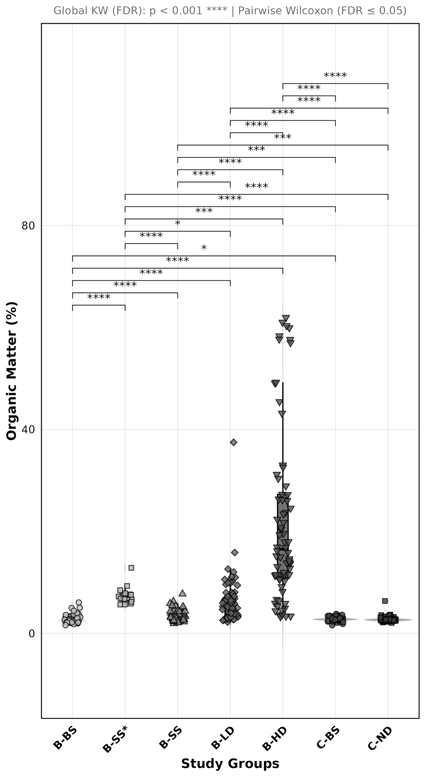
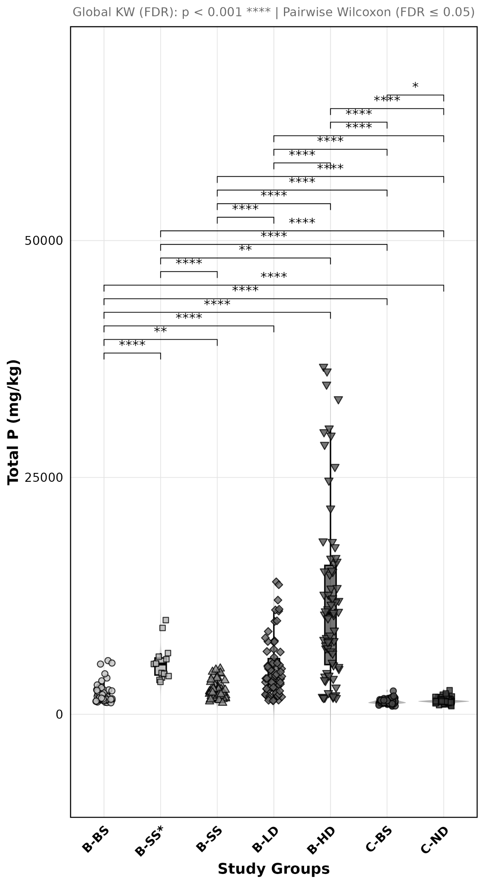

Slide 11
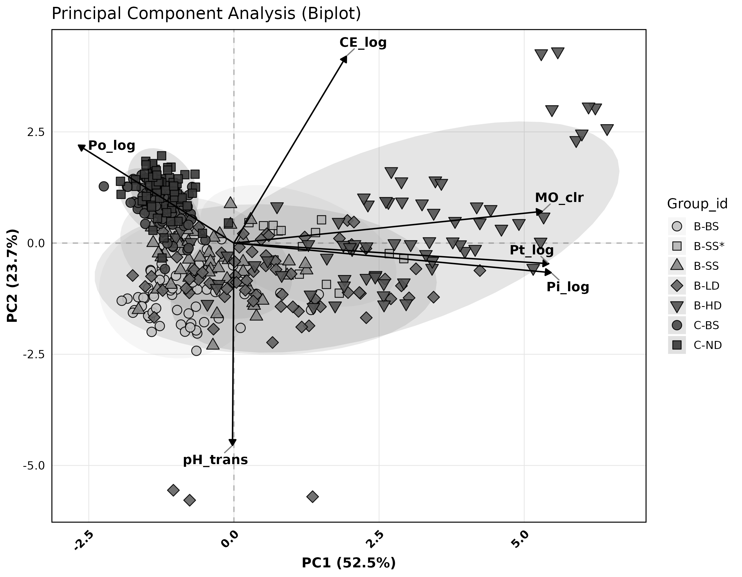
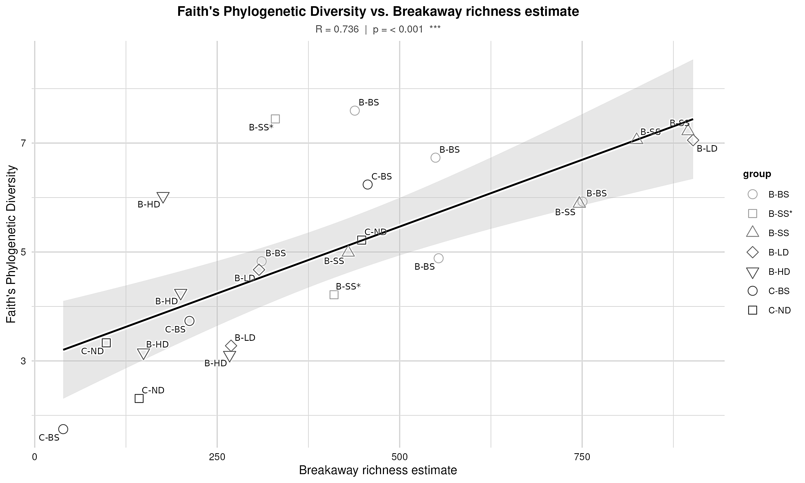
Next step : Actual quantification and upscaling
Further enlightenment on the actual baseline contribution and importance of seabirds (and birds in general) to soil P provision, is critical for future design into approaches to sustainable optimizing of nutrient management and ecosystem functionality, especially in the wider context of the worrying global decline in bird numbers and its diversity.

Slide 12
Thank you for your attention ! Questions welcome !

