Slide 1
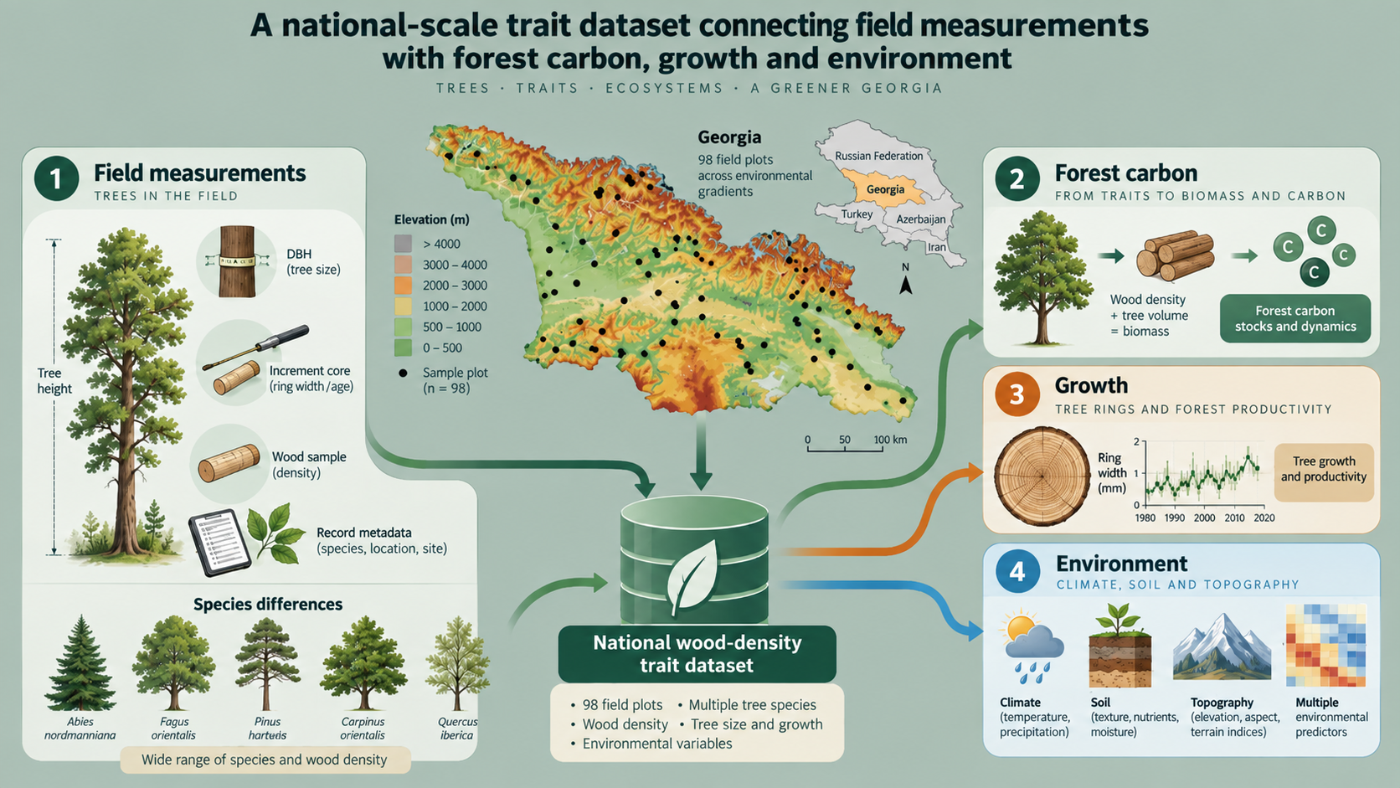
Wood Density Variation across Georgian Forests
Species Differences and Environmental and Stand-Structural Controls
98 plots
629 cores
13 species
Vasil Metreveli et al.
Ilia State University · Tbilisi, Georgia
Conference presentation · September 2026

Slide 2

A 30-minute story in four steps
ROADMAP
TALK STRUCTURE
01
02
03
04
Why it matters for Georgia
Why it matters
How we measured it
What varies
Wood density influences tree strategy, mechanical characteristics, biomass, and carbon.
98 NFI plots, 629 cores, 13 species, standardized field and laboratory protocol.
Strong species contrasts, smaller
stand-structural and environmental effects.
Improved species-specific carbon conversion and geographical prediction.

Slide 3
MOTIVATION
WHY IT MATTERS
Wood density is a powerful forest trait
WOOD DENSITY
Carbon accounting
Converts measured stem volume into dry biomass and carbon.
ρ = m dry / V
A simple trait with multiple downstream consequences
Tree strategy
Reflects structural investment, growth and hydraulic safety.
Wood quality
Related to strength, durability and potential uses.
Background: Chave et al. (2006); Pan et al. (2011); Mo, Crowther & Maynard (2024).

Slide 4
CARBON LOGIC
FROM VOLUME TO CARBON
Species-specific density changes biomass estimates
Stem volume × wood density = dry woody biomass
0.42 g cm⁻³
Low-density species
0.64 g cm⁻³
High-density species
≈ 420 kg dry mass per m³
≈ 640 kg dry mass per m³
For the same stem volume, the difference is about 52% in dry mass.

Slide 5
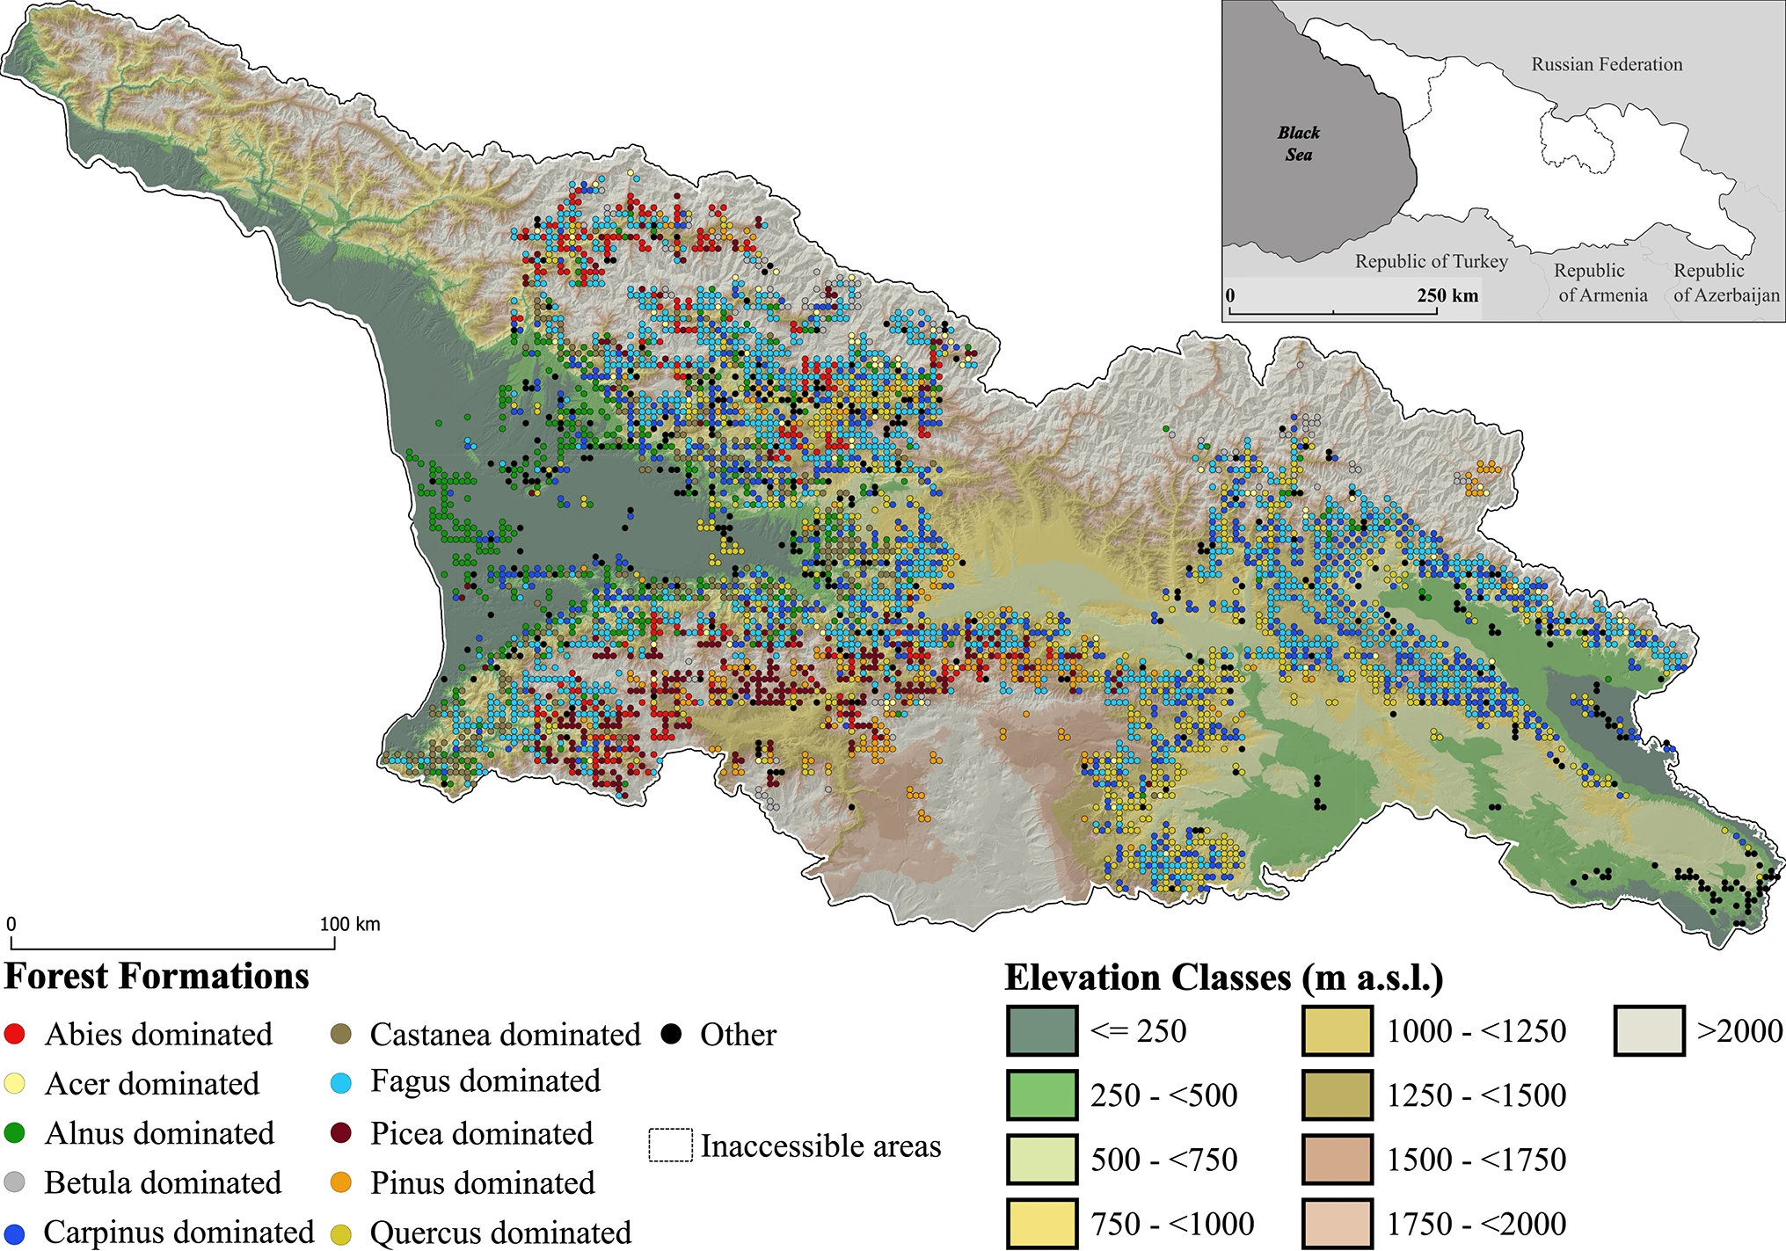
Georgia combines high forest diversity with changing environmental gradients
Wellenbeck et al., 2026
~45%
of the country is forested
4,598
First NFI plots
A natural gradient laboratory
Humid western forests, drier eastern landscapes, broad elevational ranges, and major transitions from deciduous stands to high-elevation conifers.
Study area and national inventory context: manuscript Introduction; MEPA (2023).

Slide 6
The Caucasus remains underrepresented in wood-density datasets
KNOWLEDGE GAP
WHY THIS STUDY
Global resources exist
Georgia-specific values are sparse
Carbon accounting needs local calibration
Despite unequal regional coverage and local calibration, large trait databases provide valuable species-level information.
Previous work in the Caucasus is often species-specific or descriptive rather than national and environmentally explicit.
When local populations, species composition, and environmental factors differ, derived densities can transmit bias.
Manuscript Introduction: Zanne et al. (2009); Kattge et al. (2020); Chalatashvili et al. (2024).

Slide 7
Four questions organize the study
OBJECTIVES
STUDY QUESTIONS
1
How much does wood density differ among Georgia’s major tree species?
2
How do tree size and long-term radial growth relate to wood density?
3
Which climate, soil and topographic variables explain additional variation?
4
How can these data support biomass, carbon and future spatial predictions?
Working expectation: species identity should dominate the signal, while structural and environmental factors refine within-species variation.

Slide 8
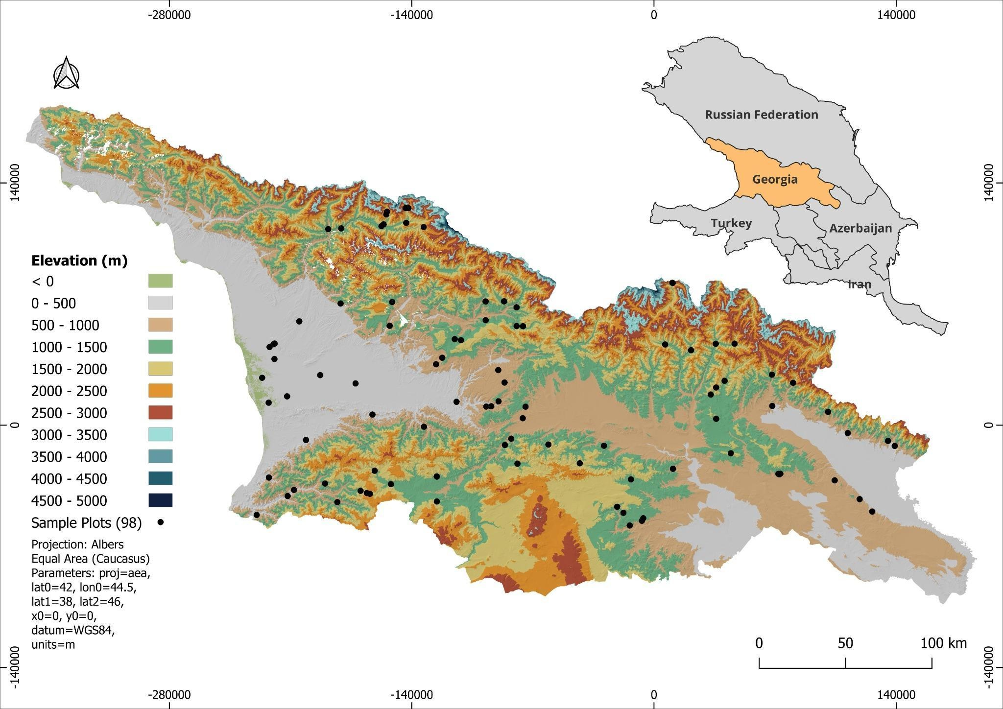
Wide environmental gradients were sampled nationally
SAMPLING DESIGN
98 PLOTS
98
sample plots
629
increment cores
13
tree species
Selected from the First NFI to span western and eastern Georgia across climatic, elevational and forest-type gradients.
Accessible territory only; Abkhazia and the Tskhinvali Region/South Ossetia were excluded because access was not possible.

Slide 9




Field sampling captured both species and size variation
FIELD METHODS
TREE SELECTION
1
2
3
4
5
Select species
Cover size classes
Core at 1.3 m
Record fresh data
Measure tree
Trees present in designated NFI plots
Small, intermediate and large DBH
4.3 mm inner diameter borer
Core length + fresh mass
DBH + height
Minimum sampled DBH: 8 cm · Standard coring height: 1.3 m · Total cores: 629
Field protocol: manuscript Methods, section 2.4.
10

Slide 10




Wood density was measured from oven-dry mass and core volume
LABORATORY METHODS
DENSITY MEASUREMENT
1
2
3
4
Measure core
Dry to constant mass
Weigh immediately
Calculate density
Length and fixed 4.3 mm diameter define cylindrical volume.
105 ± 2 °C for 48–72
h.
Minimize moisture reabsorption after removal from oven.
Oven-dry mass divided by core volume.
ρ = oven-dry mass (g) / core volume (cm³)
Laboratory protocol follows Chave et al. (2006) and related wood-density methods.

Slide 11


The same cores also provided long-term radial growth information
LABORATORY METHODS
TREE RINGS
1
2
3
4
5
Mount cores
Prepare surface
Scan
Measure rings
Summarize growth
Affix dried cores to wooden boards
WSL Core Microtome; sanding when needed
1,200 dpi
high-resolution images
CooRecorder / CDendro; 0.01 mm precision
Mean radial increment for each core
Quality control: incomplete outer rings from the sampling year were omitted before calculating mean radial increment.

Slide 12
One response variable, multiple predictor domains
DATA STRUCTURE
PREDICTOR FAMILIES
Tree & stand
Soils
Age · DBH · height · mean/median radial increment · volume
Bulk density · pH · texture · N · CEC · organic carbon
WOOD DENSITY
Climate
Topography & space
CHELSA temperature and precipitation variables
Elevation · slope · aspect · roughness · TPI · plot effect
All predictors were complete for n = 629 observations in the analysis dataset.

Slide 13
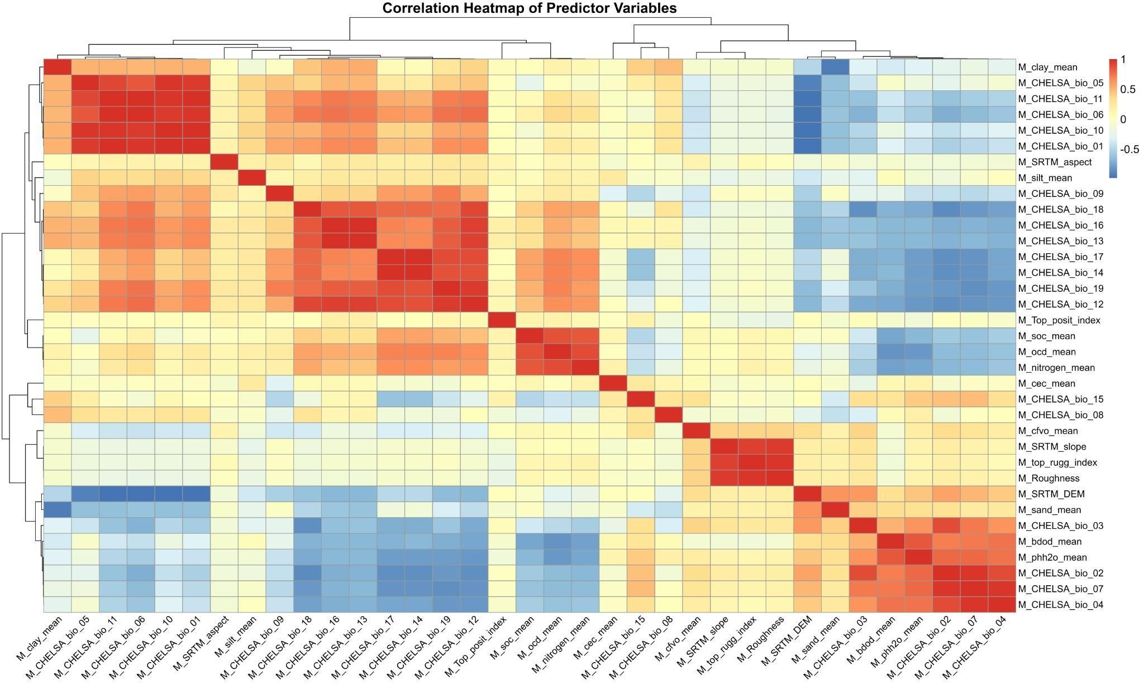
Predictor screening is essential before ecological interpretation
COLLINEARITY
CORRELATION STRUCTURE
Temperature block
Several CHELSA temperature metrics are strongly positively correlated.
Precipitation block
Multiple precipitation metrics carry overlapping information.
Terrain + soil
Topographic metrics cluster, while soil texture/chemistry show their own dependence structure.
Modeling implication: select representative predictors rather than fitting every correlated variable together.

Slide 14
The analysis separates species effects from residual structural and environmental effects
1
2
3
4
Species baseline
Structural controls
Environmental controls
Plot structure
Quantify mean density and uncertainty for each of the 13 species.
Test DBH and long-term radial increment within the broader model.
Evaluate selected soil, climate and topographic predictors after collinearity screening.
Account for residual
plot-level differences and spatial clustering.
Generalized Additive Mixed Model (GAMM) was used for the analyses
GAMs are useful here because several ecological relationships are expected to be nonlinear rather than strictly linear.

Slide 15
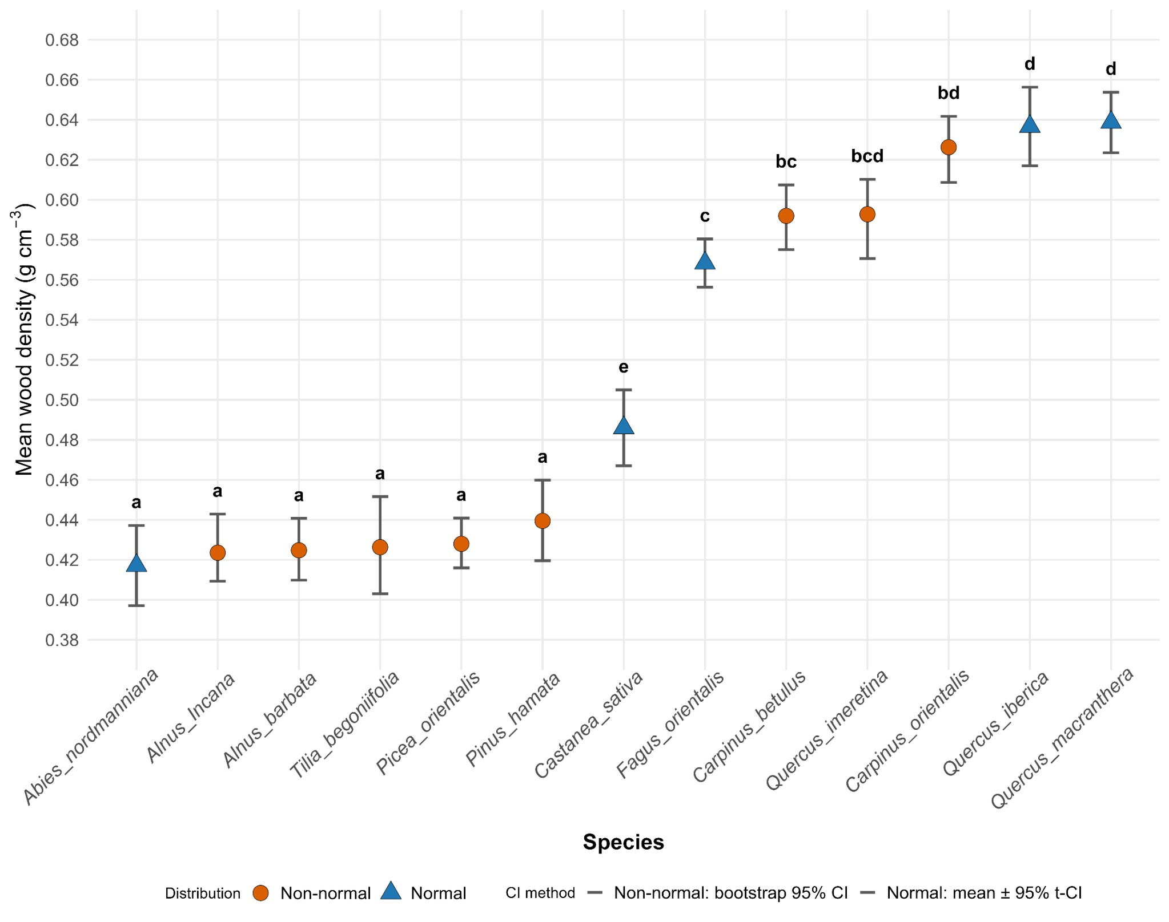
Species identity produces the clearest wood-density contrast
RESULTS
SPECIES DIFFERENCES
≈ 0.42 → 0.64 g cm⁻³
Points show species means with 95% confidence intervals; symbols distinguish normal vs non-normal distributions; letters indicate group comparisons.

Slide 16
The species ranking forms three broad density groups
RESULTS
ECOLOGICAL RANKING
LOW
INTERMEDIATE
HIGH
≈ 0.42–0.44 g cm⁻³
≈ 0.49–0.57 g cm⁻³
≈ 0.59–0.64 g cm⁻³
Abies nordmanniana Alnus incana / A. barbata Tilia begonifolia
Picea orientalis Pinus hamata
Carpinus betulus Quercus imeretina Carpinus orientalis Quercus iberica Quercus macranthera
Castanea sativa Fagus orientalis
The ranking is more informative for carbon conversion than a single national average density.

Slide 17
The observed ranking is consistent with major wood-strategy differences
INTERPRETATION
FUNCTIONAL CONTEXT
Gymnosperms in this dataset
Angiosperms span a wider range
Caucasian fir, Oriental spruce, and pine are low-density. Tracheid-based wood is commonly used for mechanical and hydraulic safety in cold or high-elevation conditions.
Deciduous trees range from light alder and linden to dense hornbeam and oak. Vessel-based wood provides more structural and hydraulic strategies.
Important: lineage does not fully determine density—species ecology and local environment still matter within each group.
Functional interpretation follows manuscript Introduction and Sperry et al. (2006); Mo, Crowther & Maynard (2024).

Slide 18
APPLICATION
CARBON ACCOUNTING
A species choice can shift biomass conversion by roughly half
Same stem volume
Inventory implication
A single default density can systematically over- or under-estimate dry biomass when species composition varies.
1 m³
Carbon implication
LOW DENSITY
≈ 420 kg dry mass
HIGH DENSITY
≈ 640 kg dry mass
The error propagates directly into carbon stock estimates and reporting.
Management implication
Species-specific density values improve conversion tables and scenario calculations.

Slide 19
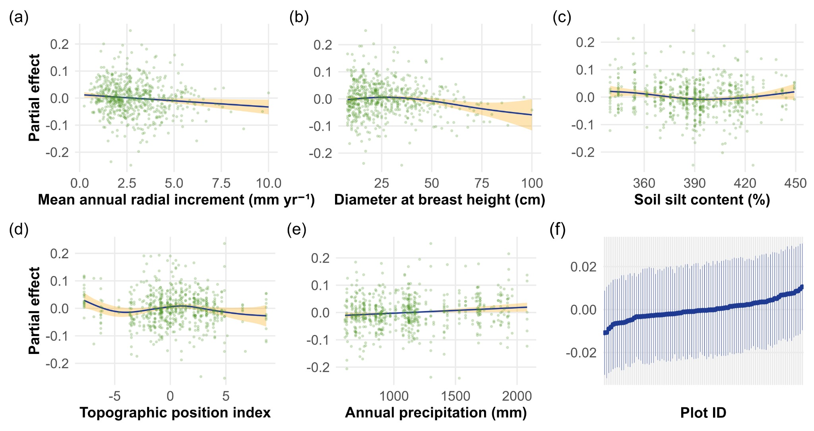
Environmental and stand-structural effects are present—but modest
RESULTS
PARTIAL EFFECTS
Most fitted effects stay close to zero relative to
the large species contrast.
Partial-effect plots shown for mean radial increment, DBH, soil silt, TPI, annual precipitation and plot-level effects.

Slide 20
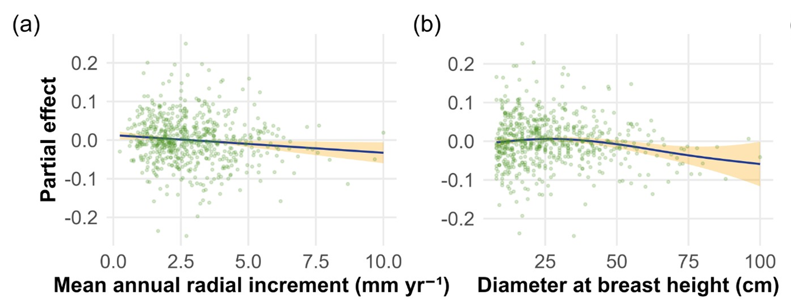
Tree size and radial growth show weak, directionally interpretable trends
RESULTS
STAND STRUCTURE
Mean radial increment
The fitted effect trends slightly downward at higher
long-term radial increment, but the magnitude is small and uncertainty widens at the extremes.
DBH
The partial response is near zero at smaller diameters and becomes more negative toward very large DBH values.
Interpretation: denser wood may be associated with slower growth or different allocation strategies, but species identity remains the dominant axis.

Slide 21
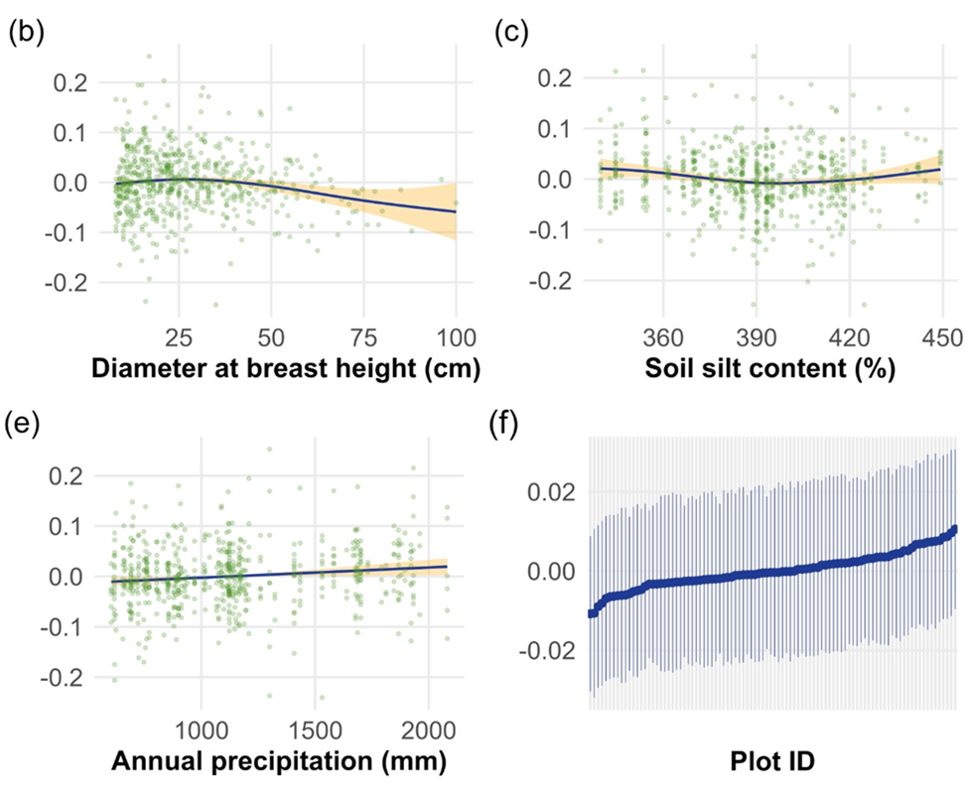
Soil, topography and precipitation refine the pattern rather than redefine it
RESULTS
ENVIRONMENTAL CONTROLS
Soil silt
A shallow U-shaped partial relationship; effect sizes remain close to zero.
Topographic position
A weak nonlinear response with a small peak around intermediate positions.
Annual precipitation
A slight positive tendency across the observed gradient, again with small magnitude.
The emerging picture is one of secondary environmental modulation around strong species-specific baselines.

Slide 22
The emerging hierarchy of controls is clear—but the analysis is still being refined
1
Species identity
Large separation among species means; primary driver in the current results.
Interpret with appropriate caution
Tree / stand structure
DBH and growth make minor intraspecies changes.
2
Some predictor ranges are sparsely sampled, which widens uncertainty.
Correlated environmental variables require careful selection.
3
Environment
Soil, topography and precipitation have modest partial effects.
The current partial-effect figure is preliminary and should be read as conditional association, not causation.
Plot-level variation
Residual local differences remain and are represented in the model.
Species × environment interactions are an important next step.
4

Slide 23
From measured cores to national trait and carbon products
OUTLOOK
NEXT STEPS
01
02
03
04
Finalize species models
Map current density
Link to biomass
Explore climate scenarios
Estimate species-specific effects and interactions with robust uncertainty.
Predict wood density across forested Georgia from environmental rasters.
Combine local density with NFI, forest composition and
remote-sensing biomass.
Assess how warming and precipitation shifts may alter density patterns and carbon estimates.
NOW
NEXT
NEXT
NEXT

Slide 24
Three take-home messages
Thank you
Questions & discussion
Species differences are large
Mean wood density spans roughly 0.42–0.64 g cm⁻³ across the 13 sampled species.
1
Secondary controls are modest
Tree size, growth, soil, topography and precipitation refine—rather than dominate—the pattern.
2
Vasil Metreveli vasil.metreveli.1@iliauni.edu.ge
Local density improves carbon accounting
Georgia-specific values strengthen biomass conversion and future spatial modeling.
Acknowledgments
3
ECO.Georgia · GCF · BMZ · GIZ · MEPA · Ilia State University · field and laboratory teams
Selected references: Chave et al. 2006 · Pan et al. 2011 · MEPA 2023 · Mo et al. 2024

