Slide 1
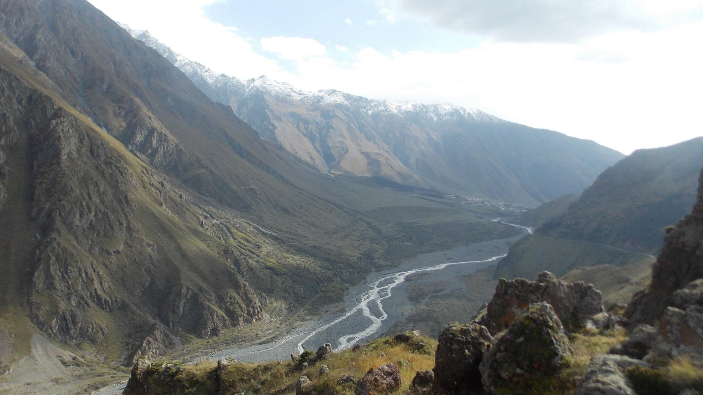
First Attempts to Apply Ellenberg Indicator Values to the Flora of Georgia
Ketevan Batsatsashvili
School of Natural Sciences and Medicine
&
Alpine Ecosystem Research Programme, Institute of Ecology
Ilia State University

Slide 2
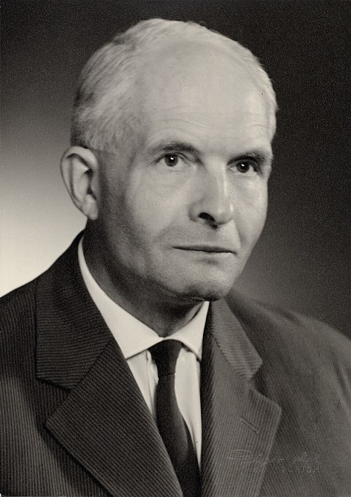
Ellenberg Indicator Values (EIVs)
Ellenberg Indicator Values (EIVs) are numerical estimates of the ecological preferences of plant species along major environmental gradients, originally developed by Heinz Ellenberg for the flora of Central Europe. EIVs indicate ecological niches rather than directly measuring environmental factors. They can be used to infer the environmental conditions of vegetation from its species composition.
Light (L)
Temperature (T)
Continentality (K)
Moisture (F)
Nutrients / nitrogen availability (N)
Salinity (S)
Ellenberg, Heinz. 1974. Zeigerwerte der Gefäßpflanzen Mitteleuropas. Scripta Geobotanica 9. Göttingen: Verlag Erich Goltze.
Ellenberg, Heinz, Heinrich E. Weber, Ruprecht Düll, Volker Wirth, Willy Werner, and Dieter Paulißen. 1992. Zeigerwerte von Pflanzen in Mitteleuropa. 2nd ed. Göttingen: Verlag Erich Goltze.
Heinz Ellenberg (1913-1997)

Slide 3
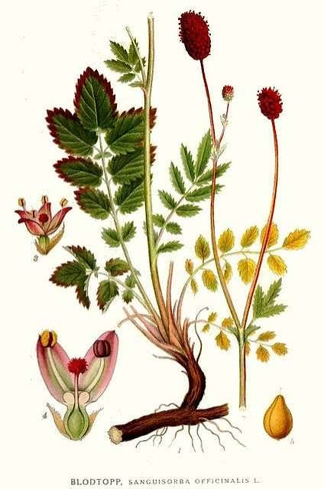
Example: Sanguisorba officinalis L.
Ellenberg indicator | Value | Meaning
L — Light | 7 | prefers well-lit sites
T — Temperature | 5 | intermediate temperature conditions
K — Continentality | 7 | relatively continental conditions
F — Moisture | 6 | moderately moist to moist soils
R — Reaction | × | indifferent to soil reaction
N — Nutrients | 5 | intermediate nutrient availability

Slide 4

Landolt Indicator Values
Landolt Indicator Values are numerical estimates of the ecological preferences of plant species, developed by Elias Landolt for the flora of Switzerland.
Light (L)
Temperature (T)
Continentality (K)
Moisture (F)
Soil reaction / pH (R)
Nutrients (N)
Salinity (S)
Aeration (D)
Landolt, Elias. Ökologische Zeigerwerte zur Flora der Schweiz. Veröffentlichungen des Geobotanischen Institutes der ETH, Stiftung Rübel, Heft 64. Bern: Verlag Hans Huber, 1977.
Landolt, Elias, Beat Bäumler, Andreas Erhardt, Otto Hegg, Frank Klötzli, Walter Lämmler, Michael Nobis, Katrin Rudmann-Maurer, Fritz H. Schweingruber, Jean-Paul Theurillat, Edwin Urmi, Mathias Vust, and Thomas Wohlgemuth. Flora indicativa: Ökologische Zeigerwerte und biologische Kennzeichen zur Flora der Schweiz und der Alpen / Ecological Indicator Values and Biological Attributes of the Flora of Switzerland and the Alps. 2nd ed. Bern, Stuttgart, Vienna: Haupt Verlag, 2010.
Elias Landolt
(1926-2013)

Slide 5
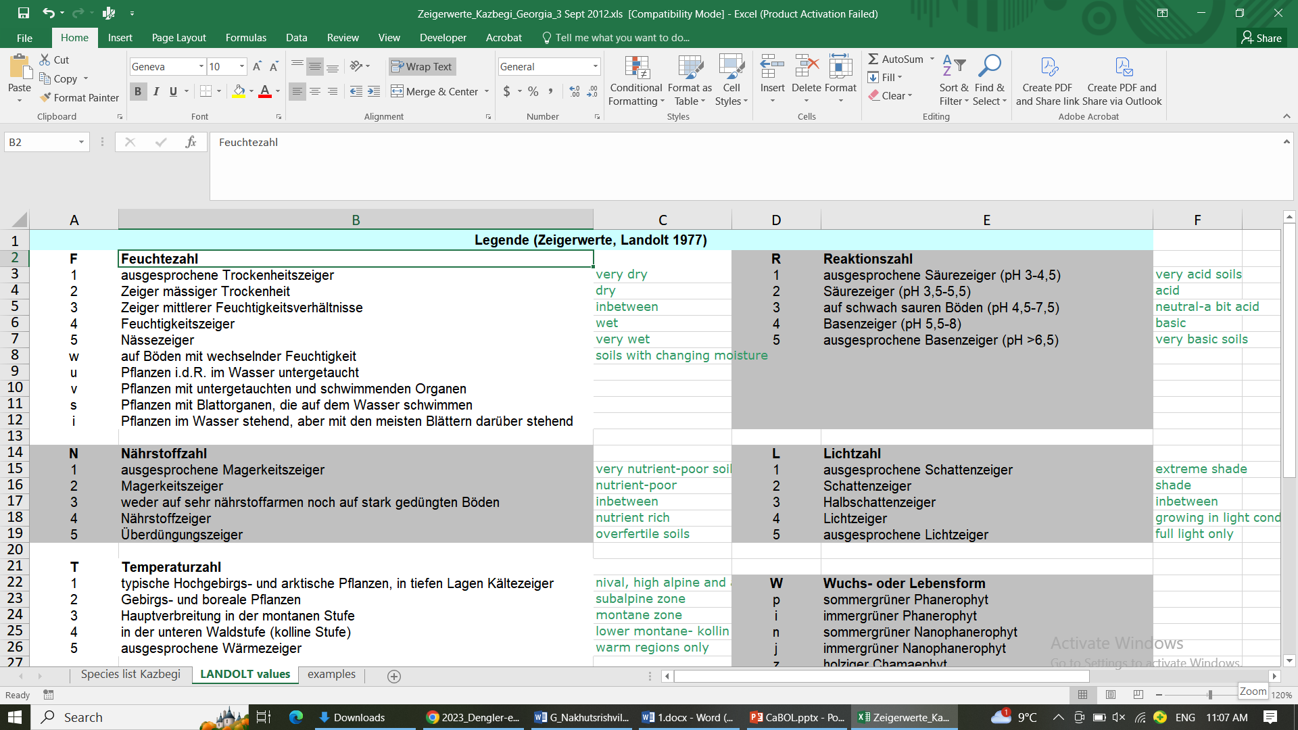

Slide 6
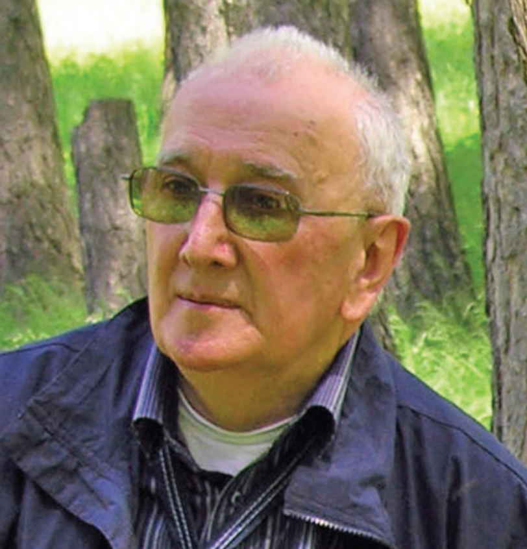
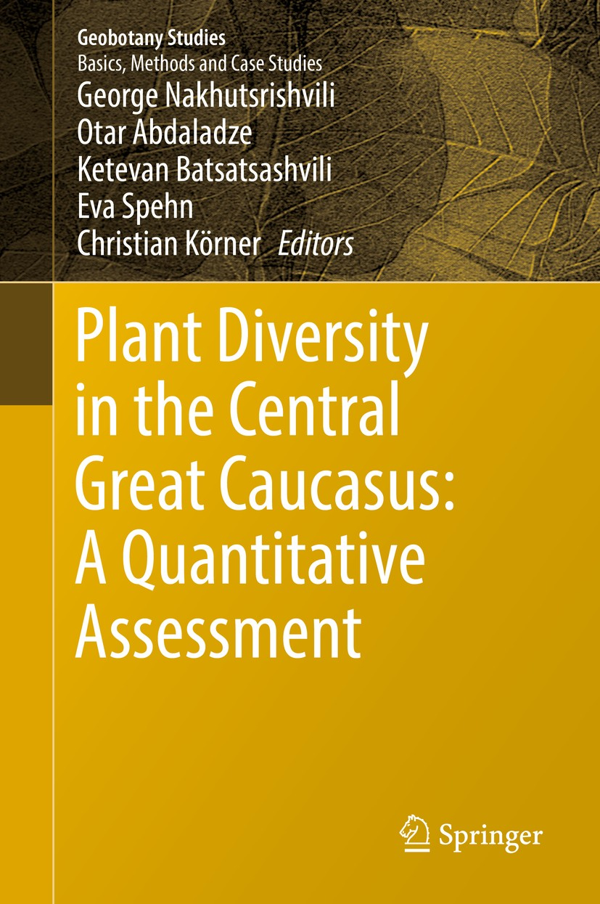
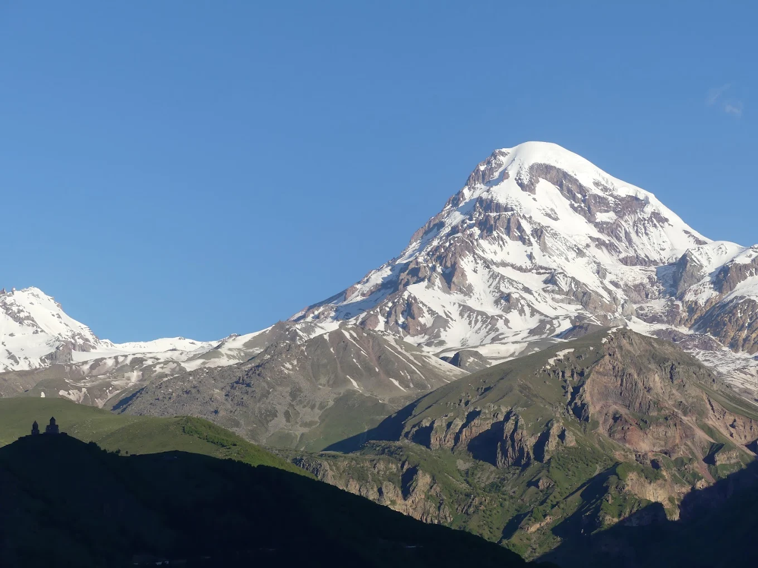
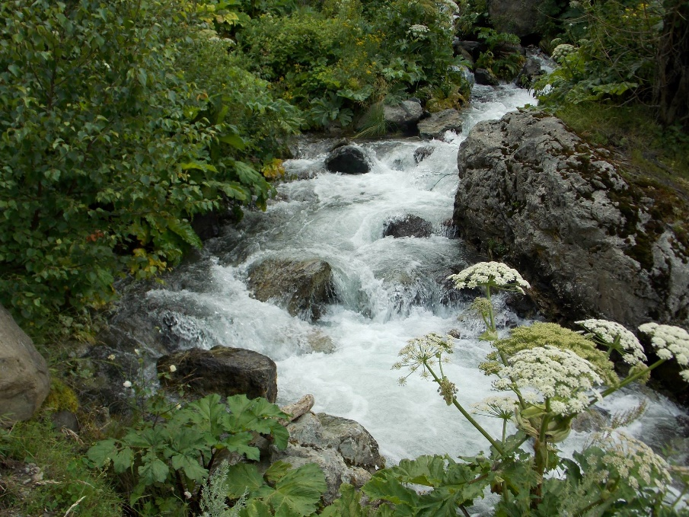
Prof. Gia Nakhutsrishvili (1932-2026)
Nakhutsrishvili, George, Ketevan Batsatsashvili, Katrin Rudmann-Maurer, Christian Körner, and Eva Spehn. "New indicator values for Central Caucasus flora." In Plant diversity in the central great Caucasus: a quantitative assessment, pp. 145-160. Cham: Springer International Publishing, 2017.

Slide 7
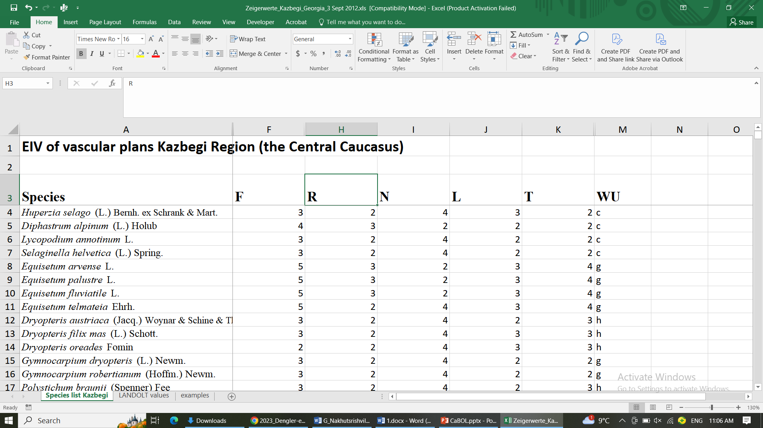

Slide 8
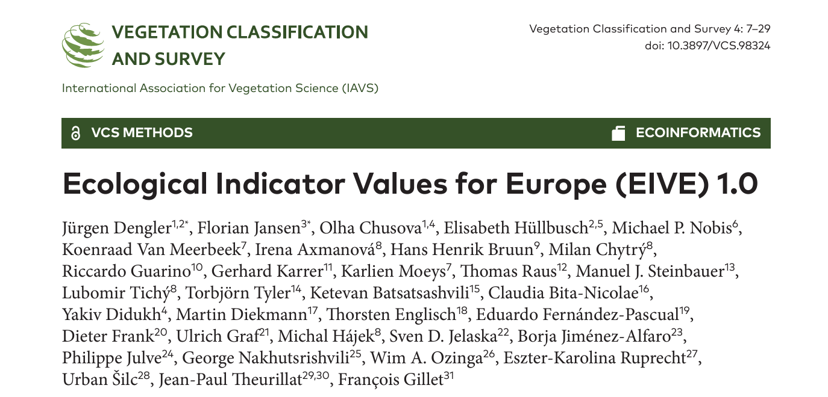
Dengler, Jürgen, Florian Jansen, Olha Chusova, Elisabeth Hüllbusch, Michael P. Nobis, Koenraad Van Meerbeek, Irena Axmanová, … George Nakhutsrishvili, Ketevan Batsatsashvili et al. "﻿ Ecological Indicator Values for Europe (EIVE) 1.0." Vegetation Classification and Survey 4 (2023): 7-29.
Aims: To develop a consistent ecological indicator value system for Europe for five of the main plant niche dimensions: soil moisture (M), soil nitrogen (N), soil reaction (R), light (L) and temperature (T).
Results: In total, we derived European indicator values of niche position and niche width for 14,835 taxa (14,714 for M, 13,748 for N, 14,254 for R, 14,054 for L, 14,496 for T).
Conclusions: EIVE is the most comprehensive ecological indicator value system for European vascular plants to date.

Slide 9
Comparison of Ellenberg, Landolt and harmonised European Indicator Values for plants
 | Ellenberg EIVs | Landolt values | EIVE 1.0
Developed for | Central Europe | Switzerland & the Alps | Europe
Main reference | Ellenberg 1974, 1992 | Landolt et al. 2010 | Dengler et al. 2023
Scale | Mostly 1–9 | 1–5 | Harmonised continuous values
Main factors | L, T, K, F, R, N (+ S) | L, T, K, F, R, N, D, S | L, T, M, R, N
Purpose | Indicate ecological preferences of species | Characterise ecological requirements and biological attributes | Harmonises indicator values across Europe

Slide 10
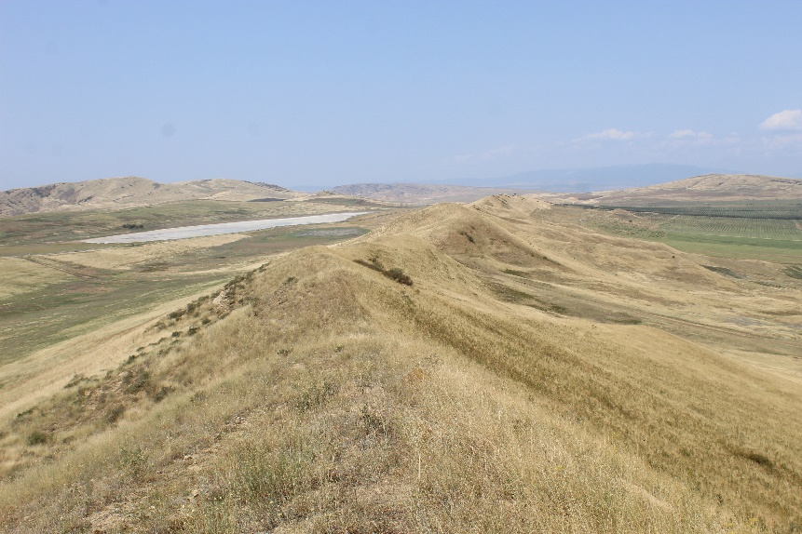
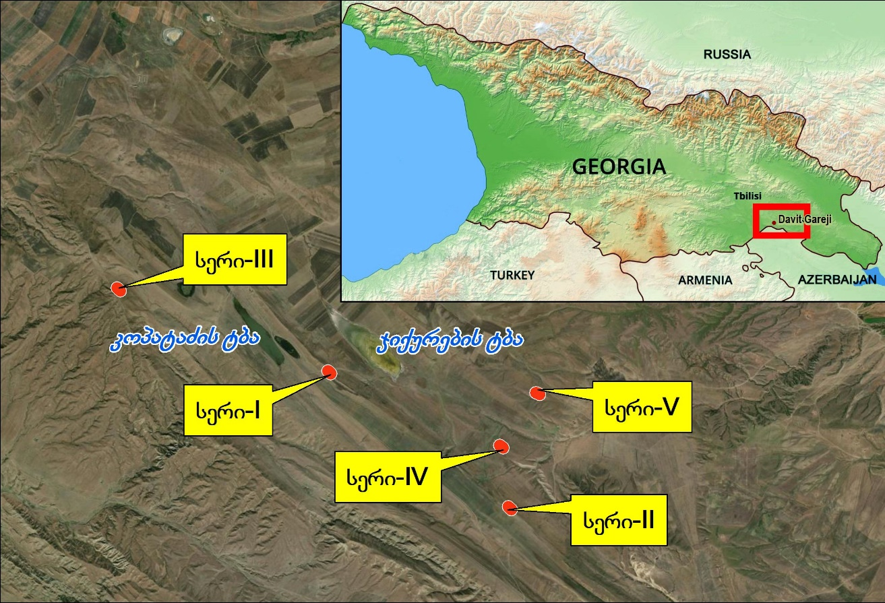
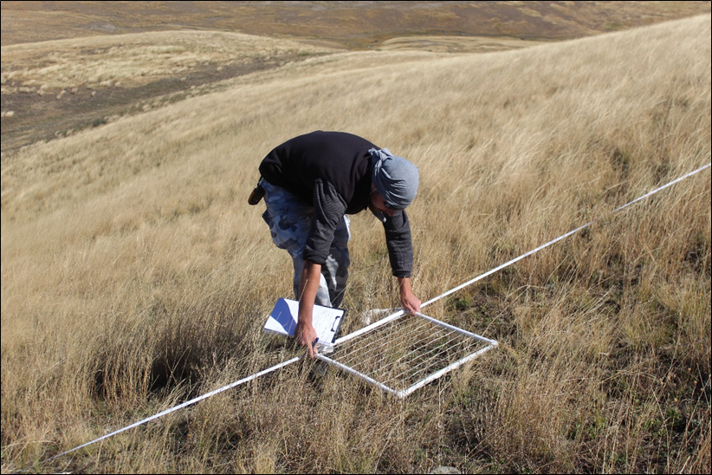
1. Species diversity of soil biological crusts and their interaction with vascular plants in the Gareji steppe
Kereselidze, K. MSc Thesis, supervised by K. Batsatsashvili, N. Lachashvili

Slide 11
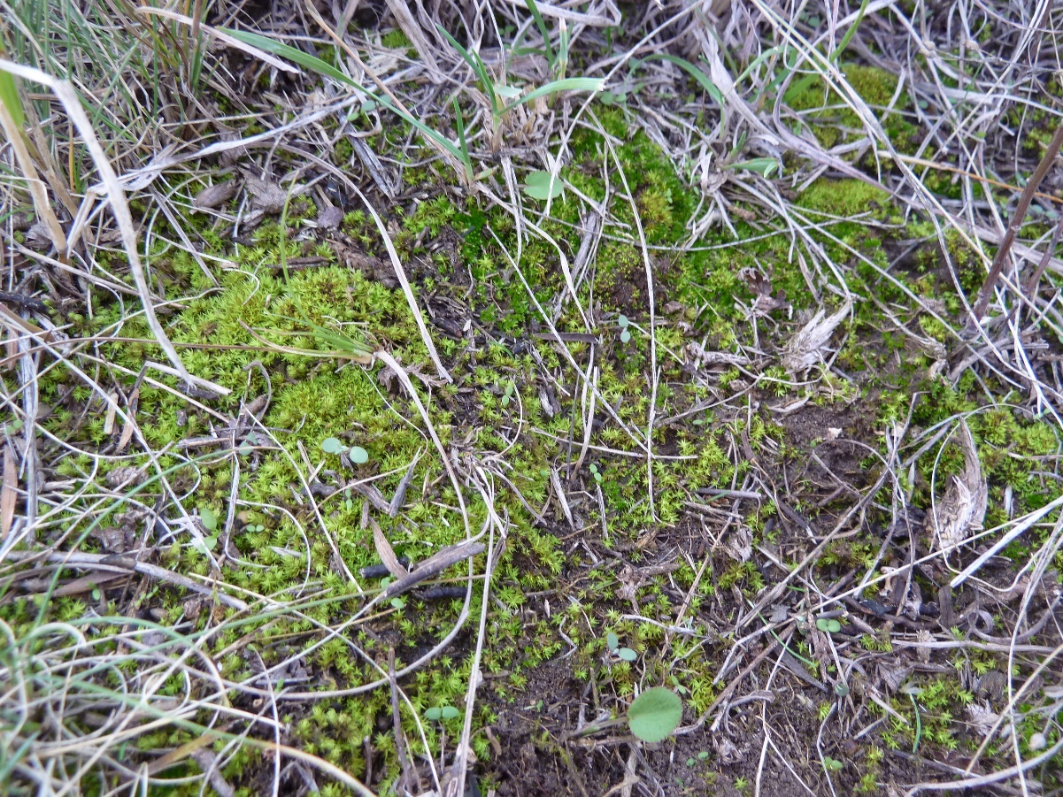
Bryophytes of soil biocrusts in Gareji steppe
Brachytheciaceae | Brachythecium campestre (Müll. Hal.) Schimp.
Bryaceae | Bryum argenteum Hedw.
 | Bryum bicolor Dicks.
 | Bryum caespiticium Hedw.
Funariaceae | Funaria hygrometrica Hedw.
Hypnaceae | Hypnum lacunosum (Brid.) Hoffm. ex Brid.
Pottiaceae | Barbula unguiculata Hedw.
 | Didymodon rigidulus Hedw.
 | Didymodon vinealis (Brid.) R. H. Zander
 | Phascum cuspidatum Schreb. ex Hedw.
 | Pleurochaete squarrosa (Brid.) Lindb.
 | Pottia lanceolata (Hedw.) Müll.Hal.
 | Pterygoneurum ovatum (Hedw.) Dixon
 | Syntrichia ruralis (Hedw.)Weber & D.Mohr
Thuidiaceae | Abietinella abietina (Hedw.) M. Fleisch.

Slide 12
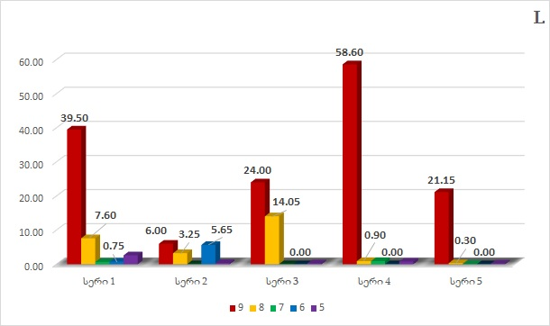
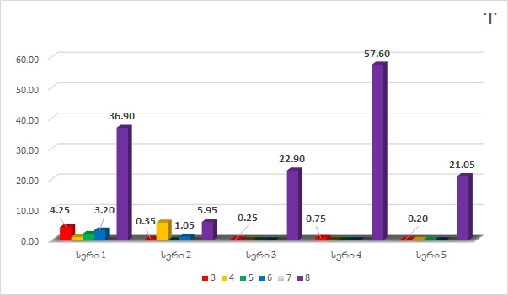
Soil biocrust bryophyte relevés describe habitat characteristics via EIVs
% Cover

Slide 13
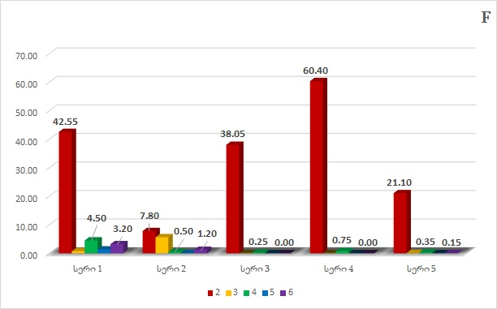
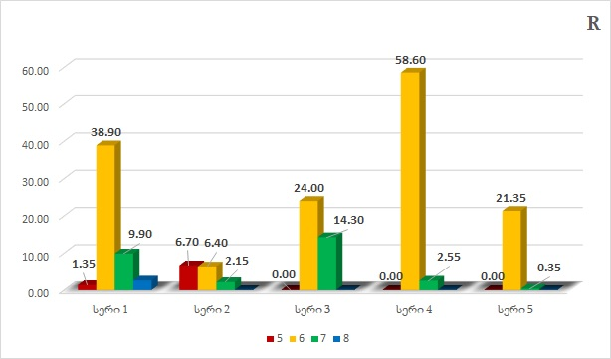
Soil biocrust bryophyte relevés describe habitat characteristics via EIVs (cont.)
% Cover

Slide 14
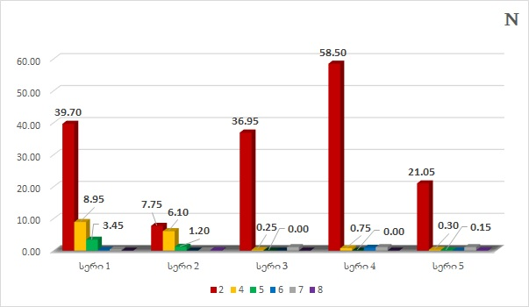
Soil biocrust bryophyte relevés describe habitat characteristics via EIVs (cont.)
% Cover

Slide 15
2. Climate change and alpine plant cover
Tephnadze-Hoernchen, N., Z. Kikvidze, G. Nakhutsrishvili, and O. Abdaladze. "Subalpine vegetation along the soil moisture gradient under the climate change conditions: Re-visitation approach (the Central Great Caucasus)." Bocconea 29 (2021): 297-310.
Research questions and answers:
Have plant species richness and composition changed over the last decades (1986-2016)?
        Significant increase in richness but not in ecology
Does the plant cover composition change (if any) exhibit selection of ecological characteristics (as expressed by Ellenberg or Landolt ecological indicator values)?
        No selection revealed
Do plant species migrate between plant communities of different ecology (e.g., from dry to moist plant communities)?
        No migration recorded
Conclusion: The increase in the species richness is most likely governed by land use change.

Slide 16
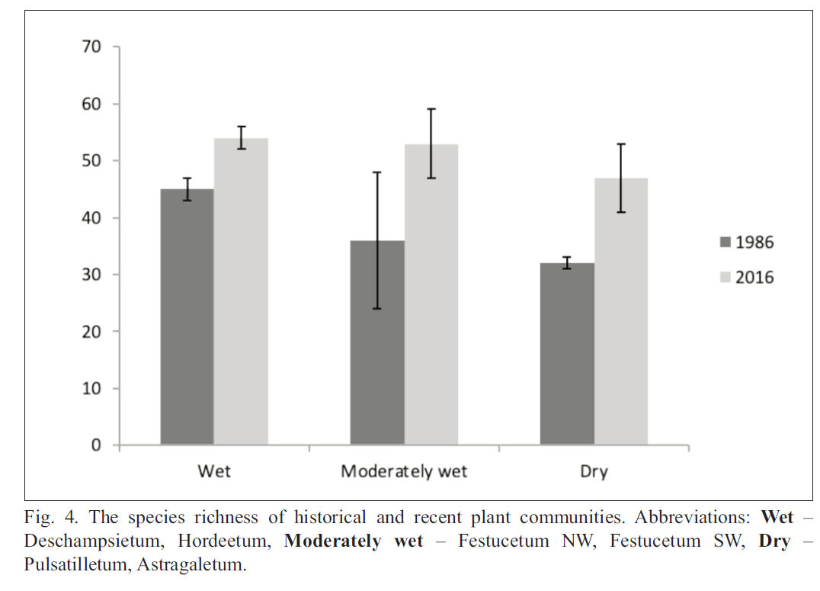
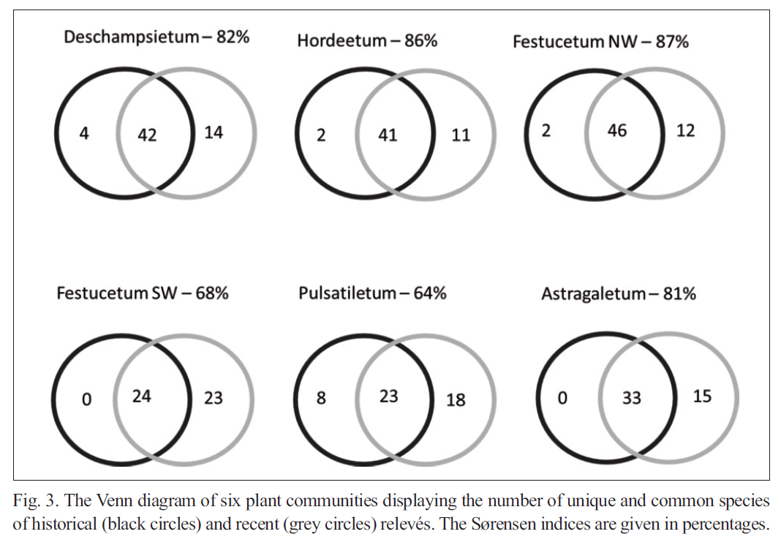
Have plant species richness and composition changed over the last decades (1986-2016)?
        Significant increase in richness but no change in ecological features

Slide 17
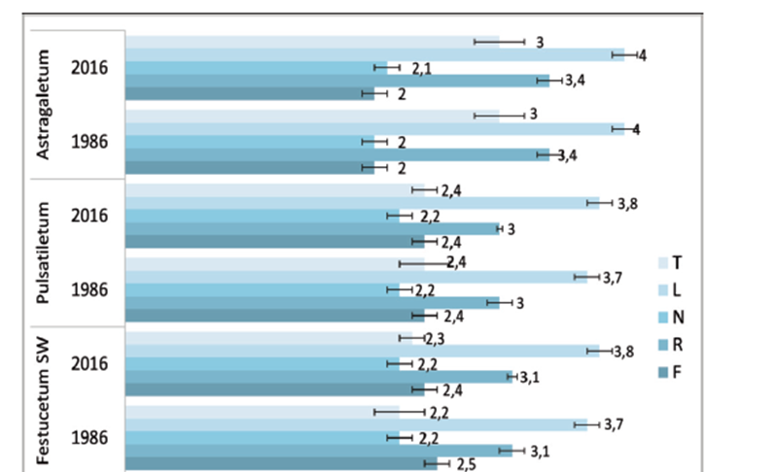
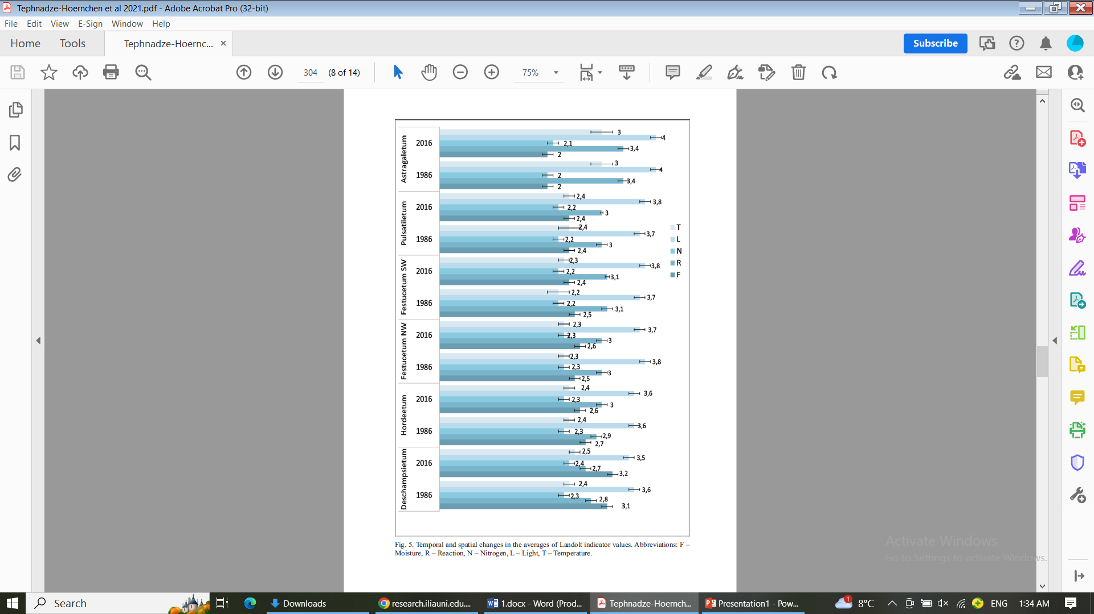
Does the plant cover composition change (if any) exhibit selection of ecological characteristics (as expressed by Ellenberg or Landolt ecological indicator values)?
          No selection revealed

Slide 18
Considerations on possible future application in Georgia:
EIVs in habitat management / restoration
Degraded habitat
Vegetation survey: species + cover
Calculate community-weighted EIVs
Environmental profile of the community
Restoration / management
Repeat vegetation survey
Change in EIV profile → indication of ecological trajectory

Slide 19

Releve No. 6 | 1 | 2 | 3 | 4 | 5
GPS coordinates: | 41.87153 N; 42.32243 E
Landscape type: | 5
Elevation, m a. s. l.: | 1940
Cardinal point exposure (°): | NW
Slope angle/Inclination (°) | 26
Litter depth (cm): | 4..5
Litter mass (g dry weight) | 29.81 98.14
pH | 4.49 4.37
Surface cover (%):
Bare soil | 3 | 2 | 10 | 2 | 10
Stones | 2 | 0 | 1 | 2 | 0
Litter | 30 | 11 | 40 | 15 | 50
Dead wood | 5 | 5 | 4 | 10 | 10
Cryptogams | 1 | 2 | 5 | 1 | 5
Plants | 59 | 80 | 40 | 70 | 25
Trees per 400 m² plot (20 X 20 m)
Tree canopy height (m): | 28
Fagus orientalis | 4
Abies nordmanniana | 1
Acer platanoides | 1
Shrubs & lianas per 25 m² plot
Shrub canopy height (m): | - | - | - | - | -
Herbaceous plants 25 m² (5 X 5 m)
Grass canopy height (cm): | 35 | 50 | 30 | 60 | 15
Dryopteris filix-mas | 3 | 3 | 3 | 4 | 1
Athyrium filix-femina | 2 | 3 |  |  | 1
Oxalis acetosella | 2 | 1 | 1 | 1 | 1
Asperula odorata | 2 |  | 2 | 2 | 2
Geranium sylvaticum | 1 | 1 |  | 1

Slide 20
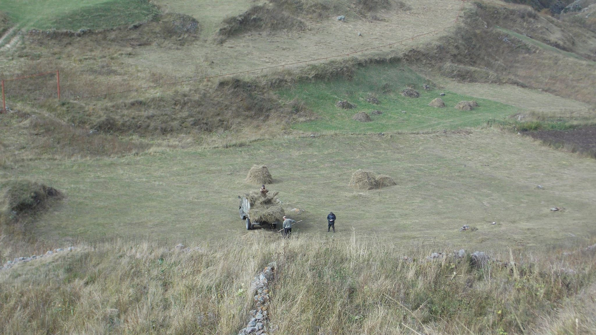
Thank you for your attention!

