Slide 1

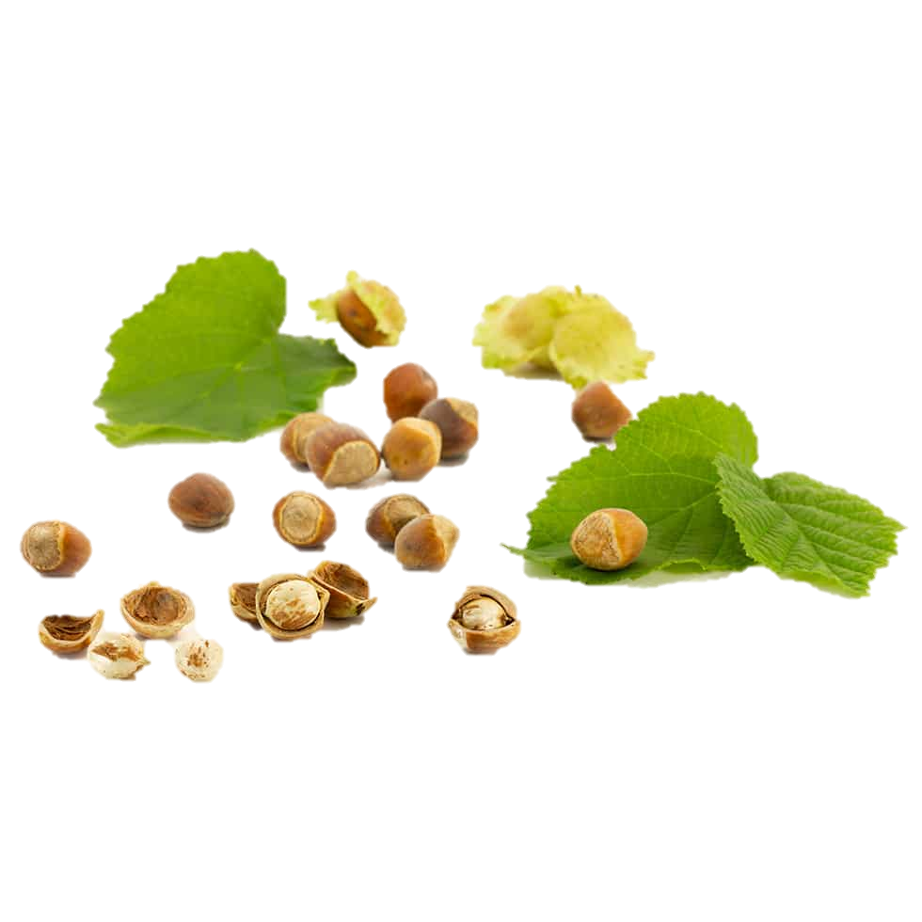
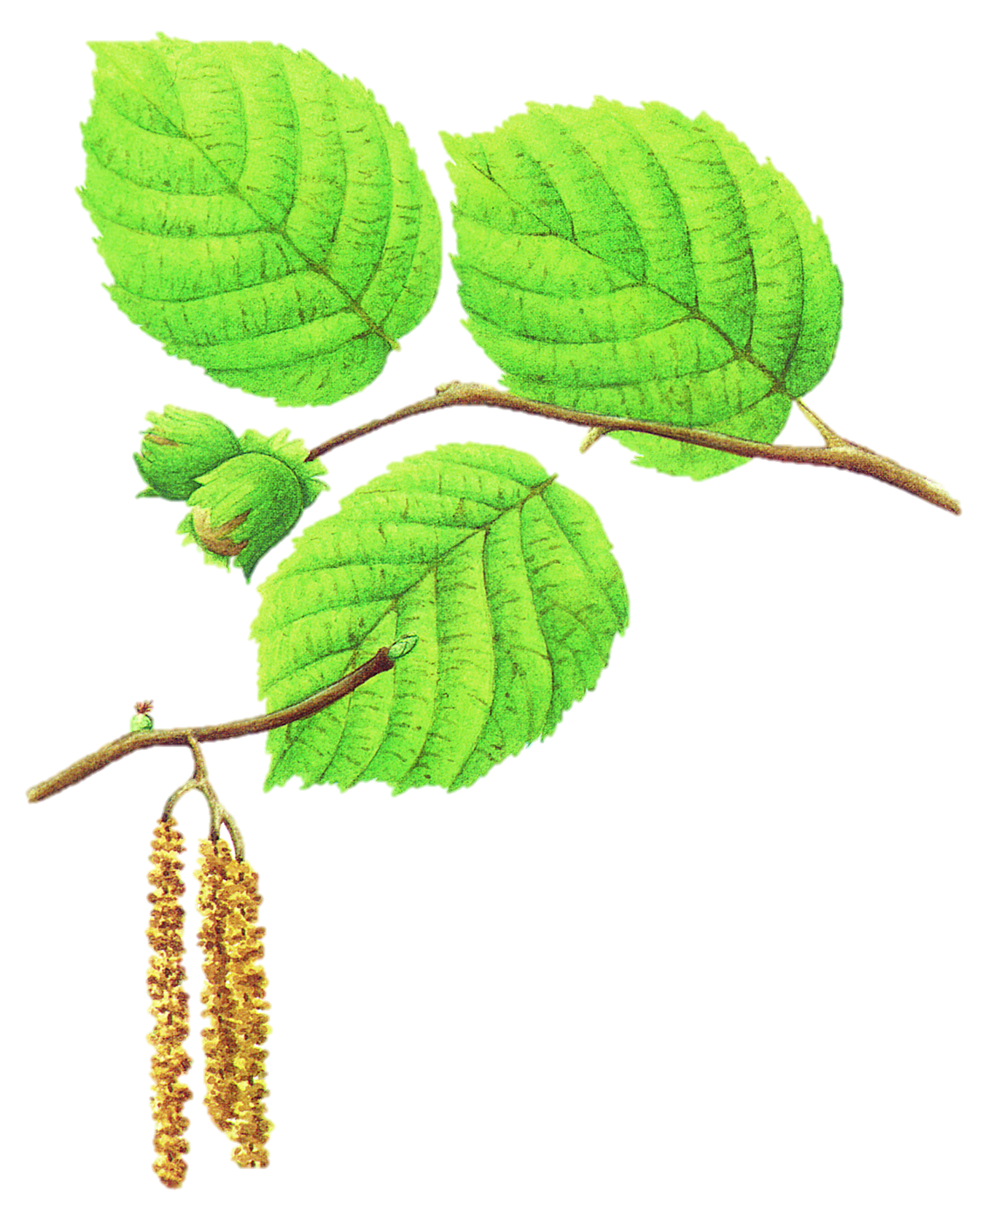
Hazelnuts in Georgia: Biodiversity, Economic Importance, and Prospects
How much of Georgia's hazelnut diversity do we actually know, characterize, and preserve?
Koba Donadze
Agricultural University of Georgia
Agronomy
GGSB 2026

Slide 2
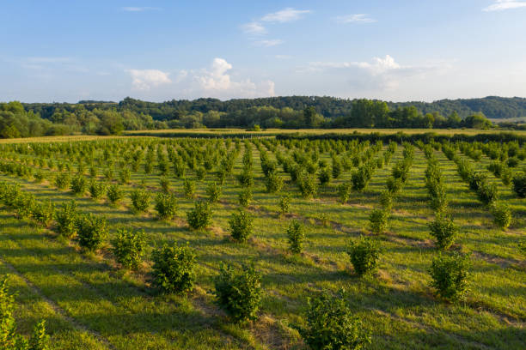
Why hazelnut?
🌱 Biodiversity
🔬 Science
💰 Economy
Hazelnut is simultaneously a biological resource, an agricultural crop, and an economic asset.

Slide 3
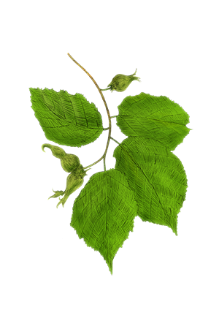
Hazel biodiversity in Georgia
Hazelnuts are cultivated across Georgia, but over 95% of total commercial production is concentrated in five main regions:
Samegrelo-Zemo Svaneti (40–45%)
Guria (~20%)
Kakheti (12–15%)
Adjara (10–12%)
Imereti (10%)
Hazels perform best in regions with an average annual temperature of 13–15°C
Wild hazels (like Corylus colchica) can be found growing in mixed mountain forests up to 1,800–2,000 meters
Primary Local Cultivars (Landraces):
Anakluri
Khachapura
Nemsa
Berdznula
Dedoflis Titi("Queen's Finger")

Slide 4
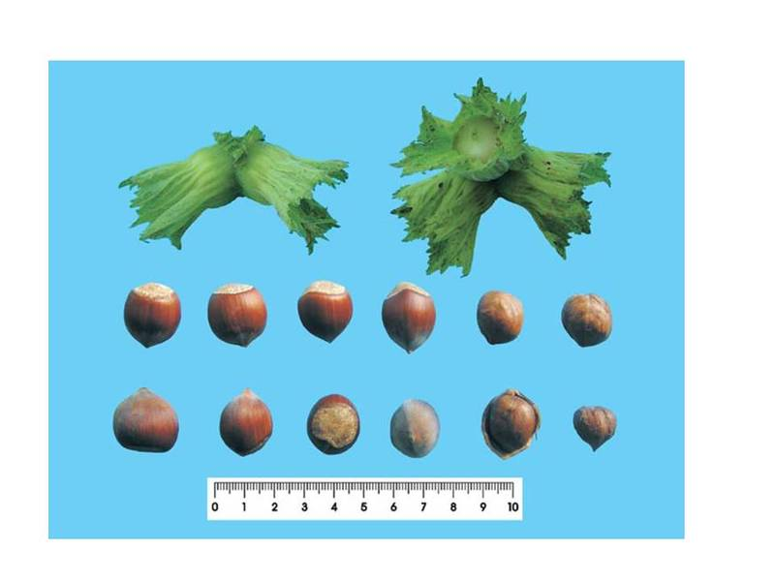
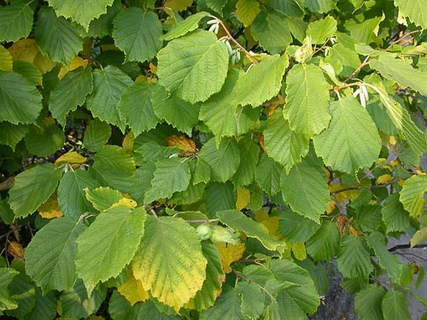
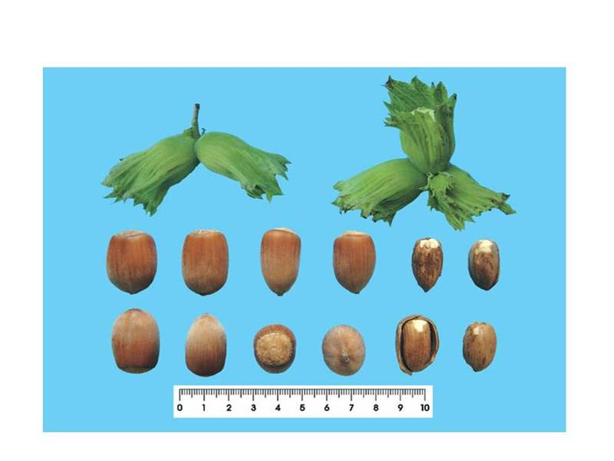
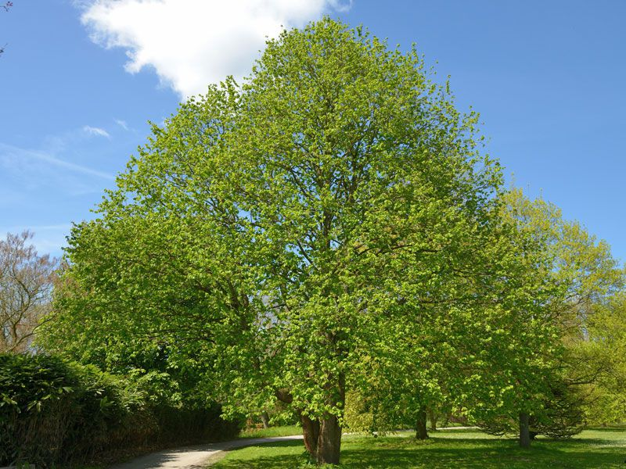
Corylus colchica
Corylus avellana 'Anakluri'
(It is listed as Vulnerable on the IUCN Red List.)
Corylus avellana ' Queen's Finger '
Corylus colurna(Tree Hazel)

Slide 5
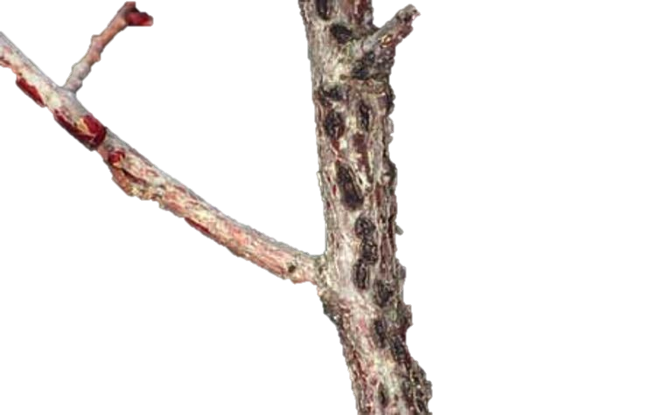
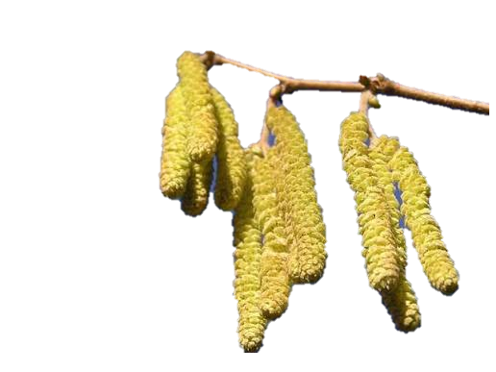
How can we identify, characterize and conserve Georgia's hazel diversity?
*Native Georgian trees harbor unique combinations of sporophytic self-incompatibility genes.
*DNA fingerprinting places Georgian landraces into a distinct eastern Eurasian cluster, genetically separated from Mediterranean and Spanish lineages
Key Survival Traits:
Deep Root
Extended Winter Dormancy
Stomatal & Cuticle Control
Cellular Osmoprotectants
EFB Resistance Genes
Rapid Shell Lignification
High S-Allele Diversity
Pollination Plasticity
Wild hazels (C. avellana) in nearby forests continuously pollinate domestic orchards, naturally refreshing and preserving local genetic diversity.
Genetic Resources for Future Breeding:
thin shells
high turnout (~50%)
easy green husk removal
oil ratios (~65% fat content ideal for processing)
fatty acid profile

Slide 6
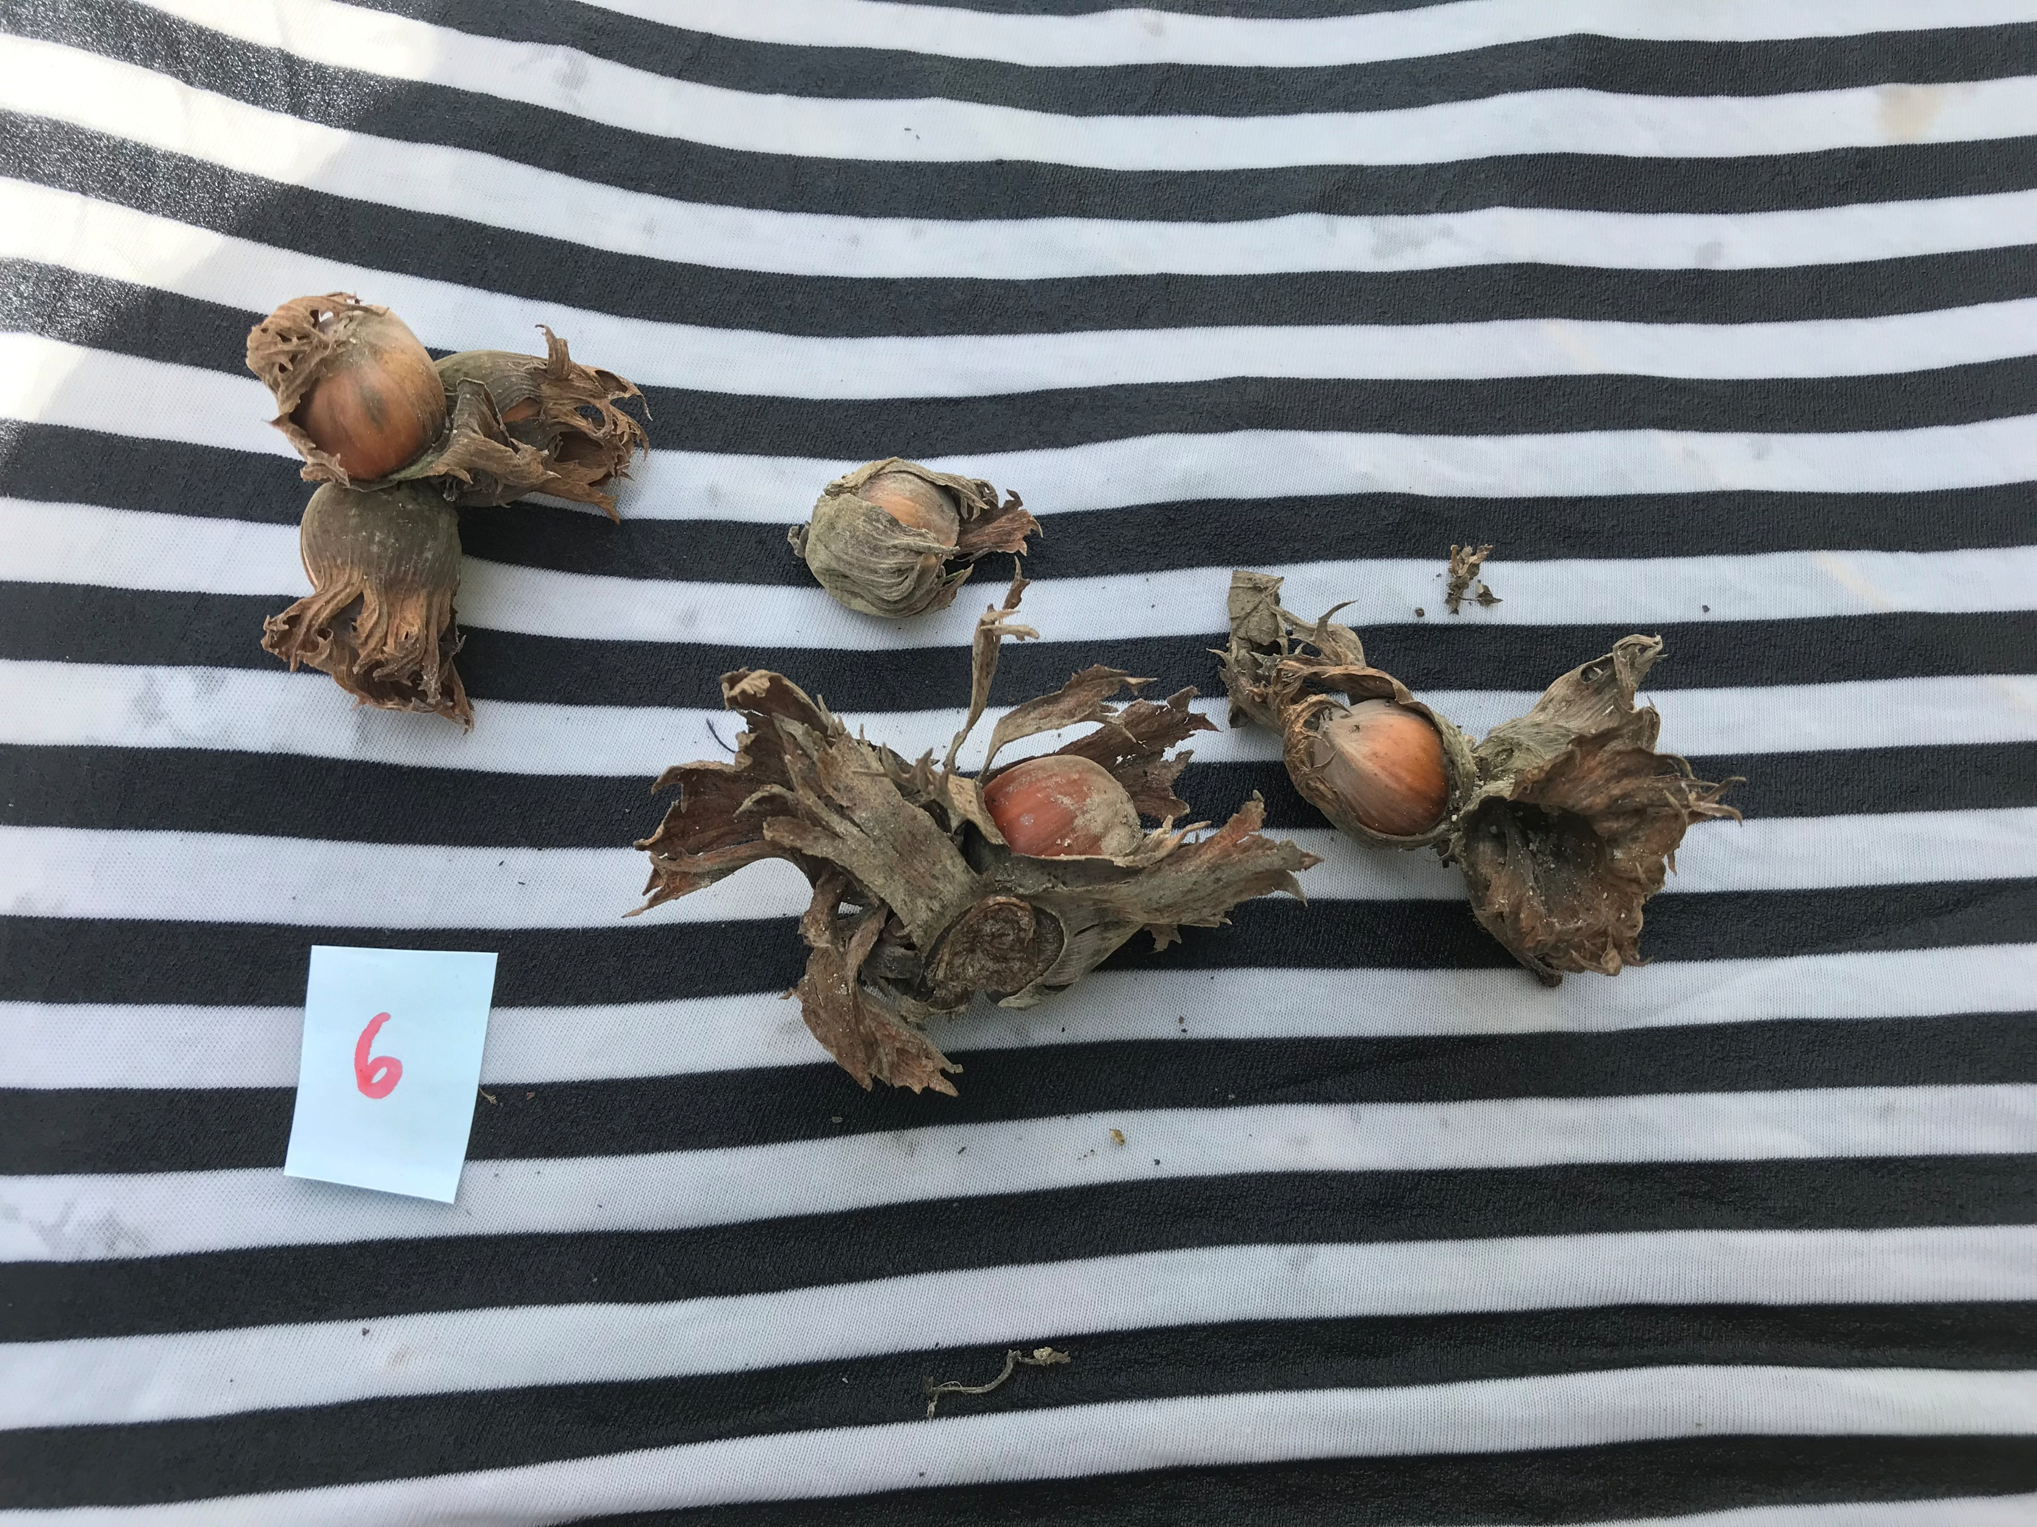
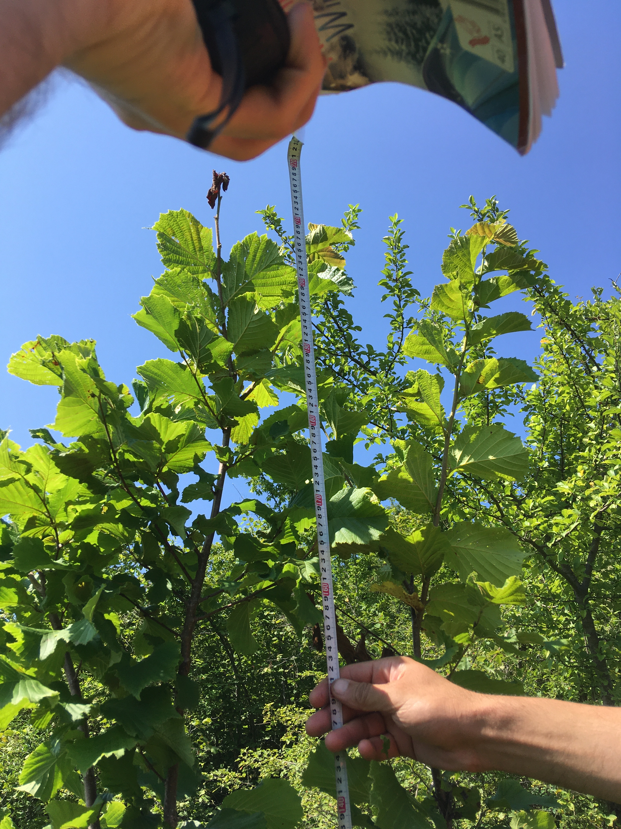
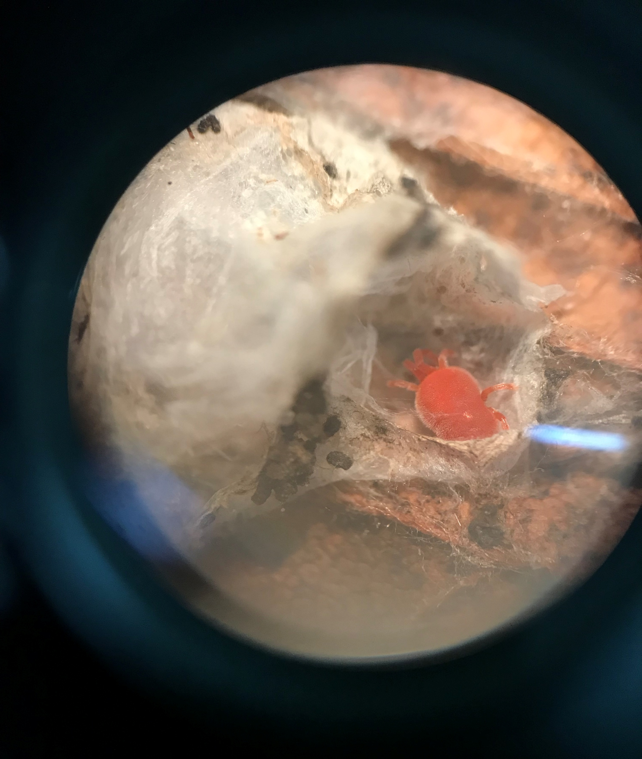

My Experience with Hazel Biodiversity Research
International Scientific Conference:
“BIODIVERSITY OF AGRICULTURAL PLANTS AND ANIMALS, THEIR CONSERVATION AND PERSPECTIVES”
Upper Imereti Region

Slide 7
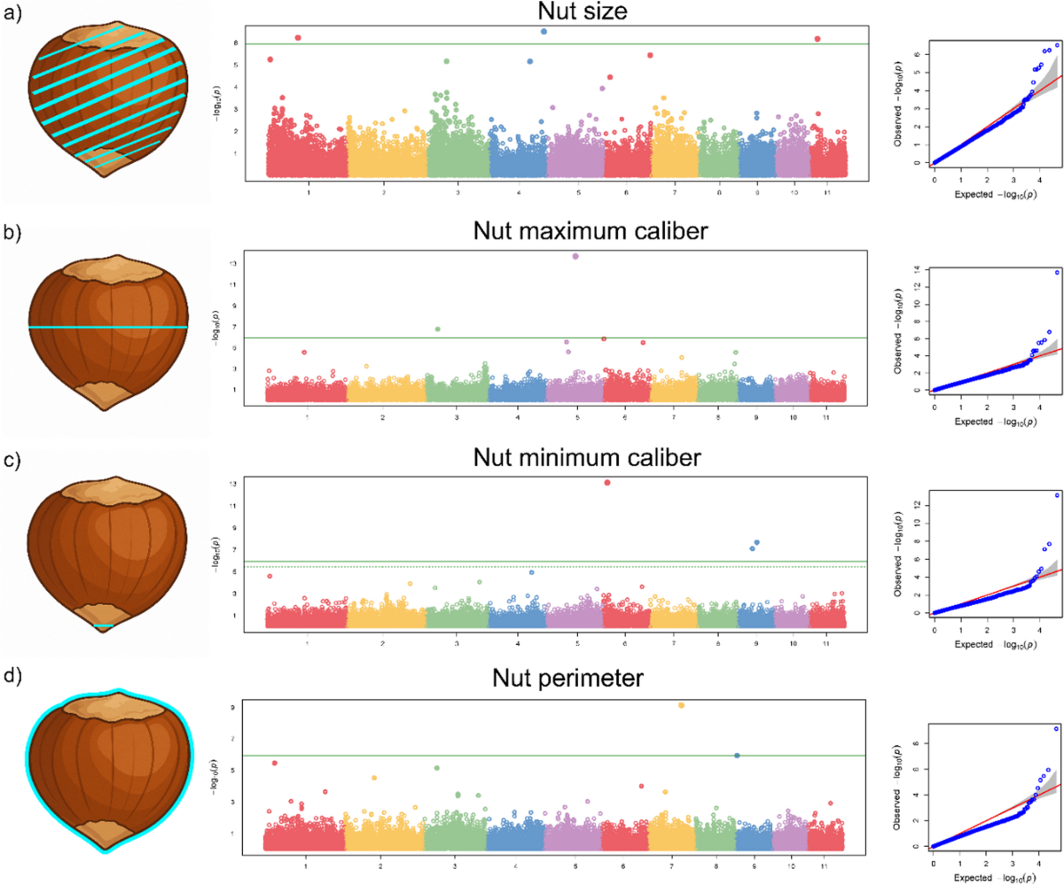
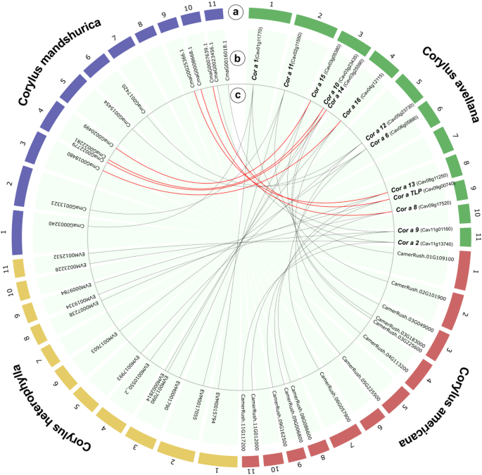
From phenotype to genotype
Field Observations
Nut & Shell Traits: Measures nut mass, shell thickness, and husk release
Tree Architecture: Assesses vigor, crown volume, and suckering tendency
Yield & Performance: Tracks seasonal production
Symptom Screening: Identifies visible leaf spots, bacterial lesions, or pest damage after infection occurs.
Laboratory Analysis (Genotype)
DNA Fingerprinting: Uses SSR markers and SNPs to verify true cultivar identity and eliminate duplicate naming.
S-Allele Profiling: Maps self-incompatibility genes to guarantee 100% compatible pollinizer orchard layouts.
Gene Marker Selection: Detects specific resistance loci and lipid pathways long before traits physically manifest.
Refugial Mapping: Uses DNA markers to locate and protect wild, genetically rich Caucasian populations—unlocking novel alleles for future breeding.

Slide 8
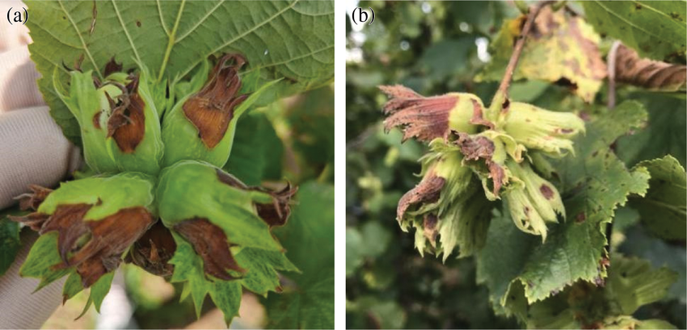
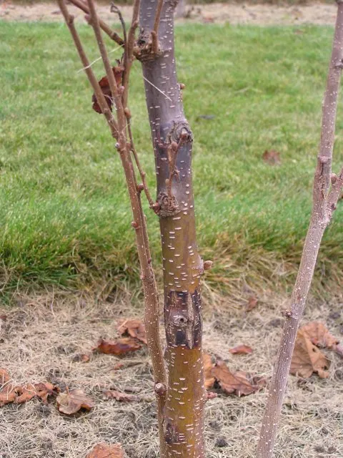
Why biodiversity has economic value?
disease resistance
climate resilience
stable production
breeding material
improved cultivars
Phenotyping provides practical performance: Tells growers how a variety behaves in a specific microclimate (e.g., Upper Imereti vs. Samegrelo).
Genotyping eliminates ambiguity: Uncovers hidden genetic diversity in wild Caucasian refugial populations, preventing duplicate planting and enabling precise marker-assisted selection (MAS) for future commercial breeding.

Slide 9
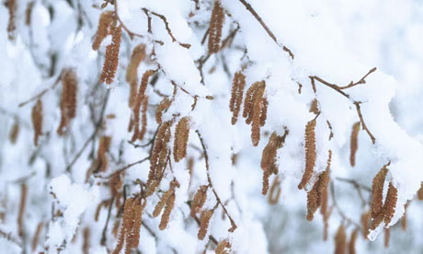
Climate change & future challenges
What happens if the conditions under which today's most productive hazelnuts grow change?
Winter Cold Limits: Male flowers (catkins) bloom in mid-winter (January–February). Temperatures below -10°C to -12°C during this sensitive flowering window freeze and kill the catkins, destroying the season's yield.
Summer Heat Limits: Sustained temperatures above 36–37°C combined with dry winds burn the foliage and cause premature nut drop.
Chilling Requirement: The plant needs around 800 to 1,200 hours of winter temperatures below 7°C to break bud dormancy. Without this winter chill, the tree will not bloom properly in spring.

Slide 10
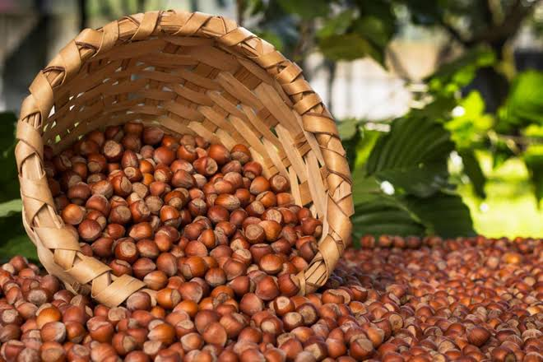
Prospects
Refugial Biodiversity & Landrace Heritage
Caucasian Genetic Center: Ancient Ice Age refugium preserved unique landraces (Anakluri, Berdznula, Nemsa, Dedoplis Titi).
Novel Gene Pool: High intraspecific diversity offers rare alleles for cross-compatibility and kernel quality.
Strategic Breeding Value
Rootstock Potential: Native tree-form Corylus colurna provides non-suckering habit and deep drought anchorage.
Marker-Assisted Selection: Utilizing genomic tools (SSRs/SNPs) to stack disease resistance, dwarfing traits, and optimal oil profiles (~65%).
Resilience & Climate Adaptability
Abiotic Stress Tolerance: Landraces show natural endurance to summer heat, cold snaps, and dry mountain soils (e.g., Upper Imereti).
Phytosanitary Buffer: Serves as an EFB-free zone; native lines possess natural defenses against local mildews and bacterial blight.

Slide 11
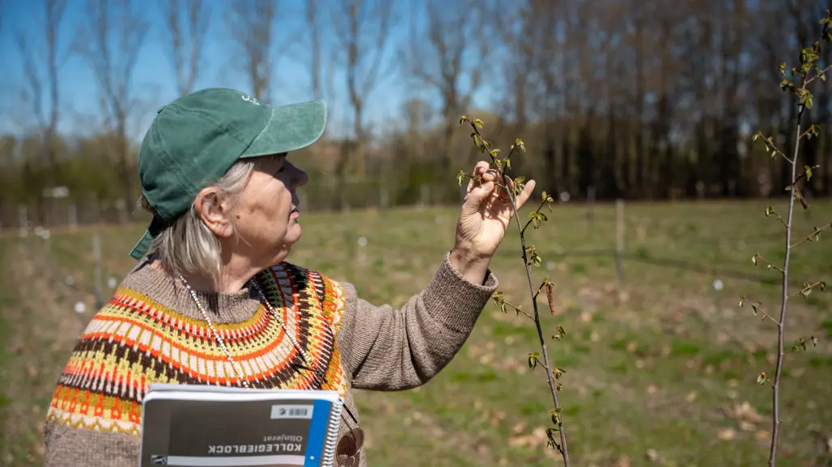
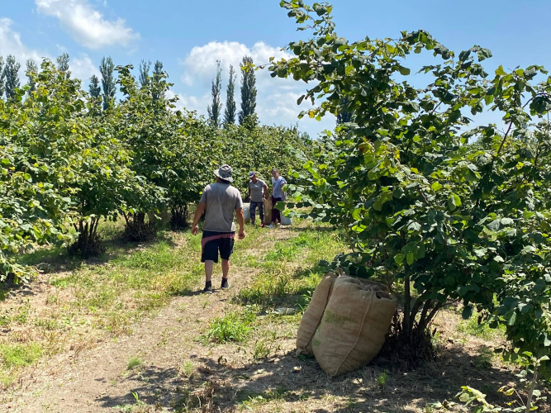
Georgia’s Hazelnut Heritage: A Hidden Gem?
Will Georgia’s ancient genetic heritage remain an undiscovered legacy—or will it redefine the future of global hazelnut production?
Bridging Georgia's ancient genetic diversity with modern genomics to cultivate the world's next generation of resilient, high-performing orchards.

Slide 12
Thank you for your attention
Questions?

