Slide 1




Climate-Resilient Urban Landscapes
Integrating Drought-Tolerant Ornamental Plants and
Sustainable Soil-Water Management
A pot experiment with Lavandula angustifolia under simulated drought conditions
Presented By:
Mariam Ghviniashvili
Agronomy programme
Agricultural University of Georgia

Slide 2




Urban Climate Challenges and Research Rationale
Urban heat
Plant survival
Water scarcity

Slide 3



The
main
problem
Can we maintain
quality and performance of ornamental plants
while reducing dependence
on irrigation?

Slide 4


Research gap
Evaluating integrated approaches to soil moisture conservation and plant resilience
soil amendments
low-cost
mulching techniques
water-efficient

Slide 5
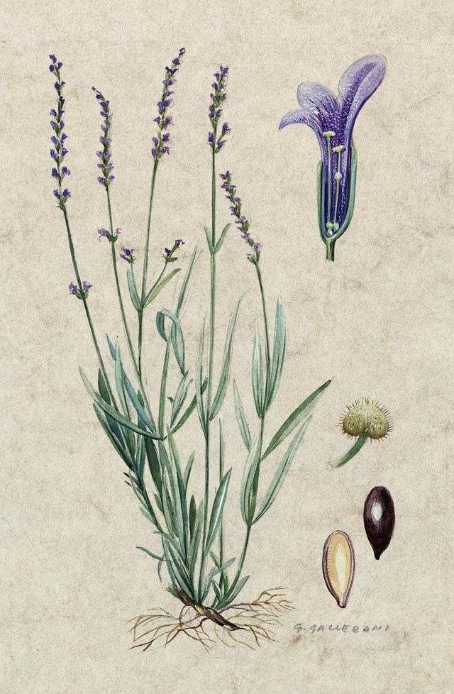
Why Lavandula angustifolia
Lavender is used as a model ornamental plant, rather than as the final solution for all urban landscapes.
drought tolerant
widely used in landscape design
high ornamental value
suitable for sunny conditions

Slide 6

RESEARCH OBJECTIVE
Water efficiency
Soil moisture
evaluate whether simple soil–water management strategies can improve soil moisture retention and maintain the ornamental performance of lavender under simulated drought conditions
Plant performance
Practical application

Slide 7
RESEARCH HYPOTHESES
H1
Organic pine bark mulch will reduce moisture loss from the soil surface.
H2
Combining perlite with pine bark mulch will improve soil moisture conditions compared with untreated soil.
H3
Improved soil–water management will help lavender maintain high ornamental quality under reduced irrigation.
H4
The most effective treatment will provide a better balance between plant performance and water consumption.

Slide 8
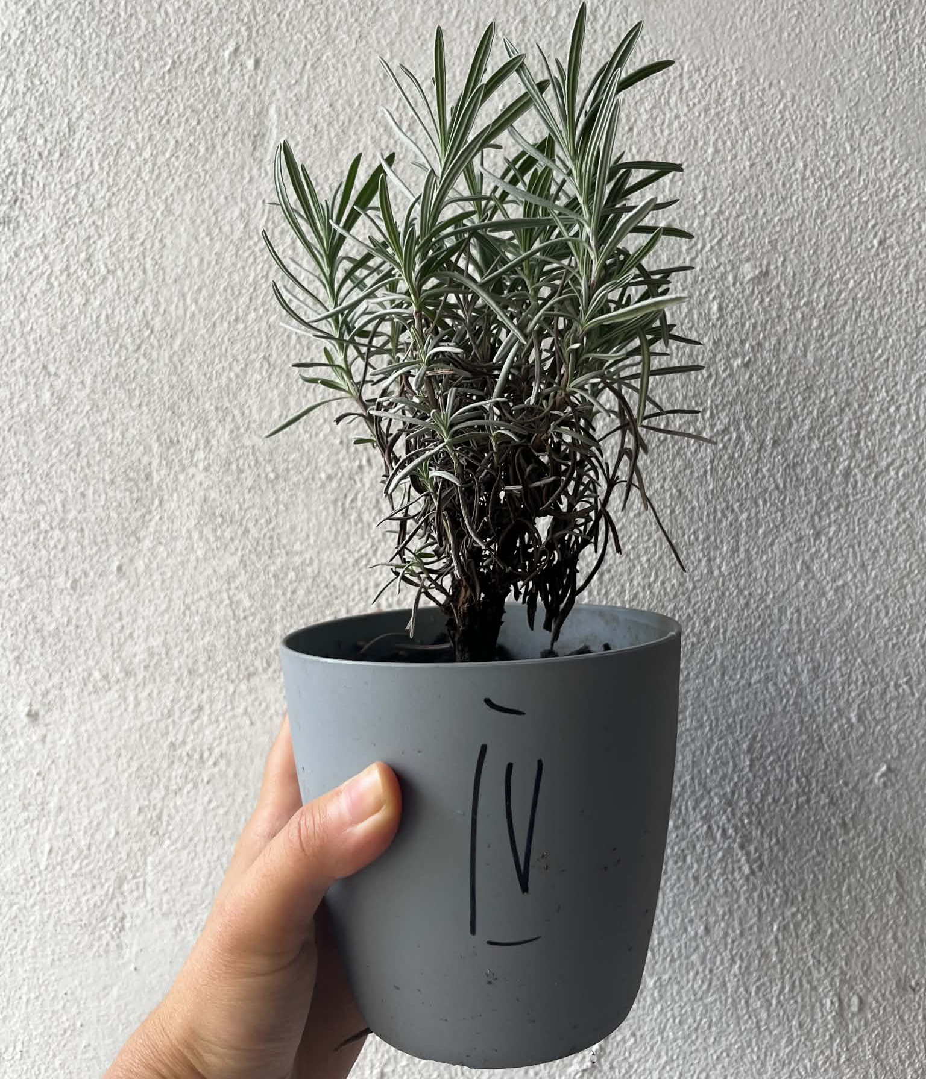
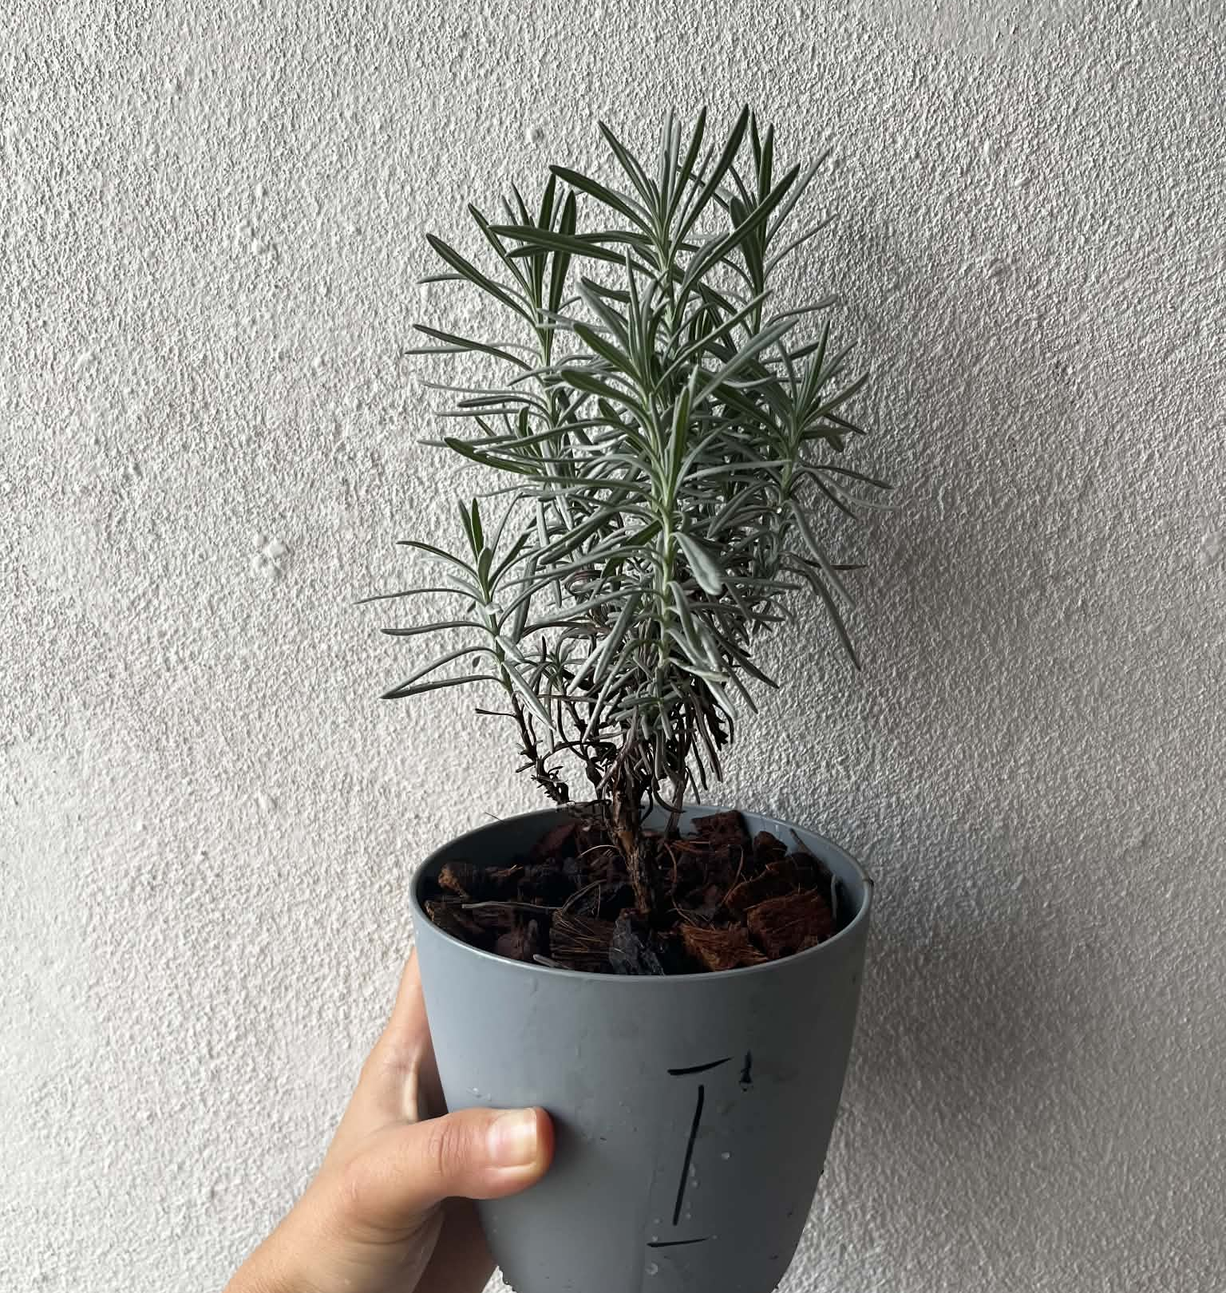
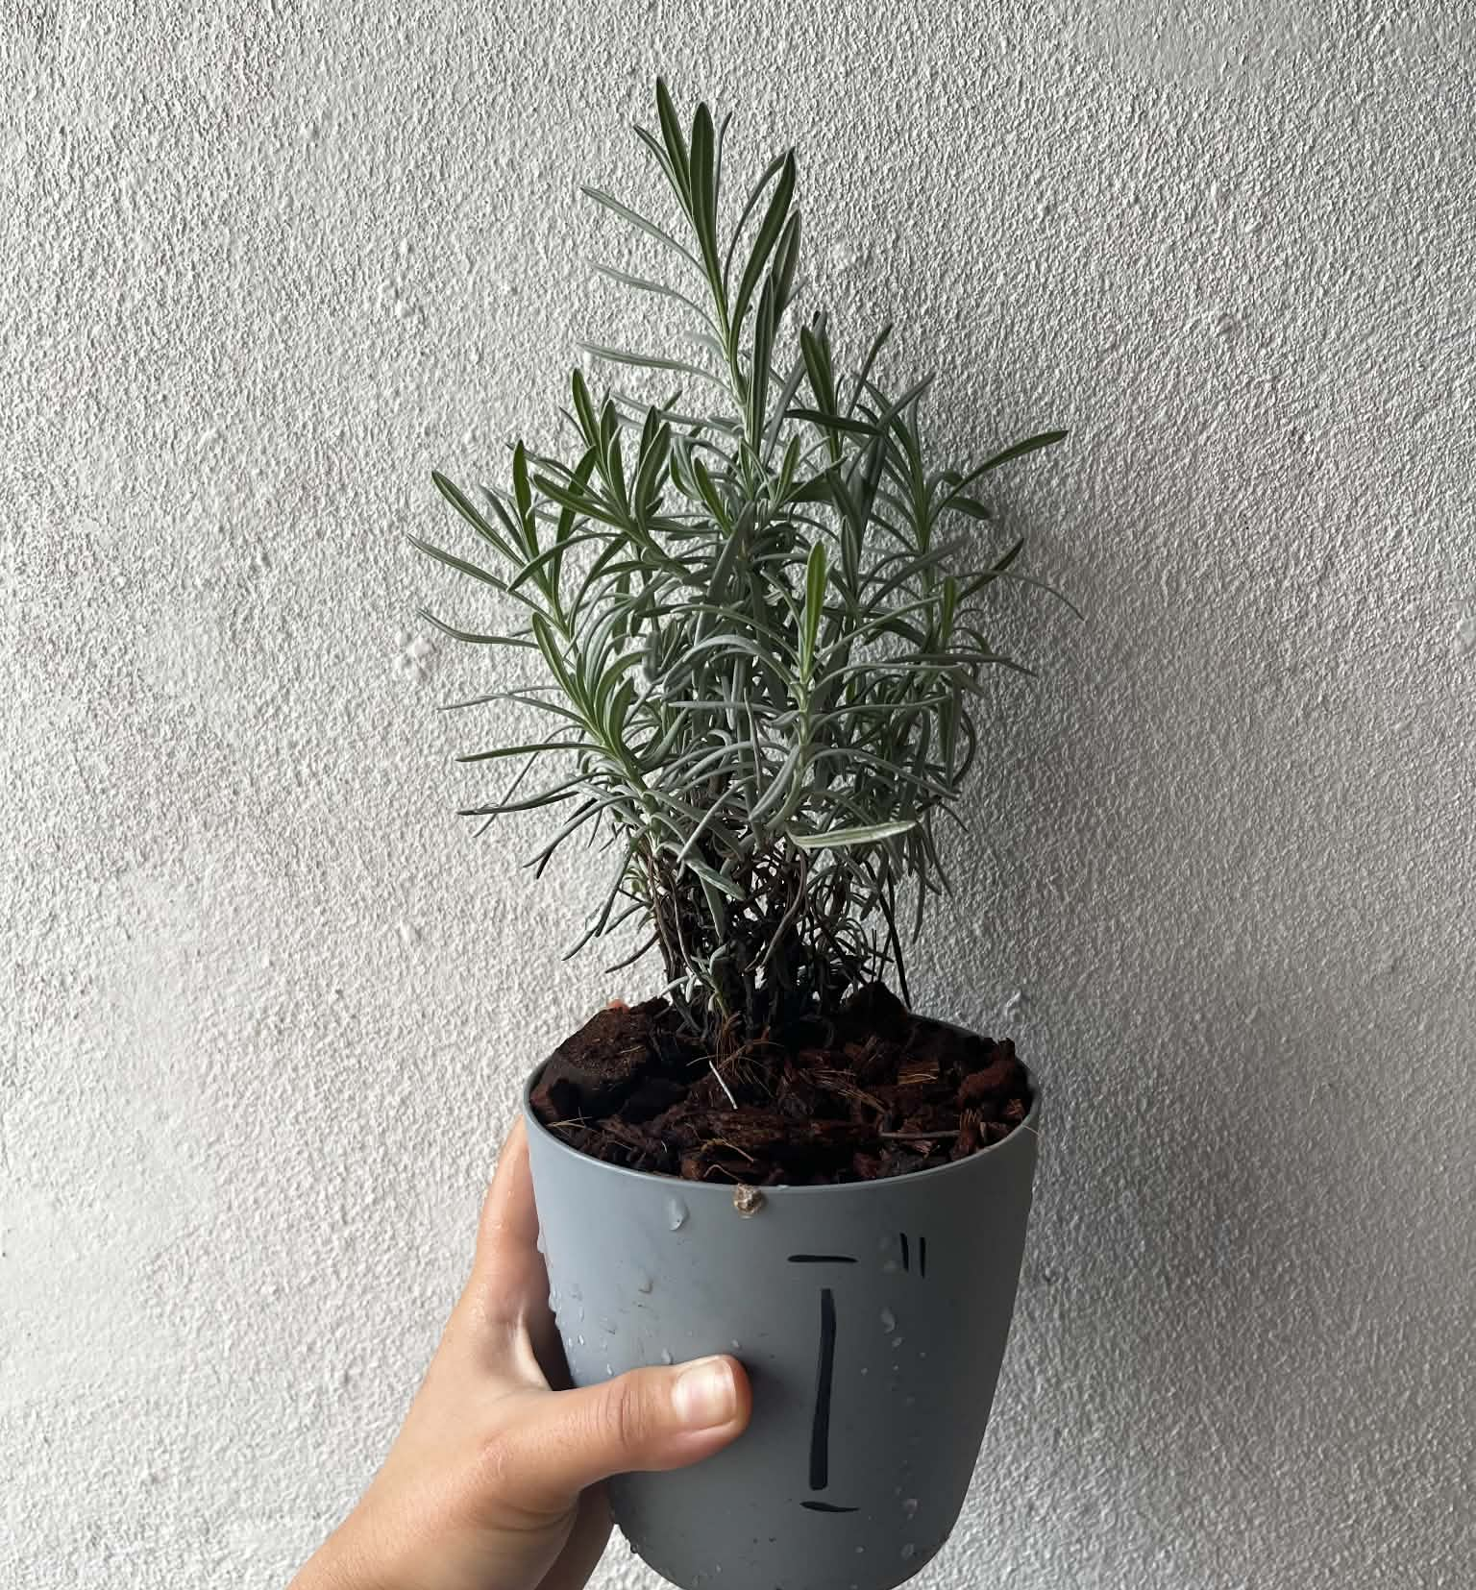
EXPERIMENTAL DESIGN
GROUP 1 — CONTROL
Standard substrate
No mulch
Standardized irrigation
GROUP 2 — MULCH
Standard substrate
100% pine bark mulch
Standardized irrigation
GROUP 3 — INTEGRATED TREATMENT
Standard substrate
Perlite soil amendment
100% pine bark mulch
Standardized irrigation

Slide 9

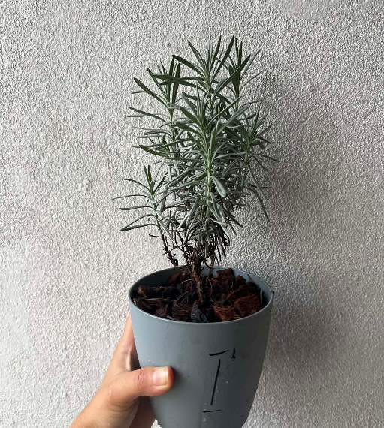
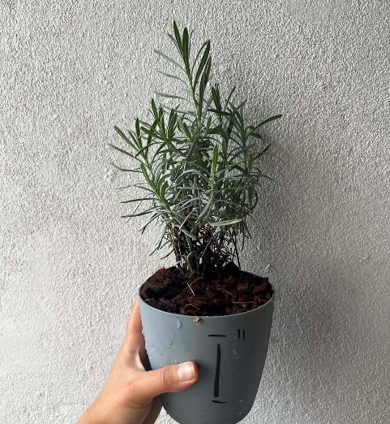

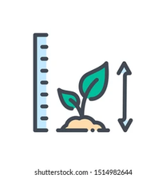
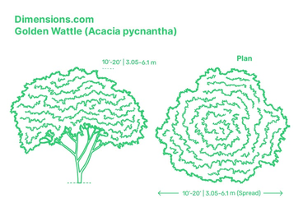



GROUP 1
GROUP 2
GROUP 3
Constant Conditions
Standard substrate
No mulch
Standard substrate
100% pine bark mulch
Standard substrate
Perlite soil amendment
100% pine bark mulch
Transferred into Identical pots — 2L;
Same base substrate;
Sunny outdoor conditions in Tbilisi;
Standardized irrigation;
Identical plants;
Each group consists of 4 plants, with a total of 12 plants.
treatment
groups
Acclimatinazion
Measurements
Simulated drought
Weekly monitoring
Final assesment
experiment
timeline
Initial measurements for all parameters
Data collection throughout the experiment
Final measurements and data analysis
22 june - 22 july
22 july - 5 september
Data analysis
Expected outcome
Control
higher water loss
data
collection
Mulch
Improved water retention
soil
moisture
(before irrigation)
plant
height
(cm)
canopy diameter
(cm)
ornamental quality
water
supplied
(ML)
Integrated
Potentially highest performance

Slide 10
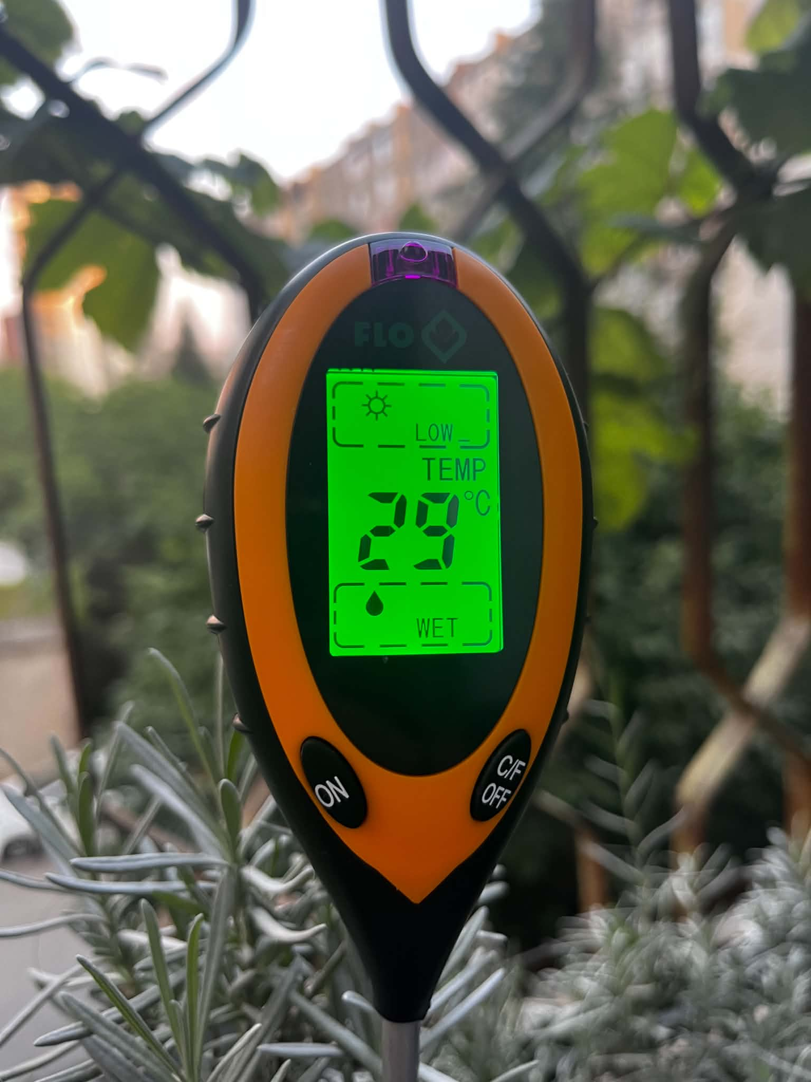
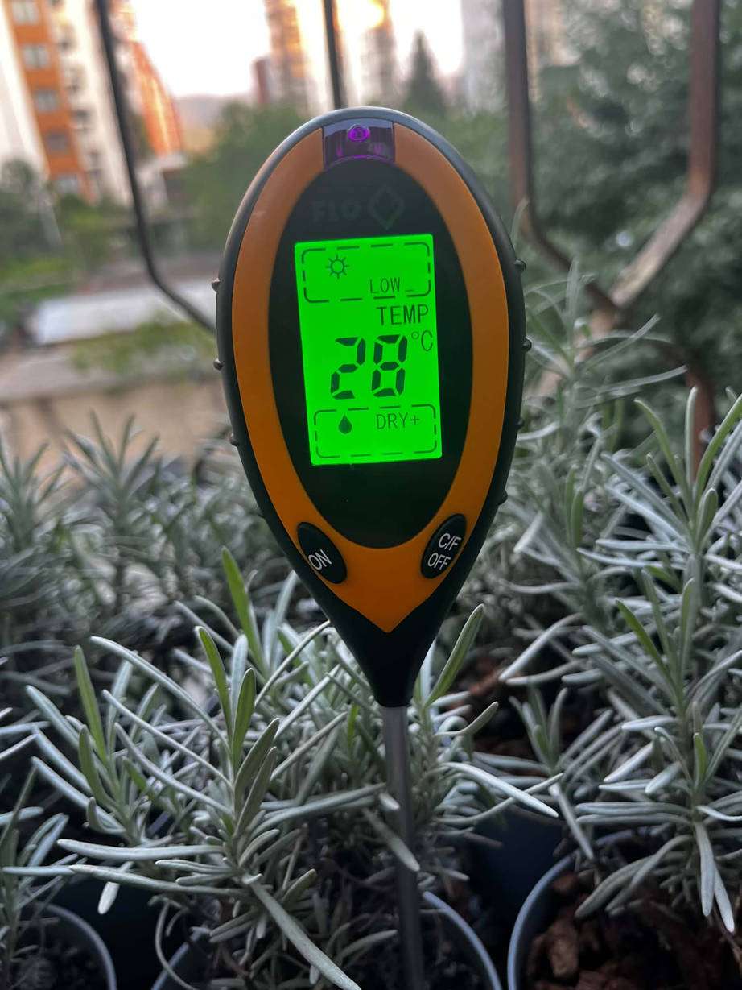
Experimental Groups and Soil Moisture Assessment
Soil moisture was assessed using a 5-point scale:
  1 – Dry+
  2 – Dry
  3 – Normal
  4 – Wet
  5 – Wet+
Acclimatization period: 22 June – 22 July
Plants were watered twice per week.
Drought period: 22 July – 5 September
The watering interval was extended to once every five days to simulate a drought period.

Slide 11
Acclimatization period: 22 June – 22 July
Group | Observation | Plant 1 | Plant 2 | Plant 3 | Plant 4 | Mean
Group 1 | 1 | Dry (2) | Dry (2) | Dry+ (1) | Dry+ (1) | 1.5
 | 2 | Dry+ (1) | Dry+ (1) | Dry+ (1) | Dry+ (1) | 1
 | 3 | Dry+ (1) | Dry+ (1) | Dry+ (1) | Dry (2) | 1.25
 | 4 | Dry+ (1) | Dry+ (1) | Dry+ (1) | Dry+ (1) | 1
 | 5 | Dry+ (1) | Dry+ (1) | Dry+ (1) | Dry+ (1) | 1
 | 6 | Dry+ (1) | Dry+ (1) | Dry+ (1) | Dry+ (1) | 1
 | 7 | Dry+ (1) | Dry+ (1) | Dry+ (1) | Dry+ (1) | 1
 | 8 | Dry (2) | Dry (2) | Dry+ (1) | Dry+ (1) | 1.5
 | 9 | Dry+ (1) | Dry+ (1) | Dry+ (1) | Dry (2) | 1.25

Slide 12
Acclimatization period: 22 June – 22 July
Group | Observation | Plant 1 | Plant 2 | Plant 3 | Plant 4 | Mean
Group 2 | 1 | Nor(3) | Nor(3) | Nor(3) | Nor(3) | 3
 | 2 | Nor(3) | Nor(3) | Nor(3) | Nor(3) | 3.00
 | 3 | Nor(3) | Wet(4) | Nor(3) | Wet(4) | 3.5
 | 4 | Nor(3) | Nor(3) | Nor(3) | Nor(3) | 3
 | 5 | Dry (2) | Dry (2) | Dry (2) | Dry (2) | 2
 | 6 | Dry (2) | Dry (2) | dry+(1) | Dry (2) | 1.75
 | 7 | dry+(1) | Dry (2) | dry+(1) | Dry (2) | 1.5
 | 8 | Nor(3) | Wet(4) | Nor(3) | Wet(4) | 3.5
 | 9 | Nor(3) | Wet(4) | Nor(3) | Wet(4) | 3.50

Slide 13
Acclimatization period: 22 June – 22 July
Group | Observation | Plant 1 | Plant 2 | Plant 3 | Plant 4 | Mean
Group 3 | 1 | Nor(3) | Wet(4) | Nor(3) | Wet(4) | 3.5
 | 2 | Wet+(5) | Wet(4) | Wet+(5) | Wet(4) | 4.5
 | 3 | Nor(3) | Wet(4) | Nor(3) | Wet(4) | 3.5
 | 4 | Nor(3) | Wet(4) | Nor(3) | Wet(4) | 3.5
 | 5 | Nor(3) | Nor(3) | Nor(3) | Nor(3) | 3
 | 6 | Nor(3) | Nor(3) | Nor(3) | Nor(3) | 3
 | 7 | Nor(3) | Wet(4) | Nor(3) | Wet(4) | 3.5
 | 8 | Nor(3) | Wet(4) | Nor(3) | Wet(4) | 3.5
 | 9 | Wet(4) | Wet(4) | Wet(4) | Wet(4) | 4

Slide 14

Soil Moisture Conditions
During the Acclimatization Period
Soil moisture was assessed using a 5-point ordinal scale (1 = Dry+ ; 5 = Wet+).
Pairwise statistical comparison*
Control and Mulch (p = 0.004)
Control and Mulch + Perlite (p = 0.004)
Mulch and Mulch + Perlite (p = 0.016)
Group 1 (Control): 1.17 ± 0.22
Group 2 (Mulch): 2.75 ± 0.79
Group 3 (Mulch + Perlite): 3.56 ± 0.46
* p-value below 0.05 means that the difference is statistically significant.”
Conclusion: The Mulch + Perlite treatment maintained significantly higher soil moisture levels than both the Control and Mulch treatments.

Slide 15
Drought period: 22 July – 5 September
Group | Observation | Plant 1 | Plant 2 | Plant 3 | Plant 4 | Mean
Group 1 | 1 | Dry (2) | Dry (2) | Dry+ (1) | Dry+ (1) | 1.5
 | 2 | Dry+ (1) | Dry+ (1) | Dry+ (1) | Dry+ (1) | 1
 | 3 | Dry+ (1) | Dry+ (1) | Dry+ (1) | Dry (2) | 1.25
 | 4 | Dry+ (1) | Dry+ (1) | Dry+ (1) | Dry+ (1) | 1
 | 5 | Dry+ (1) | Dry+ (1) | Dry+ (1) | Dry+ (1) | 1
 | 6 | Dry+ (1) | Dry+ (1) | Dry+ (1) | Dry+ (1) | 1
 | 7 | Dry+ (1) | Dry+ (1) | Dry+ (1) | Dry+ (1) | 1
 | 8 | Dry (2) | Dry (2) | Dry+ (1) | Dry+ (1) | 1.5
 | 9 | Dry+ (1) | Dry+ (1) | Dry+ (1) | Dry (2) | 1.25

Slide 16
Drought period: 22 July – 5 September
Group | Observation | Plant 1 | Plant 2 | Plant 3 | Plant 4 | Mean
Group 2 | 1 | Dry (2) | Dry (2) | Dry (2) | Nor(3) | 2.25
 | 2 | Dry (2) | Dry (2) | Dry (2) | Dry (2) | 2.00
 | 3 | Dry (2) | Nor(3) | Nor(3) | Nor(3) | 2.75
 | 4 | Nor(3) | Nor(3) | Nor(3) | Nor(3) | 3
 | 5 | Nor(3) | Nor(3) | Nor(3) | Nor(3) | 3
 | 6 | Dry (2) | Nor(3) | Nor(3) | Nor(3) | 2.75
 | 7 | Dry (2) | Dry (2) | Dry (2) | Nor(3) | 2.25
 | 8 | Nor(3) | Nor(3) | Nor(3) | Nor(3) | 3
 | 9 | Dry (2) | Dry (2) | Nor(3) | Nor(3) | 2.50

Slide 17
Drought period: 22 July – 5 September
Group | Observation | Plant 1 | Plant 2 | Plant 3 | Plant 4 | Mean
Group 3 | 1 | Nor(3) | Nor(3) | Nor(3) | Nor(3) | 3
 | 2 | Wet(4) | Wet+(5) | Wet(4) | Wet+(5) | 4.5
 | 3 | Nor(3) | Nor(3) | Wet(4) | Wet(4) | 3.5
 | 4 | Nor(3) | Nor(3) | Nor(3) | Nor(3) | 3
 | 5 | Nor(3) | Nor(3) | dry+(1) | dry+(1) | 2
 | 6 | Dry (2) | Dry (2) | Dry (2) | Nor(3) | 2.25
 | 7 | Dry (2) | Dry (2) | Dry (2) | Dry (2) | 2
 | 8 | Nor(3) | Nor(3) | Wet(4) | Wet(4) | 3.5
 | 9 | Nor(3) | Nor(3) | Wet(4) | Wet(4) | 3.5

Slide 18

Soil Moisture Conditions
During the “Drought Period”
During the acclimatization period (22 June–22 July), all plants were watered twice per week. Soil moisture was assessed nine times using a 5-point ordinal scale (1 = Dry+ ; 5 = Wet+).
Group 1 (Control): 1.17 ± 0.22
Group 2 (Mulch): 2.61 ± 0.38
Group 3 (Mulch + Perlite): 3.03 ± 0.83 .
Pairwise statistical comparison
Control and Mulch (p = 0.0039)
Control and Mulch + Perlite (p = 0.0039)
Mulch and Mulch + Perlite (p = 0.2734)
Conclusion: Both mulch treatments significantly improved soil moisture retention compared with the Control, while the additional effect of perlite was not statistically significant.

Slide 19

Pine bark mulch is expected to reduce soil moisture loss and maintain higher moisture levels between irrigation events.
Day | Control | Pine Bark Mulch | Mulch + Perlite
Day 1 – after irrigation | 5.0 | 5.0 | 5.0
Day 2 | 3.7 | 3.8 | 4.1
Day 3 | 2.6 | 2.8 | 2.9
Day 4 | 1.8 | 2.2 | 2.3
Day 5 – before irrigation | 1.0 | 1.9 | 2.0

Slide 20
Comparison | Acclimatization | Drought simulation
Control vs Mulch | Significant | Significant
Control vs Mulch + Perlite | Significant | Significant
Mulch vs Mulch + Perlite | Significant | Not significant
Overall
Conclusions
The Control group consistently showed the lowest soil moisture levels throughout the experiment.
Mulch significantly improved soil moisture retention compared with the Control treatment.
Mulch + Perlite showed the highest mean soil moisture score during both periods.
During the drought simulation period, although Mulch + Perlite maintained the highest mean moisture score, its difference from Mulch alone was not statistically significant.
Initial plant height was approximately 15–17 cm, and plants increased by around 1–2 cm. Canopy diameter remained relatively stable.

Slide 21

Research Agenda
Experimental results
Urban application
Economic & ecological benefits

Slide 22

From Experimental Results to Urban Application
Water per plant: 350 mL per irrigation
Conventional regime: 2 irrigations/week
Drought-simulation regime: approximately every 5 days
Step 1 — Experimental irrigation regime
Conventional:
0.35 L × 2 × 52 = 36.4 L/plant/year
Drought-simulation:
0.35 L × 73 irrigations = 25.55 L/plant/year
Step 2 — Annual water demand per plant
Step 3 — Potential water saving
36.4 − 25.55 = 10.85 L/plant/year
→ ≈29.8% lower water use
Assuming 4 lavender plants/m²:
1,000 m² × 4 = 4,000 plants
Conventional irrigation: 145.6 m³/year
Reduced irrigation: 102.2 m³/year
Step 4 — Scaling up to 1,000 m²
Potential saving:
≈43,400 litres/year

Slide 23
Potential City-Scale Benefits
Scenario-based projection using the current Tbilisi non-household water tariff of 8.807 GEL/m³. Actual savings would depend on irrigation system efficiency, plant density, water source and applicable tariff.
Using an indicative water cost of 8.807 GEL/m³ :
43.4 m³ × 8.807 GEL
≈382 GEL/year per 1,000 m²
City-scale projection:
1,000 m² ≈ 382 GEL/year | $146/year | €126/year
10 ha ≈ 38,225 GEL/year | $14,604/year | €12,589/year
100 ha ≈ 382,224 GEL/year | $146,000/year | €125,885/year

Slide 24
From Experiment to Urban Application
Key Takeaways:
01 — Mulch matters
Pine bark mulch significantly improved soil moisture retention compared with the Control.
02 — Integration showed potential
Mulch + Perlite produced the highest mean soil-moisture scores, although its additional effect over mulch alone was not significant during drought.
03 — Water efficiency is the next step
The findings suggest potential for reducing irrigation dependence in ornamental landscapes.
04 — Further validation is needed
Larger experiments, more species and field trials are needed before practical recommendations.

Slide 25



Thank you
  +995 595 555 095
  mghvi2021@agruni.edu.ge
  Agricultural University of Georgia
  Tbilisi,Georgia.

