Slide 1
Radiation Pressure Effect On The Degenerate Plasma Dynamics
Reporter | Irakli Ugulava
Authors | Irakli Ugulava, Vazha Berezhiani

Slide 2
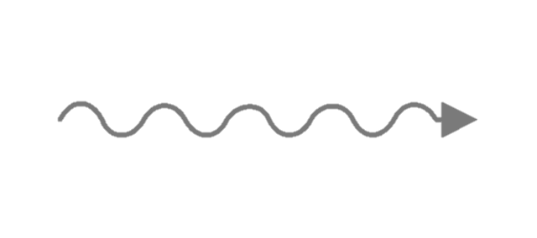












Force acting on the single particle
$$e$$
$$e$$
$$v$$
Laboratory Reference Frame
Rest frame
$$Radiated Photon Energy$$
$$ℏω′ \sim { γ}_{v}^{2}ℏω$$
$$Total Momentum of Radiation$$
$$dP_{rad}=0$$
$$Force Acting on the Charge$$
$$F \sim { γ}_{v}^{2}σU_{in}n$$
$$Force Acting on the Charge$$
$$F=σU_{in}^{′}n$$

Slide 3









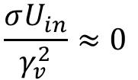








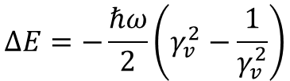
Averaged Picture
$$e$$
$$e$$
$$e$$
$${ γ}_{v}^{2}σU_{in}$$
$$v$$
Plasma accelerates, but rapidly cools down
$$e$$
$$e$$
$$e$$
$$\frac{σU_{in}}{γ_{v}^{2}}≈0$$
$$v$$
$$e$$
$$e$$
$$e$$
$$ΔE=−\frac{ℏω}{2}\left(γ_{v}^{2}−\frac{1}{γ_{v}^{2}}\right)$$
$$v$$
$$e$$
$$e$$
$$e$$
$$v$$

Slide 4




Degenerated Plasma
$$d$$
$$d$$
$$d=n^{−\frac{1}{3}}$$
$$p \sim \frac{ℏ}{2d}$$
Relativistic Momentum

Slide 5
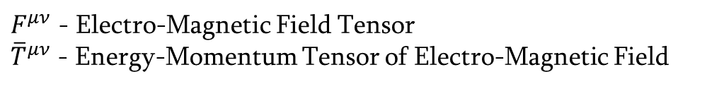
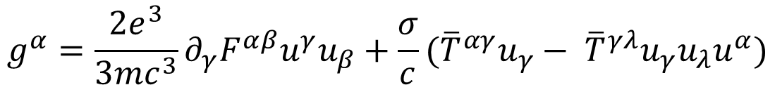

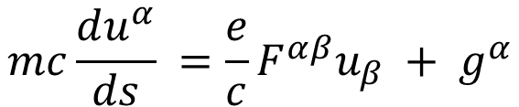



Theoretical Model- Equation of Dynamics
$$mc\frac{du^{α}}{ds} =\frac{e}{c}F^{αβ}u_{β} + g^{α}$$
$$Electro−Magnetic Force$$
Equation of Motion
$$g^{α}=\frac{2e^{3}}{3mc^{3}}∂_{γ}F^{αβ}u^{γ}u_{β}+\frac{σ}{c}({\overline{T}}^{αγ}u_{γ}− {\overline{T}}^{γλ}u_{γ}u_{λ}u^{α})$$
$$e$$
$$v$$
Radiation Reaction Force
$$Radiation Reaction Force$$
$F^{μν}$ - Electro-Magnetic Field Tensor
${\overline{T}}^{μν}$ - Energy-Momentum Tensor of Electro-Magnetic Field

Slide 6
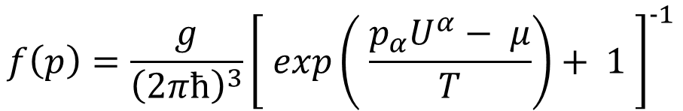
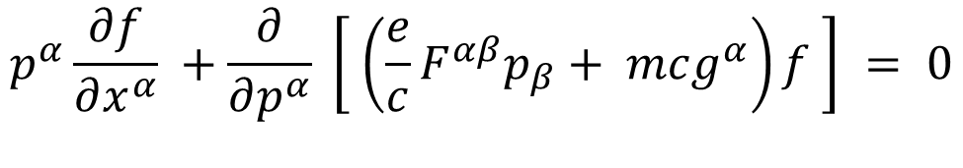
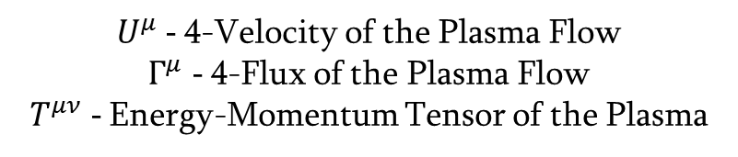
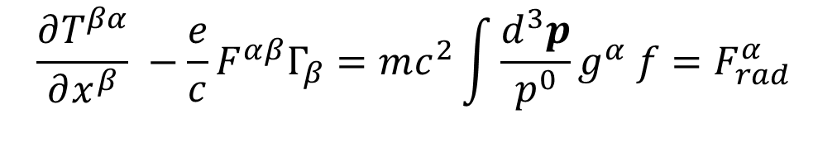
Theoretical Model- Equation of Dynamics
$$p^{α}\frac{∂f}{∂x^{α}} +\frac{∂}{∂p^{α}} \left[ \left(\frac{e}{c}F^{αβ}p_{β}+ mcg^{α}\right)f \right] = 0$$
$$f\left(p\right)=\frac{g}{{\left(2πħ\right)}^{3}}{\left[ exp\left( \frac{p_{α}U^{α}− μ}{T}\right)+ 1 \right]}^{−1}$$
$$\frac{∂T^{βα}}{∂x^{β}} −\frac{e}{c}F^{αβ}Γ_{β}=mc^{2}\int{\frac{d^{3}p}{p^{0}}g^{α} f}=F_{rad}^{α}$$
$U^{μ}$ - 4-Velocity of the Plasma Flow
$Γ^{μ}$- 4-Flux of the Plasma Flow
$T^{μν}$ - Energy-Momentum Tensor of the Plasma

Slide 7
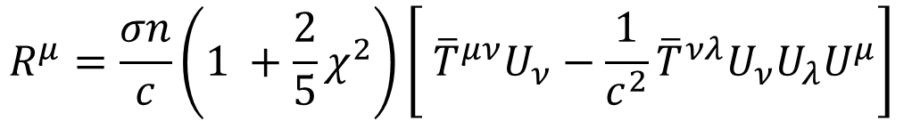
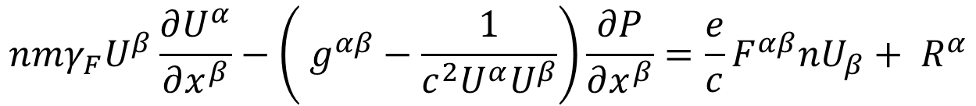
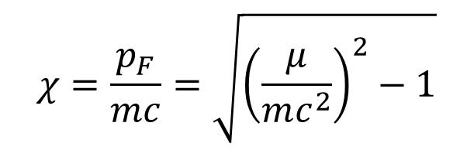
Cold Degenerate Plasma Limit
$$nmγ_{F}U^{β}\frac{∂U^{α}}{∂x^{β}}−\left( g^{αβ}−\frac{1}{c^{2}U^{α}U^{β}}\right)\frac{∂P}{∂x^{β}}=\frac{e}{c}F^{αβ}nU_{β}+ R^{α}$$
$$R^{μ}=\frac{σn}{c}\left(1 +\frac{2}{5}χ^{2}\right)\left[ {\overline{T}}^{μν}U_{ν}−\frac{1}{c^{2}}{\overline{T}}^{νλ}U_{ν}U_{λ}U^{μ}\right]$$
$$χ=\frac{p_{F}}{mc}=\sqrt{{\left(\frac{μ}{mc^{2}}\right)}^{2}−1}$$
Enhancement Coefficient
Reduced Fermi Momentum

Slide 8

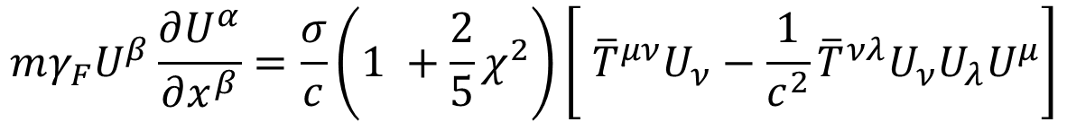
Cold Degenerate Plasma Limit
$$mγ_{F}U^{β}\frac{∂U^{α}}{∂x^{β}}=\frac{σ}{c}\left(1 +\frac{2}{5}χ^{2}\right)\left[ {\overline{T}}^{μν}U_{ν}−\frac{1}{c^{2}}{\overline{T}}^{νλ}U_{ν}U_{λ}U^{μ}\right]$$
Effective Mass
$$m_{eff}={mγ}_{F}=m\sqrt{1+χ^{2}}$$

Slide 9

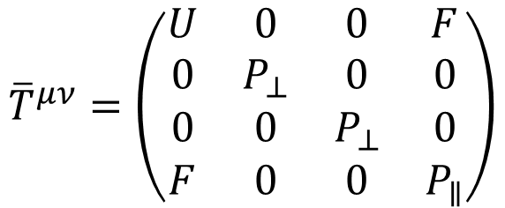
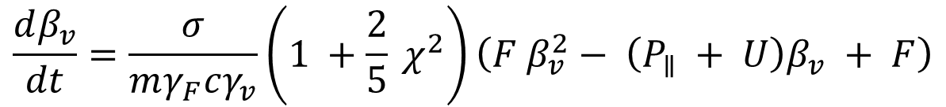
Axially Symmetric Radiation
$$Z$$
$${\overline{T}}^{μν}=\left(\begin{matrix}U & 0 & 0 & F \\ 0 & P_{⊥} & 0 & 0 \\ 0 & 0 & P_{⊥} & 0 \\ F & 0 & 0 & P_{∥}\end{matrix}\right)$$
Axially Symmetric Radiation Energy-Momentum Tensor
$$\frac{dβ_{v}}{dt}=\frac{σ}{mγ_{F}cγ_{v}}\left(1 +\frac{2}{5} χ^{2}\right)\left(F β_{v}^{2}− \left(P_{∥} + U\right)β_{v} + F\right)$$
Equation of Motion

Slide 10
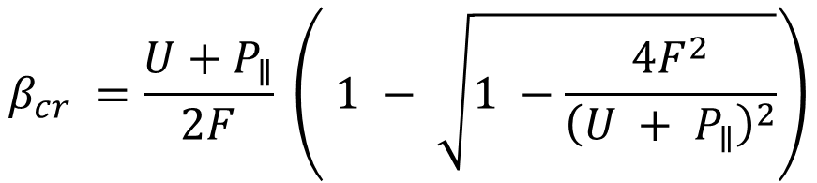
Critical Velocity
$$Z$$
$$β_{cr} =\frac{U+P_{∥}}{2F} \left( 1 − \sqrt{1 −\frac{4F^{2}}{{\left(U + P_{∥}\right)}^{2}}}\right)$$
Result of Sikora, Kovner

Slide 11

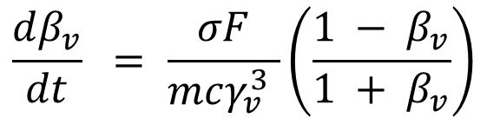
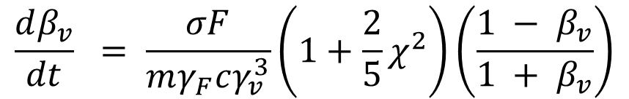
Plane Wave Radiation
$$Z$$
$$U=P_{∥}=F, P_{⊥}=0$$
$$\frac{dβ_{v}}{dt} = \frac{σF}{mγ_{F}cγ_{v}^{3}}\left(1+\frac{2}{5}χ^{2}\right)\left(\frac{1 − β_{v}}{1 + β_{v}}\right)$$
Our Result
$$\frac{dβ_{v}}{dt} = \frac{σF}{mcγ_{v}^{3} }\left(\frac{1 − β_{v}}{1 + β_{v}}\right)$$
Equation of Landau

Slide 12
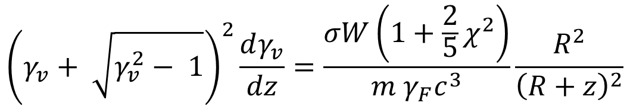
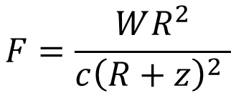
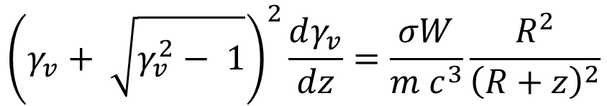
Plane Wave Radiation
$$Z$$
$$F=\frac{WR^{2}}{c{\left(R+z\right)}^{2} }$$
$${\left(γ_{v}+ \sqrt{γ_{v}^{2}− 1}\right)}^{2}\frac{dγ_{v}}{dz}=\frac{σW\left(1+\frac{2}{5}χ^{2}\right)}{m γ_{F}c^{3}}\frac{R^{2}}{{\left(R+z\right)}^{2}}$$
$${\left(γ_{v}+ \sqrt{γ_{v}^{2}− 1}\right)}^{2}\frac{dγ_{v}}{dz}=\frac{σW}{m c^{3}}\frac{R^{2}}{{\left(R+z\right)}^{2}}$$

Slide 13
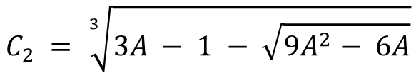
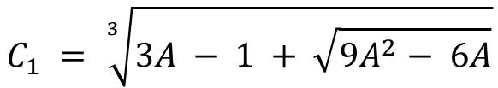
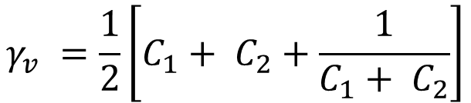
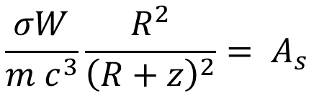
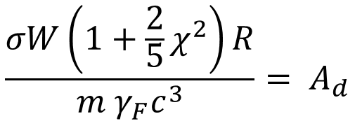
Plane Wave Radiation
$$Z$$
$$\frac{σW\left(1+\frac{2}{5}χ^{2}\right)R}{m γ_{F}c^{3}}= A_{d}$$
$$\frac{σW}{m c^{3}}\frac{R^{2}}{{\left(R+z\right)}^{2}}= A_{s}$$
$$γ_{v} =\frac{1}{2}\left[C_{1}+ C_{2}+\frac{1}{C_{1}+ C_{2}}\right]$$
$$C_{1} = \sqrt[3]{3A − 1 + \sqrt{9A^{2}− 6A}}$$
$$C_{2} = \sqrt[3]{3A − 1 − \sqrt{9A^{2}− 6A}}$$

Slide 14
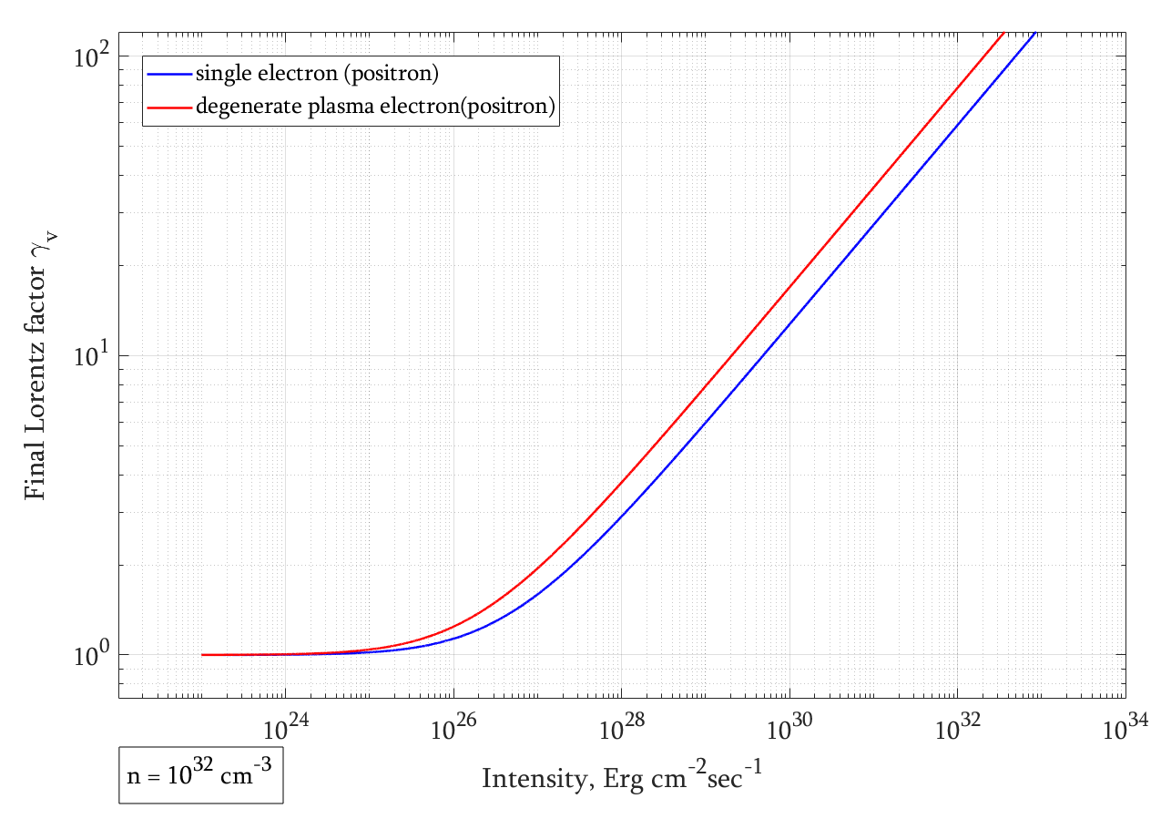
Lorentz-factor vs Radiation Intensity

Slide 15
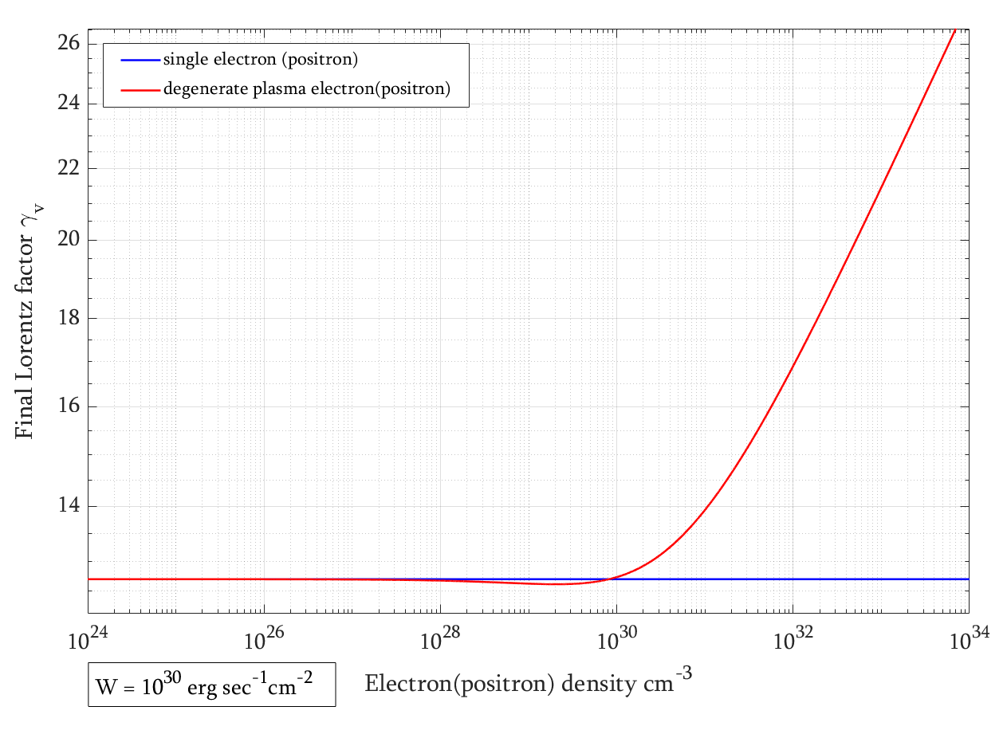
Lorentz-factor vs Plasma Density

Slide 16
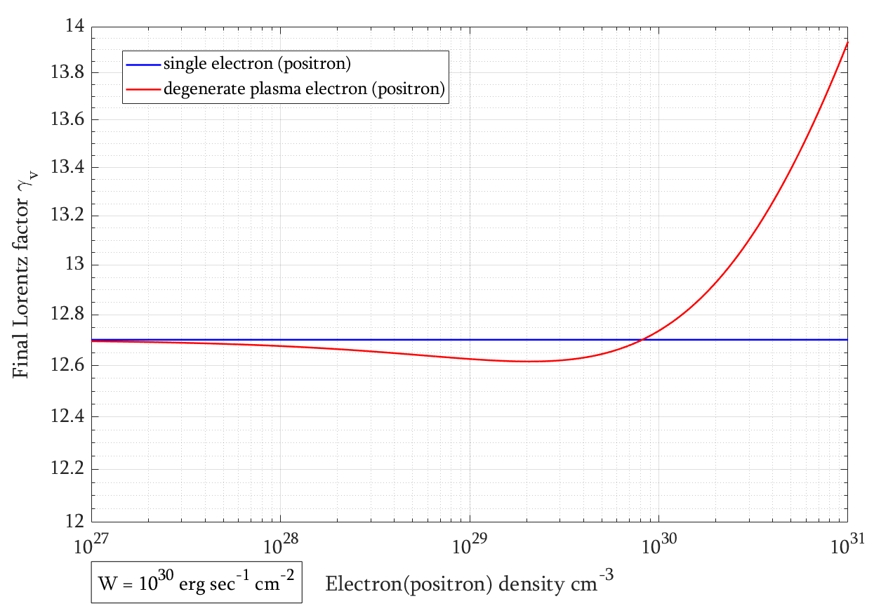


Lorentz-factor vs Plasma Density
$$1+\frac{2}{5}χ^{2}<\sqrt{1+χ^{2}}$$
$$χ<\frac{\sqrt{5}}{2}≈1,118$$

Slide 17
Thank you very much

Slide 18
References
V. I. Berezhiani and S. M. Mahajan, “Compton Rocket Effect Due to the Action of Radiation Reaction Force in Degenerate Plasma,” Physics of Plasmas 31, no. 7 (2024): 070702
Faussurier, Gerald. “Equation of State of the Relativistic Free Electron Gas at Arbitrary Degeneracy.” Physics of Plasmas 23, no. 12 (2016): 122702
Kovner, I. “Relativistic Positron Stream in the Electric Field Generated by Radiation Pressure.” Astronomy and Astrophysics 141 (1984): 341–350.
E. S. Phinney, “Acceleration of a Relativistic Plasma by Radiation Pressure,” Monthly Notices of the Royal Astronomical Society 198 (1982): 1109–1118.
O’Dell, S. L. "Radiation Force on a Relativistic Plasma and the Eddington Limit." The Astrophysical Journal 243 (February 1, 1981): L147–L149.
Landau, L. D., and E. M. Lifshitz. The Classical Theory of Fields. Translated by Morton Hamermesh. 4th rev. English ed. Vol. 2 of Course of Theoretical Physics. Oxford: Pergamon Press, 1975.

Slide 19
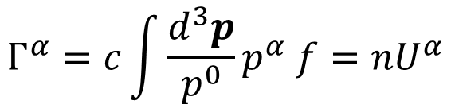
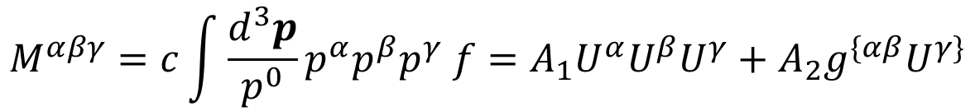
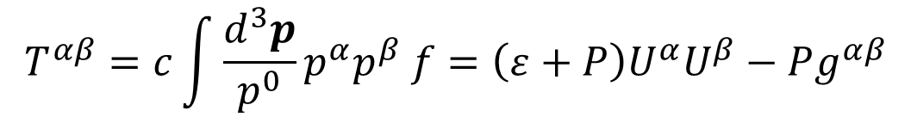
Theoretical Model – Equation of Dynamics
$$F_{rad}^{μ} =\frac{2 e^{3}}{3 m^{2}c^{4}}∂_{λ}F^{μν}T_{ν}^{λ}+\frac{σ}{c}{\overline{T}}^{αβ}Γ_{β}−\frac{σ}{m^{2}c^{3}}{\overline{T}}_{νλ }M^{νλμ}$$
$$Γ^{α}=c\int{\frac{d^{3}p}{p^{0}}p^{α} f}=nU^{α}$$
$$T^{αβ}=c\int{\frac{d^{3}p}{p^{0}}p^{α}p^{β} f}=\left(ε+P\right)U^{α}U^{β}−Pg^{αβ}$$
$$M^{αβγ}=c\int{\frac{d^{3}p}{p^{0}}p^{α}p^{β}p^{γ} f}=A_{1}U^{α}U^{β}U^{γ}+A_{2}g^{\{αβ}U^{γ\}}$$

Slide 20
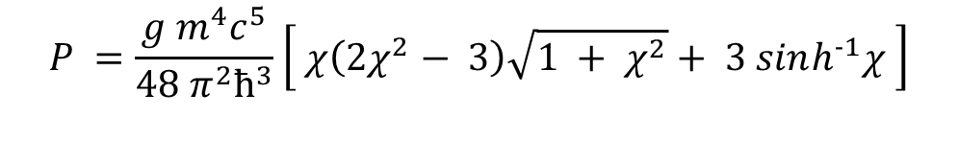
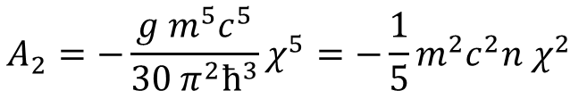
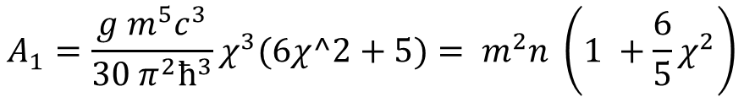
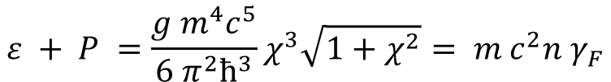
Cold Plasma, Approximation of the parameters near zero temperature
$$n =\frac{g{\left(μ^{2}− m^{2}c^{4}\right)}^{\frac{3}{2}}}{6 π^{2}ħ^{3}c^{3}} =\frac{g m^{3}c^{3}}{6 π^{2}ħ^{3}}χ^{3}, χ=\sqrt{{\left(\frac{μ}{mc^{2}}\right)}^{2}−1}$$
$$P =\frac{g m^{4}c^{5}}{48 π^{2}ħ^{3}}\left[ χ\left(2χ^{2}− 3\right)\sqrt{1 + χ^{2}}+ 3 sinh^{−1}χ \right]$$
$$ε + P =\frac{g m^{4}c^{5}}{6 π^{2}ħ^{3}}χ^{3}\sqrt{1+χ^{2}}= m c^{2}n γ_{F}$$
$$A_{1}=\frac{g m^{5}c^{3}}{30 π^{2}ħ^{3}}χ^{3}(6χ^2+5)= m^{2}n \left(1 +\frac{6}{5}χ^{2}\right)$$
$$A_{2}=−\frac{g m^{5}c^{5}}{30 π^{2}ħ^{3}}χ^{5}=−\frac{1}{5}m^{2}c^{2}n χ^{2}$$

