Slide 1

Nuclear Reactor Dynamics
Simulation Using FPGA
Pavle Erikashvili
Supervisor: Giorgi Macharashvili
Agricultural University of Georgia
GGSB 2026 · Physics session · 8 September 2026
Notes:
TIME: 20 seconds. Running time: 0:00–0:20.
SPEAKER NOTES
I am Pavle Erikashvili, from the Agricultural University of Georgia. This project was carried out with Giorgi Macharashvili. I developed a simulator of nuclear-reactor dynamics and implemented its physics model on an FPGA. I will explain the motivation, the physical model, the hardware, and the experiments.
SOURCES
Pavle Erikashvili, original Georgian presentation: პრეზენტაცია.pptx (27 slides).
GGSB_Workshop_2026_Program_FINAL_September.pdf, pp. 4–5: Physics Topics, 8 September 2026, AUG/FUT, Auditorium 314; Pavle Erikashvili (with Macharashvili), AUG.
SOURCE / EDITORIAL NOTES
The supervisor’s full name is taken from the original Georgian title slide. The title has no explanatory or promotional subtitle.

Slide 2
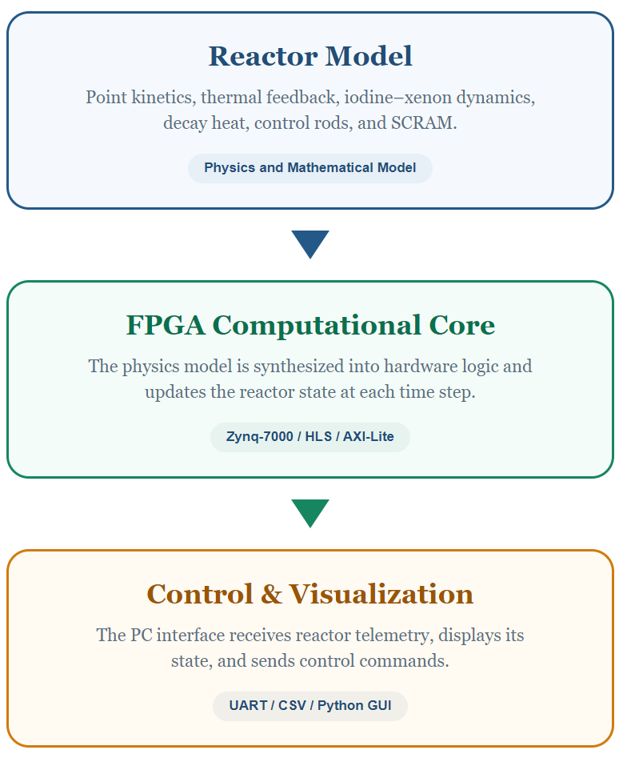
What’s it all about?
The aim of the project is to create a simplified digital analogue of a small modular pressurized water reactor on an FPGA platform.
The FPGA-based simulator calculates in real time:
Reactor power changes
Fuel and coolant temperatures
Reactivity
Decay heat
Iodine-135 and Xenon-135 dynamics

Slide 3
Presentation Overview
Motivation & Georgia’s Energy Context
Reactor Physics Fundamentals
Target Reactor & Mathematical Model
FPGA Implementation
Simulator Architecture & Operation
Experimental Results & Verification

Slide 4
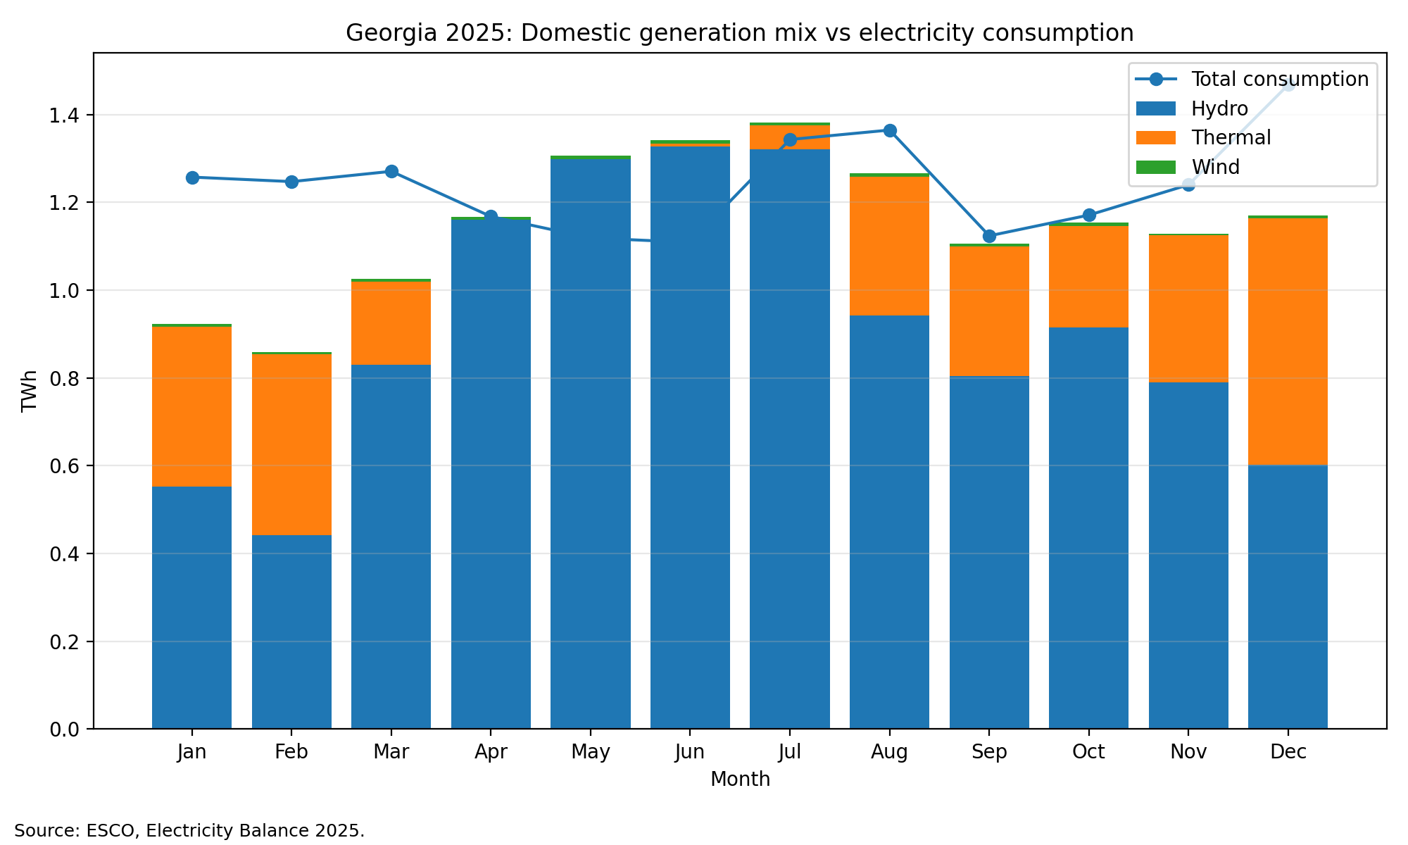
Context
Hydropower output
is seasonal.
Solar is intermittent.
Nuclear power is one
option to study for
supply diversification.

Slide 5
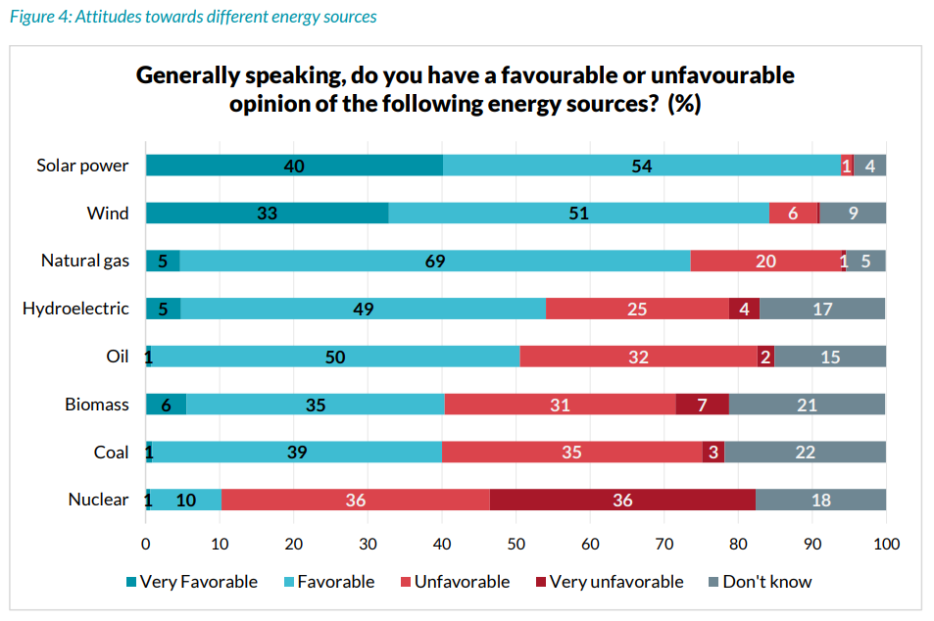
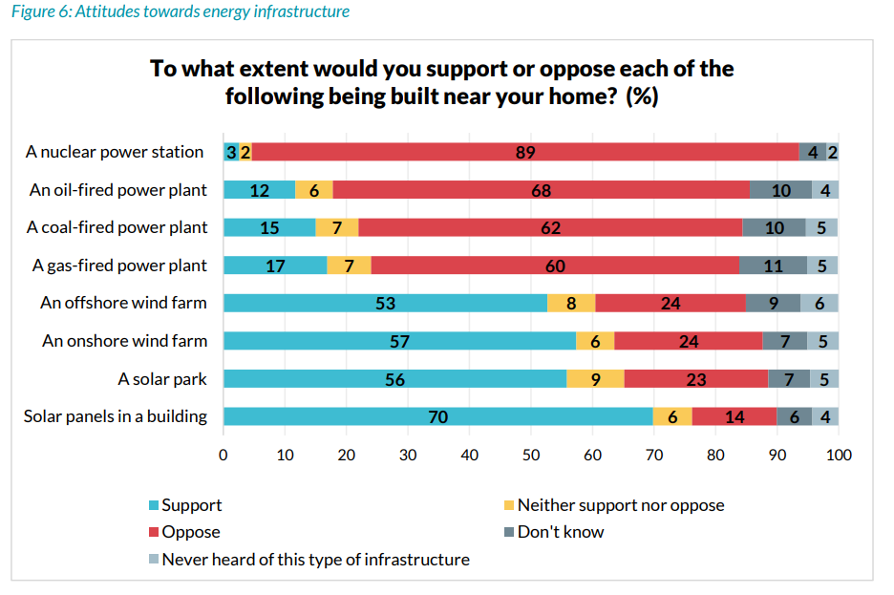
Context
Source: Caucasus Research Resource Centers, Georgia - attitudes towards climate change

Slide 6
Making Reactor Physics Intuitive
Reactor physics is easier to understand when its dynamics can be seen, not only calculated.
The simulator helps students and the public build an intuitive understanding of:
power increase and decrease
control-rod effects
emergency shutdown - SCRAM
temperature feedback
xenon poisoning
It turns abstract reactor physics into observable behavior.

Slide 7
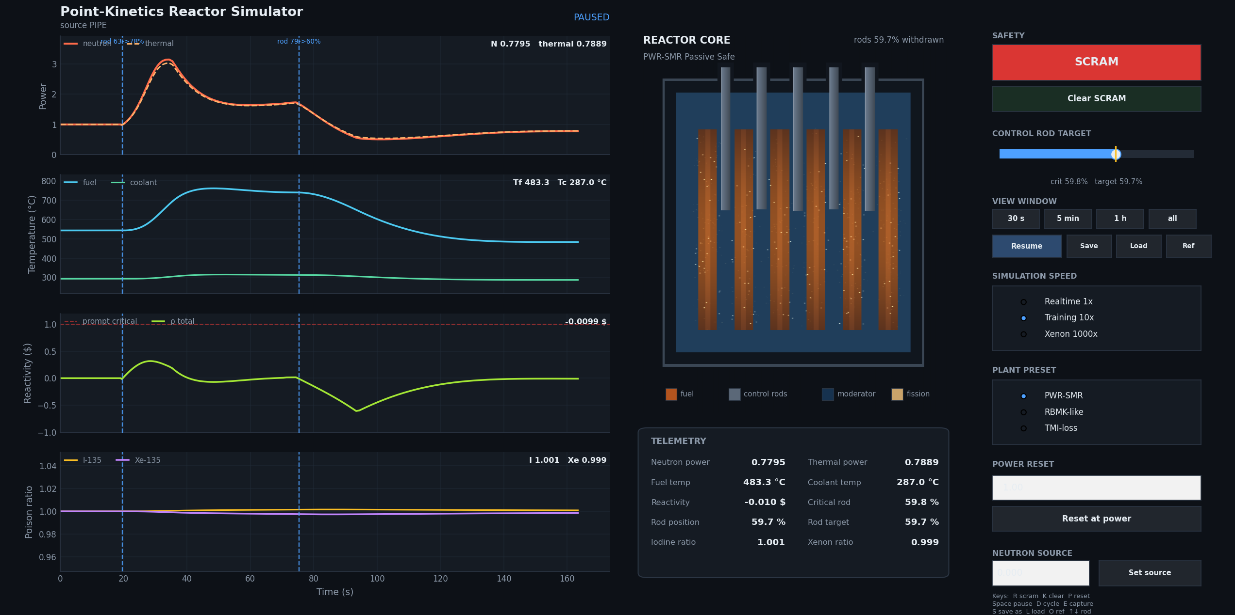
Prototype Interface

Slide 8
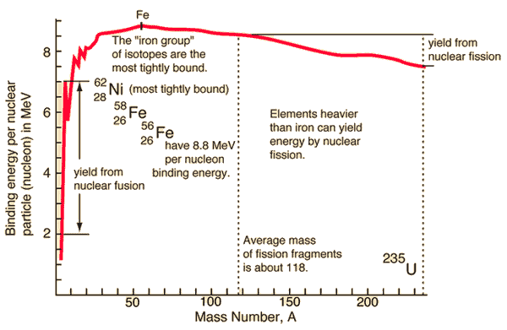
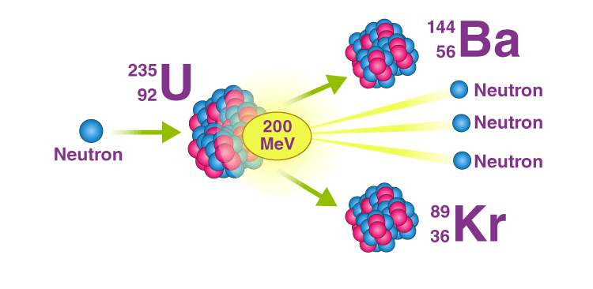

Mass Defect

Slide 9
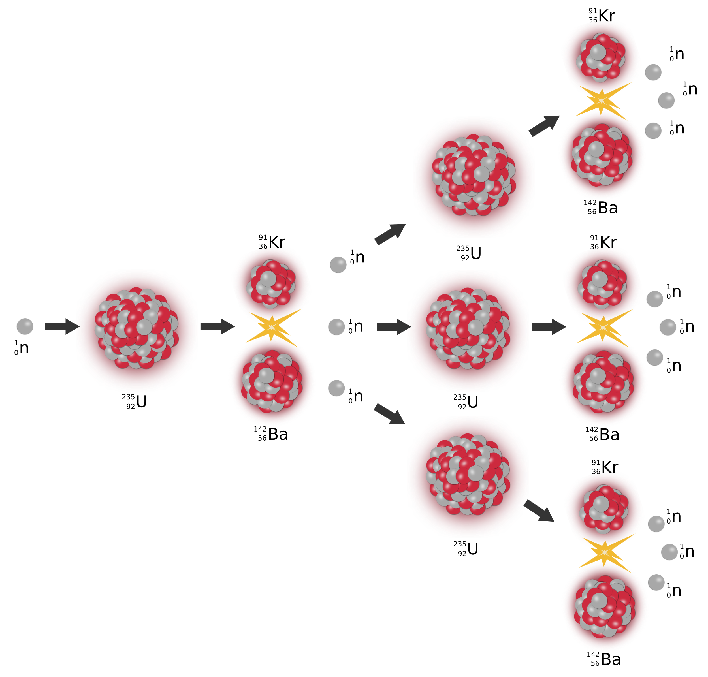
Chain Reaction

Slide 10
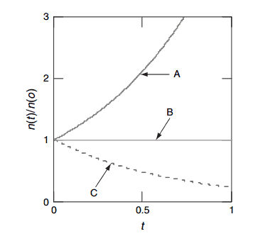
Chain Reaction
Criticality is a neutron balance
k is the neutron multiplication factor from one generation to the next.
ρ = (k − 1) / k
Reactivity measures departure from criticality.
Subcritical
k < 1
Withdraw rods
The chain reaction decreases.
Less neutron absorption
Higher reactivity
Critical
k = 1
Steady power at equilibrium.
Insert rods
More neutron absorption
Lower reactivity
Supercritical
k > 1
The chain reaction grows.

Slide 11
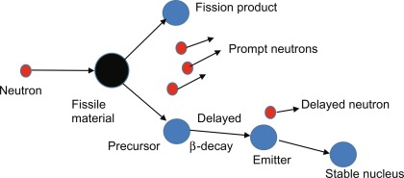
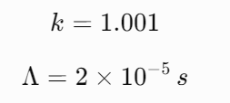



Prompt and Delayed Neutrons
Effective delayed fraction
β = 0.007 in this model
Λ = 20 μs
Prompt generation time

Slide 12
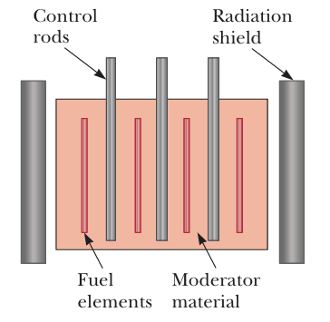
Fuel, moderator and control rods
The neutron balance depends on what each material does.
Fuel
Fission produces heat and new neutrons.
Moderator: water
Slows neutrons, increasing the probability
of U-235 fission.
Control rods
Absorb neutrons; insertion reduces reactivity.
In this reactor type, the same water also removes heat from the fuel.

Slide 13
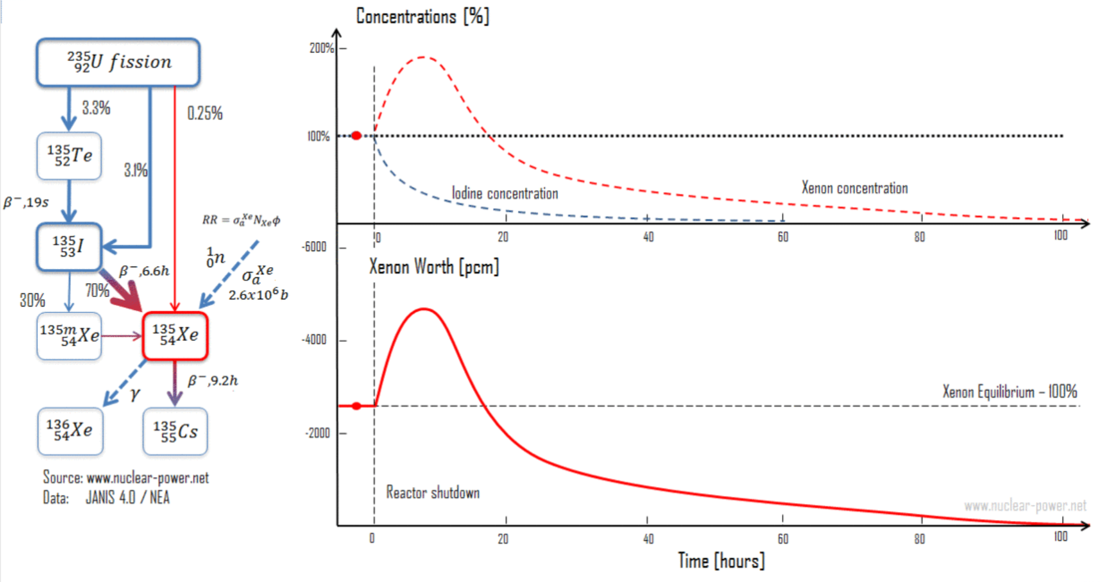
Iodine & Xenon
Xe-135:
2.65 × 10⁶ b
585 b
U-235:
Thermal absorption cross-section
at 0.0253 eV

Slide 14
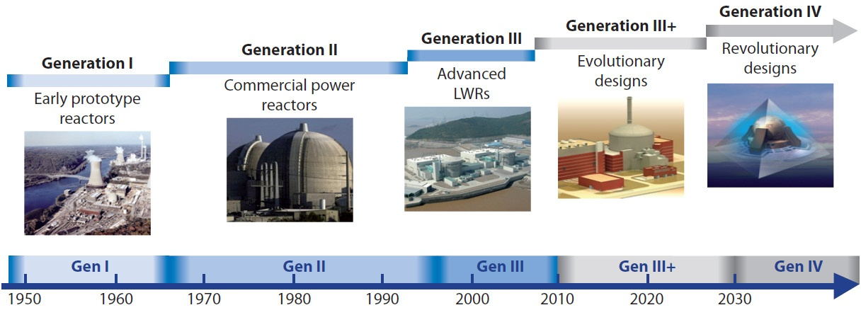
Reactor Types

Slide 15
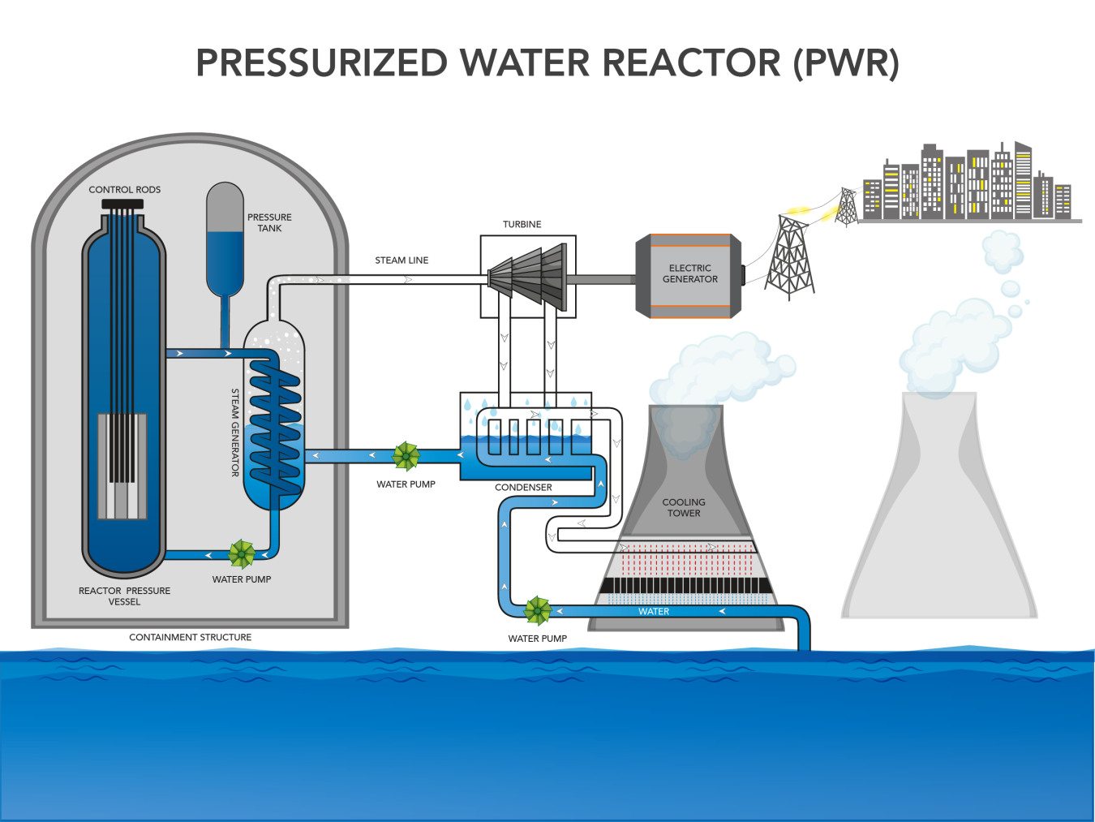
Target Reactor
The selected reference model is a small modular pressurized water reactor: PWR-SMR.
PWR: Pressurized Water Reactor
SMR: Small Modular Reactor
Generation III: passive safety features
Coolant: light water (H₂O with deuterium)
Moderator: light water
The reactor core is relatively compact
The model is intended to study the reactor’s overall dynamic behavior

Slide 16
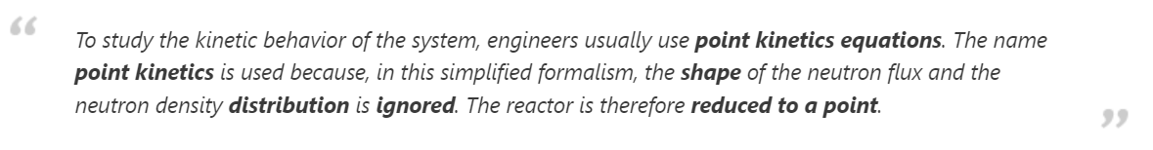
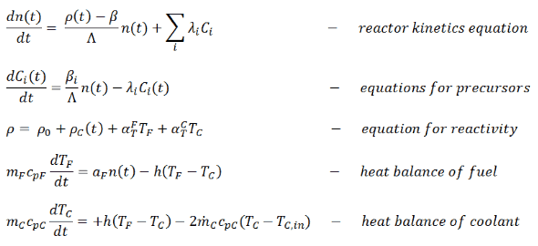
Point Kinetics
Pros:
Much lower computational complexity.
Fast enough for real-time simulation
Well suited for studying overall reactor power dynamics
Easy to couple with temperature feedback, xenon, decay heat, and control rods

Slide 17
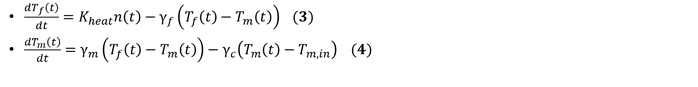
Negative Thermal Feedback
$\frac{dT_{f}\left(t\right)}{dt}=K_{heat}n\left(t\right)−γ_{f}\left(T_{f}\left(t\right)−T_{m}\left(t\right)\right) (3)$
$\frac{dT_{m}\left(t\right)}{dt}=γ_{m}\left(T_{f}\left(t\right)−T_{m}\left(t\right)\right)−γ_{c}\left(T_{m}\left(t\right)−T_{m,in}\right) (4)$
Reactor power increases → fuel and coolant temperatures rise.
Higher temperature introduces negative reactivity in the model.
Negative reactivity slows the chain reaction and limits further power increase.
This creates a self-stabilizing feedback loop.
Fuel temperature responds faster than coolant temperature.
In the model, total temperature feedback is the sum of fuel and coolant contributions:
Power ↑ → Temperature ↑ → Reactivity ↓ → Power growth is suppressed.

Slide 18
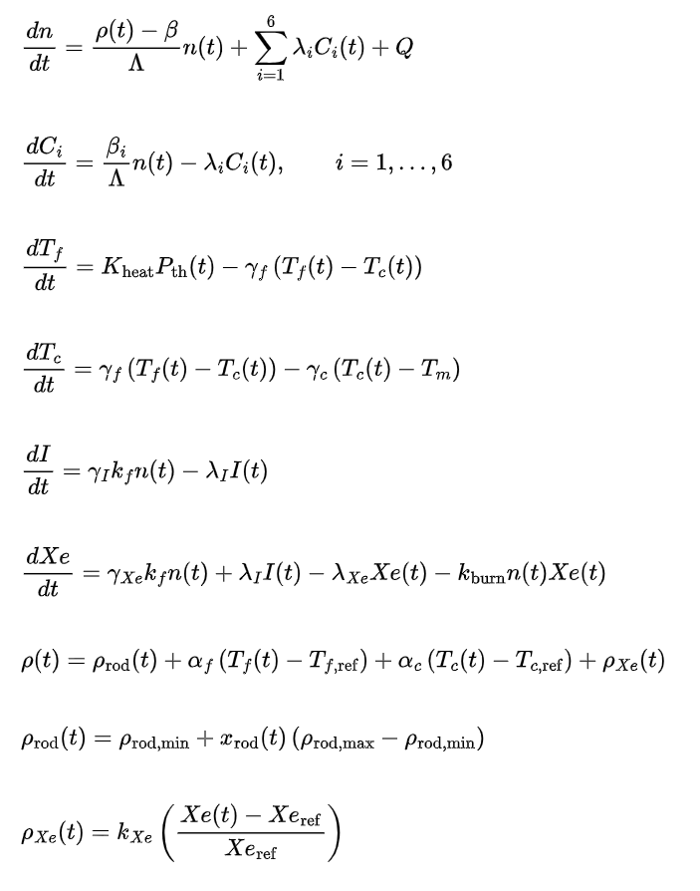
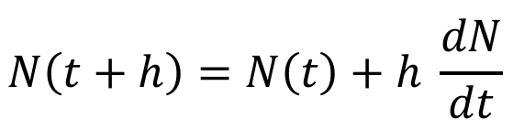
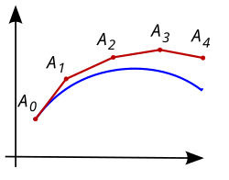
Mathematical System and Solver
Stiff Differential Equation System
Numerical Solver
taylor first order approximation:

Slide 19
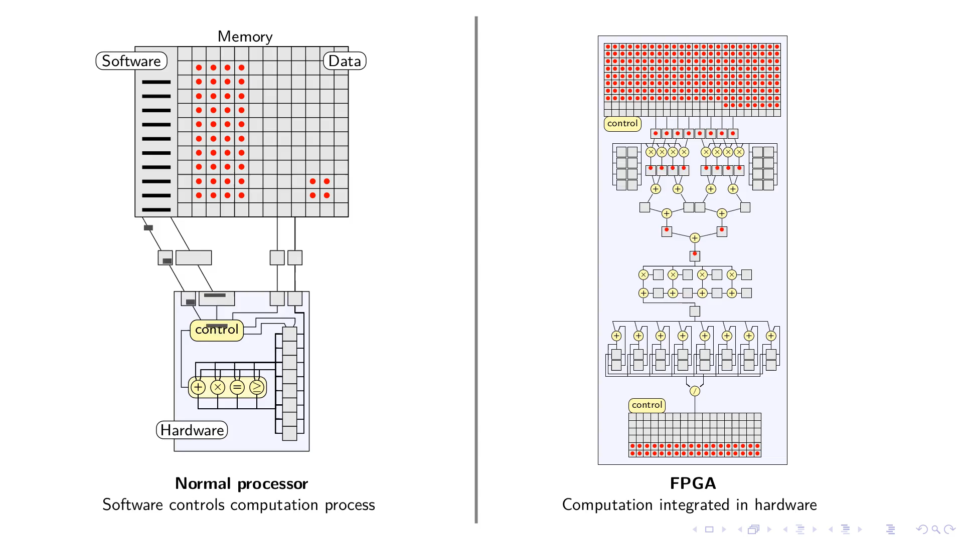
Field Programmable Gate Array (FPGA)
FPGA - Field-Programmable Gate Array is a chip whose digital logic can be configured for a specific task.
Unlike a CPU, it does not simply execute a sequence of software instructions; the algorithm is implemented as hardware logic.
This gives predictable and repeatable execution time, which is useful for real-time simulation.
Independent operations can be organized in parallel or pipelined hardware.

Slide 20
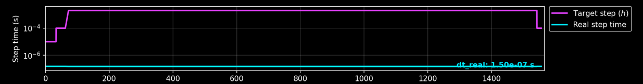
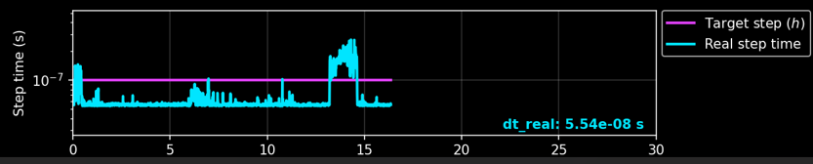
Timestep Comparison
FGPA:
CPU:

Slide 21
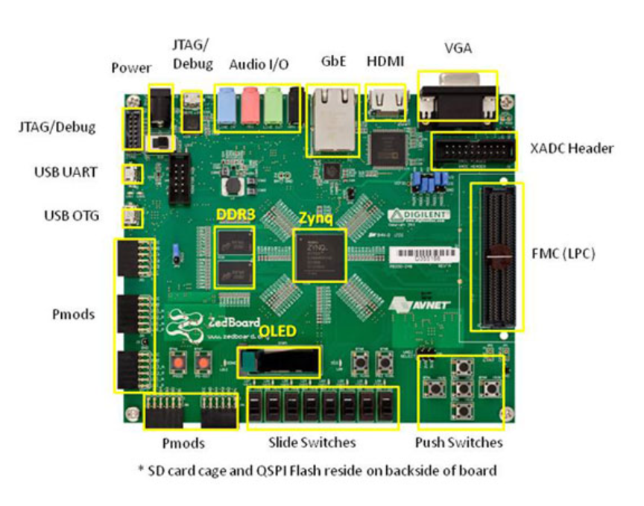
ZedBoard Zynq-7000 ARM/FPGA SoC Board
AMD Zynq-7000 AP SoC XC7Z020-CLG484
Dual-core ARM Cortex™-A9 processor
512 MB DDR3
256 MB Quad-SPI Flash
On-board USB-JTAG Programming
10/100/1000 Ethernet
USB OTG 2.0 and USB-UART
Analog Devices ADAU1761 SigmaDSP® Stereo, Low Power, 96 kHz, 24-Bit Audio Codec
Analog Devices ADV7511 High Performance 225 MHz HDMI Transmitter (1080p HDMI, 8-bit VGA, 128x32 OLED)
PS & PL I/O expansion (FMC, Pmod, XADC)

Slide 22
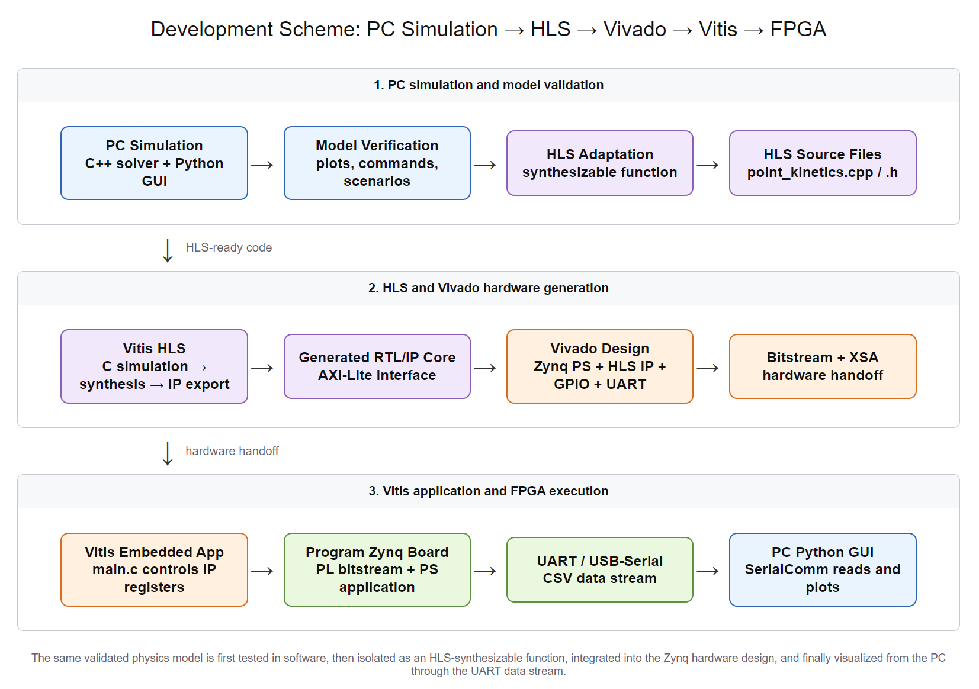
Development Flow

Slide 23
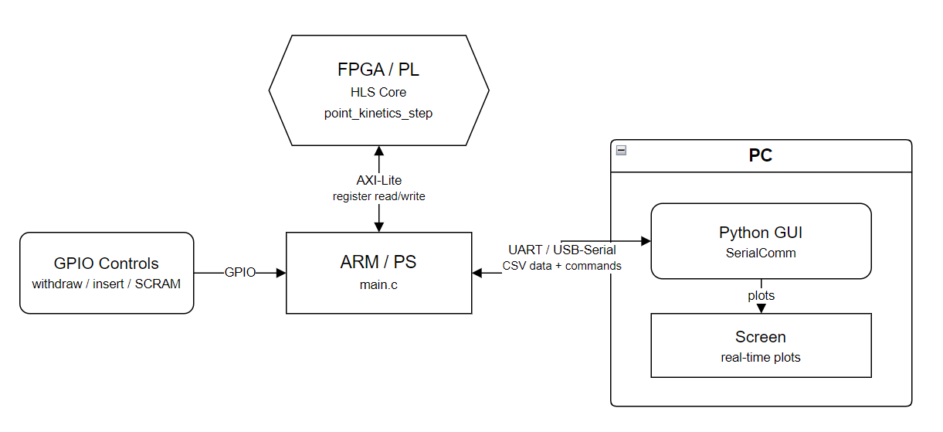
Control Flow

Slide 24
What the Simulator Does
A real-time, controllable PWR-SMR-like reactor dynamics model running on both PC and FPGA.
Neutron kinetics — reactor power and six delayed-neutron precursor groups
Reactivity & control — control rods, temperature feedback, xenon feedback, and SCRAM
Thermal response — fuel and coolant temperatures, thermal power, and decay heat after shutdown
Iodine–xenon dynamics — I-135/Xe-135 production, decay, neutron absorption, and the post-shutdown xenon peak
Operation & observation — power presets, reset, 1× / 10× / 1000× time modes, telemetry, and graphical monitoring
PC–FPGA comparison — the same physics core runs in software and on the FPGA for direct result comparison

Slide 25
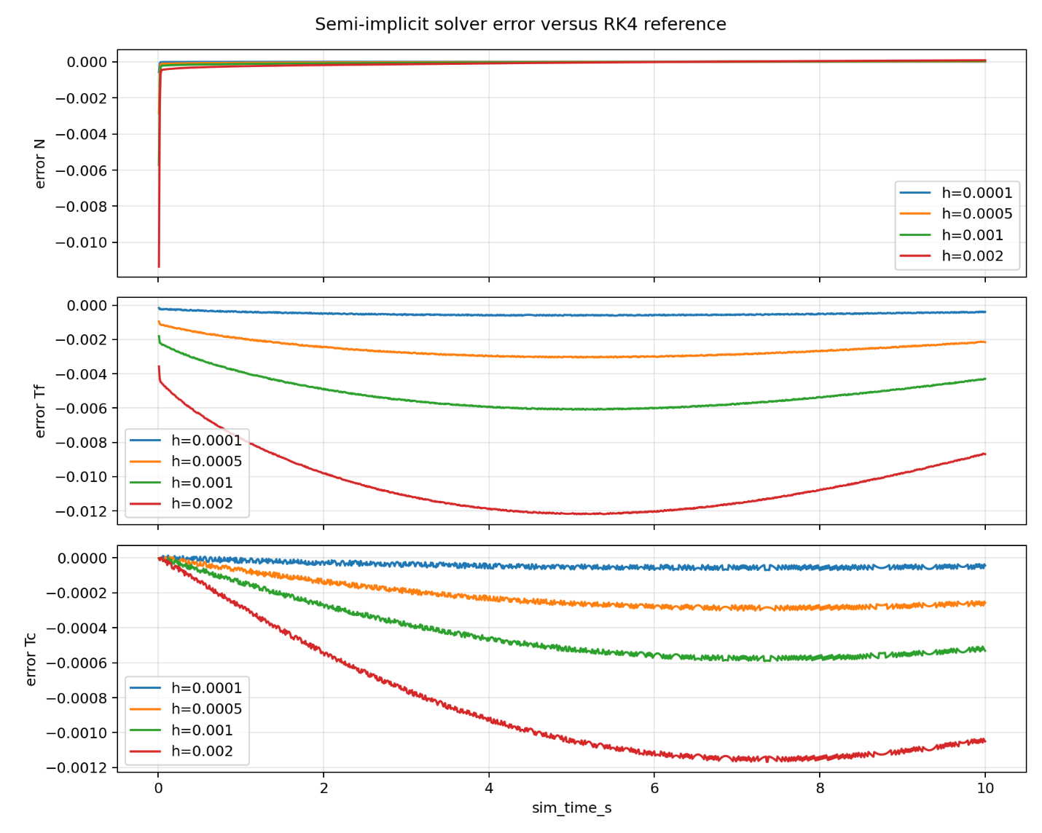
Results
Solver Accuracy compared to RK4
Achieved computation time
Mode | Frames | Average time per step | Frame computation time | Achieved time factor | Missed Frame
REALTIME | 1051 | 1.113 μs | 1.113 ms | 1.000856 / 1.000841 | 0
TRAINING | 1051 | 1.113 μs | 1.113 ms | 9.999985 / 10.008559 | 0
XENON | 1050 | 1.110 μs | 55.500 ms | 999.362728 / 1000.304810 | 1

Slide 26
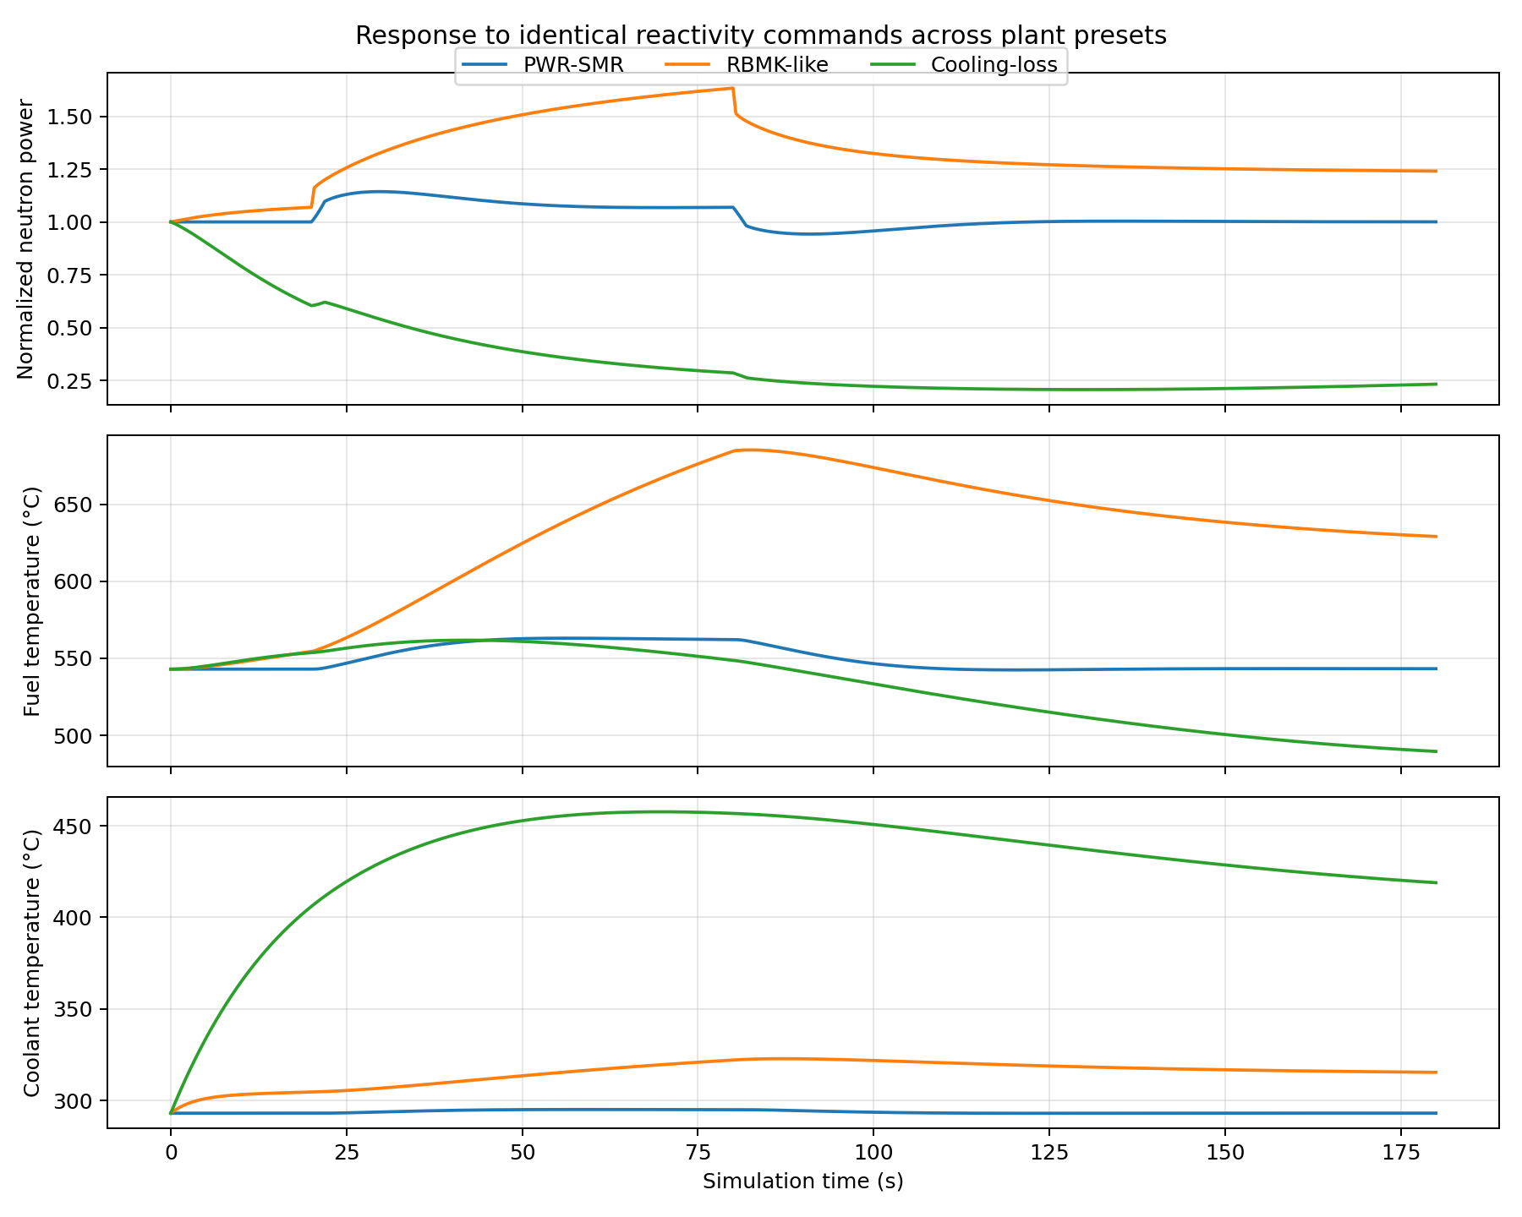
Results
Different plant types comparison

Slide 27
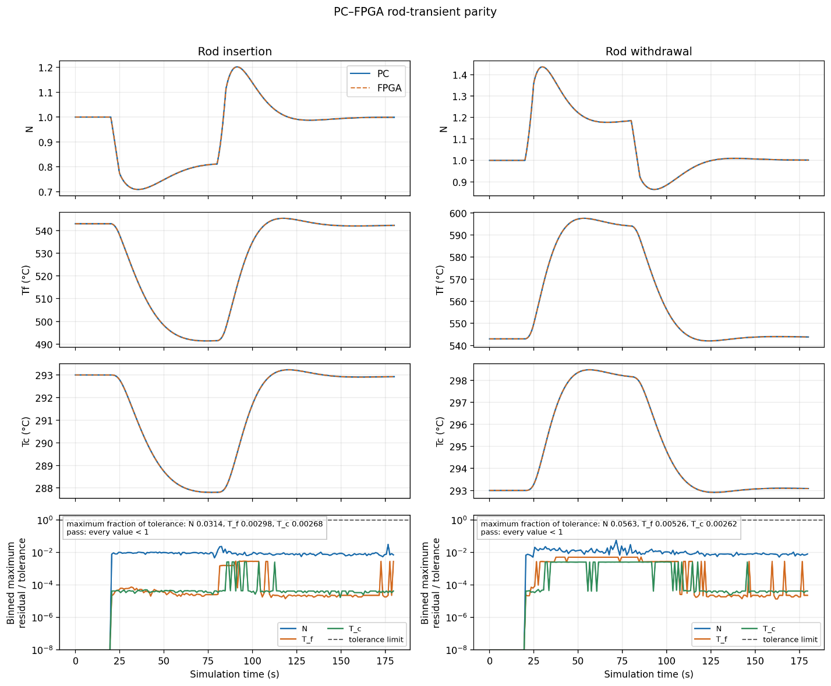
Results
PC – FPGA Parity

Slide 28
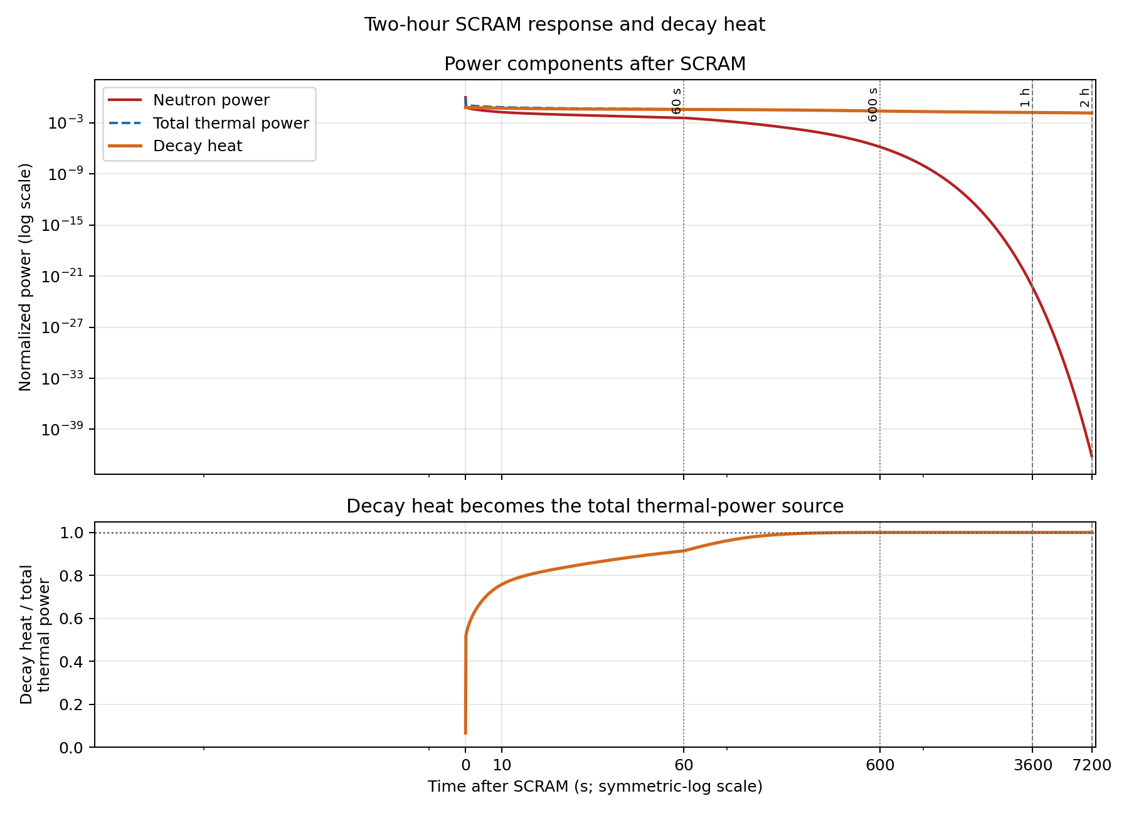
Results
Decay Heat

Slide 29
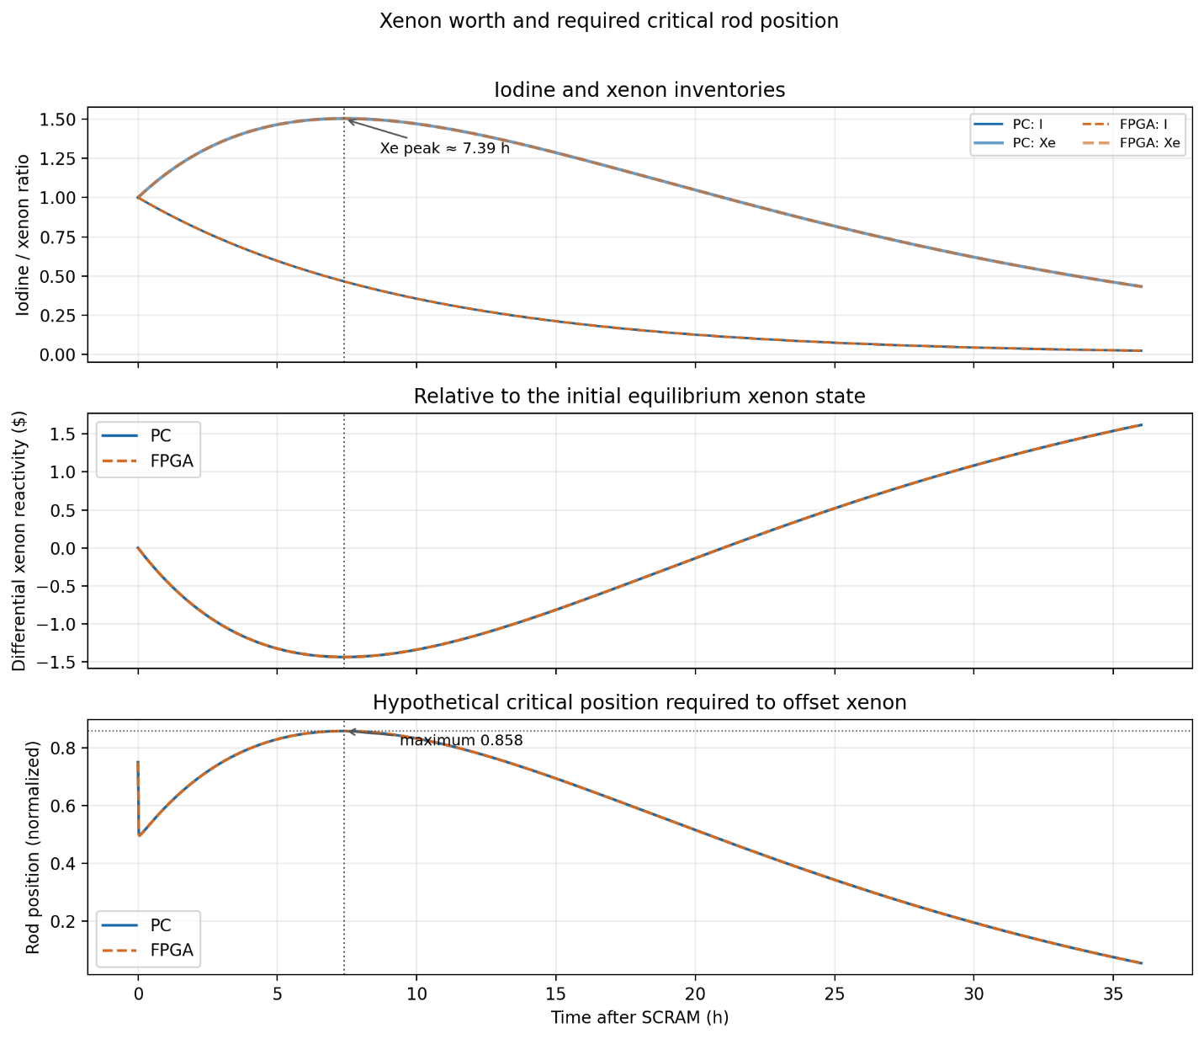
Results
Xenon Worth and Required Critical Rod Position

Slide 30
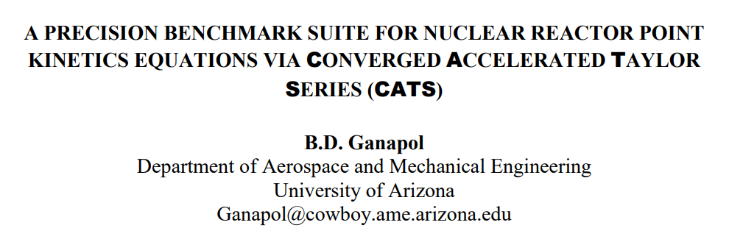
Numerical Verification Against CATS
Public benchmarks verified:
CATS Thermal Reactor I, −0.5$ reactivity step, Table 2a
Maximum sampled neutron-density error: 0.01599%.
CATS Thermal Reactor I, −1.0$ reactivity step, Table 2b
Maximum sampled neutron-density error: 0.02338%.
CATS Thermal Reactor IV, +1$ adiabatic Doppler-feedback transient, Table 6a
This is the closed feedback-loop case. Maximum error across 11 published values from 1–100 s: 0.00703%.

Slide 31
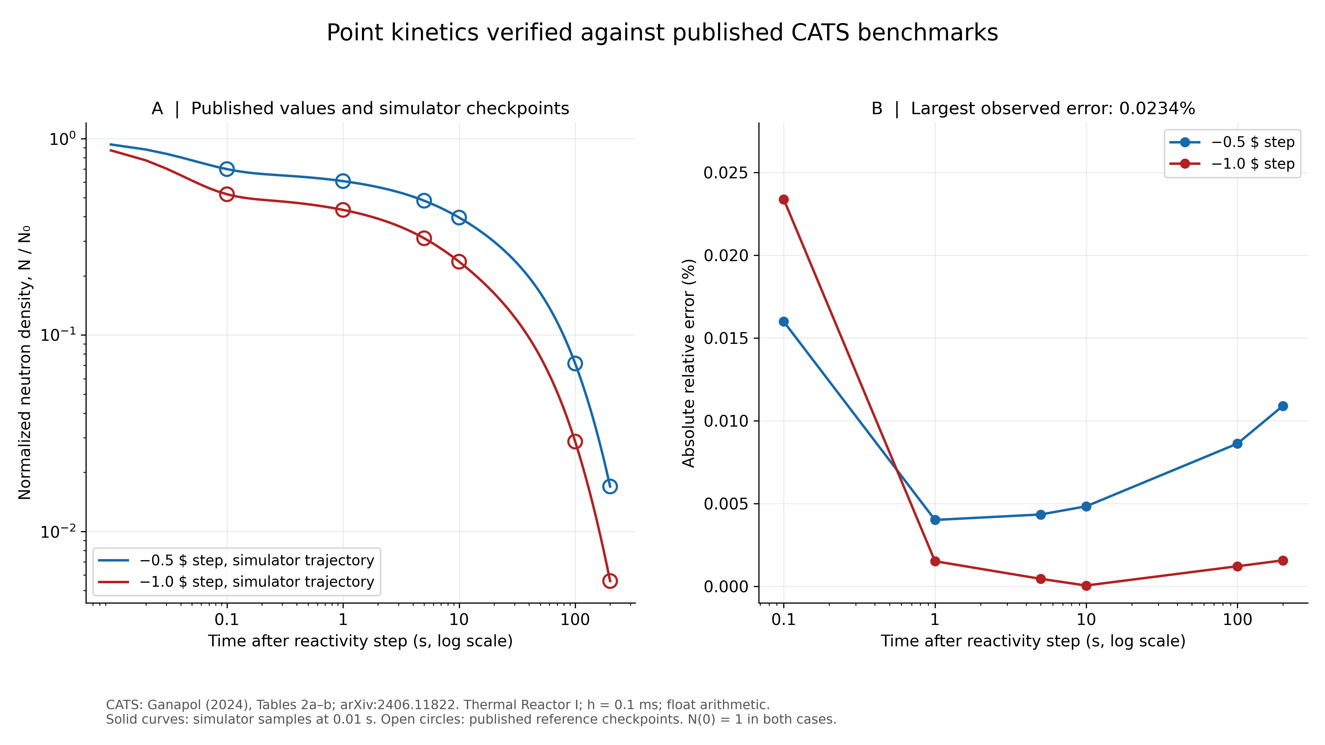
Numerical Verification Against CATS

Slide 32
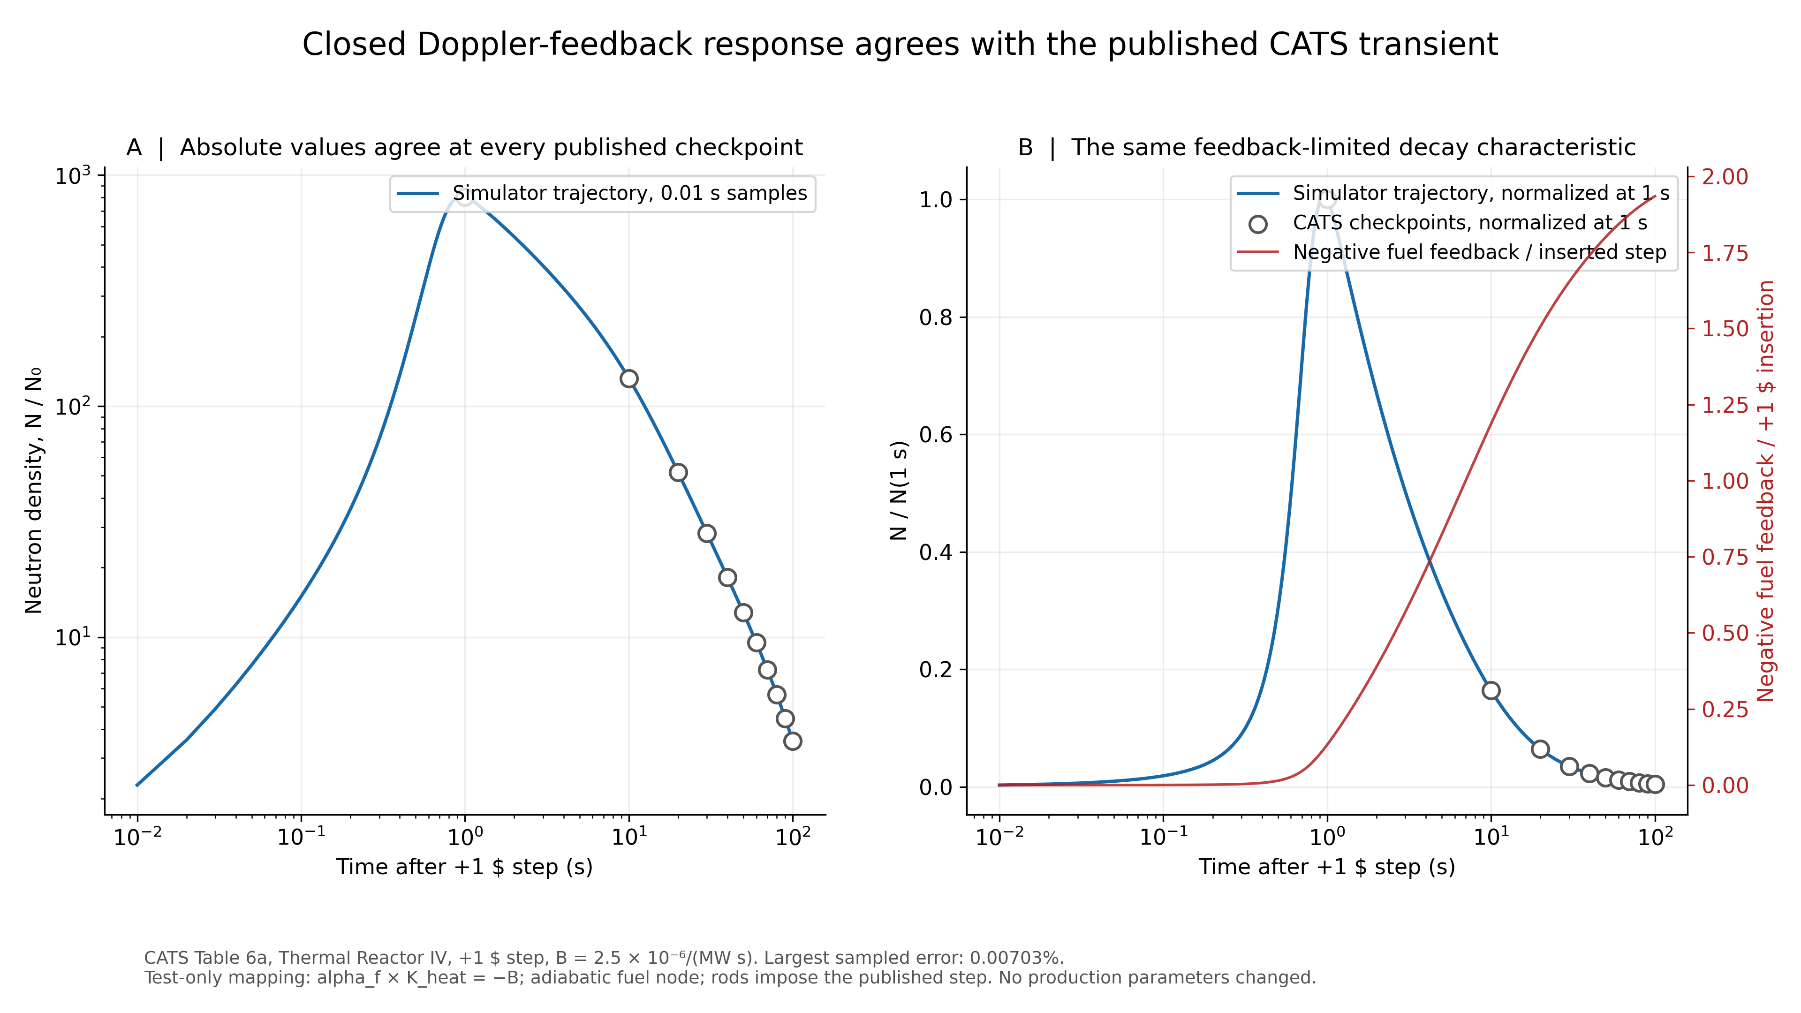
Numerical Verification Against CATS

Slide 33
Demonstration

Slide 34
Future Development
Higher dimension reactor model - move beyond point kinetics to spatial neutron-flux and temperature distributions
Hardware-in-the-Loop (HIL) - use the FPGA simulator as a real-time plant model for testing external control systems
Plant-specific validation - calibrate and compare the model against a defined reactor design and published transients
Higher-fidelity thermal hydraulics - add pressure, coolant flow, steam generation, and more detailed heat transfer
Improved iodine-xenon model - more detailed poison dynamics and spatial xenon effects
Expanded control and safety systems - automatic regulation, protection logic, and additional accident scenarios
Scalable FPGA architecture - distribute larger models across more FPGA resources or multiple devices

Slide 35
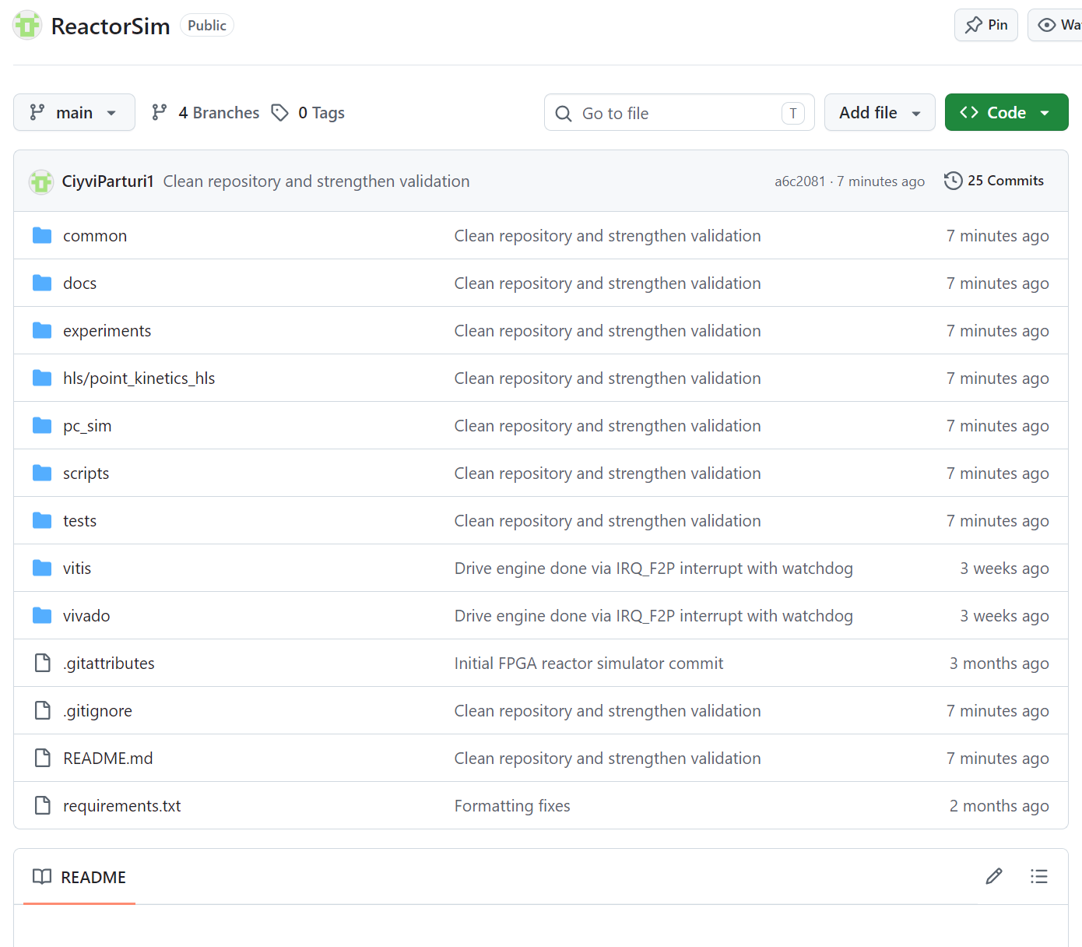

Github Project
https://github.com/CiyviParturi1/ReactorSim

Slide 36
Thank You!
Pavle Erikashvili
Supervisor: Giorgi Macharashvili
Agricultural University of Georgia
GGSB 2026 · Physics session · 8 September 2026
Notes:
TIME: 20 seconds. Running time: 0:00–0:20.
SPEAKER NOTES
I am Pavle Erikashvili, from the Agricultural University of Georgia. This project was carried out with Giorgi Macharashvili. I developed a simulator of nuclear-reactor dynamics and implemented its physics model on an FPGA. I will explain the motivation, the physical model, the hardware, and the experiments.
SOURCES
Pavle Erikashvili, original Georgian presentation: პრეზენტაცია.pptx (27 slides).
GGSB_Workshop_2026_Program_FINAL_September.pdf, pp. 4–5: Physics Topics, 8 September 2026, AUG/FUT, Auditorium 314; Pavle Erikashvili (with Macharashvili), AUG.
SOURCE / EDITORIAL NOTES
The supervisor’s full name is taken from the original Georgian title slide. The title has no explanatory or promotional subtitle.

