Slide 1
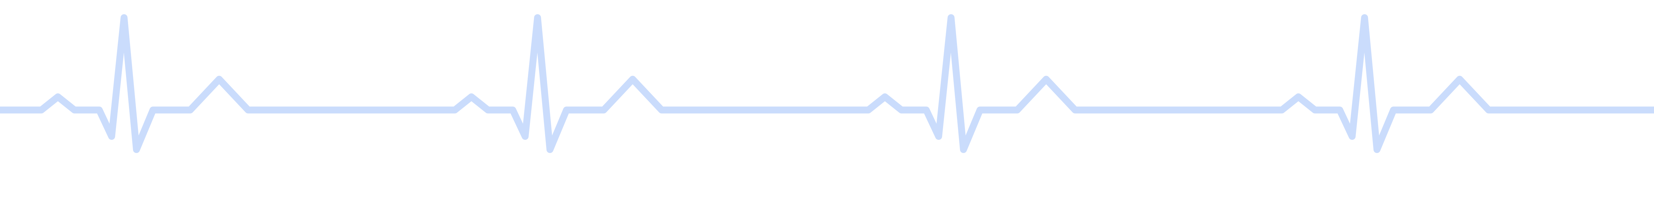


ELECTROCARDIOGRAPH
Design and Implementation of a Single-Lead ECG Acquisition System
SENIOR ENGINEERING PROJECT – ELECTRICAL ENGINEERING
Presented by
Supervisor
Year
Elene Chanturia
Aleksandre Anasovi
2026

Slide 2
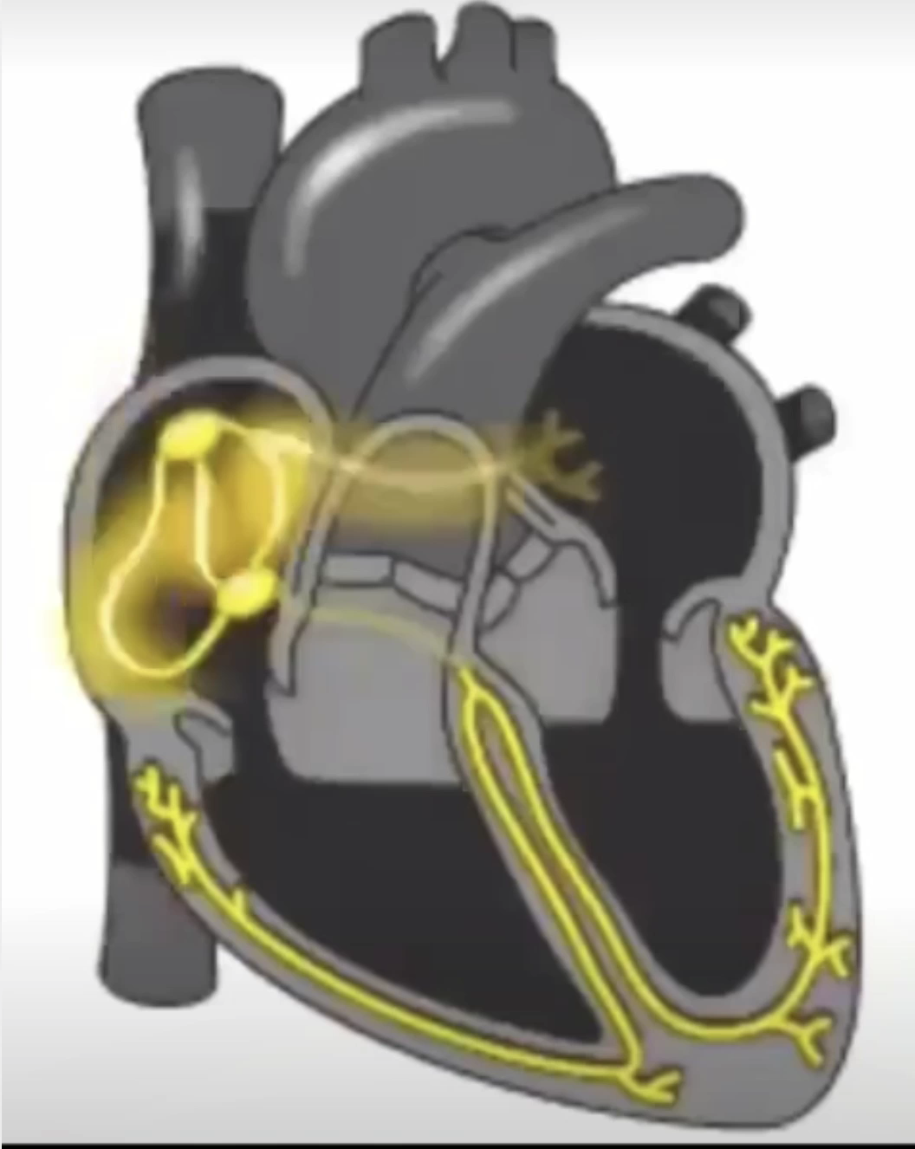
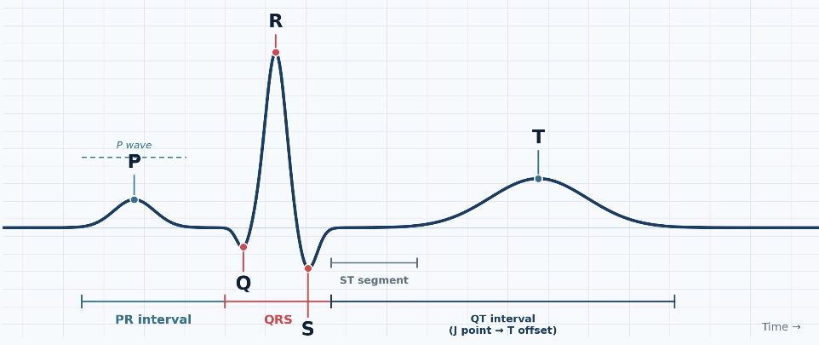
Electrocardiography: Background and Applications
ECG measures the heart’s electrical activity — a small voltage detected on the skin via electrodes.
1
Waveform recording
Each heartbeat’s signal is displayed as a waveform over time.
2
Diagnostic information
Reveals heart rate, rhythm, and conduction timing.
3
Cardiac cycle correlation
Waveform changes can flag conduction abnormalities.
ECG Waveform: P–QRS–T Complex
P wave, QRS complex, T wave — with the PR, ST, and QT intervals.

Slide 3



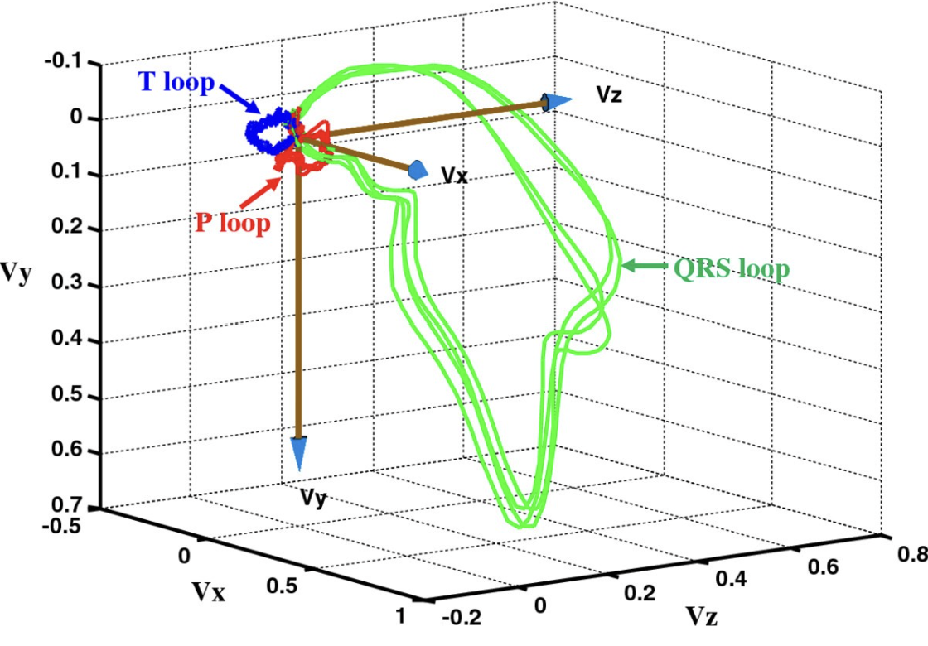

ECG electrodes configuration
Clinical (12-Lead)
Continuous Monitoring
Vectorcardiography
10 electrodes, 12 leads — full diagnostic detail.
One or a few leads — Holter, bedside, wearables.
Represents cardiac activity in three dimensions.
Method Selected for This Project
A single-lead, three-electrode setup — built for monitoring and heart-rate measurement, not full diagnosis.

Slide 4





Proposed ECG Acquisition System
From the electrodes on the skin to a processed waveform in MATLAB — the signal path of the acquisition system.
1
2
3
4
5
Electrodes
→
Analog Front End
→
ADC (Microcontroller)
→
UART Transfer
→
MATLAB Processing
Detect the heart’s electrical signal at the skin.
Amplifies and filters the signal.
Converts the signal to digital samples.
Sends samples to the computer.
Extracts the waveform, R-peaks, and heart rate.

Slide 5
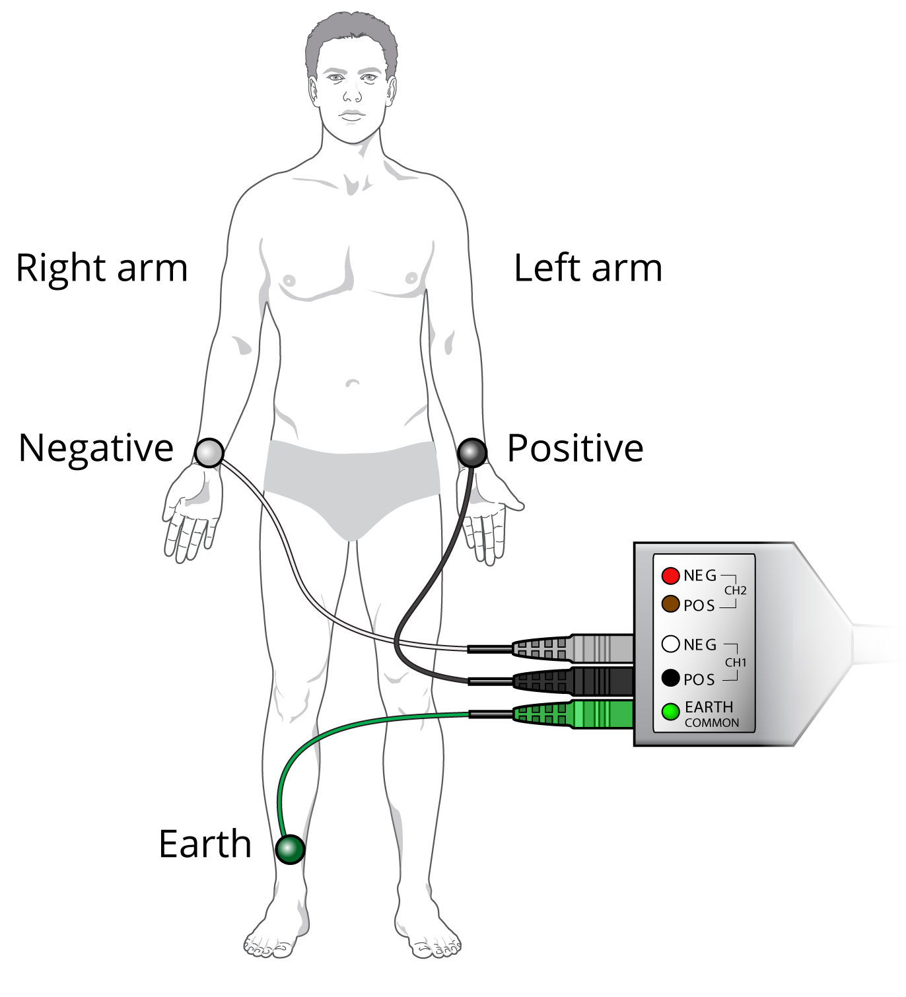



Three-Electrode Configuration
Before looking at the electronic circuit, here is how the ECG signal is obtained from the body.
RA
Right Arm
LA
Left Arm
RL
Right Leg
Sensing electrode
Sensing electrode
Reference / drive electrode
V(Lead I) = V(LA) − V(RA)
Voltage difference between the two sensing electrodes.
Right-Leg Drive
Feeds the right-leg-drive circuit to reduce common-mode interference.
Why Placement Matters
Different electrode locations capture different electrical views of the heart.
Electrode Wiring to Acquisition Channel
Negative = RA, Positive = LA — the sensing pair; Earth = RL, the reference/drive connection.
Simplified for This Project
Single-lead setup for monitoring and heart rate — not full diagnosis.

Slide 6

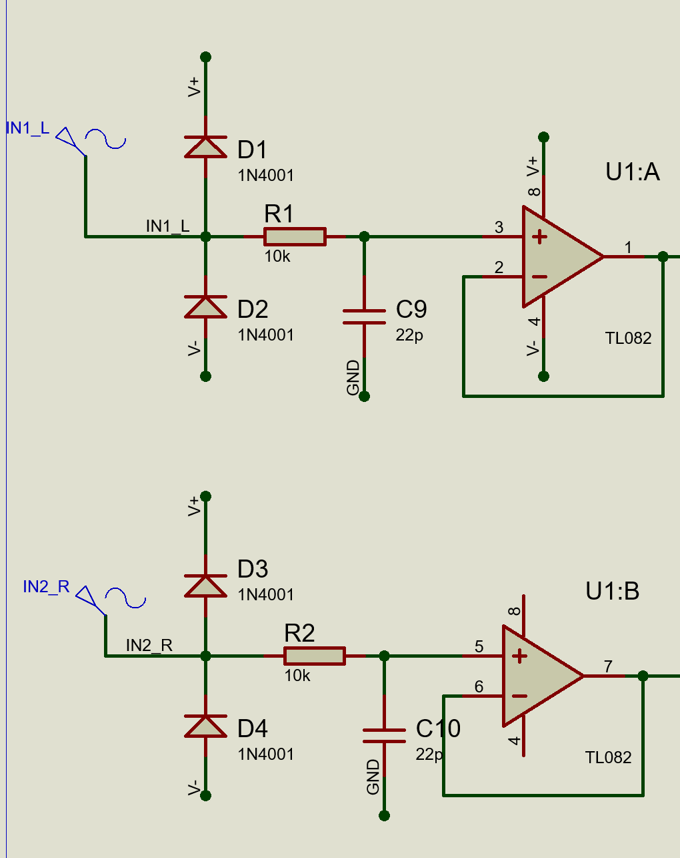


Analog Front-End: Electrode Interface
The first major engineering stage — conditioning the raw electrode signal before digitization.
0.5 – 5 mV
Electrode–Skin Interface
Typical ECG amplitude at the skin surface
Contact produces a DC offset and high, variable impedance — so the first stage needs high input impedance to avoid loading the electrodes.
Input Buffers (Voltage Followers)
One buffer per sensing electrode: high input impedance in, low impedance out. It does not amplify — it isolates the electrode interface and drives the next stage.
RC Input Filter (10 kΩ + 22 pF)
f_c = 1/(2πRC) ≈ 723 kHz — far above the ECG band, so it attenuates RF/high-frequency interference without touching the ECG signal.
Next: RLD & Differential Amplifier
The buffered outputs continue on — common-mode interference is handled by the RLD circuit, and the ECG signal is extracted by the differential amplifier.
Input Buffer Circuit
One high-input-impedance buffer (TL082) per sensing electrode, RA and LA.

Slide 7
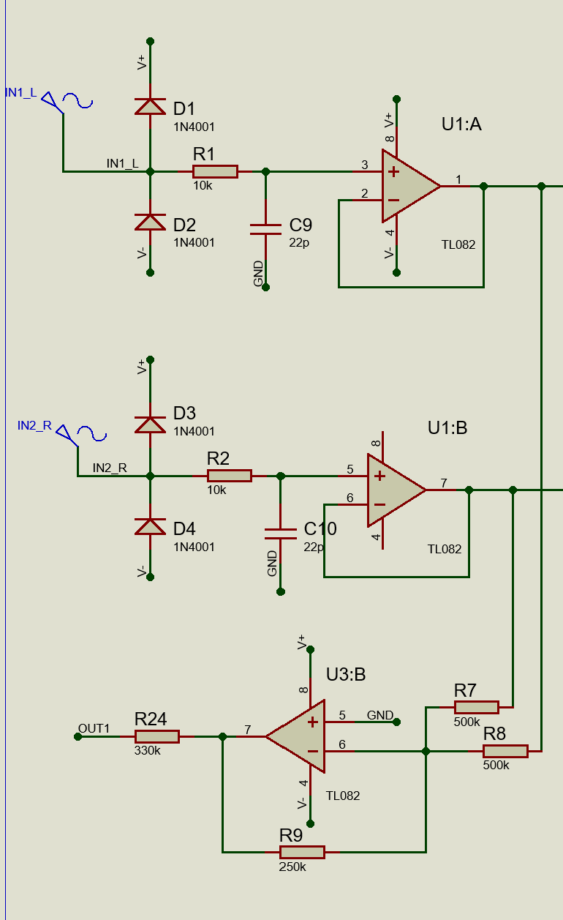
Right-Leg-Drive Circuit
Reducing common-mode interference before it reaches the differential stage.
A real amplifier has finite CMRR, and the two electrode–skin impedances are never exactly equal — so part of the common-mode interference leaks through as a differential error at the output.
V_ECG = V_LA − V_RA
V_CM = (V_LA + V_RA) / 2
Desired ECG signal
Common-mode voltage
50 Hz Common-Mode Pickup
The body picks up power-line interference at nearly the same voltage on both sensing electrodes.
Negative Feedback via RL
The RLD circuit senses V_CM, inverts it, and drives it back into the body through the RL electrode — cancelling the common-mode voltage at the input.
Safety & Stability
A high-value series resistor limits current to the body; feedback compensation keeps the loop stable against body and electrode impedances.
RLD Summing & Inversion Stage
U3:B — averages, inverts, and feeds back through RL
The RLD circuit does not remove the ECG signal — it removes the component common to both electrodes, so the differential amplifier sees a cleaner input.

Slide 8
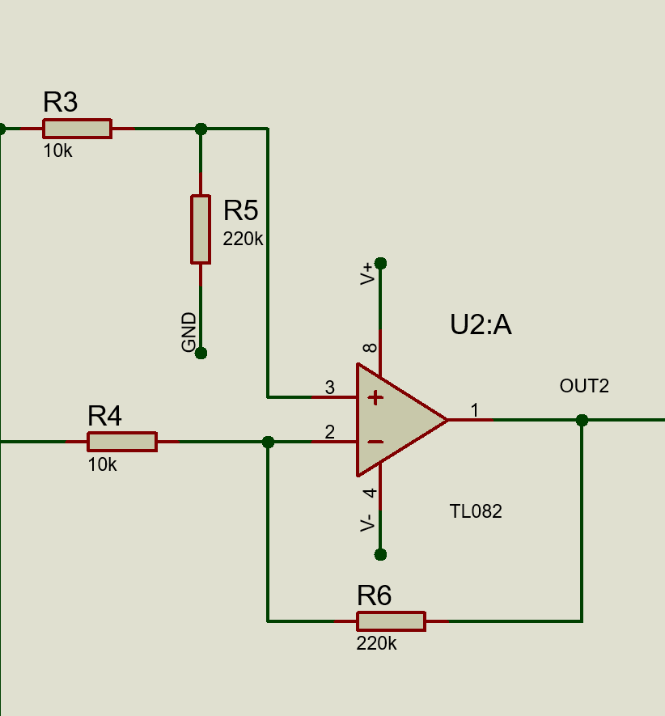
Differential Amplification and Gain Design
SIGNAL OF INTEREST
V_diff = V_LA − V_RA
Amplifies the electrode difference; rejects the common-mode signal on both inputs.
GENERAL TRANSFER FUNCTION (matched ratios: R6/R4 = R5/R3)
V_out = (R6/R4)·(V_LA − V_RA)
Full expression: V_out = −(R6/R4)·V_RA + (1+R6/R4)·[R5/(R3+R5)]·V_LA, which reduces to the difference form above.
GAIN OF THIS STAGE (actual resistor values)
Gain = 220kΩ / 10kΩ = 22 (≈ 27 dB)
V_out = 22 × (V_LA − V_RA)
WHY THE FIRST-STAGE GAIN IS KEPT MODERATE
G_max < V_out,max / (V_ECG,max + V_offset,max)
R3 = R4 = 10 kΩ · input resistors
Electrode offset can far exceed the ECG signal, so a large single-stage gain would saturate the TL082. Remaining gain (to reach 500–1000× total) is applied after DC-offset removal, keeping the output within the ADC range.
R5 = R6 = 220 kΩ · gain-setting resistors

Slide 9
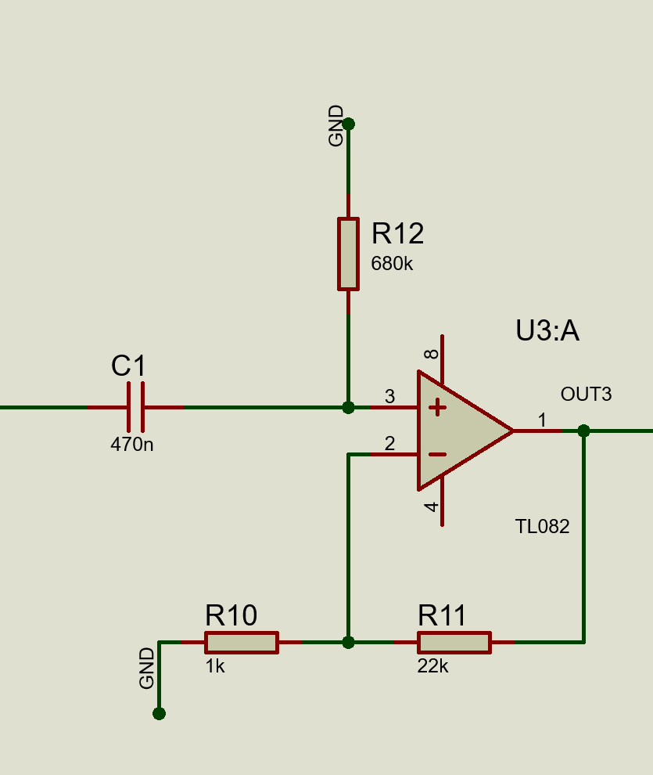
High-Pass Filtering and Second-Stage Amplification
High-pass filtering and additional gain — shaping the 0.5–40 Hz monitoring band.
MONITORING BANDWIDTH
0.5 – 40 Hz
For monitoring and heart-rate use, not full clinical diagnosis.
HIGH-PASS FILTER (C1 series + R12 to ground)
f_c = 1/(2π·R12·C1) = 0.50 Hz
R12 = 680 kΩ, C1 = 470 nF. Blocks DC and baseline drift before gain is applied, protecting the output operating point.
NON-INVERTING GAIN (R10, R11)
G = 1 + R11/R10 = 1 + 22k/1k = 23
Amplifies the ECG signal after DC and low-frequency components have been removed.
WHY THIS ORDER MATTERS
U3:A — High-Pass Filter + Non-Inverting Gain
Filter first, then gain
C1 = 470 nF, R12 = 680 kΩ · R10 = 1 kΩ, R11 = 22 kΩ
Amplifying DC/baseline components first would shift the output operating point and eat into the ECG voltage range. The upper band edge (40 Hz) is set by the low-pass stage that follows.

Slide 10
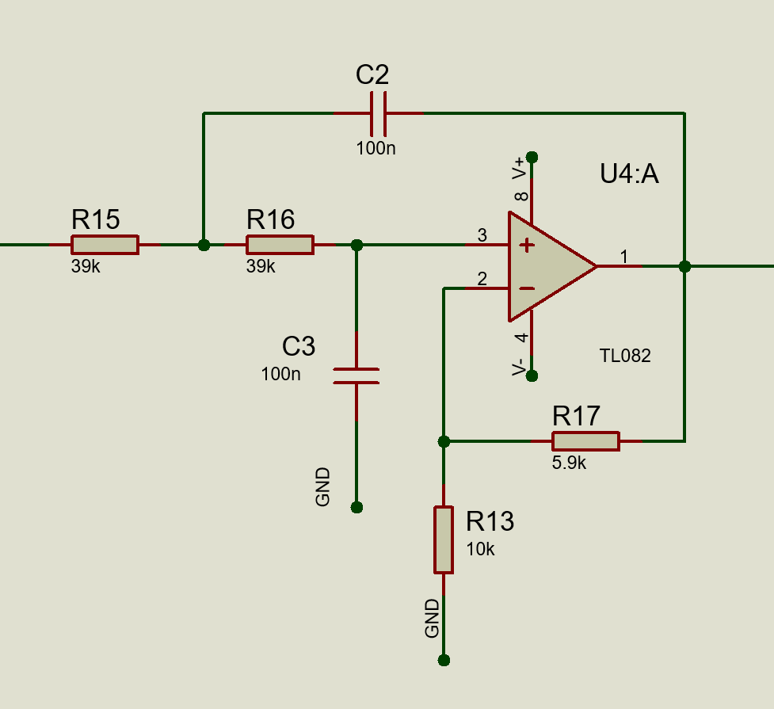
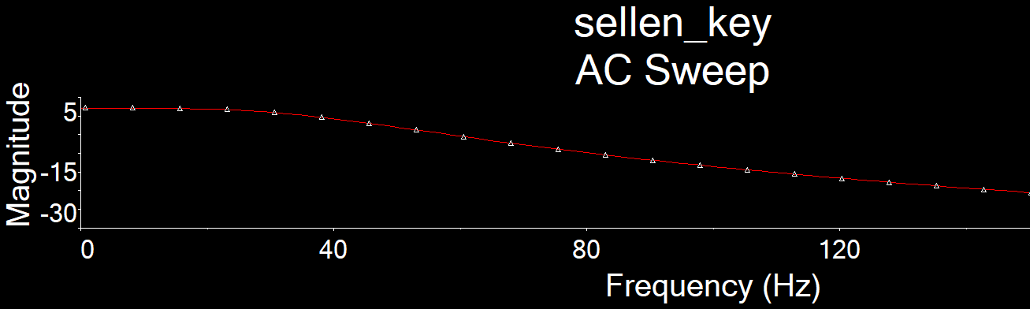
Low-Pass Filter Design
ECG BANDWIDTH
Diagnostic: 0.05 – 150 Hz
Monitoring (this project): 0.5 – 40 Hz
Preserves ST-segment and QRS detail for clinical use.
Enough for heart-rate estimation and waveform monitoring.
TRANSFER FUNCTION & CUTOFF (2nd-order Sallen-Key)
H(s) = Kωc² / (s² + ωc·s/Q + ωc²)
ωc = 2πf_c ≈ 251.3 rad/s;
Q = 1/√2 ≈ 0.707;
f_c = 1/(2π√(R15·R16·C2·C3)) ≈ 40.8 Hz — maximally flat passband.
GAIN FORMULA (non-inverting stage, R13, R17)
U4:A — Sallen-Key Low-Pass Filter
K = 1 + R17/R13 = 1 + 5.9k/10k ≈ 1.59
R15 = R16 = 39 kΩ, C2 = C3 = 100 nF · R13 = 10 kΩ, R17 = 5.9 kΩ
Required for Butterworth Q = 0.707 (equal-R,C Sallen-Key):
K = 3 − 1/Q ≈ 1.586 — matches the implemented gain.
COMPONENT CHECK & SIMULATION
R ≈ 39.8 kΩ target → R15 = R16 = 39 kΩ used
Gives f_c ≈ 40.8 Hz, within ~2% of the 40 Hz target. The AC sweep confirms the roll-off begins near this point, completing the 0.5–40 Hz monitoring band.

Slide 11
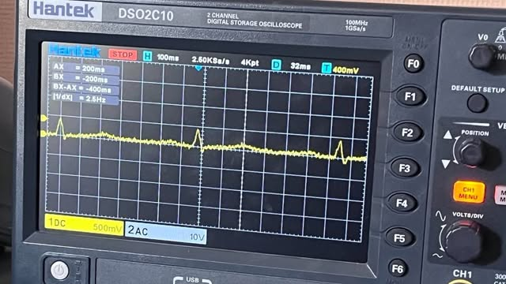
Experimental Results
The analog ECG output, measured directly before the MCU ADC.
QRS Complexes Visible
Periodic QRS complexes and R peaks appear in the captured waveform — confirming the analog front end acquires and amplifies the weak electrode signal while reducing enough noise for heartbeat events to be recognized.
Output Amplitude
0.5V amplitude. Gain is adjusted to keep the signal within the ADC input range without clipping.
Next: Digitization & Processing
Sample the signal with the MCU, transfer the data through UART, then use MATLAB for digital filtering, R-peak detection, and average heart-rate calculation.
Analog ECG Output Before ADC
CH1, 500 mV/div, 100 ms/div. Periodic QRS spikes visible on the trace.

Slide 12
Analog-to-Digital Conversion
Converting the conditioned ECG signal into digital samples with the ATmega168’s internal ADC.
SAMPLING FREQUENCY (≫ Nyquist minimum)
f_s = 1000 Hz
The maximum frequency of interest is ≈ 40 Hz, so the Nyquist minimum is only 80 Hz. Sampling at 1000 Hz gives many samples per waveform — useful for visualization and future digital processing.
ADC RESOLUTION (ATmega168, 10-bit)
1 LSB = V_ref / 2^10 = 5V / 1024 ≈ 4.88 mV
The reference voltage sets both the ADC input range and the voltage represented by each count — a larger reference means a coarser step size.
MATCHING OUTPUT RANGE TO THE REFERENCE
V_out,max ≈ V_ref (with margin against clipping)
An unnecessarily large reference wastes ADC resolution on range the ECG signal never uses. The analog front-end output and ADC reference should be matched as closely as possible, while leaving enough margin to prevent clipping.

Slide 13



Microcontroller & UART Communication
Bridging the ADC and the computer — transferring the ECG samples over a serial link.
Role of the Microcontroller
Receives the digitized ECG samples from its own ADC and forwards them to the computer via UART — the link between acquisition and processing.
UART Frame Format
An asynchronous serial protocol: a start bit, data bits, one or more stop bits, and optional parity for error checking.
Baud Rate Selection
Must be fast enough to transmit every sample without creating a bottleneck — depends jointly on the sampling frequency, bits per sample, and the UART frame format.
Current Focus
The microcontroller continuously converts and transfers ECG samples to the computer.

Slide 14
MATLAB: R peak detection
PROCESSING PIPELINE
After the ECG samples are transmitted to the computer, MATLAB receives the digital data and reconstructs the signal as a waveform over time, so it can be displayed and analyzed.
1
Serial Reception
MATLAB receives the digital ECG samples through the serial (UART) interface.
2
Waveform Reconstruction
The signal is reconstructed and displayed as a waveform over time.
Beyond visualization, this stage also supports further digital signal processing — additional filtering, R-peak detection, and heart-rate calculation from the interval between consecutive R peaks.
3
Filtering & R-Peak Detection
Further digital filtering is applied, and an algorithm detects each R peak.
PROJECT STATUS
Experimental work so far has focused on the analog front end. The MATLAB processing stage — reconstruction, filtering, R-peak detection, and heart-rate calculation — represents the part of the system to be developed.
4
Heart Rate Calculation
The R-R interval between consecutive peaks is converted into heart rate.

Slide 15
My Interests and Future Plans
Looking beyond this project, my main area of interest is biomedical engineering, with a particular focus on neural engineering — a field that creates a direct connection between engineering technology and the neuroscience.
AREAS I WANT TO WORK IN
1
Brain–Computer Interfaces
2
Neuroprosthetic Devices
Recording and interpreting neural signals
Restoring lost motor or sensory function
3
Neural Recording Systems
4
Rehabilitation Technologies
Capturing signals from the nervous system
Aiding recovery from neurological injury
NEURAL ENGINEERING

Slide 16
Questions?
Thank you for your attention!

