Slide 1
Determining the Movement of an Object Using IMU Sensors
Bachelor project • Embedded IMU system • Real-time inertial measurement and flight-distance estimation
PRESENTED BY
PROGRAMME / INSTITUTION
SUPPORTED BY
Nikoloz Kurdghelashvili
[agricultural university of Georgia(AUG)/electrical engineering]
GGSB

Slide 2

Why measure the movement of an object?
The project began with a general motion-tracking problem and evolved into a focused, testable measurement task.
WHERE IMUS ARE USED
MY MOTIVATION
Inertial sensing is common when direct position measurement is difficult or impractical.
Build a low-cost embedded system that can observe a thrown object's motion using only onboard inertial sensors.
Robotics and drones
Portable hardware
Navigation and motion tracking
No external positioning system
Wearable and sports systems
Real-time processing on an STM32
Industrial monitoring
Physically measurable output
The goal was not just to read sensors — it was to turn inertial measurements into a meaningful physical quantity.

Slide 3
What is an IMU?
An Inertial Measurement Unit measures motion using inertial sensors.
Accelerometer
Gyroscope
Linear specific force
Angular velocity
Measures along X, Y, Z
Measures rotation about X, Y, Z
Gravity is included in the measurement
Used to track orientation changes
Sensor fusion
My IMU
Combine measurements
Two sensors + MCU
MMA8452Q accelerometer
Orientation helps interpret acceleration
MPU6050 gyroscope
Calibration and filtering reduce error
STM32F103C8T6 processor

Slide 4
How an IMU turns motion into data
The sensors do not directly measure position. Position must be reconstructed from measured acceleration and rotation.
1
Measure
aₓ, aᵧ,a + ωₓ, ωᵧ, ω Acceleration and angular velocity are sampled over time
2
Estimate orientation
Roll and pitch Gyroscope tracks changes. Accelerometer provides gravity reference
3
Transform
Body frame → world frame Rotate acceleration into a fixed coordinate frame
4
Remove gravity
Linear acceleration Subtract the gravity vector after orientation correction
5
Integrate
Velocity → position Numerical integration accumulates motion over time

Slide 5
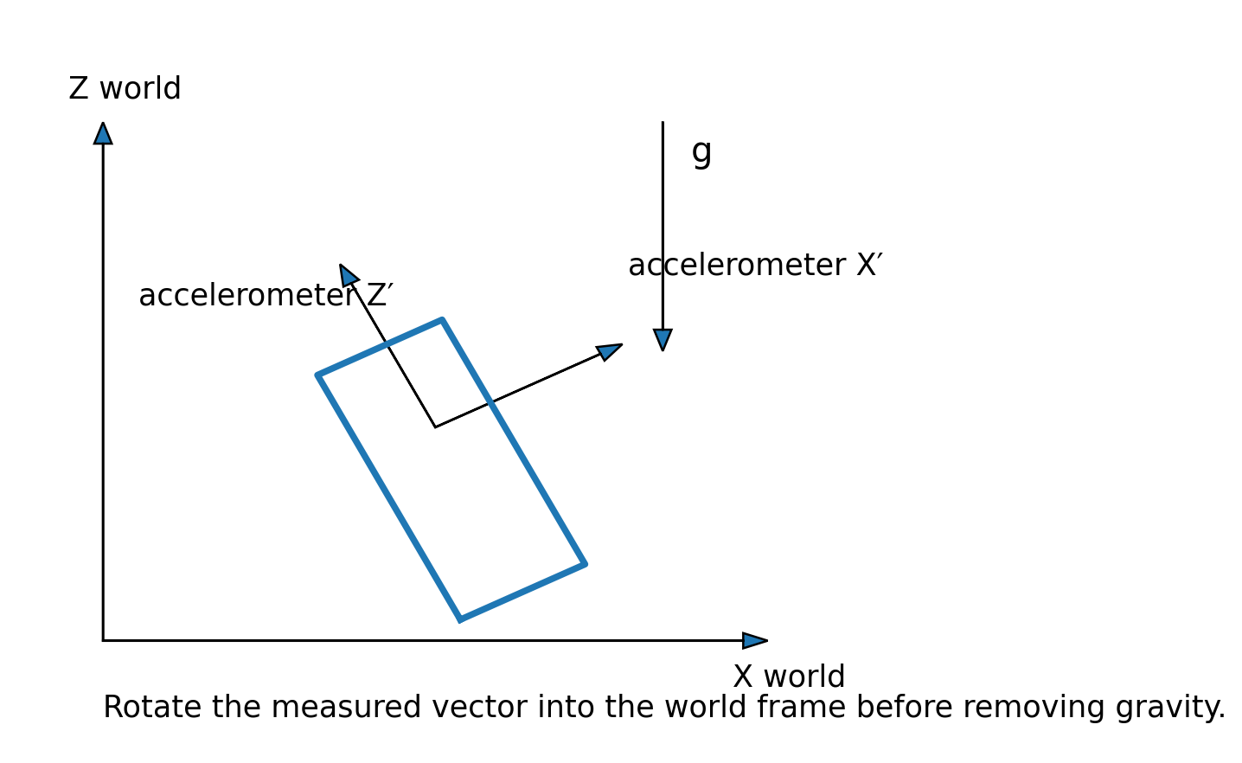
How an IMU turns motion into data

Slide 6
Why direct IMU position tracking is difficult
The key problem is not the integral itself — it is the small errors entering the integral.
IDEAL PHYSICS
REAL SENSOR
Acceleration
velocity
position
Bias + noise + orientation error
v(t) = ∫ a(t) dt
Small acceleration bias creates velocity drift
x(t) = ∫ v(t) dt
Orientation error leaks gravity into linear acceleration
Double integration makes position error grow rapidly
The project therefore shifted from full inertial navigation to a constrained flight experiment.

Slide 7
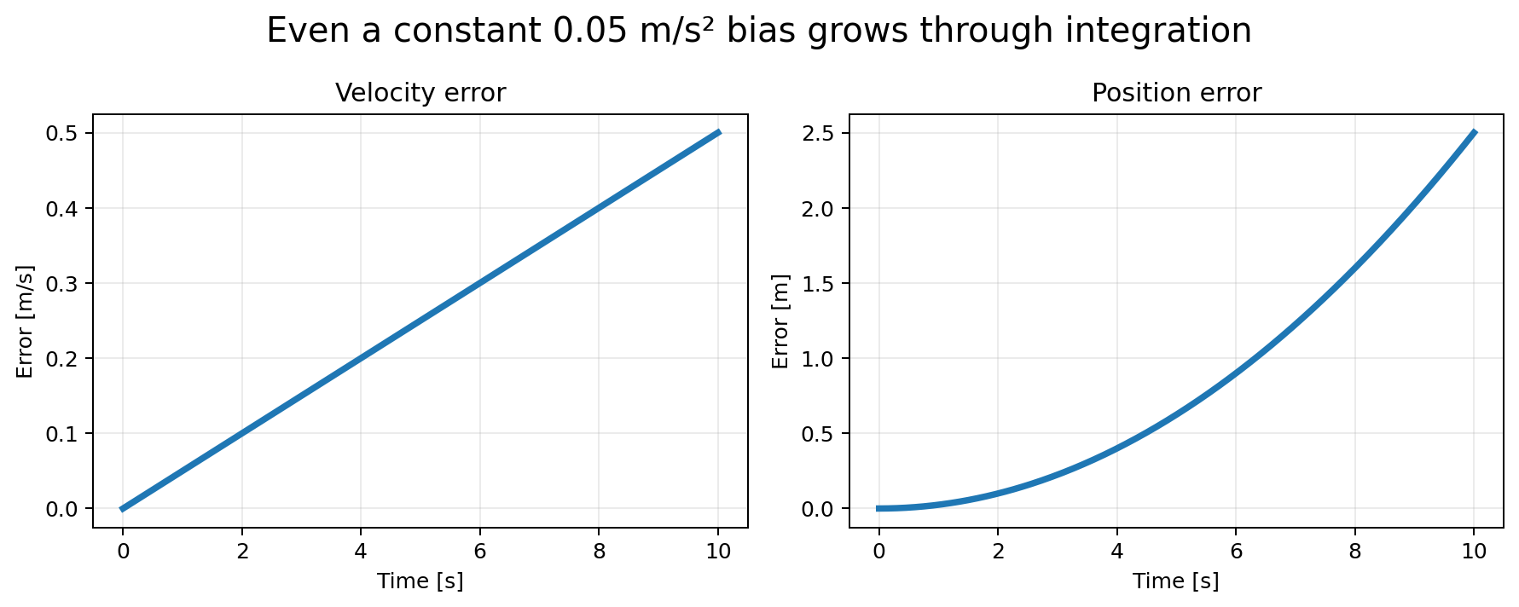
Why direct IMU position tracking is difficult
The key problem is not the integral itself — it is the small errors entering the integral.
IDEAL PHYSICS
Acceleration
velocity
position
v(t) = ∫ a(t) dt
x(t) = ∫ v(t) dt
The project therefore shifted from full inertial navigation to a constrained flight experiment.

Slide 8
The project changed because
the physics exposed a limitation
The original objective was more ambitious than the available sensing accuracy could support.
INITIAL OBJECTIVE
FINAL OBJECTIVE
Real-time 3D position
Horizontal flight distance
Estimate x, y, z continuously
Detect launch and impact
Start from an arbitrary initial orientation
Estimate horizontal velocity
Use IMU measurements to reconstruct the trajectory
Use measured flight time to calculate traveled distance

Slide 9
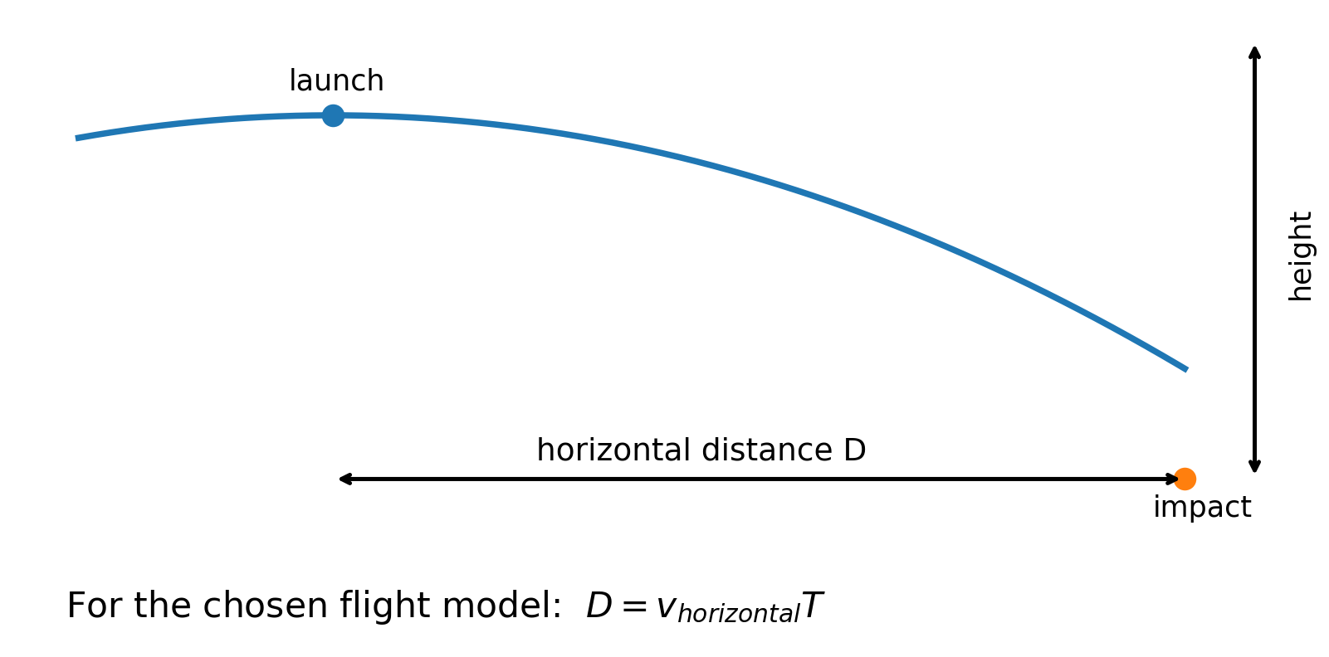
Physics approach

Slide 10
System hardware
A compact embedded prototype combines inertial sensors, an MCU and a local display.
STM32F103C8T6
MMA8452Q
Main controller
3-axis accelerometer
Runs firmware
±2 g configuration
Performs calculations
8 MHz system clock in current project
Corrected interpretation: 12-bit, 1024 counts/g
MPU6050
16×2 LCD
3-axis gyroscope
Local interface
±250 °/s configuration
Shows operating state
131 LSB/(°/s) scale in driver
Displays velocity, flight time and result

Slide 11
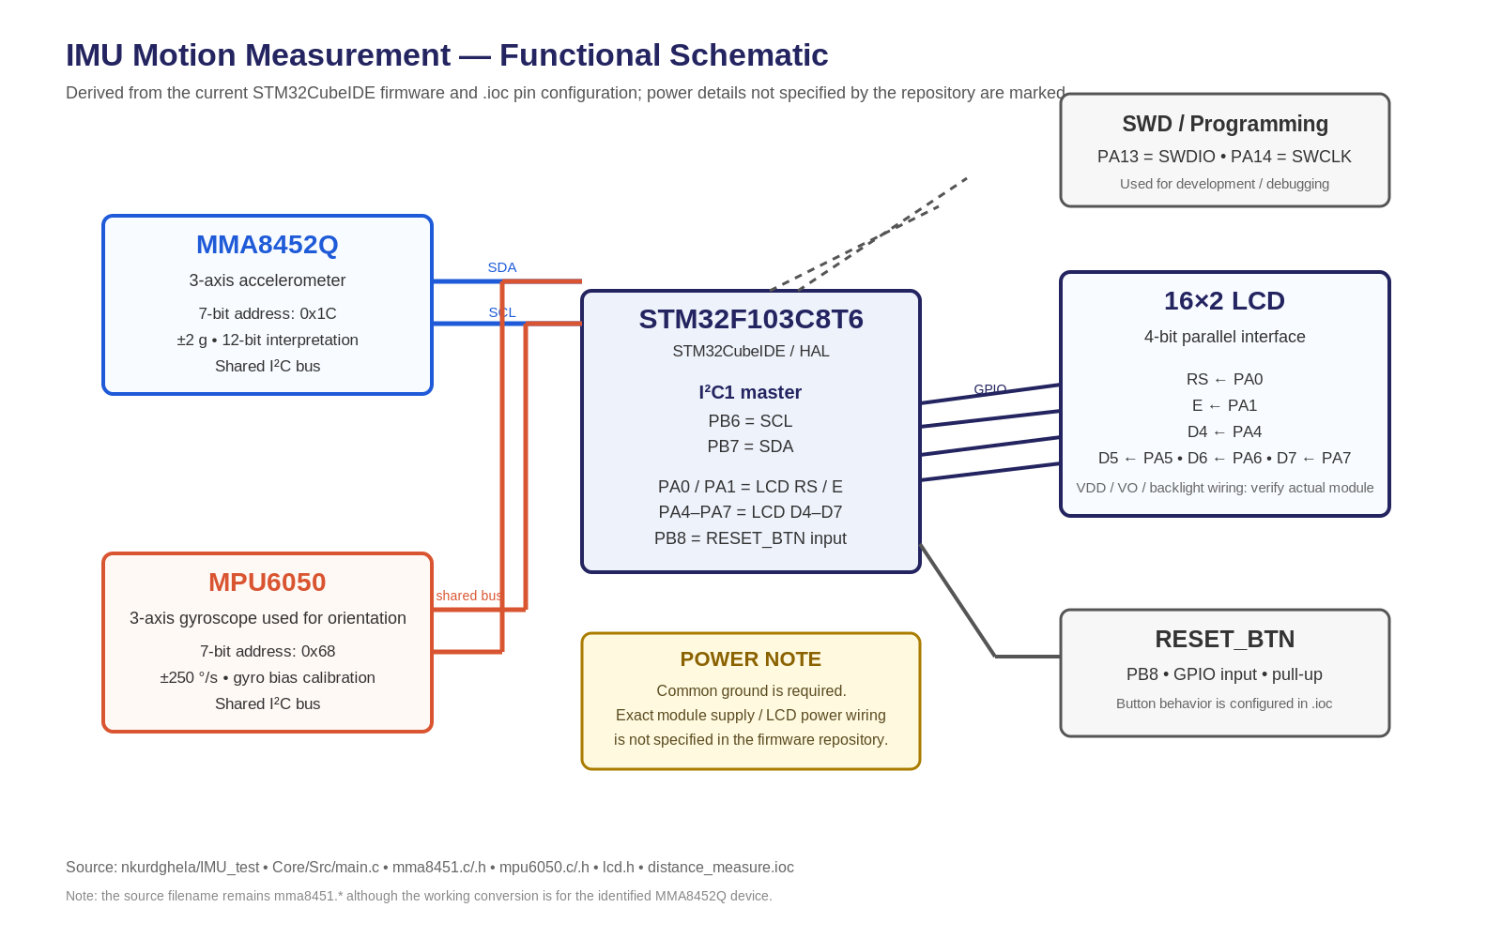
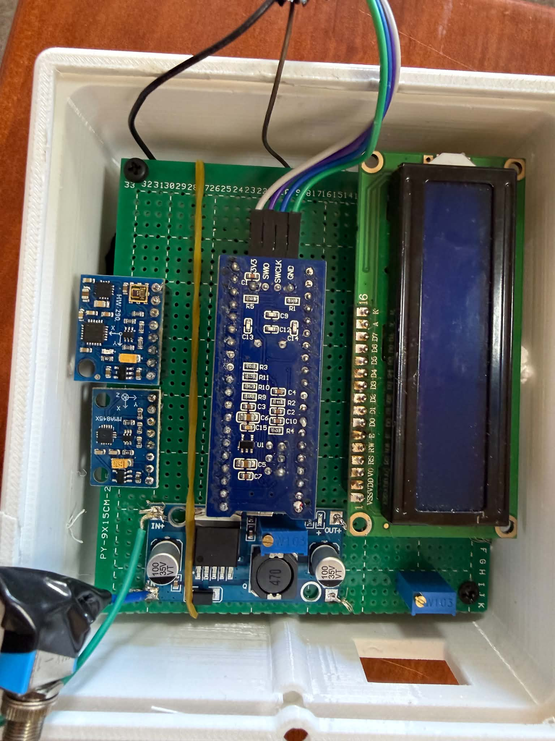
Built schematic

Slide 12
Electrical architecture and key interfaces
Derived directly from the STM32CubeMX configuration and firmware.
Function | Device / signal | STM32 pins | Interface / role
Shared IMU bus | MMA8452Q + MPU6050 | PB6 / PB7 | I²C1 SCL / SDA
LCD control | RS / E | PA0 / PA1 | GPIO output
LCD data | D4–D7 | PA4–PA7 | 4-bit parallel GPIO
Reset input | RESET_BTN | PB8 | GPIO input with pull-up

Slide 13
The mathematical pipeline
This is the core physics-to-computation path used by the project.
1. Calibrate
Estimate sensor bias Average stationary samples. Gyro zero-rate bias. Accelerometer bias
2. Estimate orientation
Roll / pitch Integrate gyro rate. Correct long-term drift with gravity reference
3. Rotate acceleration
R = R(roll,pitch) Convert body-frame acceleration to world frame
4. Remove gravity
a_linear = a_world − g Gravity is subtracted only after frame transformation
5. Integrate
v = ∫a dt Accumulate pre-launch velocity estimate

Slide 14
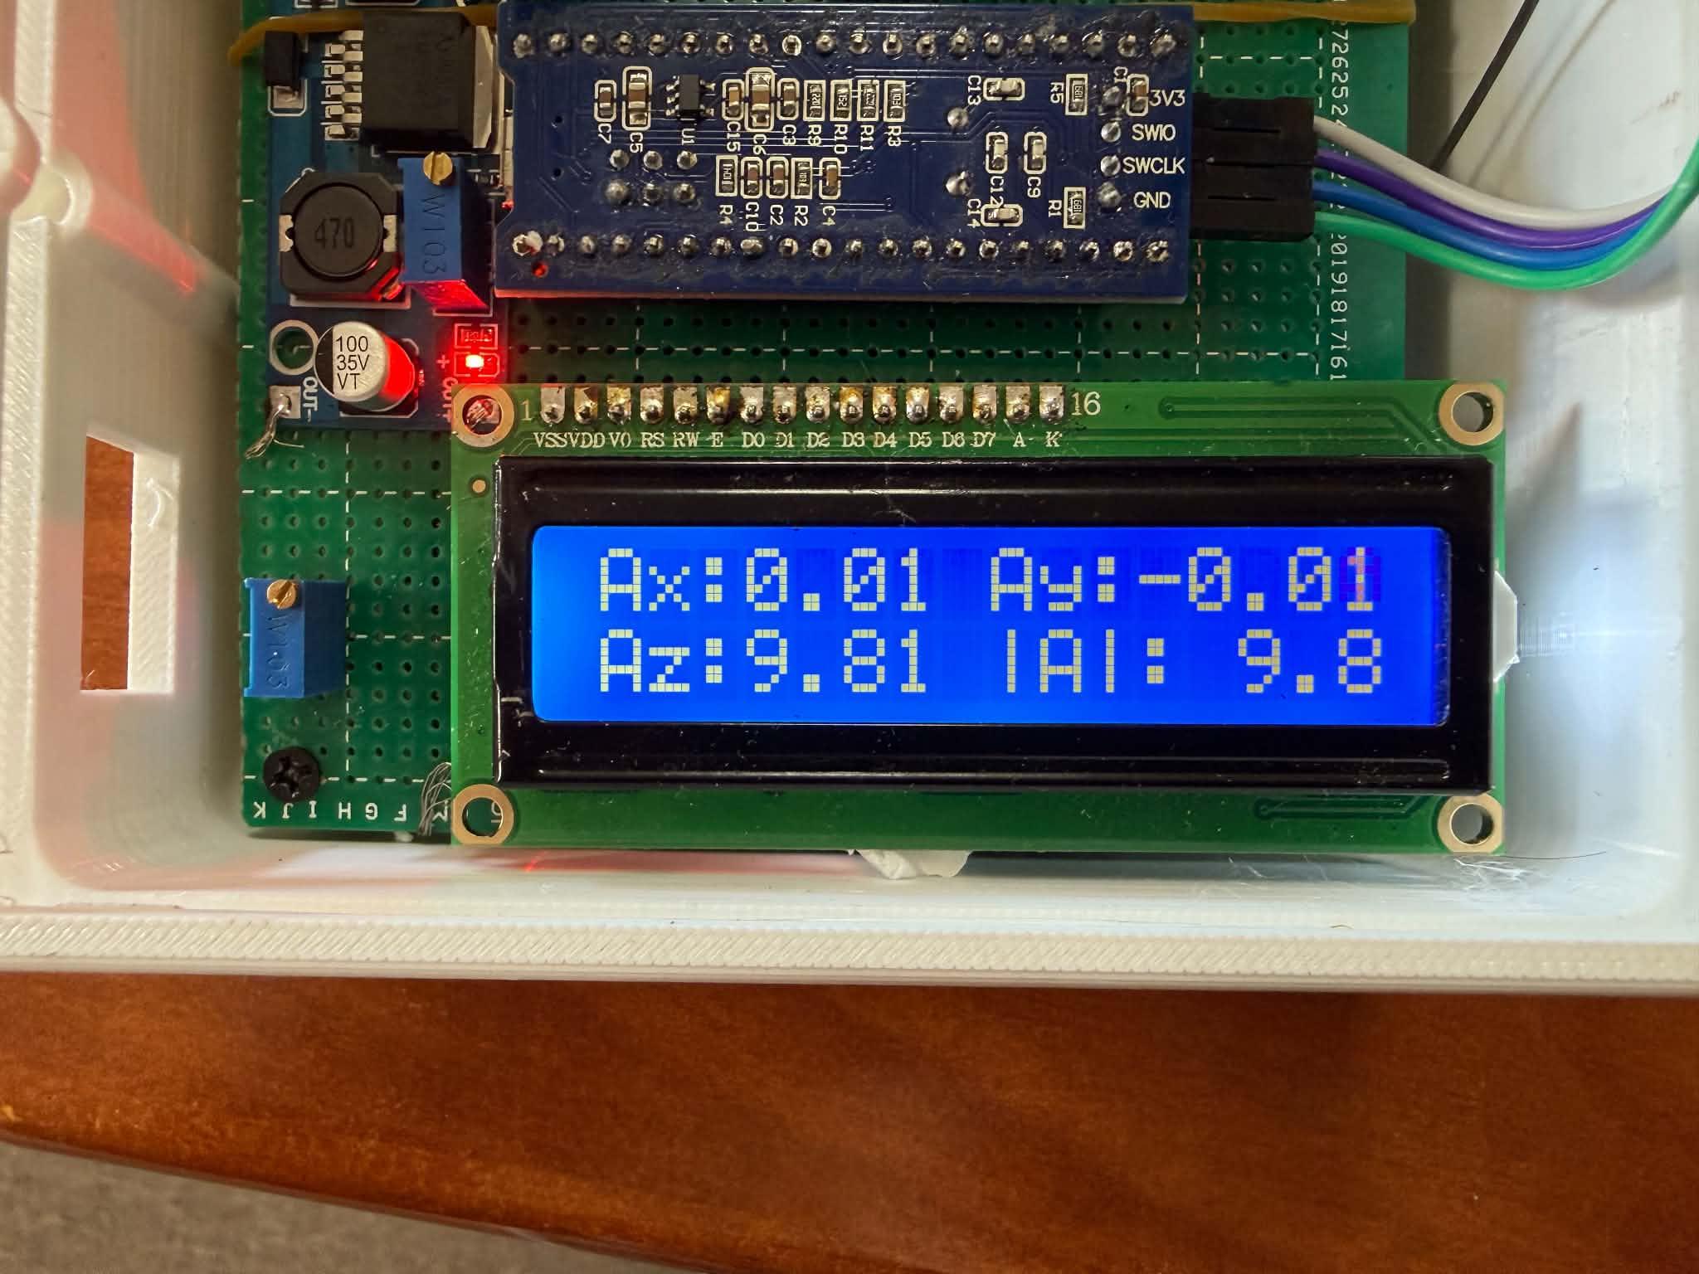

Slide 15
Launch and impact become events in a state machine
Instead of trying to reconstruct the full trajectory continuously, the firmware detects key transition events.
IDLE
PRE-LAUNCH
FLIGHT
LANDED
Waiting
Acceleration phase
Free-flight phase
Impact detected
Orientation updated. Monitor acceleration magnitude
Freeze launch velocity estimate. Measure elapsed flight time
Compute distance. Display result. Reset for next test
Begin velocity integration. Track body-to-world acceleration

Slide 16
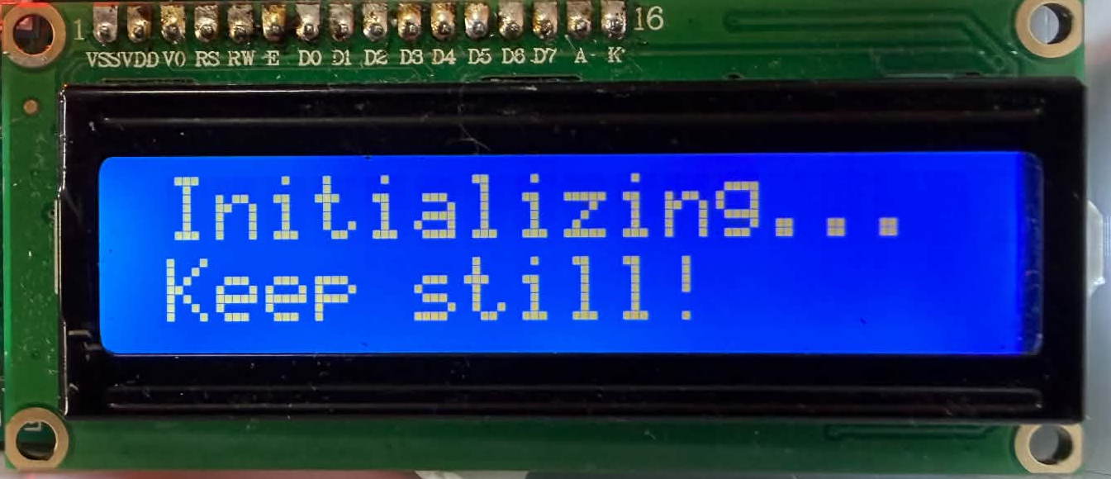
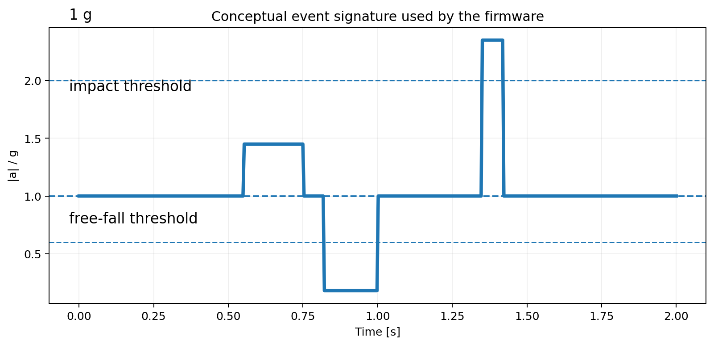
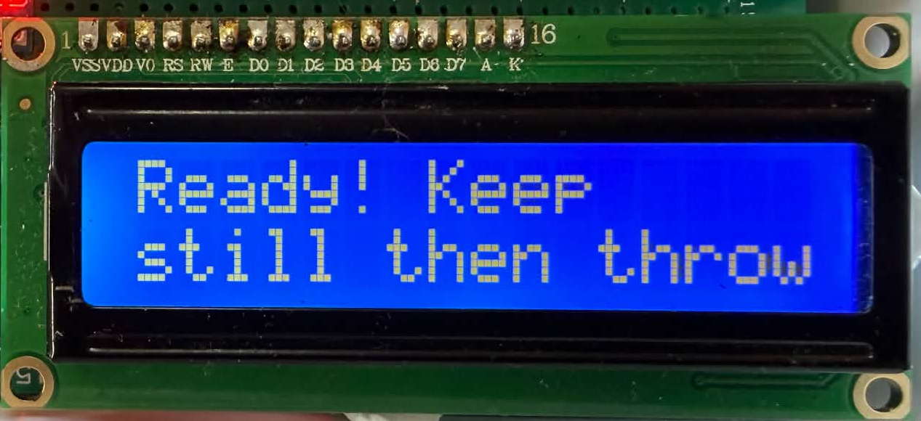
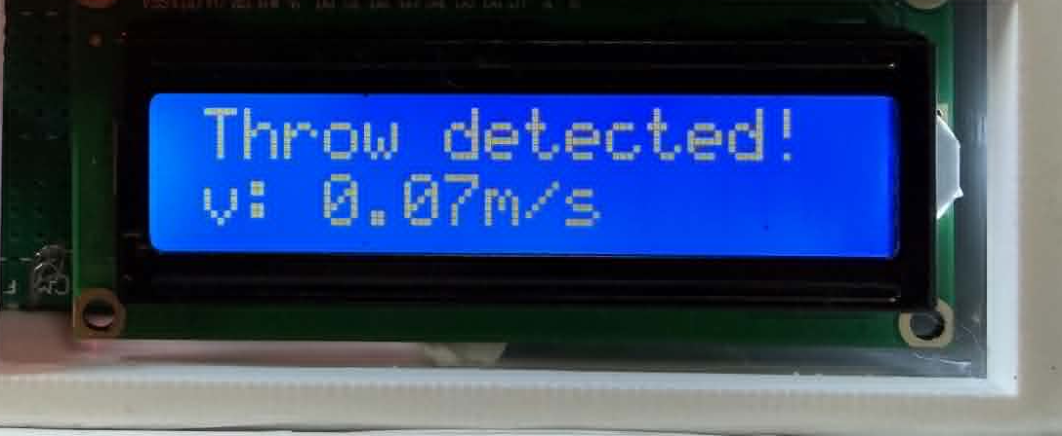
Launch and impact become events in a state machine

Slide 17
Distance estimation uses
a deliberately constrained physical model
For a short flight, horizontal acceleration is assumed negligible compared with the launch velocity.
MEASURED / ESTIMATED
PHYSICS MODEL
From the IMU
Projectile motion approximation
Horizontal launch velocity: v_horizontal
D = v_horizontal × T
Assumes negligible horizontal air resistance
Flight time: T = t_impact − t_launch
Assumes launch and impact define the measured flight interval
The simplification reduces the amount of inertial integration required during free flight.

Slide 18
Building the prototype: from firmware to physical hardware
The system was assembled as a compact throw-test unit with the electronics protected inside an enclosure.
ELECTRICAL BUILD
MECHANICAL BUILD
Wiring and interfaces
Protect the electronics
Shared I²C bus for both IMU devices
IMU and controller placed inside a protective box
4-bit parallel LCD
Designed to survive repeated throwing and impact
Sensor orientation fixed relative to the enclosure

Slide 19
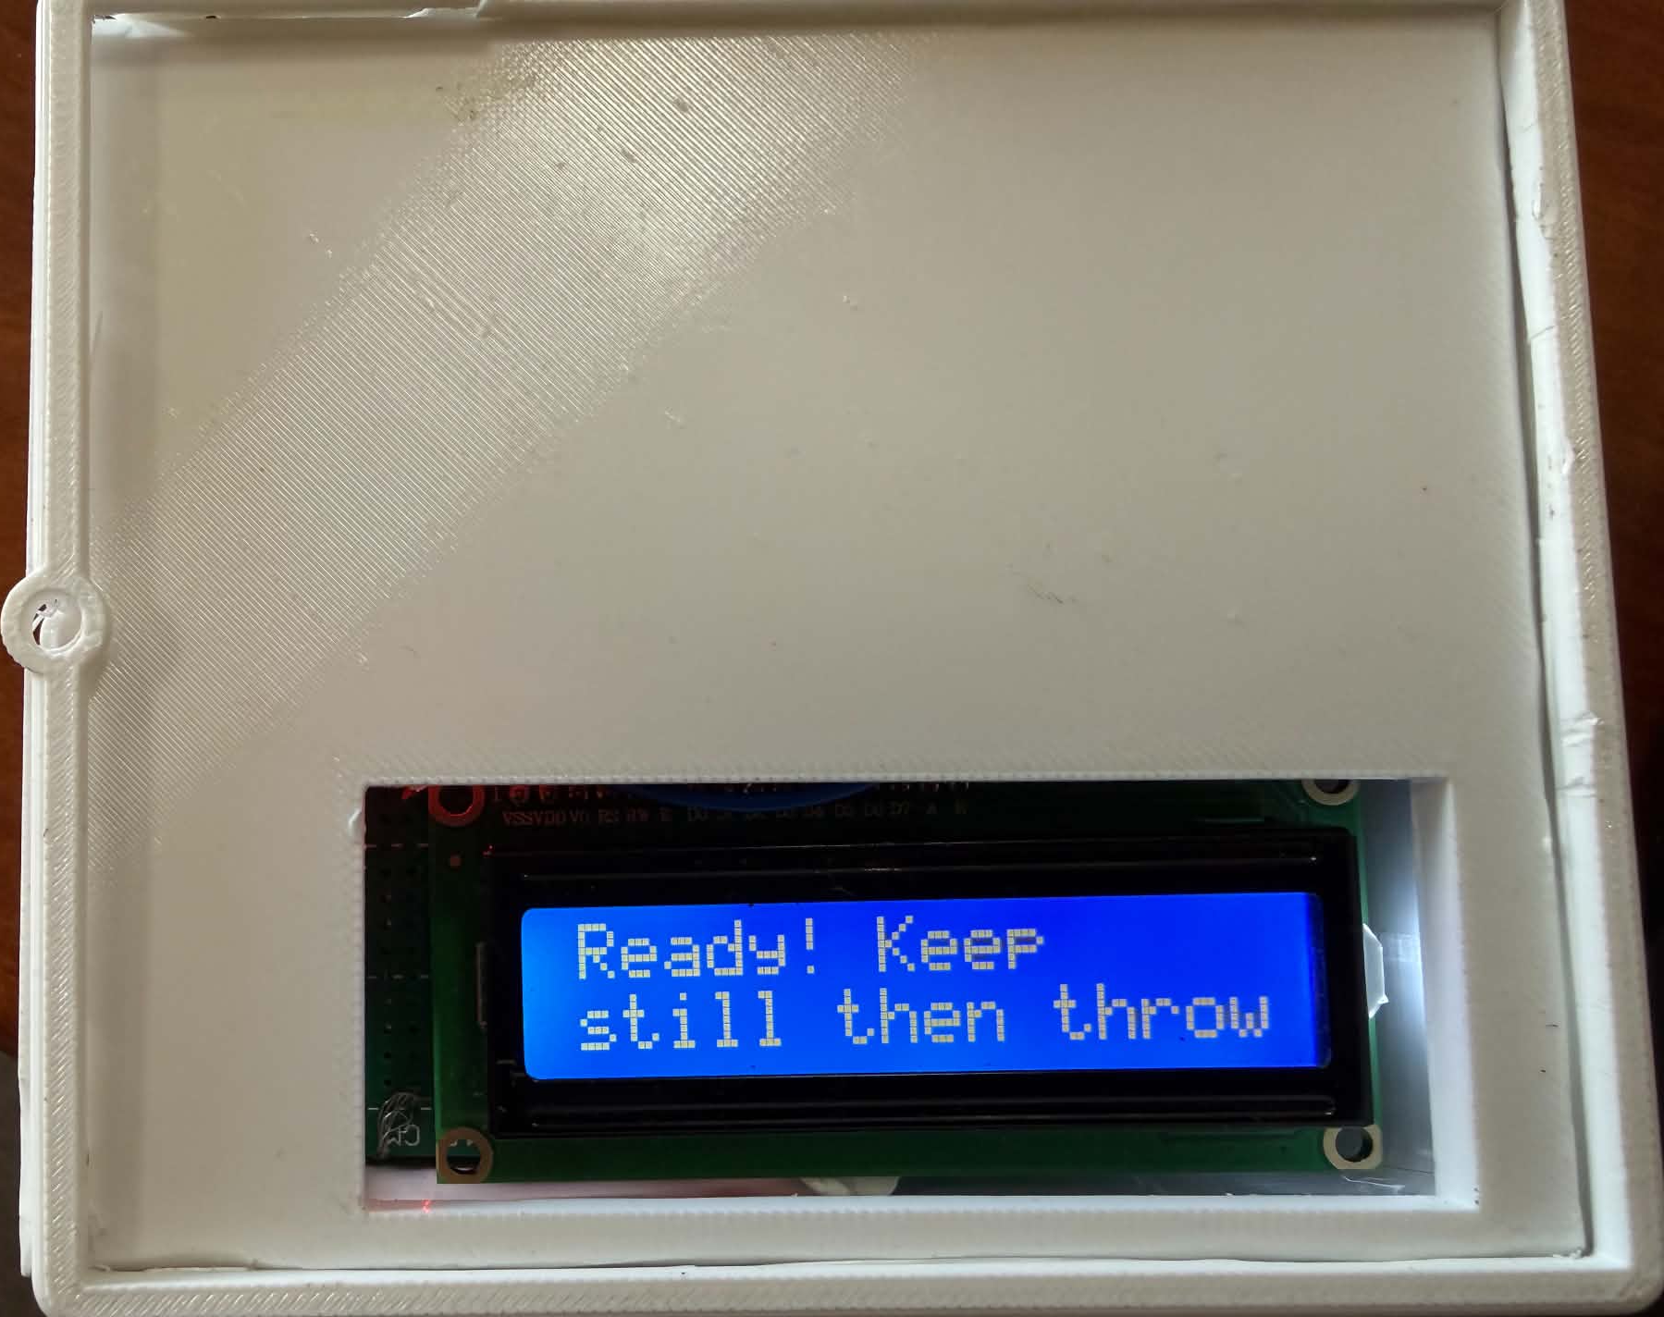
Building the prototype: from firmware to physical hardware
The system was assembled as a compact throw-test unit with the electronics protected inside an enclosure.

Slide 20
Testing exposed problems that were invisible on paper
The first working prototype did not behave as the ideal model predicted.
OBSERVED PROBLEMS
DEBUGGING APPROACH
During early testing
Reduce complexity
Very large apparent drift
Test raw acceleration first
Free-flight detection did not trigger reliably
Compare expected axis response with actual readings
Position reconstruction was therefore abandoned
Verify sensor identity and scaling before changing algorithms

Slide 21
A hardware identification error became
a key debugging lesson
The accelerometer driver was initially written for MMA8451Q, but the actual device identified itself differently.
WHAT THE SOFTWARE ASSUMED
WHAT THE HARDWARE REPORTED
MMA8451Q
WHO_AM_I = 0x2A
14-bit interpretation
MMA8452Q identity
12-bit output
>> 2 conversion
>> 4 interpretation
4096 counts/g
1024 counts/g at ±2 g
Correctly identifying the sensor fixed the axis-scaling problem and restored normal acceleration measurements.

Slide 22
Results table — replace placeholders before presenting
A compact table for comparing measured ground truth with the embedded estimate.
Trial | Actual distance (m) | Calculated distance (m) | Error (%) | Flight time (s)
1 | [_5m__] | [__7.5m_] | [_25%__] | [_3__]
2 | [_10m__] | [_8m__] | [_20%__] | [_6__]
3 | [__15m_] | [__16.7_] | [__11%_] | [_8__]
4 | [__20m_] | [__18.6_] | [__7%_] | [_10__]

Slide 23
What I gained from the project
The strongest outcome is the ability to move between theory, hardware, firmware and experimental evidence.
1
Physics
Connected projectile motion, gravity and numerical integration to a real measurement problem.
2
Embedded systems
Built an STM32-based sensing system with I²C peripherals, timing and a local user interface.
3
Sensor fusion
Learned why orientation quality controls gravity compensation and therefore velocity accuracy.
4
Experimental method
Learned to isolate faults systematically instead of tuning thresholds blindly.

Slide 24
Future goals
1
Less errors
With better hardware reduce the error as much as possible
2
Real life usage
To implement this device into real life appliations
3
Return to the original
After making this project better, finish what I started and make 3d navigation

Slide 25
The main conclusion
The project became stronger when the real engineering limitations were treated as part of the research.
1
The problem
IMU-based movement estimation is fundamentally sensitive to sensor error and orientation.
2
The solution
The original 3D-position objective was reformulated into a constrained flight-distance measurement problem.
3
The lesson
Correct sensor identification, calibration, physics and experimental validation matter as much as the firmware itself.

Slide 26
Thank you
Questions & discussion
TAKEAWAY
Determining the Movement of an Object Using IMU Sensors

