Slide 1



Portable Data Acquisition System
for SiPM-Based Particle Detectors
Presented by-Mariam Titilokashvili
Supervisor- David Mchedlishvili
Agricultural University of Georgia

Slide 2
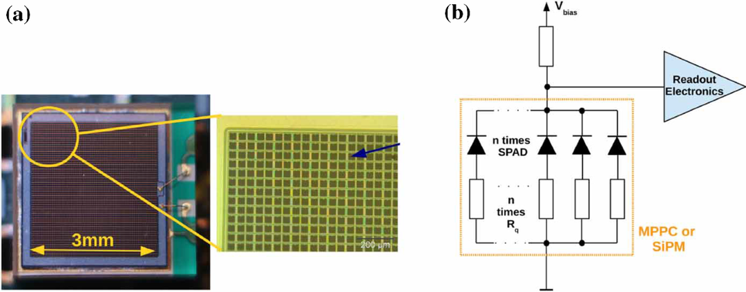
What is SiPM
  Highly sensitive semiconductor device
  Detects very weak light signals
  Consists of many small SPAD cells

Slide 3
SiPM Signal characteristics
Amplitude:~ μA-mA
Rise time:~1ns
Pulse duration:~10-100ns
Requires fast electronics for readout

Slide 4
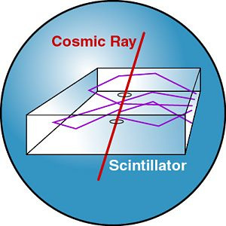
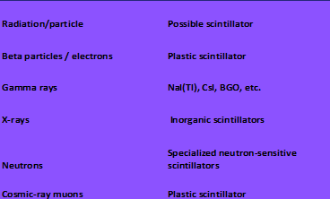

How to detect particles with SiPM?
A scintillator is a material that produces photons when a particle deposits energy in it.

Slide 5

Motivation
Making a low-budget and simple DAQ system for particle detection
Based on locally available hardware components
Portable and compact system

Slide 6
System Development Approach
Detect and amplify short SiPM signals.
Signal reshaping for slow electronics(mcu)
MCU-based rate counter(and amplitude spectrum)
User interface

Slide 7
System Overview
Counting and data representation
SiPM Detector
BJT Preamplifier
Monovibrator

Slide 8
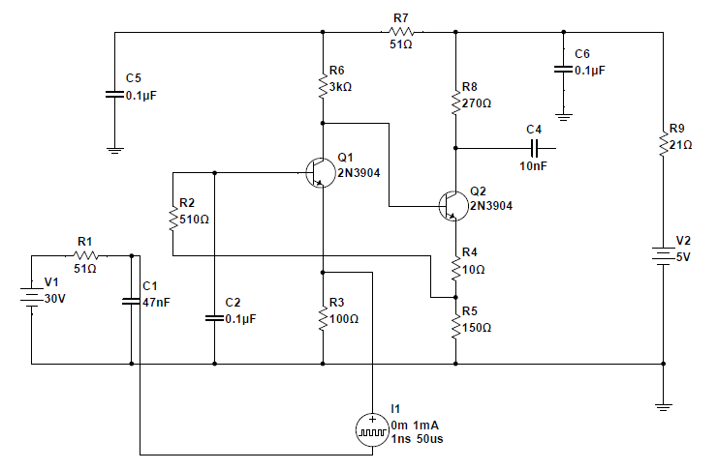
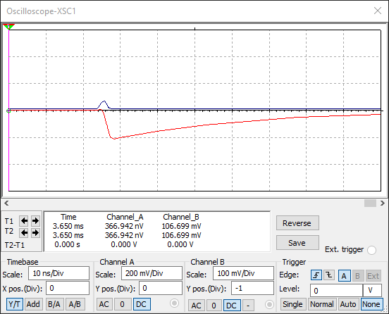
Amplifier circuit
Simulated in NI Multisim
SiPM signal
Preamplifier output

Slide 9
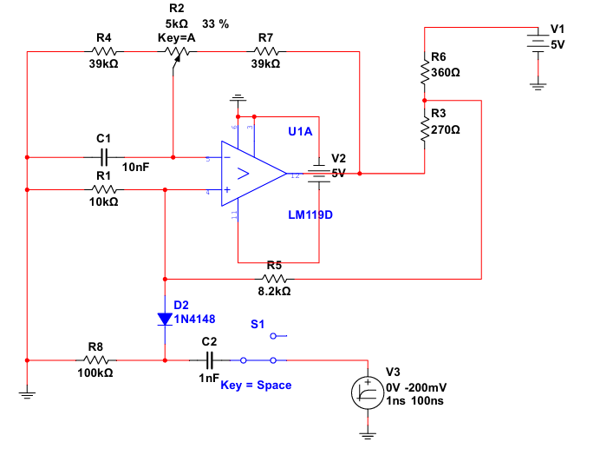
Monovibrator circuit
Simulated in NI Multisim
<2.52V
2.52V
Signal from preamplifier

Slide 10



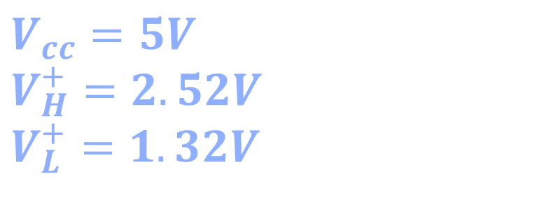



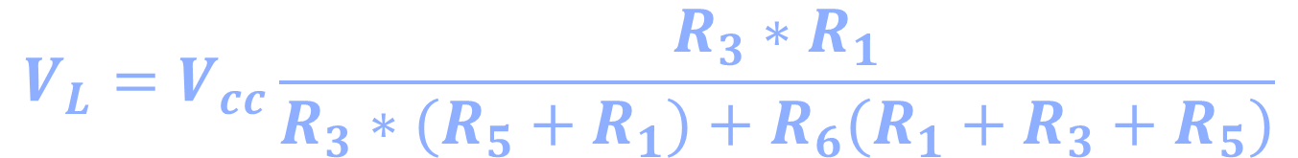

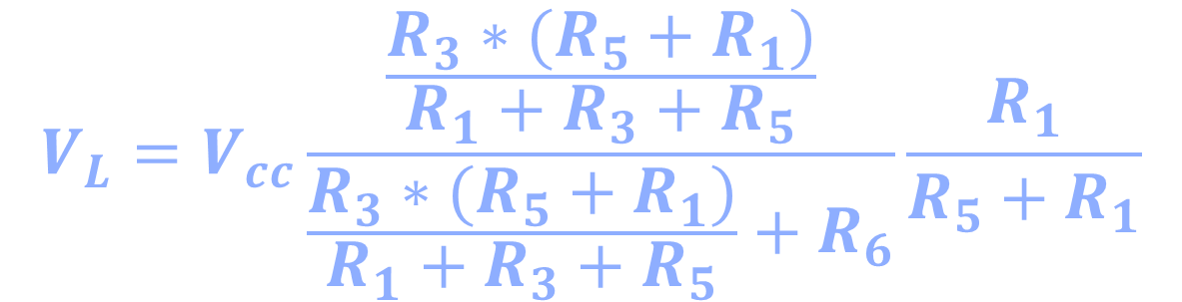
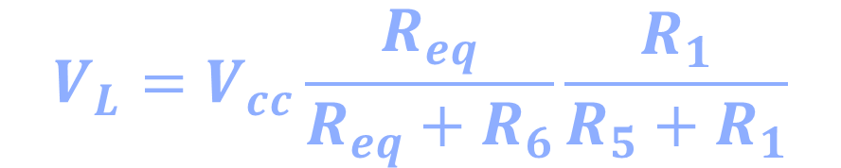
+VCC
+VCC
$$R_{eq}=\frac{R_{3}∗(R_{5}+R_{1})}{R_{1}+R_{3}+R_{5}}$$
R3
R6
R6
R5
VL
$$V_{a}=V_{cc}\frac{R_{eq}}{R_{eq}+R_{6}}$$
a
R3
R1
$$V_{L}=V_{a}\frac{R_{1}}{R_{5}+R_{1}}$$
R5
VH
$$V_{L}=V_{cc}\frac{R_{eq}}{R_{eq}+R_{6}}\frac{R_{1}}{R_{5}+R_{1}}$$
R1
$$V_{L}=V_{cc}\frac{\frac{R_{3}∗(R_{5}+R_{1})}{R_{1}+R_{3}+R_{5}}}{\frac{R_{3}∗(R_{5}+R_{1})}{R_{1}+R_{3}+R_{5}}+R_{6}}\frac{R_{1}}{R_{5}+R_{1}}$$
$$V_{L}=V_{cc}\frac{R_{3}∗R_{1}}{R_{3}∗(R_{5}+R_{1})+R_{6}(R_{1}+R_{3}+R_{5})}$$
$$V_{H}=\frac{R_{1}}{R_{1}+R_{3}||R_{6}+R_{4}}$$
$$V_{cc}=5V$$
$$V_{H}^{+}=2.52V$$
$$V_{L}^{+}=1.32V$$
$$V_{H}=\frac{R_{1}(R_{3}+R_{6})}{{(R}_{1}+R_{4})(R_{3}+R_{6})+R_{3}∗R_{6}}$$

Slide 11

R4
R2
R7
$$R_{eq1}=R_{4}+0.33∗R_{2}$$
C1
$$R_{eq2}=R_{4}+0.67∗R_{2}$$
$$R_{eq}=R_{eq1}||R_{eq2}$$
$$τ=R_{eq}∗C_{1}∗ln\left(\frac{V_{1}}{V_{2}}\right)=150μs$$

Slide 12
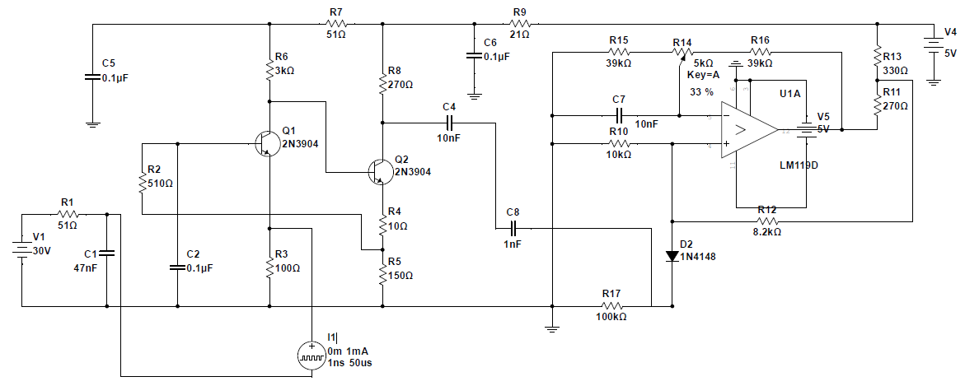
Complete circuit

Slide 13
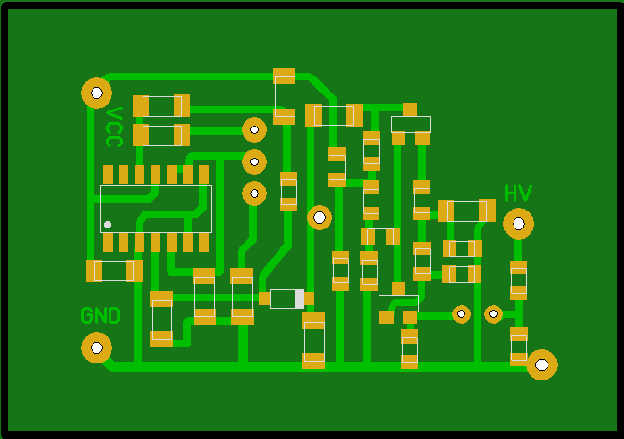
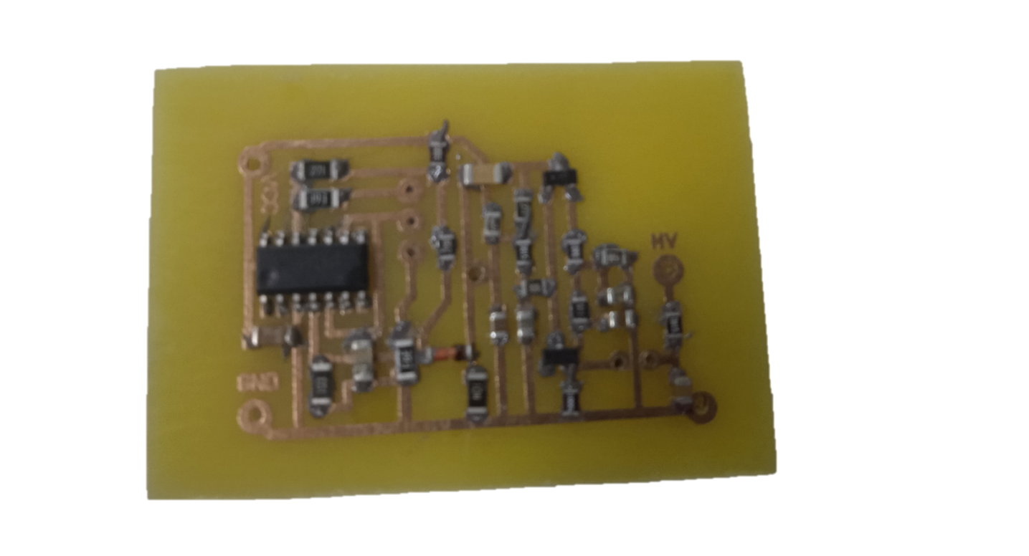
PCB design
Laser printer;
Iron;
Na peroxide;
Copper board;
Liquid soldering paste;

Slide 14

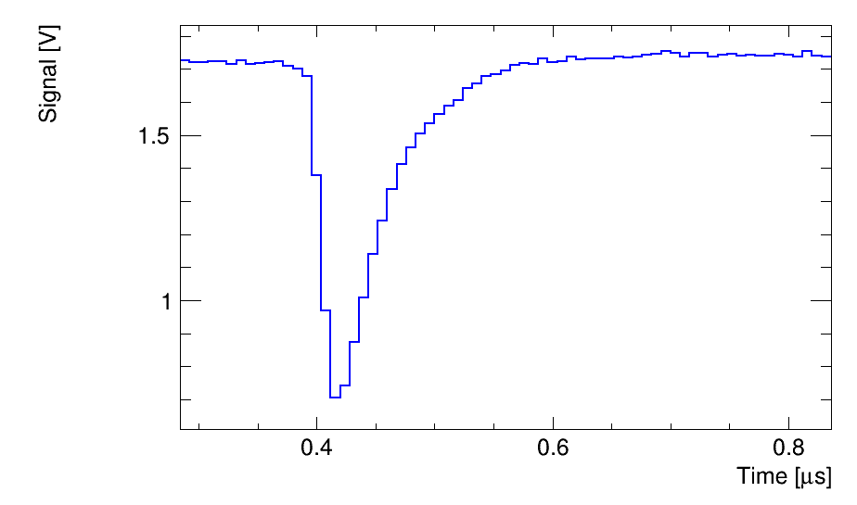
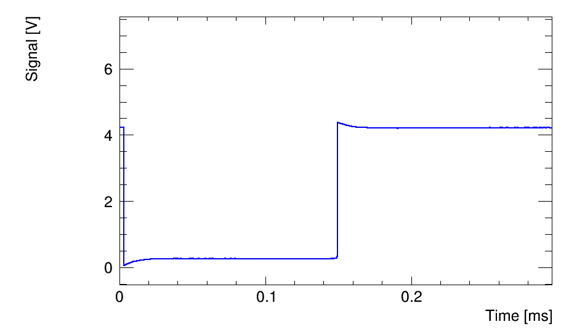
Generator test
Input signal characteristics:
Type: Pulse
Frequency: 100Hz
Amplitude: 10mV
30Ω
Pulse width: 20ns
Lead edge: 4ns
Trail edge: 4ns
20Ω
Preamplifier output signal
Monovibrator output signal

Slide 15
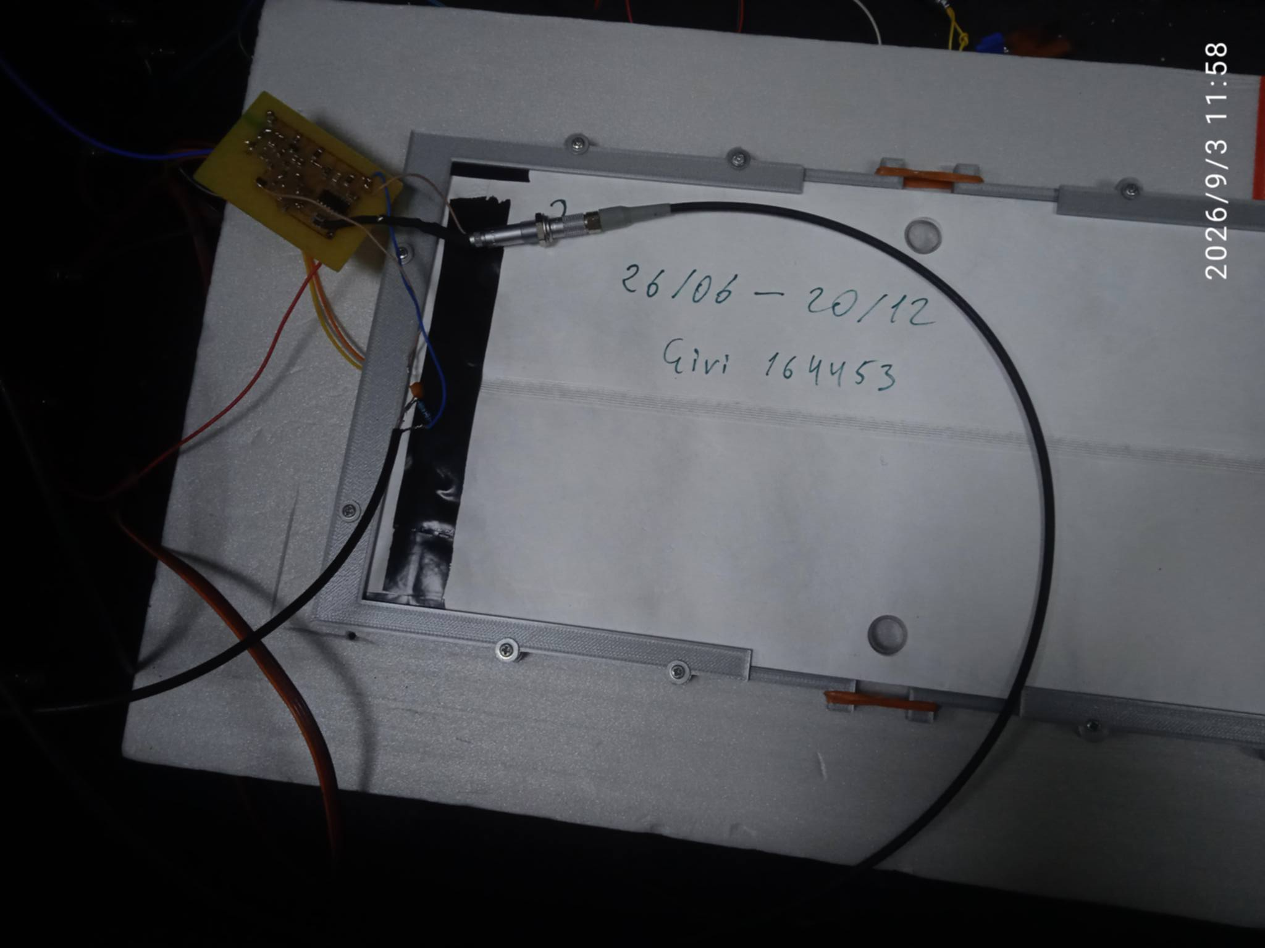
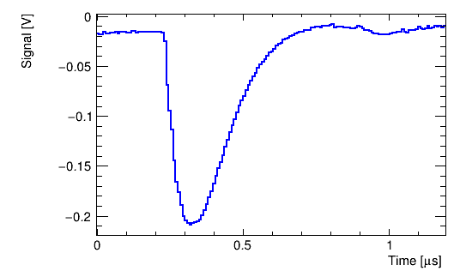
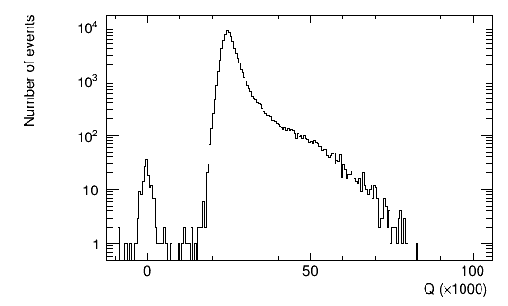
Real test with cosmics
Input SiPM signal
Plastic scintillator
Board
Output signal

Slide 16
Future Plans
  Implement SiPM signal counting and rate analysis using a microcontroller
  Measure the amplitude of SiPM signals
  Analyze and characterize the detected signals

Slide 17
Thank You!

