Slide 1


Mikheil Kalantarovi
Completed Bachelor's and pursuing Master’s Degree in Electrical Engineering at Agricultural University of Georgia.
Participating in projects at SMART|EDM_lab since 2024
  Under the guidance of David Mchedlishvili.

Slide 2
Design of Thermostatic chambers
Mikheil Kalantarovi

Slide 3
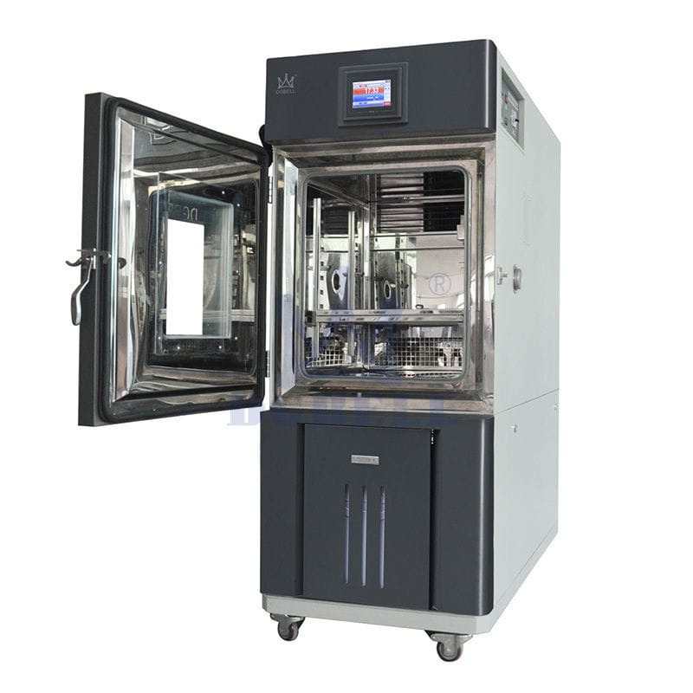
Thermostatic chamber
What is thermostatic chamber
  a device used to create and maintain a specific, stable temperature environment.
Applications
  used to examine temperature dependence in devices.

Slide 4
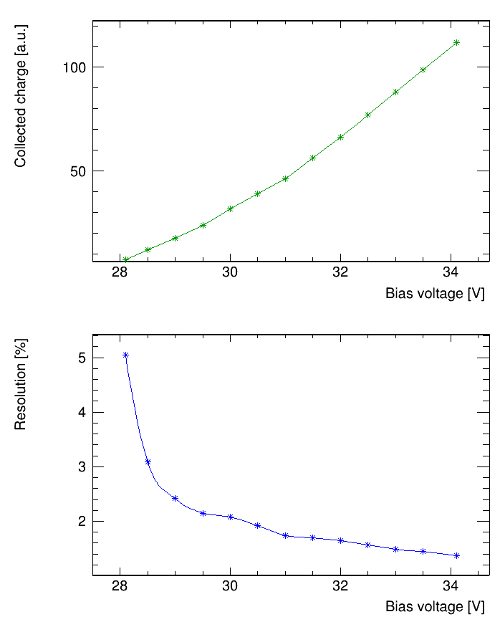
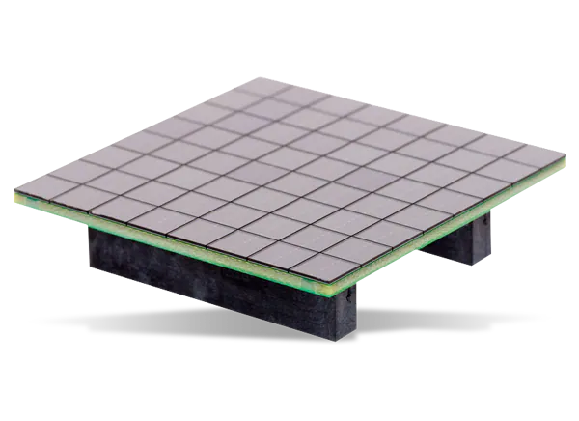
Project held at SMART|EDM_LAB
Main SiPM characteristics, such as Gain and Resolution, are highly dependent on voltage.
Gain
Resolution

Slide 5
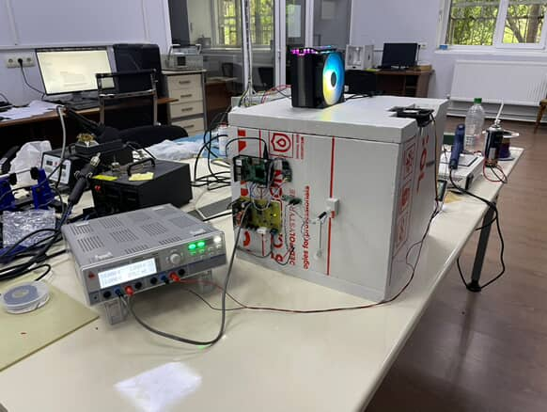
Project overview
System contains:
Thermally isolated box;
Heater(power resistor) and cooler(Peltier element);
Digital sensors for internal and ambient temperature measurements;
Adjustable power supply for heating and cooling;
Raspberry Pi: main component of the system;
Web interface for real-time control and monitoring.

Slide 6
Block diagram
Internal temperature sensor
External temperature sensor
Cooling element
Web control interface
Raspberry PI
DAC
DC-DC
Remote temperature monitoring
Heating element

Slide 7
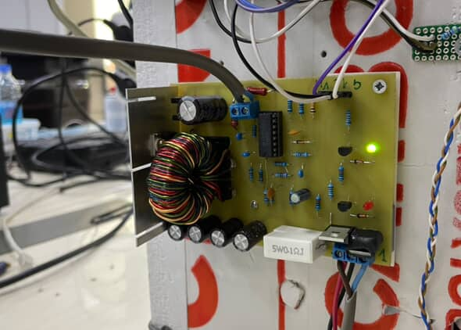
Power supply overview
Converts 24VDC input to a variable output
Custom made;
Based on DC-DC buck converter topology;
Operating frequency: ≈ 100 kHz;
Max. output current: 6 A(current limiting);
Output voltage: 0 – 23 V.

Slide 8
Software overview
Main program code is written on Python. It contains:
Temperature readout
Heating/Cooling control using PID algorithm
Web control interface, based on Flask framework
Remote temperature monitoring
  CERN ROOT framework(external)
  WebSockets

Slide 9
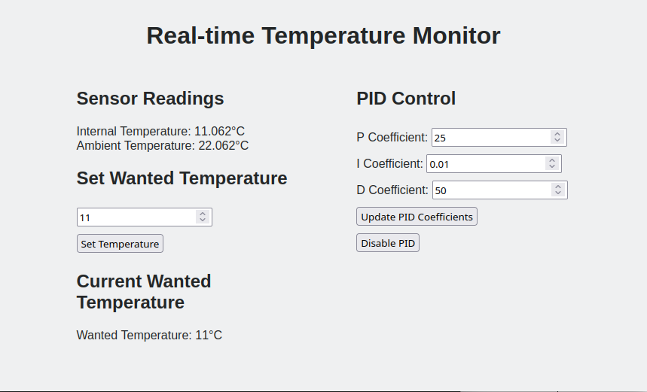
Graphical User Interface(GUI)

Slide 10
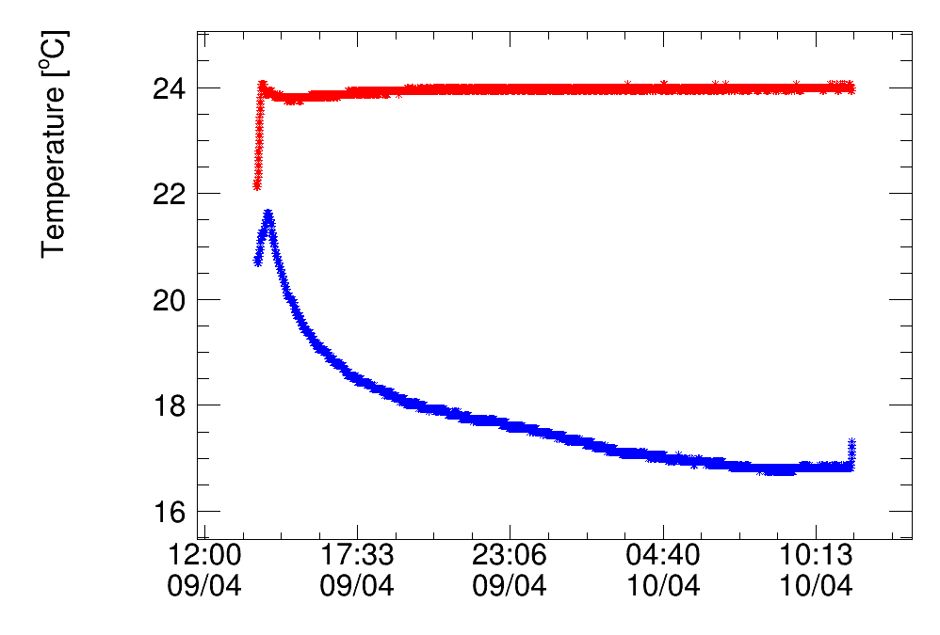
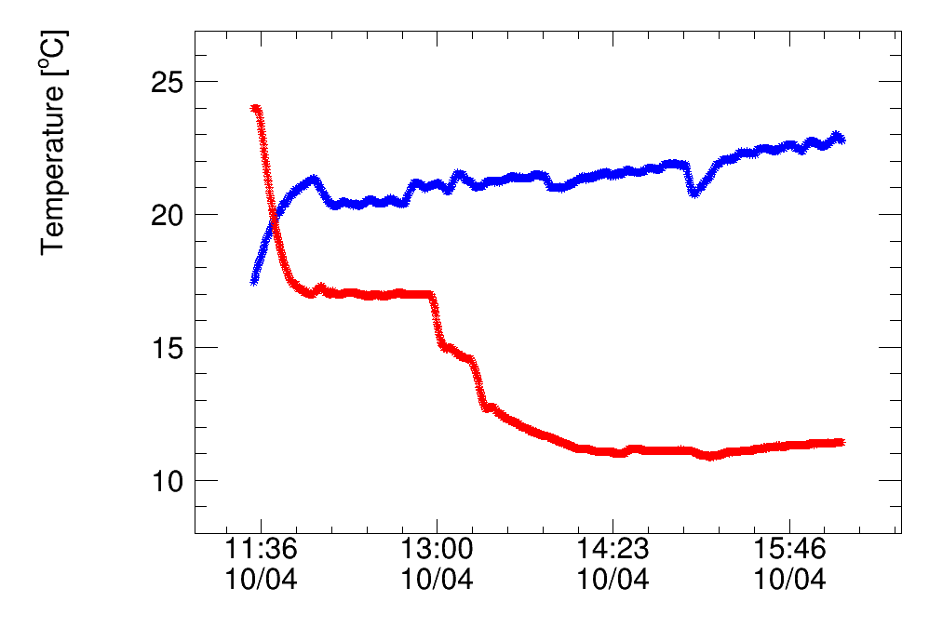
Tests
Ambient temperature
Internal temperature
Ambient temperature
Internal temperature
t_{max} > 45°C
t_{min} = t_{ambient} - 11°C

Slide 11
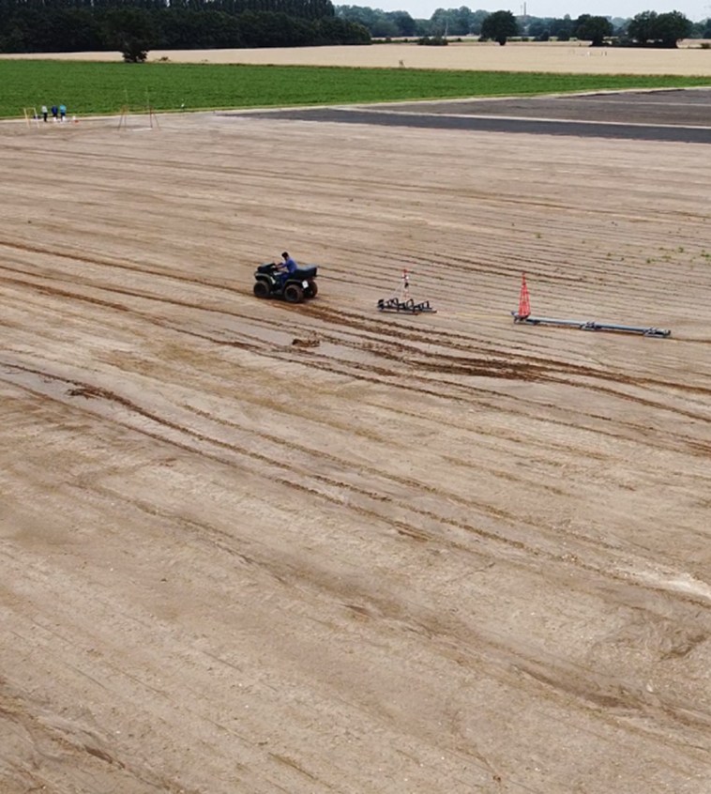
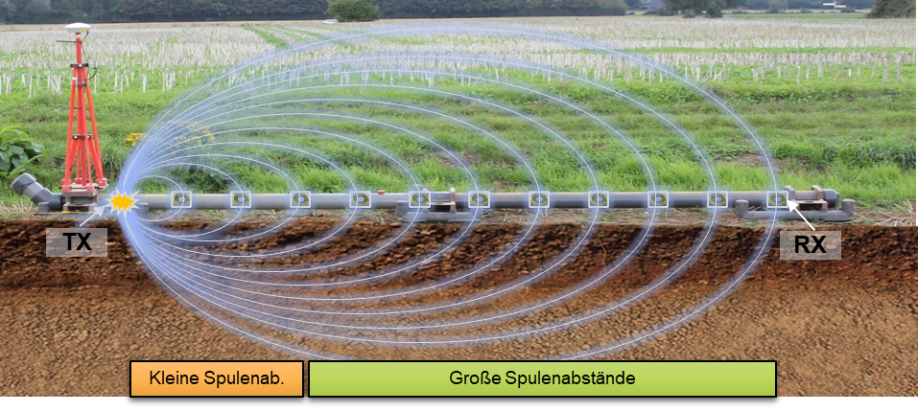
Project held at Forschungszentrum Jülich
SELMA is an electromagnetic multi-coil induction system, which evaluates the soil by measuring magnetic field. It uses multiple sensors that are dependant on temperature.

Slide 12
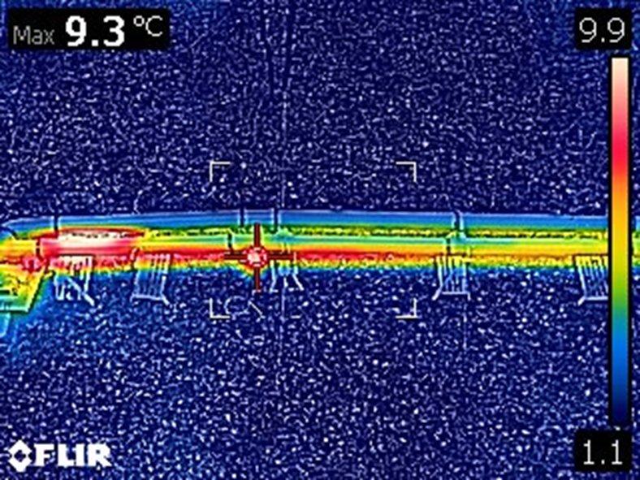
Requirements
The Thermostatic chamber must have:
Heating source with automated power adjustment.
User-friendly interface for the remote control.
Graphing tool for visualizing
results.
Challenges:
  Chamber should fit inside the tube.
  Constantly changing environment.
  Delayed control.

Slide 13
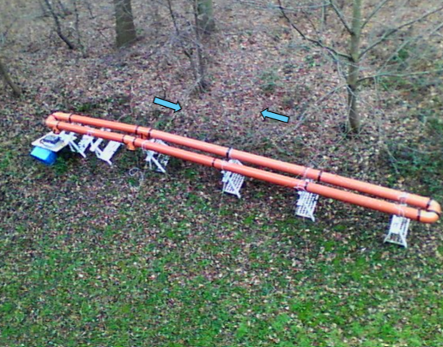
Project overview
System contains:
Isolated pipe.
Heating elements(power resistors).
Digital sensors for internal temperature measurements.
Adjustable power supply for heating.
Raspberry Pi: main component of the system.
Web interface for real-time control and monitoring.
Grafana plots for the visualization.

Slide 14
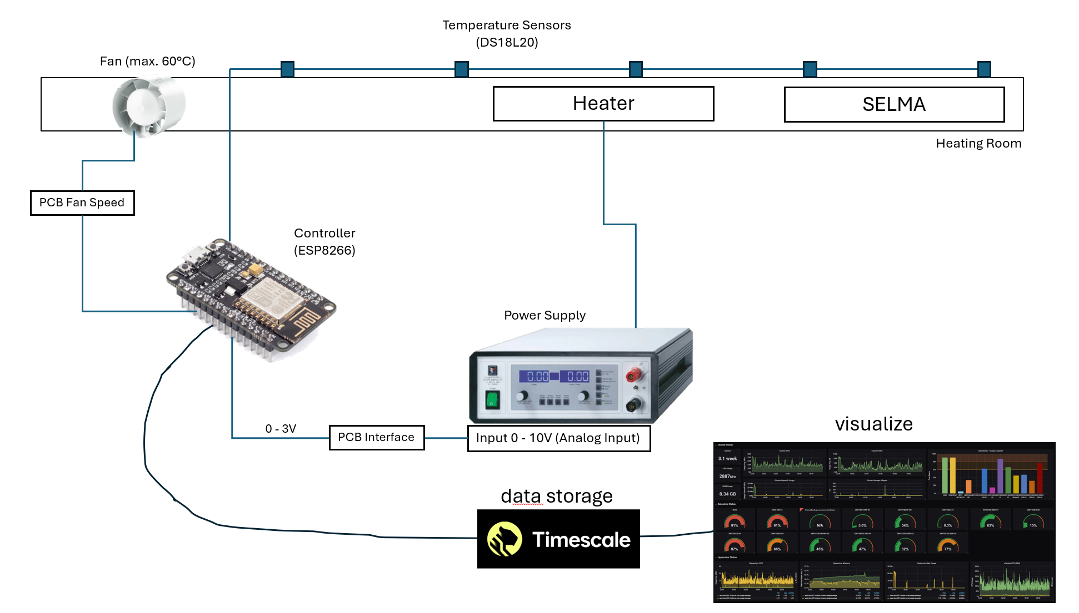
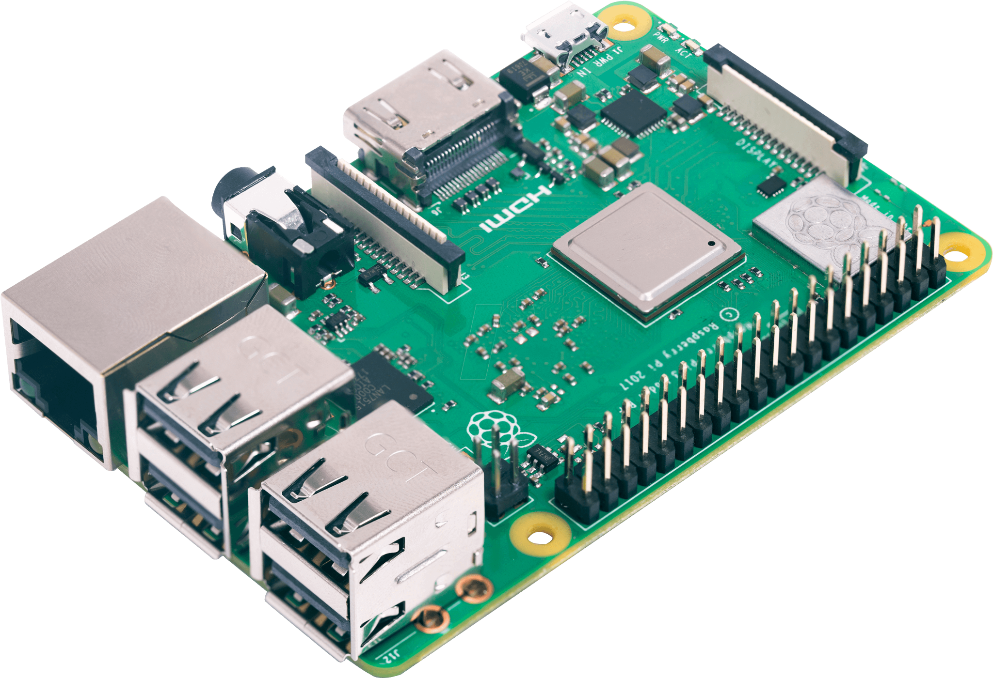

System diagram
Raspberry
Pi 4
All of the software is running on Raspberry Pi
Visualization
DAC Interface
Data storage

Slide 15
Software overview
Main program code is written on Python. It contains:
Temperature readout
Heating control using synchronized PID algorithm
Web control interface, based on Flask framework
Communication between devices using MQTT
Remote temperature monitoring
  PostgreSQL
  Grafana

Slide 16


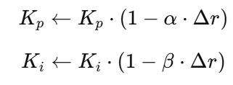



Synchronized PID algorithm
Continuously observes system behavior
Adjusts PID coefficients in real time
Predicts future temperature using delay
PID for delayed system
Rate of change
Synchronized control

Slide 17
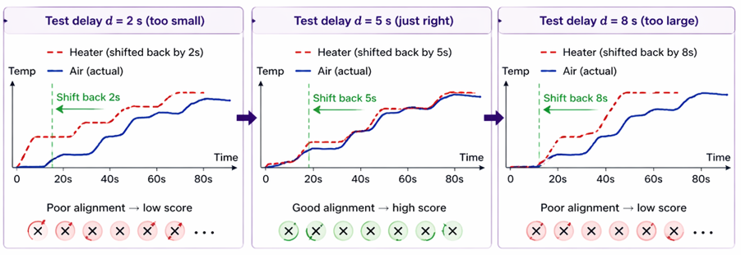

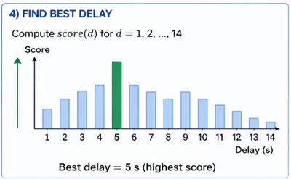
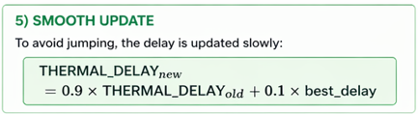
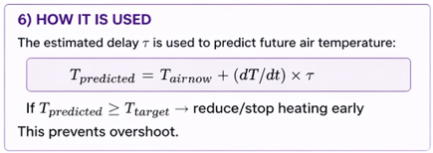
Synchronized PID algorithm

Slide 18
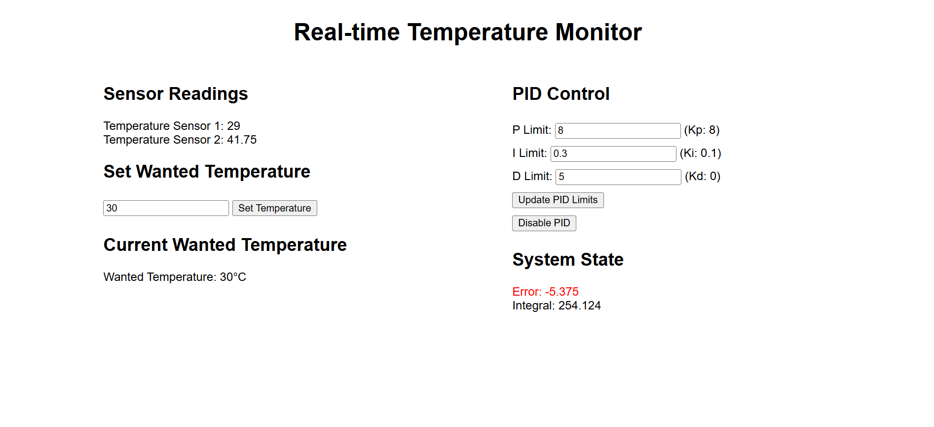
Graphical User Interface(GUI)

Slide 19
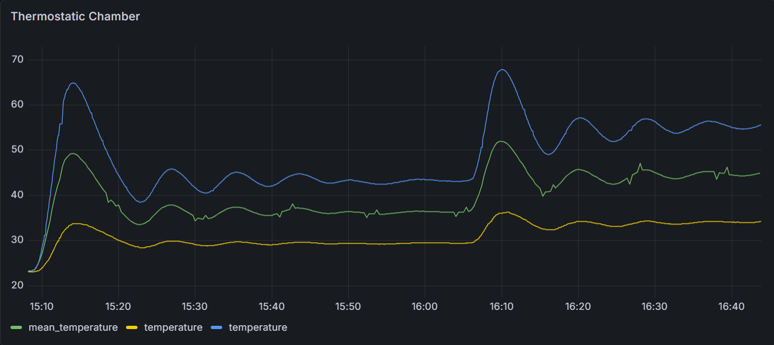
Tests
Final configuration.
Sensor at the end of the tube
Sensor on the heater

Slide 20

Accomplishments
Heating source with automated power adjustment.
User-friendly interface for the remote control.
Graphing tool for visualizing results.

Slide 21
Institute of Technology and Engineering (ITE)
Thank you
FORSCHUNGSZENTRUM JÜLICH GMBH

Slide 22
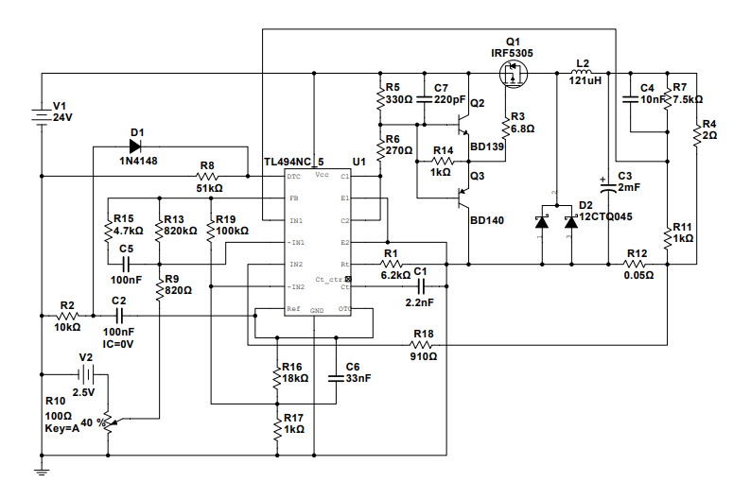
Power supply circuit
MOSFET driver
Buck converter
Designed and simulated in NI Multisim
Simulated DAC output
Shunt resistor for current limiting
PWM controller

Slide 23
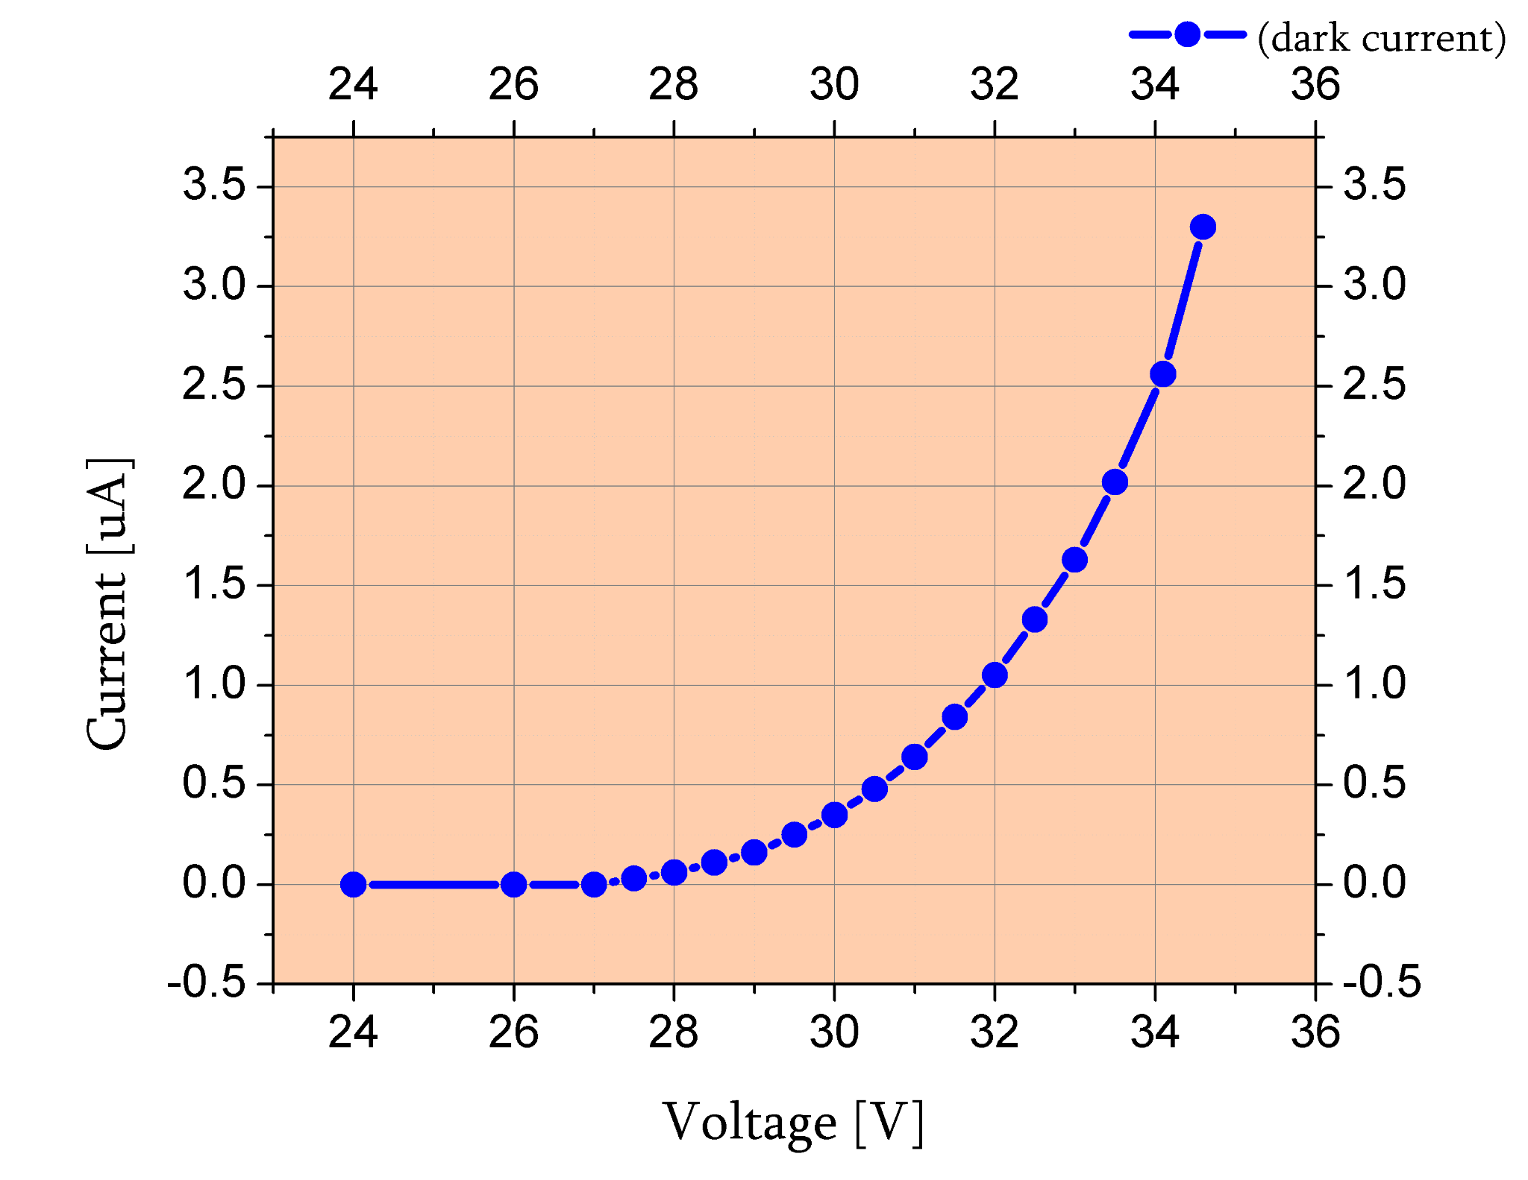
Typical SiPM characteristics
Measured SiPM sample: AFBR-S4N33C013
Gain
Dark current
Resolution
Main characteristics are highly dependent on voltage.

Slide 24
SELMA
Evaluates the soil by measuring the magnetic field.
Uses multiple sensors that are dependant on temperature.
Requires a calibration to ensure consistent results.

Slide 25
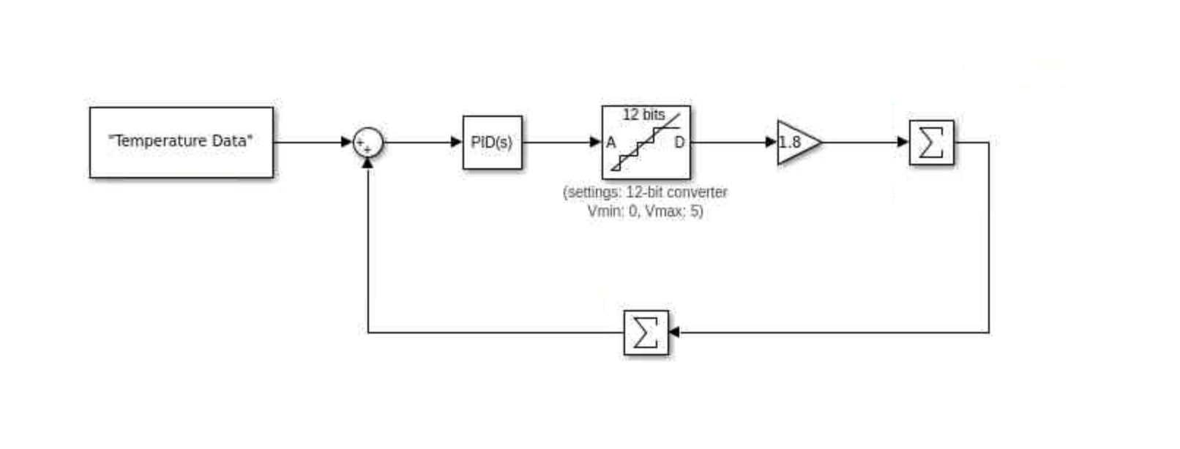
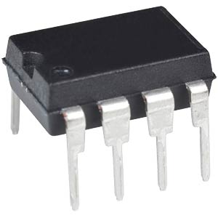
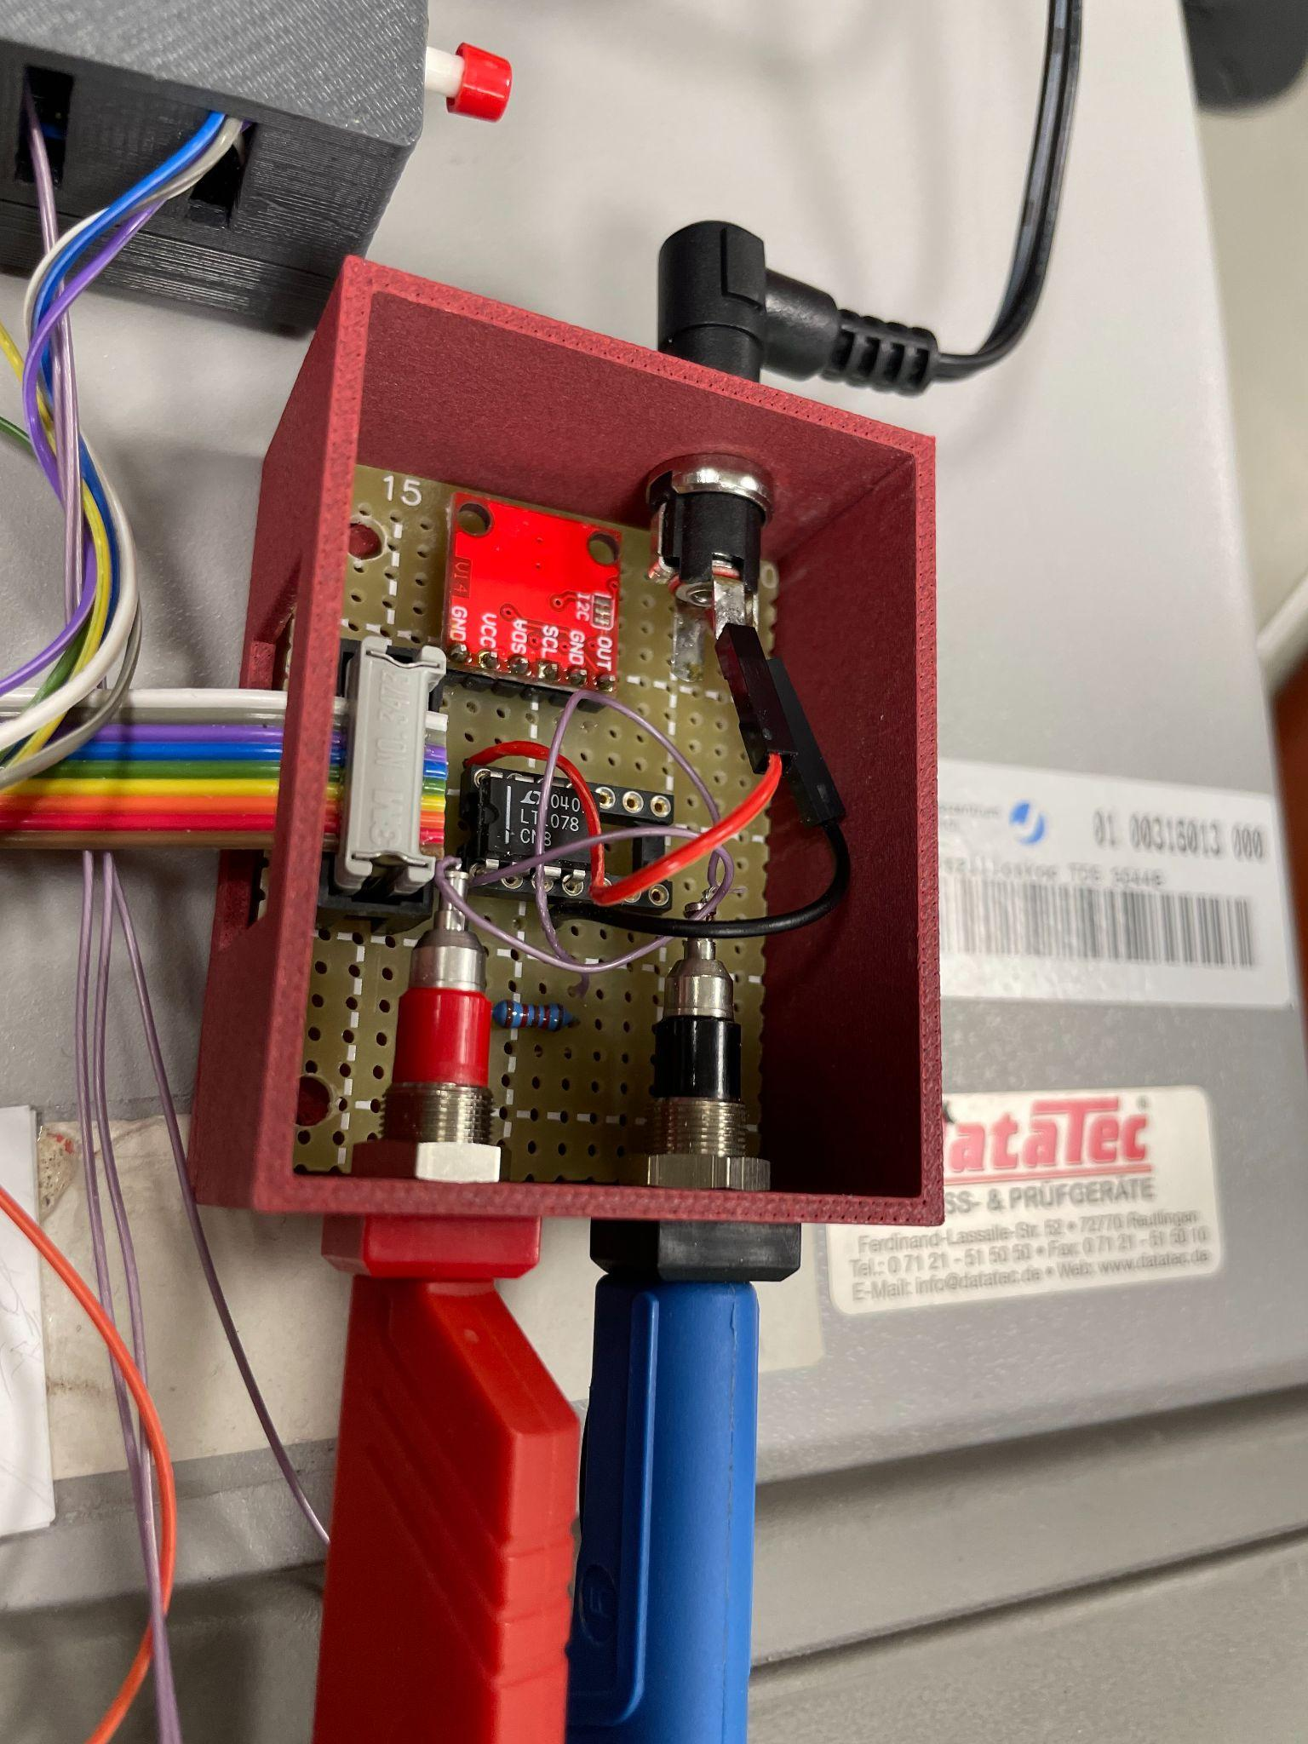
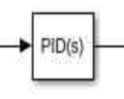
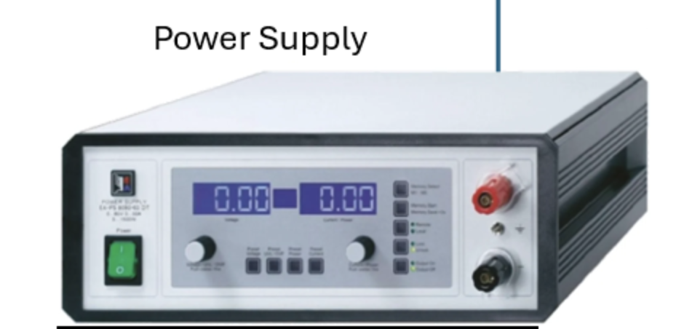
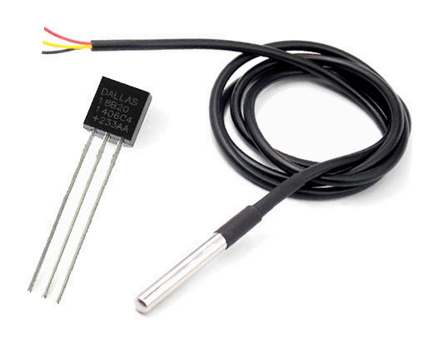
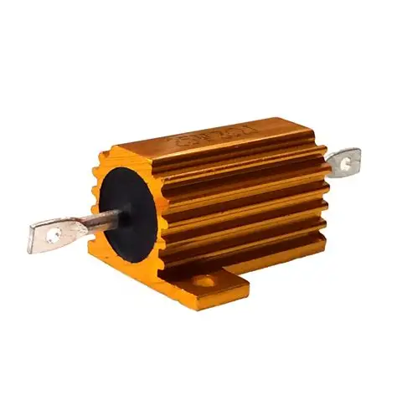
Practical realization
LT 1078
DAC Interface
DAC
Power resistor
Temperature sensor(DS18B20)
Accuracy: ± 0.5 °C (from -10°C to +85°C)
Resolution: 0.0625 °C (at 12 bit internal ADC resolution)

Slide 26
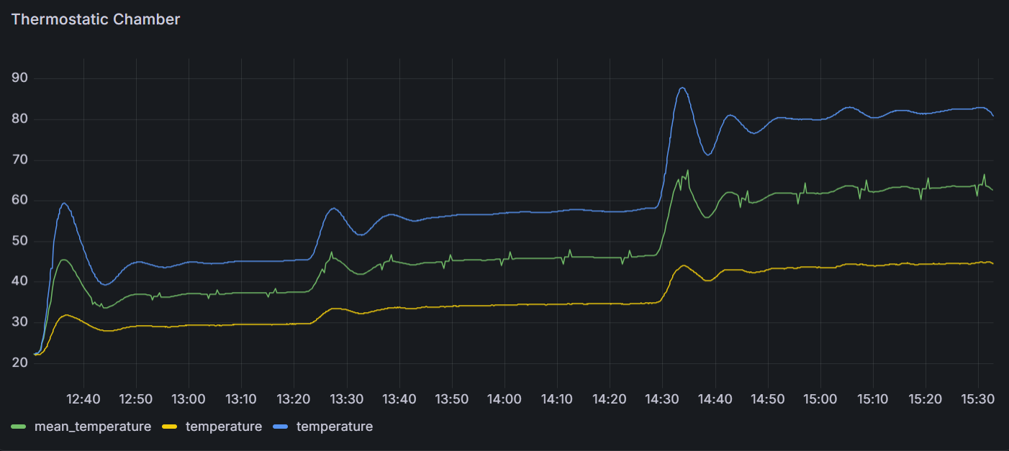
Tests
Integral resets after each successful step.
Delay computing.
Sensor at the end of the tube
Sensor on the heater

Slide 27
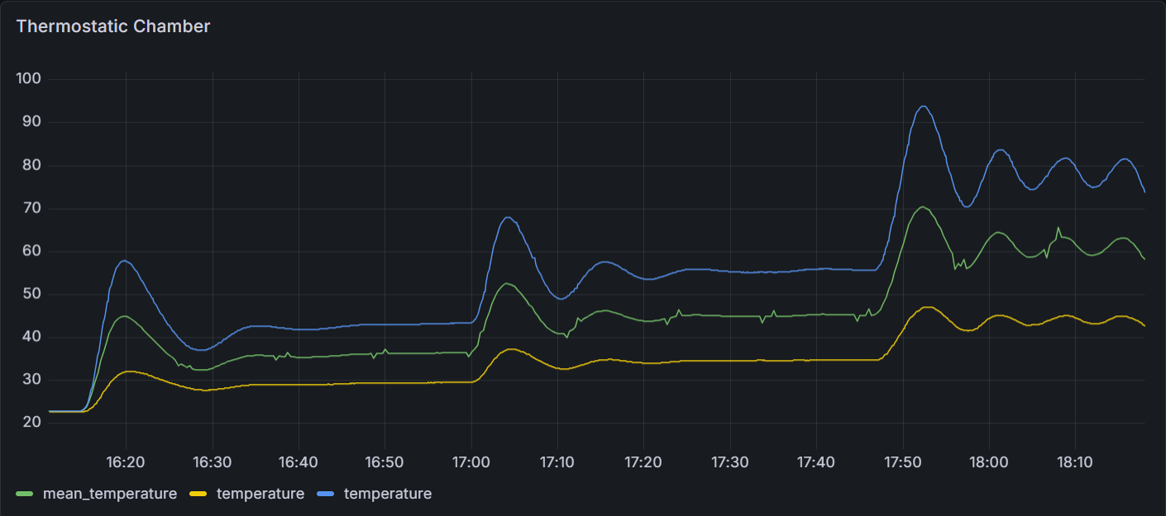
Tests
System was moved into the tube, to create a similar environment to an actual experiment.
Introduction to the delay.
Still no limit on the integral, but the output limit was removed.
Sensor at the end of the tube
Sensor on the heater

Slide 28
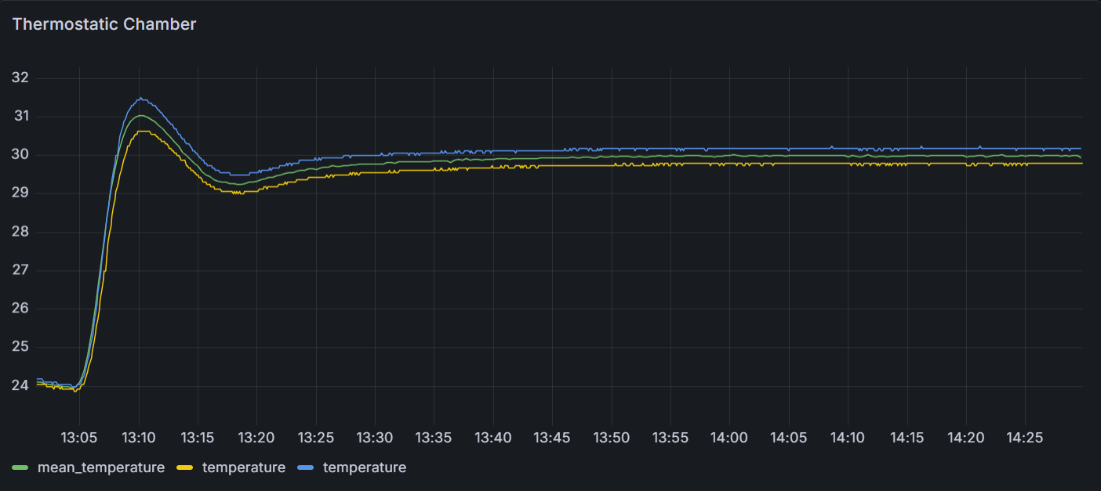
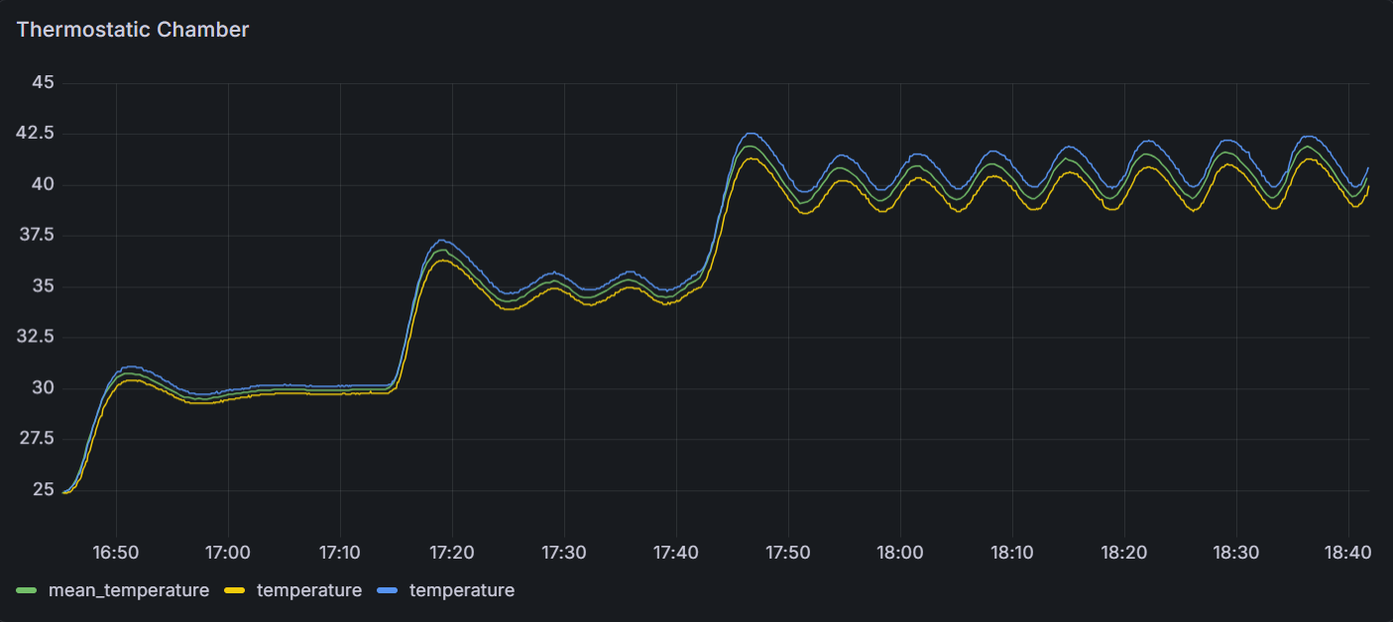
Tests
Final configured version of automatic PID
Tests with multiple steps, unlimited integral

Slide 29
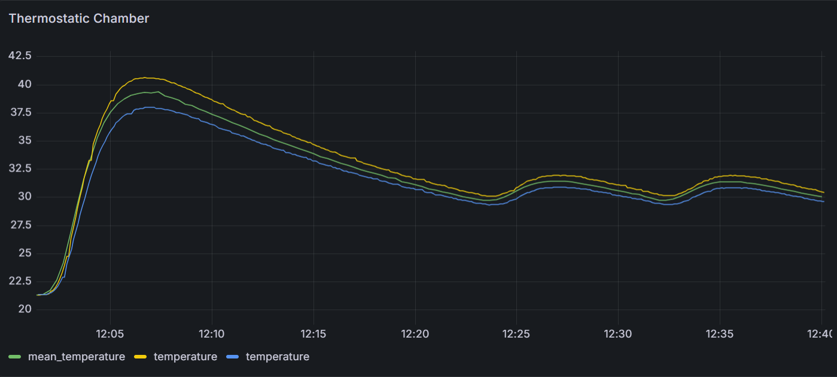
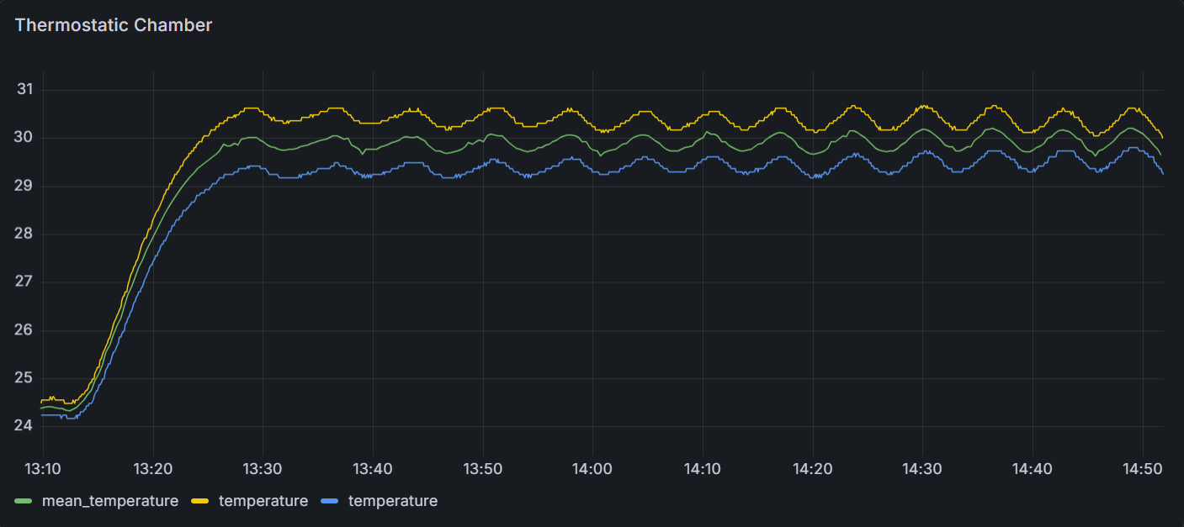
Tests
First test of automatic PID with no limits
Limiting the output and the coefficients

